Slide 1
Read Out Electronics overview
KM3Net General Meeting 2012 Catania
Frédéric LOUIS

Slide 2
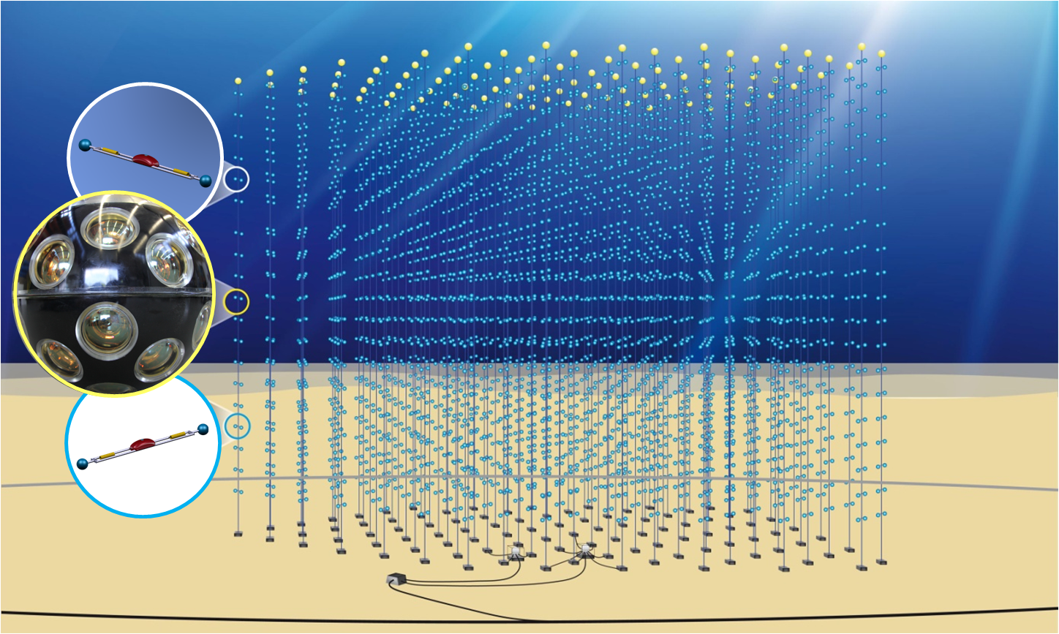
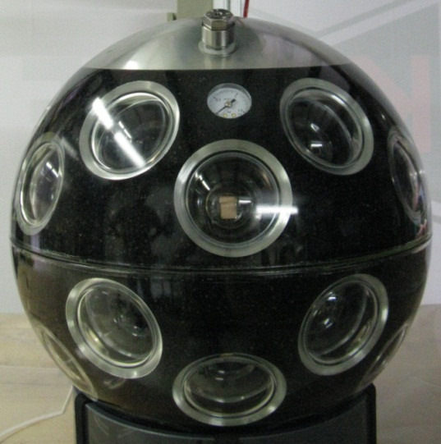
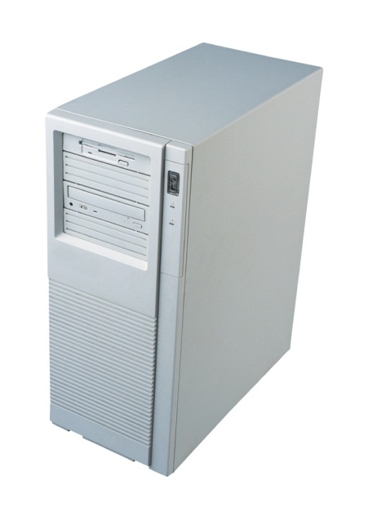
Digital
Optical
Module
Considered
like a PC
KM3Net General Meeting 2012 Catania Frédéric LOUIS

Slide 3
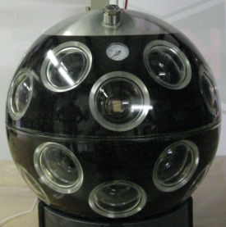
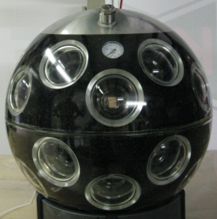
Data communication
model
Optical Network
Off Shore Nodes
On Shore Station
KM3Net General Meeting 2012 Catania Frédéric LOUIS

Slide 4
Clock & Command
distribution
Reference
Clock
Optical Network
Known latency
Synchronous commands
KM3Net General Meeting 2012 Catania Frédéric LOUIS

Slide 5
Calibration system
Optical Network
Time measurement
KM3Net General Meeting 2012 Catania Frédéric LOUIS

Slide 6
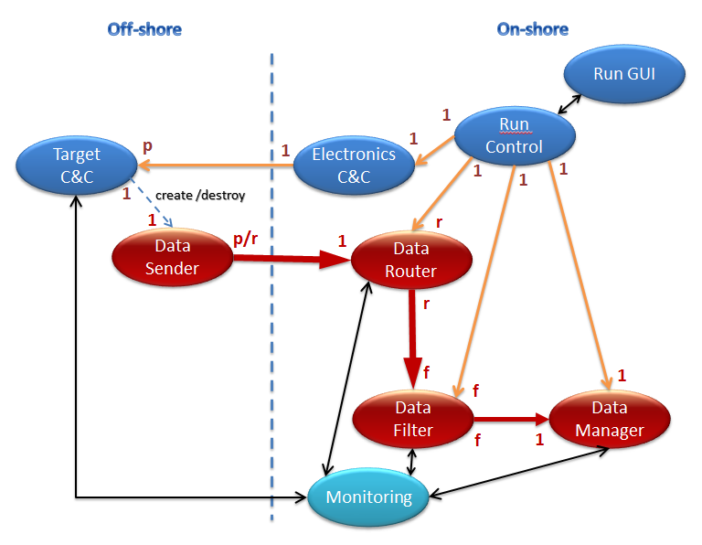
Read out, Control
&
configuration Software
KM3Net General Meeting 2012 Catania Frédéric LOUIS

Slide 7
Off Shore Electronics Status
KM3Net General Meeting 2012 Catania Frédéric LOUIS

Slide 8
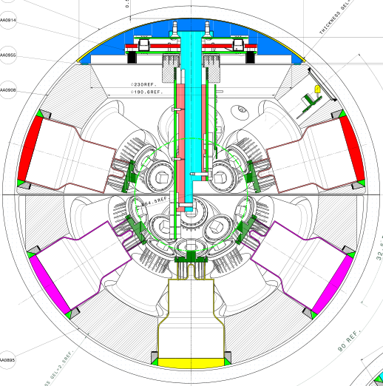
DOM internal description
Heat conductor
Mechanical support
Read Out
Electronics
Photomultipliers
KM3Net General Meeting 2012 Catania Frédéric LOUIS

Slide 9
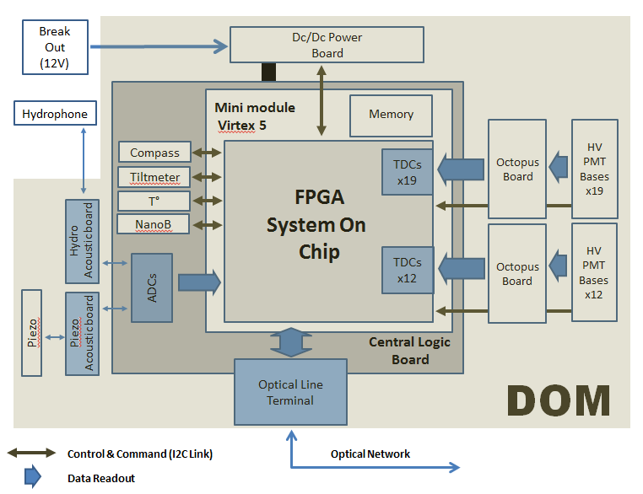
DOM electronic description
Power management
Front End
Instrumentation
Data Management
KM3Net General Meeting 2012 Catania Frédéric LOUIS

Slide 10
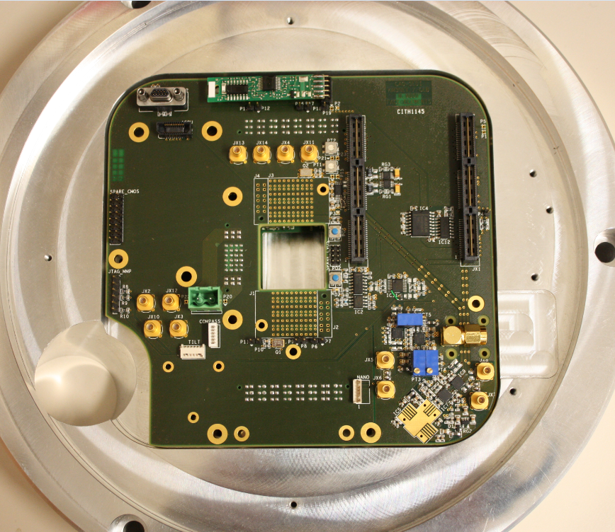
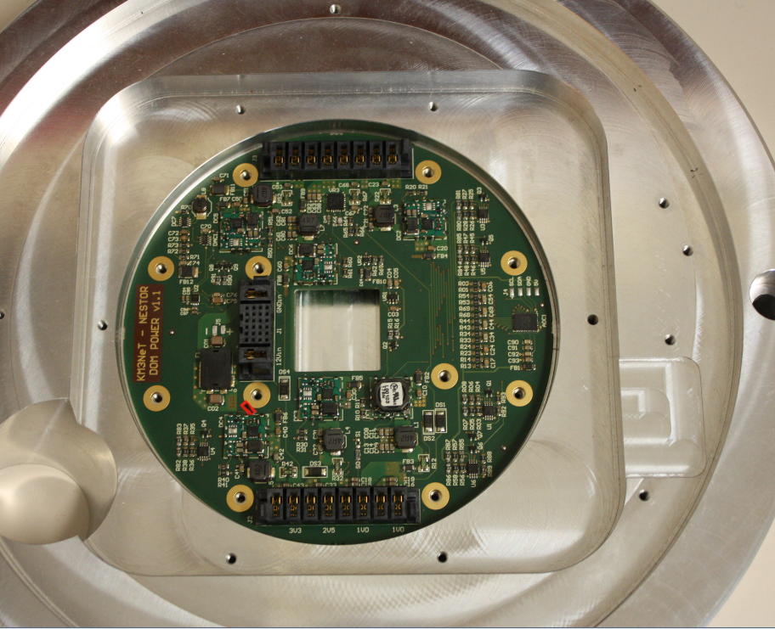
Central Logic Board
Power board
Mechanical support
KM3Net General Meeting 2012 Catania Frédéric LOUIS

Slide 11
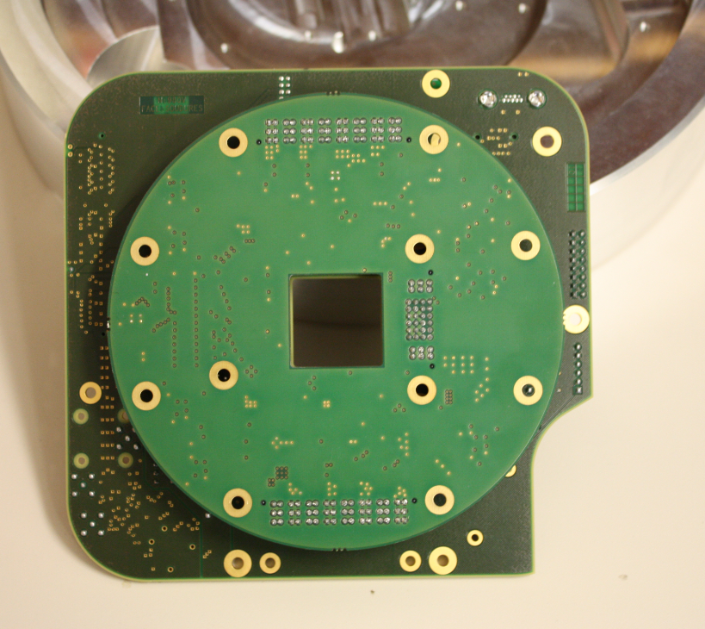
CLB & Power board
assembly
KM3Net General Meeting 2012 Catania Frédéric LOUIS

Slide 12
Front end
HV Base Available
Long Signal collection boards Available
Short Signal collection boards Available
FPGA Firmware/Software
31 TDC Under characterization
Firmware Read out Need optimization
Software Read out Need optimization
Acouboard Read out Integration March
Slow Control Available
KM3Net General Meeting 2012 Catania Frédéric LOUIS

Slide 13
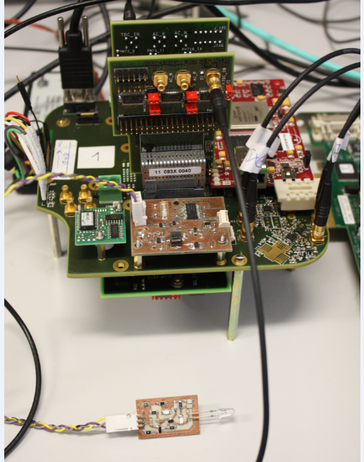
Instrumentation
Nano Beacon Prototype OK
Digippico sensor OK
Tiltmeter Received
Compass Received
Piezo & Hydro sensors Available
Piezo board Available
Acouboard Available
KM3Net General Meeting 2012 Catania Frédéric LOUIS

Slide 14
Optical Line Terminal
REAM and Pin diode design Tested on evaluation bench
OLT on CLB Tests foreseen in March
Complete test /Optical network Tests foreseen in April
KM3Net General Meeting 2012 Catania Frédéric LOUIS

Slide 15
PPM DOM Electronics Status
KM3Net General Meeting 2012 Catania Frédéric LOUIS

Slide 16
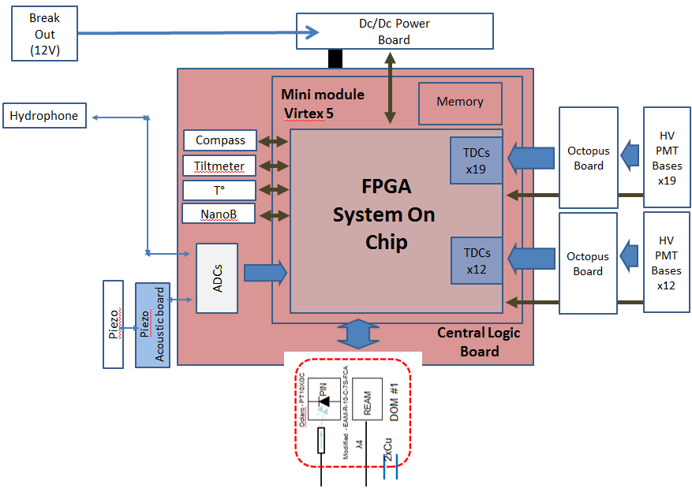
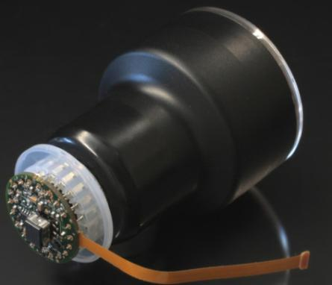
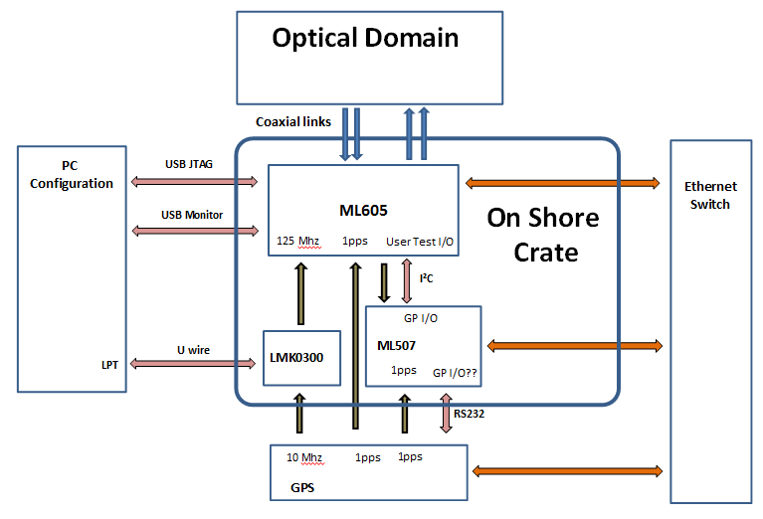
DOM
PPM DOM
Off Shore
PPM DOM
Data Readout flow
PC
On Shore 1
PC
On Shore 2
On Shore
KM3Net General Meeting 2012 Catania Frédéric LOUIS

Slide 17
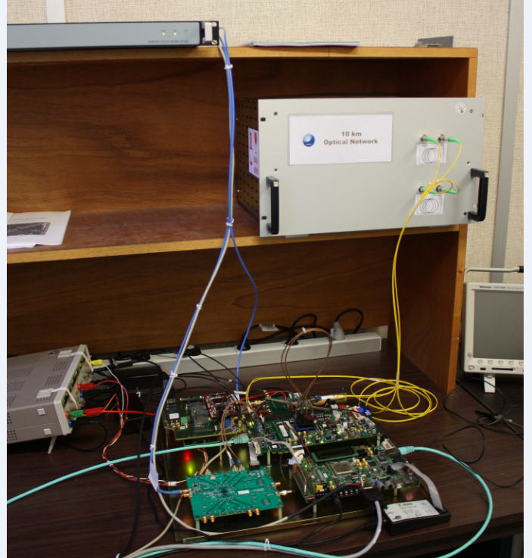
Boards
ConfigurationSystem
KM3Net General Meeting 2012 Catania Frédéric LOUIS

Slide 18
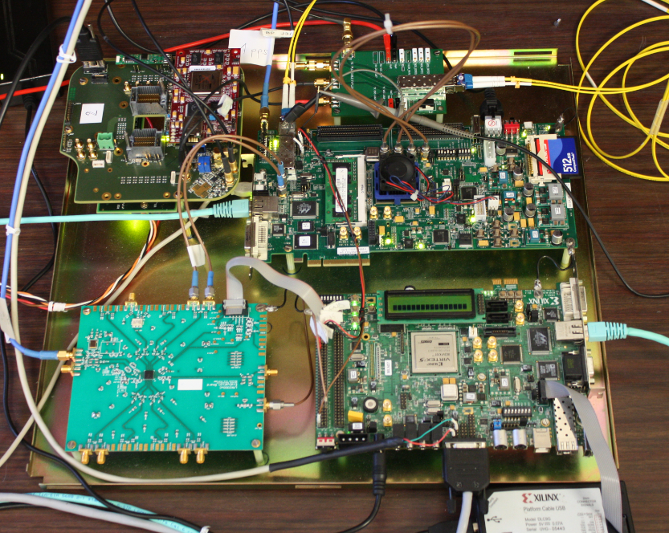
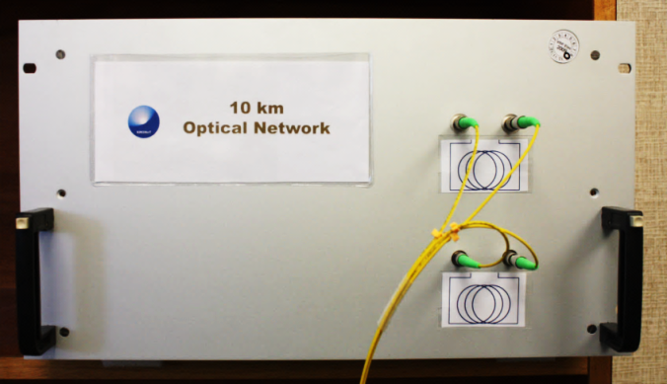
Off Shore part
GPS
20 km
Optical Network
On Shore part
KM3Net General Meeting 2012 Catania Frédéric LOUIS

Slide 19
On Shore PPM DOM Configuration
Clk & Cmd
Insertion
GTX
Off Shore Side
On Shore Side
GTX
Clk & Cmd
Extraction
GTX
Phase &
Time measurement
Clk & Cmd
Control
Time system
(Counter, etc….)
Measurement
Control
ML 605
GPS
Master
Clock
ML507
SPI Link
External
measurement
Start/Stop
GPS
Tag 1 pps
KM3Net General Meeting 2012 Catania Frédéric LOUIS

Slide 20
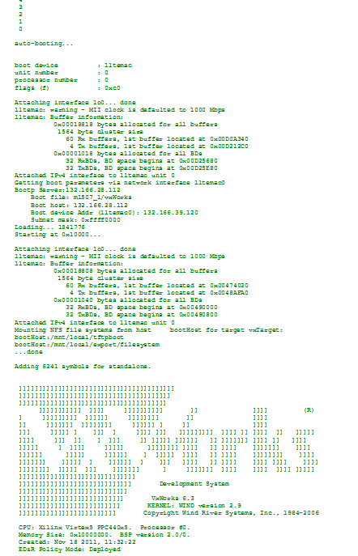
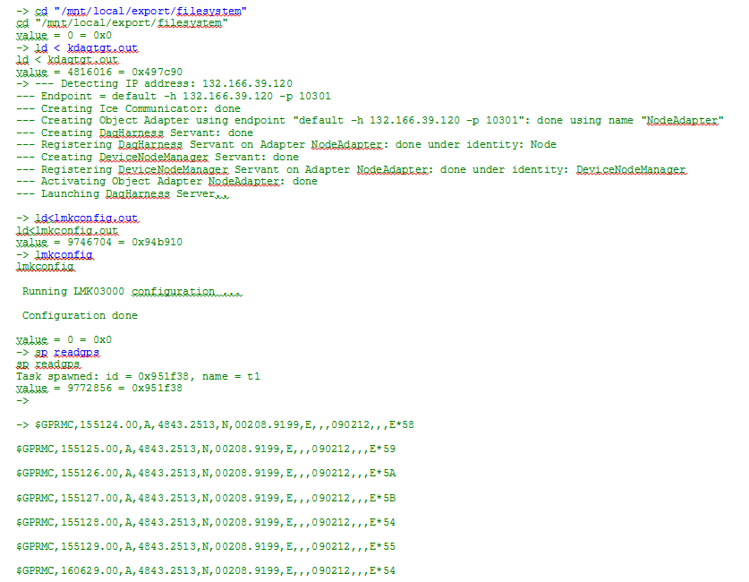
PPC Boot across
Optical Network
Load software
&
LMK configuration
GPS data
for each ’’Start Run’’
KM3Net General Meeting 2012 Catania Frédéric LOUIS

Slide 21
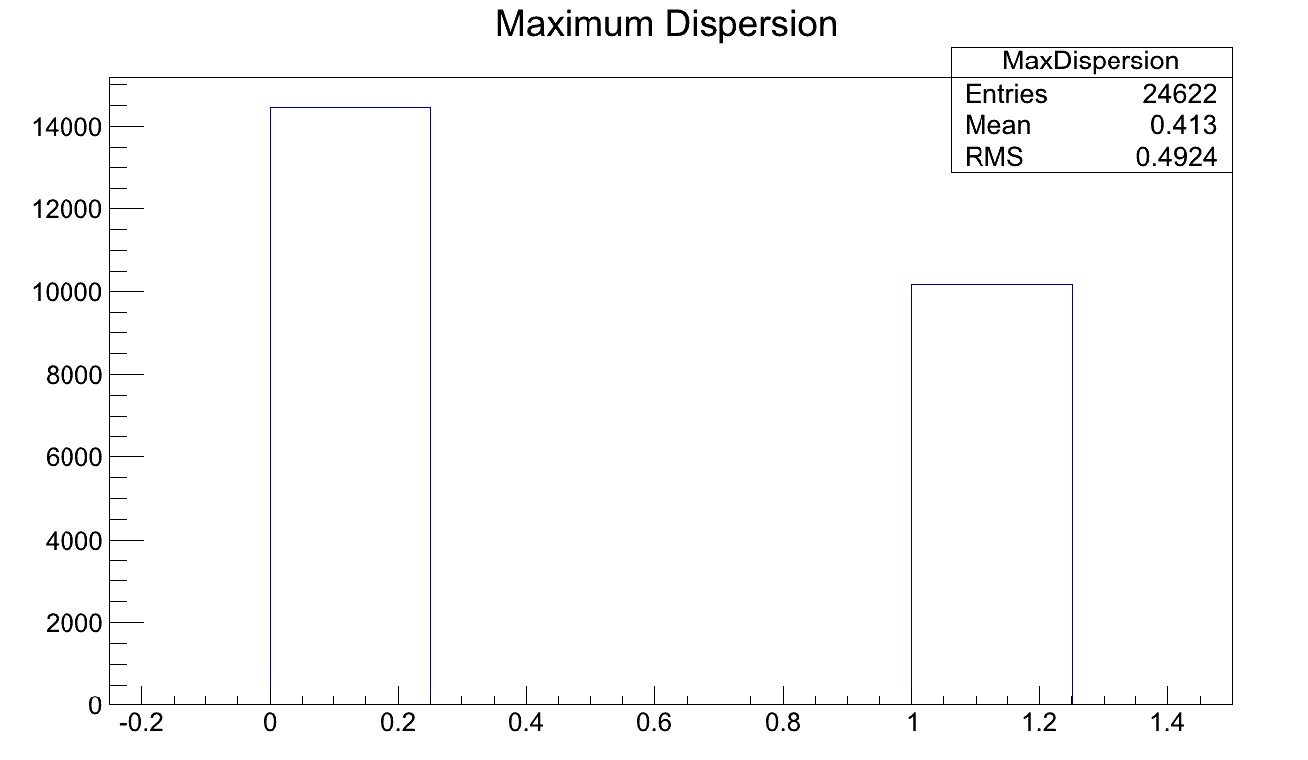
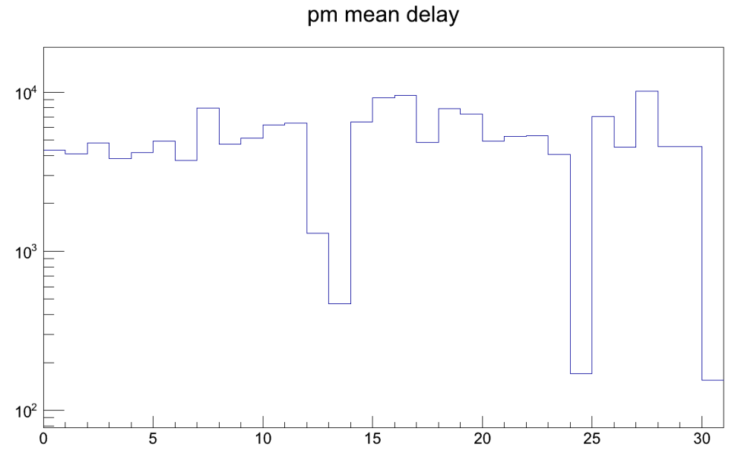
TDC performance (same signal on all channels)
For each event, difference between the first and the last value on all TDC channels
PRELIMINARY
For each event, number of hit in time with the first stamped channel
KM3Net General Meeting 2012 Catania Frédéric LOUIS

Slide 22
Clock recovery and known latency
Virtex 5 circuit dependence
With Old date code (2008)
The value of the latency can be obtained by the Time Slice and the embedded Onshore TDC (1ns)
With New date code (2010)
The value of the latency can be obtained by the Time Slice and a precise TDC (> 1ns)
KM3Net General Meeting 2012 Catania Frédéric LOUIS

Slide 23
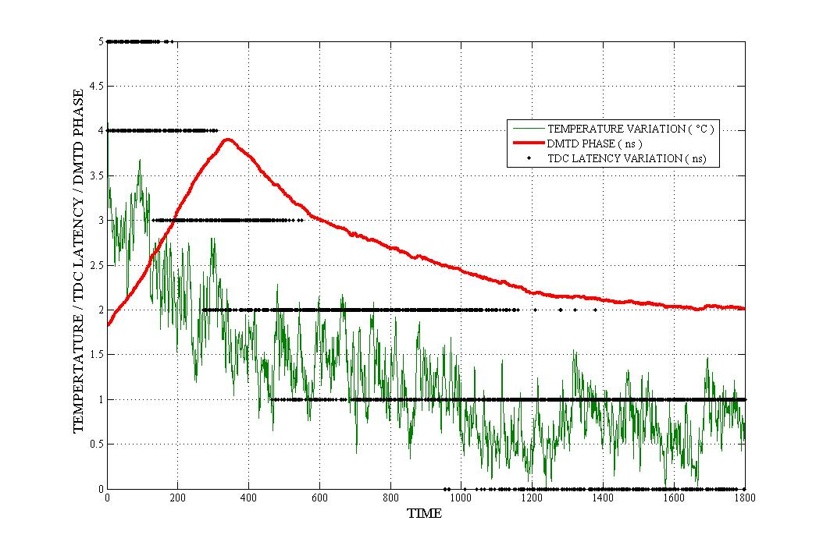
Clock recovery and known latency
Long term stability
PRELIMINARY
~ 10 h
KM3Net General Meeting 2012 Catania Frédéric LOUIS

Slide 24
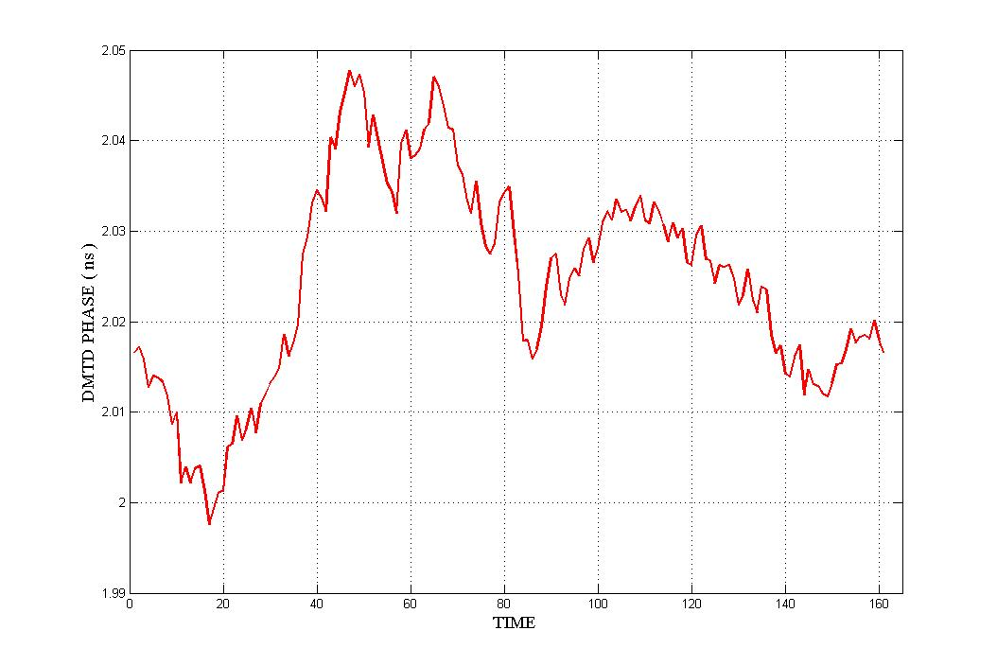
Clock recovery and known latency
High stability latency
PRELIMINARY
~ 1 h
KM3Net General Meeting 2012 Catania Frédéric LOUIS

Slide 25
PPM DOM / PPM DU
PPM DOM versus PPM DU
Off shore CLB/FPGA CLB/FPGA
On Shore One Channel Three channels
broadcast
Clock & Cmd Clock & Cmd
system system
TDC & Fine TDC TDC & Fine TDC
KM3Net General Meeting 2012 Catania Frédéric LOUIS

Slide 26
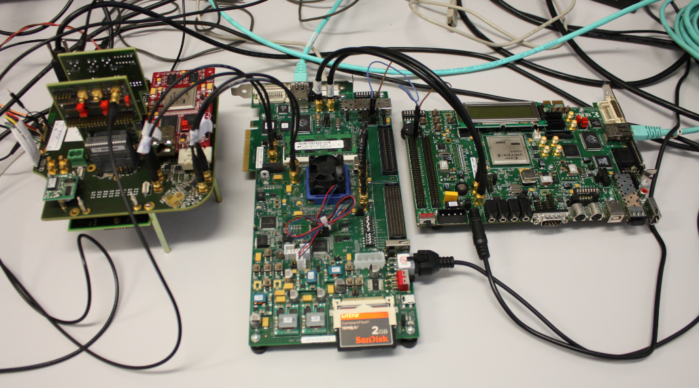
Minimal Test bench
On Shore part
Off Shore
part
KM3Net General Meeting 2012 Catania Frédéric LOUIS

Slide 27
Thank you for your attention
KM3Net General Meeting 2012 Catania Frédéric LOUIS

Slide 29
Dissipated Power
Pseudo power & CLB only 1,791 W
Pseudo power & CLB & MM+ 6,963 W
MM+ only 5,172 W
Power Board & CLB only 2,808 W
Power Board & CLB & MM+ 9,564 W
Power Board only without MM+ 1,017 W
Power Board only with MM+ 2,601 W

