Slide 1

KM3NeT: where are we and where do we go
E. Migneco
KM3NeT general meeting, Catania, february 22 2012

Slide 2
Outline
A brief history of KM3NeT: from the Design Study to the Preparatory Phase
What we have achieved
Future programs

Slide 3
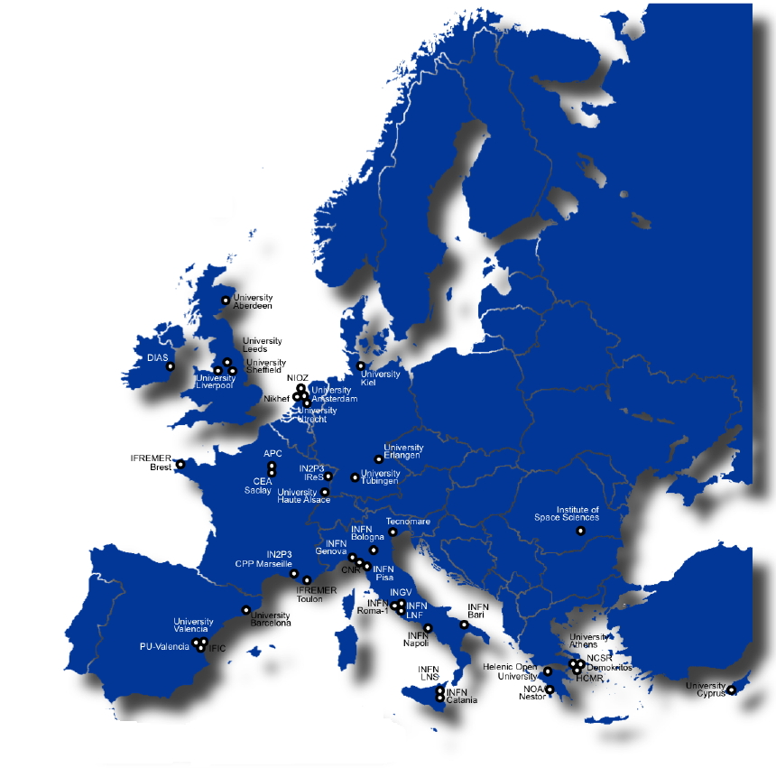
KM3NeT
International consortium involving more than 300 scientists from 10 EU countries
One objective: build the most sensitive high energy neutrino telescope
KM3NeT is one of the 44
pan-european research
infrastructures on the ESFRI EU roadmap

Slide 4
A brief history of KM3NeT
Started in february 2006 with the Design Study project co-funded with 9 M€ under the 6th EC Framework Programme
  Coordinated by University of Erlangen (U. Katz)
In 2007 included in the roadmap of the European Strategy Forum of Research Infrastructures (ESFRI)
In 2008 co-funded with 5 M€ for a “Preparatory Phase” under the 7th EC Framework Programme and will conclude in february 2012
  Coordinated by INFN-LNS (E. M.)

Slide 5
KM3NeT Design Study main objectives
Energy range and main physics goals
  Optimization to investigate neutrino “point sources” → optimisation in the energy regime 1-100 TeV
  Diffuse neutrino fluxes
  Other items (… but not optimized for):
    Dark Matter
    Neutrino particle physics
    Exotics (Magnetic Monopoles, Lorentz invariance violation, …)
Implementation requirements
  Construction time ≤5 years
  Operation over at least 10 years without “major maintenance”
Provide a deep-sea cabled platform for Sea and Earth sciences

Slide 6
The KM3NeT sky view
Sensitivity for up-going
neutrinos considered
From Mediterranean
24h per day
visibility up to
about δ= -50°
>25%
>75%
KM3NeT complements the IceCube field of view
KM3NeT observes a large part of the sky (~3.5π)

Slide 7
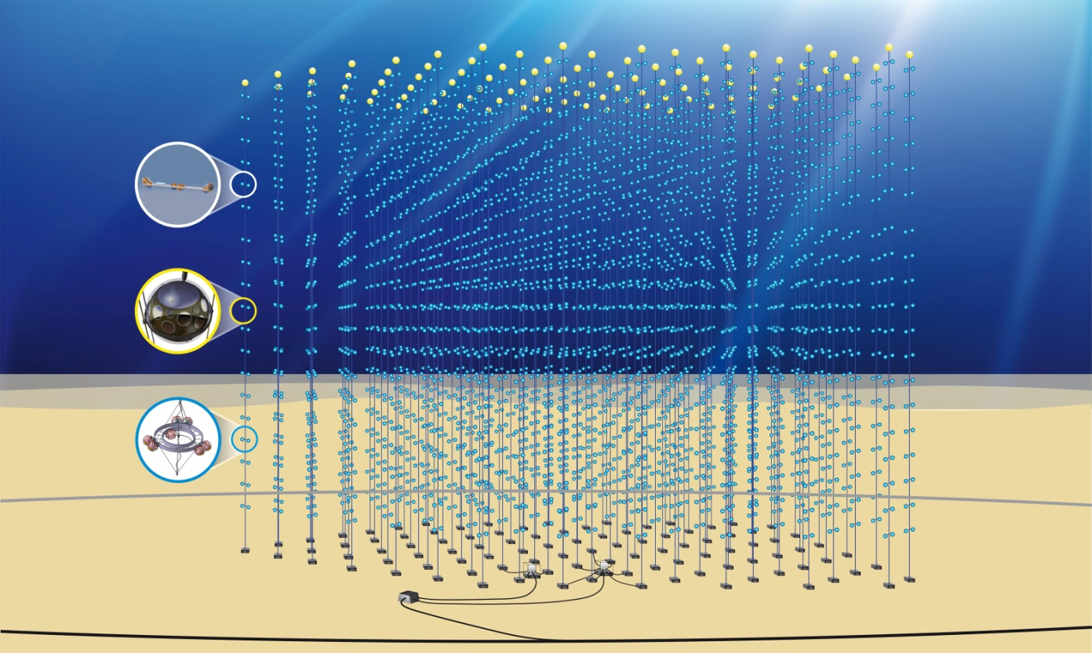

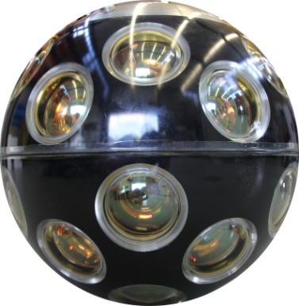

An artists impression of KM3NeT (≈ 1/3)
Detection Units
Primary Junction box
Secondary Junction boxes
Electro-optical cable

Slide 8
Main conclusions of the TDR
Construction is possible with viable technologies
About 300 detection units needed to achieve the required sensitivity, with a discovery potential 5-6 times better than IceCube
Full KM3NeT has to be built in several independent “building blocks”
Overall investment ~220 M€
Staged implementation possible
Science potential from very early stage of construction on
Operational costs 4-6 M€ per year (2-3% of capital investment), including electricity, maintenance, computing, data centre and management
Still some alternative options were left open

Slide 9
KM3NeT Preparatory Phase objectives
Build up the collaboration by facilitating the political convergence
Define the legal form and the governance of the future Research Infrastructure
Explore funding perspectives
Prepare for construction

Slide 10
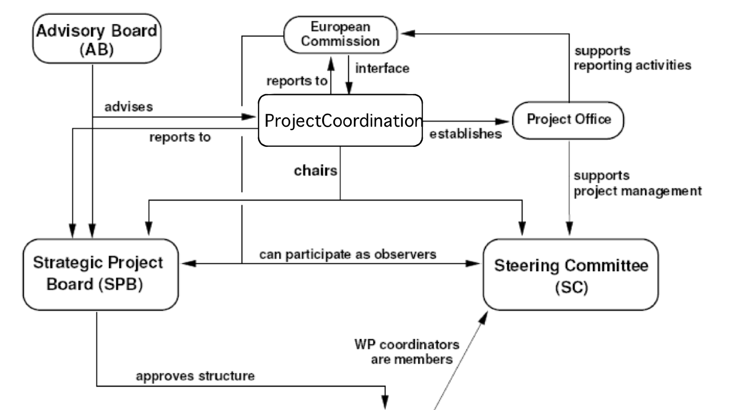
KM3NeT-PP management structures
KM3NeT-PP management structure
Scientific Standing Committee
Administrative Standing Committee
Work Packages
WPA
WPB
WPN
The task of the ASC and SSC is to prepare the ground for the necessary political decisions

Slide 11
Technology
We are now strongly engaged in the construction and validation of Pre-Production Models (PPM) of the major components of the Detection Unit
Status and details discussed in the parallel sessions of this meeting
A summary will be presented in the Work Package reports

Slide 12
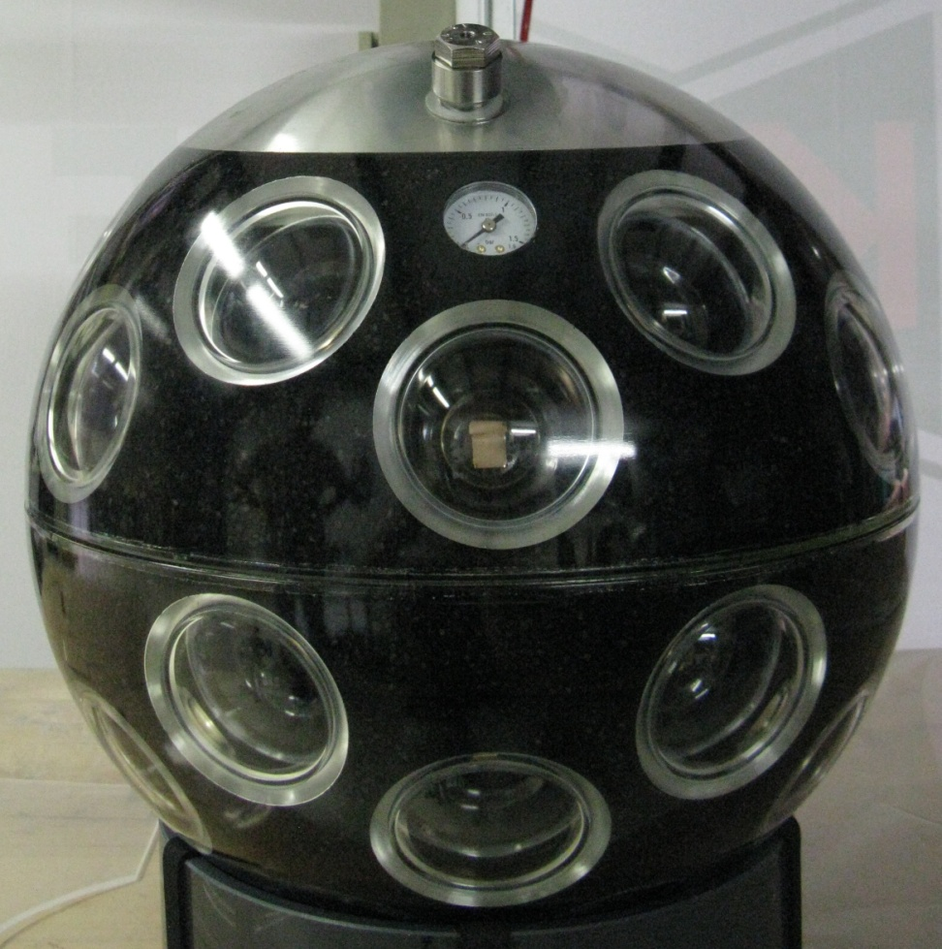
The Digital Optical Module (DOM)
Multi-PMT DOM
Many small PMTs
Almost uniform coverage
Photon counting
Minimize pressure transitions
All electronics inside
All identical units

Slide 13
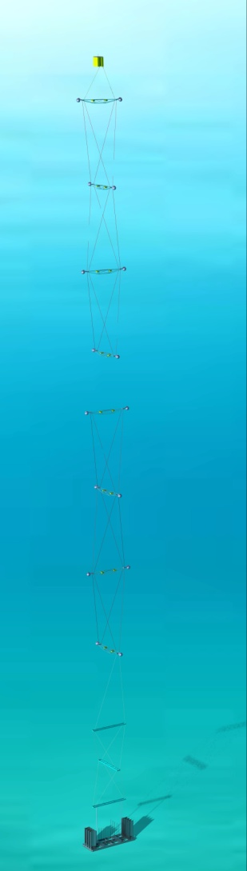
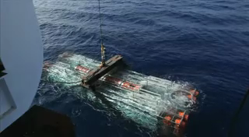
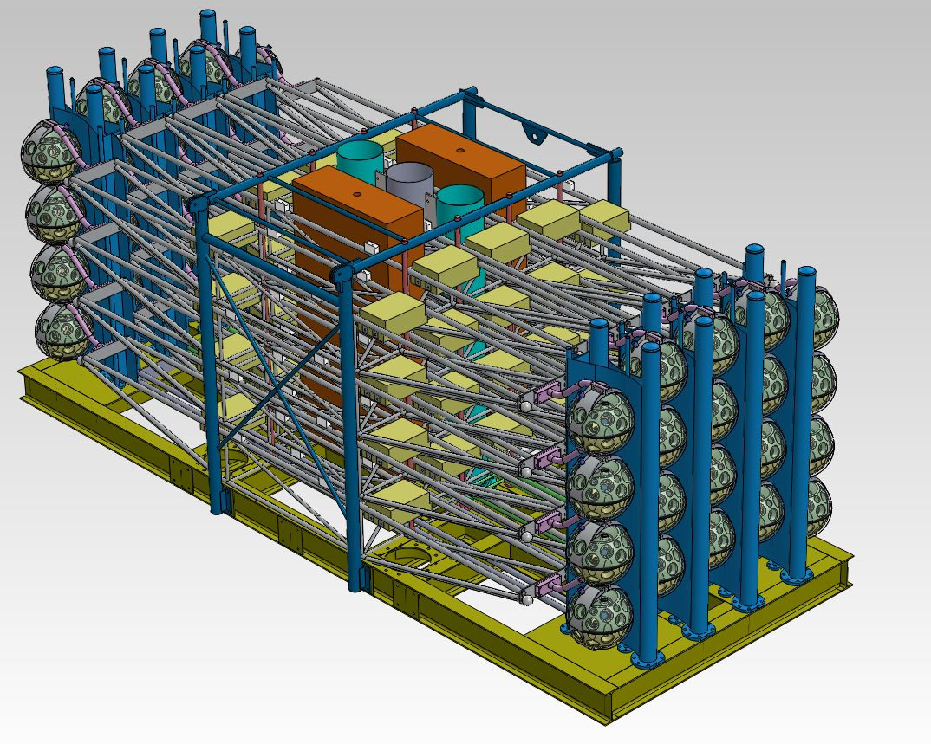
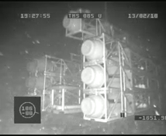
The Detection Unit (DU)
6 m bar length
DOM on either end
Consecutive storeys perpendicular
Two vertical electro-optical cables
40 m inter-storey distance
320 towers
Compact deployment

Slide 14
Funding
Major funding may come from EU structural funds
Significative fundings have been allocated
  France 8 M€ (phase 1) + 9 M€
  Italy 20.8 M€
  The Netherlands 7 M€ + 1 M€ to set-up headquarters
Other funds may become available in the near future
  Greece 50 M€ allocated for KM3NeT
  Romania up to 2.5 M€
  Spain 1 M€
  Germany may also contribute
Funds in France, Italy and Greece are “site”-linked

Slide 15
What after the Preparatory Phase?
Need an organizational structure to manage the post-PP phase
A Memorandum of Understanding is in preparation
Our intention is to strenghten the collaboration
  Central management
  Definition of collaboration rules
  Validation of chosen technologies
  Start of construction with engineering arrays in Toulon and Capo Passero

Slide 16
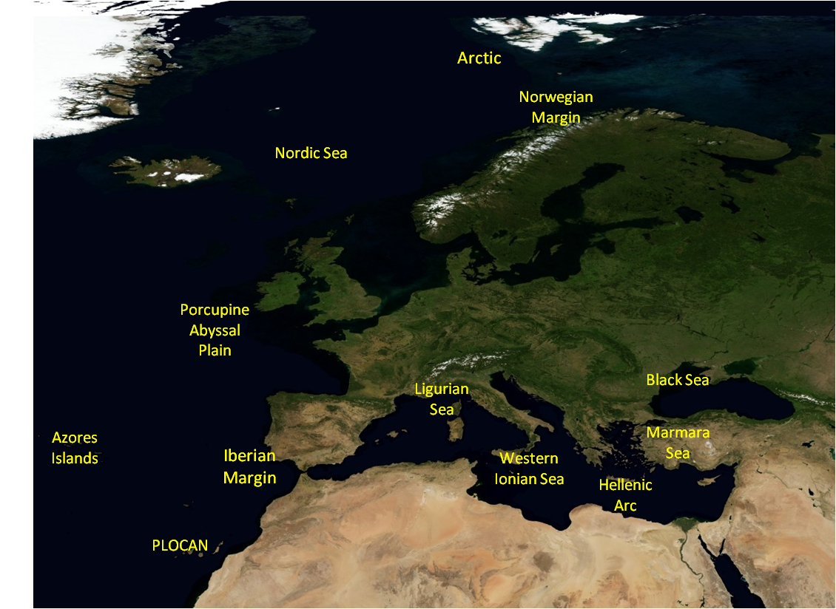
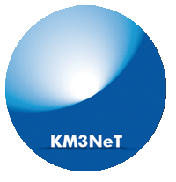

KM3NeT and EMSO
Sinergy with the Earth and Sea Science Community
Real Time
Environmental Monitoring
Toulon, Sicily and Hellenic:
sites of common interest for KM3NeT and EMSO
Oceanography (water circulation, climate change):
Current intensity and direction, Water temperature, Water salinity ,...
Geophisics (geohazard):
Seismic phenomena, low frequency passive acoustics, magnetic field variations,...
Biology (micro-biology, cetaceans,...):
Passive acoustics, Biofouling, Bioluminescence, Water samples analysis,...

Slide 17
Conclusions
KM3NeT has gone through a long and difficult path, impressive achievements have been reached both on technologies and on simulations and optimization of telescope performance
We have now reached a essential stage with the definition of the technology
Fundings to start a first phase of detector construction are now available
A rapid and positive conclusion of the validation tests and a time schedule compatible with the constraints imposed by the Structural Funds rules are now essential for further development of KM3NeT
Then. Let’s go for it!

