Slide 1
PPM Shore Station Report
Electronics
DAQ

Slide 2
Shore Station for PPM
Shore station Electronics
Receive all data from the photonic network
Data Gathering: point-to-point each DOM to shore
Data Broadcasting: Shore to all DOMs
➔ Talk by Kostas Manolopoulos
Shore station DAQ
Single command & control of data tacking
Routing data from electronics to processors
Store data and/or processing results to disk
On-line monitoring DOM data and DAQ system

Slide 3
Shore Station DAQ
Software Tasks
design CEA/Saclay
Run GUI
1
Run Control
Target C&C
p
1
1
Electronics C&C
1
1
1
1
create /destroy
GRID
1
r
Data Sender
p/r
1
Data Router
local
Database
Storage
r
f
1
f
Data Filter
Data Manager
f
1
Monitoring
Off-shore
On-shore

Slide 4
Using the ICE middleware
Internet Communications Engine (ICE) :
modern, widely deployed object-oriented middleware (by ZeroC™)
support for C++, .NET, Java, Python, Objective-C, Ruby, and PHP
similar to CORBA, but improved:
user datagram protocol (TCP/IP, UDP) support
asynchronous method dispatch
built-in security
automatic object persistence
interface aggregation
hence, ICE is the best choice for the infrastructure of the KM3NeT DAQ system
In KM3NeT the ICE-Guru is Shebli Anvar (CEA/Saclay)
A. BELIAS - NESTOR

Slide 5
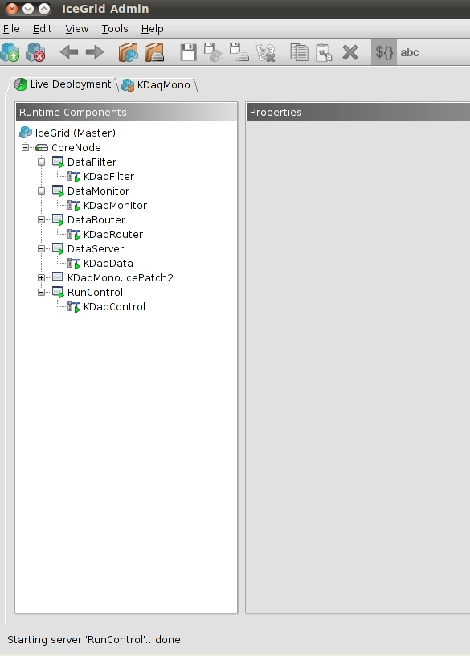
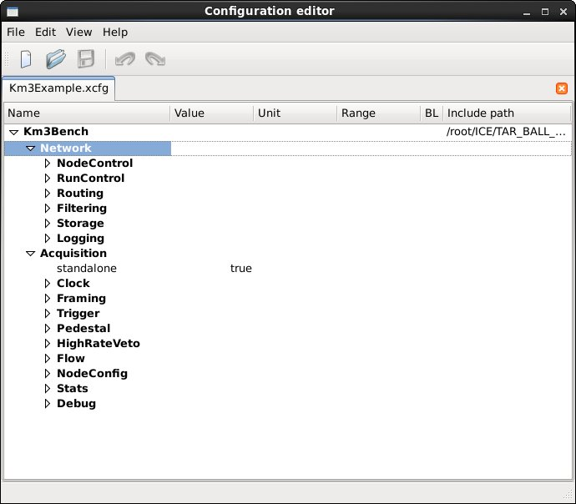
Example of live deployment
administrating the various nodes of the ICE-Grid, which refer to different processes/software tasks
editing the configuration file for all shore DAQ tasks with the configuration editor

Slide 6
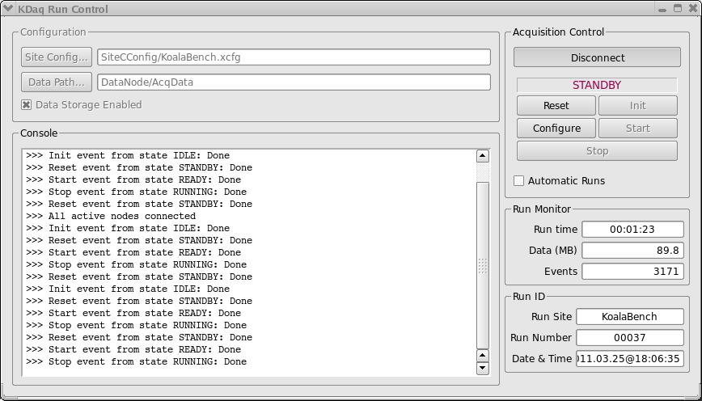
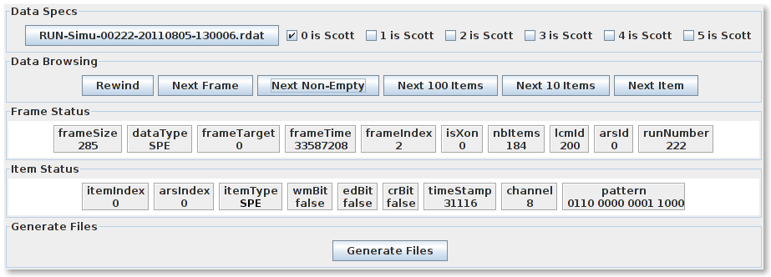
Example of running a test
looking at acquired data via a display program written in java
DAQ Run Control GUI in action
A. BELIAS - NESTOR

Slide 7
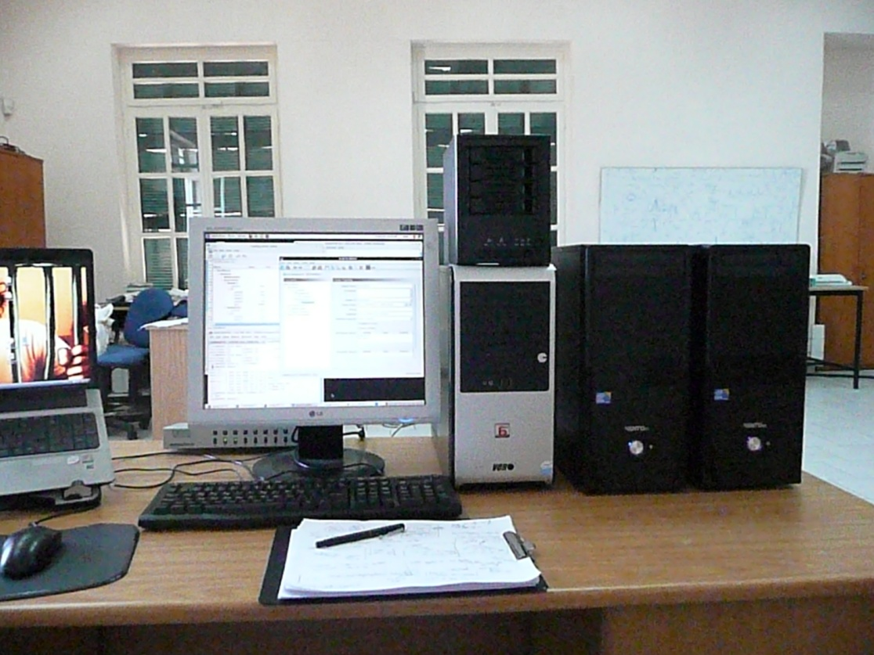
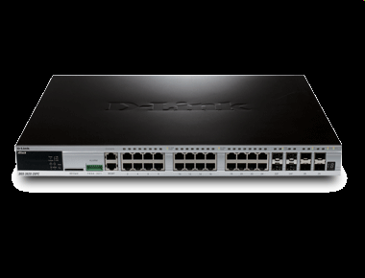
DAQ Switch
Hardware order in progress
Shore DAQ Development
Station @Pylos
Network Storage
Hardware available
4 HDD & RAID
DAQ PCs
Hardware available
Run Control; OK
Data Router; OK
Data Filter; In progress
Monitor Data &
System; In progress
Data storage; In progress
Tests to dimension PPM DAQ system;
In progress

Slide 8
Shore Station DAQ - Outlook
DAQ on-shore software development & tests in progress
Implement PPM specific configurations and data taking conditions
DAQ on-shore software release (live-CD installation)
Full Data Chain integration
For PPM project best to have local DAQ expertise on-site

