Slide 1
CoCo – Cockroft Walton Feedback Control Circuit
On the behalf of
Deepak G, Paul T, Vladimir G

Slide 2
Motivation for HV and its regulation…
3” Photo Multiplier Tubes (PMT) operate with high voltage (HV) in the order of kV.
The gain of the PMT varies linearly with HV.
The HV is generated using a Cockroft Walton (CW) multiplier circuit.
This HV should be regulated in order to have stable operation of the PMT.
No second source for the present driver

Slide 3
Present Solution using COTS component
AD 1111
The input 7 μs DC pulses to the CW multiplier were supplied with a load dependent frequency between 1 and 5 kHz.
The circuit had stability problems at lower HV outputs.
The output load current rating was too high.
House keeping power high because its generic functions.
The COTS is also costly at low volume (~0.5M).

Slide 4
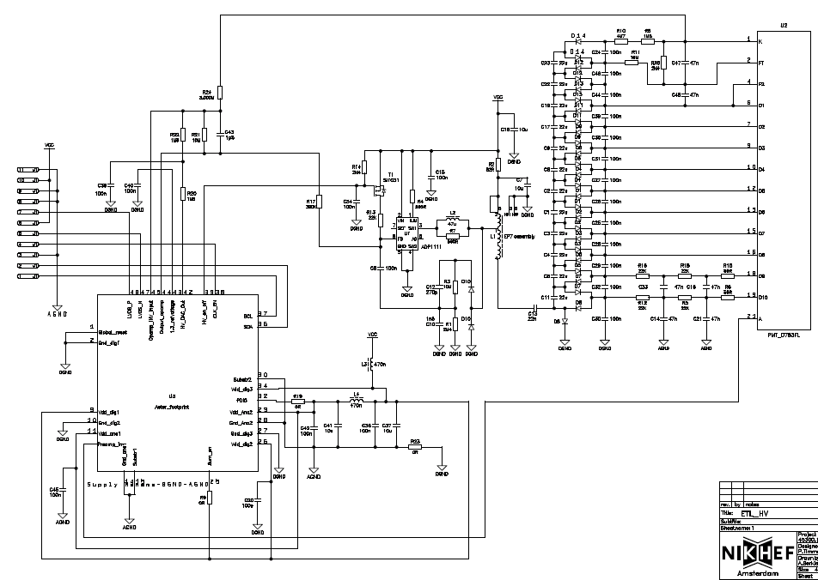
COTS..we intend to replace
PROMiS
Cockroft-Walton Multiplier

Slide 5
Goals for CoCo
CoCo should regulate the frequency of the 6.5 μs pulses.
For example, during start-up of the HV circuit, CoCo should supply the pulses at a maximum of 50kHz and when the desired HV is reached, the pulses are slowed down to a few Hz based on the feedback-> Low power operation ☺.
The width of these pulses should also be controlled by sensing the current, to avoid saturation of the transformer.
The regulation should be stable, even at lower voltages.
Should have smaller footprint, cheaper and consume less power.

Slide 6
CoCo sample simulation
Across Capacitor
Driver out
200ns pulse
6.5us pulse
CLK

Slide 7
Are we in line with the goal?
CoCo is designed to control and regulate the feedback of the CW HV generator.
CoCo is designed in 350nm CMOS technology, consumes ~ 1.7 mW power.
CoCo is stable even at lower CW voltages.

Slide 8
Layout of CoCo
GND
1 mm x 1 mm in size
NSC
PSC
BG
16 pads
CF
GND
CSNS
FB_IN
SW
OPAMP_OUT
GND
VDD
200n
6u5
CLK
CSNS_C

Slide 9
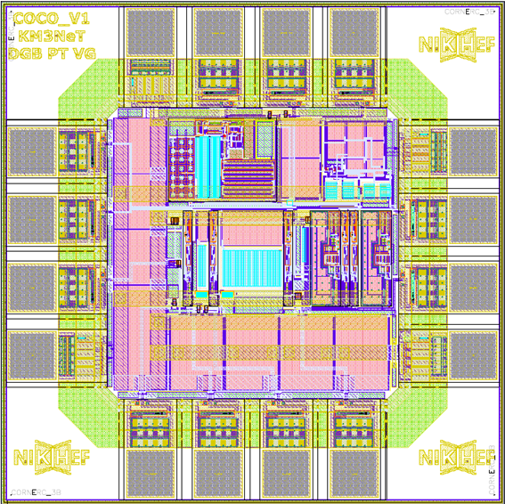
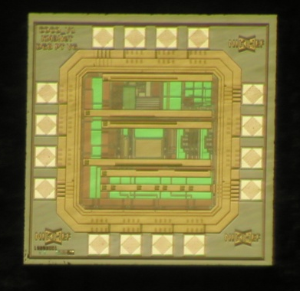
Dec 5 Tapeout, Dies received 3rd Feb.

Slide 10
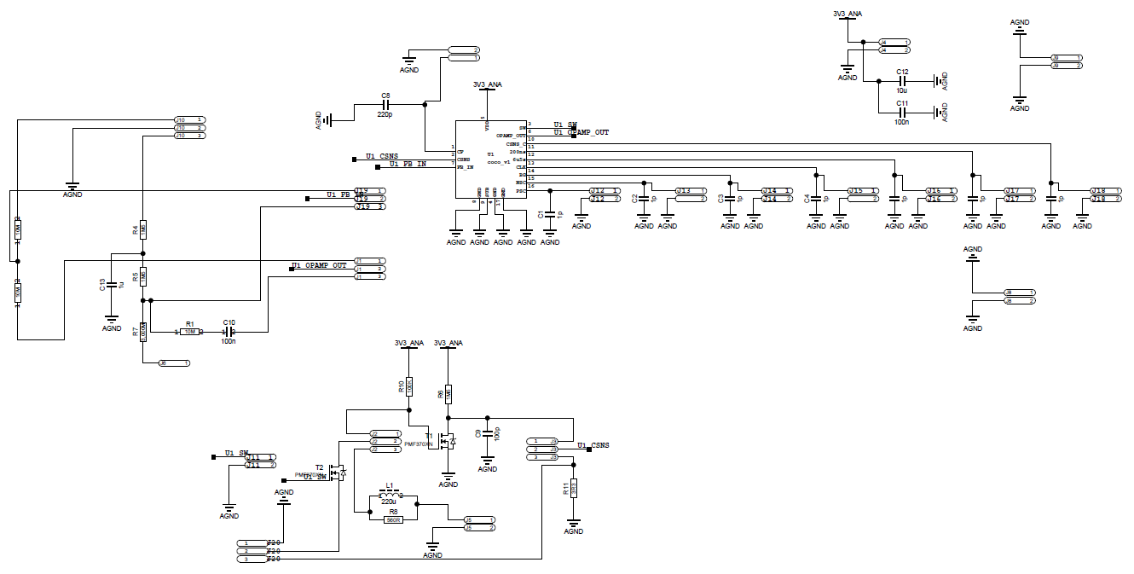
Test Board schematic
Designed in away that it can be tested on the lab table, with a few DC supplies and also with the HV PMT Base!

Slide 11
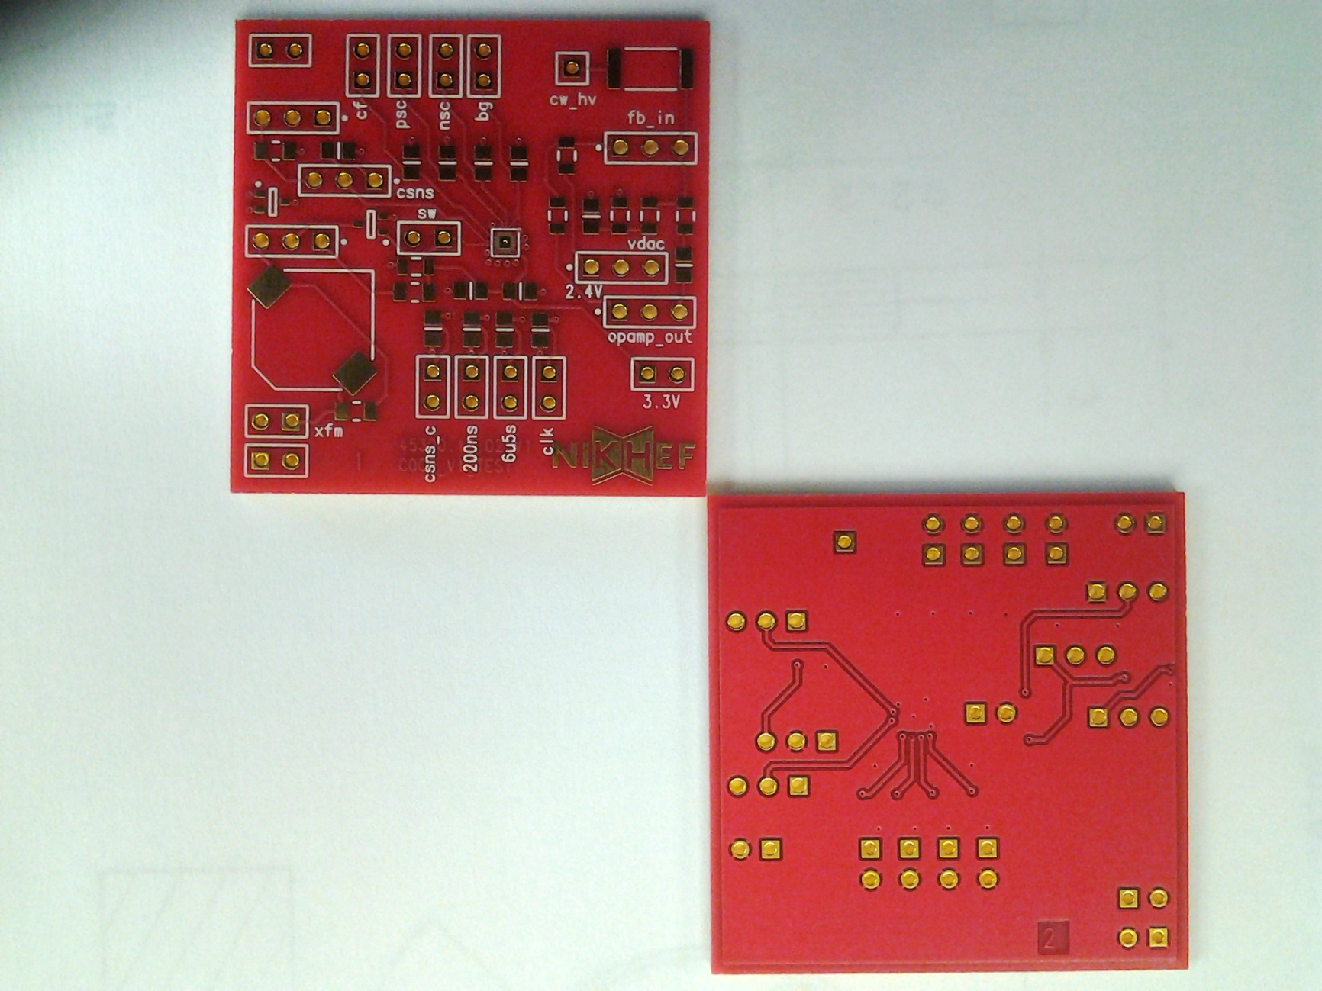
Test board Layout

Slide 12
GND
3G
3.3V
J20
HV from
PMT Base
Internal DAC test V 0->2.4V
3.3
100p
10M
220p
1p
1p
1p
HV DAC setting 1.9->2.7V finally from PROMIS_V2
10M
1u
1M5
1M5
10M
J2
1M5
Now300k
100n
To transformer on PMT Base
100k
10u
100n
Now3.3k
1p
1p
1p
1p
CRO Monitor Points
Jumper while testing on the CoCo testboard
560
Jumper while testing from PMT Base

Slide 13
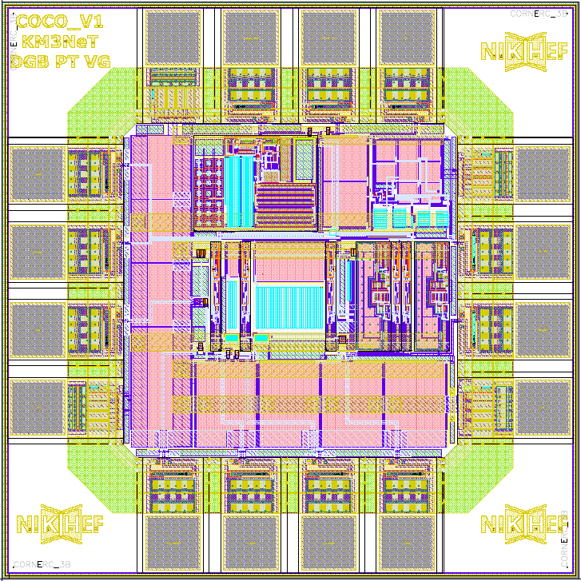

Slide 14
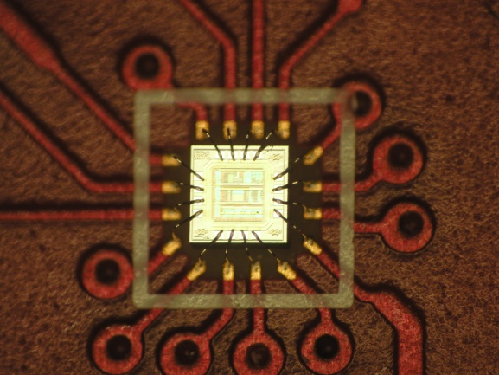
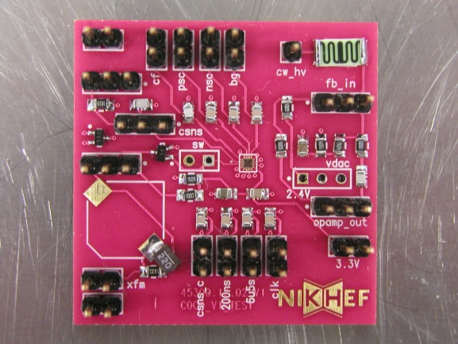
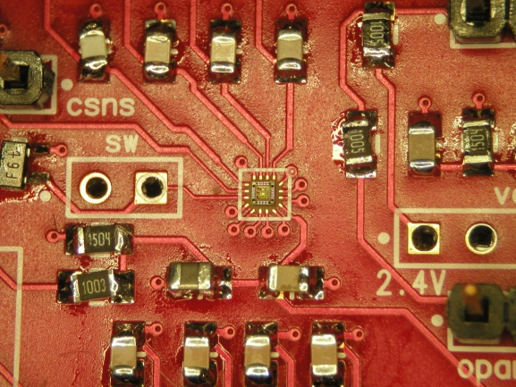
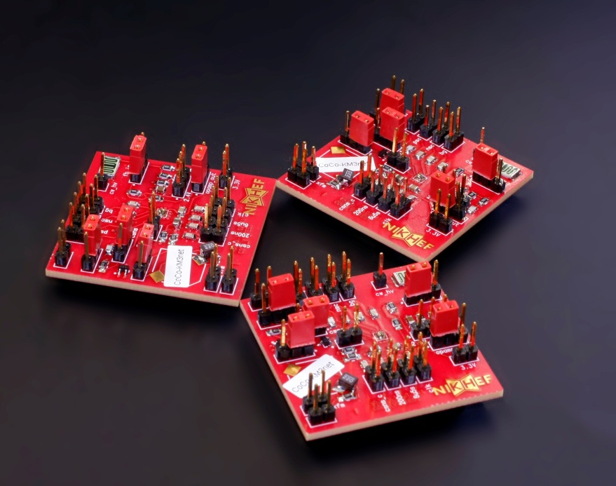
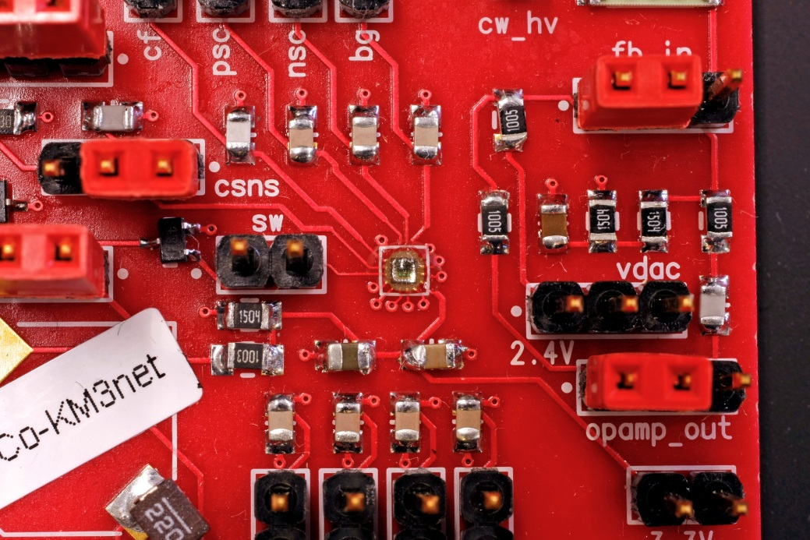
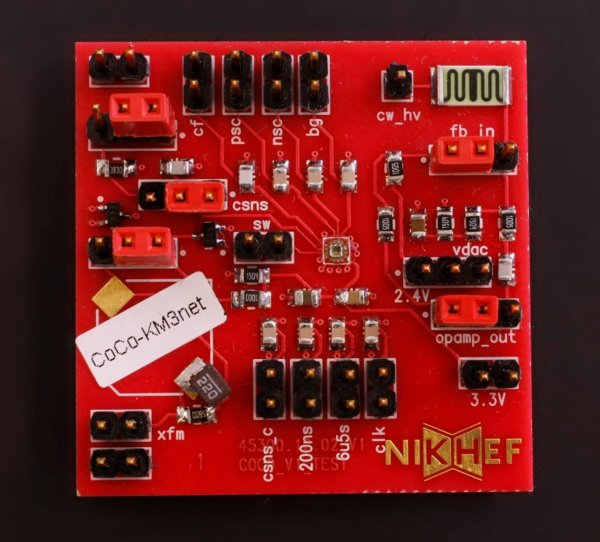
Bonded Dies

Slide 15
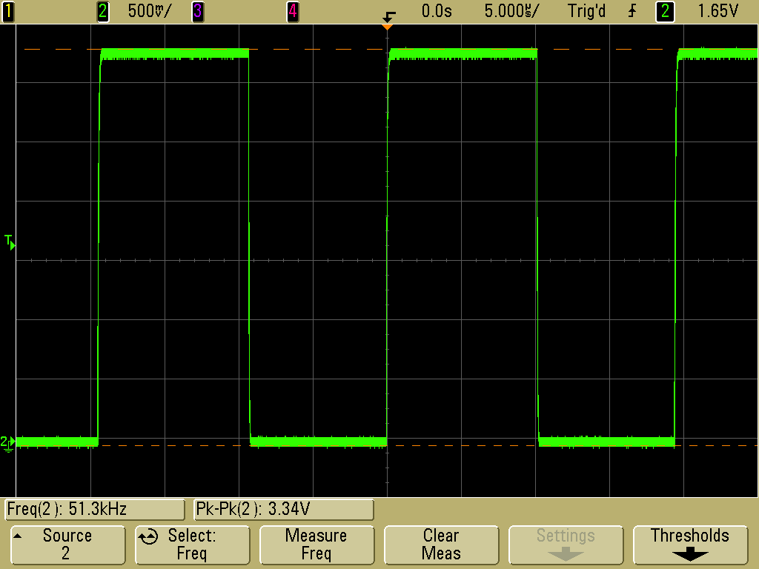
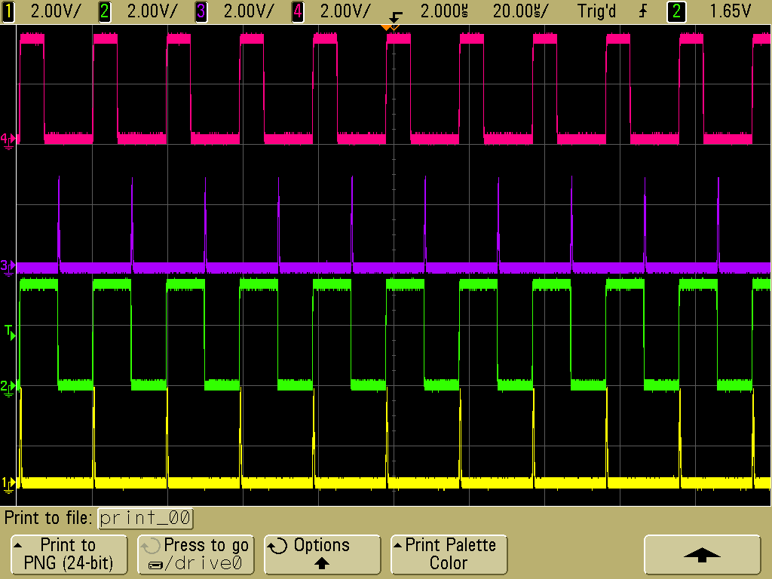
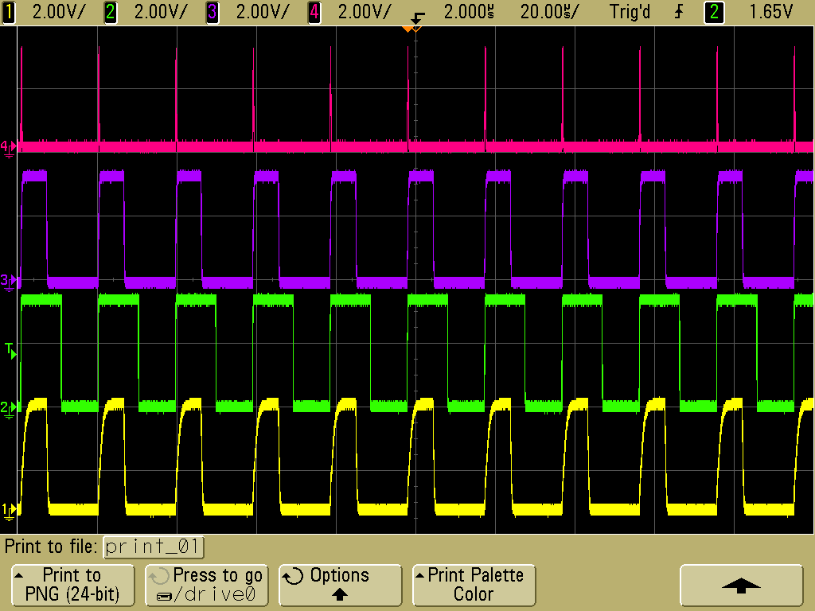
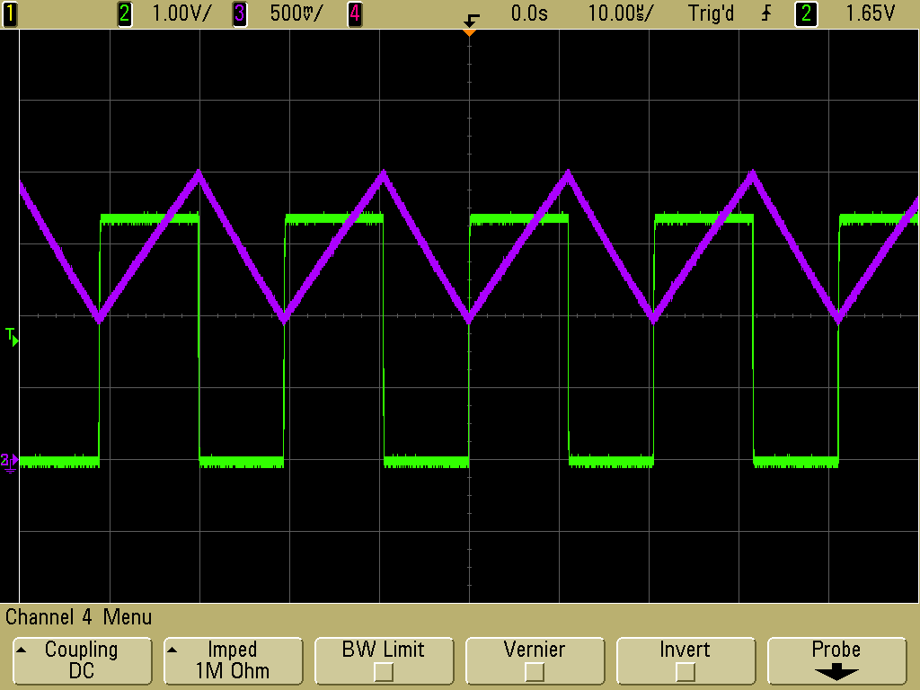
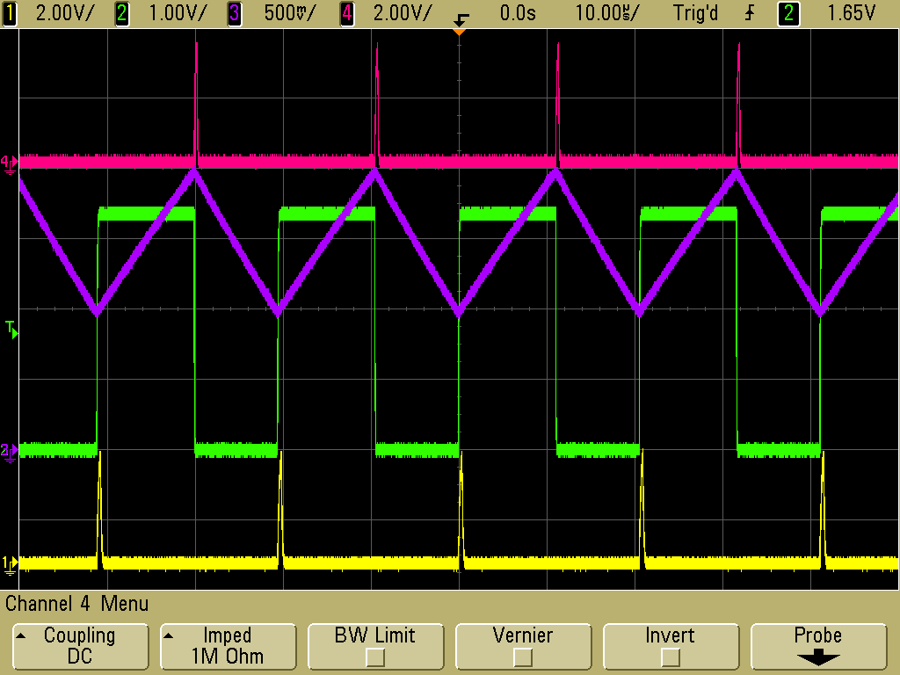
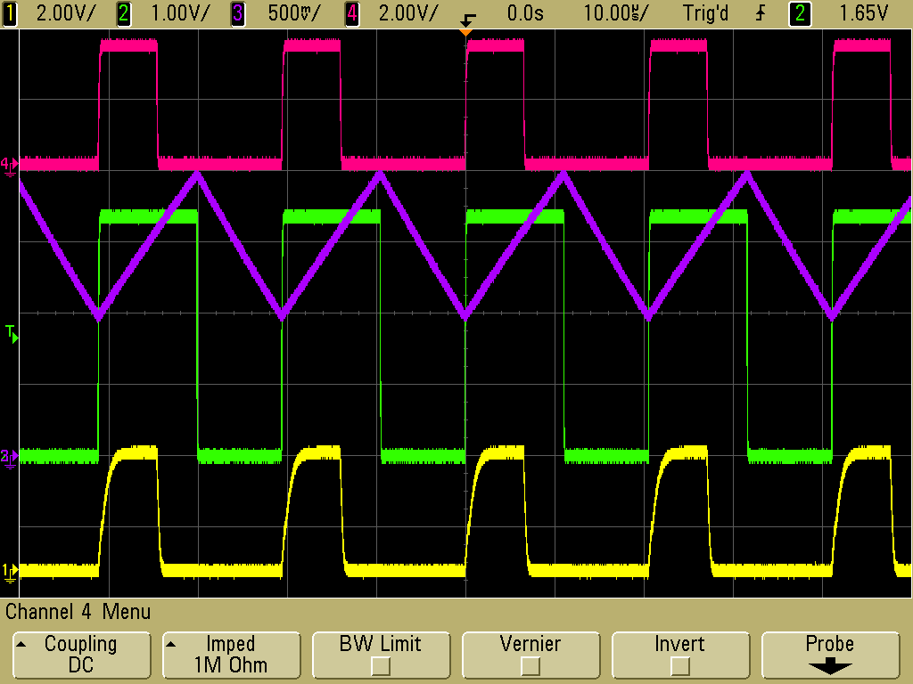
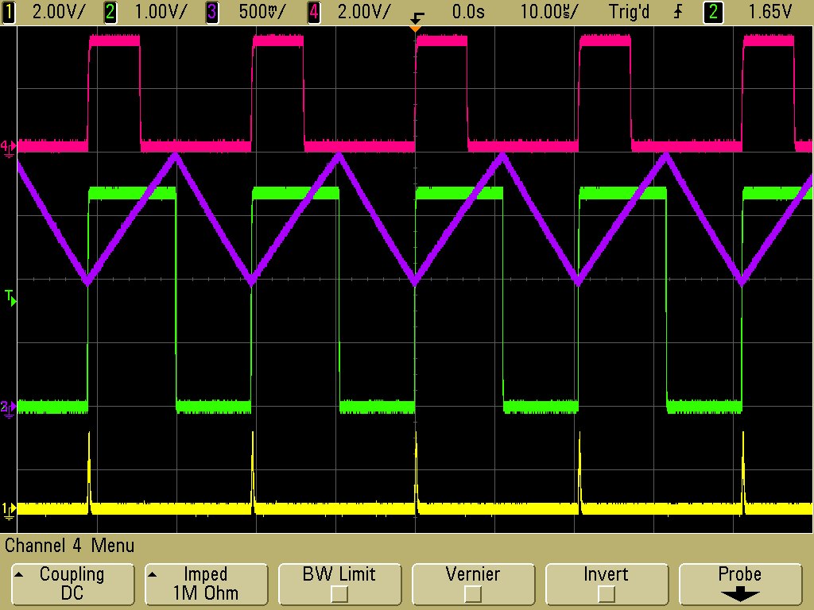
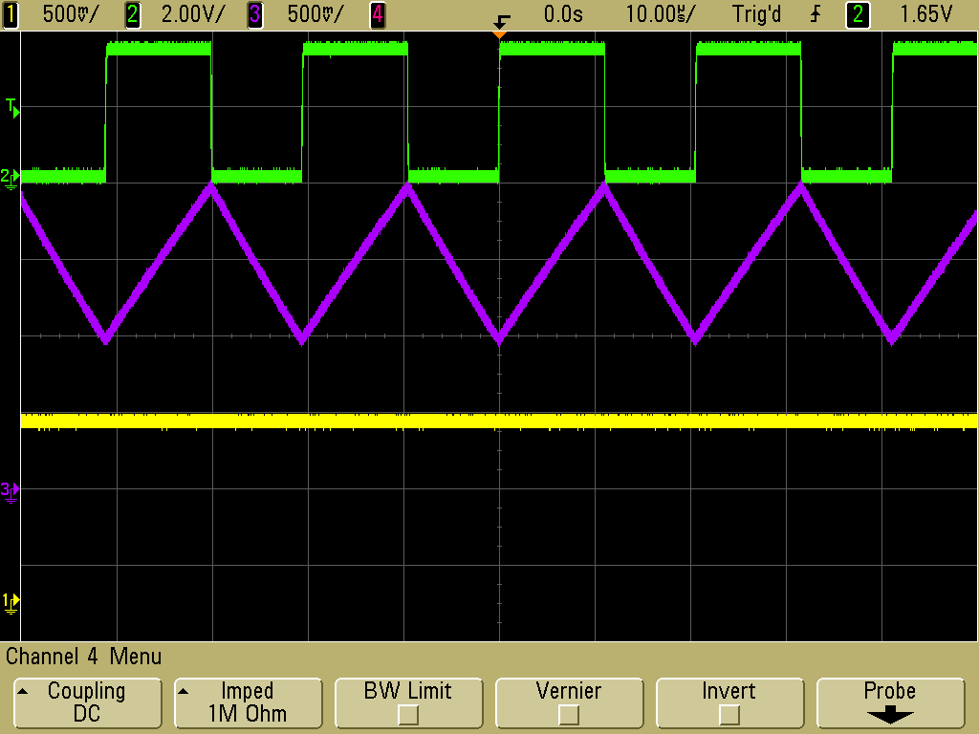
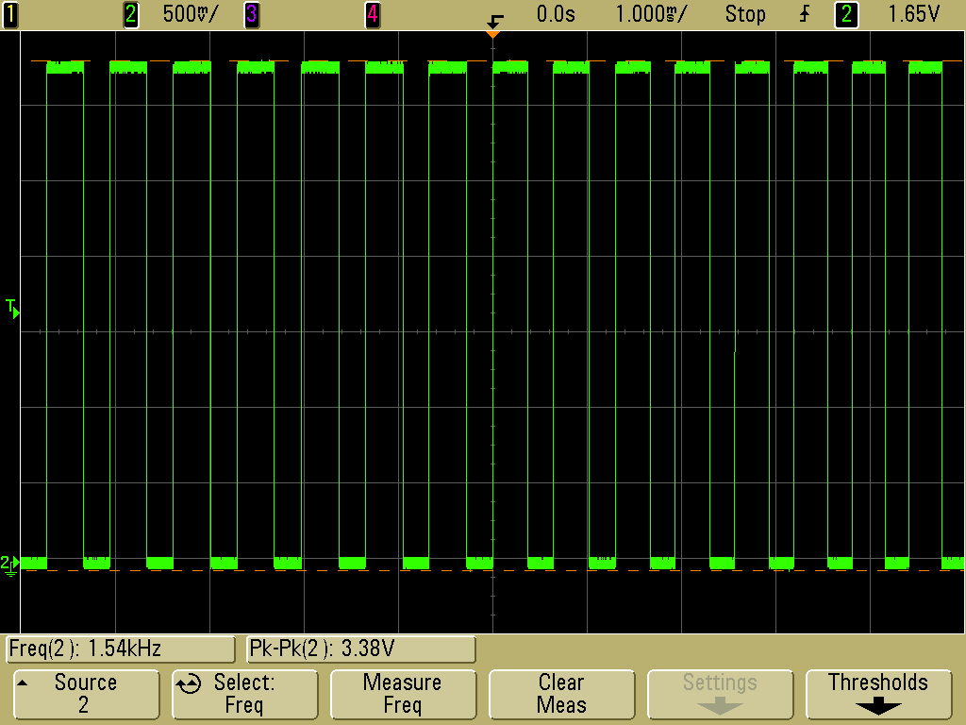
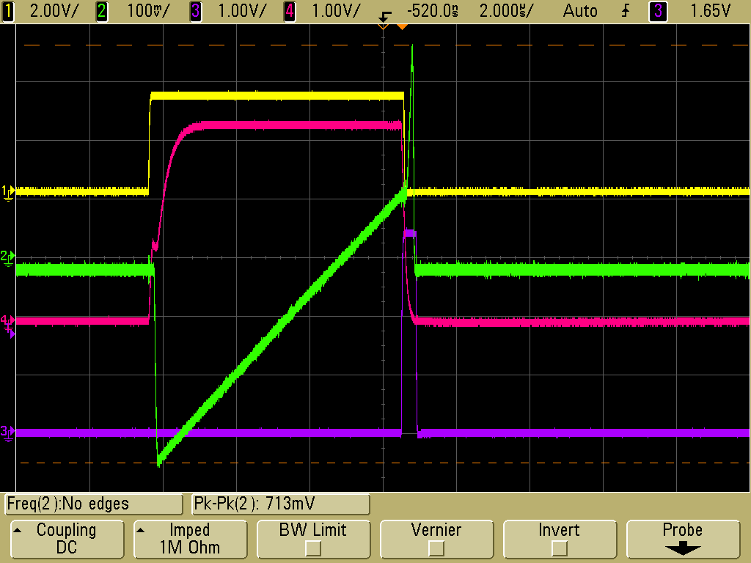
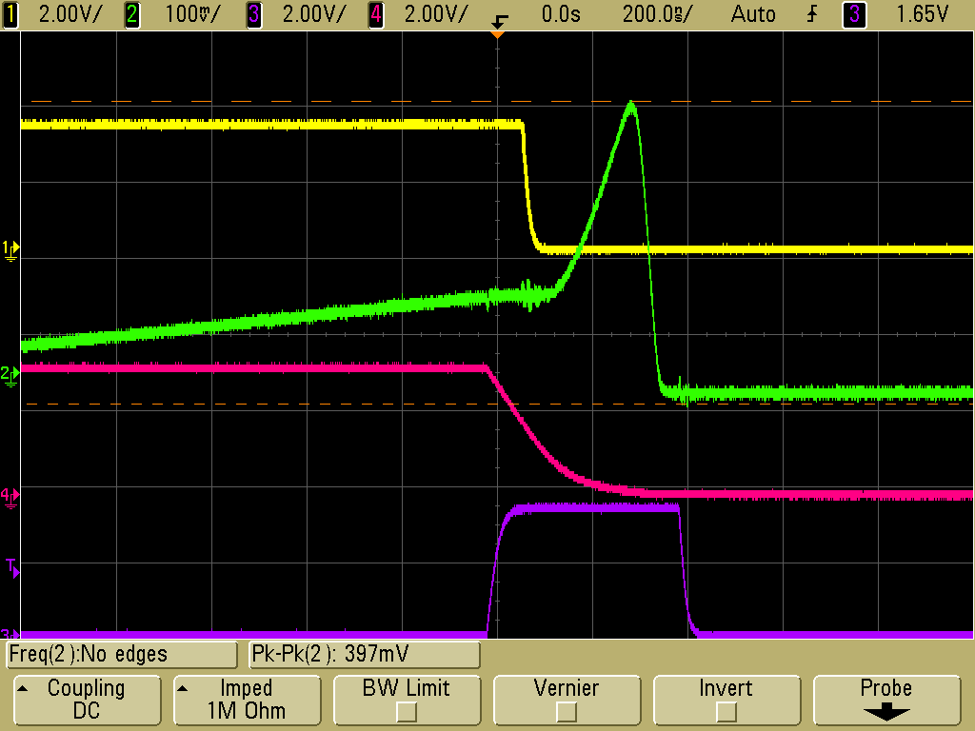
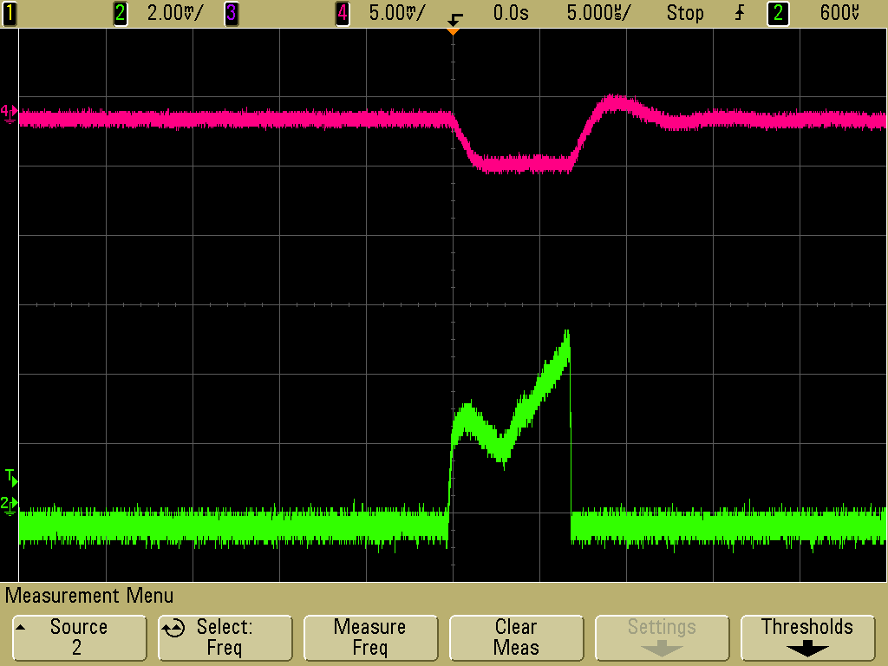
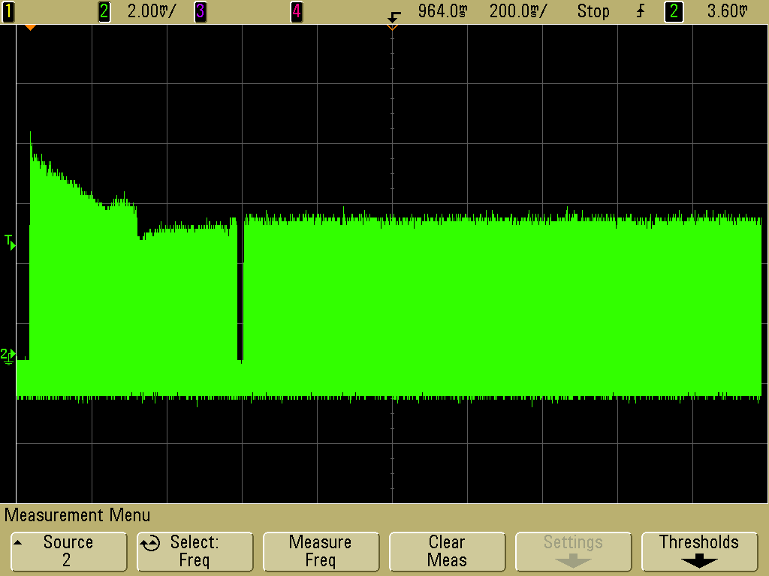
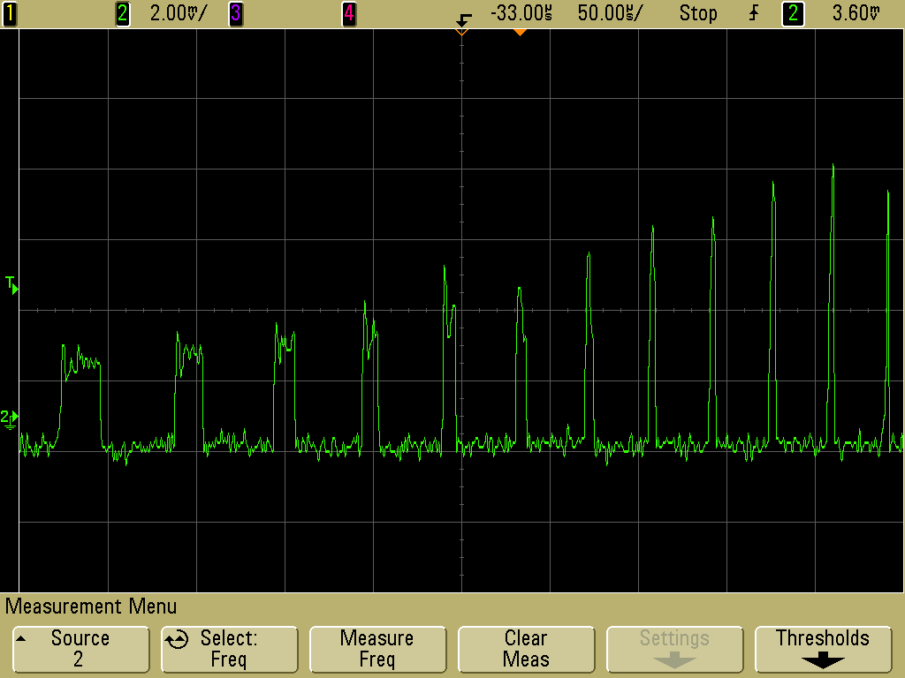
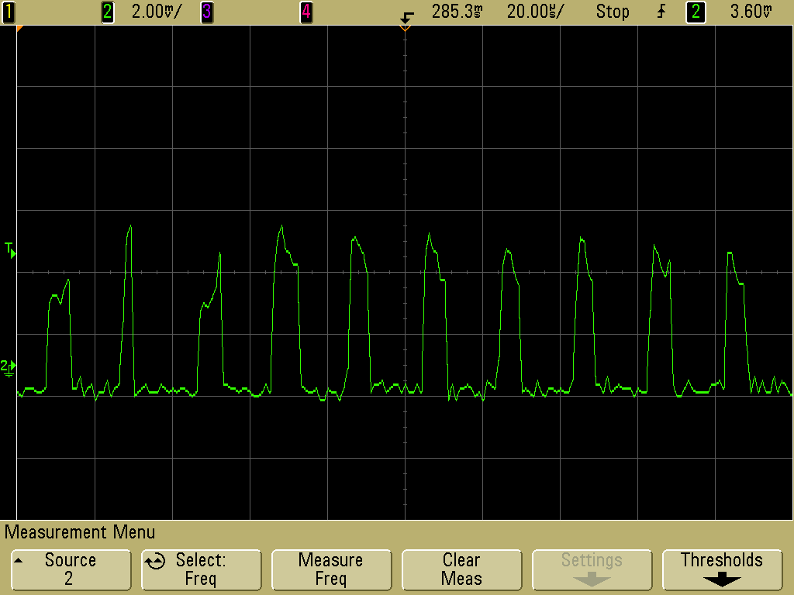
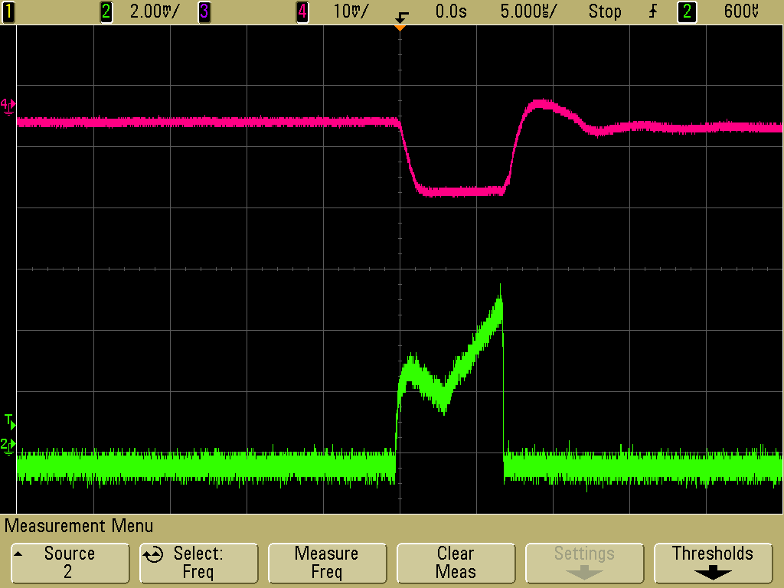
Across Capacitor
Pos edge comp
CLK
CLK
Neg edge comp
CLK
6.5 us output
Switch output
200 ns output
Bandgap
Current Sense
Current Sense
HV Ripple
CLK
6.5 us output
Current in the Transformer
6.5 us output
Current Sense
Current Sense
Current Sense
HV Ripple
Current in the Transformer

Slide 16
Measurements on the testboard

Slide 17
Measurements with the HV PMT Base!

Slide 18
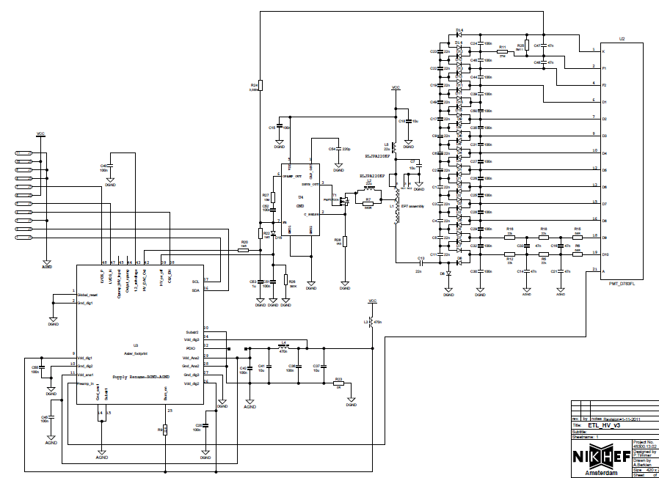
COTS..we intend to replace
CoCo
PROMiS_V2
PROMiS
Cockroft-Walton Multiplier
Cockroft-Walton Multiplier

Slide 19
Thank you for your attention

Slide 20
Chip Schematics
Bias Block
Current sense comparator
Bandgap
SR Latch
200ns Monostable
Feedback opamp
CCO
6.5us Monostable
Driver

Slide 21
Current controlled Oscillator
Charging Current Mirror
Positive Swing Comparator
FB control Opamp
1.2 V Bandgap
2V
SR Latch
Negative Swing Comparator
Discharging Current Mirror
1V

Slide 22
Monostable multivibrator
DFF
RC = 200ns or 6.5us
Comparator
1.2 V Bandgap

Slide 23
PCB Bonding
Chip goes here! Direct bonding on the PCB
ORIENT THE LOGOS ☺

