Slide 1
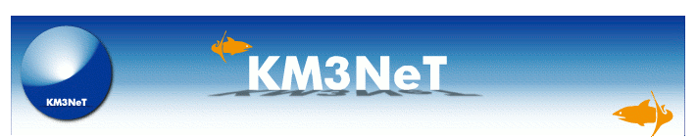





KM3NeT General Meeting
Catania – February 20-24, 2012
PPM-DOM: Acoustics
G. Riccobene and F. Ameli on behalf of
CPPM, ECAP, INFN, UPV Acoustic calibration groups

Slide 2
Joint Activities Summary
A fruitful collaboration !
Joint tests (CPPM, ECAP, INFV, UPV)
Gandia, May 2010:
Electronics test and water pool tests
LNS, August 2010:
Electronics test of INFN and UPV hydrophones
LNS, March-April 2011:
Full DAQ chain tests (ECAP piezo, UPV and INFN hydrophones)
Roma, September 2011:
Water pool test of full DAQ chain (FFR and INFN hydrophones)
LNS, November 2011:
Integration and test of OAM (Opto-Acoustic Module)
first tests on KM3NeT PPM Acou-plug

Slide 3
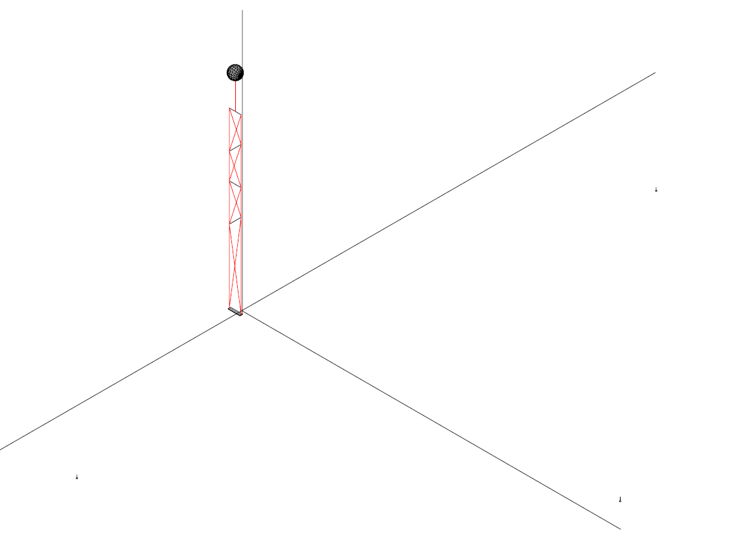
Key elements of the deep sea acoustic positioning system
Key elements for the Acoustic Positioning System (APS):
  Auto-calibrating Long Baseline of acoustic transceivers anchored in known and fixed positions
  Array of acoustic sensors (hydrophones) moving with the Detection Unit mechanical structure
  Data acquisition and transmission system
  Data analysis system
Detection Unit
- Emission frequency : 25 kHz÷45 kHz
- LBL transcievers and hydrophones phased and synchronous with Mclk
- Acoustic signal amplitude can be set from shore
Hydrophone
Measurament Technique:
TDoA (Time Difference of Arrival):
T^{Emit}(Beacon) – T^{Receive}(Hydro)
2. Geometrical Triangulation
LBL transceivers

Slide 4
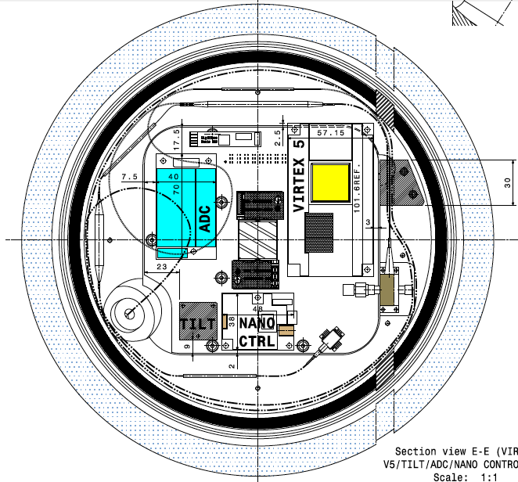
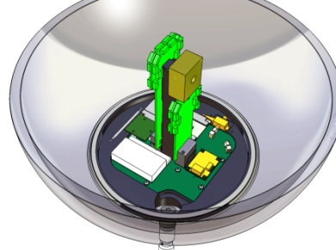
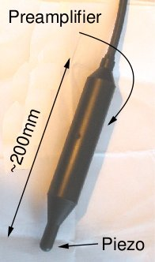
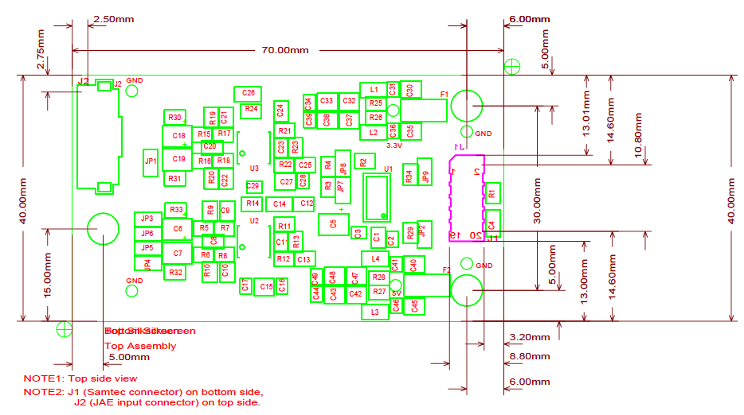
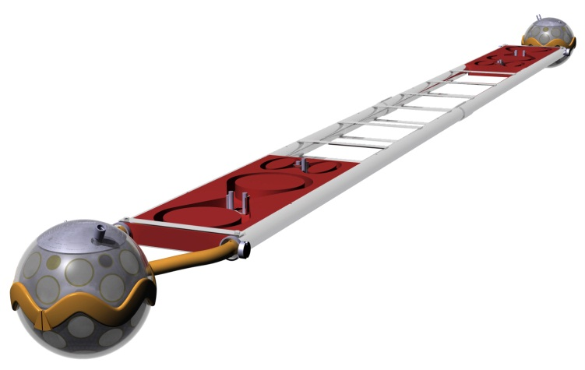
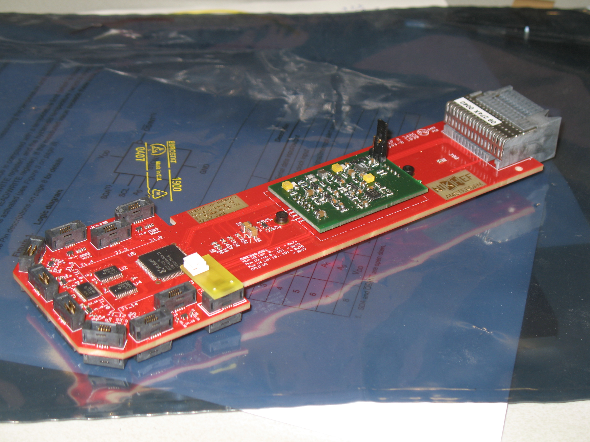
Acoustics for the KM3NeT PPM
Acoustic System in the PPM – DOM
All data to shore.
Positioning and multidisciplinary science
Stereo 200 kHz/24bit ADC
Master clk synchro
Interfaced with Central Logic Board.
Acoustic Sensors (per DOM):
1 external hydrophone (INFN or UPV-FFR)
1 internal piezo (ECAP)
4 hydrophones and piezos ready
4 acou-plugs ready
DOM octopus board with amplifier board for piezo signal

Slide 5
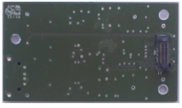
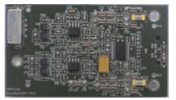
The Acou-plug for the PPM-DOM
Multi-layer PCB
with low-noise audio performance
Samtech 20 pin connector to CLB:
I²S stereo signal outuput
Power supply
Clk (12.5 MHz)
ADC reset and controls
Piezo signal input from octopus board
Hydrophone (and piezo)differential signal input and preamp(s) power supply
Capacitors for AC-coupling
of input signal
Stereo ADC
24 bit @ 200 kHz
Low-noise differential amplifiers

Slide 6
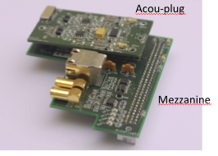
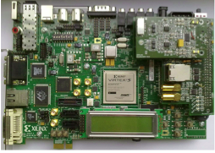
Acou-plug testbench
Test configuration with Xilinx EVB ML507
AES3/EBU output
GPS input (clock and IRIG data)
Firmware occupation:
1% of FPGA VIRTEX 5 + buffer (8 KWords)

Slide 7
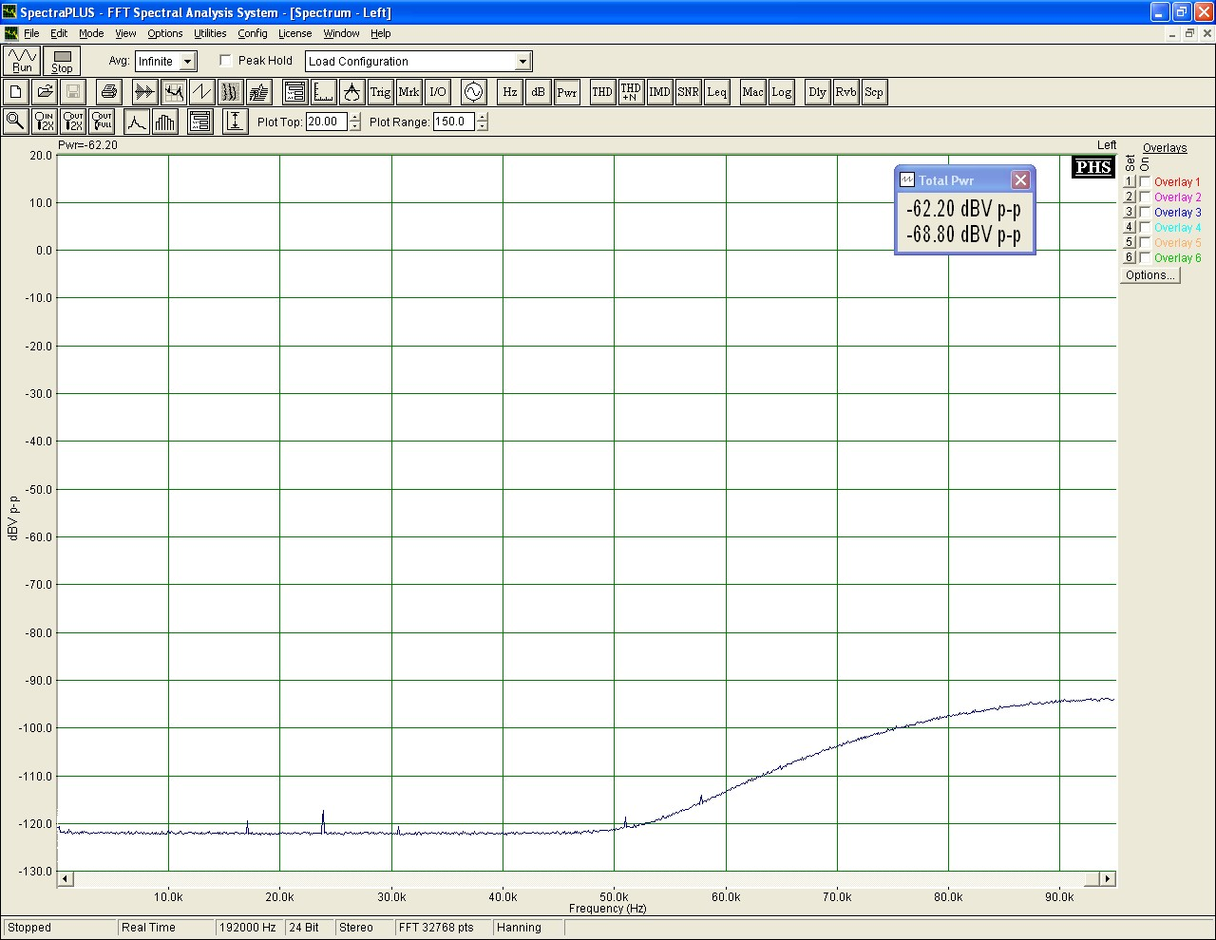
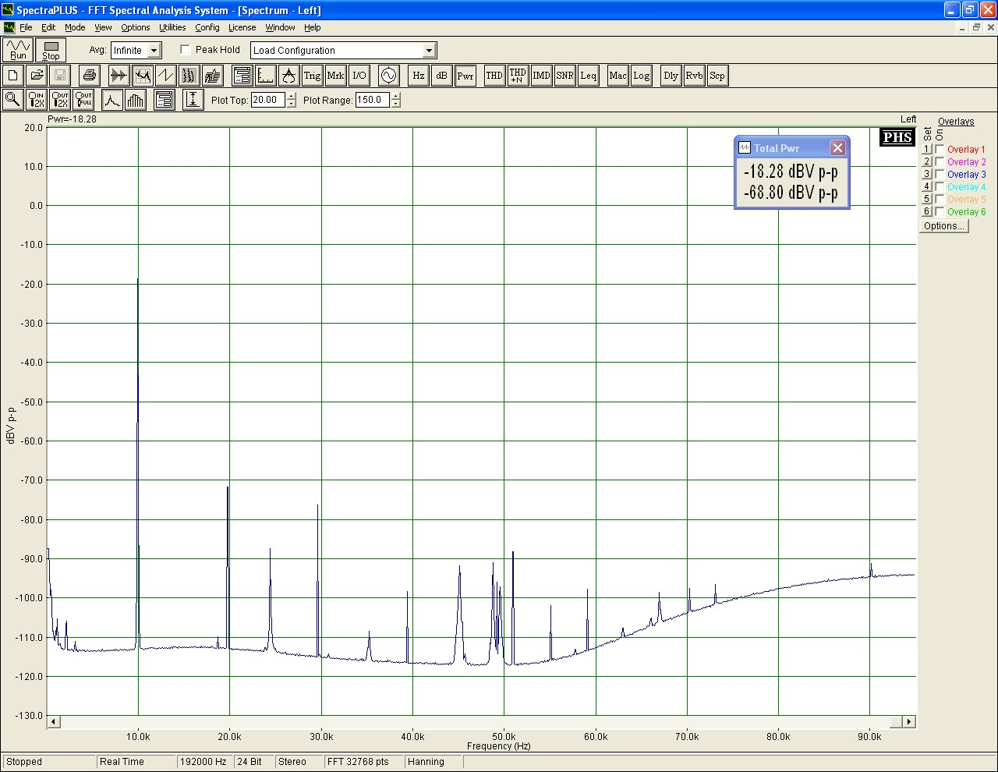
Acou-plug: first Results
Measured electronics noise spectrum:
Performance similar to NEMO Acou-board
ADC noise consistent with maufacturer specs
Board functionality test
Injected sinusoidal signal: 10 kHz, -20 dBm

Slide 8
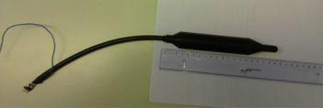
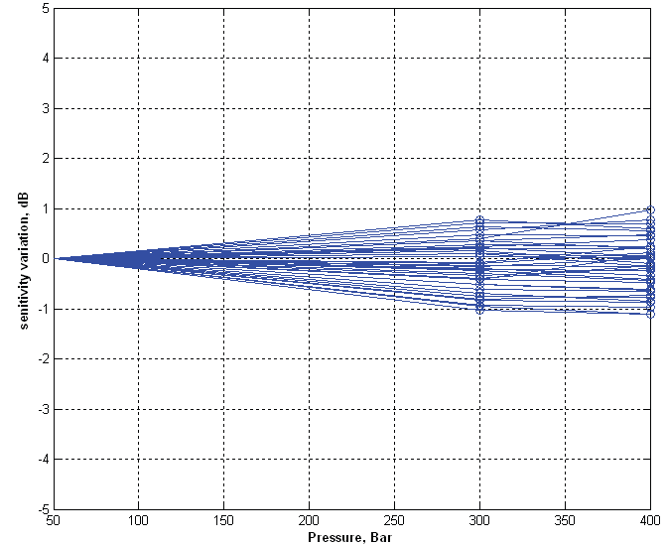
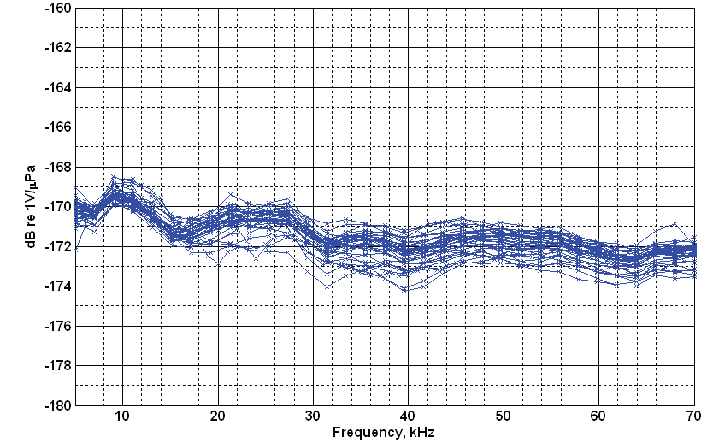
External hydrophone for the PPM
Omnidirectional, large bandwidth external hydrophone.
Tested and calibrated at NATO URC.
Average sensitivity -172 dB re V/uPa
Preamp Gain +38 dB (differential)
Relative Hydrophone sensitivity variation with hydrostatic pressure at 20 kHz
300 bar
400 bar
Measured variation ≤ ±1 dB

Slide 9
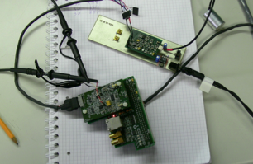
Functionality test of Piezo Amplifier board with Acou-board
Piezo
Acou-Plug Board
Amp Board
Xilinx ML507
Mezzanine Board
Analogue signal tested, good performances.
Reduced amplifier gain (-10 dB w.r.t. standard design)

Slide 10
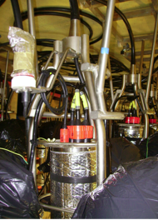
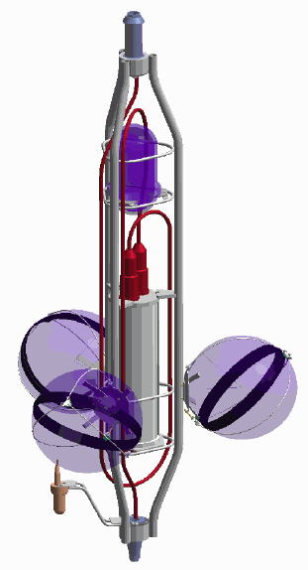
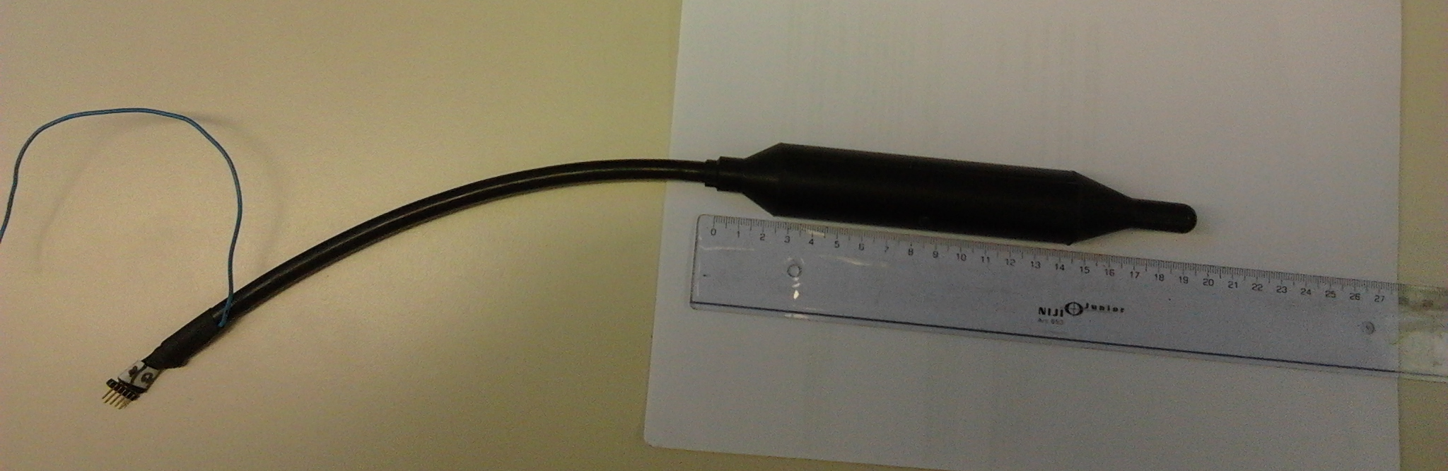
Test of DOM on ANTARES Line
Full PPM-DOM (including piezo) to be installed on ANTARES storey
Hydrophone to be installed at support for ANTARES positioning hydrophone.
Coordination P. Lamare (CPPM)
Hydrophone, piezo and Acou-board ready
Hydrophone support in Ti under construction
Ready for Power and DAQ tests

Slide 11

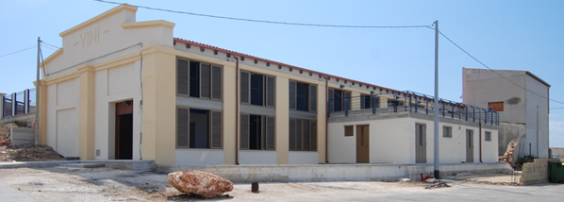
NEMO – SMO tower
NEMO Phase II detector
8 floors plus a tower base
Floor length: 10 m
Distance between floors: 40 m
32 optical modules ( 4 OMs/storey)
18 acoustic sensors ( 2 sensors/ storey + 2 sensors @ tower-base)
4 autonomous acoustic beacons (for acoustic positioning)
environmental sensors (compasses, CTD, Current-meter, C-Star)
Acoustic beacon and laser beacon
SMO: a 3D array of 14 acoustic sensors installed onboard the demonstrator NEMO – Phase II for acoustic environmental monitoring and test for HE neutrino acoustic detection.
Shore Laboratory in Capo Passero harbour
96 km
20 optical fibres
10 kV DC monopolar with sea return

Slide 12
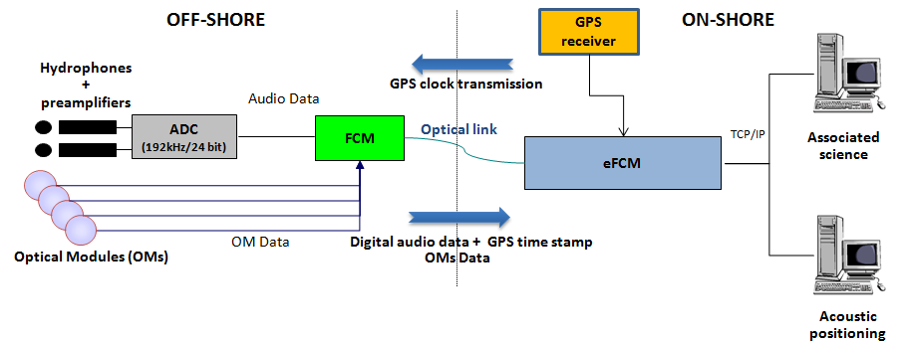
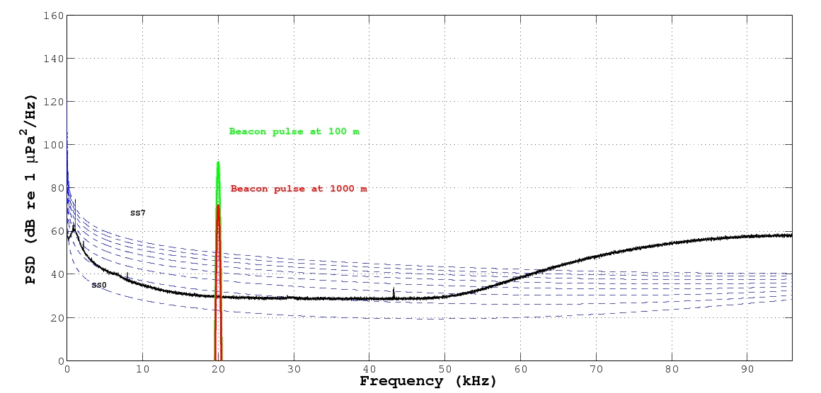
The hydrophone data acquisition chain
The hydrophones data acquisition chain is based on “all data to shore” philosophy, raw data are continuously transmitted to shore on a local internet network at the shore station.
Data stream 32 bits @ 192 kHz → 12 Mbps (2 hydrophones)
Signal (beacon @1km)
Signal (beacon @ 100 m)
Noise(electronics+sea)
INFN standard hydrophones on floors
1 to 6 and on tower base.
System latency 39+0.1 µs
GPS clk time stamp and synchro

Slide 13

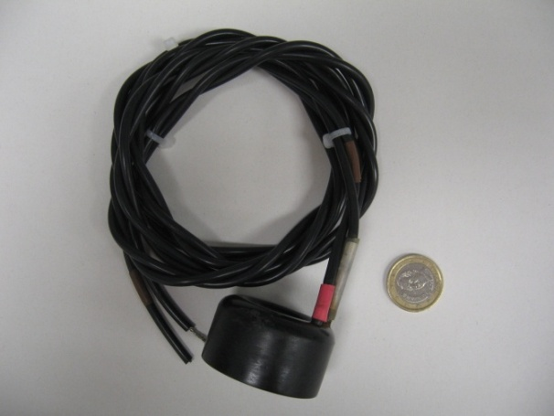
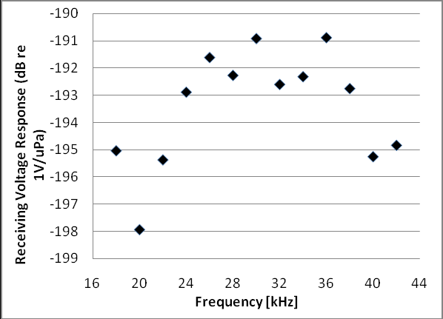


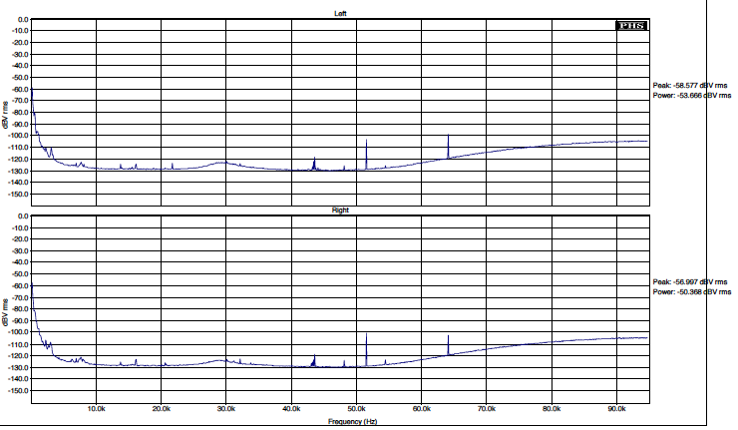
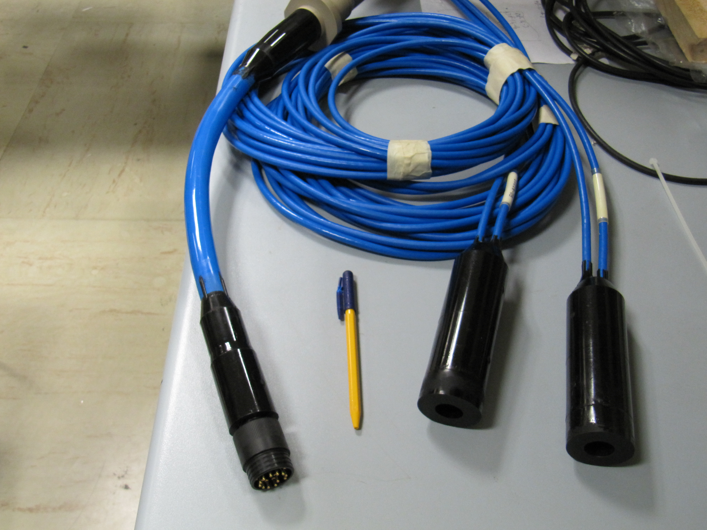
FFR (receivers) on NEMO Phase II
Floor #7
FFR(Free Flooded Rings )Hydrophones + SMID preamplifiers (gain :+38 dB )
Receiving Response
FFR - SX30
FFR +SMID preamp

Slide 14
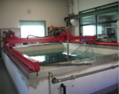
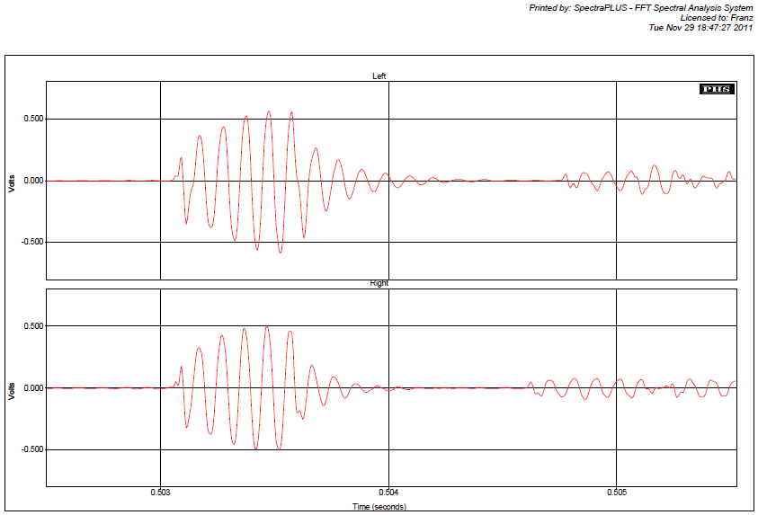
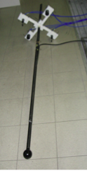
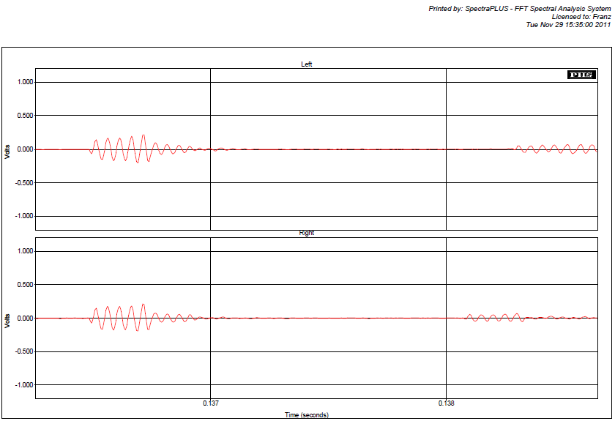
Test in water pool FFR and INFN hydros
UPV (FFR)
10kHz, 5 cycles
All DAQ chain
Test of
Hydro sensitivity
GPS time stamping
MClk synchronization
UPV
INFN
INFN (SMID)
Calibrated transducer
10kHz, 5 cycles

Slide 15
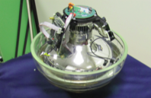
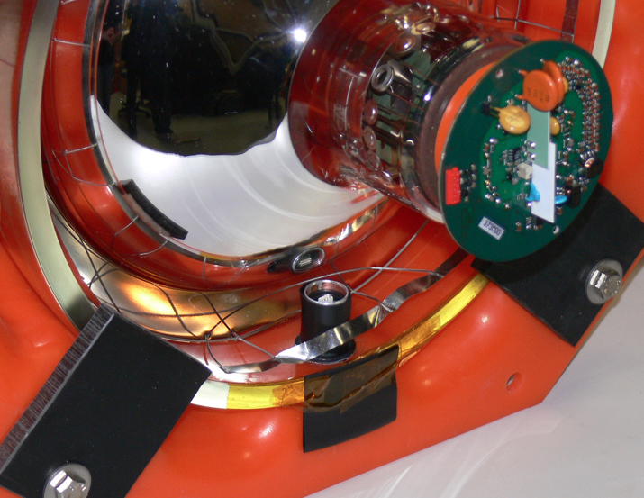
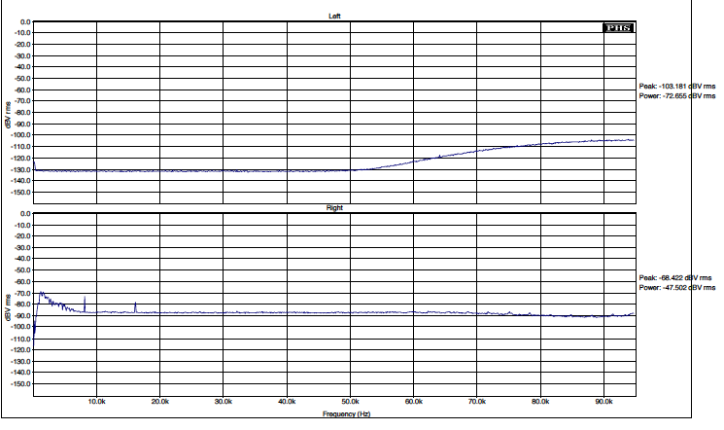
OAM in NEMO Phase II
Floor #8
ECAP Piezo sensors + ECAP preamplifiers
Typical sensitivity -145 dB re. 1V/μPa
Acou Board noise
DAQ system fully compliant:
Reduced amplifier gain
(-10 dB w.r.t. standard design)
Piezo + Acou Board noise
No electric interference on piezo when powering PMT-HV

Slide 16

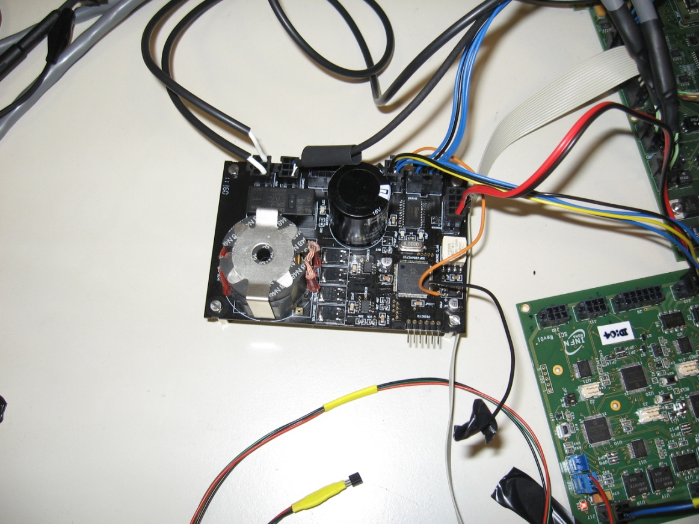
Acoustic transceiver for the LBL
Acoustic transducer:
  UPV has selected the commercially-available SX30 Free Flooded Ring from Sensortech, Canada, since it fulfils all the requirements:
    It can operate as emitter and receiver with good efficiencies (20-40 kHz)
    It can stand high power signals and high pressures
    It can be affordable in the large number of units required by KM3NeT
Electronics
  Especially developed electronics to:
    Fulfill the special requirements of the system: low-power consumption, configurable from shore, high intensity for emission, arbitrary signals for emission and low intrinsic noise.
    Optimize to the transducer chosen
    Reduced costs
+
Hydrophone
Sound Emission Board

Slide 17
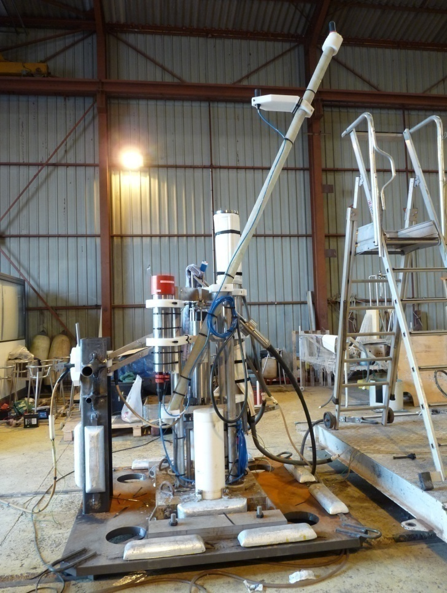
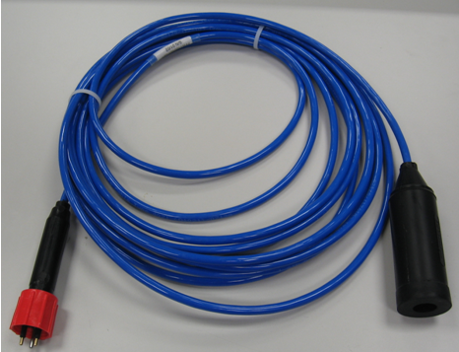

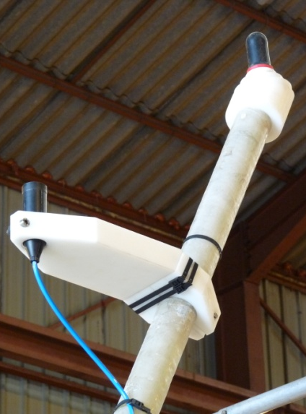
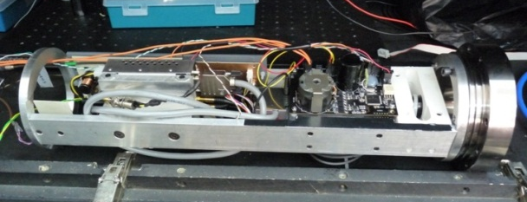
Transceiver integration in ANTARES and NEMO Phase II
Anchor of the IL11 of ANTARES
NEMO
TOWER BASE
SEB will be integrated inside of the titanium vessel of the Laser calibrator.
FFR hydrophone with the support and the titanium laser container.

Slide 18
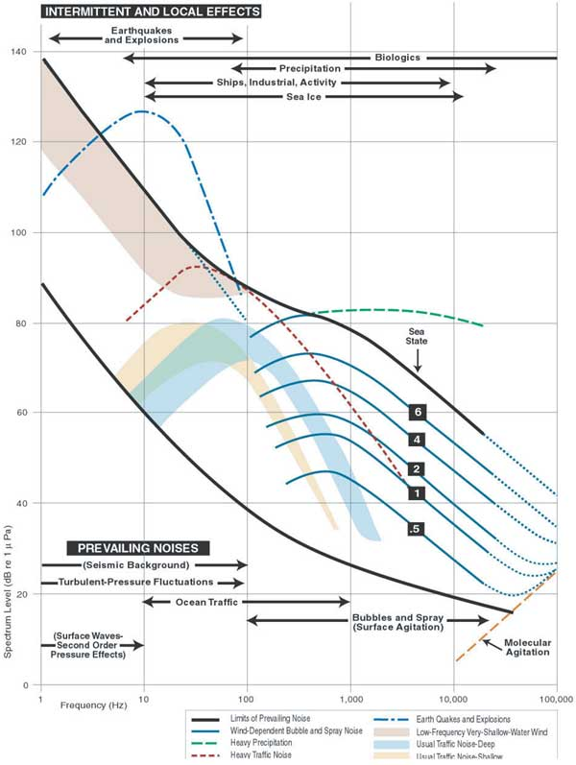
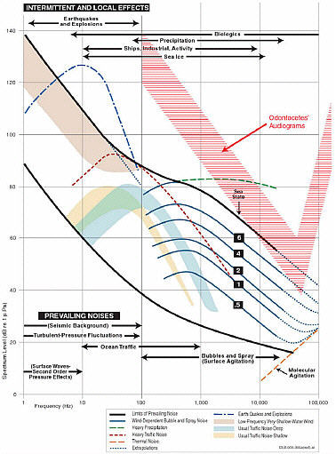
Conclusions and perspectives
PPM Acoustic chain built and under test (stand alone)
To be done:
- tests with CLB
- test with Power system
- test with shore DAQ
Intriguing possibilties for the near future, thanks to new technology improvements
-) ADC with enahnaced low-noise performances @> 50 kHz
-) Ultra low-noise hydrophones (below SS0)
A important step towards neutrino acoustic detection
100
from [Ainslie, 2011]

