Slide 1
KM3Net VEOC
KM3NeT VEOC (Vertical Electrical Optical Cable)
Motivations
Based on developments on solid cable at NEMO and Antares project and proto cable of Seacon.
Optimizing properties like;
flexibility
weight
drag resistance
costs

Slide 2
KM3Net VEOC
KM3NeT VEOC (Vertical Electrical Optical Cable)
Goals
-Design
-Cable Specs
-Layout
-Pressure Balanced Oil Filled cable design (PBOF)
-Storage
-Connection to DOM (BEOC)
-Prototyping
-Prototype VEOC I & VEOC IIa (pressure tests)
-Prototype VEOC III, VEOC IV, VEOC IIb (spiral test)
-Summery of tests
-Conclusion
-Outlook

Slide 3
KM3Net VEOC
Specifications of the VEOC
Type | specs | value | comments
Optic/ electronic | Optical 12 | Attenuation <1 dB/Km los
 | 400 Vdc | Voltage window 350-400 Vdc | Power inventory
Du Specs Mechanical | Density | =water (1048 kg/m³) | reduce load on Dyneema cable
 | Projected area | <0,45 M² | reduce load on Dyneema cable
 | Storage of cable for deployment | Cable flexible Bending radius <120 mm | package
 | DU life time | 15 Years
Environment | Pressure | 60 MPa
 | Chemical | Sea water
 | Temperature | 15 °C

Slide 4
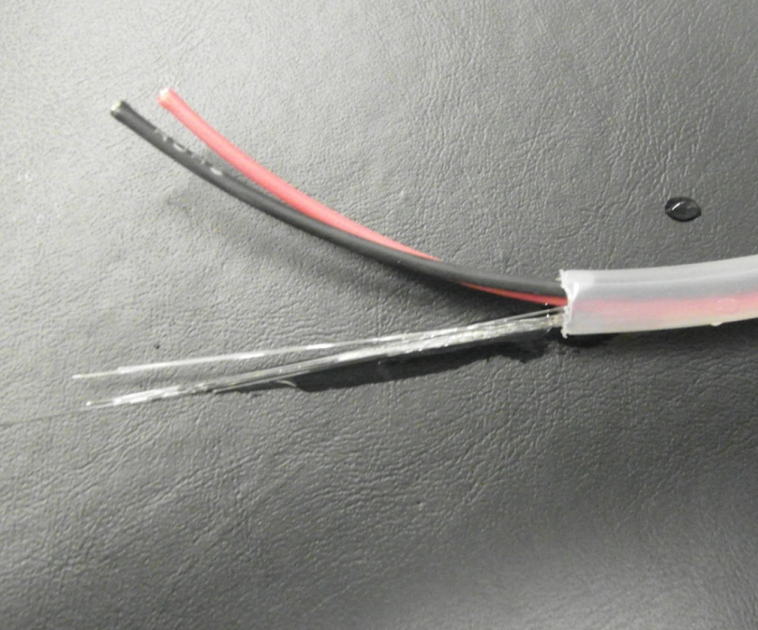
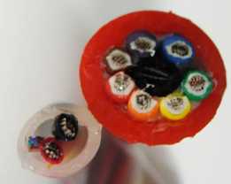
VEOC Cable
Cable characteristics.
Cross section of the
pressure balanced cable
1) Outer shell ¼ LDPE Tube
2) 11 optical fibers
3) 2 Electrical wires
4) Oil Filling middle
3
Comparing Diameters
2
4
1
PBOF= Pressure balanced oil filled Solid= cable of MacArtney just as example
 | VEOC | Drift | buoy | ropes | Weight
 | mm | m | N | mm | Kg/km
PBOF | 6.35 | 167 | 6000 | 4 | 11
PBOF | 10 | 199 | 7600 | 5 | 6.9
solid | 10 | 225 | 8620 | 5 | 82
Just as example for trends

Slide 5
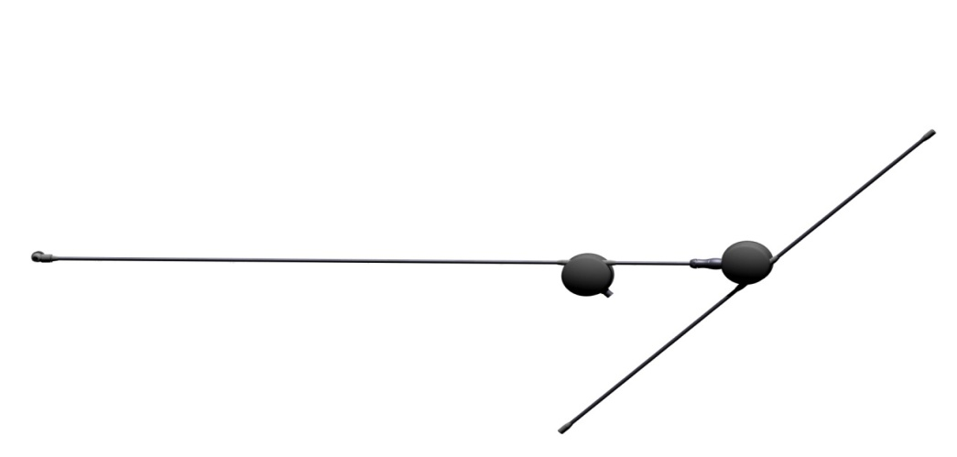
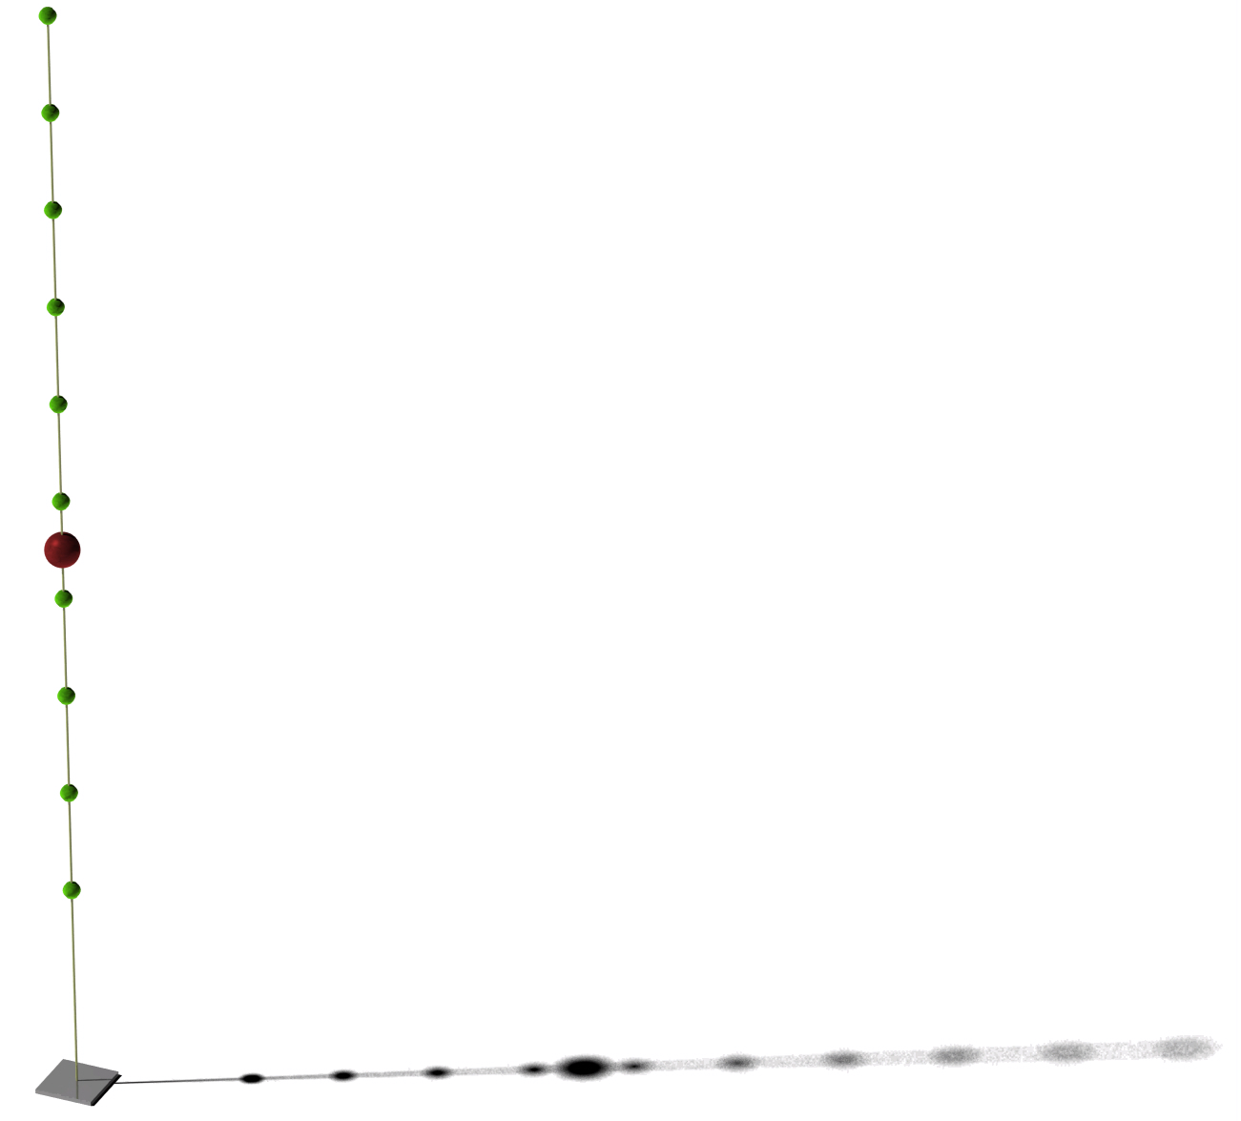
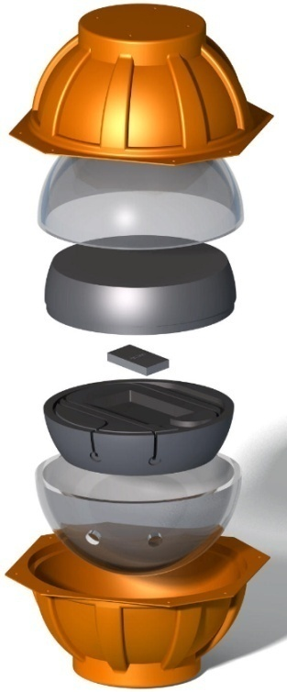
KM3Net VEOC
Layout
Connector
Beoc
Dom
Connecting 11 DOM’s
Veoc 2
Veoc
DWDM
860 Meter
DWDM
Connecting 9 DOM’s
Veoc 1

Slide 6
KM3Net VEOC
Storage
Cable layout spiral dimensions
624
624
Detector unit
Detector unit pallet
D 149
D 68

Slide 7
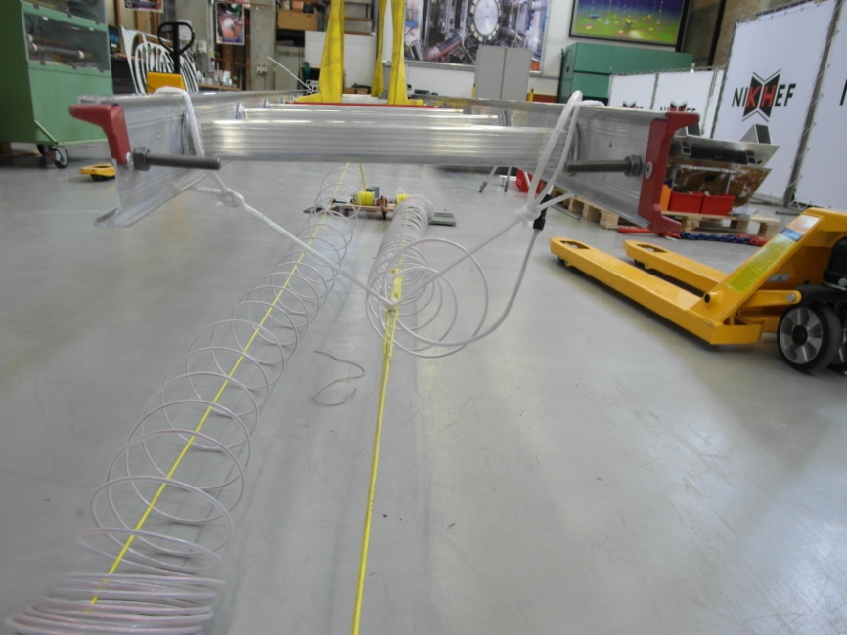
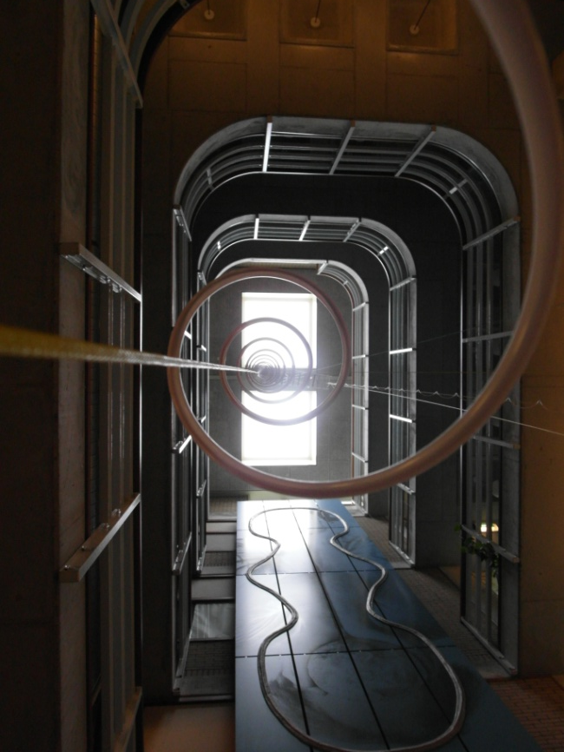
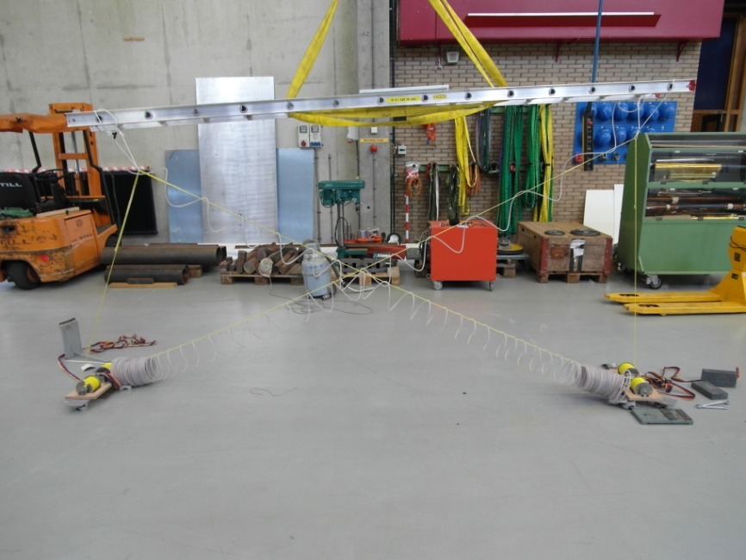
KM3Net Rope & Cable management VLVnT11
Test Rope management July 2011
Roll Stabilility
VEOC
Dyneema® Reel
4 m

Slide 8
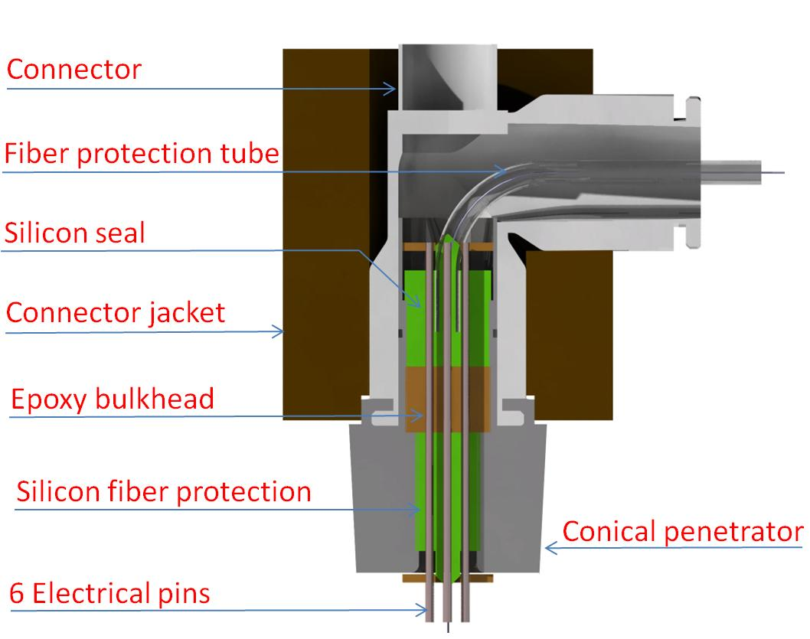
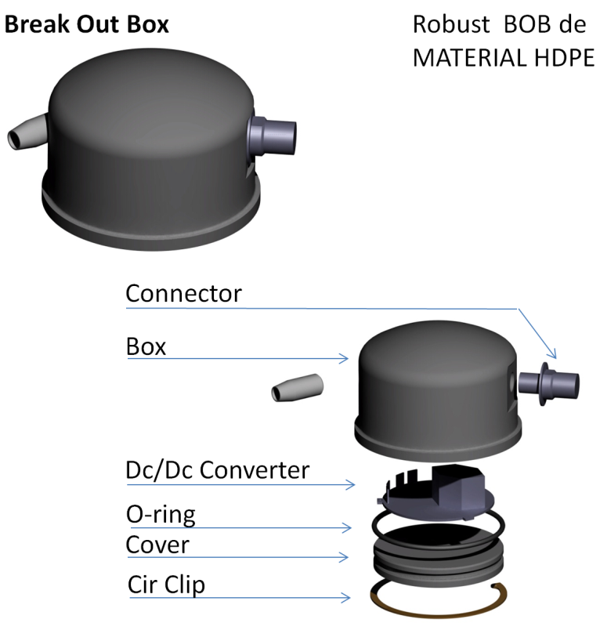
Connection to DOM (BEOC)

Slide 9
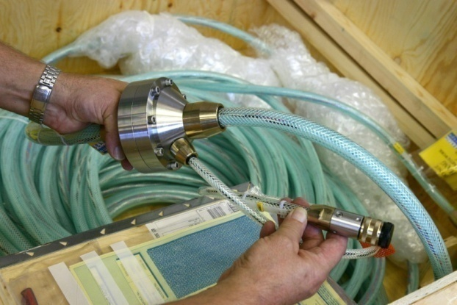
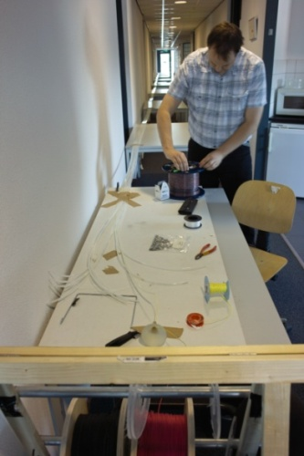
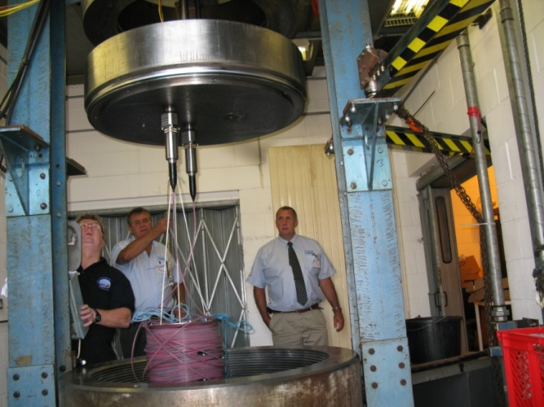
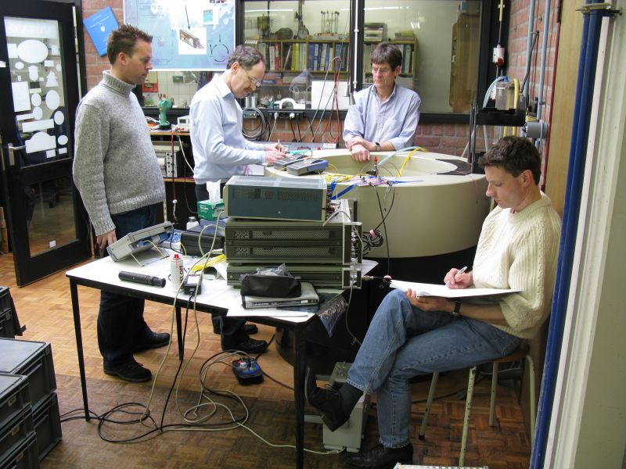
KM3Net Rope & Cable management VLVnT11
Prototype VEOC I & VEOC IIa (pressure tests)
VEOC I Layout
VEOC II
100 meter Cable by.
22 fibers 1” tube 4 electrical wires
under pressure 60 MPa
Optical Attenuation 0,55 dB/Km
210 meter Cable by
13 fibers in a bundle 2 electrical wires.
¼ “ LDPE tube
(fibers are bend bright 15 mm bend radius)
Test at pressure 60 MPa
Optical Attenuation 0,55 dB/Km
Nikhef, Baas, NIOZ & Seacon.
Nikhef , Seacon & NIOZ

Slide 10
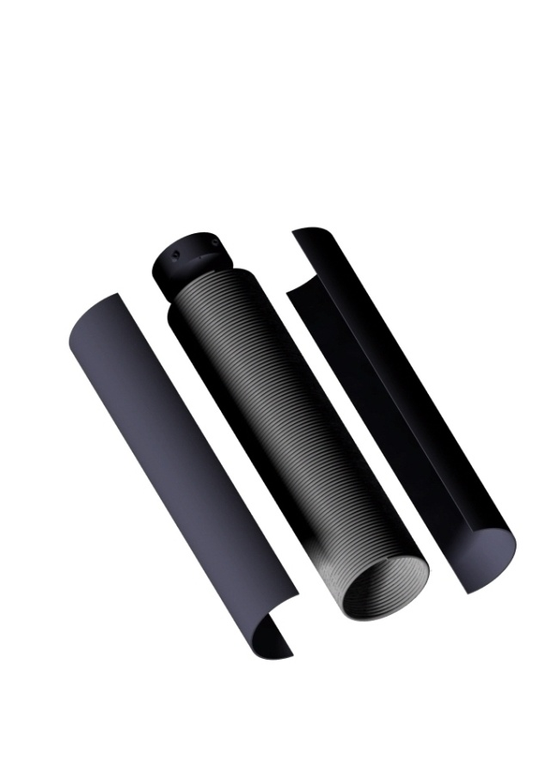
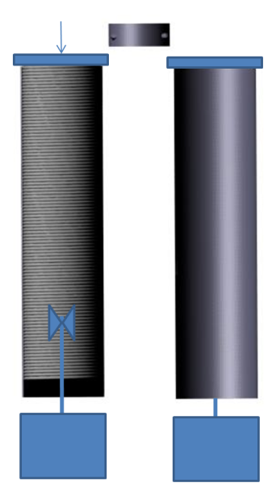
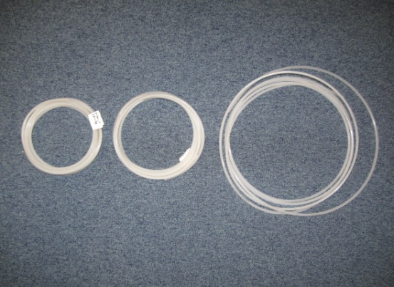
KM3Net Rope & Cable management VLVnT11
Prototype VEOC III VEOCIV & VEOC IIb spiral testing
Coiling
Heating
Steam Boiler
-100 °C
-5 min
-.1 MPa
D1 =167 mm 110 °C during 1 hour
D2 =190 mm 90 °C during 1 hour
d1
d2
d3
D3 =320 mm no heat treatment

Slide 11
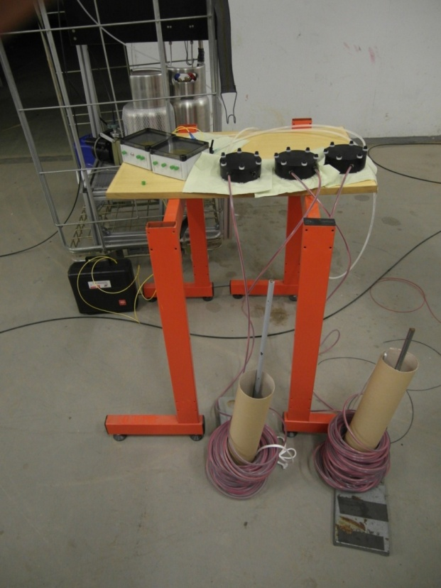
KM3Net VEOC
Layout of VEOC III spiral Cable
13 loose Fiber standard SMF 28 2 electrical wires 18awg
¼” LDPE tube
Break Out Box
Spiral Storage 45 m
Break Out Box
Connector Box
VEOC Spiral

Slide 12
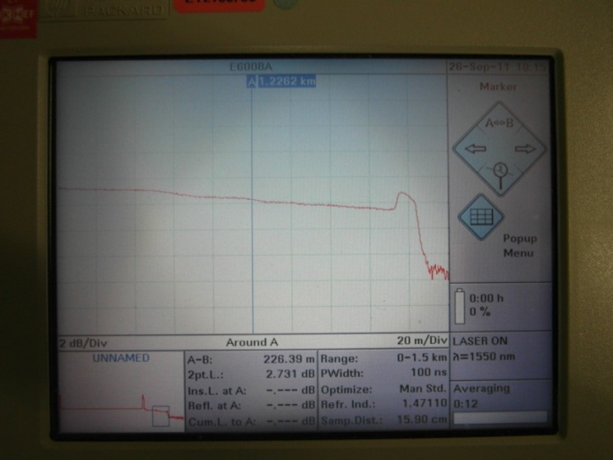
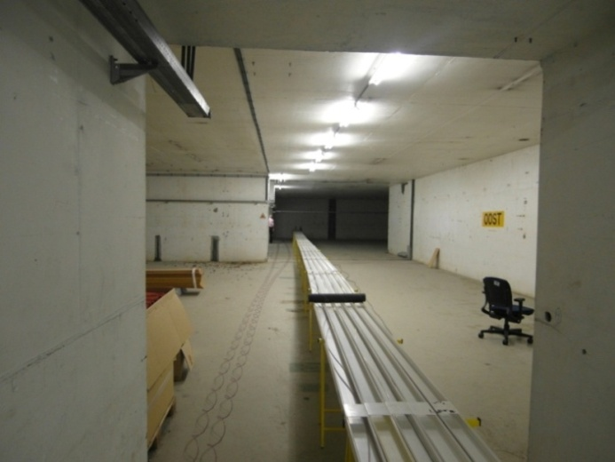
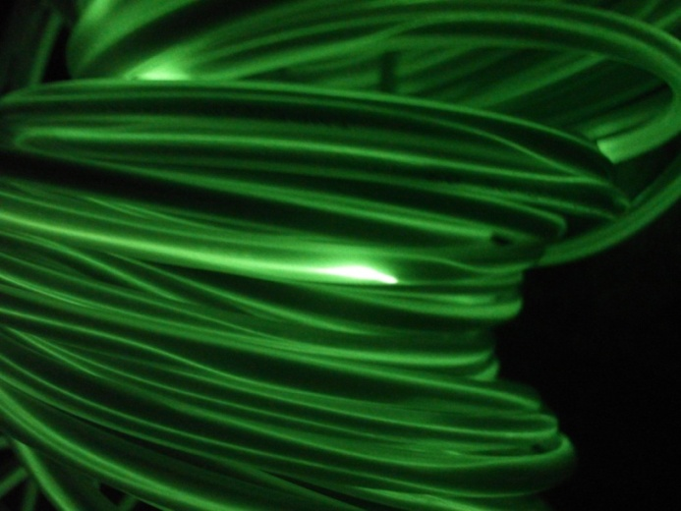
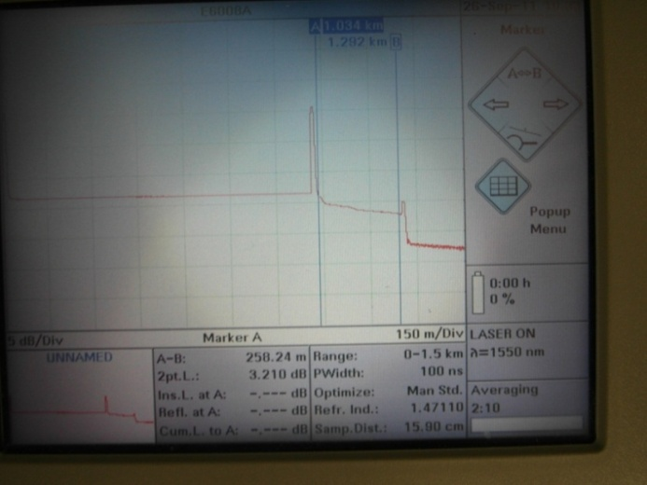
KM3Net VEOC
40 m
Stretched over a length
Not stretched
Attenuation 11 dB/Km
Sharp bend < 30 mm
Attenuation
Stretched
Attenuation 12 dB/Km
Green laser 125 mW

Slide 13
KM3Net VEOC
conclusion of VEOC III spiral Cable
Test of the proto type
Problems with loose fibers
-Because of length differences in tube
optical fiber twist at some points in the tube
resulting in a small bend < 30
-Standard SMF28 fibers have a min. bend radius of 30 mm

Slide 14
KM3Net VEOC
Layout of VEOC IV spiral, Cable for better understanding of the spiraling process
40 M
¼ LDPE Tube 2 electric wires, 5 loose fibers standard SMF28
(fiber length 213 m, 1 Connector)

Slide 15
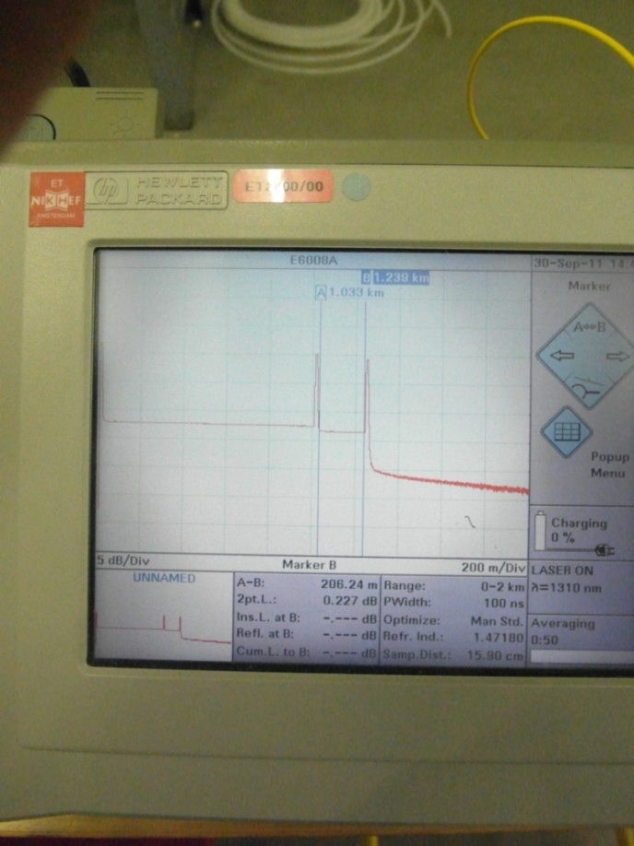
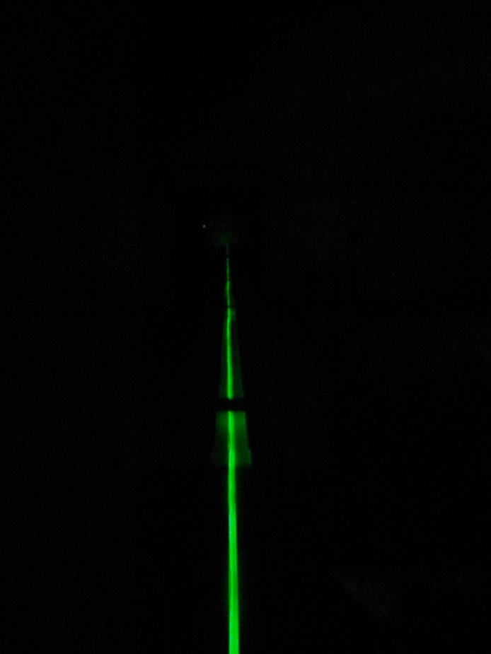
KM3Net VEOC
Layout of Prototype IV Loose fibers Standard SMF 28 . Fiber Length 210 M
proto 2
40 m
New 40 meter Cable, Optical 1,1 dB/Km 5 fibers standard smf28

Slide 16
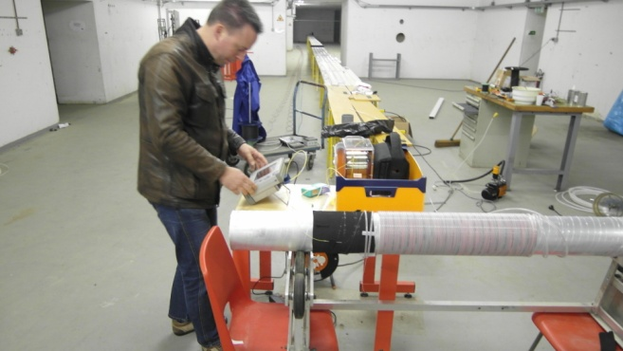
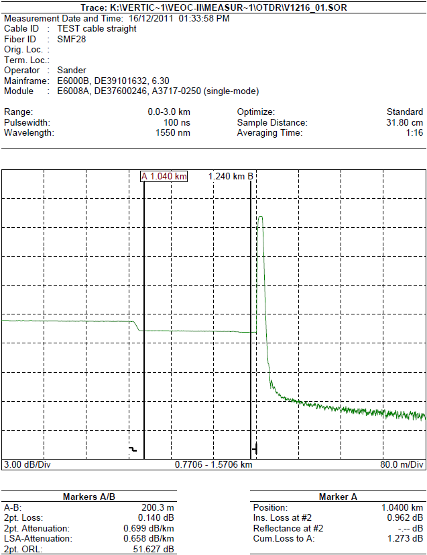
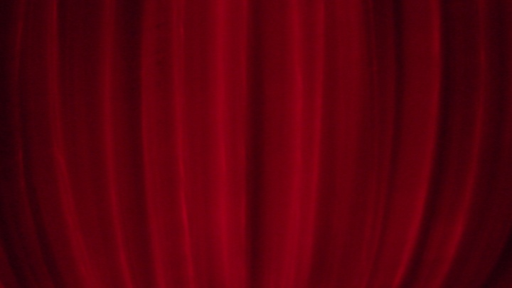
KM3Net VEOC
Prototype IV Loose fibers Standard SMF 28 . Fiber Length 210 M
OTDR
Spiral
No bends smaller than 30 mm radius
But still a lot of bend < 40 mm
Loss 0,7 dB/Km

Slide 17
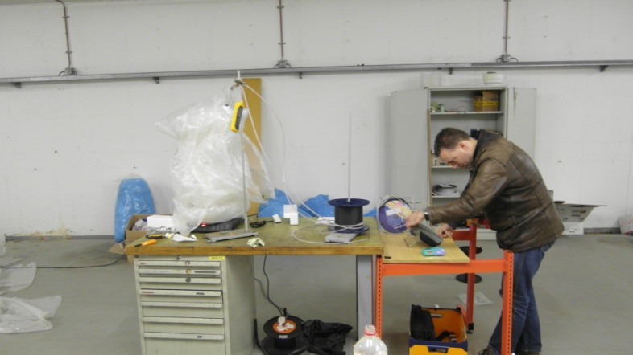
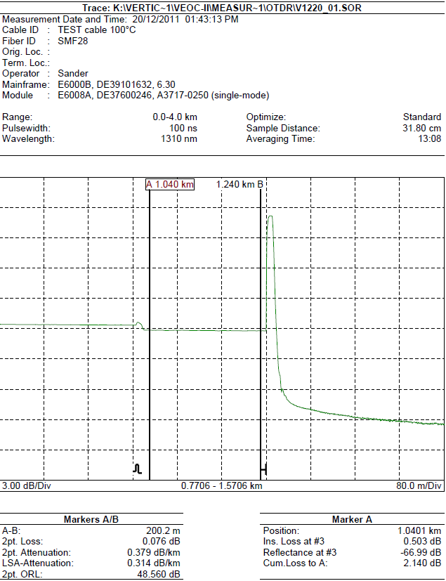
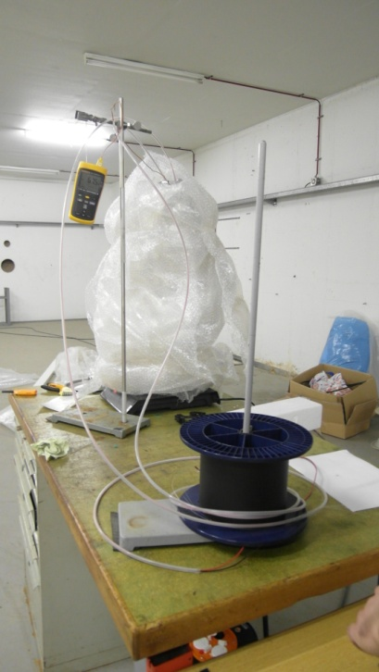
KM3Net VEOC
Prototype IV Loose fibers Standard SMF 28 . Fiber Length 210 M
Status
Spiral
0,37 dB/Km 100 C

Slide 18
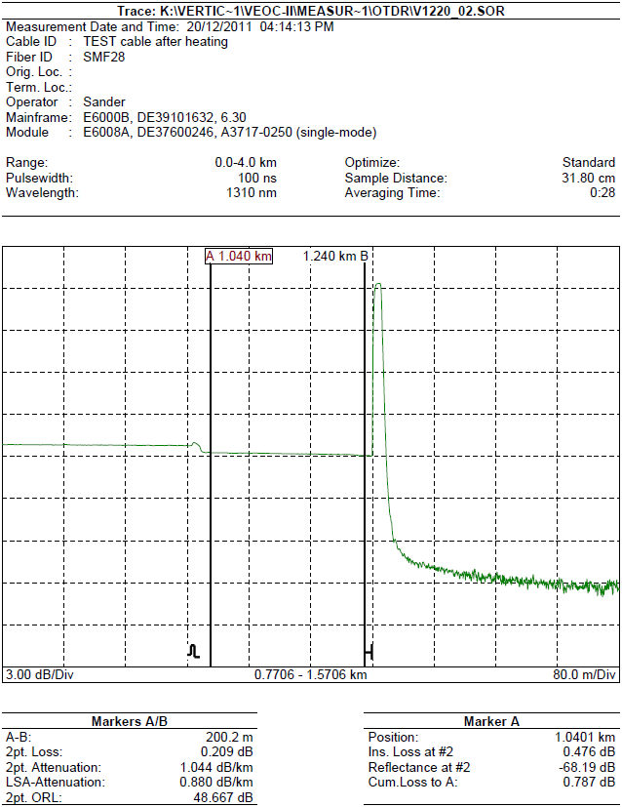
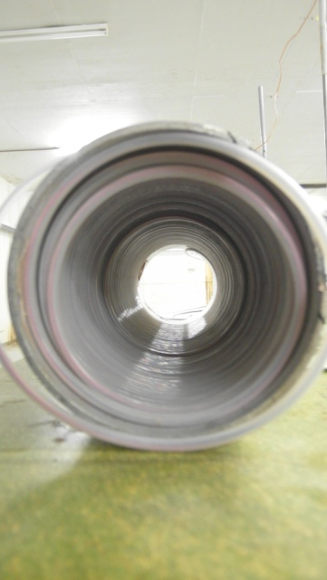
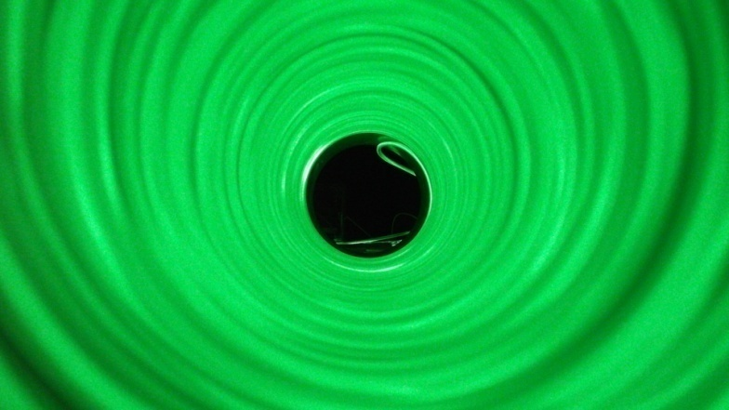
KM3Net VEOC
Prototype IV Loose fibers Standard SMF 28 . Fiber Length 210 M
Status
Sharp bend < 30 mm
3,6 dB/km

Slide 19
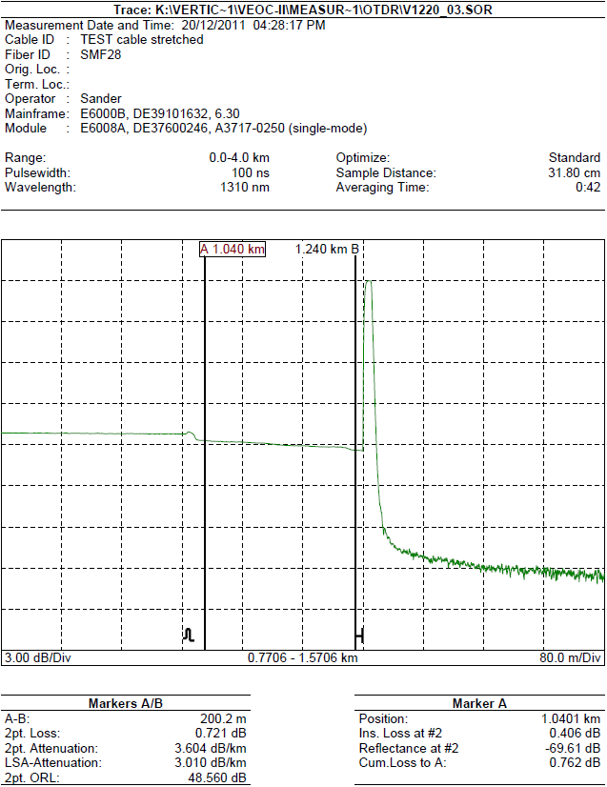
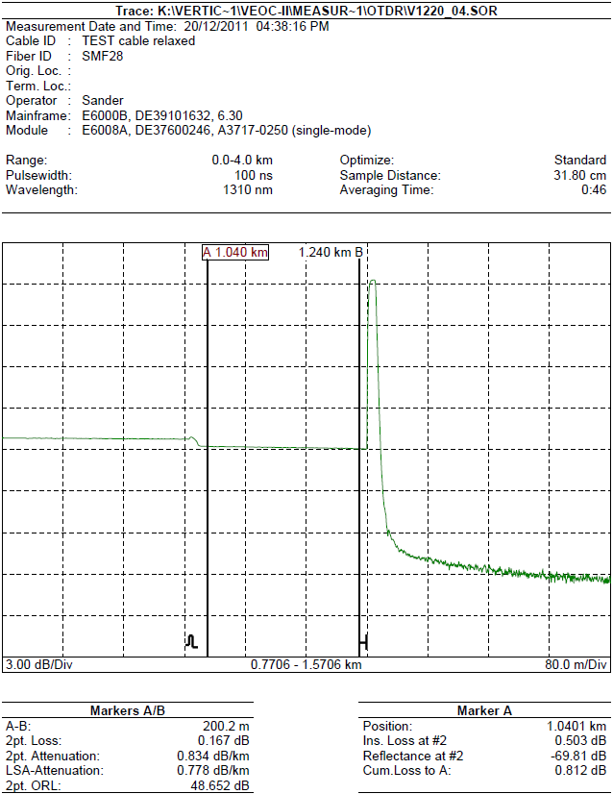
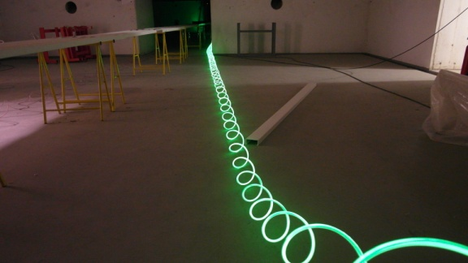
KM3Net VEOC
Prototype IV Loose fibers Standard SMF 28 . Fiber Length 210 M
Status
3.6 dB/km
1,6 dB/km

Slide 20
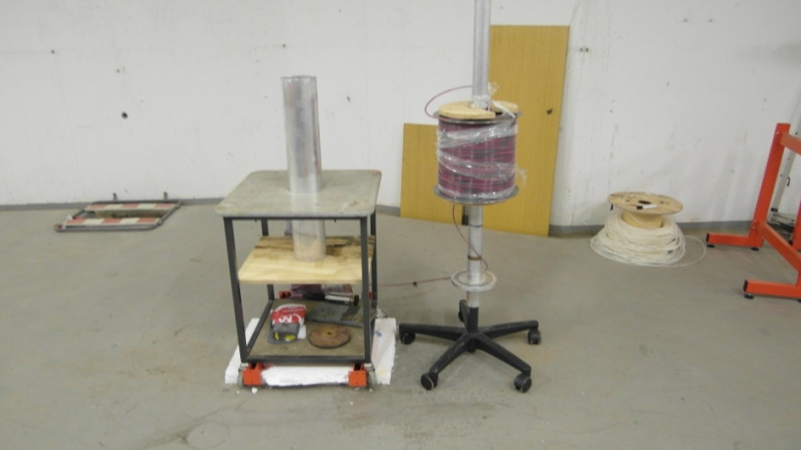
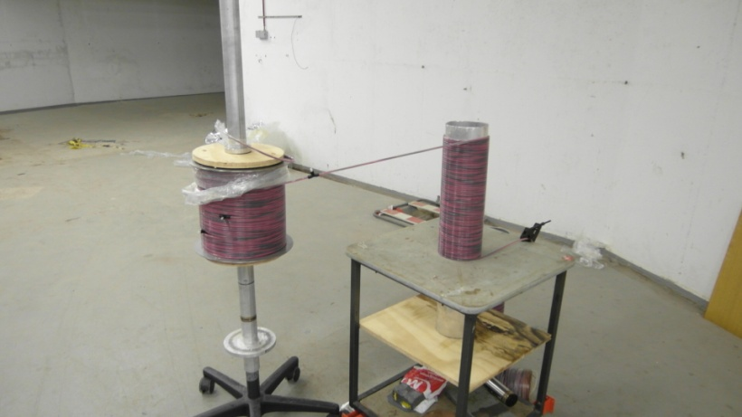
KM3Net VEOC
Test of cable with BendBright fiber and with Seacon connectors build by BAAS b.v.
Status
30 M
Build Up of test
Fibers are connected in series,
24 connections
Cable length is 210 meters
Spiralized over a length of 30 meters
Cable Build up:
2 x AWG 18
bundle of 12 Bend Bright fibers,
supplied by DRAKA
Total Fiber length 2520 m
210 m
connector

Slide 21
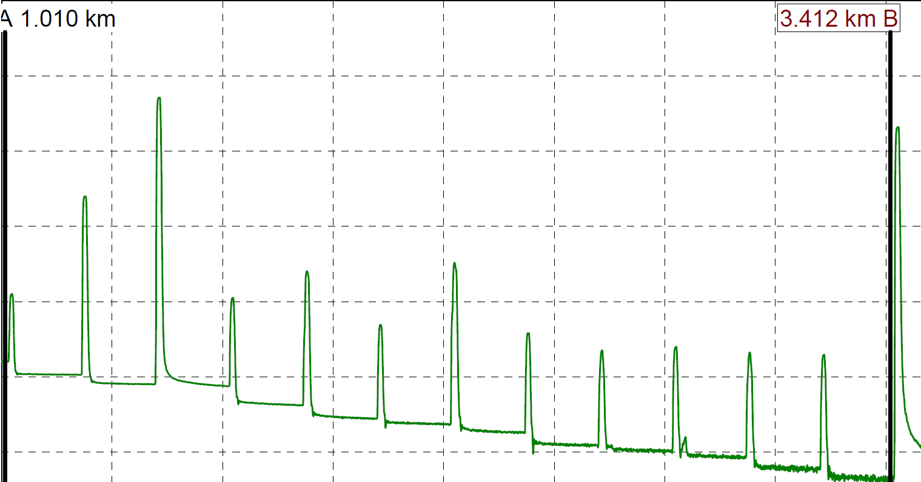
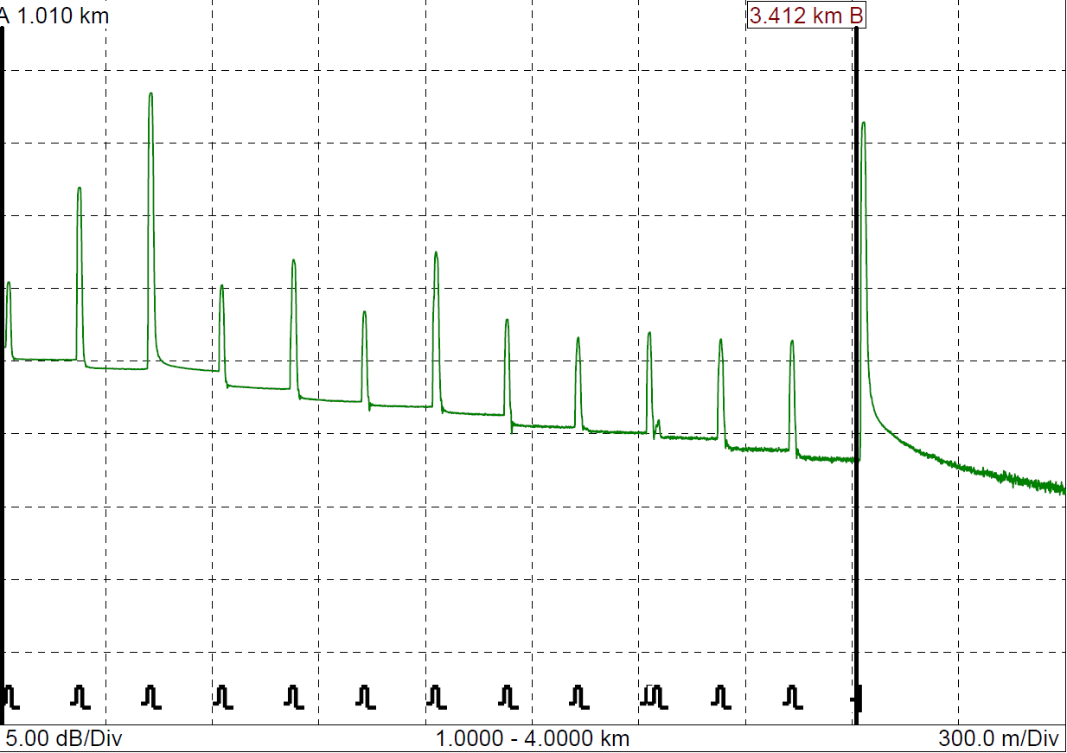
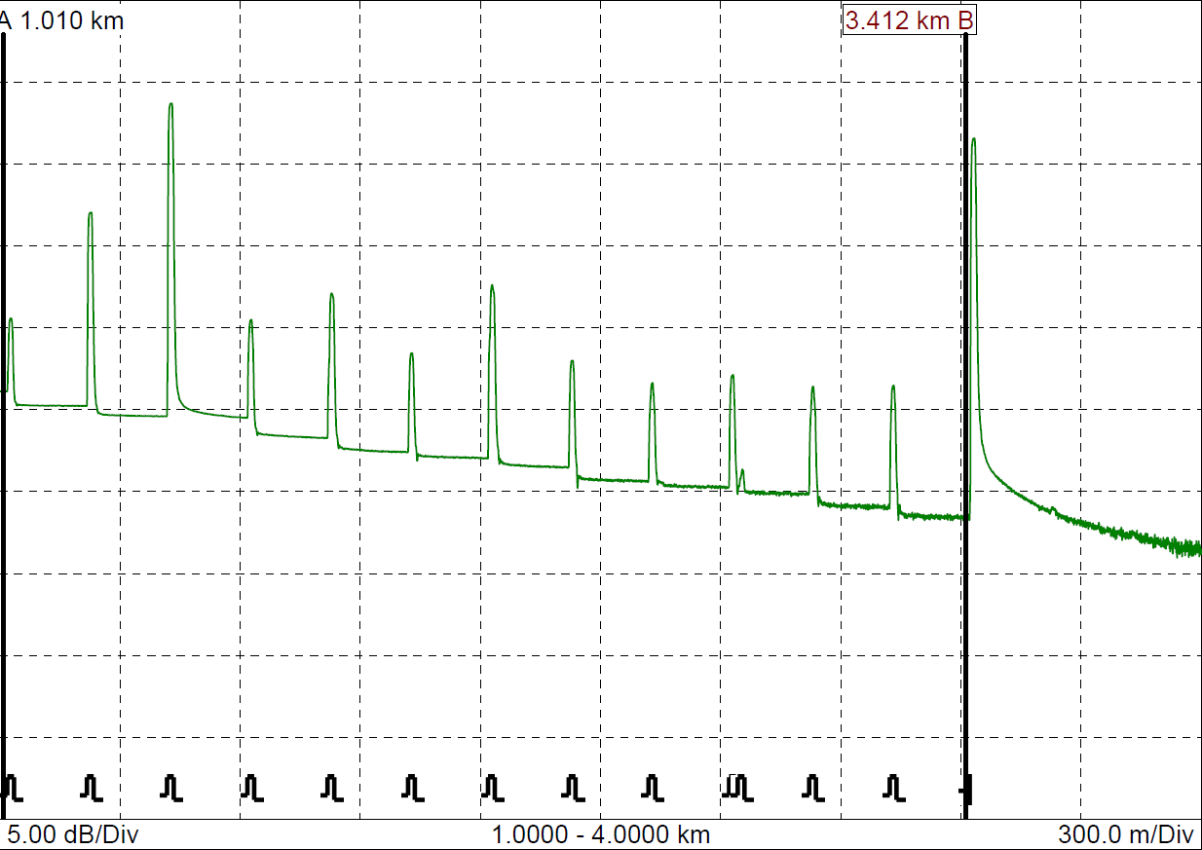
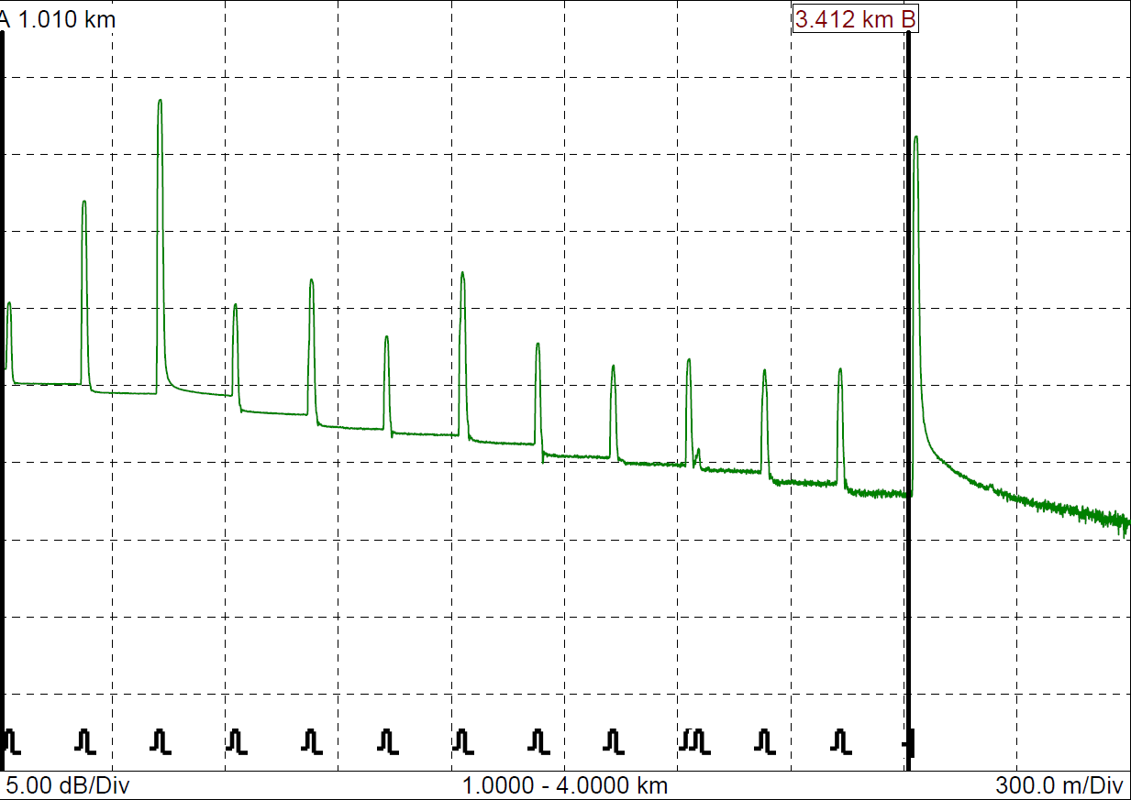
KM3Net VEOC
Test of cable with BendBright fiber and with Seacon connectors
Losses due to Connectors
1
2
Total attenuation: Connectors + Fiber (2,4) km 7.86 dB
Attenuation @ 100°C 7,6 dB
Attenuation after Heating 7,8 dB
Attenuation after stretching the spiral 8 dB

Slide 22
KM3Net VEOC
Test of Nikhef Prototype
Cable | Oil filling | Tube diameter | Fibers/ Electric | Spiral test | Pressure Test (60MPa) | State of measurement | Attenuation | Fiber Type
VEOC I (100 m) | Oil | 25,4 mm | 12/4 | no | Yes |  |  | SMF 28
VEOC II (210 m) | Oil | 6,35 mm | 12/2 | no | Yes | Under pressure | 0.55dB/Km | BendBright
VEOC III (100 m) | Oil | 6,35mm | 12/2 | Yes | no | Spiral relaxed Spiral stretched | 11dB/km 12 dB/km | SMF 28
VEOC IV (40 m) | - | 6,35 mm | 12/2 | Yes | no | Coiling Cooled down Spiral stretched Spiral massage Spiral stretched | 0.7 dB/km 1,53 dB/Km 3,7 dB/Km 0.9 dB/km 1,6 dB/km | SMF 28
VEOC II (210 m) (spiral) | Oil | 6,35 mm | 12/2 | Yes | no | Spiral cooled down Spiral stretched | 0,55 dB/km 0,7 dB/Km | BendBright

Slide 23
Conclusion :
From the test it is clear the heat treatment used,
Were by the Cable is clamped in the aluminum tube preventing
the LDPE cable to expand . Resulting in plastic deformation and as result
giving the tube a sorter length. Calculated at 1% of the cable length.
This will bend the fibers and resulting in small fiber radius<30mm
KM3Net VEOC
Most interesting Conclusion of spiral test
Status
..
VEOC
Start
100 C
Cooled down
Aluminum tube
Blocked expansion
deformation and as result
the tube has a sorter length
Shorter
Fiber

Slide 24
Conclusion :
From the test it is clear the heat treatment used,
Were by the Cable is clamped in the aluminum tube preventing
the LDPE cable to expand . Resulting in plastic deformation and as result
giving the tube a sorter length. Calculated at 1% of the cable length.
This will bend the fibers and resulting in small fiber radius<30mm
KM3Net VEOC
So some room for improvement in the spiral production
Status
VEOC
Start
100 C
Cooled down
Aluminum tube
Free expansion
No deformation and as result
the tube has the same length

Slide 25
KM3Net VEOC
Status
Conclusion :
BendBrightTM fibers significantly improve the cable optical performance when spiralized
(straight cable is already optimal in performance)
Heat Treatment has little influence because BendBright allows for smaller
bending radius (15 mm compared to 30 mm)
The new method for heating the cable will improve the optical performance
But more tests are needed to give an number

Slide 26
Are we meeting the VEOC specifications ?
Type | Specs | Values | comments
Optic/ electronic | Optical 12 fibers | Attenuation <1 dB/Km loss 0,7dB/km
 | 400 V dc | Voltage Drop <30 V
Du Specs Mechanical | Density | =water (1000 kg/m³) 1300 kg/m³
 | Projected area | <0,45 M²
 | Storage of cable for deployment | Cable flexible Bending radius <120 mm Bending radius >60mm | Package as Spiral is possible
 | Du life time | 15 Years ?
Environment | Pressure | 60 MPa With the PBOF pressure is no problem
 | Chemical | Sea water LDPE HDPE middle oil Resistant to Sea water | Used oil is environmentally friendly
Cost | Low | No splicing needed
Status

Slide 27
KM3Net VEOC
Out Look
-optimizing production system
-Tooling for pulling fibers.
-Tooling for spiraling the cable. -Interests
Hydro group: consider this as most favorable solution but has no interest to participate
JDR: consider this as possible solution but they are specialist on solid cables
Seacon and MacArtney have there doubts to participate because they are
focused on solid cable.
VEOC V sections spiraled and sections straight for sea test at Catania VEOC VI & VEOC VII two cables for the mini-tower; 7 x interval with 2 active breakouts, tested in pressure tank VEOC VIII a 500m piece as planned for a real tower.
BEOC -Lead time ~10 wks. Seacon model, 5 weeks Nikhef model
(used for Antares connection)

Slide 28
Alternatives
Solid Cable
Splices on each floor for each continuing fiber (manpower, reliability, attenuation)
For a complete solid vertical cable of 2 x 10 floors = 88 extra splices are needed
(average splice time is 5 – 10 min per splice)
Pressure resistant box (water blockers, etc.)

Slide 29
?

