Slide 1
DOM developments
Mini DOM
PPM-DOM in Antares
PPM
future
WP F-L

Slide 2
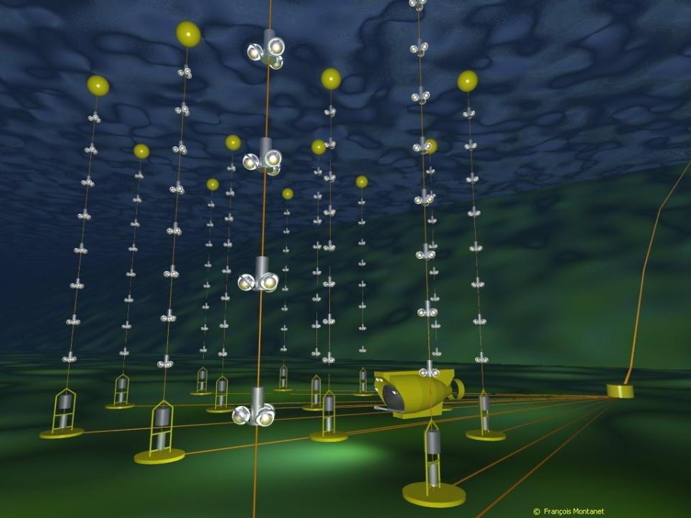
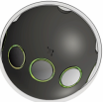
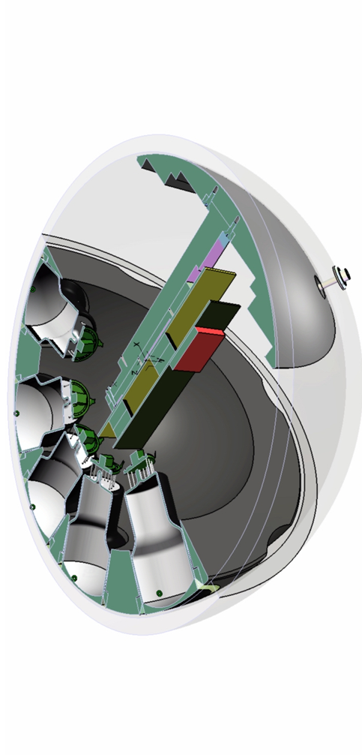
Mini DOM
motivation
To measure the L1 coincidence rates as a function of the space angle between the axes of the PMTs.
Use of the infra structure of Antares
Comparison with Antares tube
Gain of knowledge versus planning
WP F-L

Slide 3
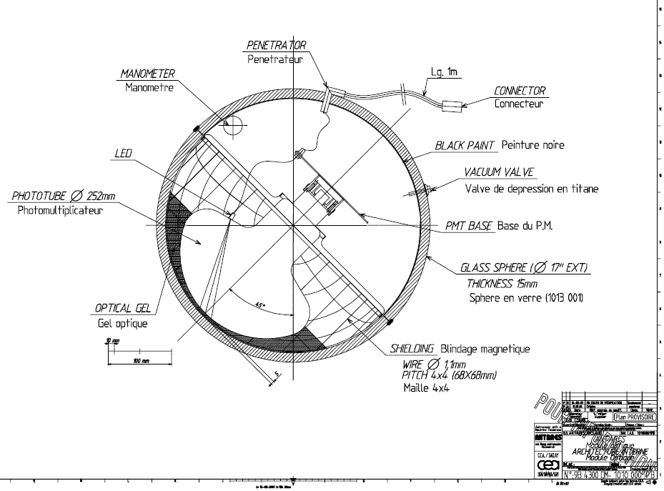
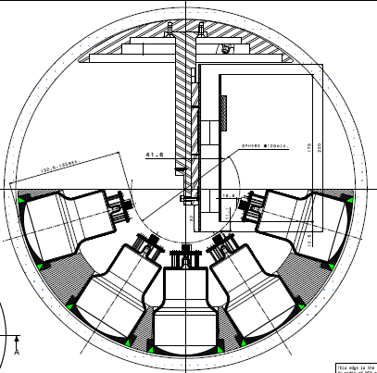
Antaris-OM to mini DOM
D
PHOTOTUBE Ø 77mm
D
D
WP F-L

Slide 4
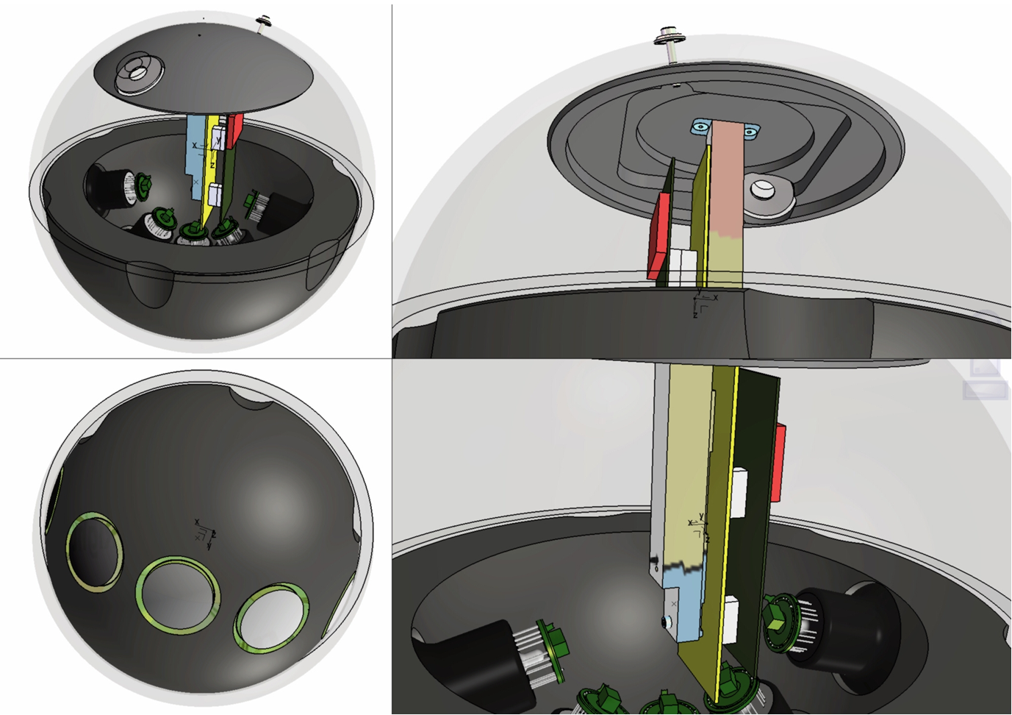
Mini DOM layout
WP F-L

Slide 5
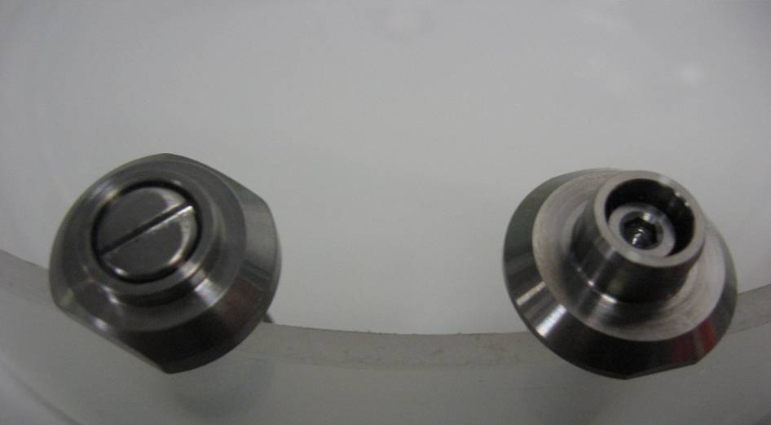
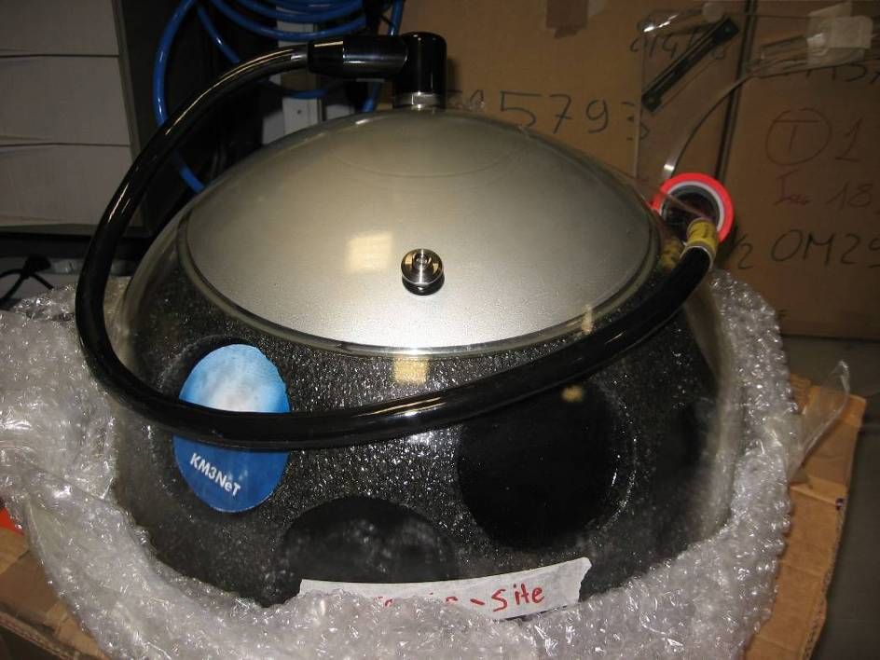
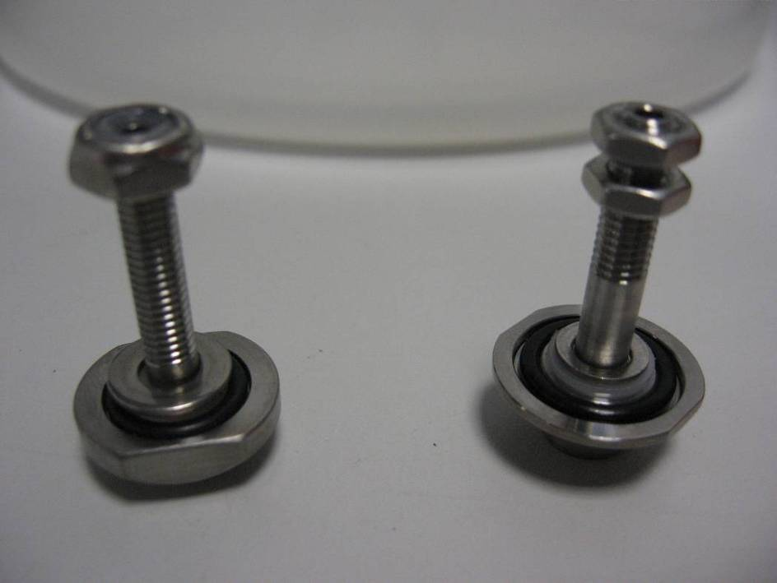
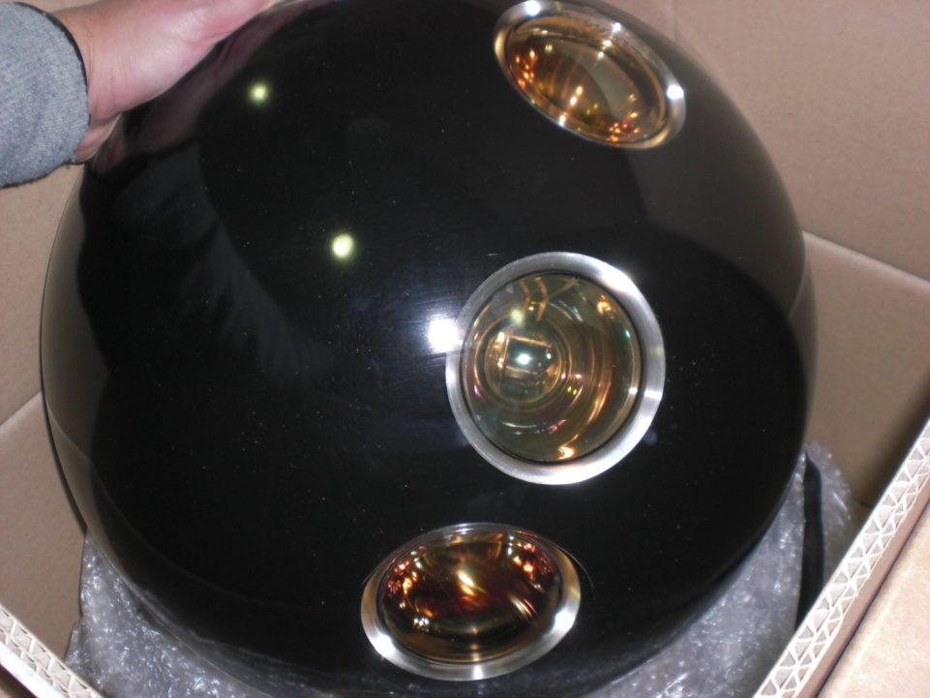
Mini DOM mechanics
a
b
External part of the vacuum valves.
(a) the new brand, (b) the old brand.
a
b
arguments
Internal part of the vacuum valves.
(a) the new brand. (b) the old one.
WP F-L

Slide 6
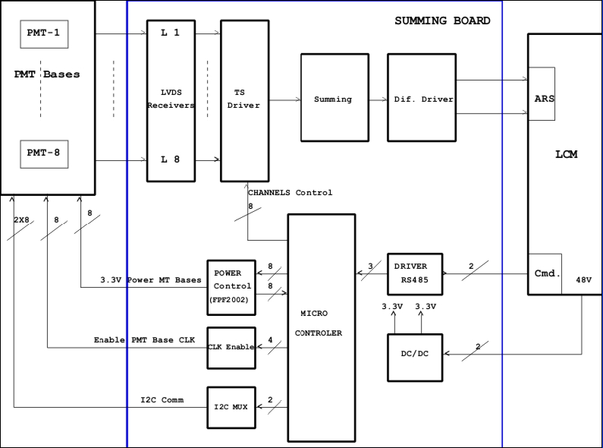
Mini DOM electronics
WP F-L

Slide 7
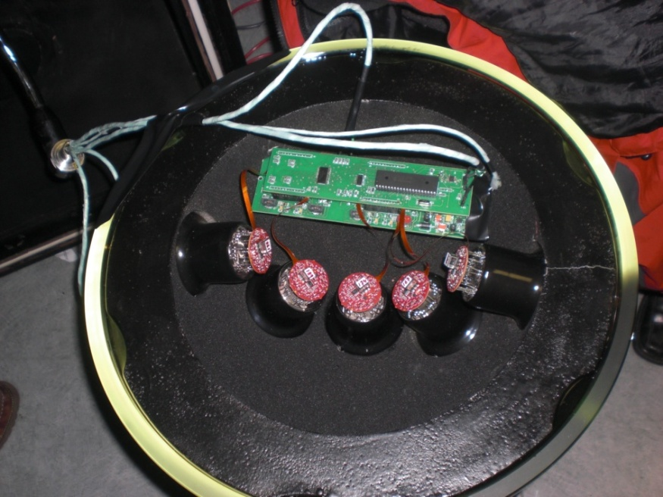
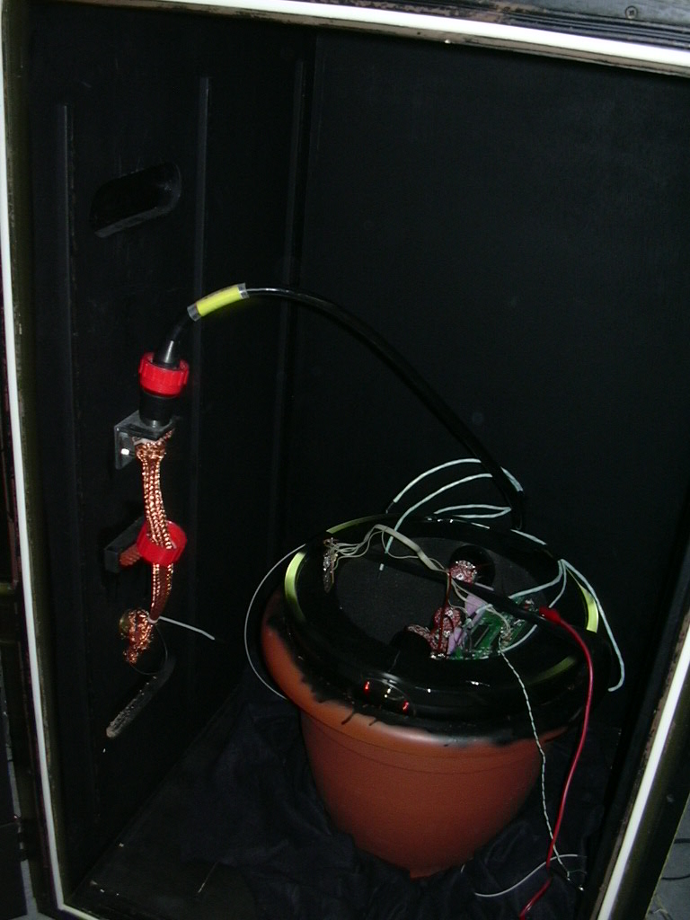
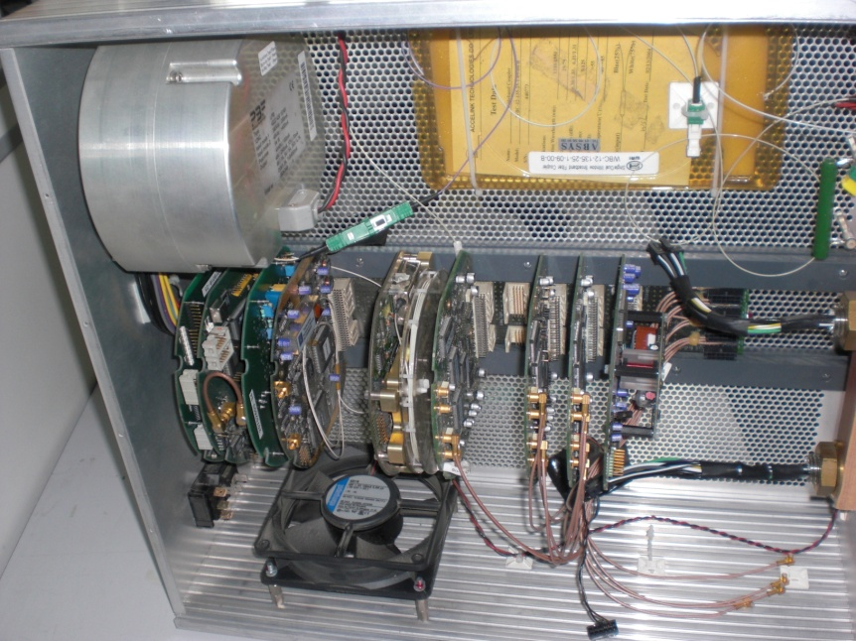
Mini DOM measurements

Slide 8
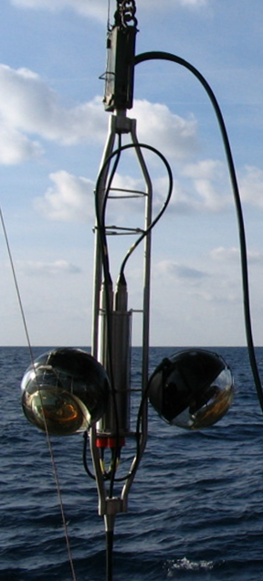

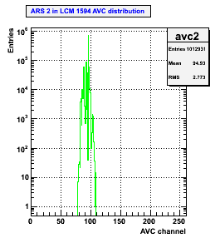
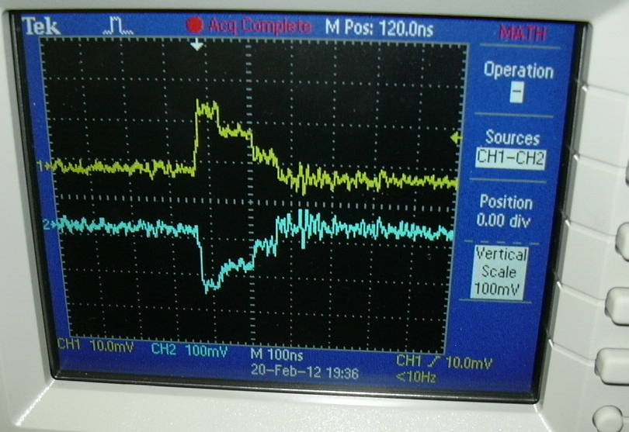
Mini DOM status
All mechanics available for integration
Electronics & PMTs tests going on at CPPM
This week
WP F-L

Slide 9
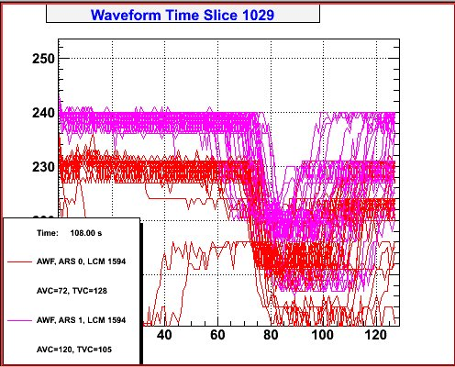
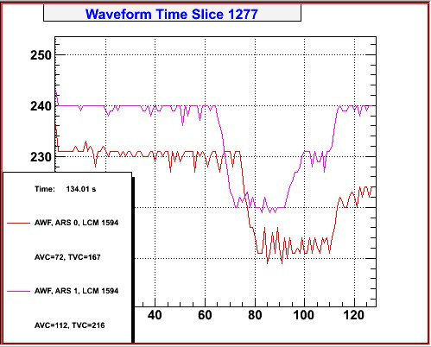
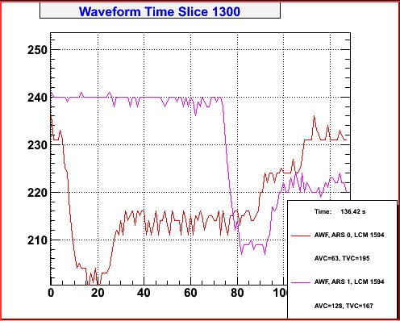
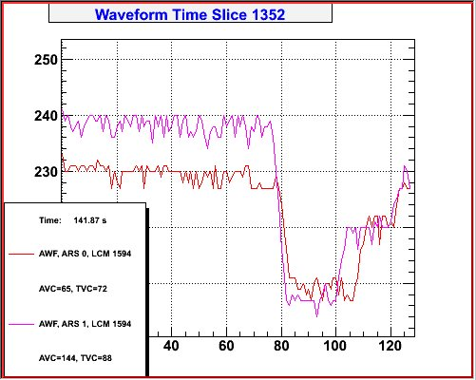
Breaking News
21-12-2012: First time slices of the mini-DOM output in the lab.

Slide 10
PPM-DOM in Antares
hydrophones
CT
motivation
14.5m
In situ qualification of the BEOC (storey part of the backbone)
Camera
ADCP
OM?
OM
80m
Validation of the DAQ system with data rates
C-Star
Mini-DOM?
CT
Validation of clock distribution on Ethernet and time stamping
SV
14.5m
hydrophones
O₂
Validation of timing calibration
14.5m
Validation of the optical data transmission with REAM
hydrophones
C-Star
80m
1st comparison between piezos and hydrophones
Camera
PPM-DOM
OM
ADCP
Coincidences between PMTs
hydrophone
98m
LB
Comparison with Antares OMs
IL11
WP F-L

Slide 11
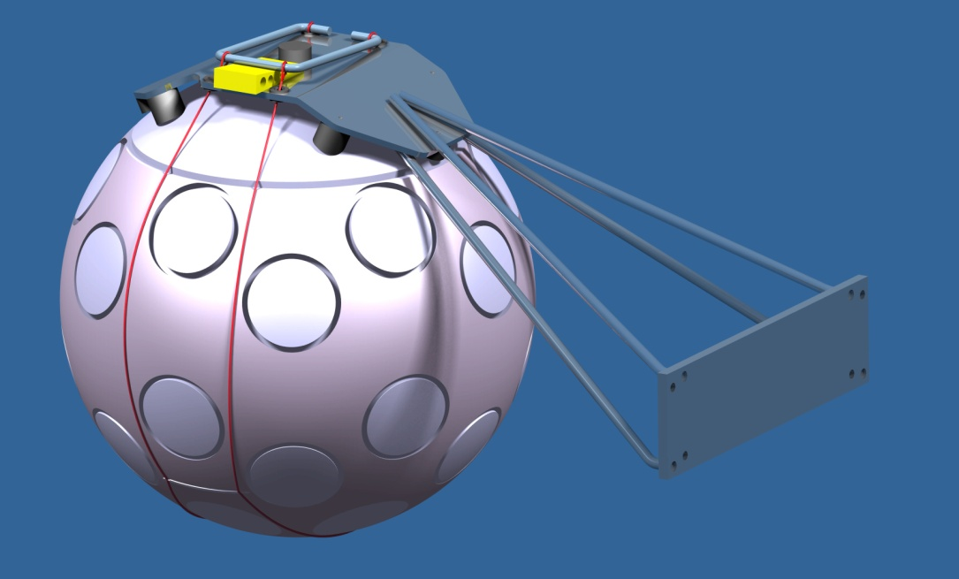
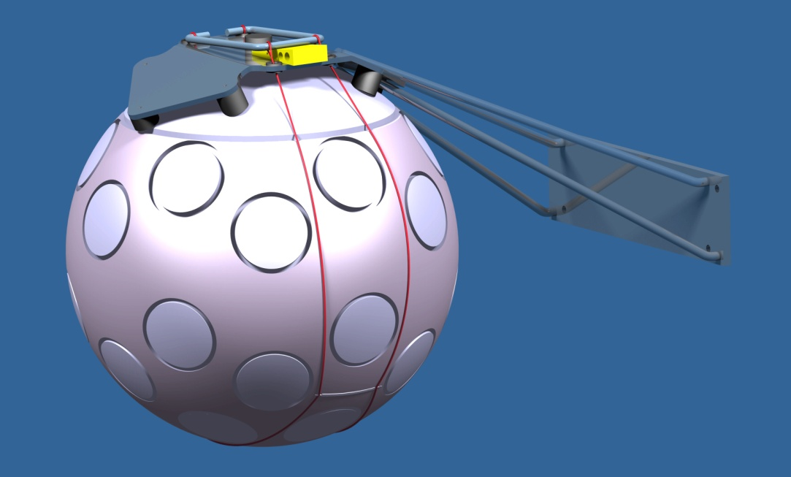
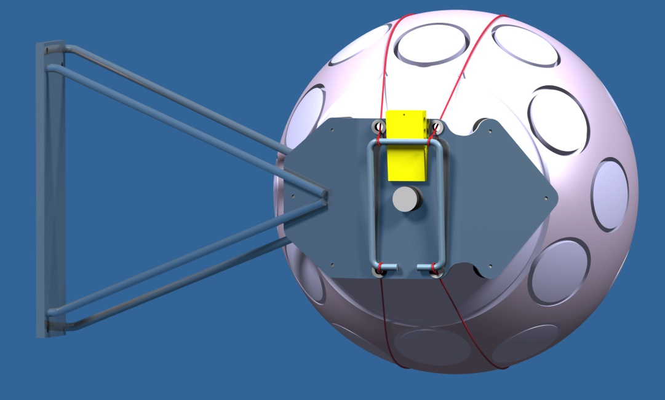
PPM-DOM = standard KM3NeT DOM
DOM
  Weight 30 kg air
  Weight -15 kg sea
Support
  Weight 3 kg air
  Weight 2kg sea
WP F-L

Slide 12
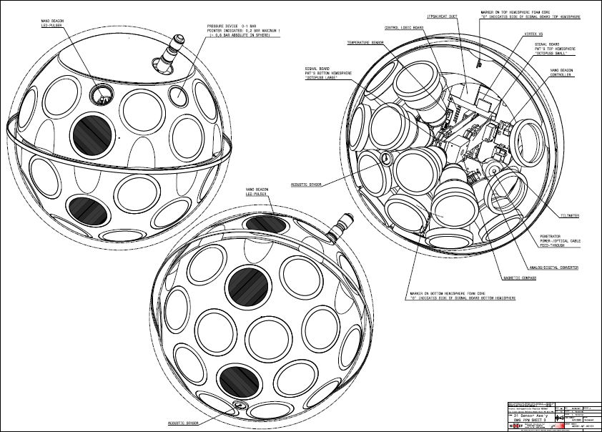
DOM mechanical overview
http://wiki.km3net.physik.uni-erlangen.de/index.php/OM_Structure
Nano beacon
Hydrophone
Temperature
Piezo
PMT
WP F-L

Slide 13
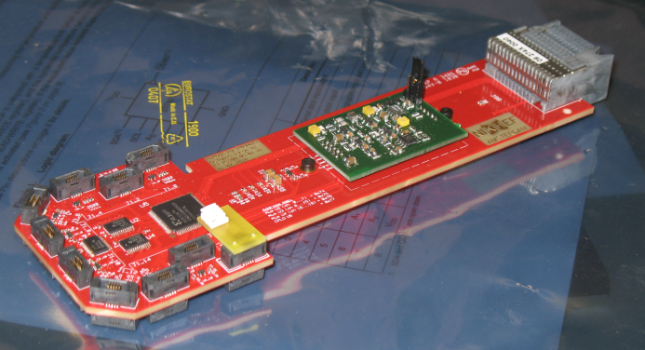
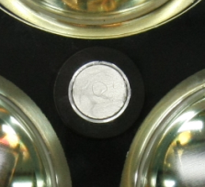
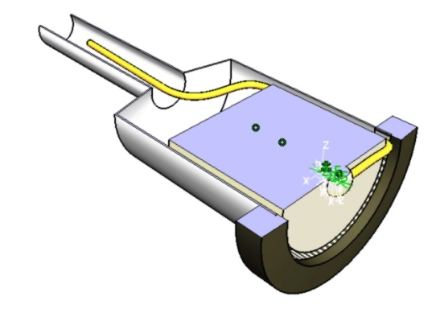
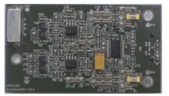
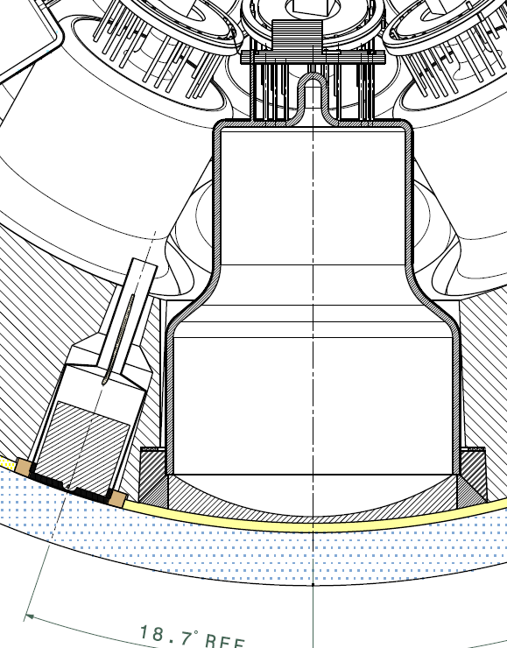
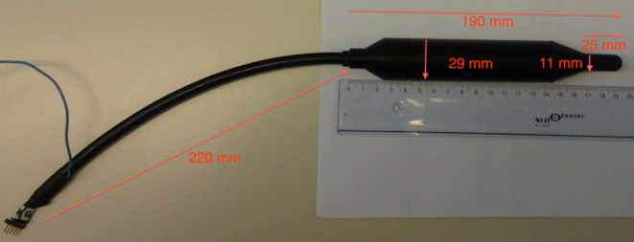
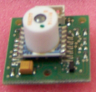
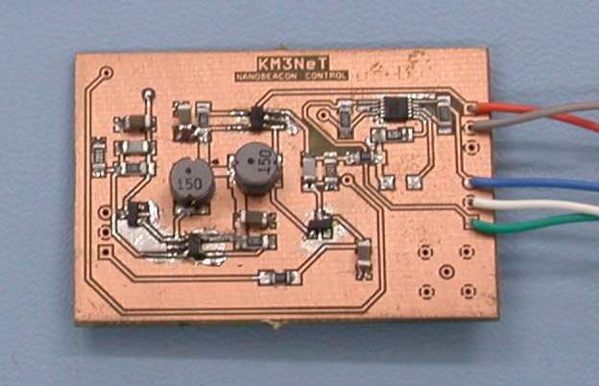
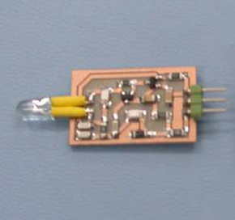
DOM sensors
PMT
  ETEL
  Hamamatsu
Piezo sensor
Aucuboard
Hydrophone
Compass
Tilt
Nano Beacon
WP F-L

Slide 14
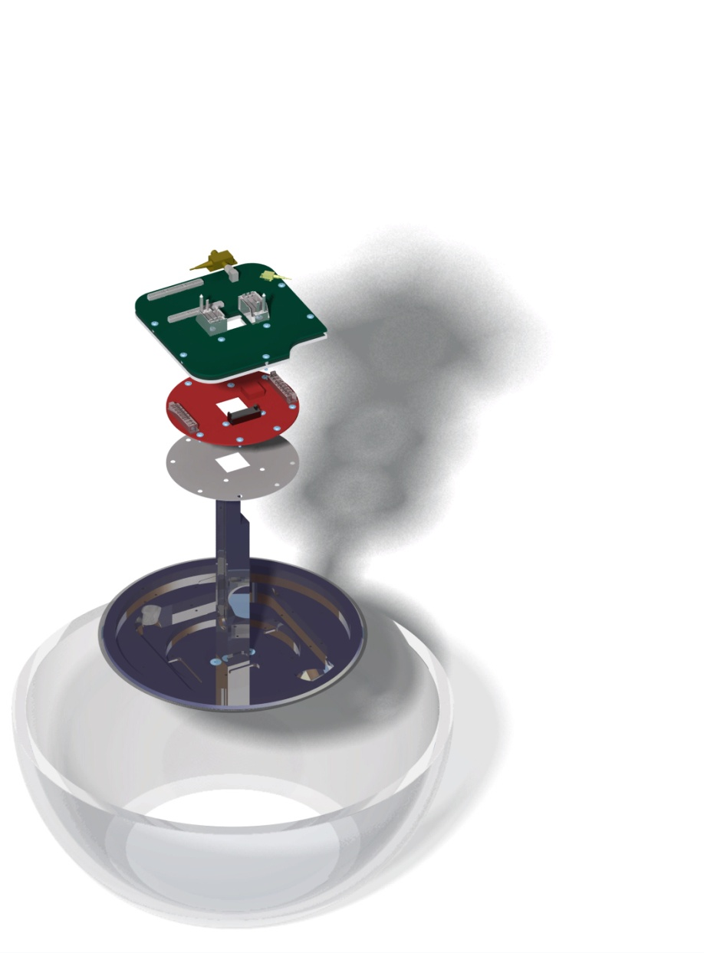
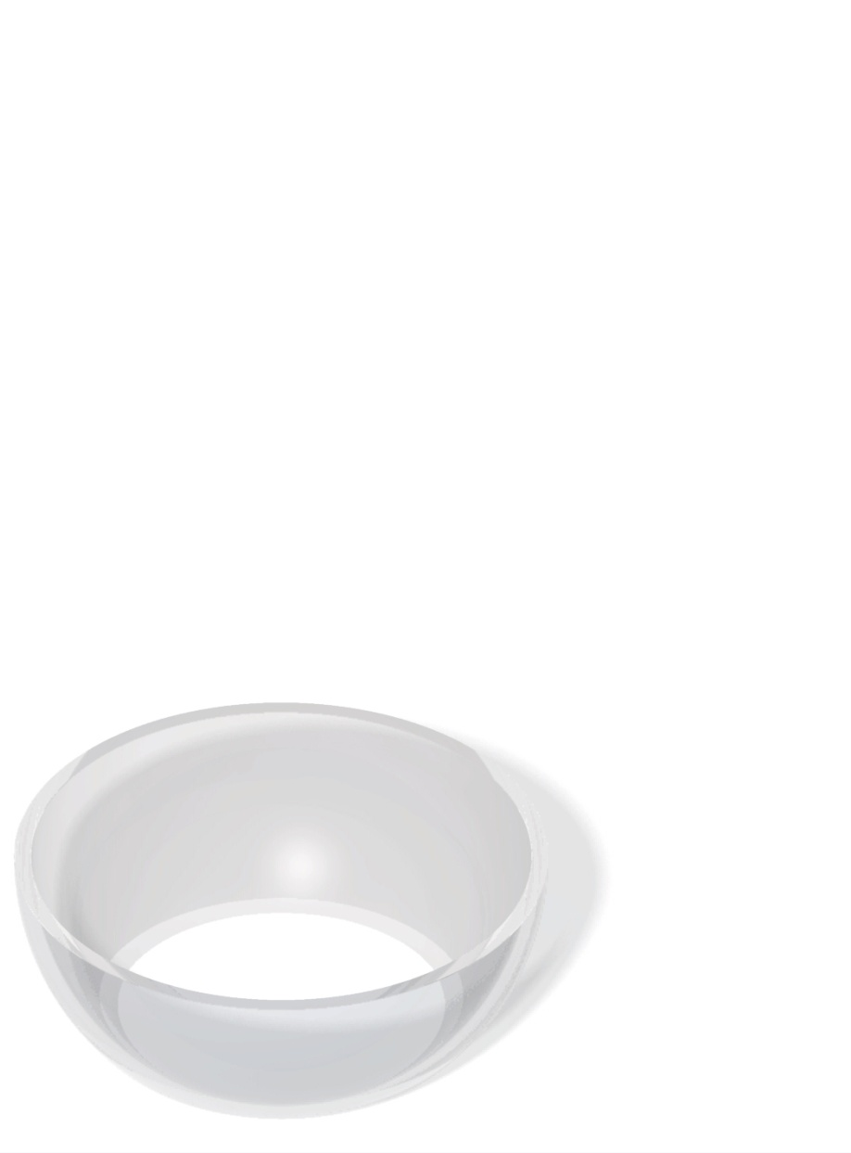
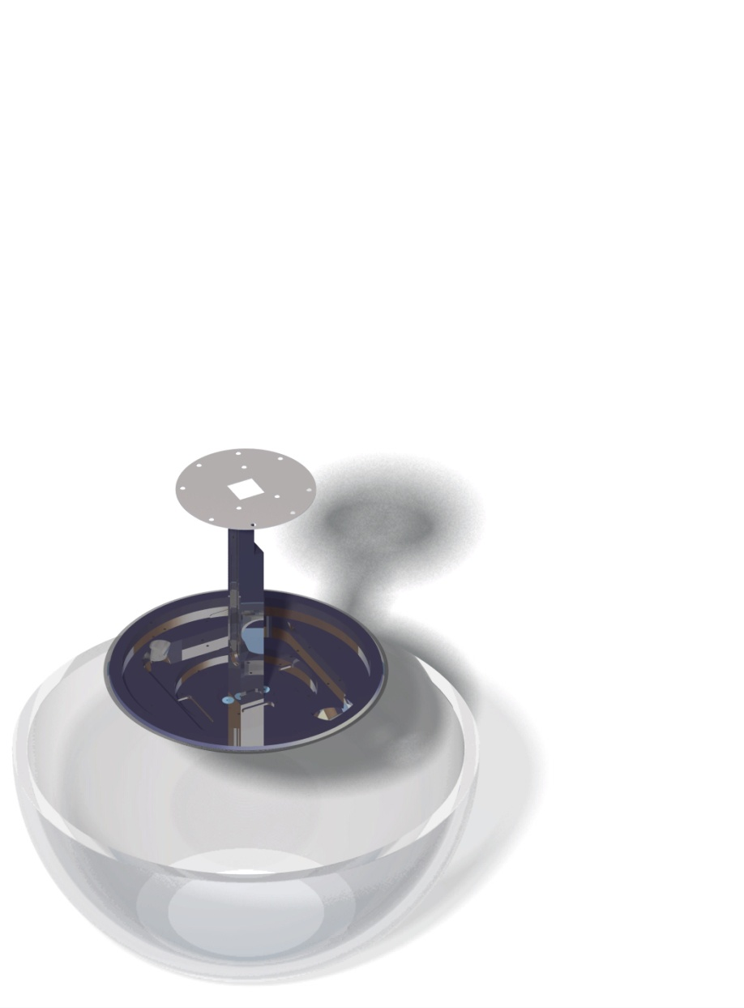
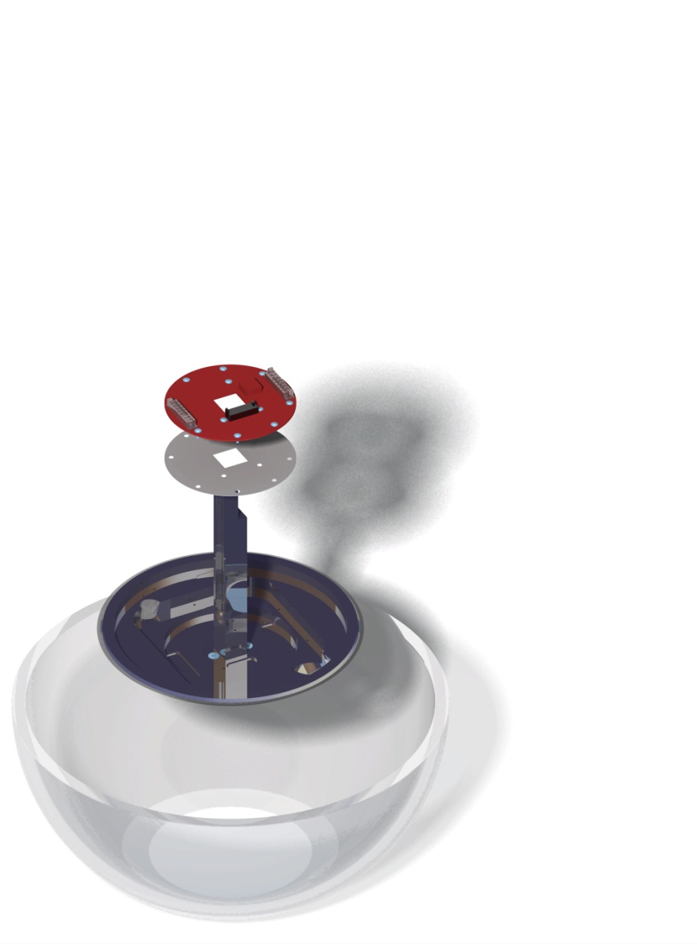
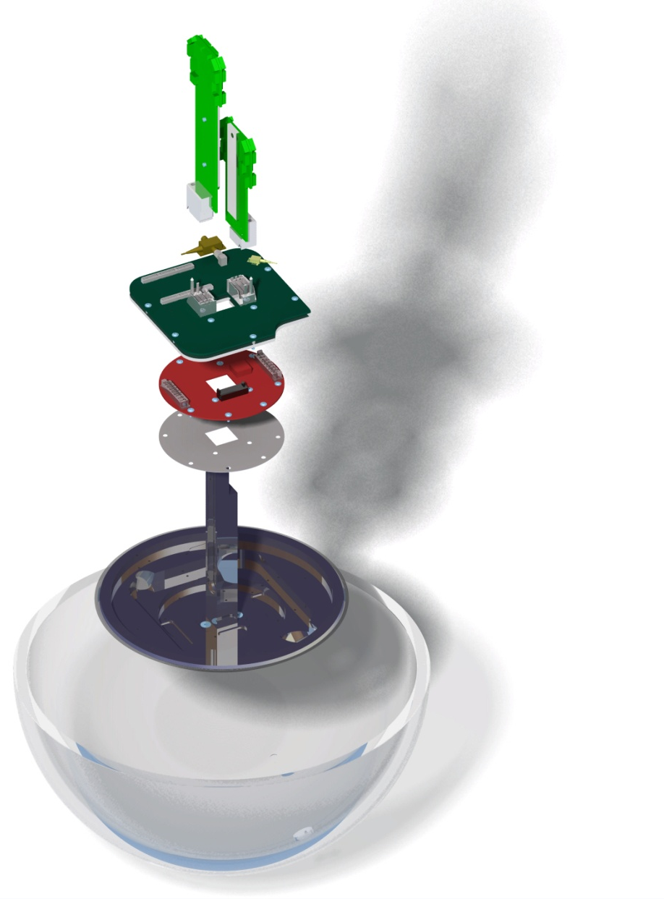
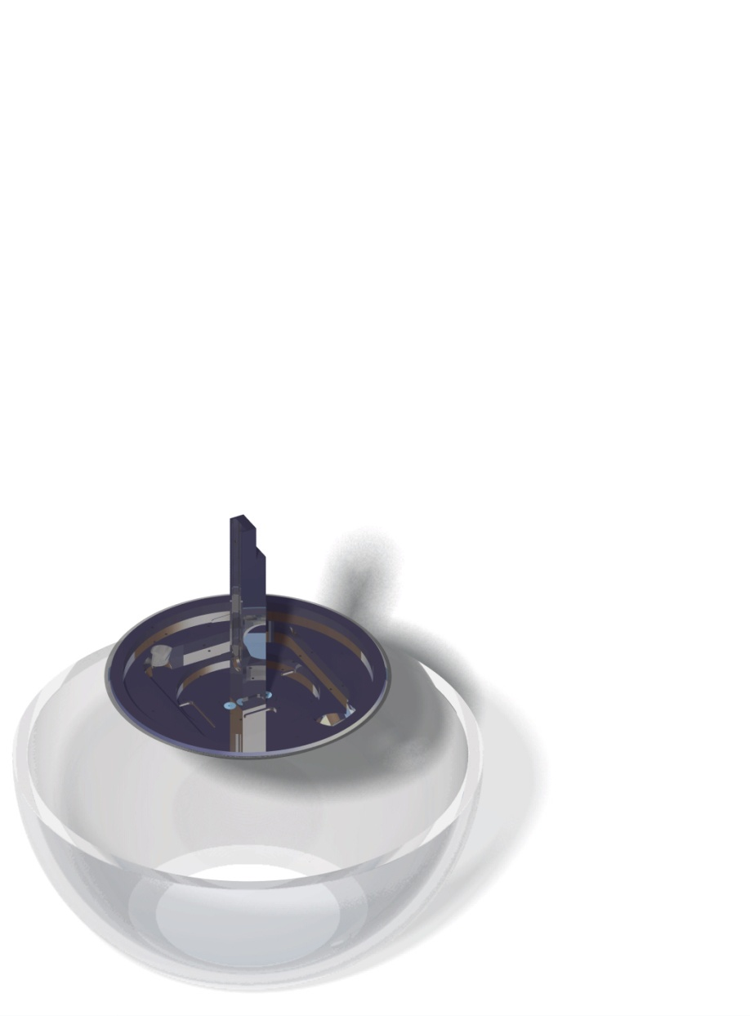
DOM electronics
Distribution boards to PMTs
Central logic board
  Optical line terminator
  Acoustic board
  Nano beacon
  Alluminium plate (cooling, rf shielding)
Power conversion board
Folie
  Thermal conduction
  Electric isolation
Cooling shield
  Alluminium
Upper hemisphere
WP F-L

Slide 15
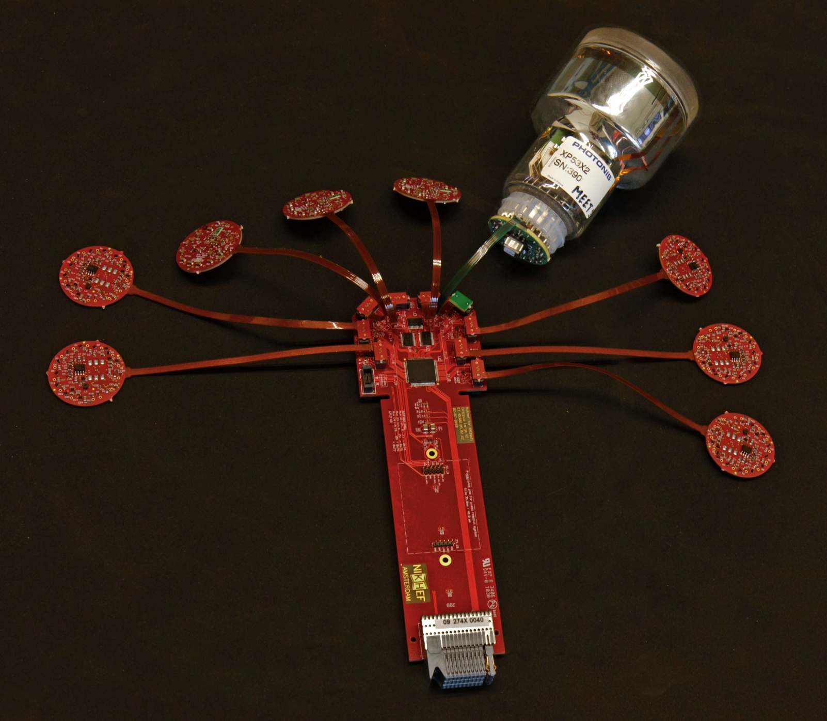
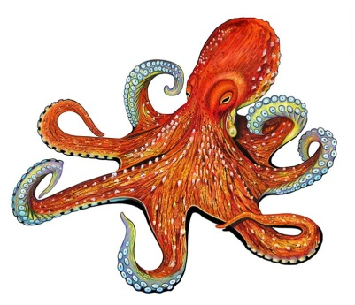
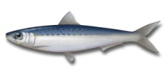
Distribution to / from PMTs
Nicknamed;
  Octopus board
  Χταπόδια
  Pulpo
  Piovra
WP F-L

Slide 16
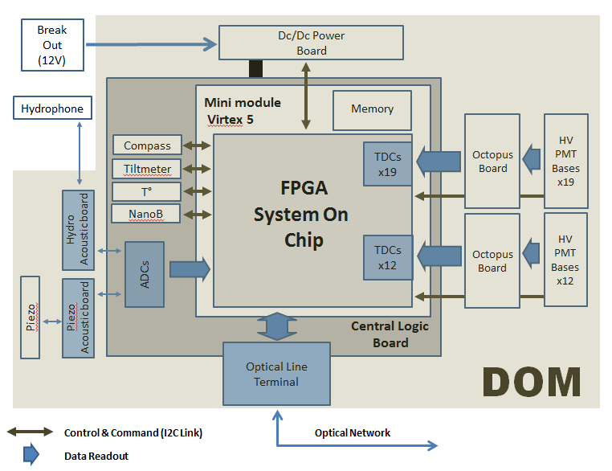
PPM-DOM functions
WP F-L

Slide 17
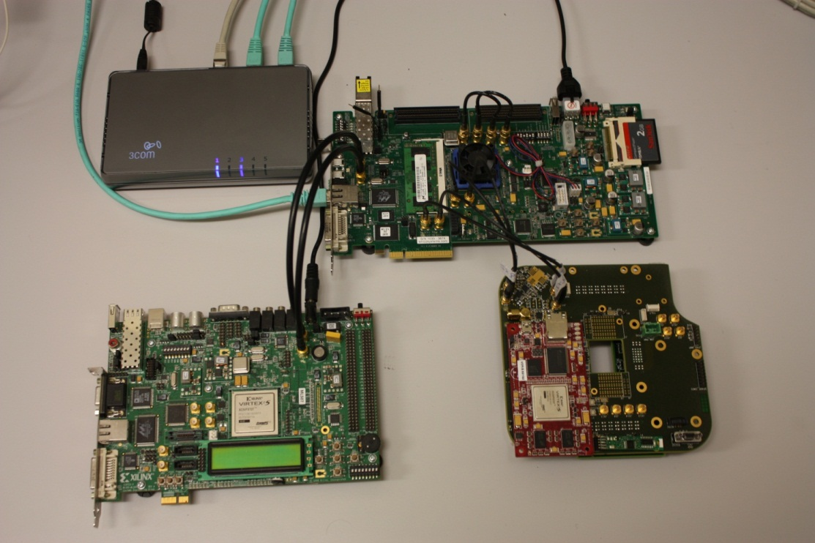
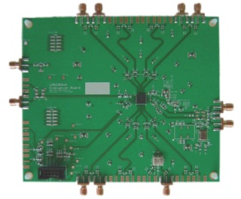
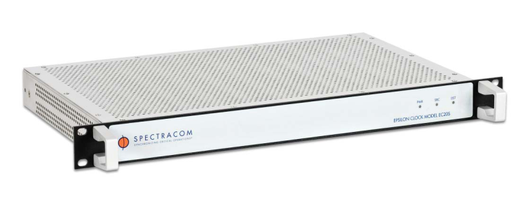
CLB test setup
Ethernet Switch
CLB
ML 605
ML 507
SACLAY test bench
GPS
LMK 0300
WP F-L

Slide 18
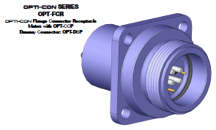
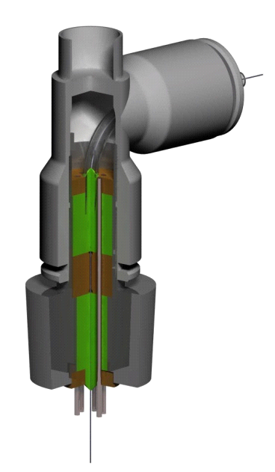
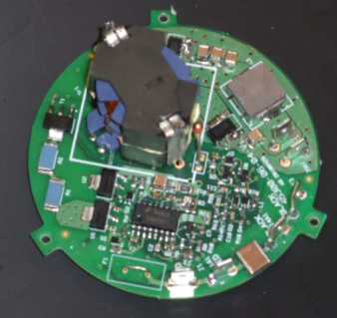
DOM-LCM cable (BEOC)
Equipressure cable (PBOF)
Penetrator into Optical Module
6 electrical wires (3x UTP)
2 fibres Bendbright
Dry mateable connector on to LCM
2 electrical wires (1 UTP)
2 fibres bendbright
1m
0.3m
DC/DC
Dry mateable connector
2 x UTP
Vent / fill for oil
Hydrophone
Tube knee
Seacon Ti connector
Bent limit tube
for fiber
Position ring
Silicon
Isolation stud
Silicon
Vin: 400Vdc
Vout: 12Vdc
Pout: < 18W
ƞ: > 90%
Titanium house
Position ring
WP F-L

Slide 19
PPM-DOM Antares Geographics
2 Lasers
tunable
MOD + Drivers
λ1
λ1
1λ CW+1λ AC
@1.25Gbps)
λ5
LiNbO3
D1
D2
A&D
50/50
λ4
A
LiNbO3
λ8
λ8
80/20
λ5
PIN
Antares DWDM crate
VOA
on/off
SMA
SMA
SMA
SPM
λ4
SMA
C1
C2
REAM
λ1
Junction Box
λ1
λ5
2xCu
DOM
APD
+?
A3
C2
D4
D3
C2
A
λ5
λ4
λ8
λ8
LCM
SS-part
40 km
ILxx
Available wavelengths
λ₄= C33=1550.92 nm
λ₅= C37=1547.72 nm
λ₆= C41=1544.53 nm
Existing component
Supplement to existing component
New component
WP F-L

Slide 20

Integration in LCM
LCM crate storey 1
2 ARS_MB not present (The 3rd one could be removed)
Acoustics boards not present
Converter board
Compass MB
CAMETH
Optics
Free slot 4
DAQ board
ARS MB
Free slot 3
CAMPOW
Clock board
Connectors
side
LPB side
Install optical components
Install a new converter board (380V/5V)
Control the VOA with DAC on the Compass board (used to set the OM HV)
May be optical components splitted in 2 slots
WP F-L

Slide 21

Shore components
WP F-L

Slide 22
Status
Project going on smoothly
Optics defined and mainly ordered
Optics on critical path
Detailed integration study in LCM will start
KM3NeT project with high priority
WP F-L

Slide 23



PPM-DOMs to KM3NeT site
3 PPM-DOMs on mini tower in Capo Passero
  Other dummy DOMs with compensation for center of gravity and center of buoyancy
  Different optical network design
  VEOC has to be validated
  BEOC has to be validated
WP F-L

Slide 24



After the PPM
Critical
  Availability of CLBs and software in time (withdrawn of Saclay contribution)
Power evaluations
  Power conversion 690 mW
  Central logic board 5410 mW
  Octopus board short 120 mW
  Octopus board long 180 mW
  PMT bases (31) 1090 mW
  External 690 mv1
Evaluation FPGA http://so-logic.net/en/fpga/table/producers
  Xilinx http://www.xilinx.com/products/silicon-devices/fpga/artix-7/index.htm
  Altera http://www.altera.com/literature/wp/wp-01160-fpga-diversify-28nm.pdf
  Actel http://www.actel.com/documents/Power Aware WP.pdf
  Lattice http://www.latticesemi.com/products/fpga/ecp3/index.cfm
PMTs, base evaluations
  Base driver ASIC upgrade
  Analogue output ASIC upgrade
  Different form factors of PMTs
Integration of mezzanine boards
Evaluations of satellites
  Hydrophone connection
  Temperature system of NIOZ
  PORFIDO
Optimizing assembly and test procedures
Tender rules
PORFIDO
COCO
PROMIS-v1
WP F-L

