Slide 1
PPM DU Sea Qualification Tests
General constraints & requirements
Preliminary tests
Full mechanical test

Slide 2
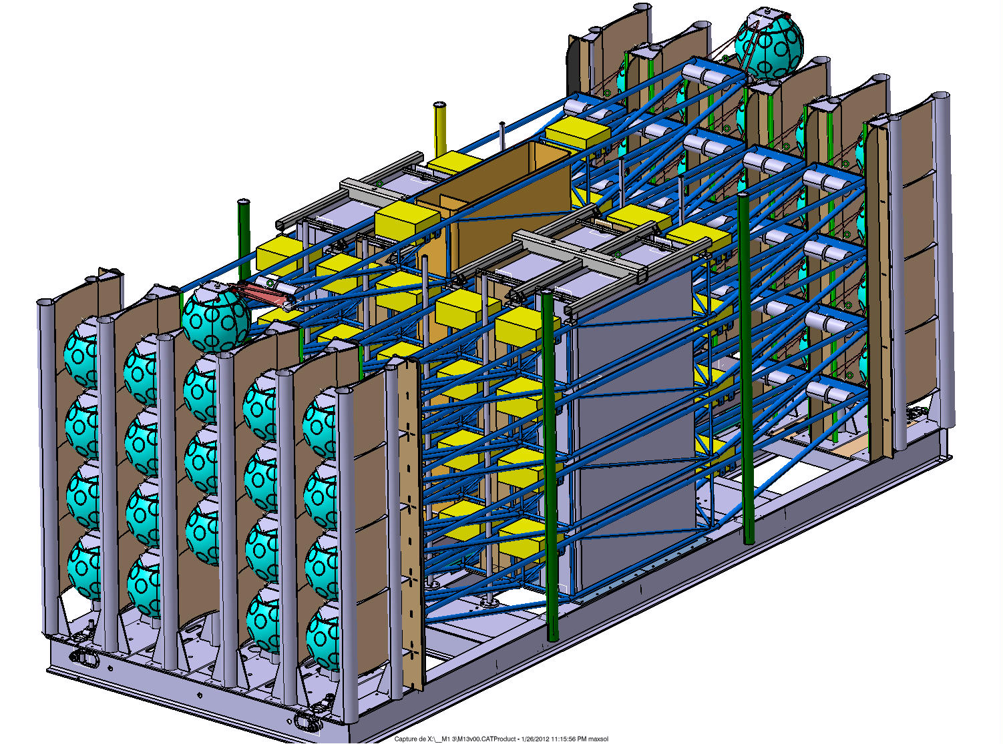
D.U. Package

Slide 3
Constraints
At every step, the D.U. pack deployed is the final one in terms of mass and buoyancy (including center of gravity and buoyancy)
If the Rov is operated with TMS, the support vessel can be linked to anchor. If no TMS, Rov is deployed when support vessel is free from any bottom link (or Rov is deployed with its own independant support vessel)
A light inspection Rov is mandatory for video tasks
For tests, Rov (Cougar) should not fly above the anchor if ropes observed buoyant above pack (INFN Cougar is never allowed to fly above the anchor)
If ropes observed buoyant above pack before landing, pack is recovered on deck for repair.

Slide 4
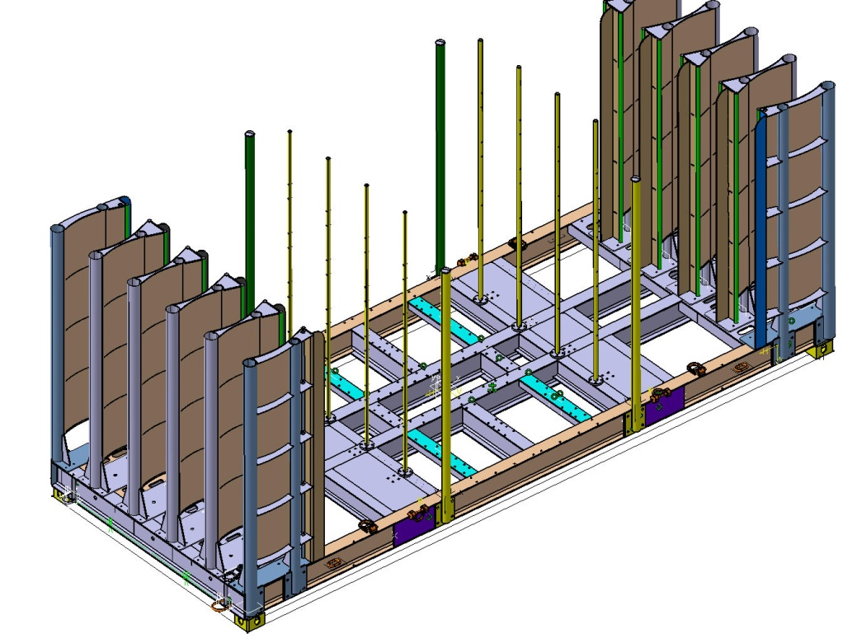
2. Prelimary tests – step 1
Proposed scope of work:
→ D.U. packaging > Loading on deck
→ Launching into sea
→ Deployment to seabed
→ Release deepsea cable
→ Connection test by Cougar
→ Top buoys + top storey releases
→ Anchor + storey recovery
DU pack configuration:
20 storeys – 2 Top buoys – 2 Separators - Base – SBS
& Complete anchor
Moke up of IL with ODI connector on Base
Recording of top storey acceleration
Acoustic release (heavy load) for load transfer

Slide 5
2. Prelimary tests – step 1
1
Pack configuration
Dead storeys are firmly
strapped on anchor
2
3

Slide 6
2. Prelimary tests – step 1
Depth 40m:
top storey stops after 20m ascent
4

Slide 7
2. Prelimary tests – step 1: schedule
Day 1:
DU loading on deck
Mobilisation of ROV (Cougar ?)
Acoustic release installation
→ Acceptance Data Package
Day 2:
1 h transit to 40 meters depth area
1 h to prepare deployment
1 h launching and place on seabed (survey ROV control)
1,5 h Cougar Rov to carry underwater actions
1,5 h recovery of DU
1 h transit back to Foselev

Slide 8
2. Prelimary tests – step 2
Proposed scope of work: end of unfurling
→ Top buoys release
→ S2, S1, base release
→ general survey after unfurling
→ Release the base from anchor (via Stabilization Base System)
→ Buoys and storeys recovery
→ Anchor recovery
DU pack configuration:
20 storeys – 2 Top buoys
2 Separators
Base – SBS – Anchor
data records and acoustic navigation (GAPS)

Slide 9
2. Prelimary tests – step 2
20m
S2
40m
S1
40m
Base
Separator 2 linked to bottom top buoy (similar as top storey)
Top buoys modified to match the S1-S2-Base release velocity ?
5m
Depth 120m

Slide 10
2. Prelimary tests – step 2: schedule
Day 3 (ashore): :
DU package re-configuration → Acceptance Data Package
Day 4:
2 h transit to 120 meters depth area
1 h to prepare deployment
1 h launching and place on seabed
3 h Cougar Rov to carry underwater actions
1 h Video of anchor and deployed structures
1 h Rov recovery
2 h transit back to Foselev
Day 5:
1 h rov deployment and base release
2 h rov and du recovery
2 h anchor recovery
2 h transit back

Slide 11
2. Prelimary tests – step 3
Proposed scope of work:
→ Top buoys release
→ 5 storeys release (a column and one crossing)
→ Separators & base release
→ general survey after unfurling
→ Check stabilisation of DU unfurled (Gaps system)
→ Check Rov tasks for recovery
→ Check DU recovery procedure
→ Check anchor recovery procedure
DU pack configuration:
20 storeys – 2 Top buoys
2 Separators
Base – SBS – Anchor
Gaps system on free storeys

Slide 12
2. Prelimary tests – step 3
20m
S20
S12
20
S3
S2
7x 40m
3
2
S1
1
sep2
12
sep1
Pack configuration
Base
5m
Depth 320m

Slide 13
2. Prelimary tests – step 3: schedule
Day 6 (ashore): :
DU package re-configuration → Acceptance Data Package
Day 7:
2 h transit to 320m depth
2 h launching and pose DU on seabed
1 h ROV deploy and survey
1 h ROV actions > unfurling
1 h video survey at anchor and storeys level
1 h rov recovery
Day 8:
1 h Rov deployment and base release(DU coming up)
½ h ROV recovery
2 h DU recovery (buoys, 5 storeys, sep and base, SBS)
4 h anchor recovery
2 h transit back to Foselev

Slide 14
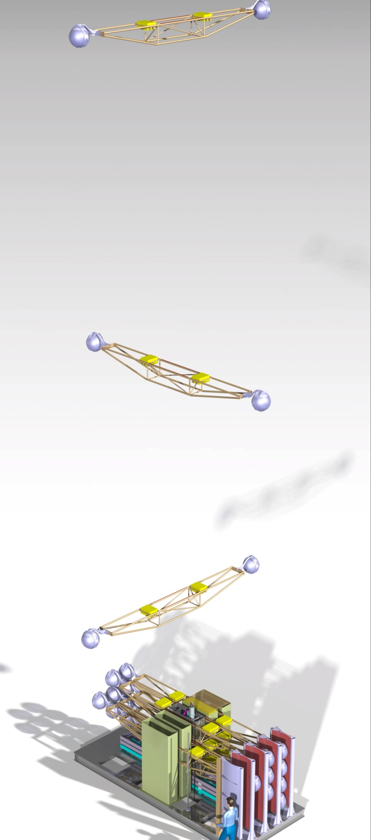
2. Prelimary tests: end
Day 9 (ashore):
demobilisation all equipments
3. Full mechanical test:
Rex preliminary tests
Modification of the du release system from the vessel cable (?)
Real veoc with optical data logger (?)

Slide 15
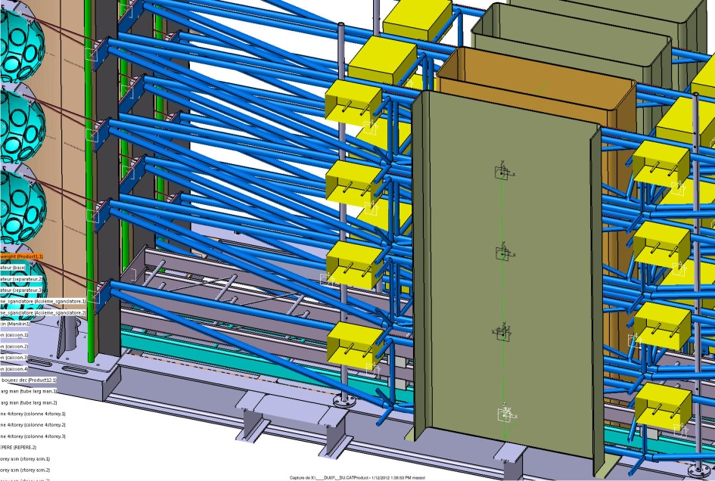
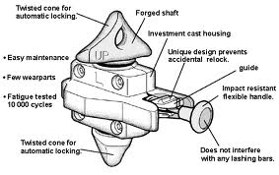
Bottom Release solution (at least for first tests)
Deep sea cable
40m dynaone HS 22mm
25t hook
mechanic release by rov
2,5m steel cable
Acoustic release for load transfer
from 25t hook to depsea deployment winch
The deployment cable is released by Rov

Slide 16
Launching: reprise treuil
Deepsea winch
Câble treuil
25t
Release 25t hook by acoustic

