Slide 1
Progress report on the detector optimization
& Progress report on observation strategies
and estimation techniques (part B)
Apostolos Tsirigotis, Antonis Leisos, Spyros Tzamarias
Physics Laboratory H.O.U
Outline
Discovery Potential using the Un-Bin method in extended sources
Comparison of different detector layouts
Stack of galactive sources
Analysis strategy taking into account the source structure
KM3NeT General Meeting
20-23 February 2012
LNS Catania

Slide 2
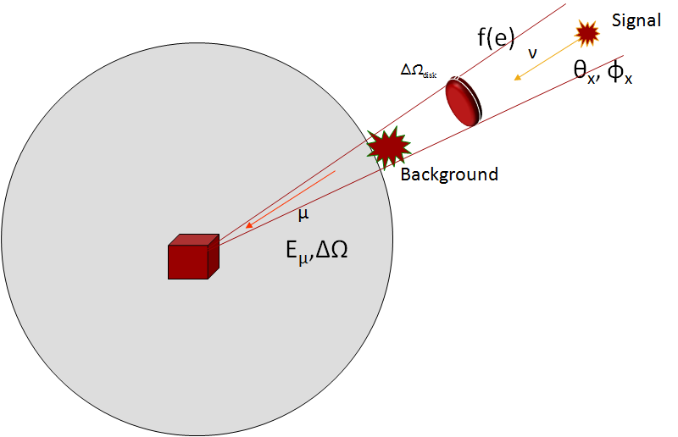
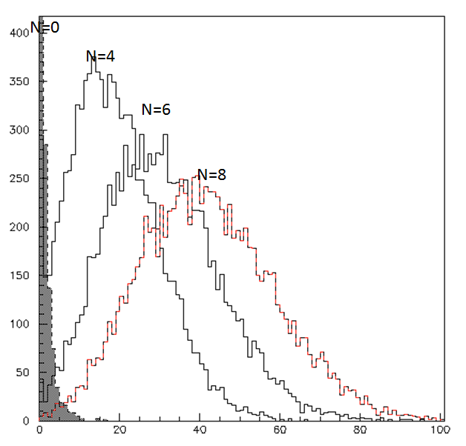
Reminder of the Un-bin method

Slide 3
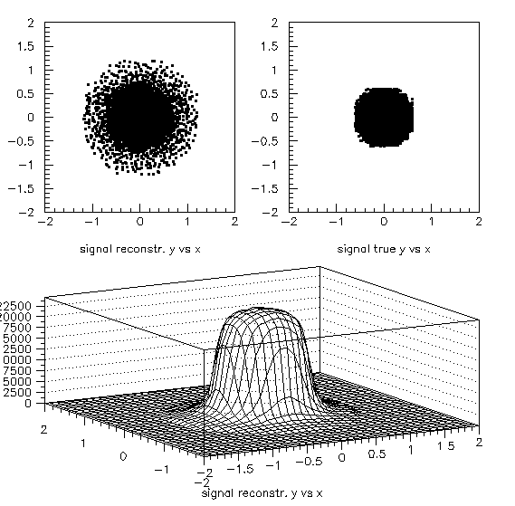
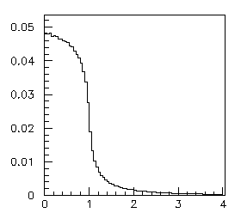
Extended Source
Point source →
d
R_{m}
cos θ=0 -0.05

Slide 4
Comparison of the Discovery Potentials
Number of events (N) – Angular profile (S) – Energy (E)
RXJ1713
Discovery Potential in units of the reference flux
years

Slide 5
cos θ=0 - -0.05
Energy distribution of signal (RXJ1713) and background (atmospheric)
Signal
Background
Signal
Background
(R/d)²
cos θ=-0.95 - -1.
logE, E in GeV
(R/d)²

Slide 6
Comparison of the Discovery Potentials
Number of events (N) – Angular profile (S) – Energy (E)
distribution of the test statistic λ
Only the Poisson term (total number of events)
Total number of events + Angular profile + Energy
Background samples
15 y 12 y 8 y 10y
21 signal events on top of bck
Cumulative Probability
Number of sets
S100
S100
Only Background

Slide 7
Comparison of the Discovery Potentials
Number of events (N) – Angular profile (S) – Energy (E)
S100
Cumulative Probability
21 signal events on top of background
22% improvement in DP
FOM 7.2y → 5.6y

Slide 8
Comparison of the Discovery Potentials
For different detector layouts
308 Towers with vertical separation of 130 m (T130)
308 Towers with vertical separation of 150 m (T150)
308 Towers with vertical separation of 180 m (T180)
616 Strings with vertical separation of 100 m (S100)
616 Strings with vertical separation of 130 m (S130)

Slide 9
5-σ DISCOVERY POTENTIAL @ 50% C.L.
Discovery Potential in units of the reference flux
years

Slide 10
FOM (years of observation time)
5-σ DISCOVERY @ 50% C.L.
8.4y
7.6y
6.4y
6.0y
5.6y

Slide 11
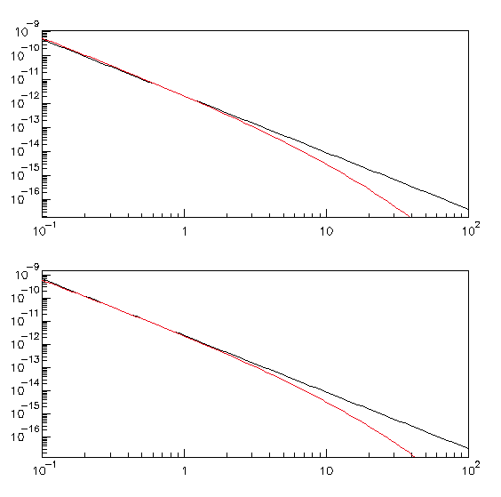
Source | Size (degrees) * | Flux
RXJ1713.7-3496 | Radius 0.65 | 1.68*10⁻¹¹*(E^{-1.72})*exp(-sqrt(E/2.1))
RXJ0852.0-4622 | Radius 1.00 | 1.676*10⁻¹¹*(E^{-1.78})*exp(-sqrt(E/1.19))
HESSJ1616-508 | Gaussian σ 0.16 | 0.42*10⁻¹¹*(E^{-2.2})*exp(-sqrt(E/2,1)) **
HESSJ1614-518 | Gaussian σ 0.25 | 0.46*10⁻¹¹*(E^{-2,2})*exp(-sqrt(E/2.1)) **
* ApJ 636 (2006) 777 , A&A 437-L7
HESSJ1616-508
dN/dE (TeV⁻¹ cm⁻² s⁻¹ )
** approximation (red line) of the ApJ 656 (2007) fluxes (black line) in order to incorporate the same energy cut-off as in the RXJ1713.7 case.
HESSJ1614-518
Energy (TeV)

Slide 12
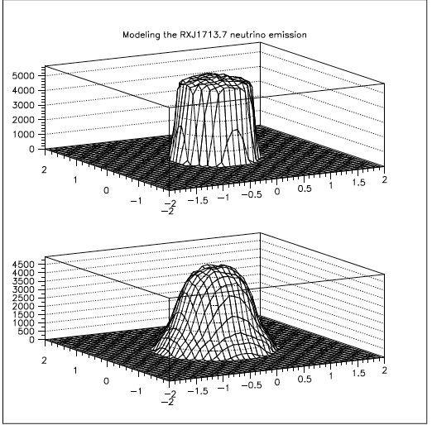
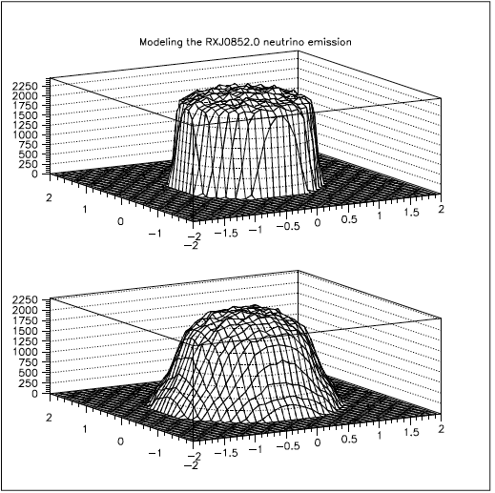
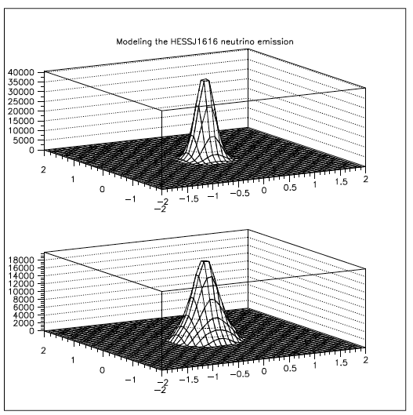
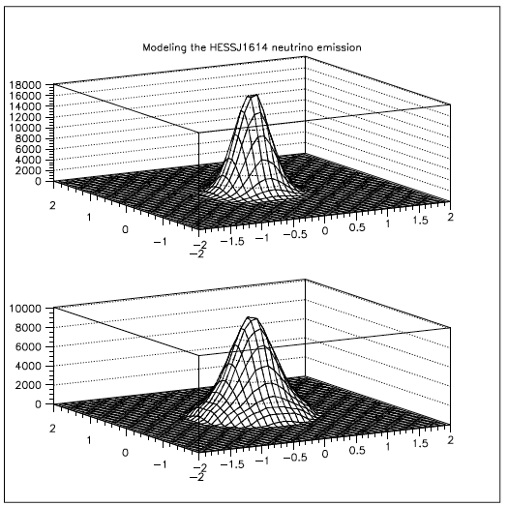
Modeling the Spatial Distribution of the Sources
generated
neutrinos
φ
θ
Reconstructed neutrino directions
generated
neutrinos
Reconstructed neutrino directions

Slide 13
WPD Full Detector – 308 Towers – 180 m horizontal separation
Source | Wide Ring Selection |  | Optimum Ring Selection * |  | FoM (y) bin | FoM (y) un-bin**
 | Signal per year | Backgr. per year | Signal per year | Backgr. per year
RXJ1713.7-3496 | 3.3 | 5.9 | 2.9 | 3.7 | 11 | 8.4*** (3σ: 3.3)
RXJ0852.0-4622 | 2.6 | 12.4 | 2.1 | 7.4 | 41 | 33 (3σ: 11)
HESSJ1616-508 | 0.9 | 2.8 | 0.7 | 1.2 | 68 | 57 (3σ: 19)
HESSJ1614-518 | 0.82 | 6.26 | 0.6 | 2.7 | - | -
* Optimum Sensitivity and cuts to reject all the atm. muon-background
** Tracking and Energy Information is used
*** Only with tracking information the FoM is 9.6 y

Slide 14
SOURCE STACKING
In case of: K sources, N_{total} observed tracks from all the sources and M_{B} total expected background

Slide 15
WPD Full Detector – 308 Towers
Stacking Sources
Assuming 6 years of observation, the 50% discovery potential of
RXJ1713.7-3496 corresponds to 1.33* 1.68*10⁻¹¹*(E^{-1.72})*exp(-sqrt(E/2.1))
RXJ0852.0-4622 corresponds to 2.55*1.676*10⁻¹¹*(E^{-1.78})*exp(-sqrt(E/1.19))
HESSJ1616-508 corresponds to 3.3*0.42*10⁻¹¹*(E^{-2.2})*exp(-sqrt(E/2,1))
HESSJ1614-518 corresponds to 5.3*0.46*10⁻¹¹*(E^{-2,2})*exp(-sqrt(E/2.1))
STACKING TOGETHER 6 years simultaneous observations of the RXJ1713.7-3496 and the RXJ0852.0-4622 , the 50 % discovery potential of observing neutrino from these sources corresponds to:
1.22* [1.68*10⁻¹¹*(E^{-1.72})*exp(-sqrt(E/2.1))+1.676*10⁻¹¹*(E^{-1.78})*exp(-sqrt(E/1.19))] using as weights the relative source strength
In this case the FoM is less than 7.5 years whilst for the RXJ1713.7-3496 alone is 8.4 y

Slide 16
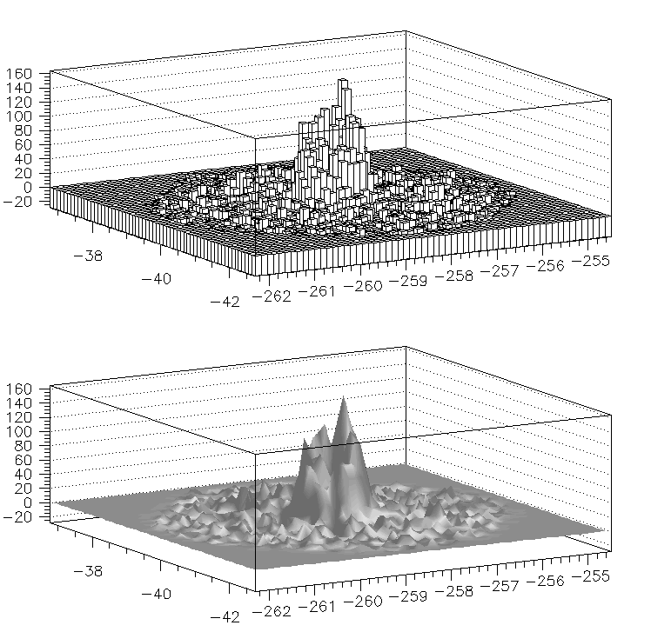
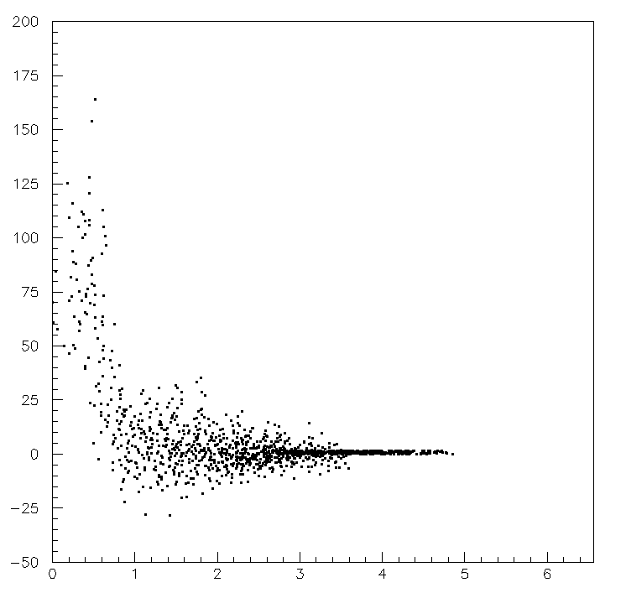
Taking into account the source structure…
Events/bin (a.u.)
R
Decl.
R.A

Slide 17
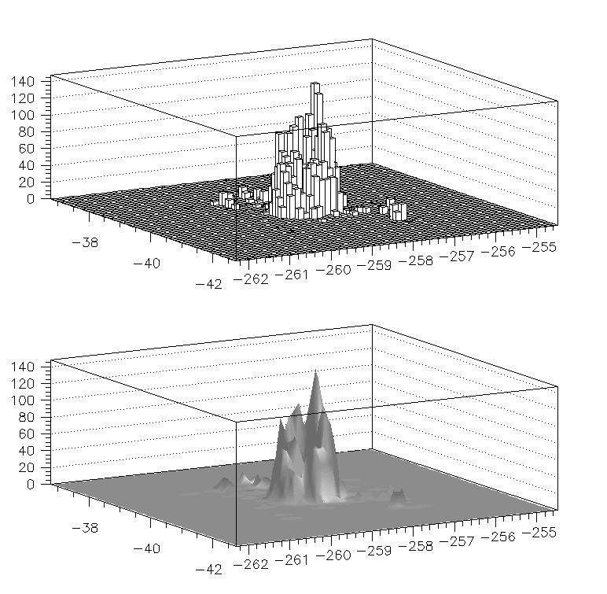

Slide 18
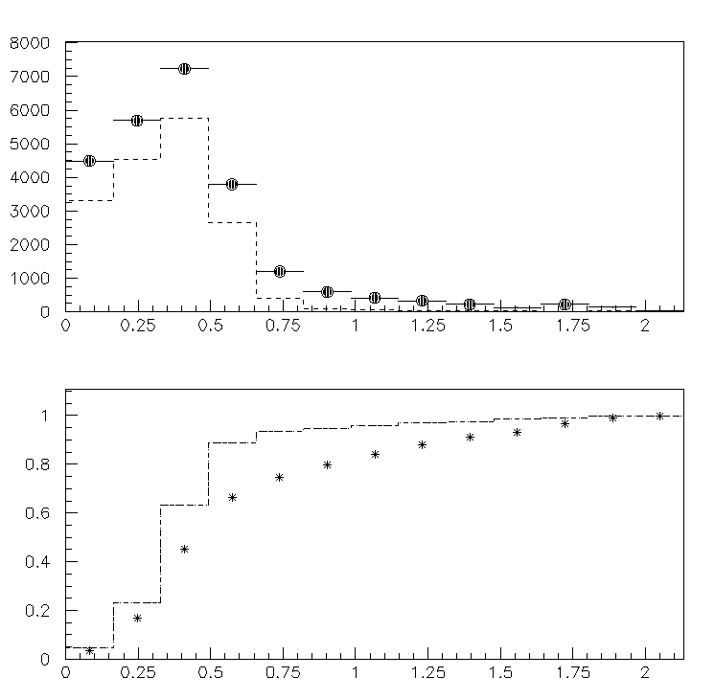
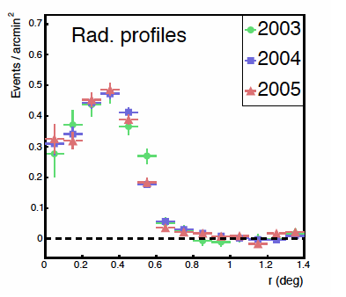
Events/deg**2
R [Degrees]
fraction
R [Degrees]

Slide 19
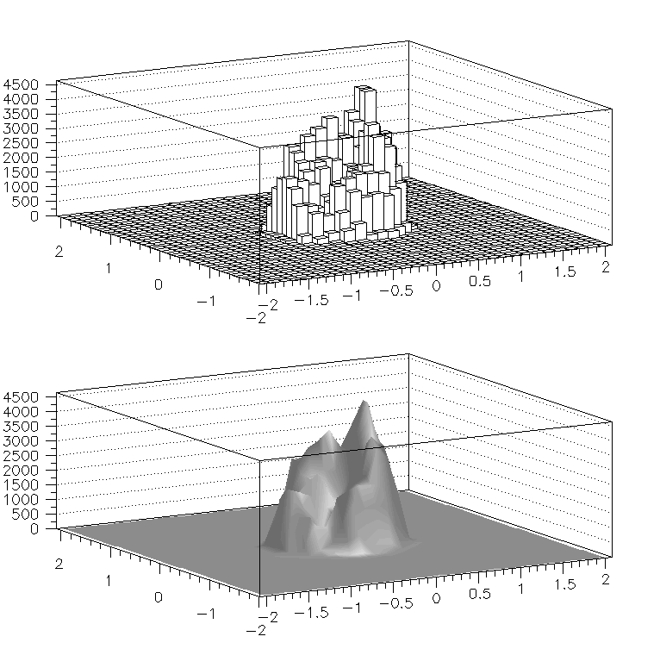
Simulate the ν emission to follow the (raw) VHE gamma emission topology
(just a toy model)

Slide 20
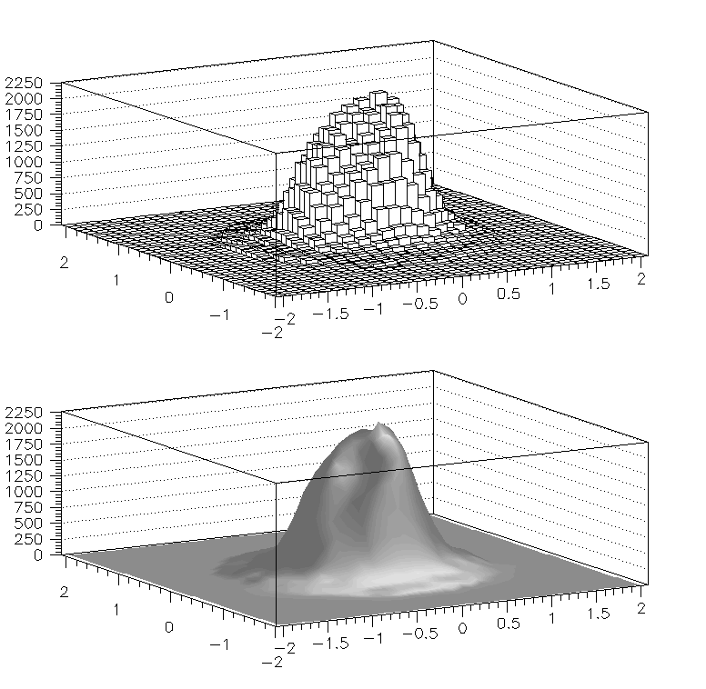
3D angular distribution of the reconstructed (ν) signal induced muons

Slide 21
Each bin of the source-model contributes as

Slide 22
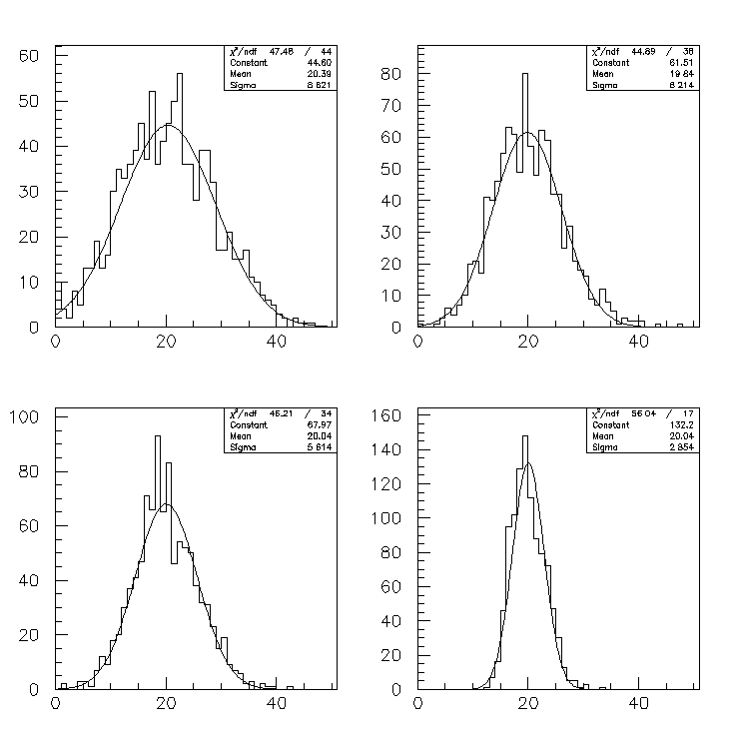
Back (15y) 166.4 μ
Back (8y) 88.7 μ
20 signal events
Back (6 y) 66.6μ
Back (1y) 11.1 μ

