Slide 1
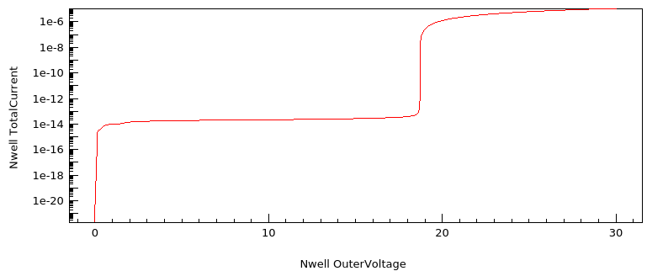
LF11 – example SPAD p+/nwell33 – IV simulation

Slide 2
LF11 – example SPAD p+/nwell33
Profiles:
Nwell1.2, nwell3.3, deep nwell from LFoundry info
Substrate, p+, n+ analytical
p+
n+
nwell3.3
Nwell1.2
Deep nwell
sub
3 contacts:
p+
nwell
Substrate

Slide 3
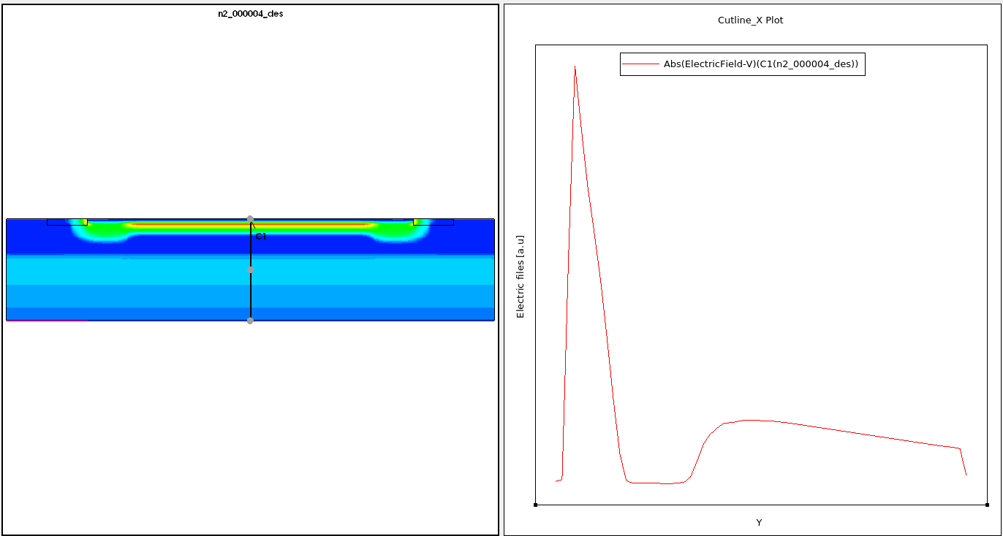
LF11 – example SPAD p+/nwell33 – Electric field @ 20V

