Slide 1
ASPIDES meeting 1
Tommaso Floris
20/02/2025

Slide 2
dSiPM worst case netlist delay
All inputs arrive at the same time
Worst delay from the last event at least 3,7 ns

Slide 3
Ortree best case netlist delay
All inputs arrive at the same time
The ORtree is not yet symmetrical
Best path delay of 68 ps

Slide 4
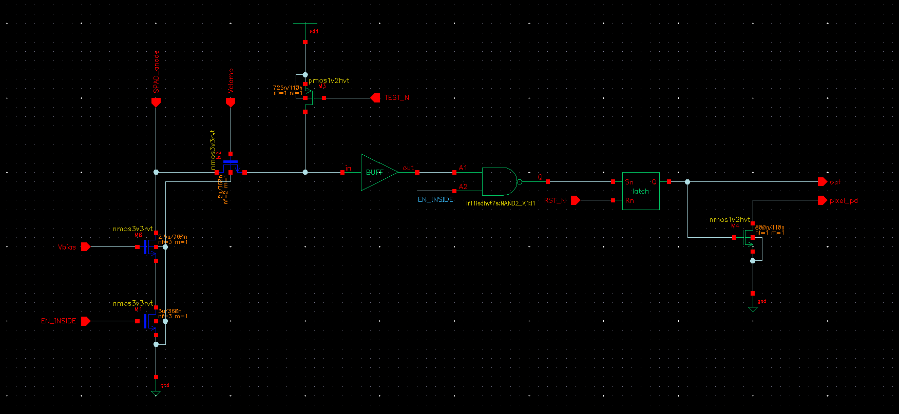
SPAD frontend circuit
Pixel enable & test electronic features
Pull-down trigger for event detection

Slide 5
2x2 pixel cluster
The pixel are organized in 2x2 cluster and represents the basic building macro for the matrix
Macro region
Routing region
Digital logic region (dSiPM)

Slide 6
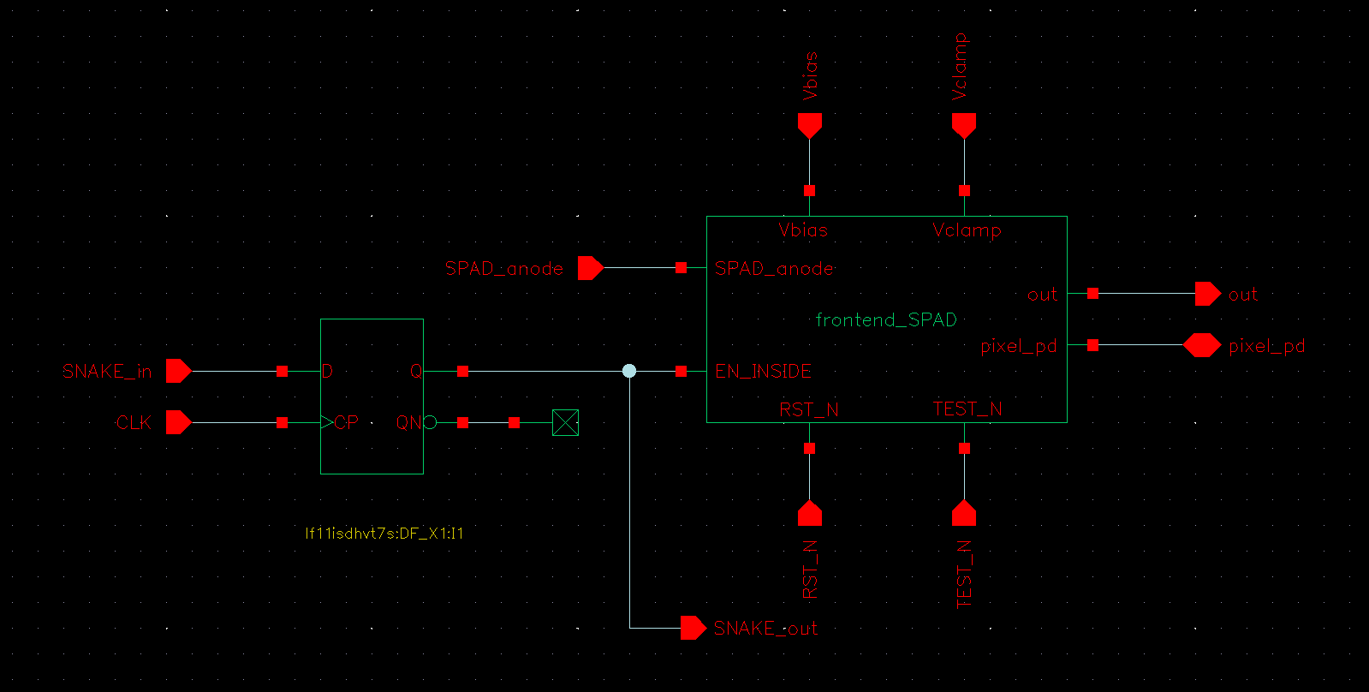
Snake pixel enabling solution
Every pixel connected to a shift-register, a synchronous snake of 1 and 0 enable only the desired pixels
10 digital pin at the interface for each 2x2 pixel cluster
One of these pin is a clock

Slide 7
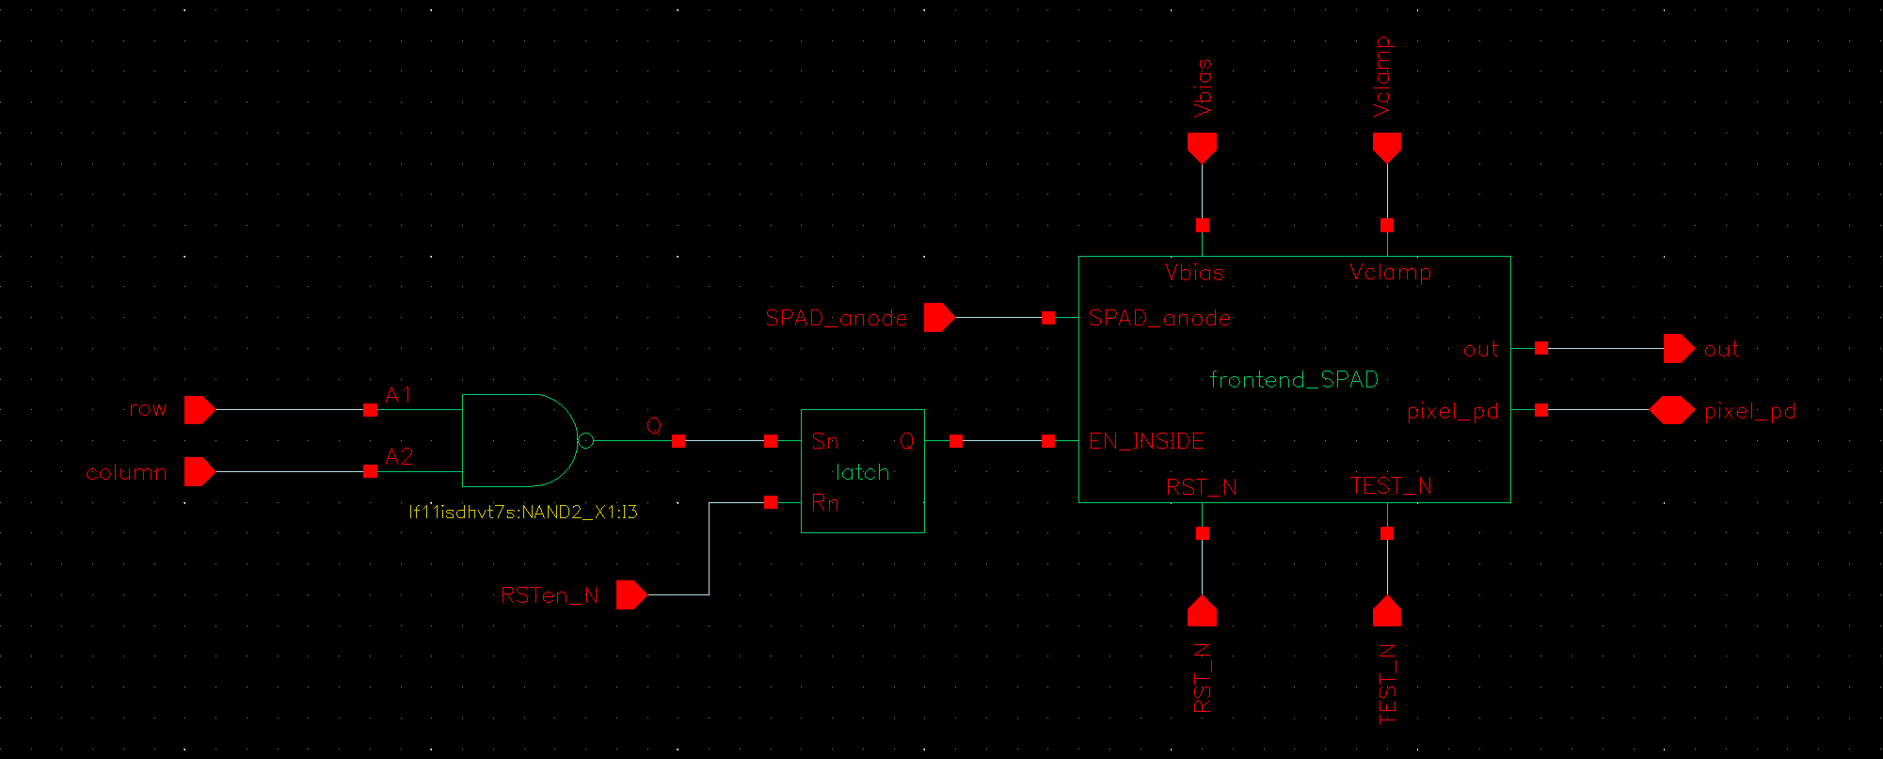
RowColumn pixel enabling solution
Two shift register are used to point to a pixel to enable it (or disable it)
12 digital pin at the interface for each 2x2 pixel cluster

