Slide 1
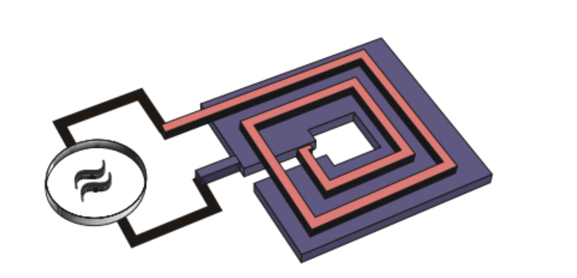
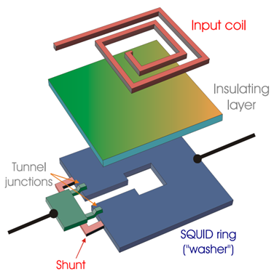
FLASH Technical Design Report
WP4 Signal Amplification and Acquisition
FLASH front-end Amplifier
Optimal MSA Noise Temperature
$$MSA Noise Temperature T_{n}$$
$$T_{n}≈{7T_{MSA}}/{G_{p}}$$
$$MSA Operation Temperature T_{MSA}$$
$$MSA Power Gain G_{p}$$
Microstrip SQUID Amplifier (MSA)
$$Cavity Operation Temperature T_{C}=1.9−4.5 K$$
Main constraints on the MSA for Flash
Operation frequency ranges: 117–206 MHz and 206-360 MHz
Operation in magnetic field up to 1.1 T
Operation temperature: 1.9 K – 4.5 K (300 mK?)
Negligible noise contribution (compared to the cavity thermal noise)
$$MSA noise contribution negligible \left(1/{10}\right) if$$
$$T_{n}≈{7T_{MSA}}/{G_{p}≲{T_{C}}/{10}}$$
$$(if T_{MSA}=T_{C})$$
$$4^{th}constraint$$
$$G_{p}≳70 (18.45 dB)$$

Slide 2
WP4 Signal Amplification and Acquisition
Participants: TIFPA/Trento, Pisa, Camerino, LNF, Bonn/Mainz
Coordinators: Paolo Falferi (MSA) (TIFPA/Trento), Gianluca Lamanna (Amplification/DAQ) (Pisa)
WP Objectives (from the CDR):
- Acquisition of some complete commercial MSA amplification systems, characterize them in terms of gain, bandwidth and noise down to temperatures of the order of 300 mK and then operate them in conditions similar to those in Flash as far as concerns operating temperature, ambient magnetic field and resonating input load.
- Digitization and acquisition of the signal, and the definition of the calibration procedure.

Slide 3
Tasks of WP4 Signal Amplification and Acquisition
Task 4.1: MSA configurations + gain, bandwidth, noise vs T measurements
Task 4.2: Stability (resonant input load ↔ WP3 RF Cavity)
Task 4.3: Postamplifier (cryogenic)
Task 4.4: Magnetic shielding ↔ WP2 Mechanical design and cryogenics
Task 4.5: Multiplexing (simultaneous measurement of multiple cavity modes)
Task 4.6: Replacement of the MSA ↔ WP2 Mechanical design and cryogenics
Task 4.7: Secondary amplification and down conversion chain
Task 4.8: Digitization and data acquisition
Task 4.9: Full test of amplification chain with a Bulk Acoustic Resonator (BAW)

Slide 4
WP4 Tasks Update
Task 4.1: MSA configurations
Decided acquisition of 5 MSA Systems from ezSQUID (TIFPA order request ok)
(MSA system = MSA + Nb shield + cryogenic semiconductor postamplifier + room-temperature bias box)
(Each team should acquire the right cryogenic cables (SMA conn.) for their cryostat)
1 MSA system (center frequency 150 MHz, bandwidth at least 100 MHz), usable down to T= 20mK.
TRENTO (bandwidth, gain, noise tests at least down to 300 mK)
1 varactor-tunable MSA system with operation frequency range from 100 MHz to 200 MHz.
TRENTO (test of the tuning of the operation frequency at 4.2K in liquid helium)
1 MSA system (center frequency 150 MHz, bandwidth at least 100 MHz)
CAMERINO (magnetic shield for test up to 1.1T )
1 MSA system (center frequency 150 MHz, bandwidth at least 100 MHz)
PISA (simultaneous measurement of multiple cavity modes)
1 MSA system (center frequency 250 MHz, bandwidth at least 100 MHz) .
PISA (simultaneous measurement of multiple cavity modes)

Slide 5
WP4 Tasks Update
Task 4.3: Postamplifier
The cryogenic semiconductor postamplifier is provided by ezSQUID → OK
Task 4.4: Magnetic shielding
Comsol simulations of the passive shielding (easiest), ferromagnetic/superconducting «hybrid» ↔ WP2 Mechanical design and cryogenics to know the operation magnetic field of the MSA (and postamp and circulators...)
Task 4.5: Multiplexing
Simultaneous measurement of multiple cavity modes → Claudio Puglia
Task 4.6: Replacement of the MSA
Considering the possibility of a separate cryostat for the MSA ↔ WP2 Mechanical design and cryogenics to evaluate the feasibility of cryogenics

Slide 6
END

