Slide 1
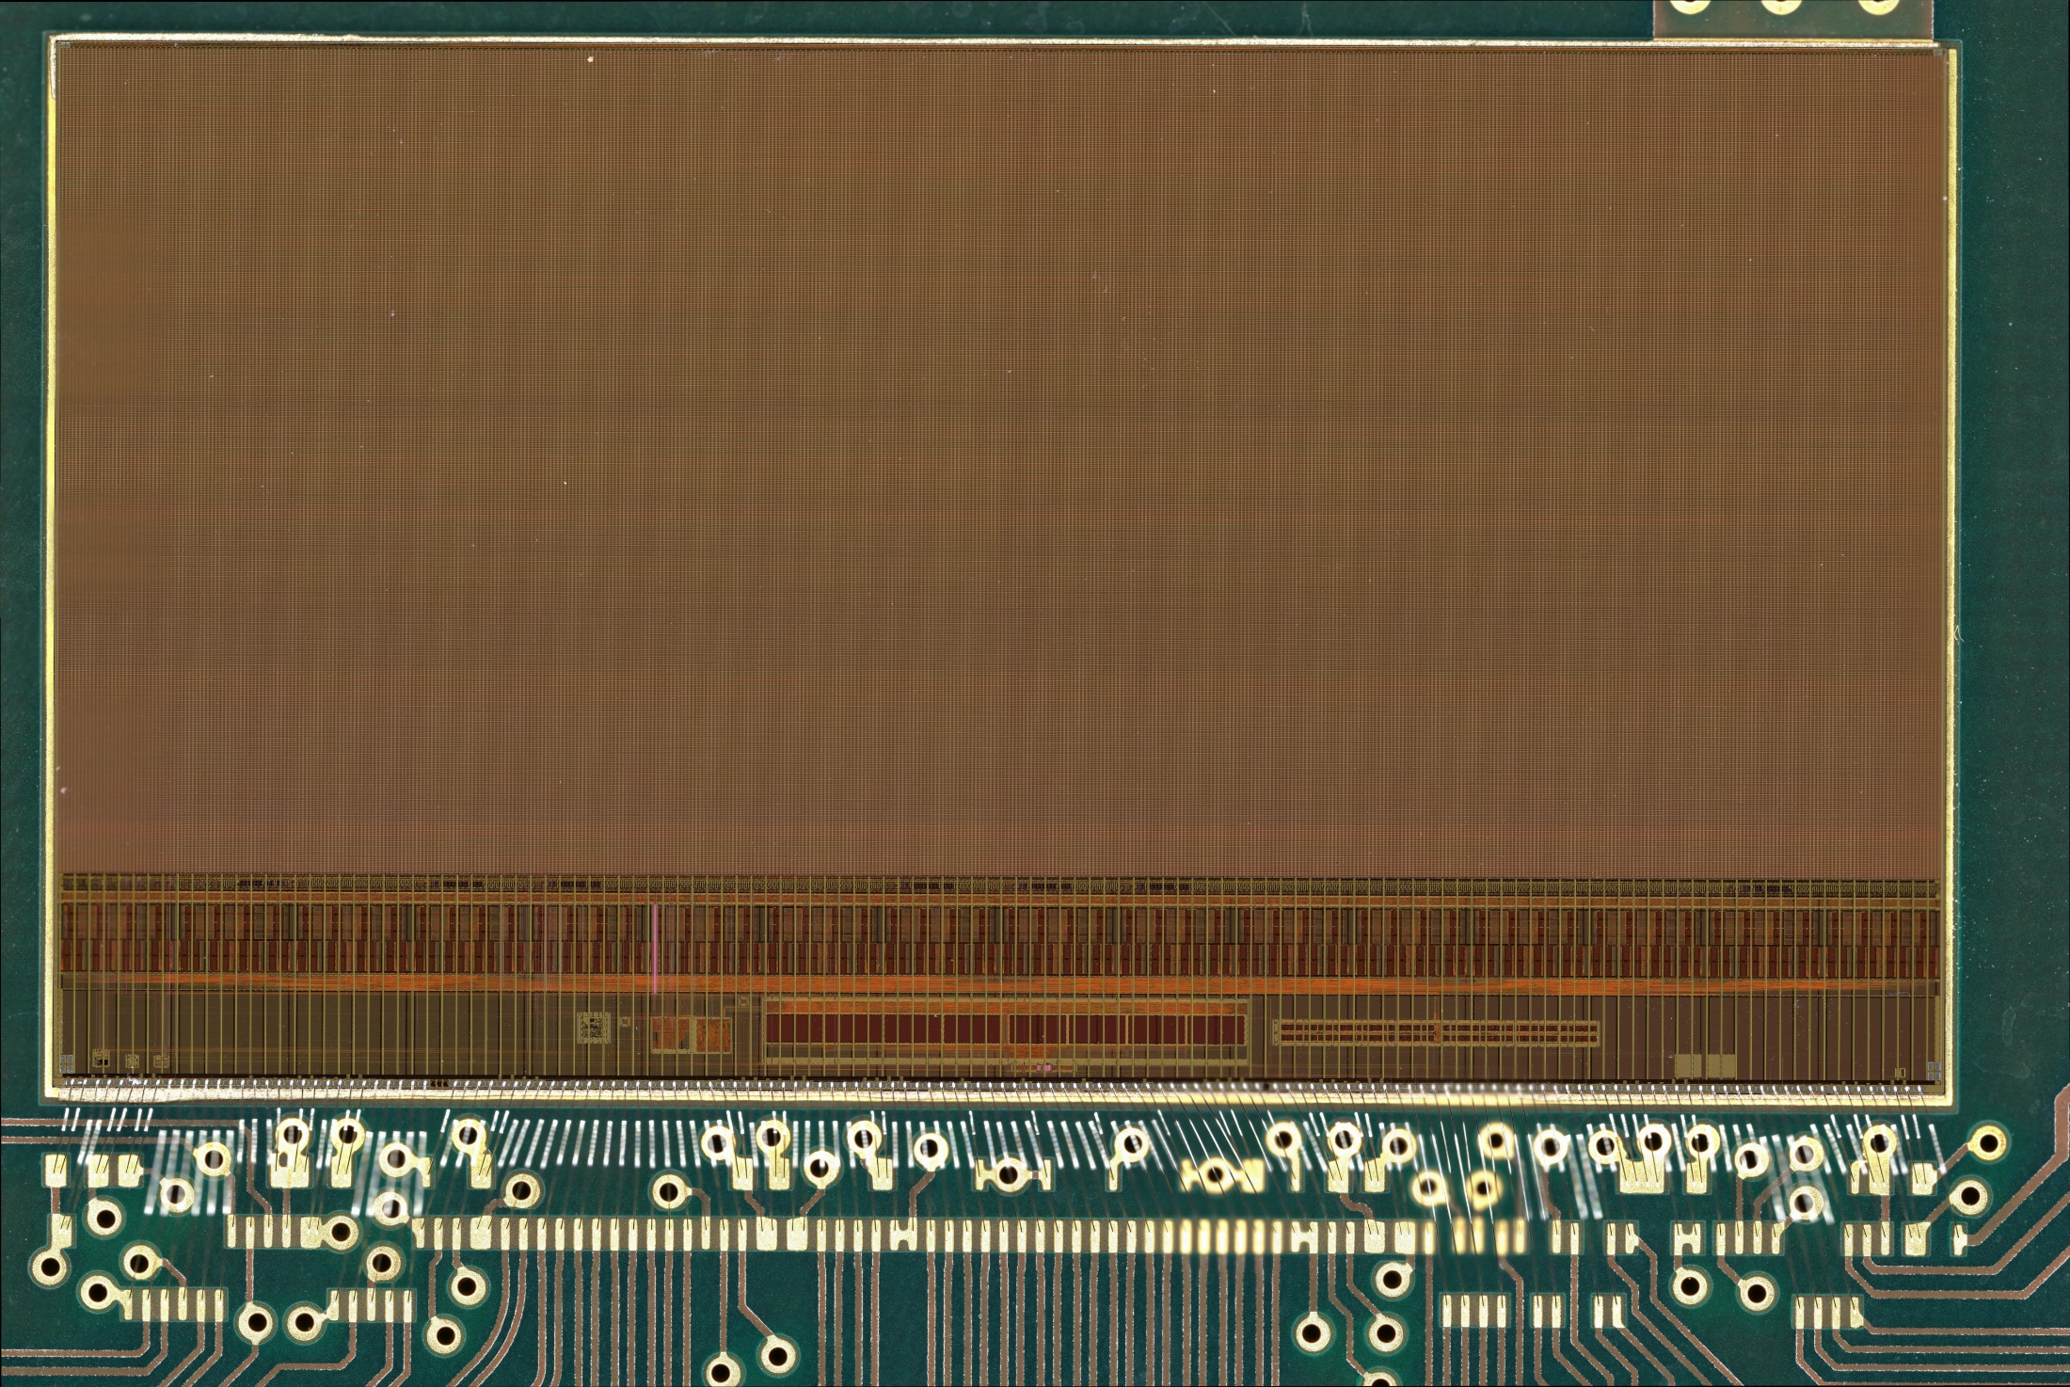
Mimosis_1

Slide 2
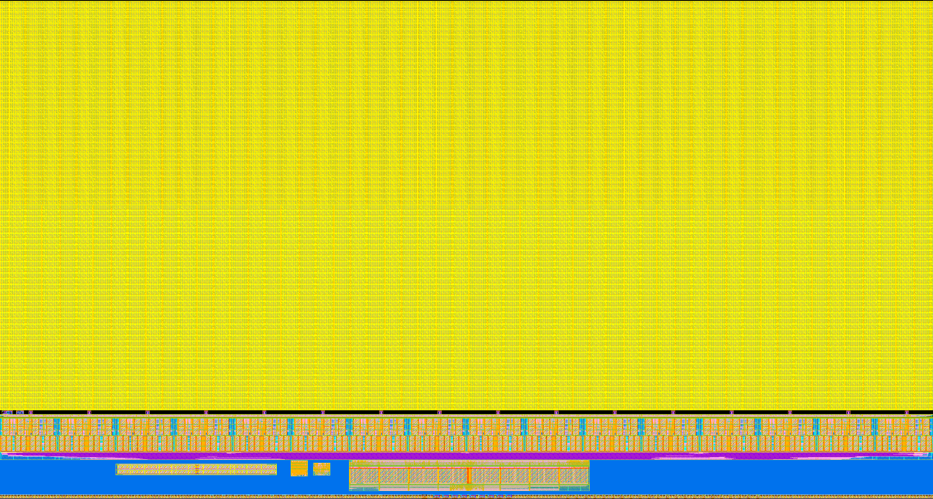
31 mm
MIMOSIS-1
1024 x 504 pixels
Pixel pitch: ~30 x 27 µm
200 kfr/s
13.55 mm
17.2 mm
Clk PLL
(40MHz)
Slow control
I2C
1 to 8 Data Output
(320MHz)
Output Clk (160MHz)
Data Marker (5µs)

Slide 6
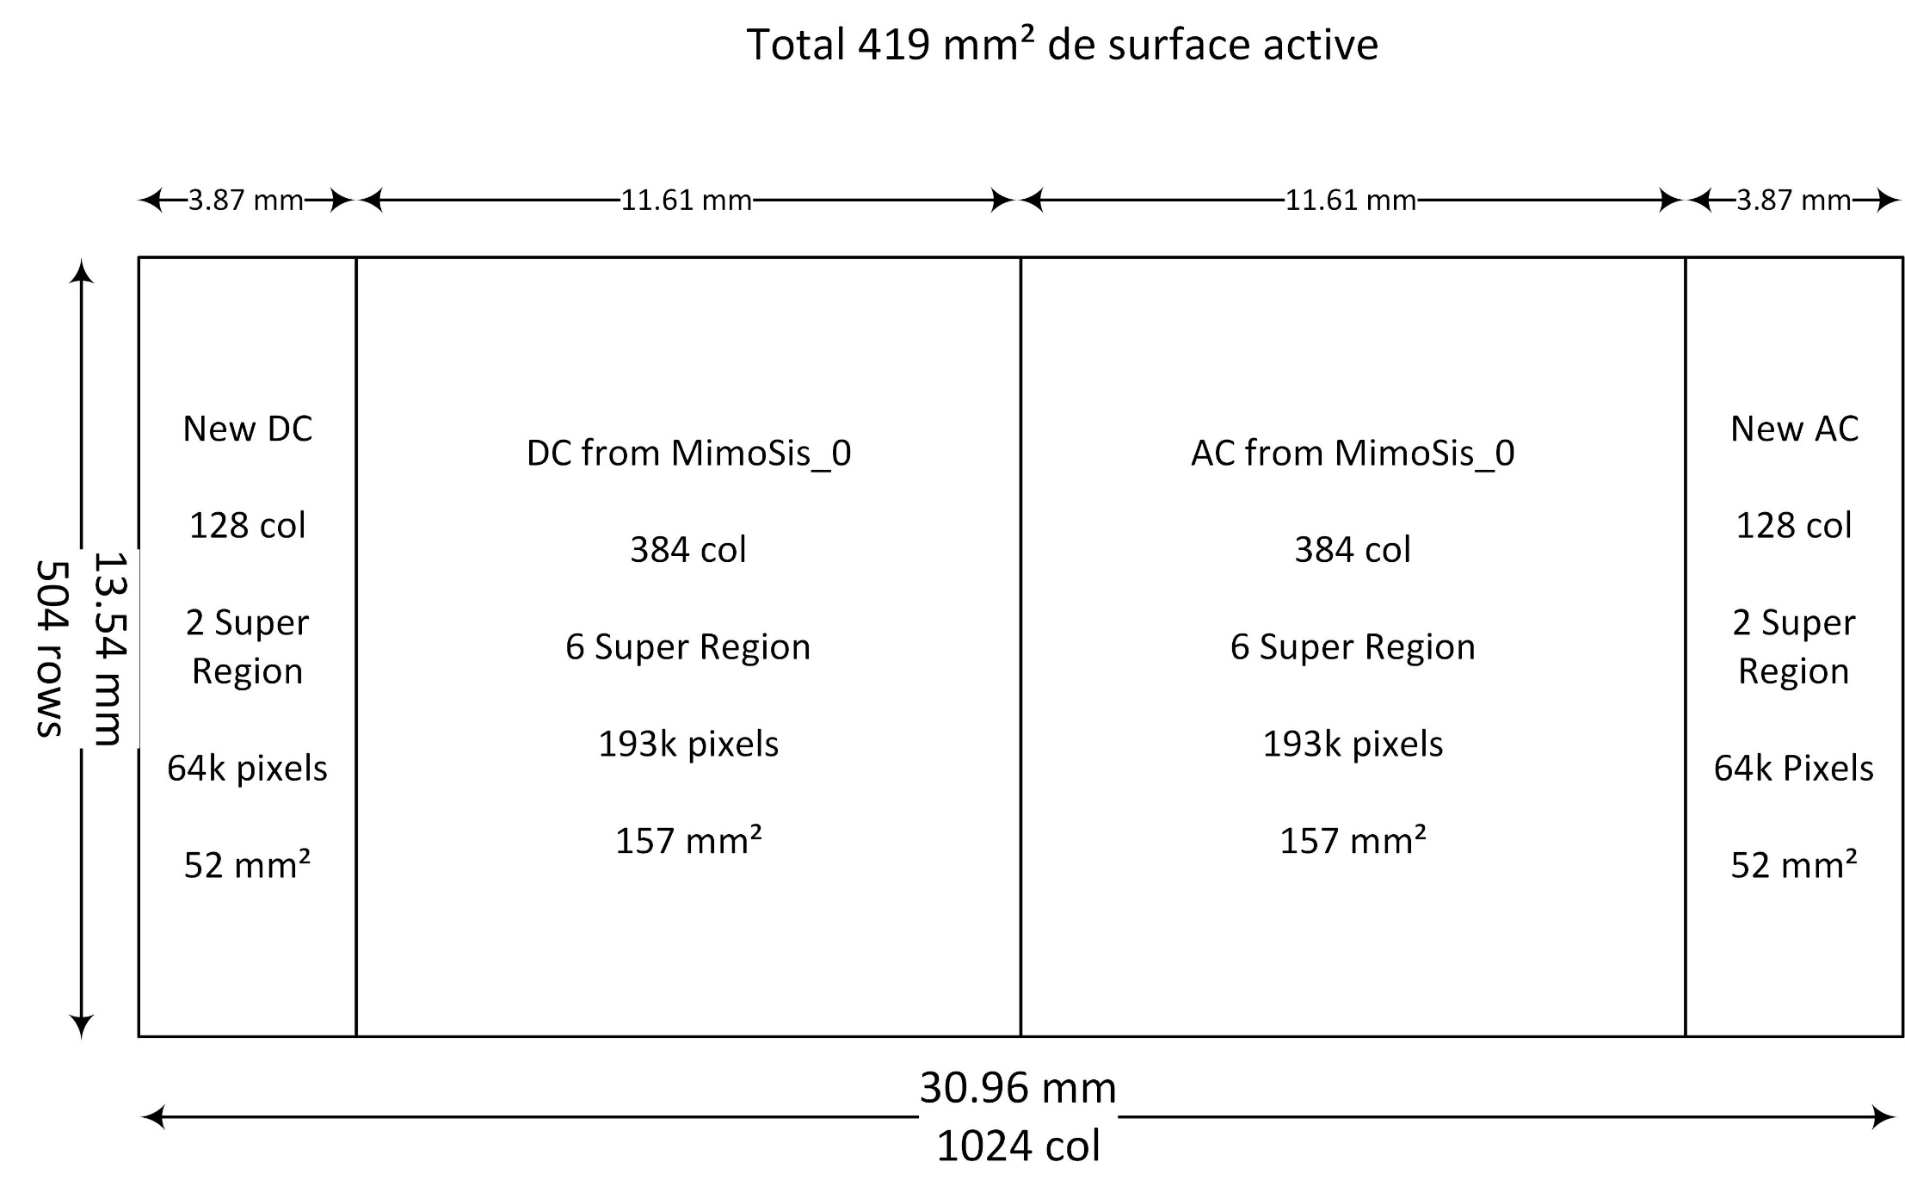

Slide 7
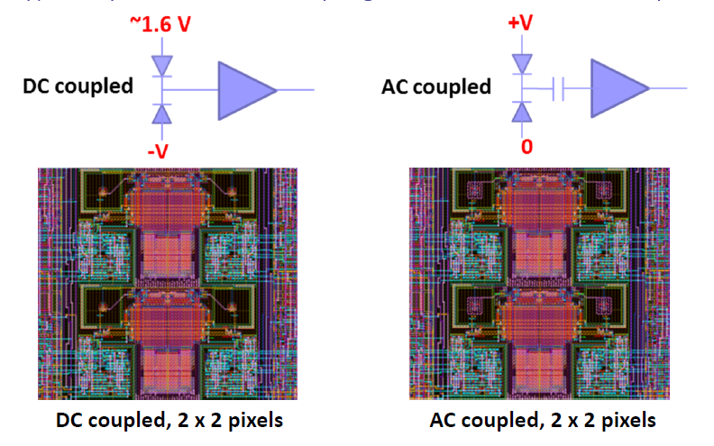
0 | 1
3 | 2
1007
0
1007
Pixel dimension: 26.88 µm (height) x 30.24 µm (width)
PE 0
PE 7
1 region = 8 Priority Encoder

Slide 8
ANALOG FRONT END AS MEMORY
ANAOUT[0]:
ANAOUT[1]
Reset : ~1 ms
OUT_D
Particle hit
2 us Peaking time
Pulse duration
PIX_IN
OUT_A
t1
t2
STATE
(Latch)
STROBE
Particle hit
ΔV = Q/C : ~ 10 ns
The front-end acts as an analogue delay line
  2 µs peaking time
When STROBE is asserted, the front-end binary output is latched into the pixel state register
Hit driven architecture
  Pixel state register readout by a zero suppression circuit based on priority encoding

Slide 9
