Slide 1
Summary on activities: Blockchain for Data Integrity, Quantum Optimization, and AI Middleware
Domingo Ranieri
INFN-CNAF, 20/02/2025
ICSC Italian Research Center on High-Performance Computing, Big Data and Quantum Computing
Missione 4 • Istruzione e Ricerca
Notes:
Cover

Slide 2
Innovation Grant: Interoperable Data Lake
WP4 Blockchain deployment on the ICSC Data Lake
Domingo Ranieri, Alessandro Costantini, Barbara Martelli

Slide 3
Interoperable Data Lake: Overview
The solution has been developed within the framework of an ICSC Innovation Grant with partners Leonardo, ThalesAlenia, INAF, and INFN.
Activity
A blockchain-based data management system that guarantees data immutability and reliability.
Adopting a combination of on-chain and off-chain data storage mechanisms to protect data.
Missione 4 • Istruzione e Ricerca
1

Slide 4
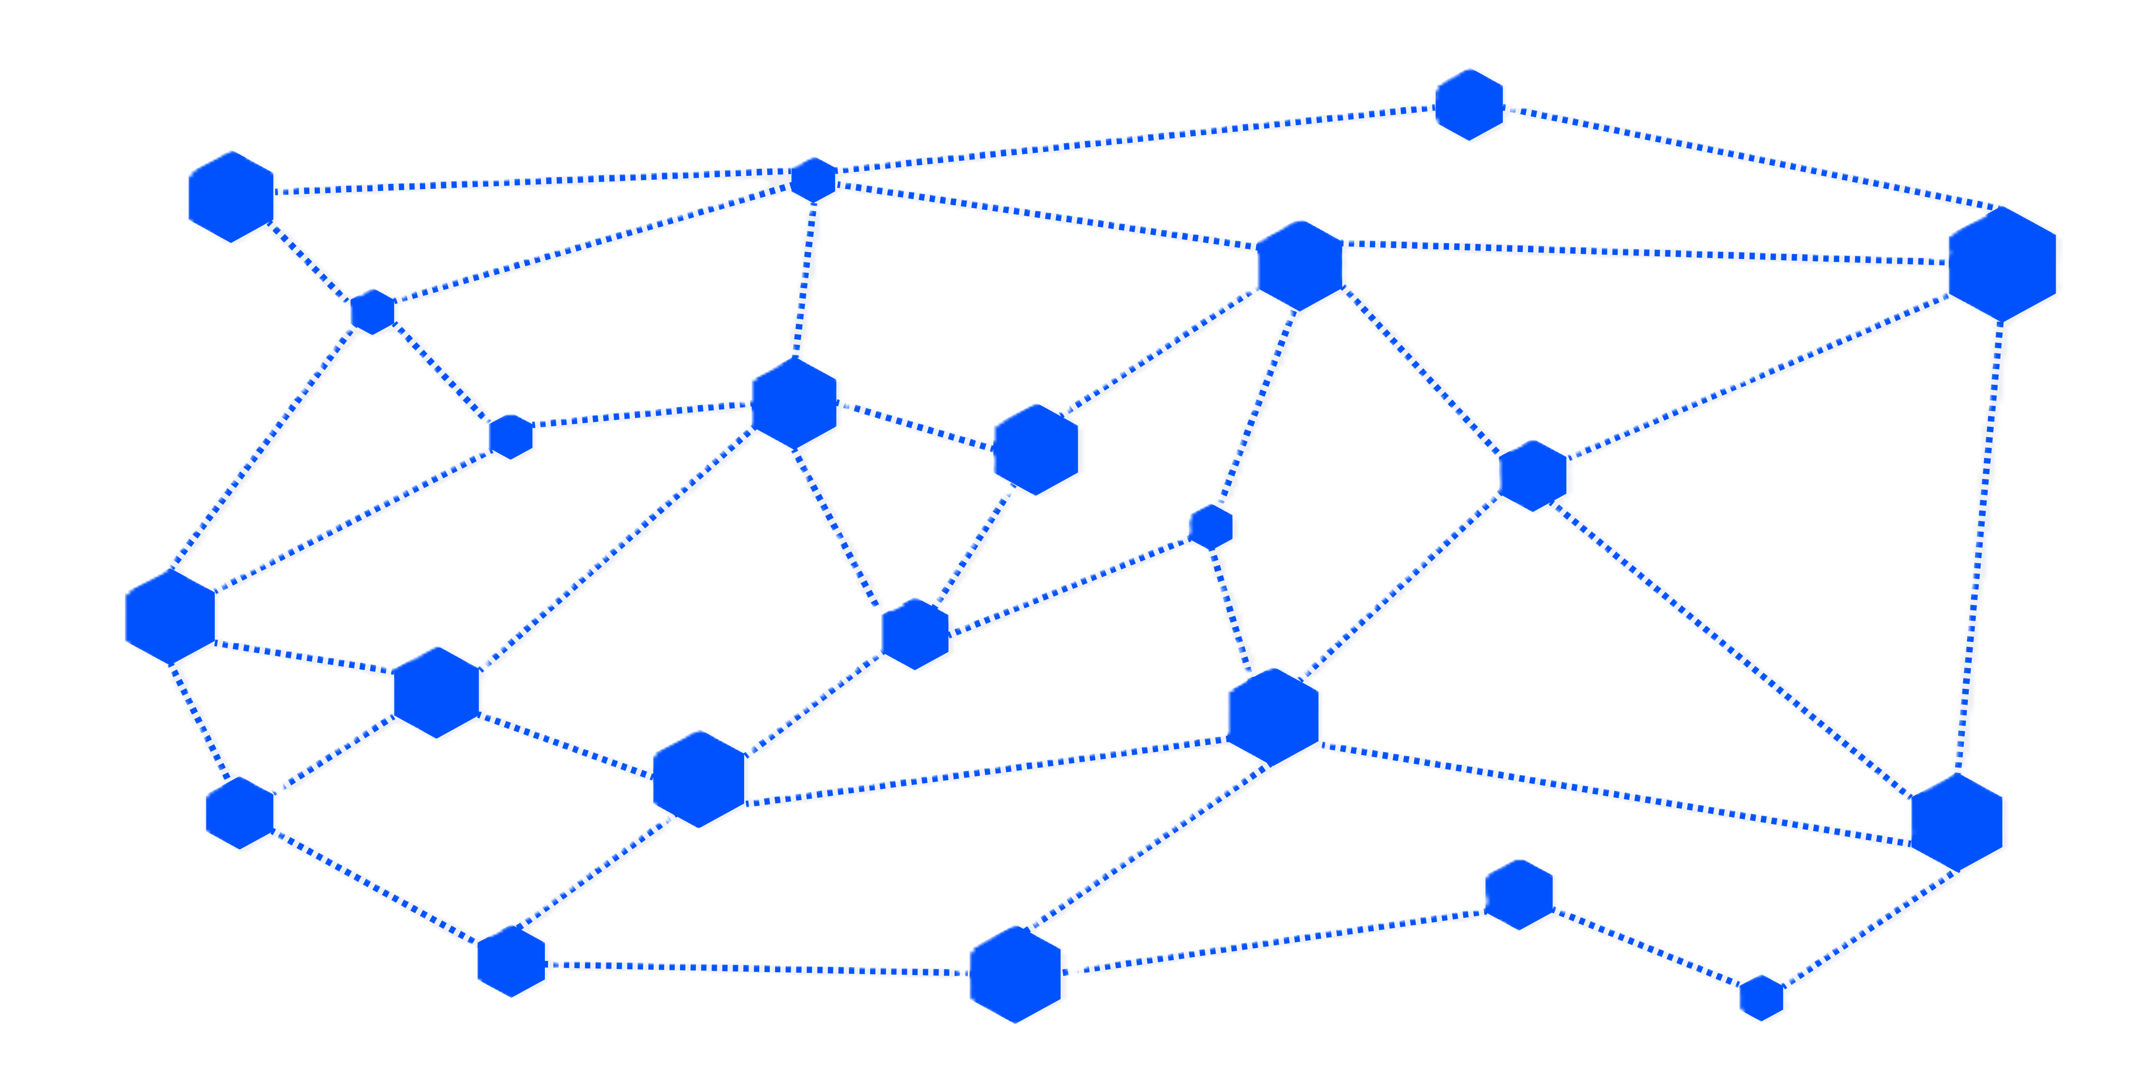
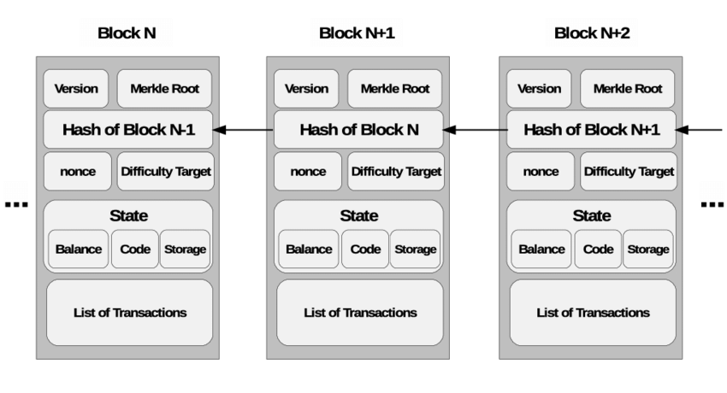
Blockchain Technology
Blockchain ensure data integrity and protection against unauthorized tampering leveraging cryptographic techniques .
Smart contracts automate predefined operations, reducing the risk of errors or disputes.
The results of these operations are saved in the Blockchain.
Missione 4 • Istruzione e Ricerca
2
Catania 12 Dic 2

Slide 5
Hyperledger Fabric
Hyperledger Fabric (HF) is an enterprise-level authorized distributed ledger platform. HF boasts a range of features:
Facilitates the development of smart contracts in multiple programming languages, including Go, JavaScript, and Java
Offers REST APIs for continuous communication with off-chain services
Modular architecture allows for the implementation and fine-tuning of specific requirements.
www.hyperledger-fabric.io
Missione 4 • Istruzione e Ricerca
3
Catania 12 Dic 3

Slide 6
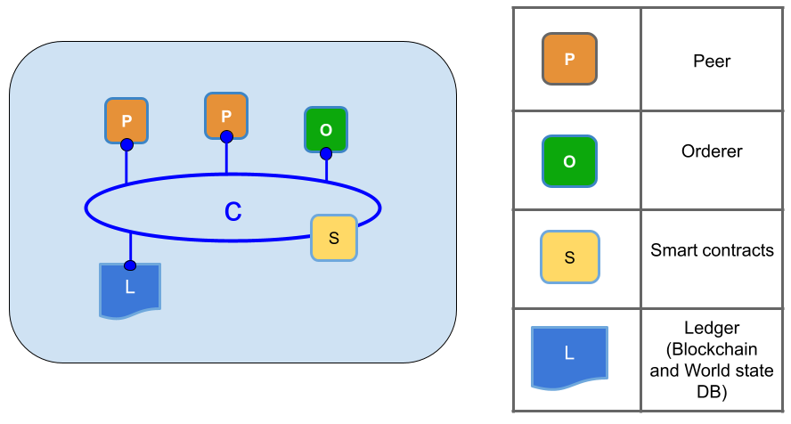
Blockchain Network
Currently, the network has:
2 peer nodes,
1 orderer node,
1 communication channel,
Consensus algorithm: Raft,
World state DB: LevelDB.
A smart contract is installed on the communication channel.
Missione 4 • Istruzione e Ricerca
4
Catania 12 Dic 4

Slide 7
Data Management Service Architecture
To allow the integration with the infrastructure developed by, we contributed to the developement of
DID-metadata plugin.
Used to save in blockchain relevant information about files during their upload.
Validation of the retrieved files using the information previously saved.
Blockchain
Missione 4 • Istruzione e Ricerca
5
Catania 12 Dic 5

Slide 8
Data Management Service Architecture
Upload
Blockchain stores SHA-256 hashes of data and metadata
Retrieve
Both metadata and data hashes are compared against blockchain stored hashes
Hashes are calculated at run time on the content of the files retrieved
Blockchain
Missione 4 • Istruzione e Ricerca
6
Catania 12 Dic 6

Slide 9
Beyond the project…

Slide 10
Traceability and reproducibility
The blockchain stores:
Metadata of data stored off-chain
Information about the operation performed
{"dataHash":"5c23dd087...068789ded69d",
"creationTimestamp":"1706659200",
"owner":"INFN",
"type":"raw",
"fromHash":"null",
"algorithmUsed":"null",
"version":0,
"executedBy":"INFN-UserID",
"operationTimestamp":"1706778000"}
Missione 4 • Istruzione e Ricerca
7
Catania 12 Dic 8

Slide 11
Traceability and reproducibility
After a processing step performed on the dataset store off-chain
{"dataHash":" 7h3g88sjl...sdvnsw342 ",
"creationTimestamp":"1706878200",
"owner":"INFN",
"type":" processed",
"fromHash":" 5c23dd087...068789ded69d ",
"algorithmUsed":" 48ffrsosl...bfenwienwcw",
"version":0,
"executedBy":"INFN-UserID",
"operationTimestamp":"1706885000"}
processing
Missione 4 • Istruzione e Ricerca
8
Catania 12 Dic 9

Slide 12
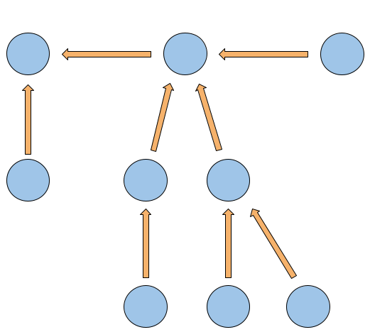
Traceability and reproducibility
versioning
Using metadata, it is possible to verify the validity of the data and reconstruct the workflow for processed data. By recording operational information, we enable transparent traceability, facilitating analysis and control.
processing
Missione 4 • Istruzione e Ricerca
9
Catania 12 Dic 10

Slide 13
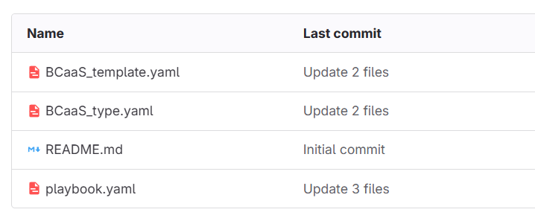
Blockchain as a Service
We have also developed the code to instantiate a Blockchain as a Service
Missione 4 • Istruzione e Ricerca
10
Catania 12 Dic 10

Slide 14
Simulation of a neuromuscular control using a quantum annealer
Domingo Ranieri, Barbara Martelli, Elisa Ercolessi, Marco Viceconti, Giorgio Davico, Alex Bersani, Claudio Sanavio

Slide 15
In previous episodes…
Link all’agenda: From Quantum Principles to Biomechanics: A Case Study on Muscular Activation (31 January 2025) · Agenda (Indico)
11
Missione 4 • Istruzione e Ricerca
Catania 12 Dic 4

Slide 16
Annealing process
Taking advantage of the quantum adiabatic theorem, if we can create a system in the ground state of a specific Hamiltonian, we can transform it in the Hamiltonian of our problem so we will end up in its ground state and find our solutions!
It is possible to set the annealing time and the number of annealing performed
12
Missione 4 • Istruzione e Ricerca
Catania 12 Dic 4

Slide 17
Annealing process
Any optimization problem can be reformulated into the task of minimizing a function.
In quantum annealing, this function is expressed as a Hamiltonian, which represents the total energy
of a quantum system.
The ground state of this Hamiltonian (its state of lowest energy) encodes the solution to the optimization problem.
This Hamiltonian can be written using Ising formulation or QUBO (Quadratic unconstrained binary optimization) formulation.
Ising formulation
QUBO formulation
13
Missione 4 • Istruzione e Ricerca
Catania 12 Dic 4

Slide 18
Problem formulation
The elbow joint primarily involves one degree of freedom, meaning its motion can be described by a single angular parameter.
However, this movement is controlled by multiple muscles, in our case we have five muscles (2 flexor and 3 extensors).
14
Missione 4 • Istruzione e Ricerca
Catania 12 Dic 4

Slide 19
Problem formulation
15
Missione 4 • Istruzione e Ricerca
Catania 12 Dic 4

Slide 20
Problem formulation
QUBO matrix
16
Missione 4 • Istruzione e Ricerca
Catania 12 Dic 4

Slide 21
Problem embedding
On the left we have the logical qubits and on the right the physical qubits
17
Missione 4 • Istruzione e Ricerca
Catania 12 Dic 4

Slide 22
Results
TIME INSTANT | BITSTRING SOLUTION | ENERGY | NUM OCCURRENCES
57 | (0, 1, 0, 0, 0, 1, 1, 0, 1, 0, 1, 0, 0, 1, 0 ) | -119.894 | 57
57 | (0, 0, 1, 0, 1, 0, 1, 0, 1, 0, 0, 0, 0, 1, 0) | -119.894 | 62
57 | (0, 1, 1, 0, 0, 0, 1, 0, 1, 0, 0, 0, 0, 1, 1) | -119.894 | 46
57 | (0, 0, 0, 0, 1, 1, 1, 0, 1, 0, 0, 0, 0, 1, 0) | -119.894 | 56
57 | (0, 0, 1, 0, 0, 1, 1, 0, 1, 0, 0, 0, 1, 1, 0) | -119.861 | 7
57 | (0, 0, 0, 0, 1, 0, 1, 0, 1, 0, 1, 0, 0, 1, 0) | -119.861 | 4
57 | (0, 1, 0, 0, 0, 0, 1, 0, 1, 0, 0, 0, 0, 1, 0) | -119.861 | 6
18
Missione 4 • Istruzione e Ricerca
Catania 12 Dic 4

Slide 23
Results
TIME INSTANT | BITSTRING SOLUTION | ENERGY | NUM OCCURRENCES
57 | (0, 1, 0, 0, 0, 1, 1, 0, 1…) | -119.894 | 57
57 | (0, 0, 1, 0, 1, 0, 1, 0, 1…) | -119.894 | 62
57 | (0, 1, 1, 0, 0, 0, 1, 0, 1…) | -119.894 | 46
57 | (0, 0, 0, 0, 1, 1, 1, 0, 1…) | -119.894 | 56
57 | (0, 0, 1, 0, 0, 1, 1, 0, 1…) | -119.861 | 7
57 | (0, 0, 0, 0, 1, 0, 1, 0, 1…) | -119.861 | 4
57 | (0, 1, 0, 0, 0, 0, 1, 0, 1…) | -119.861 | 6
19
Missione 4 • Istruzione e Ricerca
Catania 12 Dic 4

Slide 24
Results
TIME INSTANT | BITSTRING SOLUTION | ENERGY | NUM OCCURRENCES
57 | (0, 1, 0, 0, 0, 1, 1, 0, 1…) | -119.894 | 57
57 | (0, 0, 1, 0, 1, 0, 1, 0, 1…) | -119.894 | 62
57 | (0, 1, 1, 0, 0, 0, 1, 0, 1…) | -119.894 | 46
57 | (0, 0, 0, 0, 1, 1, 1, 0, 1…) | -119.894 | 56
57 | (0, 0, 1, 0, 0, 1, 1, 0, 1…) | -119.861 | 7
57 | (0, 0, 0, 0, 1, 0, 1, 0, 1…) | -119.861 | 4
57 | (0, 1, 0, 0, 0, 0, 1, 0, 1…) | -119.861 | 6
20
Missione 4 • Istruzione e Ricerca
Catania 12 Dic 4

Slide 25
Results
TIME INSTANT | BITSTRING SOLUTION | ENERGY | NUM OCCURRENCES
57 | (0, 1, 0, 0, 0, 1, 1, 0, 1…) | -119.894 | 57
57 | (0, 0, 1, 0, 1, 0, 1, 0, 1…) | -119.894 | 62
57 | (0, 1, 1, 0, 0, 0, 1, 0, 1…) | -119.894 | 46
57 | (0, 0, 0, 0, 1, 1, 1, 0, 1…) | -119.894 | 56
57 | (0, 0, 1, 0, 0, 1, 1, 0, 1…) | -119.861 | 7
57 | (0, 0, 0, 0, 1, 0, 1, 0, 1…) | -119.861 | 4
57 | (0, 1, 0, 0, 0, 0, 1, 0, 1…) | -119.861 | 6
21
Missione 4 • Istruzione e Ricerca
Catania 12 Dic 4

Slide 26
Results
Number of qubits per activation: 3, antagonists muscles decoupled
22
Missione 4 • Istruzione e Ricerca
Catania 12 Dic 4

Slide 27
Results
Number of qubits per activation: 5, antagonists muscles decoupled
23
Missione 4 • Istruzione e Ricerca
Catania 12 Dic 4

Slide 28
Results
Number of qubits per activation: 8, antagonists muscles decoupled
24
Missione 4 • Istruzione e Ricerca
Catania 12 Dic 4

Slide 29
Implementation of AI-Ranker service on INFN DataCloud Orchestrator
Domingo Ranieri, Luca Giommi, Giovanni Savarese Gioacchino Vino, Alessandro Costantini,

Slide 30
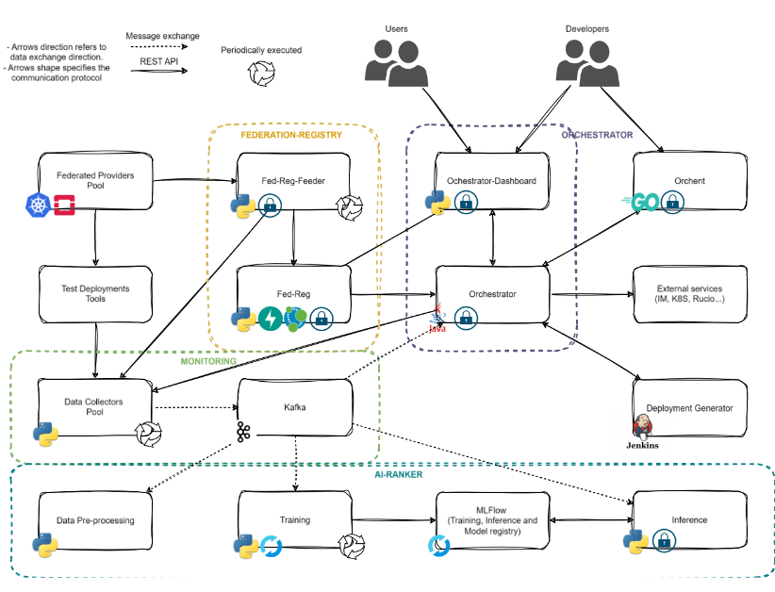
25
Missione 4 • Istruzione e Ricerca
Catania 12 Dic 4

Slide 31
Training : preprocessing
Fed-Reg-Feeder
Monitoring
Kafka queue
Ai-ranker-training
Preprocessing
Tosca Template of the
Deployment
26
Missione 4 • Istruzione e Ricerca
Catania 12 Dic 4

Slide 32
Training : preprocessing
Example of ai-ranker-training message
{
"gpus_requ": 0.0,
"images": 1.0,
"provider_name": "RECAS-BARI",
"ram_gb_quota": 100.0,
"ram_gb_requ": 12.0,
"ram_gb_usage": 42.0,
.
.
.
"region_name": "RegionOne",
"test_failure_perc_30d": 0.0,
"test_failure_perc_7d": 0.0,
"test_failure_perc_1d": 0.0,
"template_name": "Cluster Kubernetes",
"timestamp": "2025-01-09 16:03:41.000000",
"usr_group": "admins/beta-testers",
"uuid": "11efce9a-e980-4e69-ad15-0242e34b7d6d",
"flavour_exact": "False",
"overbooking_ram":1.2,
"overbooking_cores":4.0,
"n_failures": 2,
"tot_failed_time": 123,
"completed_time": 50,
"status": "CREATE_COMPLETED",
"status_reason": "MESSAGGIO"}
27
Missione 4 • Istruzione e Ricerca
Catania 12 Dic 4

Slide 33
Training : preprocessing
avg_deployment_time: the average time a specific type of successful deployment takes to be completed
by a particular provider within a given timeframe.
failure_percentage: the percentage of failures recorded for a specific type of deployment by
a particular provider within a given timeframe.
Differences: For CPU, RAM, number of instances, storage space, volumes, and floating IPs, the differences
are calculated between the project's assigned quota, the amount already used,
and the requested quantity.
28
Missione 4 • Istruzione e Ricerca
Catania 12 Dic 4

Slide 34
Training
Preprocessing
Training script
Mlflow
Two models are trained:
Classification model: Predicts the probability of deployment success or failure.
Regression model: Estimates the deployment time.
29
Missione 4 • Istruzione e Ricerca
Catania 12 Dic 4

Slide 35
Inference
Fed-Reg-Feeder
Monitoring
Kafka queue
Ai-ranker-inference
Preprocessing
Tosca Template of the
Deployment
Kafka queue
Ai-ranker-training
30
Missione 4 • Istruzione e Ricerca
Catania 12 Dic 4

Slide 36
Inference : preprocessing
{
"providers": [
{
"provider_name": "BACKBONE",
"region_name": "cnaf",
.
.
},
{
"provider_name": "BACKBONE",
"region_name": "bari",
.
.
}],
Example of ai-ranker-inference message
"template_name": "Cluster Kubernetes",
"timestamp": "2025-01-09 16:03:41.000000",
"user_group": "admins/beta-testers",
"uuid": "11efce9a-e980-4e69-ad15-0242e34b7d6d"
}
31
Missione 4 • Istruzione e Ricerca
Catania 12 Dic 4

Slide 37
Inference : preprocessing
Calculated from the data in the Kafka queue ai-ranker-training
avg_deployment_time: the average time a specific type of successful deployment takes to be completed
by a particular provider within a given timeframe.
failure_percentage: the percentage of failures recorded for a specific type of deployment by
a particular provider within a given timeframe.
Calculated from the data in the Kafka queue ai-ranker-inference
Differences: For CPU, RAM, number of instances, storage space, volumes, and floating IPs, the differences
are calculated between the project's assigned quota, the amount already used,
and the requested quantity.
32
Missione 4 • Istruzione e Ricerca
Catania 12 Dic 4

Slide 38
Inference
Mlflow
Preprocessing
Inference script
Kafka queue
Messaggio con i provider rankati
33
Missione 4 • Istruzione e Ricerca
Catania 12 Dic 4

Slide 39
Thank you for your attention
Domingo.ranieri@cnaf.infn.it

