Slide 1
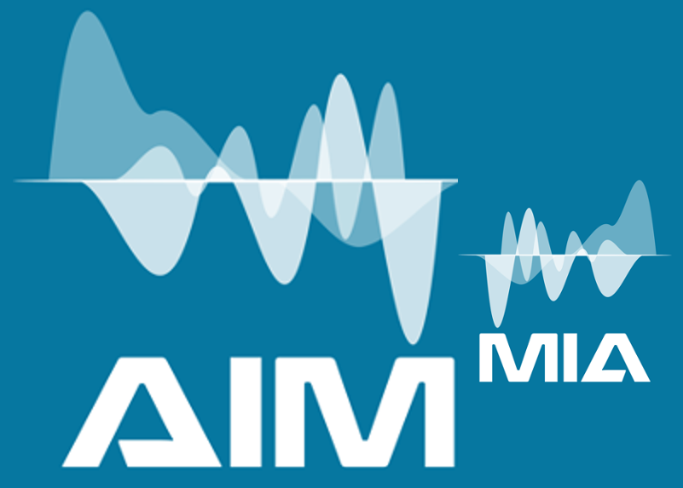
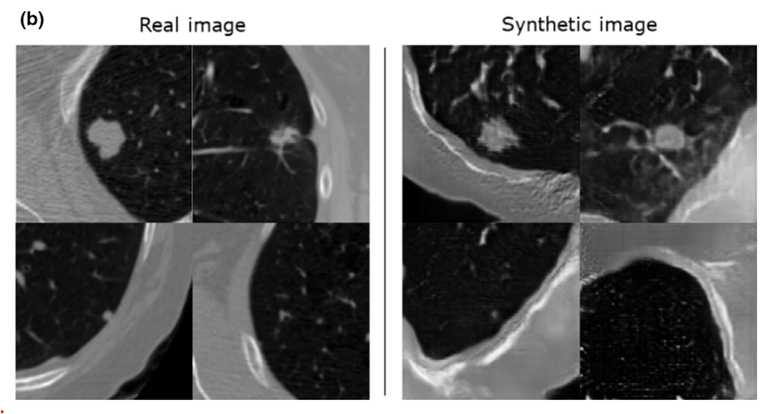
T.2.2 GAN for Medical Image Augmentation
GAN diagram
Find the GAN architecture based on image type and desired augmentation;
Training of the GAN to ensure the generator produces realistic samples,
Generate the augmented data,
Evaluation of GAN augmented datasets (Inception Score, FID, visual inspection).

Slide 2
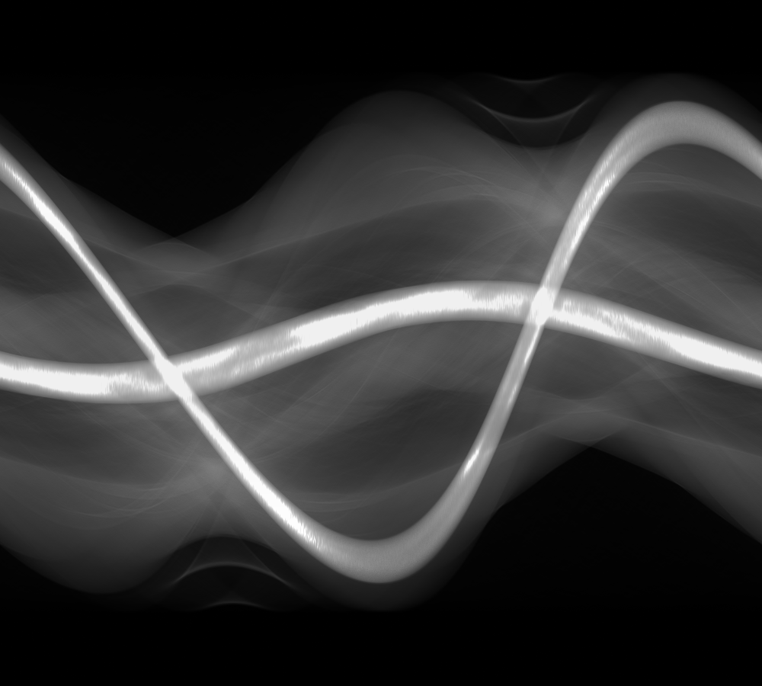
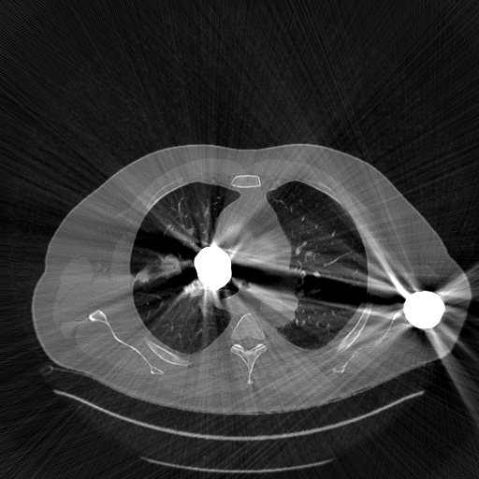
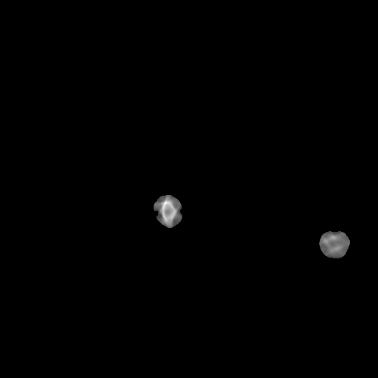

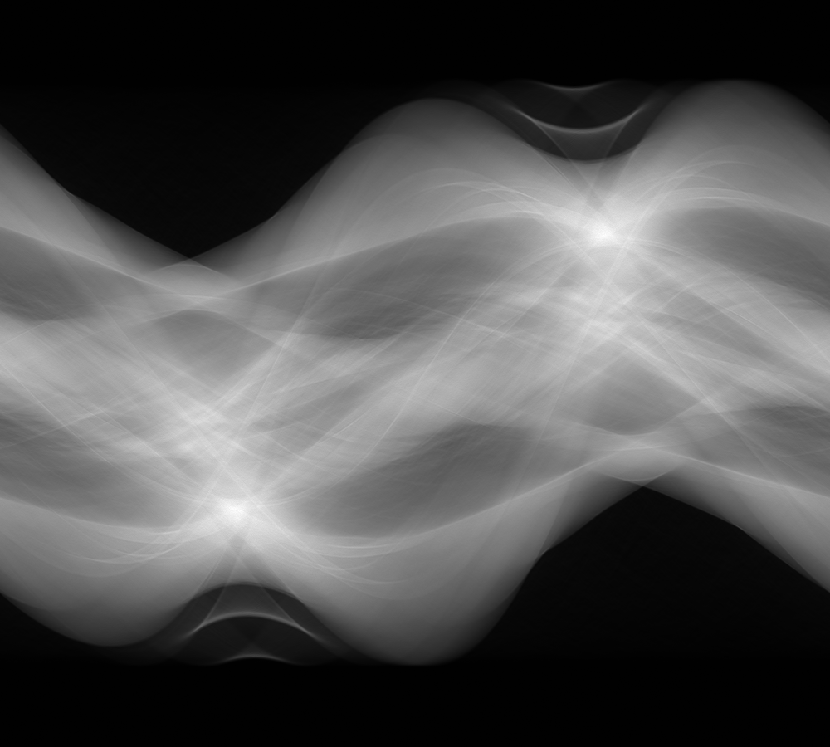
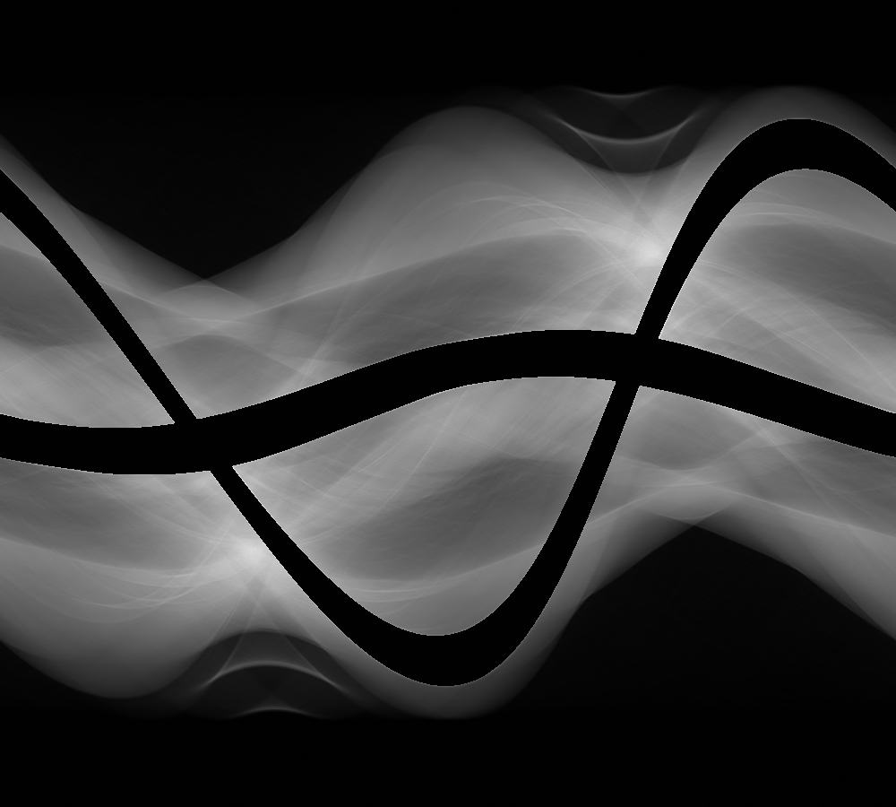
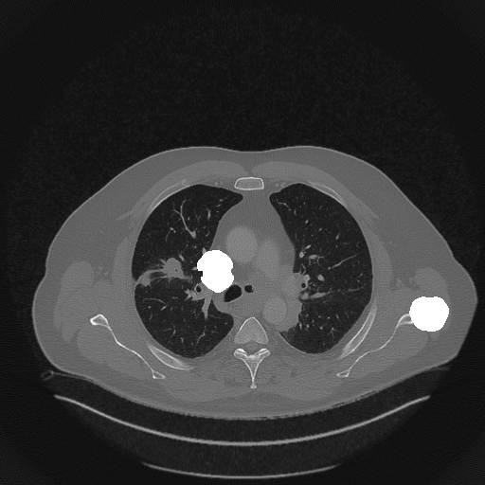
Metal Artifacts Reduction (MAR)
Metal corrupted
sinogram
Metal artifacts
Metal segmentation
Sinogram Mask
FBP
Sinogram Mask
Interpolation (LI-MAR, N-MAR)
Patch based inpainting
DL inpainting
….
How to impaint the missing part of sinogram?

Slide 3
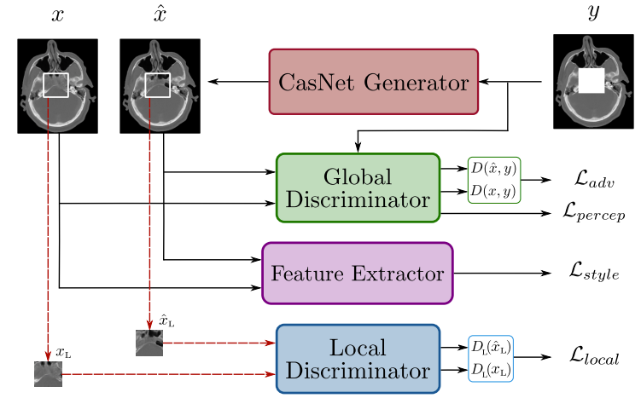
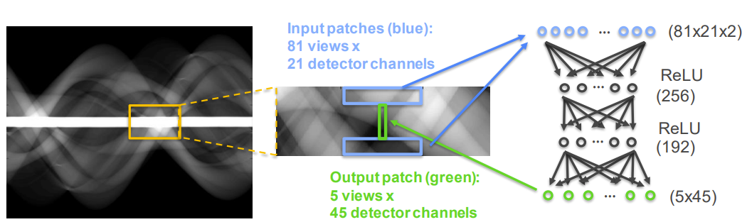
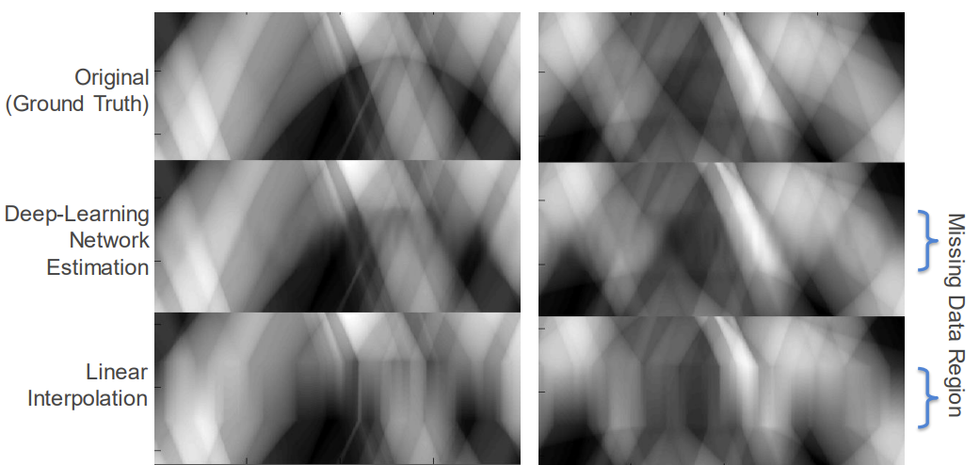
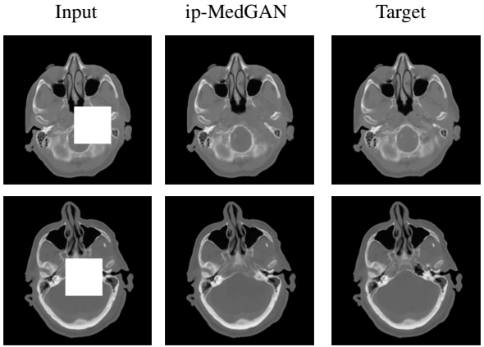
T.2.3 Data inpainting with CNN
Predict the missing part of the image information based on the remaining part of the image information.
Development of deep learning methods for inpainting sinograms affected by metallic implant problems.
Sinogram with missing data
ADVERSARIAL INPAINTING OF MEDICAL IMAGE MODALITIES, Karim Armanious, Youssef Mecky Sergios Gatidis, Bin Yang, ICASSP-2019
Metal-Artifact Reduction Using Deep-Learning Based Sinogram Completion: Initial Results, Bernhard E. H. Claus, Yannan Jin, Lars A. Gjesteby, Ge Wang, Bruno De Man, Fully3D-2017

