Slide 1
Artificial Intelligence in Medicine:
focus on Multi-Input Analysis
Data Platform
Camilla Scapicchio
INFN
Sezione di Pisa
Meeting di Avvio Progetto 13-02-2025

Slide 2
Outline
Introduction to XNAT
XNAT @ INFN: Infrastructure details→ A. Formuso
Platform Configuration in AIM_MIA
Operational Steps and Discussion
Outline
Introduction to XNAT
XNAT @INFN
Platform configuration in AIM_MIA
Operational Steps and Discussion

Slide 3
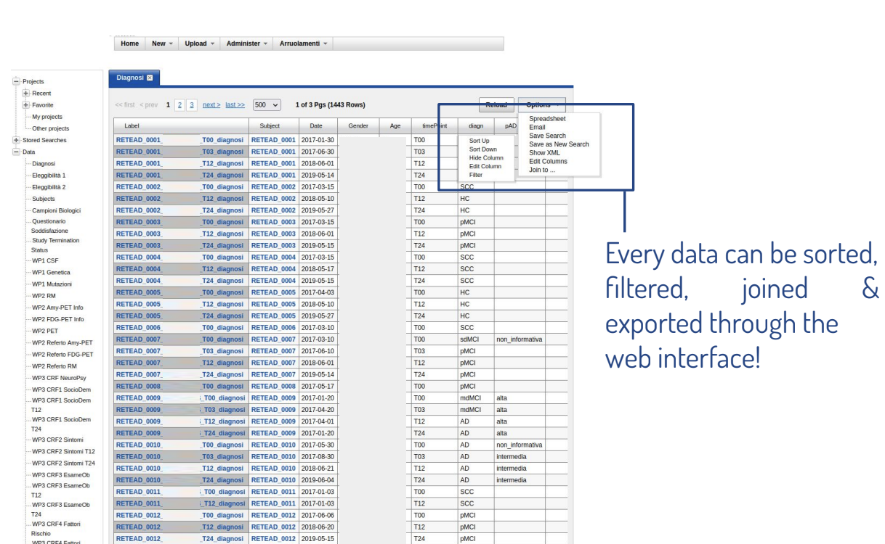
Introduction to XNAT
XNAT is an open-source imaging informatics software platform dedicated to helping you perform imaging-based research.
https://wiki.xnat.org/documentation/
Outline
Introduction to XNAT
XNAT @INFN
Platform configuration in AIM_MIA
Operational Steps and Discussion

Slide 4
Introduction to XNAT
Upload Data. Importing DICOM image data and metadata; customizable forms for direct entry of clinical or psychometric data; and ZIP-enabled uploaders for archived data of all kinds.
Organize and Share your Data. All data associated with a user-defined project. Users are given access to data on a project-by-project basis. Possible configuration of different types of projects.
Outline
Introduction to XNAT
XNAT @INFN
Platform configuration in AIM_MIA
Operational Steps and Discussion
View and Download your Data. Online image viewer that supports a number of common formats. The viewer can be extended to support additional formats and to generate custom displays.
Securing and Managing Access to Data. Quality control procedures and secure ways to access your data. Data can be entered into the archive as XML or through data entry forms.
Search and Explore Large Data Sets. A usable web interface which allows you to store, retrieve, navigate and query data.
Run Complex Processing on your Data, using High-powered Computing. XNAT includes a powerful pipeline engine that allows for the programming of complex workflows. API allows you to leverage high-powered computing clusters to perform these processes.
Extensibility --> You can configure XNAT in different ways to support your data management and project management needs.

Slide 5
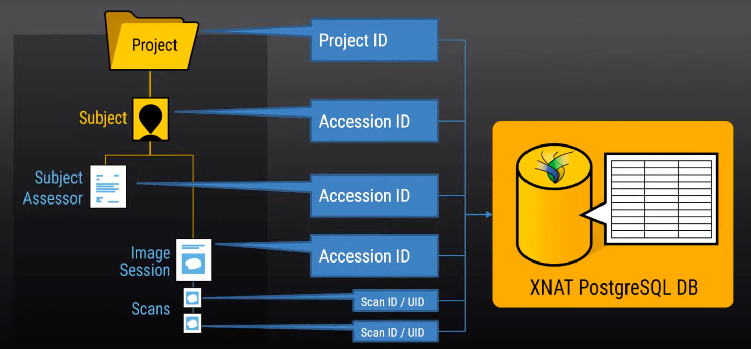
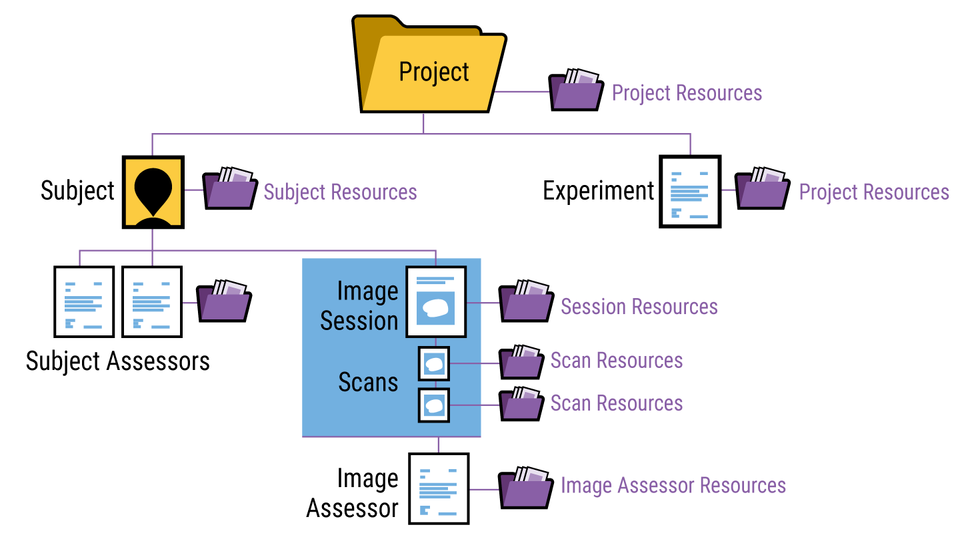
Introduction to XNAT
XNAT Data Model
● XNAT’s data structure is defined in a series of XML schema documents (XSDs)
Outline
Introduction to XNAT
XNAT @INFN
Platform configuration in AIM_MIA
Operational Steps and Discussion
● 3 core data types: Project, Subjects, Experiments
● XNAT’S XSD is endlessly extensible. It is possible to create new XNAT data types.
Notes:
A project is used to define a collection of data stored in XNAT. These often correlate directly to an IRB-approved study, or a multi-site data acquisition program. Data is assigned to certain projects.
A subject is anyone who participates in a study. XNAT has traditionally focused on human studies. However, in practice, a subject could be a non-human subject as well. A subject cannot exist outside the context of a project. Subjects can be shared with other projects (to capture longitudinal data from various studies).
An experiment is an event by which data is acquired. An experiment cannot exist outside the context of a project. It is owned by the project which first added it. It can additionally be shared into other projects. Experiments are usually extended within XNAT to be specific kinds of experiments.
A subject assessor is a specific kind of experiment which is associated with a subject. Only one extension of subject assessors is provided in the default XNAT install (Image Session). However, many XNAT installations create their own subject assessors to model a variety of subject tests, forms, etc.
Resources: additional files that are associated with something (e.g. image file, pdf, or other background reference document), but NOT SEARCHABLE

Slide 6
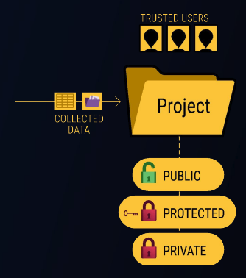
Per-project user permissions
Public
All XNAT users will be able to view or download your project and its data. Owners of other XNAT projects can share your data into their studies.
Outline
Introduction to XNAT
XNAT @INFN
Platform configuration in AIM_MIA
Operational Steps and Discussion
Protected
All XNAT users will be able to see your project title and description, but only users assigned by project owners will be able to access its data.
Private
Only XNAT users assigned by project owners will be able to see the project in XNAT, or access its data.
You can change your project's access settings at any time.

Slide 7
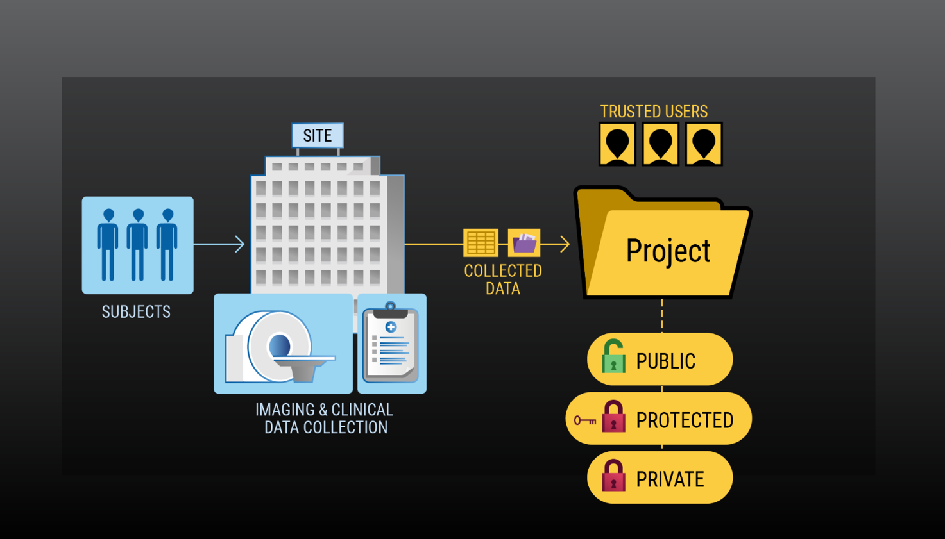
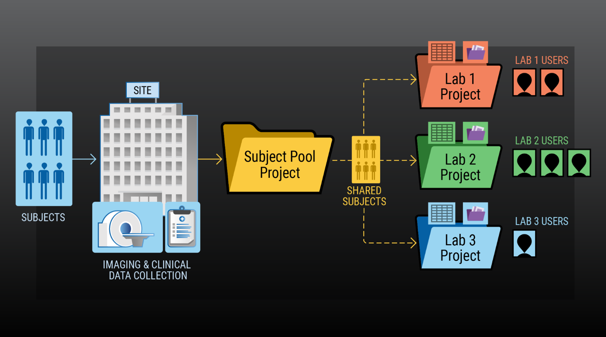
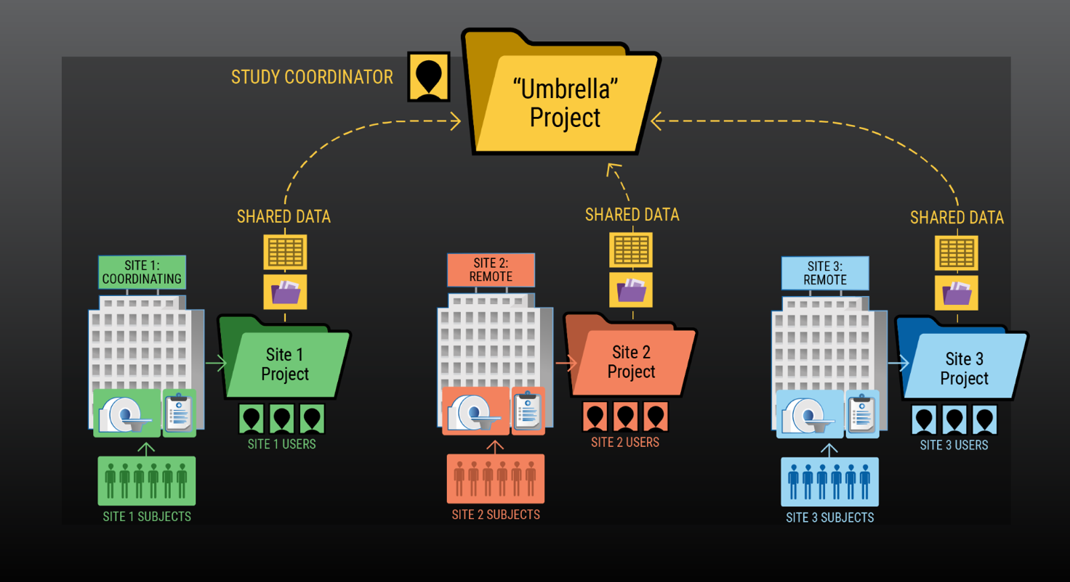
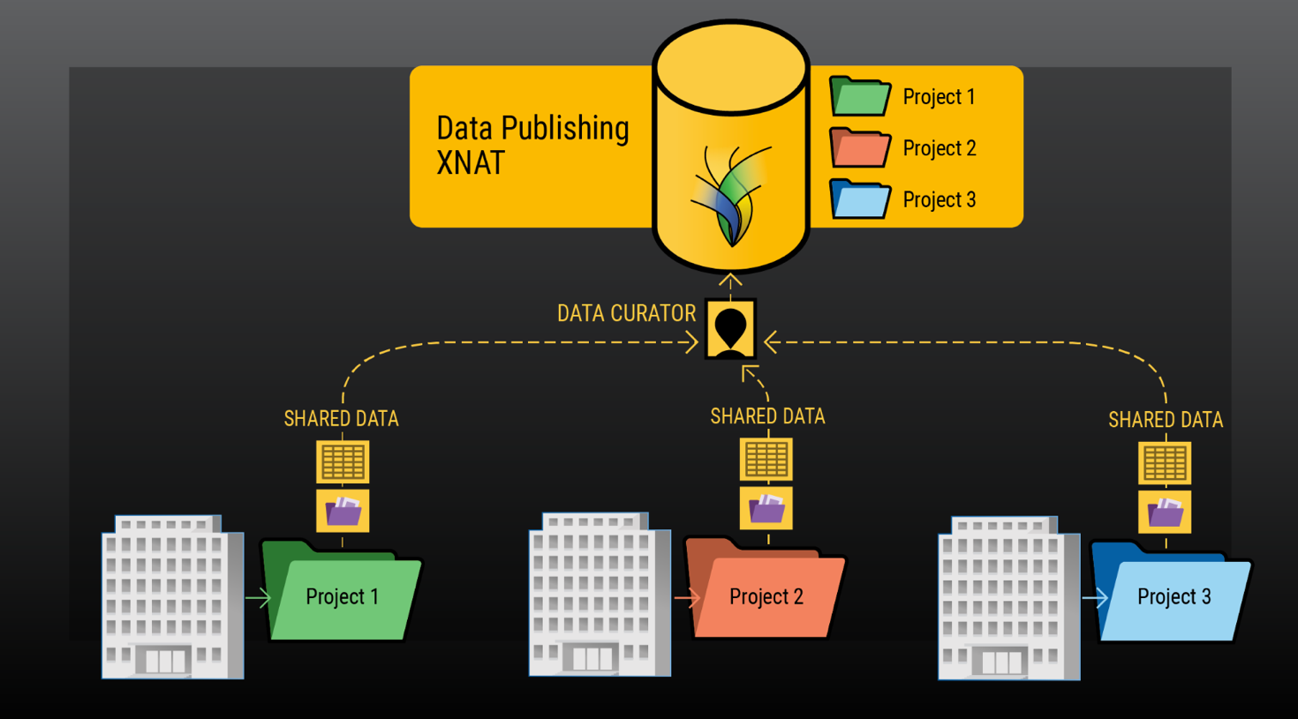
Project types in XNAT
Single Project
Shared Subject Pools
Outline
Introduction to XNAT
XNAT @INFN
Platform configuration in AIM_MIA
Operational Steps and Discussion
Umbrella projects
Published Data project
Notes:
Single Project:
Your study is not directly related to any other study.
All your data is being collected at a single site.
All your collaborators are known to you and/or trusted by you.
Setting up this single project doesn't preclude you from sharing your data in the future
Shared Subject Pools
A set of subjects that have been recruited for multiple related studies (e.g. in a clinical trial setting).
Particularly useful in longitudinal studies where newly collected data can be compared over time to what's been collected already.
Umbrella Projects
A multi-site study where subjects are being recruited for data collection at multiple physical sites.
Each site will have a set of users that's responsible for its own data-gathering. And, a central study coordinator will be responsible for making sure that completed data sets are shared into a central aggregation project, which is sometimes called an "umbrella project."
This kind of project structure doesn't just apply to data that's coming from two different locations on a map. It could apply to a single institution that's gathering data from multiple types of scanners.
Published Data Project
This is particularly useful in comparative research studies where multiple institutions collect data over time following a common research protocol and then publish their data to allow for comparison and new findings.
A central XNAT that is focused on data publishing, and a data curation team that administers it.
Data can be gathered in one or more additional XNAT instances by each of these study sites.
Each study can decide which of its collected data to share, and which data to keep private.

Slide 8
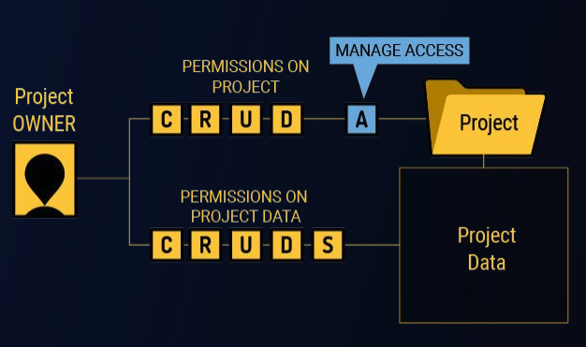
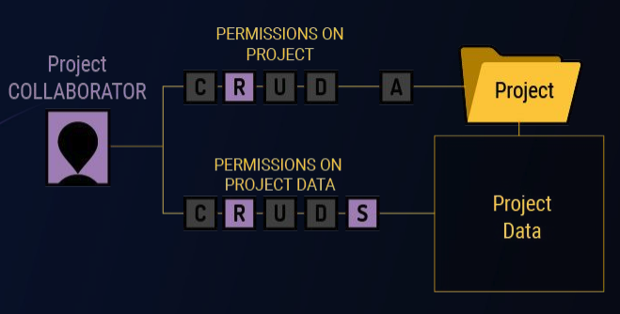
User permissions
● Data access governed at 3 levels: site-wide, per-project, per-user
● 5 activities: Create, Reade, Update, Delete, Share
● 3 default permissions group: Owner, Member, Collaborator
Collaborator: view-only
Member: view, create, edit, execute pipelines
Owner: view, create, edit, delete, execute pipelines, add pipelines to project, grant user access, configure project
● Anyone who’s been added to your project can then share your project data into their project
Outline
Introduction to XNAT
XNAT @INFN
Platform configuration in AIM_MIA
Operational Steps and Discussion

Slide 9
XNAT Plugins
The primary recommended method for extending XNAT functionality is via plugins. A plugin is a compiled, self-contained package separate from your XNAT server but installed into the XNAT plugins folder.
Outline
Introduction to XNAT
XNAT @INFN
Platform configuration in AIM_MIA
Operational Steps and Discussion
The XNAT plugin framework gives you the tools to:
Add and configure XNAT data types
Create new user interface elements or extend existing ones
Create new services
…
XNAT Core Plugins: https://www.xnat.org/download/
https://wiki.xnat.org/documentation/developing-xnat-plugins
https://wiki.xnat.org/documentation/deploying-plugins-in-xnat

Slide 10
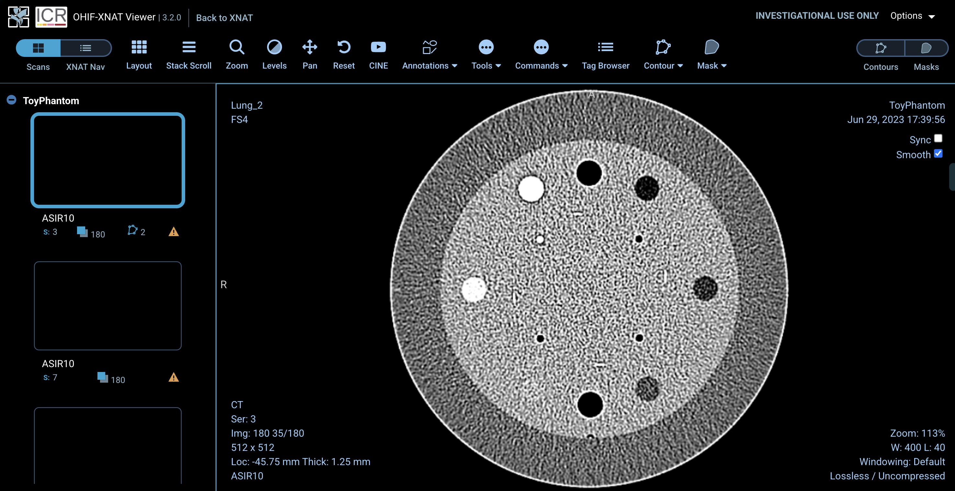
XNAT Plugins
Example: XNAT OHIF Viewer
Outline
Introduction to XNAT
XNAT @INFN
Platform configuration in AIM_MIA
Operational Steps and Discussion

Slide 11
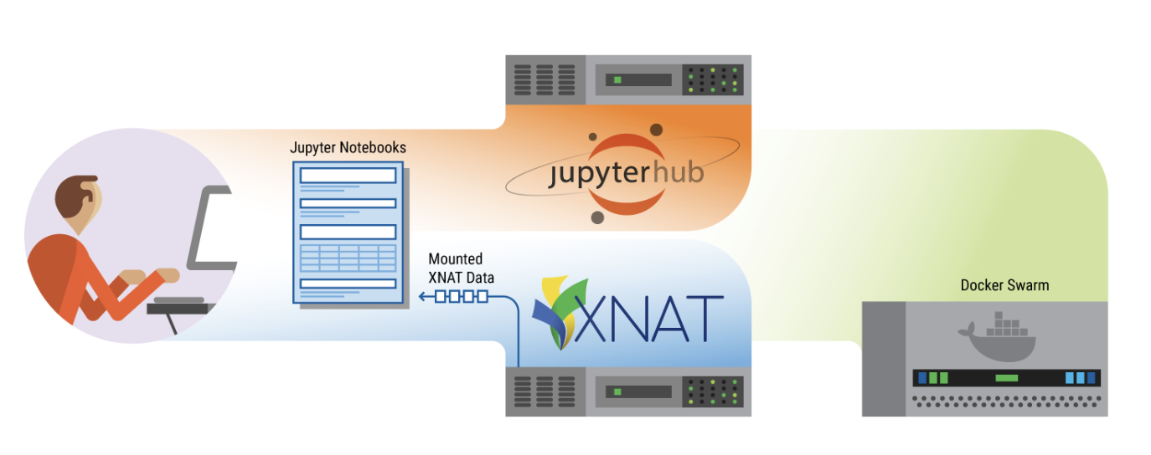
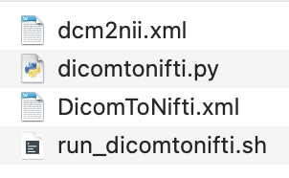
Pipeline
Different methods to launch an analysis pipeline on the data in xnat: Plugin, JupiterHub, pyxnat, docker container, pipeline engine
Outline
Introduction to XNAT
XNAT @INFN
Platform configuration in AIM_MIA
Operational Steps and Discussion
Example of integrated pipeline: Dicom to Nifti

Slide 12
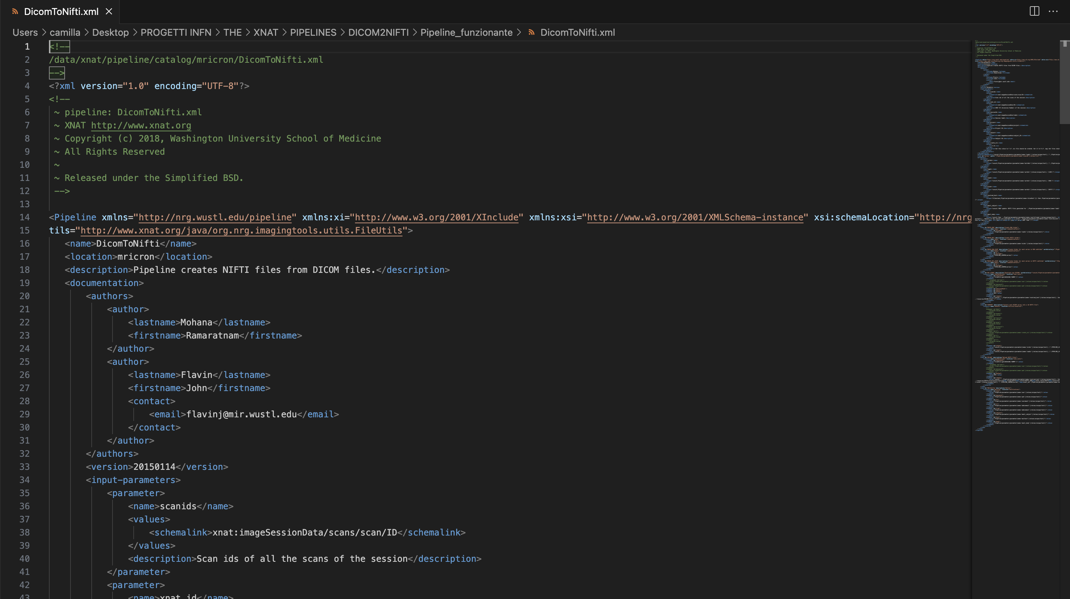
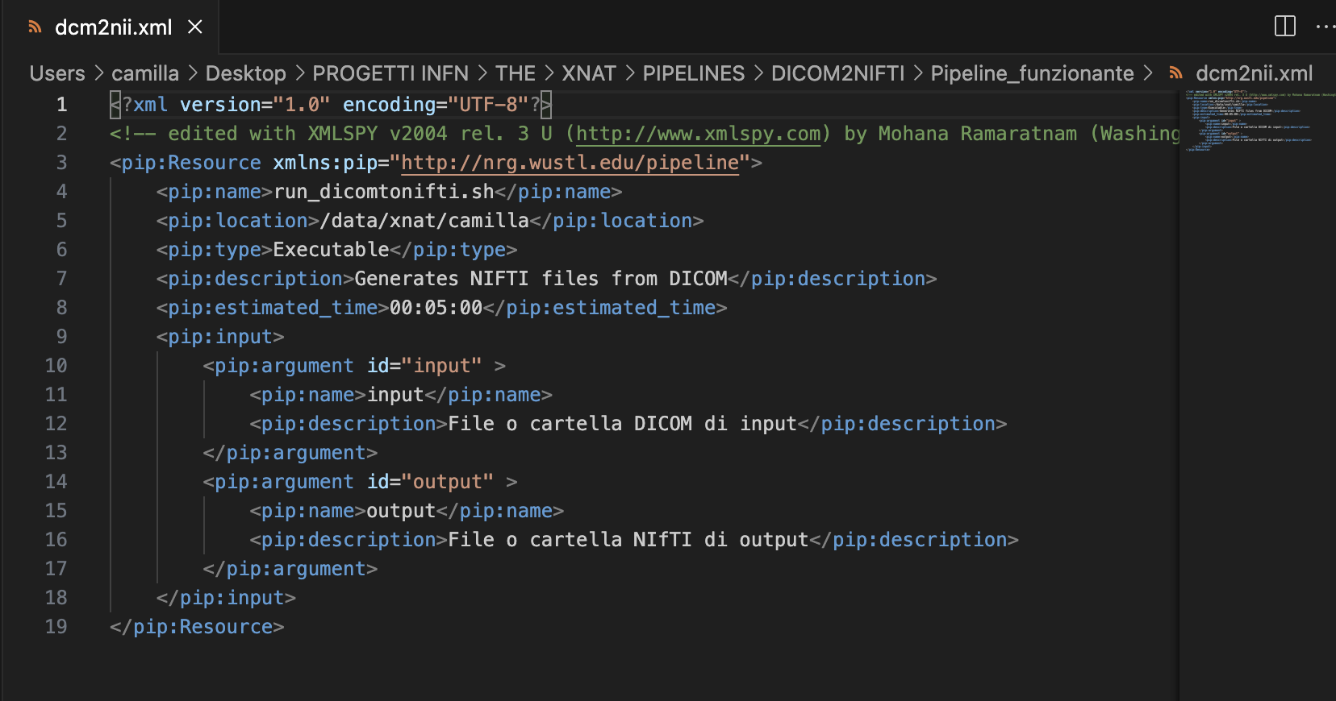
XNAT @INFN: Demo
Outline
Introduction to XNAT
XNAT @INFN
Platform configuration in AIM_MIA
Operational Steps and Discussion

Slide 13
XNAT @INFN
We have already installed XNAT on the INFN Pisa machines.
Outline
Introduction to XNAT
XNAT @INFN
Platform configuration in AIM_MIA
Operational Steps and Discussion
https://xnat.pi.infn.it/
Infrastructure details
Antonino Formuso

Slide 14
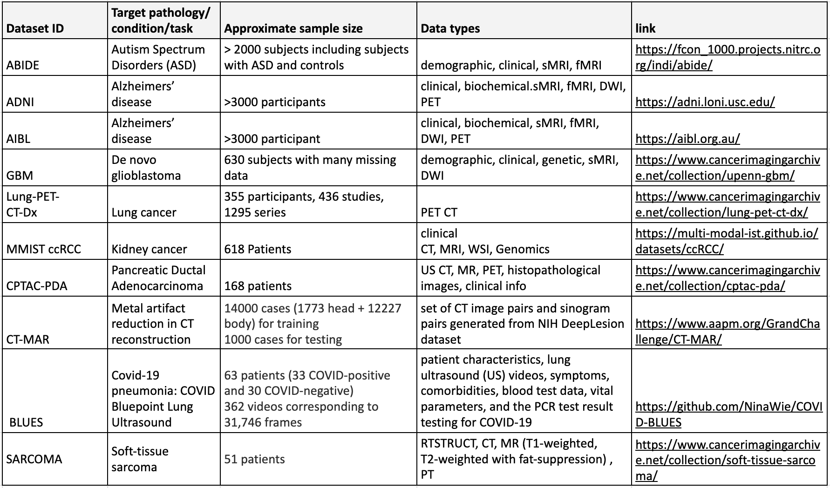
AIM_MIA platform configuration
XNAT is suitable for handling heterogeneous data and multiple data associated with a subject (AIM_MIA)
Outline
Introduction to XNAT
XNAT @INFN
Platform configuration in AIM_MIA
Operational Steps and Discussion

Slide 15
Operational Steps- Discussion
Referenti sede per sede (almeno un amministratore che gestisce il progetto)
Qualcuno che si interessa alla parte di sviluppo?
Template di descrizione del Progetto: https://docs.google.com/document/d/1_ksuMG8sXzI9J6z7_iCGxE-aezlwnpulZWjbRe7BDxw/edit?tab=t.0
Progetti pubblici, se si vogliono creare progetti privati, contattarci per chiarire le motivazioni (dati privati al momento non si possono caricare!)
Outline
Introduction to XNAT
XNAT @INFN
Platform configuration in AIM_MIA
Operational Steps and Discussion

Slide 16
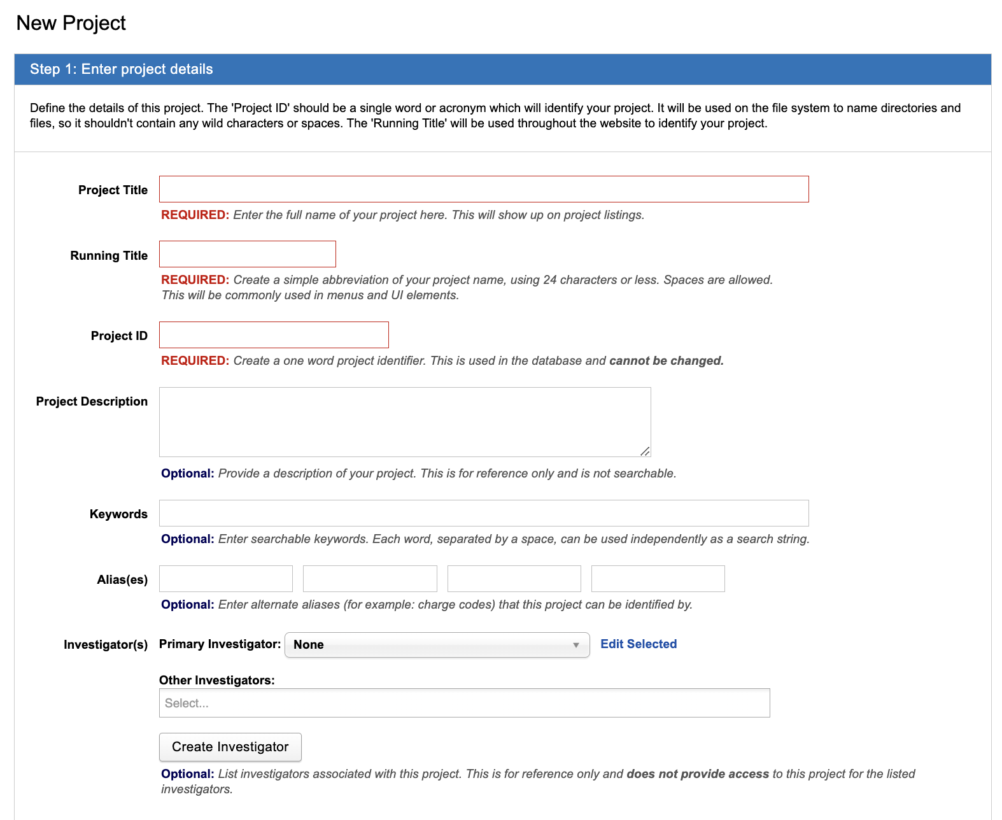
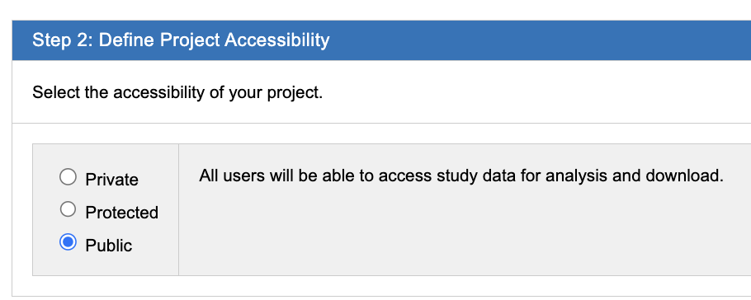
XNAT @INFN: Demo
Outline
Introduction to XNAT
XNAT @INFN
Platform configuration in AIM_MIA
Operational Steps and Discussion

Slide 17
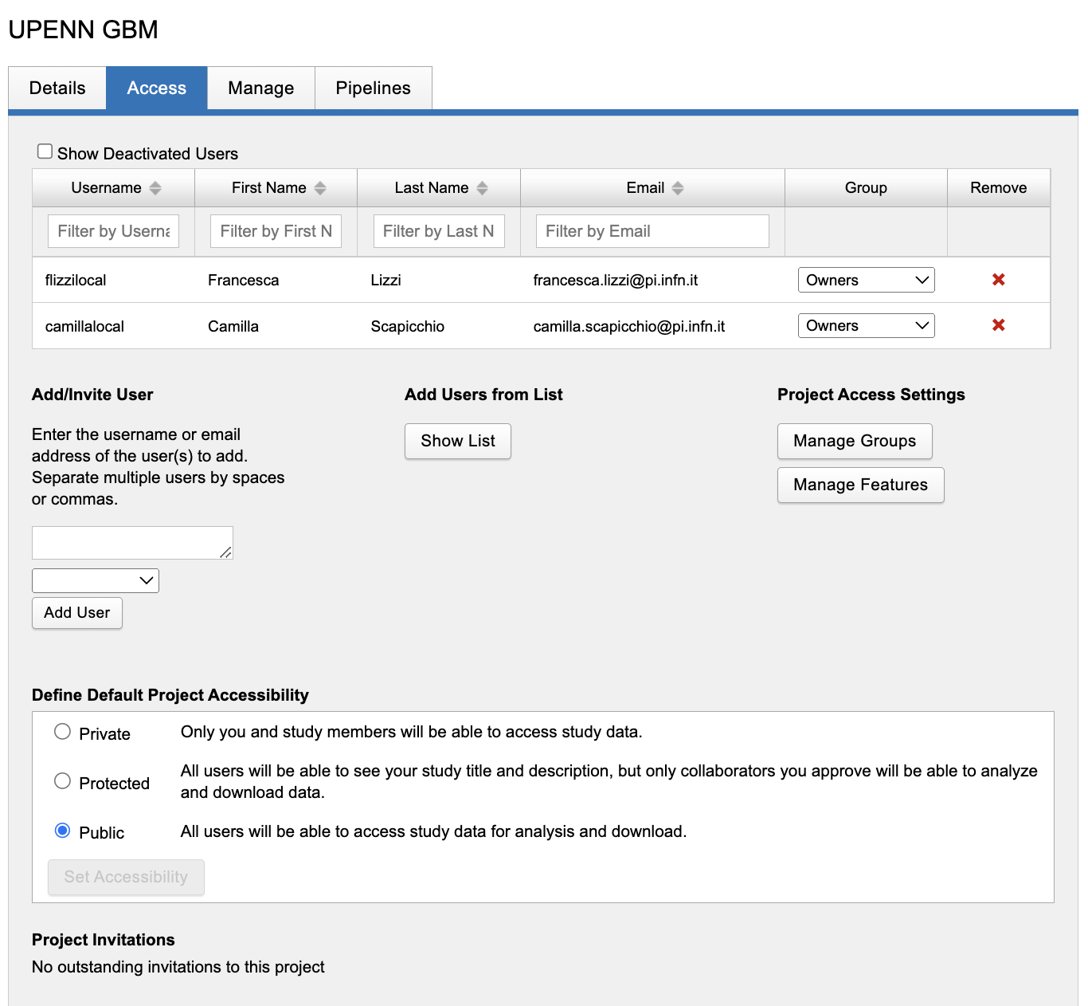
XNAT @INFN: Demo
Outline
Introduction to XNAT
XNAT @INFN
Platform configuration in AIM_MIA
Operational Steps and Discussion

Slide 18
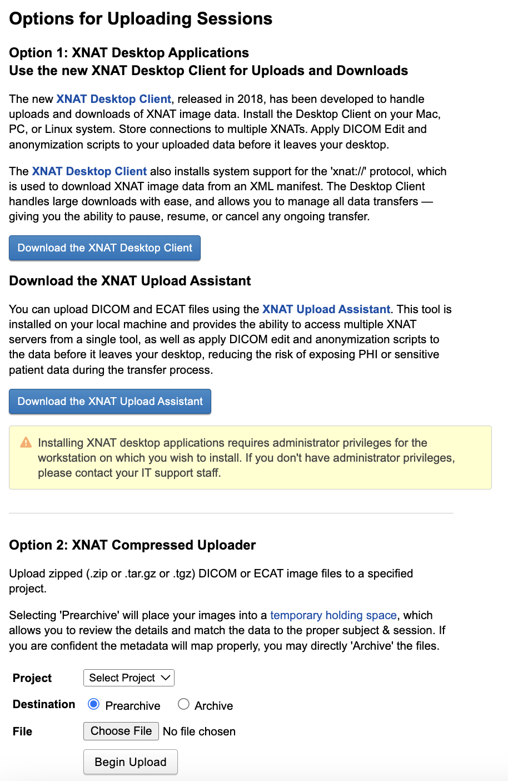
Outline
Introduction to XNAT
XNAT @INFN
Platform configuration in AIM_MIA
Operational Steps and Discussion

Slide 19
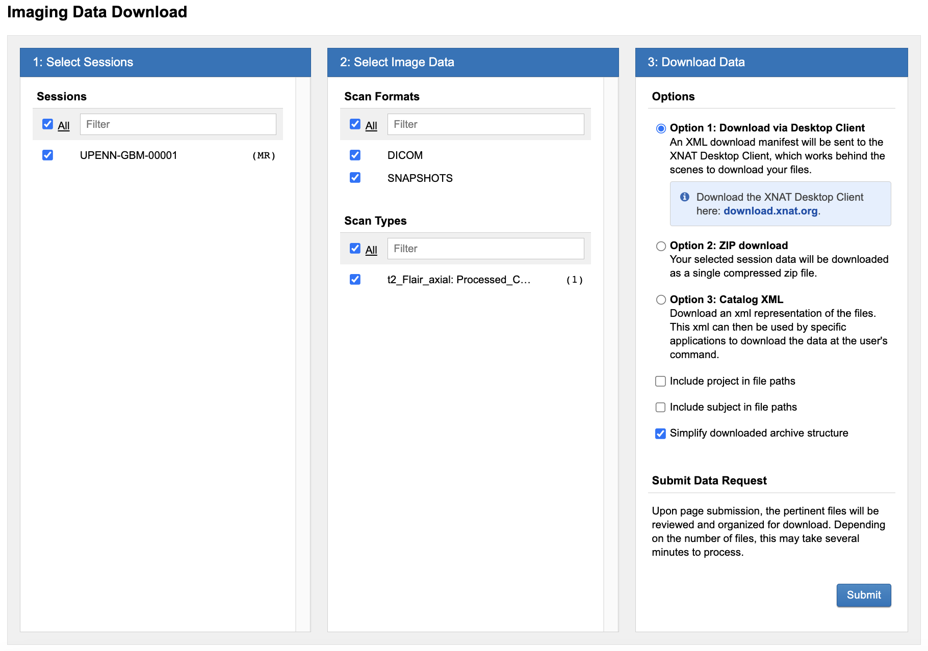
Outline
Introduction to XNAT
XNAT @INFN
Platform configuration in AIM_MIA
Operational Steps and Discussion

