Slide 1
RF1 : RF Gun
Fabio Cardelli and Luigi Faillace
INFN-LNF
Overview:
Description of Photocathode RF Gun System and working principle
Theory of Resonant cavities and Multi-cells structures
Tuning of a cavity: Slater theorem and bead drop technique
Example of a real RF Gun
Scattering Parameters
VNA description
Overview of the activity

Slide 2
RF Laboratory: RF Photocathode Gun
  This device is used as particles source in high brightness electron Linacs
  An RF Gun is an electron source that generates very low emittance pulsed beams. The electron bunches are generated by photoelectric effect.
  Very short laser pulses hit a metallic cathode, which is embedded in an electromagnetic accelerating structure. The generated bunch is immediately accelerated by an intense oscillating (RF) Electric field on the gun axis (60-120 MV/m).
  Usually. it is a Standing Wave (SW) structure realized by two (or more) coupled resonant cavities. Mostly used RF technology is the L or S-band (f₀=1.3 or 3 GHz)
  The emitted electron bunches are confined by a solenoidal magnetic field to counteract the space charge repulsion effect.
  Picosecond laser pulses and RF fields are synchronized for efficient acceleration.
  The ratio of the number of electrons emitted per incident photon is called Quantum Efficiency (Q_{e}). It is a function of the photon energy. For metals, the minimum laser energy is typically in the ultraviolet range (λ(Cu) < 267nm).
Master Oscillator
Klystron
RF transfer line (waveguide)
Synchro
system
Circulator
Drive Laser
Optical transfer line
Solenoid
Electron beam
Cathode
Laser Injection chamber
RF Gun (Resonant Cavity)

Slide 3
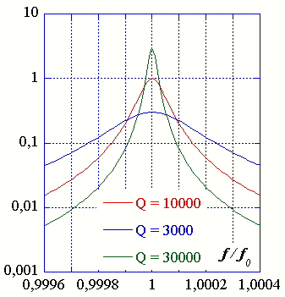

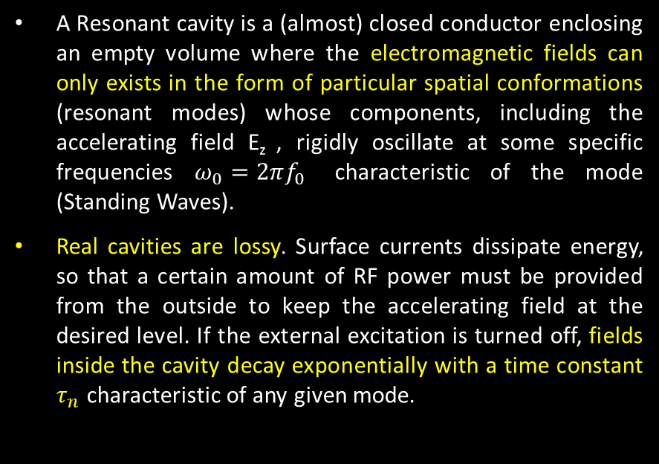



Standing Wave structures: Resonant cavities
A Resonant cavity is a (almost) closed conductor enclosing an empty volume where the electromagnetic fields can only exists in the form of particular spatial conformations (resonant modes) whose components, including the accelerating field E_{z} , rigidly oscillate at some specific frequencies $ω_{0}=2πf_{0}$ characteristic of the mode (Standing Waves).
Real cavities are lossy. Surface currents dissipate energy, so that a certain amount of RF power must be provided from the outside to keep the accelerating field at the desired level. If the external excitation is turned off, fields inside the cavity decay exponentially with a time constant $τ_{n}$ characteristic of any given mode.
Electric field
beam
${Q_{L}}_{ }=ω_{0}\frac{U}{P_{diss}+P_{out}} →$ $\frac{1}{Q_{L}}= \frac{1}{Q_{0}}+\frac{1}{Q_{ext}} →$ $\left\{\begin{matrix}Q_{0}=(1+β)Q_{L} \\ Q_{ext}= {Q_{0}}/β\end{matrix}\right.$
$$Q_{L}=\frac{∆ω|_{3 dB}}{ω_{0}}$$
$$β= \frac{Q_{0}}{Q_{ext}}=\frac{P_{out}}{P_{diss}} ≅\left\{\begin{aligned}\begin{matrix}<1 undercoupled → \frac{1−|ρ|}{1+|ρ|} \\ =1 critically coupled \end{matrix} \\ >1 overcouped → \frac{1+|ρ|}{1−|ρ|}\end{aligned}\right.$$
$$ρ$$
Reflection coefficient

Slide 4
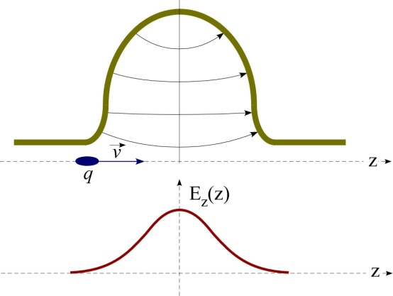
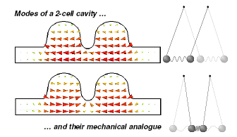





Cavities and multi-cell cavities
Cylindrical cavity or pillbox operating at the TM₀₁₀ accelerating mode. This mode has a longitudinal electric field in the centre of the cavity which is suitable for particle acceleration.
$$E_{r}=E_{θ}=H_{r}=H_{z}=0$$
$$E_{z}\left(r\right)=E_{0}J_{o}({p_{01}r}/a)$$
$$H_{θ}\left(r\right)={−j\sqrt{ε/μ}E}_{0}J_{1}({p_{01}r}/a)$$
Usually to have a more efficient acceleration more cavities (N) are coupled together.
The N-cells structure obtained behaves like a system composed by N oscillators coupled together.
Each single-cell mode degenerates in a set of N possible coupled oscillation modes of the whole system, characterized by a cell-to-cell phase advance given by:
$Δφ_{n}={nπ}/{N−1}$ $n=0,1…N−1$
SW multi-cell cavities are designed to use the last mode ($∆φ_{N−1}=π)$for acceleration ($L_{cell}= λ/2)$.

Slide 5
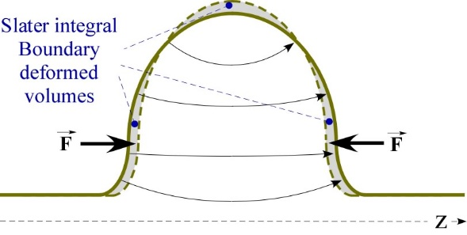
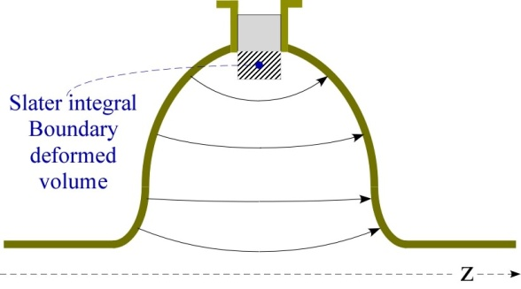

Slater Theorem
For a cavity on resonance, the electric and magnetic stored energies are equal. If a small perturbation is made on the cavity wall, this will generally produce an imbalance of the electric and magnetic energies, and the resonant frequency will shift to restore the balance. The Slater perturbation theorem describes the shift of the resonant frequency, when a small volume ΔV is removed from the cavity of volume V. The general result is
$$\frac{ω_{pert}−ω_{0}}{ω_{0}}=\frac{\int_{∆V}^{ }{(μH^{2}−εE^{2})}dτ}{\int_{V}^{ }{(μH^{2}+εE^{2})}dτ}=\frac{∆U_{H}−∆U_{E}}{U}$$
Where U is the total stored energy.
This theorem can be used also to measure the field profiles in the cavity by inserting a perturbing object and measuring the frequency shifts while moving it along selected paths. The theorem mathematical expression is different in this case and form factors need to be introduced because field lines are strongly deformed in this case, while they are almost unperturbed when the boundary is slightly deformed.
$$\frac{ω_{pert}−ω_{0}}{ω_{0}}=\frac{1}{4U}\int_{∆V}^{ }{(k_{B_{∥}}}μB_{∥}^{2}+k_{B_{⊥}}μB_{⊥}^{2}−k_{E_{∥}}εE_{∥}^{2}−k_{E_{⊥}}εE_{⊥}^{2})dτ$$

Slide 6
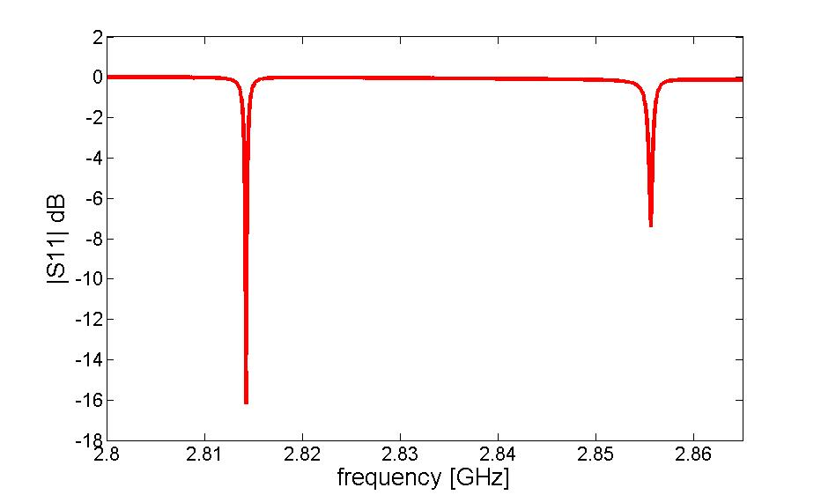




Bead Drop Measurement
Nylon wire
Probe
Network Analyzer
1-port Reflection measurement
bead
If the perturbing object (bead) is a perfectly conducting sphere the values of the form factors are:
$$k_{E_{∥}}=k_{E_{⊥}}=3; k_{B_{∥}}=k_{B_{⊥}}=3/2$$
If a sphere of radius a is moved along the beam axis of a cavity the E field profile and the R/Q of a resonant accelerating mode can be estimated according to:
$$E_{z}(z)≈ \sqrt{\left|\frac{(ω_{pert}(z)−ω_{0})}{ω_{0}}\right|\frac{U}{επa^{3}} }$$
R
Q
$$\frac{R}{Q}= \frac{V^{2}}{2P_{diss}}∙\frac{P_{diss}}{ω_{0}U}= \frac{1}{2πω_{0}εa^{3}}{\left|\int_{L}^{ }{\sqrt{\left|\frac{\left(ω_{pert}−ω_{0}\right)}{ω_{0}}\right|}sign(z)e^{jω_{0}z/c}dz}\right|}^{2}$$
$$V={\left|\int_{L}^{ }{{\hat{E}}_{z}\left(z\right)e^{jω_{0}z/c}dz}\right|}^{ }$$
Sign of the E-field profile (it takes into account the phase variation of the field )

Slide 7
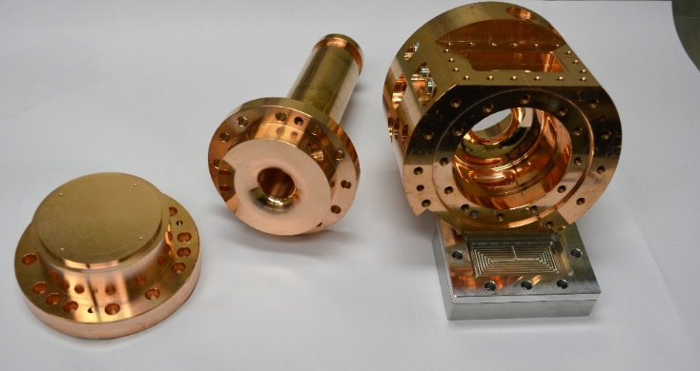
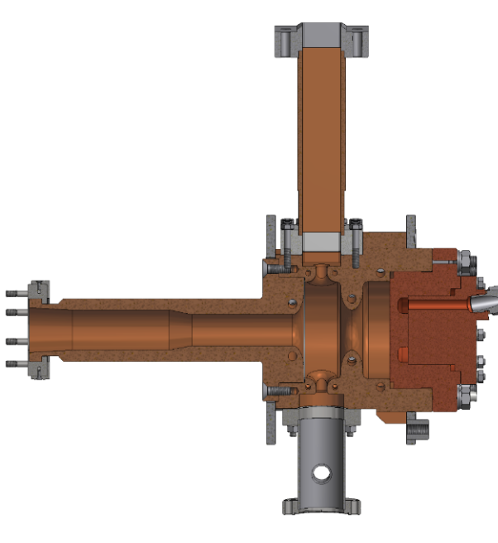
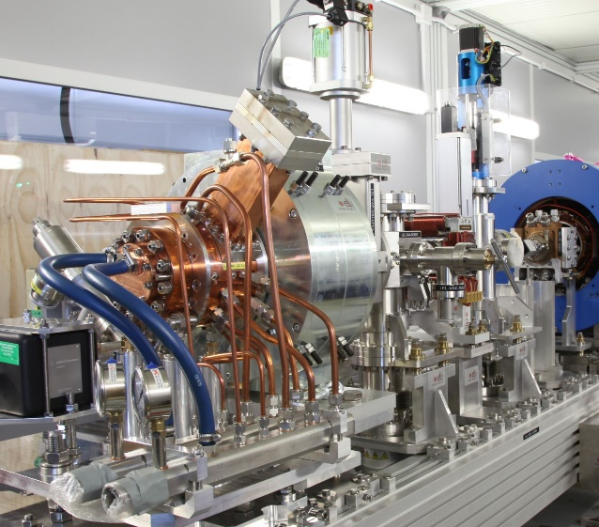
ELI-NP RF photocathode gun
1.6 cell photoinjector of the BNL/SLAC/UCLA type with new features:
elliptical shaped irises with larger aperture
2 Symmetric port to compensate the dipole field component
Hole coupling rounded to reduce the pulsed heating
cooled cathode
fabrication without brazing using the clamping gasket technique
Parameter | Unit | Value
RF frequency | GHz | 2.856
Rep. Rate | Hz | 100
Working Mode | π mode (SW)
Max Rf input power | MW |  | 16
RF peak field at the cathode | MV/m |  | 120
Average dissipated power | kW |  | 1.5
Unloaded Q factor | 14500
Coupling coefficent β | 3
Working temperature | °C |  | 33 -34
Filling time | ns |  | 420
Shunt Impedance | MΩ/m |  | 1.64
Type of cathode | copper
RF gun
Input Waveguide
waveguide
cathode
Beam tube
pumping port
cells
Cathode
Solenoid

Slide 8
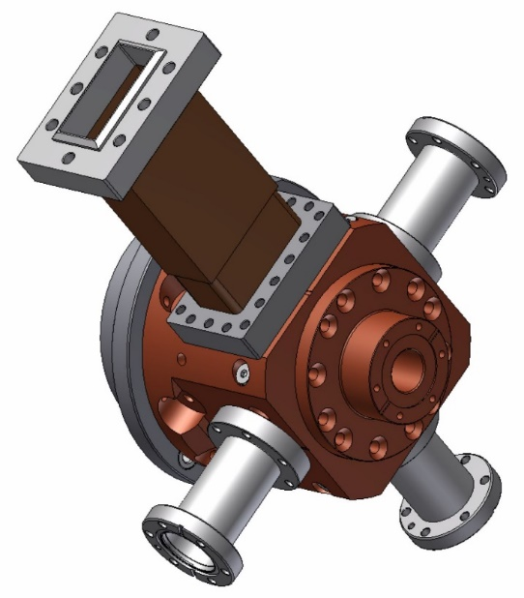
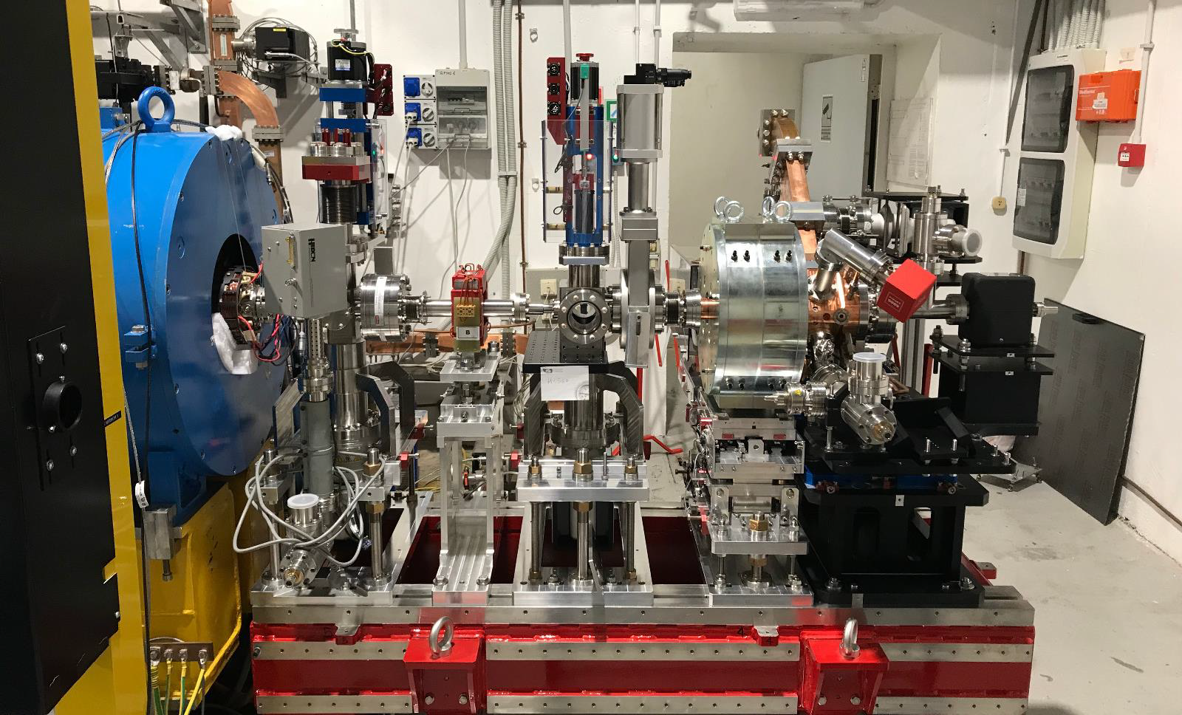
New SPARC_LAB RF photocathode gun
1.6 cell photoinjector of the BNL/SLAC/UCLA type with new features:
elliptical shaped irises with larger aperture
4 Symmetric port to compensate the dipole field component
Hole coupling rounded to reduce the pulsed heating
fabrication without brazing using the clamping gasket technique
Parameters | Value
f_{res} [GHz] | 2.856
Q₀ | 13500
Nominal Cath. peak field [MV/m] | 120
E_{cathode}/√(P_{diss}) [MV/(mMW^{0.5})] | 37.5
E_{surf}/E_{cath} | 0.9
Δfreq. 0 /π-mode [MHz] | ∼ 41
RF input power [MW] | 12-16
RF pulse length [μs] | 1-2
Coupling β | 2
H_{surf} [kA/m] | < 300
Pulsed heating | < 30 [°C]
Repetition rate | 10 [Hz]
Working temp. | 30 [°C]
Fill. Time (τ) | ∼ 500 ns
Input waveguide
RF gun
Solenoid

Slide 9
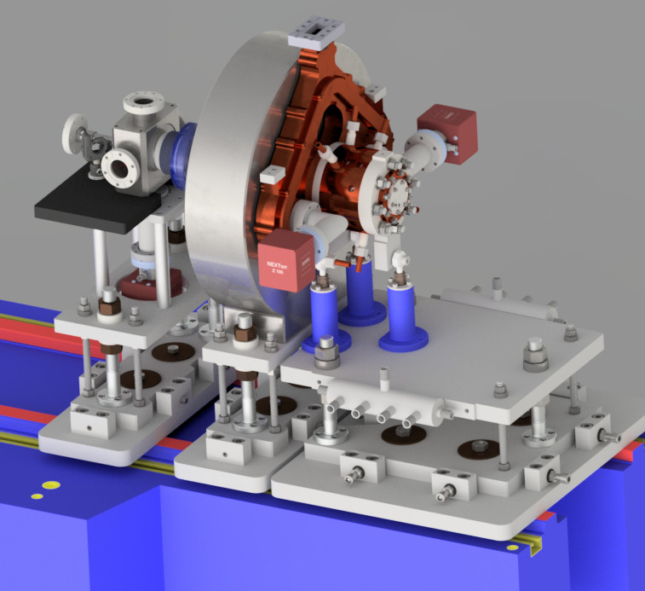
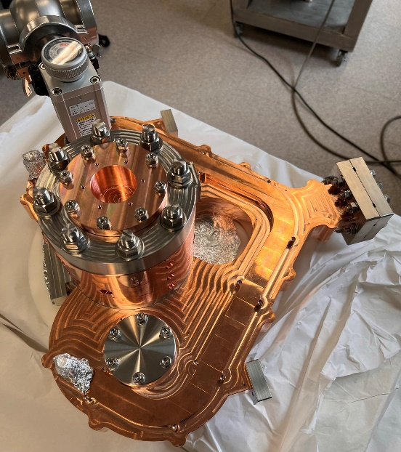
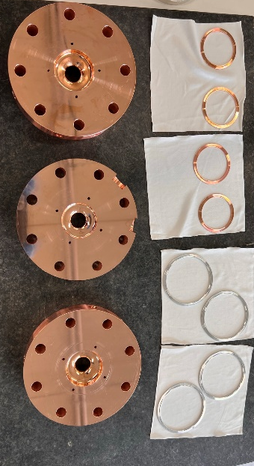
C-band high gradient RF photocathode gun
2.6 cell photoinjector :
Coupling coefficient = 3
elliptical shaped irises profile
4 port mode launcher
cooled cells and cathode
fabrication without brazing using the clamping gasket technique
Parameter | Unit | Value
Frequency | GHz | 5.712
Number of cells |  | 2.6
E_{cath}/√P_{diss} | MV/(m⋅MW^{0.5}) | 51.4
Peak input power | MW | 18
Cathode field | MV/m | 160
Cathode type |  | OFHC copper
Rep. rate | Hz | 100 (400)
Quality factor |  | 11900
Filling time | ns | 166
Coupling coefficient |  | 3
RF pulse length | ns | 300
E_{surf}/E_{cath} |  | 0.96
Mod. Poy. Vect. | W/μm² | 2.5
Pulsed heating | °C | <16
Av.diss. Power | W | 300 (1000)

Slide 10
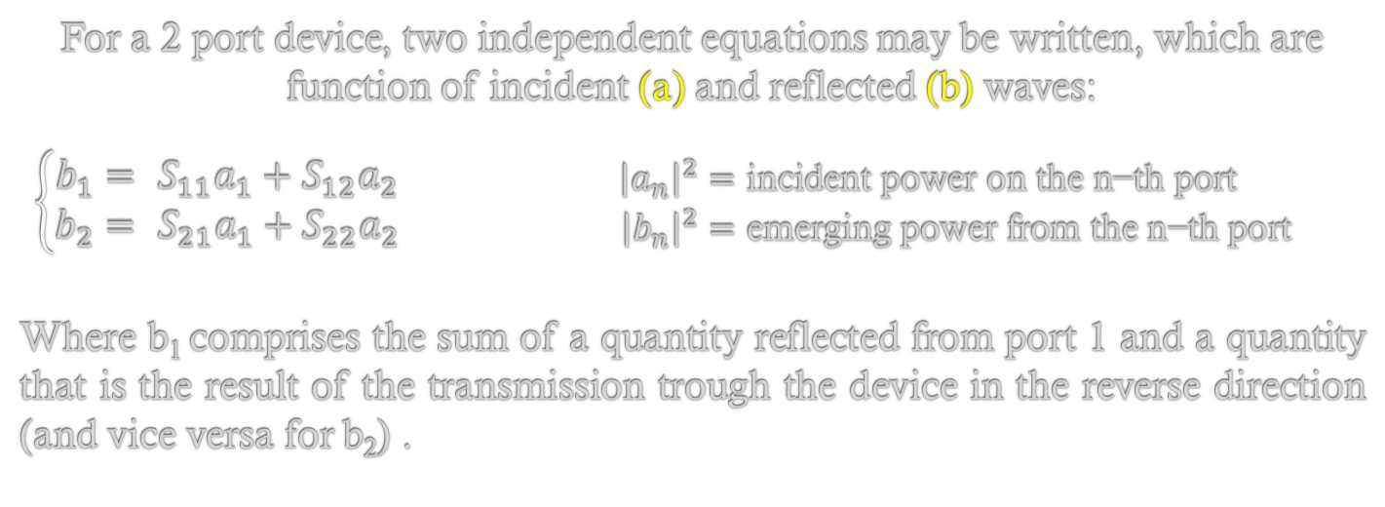
Scattering Parameters
Incident
S₂₁
Transmitted
a₁
Reflected
b₂
S₁₁
DUT
Port 1
Port 2
S₂₂
b₁
Reflected
a₂
Transmitted
S₁₂
Incident
For a 2 port device, two independent equations may be written, which are function of incident (a) and reflected (b) waves:
$\left\{\begin{aligned}b_{1}= S_{11}a_{1}+S_{12}a_{2} \\ &b_{2}= S_{21}a_{1}+S_{22}a_{2}\end{aligned}\right.$ $\begin{matrix}{\left|a_{n}\right|}^{2}=\text{incident} \text{power} \text{on} \text{the} \text{n}\text{−}\text{th} \text{port} \\ {\left|b_{n}\right|}^{2}=\text{emerging} \text{power} \text{from} \text{the} \text{n}\text{−}\text{th} \text{port}\end{matrix}$
Where b₁ comprises the sum of a quantity reflected from port 1 and a quantity that is the result of the transmission trough the device in the reverse direction (and vice versa for b₂) .
Notes:
At high frequency is very hard to measure total voltage and current at the device ports

Slide 11



Scattering Parameters (2)
Incident
S₂₁
Transmitted
a₁
b₂
S₁₁
DUT
Port 1
Port 2
b₁
a₂
Reflected
$b_{1}=$ $S_{11}a_{1}+S_{12}a_{2}$
$b_{2}=$ $S_{21}a_{1}+S_{22}a_{2}$
$$S_{11}={\left.\frac{b_{1}}{a_{1}}\right|}_{a_{2}=0}$$
$$S_{21}={\left.\frac{b_{2}}{a_{1}}\right|}_{a_{2}=0}$$
Ideal matched load (Z₀) on port 2
Related to familiar measurements: gain, loss, reflection coefficient
Defined in terms of voltage travelling waves – relatively easy to measure at high frequencies
Don’t require connections of undesirable loads to the DUT (short or open), but only matched loads
Measured S parameters of multiple devices can be cascaded to predict overall system performance

Slide 12
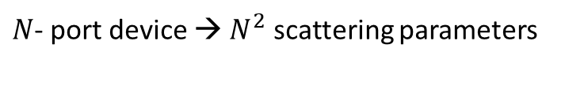
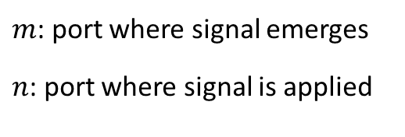
Scattering Parameters (3)
$m$: port where signal emerges
$n$: port where signal is applied
$N$- port device → $N^{2}$ scattering parameters
S_{mn}
Parameter | Common measurement term
S₁₁ | Forward reflection coefficient (input match)
S₂₁ | Forward transmission coefficient (gain or loss)
S₂₂ | Reverse reflection coefficient (output match)
S₁₂ | Reverse transmission coefficient (isolation)
S parameters are inherently complex, linear quantities. They are expressed as real-and-imaginary or amplitude-and-phase pairs
However, often we want to look only at the magnitude of an S-parameter (e.g. when looking at insertion loss or input match), and often a logarithmic scale is more useful. A log-magnitude display let us see far more dynamic range than a linear format

Slide 13
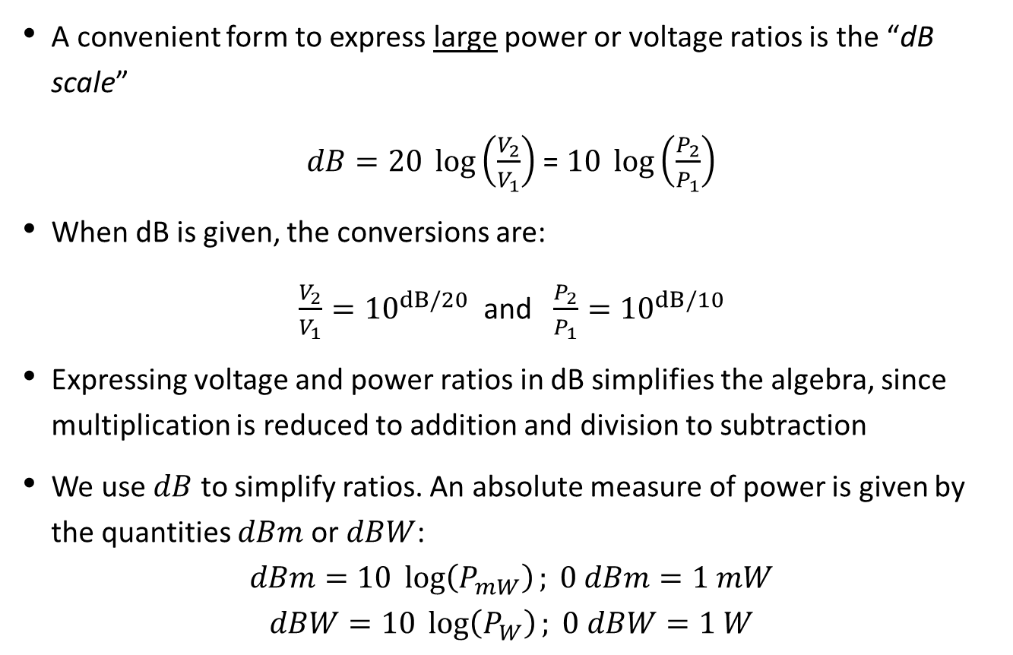
Useful Formulae
A convenient form to express large power or voltage ratios is the “dB scale”
$dB=20 \log\left(\frac{V_{2}}{V_{1}}\right)$ = $10 \log\left(\frac{P_{2}}{P_{1}}\right)$
When dB is given, the conversions are:
$\frac{V_{2}}{V_{1}}={10}^{dB/20}$ and $\frac{P_{2}}{P_{1}}={10}^{dB/10}$
Expressing voltage and power ratios in dB simplifies the algebra, since multiplication is reduced to addition and division to subtraction
We use $dB$ to simplify ratios. An absolute measure of power is given by the quantities $dBm$ or $dBW$:
$$dBm=10 \log\left(P_{mW}\right); 0 dBm=1 mW$$
$$dBW=10 \log\left(P_{W}\right); 0 dBW=1 W$$
Power | 1 µW | 10 µW | .1 mW | 1 mW | 10 mW | .1 W | 1 W | 10 W | .1 kW | 1 kW | 10 kW | .1 MW | 1 MW
dBm | -30 | -20 | -10 | 0 | 10 | 20 | 30 | 40 | 50 | 60 | 70 | 80 | 90
dBW | -60 | -50 | -40 | -30 | -20 | -10 | 0 | 10 | 20 | 30 | 40 | 50 | 60

Slide 14
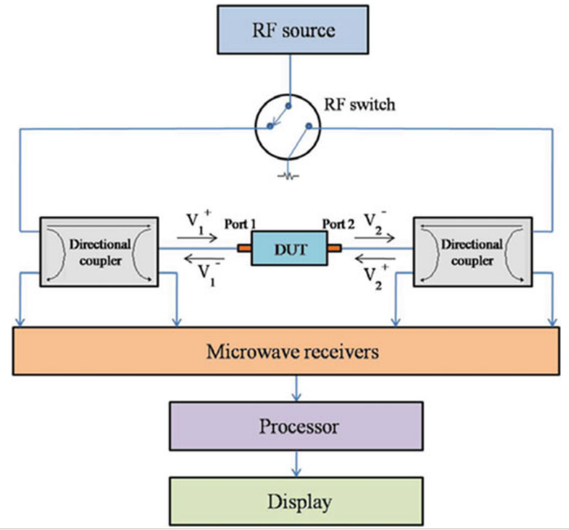
Vector Analyzer General Architecture

Slide 15
VNA Building blocks
A Vector Network Analyzer measures the scattering matrix elements s_{mn} (i.e. input/output matching and forward/backward transfer function) of a Device Under Test
1. Source
Device Under Test
(DUT)
Z₀
2. Signal separation
4. Process and display
Incident
Reflected
Transmitted
3. Detector and receiver
An internal sine wave source is swept within a given frequency range.
Reflected and transmitted signals are measuerd and normalized to the source. The direction of the excitation can be inverted.

Slide 16

Experience overwiew
RF Gun characterization in reflection with Network Analizer
  Calibration
  Localize the two resonating modes measuring the S11 (NA settings: f_{start}=2.8GHz f_{stop}=2.86GHz)
  Estimate the frequency separation $Δf$ between the two modes.
  Measure the resonant frequency and the S11|_{fres} and compute the coupling factor β for the two modes (NA settings: f_{center}=f_{res} span=4MHz) (NOTE: the π-mode is overcoupled β > 1, the 0-mode is undercoupled β < 1)
RF Gun characterization in transmission with Network Analizer
  Measure the S21 of the device and using the «Bandwidth» function (Marker Search -> Bandwidth) measure the Loaded Quality Factor Q_{L}
  Compute the Unloaded Quality Factor Q₀ and the External Quality Factor Q_{ext}
Longitudinal electric field profile measurement with “bead-drop” technique (mode π):
  Ticks drawn on the nylon wire are equally spaced every 5 mm
  Fill a spreadsheet with: bead position (z [m]) and measured f_{res}
  Compute and plot (f-fres)/fres vs z and finally E_{z} vs z

Slide 17

R/Q calculation:
  From the spreadsheet, compute R/Q
  (Note: The spherical bead radius is a=0.0018m, ε=8.85418781762E-12, c=299792458 m/s)
Filling/Decay time $τ$ measurement (time domain with realistic RF pulse)
  The filling or decay time, is the time for the energy stored in the cavity with loaded Q = Q_{L} to build to 1/e of its saturation point
  Connect the RF signal generator through a switch and an amplifier to the Gun and read the output probe through the oscilloscope
100Hz, few us pulses
5V
15V
switch
scope
f_{π}
  Measure the filling time τ of the gun. Compare it with the one evaluated from Q_{L.}
(OPTIONAL) Longitudinal electric field profile measurement with “bead-drop” technique (mode 0)
  Repeat the procedure of point 3 for the 0 mode

Slide 18









Useful Formulae
Accelerating voltage on axis
Cavity filling time
$$V={\left|\int_{L}^{ }{{\hat{E}}_{z}\left(z\right)e^{jω_{0}z/c}dz}\right|}^{ }$$
$$τ=\frac{2Q_{L}}{ω_{0}}$$
Unloaded Q
External Q factor
$$Q_{0}= ω_{0}\frac{U}{P_{diss}}$$
$$Q_{ext}= ω_{0}\frac{U}{P_{out}}$$
Loaded Q factor
$\frac{1}{Q_{L}}= \frac{1}{Q_{0}}+\frac{1}{Q_{ext}} →$ $\left\{\begin{matrix}Q_{0}=(1+β)Q_{L} \\ Q_{ext}= {Q_{0}}/β\end{matrix}\right.$
$$Q_{L}=ω_{0}\frac{U}{P_{tot}} → Q_{L}=\frac{∆ω_{0}|_{3 dB}}{ω_{0}}$$
Coupling coefficient β
$$β= \frac{Q_{0}}{Q_{ext}}=\frac{P_{out}}{P_{diss}} ≅\left\{\begin{matrix}\frac{1+|ρ|}{1−|ρ|} if overcoupled \\ \frac{1−|ρ|}{1+|ρ|} if undercoupled\end{matrix}\right.$$
R/Q and Accelerating field from the perturbation measurement
$$E^{2}≈ \left|\frac{(ω_{pert}−ω_{0})}{ω_{0}}\right|\frac{U}{επa^{3}}$$
$$\frac{R}{Q}= \frac{1}{2πω_{0}εa^{3}}{\left|\int_{L}^{ }{\sqrt{\left|\frac{\left(ω_{pert}−ω_{0}\right)}{ω_{0}}\right|}sign(z)e^{jω_{0}z/c}dz}\right|}^{2}$$

Slide 19
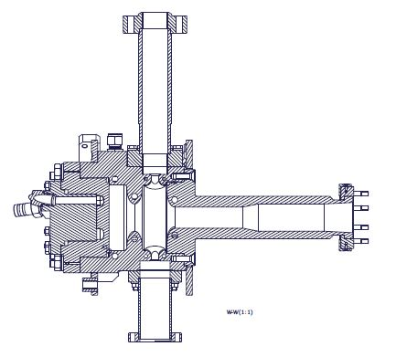
Solutions
Main Parameters | 0-mode | π-mode
Res. frequency | 2814.3 GHz | 2855.7 GHz
Freq. separation | 41 MHz
Input coupling coeff. (β) | 0.9 | 1.86
Q_{L} | 4700 | 3600
Q₀ | 9000 | 10400
Q_{ext} | 9900 | 5600
R/Q factor | ≈117 Ω | -
Filling time | ≈360 ns | -
Input waveguide
cathode
Full cell
Beam pipe
Vacuum tube
½ cell
General measurement
settings:
f_{start} = 2.8 GHz
f_{stop} = 2.86 GHz
Single mode measurement
settings:
f_{center} = f_{res}
f_{span} = 4 MHz

