Slide 1

RF PULSE COMPRESSOR
EXPERIMENTAL ACTIVITY: RADIOFREQUENCY LABORATORY

Slide 2
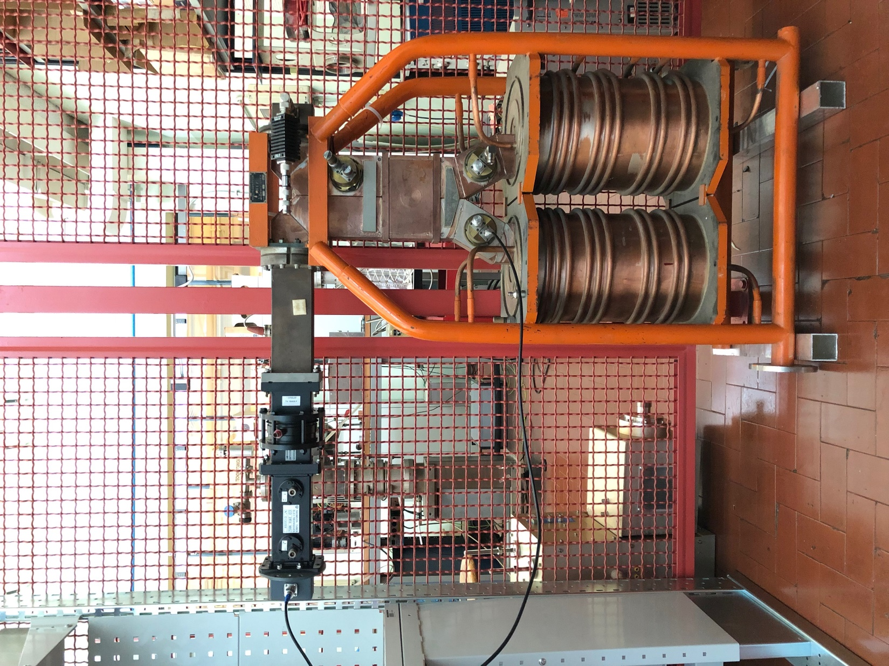
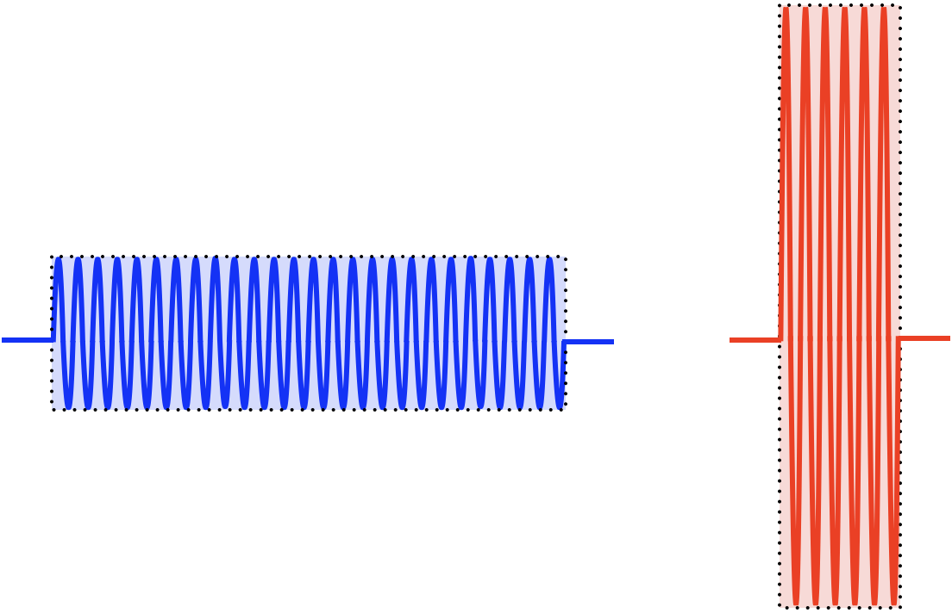
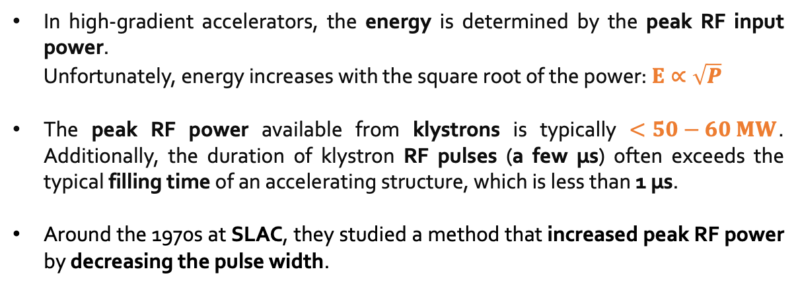
RF PULSE COMPRESSOR – GENERAL OVERVIEW
In high-gradient accelerators, the energy is determined by the peak RF input power.
Unfortunately, energy increases with the square root of the power: $E∝\sqrt{P}$
The peak RF power available from klystrons is typically $<50−60 MW$.
Additionally, the duration of klystron RF pulses (a few µs) often exceeds the typical filling time of an accelerating structure, which is less than 1 µs.
Around the 1970s at SLAC, they studied a method that increased peak RF power by decreasing the pulse width.
Compressed pulse
Klystron typical RF pulse
200 MW
50 MW
4 µs
1 µs

Slide 3
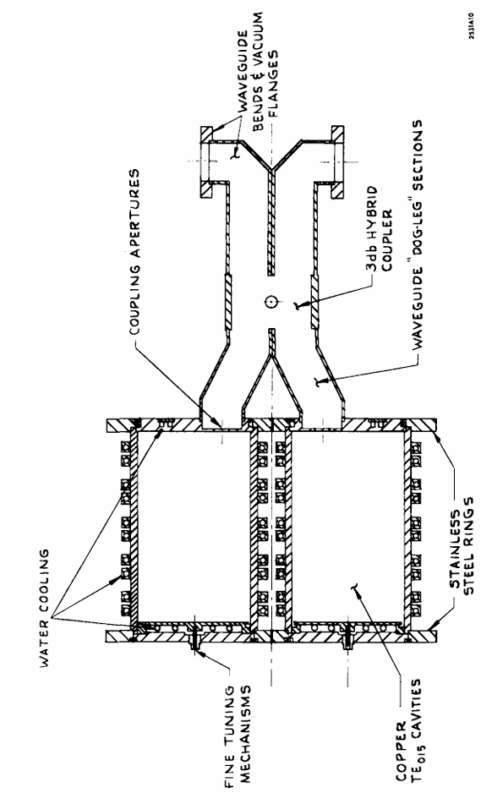
RF PULSE COMPRESSOR – SLED WORKING PRINCIPLE
The SLED (Stanford Linac Energy Doubler) is added at the output of the klystron.
The cavities are assumed to be identical and tuned to resonance.
After the RF pulse is turned on, the fields in the cavities build up and a wave of increasing amplitude is radiated from the coupling apertures of each cavity.
The two waves emitted combine to add at the accelerator port of the coupler and to cancel at the klystron port.
The direct wave is opposite in phase to the combined emitted waves.
Approximately 0.8 µs before the end of the RF pulse (which corresponds to the accelerator filling time), the π phase shifter reverses the phase of the output wave from the klystron. Immediately after this phase reversal, the emitted and direct waves add in phase at the accelerator.
Link to original SLAC article published in 1973:
KLYSTRON
ACCELERATOR
[1] Farkas et al. - SLED A method of doubling SLAC energy

Slide 4
RESONANT CAVITIES
REVIEW

Slide 5
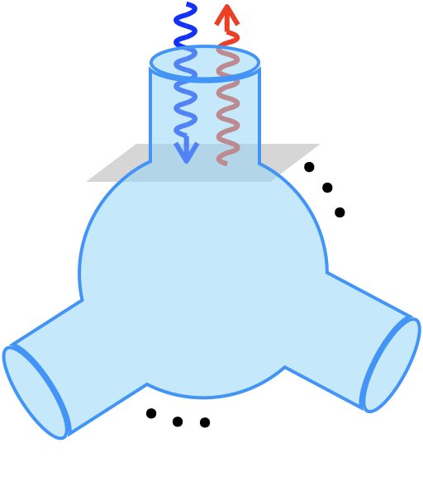
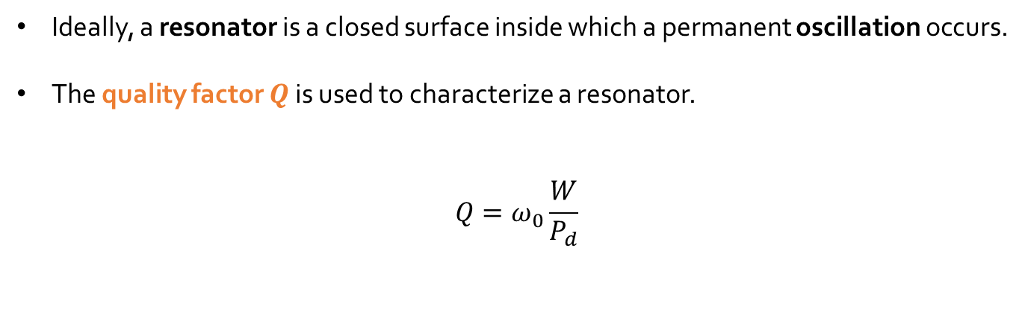


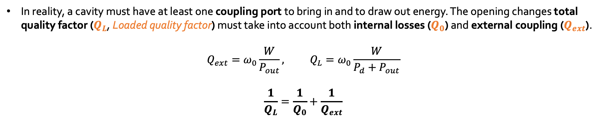
REVIEW– RESONANT CAVITIES (1)
Ideally, a resonator is a closed surface inside which a permanent oscillation occurs.
The quality factor $Q$ is used to characterize a resonator.
$$Q=ω_{0}\frac{W}{P_{d}}$$
$V_{FWD}$
$V_{REV}$
Average electromagnetic energy stored in the volume which represents the resonator
Power dissipated on the walls (in the case of metallic resonator).
In reality, a cavity must have at least one coupling port to bring in and to draw out energy. The opening changes total quality factor ($Q_{L}$, Loaded quality factor) must take into account both internal losses ($Q_{0}$) and external coupling ($Q_{ext}$).
$$Q_{ext}=ω_{0}\frac{W}{P_{out}}, {Q_{L}=ω}_{0}\frac{W}{P_{d}+P_{out}}$$
$$\frac{1}{Q_{L}}=\frac{1}{Q_{0}}+\frac{1}{Q_{ext}}$$
Power extracted from the cavity through the port itself for a given level of the mode fields inside

Slide 6
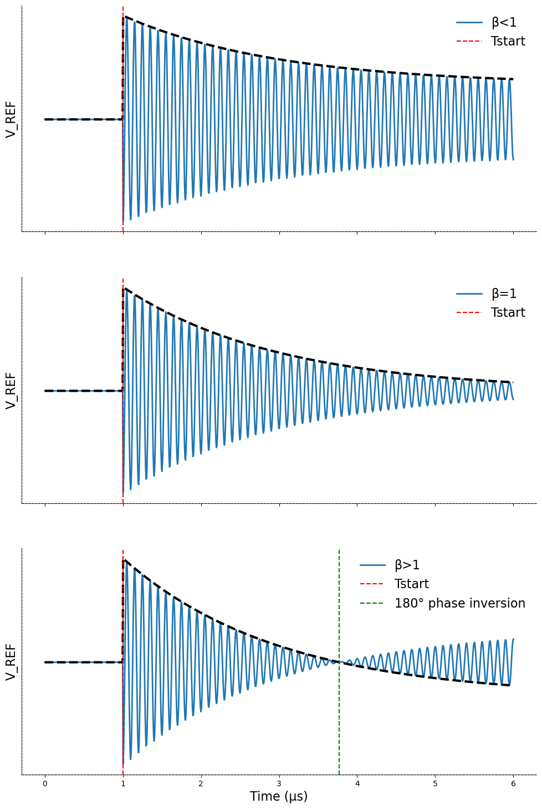
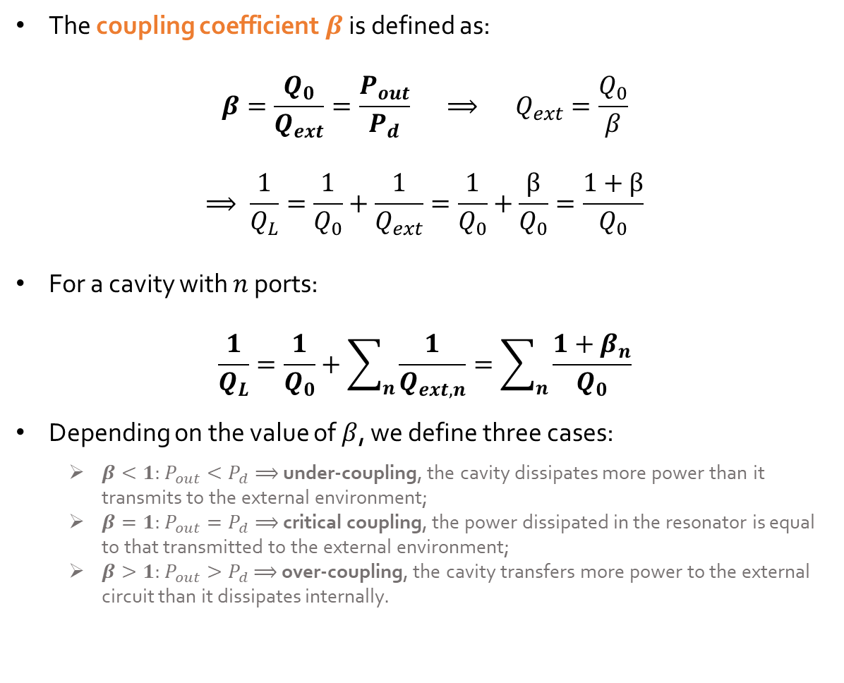
REVIEW– RESONANT CAVITIES (2)
The coupling coefficient $β$ is defined as:
$$β=\frac{Q_{0}}{Q_{ext}}=\frac{P_{out}}{P_{d}} ⟹ Q_{ext}=\frac{Q_{0}}{β}$$
$$⟹ \frac{1}{Q_{L}}=\frac{1}{Q_{0}}+\frac{1}{Q_{ext}}=\frac{1}{Q_{0}}+\frac{β}{Q_{0}}=\frac{1+β}{Q_{0}}$$
For a cavity with $n$ ports:
$$\frac{1}{Q_{L}}=\frac{1}{Q_{0}}+\sum_{n}{\frac{1}{Q_{ext,n}}}=\sum_{n}{\frac{1+β_{n}}{Q_{0}}}$$
Depending on the value of $β$, we define three cases:
  $β<1$: $P_{out}<P_{d}⟹$ under-coupling, the cavity dissipates more power than it transmits to the external environment;
  $β=1$: $P_{out}=P_{d}⟹$ critical coupling, the power dissipated in the resonator is equal to that transmitted to the external environment;
  $β>1$: $P_{out}>P_{d}$ $⟹$ over-coupling, the cavity transfers more power to the external circuit than it dissipates internally.

Slide 7
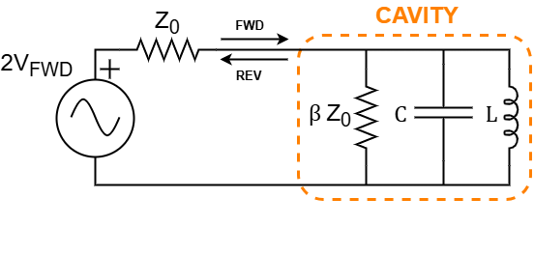
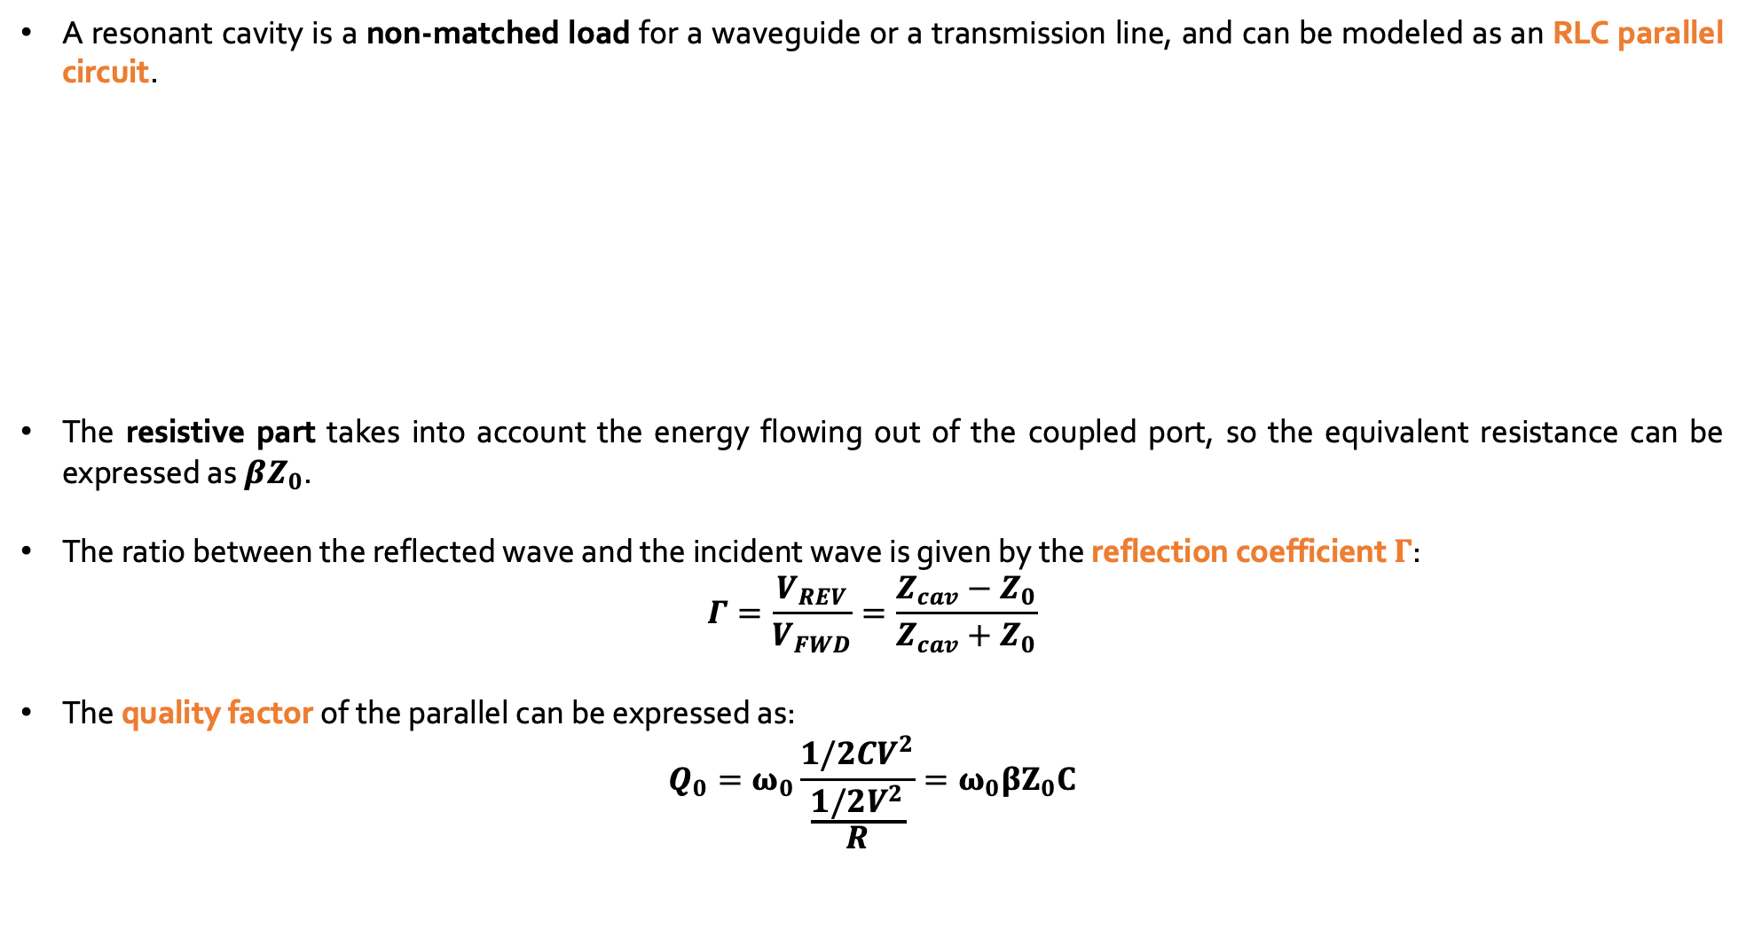

REVIEW– CAVITY AS RESONANT LOAD
A resonant cavity is a non-matched load for a waveguide or a transmission line, and can be modeled as an RLC parallel circuit.
The resistive part takes into account the energy flowing out of the coupled port, so the equivalent resistance can be expressed as$βZ_{0}$.
The ratio between the reflected wave and the incident wave is given by the reflection coefficient $Γ$:
$$Γ=\frac{V_{REV}}{V_{FWD}}=\frac{Z_{cav}−Z_{0}}{Z_{cav}+Z_{0}}$$
The quality factor of the parallel can be expressed as:
$$Q_{0}=ω_{0}\frac{1/2CV^{2}}{\frac{1/2V^{2}}{R}}=ω_{0}βZ_{0}C$$
Characteristic impedance of the transmission line
$$Z_{cav}=βZ_{0}∕∕C∕∕L$$

Slide 8
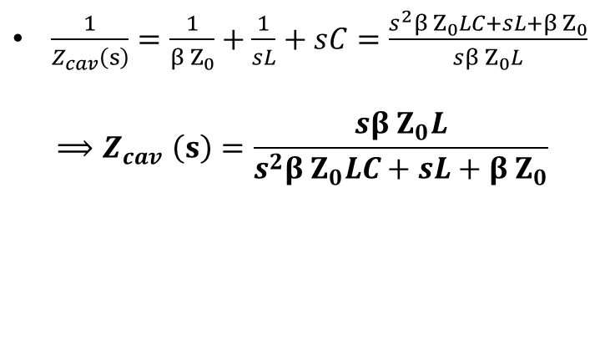

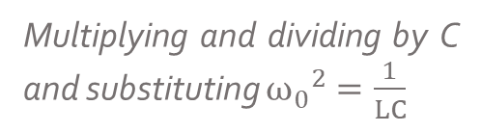
REVIEW– CALCULATION OF THE EQUIVALENT IMPEDANCE OF THE CAVITY
$\frac{1}{Z_{cav}\left(s\right)}=\frac{1}{β Z_{0}}+\frac{1}{sL}+sC=\frac{s^{2}β Z_{0}LC+sL+β Z_{0}}{sβ Z_{0}L}$
$${⟹Z}_{cav}\left(s\right)=\frac{sβ Z_{0}L}{s^{2}β Z_{0}LC+sL+β Z_{0}}$$
Multiplying and dividing by C
and substituting ${ω_{0}}^{2}=\frac{1}{LC}$
$$Z_{cav}\left(s\right)=β Z_{0}\frac{sLC}{s^{2}β Z_{0}LC^{2}+sLC+β Z_{0}C}=β Z_{0}\frac{s/{ω_{0}}^{2}}{s^{2}β Z_{0}C/{ω_{0}}^{2}+s/{ω_{0}}^{2}+β Z_{0}C}$$
$${{ Q}_{0}=ω}_{0}βZ_{0}C$$
$$Z_{cav}(s)=β Z_{0}\frac{s/{ω_{0}}^{2}}{s^{2}Q_{0}/{ω_{0}}^{3}+s/{ω_{0}}^{2}+Q_{0}/ω_{0}}=β Z_{0}\frac{s/ω_{0}}{s^{2}Q_{0}/{ω_{0}}^{2}+s/ω_{0}+Q_{0}}=β Z_{0}\frac{s/{{(Q}_{0}ω}_{0})}{s^{2}/{ω_{0}}^{2}+s/Q_{0}ω_{0}+1}$$

Slide 9
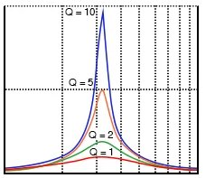


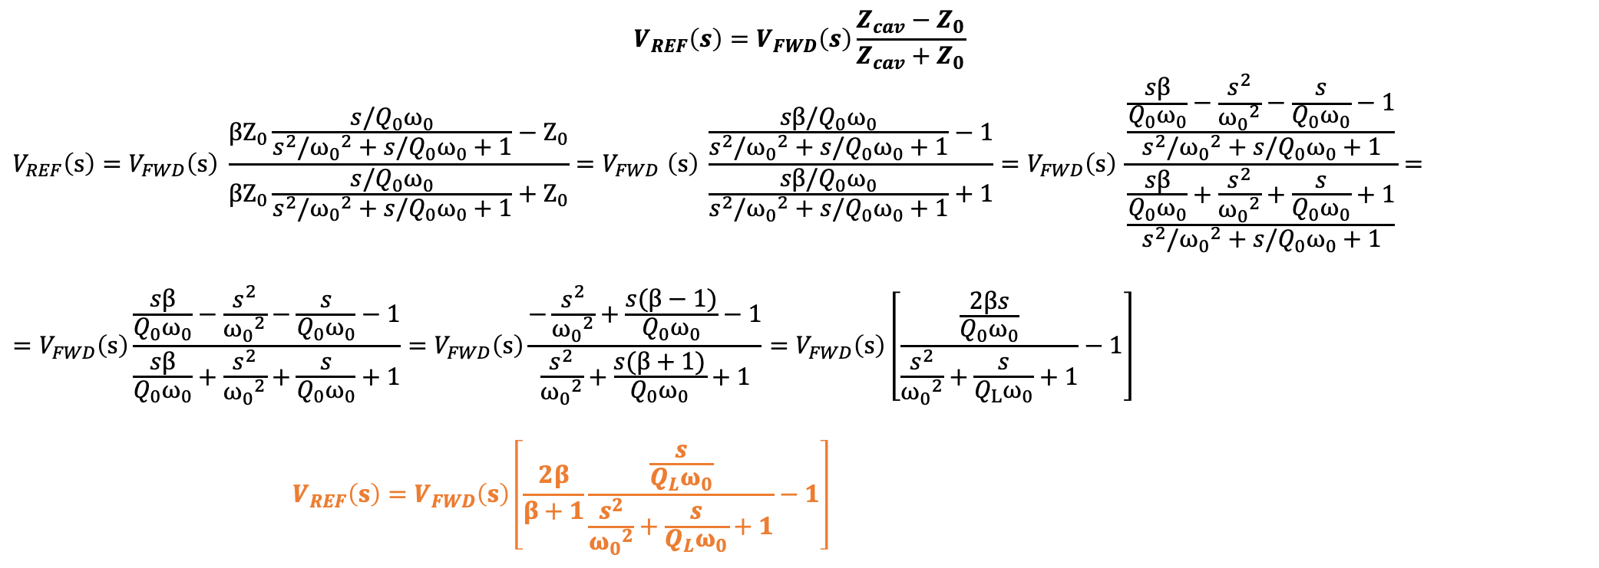
REVIEW– CAVITY REFLECTED WAVE AND INPUT COUPLING COEFFICIENT
In the previous equation, if we substitute the expression for $Z_{cav}$ the reflected wave becomes function of the coupling coefficient:
$$V_{REF}\left(s\right)=V_{FWD}\left(s\right)\frac{Z_{cav}−Z_{0}}{Z_{cav}+Z_{0}}$$
$$V_{REF}\left(s\right)=V_{FWD}\left(s\right) \frac{{βZ}_{0}\frac{s/{Q_{0}ω}_{0}}{s^{2}/{ω_{0}}^{2}+s/Q_{0}ω_{0}+1}−Z_{0}}{{βZ}_{0}\frac{s/{Q_{0}ω}_{0}}{s^{2}/{ω_{0}}^{2}+s/Q_{0}ω_{0}+1}+Z_{0}}{=V}_{FWD}\left(s\right) \frac{\frac{sβ/{Q_{0}ω}_{0}}{s^{2}/{ω_{0}}^{2}+s/Q_{0}ω_{0}+1}−1}{\frac{sβ/{Q_{0}ω}_{0}}{s^{2}/{ω_{0}}^{2}+s/Q_{0}ω_{0}+1}+1}=V_{FWD}\left(s\right) \frac{\frac{\frac{sβ}{{Q_{0}ω}_{0}}−\frac{s^{2}}{{ω_{0}}^{2}}−\frac{s}{Q_{0}ω_{0}}−1}{s^{2}/{ω_{0}}^{2}+s/Q_{0}ω_{0}+1}}{\frac{\frac{sβ}{{Q_{0}ω}_{0}}+\frac{s^{2}}{{ω_{0}}^{2}}+\frac{s}{Q_{0}ω_{0}}+1}{s^{2}/{ω_{0}}^{2}+s/Q_{0}ω_{0}+1}}=$$
$$=V_{FWD}\left(s\right)\frac{\frac{sβ}{{Q_{0}ω}_{0}}−\frac{s^{2}}{{ω_{0}}^{2}}−\frac{s}{Q_{0}ω_{0}}−1}{\frac{sβ}{{Q_{0}ω}_{0}}+\frac{s^{2}}{{ω_{0}}^{2}}+\frac{s}{Q_{0}ω_{0}}+1}=V_{FWD}\left(s\right)\frac{−\frac{s^{2}}{{ω_{0}}^{2}}+\frac{s(β−1)}{Q_{0}ω_{0}}−1}{\frac{s^{2}}{{ω_{0}}^{2}}+\frac{s(β+1)}{Q_{0}ω_{0}}+1}=V_{FWD}\left(s\right)\left[\frac{\frac{2βs}{Q_{0}ω_{0}}}{\frac{s^{2}}{{ω_{0}}^{2}}+\frac{s}{Q_{L}ω_{0}}+1}−1\right]$$
$$V_{REF}\left(s\right)=V_{FWD}\left(s\right)\left[\frac{2β}{β+1}\frac{\frac{s}{Q_{L}ω_{0}}}{\frac{s^{2}}{{ω_{0}}^{2}}+\frac{s}{Q_{L}ω_{0}}+1}−1\right]$$
|Trasf. Func ($jω$)|
Coupl. coeff.
Lorentzian network
transfer function
$$ω$$

Slide 10
RESONANT CAVITIES
LORENTZIAN NETWORK RESPONSE

Slide 11
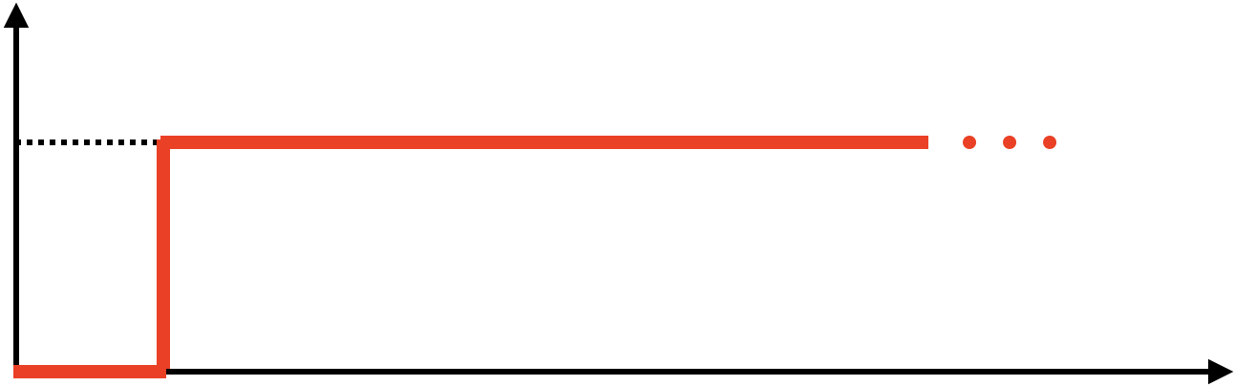
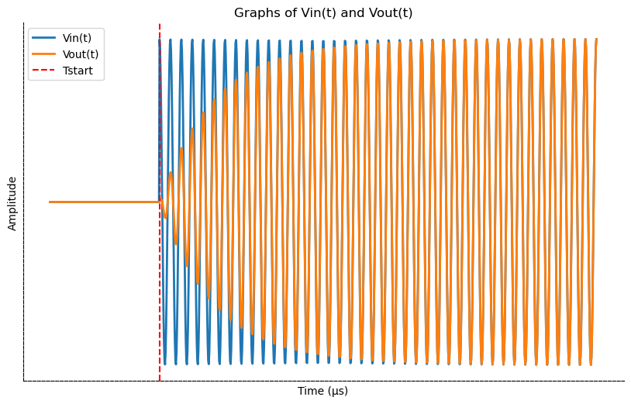



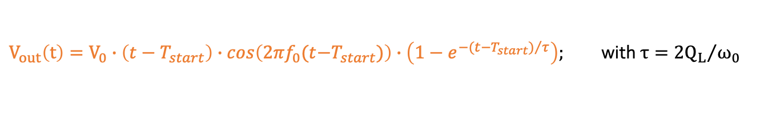

LORENTZIAN NETWORK RESPONSE – RF STEP PULSE
The response of a Lorentzian network to an RF step pulse is::
$V_{in}$
$V_{0}$
$$V_{in}(t)=V_{0}∙(t−T_{start})∙cos\left({2πf}_{0}(t−T_{start}\right))$$
$V_{out}\left(t\right)=V_{0}∙\left(t−T_{start}\right)∙cos\left({2πf}_{0}(t{−T}_{start})\right)∙\left(1−e^{−{(t−T_{start})}/τ}\right);$with $τ={2Q_{L}}/{ω_{0}}$
$T_{start}$
$$t$$

Slide 12
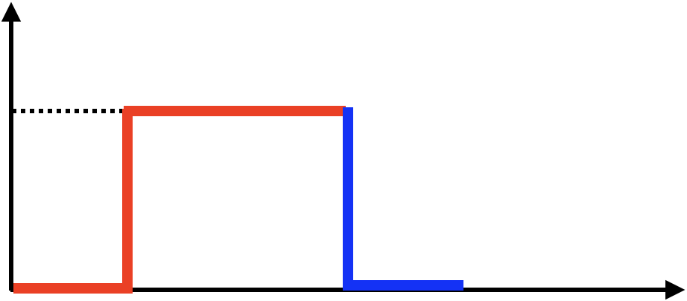
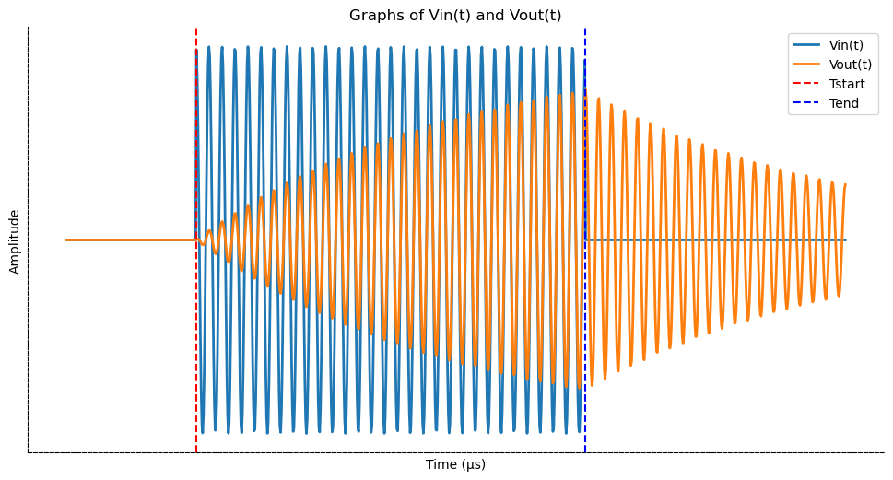



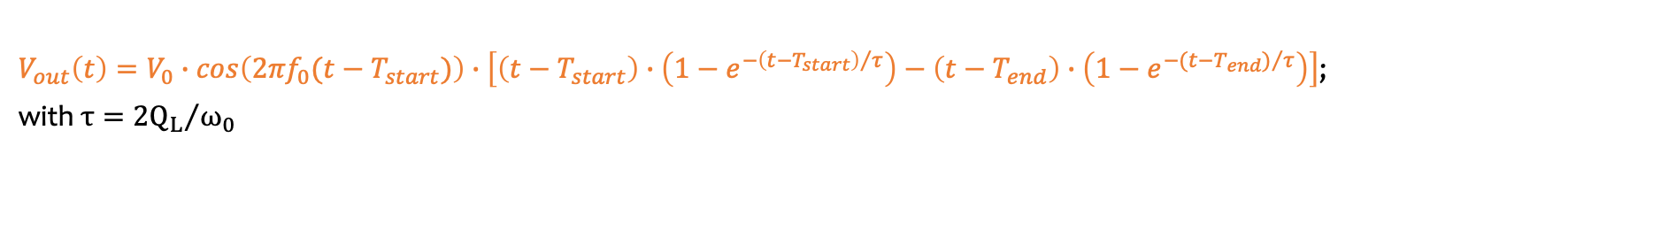


LORENTZIAN NETWORK RESPONSE – RF RECTANGULAR PULSE
The response of a Lorentzian network to an RF rectangular pulse is::
$V_{in}$
$V_{0}$
$V_{in}(t)=V_{0}∙cos\left({2πf}_{0}(t−T_{start})\right)$ $∙\left[\left(t−T_{start}\right)−(t−T_{end})\right]$
$T_{end}$
$V_{out}\left(t\right)=V_{0}∙cos\left({2πf}_{0}(t−T_{start})\right)∙\left[\left(t−T_{start}\right)∙\left(1−e^{−{\left(t−T_{start}\right)}/τ}\right)−\left(t−T_{end}\right)∙\left(1−e^{−({t−T_{end})}/τ}\right)\right]$;
with $τ={2Q_{L}}/{ω_{0}}$
$T_{start}$
$$t$$

Slide 13




LORENTZIAN NETWORK RESPONSE– RF STEP PULSE REFLECTED BY A RESONANT CAVITY
The reflected wave of a resonant cavity to an RF step pulse has the following transfer function:
$$V_{RFL}=V_{FWD}\left[\frac{2β}{β+1} \frac{s/{ω_{0}Q_{L}}}{{\left(s/{ω_{0}}\right)}^{2}+s/{ω_{0}Q_{L}}+1} −1\right]$$
In time domain:
$V_{FWD}(t)=V_{0}∙(t−T_{start})∙cos\left(ω_{0}(t−T_{start})\right)$;
$$V_{RFL}\left(t\right)=V_{0}∙\left(t−T_{start}\right)∙cos\left(ω_{0}(t−T_{start})\right)∙\left[\frac{2β}{β+1}\left(1−e^{−({t−T_{start})}/τ}\right)−1\right]$$
In the case of over-coupled cavity (𝜷>𝟏), the reflected wave shape is:
$V_{FWD}$
$V_{0}$
$T_{start}$

Slide 14
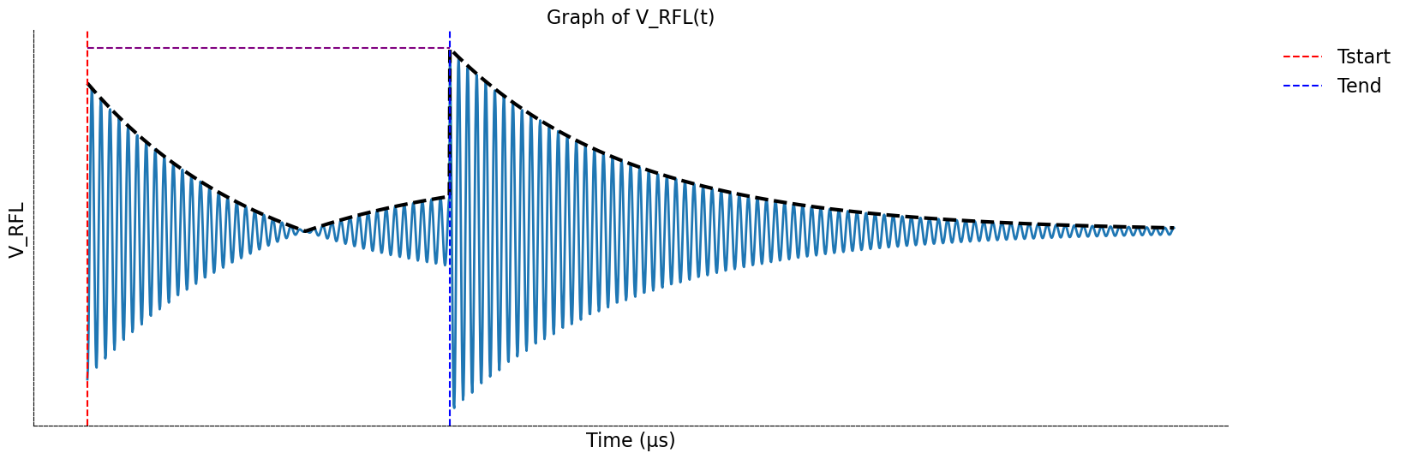






LORENTZIAN NETWORK RESPONSE– RF RECTANGULAR PULSE REFLECTED BY A RESONANT CAVITY
In time domain:
$V_{FWD}(t)=V_{0}∙cos\left(ω_{0}t\right)∙\left[t−(t−T_{end}) \right]$;
$$T_{start}=0$$
$$V_{RFL}\left(t\right)=V_{0}∙cos\left(ω_{0}t\right)∙\left\{1\left(t\right)\left[\frac{2β}{β+1}\left(1−e^{−t/τ}\right)−1\right]−\left(t−T_{end}\right)\left[\frac{2β}{β+1}\left(1−e^{−{\left(t−T_{end}\right)}/τ}\right)−1\right]\right\}$$
The RFL peak field is maximum at the end of the FWD pulse (the negative step sums in phase with the reflected wave).
Its value is larger than the peak of the FWD itself.
$V_{FWD}$
$V_{0}$
$T_{start}$
$T_{end}$
$$t$$

Slide 15
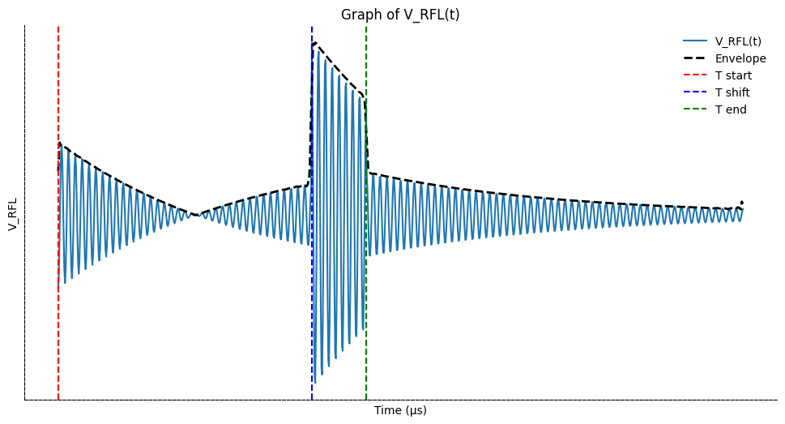
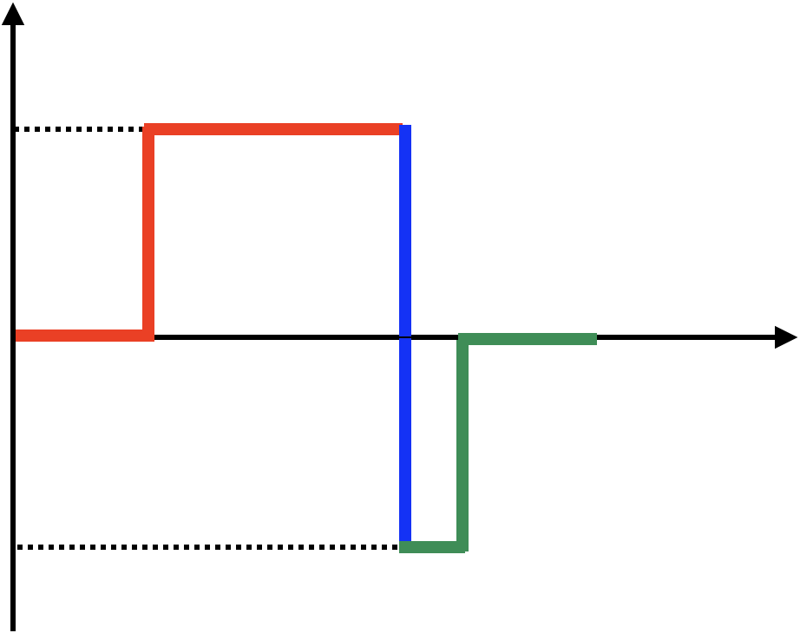







LORENTZIAN NETWORK RESPONSE– RF RECTANGULAR PULSE WITH 180° PHASE SHIFT REFLECTED BY A RESONANT CAVITY
The idea: apply a 180° phase inversion to the final part of the input pulse so that, after the phase inversion in the SLED, the waves add in phase, maximizing the amplitude of the compressed pulse.
In time domain:
$$V_{FWD}(t)=V_{0}∙cos\left(ω_{0}t\right)∙\left[1\left(t\right) −2\left(t−T_{shift}\right)+(t−T_{end}) \right]$$
$$V_{RFL}\left(t\right)=V_{0}∙cos\left(ω_{0}t\right)∙\left\{1\left(t\right)\left[\frac{2β}{β+1}\left(1−e^{−t/τ}\right)−1\right]−2\left(t−T_{shift}\right)\left[\frac{2β}{β+1}\left(1−e^{−{\left(t−T_{shift}\right)}/τ}\right)−1\right]+\left(t−T_{end}\right)\left[\frac{2β}{β+1}\left(1−e^{−{\left(t−T_{end}\right)}/τ}\right)−1\right]\right\}$$
$V_{FWD}$
$V_{0}$
Theoretical max amplitude gain =3
$T_{start}$
$T_{shift}$
$T_{end}$
$$t$$
${−V}_{0}$

Slide 16
90° HYBRID
HOW TO ROUTE THE POWER FLOW TOWARDS THE ACCELERATOR?

Slide 17

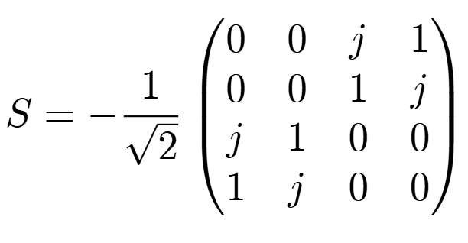
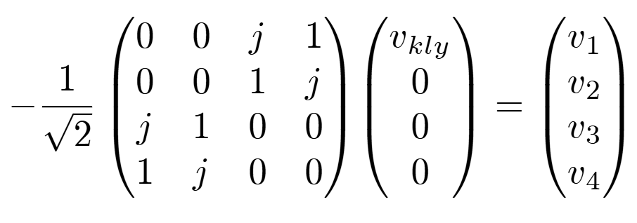





90° HYBRID – WORKING PRINCIPLE (1)
RF source
(klystron)
Accelerating structure
90° hybrids are 4-ports devices whose scattering matrix is ideally given by:
$$1$$
$$2$$
Reflected wave
Incident wave
$$\underline{b}=\underline{S}∙\underline{a}$$
We excite from the klystron and assume to a first approximation that all other ports are closed on matched loads:
$$3$$
$$4$$
RF cavity 1
RF cavity 2
$v_{1}=v_{2}=0$; $v_{3}=−\frac{j}{\sqrt{2}}v_{kly}$; $v_{4}=−\frac{1}{\sqrt{2}}v_{kly}$
$P_{active}^{port 3}=\frac{1}{2}{\left|v_{3}\right|}^{2}=\frac{1}{2}\frac{1}{2} {\left|v_{kly}\right|}^{2}=\frac{1}{2}P_{active}^{port 1}$; $P_{active}^{port 4}=\frac{1}{2}{\left|v_{4}\right|}^{2}=\frac{1}{2}\frac{1}{2} {\left|v_{kly}\right|}^{2}=\frac{1}{2}P_{active}^{port 1}$

Slide 18
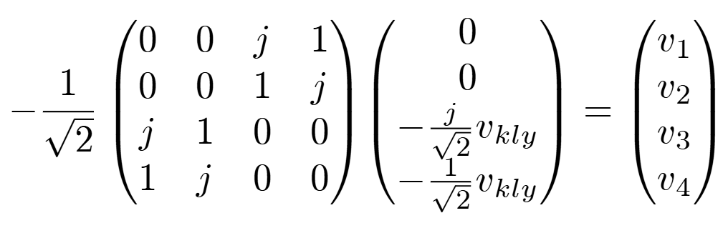





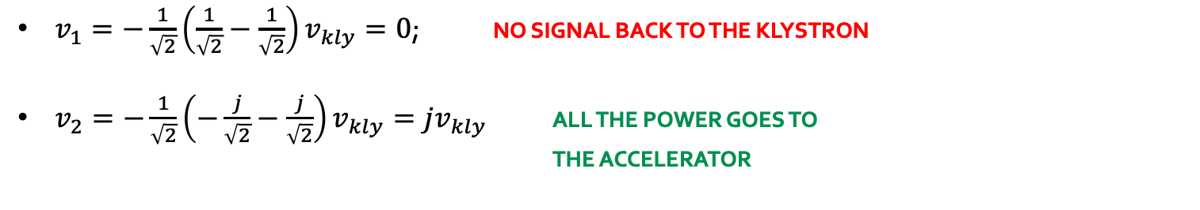
90° HYBRID – WORKING PRINCIPLE (2)
We have seen that cavities are non-matched loads for the hybrid, so where does the reflected wave go?
RF source
(klystron)
Accelerating structure
$$1$$
$$2$$
OUTPUT
$v_{1}=−\frac{1}{\sqrt{2}}\left(\frac{1}{\sqrt{2}}−\frac{1}{\sqrt{2}}\right)v_{kly}=0$; NO SIGNAL BACK TO THE KLYSTRON
$v_{2}=−\frac{1}{\sqrt{2}}\left(−\frac{j}{\sqrt{2}}−\frac{j}{\sqrt{2}}\right)v_{kly}=jv_{kly}$ ALL THE POWER GOES TO
                THE ACCELERATOR
$$3$$
$$4$$
RF cavity 1
RF cavity 2

Slide 19
EXPERIMENTAL ACTIVITY
SLED TUNING

Slide 20
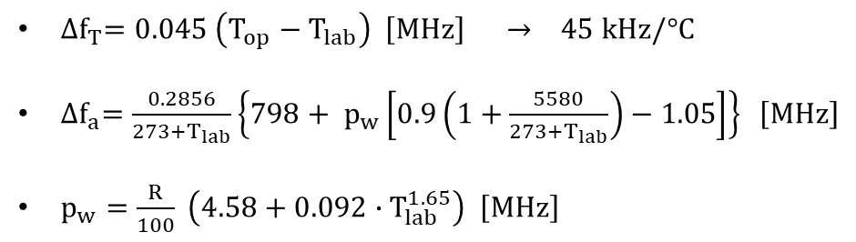


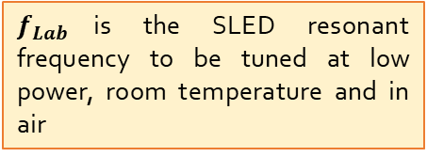

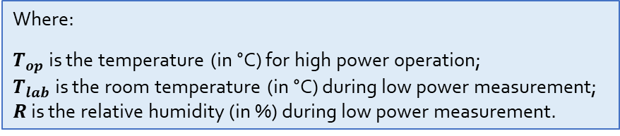
EXPERIMENTAL ACTIVITY – SLED TUNING
WHY?
If the resonant frequencies of the 2 cavities are not the same and/or equal to the operating frequency (2856 MHz for S-band linacs) the SLED can produce high reflections at the input port, causing breakdowns in the input waveguide or near the klystron window.
HOW?
Generally, frequency tuning is done in air and with low RF power. For this reason the measurement needs to account for several environmental variation with respect to nominal conditions: room temperature, pressure, humidity and air (instead of vacuum).
$$f_{Lab}\left(MHz\right)=f_{RF}(MHz)+∆f_{T}\left(MHz\right)−∆f_{a}(MHz)$$
$f_{Lab}$is the SLED resonant frequency to be tuned at low power, room temperature and in air
$f_{RF}$ is the SLED nominal working frequency = 2856 MHz
${∆f}_{T}$ is the frequency correction for temperature
${∆f}_{a}$ is the frequency correction for pressure and humidity
${∆f}_{T}=0.045 \left(T_{op}−T_{lab}\right) \left[MHz\right] → 45 kHz/°C$
${∆f}_{a}=\frac{0.2856}{273+T_{lab}}\left\{798+ p_{w}\left[0.9\left(1+\frac{5580}{{273+T}_{lab}}\right)−1.05\right]\right\} \left[MHz\right]$
$p_{w}=\frac{R}{100} \left(4.58+0.092∙T_{lab}^{1.65}\right) \left[MHz\right]$
Where:
$T_{op}$ is the temperature (in °C) for high power operation;
$T_{lab}$ is the room temperature (in °C) during low power measurement;
$R$ is the relative humidity (in %) during low power measurement.

Slide 21
EXPERIMENTAL ACTIVITY
TIME AND FREQUENCY DOMAIN ANALYSIS

Slide 22
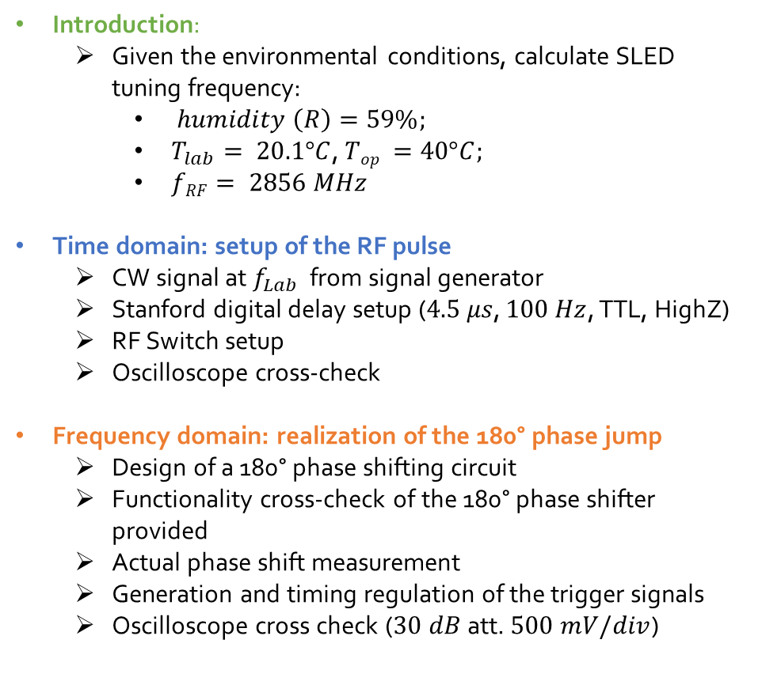
EXPERIMENTAL ACTIVITY
Introduction:
  Given the environmental conditions, calculate SLED tuning frequency:
    $humidity \left(R\right)=59\%;$
    $T_{lab}= 20.1°C$, $Top =40°C;$
    $fRF= 2856 MHz$
Time domain: setup of the RF pulse
  CW signal at $f_{Lab}$ from signal generator
  Stanford digital delay setup ($4.5 μs$, $100 Hz$, TTL, HighZ)
  RF Switch setup
  Oscilloscope cross-check
Frequency domain: realization of the 180° phase jump
  Design of a 180° phase shifting circuit
  Functionality cross-check of the 180° phase shifter provided
  Actual phase shift measurement
  Generation and timing regulation of the trigger signals
  Oscilloscope cross check ($30 dB$att. $500 mV/div$)
Time domain: SLED tuning with rectangular input pulse (no 180° phase jump)
  Cavity n.1 optimization
  Cavity n.2 optimization
  Tuning optimizing SLED output
Time domain: visualization of SLED output pulse with 180° phase jump
  Fine frequency tuning of the SLED pulse
  Qualitative measurement of energy/power gain
  Scan Tjump vs energy gain

