Slide 1
ISDD 15 YEARS - MEG
- WHAT ARE WE DOING ?
- ORGANISATION AND STAFF
- CHALLENGES & CONCLUSION

Slide 2
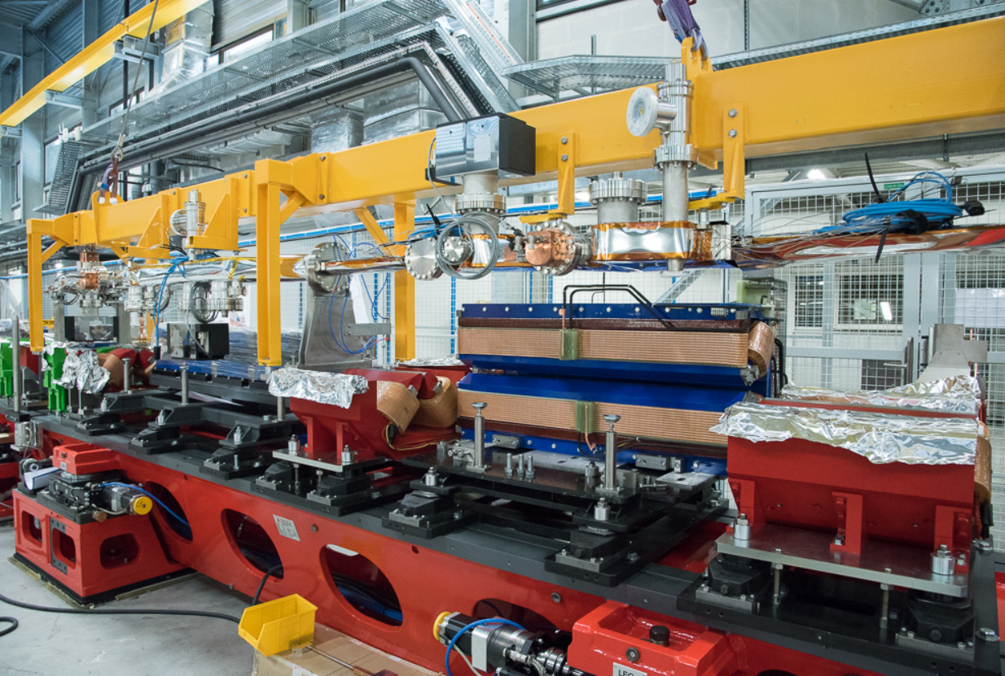
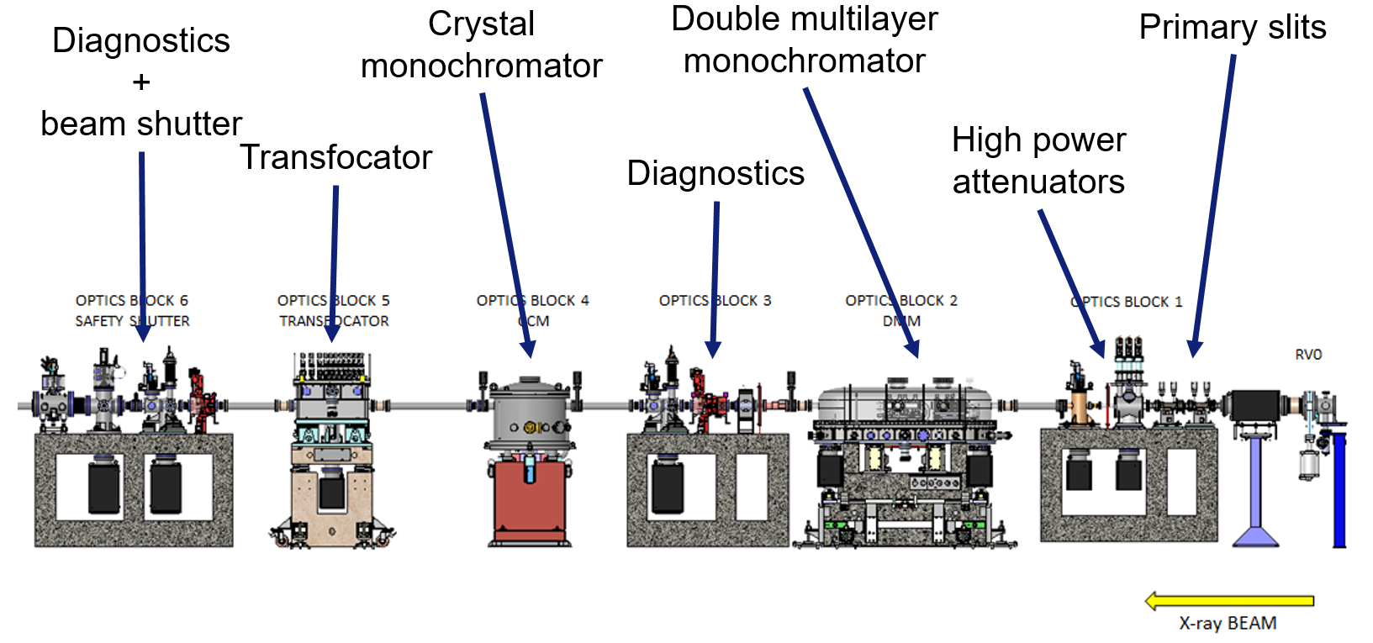
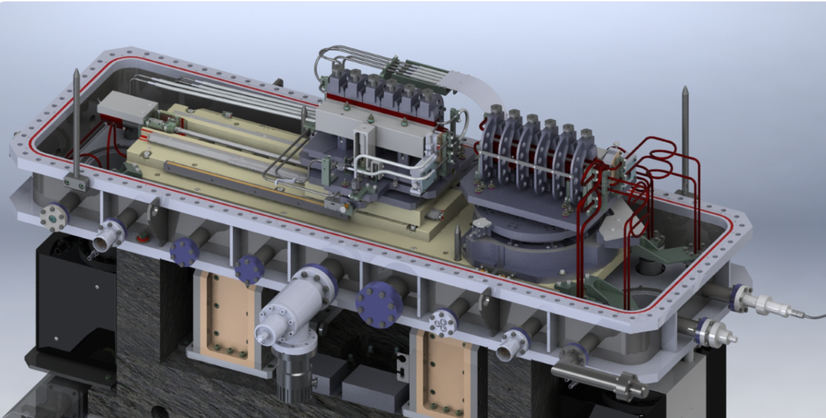
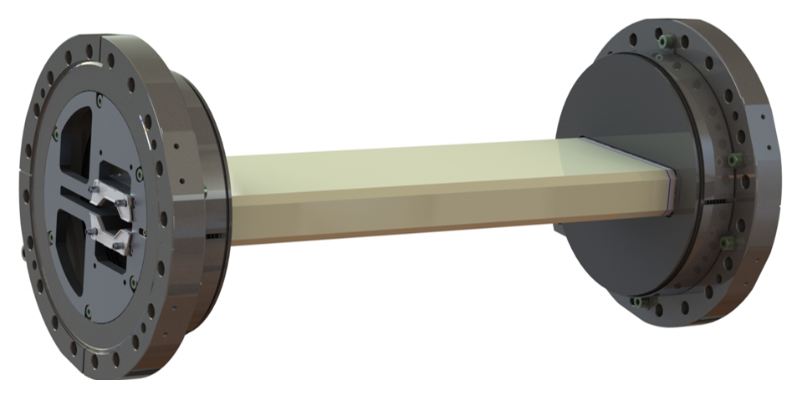
WHAT ARE WE DOING ?
MEG = team of engineers and technicians in charge of developing advanced instrumentation for the ESRF beamlines
and accelerator complex

Slide 3
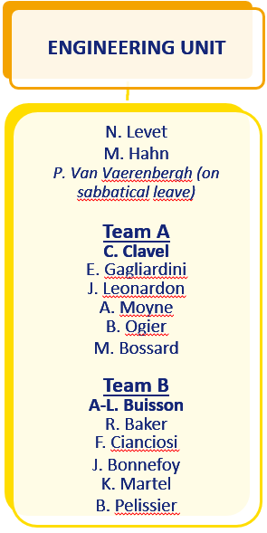
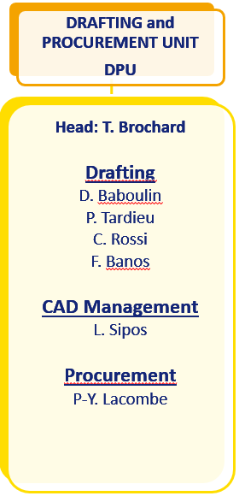
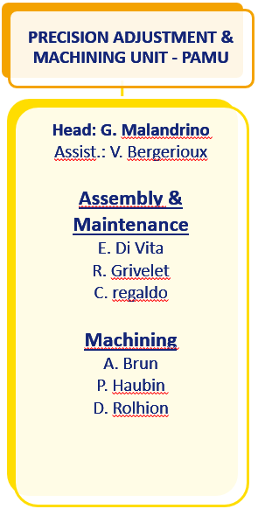
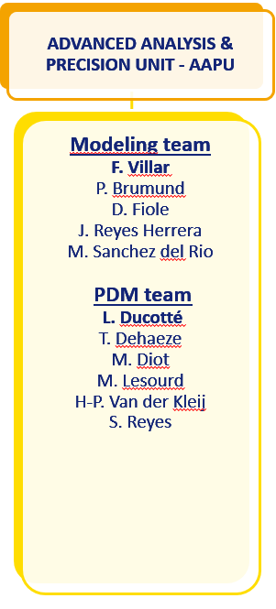
ORGANISATION AND STAFF
Drawings, CAD, Procurement assistance
Mechanical Assembly, Machining
Expertise in calculations, visible optics, tests and optimisation of precision motion systems
Engineering projects for the beamlines and the accelerators
L. Loiacono – MEG Assitant

Slide 4
MEG – ENG. UNIT
Beamline/machine
Technical specification
Equipment installation
DEG/ACU-BCU/XOG
ISDD
Design (choice) compatibility
Design & drawings
Drafting, procurement
Mechanical Engineering Unit missions
MEG – Eng Unit
Project management & Mechanical design
Calculation
Mounting & measurement
Advanced Analysis & Precision unit
Buildings, Handling
Alignment
PAMU / PEL
BIG Vacuum group ALGE
TID

Slide 5
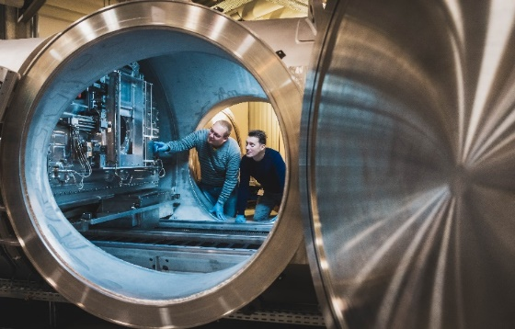
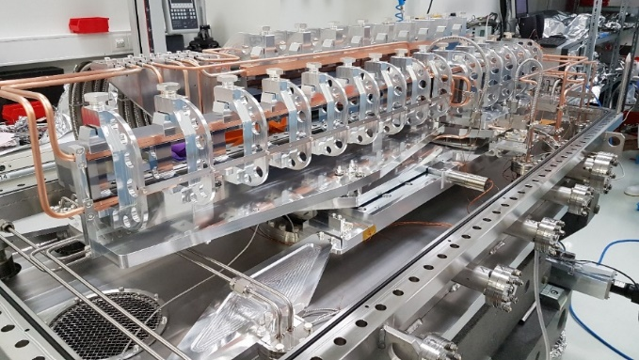
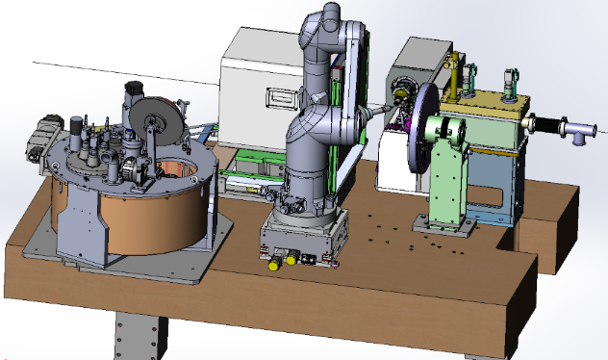
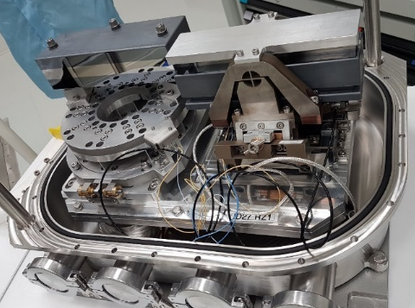
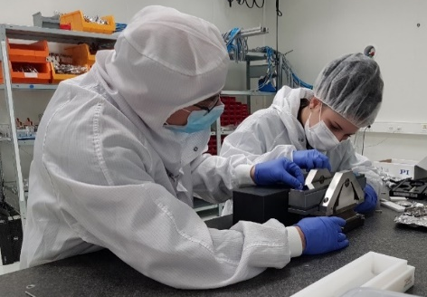
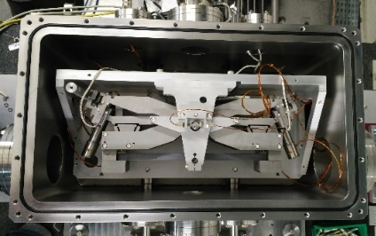
Meg – ENG U / team a
Carole CLAVEL
Mechanical Engineer Team A leader
Beamline ID10, ID23, ID24, ID29, Mirrors, KB
Joachim Léonardon
Beamline BM05, ID02, Choppers, HPSlits

Slide 6
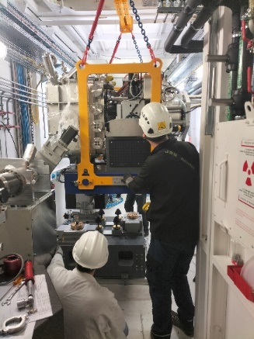
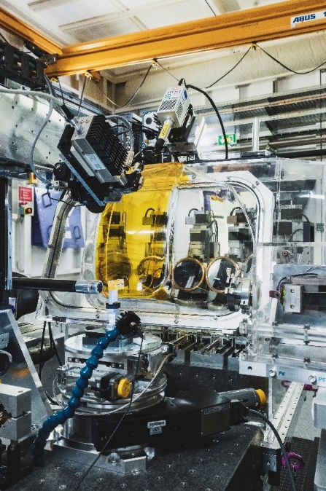
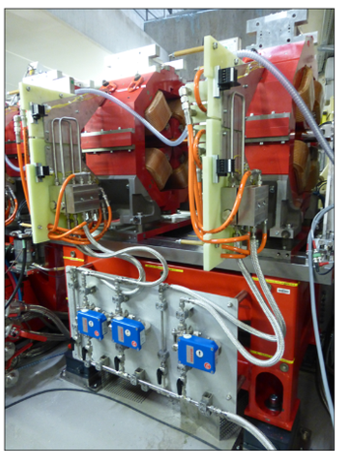
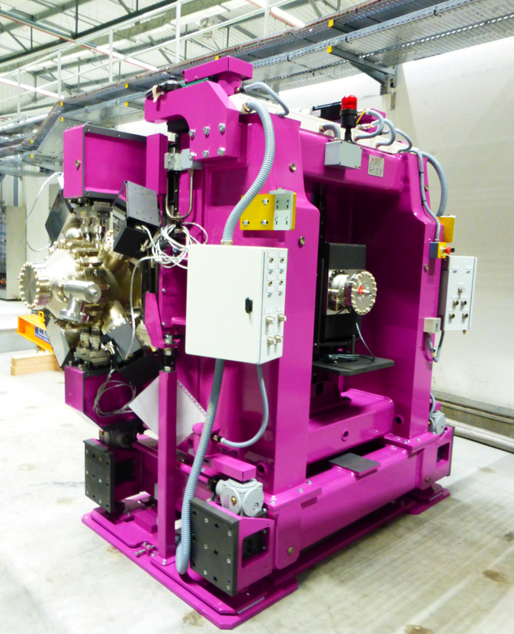
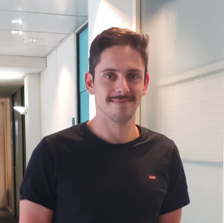
Meg – ENG U / team a
Bernard Ogier
Mechanical Engineer
Mechanical Project for Machine (insertion device, RF
Transfer Line, Booster)
Alban Moyne
Mechanical Engineer
DCM, Beamline BM23, ID15

Slide 7
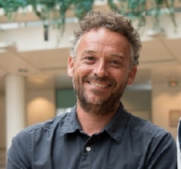
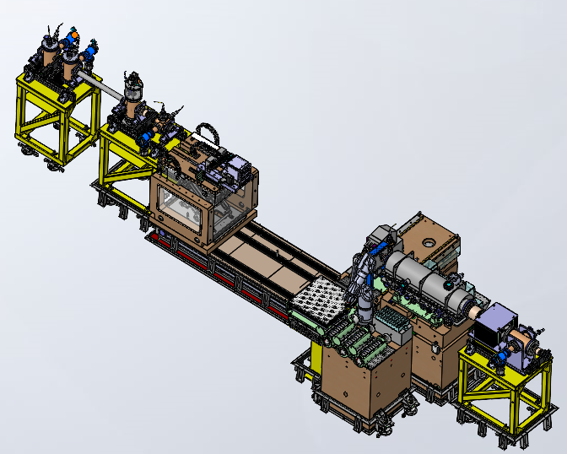
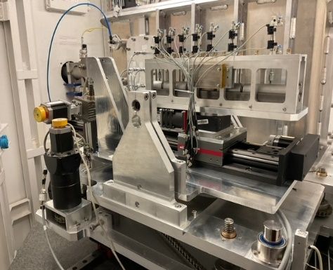
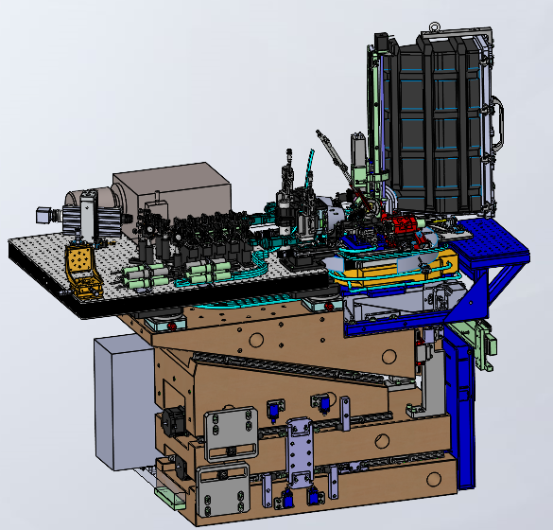
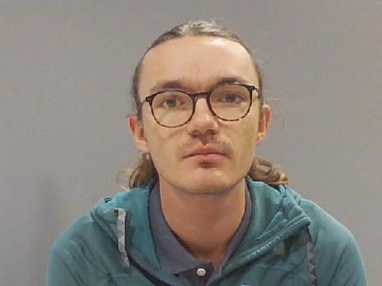
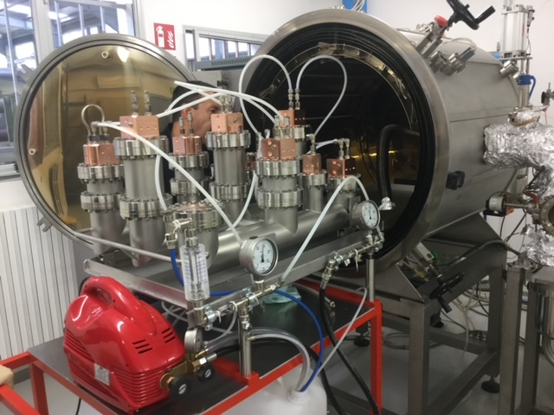
Meg – ENG U / team a
Eric Gagliardini
Mechanical Engineer
Beamline ID11, ID16B
EBS - absorbers
Marin Bossard
Mechanical Engineer
Beamline ID24, ID10, ID29

Slide 8
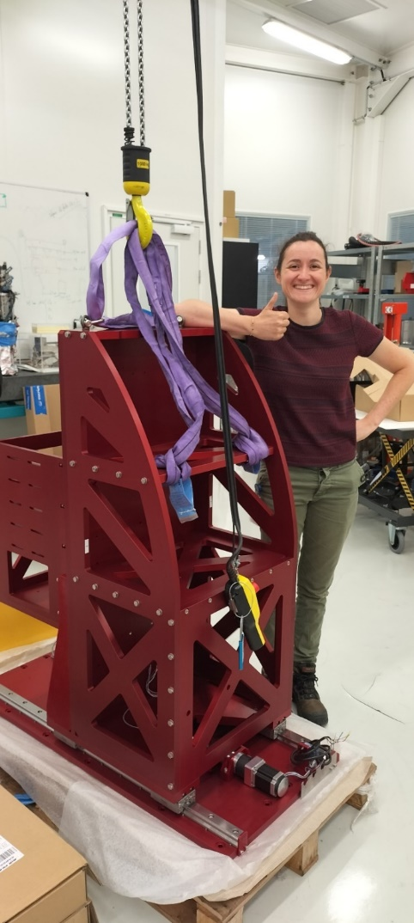
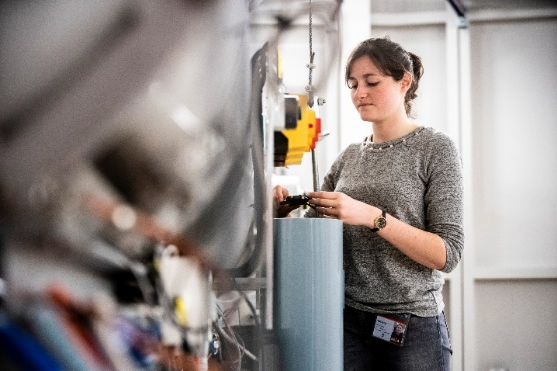
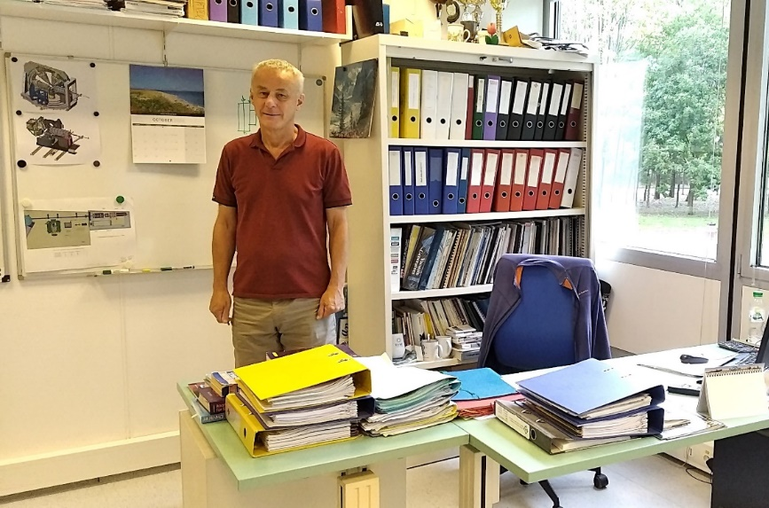
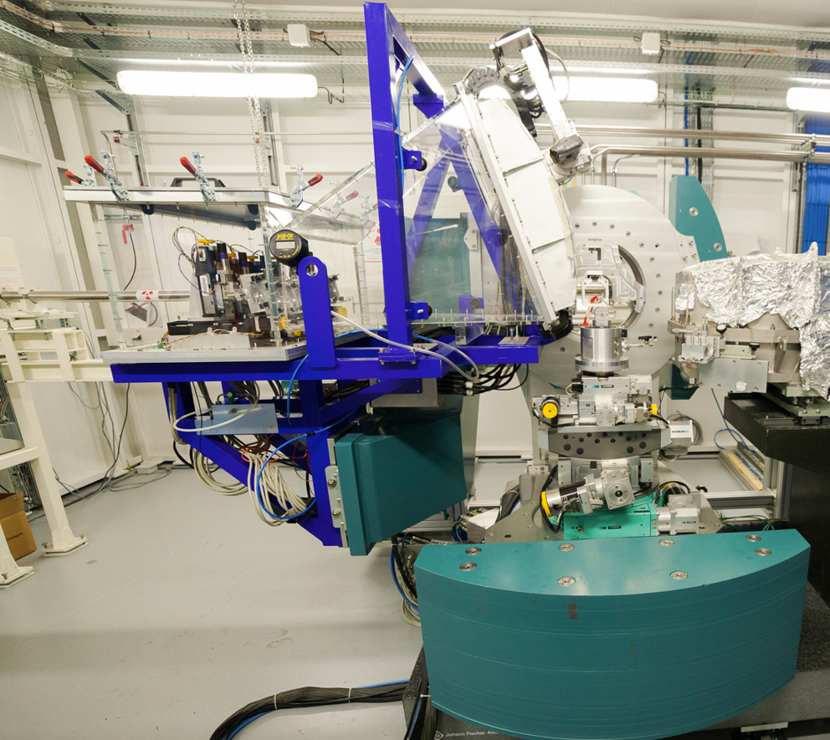
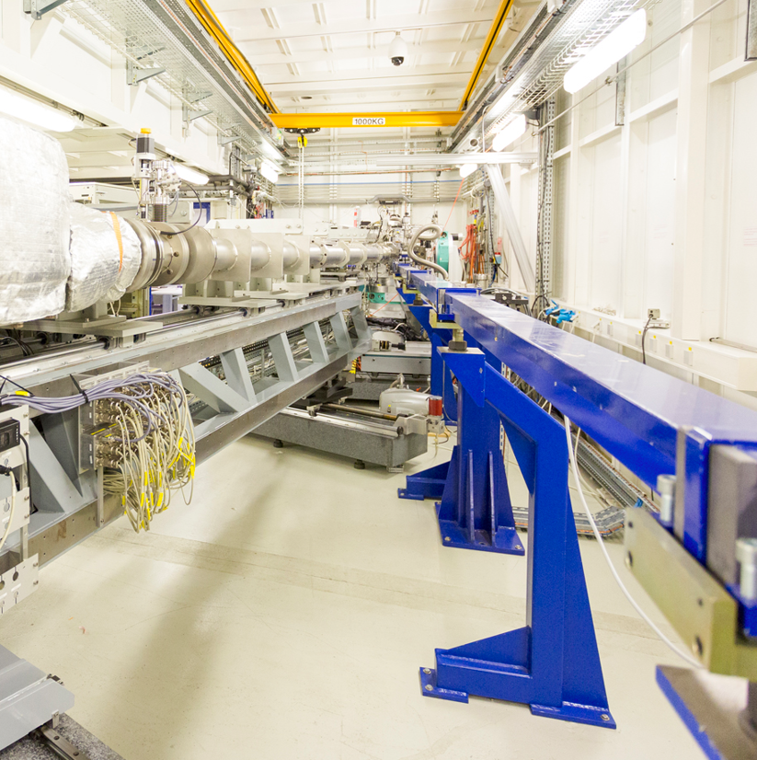
Meg – ENG U / team B
Anne-Lise Buisson
Team B Leader
Beamline correspondent
ID01, BM29, ID30A, ID30B
Keith Martel
Mechanical Engineer
Mechanical Project Leader for ID20, ID27, ID28

Slide 9
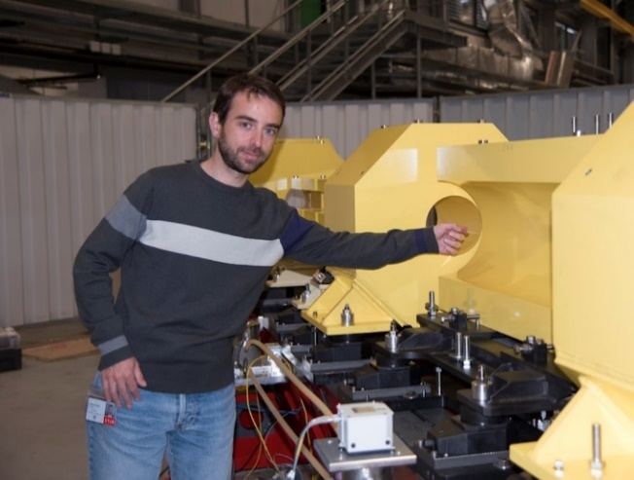
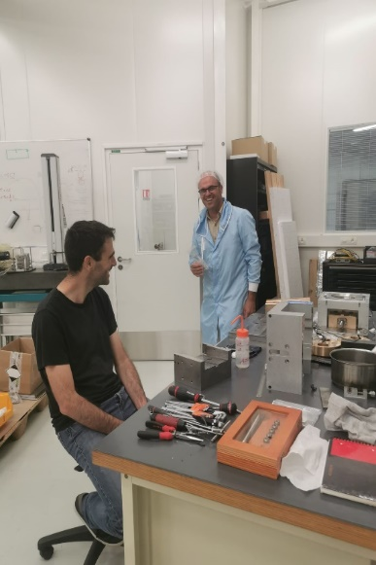
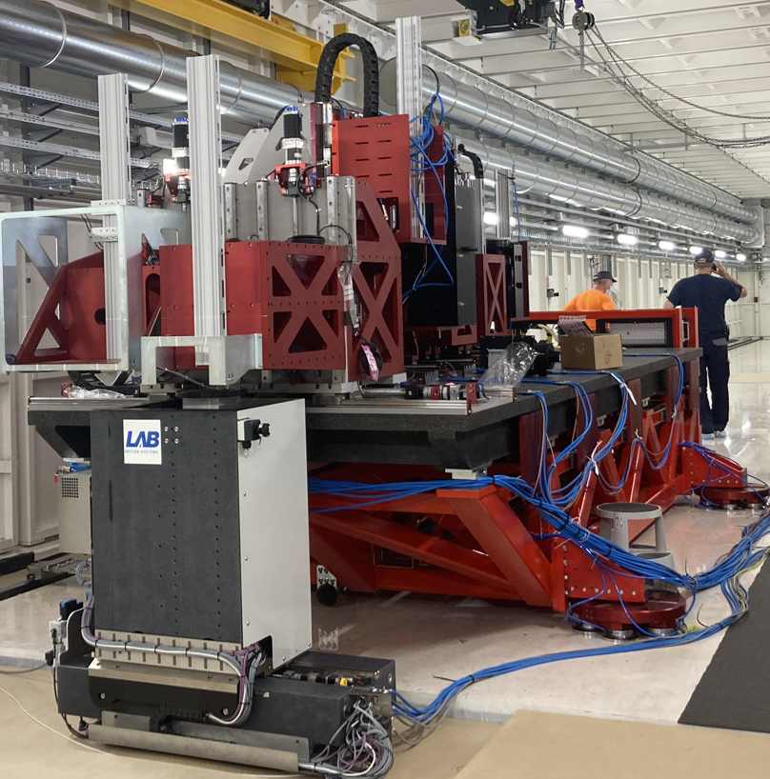
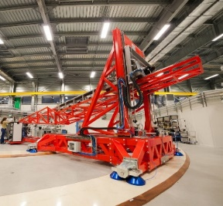
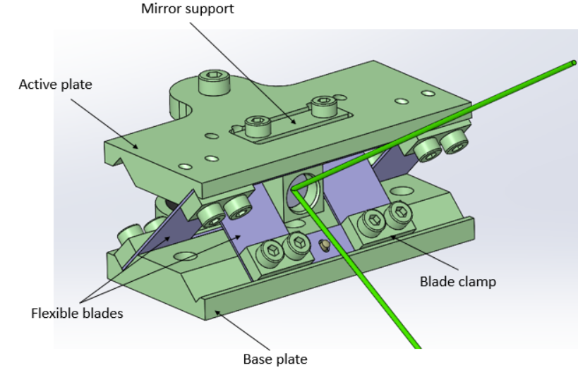
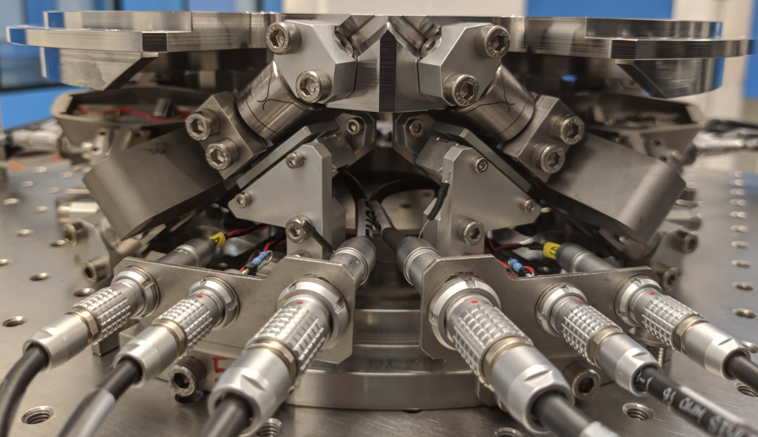
Meg – ENG U / team B
Filippo Cianciosi
Mechanical Engineer
EBS girders& Dchambers, BM18 Mec. Resp., ID32 Spectrometer
Julien Bonnefoy
Mechanical Engineer
DCM Team, ID31-ID09 MEG correspondent
Nano-Hexapod, LEAPS

Slide 10
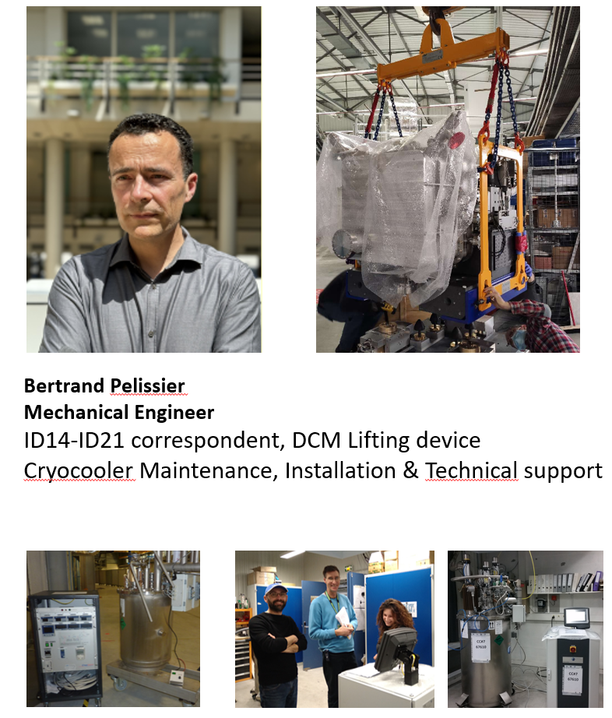
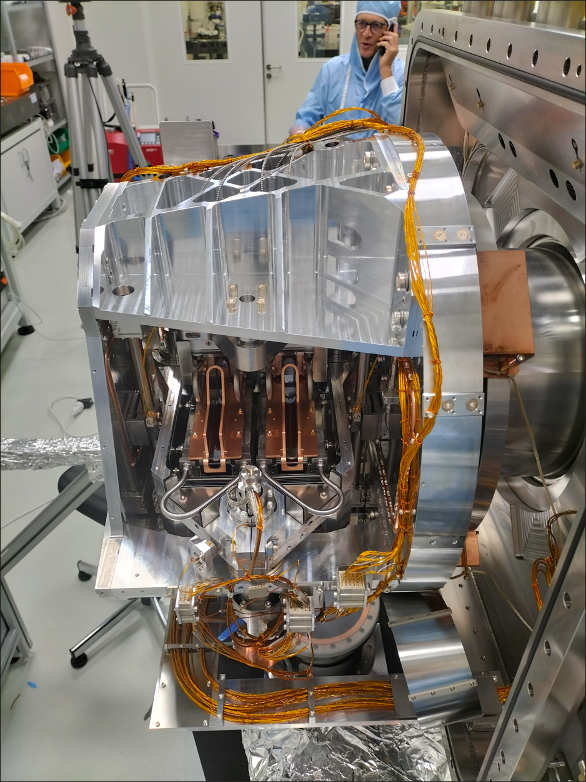
Meg – ENG U / team B
Noel Levet – Engineer
In charge of alignment tasks for CRG BL + BM05 (14 BL)
+ Carry out geometrical measurements on in-house designed
and outsourced equipment during the assembly process in labs

Slide 11
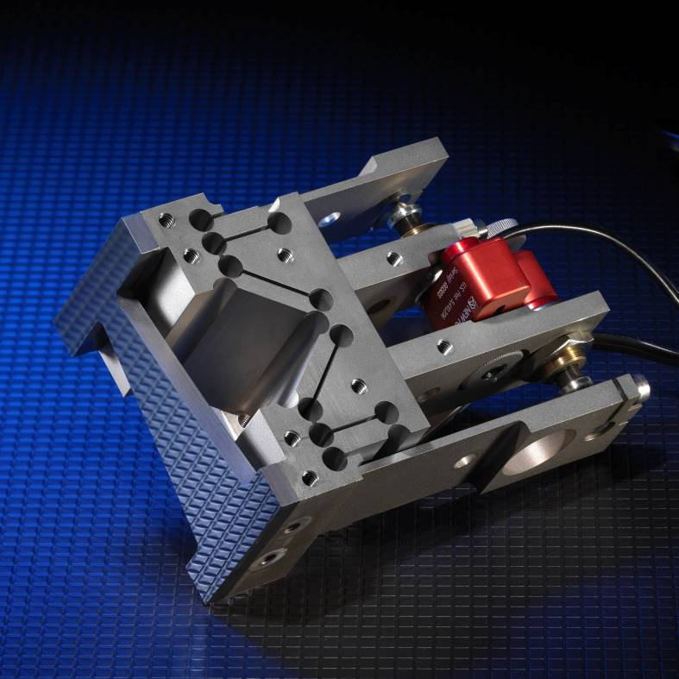
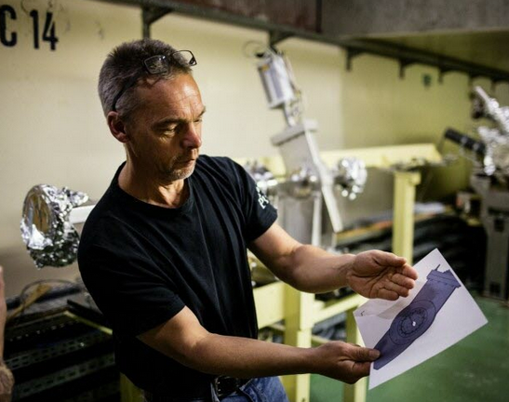
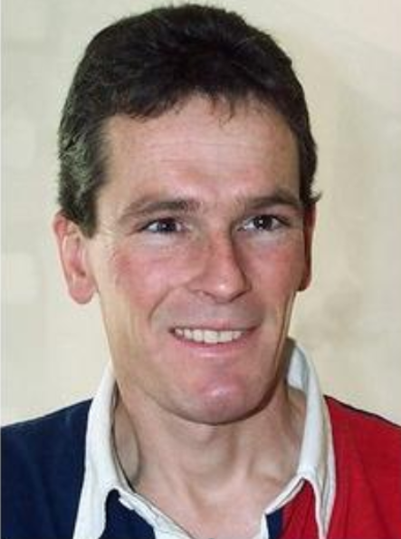
Meg – ENG U
5mm
76mm
Michael Hahn – Engineer
Just arrived in MEG correspondent
for ID13 and ID19
Bob Baker – our opto-mechanical expert
KB/Mirror/DCM monochromator
“almost” retired.

Slide 12
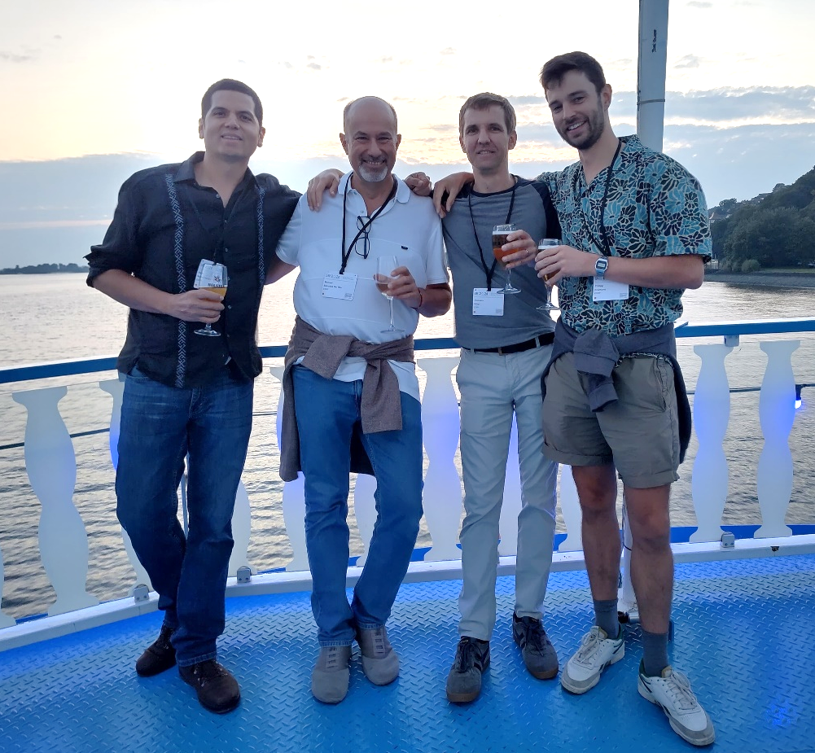
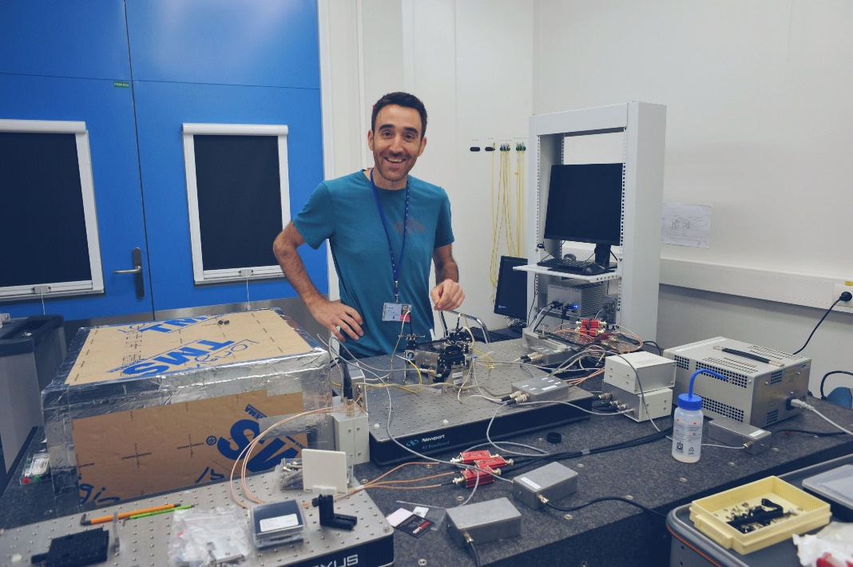
ISDD/MEG/AAP unit /Modelling team
François Villar
Team leader + mechanical engineering

Slide 13
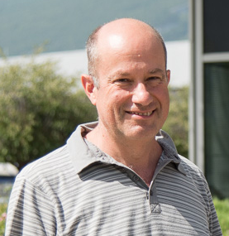
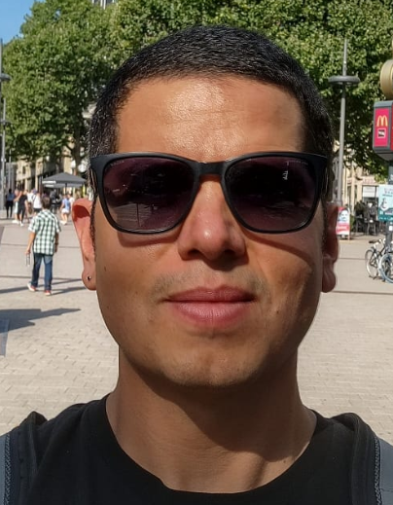
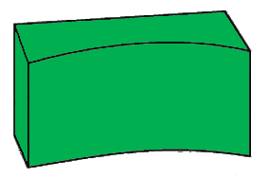
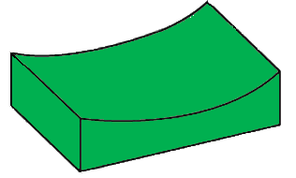
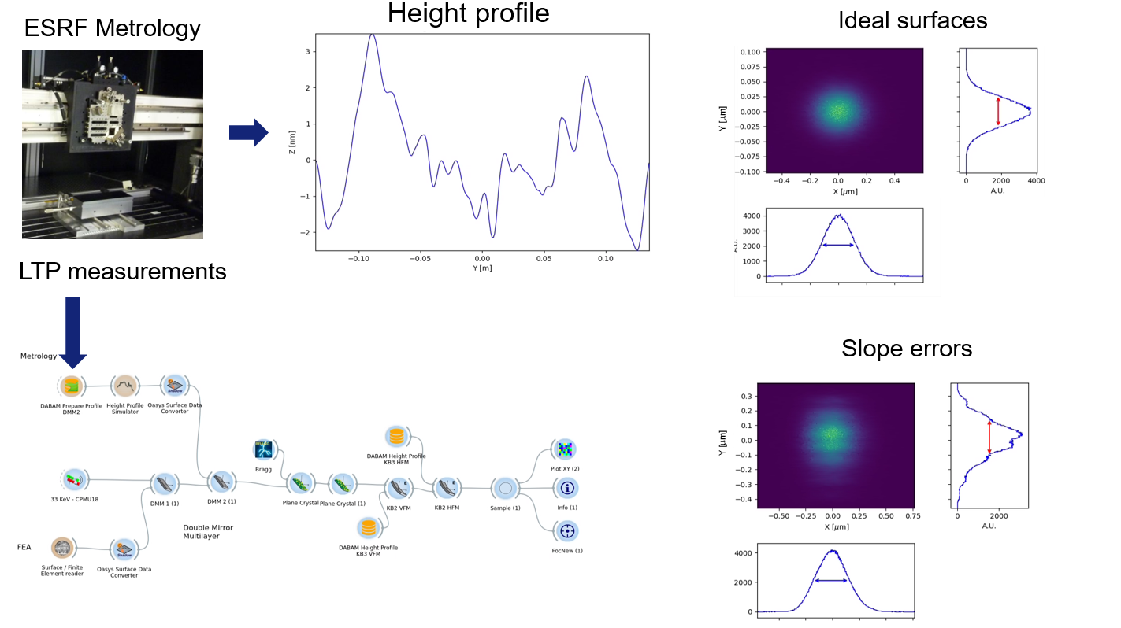
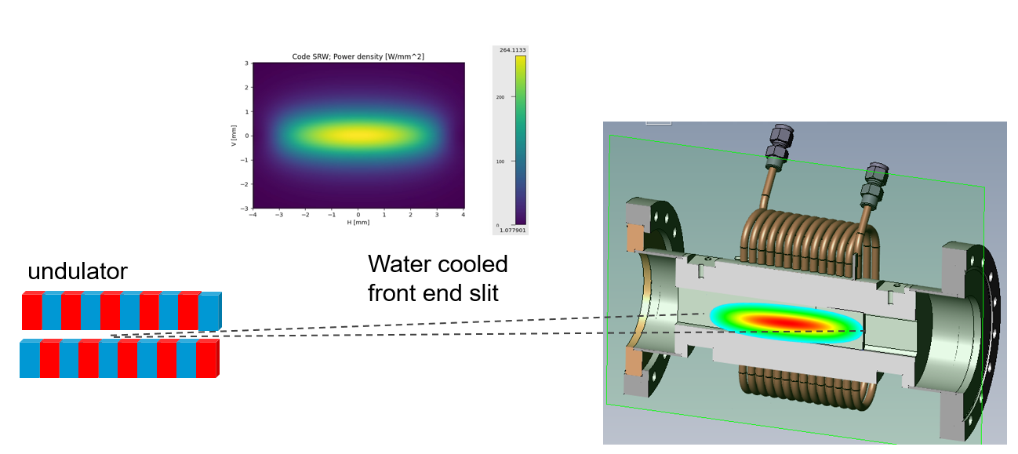
ISDD/MEG/AAP unit /Modelling team
Power management
Photon transport
Coherence transport
Manuel Sánchez del Río
Juan Reyes-Herrera
Focusing system
Front end
Primary slits
Monochromator
Source
Sample
Primary mirrors
KB mirrors
Water-cooled
slits
Windows
& Absorbers
Power management
Photon transport

Slide 14
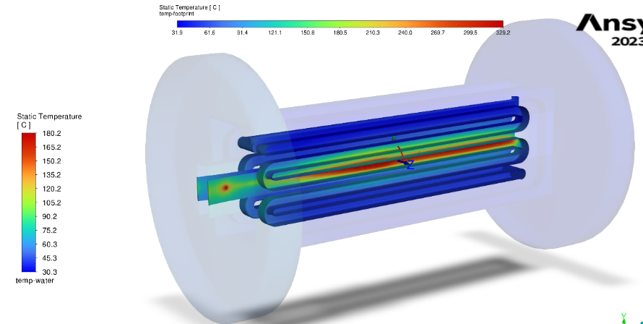
ISDD/MEG/AAP unit /Modelling team
Finite element analysis
Mechanical engineering
New design of Front End slit
(Computational Fluid Dynamics)
Philipp Brumund
Optical design
and simulation
Daniel Fiole

Slide 15
Precision Dynamics & Mechatronics Team
Precision Dynamics & Mechatronics Team
Metrology
Characterisation of positioning systems performances
PEL
Hans-Peter
Vibrations
Characterisation of dynamic behaviour, vibration amplification
DEL
Marc Lesourd
Development of nanopositioning systems
Mechatronic design process :
Architecture design
Actuators selection or custom design
Simulations
Design of embedded metrology systems
Thomas & Ludovic
Signal analysis
Expertise
Marc Diot
Mechatronic systems
Expertise/Projects/Tests
MEL
Thomas Dehaeze
Sébastien Reyes (newcomer oct-2024)

Slide 16
PEL : Precision engineering lab
Hans-Peter van der Kleij
Example : Fastjack test bench
Example : ID03 GONIOMETER – CONTINUOUS SCANS
Characterisation of positioning systems
Contractual acceptance tests
Development of new systems at ESRF
Characterisation of mechatronic & optical systems
Contractual acceptance tests
Development of new systems at ESRF
Sébastien Reyes
(newcomer oct-2024)

Slide 17
PDM = VIBRATIONS & SIGNAL ANALYSIS
Marc Lesourd
Example : Large Volume Press – ID06
Analysis of structure deformation and implementation of data processing system to detect irregular events
16Hz
Correlation camera / vibration
Marc Diot
Example at BM30:
correlation vib / X-ray → identification of sources + structural modes

Slide 18
MEL : Mechatronics Engineering Lab
Active Vibration Control
Thomas Dehaeze
System Modelling
Predict System Performances
ID31
Without Control
With Control
6 µm
0,2 µm

Slide 19
OTHER ACTIVITIES
Management of PDM Team
Design, prototyping and tests of high precision positioning systems and online metrology systems
Ludovic Ducotté
Participation to ESRF DCM project over last years

Slide 20
ISDD / MEG / DPU / drafting
DPU mission is to provide assistance in mechanical design 3D + 2D to procurement
Drafting Unit
4 ESRF Staff
+
2 External companies
( 3 persons in total)
Budget:
~ 300-500k€ / Year
EXPD
Normal communication way is through EngU
ASD
ENG Unit
3D drawings
TID
2D drawings
ISDD
(BIG)
Procurement
(DEG)
Some projects are driven with direct supervision of the main proposer

Slide 21
ISDD / MEG / DPU Organization chart
Drafting and Procurement Unit
Head: Thierry Brochard
Assist. :
L. Loiacono Levet
Drafting
CAD Management
Procurement
ESRF Staff
Delphine Baboulin
Florian Banos
Christopher Rossi
Philippe Tardieu
Ext. Company
ERIA = 1.5
Probent = 1.5
Ludovic Sipos
Pierre Yves Lacombe

Slide 22
ISDD / MEG / DPU / drafting
Delphine Baboulin
ID03 - DMM
Cryostat
Philippe Tardieu
ID21 - station
ESRF - DCM

Slide 23
ISDD / MEG / DPU / drafting
Christopher Rossi
+ ASD projects
Cooling absorber
Newcomer Arrived 1st October
ID26 – Xtal support
Florian Banos
Electronics integration

Slide 24
ISDD / MEG / DPU / CAD management & procurement
55 SW licences – 250 users
55 EPDM licences
180 users
Ludovic Sipos
Cad manager
Pierre Yves Lacombe
procurement

Slide 25
ISDD / MEG / DPU /
2 External companies
(3 persons in total)
Budget:
~ 300-500k€ / Year
Loiacono Laurence
Assistante

Slide 26
pamu - Precision Adjustment & Machining Unit
The main mission of the Precision Adjustment & Machining Unit
Assemble and test high precision instrumentation ( DCM, MML, KB, etc … )
Manage standard Beamline instruments (slits, attenuators, shutters, photon absorbers, etc…)
Produce urgent machined components either in-house or through subcontractors
Giovanni Malandrino
Team Leader
Machining part
DCM
ID27 KB

Slide 27
PAMU : machining workshop
The machining team is specialized in high accuracy parts
Valérie manages the subcontracting activity and procurement
Arnaud Brun
Pierre Haubin
Dominique Rolhion
Valérie Bergerioux
Sample environment
V – HRC 60
DCM- UHV below
Key figures = up to 200 projects and 120K€/subcontracting

Slide 28
Pamu : assembly lab
The main activities are the Opto-Mecanique assembly & Cryocooler Maintenance
Eve Di-Vita
Rodolphe Grivelet
Cédric Régaldo
Clean room
ID21 NANO KB
MML
Cryocooler
BM18 Cross Lenses

Slide 29
Challenges & Conclusions
We're facing the same challenges as 15 years ago, only more difficult.
With continued improvements of optics and insertion device technologies the beam is getting smaller and smaller while beam power density is getting higher and higher (800 W/mm2)
=> We need higher-precision mechanisms that are even more compact and sometimes even faster.
=> We have a much better organization (ISDD) and we have gained expertise with modelling (beam & mechanisms) and real-time control. We have Projects that are already working well (DCM/nano station/beamlines). We have to develop/test new actuators and new on-line measurement system.
=> We need ambitious beamline projects to move forward

Slide 30
ISDD 15 YEARS - MEG
THANK YOU FOR YOUR ATTENTION

Slide 32
MEG – ENG. UNIT

