Slide 1
07/01/2022

Slide 2
19/08/2022

Slide 3
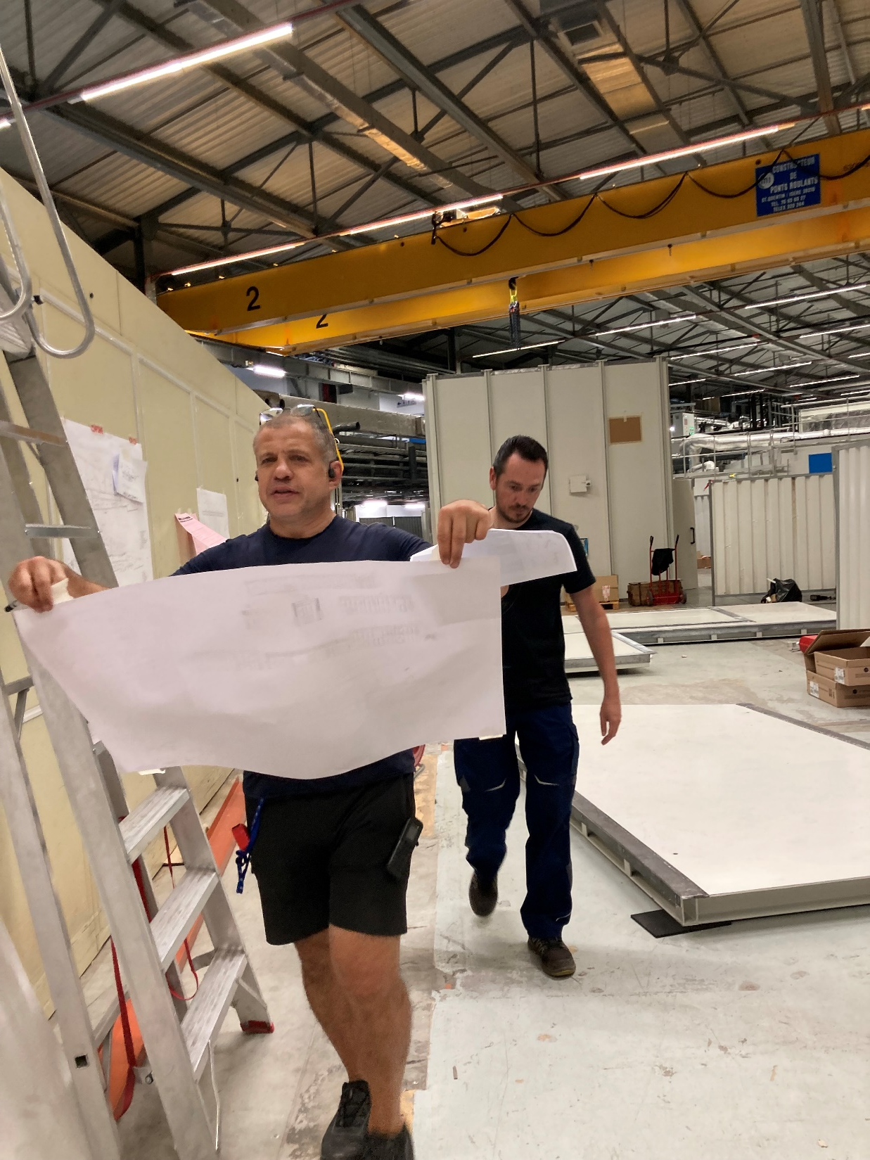
16/08/2022
Photo credit: Helena Isern

Slide 4
13/09/2022
Photo credit: Helena Isern

Slide 5
14/10/2022

Slide 6
14/10/2022

Slide 7
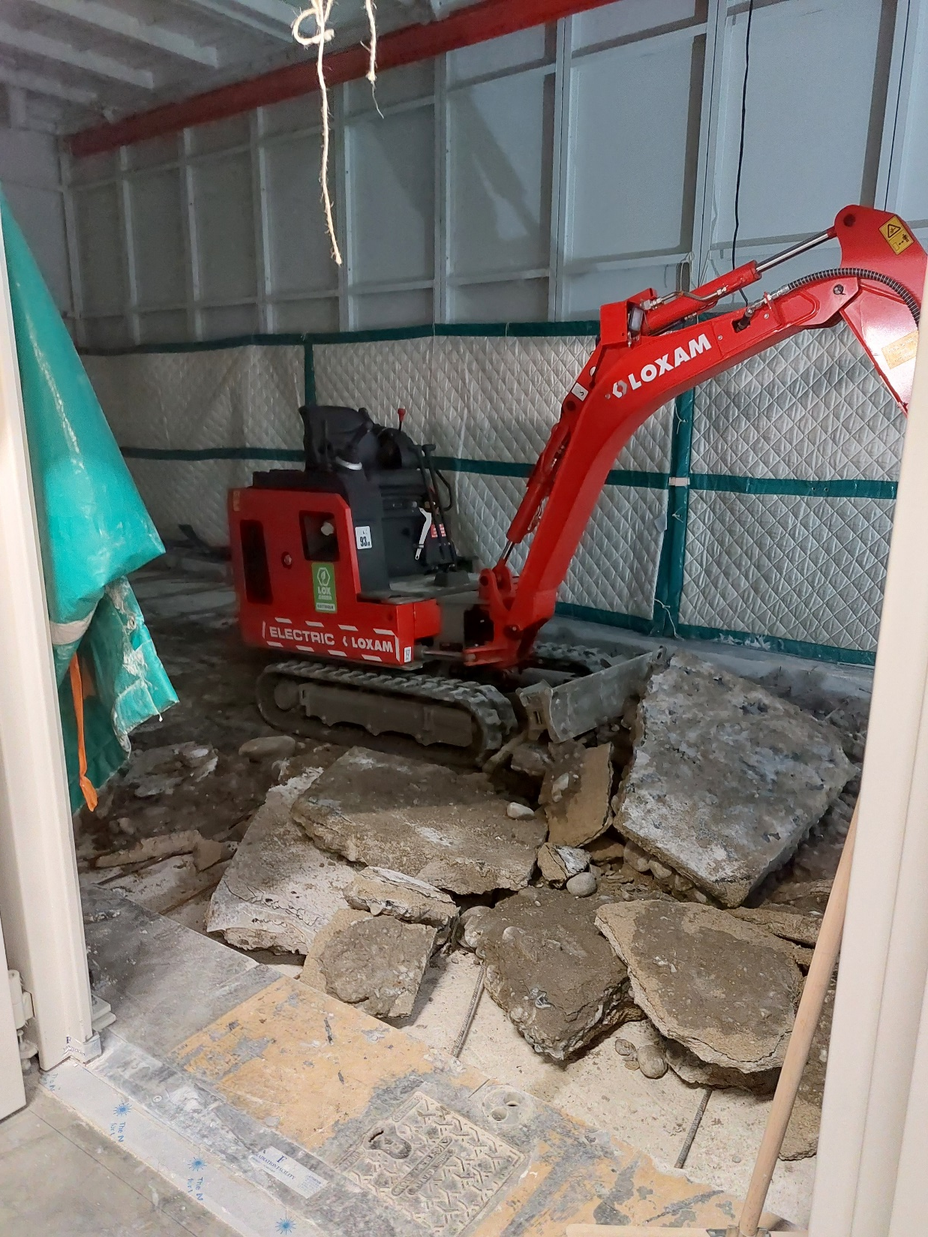
20/10/2022

Slide 8
02/12/2022

Slide 9
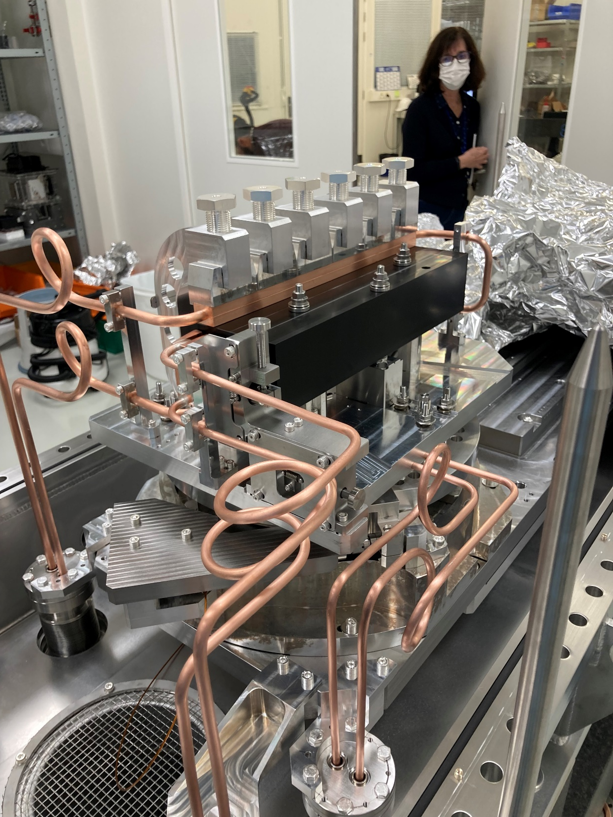
05/12/2022
Photo credit: Helena Isern

Slide 10
07/12/2022

Slide 11
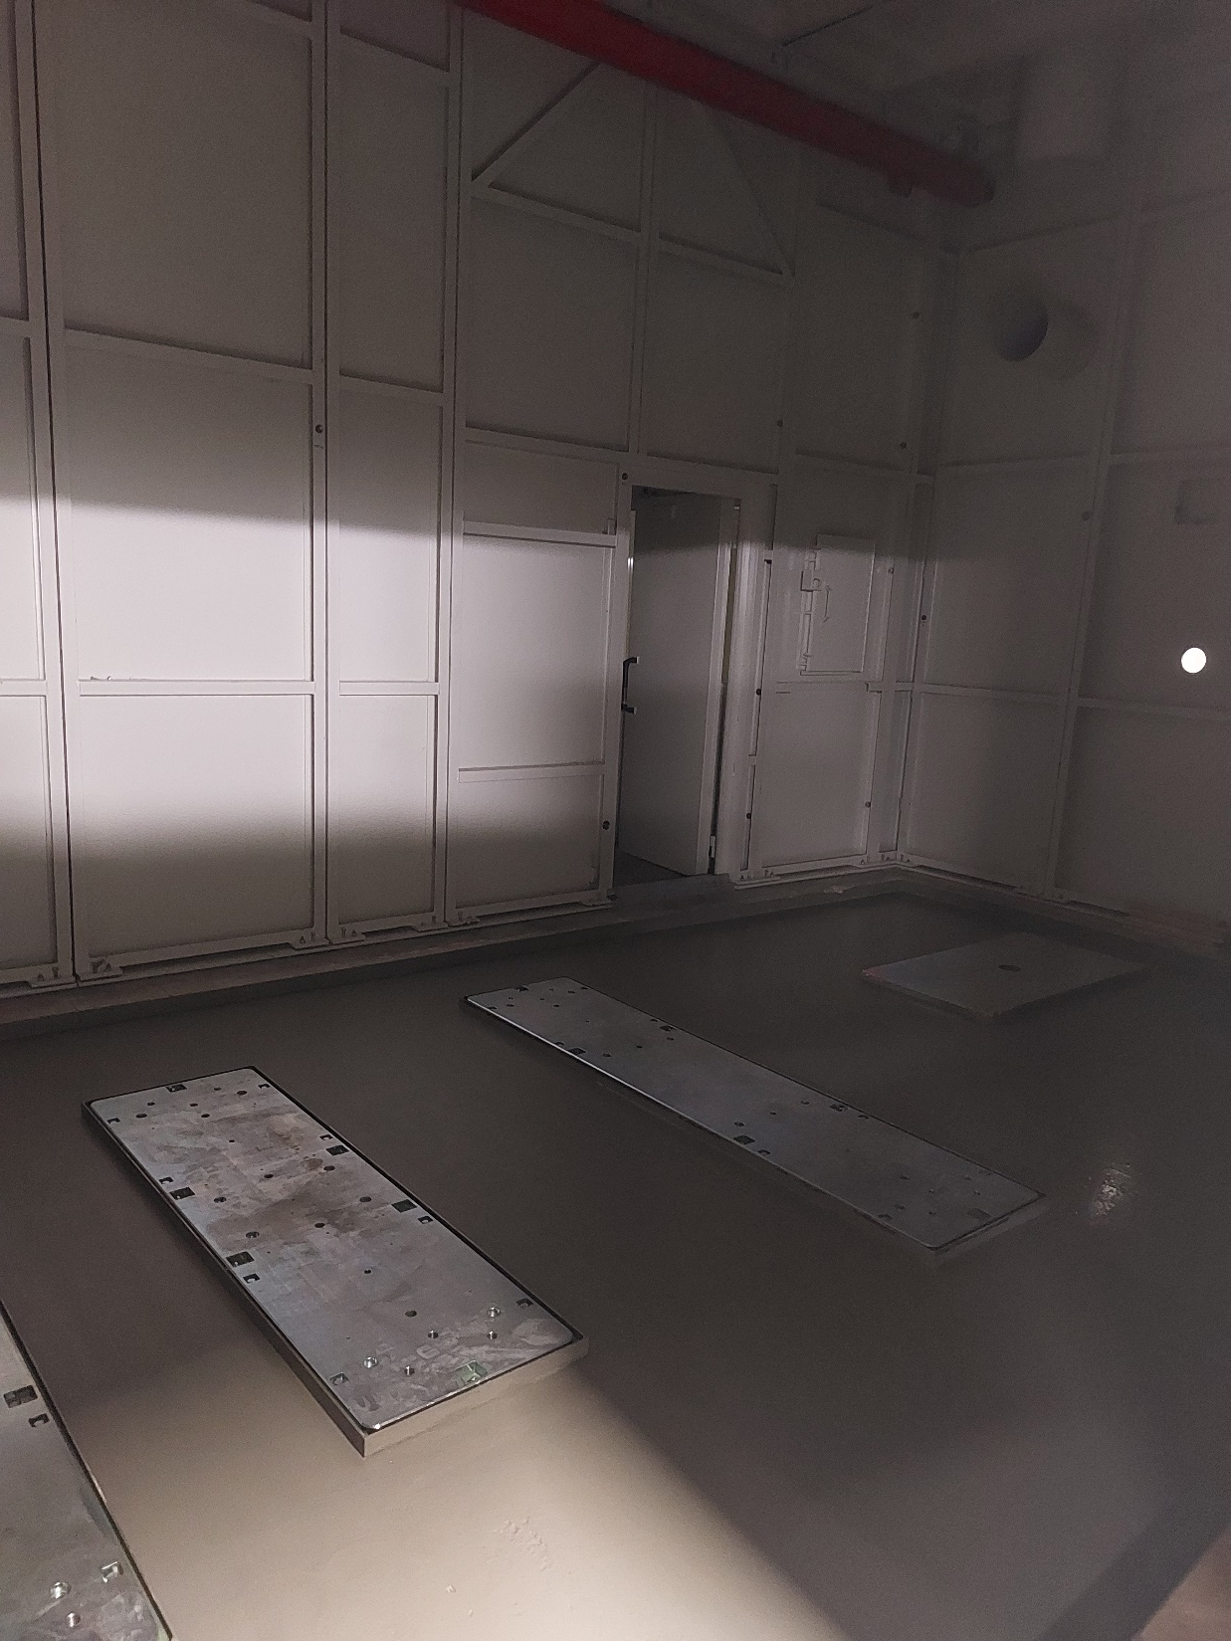
07/12/2022

Slide 12
04/01/2023

Slide 13
04/01/2023

Slide 14
04/01/2023

Slide 15
13/01/2023

Slide 16
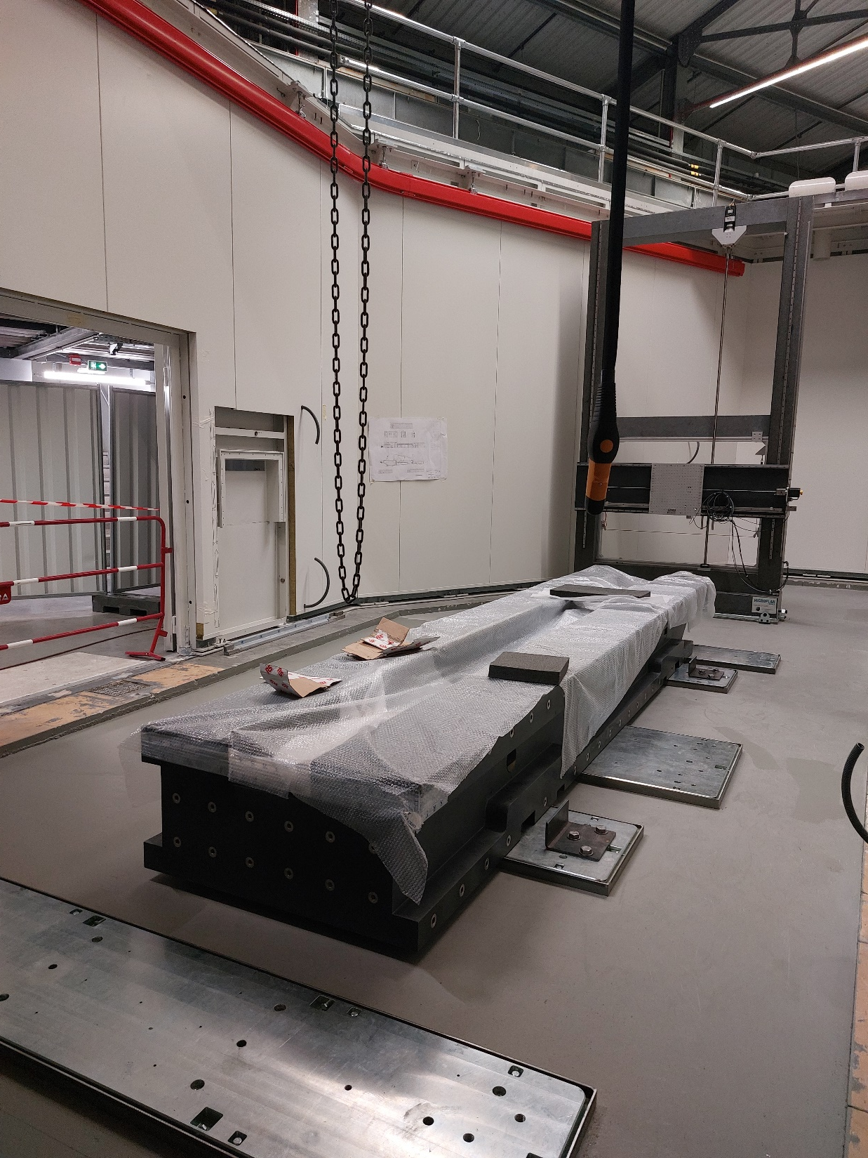
13/01/2023

Slide 17
17/01/2023

Slide 18
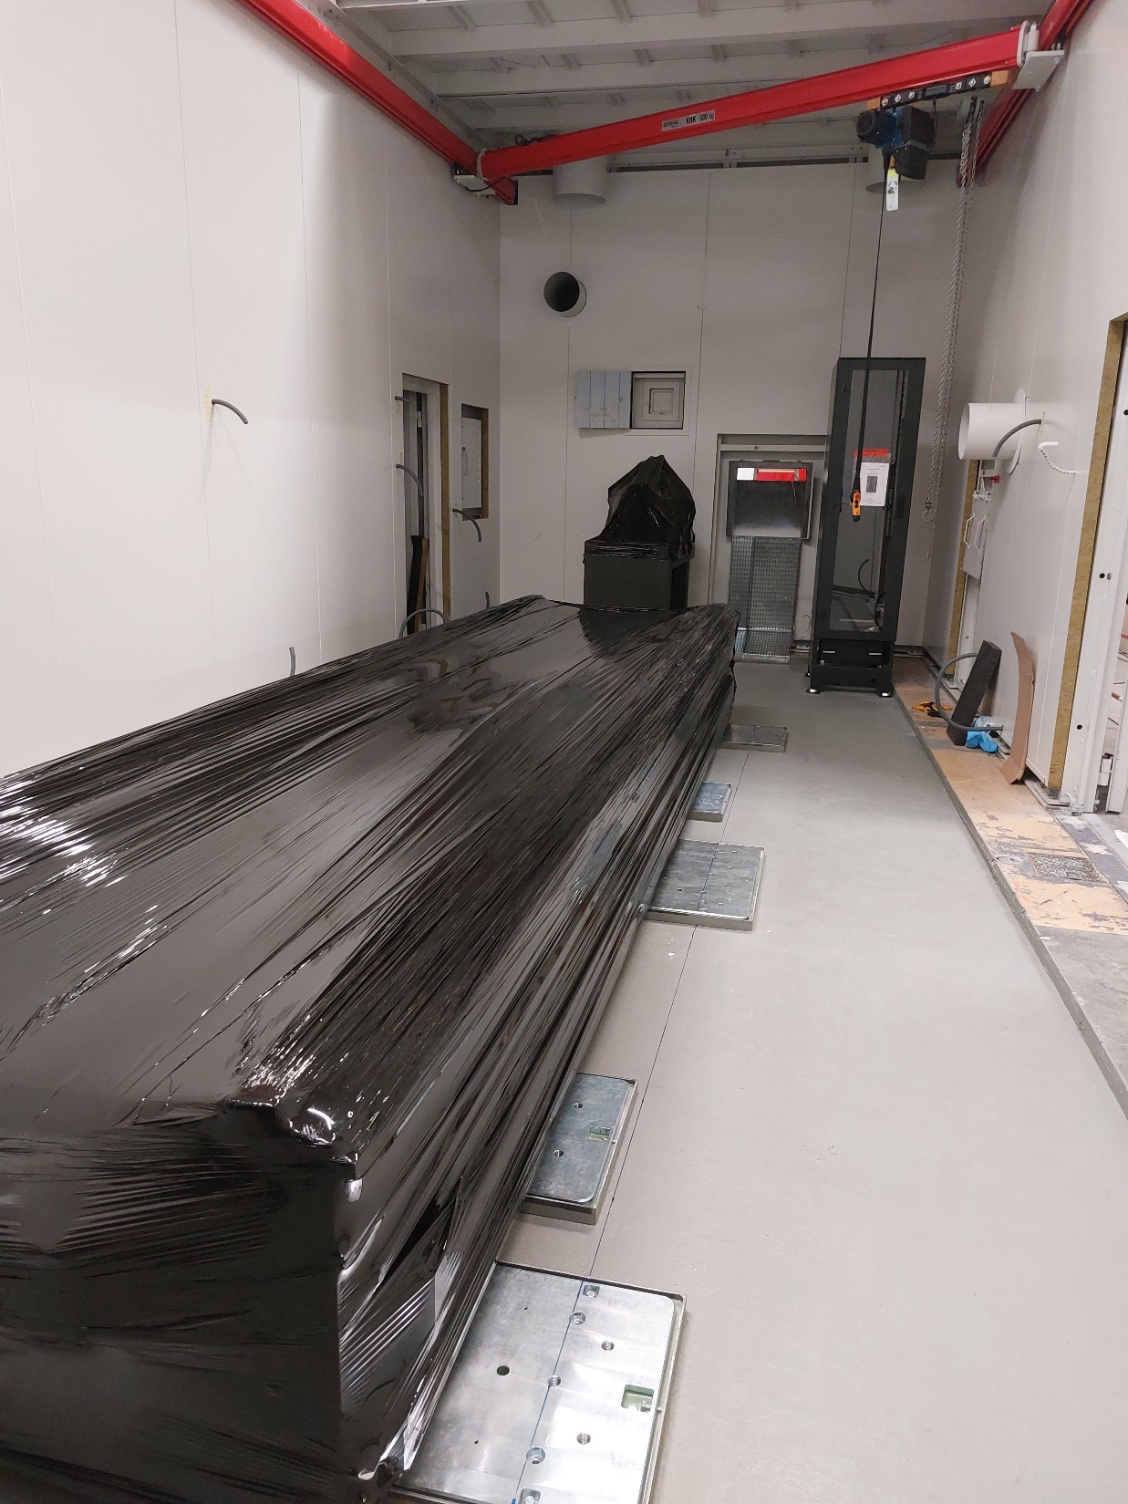
17/01/2023

Slide 19
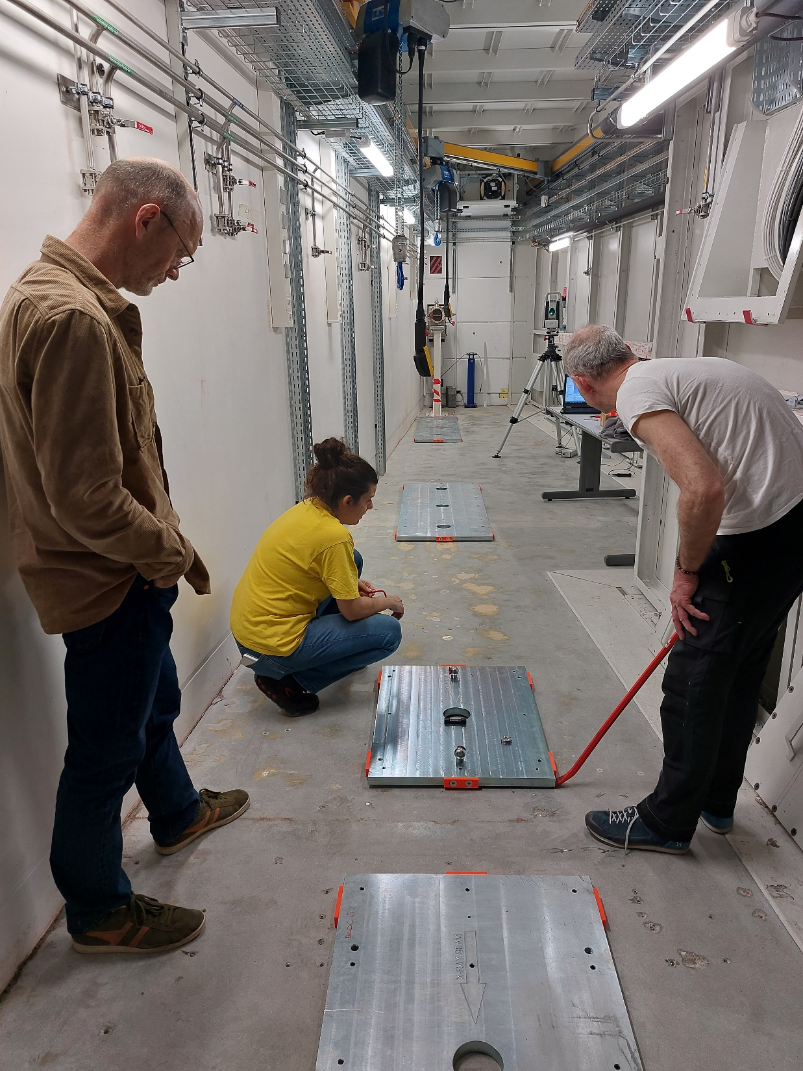
20/04/2023

Slide 20
25/04/2023

Slide 21
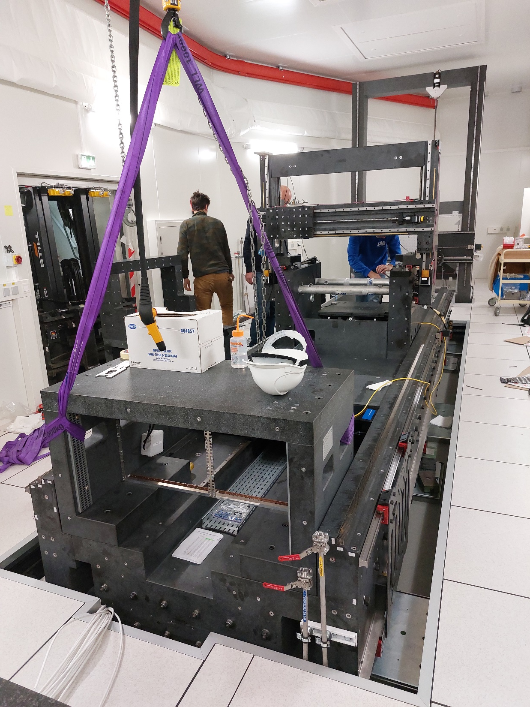
26/04/2023

Slide 24
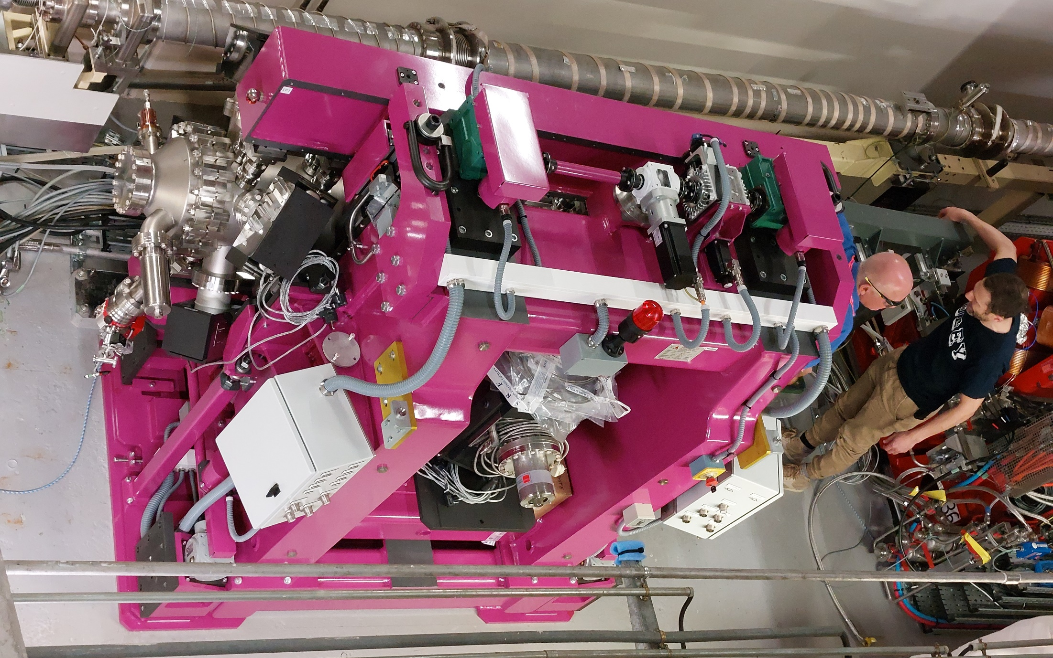
07/08/2023

Slide 25
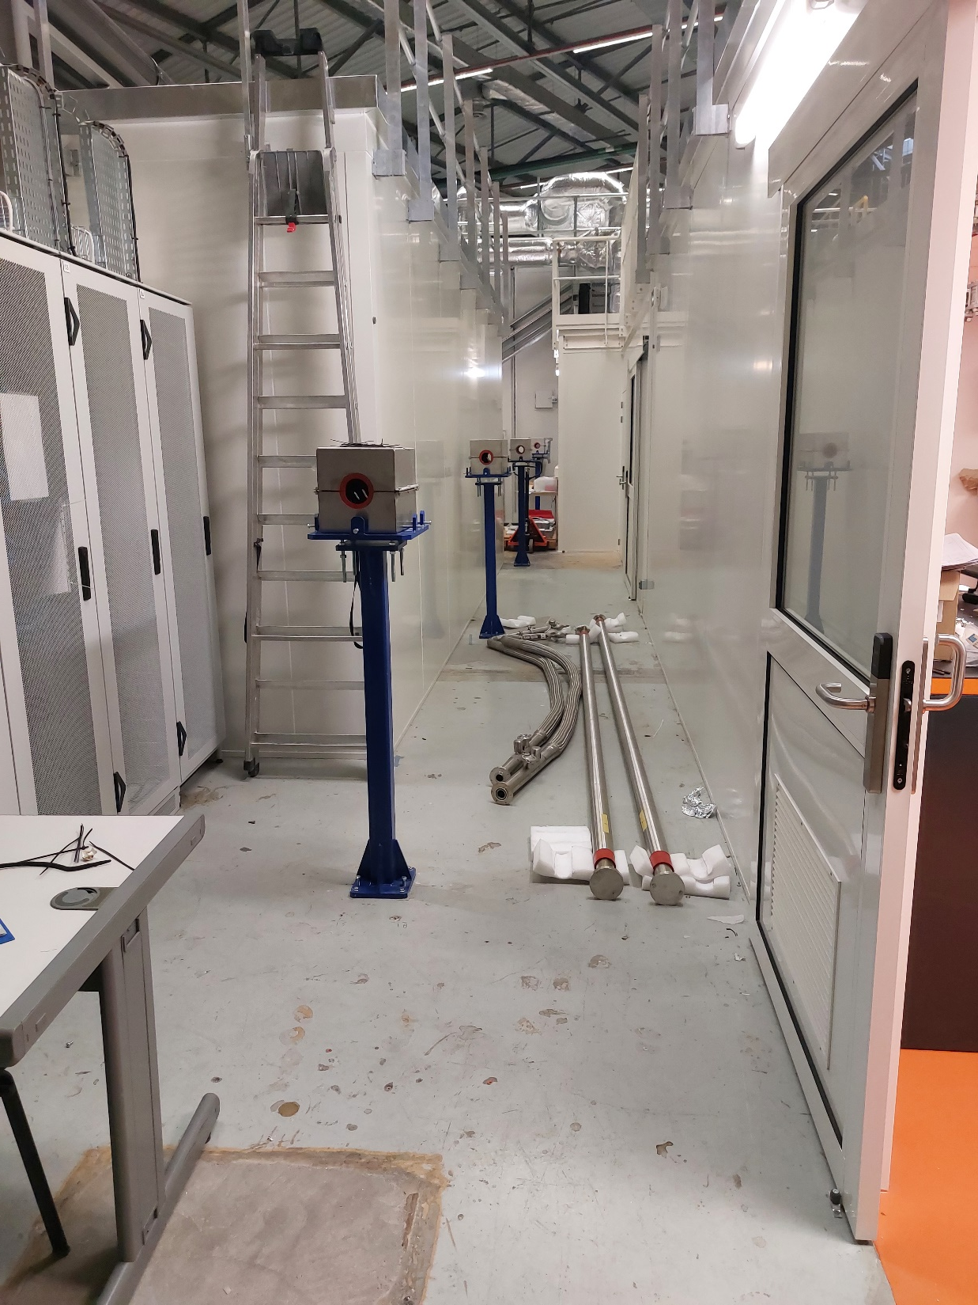
05/05/2023

Slide 26
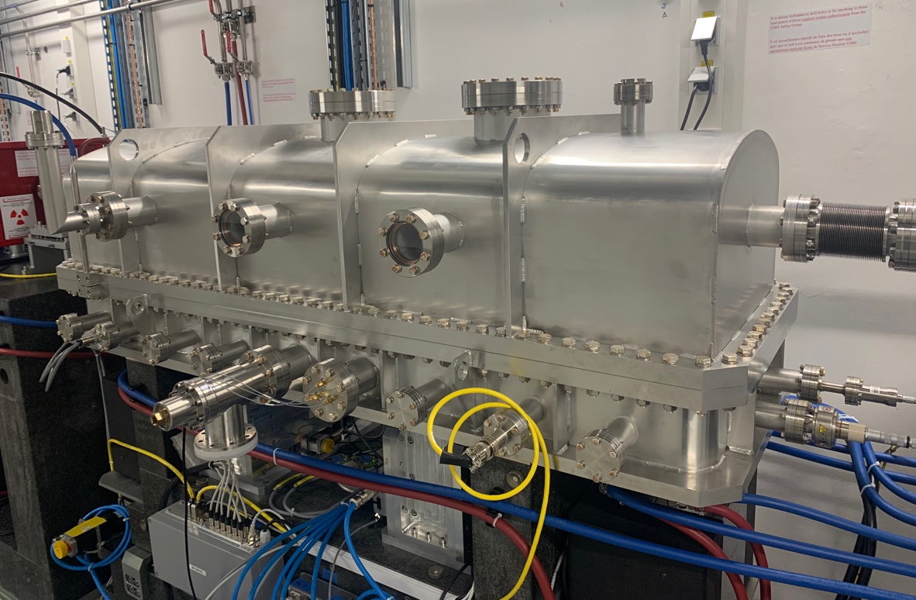
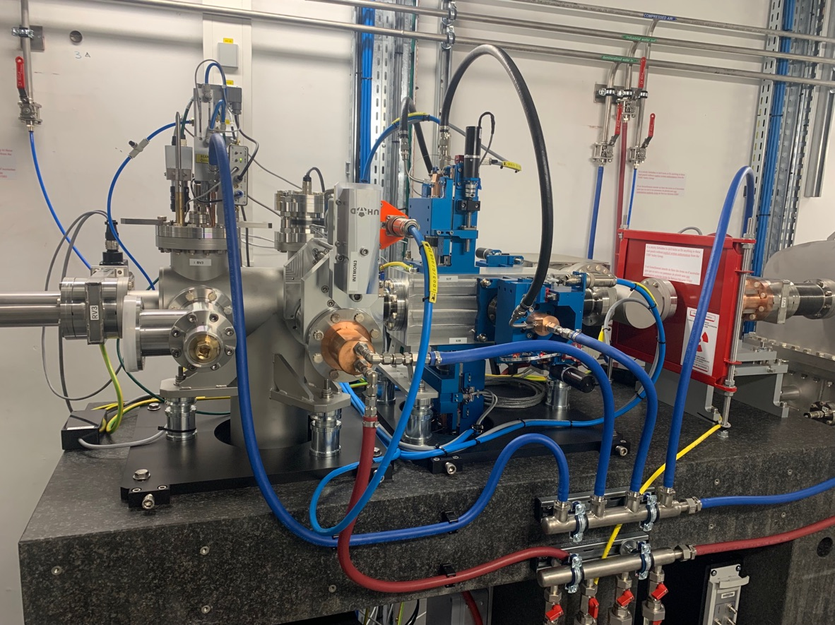
17/09/2023
Photo credit: Thomas Dufrane

Slide 27
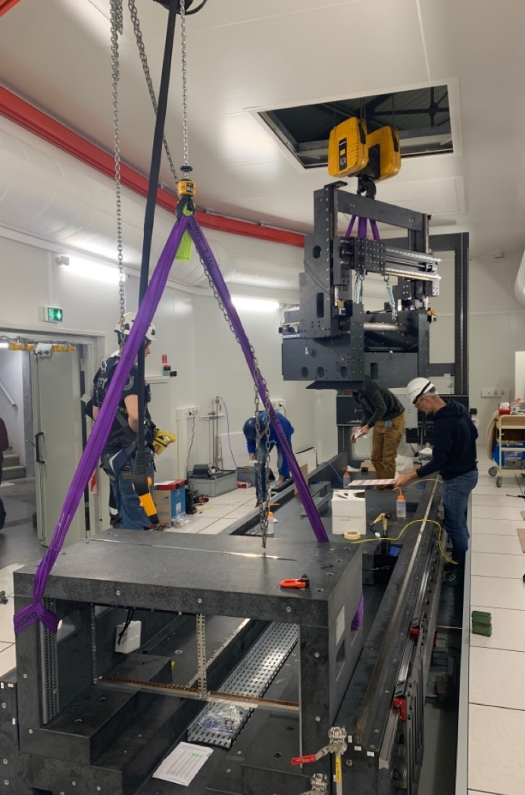
05/05/2023
25/04/2023
Photo credit: Thomas Dufrane

Slide 28
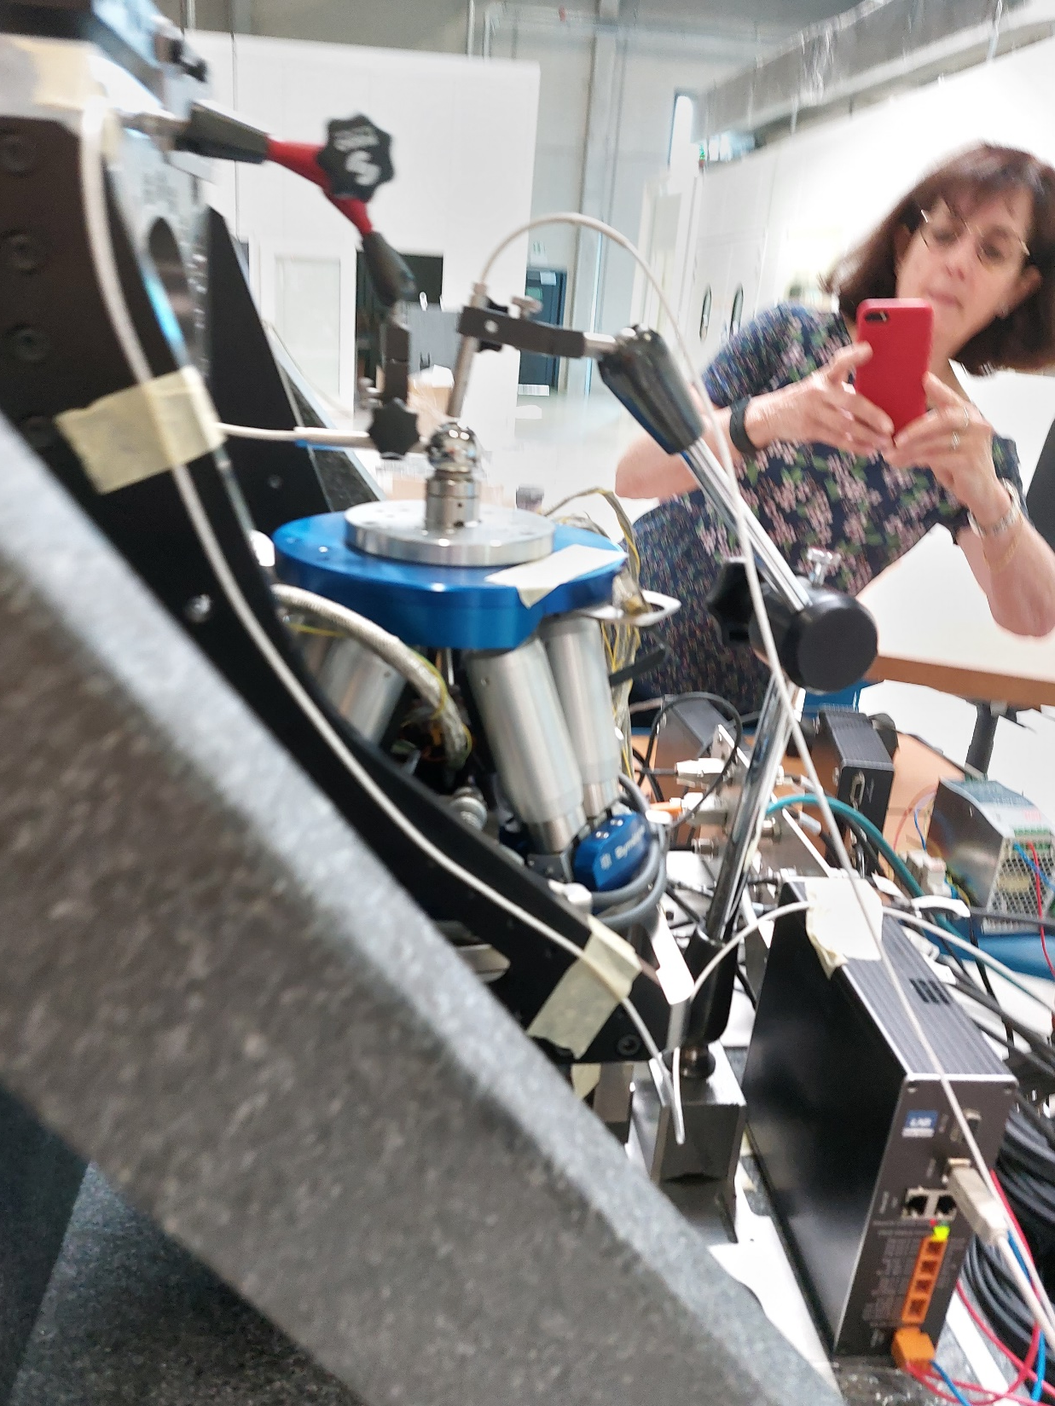
14/06/2023

Slide 29
07/07/2023

Slide 30
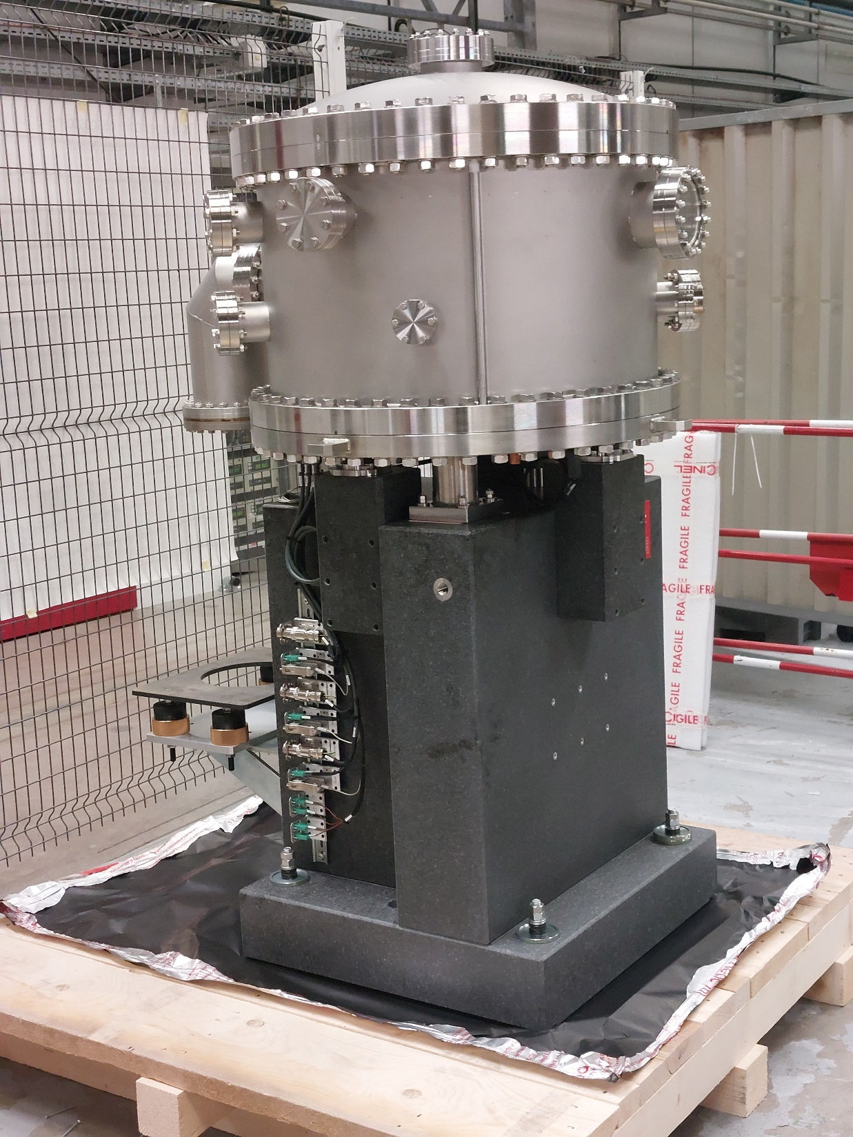
06/12/2023

Slide 31
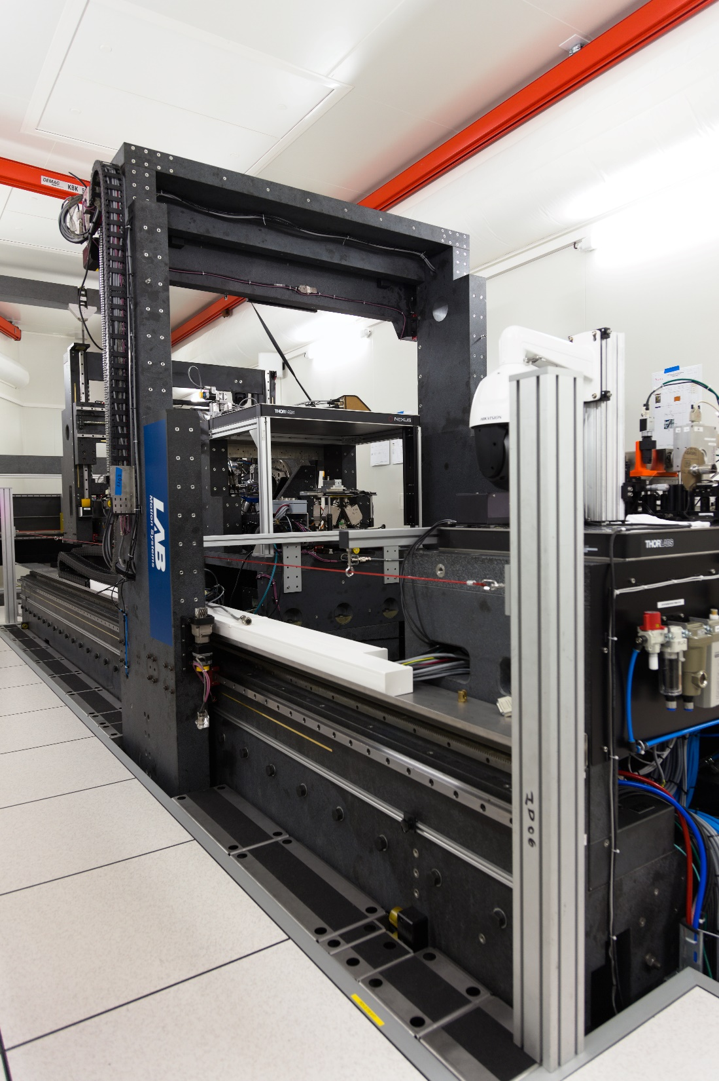
29/04/2024

Slide 32
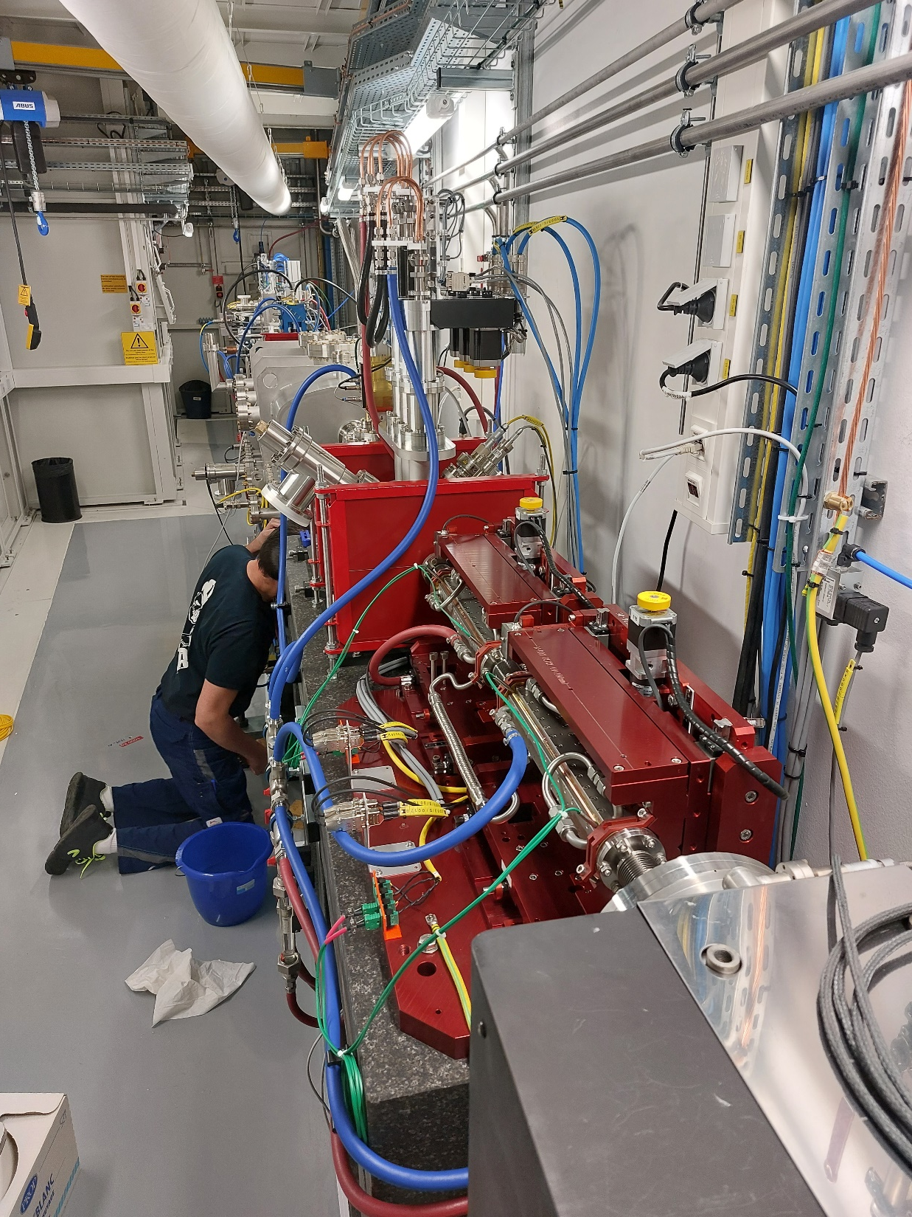
14/11/2023
24/11/2023

Slide 33
29/04/2024
Photo credit: Jeff Wade

Slide 34
29/04/2024

Slide 35
29/04/2024
Photo credit: Jeff Wade

Slide 36
29/04/2024

Slide 37
Photo credit: Jeff Wade
29/04/2024

Slide 38
29/04/2024
Photo credit: Jeff Wade

Slide 39
Photo credit: Jeff Wade
29/04/2024

Slide 40
29/04/2024

Slide 41
29/04/2024

Slide 42
29/04/2024

Slide 43
29/04/2024
Photo credit: Jeff Wade

Slide 44
21/04/2024

Slide 46
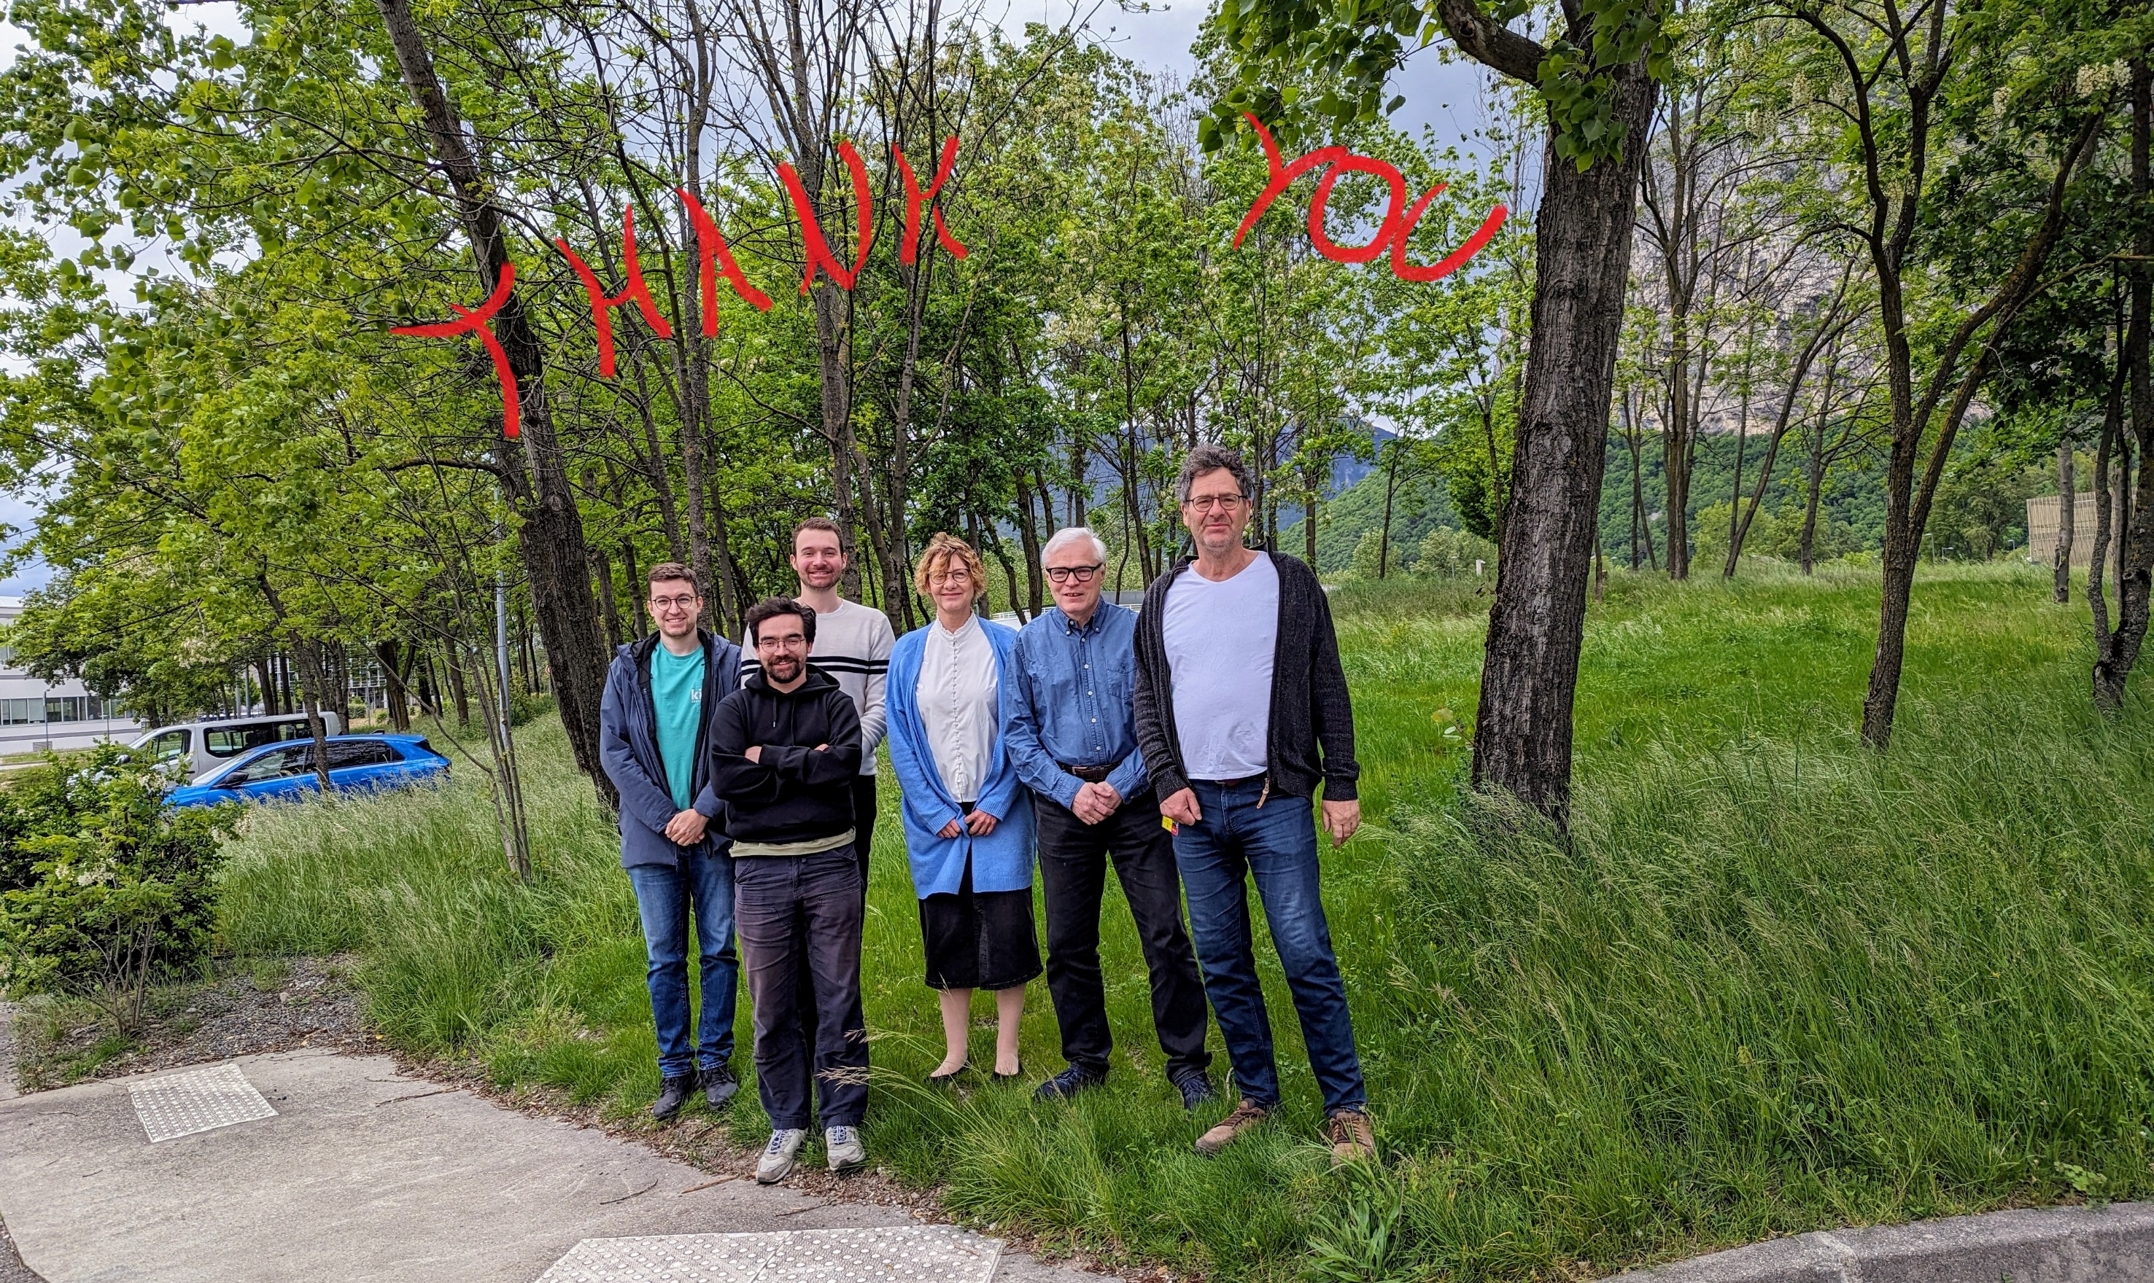
28/04/2024

Slide 47
07/05/2024

