Slide 2
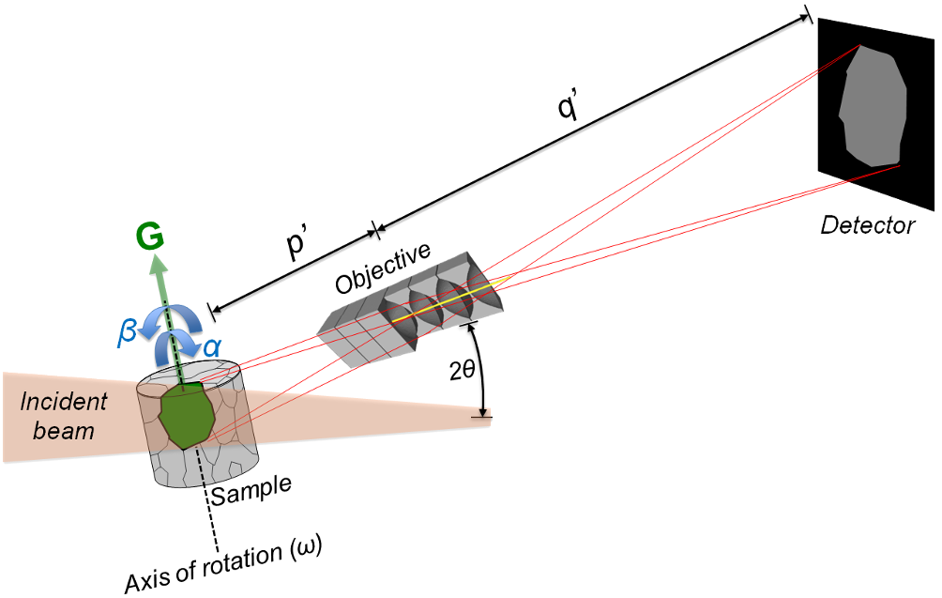
ID03,
the ESRF Dark-Field X-ray microscopy beamline
C. Detlefs (ESRF), on behalf of the ID03 team:
Helena Isern
Raquel Rodriguez Lamas
Thierry Brochard
Thomas Dufrane
Can Yildirim
and many collaborators

Slide 3
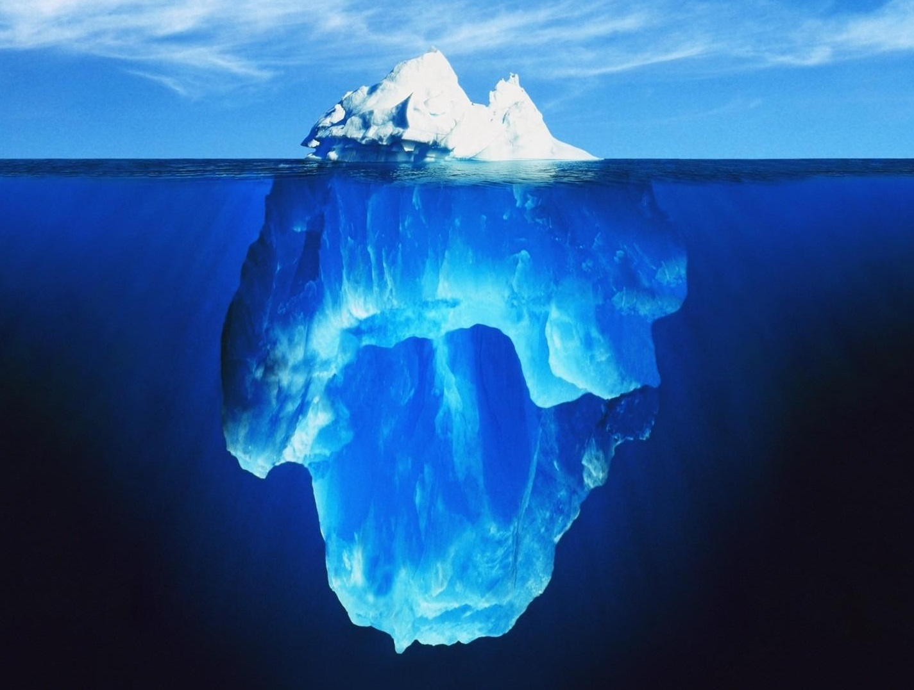
T. Brochard, T. Dufrane,
H. Isern. C. Detlefs
ESRF Support Services

Slide 4
How to build a beamline
Figure out what the beamline should do
Scientific case
Technical concept
→ Conceptual Design Report (CDR)
Figure out how to do that
Technical Design Report (TDR)
Source
Optics
End station

Slide 5
Dark field x-ray microscopy
Magnified diffraction topography
using a lens between sample and detector
You take a sample and align a Bragg reflection
You put an imaging detector in the diffracted beam
You insert an objective lens between the sample and the detector
Diffraction topography
Rocking curve imaging
X-ray microscopy
H. Simons et al. (2014). Dark-field X-ray microscopy for multiscale structural characterization. Nature Communications 6, 6098. DOI: 10.1038/ncomms7098

Slide 6
Dark field x-ray microscopy
Magnified diffraction topography
using a lens between sample and detector
Detector resolution 1 μm
Magnification 10x – 30x
→Resolution at the sample 100 nm – 30 nm.
Advantages:
Full field method,
High spatial and angular resolution,
Diffraction
H. Simons et al. (2014). Dark-field X-ray microscopy for multiscale structural characterization. Nature Communications 6, 6098. DOI: 10.1038/ncomms7098

Slide 7
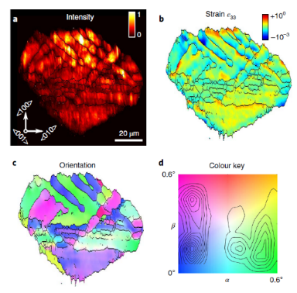
ID03: Scientific case
Metallurgy
Functional materials
Pattern formation
Materials fatigue
Recovery and recrystallization
Strain at grain boundaries
Formation of domain patterns
Dynamics of domain switching
3D strain maps with 150 nm spatial resolution
Biominerals
Microstructure
Image
Ceramics
Dislocation-
toughening
Nano-
twinning
C. Yildirim et al. (2020). Probing nanoscale structure and strain by dark-field x-ray microscopy. MRS Bulletin, 45, 277. DOI:10.1557/mrs.2020.89

Slide 8
Technical concept

Slide 9
Conceptual design of ID03/EBSL2
Boundary conditions:
Evolution of the prototype beamline ID06-HXM
Re-use the end station from ID06-HXM
Key parameters:
  Typical working energy 17-33 keV, up to 60 keV for complementary techniques (3DXRD, DCT)
  Resolution ~150 nm, diffraction limits ~60 nm
Design new optics fully optimized for Dark-Field x-ray microscopy
Pink beam and monochromatic beam
Rebuild beamline infrastructure from ground up
Budget envelope ~4 MEuros, excluding in-house man power
M. Kutsal et al. (2019). The ESRF dark-field x-ray microscope at ID06. IOP Conference Series: Materials Science and Engineering, 580, 012007. DOI: 10.1088/1757-899X/580/1/012007.

Slide 10
Technical design of ID03/EBSL2: priorities (1)
Dark-field x-ray microscopy is a notoriously photon-starved technique
Optimize photon flux
Use the best available source device
  New generation of cryogenically-cooled permanent magnet undulators (CPMU)
  Machine project for minimum gap 4 mm (currently 5 mm)
Allow “pink beam” operation
  Band width ΔE/E ~ 10⁻² given by peak width of the undulator harmonic
  gain of ~ x100 compared to Si(111) crystal monochromator

Slide 11
Technical design of ID03/EBSL2: Priorities (2)
Spatial resolution at present ~150 nm, future target ~60 nm
→ Optimize stability
Optical elements with horizontal deflection
  Ground vibrations are mainly vertical
  → horizontal optics less sensitive
  Vertical source size is still smaller than horizontal source size
Thermal stability of end station
  High performance HVAC
  Use of granite for support frames

Slide 12
Conceptual design of ID03/EBSL2
CDR was approved
“Gate B letter” 11/03/2021
Marching order to develop the Technical Design Report (TDR)
Total budget envelope of 4 Meuros
Implementation on sector ID03
Target date September 2023 for start of user operations.
Implicit: Allocation of internal resources for design studies
Project team
Helena Isern (Beamline operations manager)
Thierry Brochard (Mechanical engineer)
Carsten Detlefs (Beard)
Thomas Dufrane (Beamline technician)

Slide 13
How to build a beamline
Figure out what the beamline should do
Scientific case
Technical concept
→ Conceptual Design Report (CDR)
Figure out how to do that
Technical Design Report (TDR)
Source
Optics
End station

Slide 14
Technical concept
The design process was iterative, so difficult to present in a linear fashion.
Starting points were the ID06 optics and the new ID27, which has similar specifications in terms of photon energy, source device, etc.
We optimized and modified from there.

Slide 15
How to build a beamline
Figure out what the beamline should do
Scientific case
Technical concept
→ Conceptual Design Report (CDR)
Figure out how to do that
Technical Design Report (TDR)
Source
Optics
End station

Slide 16
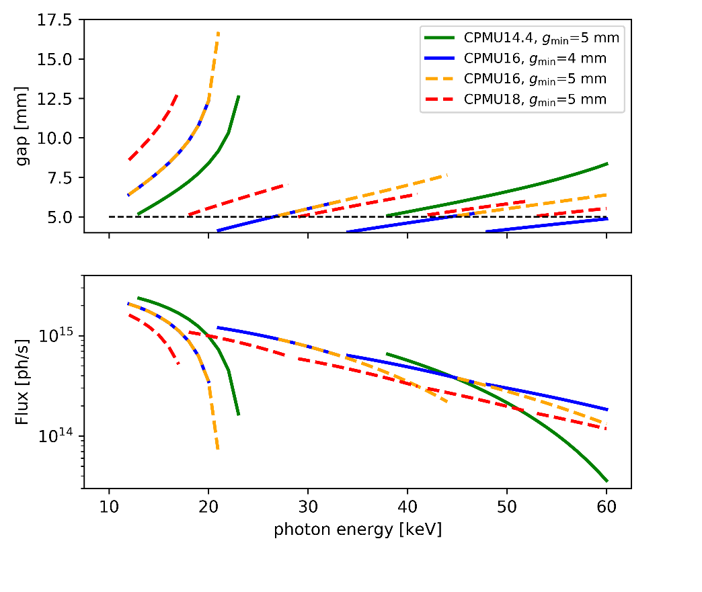
Source device
Reducing the gap from 5 mm to 4 mm closes the “dark” energy range between the fundamental and 3rd harmonic.
Disadvantage: At 4 mm gap, the heat load becomes …. interesting.
We had to do a lot of heat load studies and re-design some optical components
→ Front end apertures
→ Primary slits
Credit: Ph. Brumund, R. Versteegen

Slide 17
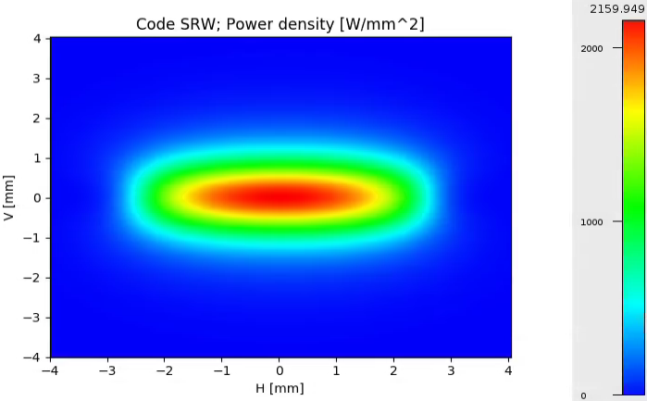
How to handle the heat load
Design choices:
Front end apertures 2mm (h) x 1 mm(v)
Leave most of the heat load in the Front End
17.4 kW → 3.4 kW
Credit: Ph. Brumund
The complete technical design is made for operation with 4 mm gap
We are still waiting for the ASD to develop the minigap straight sections
→ Until further notice, the minimum operation gap is 5 mm

Slide 18
How to build a beamline
Figure out what the beamline should do
Scientific case
Technical concept
→ Conceptual Design Report (CDR)
Figure out how to do that
Technical Design Report (TDR)
Source
Optics
End station

Slide 19
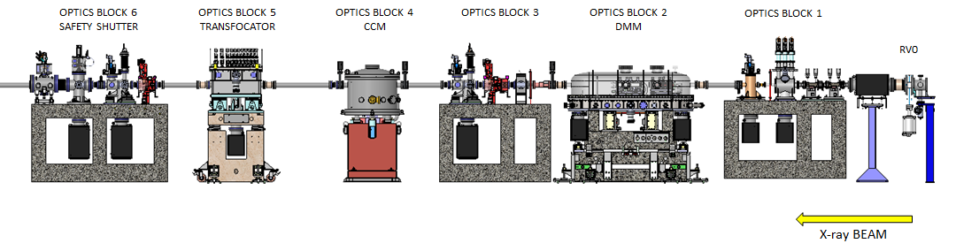
Optics overview
Crystal monochromator
Double multilayer monochromator
Primary slits
Diagnostics
+
beam shutter
High power attenuators
Transfocator
Diagnostics
Modules, each on a granite support

Slide 20
Design principle:
Organized in “blocks”
Diagnostics elements after each optical element
Double multilayer monochromator

Slide 21
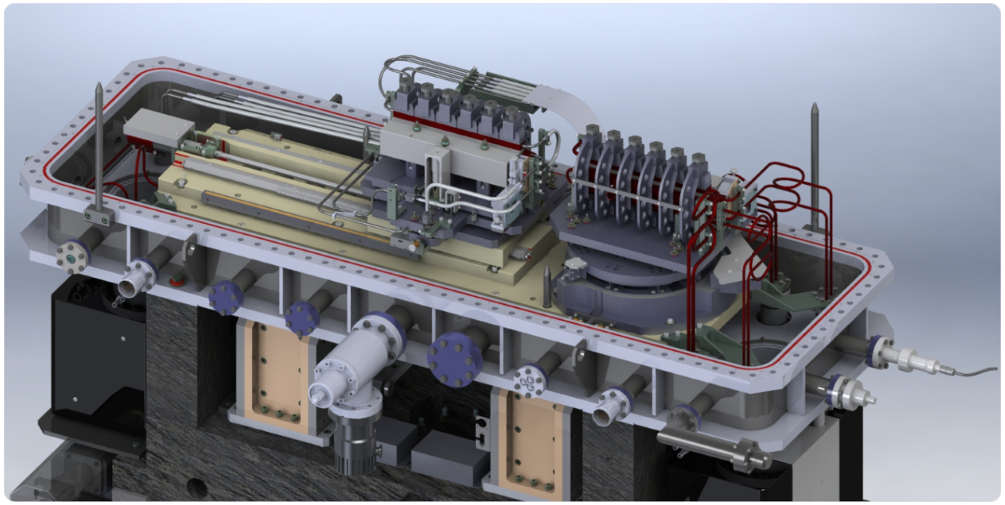
Double multilayer monochromator: Modified ESRF standard design
(Carole Clavel, Philipp Brumund, Christian Morawe, Ray Barrett, PAMU)
R. Baker et al (2013) New generation mirror systems for the ESRF upgrade beamlines, J. Phys. Conf. Series 425, 052015 (2013),
DOI: 10.1088/1742-6596/425/5/052015

Slide 22
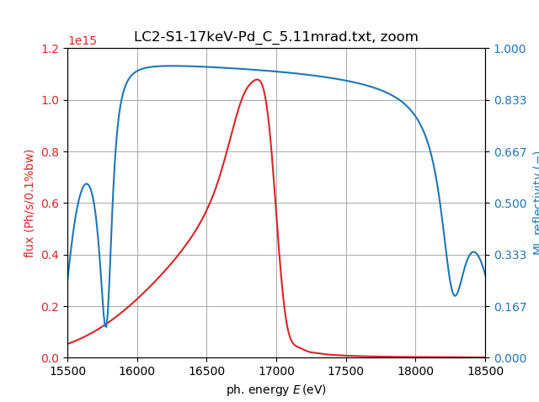
Multilayer specifications:
300 mm long
Angle of incidence: 3.5 – 7.4 mrad (0.2 – 0.4 deg)
→ projected size 1 – 2 mm
3 multilayer stripes
Stripe | #1 | #2 | #3
Multilayer system | [Pd(3.50)/C(5.00)]₂₀ | [W(2.00)/B₄C(2.80)]₃₀ | [W(1.45)/B₄C(1.60)]₇₀
Energy range (keV) | 12 – 24 | 20 – 40 | 30 – 60
Total Transmission | 82% – 93% | 66% – 87% | 72% - 88%
dE/E FWHM | 12% | 6.0% – 6.9% | 2.5% – 2.6%
Credit: Christian Morawe, ESRF

Slide 23
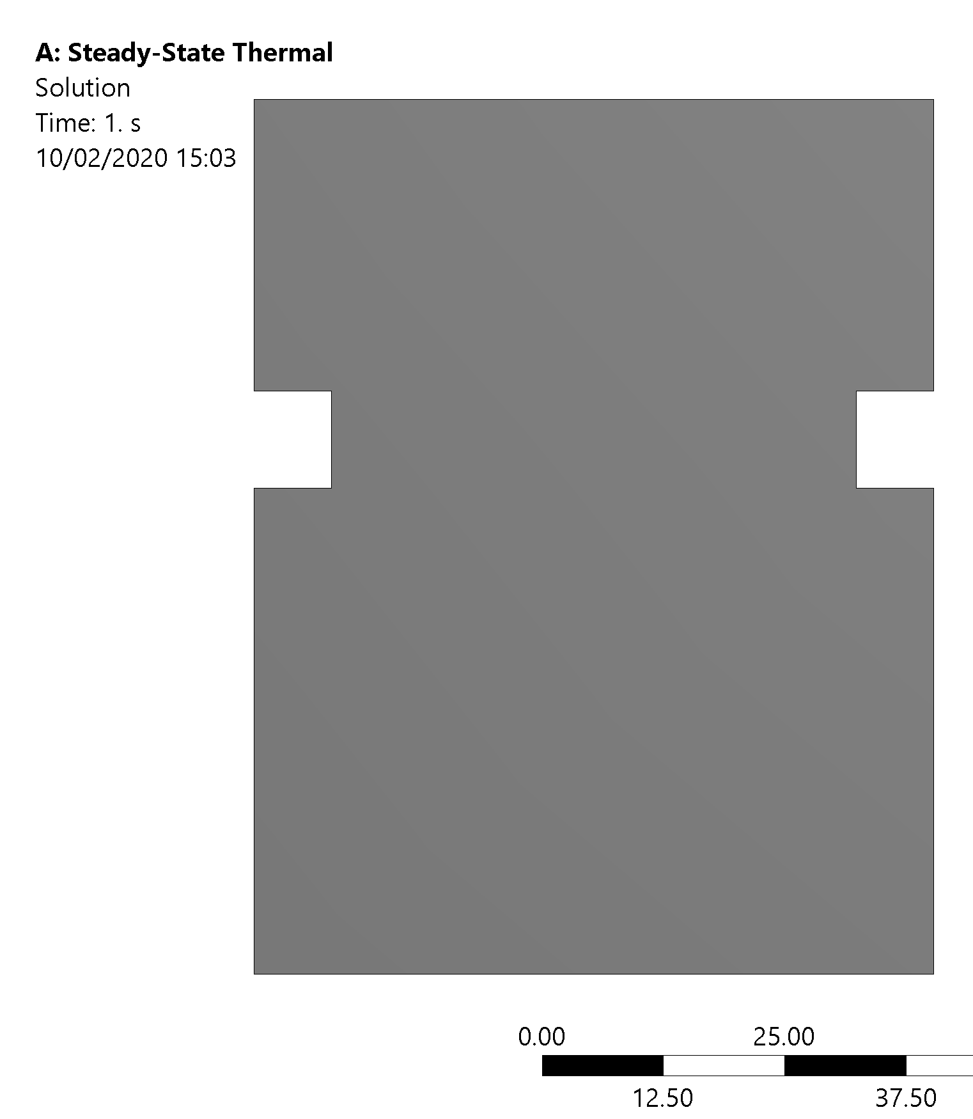
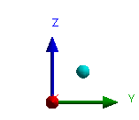




$$W$$
$$H_{cooled}$$
$$H$$
$$W_{cut}$$
Credit: Ph. Brumund, ESRF
Ph. Brumund et al: Thermal optimization of a high-heat-load double-multilayer monochromator, J. Synchrotron Rad. 28, 1423 (2021)
DOI: 10.1107/S160057752100758X

Slide 24
Diagnostics block

Slide 25
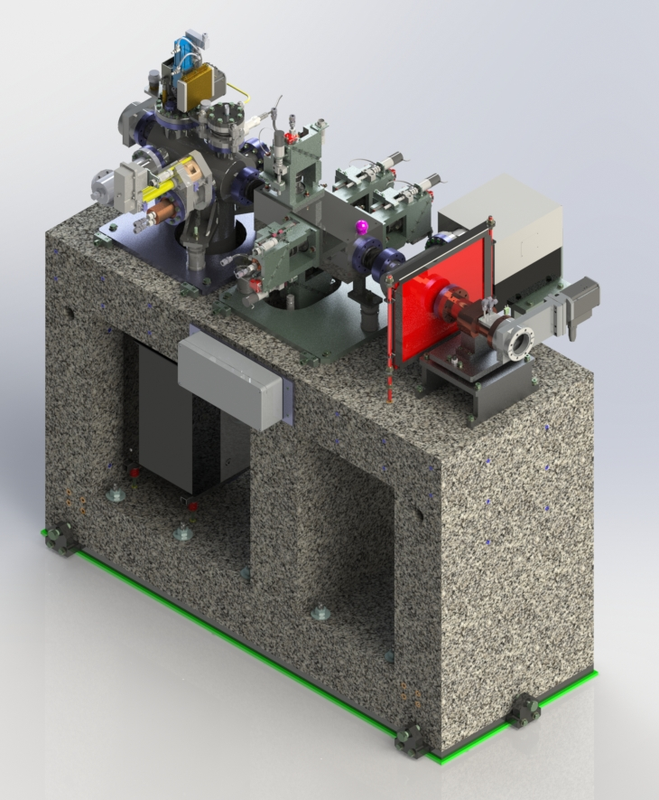
Diagnostics block 3:
(Thierry Brochard, Thomas Dufrane)
Emergency white beam stop
Beam limiting aperture
Secondary slits
Water cooled, new design
Intensity monitor
back-scattering diamond with metal coatings
4-quadrant photodiode
“Beam viewer”
Diamond with video camera
Beam

Slide 26
Crystal monochromator

Slide 27
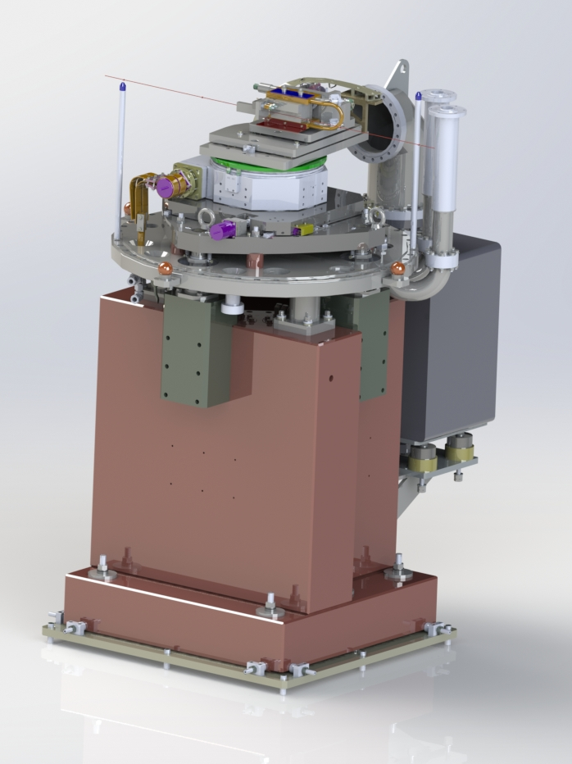
Crystal monochromator:
Subcontracted to Cinel (Italy)
Channel cut Si(111) crystal
Liquid Nitrogen cooled
Horizontally deflecting
8 mm offset
12 – 60 keV
In-vacuum:
  In-out translation (y)
  Main Bragg rotation
  Second surface pitch fine-tuning
Channel cut crystal produced in-house

Slide 28
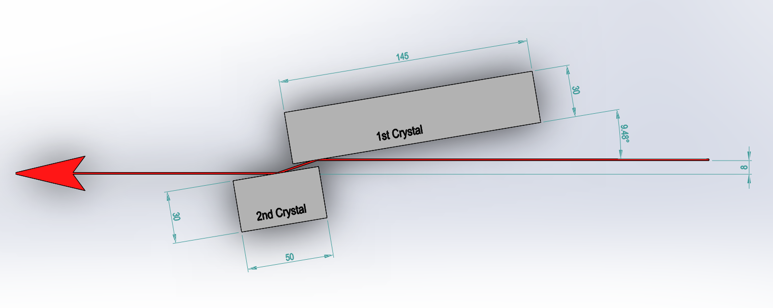
Trade-off: Large offset vs. small offset
Large offset:
Allows larger angles/lower energies
For channel cut: Easier access
to optical surfaces
Small offset:
Smaller crystal size/less travel when changing Bragg angle
For fixed offset: Smaller variation of beam offset
Ph. Brumund et al,
Design Simulations Of A Horizontally Deflecting High-Heat-Load Monochromator,
J. Synchrotron Rad 28, 91 (2021)
DOI: 10.1107/S1600577520014009

Slide 29
Channel cut
Advantages:
Mechanical stability
Good thermal contact to second “crystal”
Simpler mechanics
Disadvantages:
Crystal surfaces more difficult to polish
No “roll” motion possible
(probably not needed)
Fixed exit not possible
(but change in offset negligible for high energies)

Slide 30
Transfocator

Slide 31
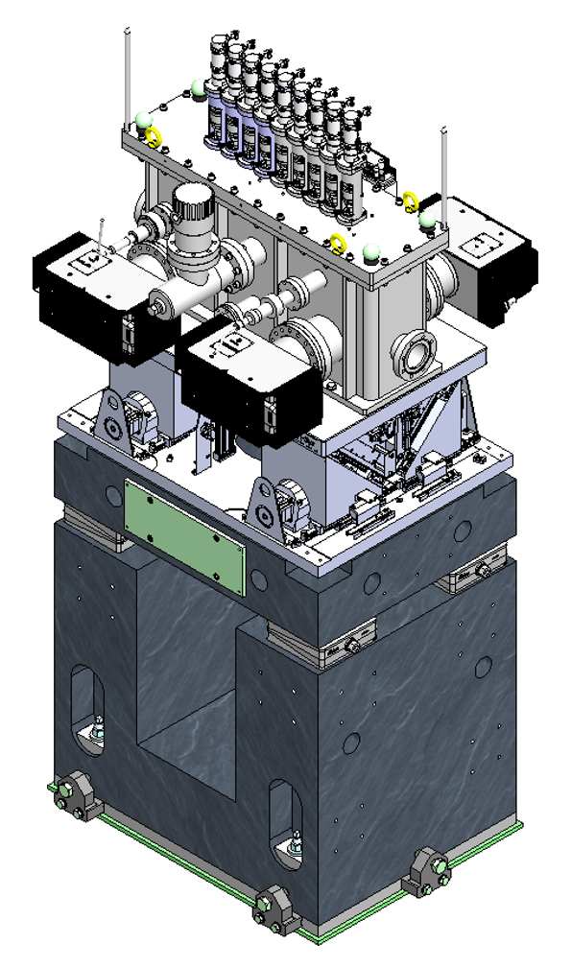
Transfocator: In-house development
(now ESRF standard)
9 Actuators
Diamond lenses (Palm Scientific)
R=320 µm, Aperture 1mm
R=640 µm and R=1280 µm for fine tuning
Alignment motions ex-vacuum
New flexor design to align lens cartridges with reference V rail
Al lenses would melt in the pink beam!

Slide 32
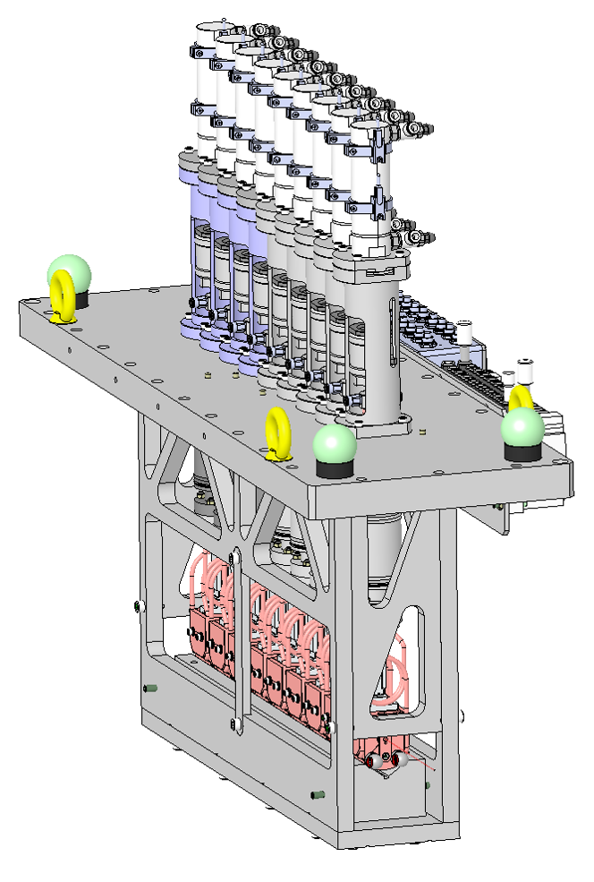
Transfocator:
CRLs are highly chromatic (f α E²)
Need to vary number of lenses when changing working energy
Either focus onto sample position
Or Collimation
Actuator | 1 | 2 | 3 | 4 | 5 | 6 | 7 | 8 | 9
Radius | 1280 | 640 | 320 | 320 | 320 | 320 | 320 | 320 | 320
Number | 1 | 1 | 1 | 2 | 4 | 8 | 16 | 16 | 16

Slide 33
How to build a beamline
Figure out what the beamline should do
Scientific case
Technical concept
→ Conceptual Design Report (CDR)
Figure out how to do that
Technical Design Report (TDR)
Source
Optics
End station

Slide 34
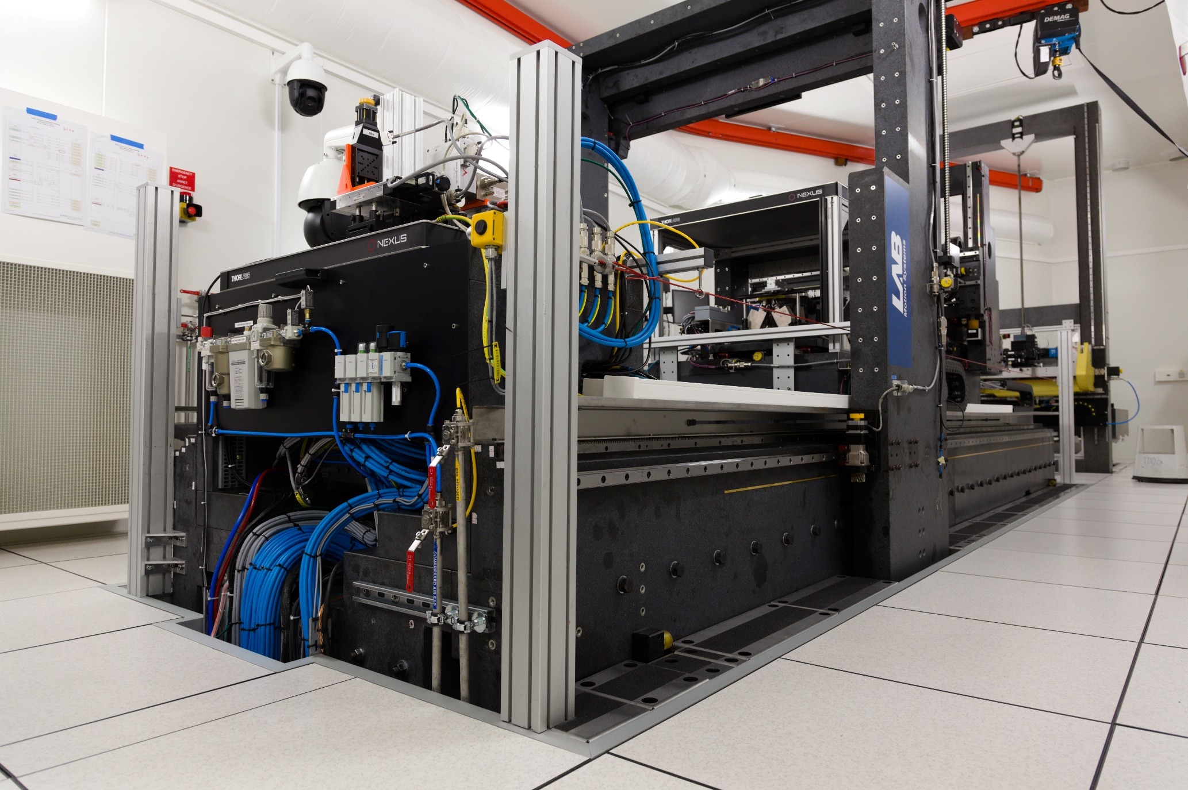

Slide 35
End station: Dismantled from ID06-HXM, re-installed on ID03
Upgrades:
EH1 is ~10 m further downstream
→ a bit more space around the bench
High-stability HVAC +/- 0.1 deg C
Large HVAC installation on roof of CC4
Thermal insulation on walls, false floor
New goniometer (LAB)
Optimized for topo-tomo scans in vertical plane
More space and better xyz positioning of the sample with Hexapod
Upgrade of far field detector
Back-illuminated sCMOS camera with ~2x better detection efficiency
Move the previous sCMOS camera to the near field camera

Slide 36
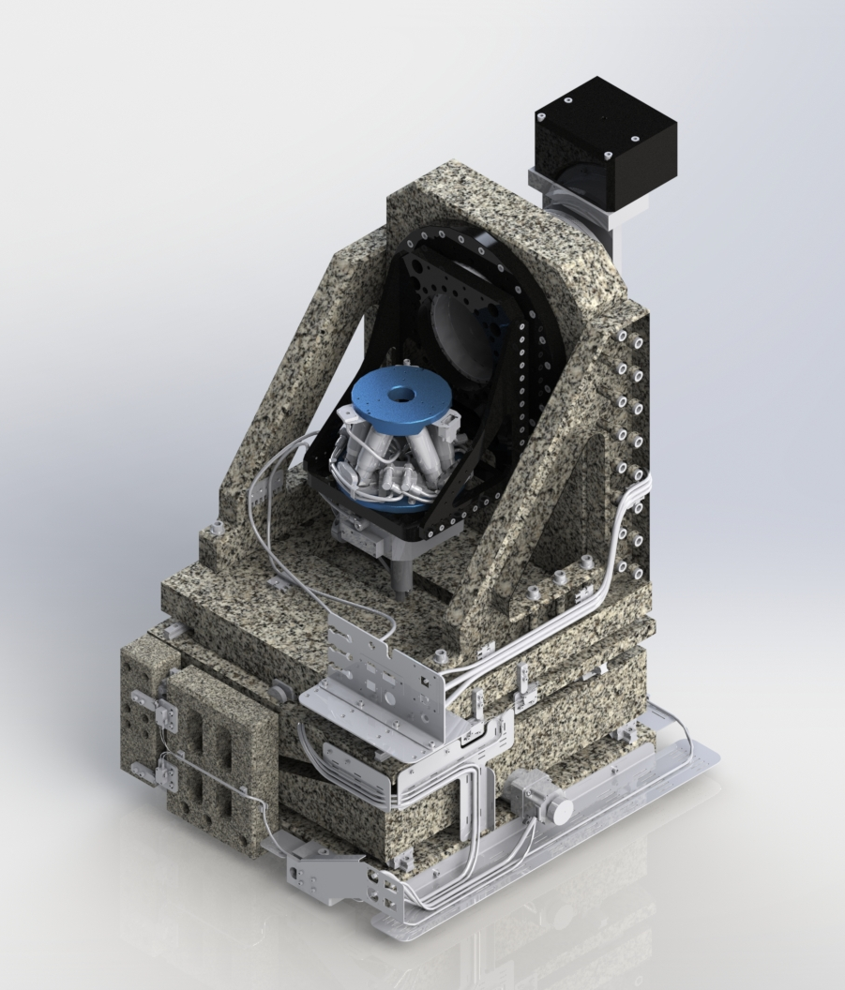
New goniometer
LAB motion systems
2 air bearing rotations
Hexapod for sample xyz
and sample tilts
Slip rings for
user electrical signals
Hexapod positioning not quite as precise and reproducible as we would like
Software coordinate system to be worked out
One of the air bearings seized
→ back at manufacturer

Slide 37
