Slide 1
EuPRAXIA@SPARC_LAB
FEL beamlines
F. Villa, INFN-LNF
On behalf of the EuPRAXIA@SPARC_LAB collaboration

Slide 2
Outline
Preliminary FEL simulations results
Scientific case and timeline
AQUA beamline
  Layout
  Optics and diagnostics
  Open questions
Discussion

Slide 3
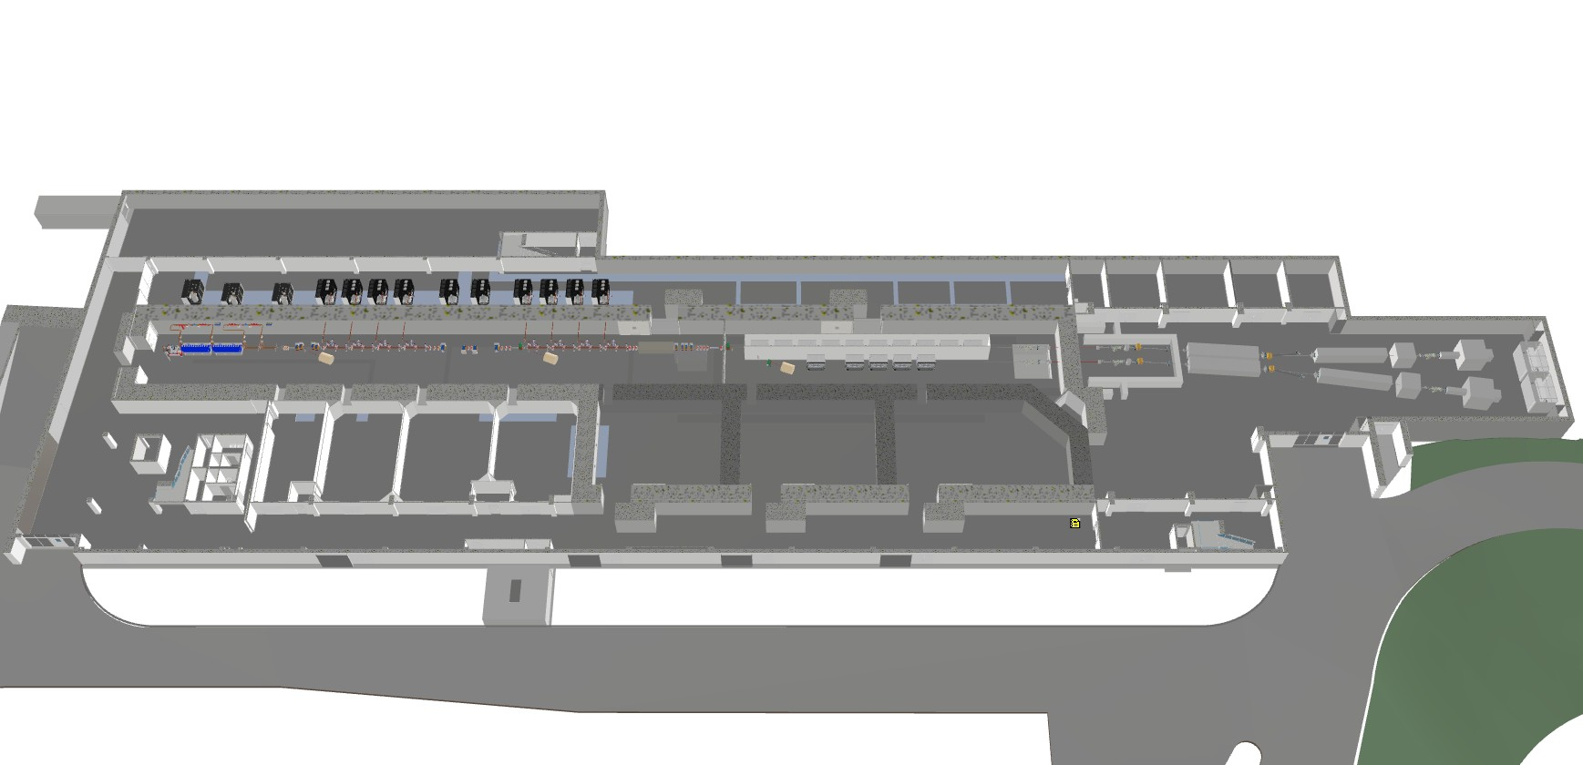
EuPRAXIA@SPARC_LAB
Photoinjector
X-band linac (and compressor)
Plasma acceleration
RF supply area 55m
Accelerator area 62m
Undulators area 38m
FEL User area 50m
Clean rooms area 32m
HEP experimental area 49m
Synchronization
Lasers (photocathode, HP)
HP laser users
HEP users with electrons (and HP laser)

Slide 4
FEL beamlines
AQUA beamline: SASE FEL from 4(3) to 10(15)nm with polarization tunability, in the EuPRAXIA@SPARC_LAB TDR
ARIA beamline: seeded FEL from 50 to 150 nm with polarization tunability, recently approved with regione Lazio funds (still in early phase of design)

Slide 5
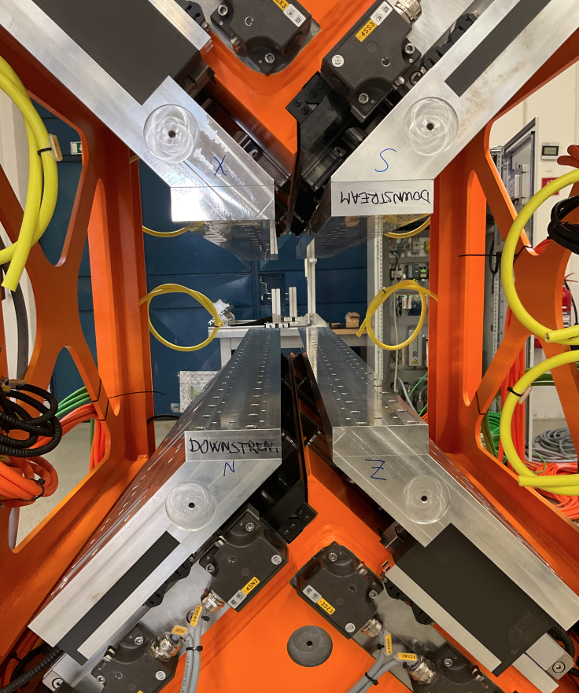
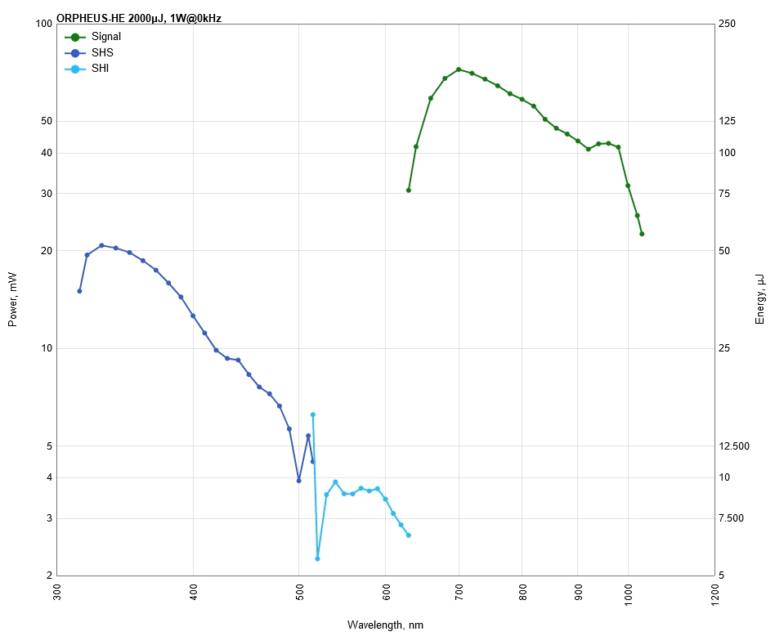
Undulators
Undulator parameters | AQUA
Period (mm) | 18
Maximum strength (k) | 1.47
Minimum gap (mm) | 6
Active length (m) | 19.8
Undulator parameters | ARIA
 | Modulator | Radiator
Period (mm) | 100 | 55
Active length (m) | 3.0 | 8.4
Seeding laser | OPA configuration
Seeding wavelengths (nm) | 320-400 + 600-800
Seeding energy | >20 µJ
Seeding duration | 200 fs
APPLE X undulator
allow for polarization tuning
(from linear to circular)
Seed laser
tunability

Slide 6
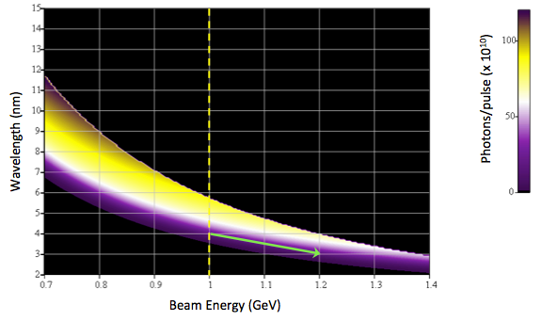
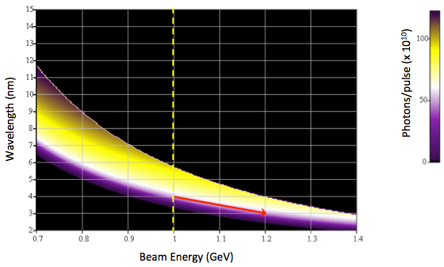
Expected FEL radiation at undulators end
AQUA PWFA
linear
 | AQUA FEL parameters (Linear Polarization) | AQUA FEL parameters (Circular Polarization)
Central wavelength range | 4.0 nm, 310eV | 4.0 nm, 310eV
Spectral bandwidth (rms) | 0.088% | 0.117%
Beam length (rms) | 3.50 fs | 3.76 fs
Beam transverse size (rms) | 133 um | 132 um
Beam divergence (half angle) | 0.023 mrad | 0.022 mrad
Photons per pulse | 2.33*10^11 | 2.77*10^11
Polarization | H | C
Repetition rate | 100 Hz | 100 Hz
AQUA PWFA
circular

Slide 7
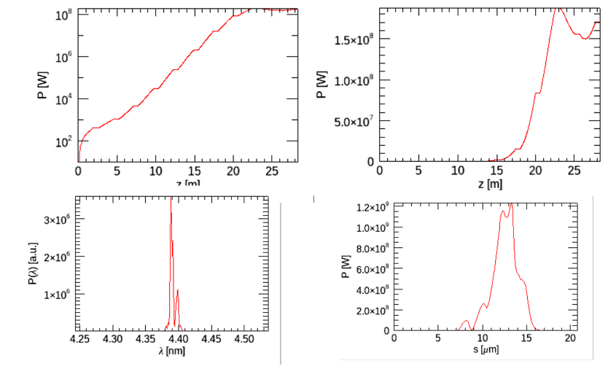
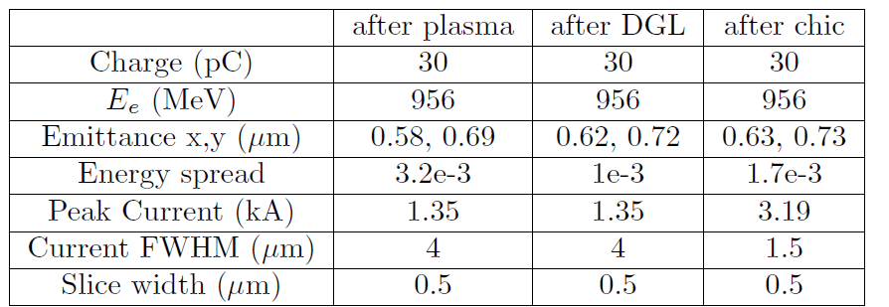
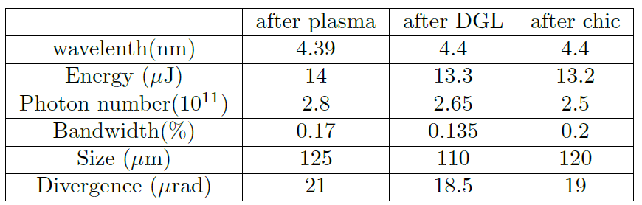
First S2E WP: AQUA SASE beamline

Slide 8
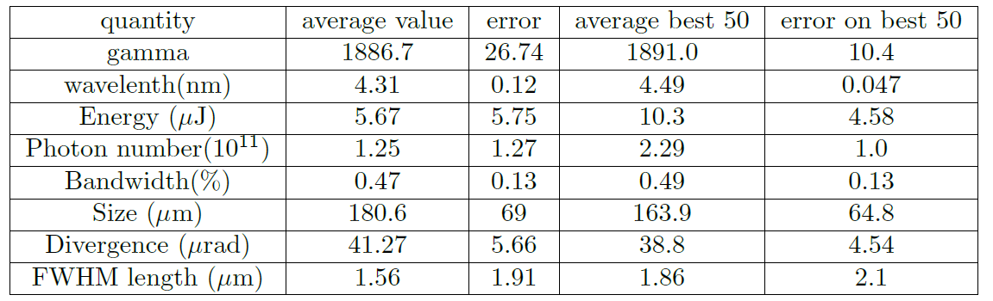
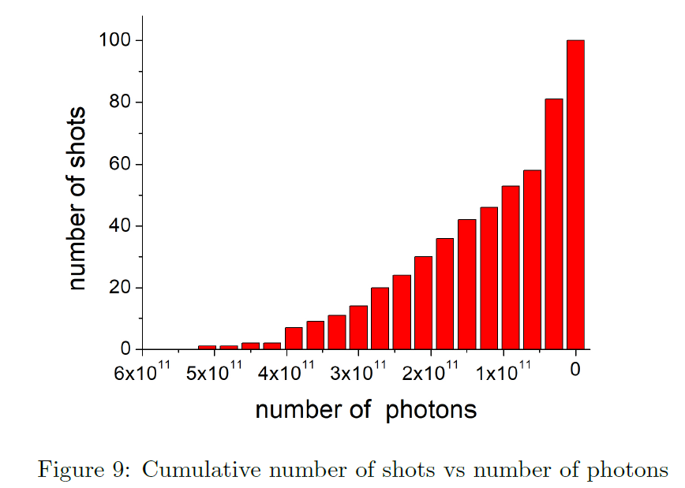
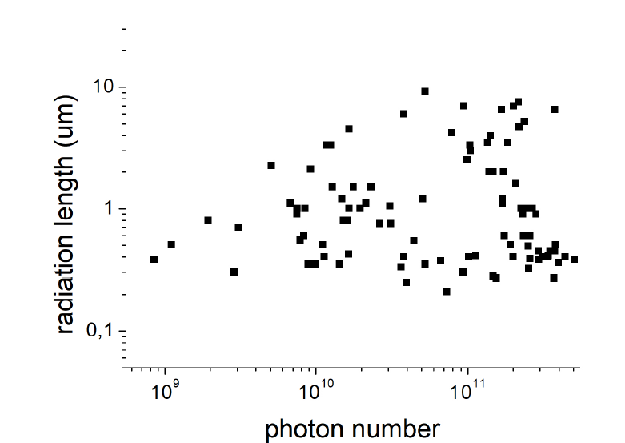
Stability (AQUA SASE beamline)

Slide 9
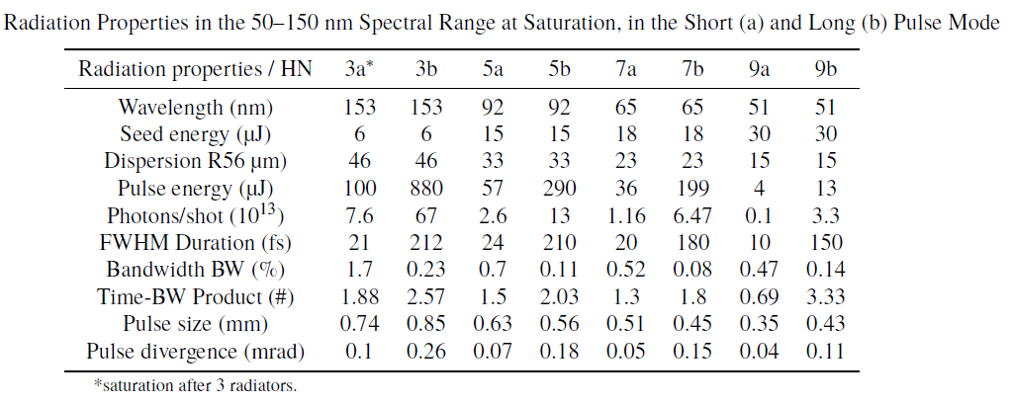
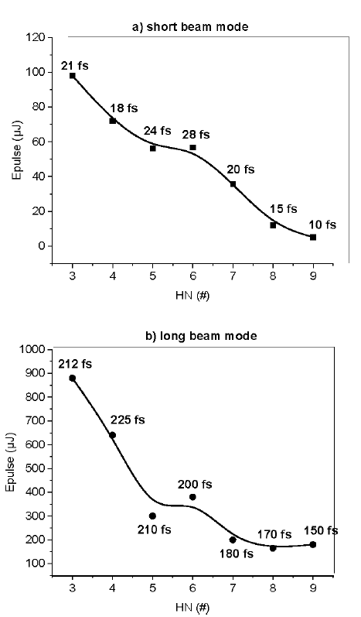
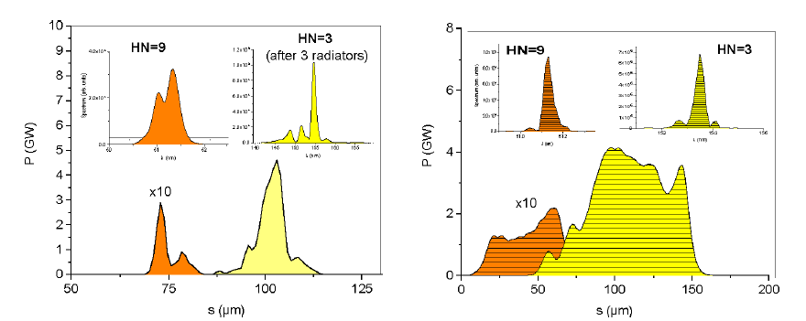
ARIA seeded beamline, preliminary simulations

Slide 10
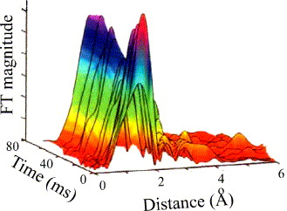
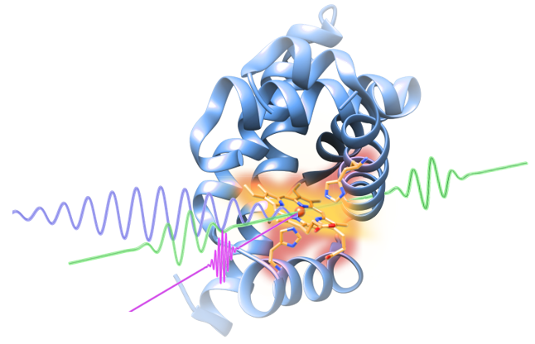
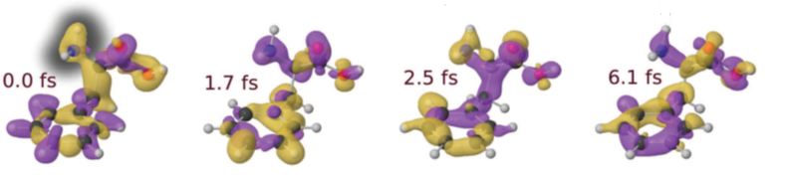
AQUA beamline scientific case
Experimental techniques and typology of samples
(Large) Viruses
Organelles
Bacteria/Cells
Metals
Semiconductors
Superconductors
Magnetic materials
Organic molecules
Coherent imaging
X-ray spectroscopy
Raman spectroscopy
Photo-fragmentation of molecules

Slide 11
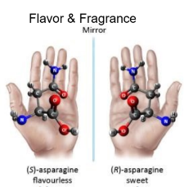
ARIA beamline scientific case
Defining experimental techniques and typology of samples (and applications)
Gas phase & Atmosphere
(Earth & Planets)
Aerosols
(Pollution, nanoparticles)
Molecules & gases
(spectroscopies, time-of-flight)
Proteins
(spectroscopies)
Surfaces
(ablation & deposition)
Photoemission
Spectroscopy
Photoelectron Circular
Dichroism
Raman spectroscopy
Photo-fragmentation of molecules
Time of Flight Spectroscopy

Slide 12
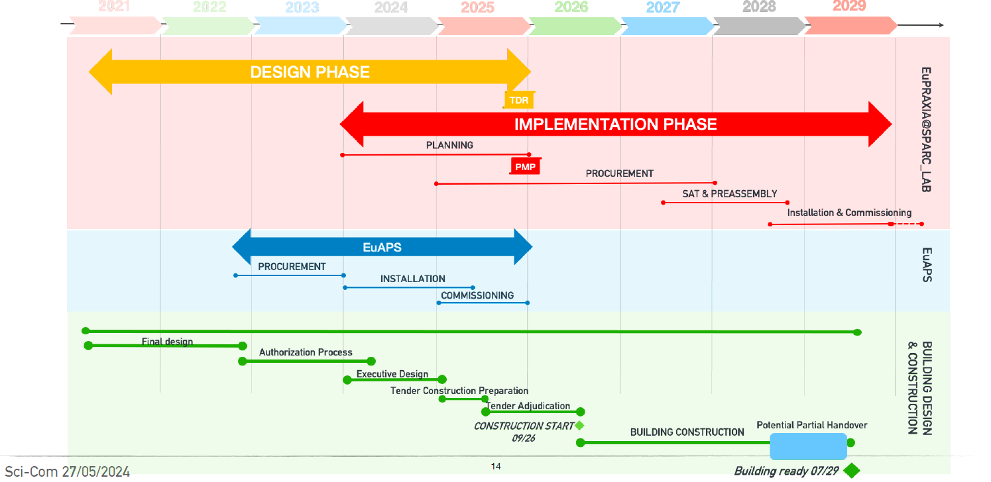
Timelines
Courtesy A. Falone

Slide 13
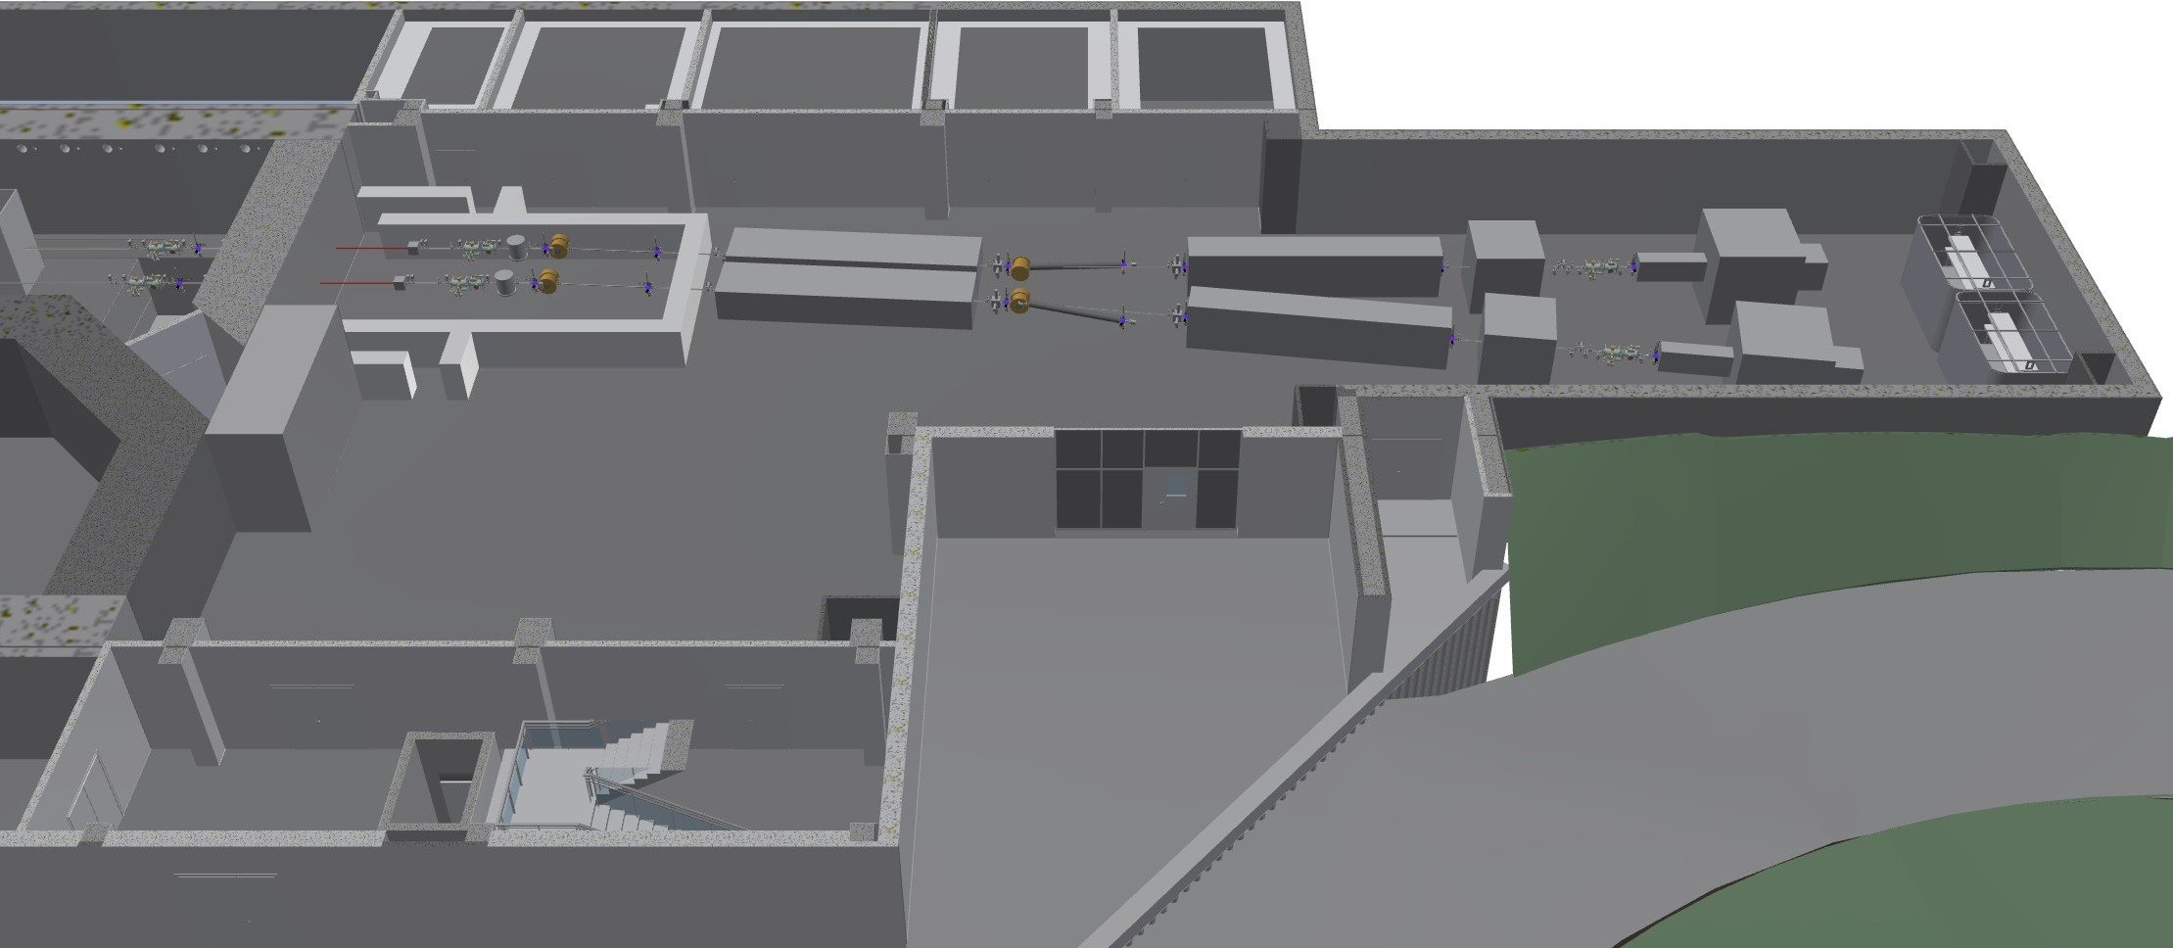
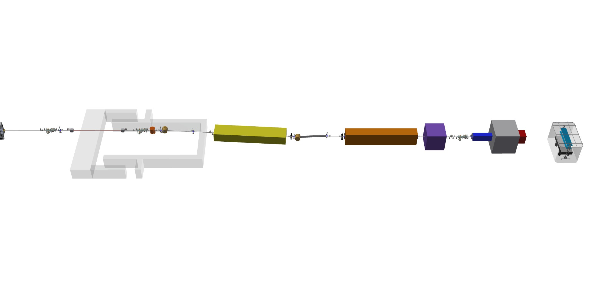
Photon beamlines
AQUA beamline

Slide 14
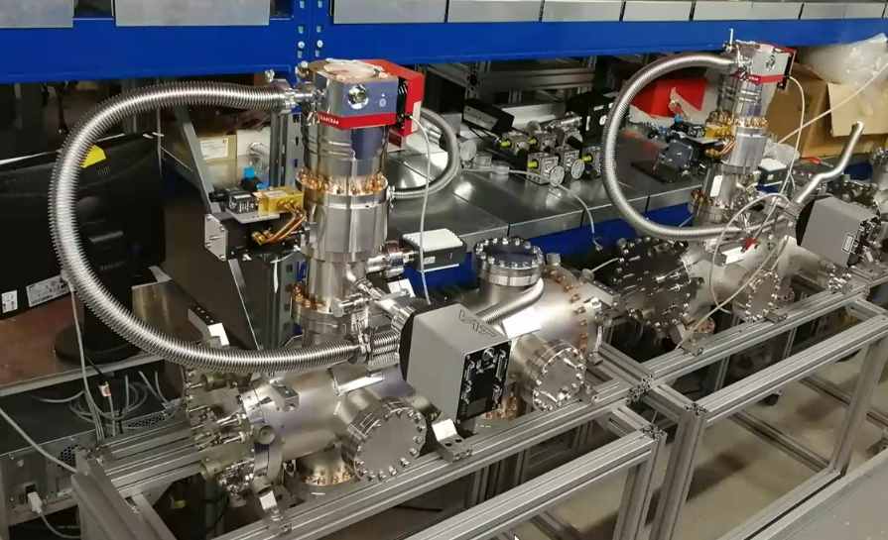
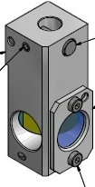
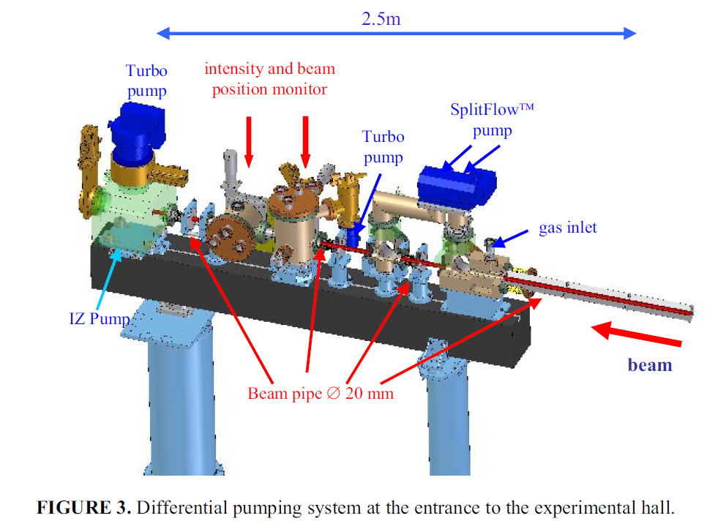
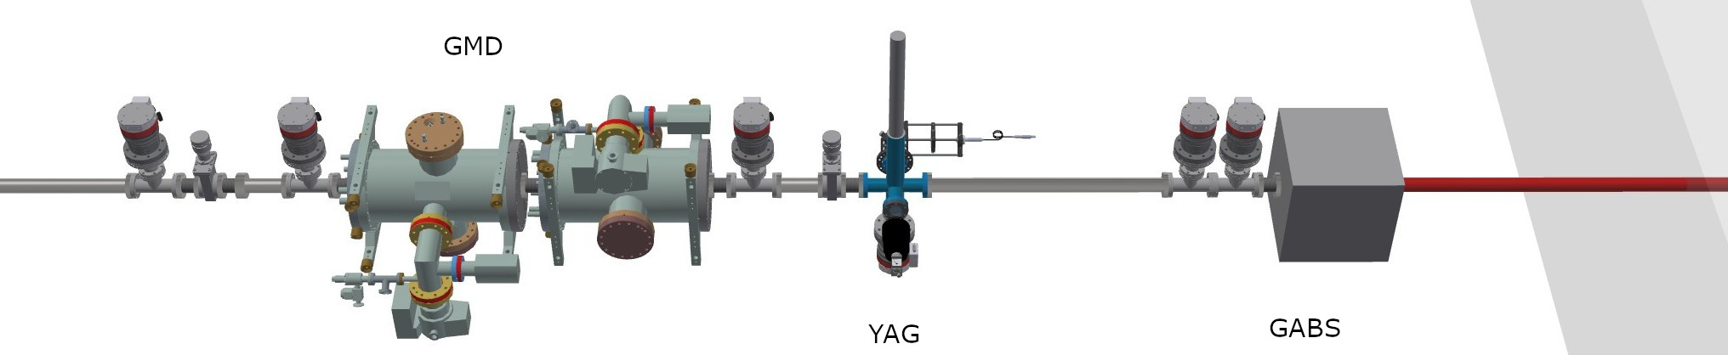

AQUA beamline
10 m
(6 m from undulators)

Slide 15
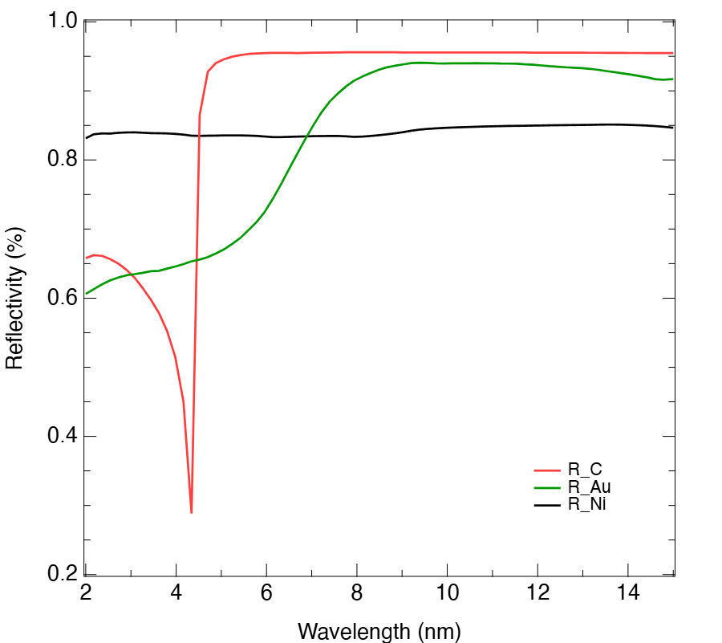
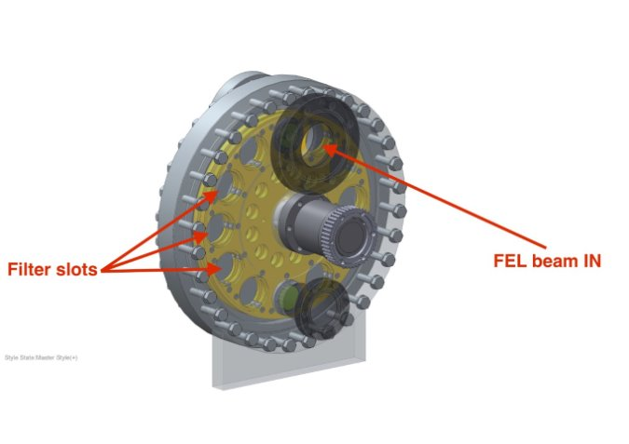
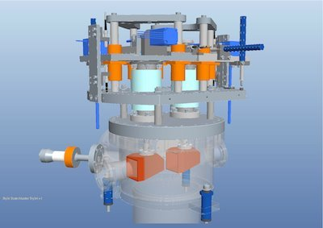
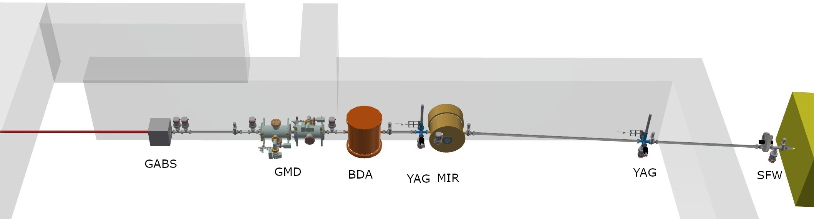


AQUA beamline
11 m

Slide 16
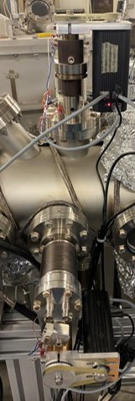
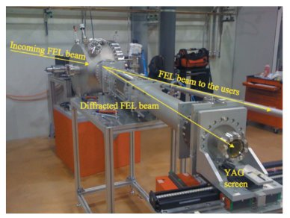
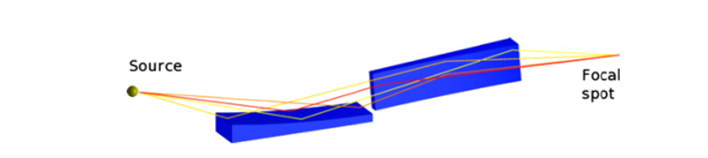
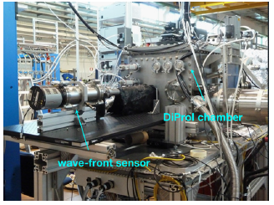
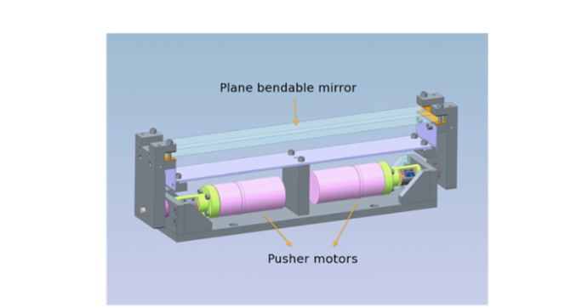
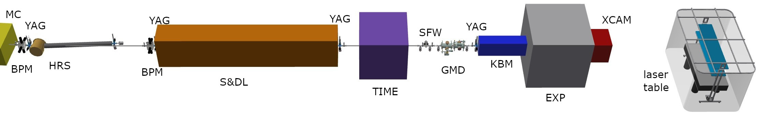
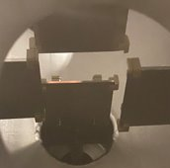
AQUA beamline
39 m

Slide 17
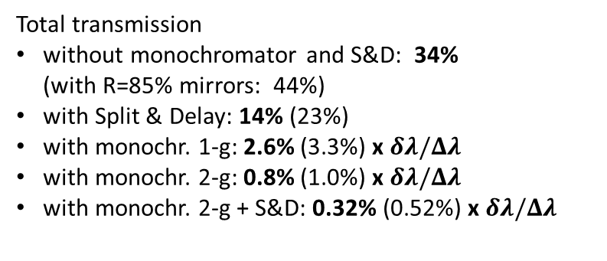
AQUA beamline losses
System | Transmission | #
Mirror chamber | 0.80 (0.85) | 1
BDA | 0.99 | 2
BPM | 0.98 | 2
Spectrometer | 0.75 (0.80) | 1
Monochromator | 0.08 to 0.02 | 1
Intensity monitor | 0.99 | 2
Time measurement | 0.99 | 1
Split & delay | 0.41 (0.52) | 1
attenuators | 1 to 0 | 3
YAG screens | 1 or 0 | 13
K-B focusing | 0.64 (0.72) | 1
Total transmission
without monochromator and S&D: 34%
(with R=85% mirrors: 44%)
with Split & Delay: 14% (23%)
with monochr. 1-g: 2.6% (3.3%) x $δλ/Δλ$
with monochr. 2-g: 0.8% (1.0%) x $δλ/Δλ$
with monochr. 2-g + S&D: 0.32% (0.52%) x $δλ/Δλ$
 | AQUA FEL parameters (Linear Polarization) | AQUA FEL parameters (Circular Polarization)
Central wavelength range (nm, eV) | 4.0 nm, 310eV | 4.0 nm
Spectral bandwidth (rms, % to the central wavelength) | 0.088% | 0.117%
Beam length (rms, fs) | 3.50 fs | 3.76 fs
Beam transverse size (rms, um) | 133 um | 132 um
Beam divergence (half angle, mrad) | 0.023 mrad | 0.022 mrad
Photons per pulse (number) | 2.33*10^11 | 2.77*10^11
Polarization (direction) | H | C
Repetition rate (Hz) | 100 | 100

Slide 18
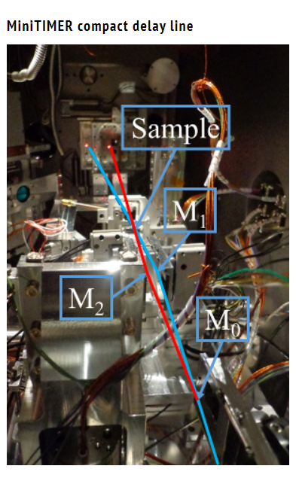
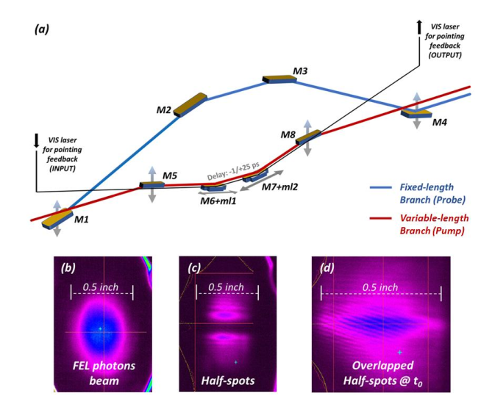
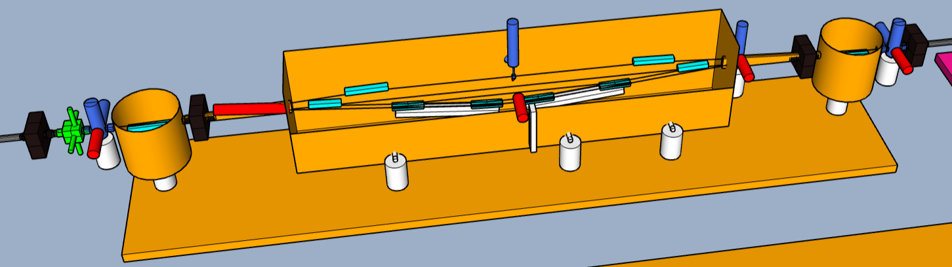
Open questions: S&D line
39 m
~26 ps delay
~100s fs delay
8m

Slide 19
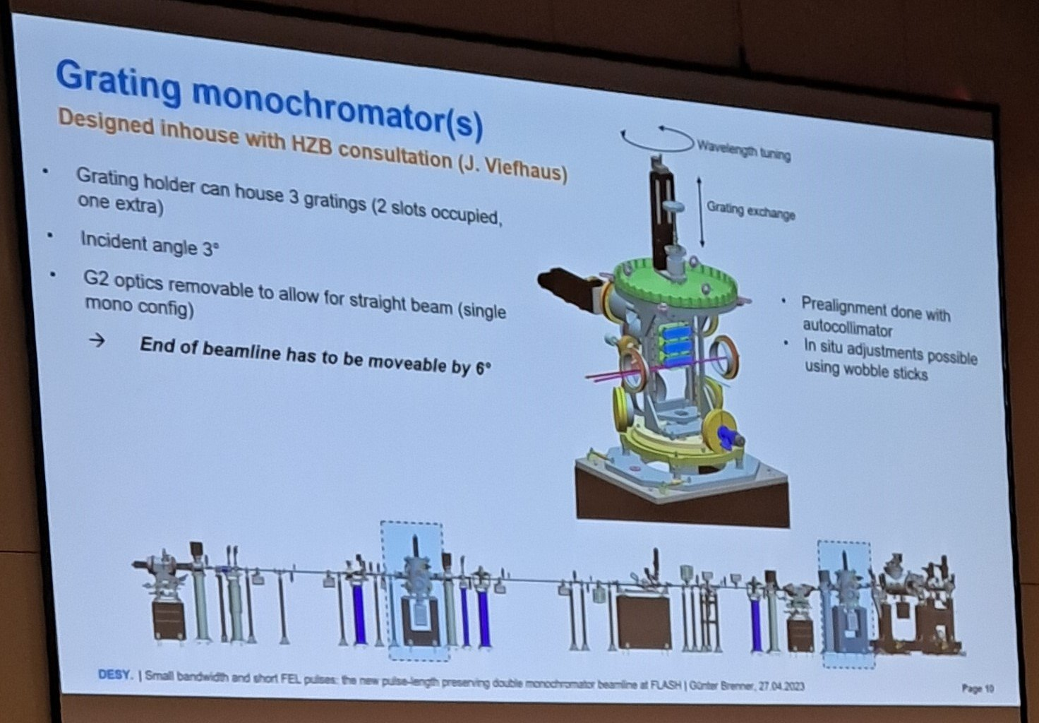
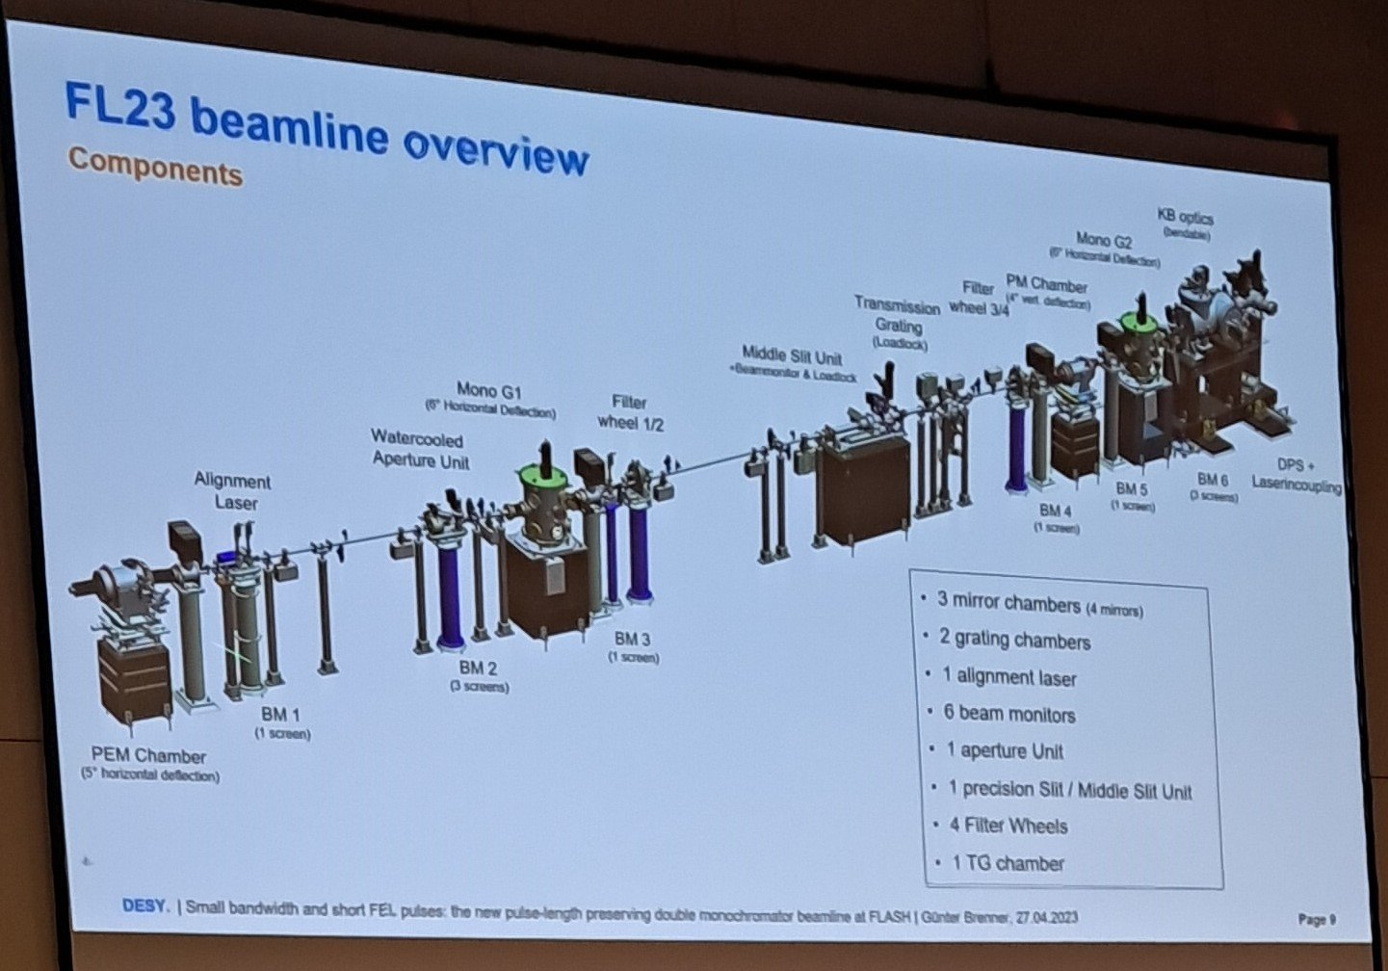

Open questions: Monochromator

Slide 20
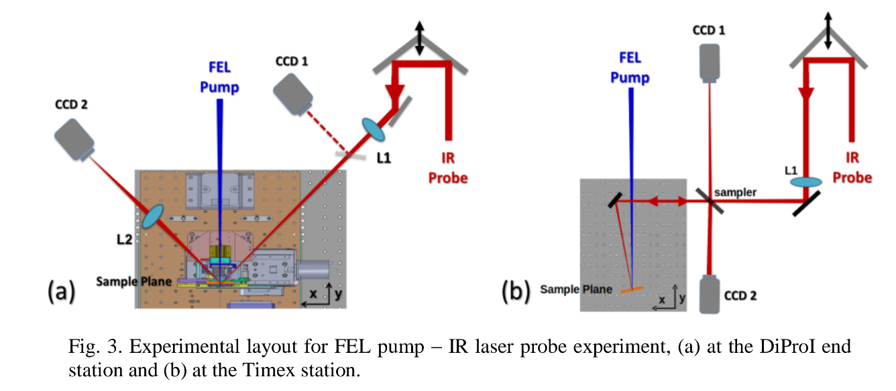
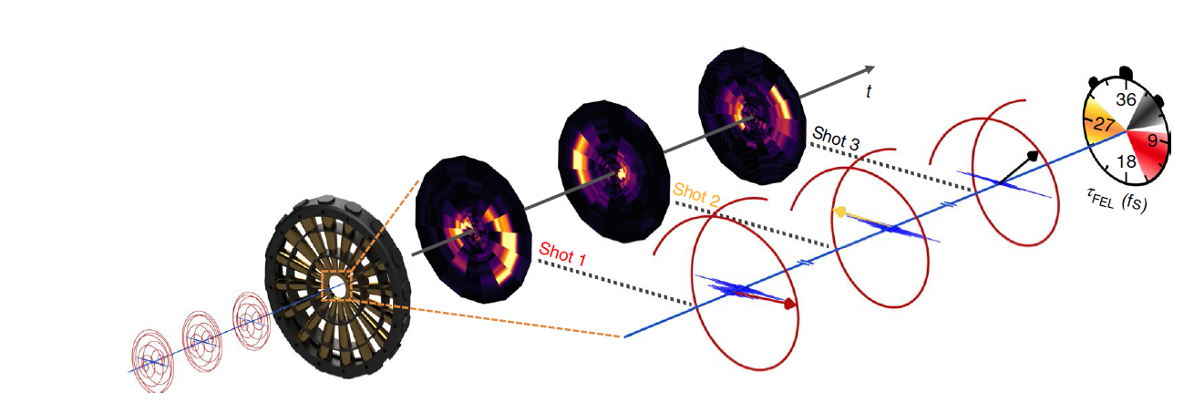
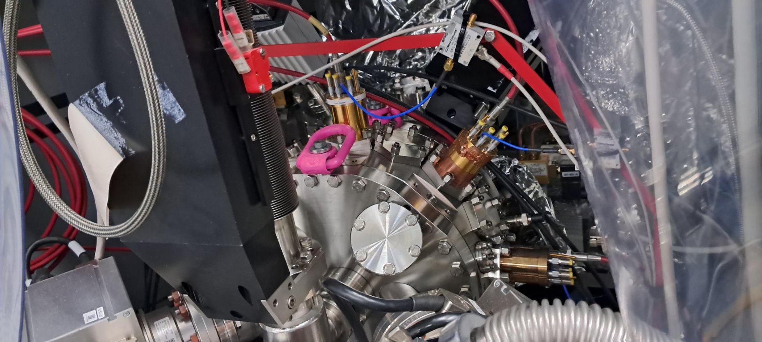
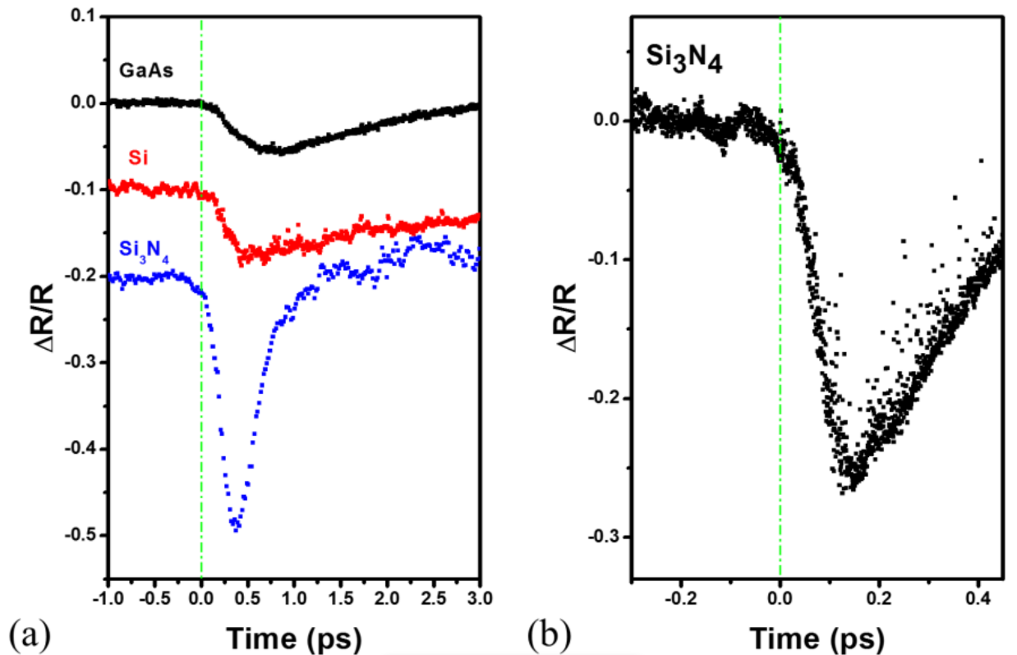
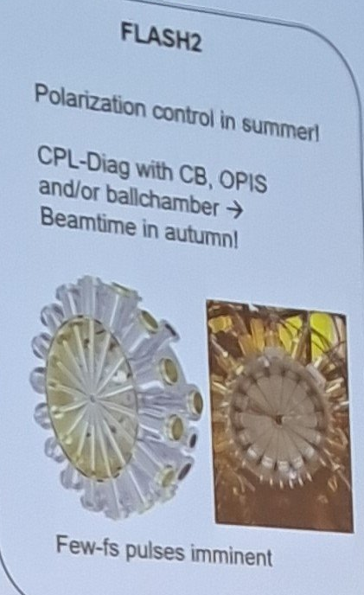
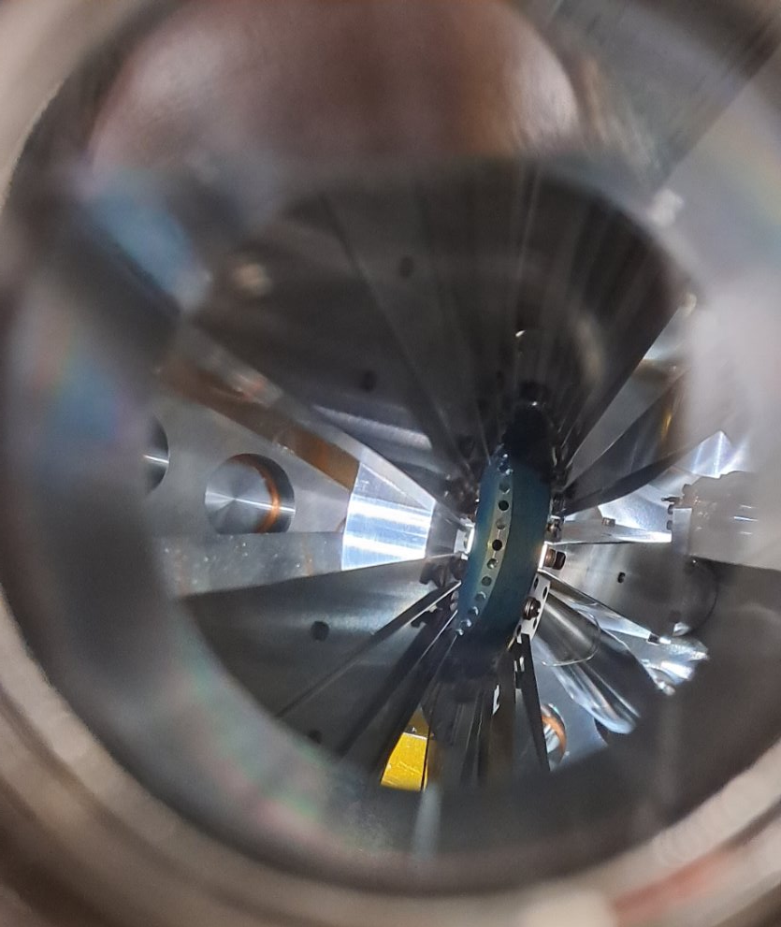

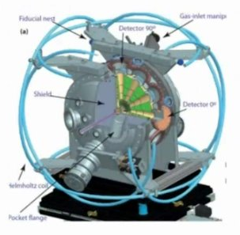
Open question: time and polarization measures
Transient reflectivity encoding of arrival time
Gas ionization ToF array + THz streaking
Nature Phot 12, 215 (2018)
Opt. Expr., 22, 12869 (2014)

