Slide 1

EuPRAXIA@SPARC-LAB project overview
Massimo Ferrario (INFN-LNF)
On behalf of the EuPRAXIA collaboration
This project has received funding from the European Union´s Horizon Europe research and innovation program under grant agreement No. 101079773
February 19, 2025

Slide 2
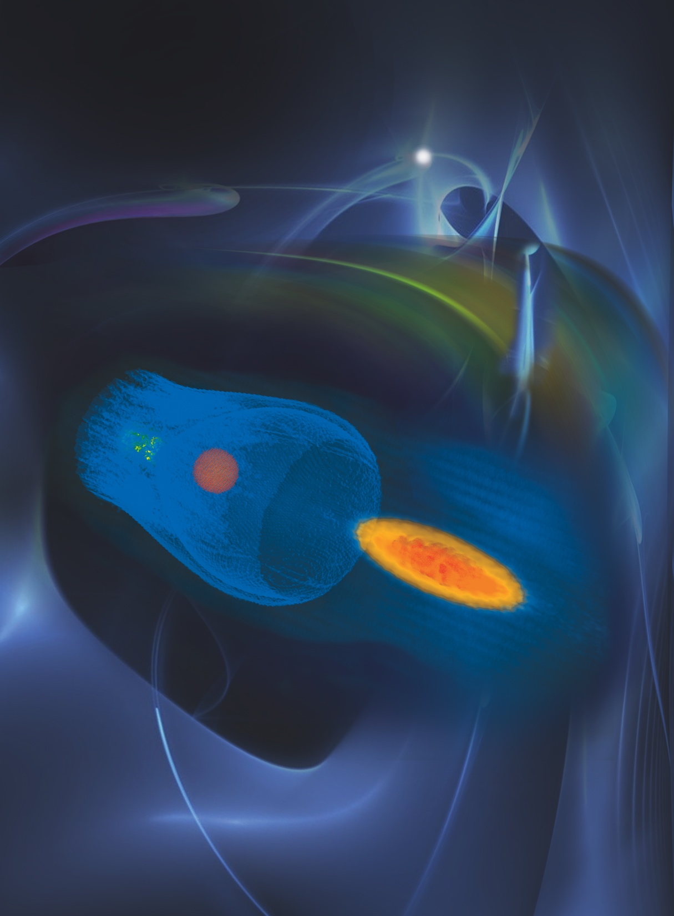
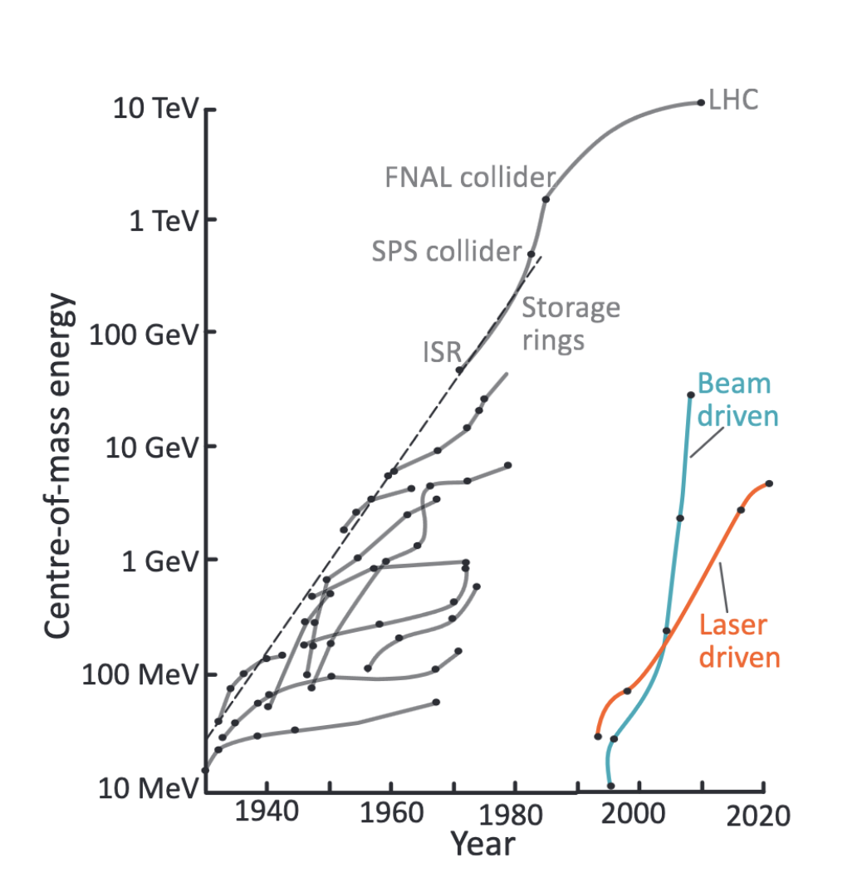
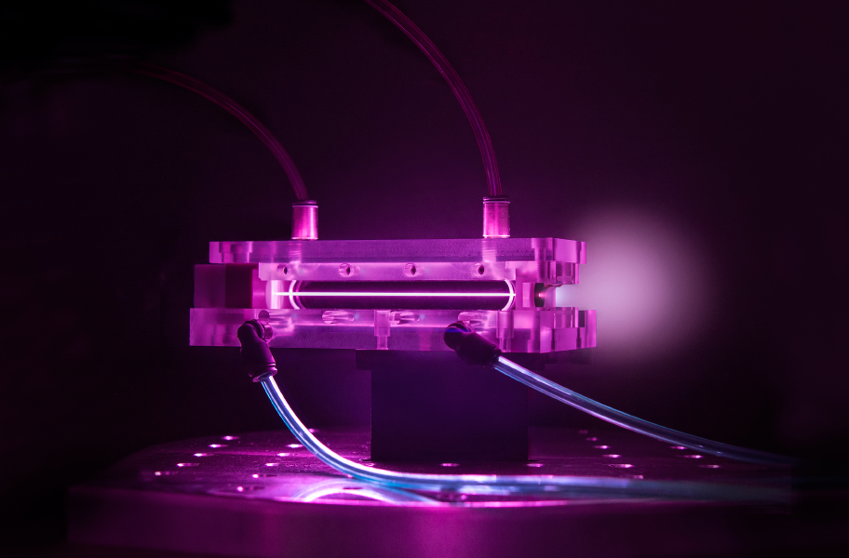

Livingstone Diagram with PWFA
Courtesy R. Assmann

Slide 3
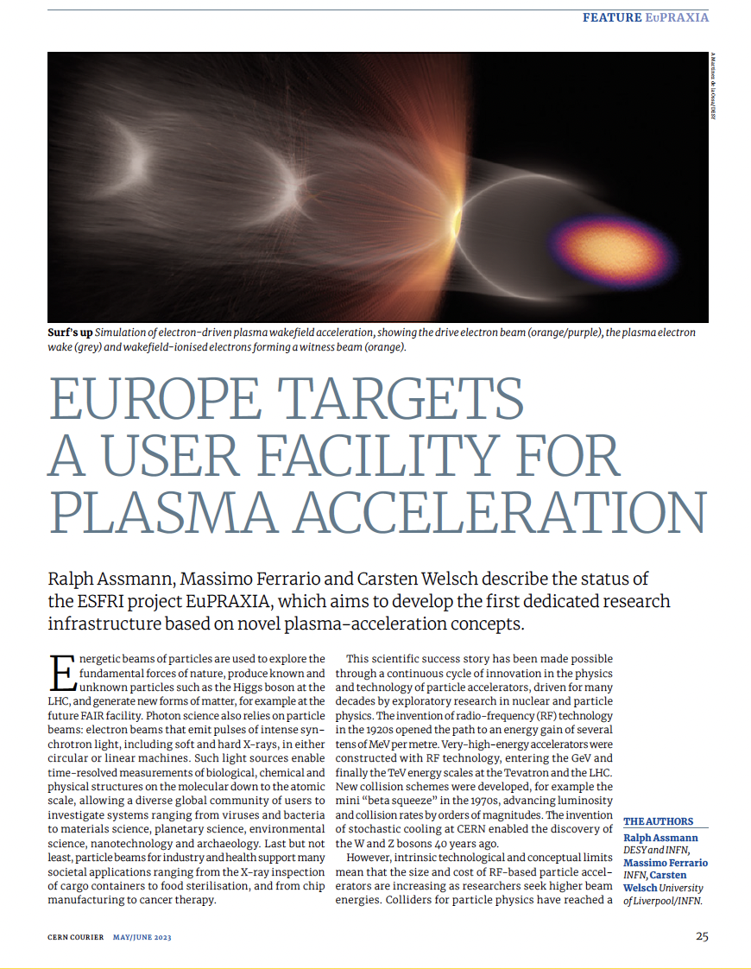
A New European High-Tech User Facility
EuPRAXIA is the first European project that develops a dedicated particle accelerator research infrastructure based on novel plasma acceleration concepts driven by innovative laser and linac technologies.
Building a facility with very high field plasma accelerators, driven by lasers or beams
1 – 100 GV/m accelerating field
Shrink down the facility size
Improve Sustainability
1
Producing particles and photons to support several urgent and timely science cases
Drive short wavelength FEL
Pave the way for future Linear Colliders
2
https://www.eupraxia-facility.org/

Slide 4
Principle of plasma acceleration
Courtesy of BELLA

Slide 5
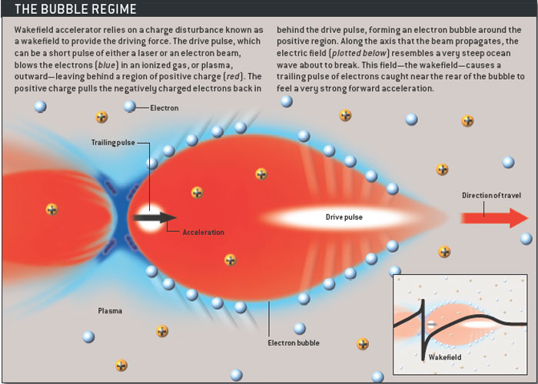
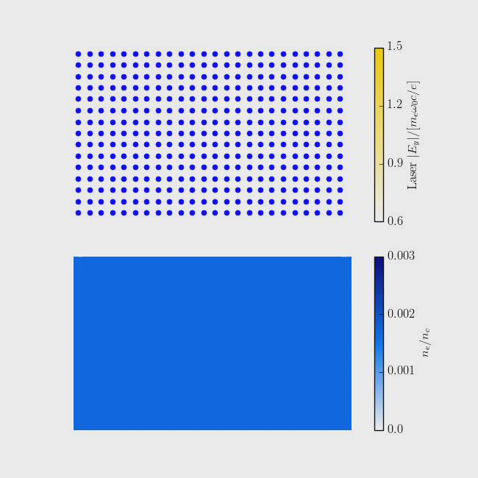
Principle of plasma acceleration
Laser Wakefield Accelerator (LWFA):
Drive beam = laser beam
Plasma WakeField Accelerator (PWFA):
Drive beam = high energy electron or proton beam
Break-Down Limit?
Wave-Breaking field:
Courtesy Sci. Am
Courtesy of BELLA

Slide 6
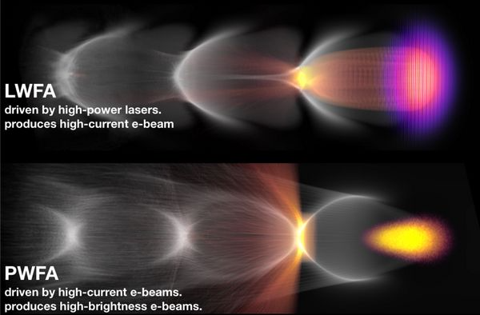
Principle of plasma acceleration
Courtesy: DESY

Slide 7


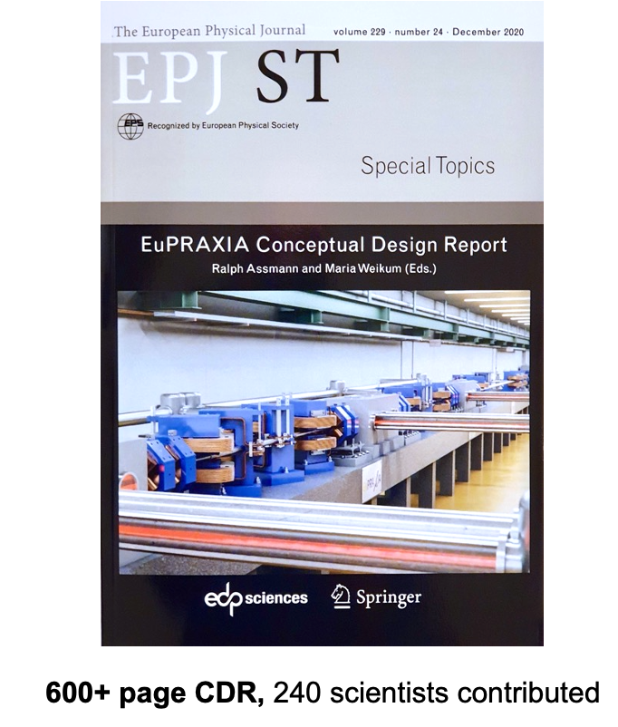
EuPRAXIA Scientific Goals
Funded by the European Union
  Free Electron Laser
Flagship Science Goal 1: EuPRAXIA will deliver free-electron laser (FEL) X rays with 10^9-10^13 photons per pulse to user areas, covering wavelengths of 0.2 nm to 36 nm. The EuPRAXIA FEL pulses are naturally short (down to 0.4 fs) and will therefore provide users with tools for investigating processes and structures in ultra-fast photon science at a reduced facility foot print.
Flagship Science Goal 2: EuPRAXIA will deliver betatron X rays with about 10^10 photons per pulse, up to 100 Hz repetition rate and an energy of 5-18 keV to users from the medical area. The much reduced longitudinal length of the X ray emission area (point-like emission) leads to an important improvement in image resolution compared to other techniques.
  Betatron Radiation Source
Flagship Science Goal 3: EuPRAXIA will deliver positron beams at energies from 0.5 MeV to 10 MeV and a repetition rate of 100 Hz for material science studies. Per pulse about 10^6 positrons will be produced in a time duration of 20-90 picoseconds on the sample, allowing time-resolved studies. EuPRAXIA will here advance the capabilities of existing positron sources in flux and time resolution.
  Positron Beams
Flagship Science Goal 4: EuPRAXIA will deliver electron and positron beams at energies from a few 100 MeV up to 5 GeV for high energy physics related R&D (detectors, linear collider topics). R&D goals include the demonstration of a linear collider stage, a "table top" HEP test beam and studies on positron transport and acceleration towards a linear collider.
  e+ / e- beams
  ICS Photon Beams
Flagship Science Goal 5: EuPRAXIA will deliver photons from an inverse Compton scattering (ICS) source. The photons of up to 600 MeV and with narrow-band spectrum will enable precision nuclear physics and highly penetrative radiography for users.
Flagship Science Goal 6: EuPRAXIA will provide access to a multi-stage, high-repetition rate plasma accelerator in the GeV range to users from accelerator science. This R&D platform will allow the testing of novel ideas and concepts, full optimisation of a plasma collider stage, certain fixed target experiments (also in combination with lasers) and performance studies of conventional versus novel accelerator technology.
  High Rep. Rate Laser
Flagship Science Goal 7: EuPRAXIA will provide access to cutting edge laser technology with short pulse length in combination with high energy photon pulses and short electron/positron bunches. Novel schemes of pump probe configurations and ultra-precise timing will be researched, feeding back into laser science.
  Laser Technology
www.eupraxia-facility.org

Slide 8
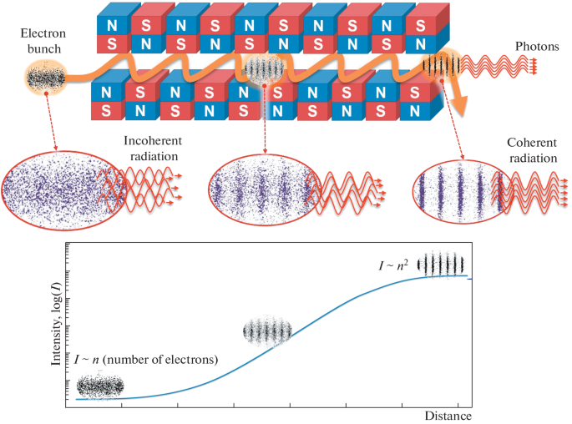
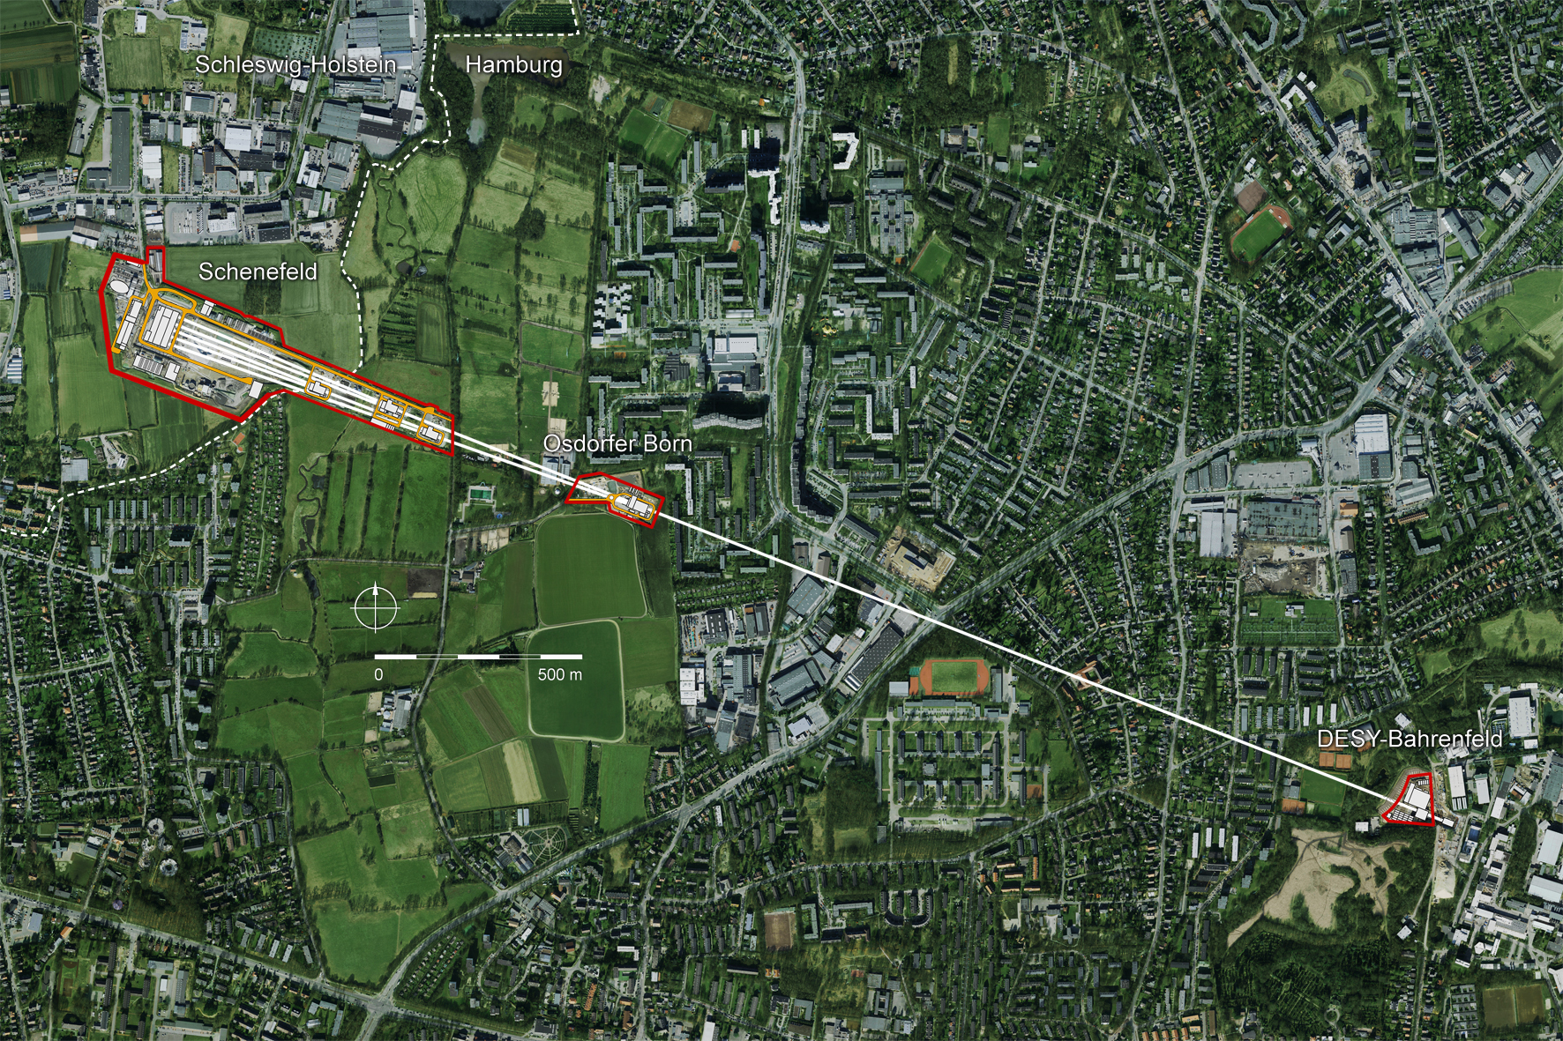
FEL is a well established technology
(But a widespread use of FEL is partially limited by its size and costs)

Slide 9
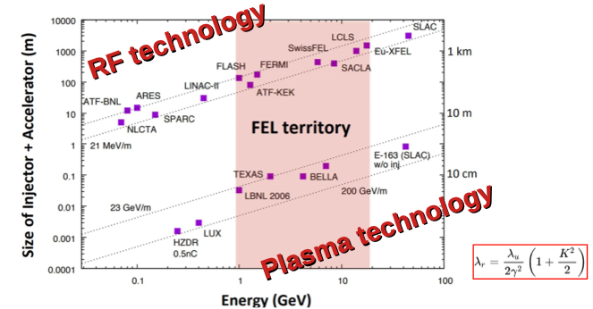
High Quality Beams Required

Slide 10
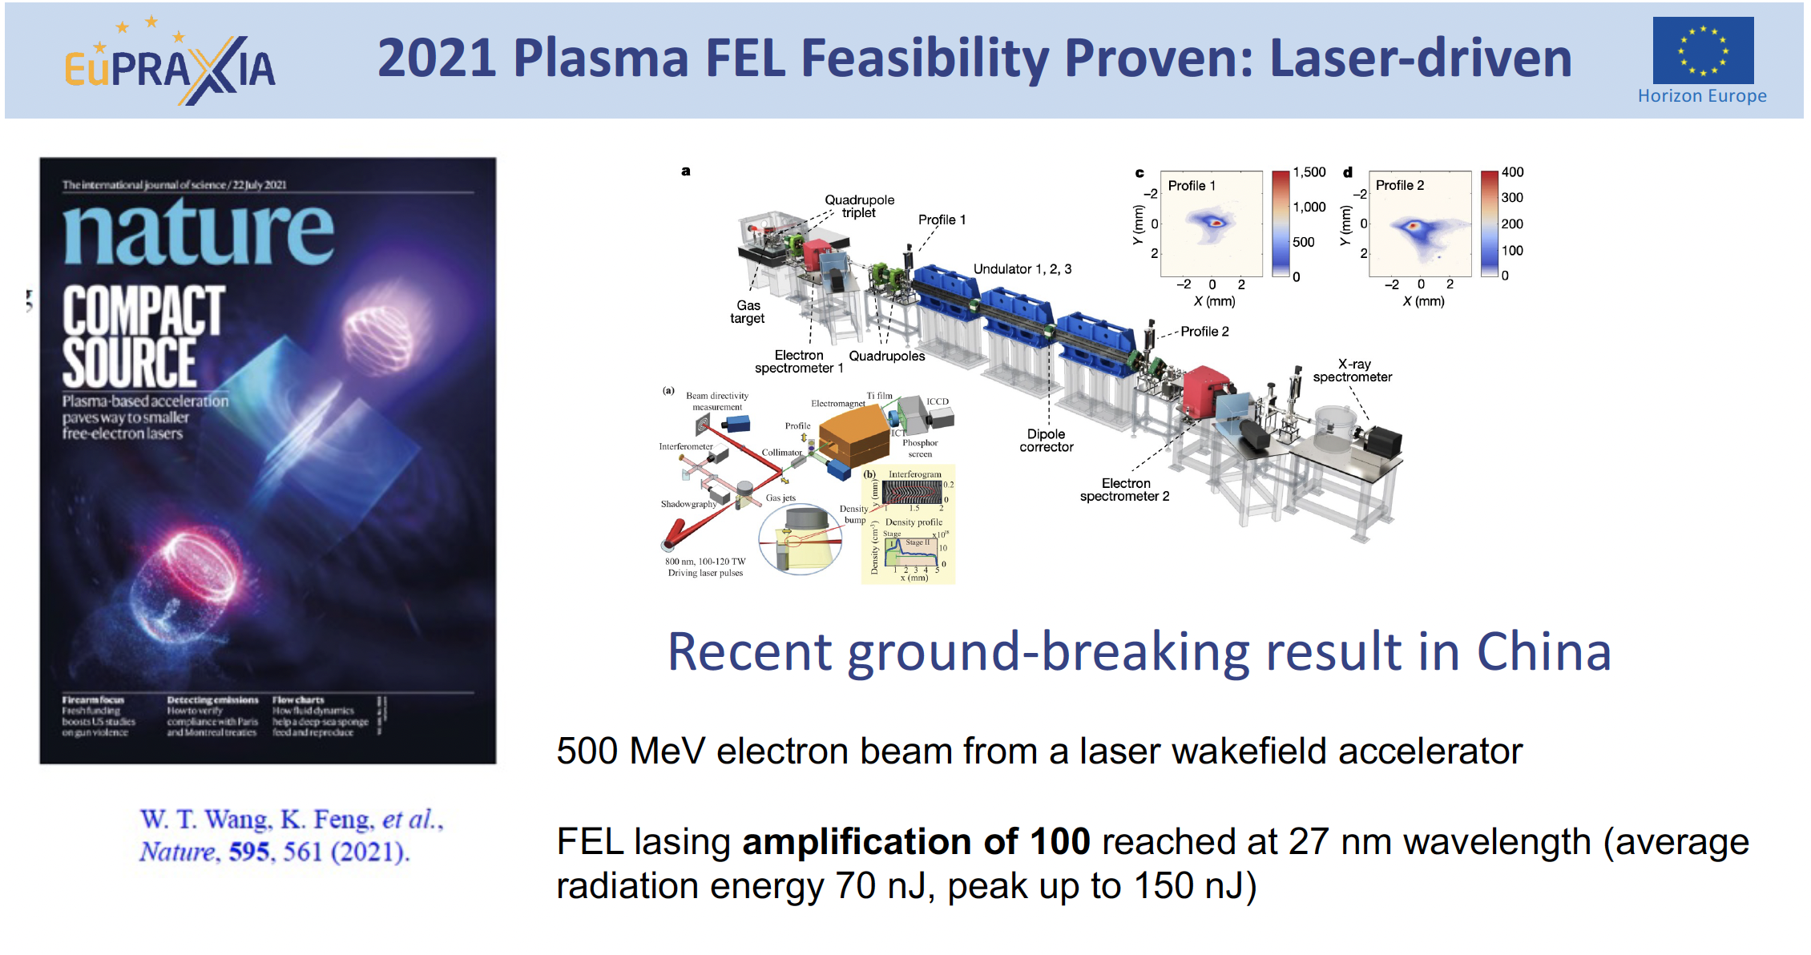
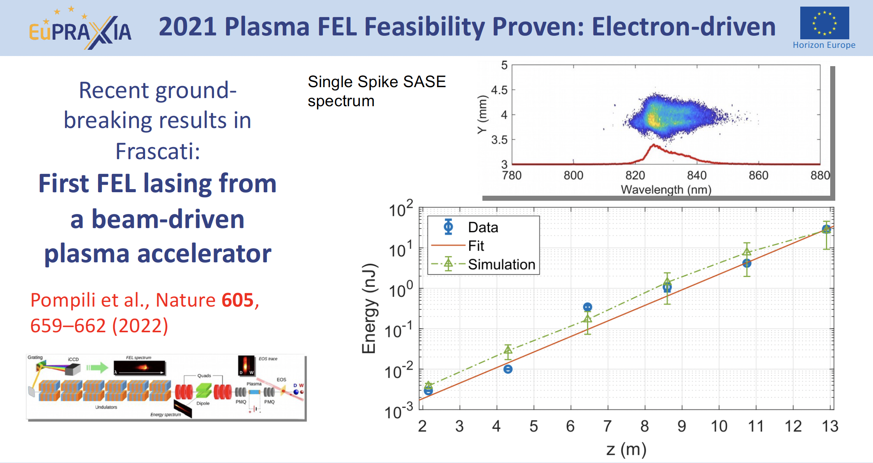
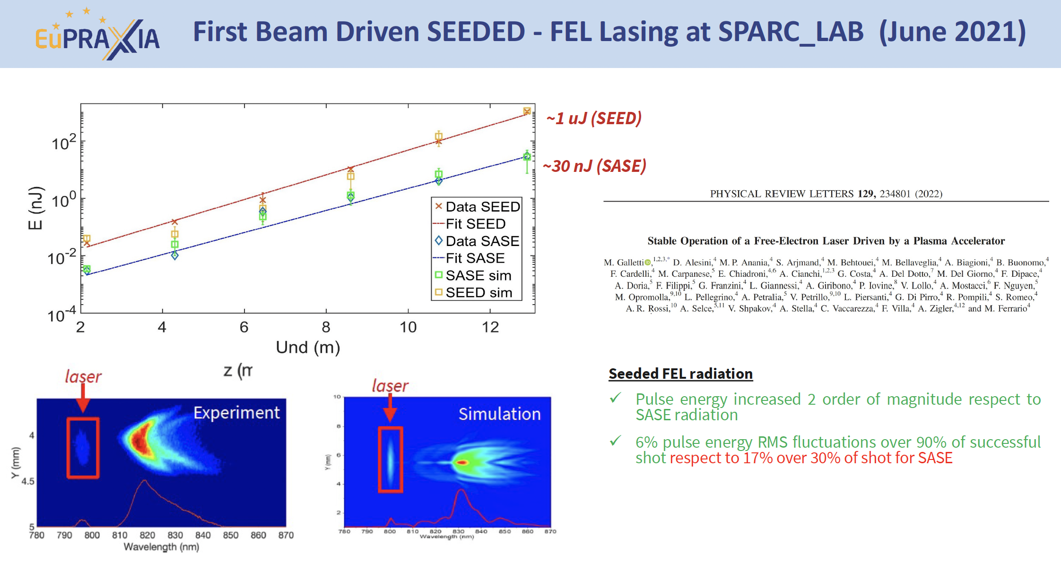
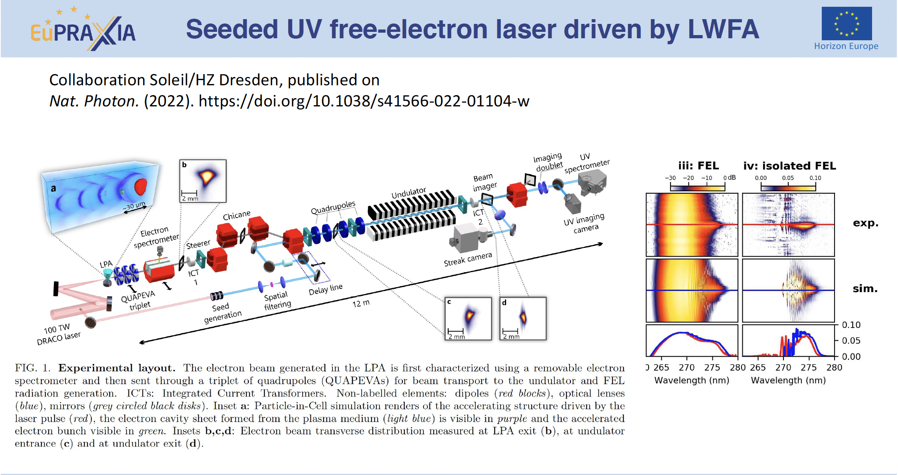
Basic beam quality achieved in pilot FEL experiments

Slide 11
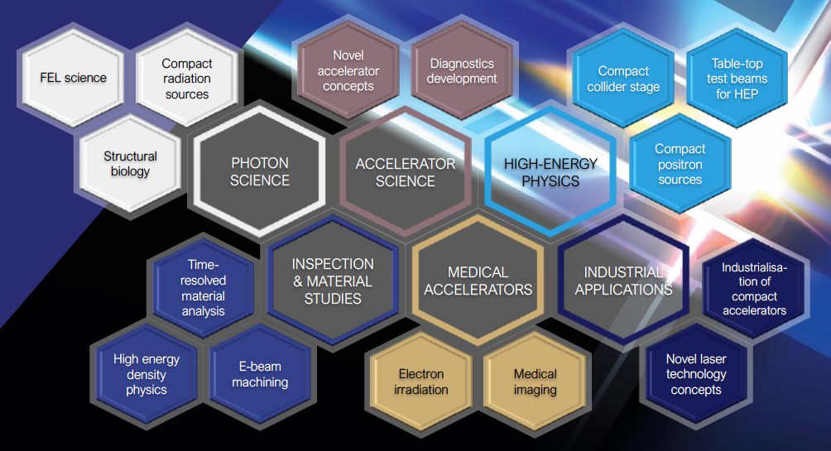
Intense R&D Program on critical components
Electrons
(0.1-5 GeV, 30 pC)
Positrons
(0.5-10 MeV, 10⁶)
Positrons (GeV source)
Lasers
(100 J, 50 fs, 10-100 Hz)
X-band RF Linac
(60 MV/m , up to 400 Hz)
Plasma Targets
Betatron X rays
(1-10 keV, 10¹⁰)
FEL light
(0.2-36 nm, 10⁹-10¹³)

Slide 12
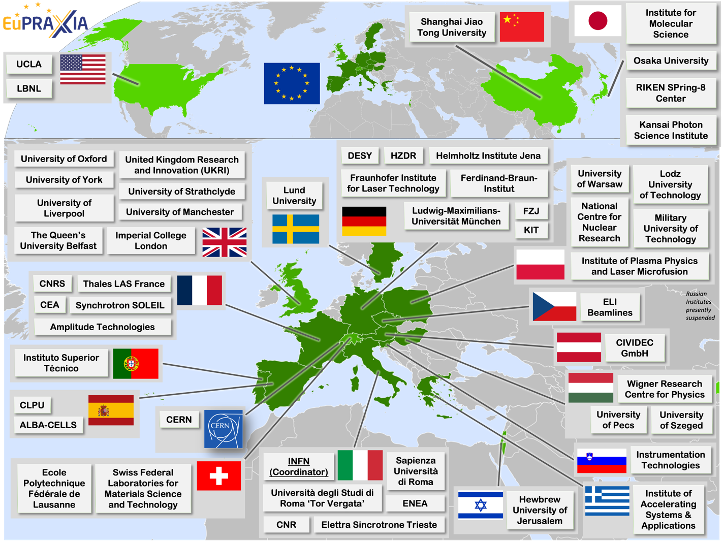
Wide International Collaboration
The EuPRAXIA Consortium today: 54 institutes from 18 countries plus CERN
Included in the ESFRI Road Map
Efficient fund raising:
  Preparatory Phase consortium (funding EU, UK, Switzerland, in-kind)
  Doctoral Network (funding EU, UK, in-kind)
  EuPRAXIA@SPARC_LAB (Italy, in-kind)
  EuAPS Project (Next Generation EU)
  What Next? => PACRI !

Slide 13
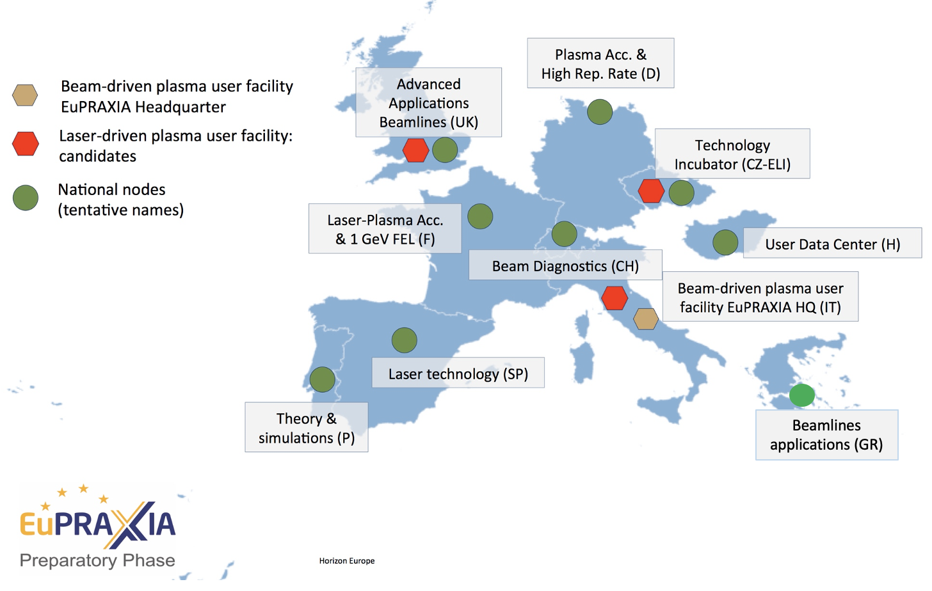
Distributed Research Infrastructure

Slide 14
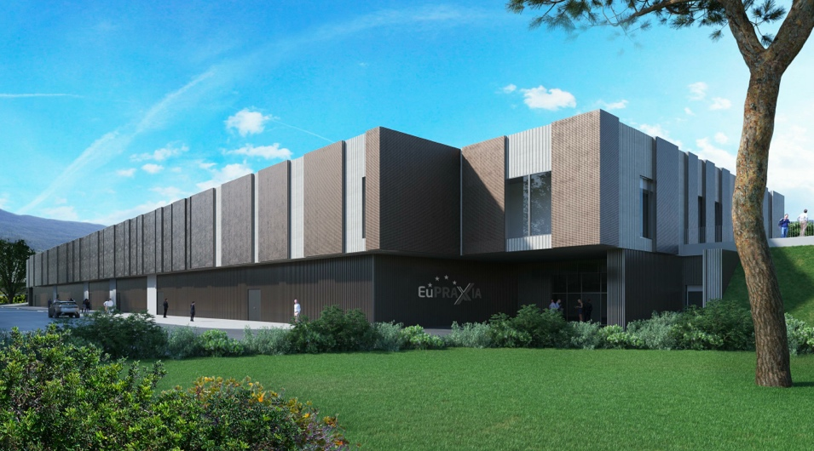
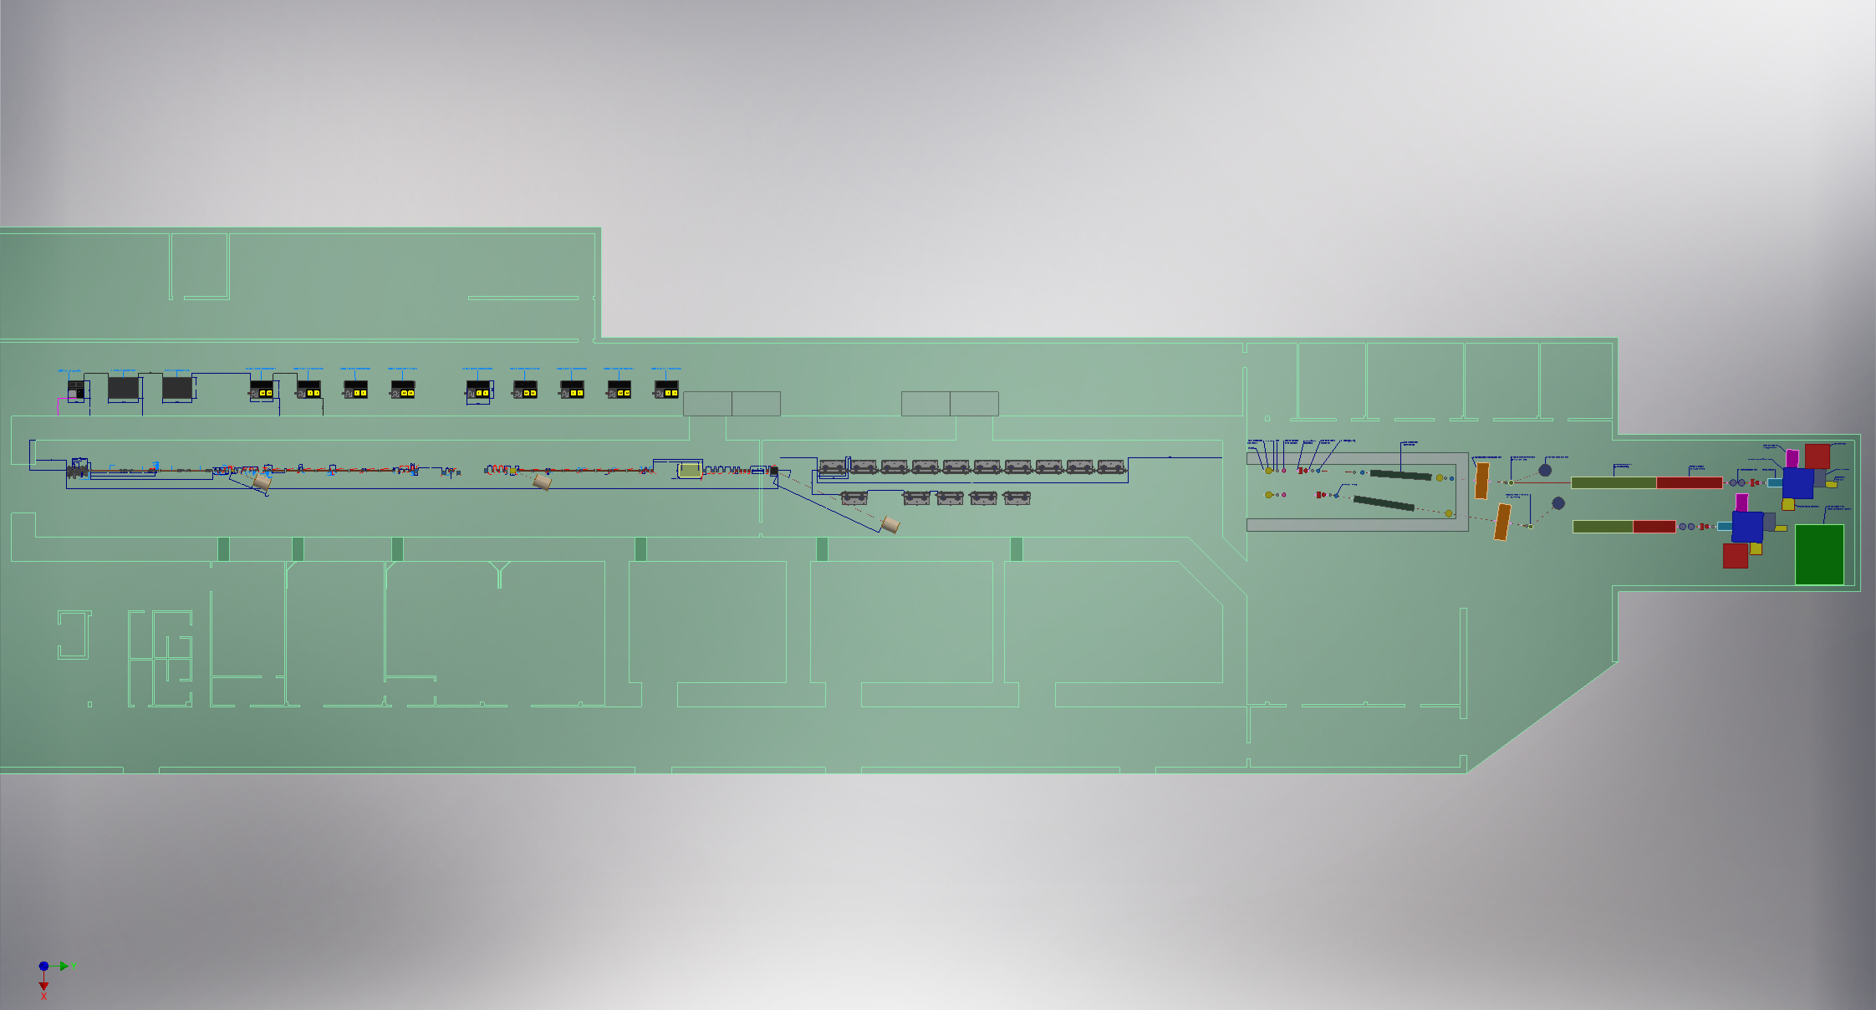
Headquarter and Site 1: EuPRAXIA@SPARC_LAB
Frascati`s future facility
> 130 M€ invest funding
Beam-driven plasma accelerator
Europe`s most compact and most southern FEL
The world`s most compact RF accelerator (X band with CERN)

Slide 15
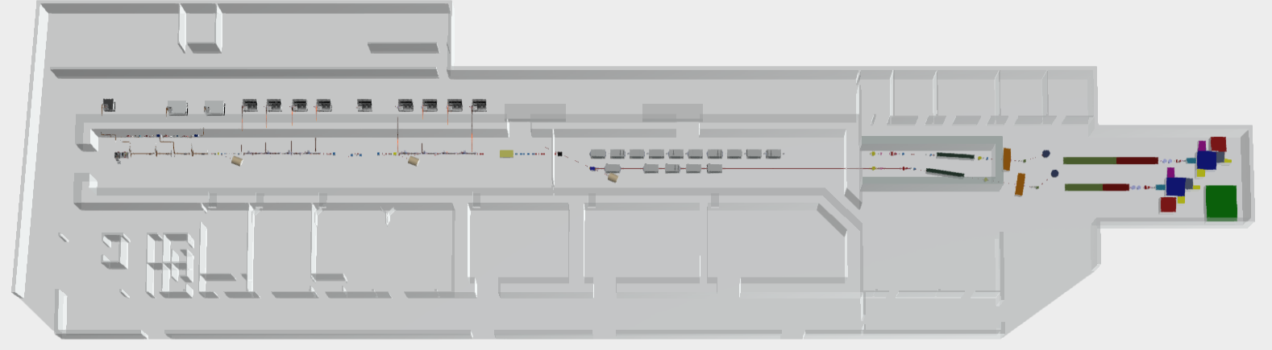
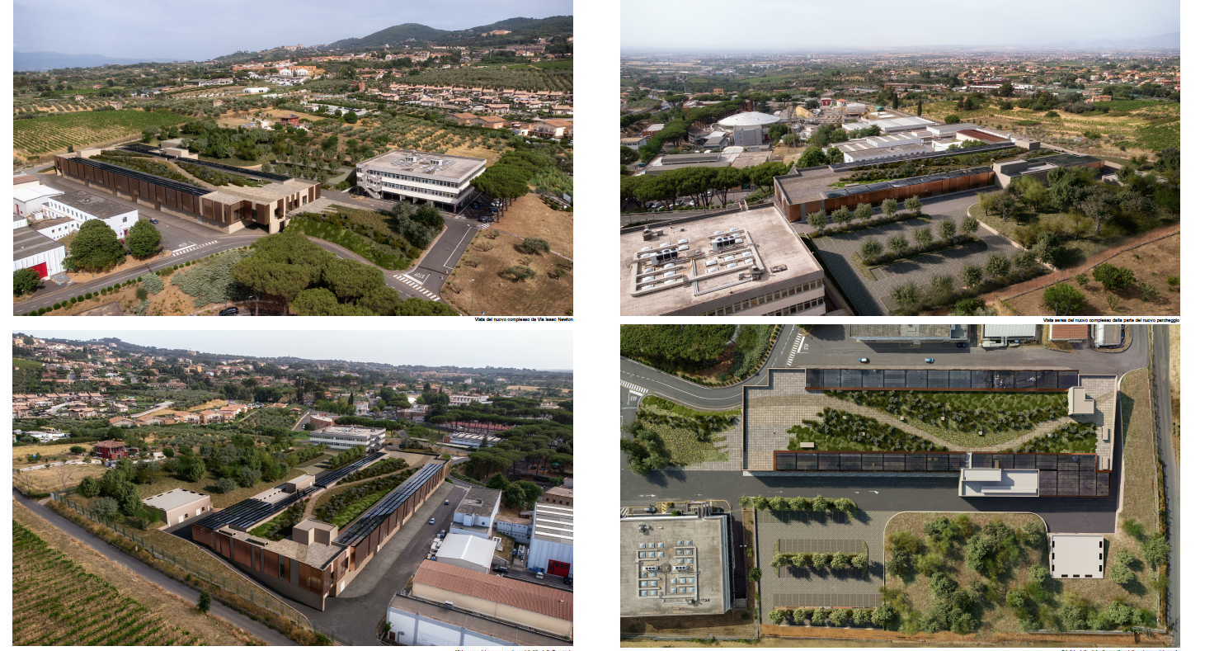
EuPRAXIA@SPARC_LAB Layout
159 m
Technical rooms
Klystron & power supplies hall
Preparations labs
AQUA beamline
45 m
Accelerator tunnel
Plasma
module
Undulator tunnel
ARIA beamline
Experimental hall
Lasers clean rooms
Laser and particle user rooms

Slide 16
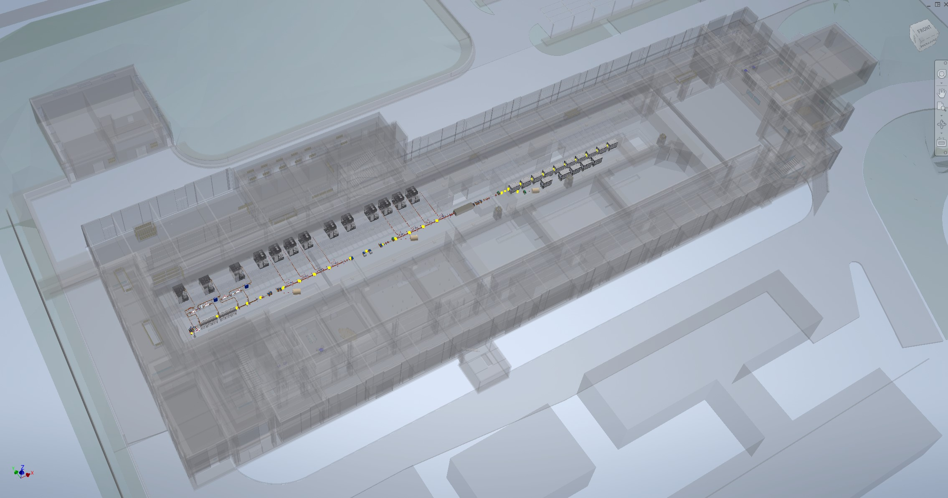
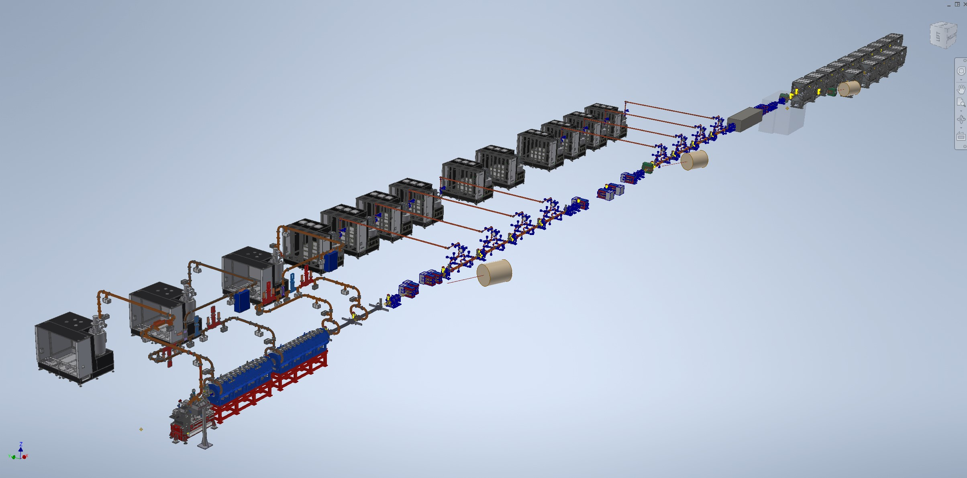
Machine Layout with all components included

Slide 17
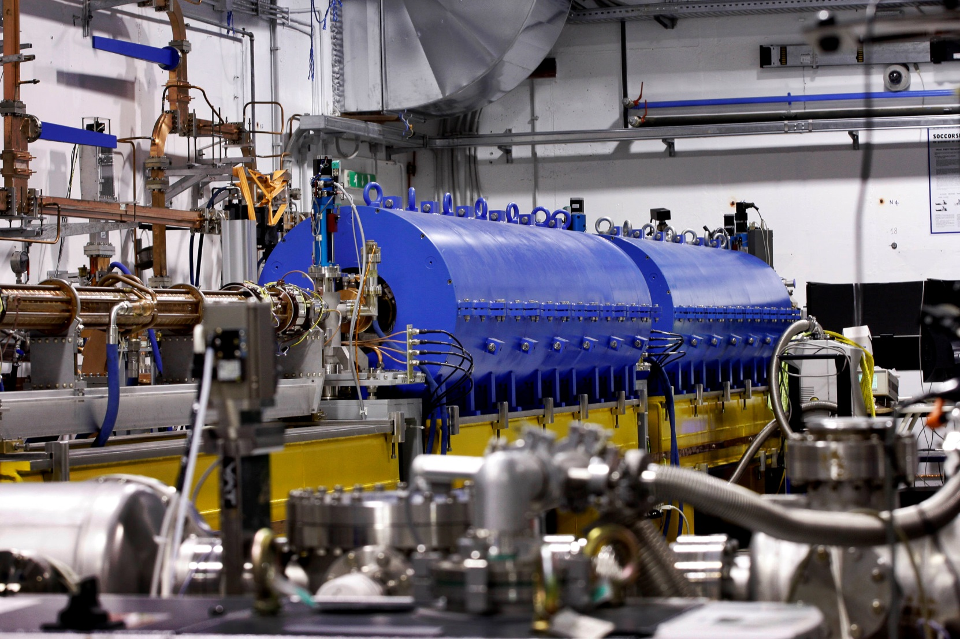
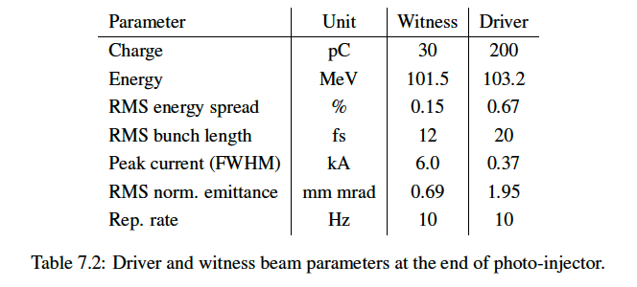
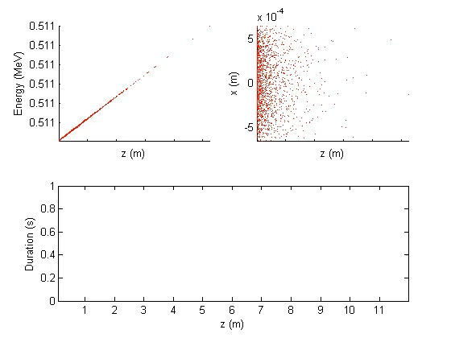
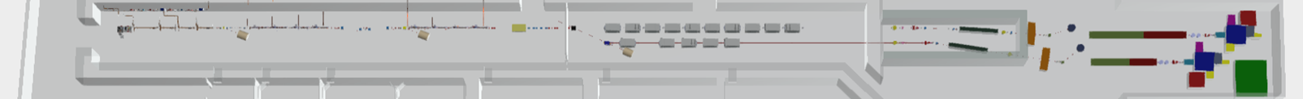
High Quality Electron Beams
10 m
Courtesy E. Chiadroni

Slide 18
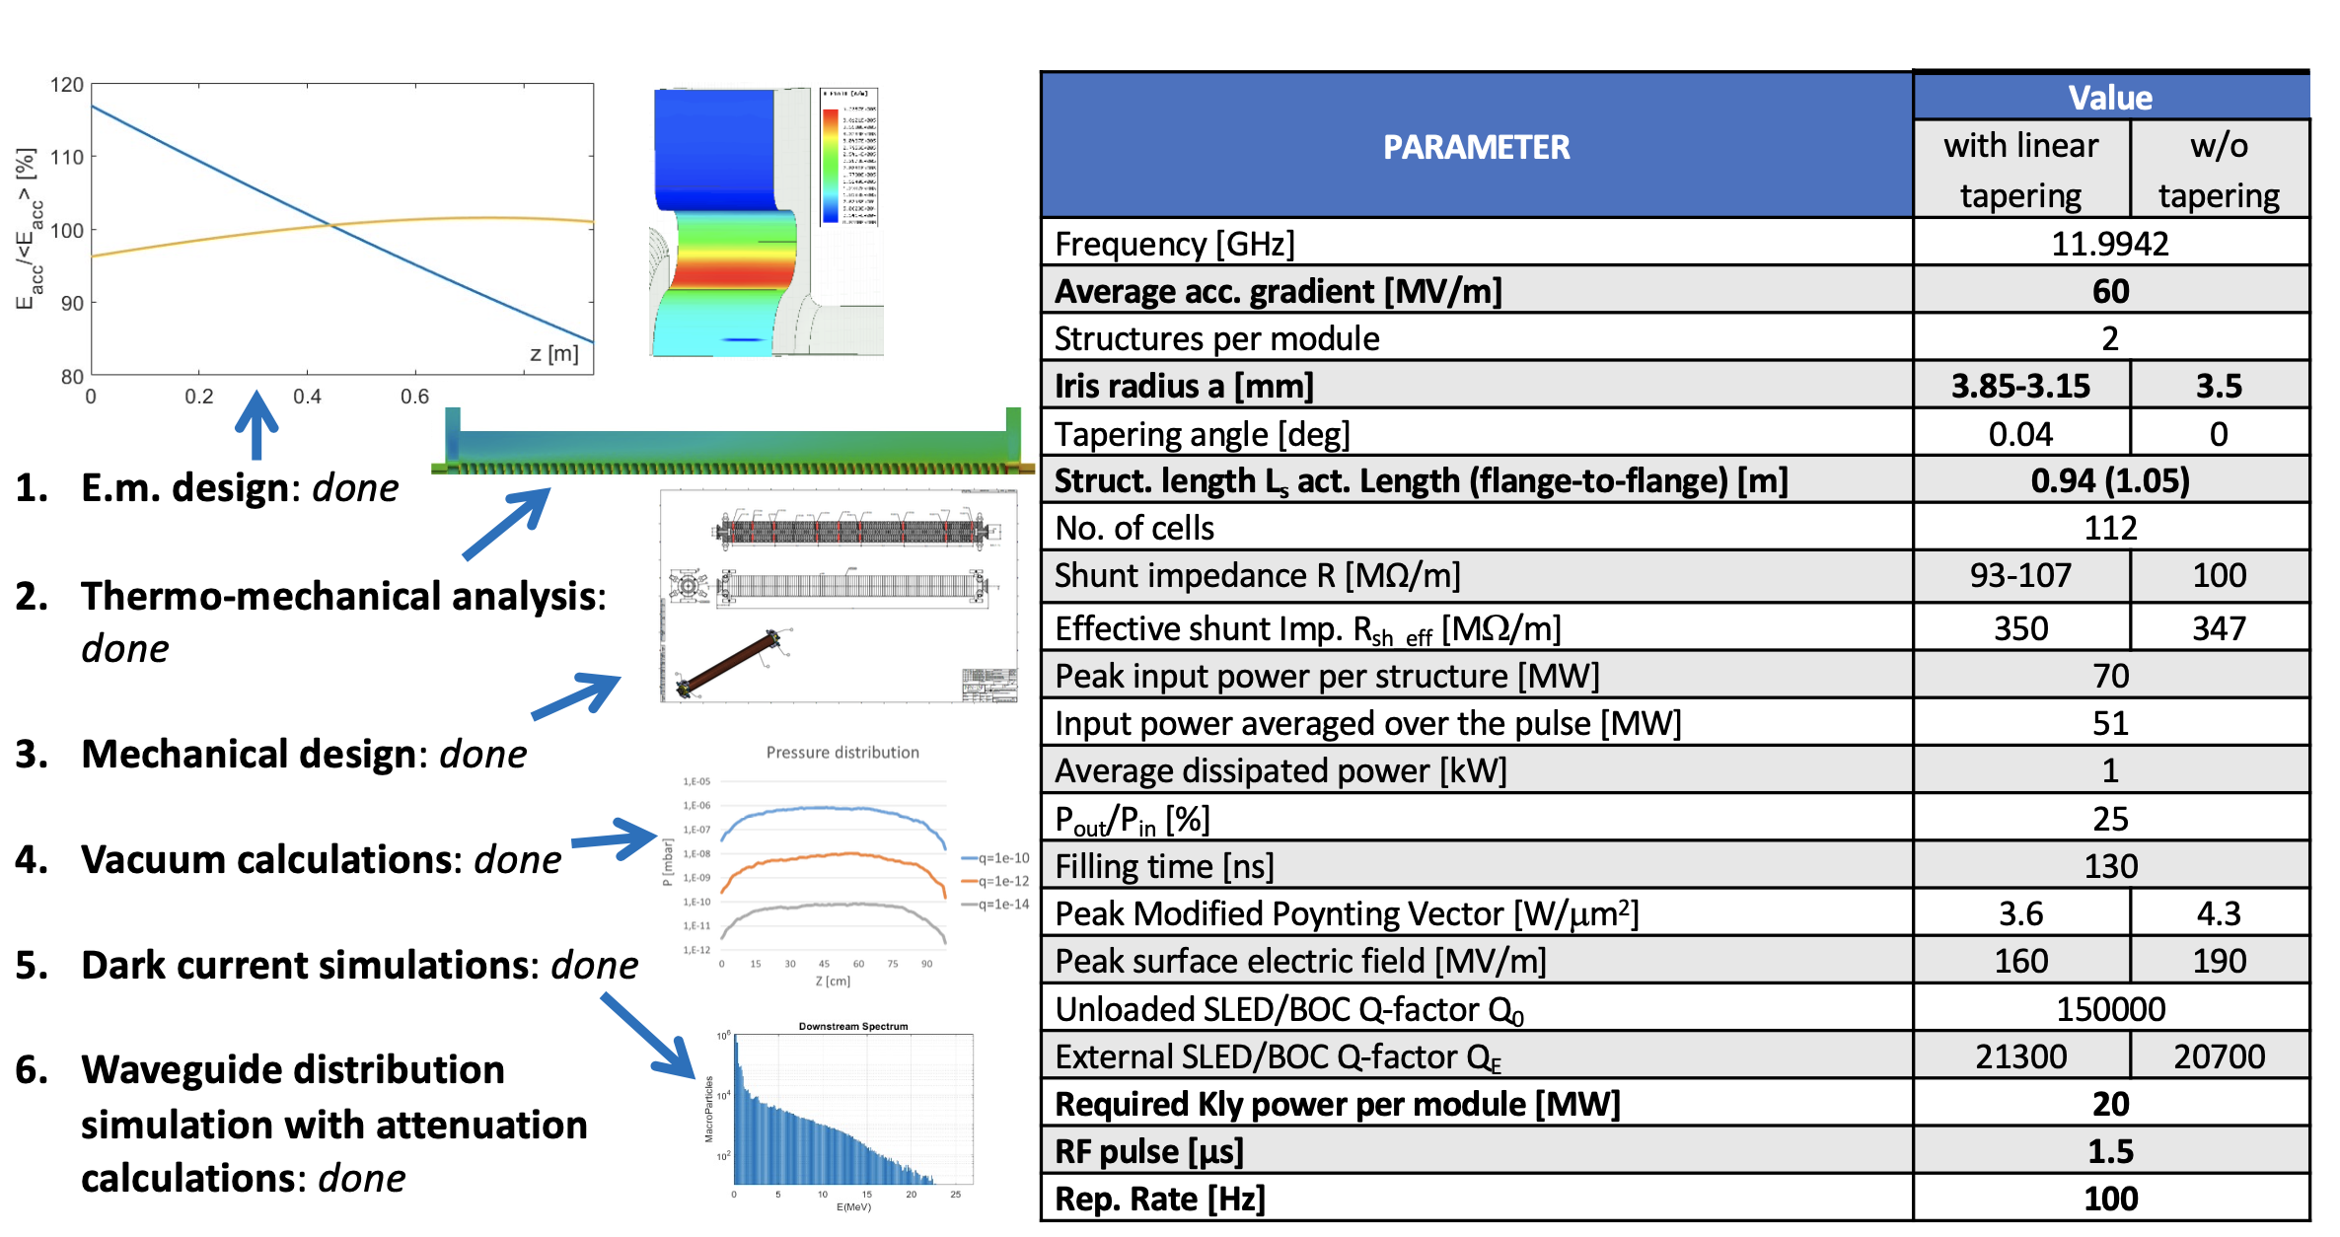
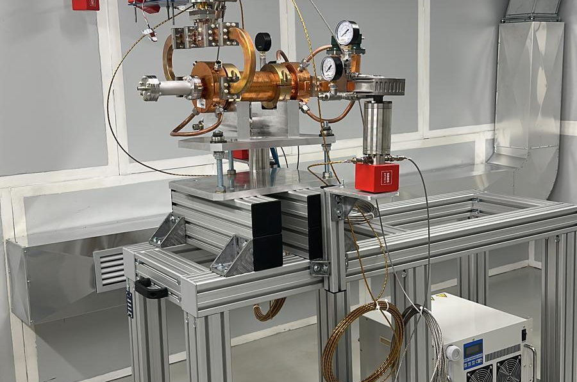
World`s Most Compact RF Linac: X Band
55 m
Courtesy D. Alesini

Slide 19
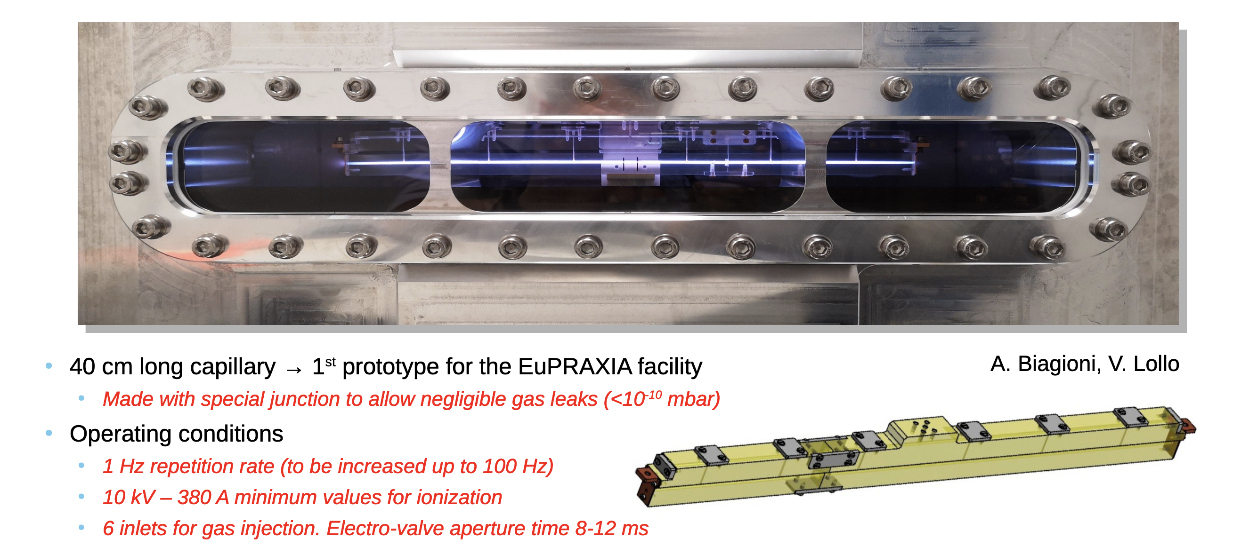
Plasma Module
3.5 m
Courtesy A. Biagioni, R. Pompili

Slide 20
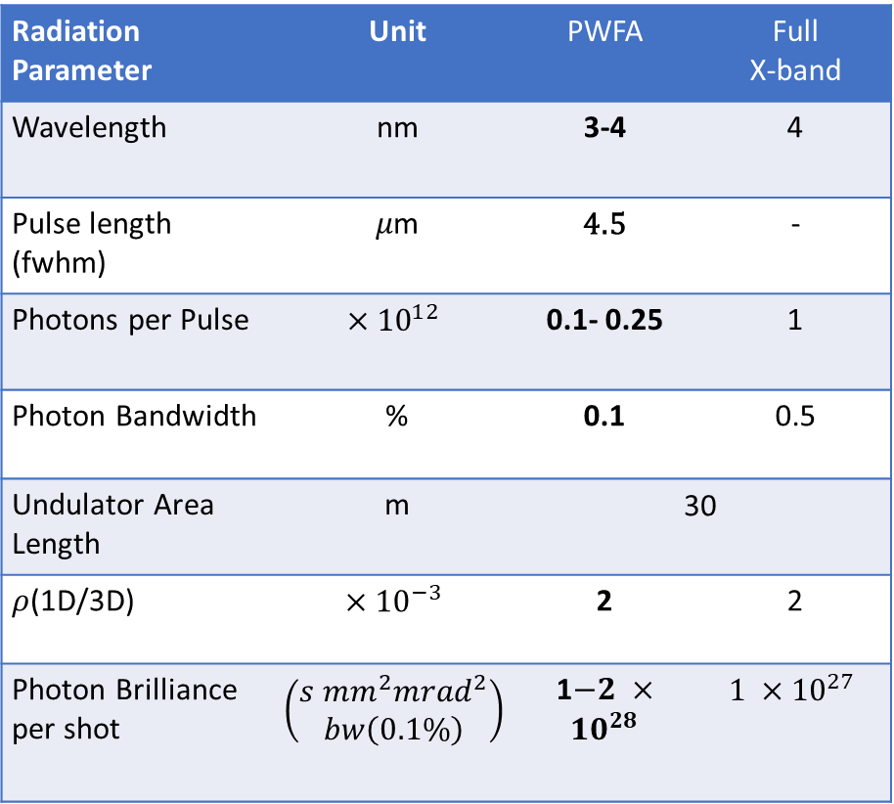
Goal parameters and design criteria
Radiation Parameter | Unit | PWFA | Full X-band
Wavelength | nm | 3-4 | 4
Pulse length (fwhm) | 𝜇m | 4.5 | -
Photons per Pulse | $$×{10}^{12}$$ | 0.1- 0.25 | 1
Photon Bandwidth | % | 0.1 | 0.5
Undulator Area Length | m | 30 | 30
𝜌(1D/3D) | $$×{10}^{−3}$$ | 2 | 2
Photon Brilliance per shot | $$\left(\begin{aligned}s {mm}^{2}{mrad}^{2} \\ bw\left(0.1\%\right)\end{aligned}\right)$$ | 1$−2 ×{10}^{28}$ | $$1 ×{10}^{27}$$
Electron Beam Parameter | Unit | PWFA | Full X-band
Electron Energy | GeV | 1-1.2 | 1
Bunch Charge | pC | 30-50 | 200-500
Peak Current | kA | ~ 2 | 1-2
RMS Energy Spread | % | < 1 | 0.1
RMS Bunch Length | 𝜇m | 3-6 | 24-20
RMS norm. Emittance | 𝜇m | 1 | 1
Slice Energy Spread | % | ≤0.05 | ≤0.05
Slice norm Emittance | mm-mrad | 0.5 | 0.5
Energy jitter | % | < 1 | 0.1
Bold values indicate currently reached ones by means of S2E simulations
Notes:
Perchè 1-2 o 6-3 nella tabella?

Slide 21
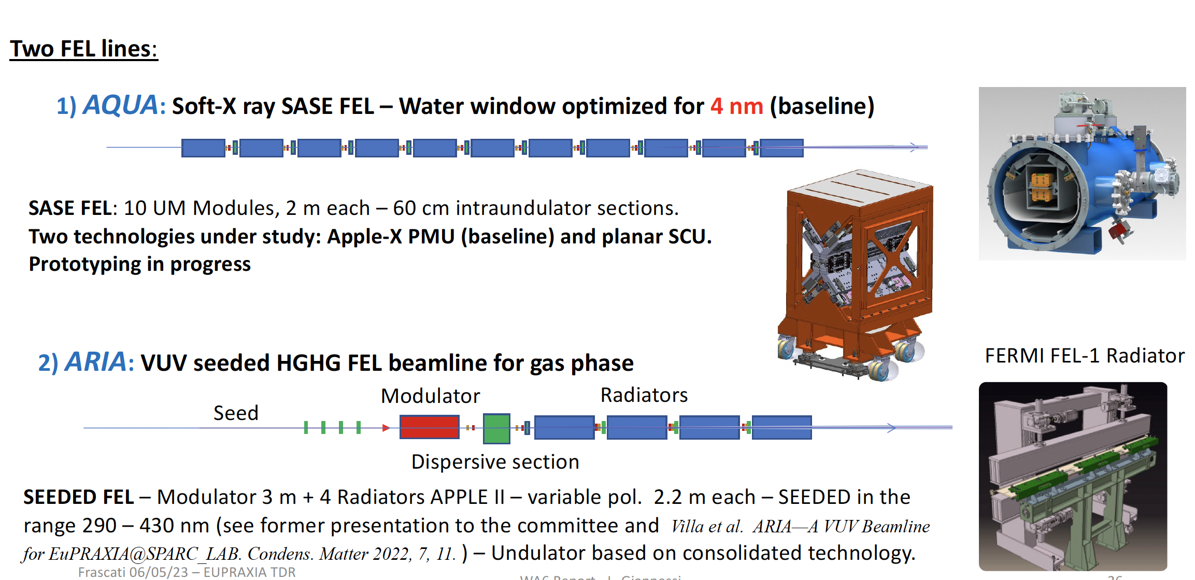
Radiation Generation: FEL
50-100
40 m
Courtesy L. Giannessi

Slide 22
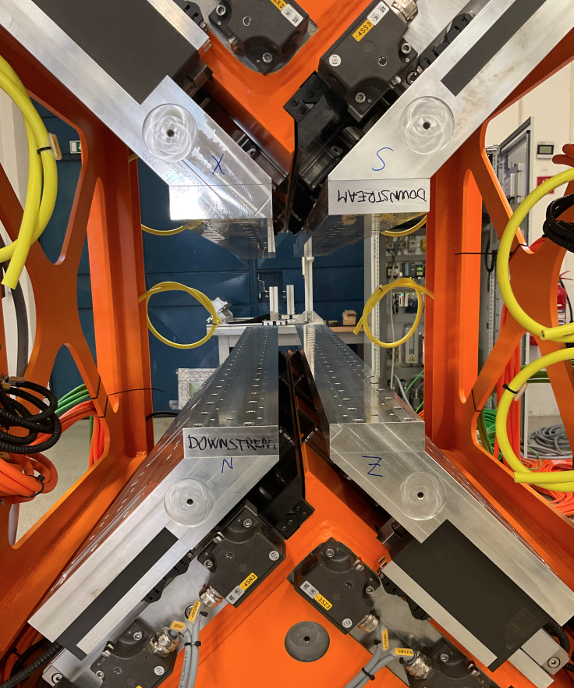
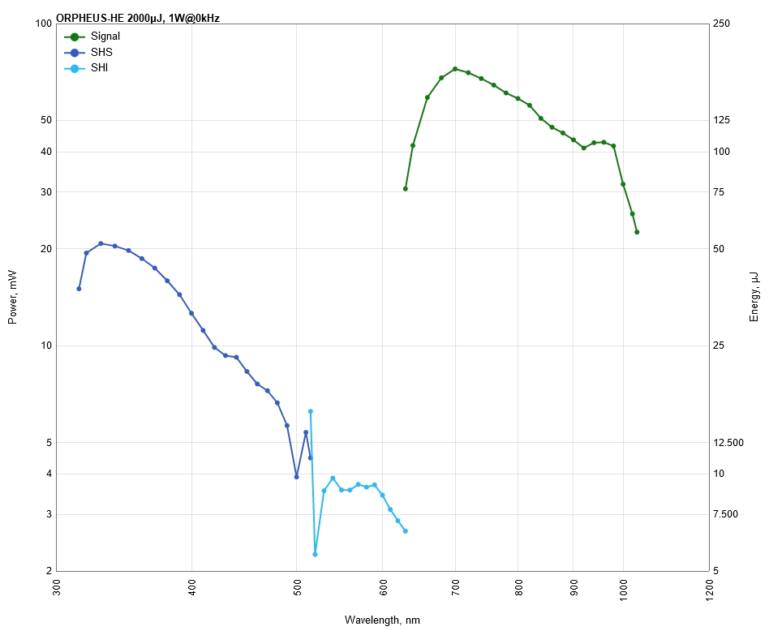
Undulators
Undulator parameters | AQUA
Period (mm) | 18
Maximum strength (k) | 1.47
Minimum gap (mm) | 6
Active length (m) | 19.8
Undulator parameters | ARIA
 | Modulator | Radiator
Period (mm) | 100 | 55
Active length (m) | 3.0 | 8.4
Seeding laser | OPA configuration
Seeding wavelengths (nm) | 320-400 + 600-800
Seeding energy | >20 µJ
Seeding duration | 200 fs
APPLE X undulator
allow for polarization tuning
(from linear to circular)
Seed laser
tunability
40 m

Slide 23
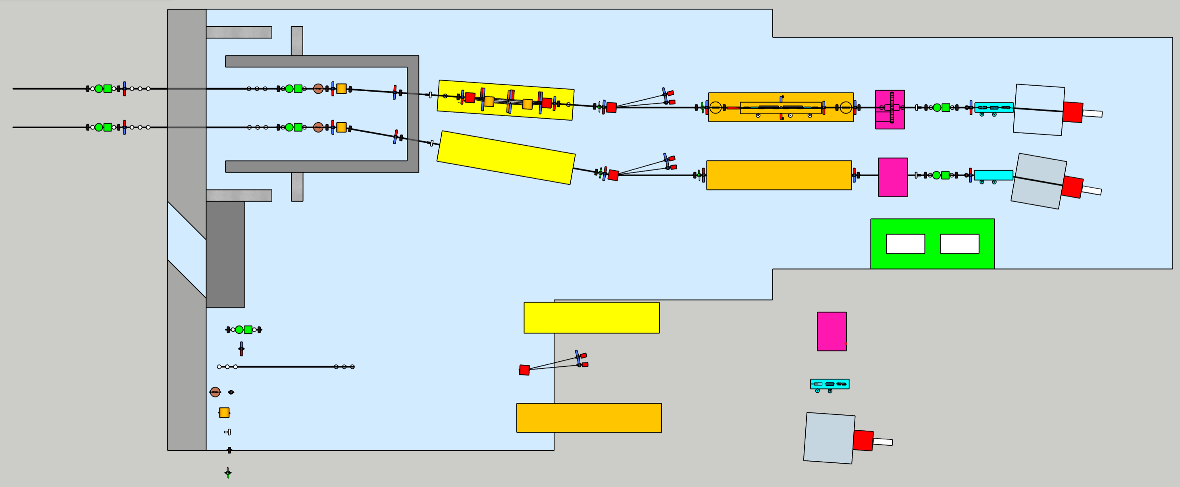
FEL Beamlines
10m
30m
20m
AQUA beamline
12m
ARIA beamline
Monochromator area
Laser hutch
GDM
Polarization/time measure area
Screens
Gas absorber
Spectrometer
Apertures
K-B mirrors
Mirror
Solid attenuators/filters
Exp. Chamber area
Valves
Split & delay line area
BPM
50 m

Slide 24
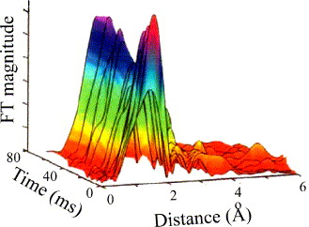
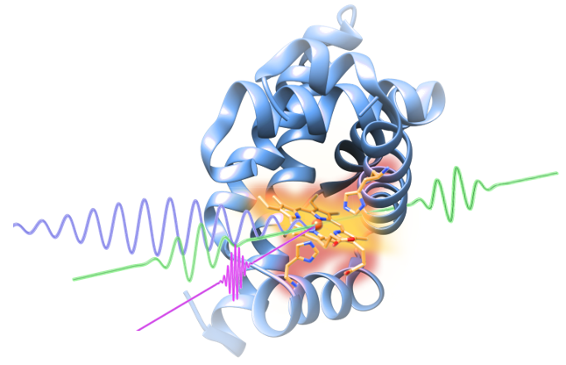
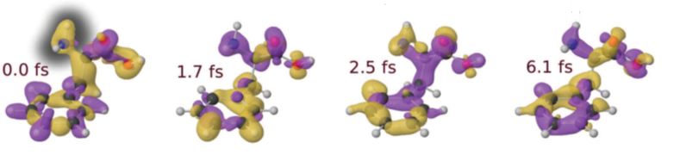
AQUA beamline scientific case
Experimental techniques and typology of samples
(Large) Viruses
Organelles
Bacteria/Cells
Metals
Semiconductors
Superconductors
Magnetic materials
Organic molecules
Coherent imaging
X-ray spectroscopy
Raman spectroscopy
Photo-fragmentation of molecules
Courtesy F. Stellato

Slide 25
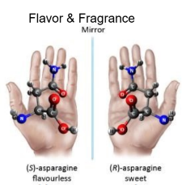
ARIA beamline scientific case
Defining experimental techniques and typology of samples (and applications)
Gas phase & Atmosphere
(Earth & Planets)
Aerosols
(Pollution, nanoparticles)
Molecules & gases
(spectroscopies, time-of-flight)
Proteins
(spectroscopies)
Surfaces
(ablation & deposition)
Photoemission
Spectroscopy
Photoelectron Circular
Dichroism
Raman spectroscopy
Photo-fragmentation of molecules
Time of Flight Spectroscopy
Courtesy F. Stellato

Slide 26
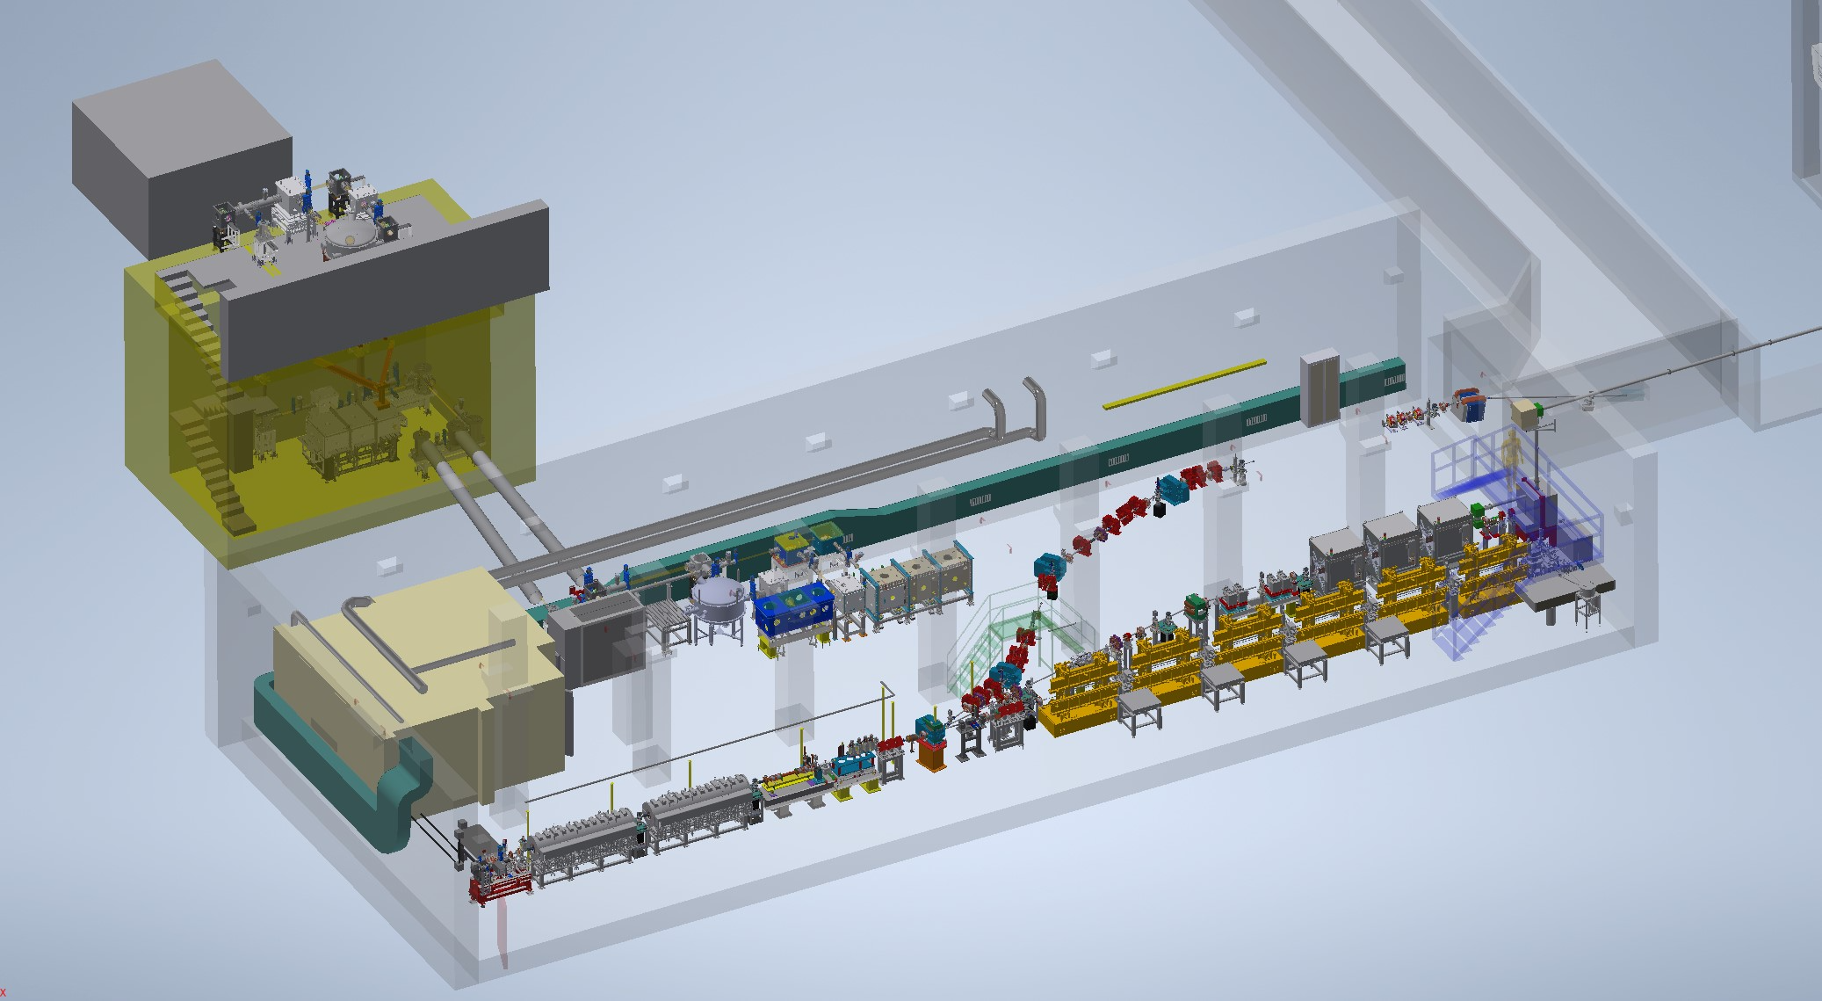
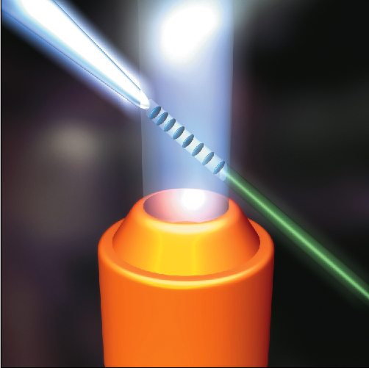
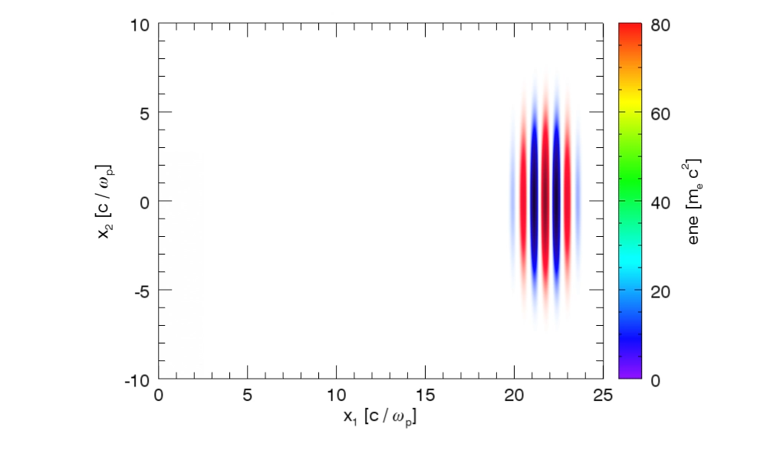
Electron beam Energy [MeV] | 50-800
Plasma Density [cm⁻³] | 10¹⁷ - 10¹⁹
Photon Critical Energy [keV] | 1 - 10
Nuber of Photons/pulse | 10⁶ – 10⁹
Courtesy J. Vieira, R. Fonseca/GoLP/IST Lisbon

Slide 27
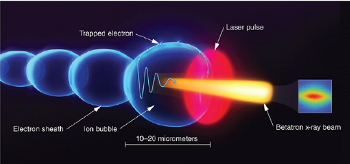
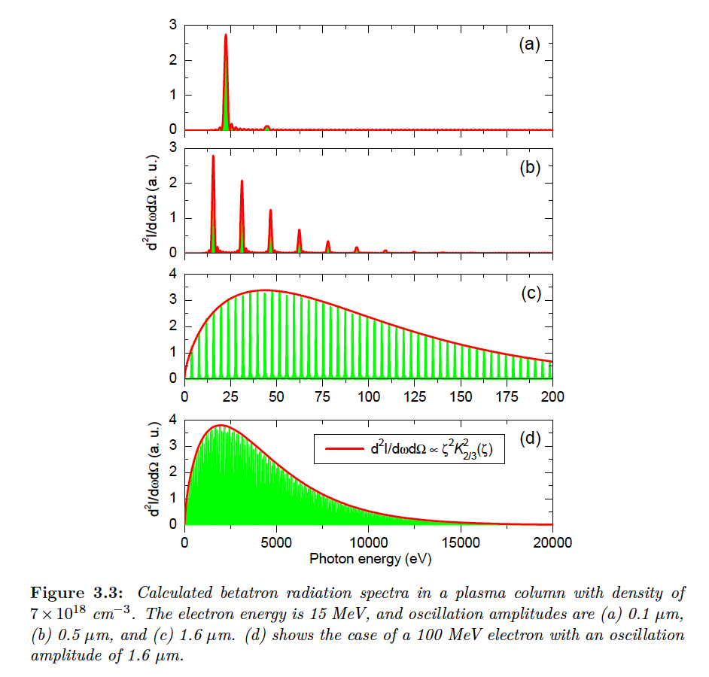
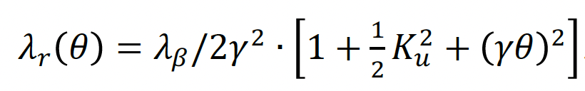





K_{u}<1
$$λ_{β}=\sqrt{2γ}λ_{p}$$
K_{u}>1
$$ω_{c}=3K_{u}γ^{2}ω_{β}$$
K_{u}>>1
$$N_{ph}∝N_{e}N_{β}K_{u}$$
$$K_{u}=γk_{β}r_{β}$$
$$r_{β}^{}=\frac{2\sqrt{a_{0}}c}{ω_{p}}$$
EuAPS Kick-off Meeting Roma , 28 February 2023, INFN Head quarter

Slide 28

Photon Science @ EuAPS
Condensed Matter 7.1 (2022): 23.
Imaging of biological (and cultural heritage) samples
  Exploits the brilliance and coherence of betatron radiation, requires small divergence and good focusing
Static X-ray Spectroscopy
  Relatively easy, but does not exploit the radiation time structure
Ultra-fast X-ray spectroscopies exploiting ultra-short betatron pulses
  More complicated, requires timing between pump and probe pulses, but fully exploits the fs pulse duration
Time-resolved imaging (ultrafast dynamics)
Wide angle scattering, diffraction
  Depending on the samples, requires monochromatic beams with high flux
Courtesy F. Stellato

Slide 29
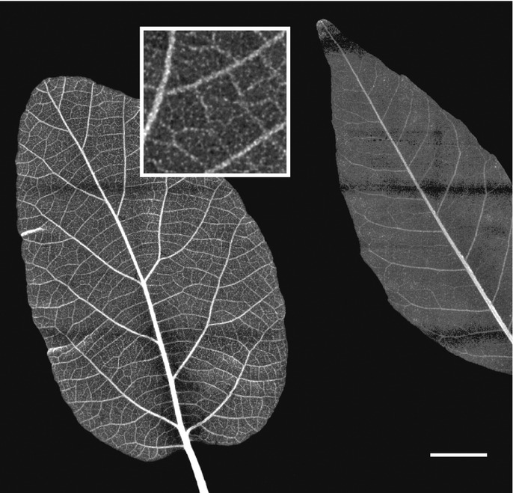
Imaging – The pilot experiment
Green science
X-ray imaging of leaves (and wood)
aiming at the (tens of) microns resolution
Experiments performed with the broad radiation spectrum filtered by different materials to obtain difference maps emphasizing the presence of heavy metal contaminants → pollution control
Reale et al. - MIDIX Soft X-rays microradiography

Slide 30
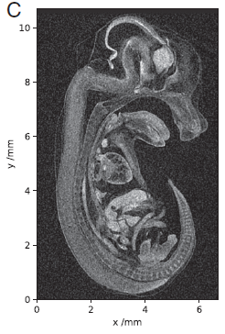
Imaging – CT and Phase Contrast
Betatron sources can fill the gap between synchrotrons and X-ray tubes for imaging and Computer Tomography (CT)
Guo et al. Scientific Reports 2019
Cole et al. PNAS 2018
Betatron sources have a spatial coherence that allows performing Phase Contrast Imaging (PCI). In PCI, one measures the difference in wavefront, while in “traditional” imaging one measures the difference in the X-ray absorption coefficient between different “objects”
PCI provides better contrast than radiography, especially when dealing with biological samples. Wenz et al. Nature communications 2015

Slide 31
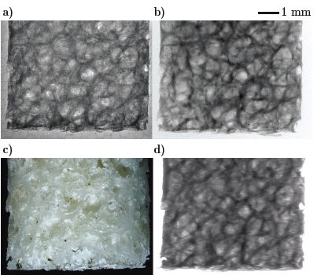
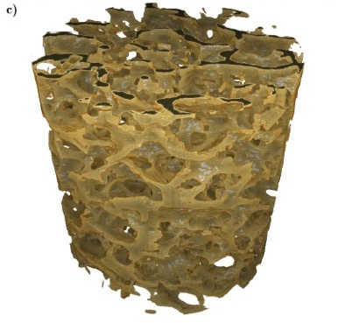
Betatron X Rays: Compact Medical Imaging
J.M. Cole et al, “Laser-wakefield accelerators as hard x-ray sources for 3D medical imaging of human bone”. Nature Scientific Reports 5, 13244 (2015)
Physics & Technology Background:
Small EuPRAXIA accelerator → small emission volume for betatron X rays.
Quasi-pointlike emission of X rays.
Sharper image from base optical principle.
Quality demonstrated and published, but takes a few hours for one image.
Advancing flux rate with EuPRAXIA laser by factor > 1,000!
EuPRAXIA technology
μCT Scanner
Added value
Sharper images with outstanding contrast
Identify smaller features (e.g. early detection of cancer at micron-scale – calcification)
Laser advance in EuPRAXIA → fast imaging (e.g. following moving organs during surgery)
3D tomography of human bone
EuPRAXIA laser advance (industry)
will push rate from 1/min to 100 Hz.
Ultra-compact source of hard X rays → exposing from various directions simultaneously is possible in upgrades
Macro-photography
Radioactive source
Notes:
Massimo

Slide 32

EuPRAXIA@SPARC_LAB baseline updating

Slide 33


Conclusions
Plasma accelerators have advanced considerably in beam quality, achieving FEL lasing.
EuPRAXIA is a design and an ESFRI project for a distributed European Research Infrastructure, building two plasma-driven FEL´s in Europe.
EuPRAXIA FEL site in Frascati LNF-INFN is sufficiently funded for first FEL user operation in 2029.
Second EuPRAXIA FEL site will be selected in next months, among 4 excellent candidate sites.
Concept today works in design and in reality. Expect (solvable) problems in stability for 24/7 user operation. Facility needed to demonstrate!
Additional fund raising is continuosly going on

Slide 34

Thank for your attention

