Slide 1

ESRF Status and Plans
S. White
Material from: N. Carmignani, L. Carver, S. Liuzzo, T. Perron, A. Sauret, P. Borowiec, M. Dubrulle, M. Morati, V. Serriere, A. D’Elia, L. Hardy, T. Brochard, D. Baboulin, G. Le Bec, C. Benabderrahmane

Slide 2
outline
ESRF-EBS accelerator complex
ESRF-EBS operation status
Storage ring improvements
Injection and injectors upgrade
New Linac project

Slide 3

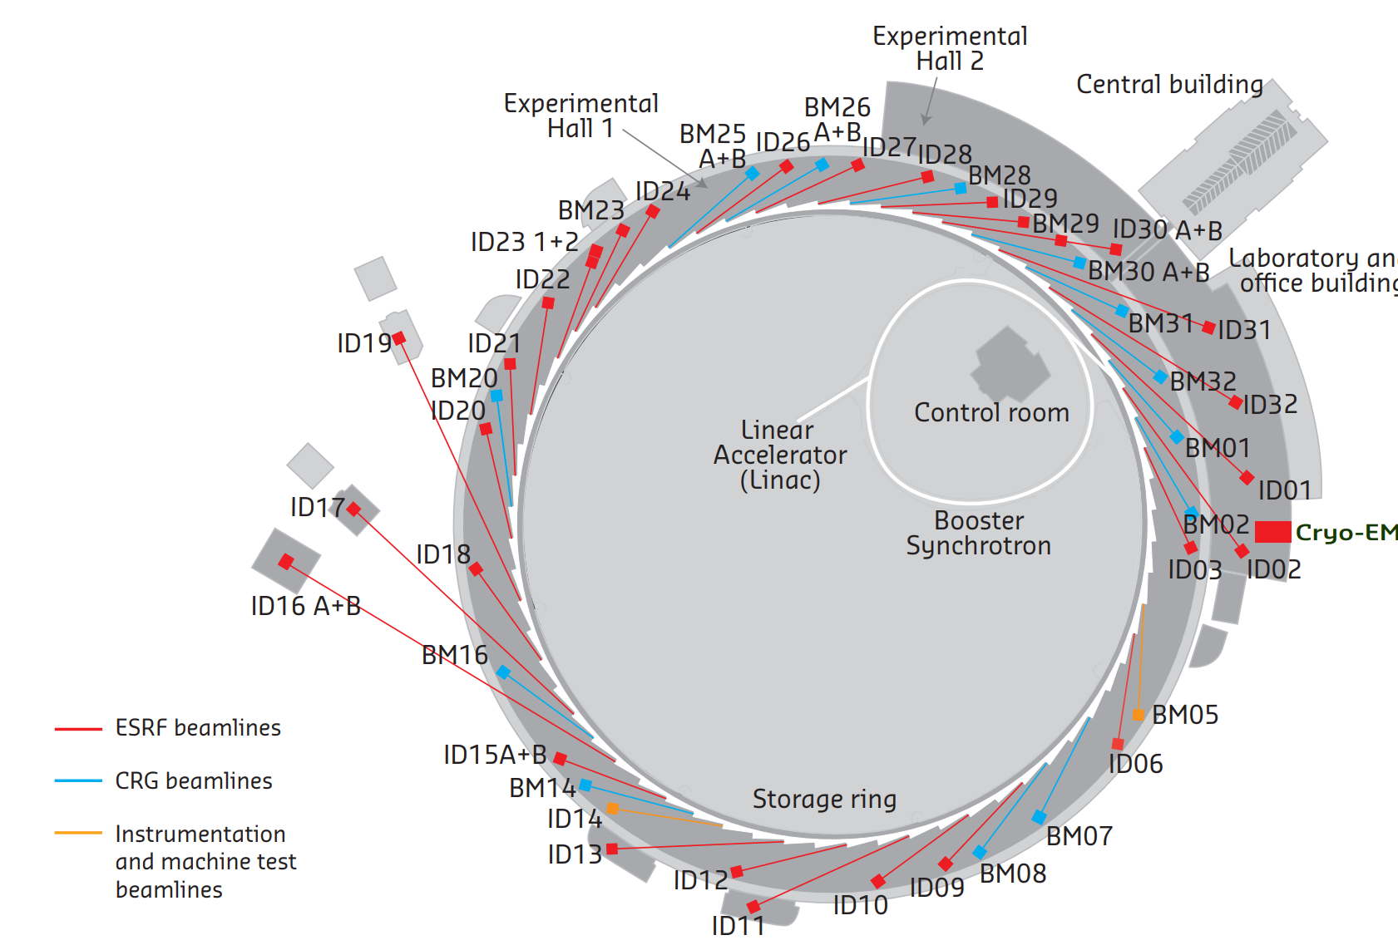
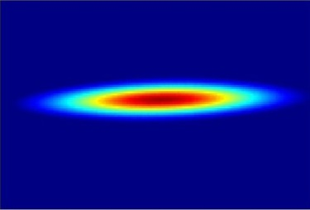
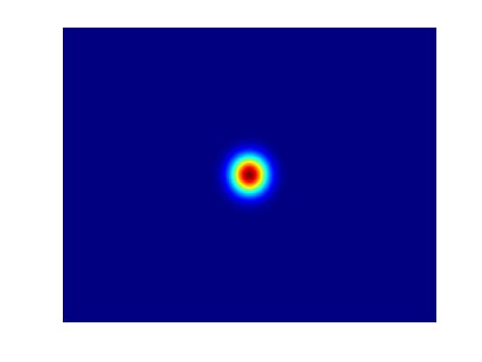
ESRF Accelerator complex
Light source in operation since 1994 located in Grenoble, France:
33 Insertion Devices (ID) end stations
16 Bending Magnets (BM) end station
1 Cryo-Electron Microscope (Cryo-EM)
22 partner nations:
Annual budget: 100 million euros
Staff: 650
The ESRF Extremely Brilliant Source upgrade:
Decrease the horizontal emittance
Increase the source brilliance
Increase the source coherence
Linac
200 MeV
Storage Ring
6 GeV
32 cells
Booster synchrotron
300m, 4Hz

Slide 4
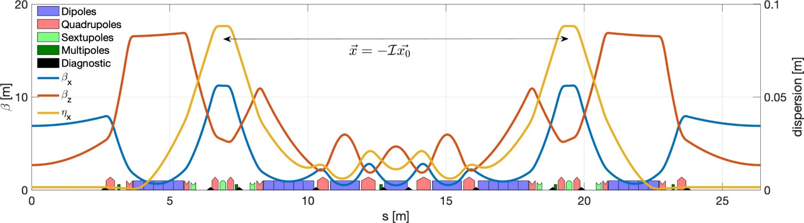
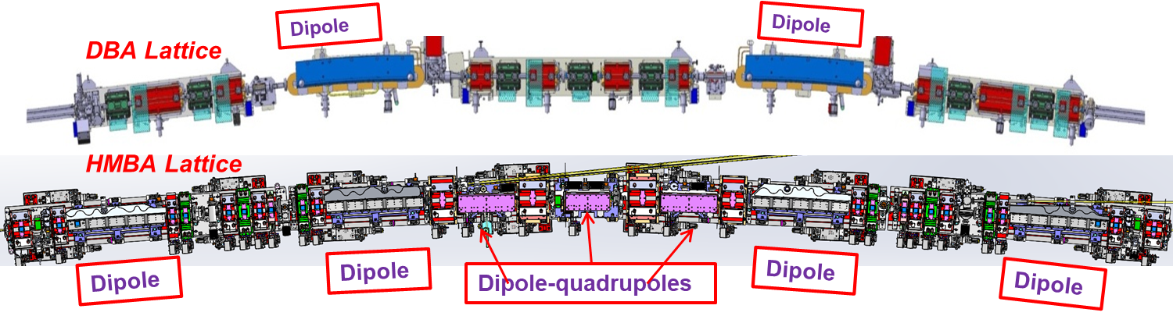
HMBA lattice
Main design constraints are:
Horizontal equilibrium emittance of <150 pm.rad
Fit existing tunnel and infrastructure and maintain beamlines
Use existing injectors chain
Minimize energy loss and power consumption
HMBA technical solutions:
Longer and weaker “Multi-Bends”: combined function magnets with low
dispersion + longitudinal gradient permanent dipoles
Dispersion bump with -I transform: weaker, fewer sextupoles with partial compensation of aberrations for improved lifetime and acceptance
31 magnets per cell instead of 17
ESRF-EBS design:
Horizontal emittance ~135 pm.rad
Touschek Lifetime ~20h
Injection efficiency >90%

Slide 5
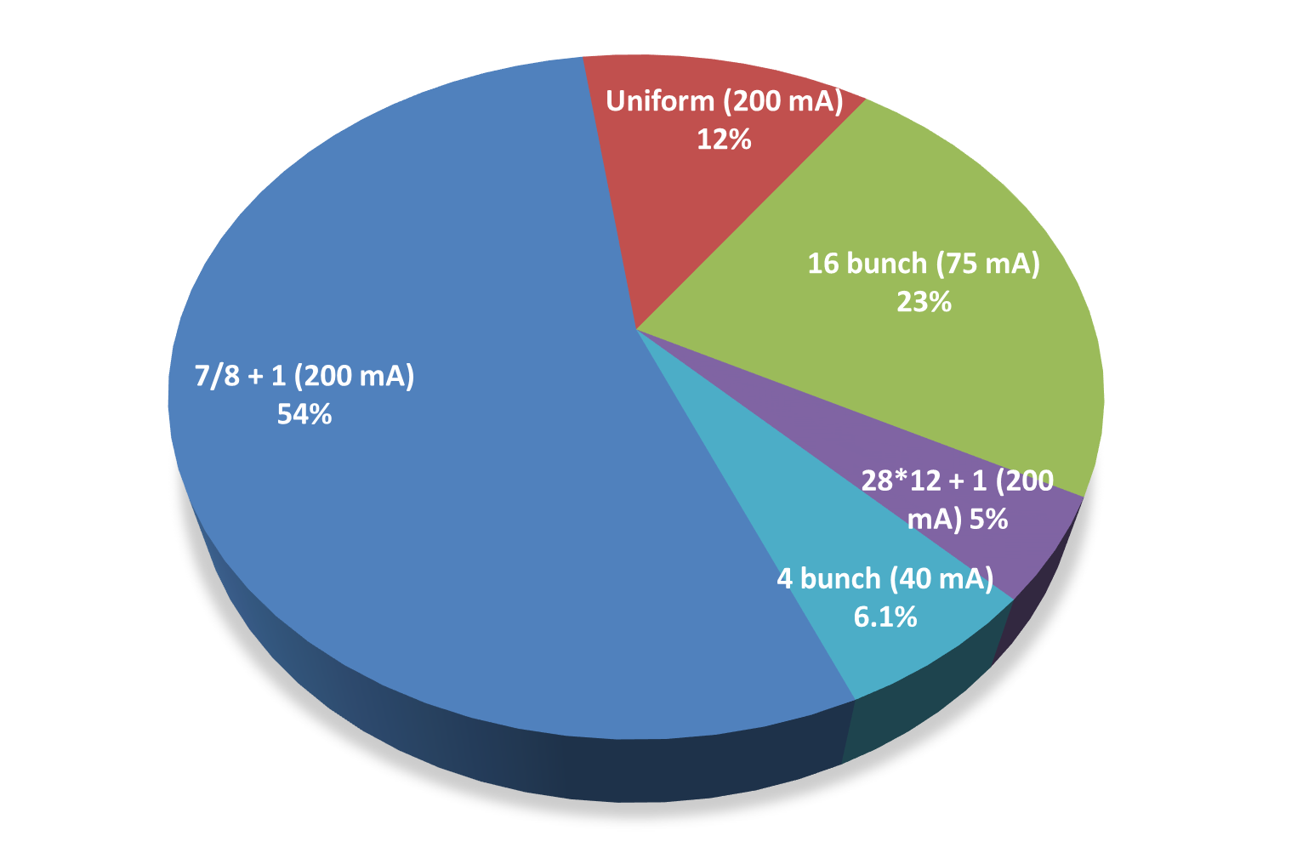
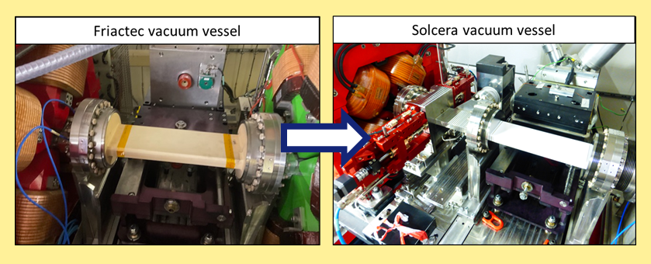
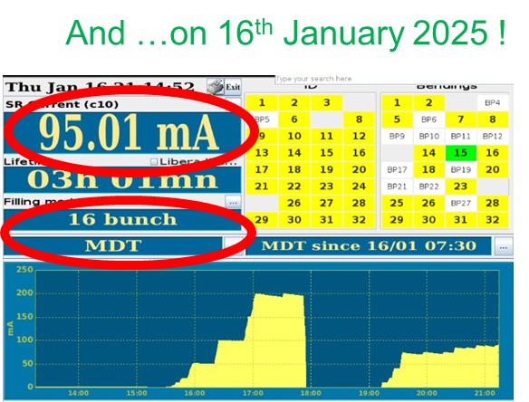
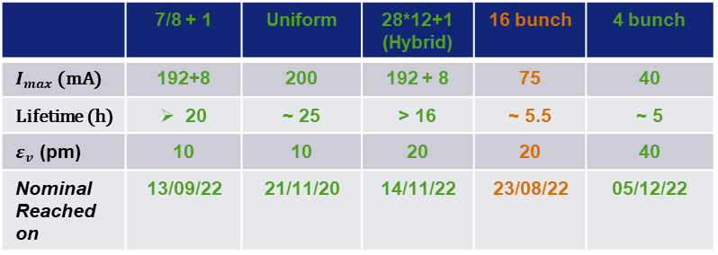
Operation modes
 | 7/8 + 1 | Uniform | 28*12+1 (Hybrid) | 16 bunch | 4 bunch
$I_{max}$ (mA) | 192+8 | 200 | 192 + 8 | 75 | 40
Lifetime (h) | 20 | ~ 25 | > 16 | ~ 5.5 | ~ 5
$ε_{v}$ (pm) | 10 | 10 | 20 | 20 | 40
Nominal Reached on | 13/09/22 | 21/11/20 | 14/11/22 | 23/08/22 | 05/12/22
* Intensity limitation for timing modes due to mech. weakness of the kicker ceramic chambers
* Vertical emittance artificially increased from 1 pm rad for an operational lifetime
* All timing modes delivered with a purity of 10⁻⁹ with cleaning process in the booster
All design parameters achieved!
New ceramic chambers finally installed and validated

Slide 6
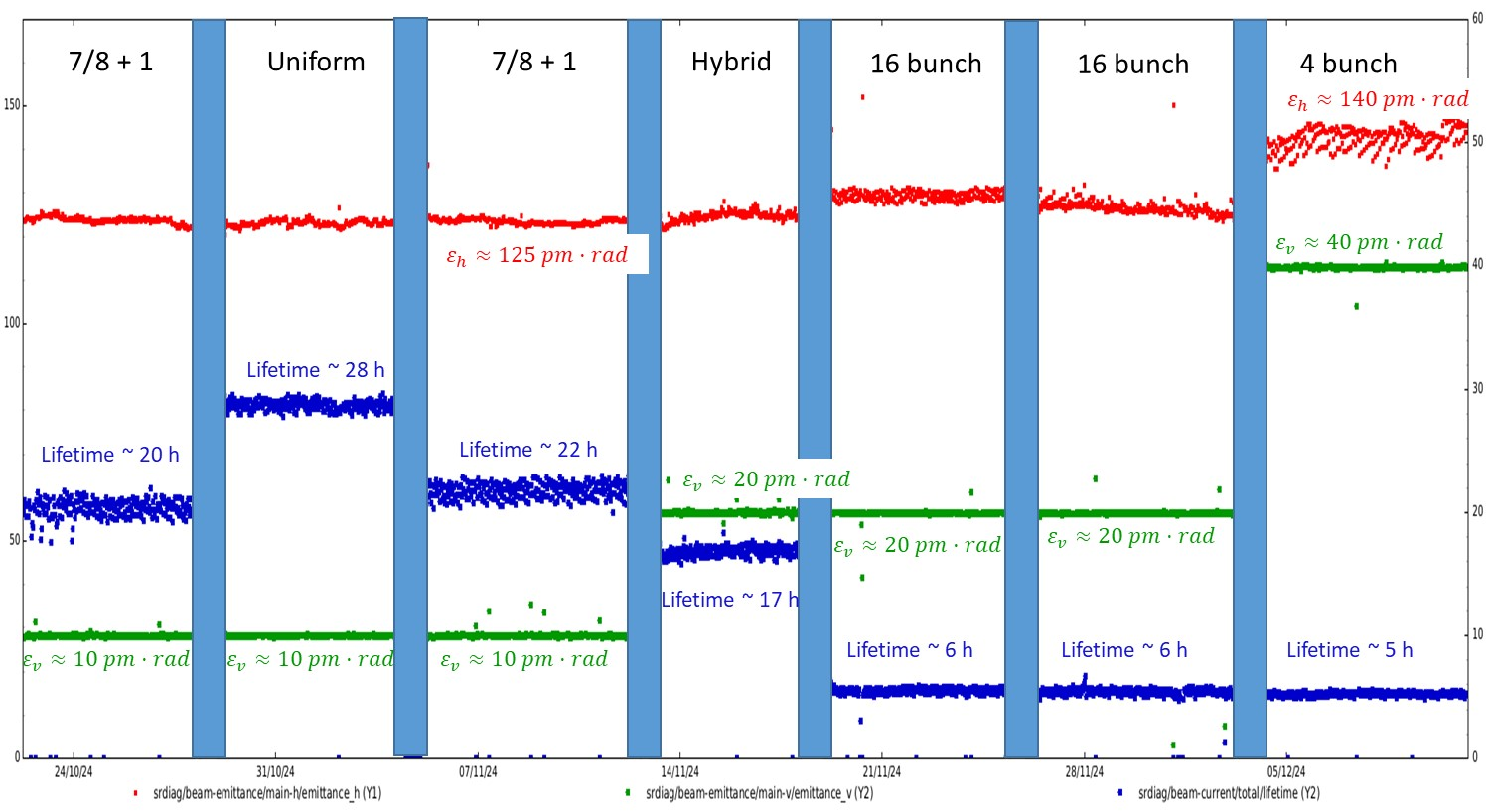
All ESRF modes in one graph
Injection efficiency in USM varies between 60% and 80% depending on the mode

Slide 7
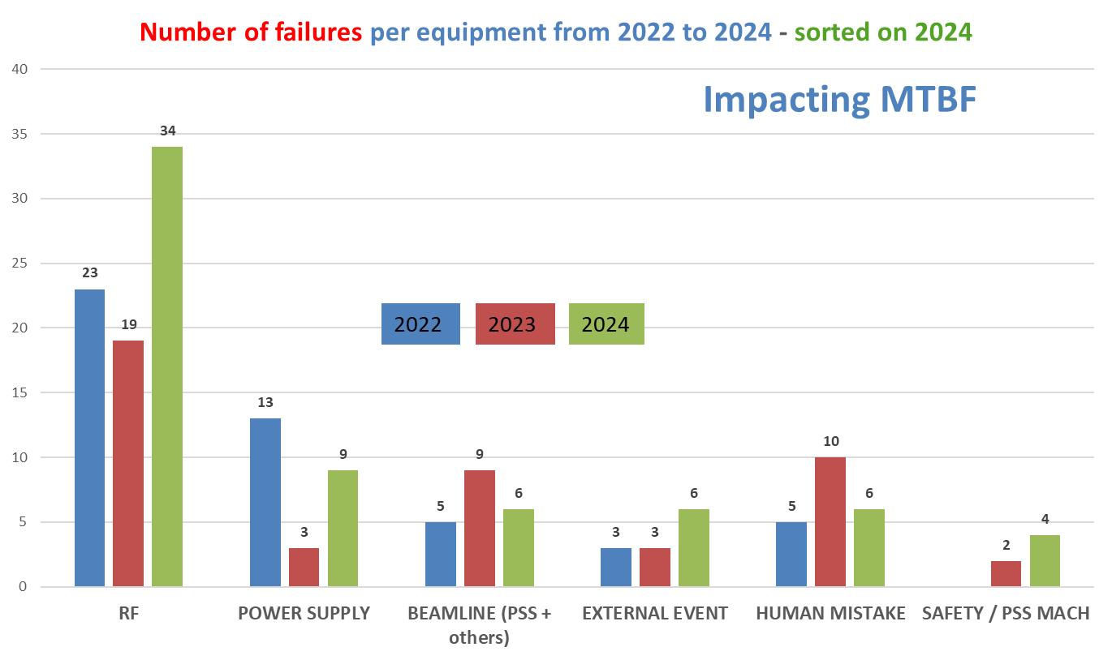
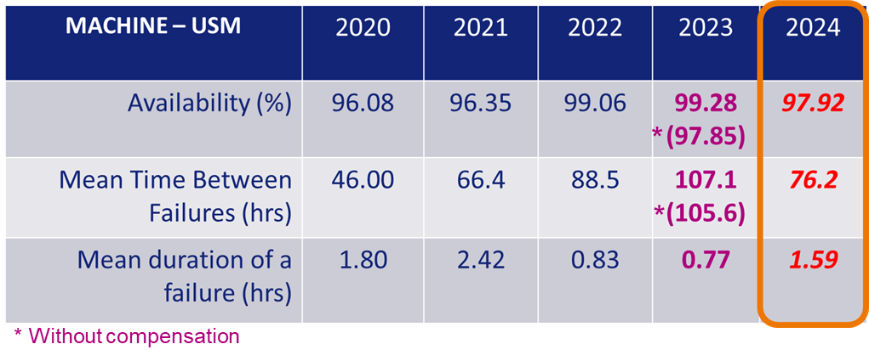
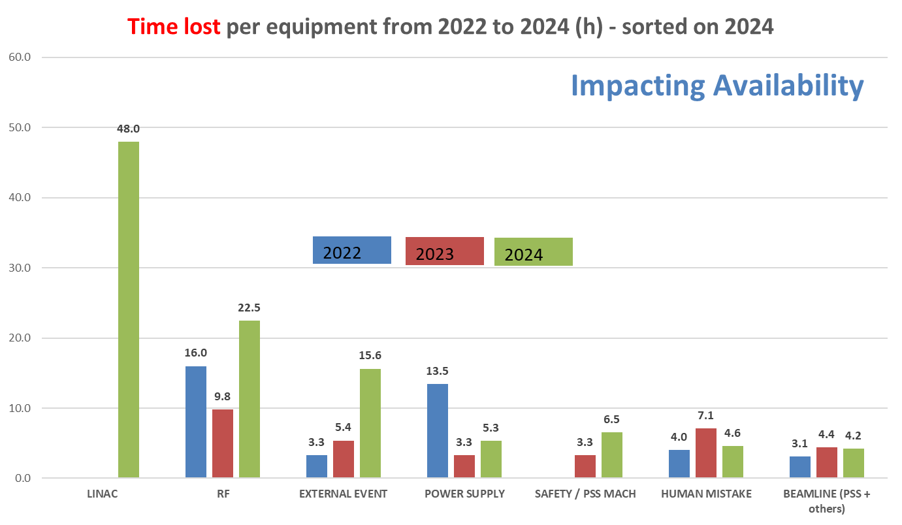
Failures and availability
Overall performance improving, main source of failures are RF systems
Power supply hotswap system now fully deployed
2024: 48h downtime due to single linac failure

Slide 8
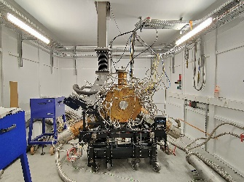
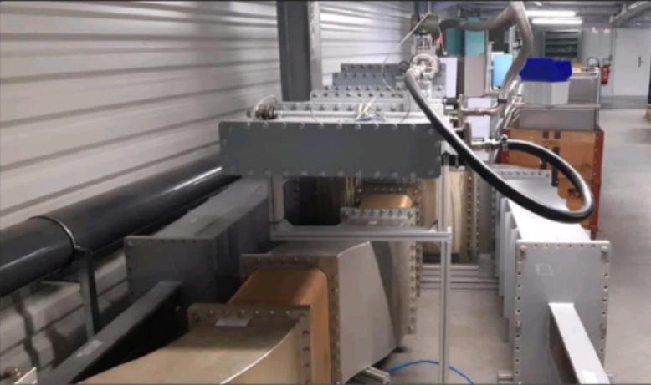
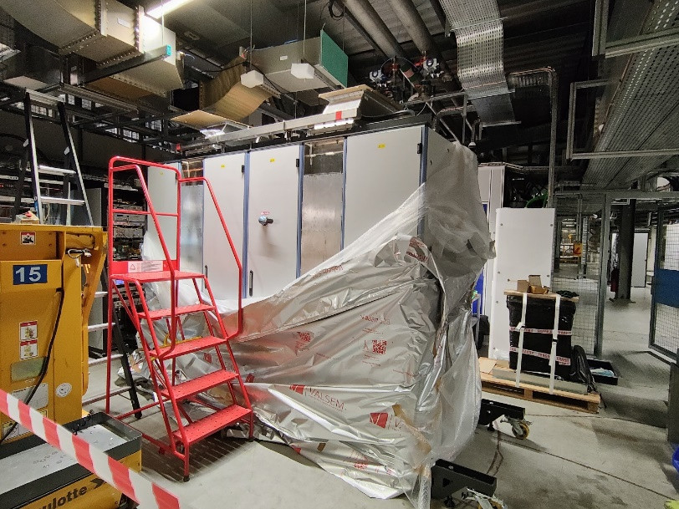
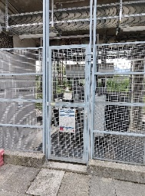
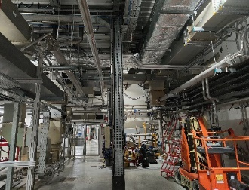
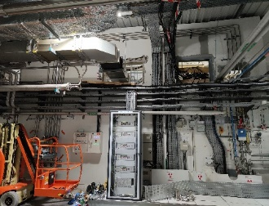
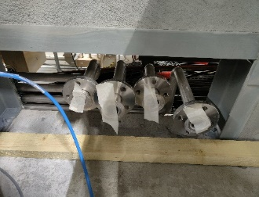
Storage ring improvement – RF systems
Replacement of 352 MHz 1.1 MW klystrons by SSA power sources:
Major infrastructure work needed (pipe, holes, cables, cooling, …)
SAT performed either with EBS mono-cell cavity of on a load
SSA0 delivered, tests and validation ongoing

Slide 9
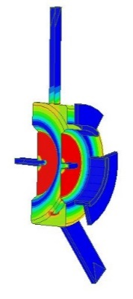
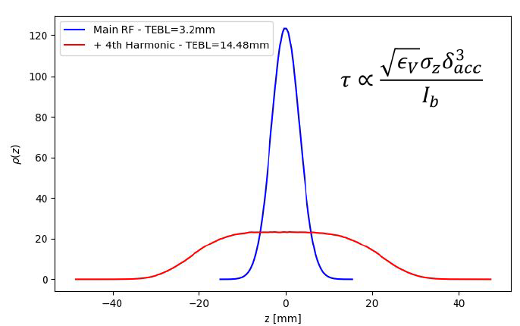
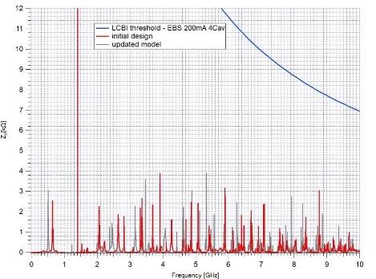
4th Harmonic cavity project
Implementation of harmonic cavities to increase lifetime has several benefits:
Fewer shorter injections
Reduced losses on ID gaps
Reduced beam induced heating
Initially considered a 2-cell cavity design, now moved to 1-cell design to simplify cooling circuits
Considered at ESRF-EBS for equidistant modes (timing + uniform);
Collective effects and instabilities
Transient beam loading for hybrid modes

Slide 10
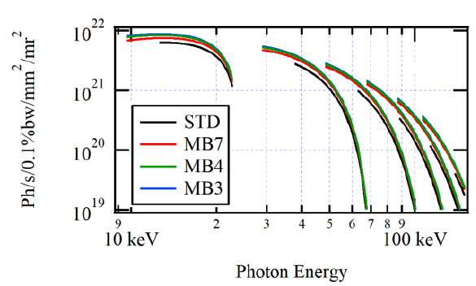
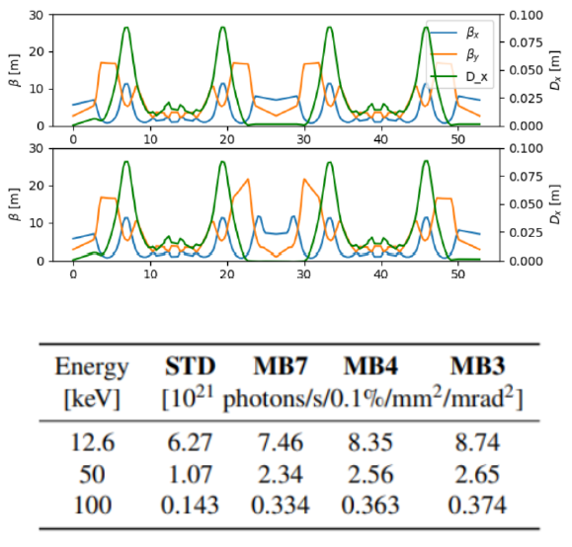
Brilliance increase
Request for beam lines to reduce ID gaps: criteria for ESRF, operate at constant losses on the gap
Mini-beta optics designed for ESRF-EBS:
Most of the gain from reduction of the ID gap
Horizontal beta matching does not contribute significantly to the brilliance

Slide 11
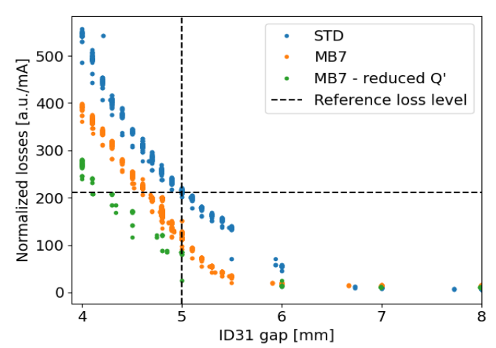
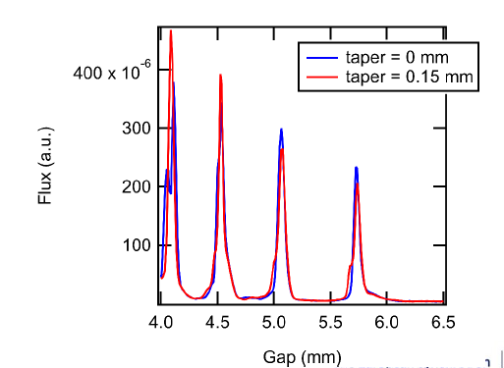
Brilliance increase
Brilliance increases as expected but losses do not scale with beta function as expected
Mini-beta optics do not seem to be the most promising option to close ID gaps:
Touschek losses increased with gap reduced to 4mm
Injection efficiency reduced by ~10% with gap closed at 4mm
Operation with low ID gap is presently not possible:
HALO reduction: low Q’ optics + HC
High brilliance uniform mode?
Alternative injection scheme: shared oscillation using fast stripline kickers

Slide 12
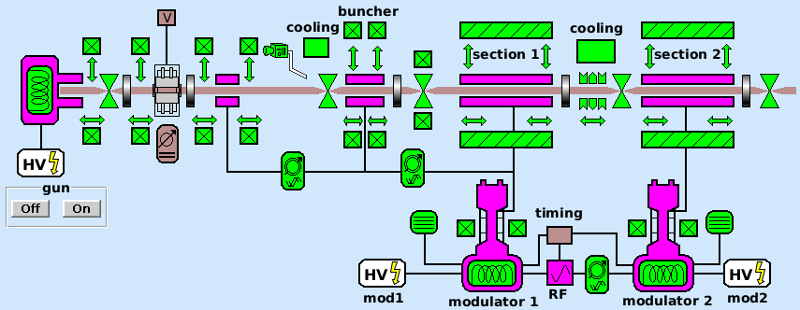
Injectors - Linac consolidation
2
2
1
No spares of:
    Gun body but cathodes on stock
    Accelerating section
1
2
    Other components are available, some partially assembled
Fall back scenario 1 (modulator 1 or modulator 2 out of order):
Modulator 3 can replace Modulator 1 or 2. Switching between modulators takes around 2 hours (2 skipped refills).
Fall back scenario 2 (section 2 out of order):
100 MeV injection with section 1 only has been validated as possible.
3
2
2
Accelerating sections in operation
since 1988
3
Modulator 3
(backup for Mod.1 or 2)
    Other interventions require much longer down time.
No simple fall back scenario if:
Leak into VAC of any section (cavities of sections are not brazed, they are just screwed together)
Section 1 failure (i.e. solenoid), (100 MeV injection with section 2 only is not possible)
Implemented actions:
    Purchase of new accelerating section -> CFT awarded by Research Instruments GmbH, delivery September 2025, kick-off meeting already held
    Purchase of RF Unit which consists: solid state modulator, HV transformer, focusing coils with PS, RF driver, control unit, Canon klystron. -> CFT awarded by Nodica Group (former Scandinova AB), delivery September 2025, kick-off meeting already held
    Purchase of vacuum chamber to replace any section -> delivered
    Machining of the gun body -> to be launched
    Working section needs to be installed on the first position
Strong motivation to increase the reliability level.
SAT: autumn 2025

Slide 13
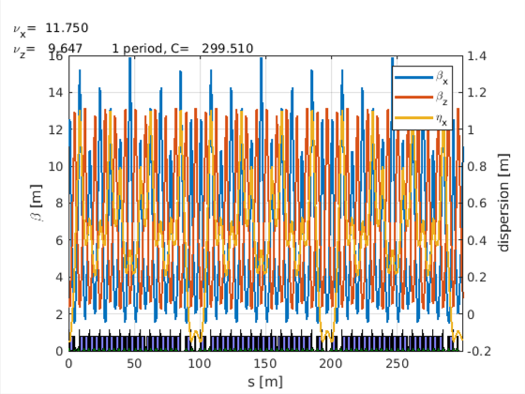
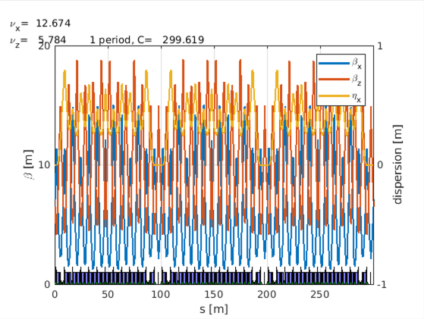
Booster light upgrade
In 2022, several options for a light upgrade of the booster have been studied and the options are presented in at IPAC22: Options for a Light Upgrade of the ESRF Booster Synchrotron Lattice (T. Perron)
The basic idea is to increase the number of quadrupole families from 2 to more (4, 5 or 6) to reduce horizontal emittance. This was initially proposed by P. Raimondi.
39 QD, 39 QF
ε_{x} = 83.1 nm
BL = 22.6 mm
39 QD, 21 QF,
6 QF1, 6 QF2, 6 QF3
ε_{x} = 59.6 nm
BL = 19.9 mm
Present lattice
2 quad families
New lattice
5 quad families
Installation: summer 2027
Page 13
ASD workshop – Booster light upgrade – Nicola Carmignani

Slide 14
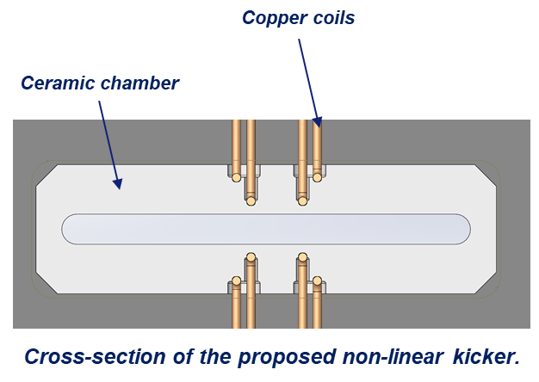
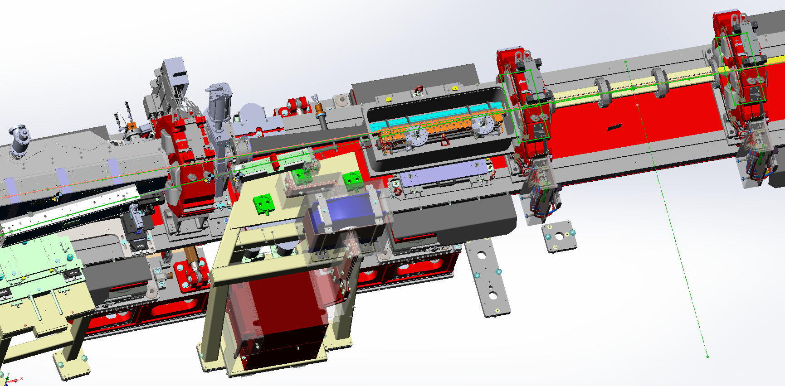
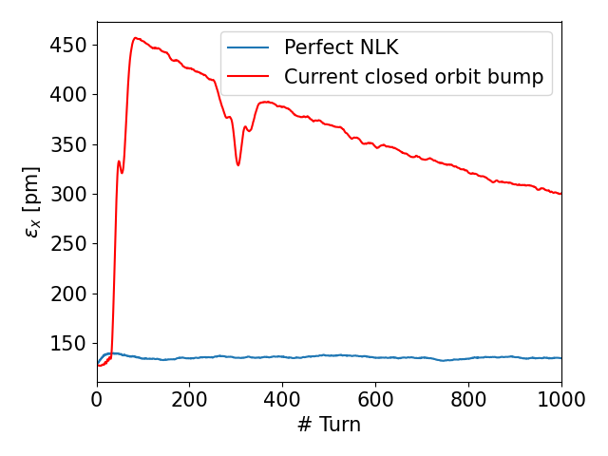
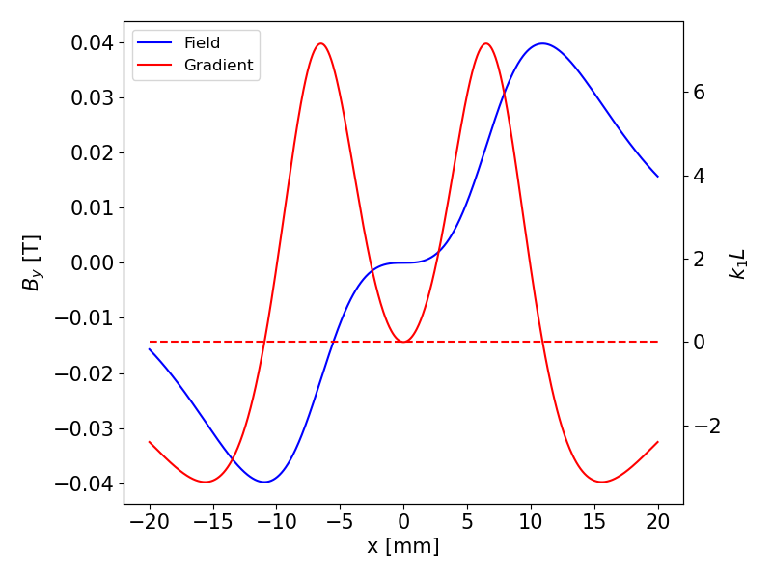
Non linear kicker injection
Provide transparent injection:
Most beam lines cannot acquire data during injections
NLK injection scheme found as the most promising option (can be combined with other methods)
3 NLK
Injected beam
Stored beam sees no field or gradient: injection perturbation suppressed
Field quality strongly depends on coils position: precise characterization required
Stored beam

Slide 15
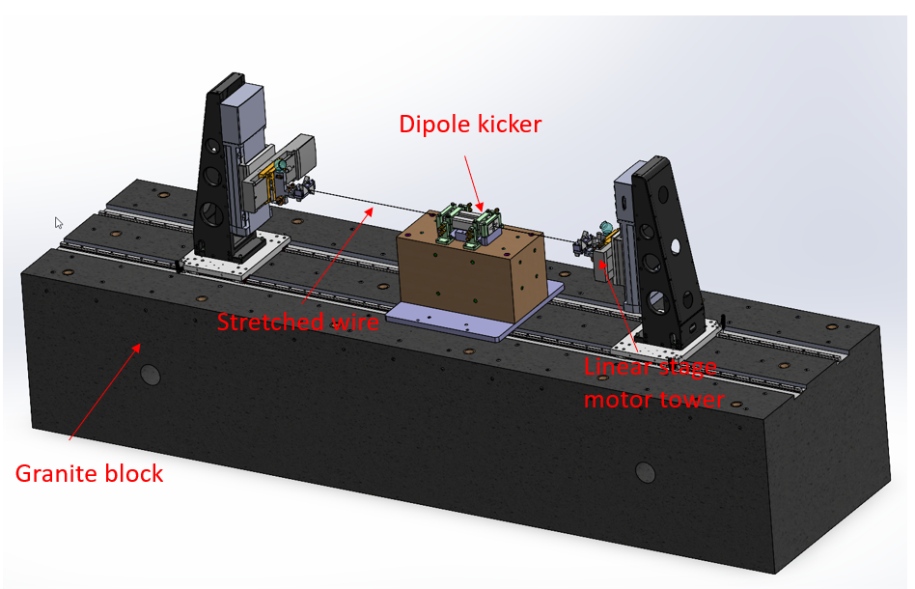

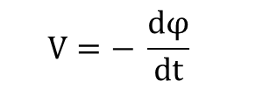
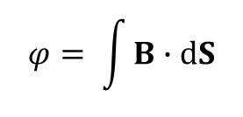
Pulsed magnets measurement bench
Developed dedicated pulsed magnets measurement bench:
Adaptation of stretched-wire measurement
2 loops for simultaneous measurement of horizontal and vertical planes
Voltage (V) measured across loops and converted to magnetic flux value
All multipoles reconstructed from 2D fit of measurement on a closed contour
Theoretically :
3D scheme of the magnetic test bench.
$$V=− \frac{dφ}{dt}$$
Faraday’s law :
Magnetic flux :
$$φ= \int{B∙dS}$$
*
Wires arrangement

Slide 16
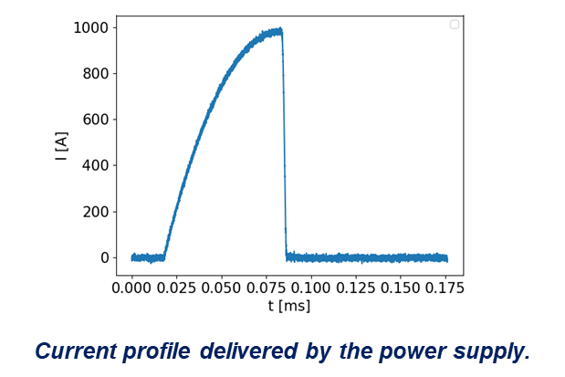
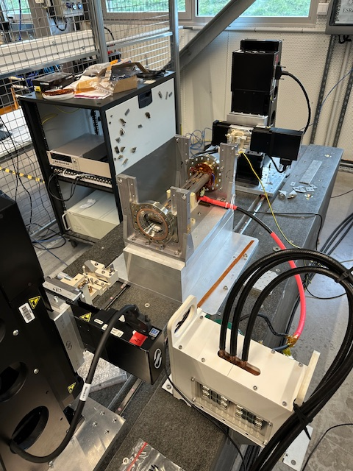
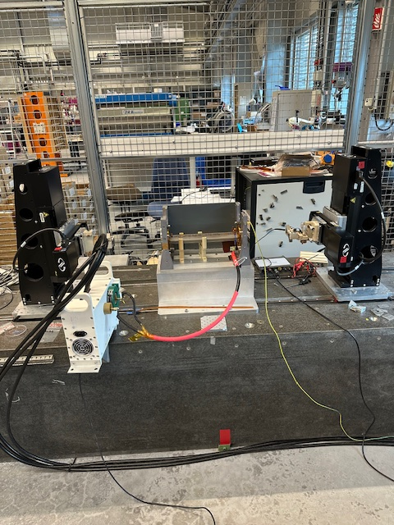
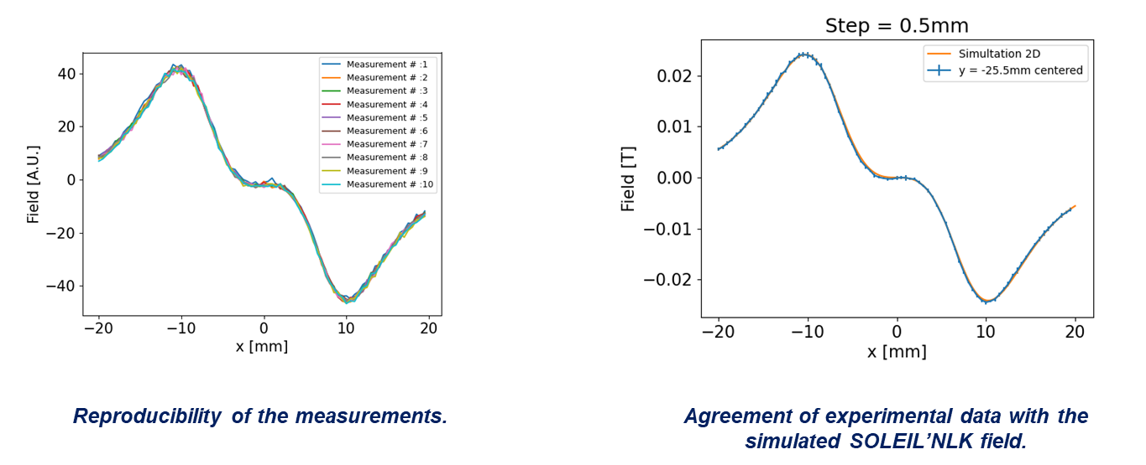
Non linear kicker measurements
Existing SOLEIL NLK installed on the bench for validation
Use ESRF injection kickers power supplies (2kA)
Test bench with SOLEIL NLK
Beam tests: summer 2026
Installation: summer 2028 (earliest)

Slide 17
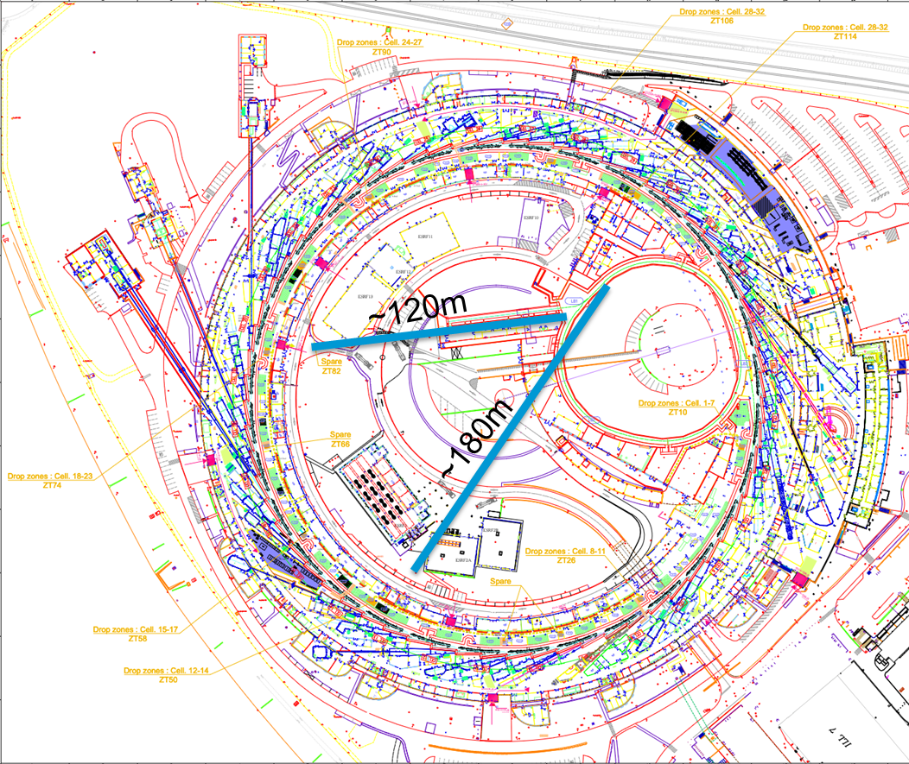
A new 6 GeV LINAC?
Presently considering a complete upgrade of our injectors with a full energy linac: limited space available, high gradient technologies could be a solution
Complete renewal of obsolete injectors providing low emittance injected beams (<1nmrad, >40 times smaller than the present injectors, <1mm bunch length >10 times shorter bunch, 0.6mA/bunch)
Enable ultra-low emittance / low aperture / low gaps SR lattice design by relaxing constraint on DA.
Demonstrate state-of-the-art compact technology for users facilities injectors
Enable transparent on-axis off-energy accumulation with ultra short injected beam (with ultra-fast kicker).
Enable new science making use of the linac electron beam (short pulse e⁻, FEL)
Possible site integration using C3 technology

Slide 18
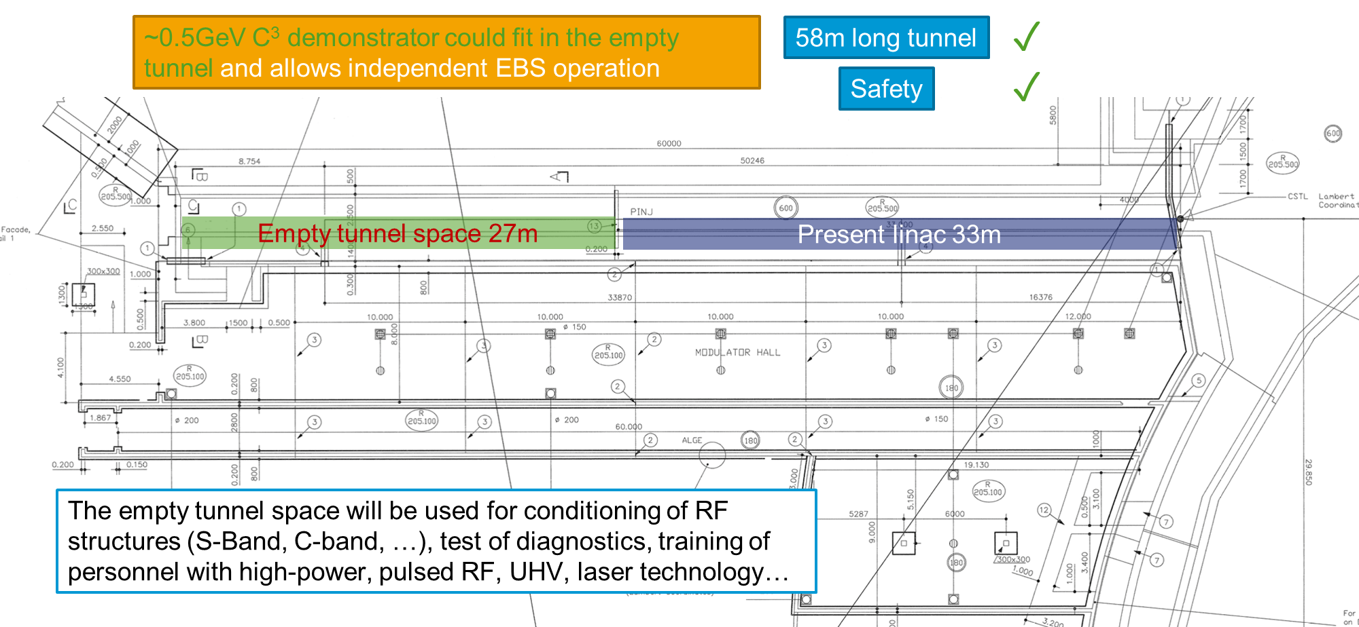
First step: Linac test facility
More in S. Liuzzo’s presentation this afternoon

Slide 19
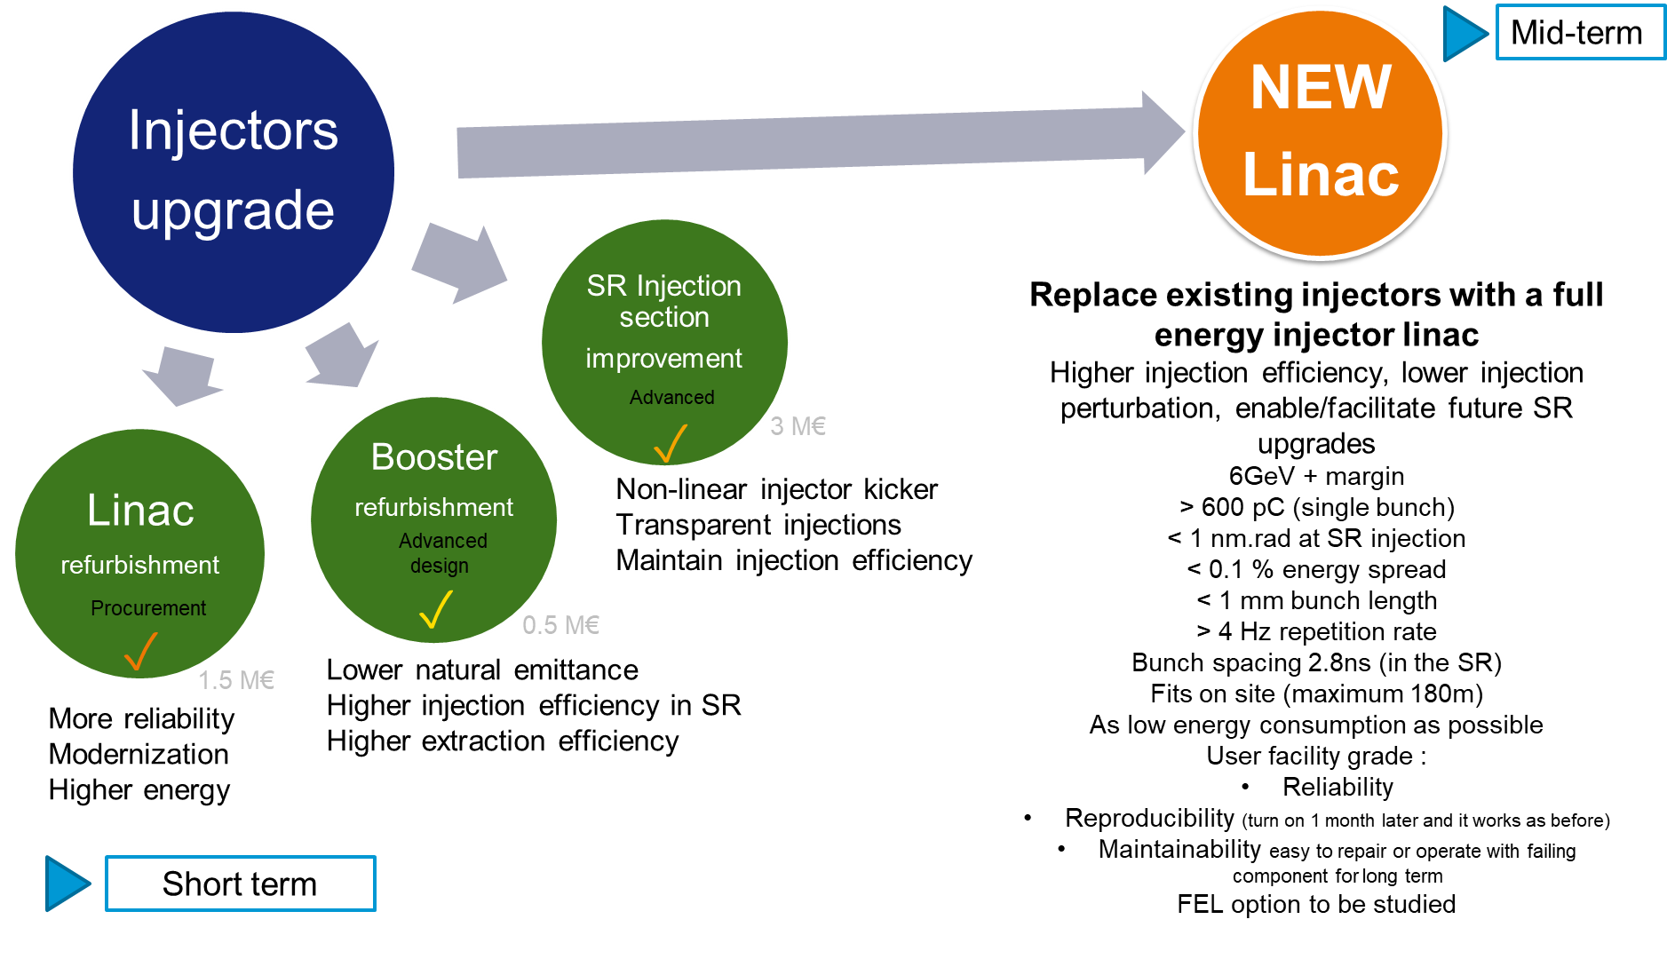
Full picture

Slide 20
Summary
ESRF finally reached design parameters for all modes in 2024
Availability and reliability slowly improving
Short / mid-term improvement program:
      Linac refurbishment
      Replacement of klystrons by SSAs for SR main RF systems
      Implementation of 4th harmonic system for bunch lengthening
      Implementation of new booster lattice for emittance reduction
      Implementation of NLK injection for transparent top-up
Long term improvement: replacement of aging injectors, a new 6 GeV LINAC? Future facility upgrades?

Slide 21
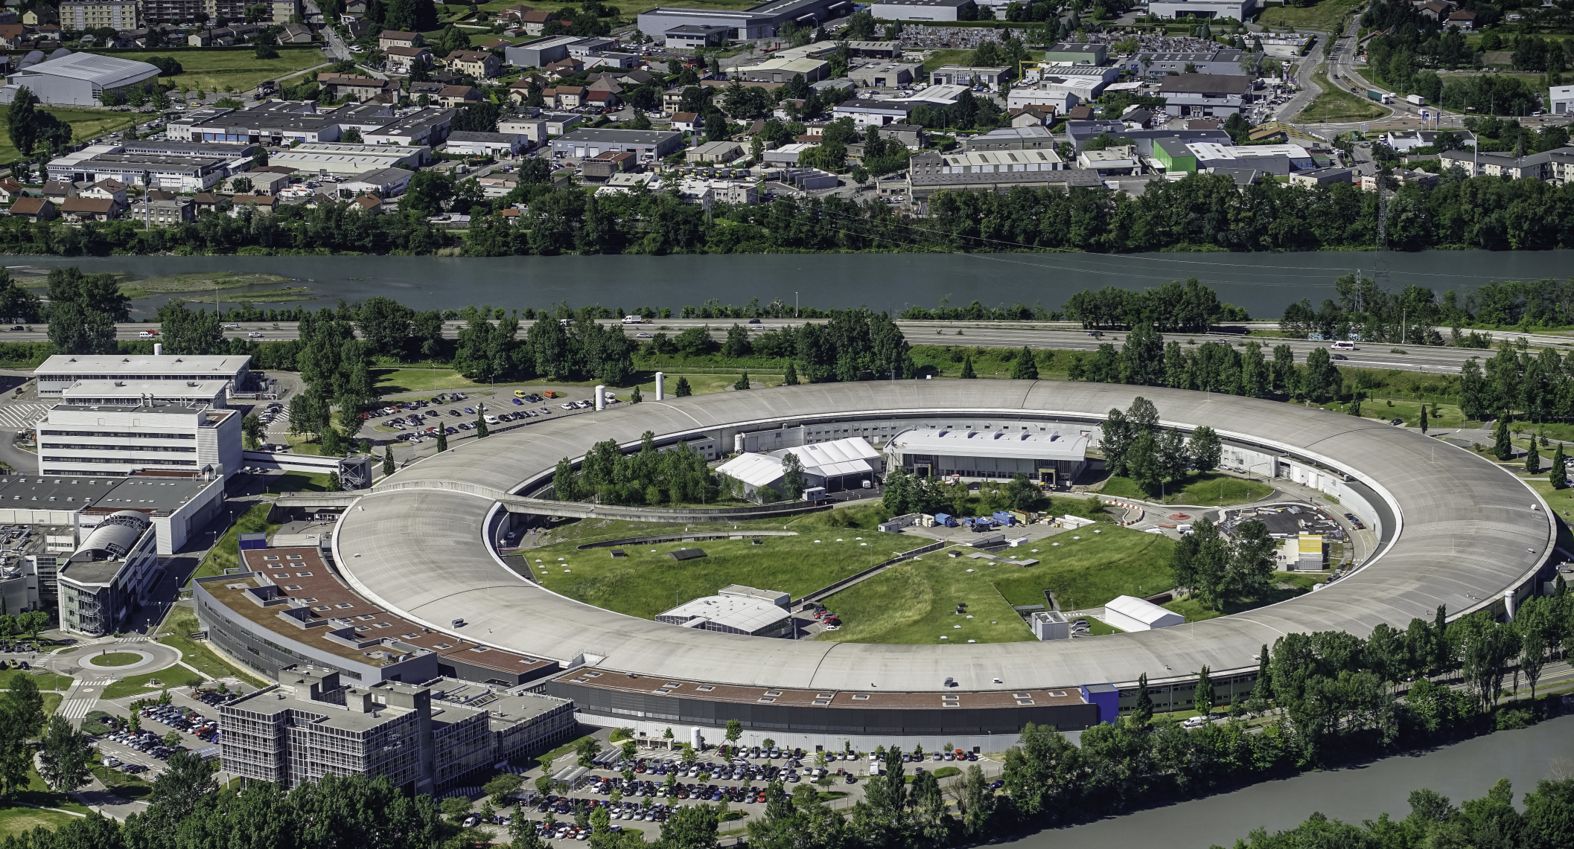
Many thanks for your attention

