Slide 1
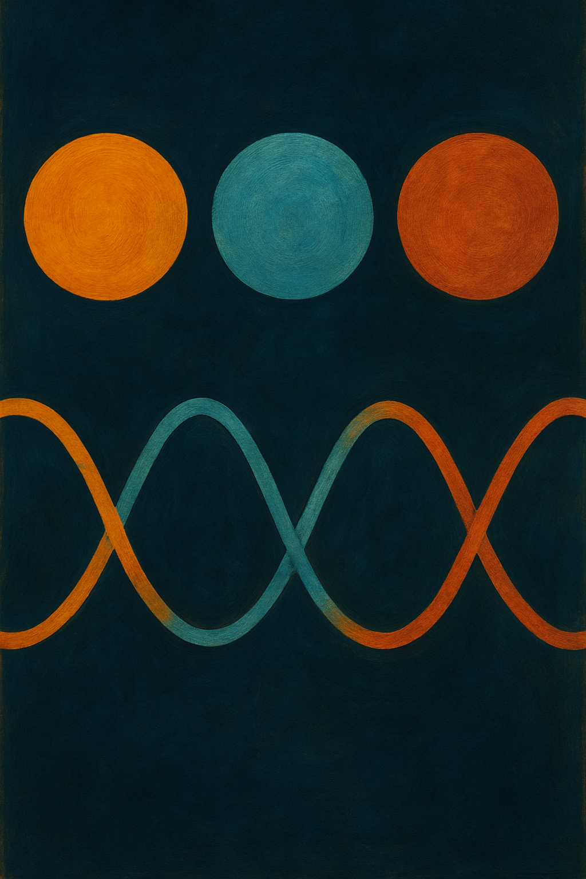
Esperimenti con neutrini
Davide Basilico
University of Milano and INFN Milano
Meeting della Commissione Nazionale II INFN
Palazzo Loredan dell'Istituto Veneto di Scienze, Lettere e Arti Venezia - 7 Aprile 2024

Slide 2
Outline
sub-percentual measurement of mixing angles and mass splittings
determination of Neutrino Mass Ordering (NMO) with high statistical significance
Flavor oscillation physics is entering its precision era
is there any CP violation phase in leptonic sector?
precision testing of 3𝜈 paradigm → unitarity mixing? sterile 𝜈? dark sector?

Slide 3
Outline
sub-percentual measurement of mixing angles and mass splittings
Focus on the current status and on challenges to be addressed in the very next years
determination of Neutrino Mass Ordering (NMO) with high statistical significance
is there any CP violation phase in leptonic sector?
precision testing of 3𝜈 paradigm → unitarity mixing? sterile 𝜈? dark sector?

Slide 4
An intense experimental effort
+
+
Atmospheric 𝜈
Accelerator 𝜈
Reactor 𝜈
L ~10³-10⁴ km, E~10²-10⁴ MeV
matter effects
L ~10²-10³ km
E~10³ MeV
matter effects
L ~1-10² km
E~MeV
KM3NeT
IceCube
(JUNO)
T2K
NOvA
(DUNE, HyperK)
(JUNO)
KamLAND
RENO
+ short-baseline

Slide 5
A multi-faceted panorama
Exploring different sectors, based on experimental design
S. Navas et al. (Particle Data Group), Phys. Rev. D 110, 030001 (2024)
Several experiments at a maturity stage, others set to begin or be upgraded

Slide 6
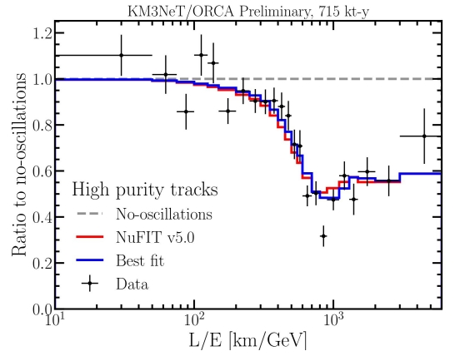
Atmospheric 𝜈 experiments
θ₂₃
Δm²₂₃
Notes:
Maximum ~13 000 km baseline,
Near minimal P survival for ~25 GeV

Slide 7
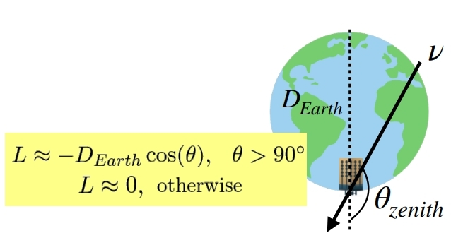
Atmospheric 𝜈 experiments: NMO
𝜈/anti-𝜈 asymmetry in MSW resonance thanks to matter effects (4-30 GeV): oscillation probabilities for NO and IO are different due to 𝜈 path through the Earth matter.
Upgoing muon 𝜈: MSW resonance takes place according to sign(A/Δm²_{3ℓ} ), where A = 𝜈-matter potential
𝜈: A > 0 → MSW if Δm²_{3ℓ} > 0 → NO
anti-𝜈: A < 0 → MSW if Δm²_{3ℓ} < 0 → IO
Notes:
Maximum ~13 000 km baseline,
Near minimal P survival for ~25 GeV

Slide 8
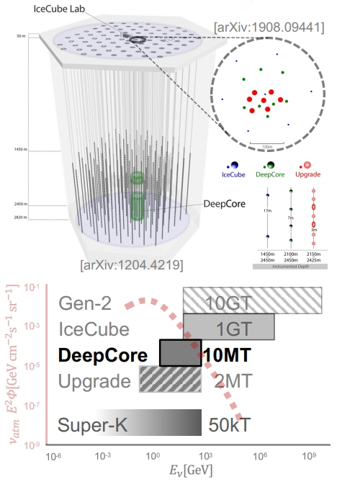
Atmospheric 𝜈 : IceCube & DeepCore & Upgrade
IceCube Neutrino Observatory
Products of 𝜈-N interactions radiate Cherenkov photons (no 𝜈/anti-𝜈ID)
5160 optical sensors on 86 strings embedded within 1 km3 of ice
Down-facing 10’’ PMT in pressure sphere at depths 1450 m - 2450 m
DeepCore: low-energy array
Low-energy extension at 5x density in the cleanest ice (below 2100 m)
Higher QE PMTs in digital optical modules (DOMs)
mHz 𝜈_{atm} rate: neutrino detection every 15 minutes
Upgrade - infill of DeepCore (2025-2026)
700 new DOMs at 10x density on 7 strings in DeepCore region
New PMTs and first multi-directional modules (D-Eggs, mDOMs)
Overall 2x 𝜈_{atm} rate and 3x 𝜈_{atm} rate of DeepCore [arXiv:1908.09441]

Slide 9
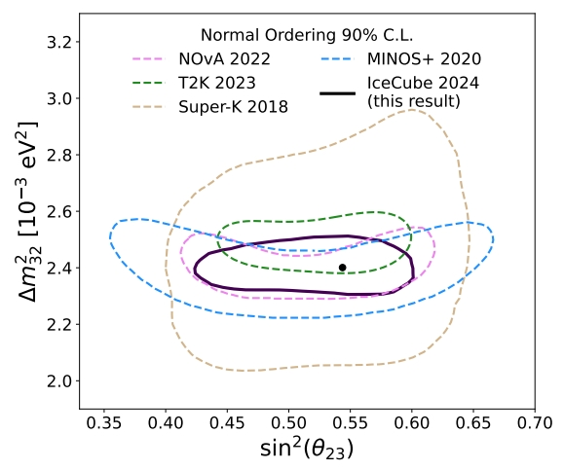
Atmospheric 𝜈 : IceCube & DeepCore & Upgrade
9.3 years of data in IceCube DeepCore
Comparable θ₂₃ and mass splitting precision to LBL experiments

Slide 10
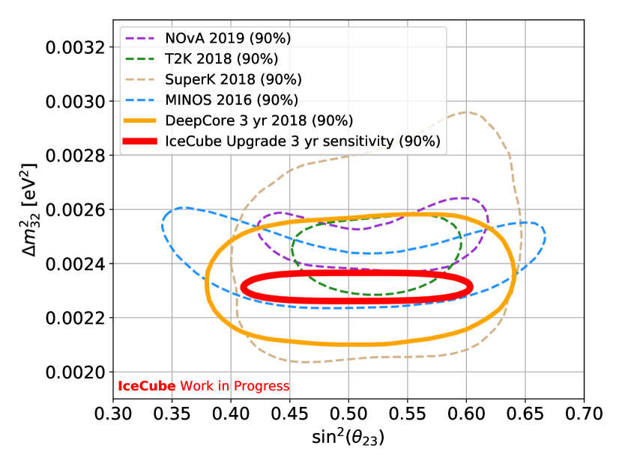
Atmospheric 𝜈 : IceCube & DeepCore & Upgrade
9.3 years of data in IceCube DeepCore
Icecube Upgrade proposal
Phys.Rev.Lett. 134 (2025) 9, 091801
Physical Review D 99 (2019) 032007
Comparable θ₂₃ and mass splitting precision to LBL experiments
Conservative estimates predict world-leading results within 1 year of data-taking

Slide 11
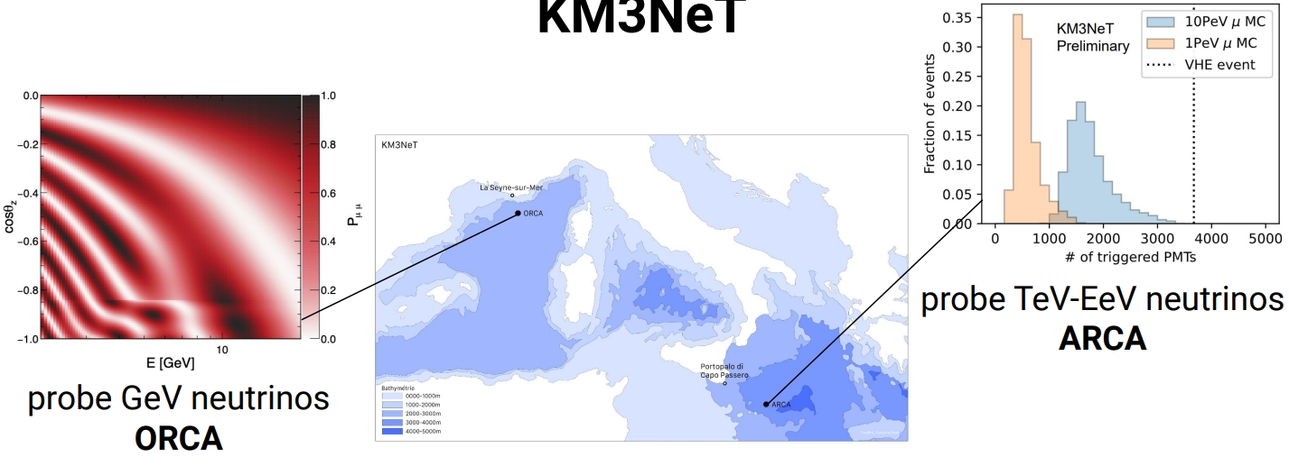
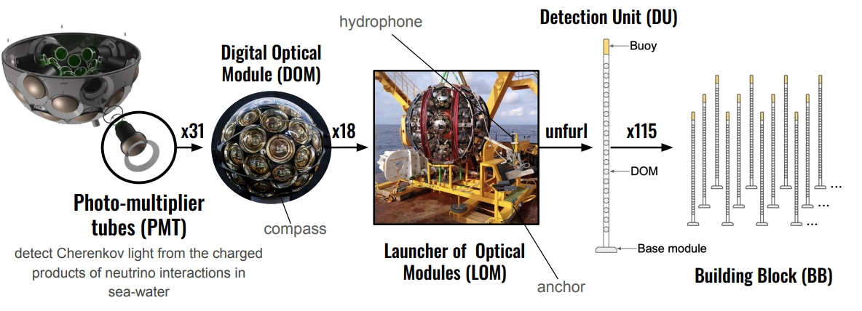
Atmospheric 𝜈 : KM3NeT
JHEP 10 (2024) 206

Slide 12
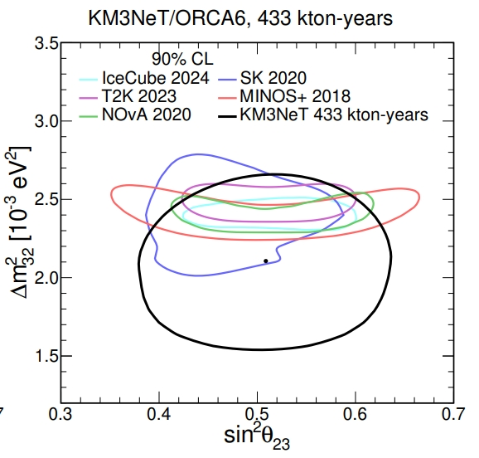
Atmospheric 𝜈 : KM3NeT
low preference for IO
maximum mixing preferred
Measurement of neutrino oscillation parameters with the first six detection units of KM3NeT/ORCA JHEP 10 (2024) 206

Slide 13
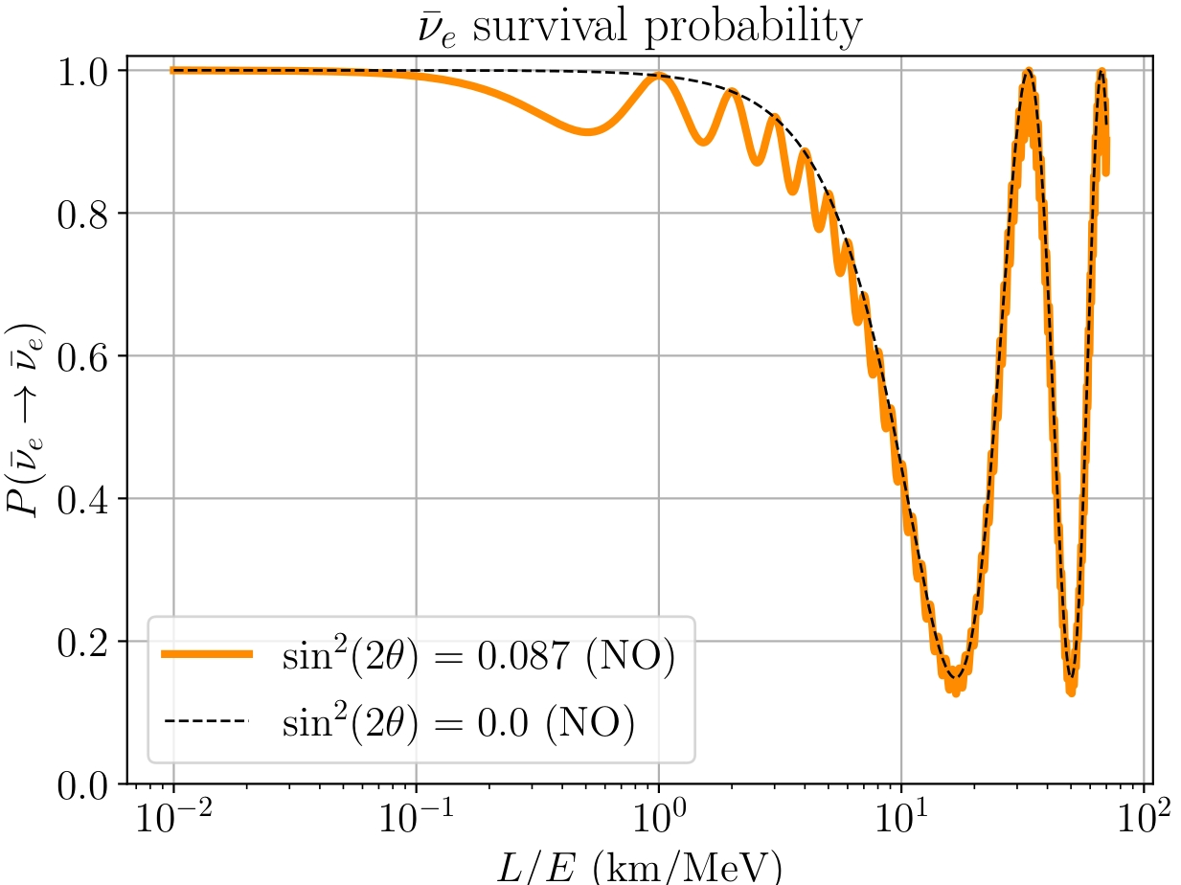
Reactor 𝜈
A wide L/E range to explore different oscillation features

Slide 14
Reactor 𝜈
A wide L/E range to explore different oscillation features
KamLAND
Medium baseline (θ₁₂, Δm²₁₂)

Slide 15
Reactor 𝜈
A wide L/E range to explore different oscillation features
KamLAND
Medium baseline (θ₁₂, Δm²₂₁)
Daya Bay
RENO
Double Chooz
Short baseline (θ₁₃, Δm²_{3l})

Slide 16
Reactor 𝜈
A wide L/E range to explore different oscillation features
JUNO
KamLAND
Medium baseline (θ₁₂, Δm²₂₁)
Daya Bay
RENO
Double Chooz
Short baseline (θ₁₃, Δm²_{3l})

Slide 17
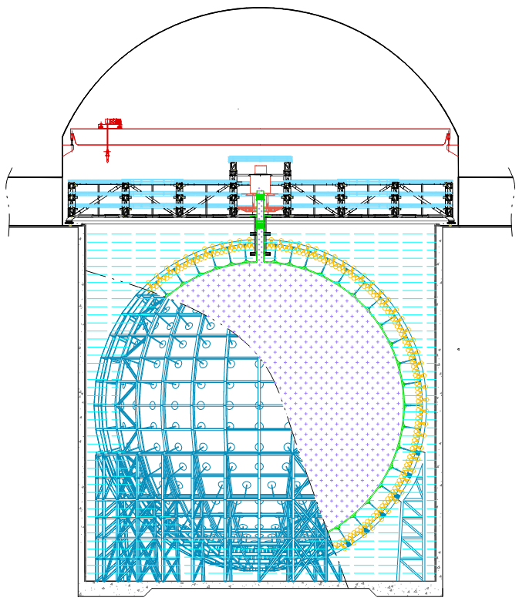
Reactor 𝜈: JUNO
Medum baseline, L = 52 km, E ~ MeV
Largest liquid scintillator ever (20 kton), equipped with 17612 large PMTs + 25600 small PMTs to collect scintillation light
Data taking started in December 2024
Top tracker
Water pool
Liquid scint. (20kt)
Experiment | Daya Bay | Borexino | KamLAND | JUNO
Target mass [kt] | 0.16 | ~0.3 | ~1 | ~20
Photo electrons / MeV | ~160 | ~500 | ~250 | ~1600
Energy resolution @MeV | ~8.5% | ~5% | ~6% | ~3%
Photocathode coverage | 12% | 34% | 34% | 78%
Energy cal. Uncert. | 0.5% | 1.0% | 2.0% | <1%
43.5 m

Slide 18
Reactor 𝜈: JUNO, experimental challenges
1) Large statistics
→ huge scintillator mass, powerful nuclear reactors
2) Energy resolution: 2.95% @ 1MeV + 1% understanding of the intrinsically non-linear energy scale
→ LS optical properties + light collection + calibrations
3) Low background
→ underground + scintillator purification system + material screening + veto systems
4) Knowledge of reactor spectra at sub-% level
→ near detector: Taishan Antineutrino Observatory (TAO) at 44 m from Taishan reactor → reduce spectral shape systematics

Slide 19
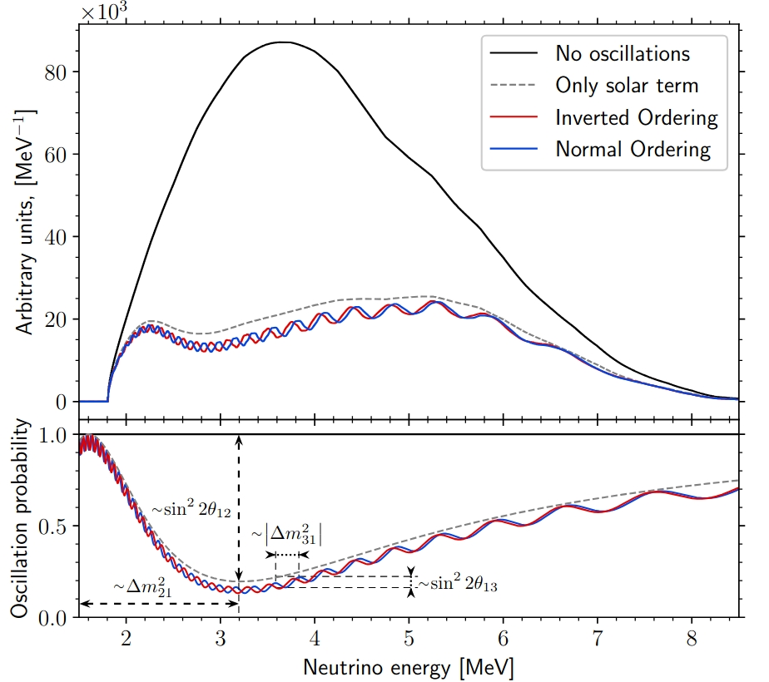
Reactor 𝜈: JUNO analysis
Exemplary spectrum, 6y (10⁵ events, σ_{E}/E = 2.95% @ 1 MeV)
First experiment to observe both fast (sin²θ₁₃, |Δm²_{3ℓ}|) and slow (sin²θ₁₂, Δm²₂₁) oscillations in vacuum
→ interference pattern depends on NMO
… no dependence on θ₂₃ , δ_{CP}, small dependence on matter effects: no degeneracies.
sin² 2θ₁₂
see A. Serafini’s talk
|Δm² _{3ℓ}|
Δm² ₂₁
Chin. Phys. C46 (2022) 12, 123001

Slide 20
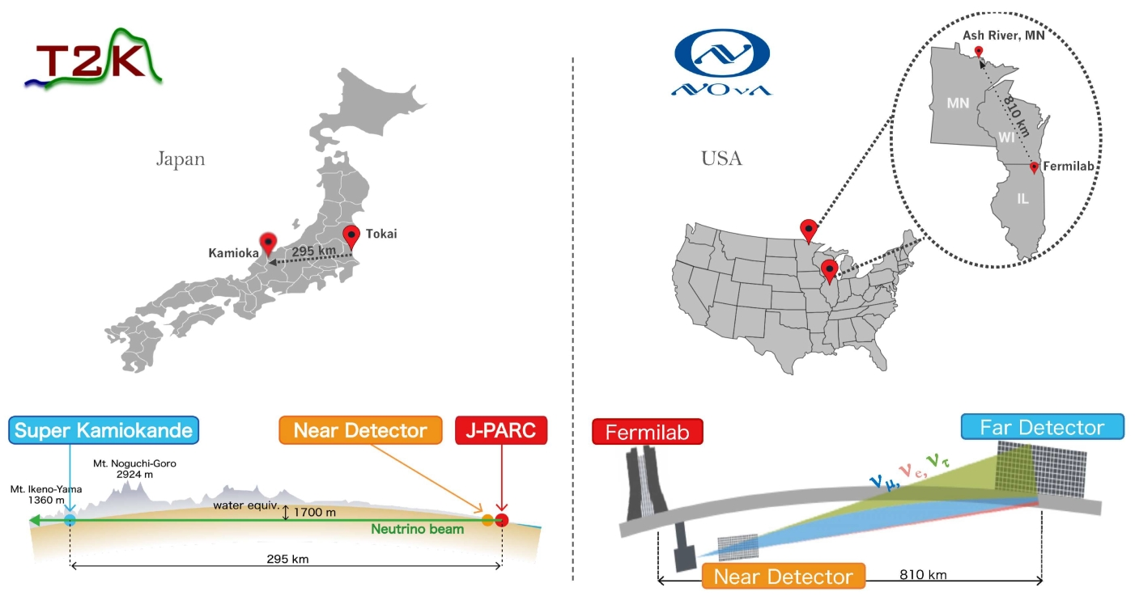
Accelerator 𝜈: NOvA and T2K
L = 295 km, E_{peak} = 0.6 GeV
L = 810 km, E_{peak} = 2 GeV

Slide 21
Accelerator 𝜈: NOvA and T2K
In LBL experiments, matter effects are “degenerate” with NMO and CP violation effects.
L = 295 km, E_{peak} = 0.6 GeV
L = 810 km, E_{peak} = 2 GeV

Slide 22
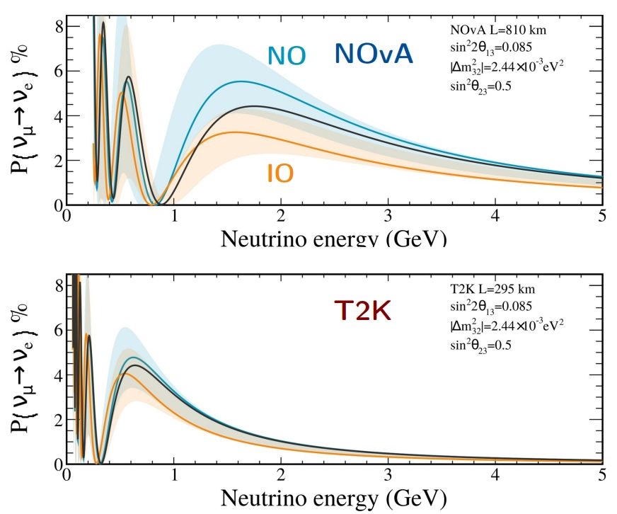
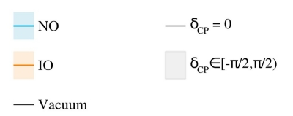
Accelerator 𝜈: NOvA and T2K
NOvA: lower E and shorter L reduces the matter effects → less degenerate CPV values of δ_{CP}
T2K: higher E and longer L enhances the NMO dependent matter effects
→ impact on P(νµ → νe ) and P(anti-νµ → anti-νe ) differs for each experiment

Slide 23
NOvA and T2K joint analysis
Joint analysis lifts degeneracies of individual experiments. Based on Eur. Phys. J. C (2023) 83: 782 and Phys. Rev. D 110, 012005

Slide 24
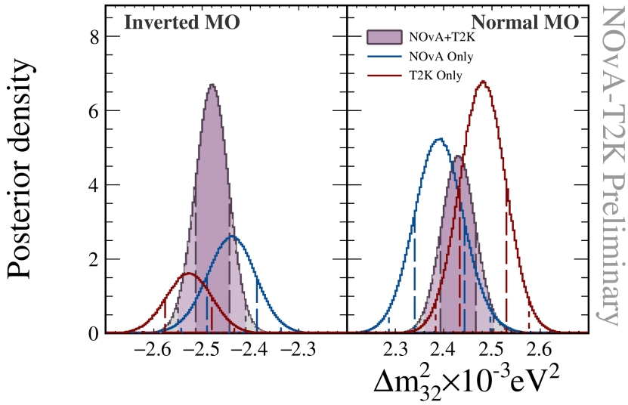
NOvA and T2K joint analysis
Joint analysis lifts degeneracies of individual experiments. Based on Eur. Phys. J. C (2023) 83: 782 and Phys. Rev. D 110, 012005
NMO:
Joint analysis flips the preference for the IO: T2K and NOvA individually prefer NO
Very weak preference for IO, Bayes factor 1.3

Slide 25
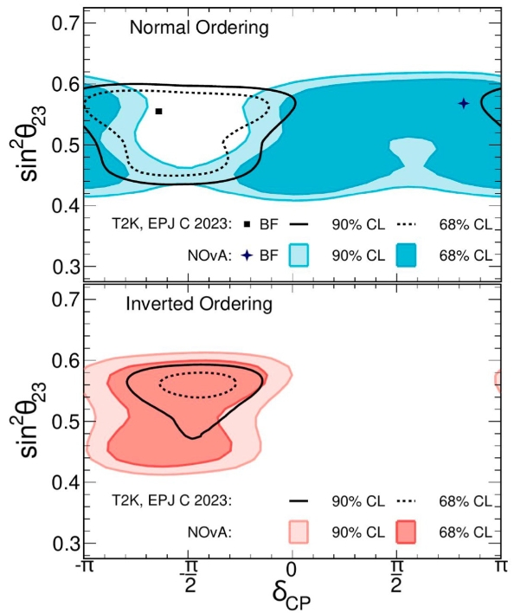
NOvA and T2K joint analysis
Joint analysis lifts degeneracies of individual experiments. Based on Eur. Phys. J. C (2023) 83: 782 and Phys. Rev. D 110, 012005
NMO:
Joint analysis flips the preference for the IO: T2K and NOvA individually prefer NO
Very weak preference for IO, Bayes factor 1.3
δCP:
Degeneracy between δCP and MO
NO: allows for a broad range of possible δCP
IO: CP-conserving outside 3σ CIs
Neither NMO points to δCP ~ +π/2 (outside 3σ CI)

Slide 26
An intense experimental effort
Global oscillations analysis of 𝜈 experiments
Atmospheric 𝜈
Recipes and Wizards:
Bari) Capozzi, Lisi et al, Neutrino masses and mixing: Entering the era of subpercent precision, https://arxiv.org/pdf/2503.07752
NuFit) Esteban et al., NuFit-6.0: updated global analysis of three-flavor neutrino oscillations, JHEP 12 (2024) 216,
Valencia) de Salas et al, JHEP 02 (2021) 071 https://globalfit.astroparticles.es/
Accelerator 𝜈
Reactor 𝜈

Slide 27
Adding ingredients to the global analysis
LBL Acc + Solar + KamLAND
NO IO
4
4
4
3
3
3
Nσ
2
2
2
1
1
1
0
0
0
Large (“atmospheric”) mass splitting
IO favored at 2σ level
θ₂₃ octant ambiguity
CP conservation in NO (δ ≃ nπ), inconsistent with it at > 3σ in IO
Capozzi, Lisi et al, https://arxiv.org/pdf/2503.07752

Slide 28
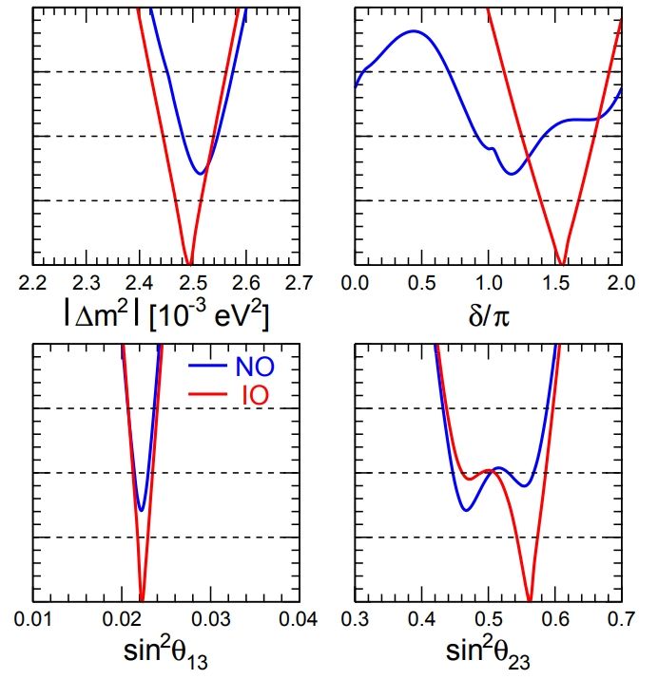
Adding ingredients to the global analysis
LBL Acc + Solar + KamLAND + short baseline reactors
NO IO
4
4
4
3
3
3
Nσ
2
2
2
1
1
1
0
0
0
IO favored at 1.4σ level
second θ₂₃ octant is favored
a strong indication for CP violation (sin δ < 0 at almost 4σ).
Capozzi, Lisi et al, https://arxiv.org/pdf/2503.07752

Slide 29
Adding ingredients to the global analysis
LBL Acc + Solar + KamLAND + short baseline reactors + SK+IC
NO IO
4
4
4
3
3
3
Nσ
2
2
2
1
1
1
0
0
0
Different tendencies in global fit!
Δm² precision 0.8%, sub-percentual for the first time
Flipped preference for MO: NO favored at 2.2σ level (2.5σ in previous analysis)
Flipped θ₂₃ octant: first octant favored at 1.1σ level
CP conservation disfavored at 1.2σ level (1.6σ in previous analysis)
Capozzi, Lisi et al, https://arxiv.org/pdf/2503.07752

Slide 30
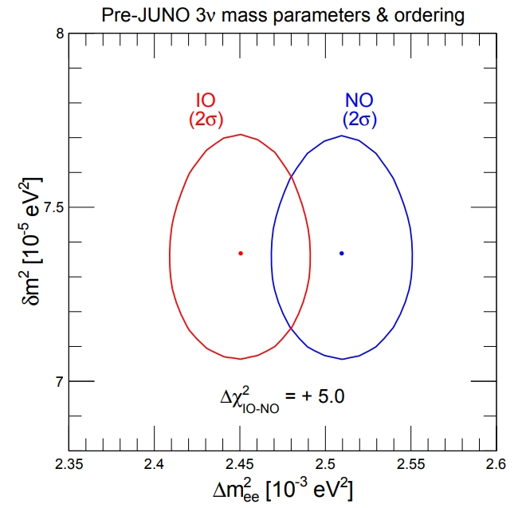
NMO in the next future: synergies with JUNO
+1 for NO, -1 for IO
3ℓ
21
MBL effective mass splitting for ν_{e} disappearance, only linear combination of ∆m₃₁² and ∆m₃₂² determined by JUNO
JUNO is expected to measure ∆m²_{ee} and ∆m²₂₁ with 2σ errors smaller than in Figure, in few months of operation
Capozzi, Lisi et al, https://arxiv.org/pdf/2503.07752

Slide 31
NMO in the next future: synergies with JUNO
+1 for NO, -1 for IO
3ℓ
21
∆m²_{ee}< 2.47 10⁻³ eV²: strong preference for NO (agreement)
2.47 10⁻³ eV²< ∆m²_{ee}< 2.49 10⁻³ eV²: ambiguity
∆m²_{ee}> 2.47 10⁻³ eV²: strong preference for IO (tension)
Central values matters! ∆m²_{ee} central value by JUNO pointing to agreement/tension with pre-JUNO constraints
Capozzi, Lisi et al, https://arxiv.org/pdf/2503.07752

Slide 32
Any anomalies?
eV-scale sterile 𝜈?
New physics from oscillations?
Unitarity of mixing matrix
Neutrino masses: ΛCDM tension?
Interplay with cosmology

Slide 33
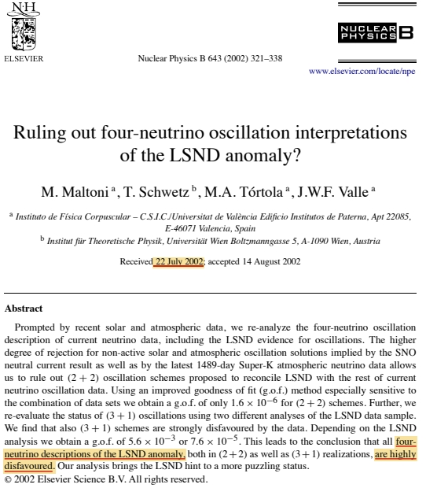
Sterile neutrinos
Global analyses disfavoured eV sterile neutrino oscillations already 20 years ago

Slide 34
Sterile neutrinos: fading away?
Global analyses disfavoured eV sterile neutrino oscillations already 20 years ago
In 20 years…
reactor anomaly: came and went away
LSND/MiniBoone: (largely) unsolved
Gallium anomaly: unsolved
Strong tension with cosmology

Slide 35
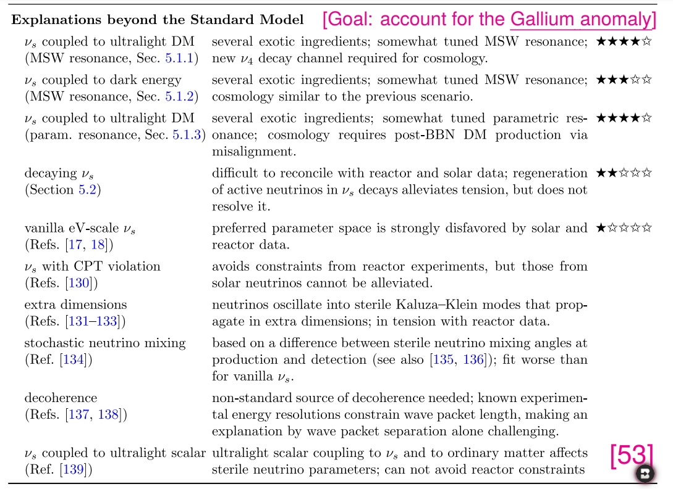
Sterile neutrinos: fading away?
Unlike a few years ago, sterile 𝜈 no longer able to simultaneously explaining anomalies sharing the same channel.
New experimental data required, as upgraded VSBL reactor experiments (KATRIN, PROSPECT-II, JUNO-TAO, DANSS)
If 𝜈𝑒 → 𝜈𝑒 and 𝜈𝜇 → 𝜈𝑒 anomalies confirmed, new physics needed: extra sterile states + something else (intense theoretical effort)
V. Brdar et al., JHEP 05 (2023) 143 [arXiv:2303.05528]

Slide 36
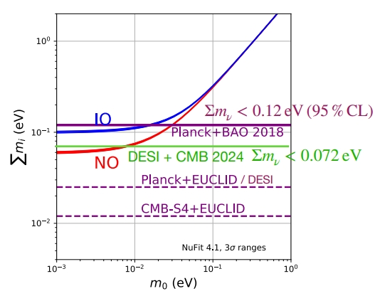
Neutrino masses: tension with cosmology?
Cosmology provides tight constraints on the sum of neutrino masses Σ in ΛCDM model. Too tight?
DESI (April 2024) + CMB Planck + CMB Atacama Telescope: - Best fit value: Σ = 0 , and Σ < 0.072 eV at 95% CL
- Relaxing the Σ > 0 prior,negative neutrino masses are favored.
Notes:
- DESI BAO best-fit ΛCDM cosmology is ∼ 1.8σ disagreement with Planck ΛCDM result
In April 2024, Dark Energy Spectroscopic Instrument (DESI) released BAO measurements based on its first year
of observations [102–106]. DESI BAO provides precise constraints on the transverse comoving distance, the Hubble
rate, and their combination (all relative to the value of the sound horizon at the drag epoch) that, when combined with
CMB data from the Planck satellite and the Atacama Cosmology Telescope (ACT) [107–109], generally push the best
fit to Σ = 0 and set a particularly tight limit Σ < 0.072 eV at 95% CL. This limit is well below the minimum allowed
by oscillation experiments for IO and close to the minimum for NO [22]. Even more puzzling is that when relaxing the
well-motivated physical prior Σ > 0 (employed in the DESI analyses) and allowing for the unphysical region Σ < 0,
negative neutrino masses appear favored by the data, as reported by a few independent groups
DESI BAO best-fit ΛCDM cosmology is found to be in ∼ 1.8σ disagreement with the best-fit Planck ΛCDM cosmology
undetected observational systematics in the DESI BAO data?
new physics beyond the ΛCDM model?
cosmological constraints on Σ are inherently model-dependent

Slide 37
Neutrino masses: tension with cosmology?
Cosmology provides tight constraints on the sum of neutrino masses Σ in ΛCDM model. Too tight?
DESI (April 2024) + CMB Planck + CMB Atacama Telescope: - Best fit value: Σ = 0 , and Σ < 0.072 eV at 95% CL
- Relaxing the Σ > 0 prior,negative neutrino masses are favored.
Long list of possible interpretations:
Undetected systematics in DESI BAO data?
Non-standard cosmology?
New physics beyond the ΛCDM model?
Exotic neutrino properties?
direct mass determinations crucial ⇒ KATRIN and beyond
Notes:
- DESI BAO best-fit ΛCDM cosmology is ∼ 1.8σ disagreement with Planck ΛCDM result
In April 2024, Dark Energy Spectroscopic Instrument (DESI) released BAO measurements based on its first year
of observations [102–106]. DESI BAO provides precise constraints on the transverse comoving distance, the Hubble
rate, and their combination (all relative to the value of the sound horizon at the drag epoch) that, when combined with
CMB data from the Planck satellite and the Atacama Cosmology Telescope (ACT) [107–109], generally push the best
fit to Σ = 0 and set a particularly tight limit Σ < 0.072 eV at 95% CL. This limit is well below the minimum allowed
by oscillation experiments for IO and close to the minimum for NO [22]. Even more puzzling is that when relaxing the
well-motivated physical prior Σ > 0 (employed in the DESI analyses) and allowing for the unphysical region Σ < 0,
negative neutrino masses appear favored by the data, as reported by a few independent groups
DESI BAO best-fit ΛCDM cosmology is found to be in ∼ 1.8σ disagreement with the best-fit Planck ΛCDM cosmology
undetected observational systematics in the DESI BAO data?
new physics beyond the ΛCDM model?
cosmological constraints on Σ are inherently model-dependent

Slide 38
Summary & hopes
Neutrino oscillation physics is entering an exciting era
A multi-faceted experimental panorama:
→ several experiments/upgrades starting, other ones reaching maturity levels
→ a variety of designs and expertises required
Near-term hopes (very few years):
Synergies leading to NMO evidence (JUNO, NOvA+T2K, SK, IC…)
Also comparing indications by experiments in the same channel
Upcoming oscillation parameters measurements to probe mixing unitarity at fine levels
Interplay with cosmology (DESI, EUCLID?) to highlight possible tensions
Notes:
- DESI BAO best-fit ΛCDM cosmology is ∼ 1.8σ disagreement with Planck ΛCDM result
In April 2024, Dark Energy Spectroscopic Instrument (DESI) released BAO measurements based on its first year
of observations [102–106]. DESI BAO provides precise constraints on the transverse comoving distance, the Hubble
rate, and their combination (all relative to the value of the sound horizon at the drag epoch) that, when combined with
CMB data from the Planck satellite and the Atacama Cosmology Telescope (ACT) [107–109], generally push the best
fit to Σ = 0 and set a particularly tight limit Σ < 0.072 eV at 95% CL. This limit is well below the minimum allowed
by oscillation experiments for IO and close to the minimum for NO [22]. Even more puzzling is that when relaxing the
well-motivated physical prior Σ > 0 (employed in the DESI analyses) and allowing for the unphysical region Σ < 0,
negative neutrino masses appear favored by the data, as reported by a few independent groups
DESI BAO best-fit ΛCDM cosmology is found to be in ∼ 1.8σ disagreement with the best-fit Planck ΛCDM cosmology
undetected observational systematics in the DESI BAO data?
new physics beyond the ΛCDM model?
cosmological constraints on Σ are inherently model-dependent

Slide 39
Thanks

Slide 40
Backup

Slide 41
Global 3ν oscillation analysis: best-fit values and 1s ranges
Small (“solar”) mass splitting
Large (“atmospheric”) mass splitting
Capozzi, Lisi et al, https://arxiv.org/pdf/2503.07752

Slide 42
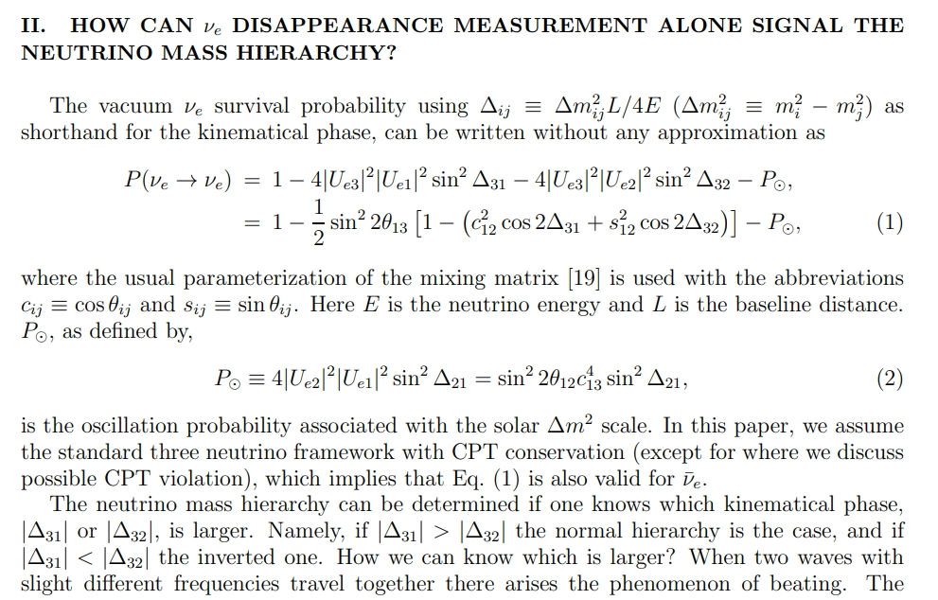
Minakata et al, Phys.Rev.D 76 (2007) 053004

Slide 43
Global 3ν oscillation analysis: best-fit values and 1s ranges
sub-percent era
CP violation preference
NO preference
Capozzi, Lisi et al, https://arxiv.org/pdf/2503.07752

Slide 44
NMO hints in JUNO perspective
JUNO will contribute to the NO and IO discrimination in two ways:
1) L/E oscillometry
2) relative difference between ∆m²_{ee} from JUNO and |∆m²| from other non-reactor data
∆m²_{ee} : short distance effective mass splitting in the νe disappearance channel:
only linear combination of ∆m₃₁² and ∆m₃₂² to be determined by JUNO
+1 for NO, -1 for IO
Capozzi, Lisi et al, https://arxiv.org/pdf/2503.07752

Slide 45
NMO hints in JUNO perspective
JUNO will contribute to the NO and IO discrimination in two ways:
1) L/E oscillometry
2) relative difference between ∆m²_{ee} from JUNO and |∆m²| from other non-reactor data
∆m²_{ee} : only linear combination of ∆m₃₁² and ∆m₃₂² that can be determined by a MBL νe disappearance experiment as JUNO
can be measured in JUNO at < % level
to be measured in JUNO at < % level
+1 for NO, -1 for IO
±0.015 eV² (0.6% diff. between ∆m²_{ee} and |∆m²|)

Slide 46
NMO hints in JUNO perspective
JUNO will contribute to the NO and IO discrimination in two ways:
1) L/E oscillometry
2) relative difference between ∆m²_{ee} from JUNO and |∆m²| from other non-reactor data
∆m²_{ee} : only linear combination of ∆m₃₁² and ∆m₃₂² that can be determined by a MBL νe disappearance experiment as JUNO
can be measured in JUNO at < % level
to be measured in JUNO at < % level
+1 for NO, -1 for IO
comparable to - current 1σ of |∆m² | (±0.8%)
- expected 1σ of ∆m²_{ee} in JUNO (±0.8% after just 100 days of operation)
±0.015 eV² (0.6% diff. between ∆m²_{ee} and |∆m²|)

Slide 47
NMO hints in JUNO perspective
JUNO is expected to measure ∆m²_{ee} and δm² with 2σ errors smaller than in Figure, in few months of operation
Central values matters! ∆m²_{ee} central value by JUNO could tell at a glance agreement/tension with rest-of-the-world constraints
Capozzi, Lisi et al, https://arxiv.org/pdf/2503.07752

Slide 48
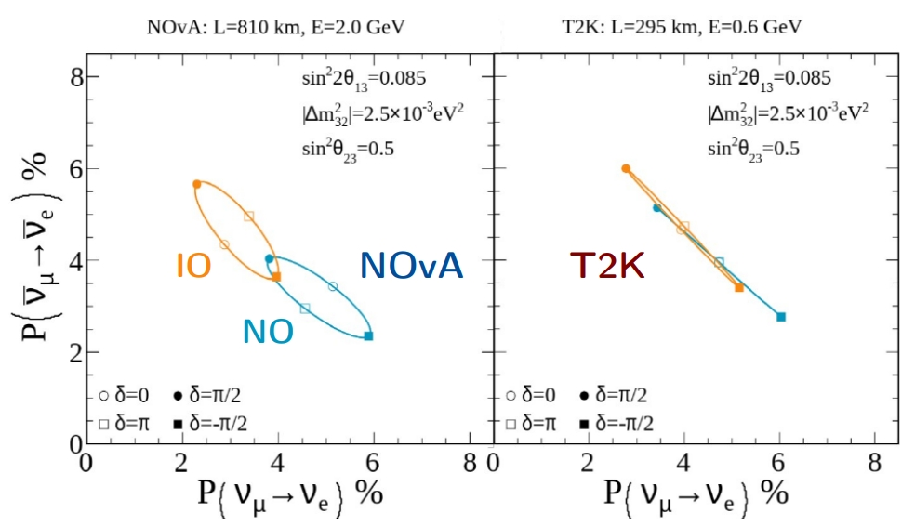
Accelerator 𝜈: NOvA and T2K
Different E and L give different oscillation probabilities and parameter sensitivity
NOvA:
Better NMO sensitivity
Degenerate for δCP ~ π/2 and ~ −π/2 (CPV)
T2K:
Better δCP sensitivity
Degenerate for around δCP = 0 and π (no-CPV)
Joint analysis probes both spaces, lifting degeneracies of individual experiments
Based on Eur. Phys. J. C (2023) 83: 782 and Phys. Rev. D 110, 012005

Slide 49
NOvA and T2K joint analysis
Results in a nutshell:
• No strong preference for mass ordering
• New ∆m²₃₂ precision < 2 %
• About 1σ (Bayes factor 3.6) preference for θ23 > 45◦
• CP conserving values of δCP = 0, π lies outside the 3σ CI in the case of IO
Next steps:
• Expected to double the statistics from both experiments in coming years
• Knowledge sharing and exchange of information resulted in a deeper understanding of each experiment

Slide 50
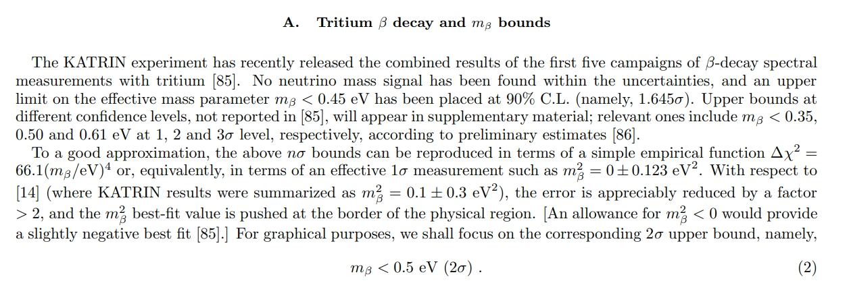
KATRIN most recent results

Slide 51
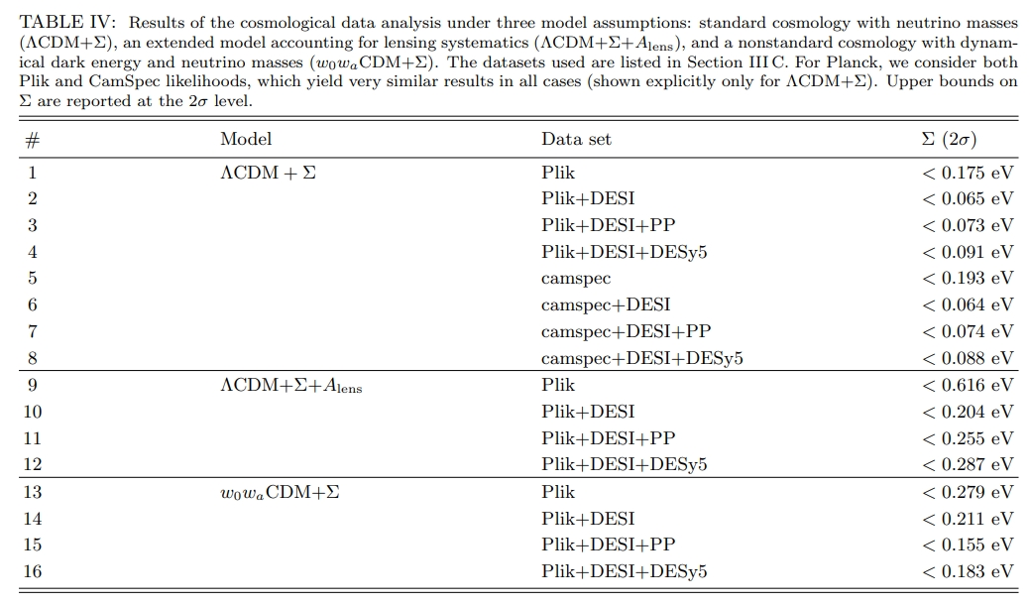
Cosmology result on sum of masses

Slide 52
Cosmology result on sum of masses
It appears rather premature to quote a “consensus” upper bound on Σ from cosmological data at present.
It could be better to quote a “range” of upper bounds, noticing that the 2σ cosmological limits on Σ cluster around a reasonable “geometric average” value of Σ < 0.2 eV, with variations up to a factor of 3 (upwards or downwards), depending on the specific model and dataset employed.
It’s more conservative stating that Σ < 0.2 eV at 2σ (within a factor of 3) may be considered as a reasonable summary of acceptable and physically motivated current bounds, ranging from very conservative (Σ < 0.60 eV) to very aggressive (Σ < 0.07 eV).
This interval of limits is essentially supported by Planck data alone within standard cosmology, as well as by both Planck and DESI in nonstandard cases.

Slide 53
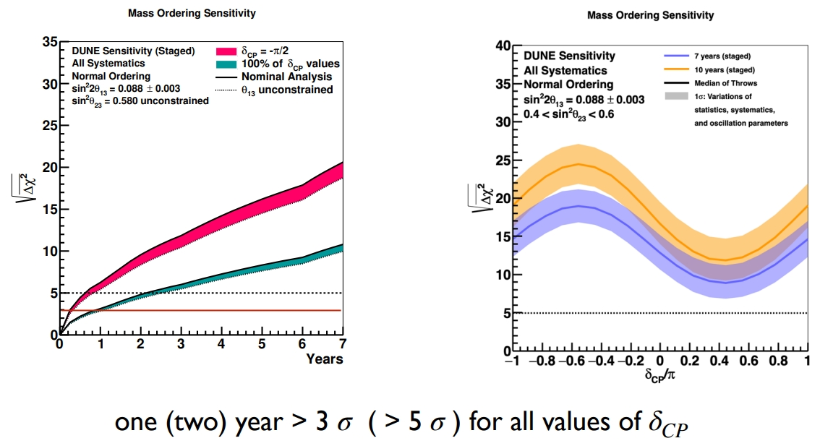
DUNE sensitivity to NMO

Slide 54
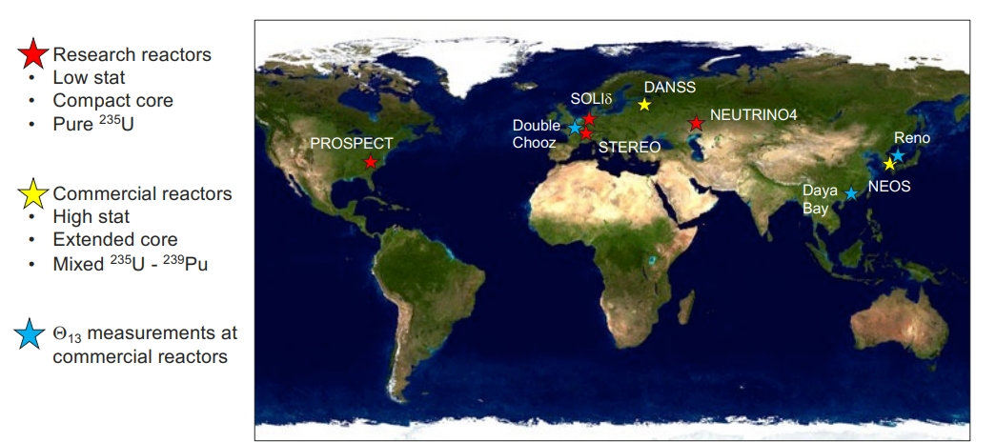
Sterile neutrinos at reactor, worldwide

Slide 55
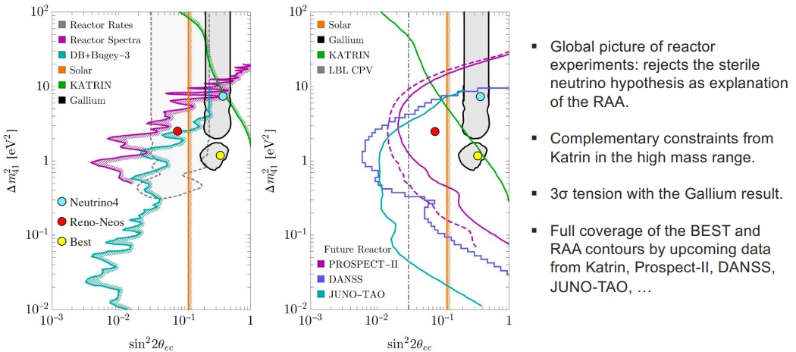
Sterile neutrinos

Slide 56
Sterile neutrinos
1. Neutrino masses (E > TeV)
2. Cosmology. (E > keV)
3. Short baseline anomalies. (m ~ eV)

Slide 57
Sterile neutrinos

Slide 58
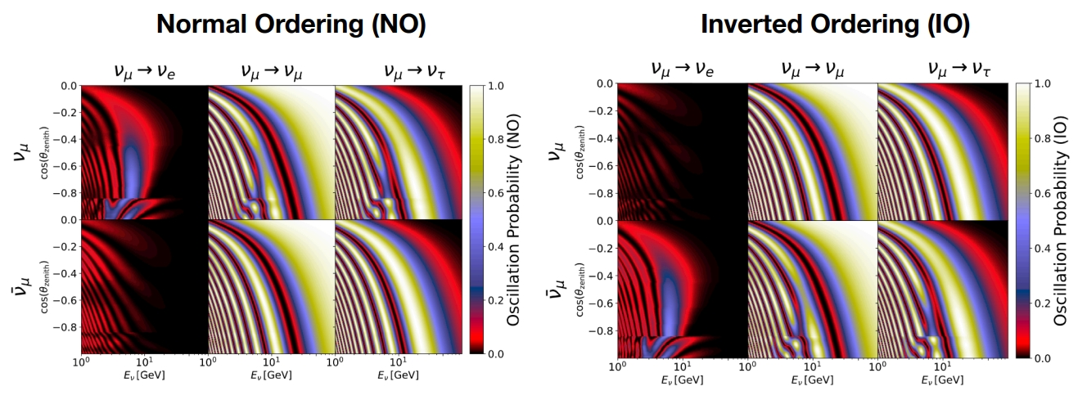
Oscillation patterns for atmospheric exp.

Slide 59
Oscillation patterns for atmospheric exp.
DeepCore cannot distinguish between neutrinos and antineutrinos
Flux and cross-section are higher for neutrinos than for antineutrinos at DeepCore energies (3 GeV-100 GeV)
For a combined neutrino/anti-neutrino sample, matter effects are more pronounced for true NO as compared to true IO

Slide 60
IceCube Upgrade

Slide 61
IceCube Upgrade
DeepCore: Almost 200k atmospheric neutrino events in 9.28 years
DeepCore faces limitations due to event quality but the IceCube Upgrade will improve this. Reconstruction capability and PID are still main limiting factors despite the increase in detector livetime
DeepCore + Upgrade combined sample will have the luxury of high statistics AND improved event quality
With 5 years of both Upgrade + JUNO data, synergistic effects could enhance NMO signal up to 5σ for both true NO and true IO

Slide 62
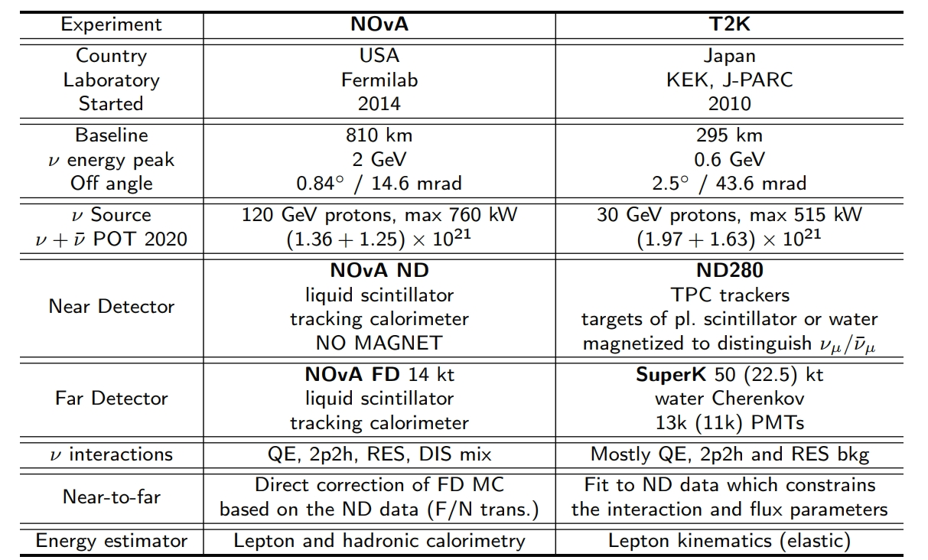
NOvA and T2K: design comparison

