Slide 1
Hardware technology trends in HEP computing
Andrea Sciabà
Workshop sul Calcolo nell'INFN: La Biodola, 26 - 30 maggio 2025

Slide 2
Outline
Introduction
Semiconductor industry
Processing units: CPUs and GPUs
Memory technology
Storage technologies
Flash storage
Disk storage
Tape storage
Prospects for capacity increase
Conclusions

Slide 3
Introduction
LHC (offline) computing is simple!
Just as many CPU cores as possible, disk and tape to store the data, and fast enough WAN
No need for fast interconnects or fast/lots of memory, very limited need for GPUs (so far)
Our needs are diverging from the state-of-the-art
We just need lots of cheap resources!
The downside is that our influence is diminishing compared to other realities
Our needs are known many years in advance
Much easier to plan for purchases
The budget is “flat”
This assumption worked so far
Still, it is very important to be aware of where technology is going
Cost forecast more difficult than ever!
GenAI and geopolitical instability may disrupt our plans

Slide 4
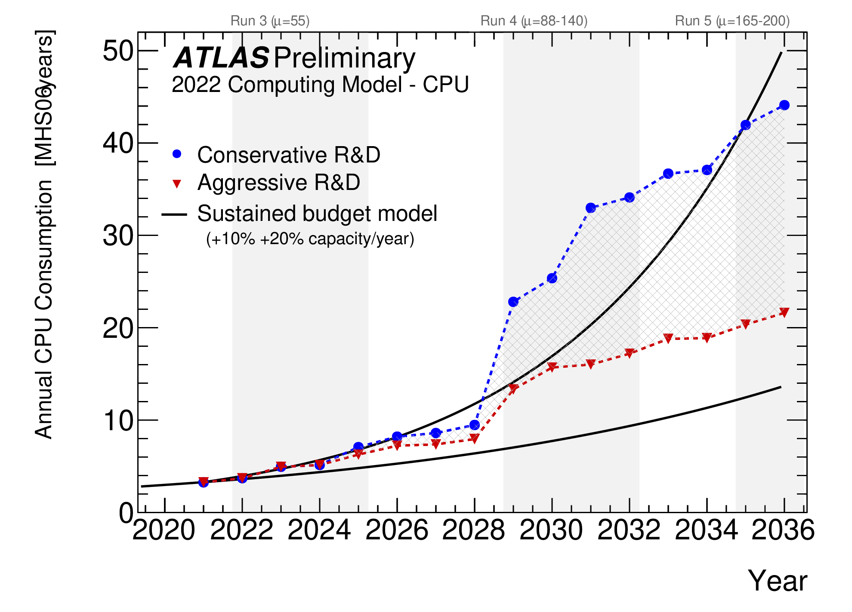
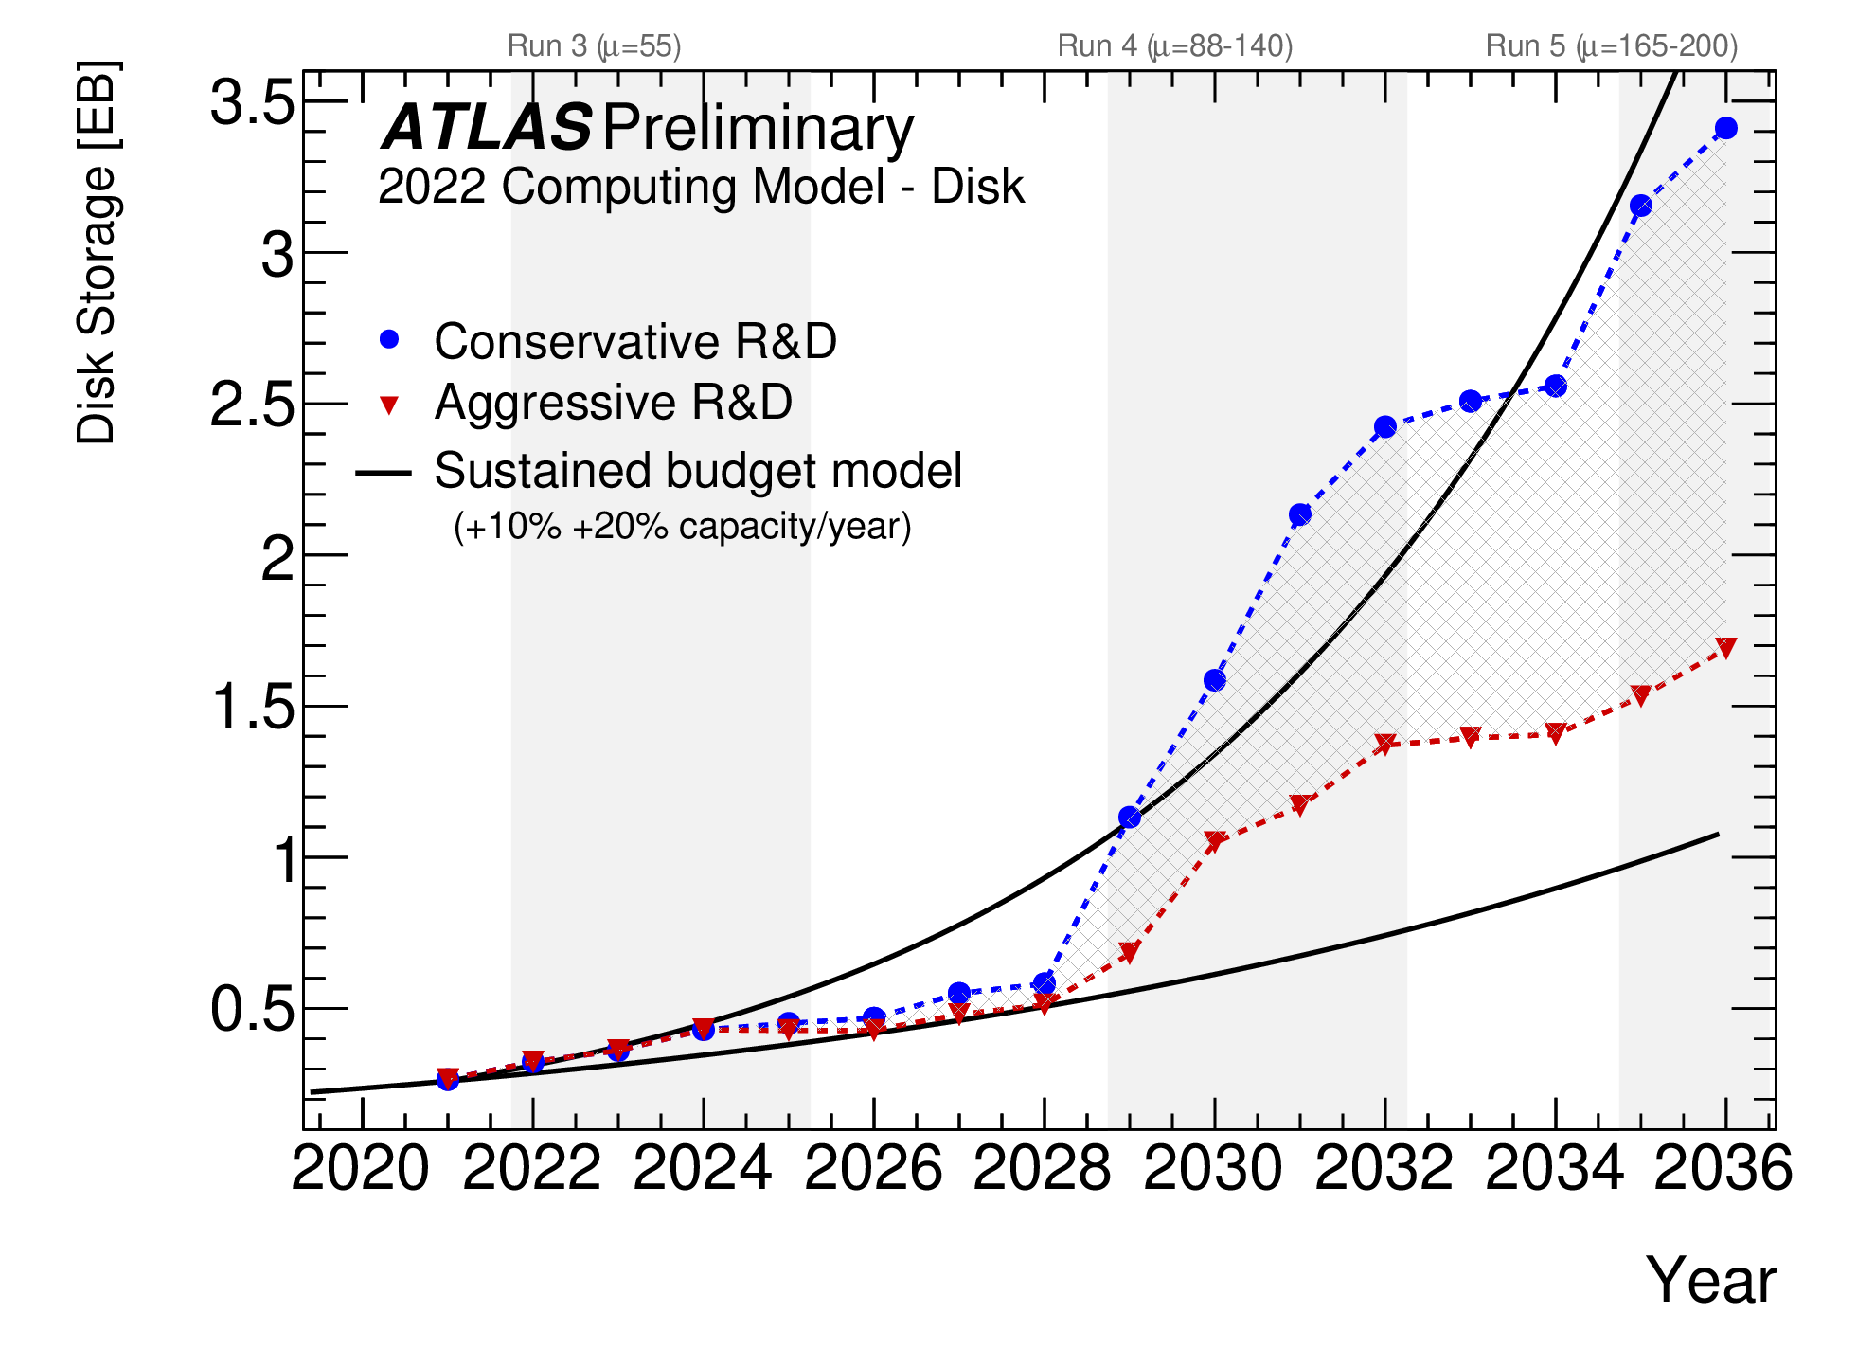
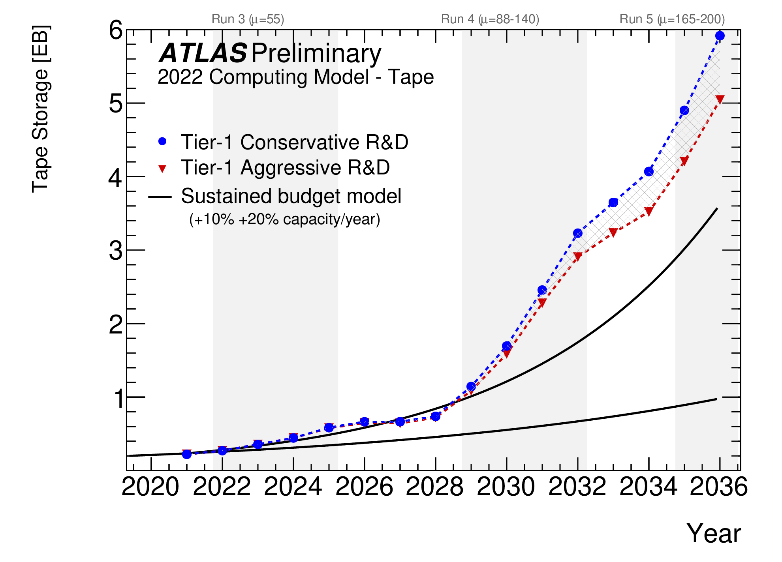
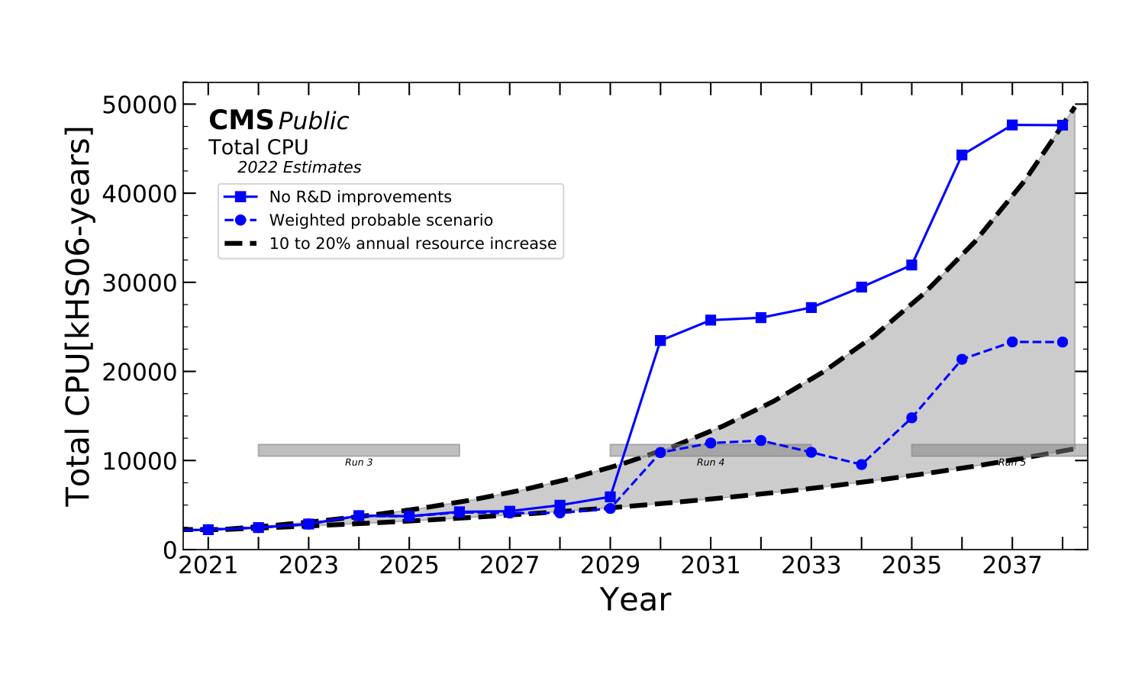
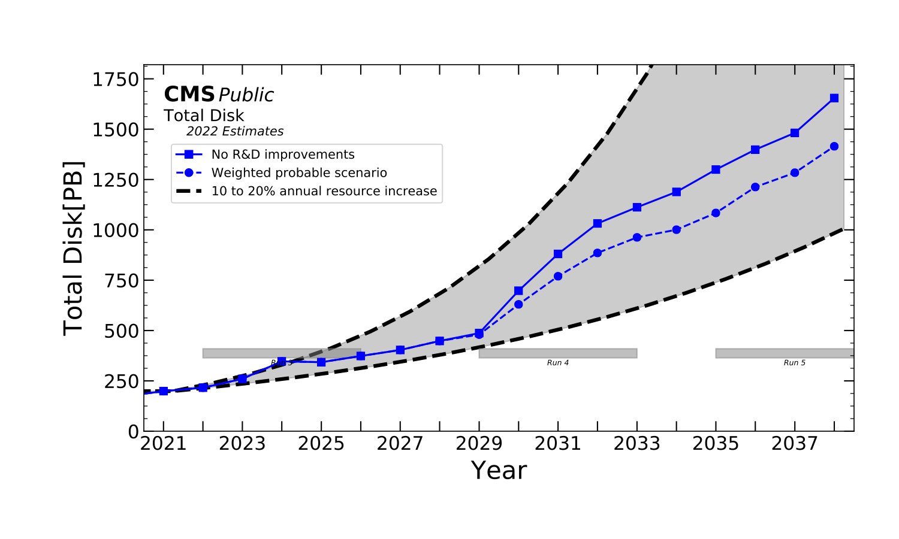
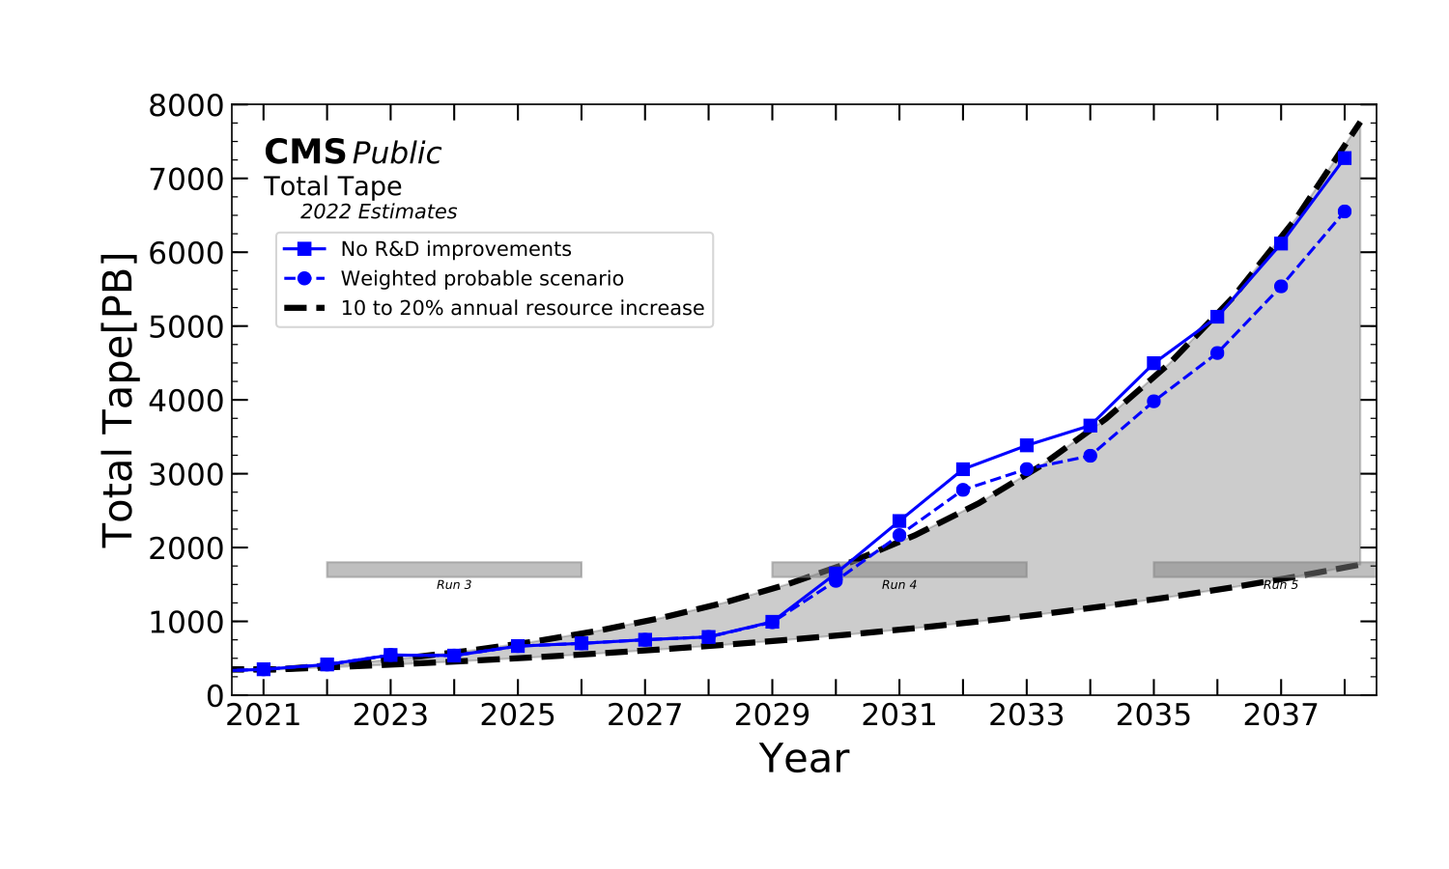
ATLAS and CMS resource needs up to HL-LHC
Sources: ATLAS and CMS
From the experiment plots, with a flat budget, a 15%/year price reduction is required even in the most optimistic case (for CPU and disk)
Situation much better than in the past, but still at the limit
Stressing the importance of technology awareness

Slide 5
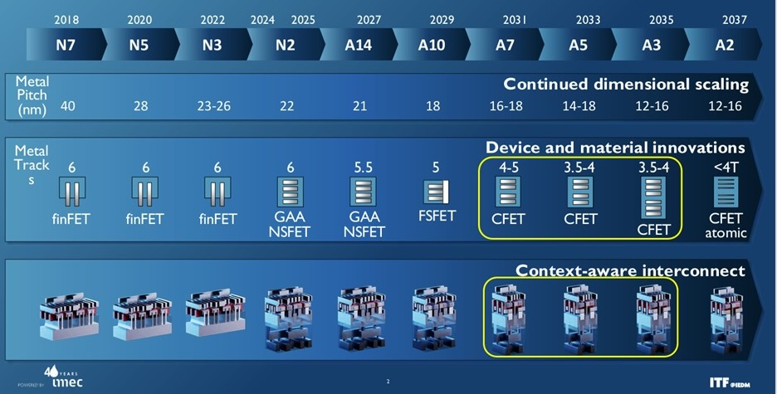
Fabrication processes
Roadmap until 2036 (“More Moore”)
Transition from FinFET transistors to GAA nanosheet designs for N2 and beyond (“Angstrom era”) is ongoing
Less leakage, faster transistor switching
Near to volume production
A16 will ramp up in the second half of 2026
CFET transistors the next big thing, from 2031
Chiplet architectures (“More than Moore”)
3D packaging used to compensate for the slower transistor shrinking
Voltages are not decreasing any more
Semiconductor technical advances focus on materials, rather than lithography
E.g. 2D materials to replace silicon transistor channels and reduce leakage
Photonic Integrated Circuits (PIC)
Would improve reliability and reduce power consumption and packaging costs
Still not viable due to difficulties in material growth

Slide 6
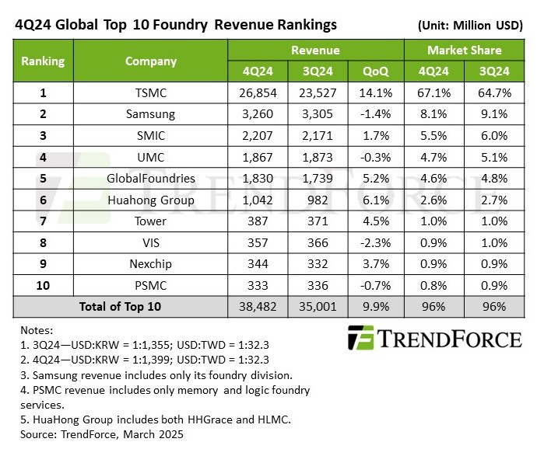
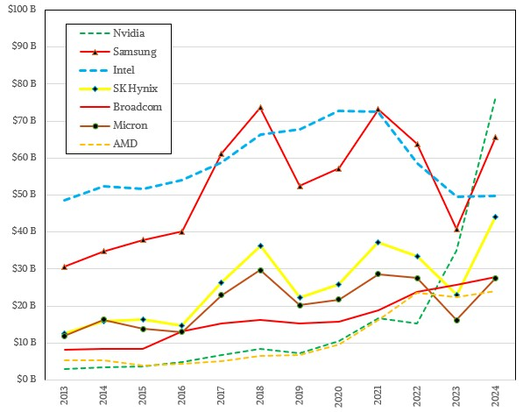
Semiconductor industry trends
TSMC dominates the market, 65% share
Samsung comes second with 9%, Intel not even visible in the table (214 M$ in Q3 2024)
Nvidia dominates among the chip designing companies
Increasing revenues for all of them apart Intel
Numbers should increase in the next years due to the GenAI boom, but many uncertainties
Will AI keep using GPUs or shift to dedicated (and cheaper) hardware?
What will be the effect of tariff wars?
TSMC investing 165 G$ to build six fabs in Arizona!
Nvidia trying to have everything they need made in the US
The initially announced USA-China tariffs were estimated to shrink semiconductor market by 34% in 2026

Slide 7
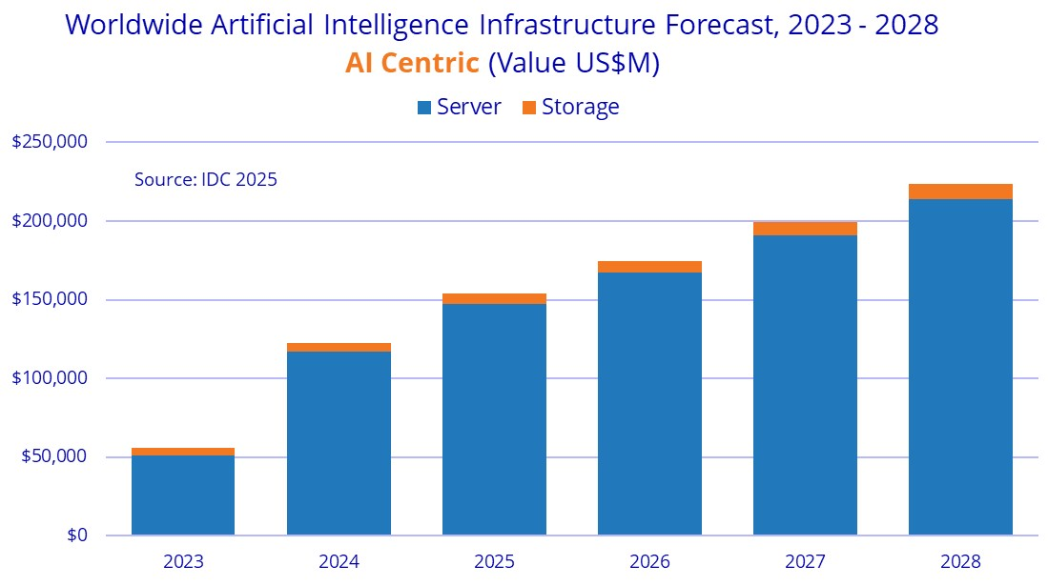
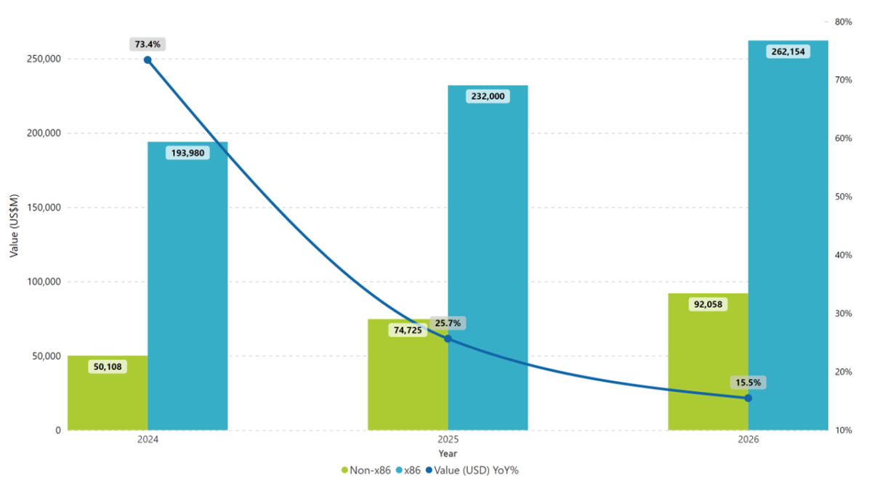
Server market
AI servers represent a rapidly increasing fraction of total servers delivered
But only small margins for integrators, (~5%, typical for HPC hardware), while Nvidia, memory & flash makers make the highest profits
Traditional servers (e.g. for databases) provide higher margins
Hyperscalers and cloud providers drive hardware market growth
Efficiency gains will not slow growth (Jevons paradox)
Total server market forecast

Slide 8
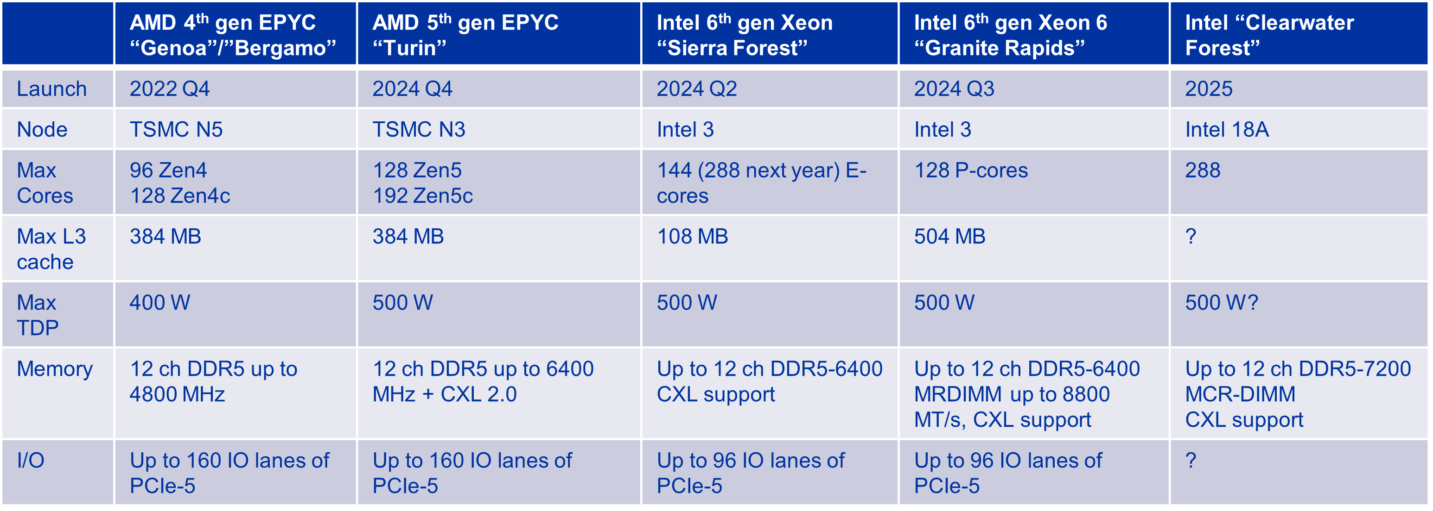
CPU processing
X86 market split between Intel and AMD
AMD reached 25% share and increasing
Core count (and maximum power) keep increasing
Air cooling becomes problematic
Choice of SKUs heavily dependent on both price and power envelope
Performance increasing at a healthy rate
~ 15% IPC between generations
More PCIe channels and memory bandwidth
Better power efficiency
Arm should become fully viable for WLCG during 2025
Very interesting price and power efficiency
But only one vendor, Ampere, as Nvidia CPUs are still too expensive, and Ampere’s future priorities are unclear
Fujitsu might also play a role

Slide 9
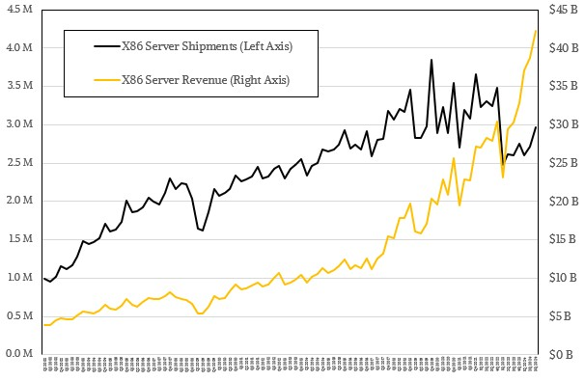
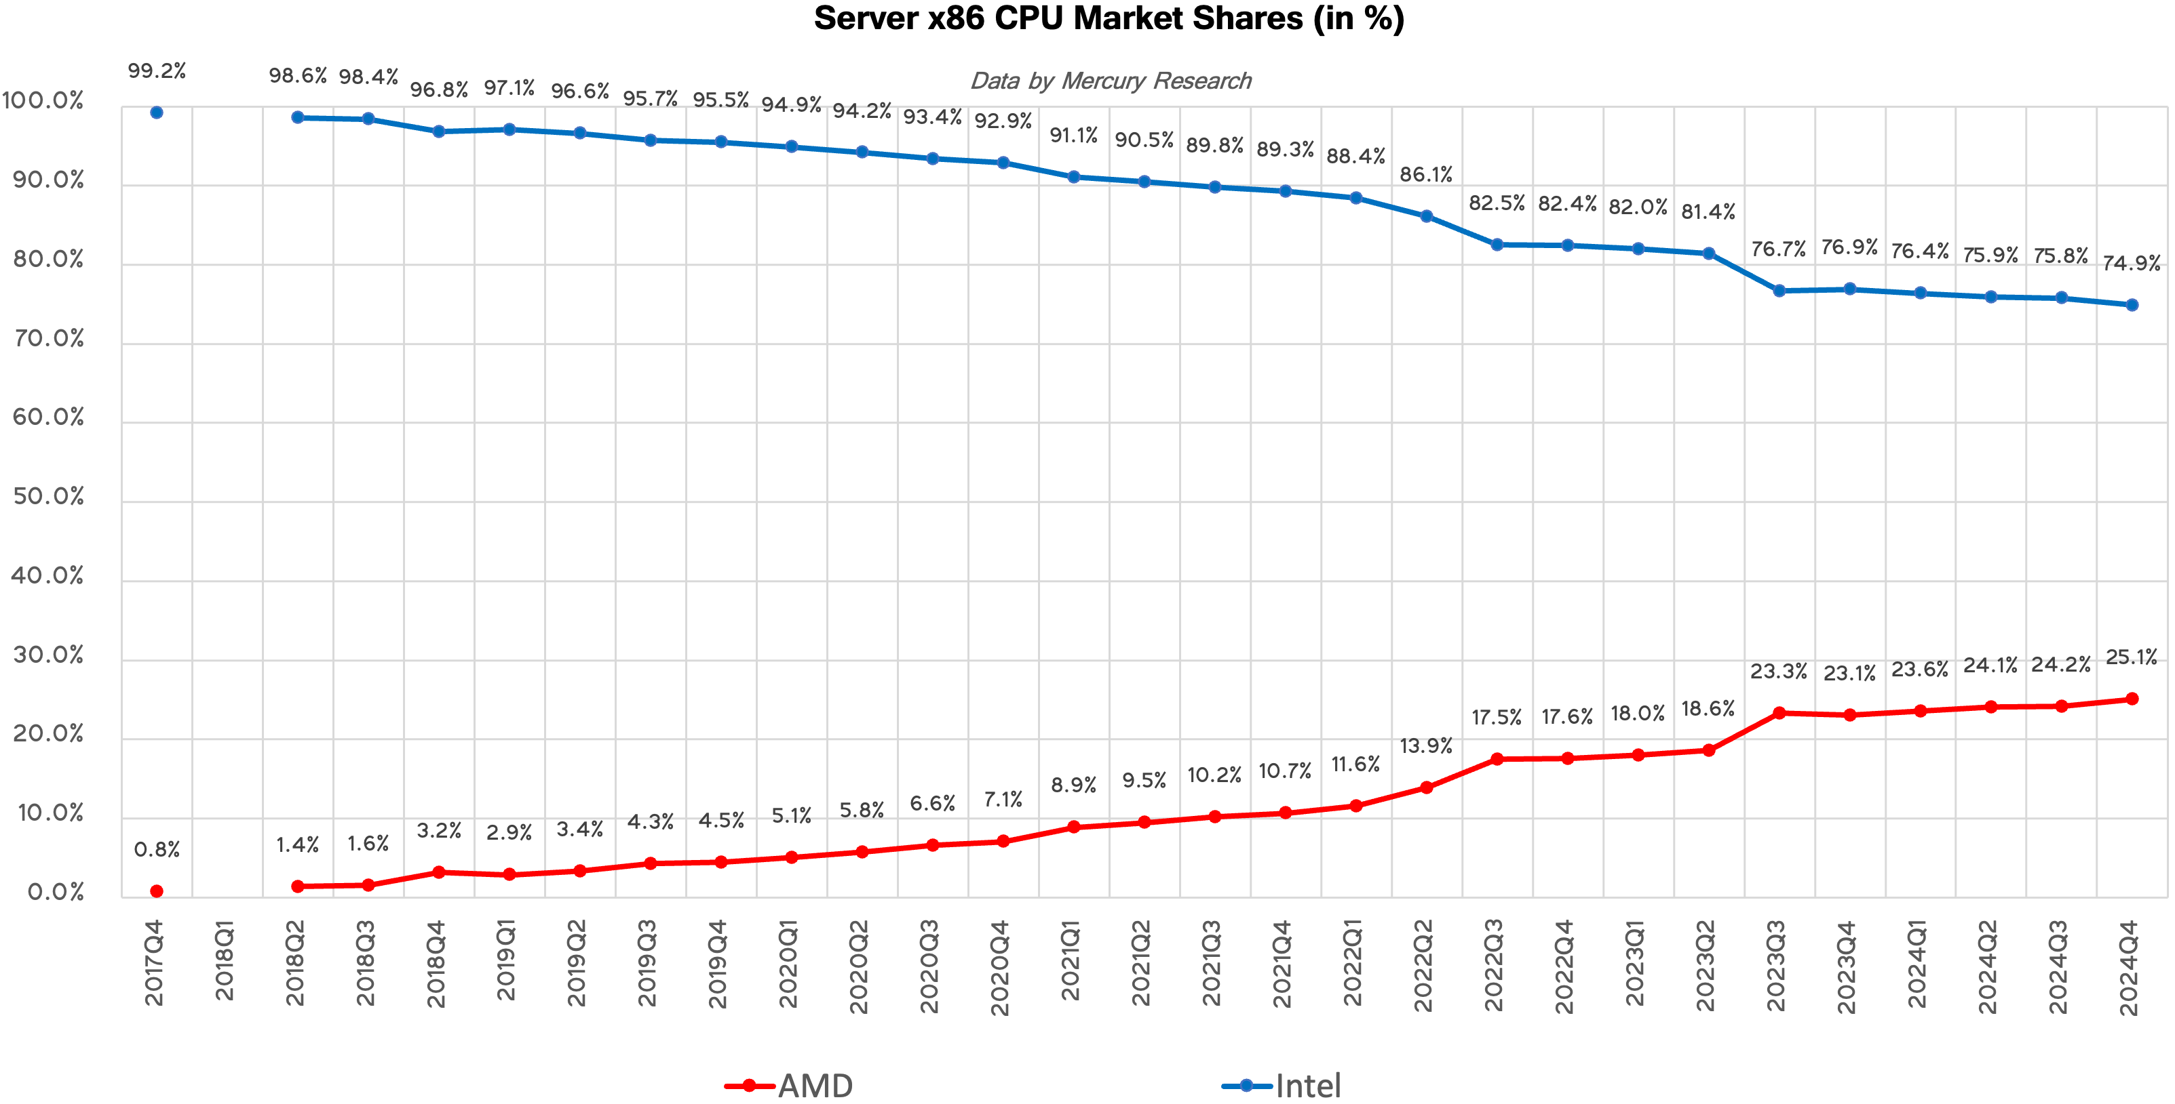
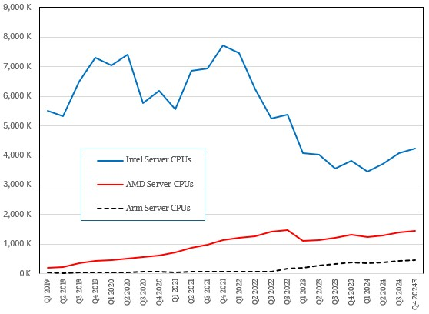
CPU server market
X86 server shipments and revenues increasing again
Both for AMD and Intel
Big drop in shipments was due to the GenAI boom, which made servers more expensive
Arm is increasing due to the much lower server operational costs
Ampere bought by Softbank, future (for us) not clear
RISC-V also gaining some traction
Much cheaper than Arm (no licensing costs)
Popular in China and in Europe for HPC
E.g. Meta designing a RISC-V AI chip for training to reduce reliance on Nvidia
25% AMD

Slide 10
Xeon 6 CPUs
Two different families
“P-Core (Granite Rapids)” – Best performance/core
“E-Core (Sierra Forest)” – Maximum core count, best power efficiency, no hyperthreading
Xeon 6 – Two different platforms, two different SOCs
6900 series: up to 500W, 12-channel DDR5, up to 128/288 cores
6500, 6700 series: up to 350W, 8-channel DDR5, up to 86/144 cores
Platform | SOC | Max core count | Max memory ch | Max memory speed
 | Sapphire rapids | 60 (P) | 8 | 4800
Eagle stream | Emerald rapids | 64 (P) | 8 | 5600
 | Granite rapids | 128 (P) | 12 | 6400 8800
Birch stream | Sierra forest | 288 (E) | 12 | 6400
 | Clearwater forest | 288 (E) | 12 | 7200
10

Slide 11
Xeon 6 CPUs - Enhancements
Compared to previous Xeon 5 generation
Multi chiplet design
Adoption of DDR5 pushes memory bandwidth up to 1.7x
Optional MRDIMM support (up to 2.3x)
Support for type 1,2,3 CXL 2.0
AI acceleration with AMX (Advanced Matrix Extension)
Hardware enhanced security for confidential computing (TDX and SGX)
Xeon 6 P-Core
Add FP16 support to AMX (INT8, BF16)
AVX-512 and AVX2
Claim is: «best CPU for AI inference»
11

Slide 12
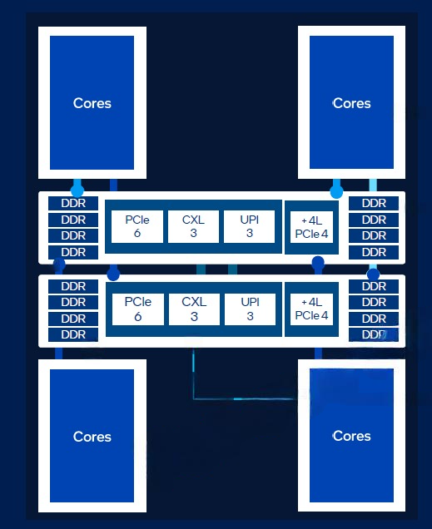
Next-gen Xeon
Targeted for 2026
New platform called «Oak Stream»
Two variants: 8-ch and 16-ch
PCIe Gen6
New SoC called «Diamond Rapids»
Built on Intel 18A node
Up to 4 compute tiles per CPU, 192 cores max
500W TDP
1S, 2S, 4S configuration
Increased efficiency of AMX
Native TF32, FP8 support
12

Slide 13
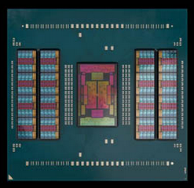
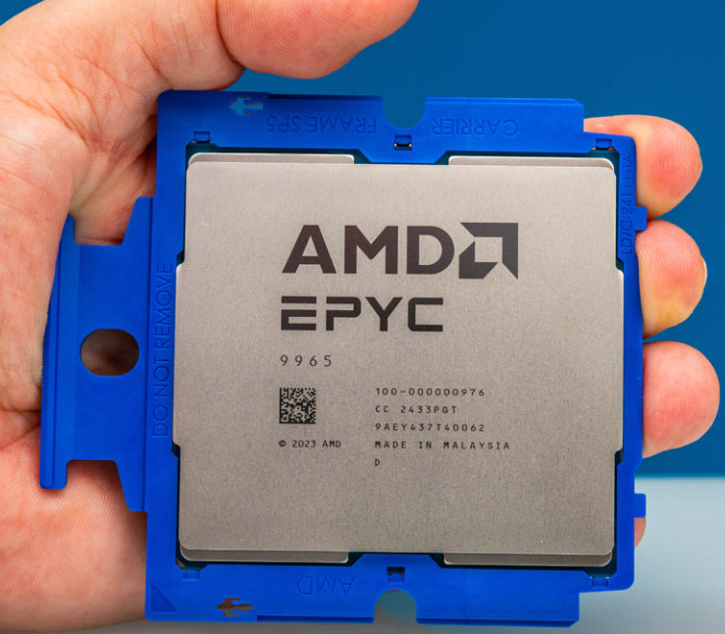
CPUs – AMD Zen5 (“Turin”) architecture
Compute
5° gen AMD EPYC 3/4nm node
Zen5 up to 128 cores/256 threads
Zen5c up to 192 cores/384 threads
AVX-512
500W max TDP
Memory
12ch. DDR ECC up to 6400MT/s
Up to 2 DIMM/channel capacity
I/O
2P and 1P configurations
Up to 160 lanes of PCIe gen5
Socket compatible with «Genoa»
CXL 2.0
13

Slide 14
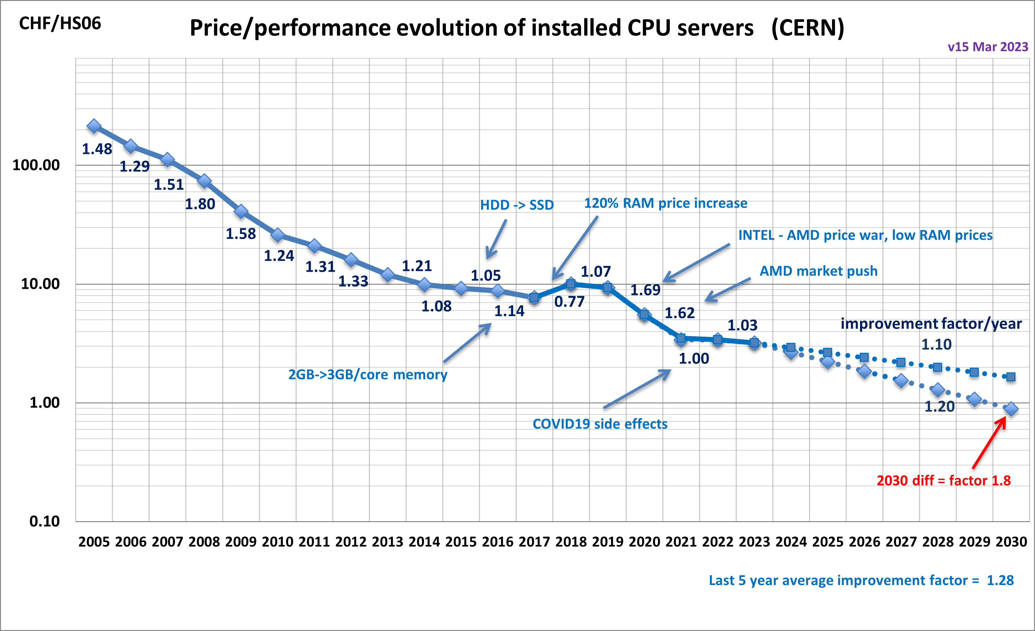
CPU cost
CPU price decrease rate relatively stable over time
AMD becoming again competitive gave a boost
Stagnant recently
Waiting to see the 2025 purchase prices to update the plot ☺
Questions:
Is Intel going to be competitive again?
When (if) will Arm start having an impact? Or RISC-V?
When will GPUs will make CPUs less relevant?
Source: B. Panzer-Steindel

Slide 15
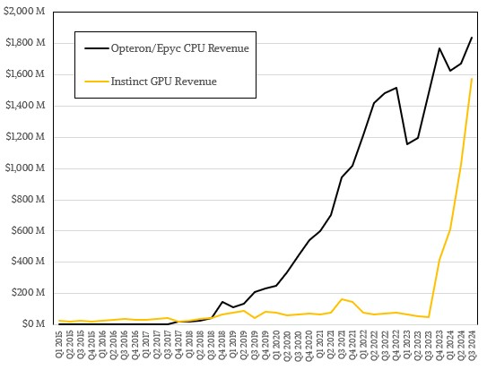
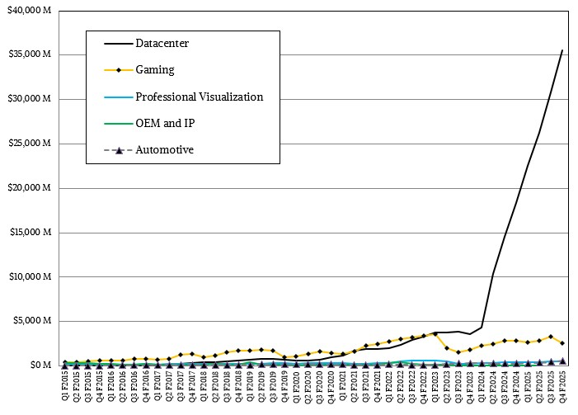
GPU processing
AMD revenues
The market most impacted by the GenAI frenzy
Nvidia dominates and imposes huge margins
AMD doing better and better, now GPU revenues as high as CPU ones
Nvidia’s roadmap to 2028 very aggressive
2024: Blackwell (B100/B200)
2025: Blackwell Ultra (B300): 288 GB of HBM3e, +50% of FP4
2026: Rubin (R100): 288 GB of HBM4, 50 PFLOPS of FP4
2027: Rubin Ultra: 1 TB of HBM4, 100 PFLOPS of FP4
2028: Feynman
AMD roadmap also plans a new product every year
2024: MI325X, 288 GB of HBM3e, CDNA 3
2025: MI350, adds FP4, CDNA 4
2026: MI450X for AI, MI430X for HPC with enhanced FP32/64 performance!
Intel still offering only Gaudi AI accelerators
Nvidia revenues

Slide 16
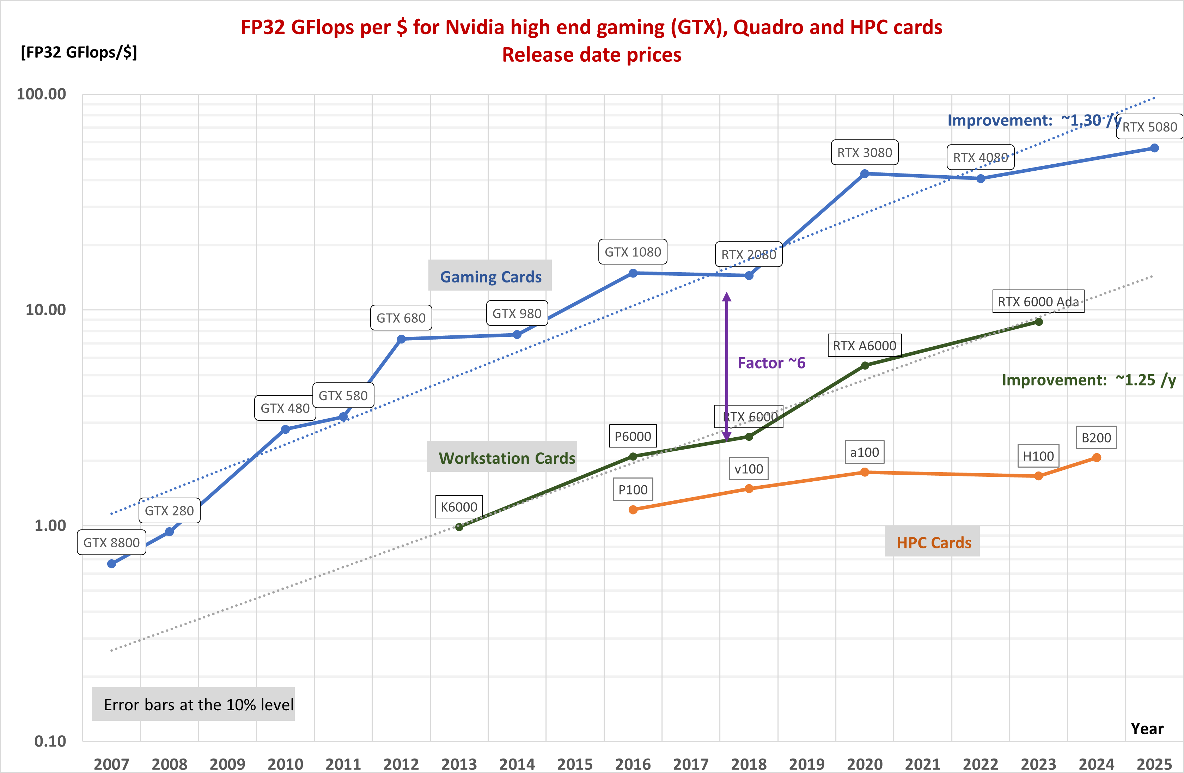
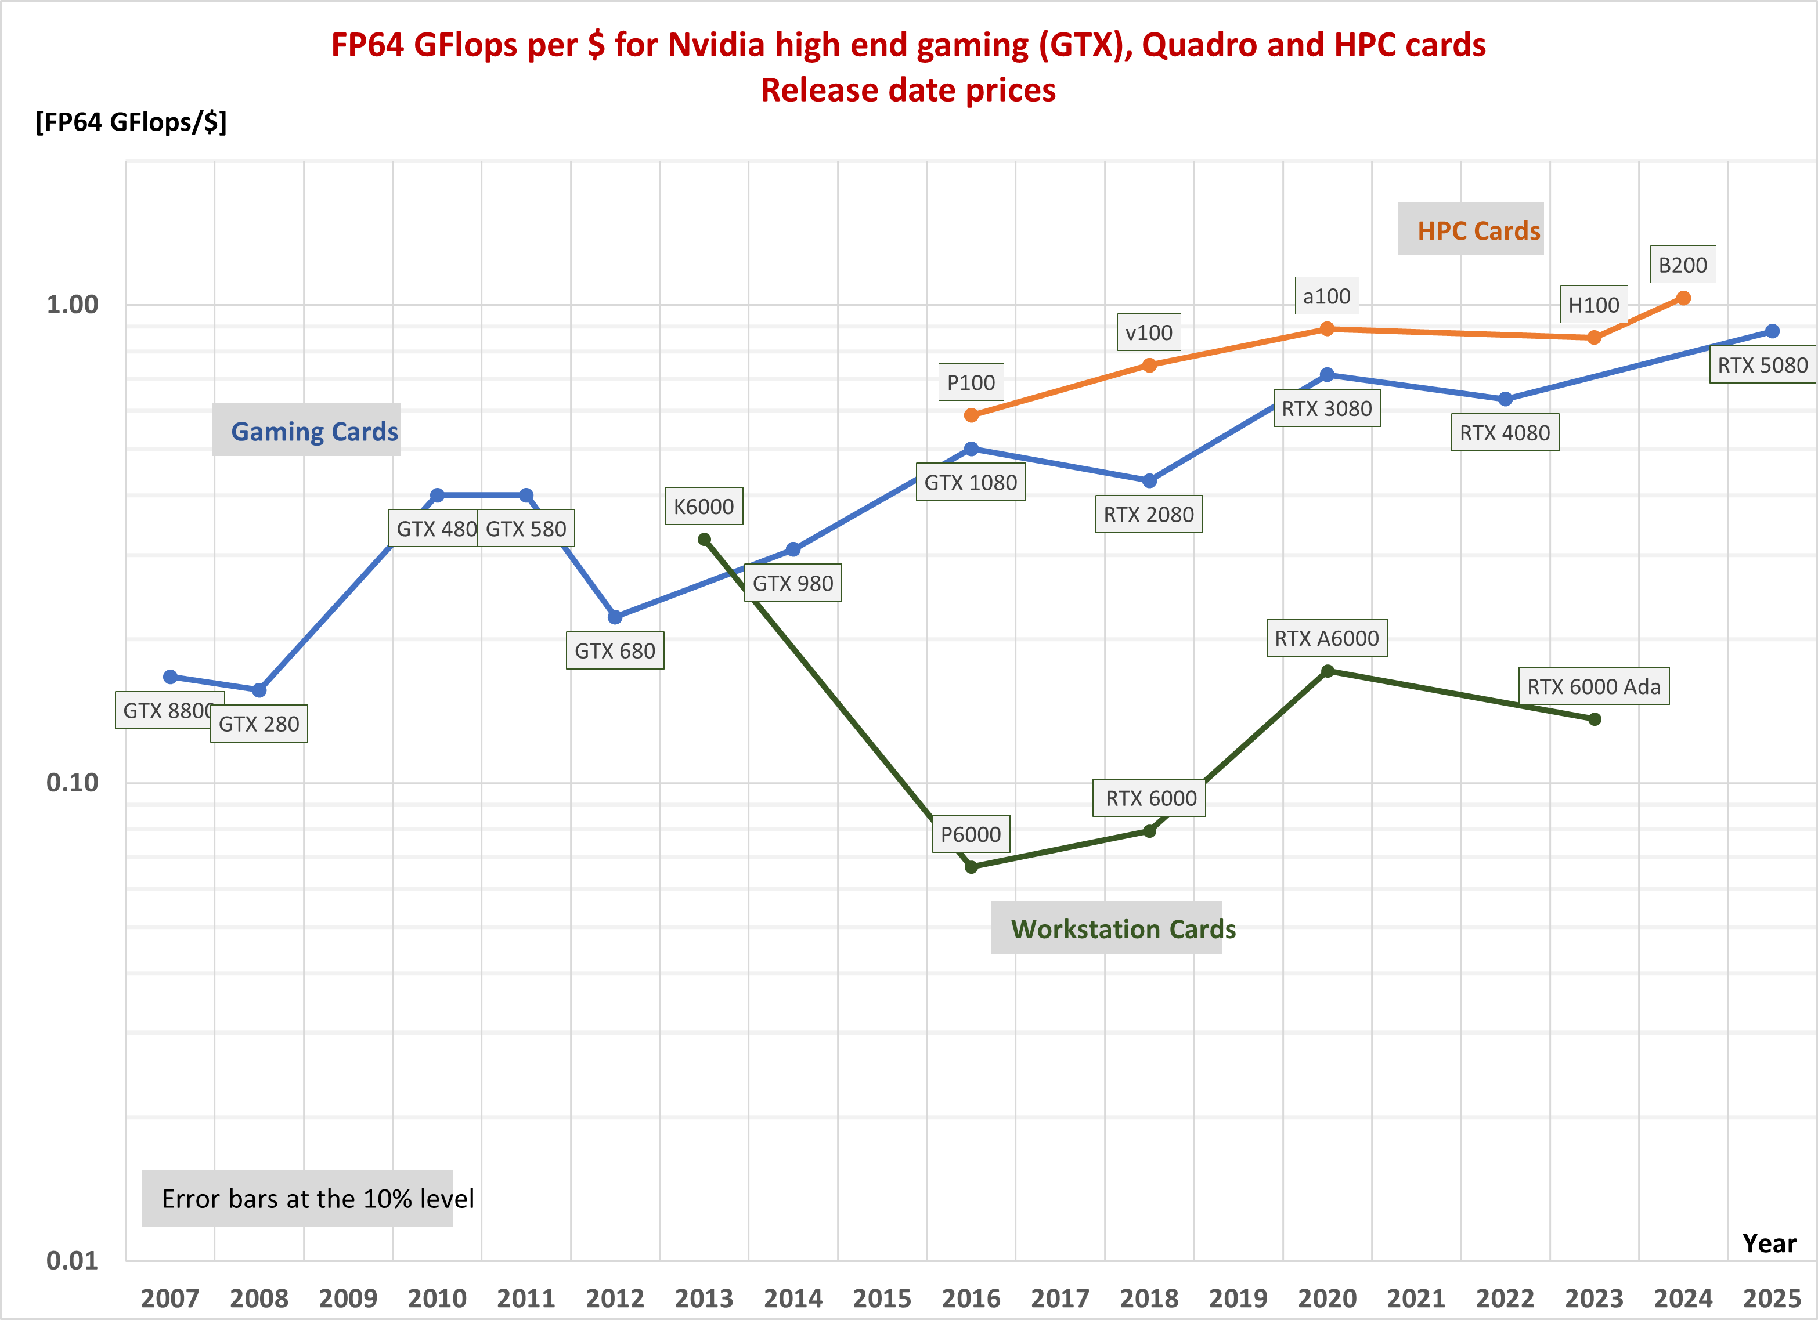
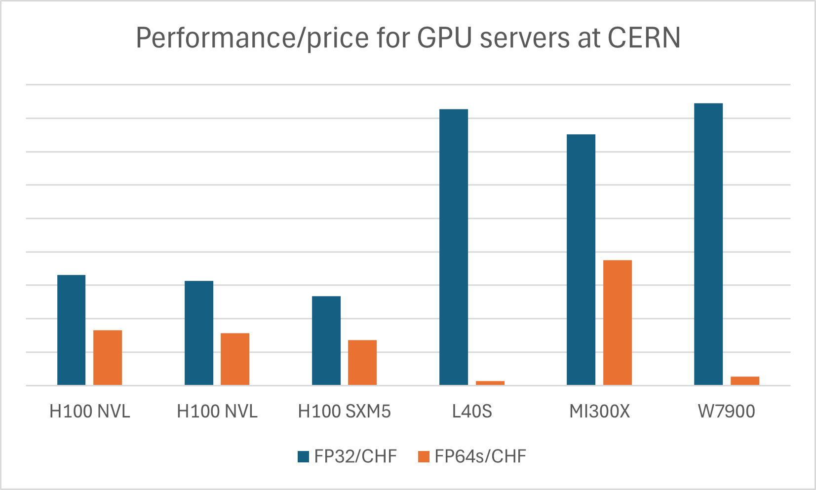
Evolution of GPU high precision performance
From Hopper to Blackwell the increase in FP64 and FP32 performance is marginal
Very hard to estimate performance/$, as the price of the single GPU is not well known
Just started tracking GPU server prices at CERN
How much we will need GPUs in HEP is still rather undefined

Slide 17
Memory technology
 | Max capacity | Bandwidth | Bus width | Used on
HBM3 | 24 GB per stack | ~820 GB/s per stack | 1024 bit | Hopper, MI300
HBM3E | 36 GB per stack | ~1.3 TB/s per stack | 1024 bit | Blackwell
GDDR7 | 64 Gbit per chip | 160 GB/s | 32 bit | RTX 50-series
MRDIMM | 256 GB per module | 8800 MT/s | 64 bit | System
Strong push towards high bandwidth, low latency for HPC and AI
Wide range of types of DRAM for different applications
Optimization via interconnecting different chiplets (logic, memory, IO)
System memory
DDR5 current standard, up to 6400 MT/s
LPDDR5X more power efficient, and cheaper than HBM, but has limitations
MRDIMM (multi-ranked buffered DIMM) to achieve 8800 MT/s and more
CXL (Compute Express Link) is a protocol on top of PCIe that allows to disaggregate memory and share it with many CPUs and GPUs, combining DRAM and non-volatile storage
Semianalysis

Slide 18
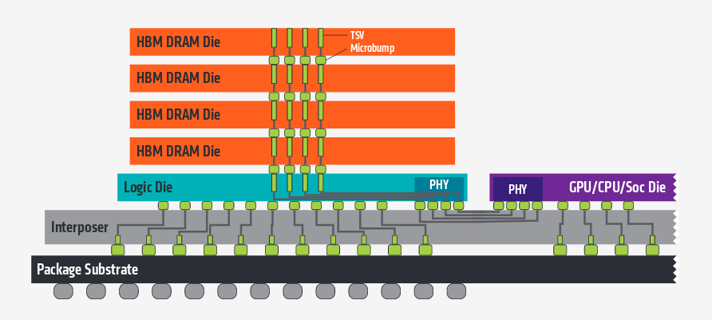
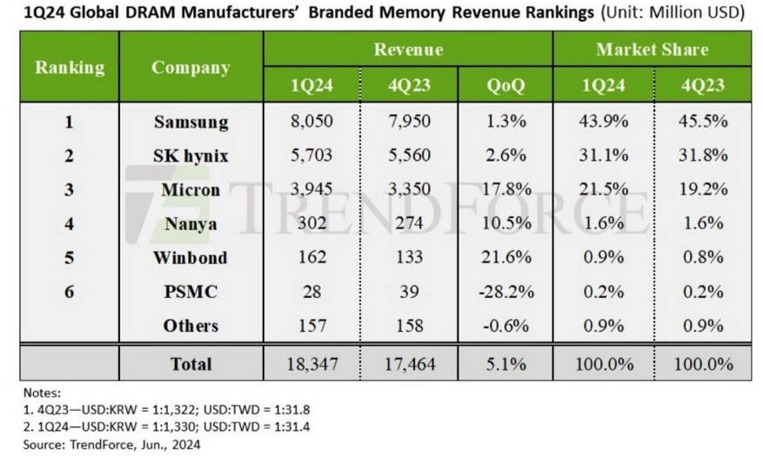
High bandwidth memory
HBM memory in increasing demand
Stacks of DRAM dies (up to 12), 1024-bit wide interface
Directly connected to the GPU (or CPU, FPGA)
Latest is HBM3e, total bandwidth per stack > 1 TB/s
Only viable solution for large model AI accelerators
3x more expensive than DDR5
HBM4 in production from 2025Q3 (SK Hynix, followed by Samsung and Micron), in time for NVIDIA’s Rubin
Memory market is recovering after collapsing in 2022-23
Memory shortages still possible as HBM uses capacity at the expense of DRAM
10% of capacity but 20-30% of market value in 2025
Beyond HBM?
In-memory computing might provide 100x more bandwidth than HBM!

Slide 19
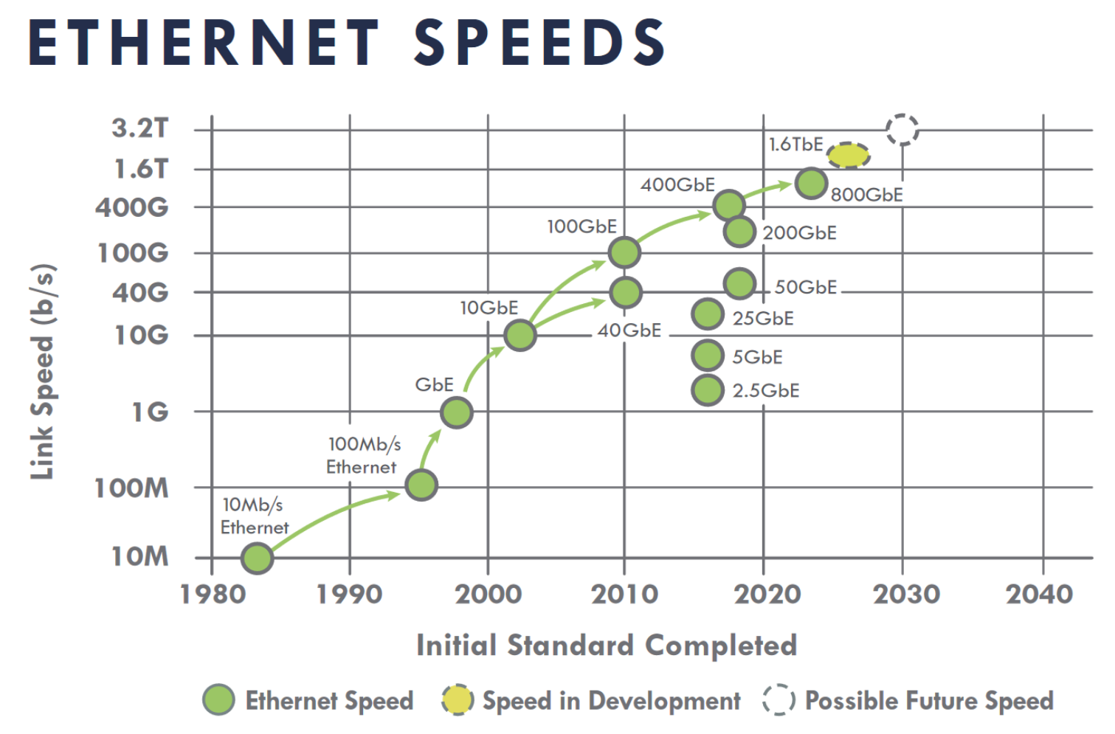
Local area network
Infiniband used for high bandwidth/low latency
Only relevant for real HPC applications (and some HEP online systems)
AI-focused and cloud providers do not need it
Ethernet-based alternatives are RoCE (now) and Ultra Ethernet (future)
Network speeds in our computing centres are increasing
10 Gbps the bare minimum, still OK for WNs and little else
25-100 Gbps on server NICs are commonplace
Networking cost not a big concern
Required switches contribute a minor amount to the overall cost

Slide 20
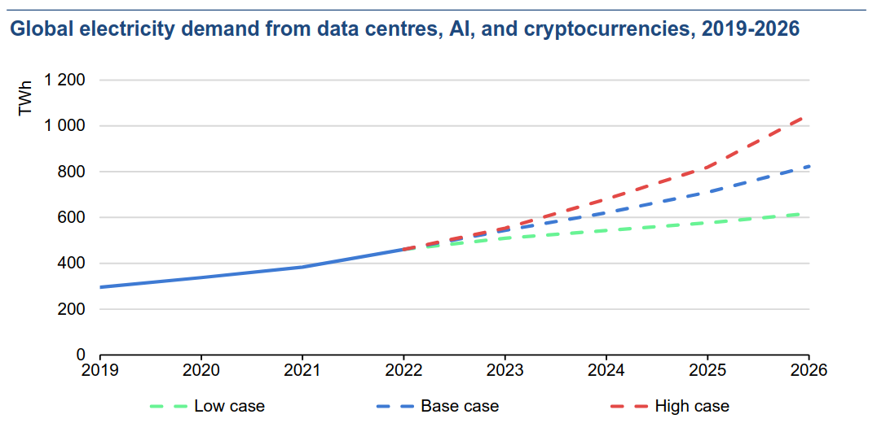
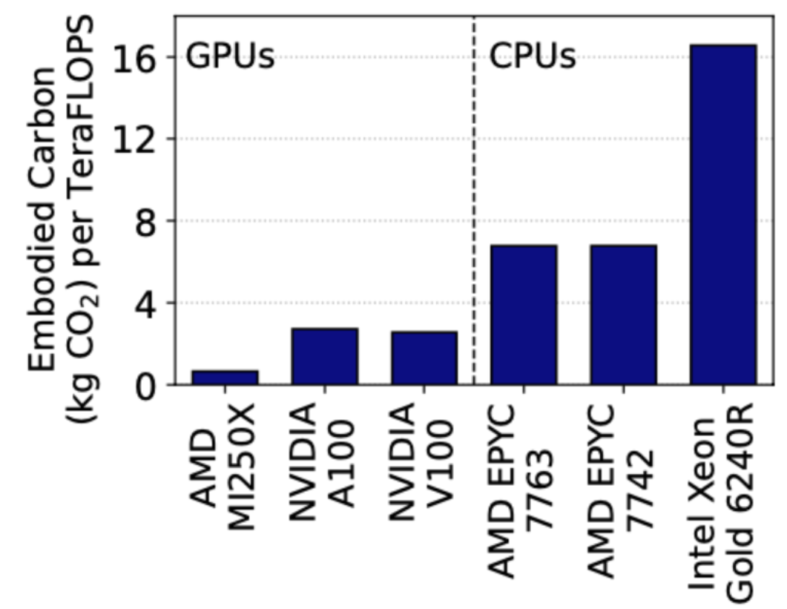
Power consumption and cooling
Electricity demand from data centers increasing very fast
Power constraints are a strong incentive to energy efficiency
Data centers used ~2% of global electricity in 2022, estimated twice as much in 2026
Power efficiency still improving, but power density of servers also increasing
Liquid cooling increasingly required
CPU power efficiency now systematically measured in our community
ARM is more efficient, but AMD is keeping up
GPUs may be 5-10x more power efficient than CPUs
Powerful incentive to move algorithms to GPUs
Embedded vs operational emissions must be considered
Best strategy for hardware replacement in a data center heavily depends on how “clean” electricity production is
Source: IEA Report 2024

Slide 21
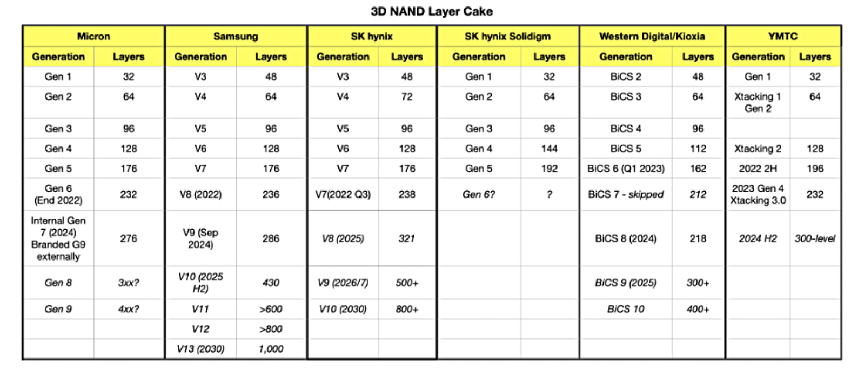
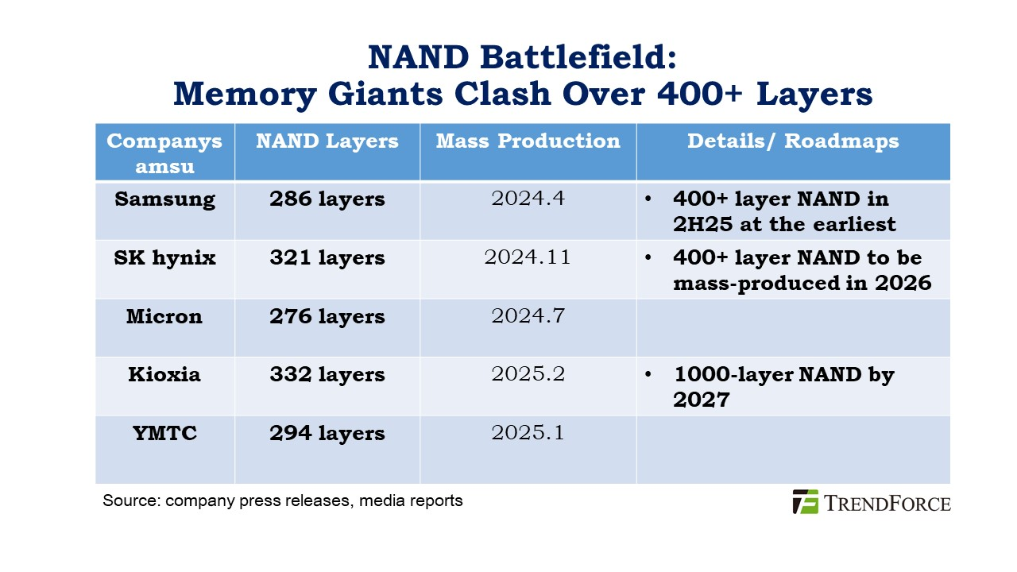
Flash storage
Capacity increasing in two dimensions
Bits/cell: SLC → MLC → TLC → QLC → PLC?
QLC for large SSD used for data serving
TLC and lower for high R/W rates
Number of layers: ~ 200-300 today, 400+ in 2025
Drive capacity soon to exceed 120 TB!
Samsung confirms plans for 1000 layers by 2030
Using a technique to bond multiple wafers, to break a manufacturing limit
Mass producing NAND with ~400 layers this year
Performance will go up with PCIe 6
Micron demoed an SSD reaching 27 GB/s!
Supplier 3D NAND layer count generations

Slide 22
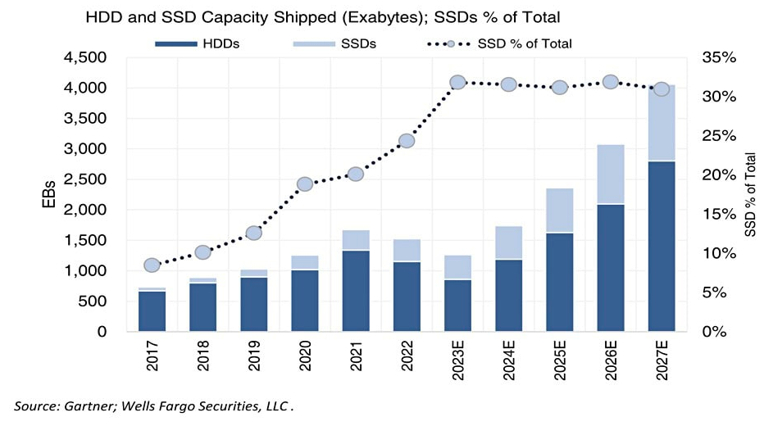
NAND Flash market
Globally, shipped NAND flash capacity amounts to 30% of the total (SSD+HDD)
For HEP, it is much less: only as system drives and for certain high IOPS/bandwidth storage systems (data caches, tape buffers, analysis facilities…)
Price gap with HDDs is still 3-4x, slowly decreasing
Growth rate for NAND flash less than predicted in the last few months (less orders from PC, mobile and key buyers)
10-15% instead of 30%, Samsung and SK Hynix will scale down production by 10%
Long term demand will go up again due to AI, no good for us!
Blocks and files

Slide 23
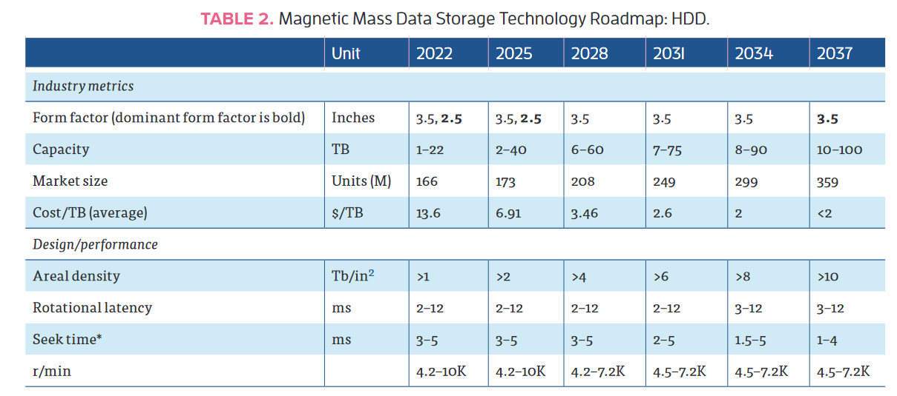
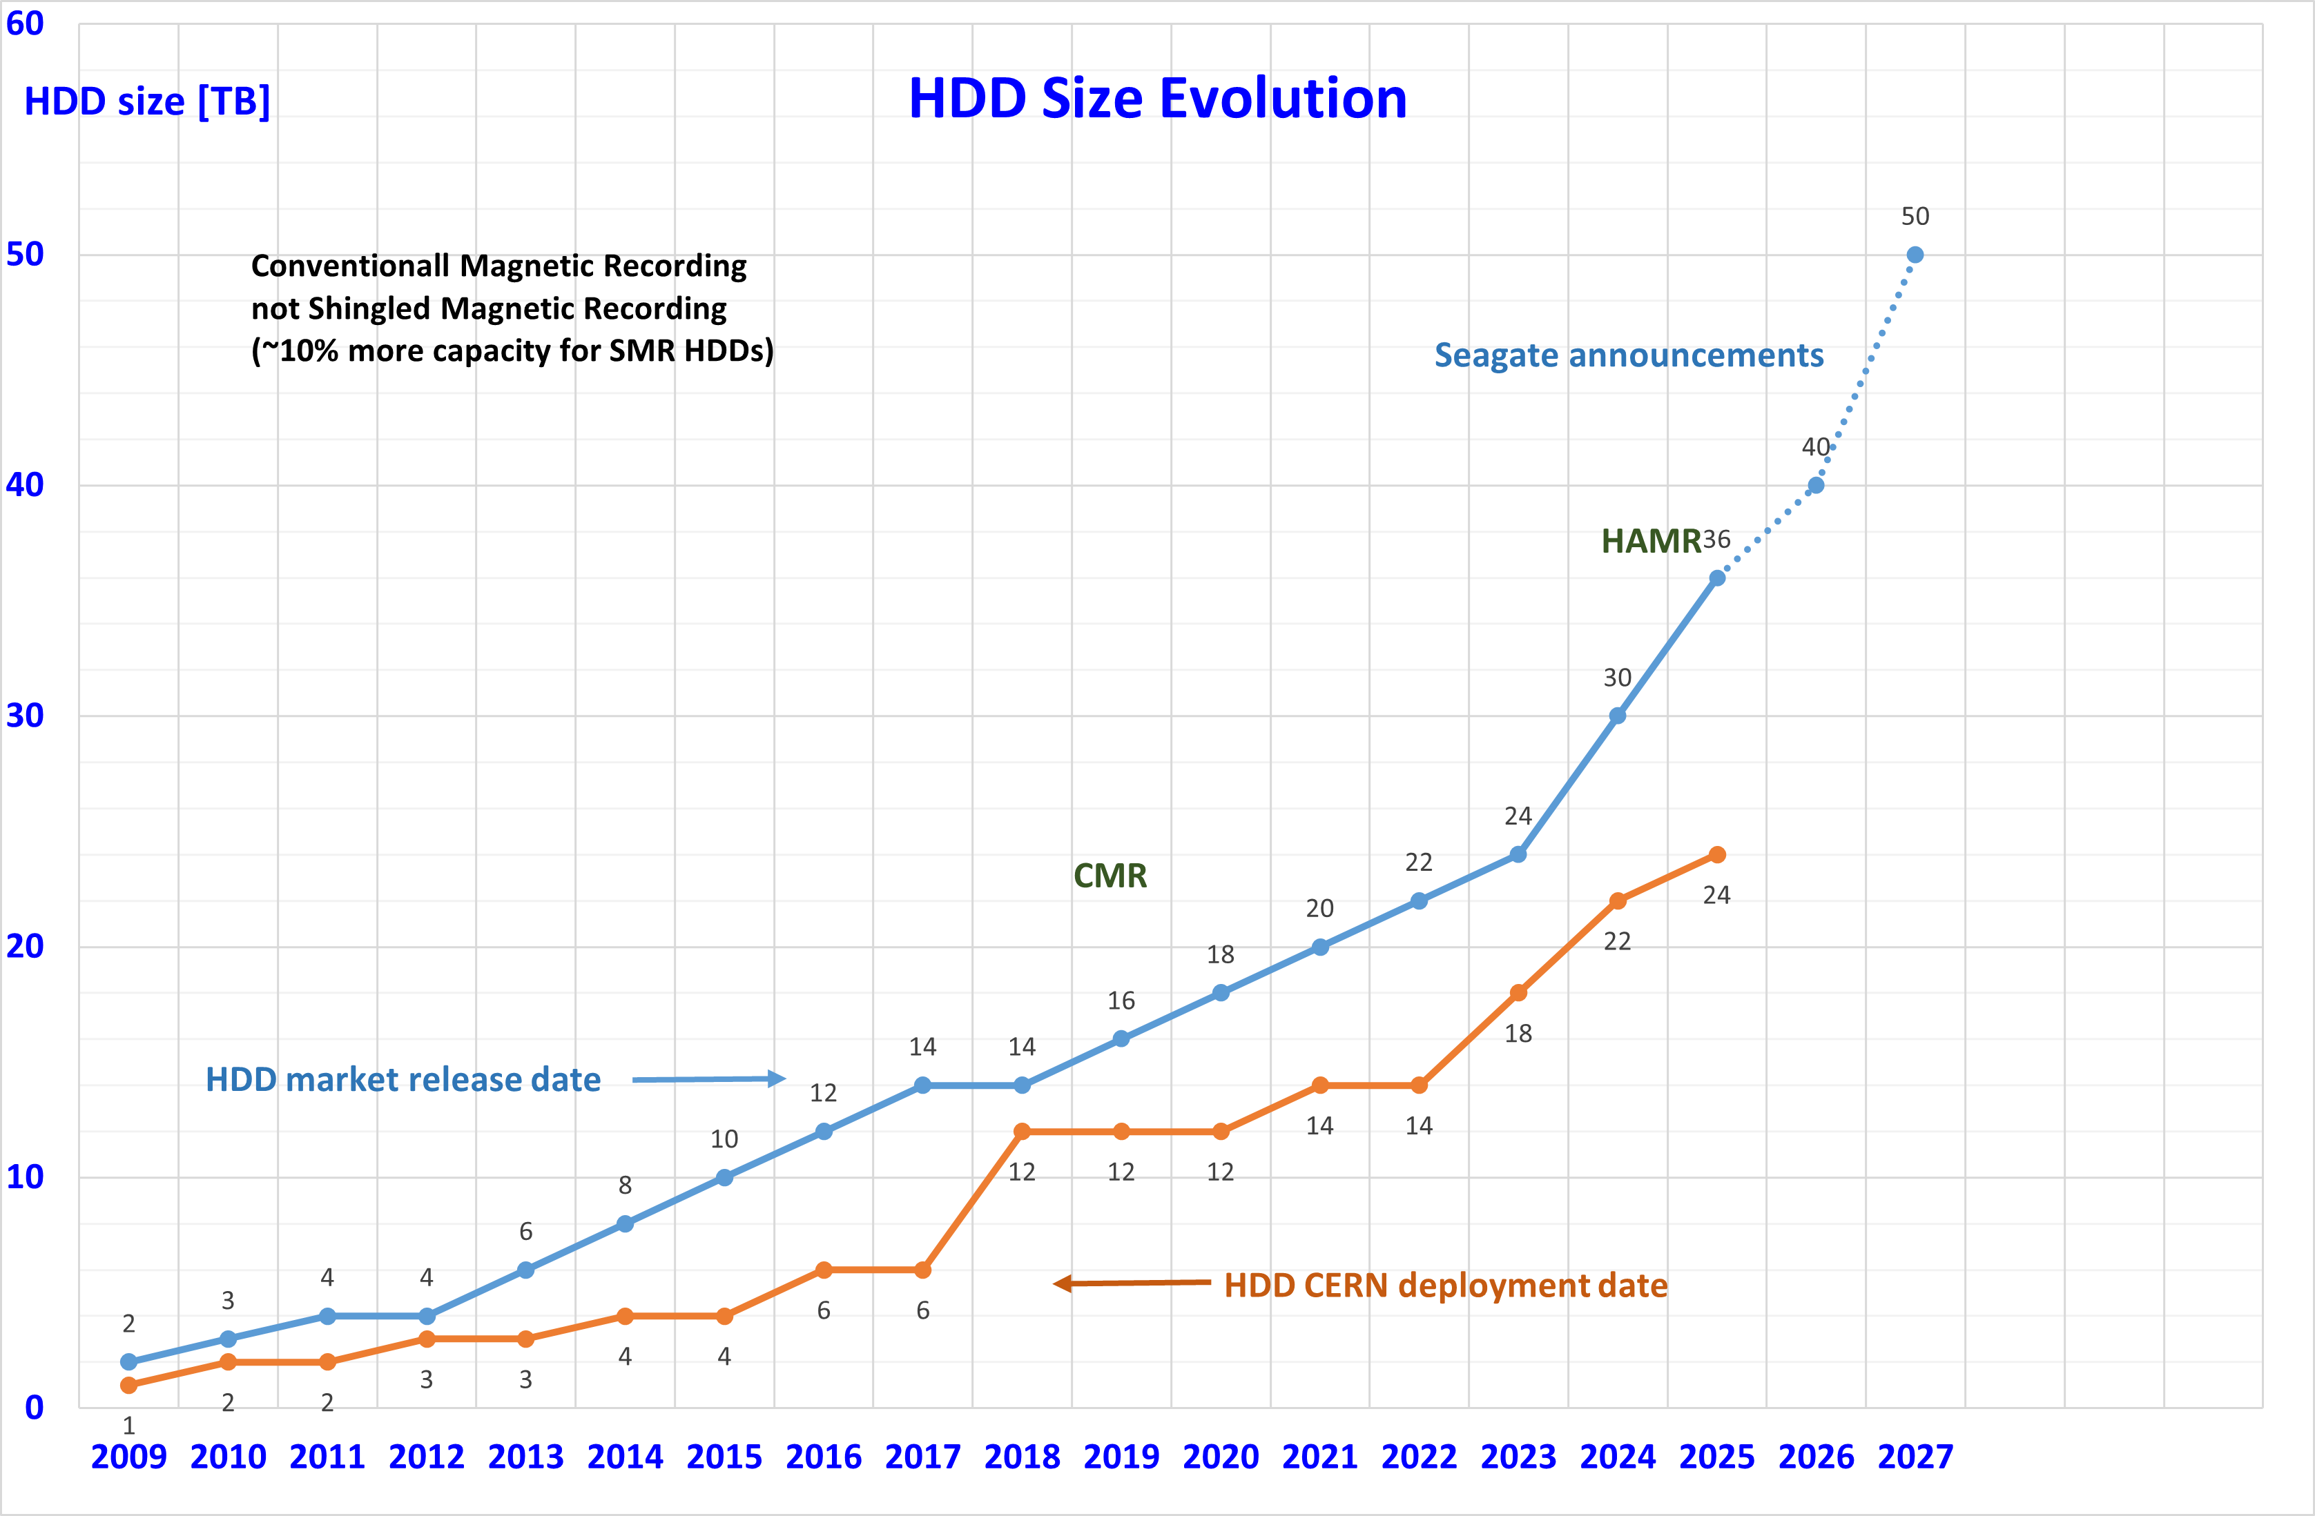
Disk storage
Market split among Seagate, WD and Toshiba
Capacities still increasing, thanks to SMR and HAMR
HDD shipments will soon be almost only nearline
HAMR drives can finally be bought, (e.g. Seagate @ 36TB) but not cost effective for now, other vendors will come later
SMR drives mostly bought by hyperscalers
Significant investments in software required
Further increases in capacity more constrained by marketability than underlying technology
60 TB disks by 2028 using HAMR?
Power consumption should stay around 10 Watt/drive, so Watt/TB will decrease
Performance is not increasing (fast enough)
Might create a bottleneck for data access in WLCG
IEEE roadmap for Mass Digital Storage Technology

Slide 24
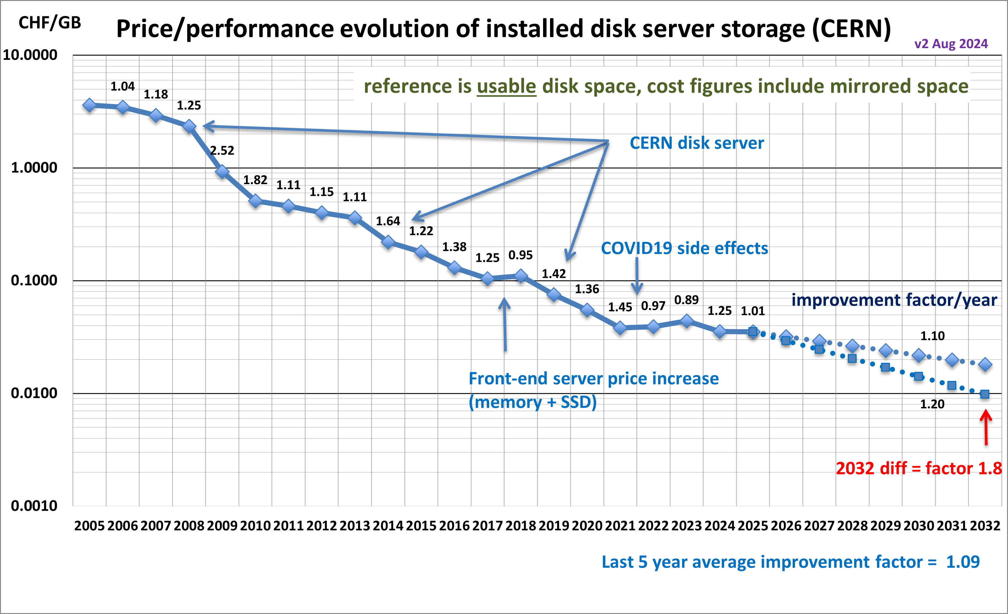
Disk cost extrapolation at CERN
Stable price decrease but also flattening out recently
Observed by many Tier-1 sites
Questions:
When will energy-assisted magnetic recording HDDs will become commonplace?
AI demand driving up demand for all storage. Any hope to get better prices in the next 2-3 years?
What about SSDs?
Won’t completely replace HDDs, but usage will increase and negatively impact the overall cost of storage
Will soon track SSD storage price at CERN

Slide 25
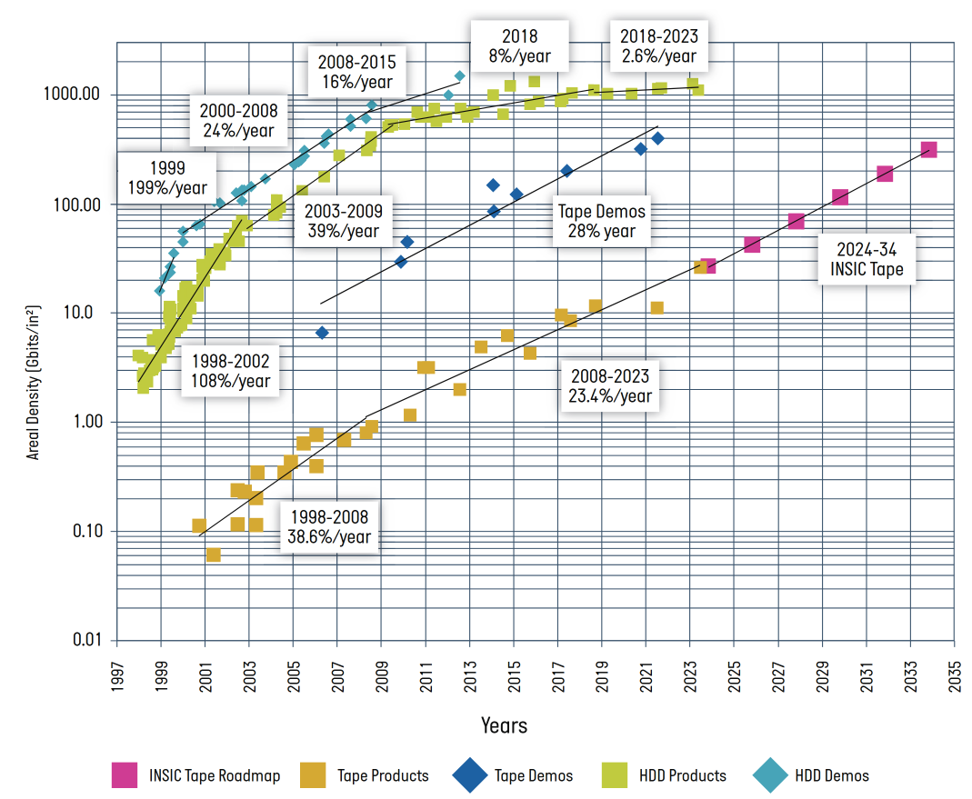
Tape storage
Still a lot of room for scaling
30%-40% yearly increase in cartridge capacity
Lots of technology advancements in both media and drives
LTO the leading standard, smaller share for the IBM TS11X0 format
LTO 10 will be released very soon
Read rates also increasing, but by only 15%/year
Last but not least, tape is very environmentally friendly
Source: V. Bahyl

Slide 26
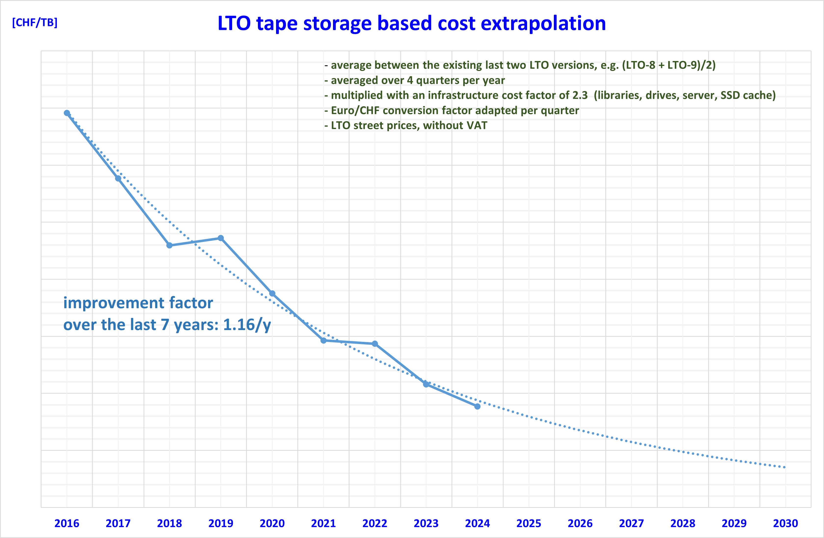
Tape media cost
Overall tape infrastructure cost at CERN dominated by media
IBM TS11x0 / 3592 technology cartridges offer ~twice the storage density but it is ~twice as expensive as LTO
Vendors now focusing on the requirements of the hyperscalers
We (HEP) have very little leverage
Significant market consolidation
Drive manufacturer monopoly (IBM), tape media duopoly (Fujifilm, Sony)
The decline in the overall cost tape technology data storage will slow down
Tape will still be the most cost-effective device to archive data
But companies need to get back the money they invested
Number of tape cartridges sold is declining
The prices per TB can not go down as fast as in the past

Slide 27
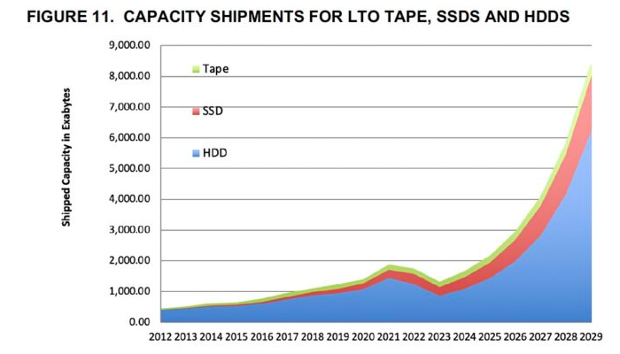
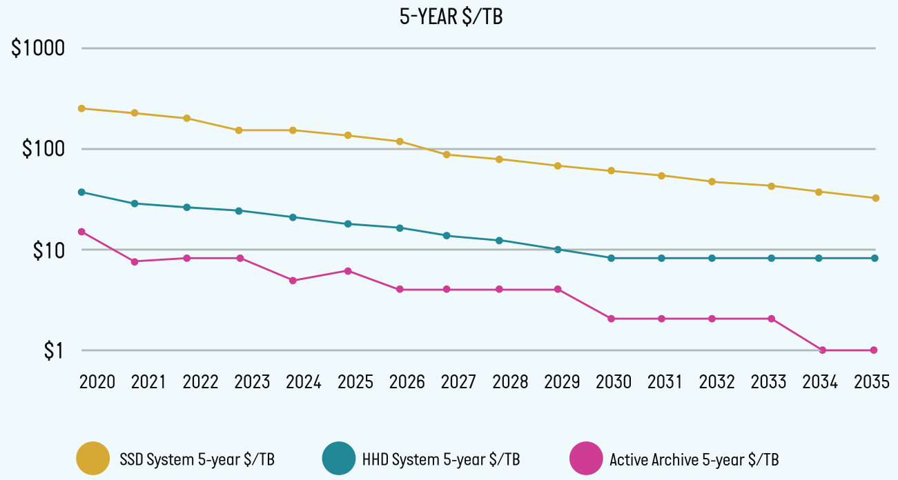
Storage evolution summary
To summarize:
AI boom drives volume increase for all types of storage
SSDs will not replace HDDs in data centers anytime soon
Our usage of SSD will probably increase to cope with the performance bottlenecks of HDDs
Tapes are not going anywhere either
Prices would go down (in a normal world) at similar rates for all storage types
Source: Blocks and Files

Slide 28
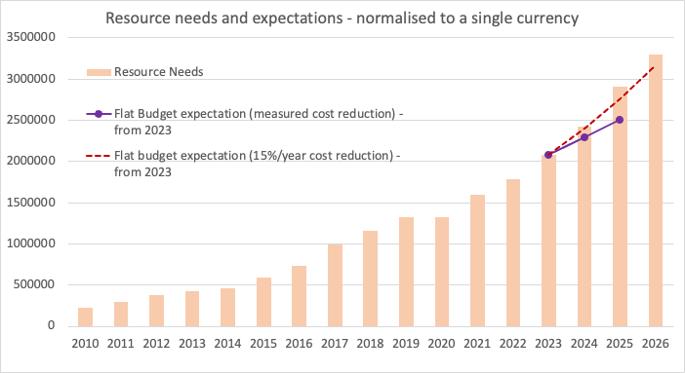
More on cost trends in WLCG
Source: S. Campana
Cost reduction/year experienced by Tier-0/1 sites is reducing
CPU: 15% (5y), 11% (3y), 13% (1y)
Disk: 11% (5y), 7% (3y), 3% (1y)
From 2023, we are falling short of the flat budget model
It is not going to get better…

Slide 29
Implications for flat budget extrapolations
Prospects for CPUs
Not critical for GenAI, so less pressure
Generational improvements still good
A 10-15% yearly improvement could still be realistic
Prospects for disk
Lots of pressure from GenAI
Technological improvements guaranteed
A 0-10% yearly improvement might be expected
Prospects for flash
Probably same trend as for HDD, we have no historical data in WLCG
Prospects for tape
15% is the current trend, might assume 10% to be conservative
Prospects for GPUs
Too early to quantify price trends, maximal pressure from GenAI

Slide 30
Conclusions
Technology tracking essential to make cost-efficient choices for HEP computing
Done in different contexts in our community, including HEPiX
Many server hardware components are rising in price due to the AI boom
Memory, GPUs, flash, HDD are all affected
AMD, Arm and Intel show healthy competition
A lot of attention to performance/Watt
Evolution of GPUs is not going in a direction very useful for us
FP32/64 performance not increasing
Shipped storage capacity increasingly driven by the global trend
SSDs, HDDs and tape all still relevant and making progress
Sustainability is more important than ever
CO2 emissions, liquid cooling, electricity costs and distribution
Flat budget in WLCG model under strain
Will likely have to lower our expectations (compared to the past)
GenAI already a problem for us, geopolitical instability even worse
We should try to quantify the risk of our resources not meeting the needs of the experiments for HL-LHC
And consider suitable alternative scenarios

Slide 31
Acknowledgements
This work was made possible by many contributions from and discussions with
The members of the HEPiX Technology Working Group
The members of the HEPiX Benchmarking Working Group
Luca Atzori, Vladimir Bahyl, Eric Bonfillou, Simone Campana, Andrea Chierici, Vincent Ducret, Michele Michelotto, Bernd Panzer-Steindel, Hervé Rousseau, Markus Schulz

Slide 32
Questions?

