Slide 1



Custom FPGA implementation of Neural Networks for Accelerated and fully controllable AI processing in medical imaging
Mattia Ricchi, Fabrizio Alfonsi, Lucrezia Fendillo, Elena Casali, Alessandra Retico, Leonardo Brizi, Alessandro Gabrielli, Claudia Testa
Workshop sul Calcolo
nell'I.N.F.N.
Hotel Hermitage
La Biodola - Isola d'Elba
26 - 30 maggio 2025

Slide 2
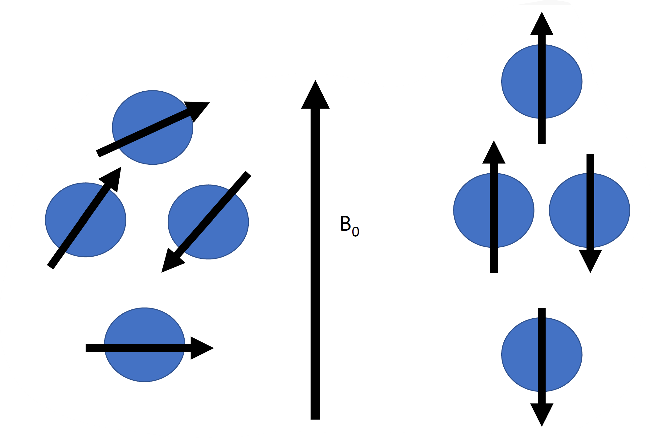
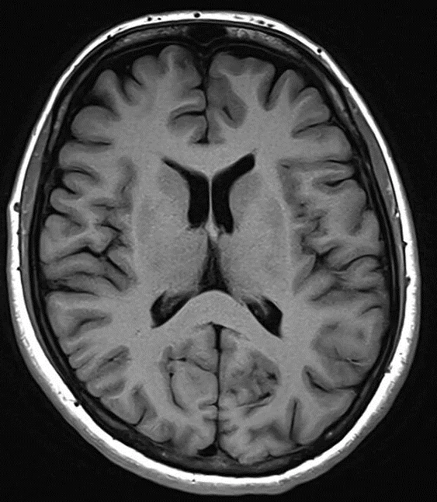
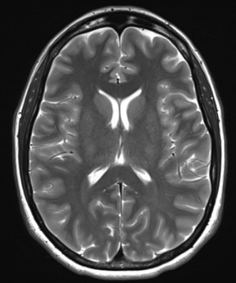
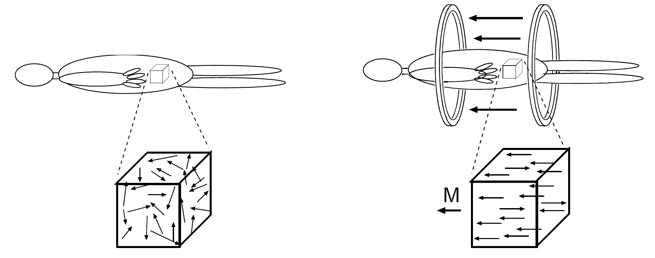
Magnetic Resonance Imaging – Basic principles
¹H
T₁-weighted image
M
T₂-weighted image

Slide 3
Magnetic Resonance Imaging – Basic principles
¹H
T₁-weighted image
M
B₁
T₂-weighted image

Slide 4
Magnetic Resonance Imaging – Basic principles
¹H
T₁-weighted image
B₁
M
T₂-weighted image

Slide 5
Magnetic Resonance Imaging – Basic principles
T₁-weighted image
¹H
M
T₂-weighted image
These images are qualitative: the value of the pixels do not represent the real value of T₁ and T₂ of the tissuses.

Slide 6
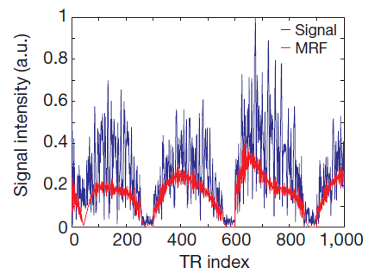
T₁
Magnetic Resonance Fingerprinting (MRF)
Magnetic Resonance Fingerprinting (MRF) is a fast quantitative MRI method that allows the simultaneous non-invasive quantification of multiple important properties of a material or tissue [Ma, D., Gulani, V., Seiberlich, N. et al. Magnetic resonance fingerprinting. Nature (2013)].
The MRF maps are quantitative: the value of the pixels is the real value of T₁ and T₂ of the tissues expressed in ms
T₂
Barbieri, Marco et al. A deep learning approach for magnetic resonance fingerprinting: Scaling capabilities and good training practices investigated by simulations. (2021).
Ma, D., Gulani, V., Seiberlich, N. et al. Magnetic resonance fingerprinting. Nature (2013)
Ma, D., Gulani, V., Seiberlich, N. et al. Magnetic resonance fingerprinting. Nature (2013)

Slide 7
T₁
Magnetic Resonance Fingerprinting (MRF)
Magnetic Resonance Fingerprinting (MRF) is a fast quantitative MRI method that allows the simultaneous non-invasive quantification of multiple important properties of a material or tissue [Ma, D., Gulani, V., Seiberlich, N. et al. Magnetic resonance fingerprinting. Nature (2013)].
The MRF maps are quantitative: the value of the pixels is the real value of T₁ and T₂ of the tissues expressed in ms
T₂
Barbieri, Marco et al. A deep learning approach for magnetic resonance fingerprinting: Scaling capabilities and good training practices investigated by simulations. (2021).
Ma, D., Gulani, V., Seiberlich, N. et al. Magnetic resonance fingerprinting. Nature (2013)
Ma, D., Gulani, V., Seiberlich, N. et al. Magnetic resonance fingerprinting. Nature (2013)

Slide 8
T₁
Magnetic Resonance Fingerprinting (MRF)
Magnetic Resonance Fingerprinting (MRF) is a fast quantitative MRI method that allows the simultaneous non-invasive quantification of multiple important properties of a material or tissue [Ma, D., Gulani, V., Seiberlich, N. et al. Magnetic resonance fingerprinting. Nature (2013)].
The MRF maps are quantitative: the value of the pixels is the real value of T₁ and T₂ of the tissues expressed in ms
Neural Network map reconstruction
T₂
Barbieri, Marco et al. A deep learning approach for magnetic resonance fingerprinting: Scaling capabilities and good training practices investigated by simulations. (2021).

Slide 9
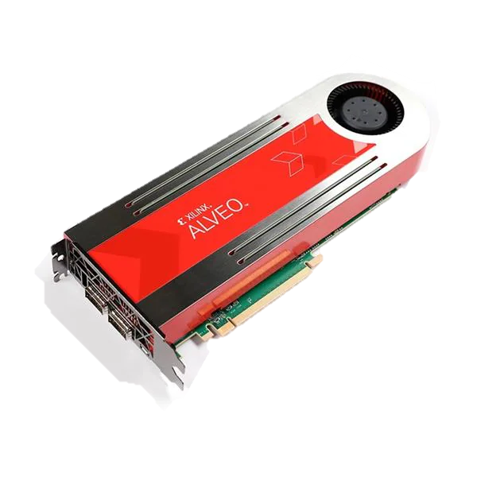
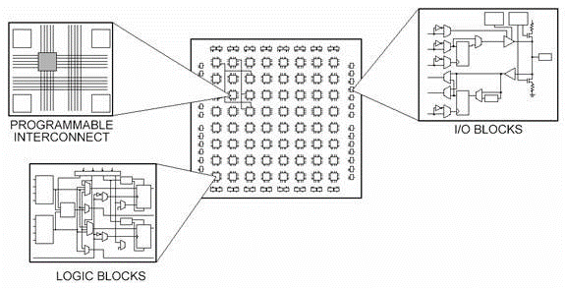
Field Programmable Gate Array (FPGA)
Configurable integrated circuit that can be repeatedly programmed after manufacturing.
Consist of configurable logic blocks, programmable interconnects, and flexible I/O, allowing for custom hardware solutions.
Key Advantages:
Parallel Processing: FPGAs can handle multiple operations simultaneously, ideal for high-performance computing and real-time processing.
Low and Fixed Latency: Direct hardware implementation reduces delay compared to software running on a CPU or GPU.
Custom Logic: Designers can implement specific algorithms directly in hardware, allowing for optimized performance.

Slide 10
Why a neural network on FPGA?
Performance and speed
Efficient parallel processing & custom architecture optimization
Energy efficiency
Lower power consumption compared to CPU and GPU
Flexibility
Reconfigurability for different neural network architectures and algorithms
Latency
Lower and fixed latency due to parallel processing and closer memory access
High throughput
The parallel processing capabilities of FPGAs can handle high data throughput
These characteristics make FPGAs particularly well-suited for real time applications of Neural Networks that require extensive and repeated training, also with very large datasets.

Slide 11
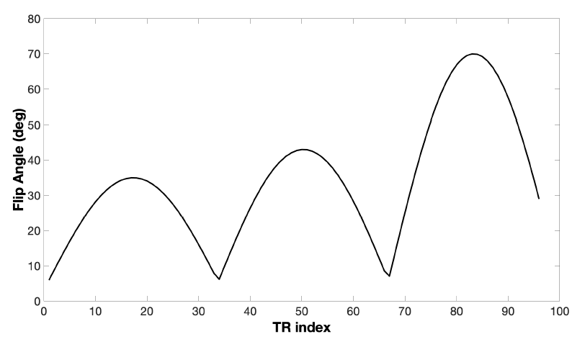
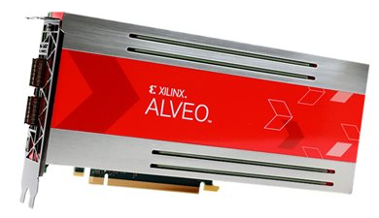
Our project workflow
SOFTWARE
Neural Network
AI Prediction:
T₁ and T₂
MR Sequence
Simulation
HARDWARE
Comparison
Neural Network
AI Prediction:
T₁ and T₂

Slide 12

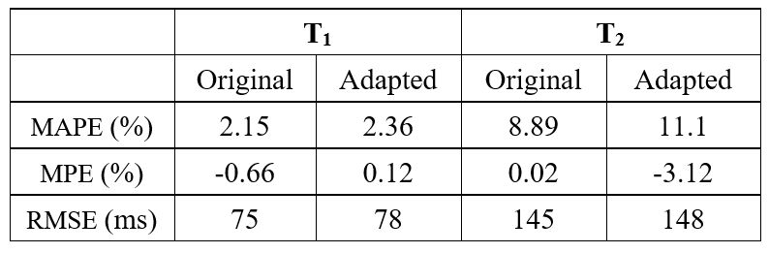



Neural Network Quantization Aware Training
Reduce network dimensions to meet available FPGA resources
Perform Quantization Aware Training so that the network operates with integers only
Dense
Dense
Dense
T₁
Dense
Dense
256
128
64
Real and Imaginary parts of signal
32
16
T₂
The quantized model uses lower precision without affecting the neural network performance.

Slide 13


Neural Network Quantization Aware Training
Reduce network dimensions to meet available FPGA resources
Perform Quantization Aware Training so that the network operates with integers only
Dense
Dense
Dense
T₁
Dense
Dense
256
128
64
Real and Imaginary parts of signal
32
16
T₂
The quantized model uses lower precision without affecting the neural network performance.

Slide 14
Neural Network Quantization Aware Training
Reduce network dimensions to meet available FPGA resources
Perform Quantization Aware Training so that the network operates with integers only
Dense
Dense
Dense
T₁
Dense
Dense
256
128
64
Real and Imaginary parts of signal
32
16
T₂
The quantized model uses lower precision without affecting the neural network performance.

Slide 15
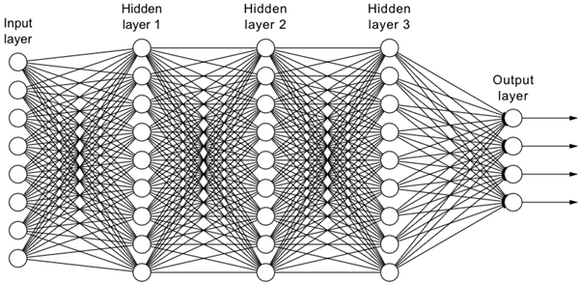
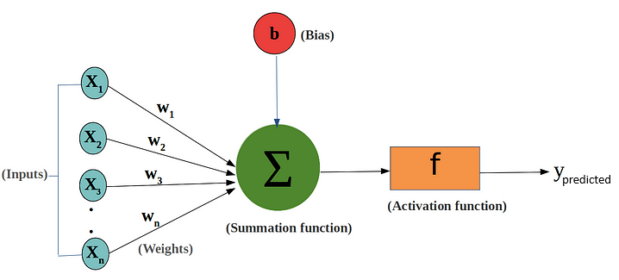
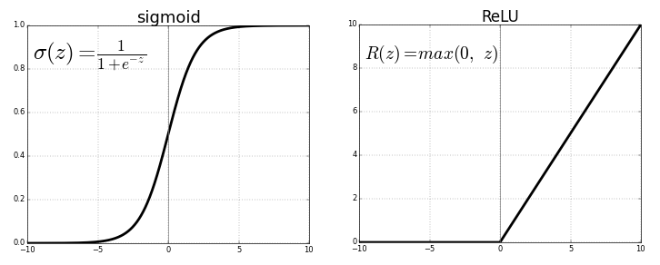

Neural Networks – working principles
A Neural Network can learn an approximation of any continuous function between observed data and target value
Output of a single node:
$$y=σ\left(\sum_{i=1}^{N_{inputs}}{x_{i}∙w_{i}}+b\right)$$
Where σ is the activation function
σ

Slide 16
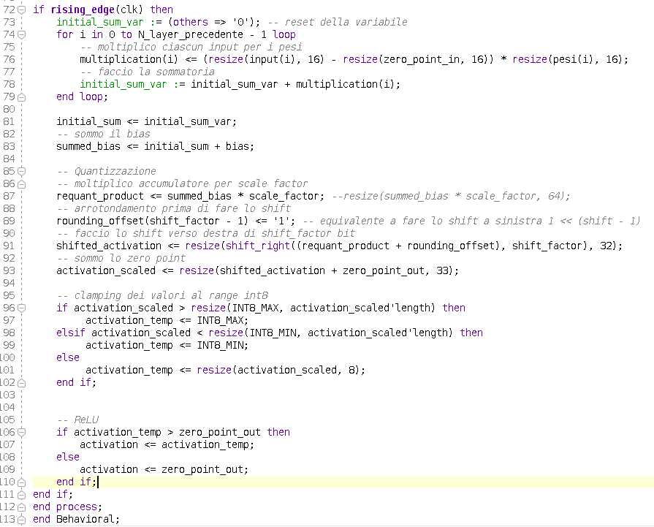
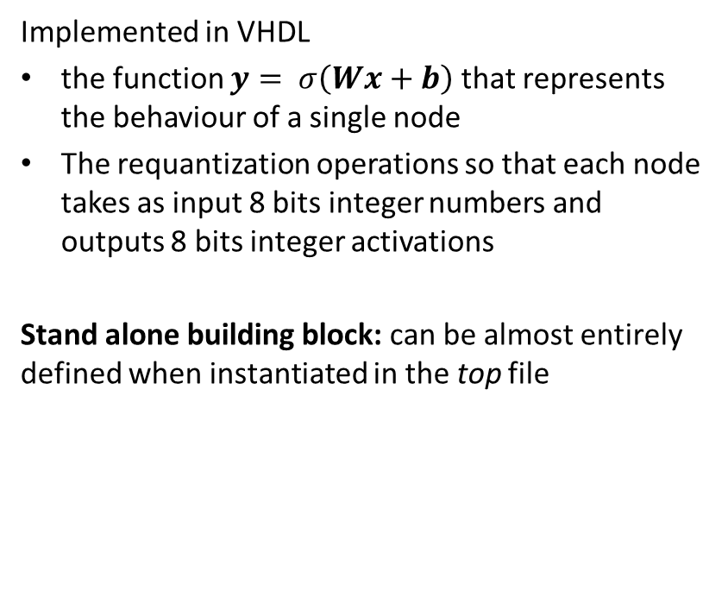
Base node
Implemented in VHDL
the function $y= σ\left(Wx+b\right)$ that represents the behaviour of a single node
The requantization operations so that each node takes as input 8 bits integer numbers and outputs 8 bits integer activations
Stand alone building block: can be almost entirely defined when instantiated in the top file

Slide 17
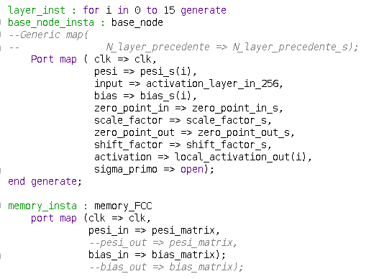
Neural network instantiation
The whole network is instantiated by using iteratively a block of 16 nodes, so that we do not saturate the FPGA available resources.
Also implemented and internal FPGA memory to store all values for weights and biases
Aimed clock frequency for the whole NN functioning is 200 MHz.
This results in an inference time of 460 ns compared to the 18 µs required with TF Lite for a single datum.

Slide 18
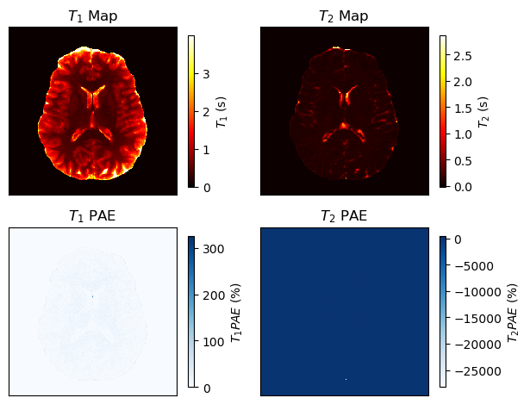
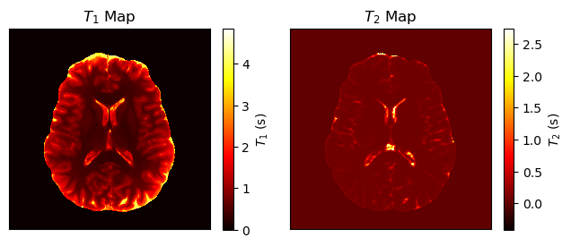

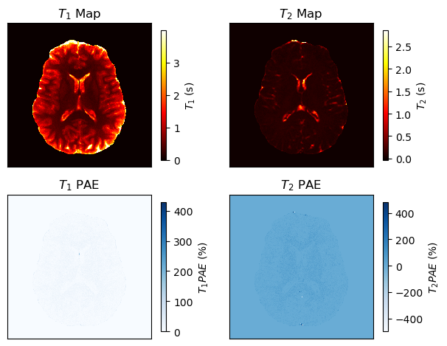
Neural Networks Results – brain phantom reconstruction
Implemented NN
Time required 0,02 s
Ground Truth
Original NN
Time required 44 s
QAT NN
Time required 0,9 s

Slide 19
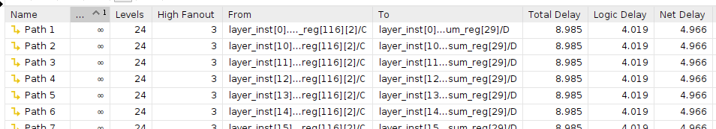
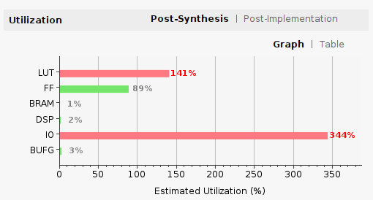
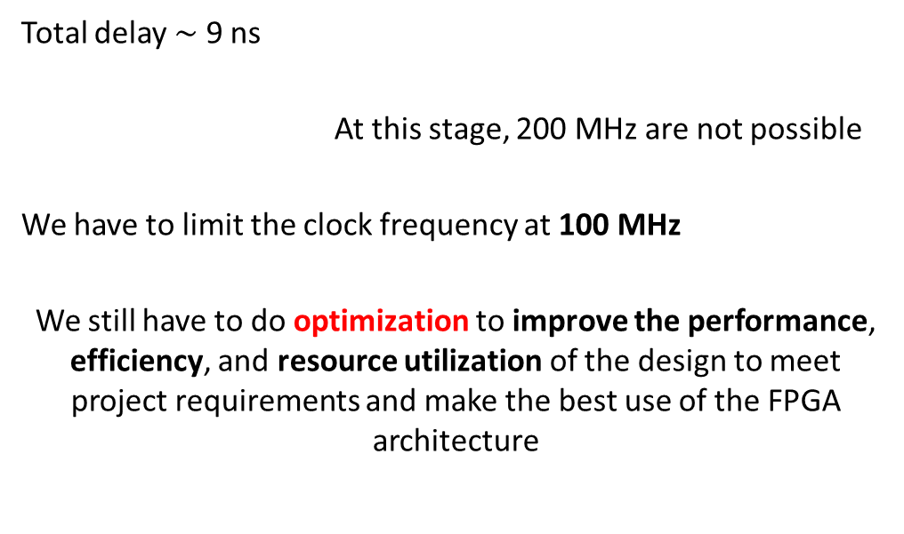
Synthesis results
FPGA: Alveo U250
(1.7M LUTs, 3.4M Flip-Flops, 12k DSPs, 2.6k BRAMs)
Total delay $\sim$ 9 ns
At this stage, 200 MHz are not possible
We have to limit the clock frequency at 100 MHz
We still have to do optimization to improve the performance, efficiency, and resource utilization of the design to meet project requirements and make the best use of the FPGA architecture

Slide 20
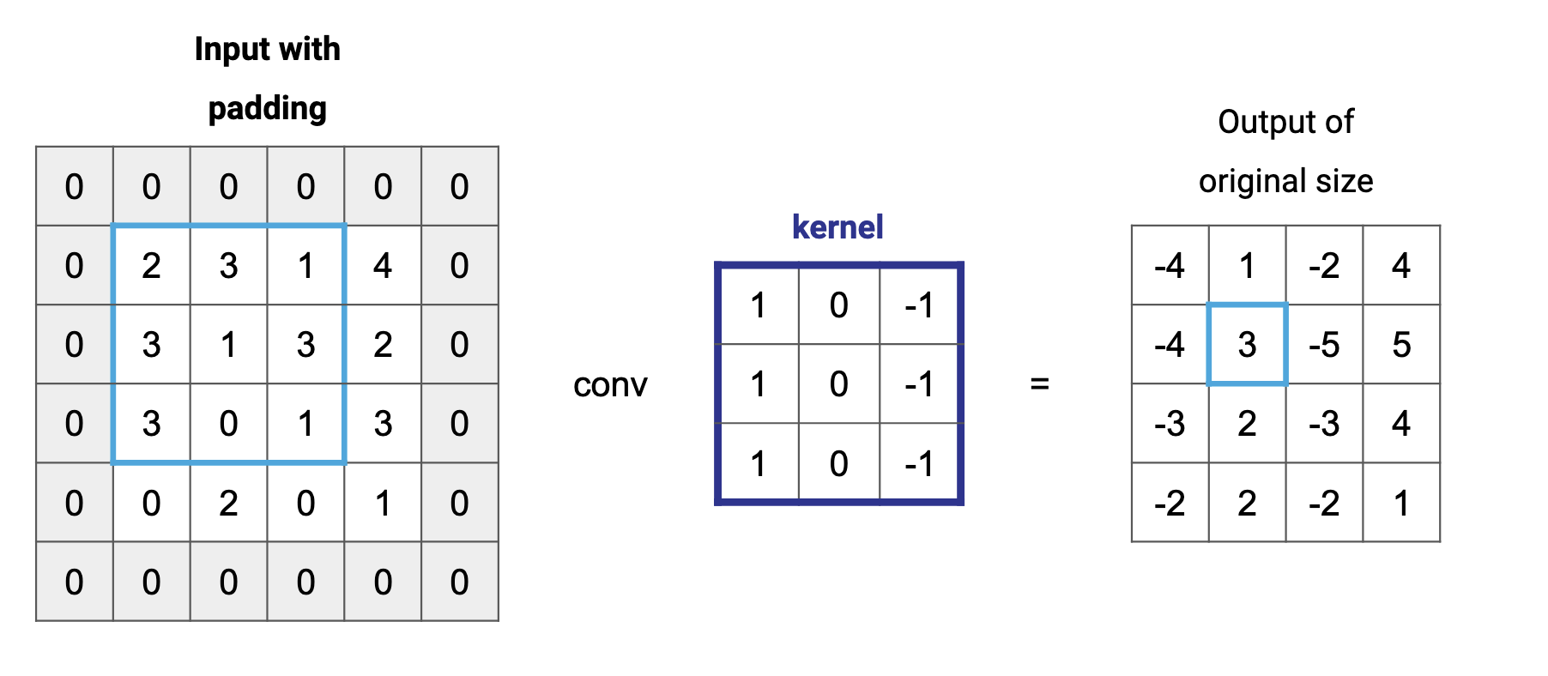
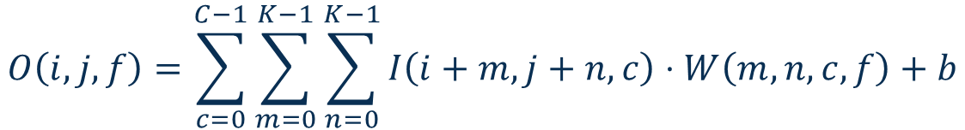
01 – Neural Networks: CNN
Convolution: small matrix (kernel) slides over large matrix (input).
Padding: convolution reduces dimensions of the image:
No padding (‘Valid’)
0-padding (‘same’)
Based on the filter used, different features are extracted.
Common filters: edge detection, noise reduction
$$O\left(i, j, f\right)=\sum_{c=0}^{C−1}{\sum_{m=0}^{K−1}{\sum_{n=0}^{K−1}{I\left(i+m, j+n, c\right)⋅W\left(m,n,c,f\right)}+b}}$$
8thlight.com

Slide 21
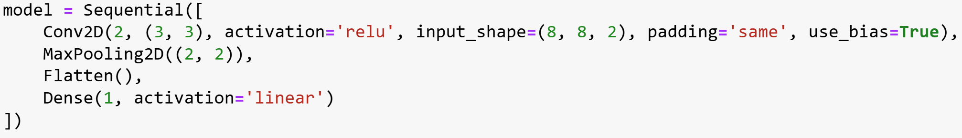
03 – Keras software implementation
Simplified model: Convolution with ‘same’ padding, ReLu activation function + MaxPooling + Flattening + Dense layer.
Average time with random inputs and weights: 0.6 s
The network works with floating point numbers at 32 bits.

Slide 22
04 – Synthesis
Resource usage and performance of different operations within the network :
 | LUT | FF | DSP | Total delay
Padding | 0 | 2048 | 0 | 1.94 ns
Convolution | 4096 | 4096 | 2304 | 15.9 ns
Relu | 0 | 32 | 0 | 1.94 ns
Maxpooling | 5120 | 1024 | 0 | 5.31 ns
Findmax | 1709 | 110 | 0 | 15.5 ns
Rescale | 11 | 21 | 3 | 3.48 ns
Flatten | 0 | 512 | 0 | 1.94 ns
Dense | 901 | 64 | 64 | 7.21 ns

Slide 23
04 – Optimization
Aim : reduce delay to enable faster processing and improve hardware efficiency.
Convolution
Use of intermediate storage to leverage parallelization and avoid simultaneous multiplications and summations in a single loop.
Result : from 15.9 ns to 2.0 ns of delay.
Findmax
Use of memory (m_v) to store precomputed values of the division to avoid division in real-time. Retrieving the result from memory, the computational delay of the system is reduced. To avoid values between 0 and 1, add 12 zeroes at the end of the number 127, removing those bits in the rescale module.
Result : from 15.5 ns to 3.2 ns of delay.

Slide 24
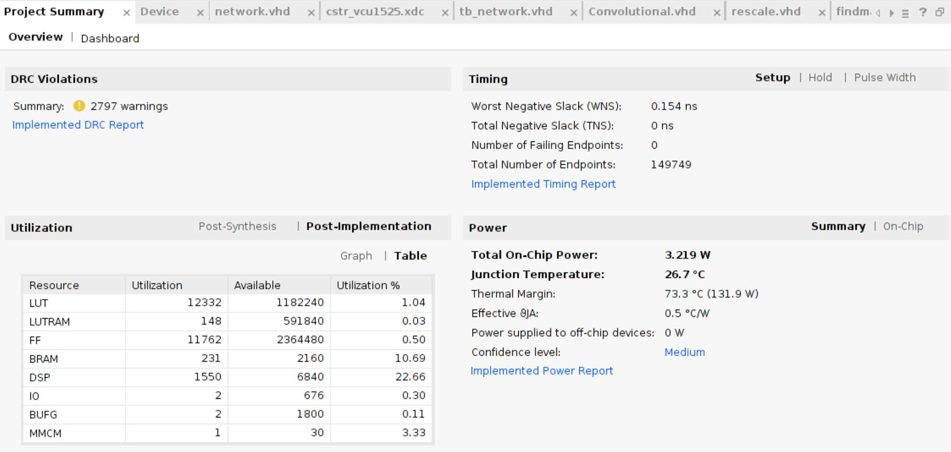
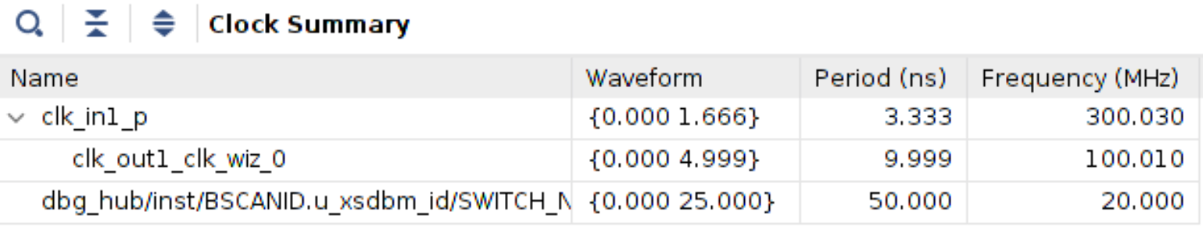
05 – Discussion: performance
Timing Analysis
Clock Frequency: 100 MHz, so the clock period is 10 ns.
Worst Negative Slack (WNS): 0.154 ns.
The slowest path completes 0.154 ns before the maximum allowed time.
The design meets the timing constraints.
Total Negative Slack (TNS): 0.000 ns
No path violates the setup constraint.
The total network delay in hardware is 4.06 ns.

Slide 25
Neural Networks Results – brain phantom reconstruction
MAPE = 8,28%
MAPE = 4,75%
MAPE = 8,29%
MAPE = 20,69%
MAPE = 8,55%
MAPE = 18,9%
Implemented NN
Ground Truth
Original NN
QAT NN

Slide 26
T₁
Magnetic Resonance Fingerprinting (MRF)
Magnetic Resonance Fingerprinting (MRF) is a fast quantitative MRI method that permits the simultaneous non-invasive quantification of multiple important properties of a material or tissue [Ma, D., Gulani, V., Seiberlich, N. et al. Magnetic resonance fingerprinting. Nature (2013)].
The MRF maps are quantitative: the value of the pixels is the real value of T₁ and T₂ of the tissues expressed in ms
Neural Network map reconstruction
T₂
Why training the network on FPGA?
MRF sequence is not standardised, several factors may influence the results:
Research centre / hospital
Scanner: vendor, magnetic field strength
Sequence and its parameters
Parameters to be retrieved
Every time the sequence is changed, the network must be trained again
Barbieri, Marco et al. A deep learning approach for magnetic resonance fingerprinting: Scaling capabilities and good training practices investigated by simulations. (2021).

Slide 27
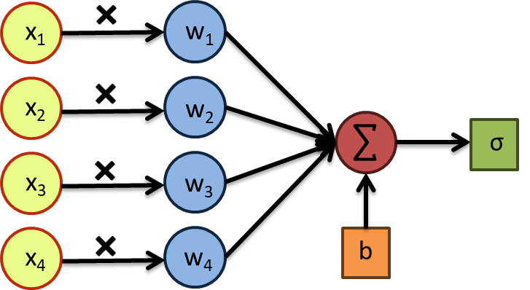

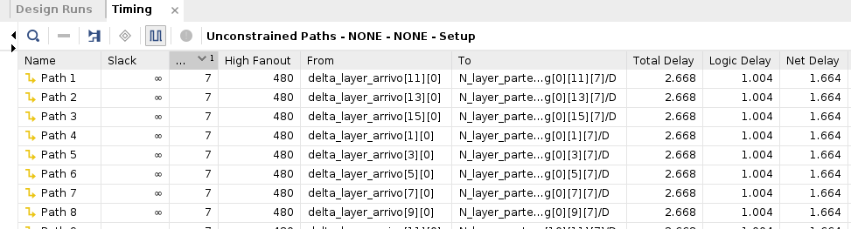
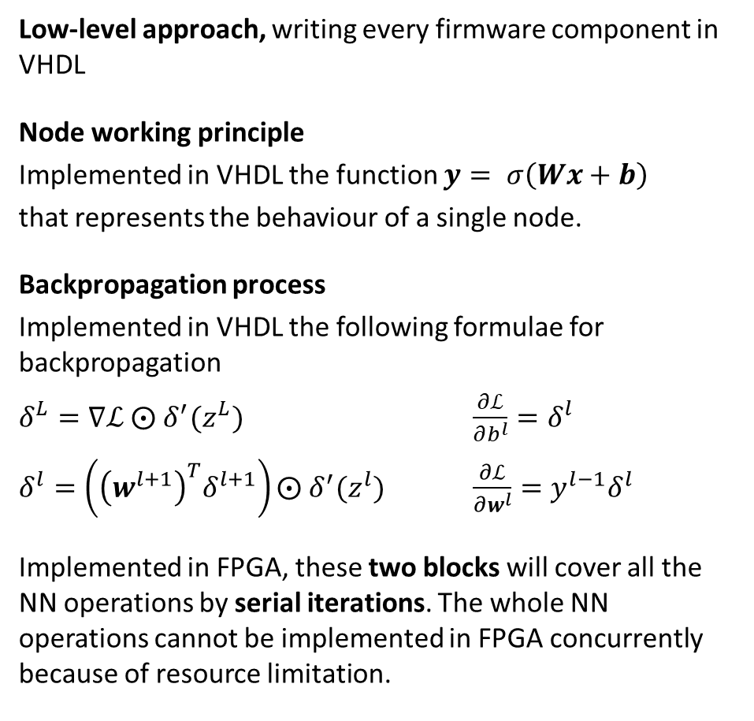

Neural Network VHDL implementation
Low-level approach, writing every firmware component in VHDL
Node working principle
Implemented in VHDL the function $y= σ\left(Wx+b\right)$
that represents the behaviour of a single node.
Backpropagation process
Implemented in VHDL the following formulae for backpropagation
$δ^{L}=∇ℒ ⨀{ δ}^{′}(z^{L})$ $\frac{∂ℒ}{∂b^{l}}=δ^{l}$
$δ^{l}=\left({\left(w^{l+1}\right)}^{T}δ^{l+1}\right)⨀{ δ}^{′}(z^{l})$ $\frac{∂ℒ}{∂w^{l}}={y^{l−1}δ}^{l}$
Implemented in FPGA, these two blocks will cover all the NN operations by serial iterations. The whole NN operations cannot be implemented in FPGA concurrently because of resource limitation.
Total training time on FPGA $\sim$ minutes

Slide 28
Conclusions and future work
Developing custom implementations at low level on FPGA is totally feasible, with a series of advantages:
Maximum customization and control
  Writing generic building blocks allows you to optimize each basic operation specifically for your design needs, minimizing resource usage and power consumption
Reusability of modules
  Once you've developed generic building blocks for operations like convolutions, activations, or matrix multiplications, they can be reused across multiple projects without starting from scratch
Architectural optimization
  You can design a highly parallel and pipelined hardware architecture
Independence from Software Tools
  You are not constrained by tools like hls4ml or Vivado HLS, which may have limitations for certain network types (e.g., 3D convolutions or skip connections)
Reduction of Resource Overhead
  Automated tools may introduce unnecessary overhead, increasing FPGA resource utilization. Implementing from scratch eliminates non-essential components

Slide 29
Thank you for your attention
Mattia Ricchi
National Institute of Nuclear Physics (INFN), Division of Bologna, Italy
Department of Computer Sciences, University of Pisa, Italy
Department of Physics and Astronomy, University of Bologna, Italy
mattia.ricchi@phd.unipi.it

Slide 30
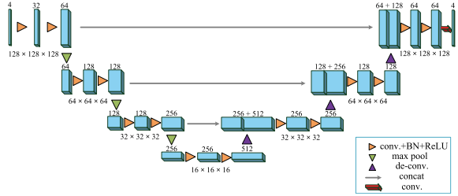
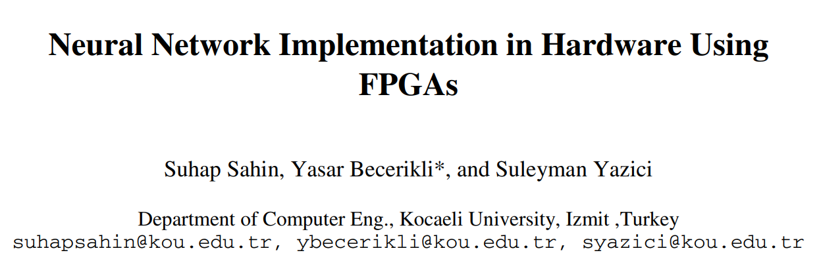
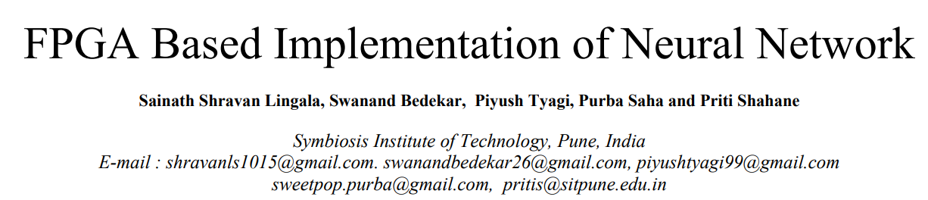
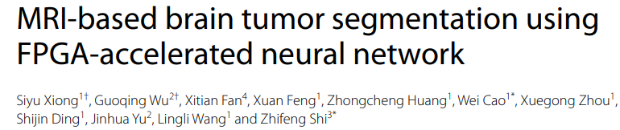
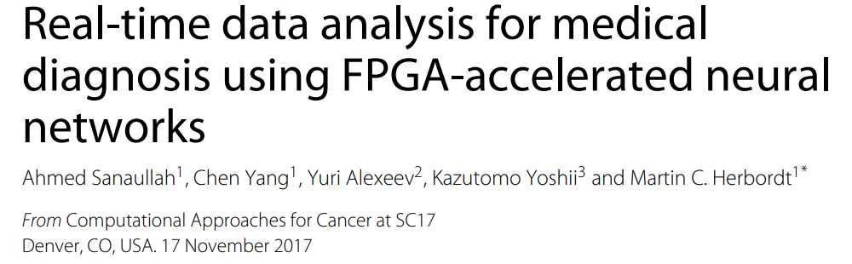
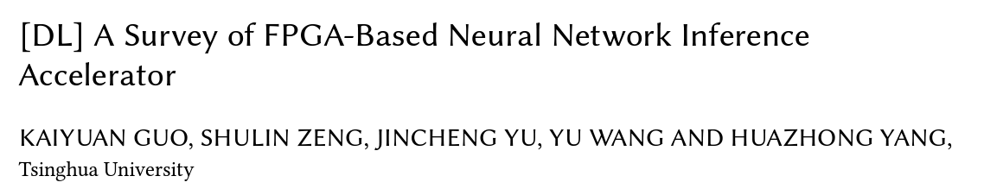
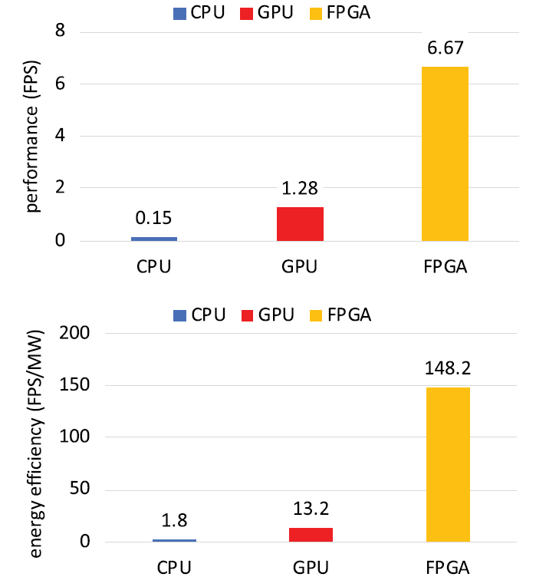
Neural Networks on FPGA
While GPUs have traditionally powered neural networks, FPGAs are gaining traction for their customizable hardware, better parallel processing, low and fixed latency and lower power consumption making then suitable for real time applications.

Slide 31
Neural Networks on FPGA

Slide 32
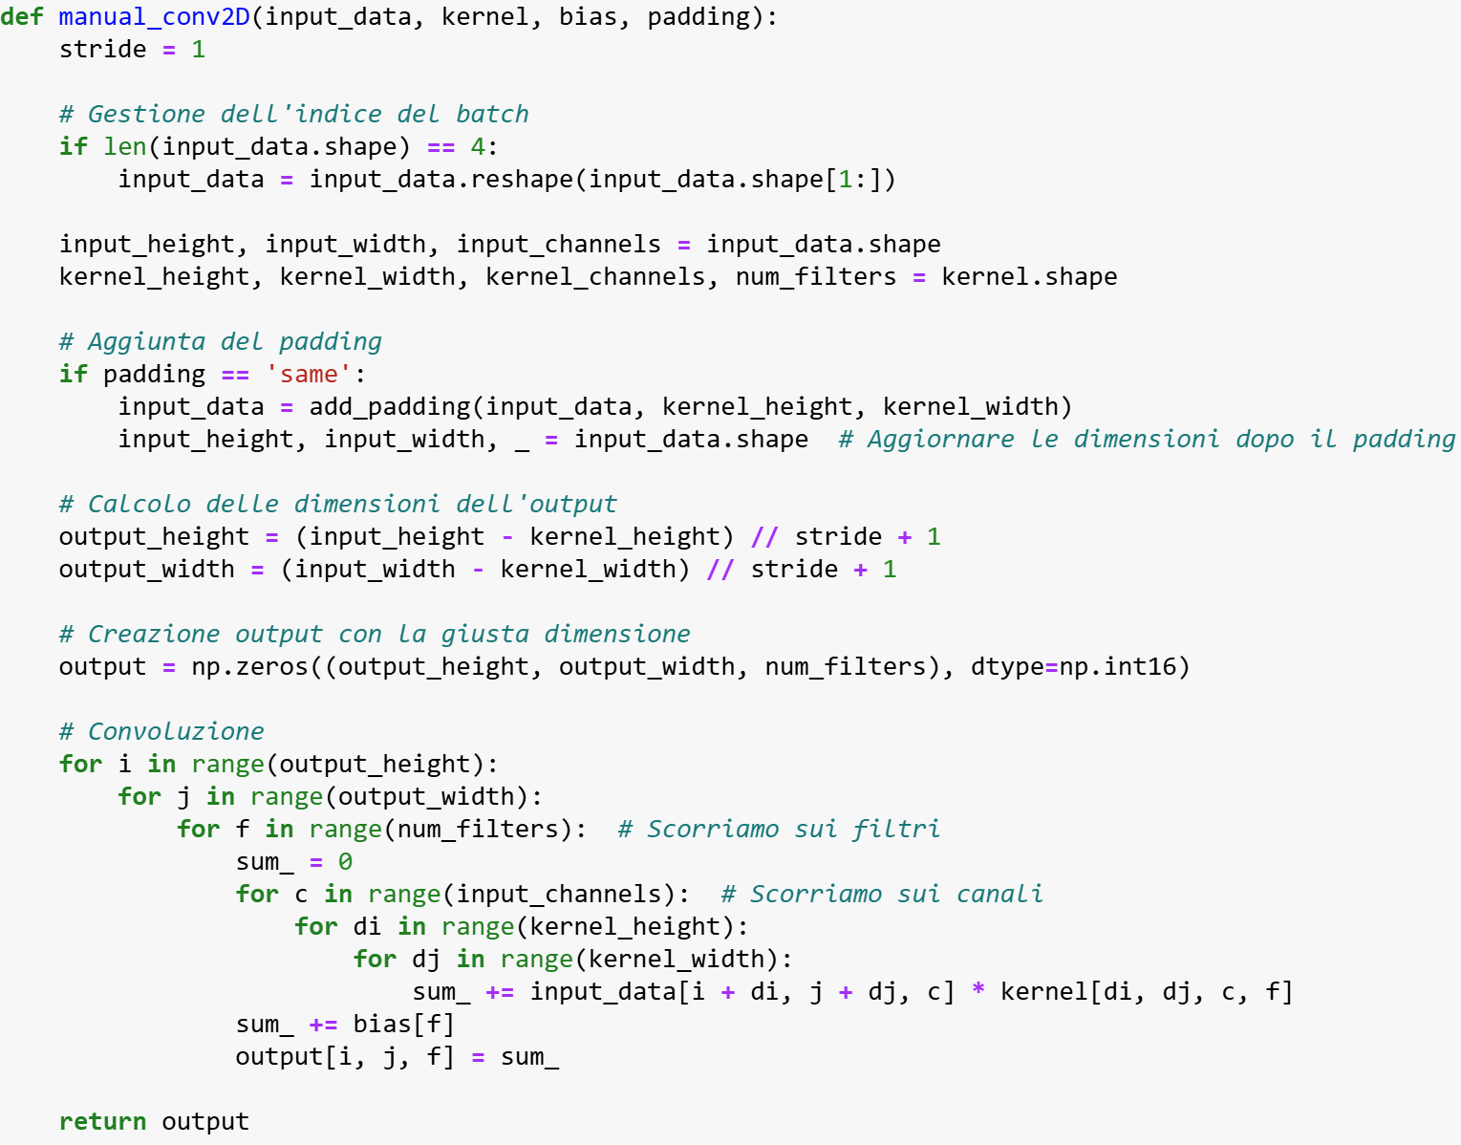
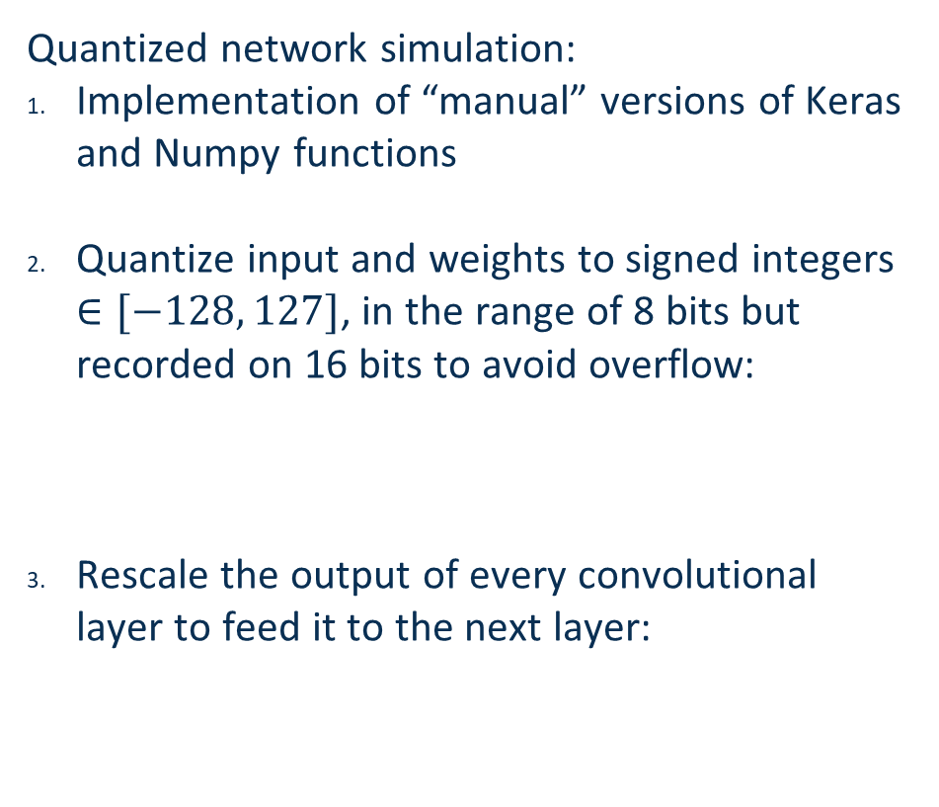



03 – Quantized software implementation
Quantized network simulation:
Implementation of “manual” versions of Keras and Numpy functions
Quantize input and weights to signed integers $∈[−128, 127]$, in the range of 8 bits but recorded on 16 bits to avoid overflow:
Rescale the output of every convolutional layer to feed it to the next layer:
$$b_{I}=8 −1 −round(\log_{2}{(max⁡(I)))}$$
$$f_{s,I}=2^{b_{I}}$$
$$f_{s,I}=\frac{127}{max⁡(I)}$$

Slide 33
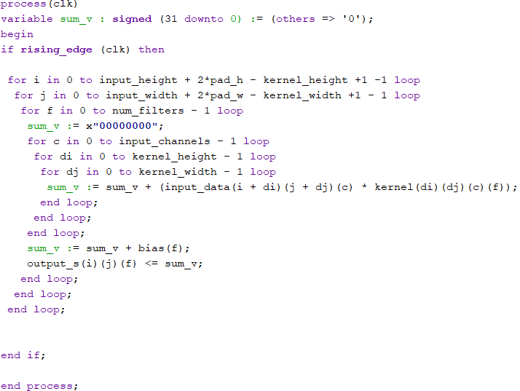
04 – Firmware implementation
Language : VHDL
Example : Convolution
The individual mathematical operations of the networks have been implemented in Vivado and tested separately, comparing the results with those obtained in software.
The network was assembled by connecting the individual packages in sequence and tested.

