Slide 1
INFN Cloud Kubeflow as a Platform and use cases
INFN
National Institute for Nuclear Physics
Italy
Mauro Gattari
DSI/DataCloud
mgattari@infn.it
CCR Workshop
05/2025

Slide 2
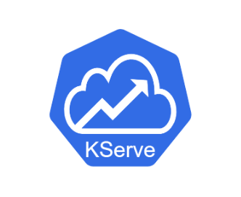
Kubeflow
Open-source Machine Learning platform built on Kubernetes providing a set of tools to manage the whole lifecycle of an ML solution.
Central Dashboard
Kubeflow Notebooks
MPI
Operator
Kubeflow Pipelines
Kubeflow Trainer
Ray
Train
Ecosystem
Kubeflow Katib
Model Registry
Spark
Operator
KServe
Object
Store
Tensor-board

Slide 3
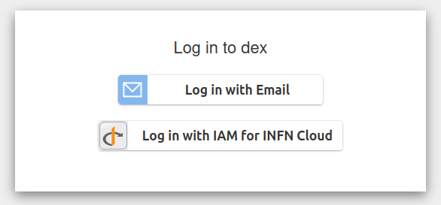
Multi-tenant
Kubeflow
components
DEX
OIDC Provider
Central Dashboard​
Side menu / Tenants / AuthN​

Slide 4
Use Case 1: ReMAT Research Metadata Analysis Tool
In prodotti.dsi.infn.it we collect metadata from several sources.
Problem: metadata consistency, e.g.:
aliases:
Rossi, Paolo Giovanni ✔
Rossi, PG ✔
Grossi, P ✗
orcid:
0000-0001-2345-6789 ✔
0000-0001-XXXX-YYYY ✗
affiliations:
INFN Frascati Natl Labs, I-00044 Frascati, Roma ✔
INFN Sez, Lab Nazl Frascati, Rome ✔
Univ Siena, Dipartimento Fis, Pisa, Italy ✗
publications'metadata
ReMAT
sanitize
persist
Prodotti
INFN
prodotti.dsi.infn.it

Slide 5
ML Task Classify Author's Affiliations
ML Task:
Text Classification
Training dataset:
~6k positive samples
"INFN Frascati Natl Labs, I-00044 Frascati, Roma" -> LNF
"INFN Bari, Dept Phys, Bari, Italy" -> BA
~6k negative samples
"Univ Siena, Dipartimento Fis, Pisa, Italy" -> [Unknown]
Dataset augmentation:
~400k synthetic samples by adding "smart" typos:
"1NFN Sez, Laab Nazl Frascati" -> LNF
Training evaluation:
97% accuracy on test set

Slide 6
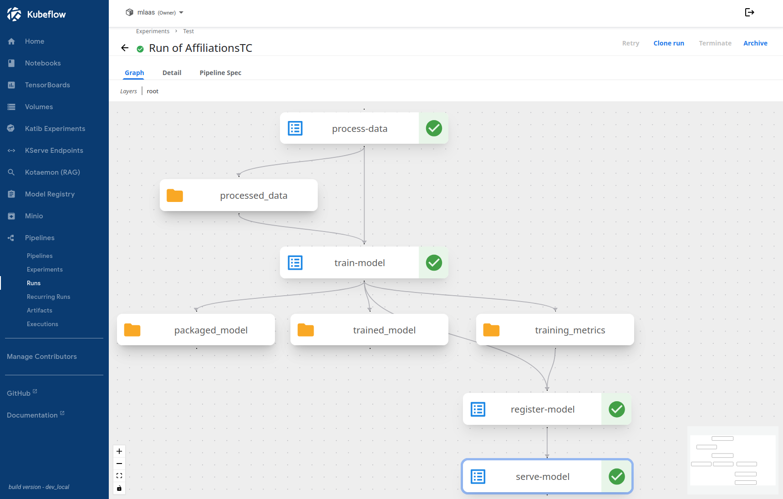
Kubeflow Pipelines​
Design/Run/Schedule ML workflow

Slide 7
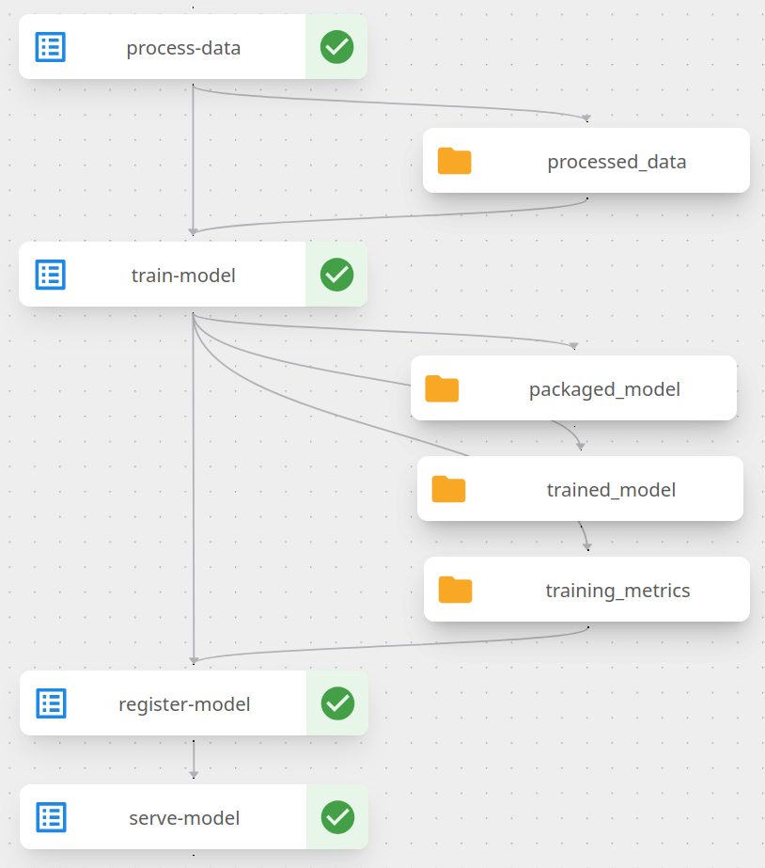
Kubeflow Notebooks
Object
Store
Kubeflow Notebooks
Kubeflow Katib
Kubeflow Trainer
Tensor-board
Object
Store
Model Registry
Kubeflow Pipelines​
Tasks / Artifacts
KServe
Object
Storage

Slide 8
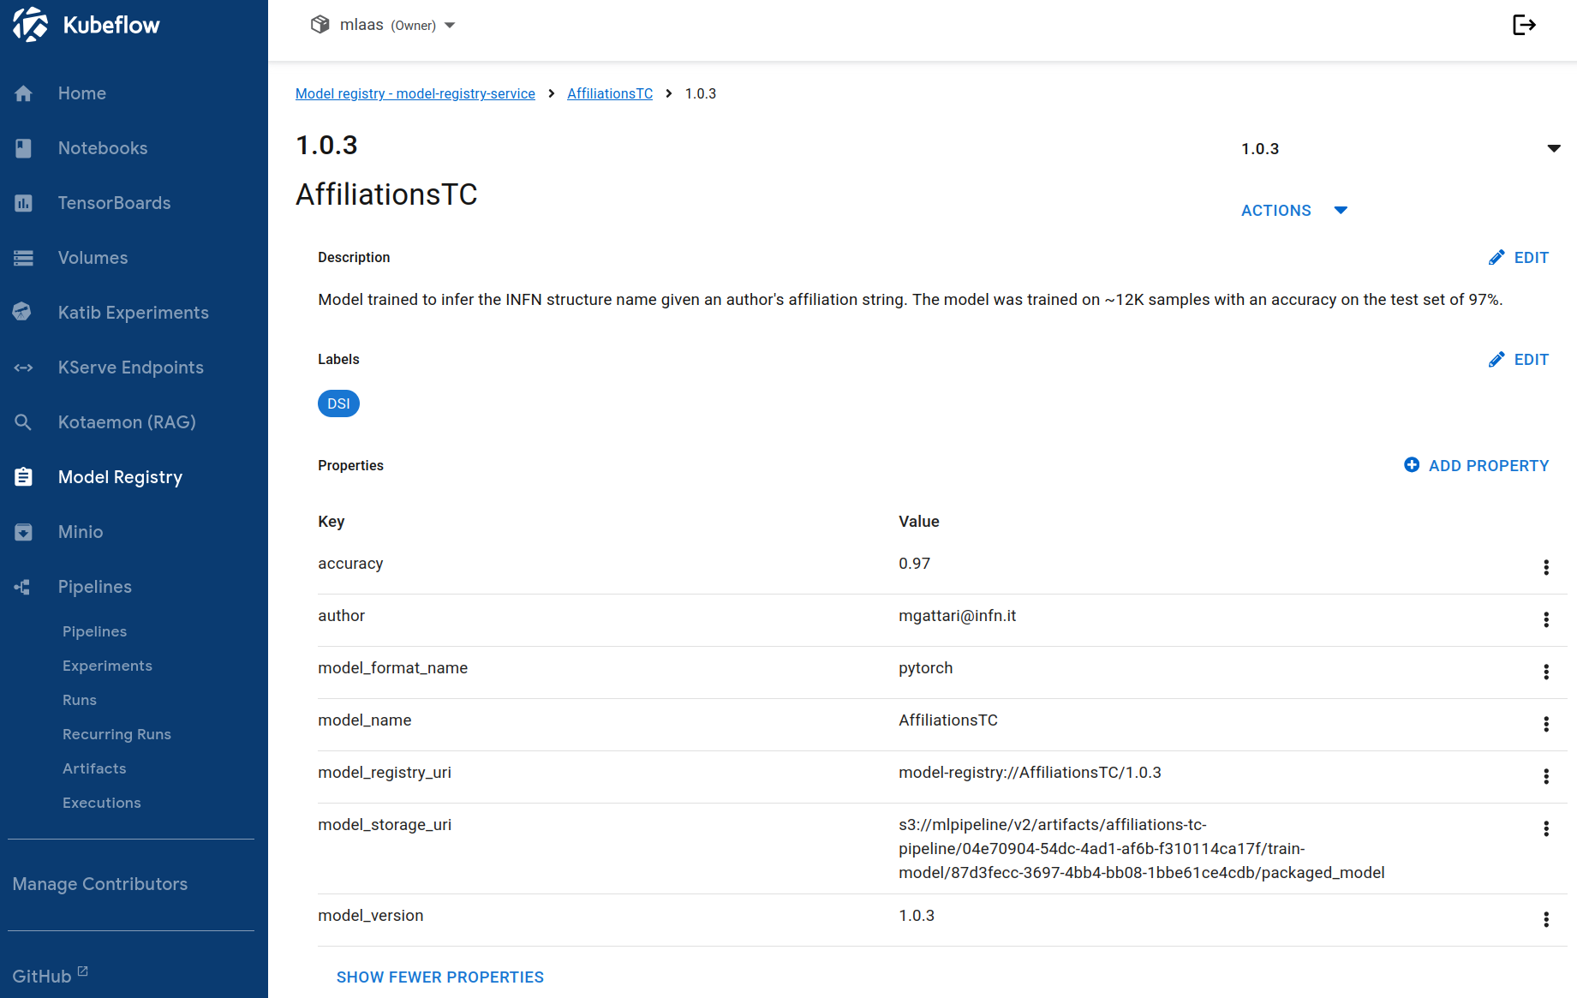
Model Registry
Metadata central index

Slide 9
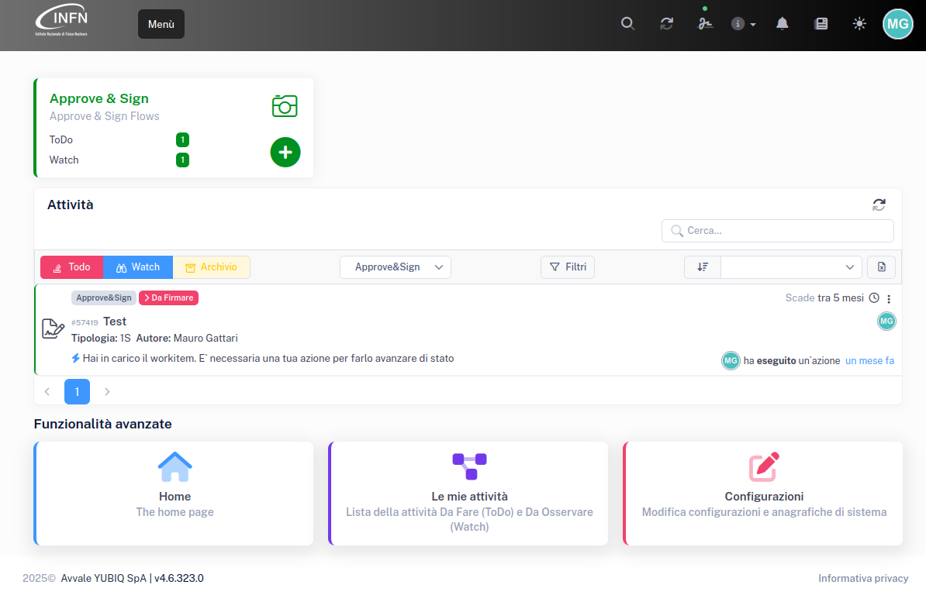
Use Case 2: ChatBot INFN LibroFirma
LibroFirma ChatBot
AI assistant that answers user questions
Knowledge Base:
ServiceDesk tickets
Transcription of "pillole formative" (https://mediawall.infn.it/)
Fully-hosted: run on INFN Cloud resources
Generative AI
Open-source LLMs (Large Language Models): provide "reasoning" capabilities
Semantic Search: retrieve relevant information from the knowledge base to answer the question

Slide 10
ChatBot Language Models
LLM (Text Generation):
Alibaba/Qwen 2.5
72B parameters
~60 tokens/sec (NVidia A100 – thanks AI_INFN)
Embeddings Model (Semantic Search):
Snowflake/snowflake-arctic-embed-l-v2.0
568M parameters
Reranker (Improve retrieval quality)
BAAI/bge-reranker-v2-m3
568M parameters
AI Tools
Kubeflow:
Design/implement/manage the AI solution
Kotaemon:
Open-source application for Q&A with your documents
KServe
Inference Services

Slide 11
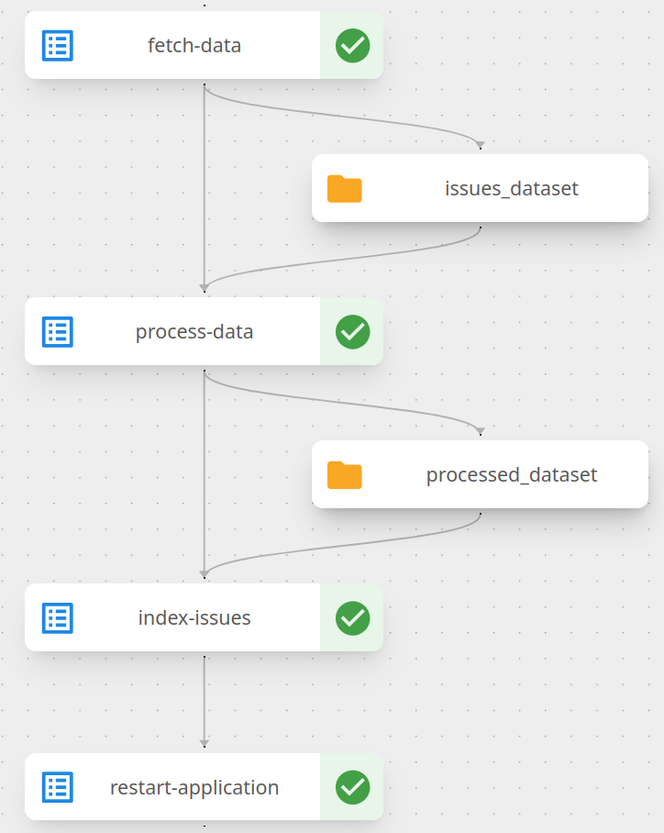
Kubeflow Notebook
Jira Service Desk
Object
Store
Kubeflow Notebook
Object
Store
chunking
Vector DB
Graph DB
Kotaemon
LibroFirma ChatBot
Kubeflow Pipelines​
Automate KB update
Object
Storage

Slide 12
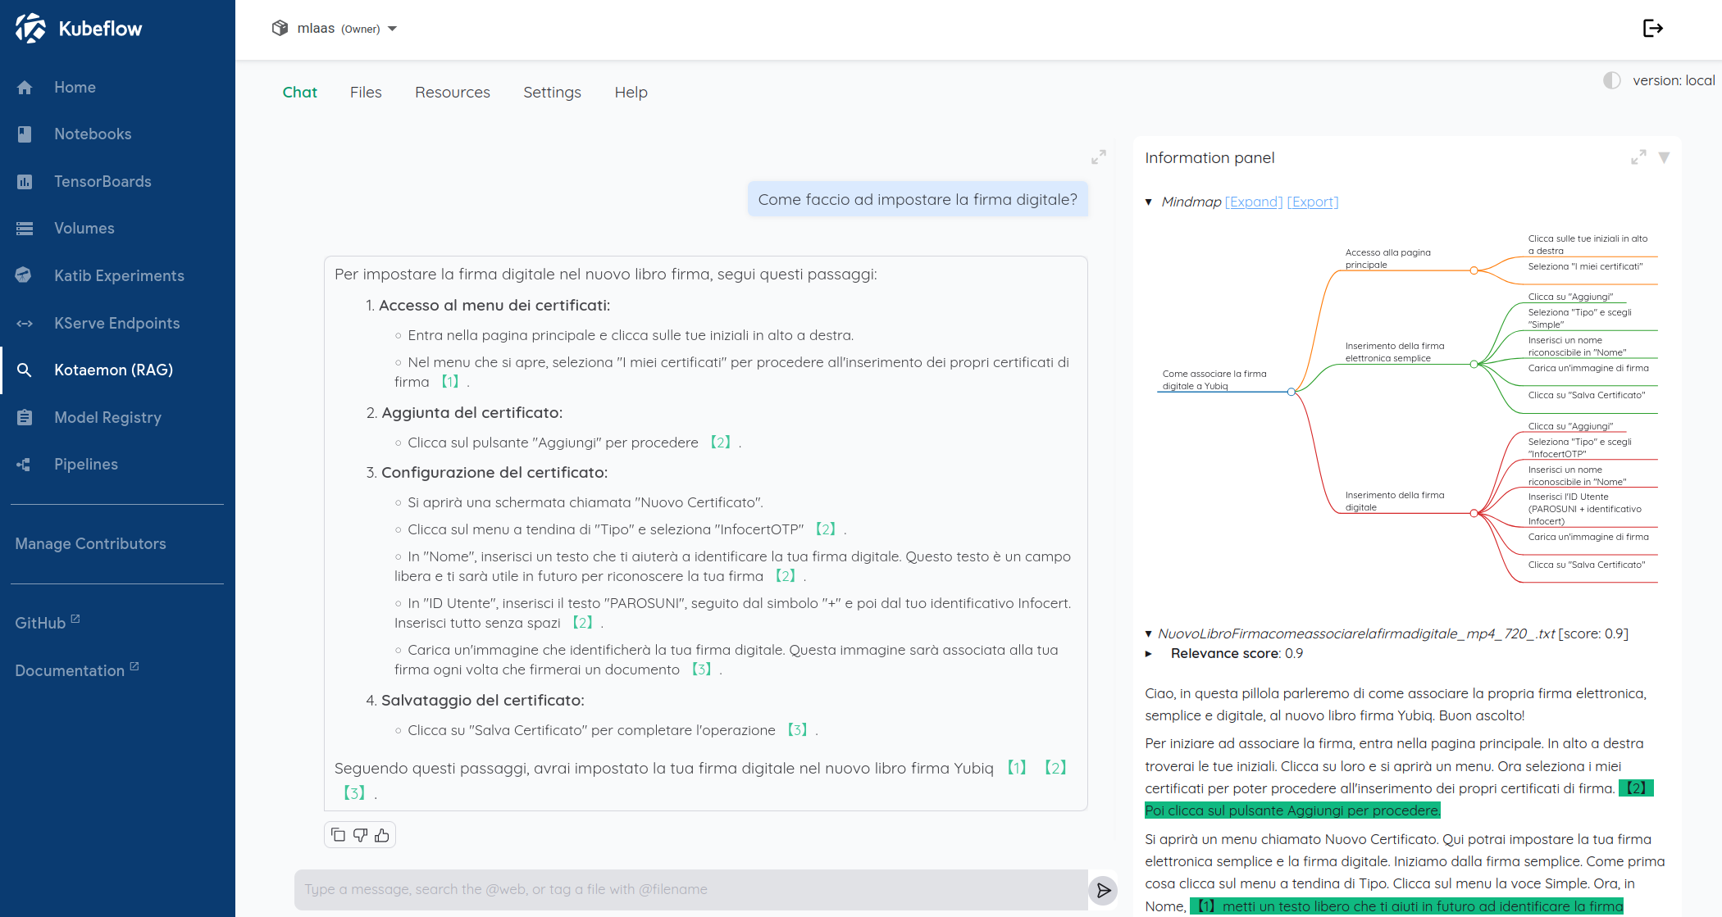
Kotaemon
LibroFirma ChatBot

Slide 13
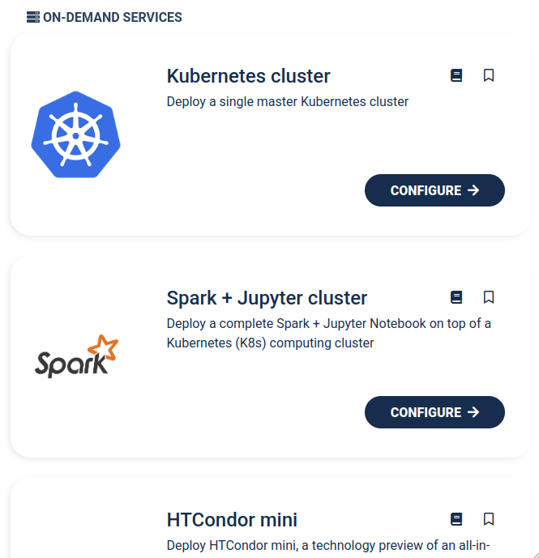
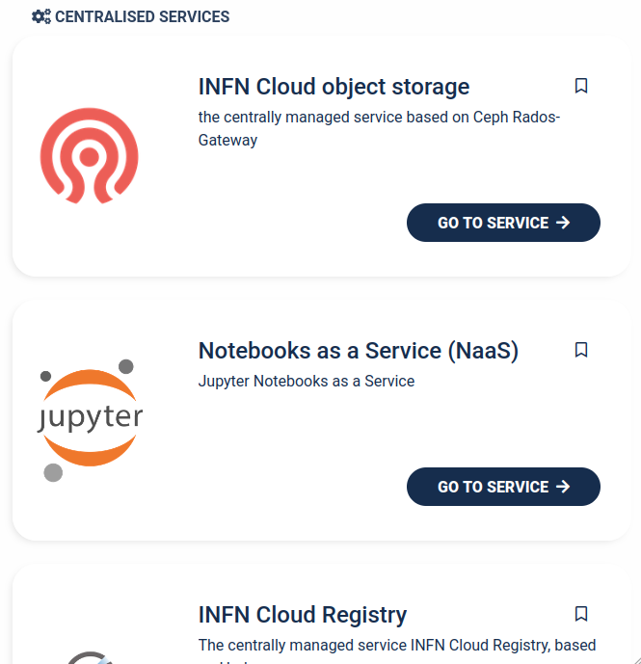
What's next INFN Cloud Integration
2. On-Demand Service
3. Centralised Service
Manual install
hard, self-managed
On-Demand Service
easy, self-managed
Centralised Service
easy, centrally-managed
e.g. ml.cern.ch is a centralized service at CERN to run machine learning workloads

Slide 14
Thank you!
References:
Kubeflow: www.kubeflow.org
Kotaemon: github.com/Cinnamon/kotaemon
KaaP (Kubeflow as a Platform):
Documentation: confluence.infn.it/Kubernetes Cluster with Kubeflow
Source code: baltig.infn.it/kaap-manifests
Manual Install (Ansible role): baltig.infn.it/ansible-role-kubeflow
ReMAT:
Documentation: confluence.infn.it/Research Metadata Analysis Tool

Slide 16
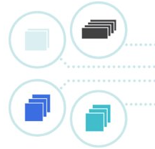
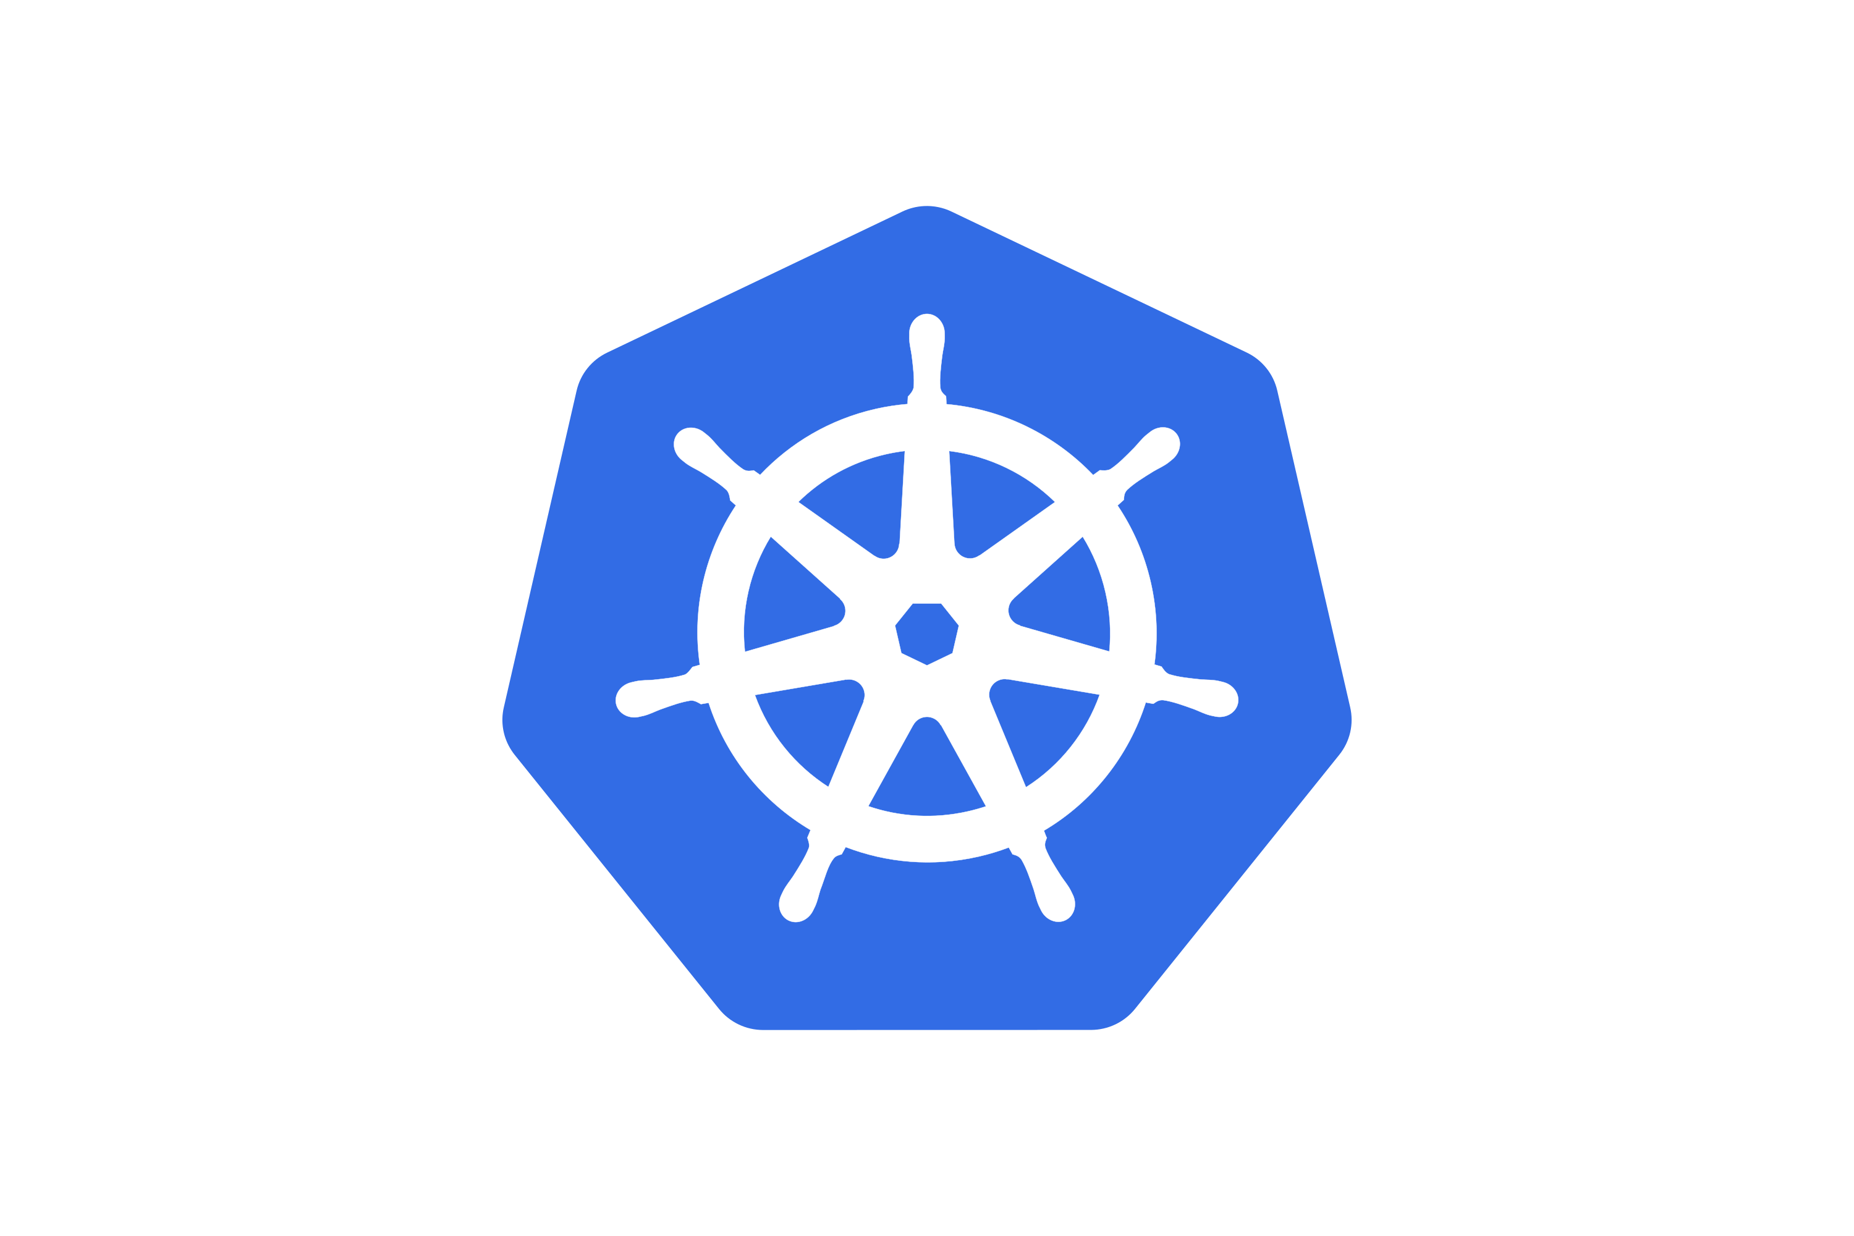
Kubernetes
containers
Open-source technology for running containerized applications at scale.
Providing features such as:
Service Discovery: enabling containers to find and communicate with each other.
Load Balancing: distributing traffic between containers.
Scaling: automatically scaling the number of running containers based on resources utilization.
Self-Healing: monitoring and restarting of failed containers.
...

Slide 17
Kubeflow Ecosystem
Open-source Machine Learning platform built on Kubernetes providing a set of tools to manage the whole lifecycle of an ML solution.
The Kubeflow Ecosystem of applications comprises the following:
Central Dashboard: web app for management of Kubeflow components.
Notebooks: web-based development environments.
Pipelines: orchestration tool to design and run ML workflows.
Trainer: distributed model training using TensorFlow, PyTorch, and other frameworks with support for GPU acceleration.
Katib: automatic hyper-parameter optimization.
Model Registry: central index to manage ML artifacts metadata.
KServe: tool for deploying ML models as scalable, reliable services.
Object Store: provides support for common storage technologies.
Components
Central Dashboard
Kubeflow Notebooks
Kubeflow Pipelines
Kubeflow Trainer
Kubeflow Katib
Model Registry
KServe
Object
Storage

Slide 18
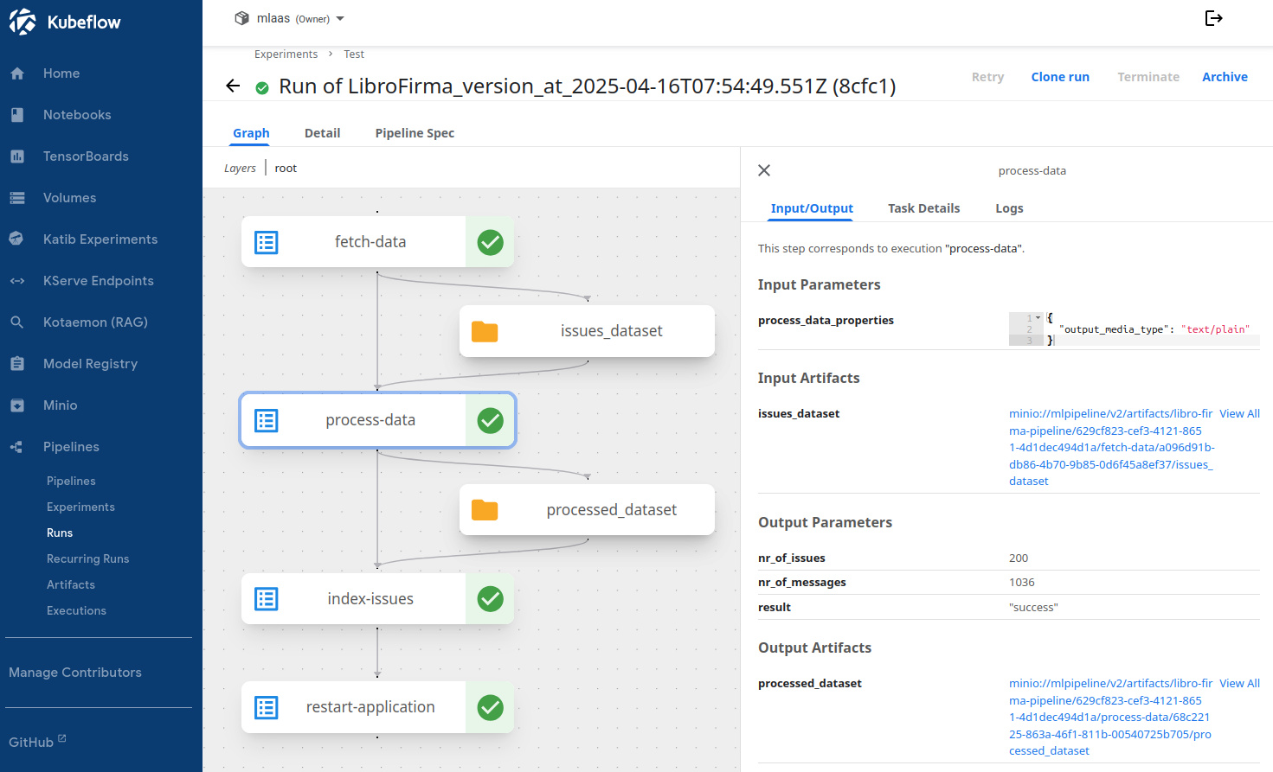
Kubeflow Pipelines​
Details view of task node
chunking

Slide 19
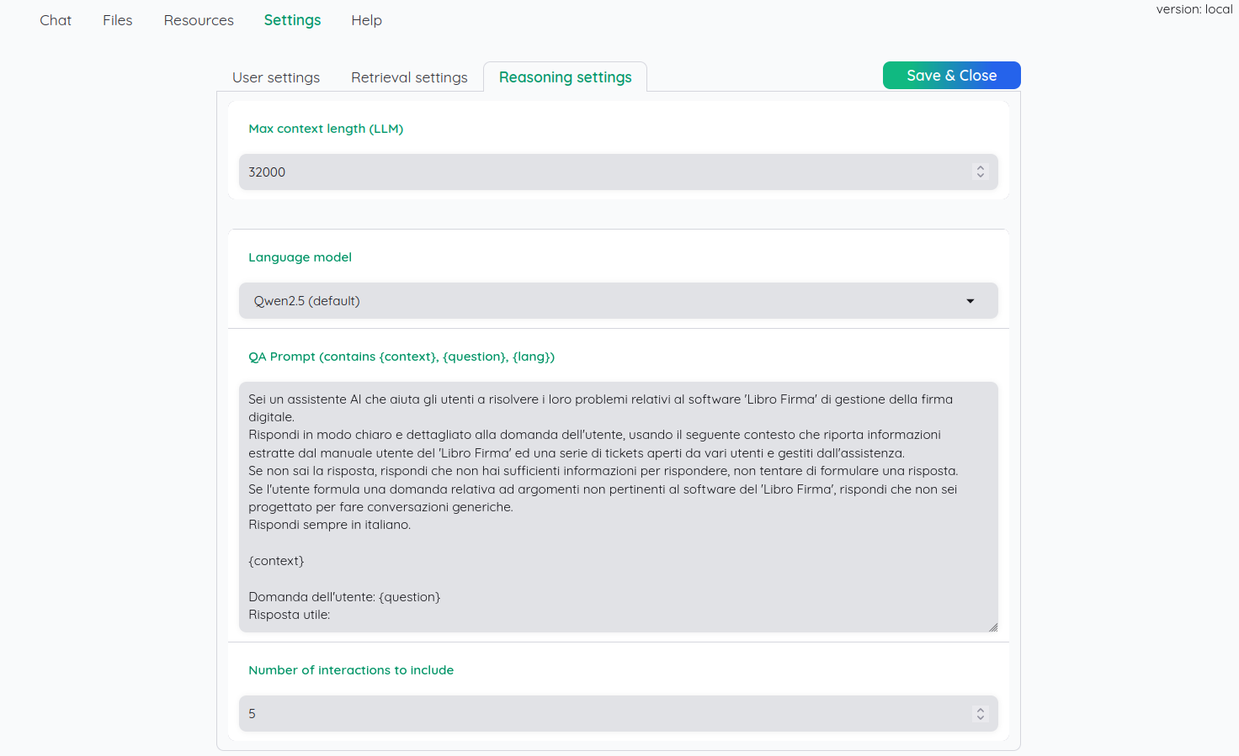
Kotaemon
Reasoning settings

Slide 20
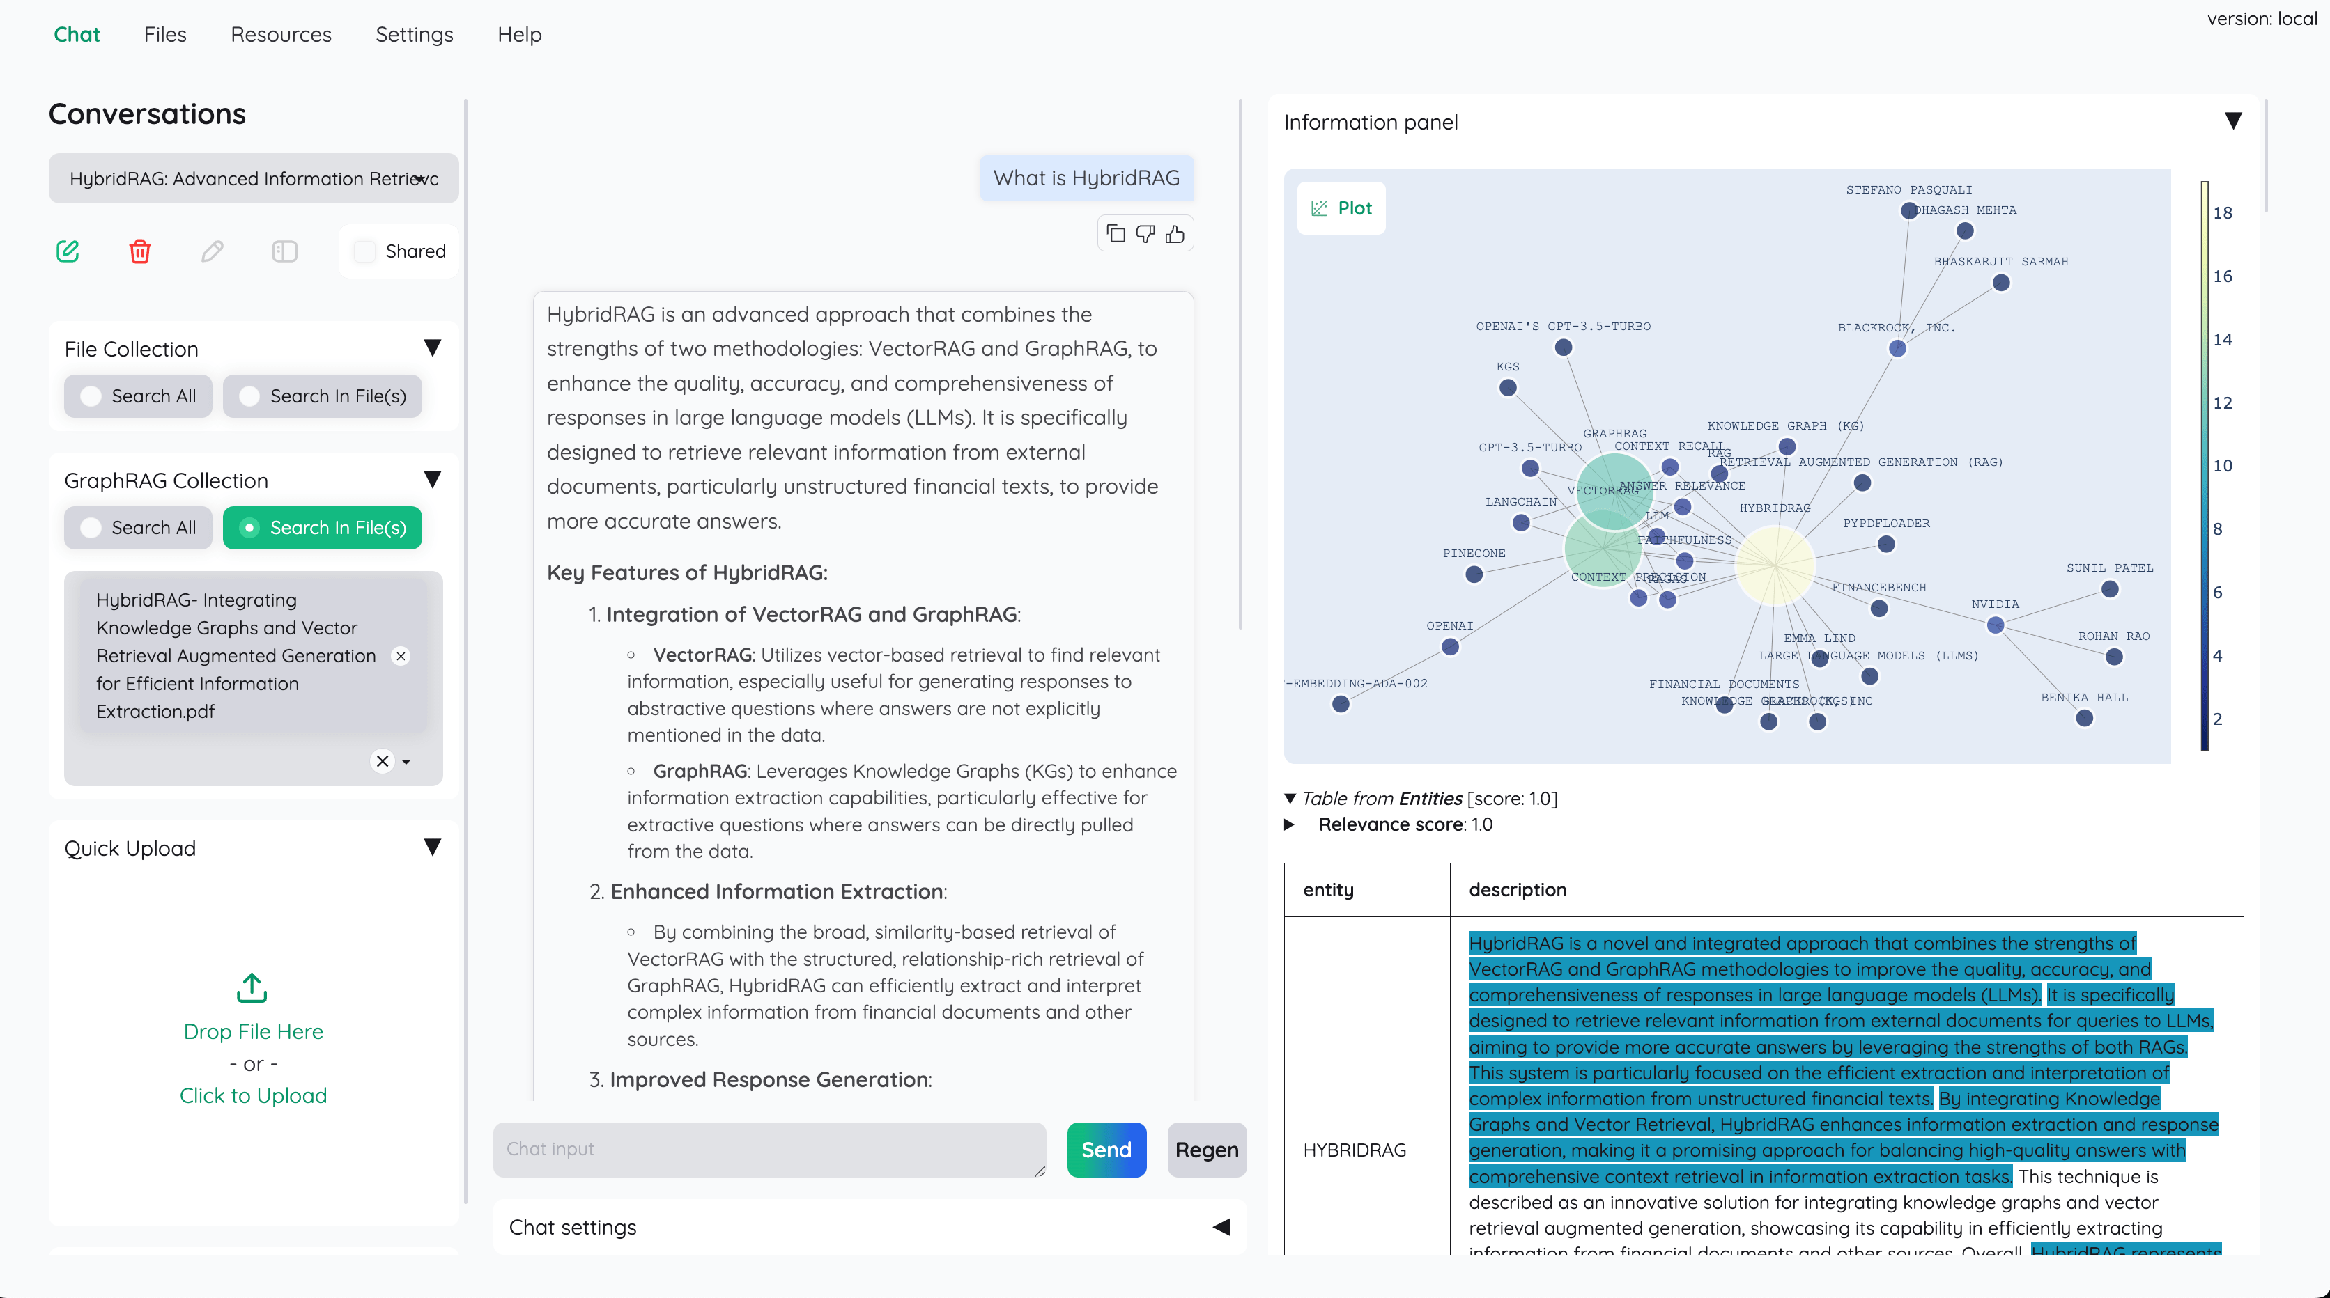
Kotaemon
Full Picture

