Slide 1
Workshop sul Calcolo nell’INFN
La Biodola - Isola d’Elba
29 Maggio 2025
Simone Lossano
Generative AI enhances conventional fluorescence microscopy towards super-resolution capabilities

Slide 2
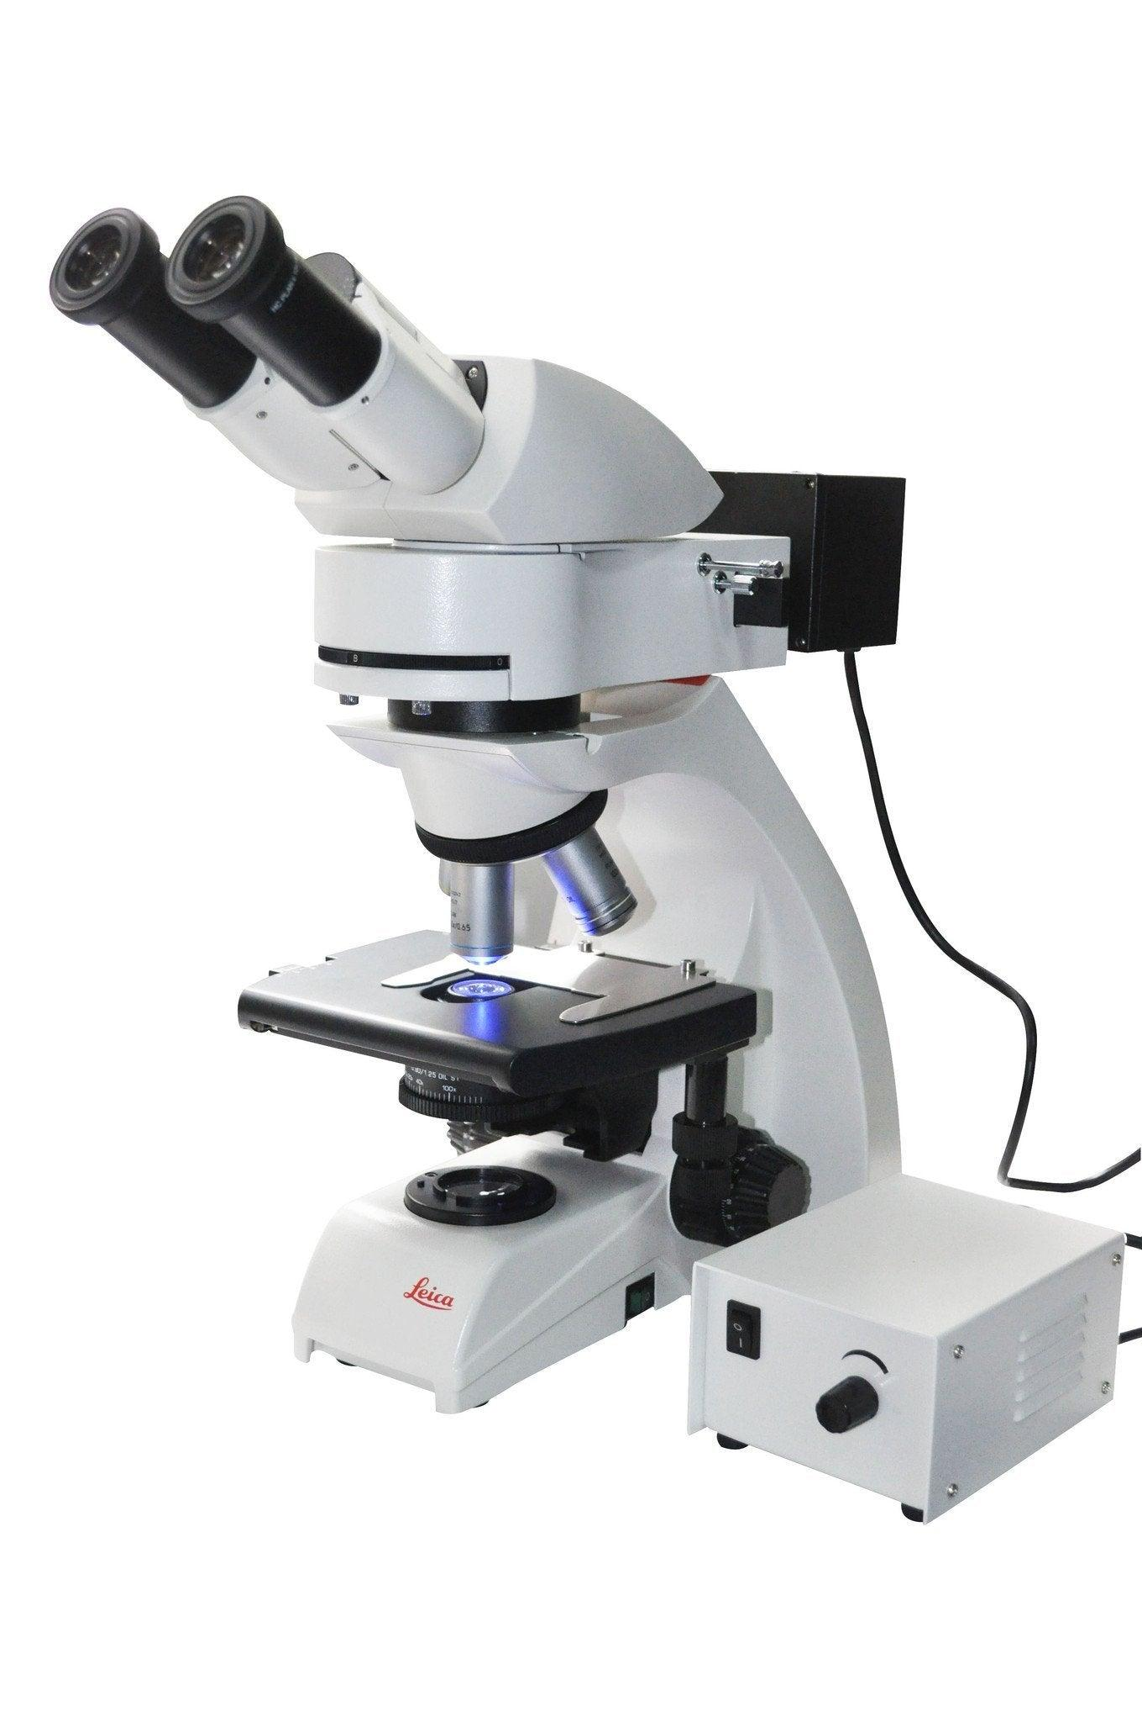
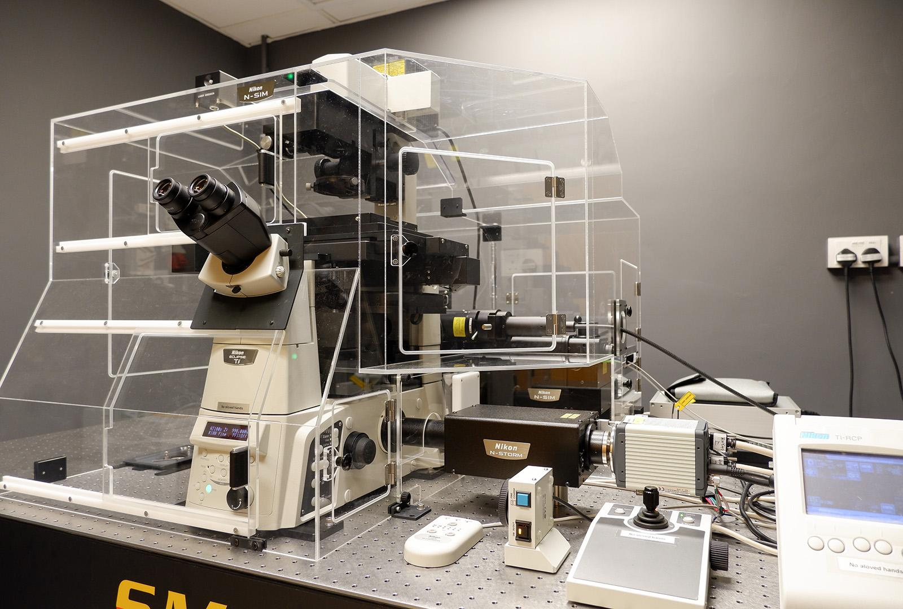
From conventional fluorescence microscopy to Super-Resolution Microscopy
Diffraction limited fluorescence microscope
Super resolution microscope
≥ 2x resolution
200 ㄧ 250 nm
1 ㄧ 100 nm

Slide 3
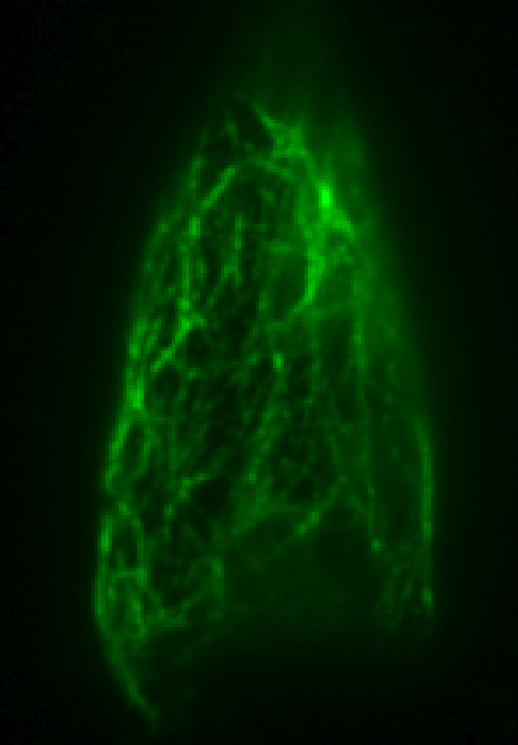
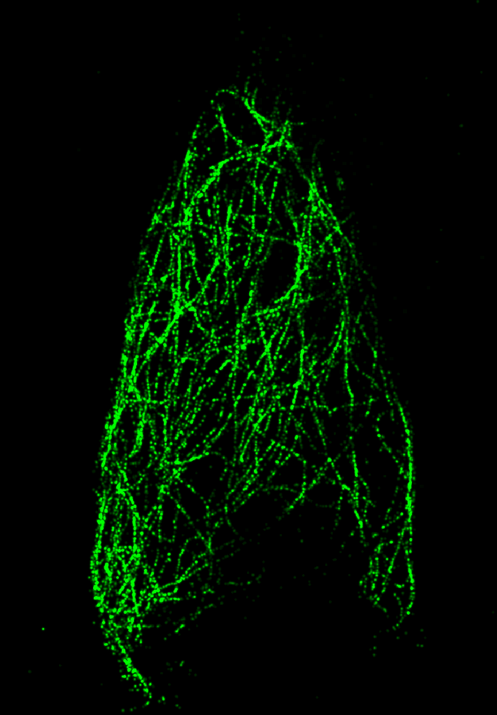
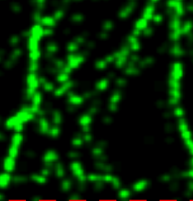
Stochastic Optical Reconstruction Microscopy (STORM)
STORM is a single-molecule localization technique that achieves lateral resolutions of 20–30 nm by stochastically activating sparse subsets of fluorophores and precisely localizing each emitter over thousands of frames.
Pros
Cons
Conventional
microscopy
High resolution (≤ 20 nm).
Quantitative localisation (coordinates) of each fluorophore.
3D capabilities.
Enables in-vivo imaging.
Complex and critical staining process.
Time-consuming acquisitions (up to 90 mins for a single image).
Not ideal for highly dynamic processes.
Complex multicolor-imaging workflow.
Is there any way to mitigate such issues?
STORM

Slide 4
All you need is AI (and a bunch of good data)
With a fair amount of data of good quality, it is indeed possible to train a Deep Neural Network model to generate super-resolved images from diffraction-limited (low resolution) ones.
Benefits
Obtain a STORM-like super-resolved image from a low-resolution one in seconds.
Increased ability to capture highly dynamic processes.
Enables for significantly simpler multicolor-imaging in combination with STORM acquisitions.
A conventional microscope could thus provide super-resolution images thanks to the integration of AI into the acquisition pipeline!

Slide 5
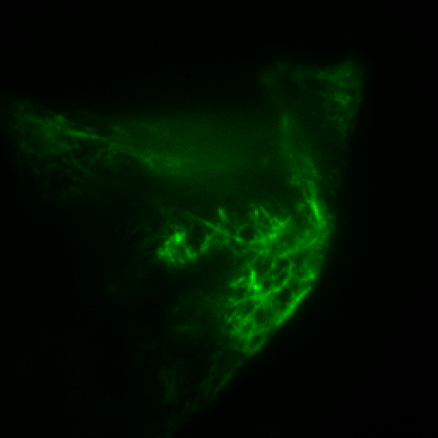
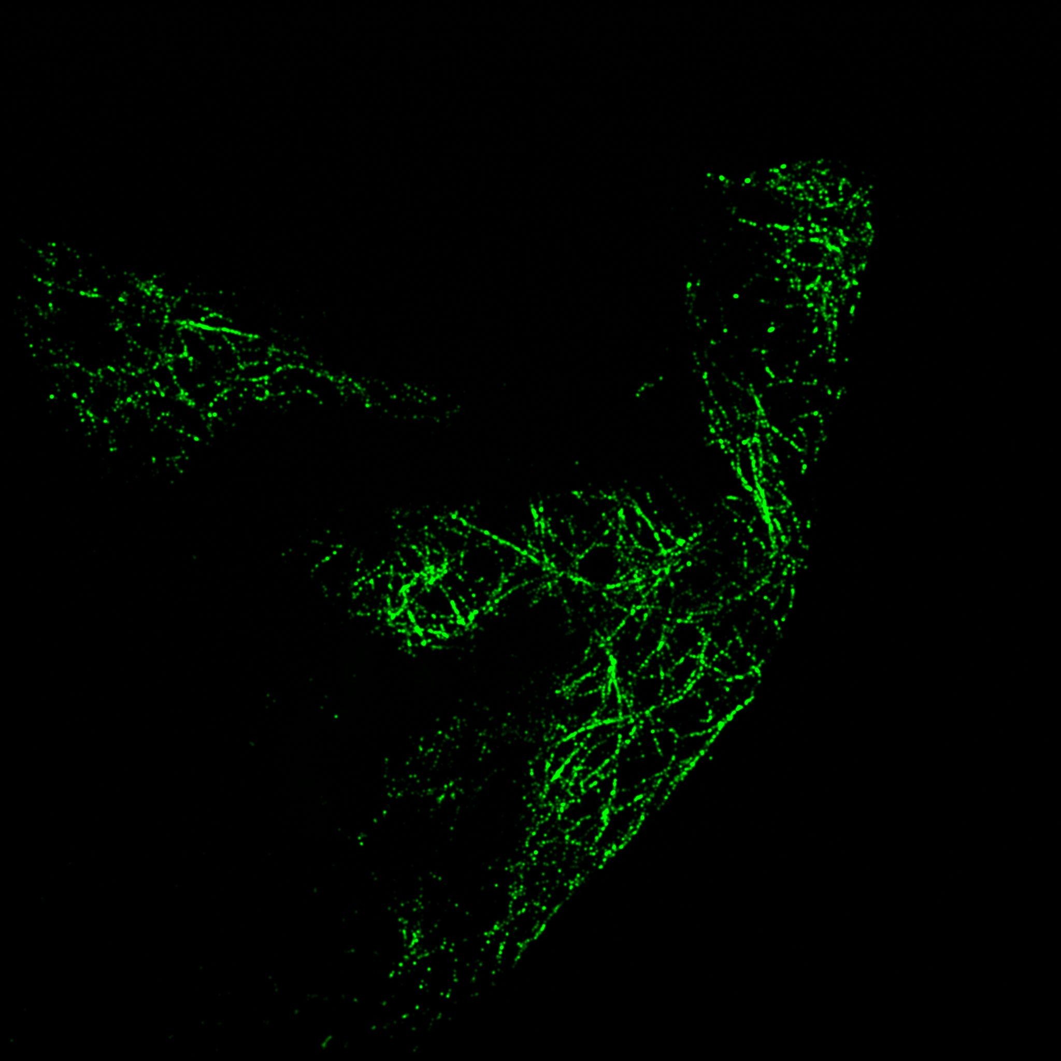
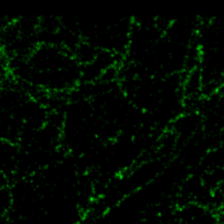
Dataset
Low-res. (512x512)
76 image pairs (8-bit RGB) collected at UniPi Physics Department of cellular microtubules.
64x64
Patching to reduce memory usage
Real-time data augmentation (random 90° rotation and flip)
60 image pairs
(Train)
3840 image pairs
patches
+
Super-res.(2048x2048)
256x256
Split ratios:
80% Train
10% Validation
10% Test
https://cisup.unipi.it/labs/fluorescence-super-resolution-microscope-nikon-storm-5-0/

Slide 6
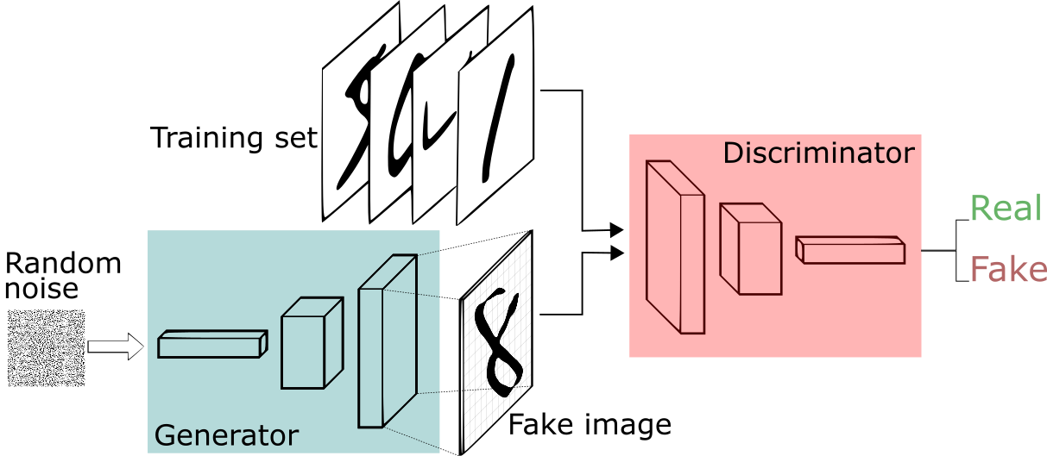
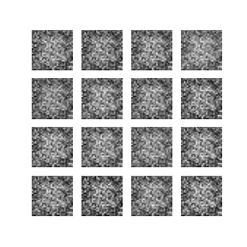
Generative Adversarial Network (GAN)
Neural networks in which two models (‘Generator’ and ‘Discriminator’) train in competition: the Generator learns to produce ‘realistic’ data, the Discriminator learns to distinguish real data from generated data in a zero-sum game.
Minmax loss function:

Slide 7
Enhanced Super Resolution GAN (ESRGAN)
Low-res. (512x512)
Generator
Generative Adversarial Network for super-resolution generation of naturalistic images. It is a perceptual-driven model.
N. parameters:
Generator: 16,697,987
Discriminator: 21,055,049
concatenation
× 23
element-wise addition
Relativistic average Discriminator
Xintao et al. ESRGAN: Enhanced super-resolution generative adversarial networks. In The European Conference on Computer Vision Workshops, September 2018.

Slide 8
Loss functions and metrics
Given I^{HR} and I^{SR} the reference and the generated image respectively, the ESRGAN network tries to minimize the sum of the generator loss L_{G} and discriminator loss L_{D}:
Low-res. (512x512)
Loss
During validation and test phase, the model performance are evaluated using the following:
Metrics

Slide 9
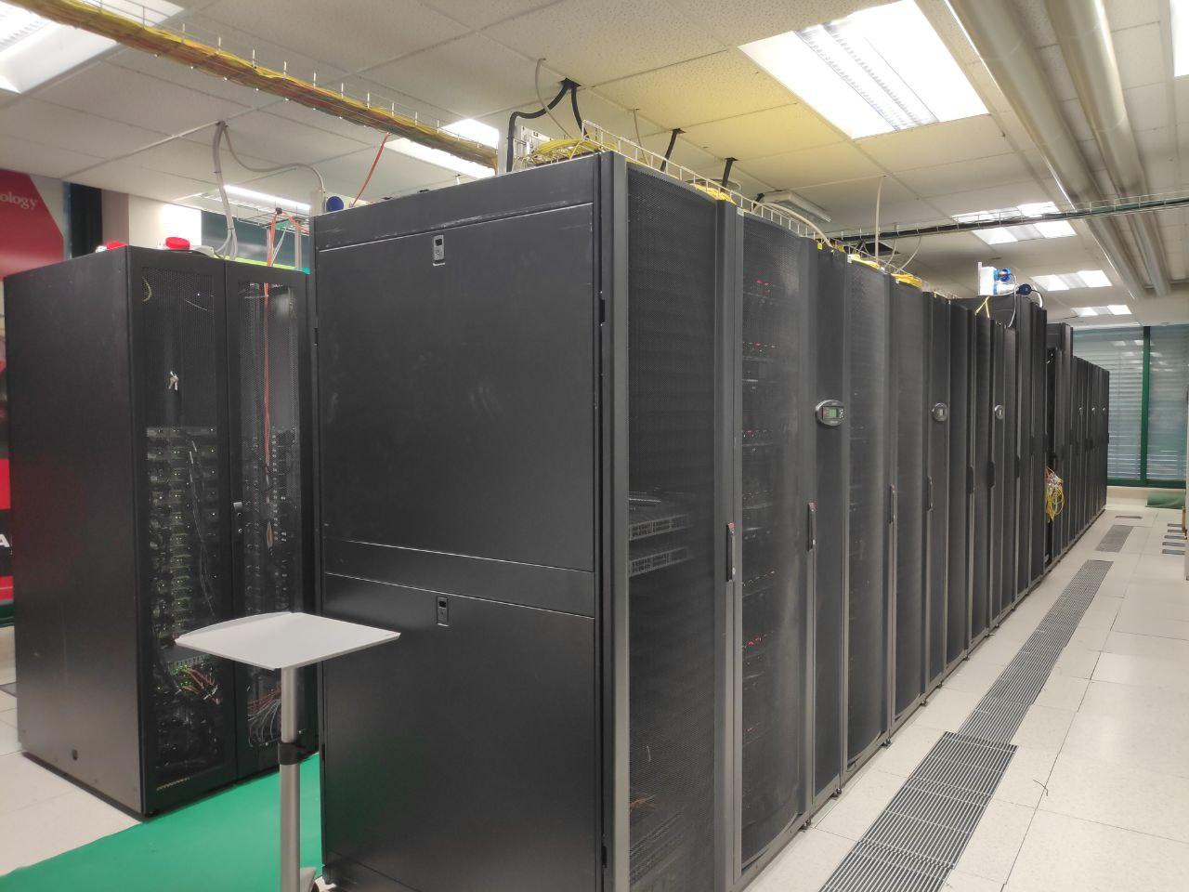
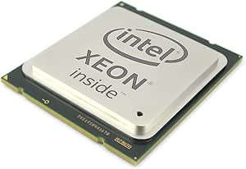
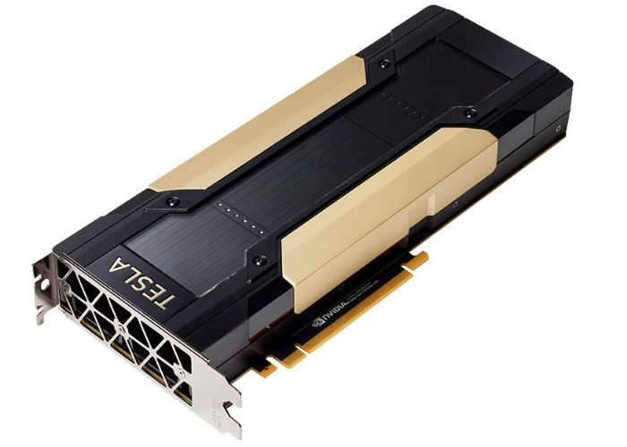
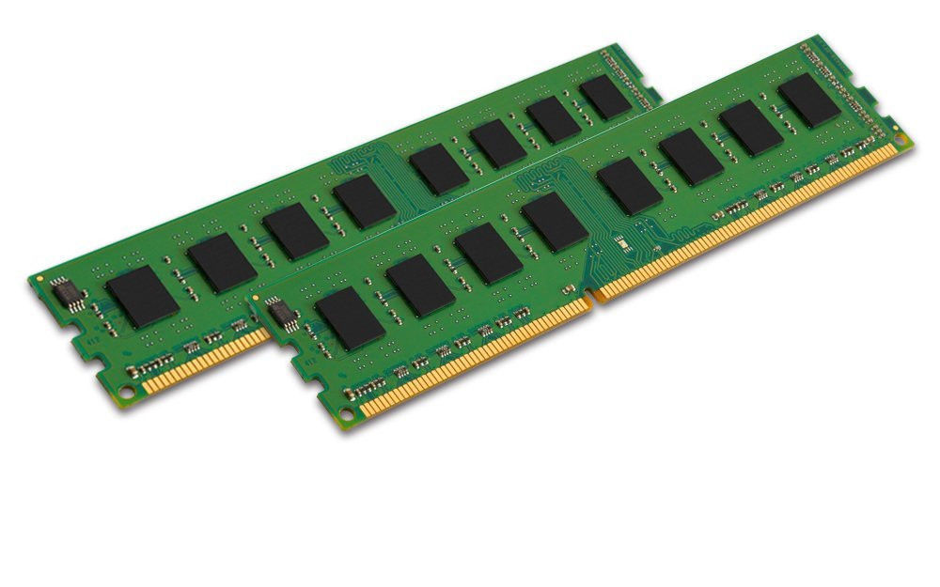
Hardware resources and computational load
10/15x 10 cores Intel Xeon E5-2640v4 @2.40 GHz
Average train execution time:
≈ 80 hours
1x NVIDA Tesla V100 32 Gb VRAM
Average inference execution time for single image:
≈ 4 s
Computing Center @ INFN-Pisa
64 Gb RAM

Slide 10
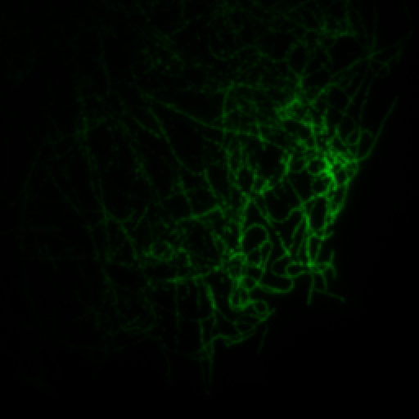
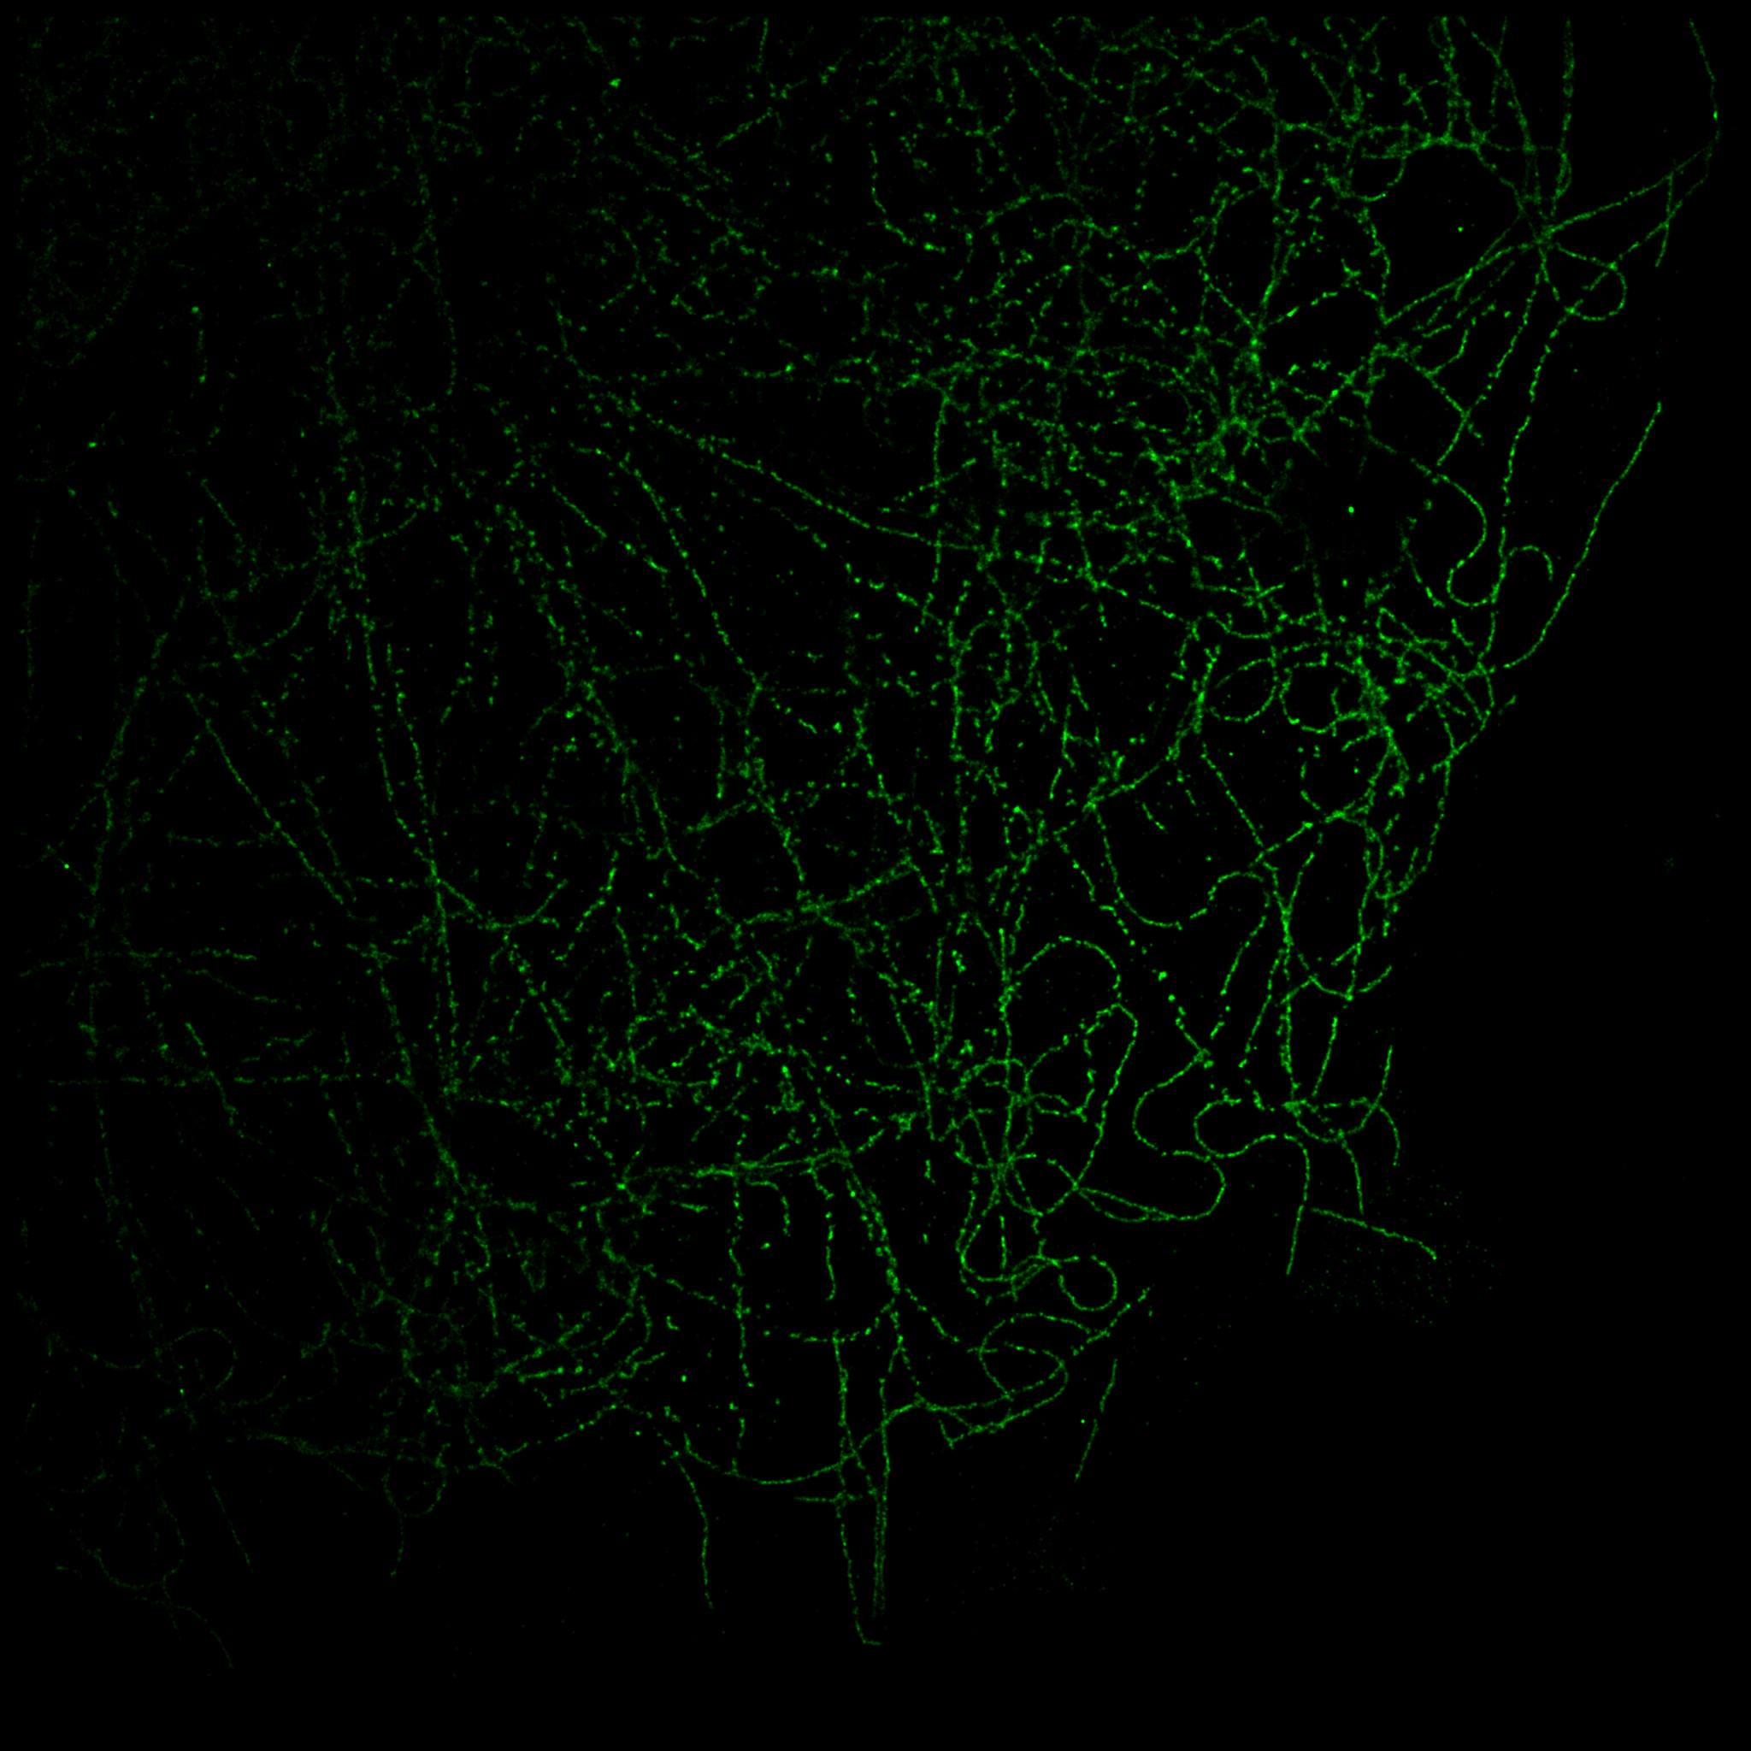
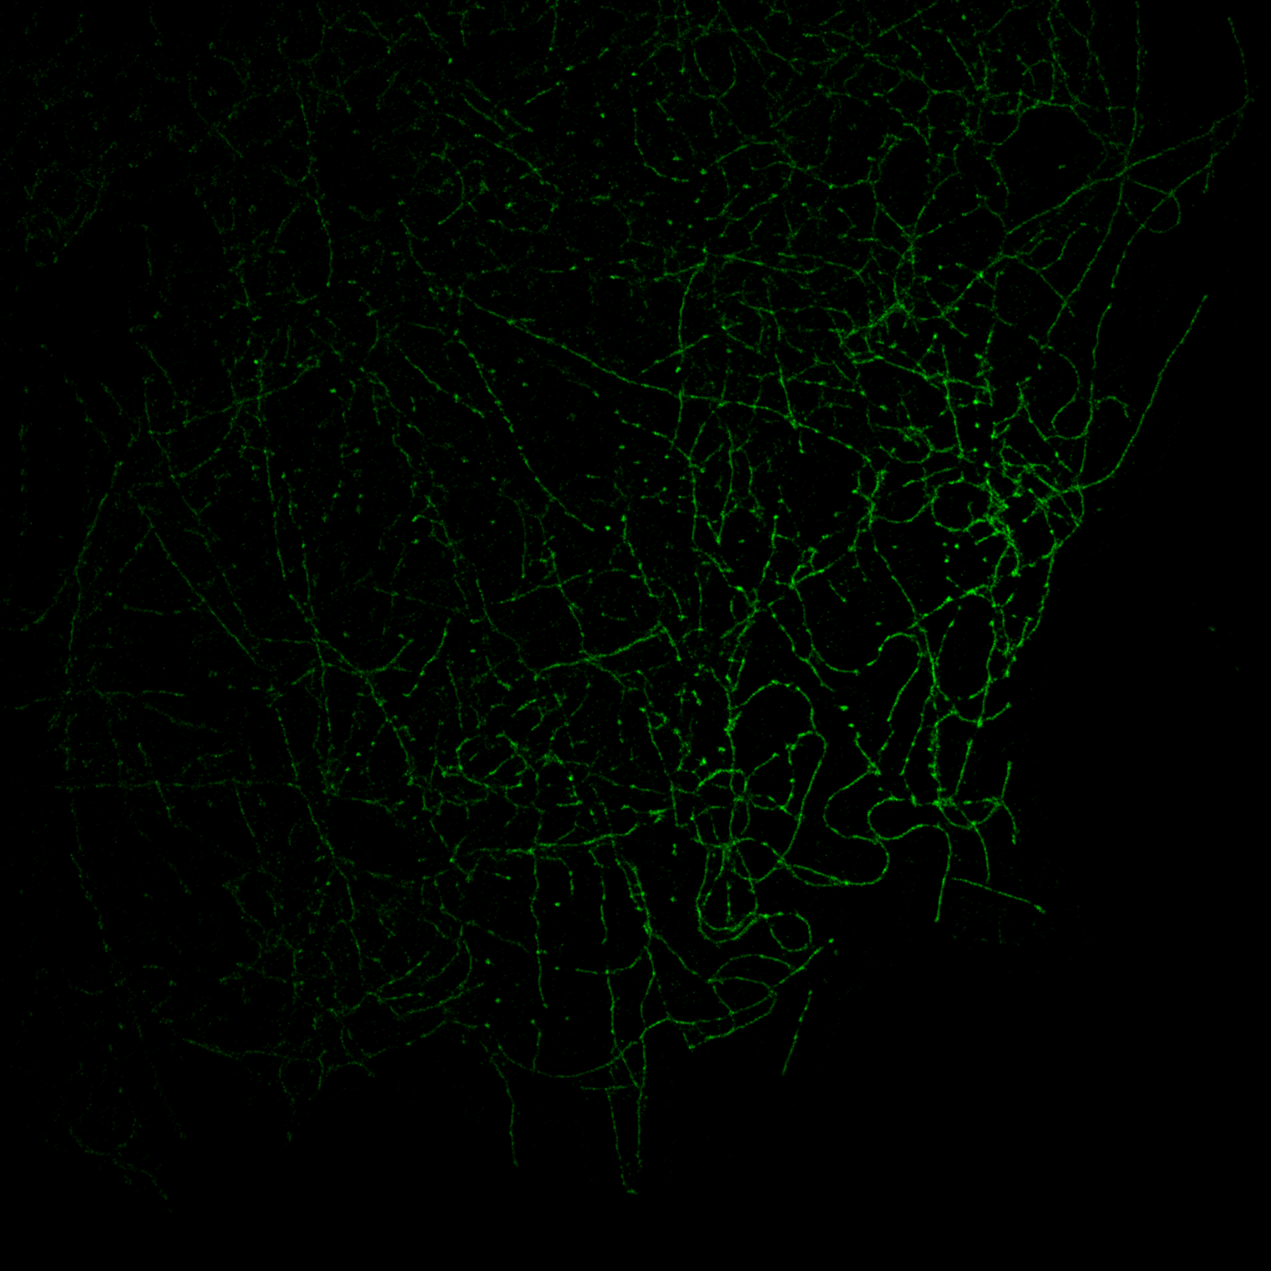
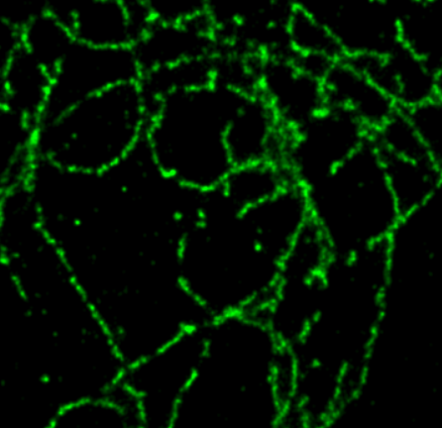
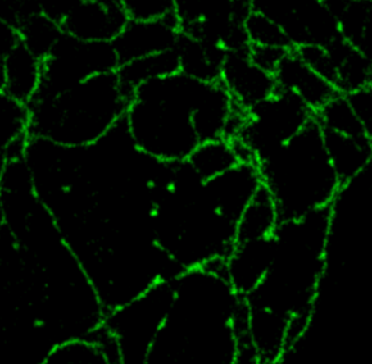
Results: STORM-like images
Low-res.
STORM
AI-generated
Using the model trained for 100k iterations (best one according to the biophysicists):
PSNR | SSIM
28∓4 | 0.8∓0.1

Slide 11
Results: Multicolor imaging
1 μm
1 μm
Dynein (cytoskeletal motor protein) acquired through STORM.
AI-generated microtubules.

Slide 12
Conclusions & future outlooks
In summary, this work contributes to AI-driven SRM through some key innovations:
Significant acceleration of SRM.
Simplified workflow.
Facilitates in vivo observation and analysis of dynamic biological processes.
Allows for simpler multicolor acquisition when combined with standard STORM.
…but there’s still a lot of work to do (and a lot of annoying problems for our HPC colleagues!)
Training on new cellular components.
Application to other super-resolution microscopy techniques.
Integration of other architectural components into the pipeline (e.g. attention-based mechanisms).
Switch to 3D images.

Slide 13
Thanks for your attention!

Slide 14
Backup slides

Slide 15
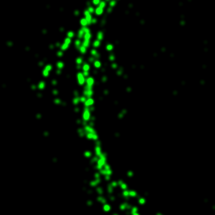
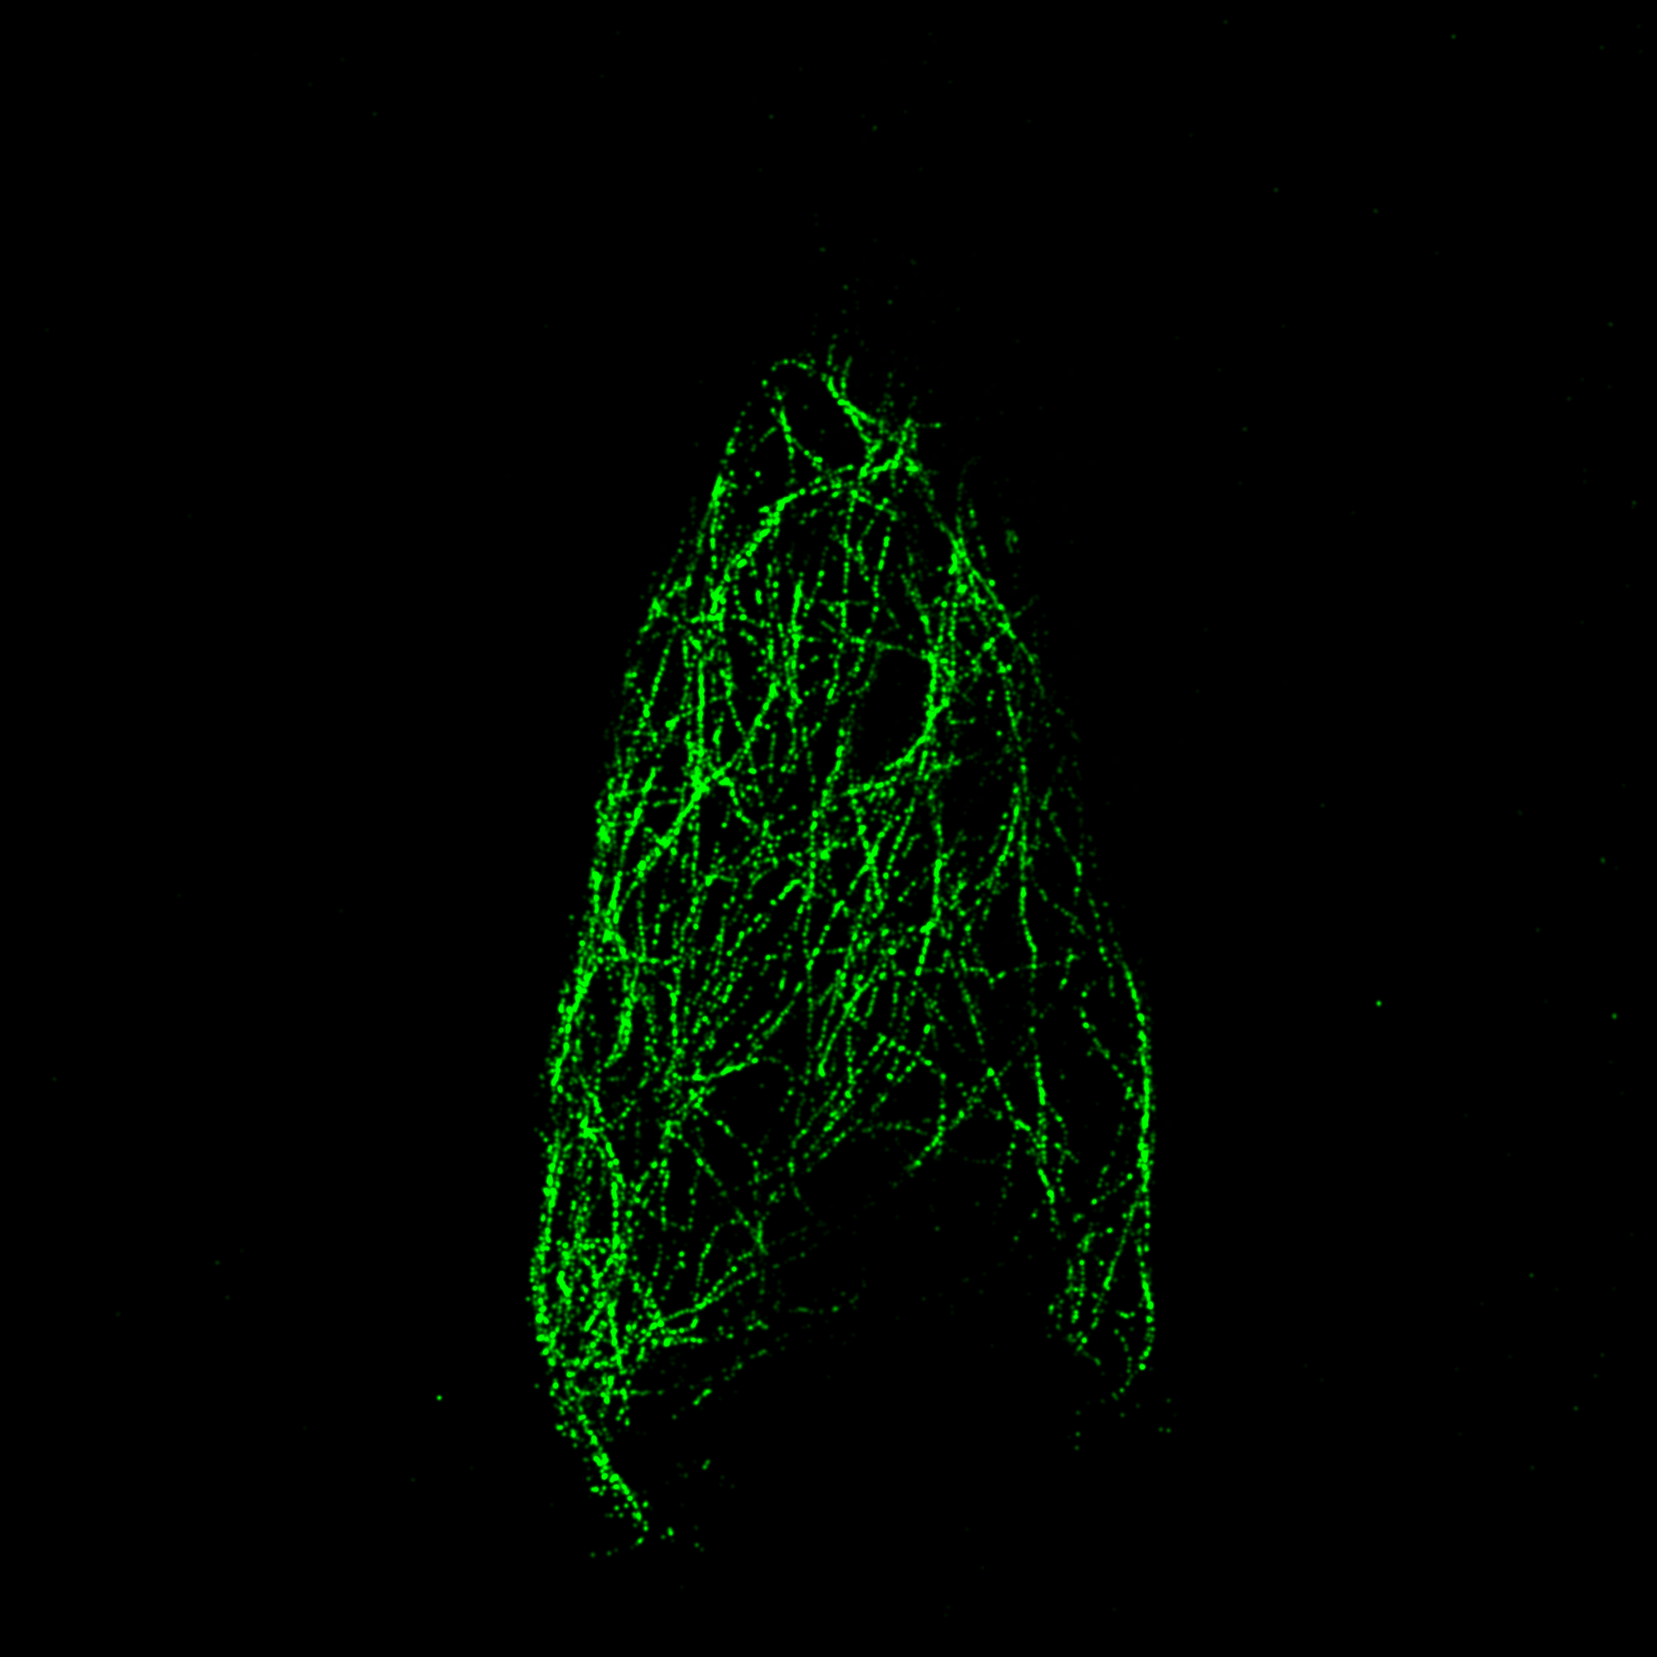
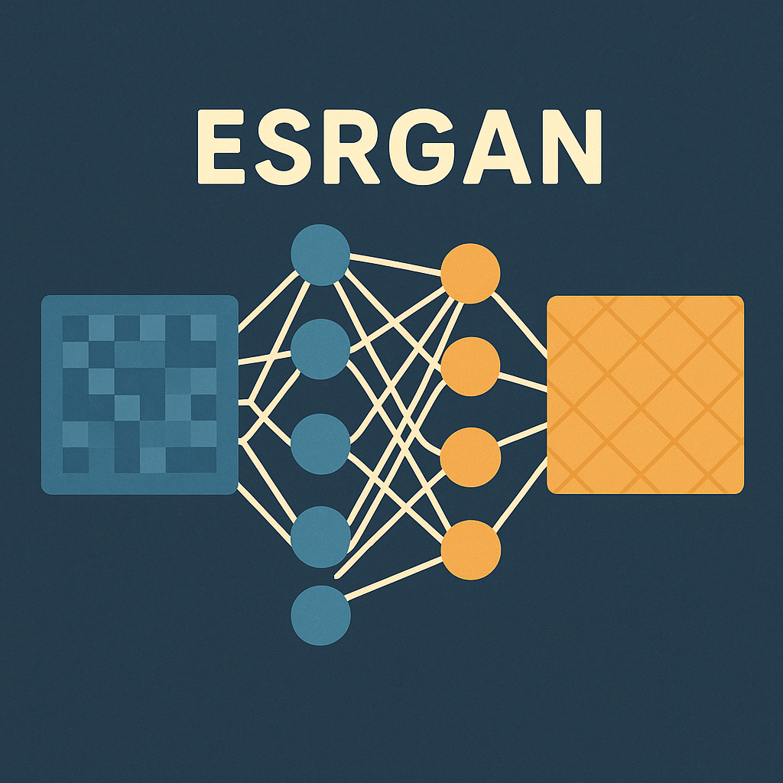
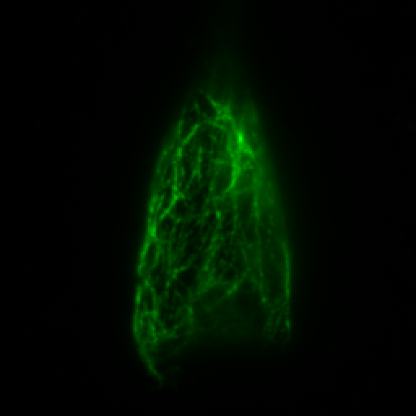
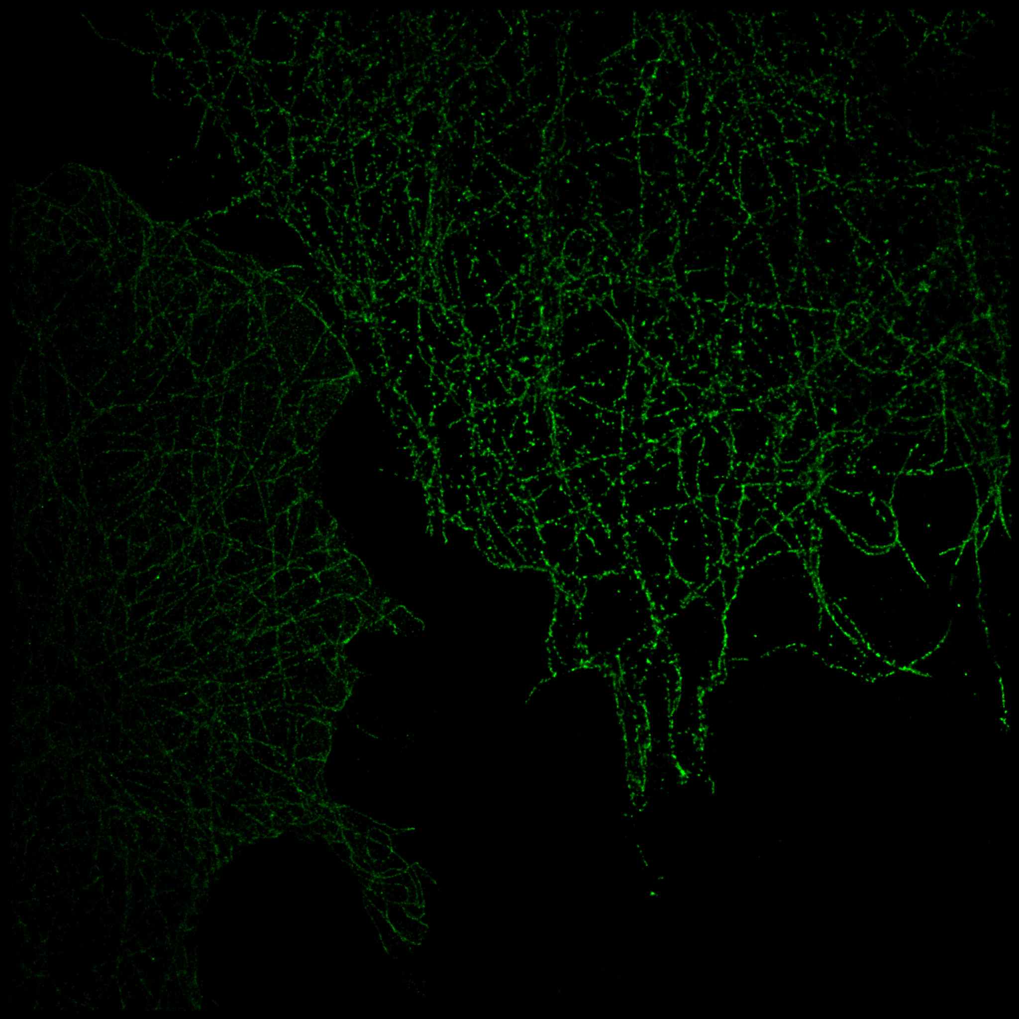
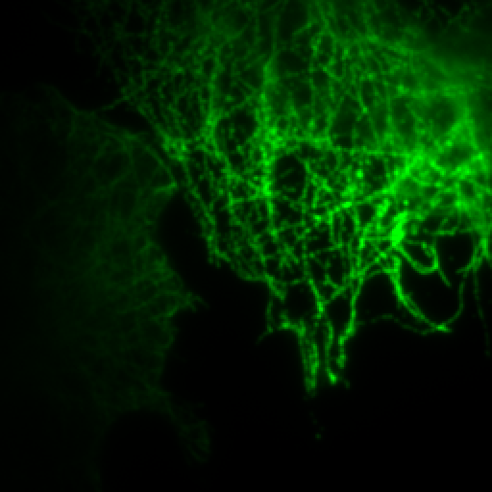
Workflow
Real-time data augmentation
Patch 64×64
Batch size: 4
Generator SR output
I^{LR}
I^{SR}
TRAIN:
43 epochs,
400k
iterations
Rel. discriminator classification + loss computation + backpropagation and weights update
I^{HR}
STORM reference
?
I^{HR}
I^{SR}
Performance evaluation
each 1k iterations using updated weights
I^{HR}
each 10/25k iterations
VALIDATION
I^{LR}
I^{SR}
I^{HR}
Model performance
TEST
I^{LR}
I^{SR}

Slide 16
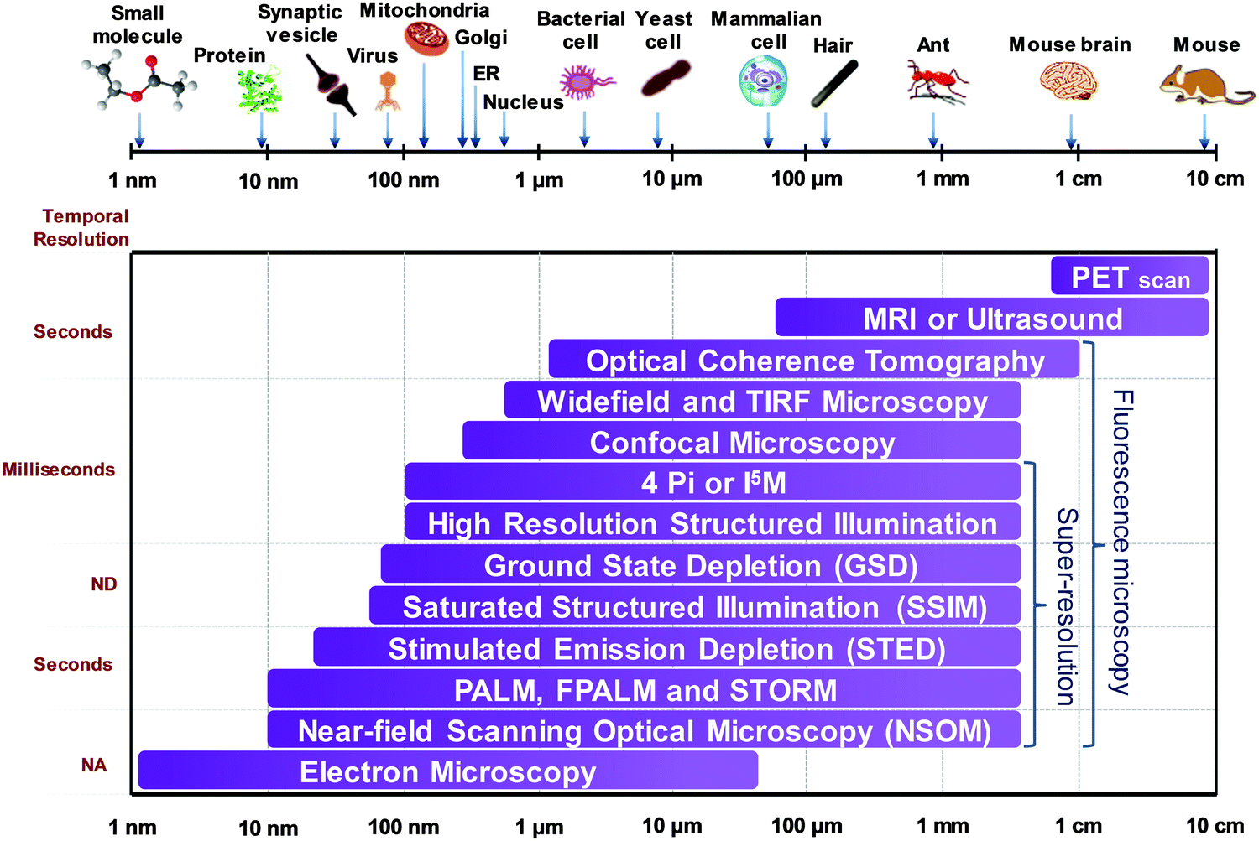
Super-resolution microscopy zoo
Technique
STED (Stimulated Emission Depletion)
SIM (Structured Illumination Microscopy)
SMLM (Single-Molecule Localization Microscopy: PALM/STORM/DNA-PAINT)
MINFLUX (Minimal Photon Fluxes)
RESOLFT (Reversible Saturable OpticaL Fluorescence Transitions)
…
Resolution
30 ㄧ 80 nm
100 nm
20 ㄧ 30 nm
1 ㄧ 3 nm
40 nm
C. G. Galbraith and J. A. Galbraith, "Super-resolution microscopy at a glance", Journal of Cell Science, 124:1607–1611342 (2011)

Slide 17
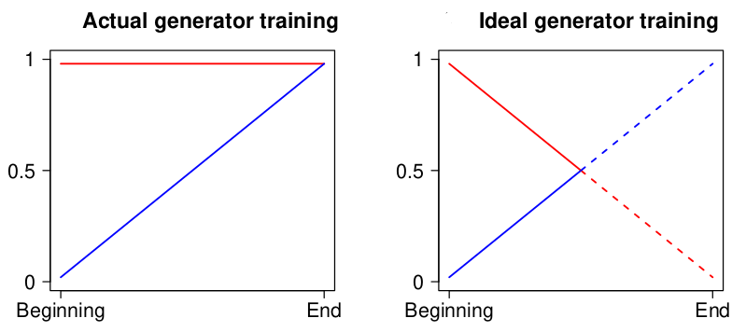
Relativistic Average GAN and Adversarial Loss
Relativistic Average GANs employ a batch-wide, mean-based comparison between real and fake samples to deliver richer, more robust feedback to both discriminator and generator.
In contrast to the standard discriminator, which assesses the likelihood that an input data x is real, a relativistic discriminator aims to predict the probability that a real data is comparatively more authentic than a fake one (on average).
While in a standard GAN the generator is trained to increase the probability that fake data is real, in a RGAN the probability that genuine data is classified as real should also decrease.
After the generator is trained to deceive the discriminator, the discriminator classifies most images, whether real or fake, as real.
Implementation of the a-priori knowledge for the discriminator that half of the test samples are false.

Slide 18
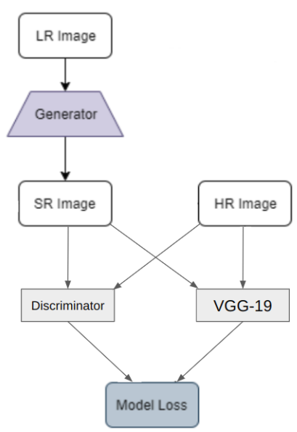
Perceptual Loss Function
The perceptual quality of a reconstructed image refers to its visual appearance as opposed to its similarity to a ground truth image.
Perceptual loss is calculated based on the differences between feature maps extracted from a pre-trained VGG-19 network.
ϕ_{i j} feature map obtained from the j-th convolution before the i-th max-pooling layer within the VGG-19 network;
w_{k} = 1 for each k-th feature map extracted.
16 Convolutional layer + ReLU
3 Fully Connected layer
5 layer di Max Pooling

Slide 19
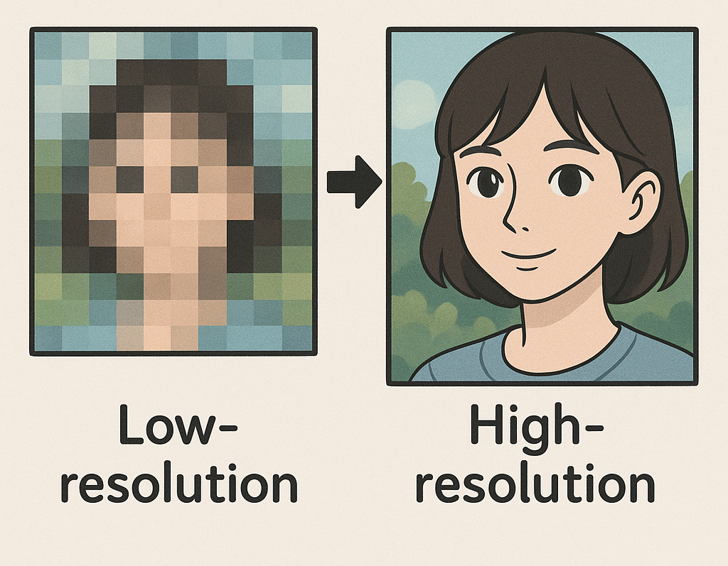
Super-resolution problem in Computer Vision
Let I_{xLR} be an LR image and I_{yHR} the corresponding HR image, d the degradation function, then:
where 𝜕 represents the set of degradation function parameters such as scaling, blurring or noise factors.
The Super-Resolution (SR) process predicts the function g = d⁻¹ such that:
where δ represents the set of input parameters of g, I_{yE} is the reconstructed SR image.
In the context of neural networks, this process corresponds to minimising a cost function called loss function:
where Ψ is a regularisation term, h a trade-off term, ϕ the set of parameters of the neural network.

Slide 20
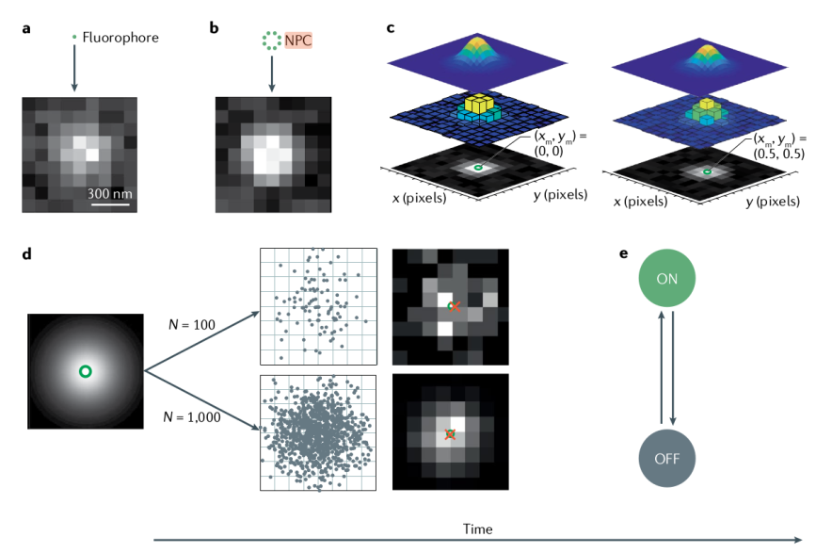
STORM
Sub-Pixel Localisation: localisation of the light intensity peak using a Gaussian PSF model.
By evaluating the intensity of the pixels surrounding the pixel where the peak is localised, a shift within the pixel itself can be assessed.

Slide 21
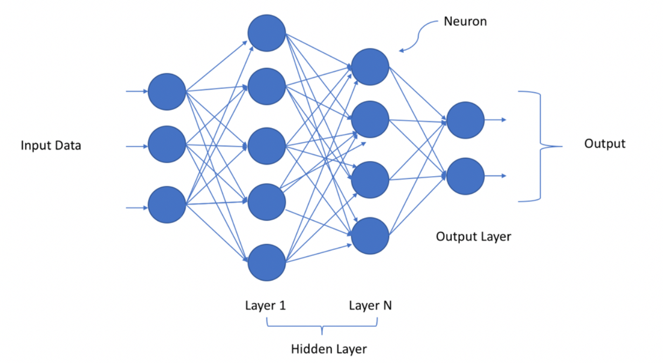
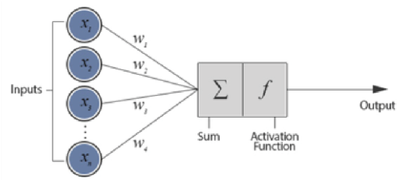
Deep Learning
Different types of approach:
Supervised learning: training on labelled data (ground truth).
Unsupervised learning: training on unlabelled data.
….
Multiples hidden-layer.
Weights (Parameters) set the connections.
Es.: Sigmoid, (Leaky)ReLU, Softmax, Tanh.
Hyperparameters: Set of fixed parameters of the model and not updated during training, e.g.:
Number of epochs
Number of layers/nodes
Activation functions
Learning rate

Slide 22
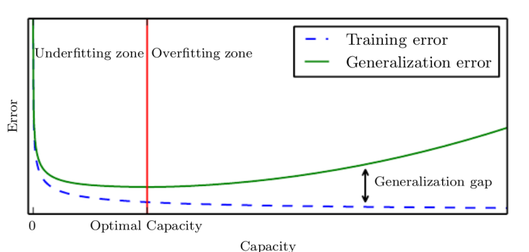
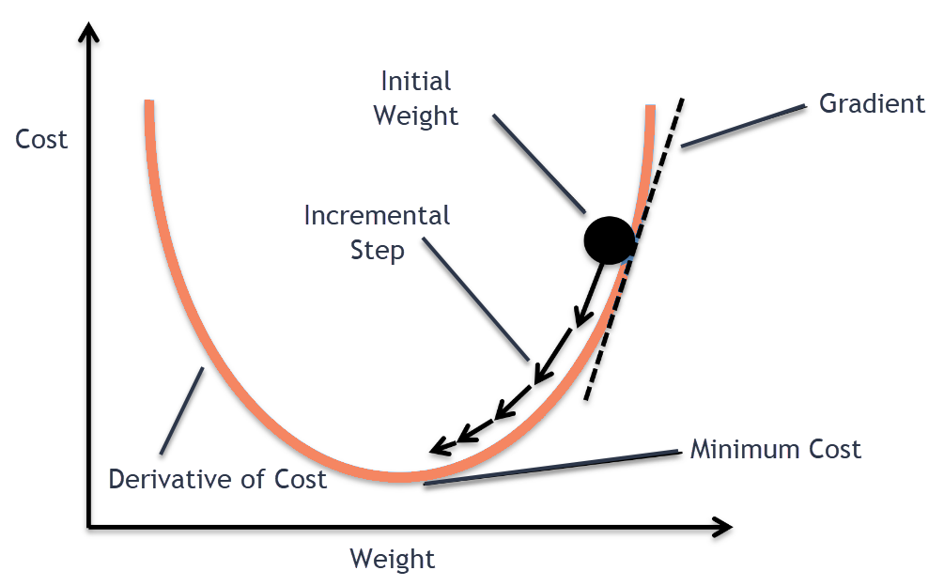
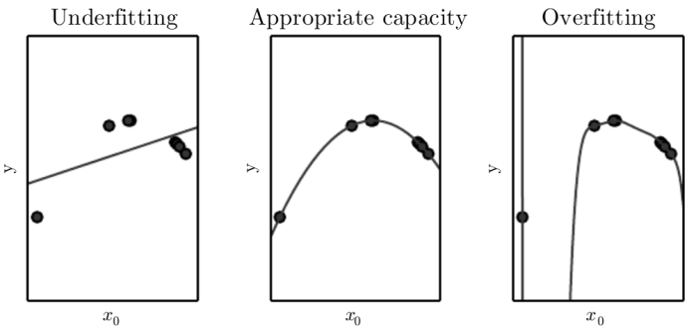
Deep Learning
Loss function minimisation
Neural network objectives
Generalisation Error minimisation
Generalisation: network ability to perform well on data not included in the train set.
Generalisation Error: Discrepancy between model predictions on test data and actual values of that data.
Capacity: Ability to recognise and represent patterns or relationships within the data. The more free parameters a neural network has, the greater its capacity.
Forward pass: calculate network output and loss function.
Backward pass: error backpropagation through chain-rule to update the weights in order to minimize the loss.

