Slide 1
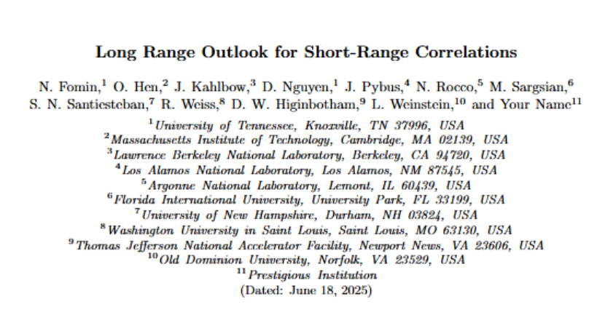
Become an Author!
Nadia Fomin
Spooky Friday, 2025
This work is supported by DOE Award Number: DE-SC0013615

Slide 2
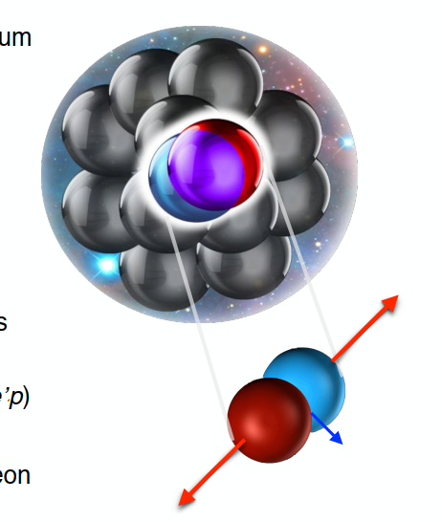
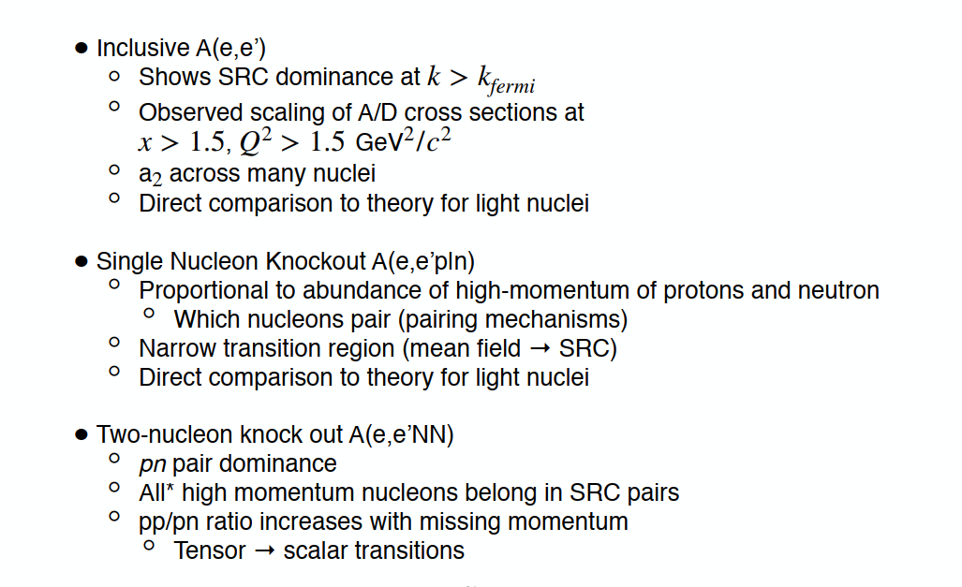
2N SRCs – we’ve learned so much!

Slide 3
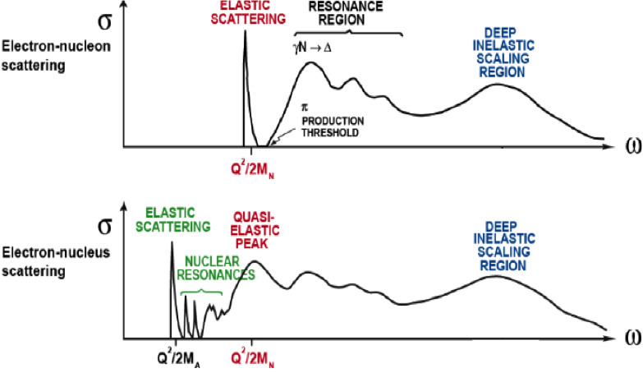


Choosing an Appropriate Microscope
$$ν$$
$$ν$$

Slide 4
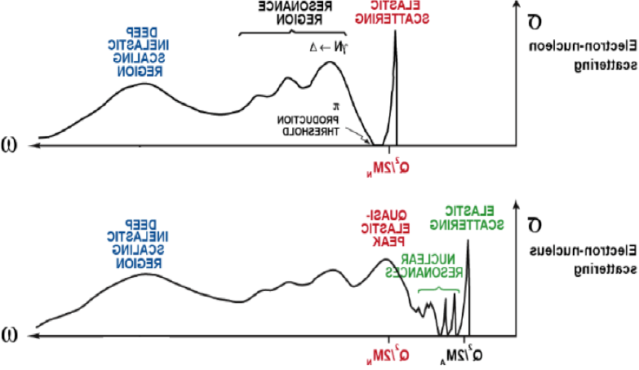



Choosing an Appropriate Microscope
$$x$$
x=1
$$x$$
x=1
x=A
1<x<2 is combination of 2-body and 1*-body contributions;
3+ body effect assumed to be small (*=Fermi-smeared)

Slide 5
Choosing an Appropriate Microscope
$$x$$
x=1
$$x$$
x=1
x=A
1<x<2 is combination of 2-body and 1*-body contributions;
3+ body effect assumed to be small (*=Fermi-smeared)

Slide 6
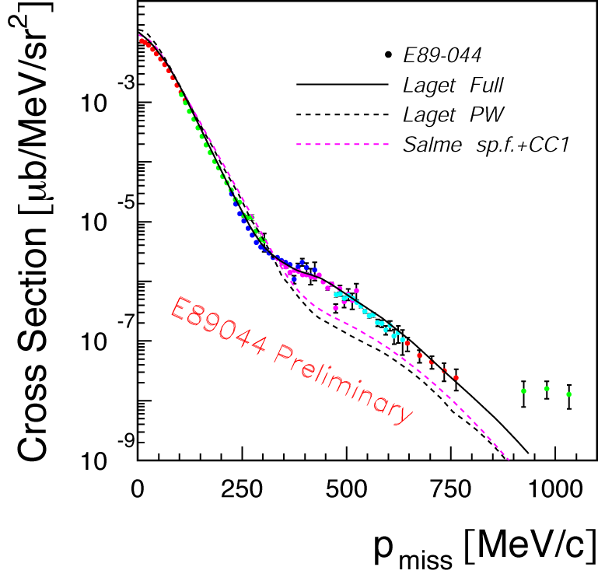
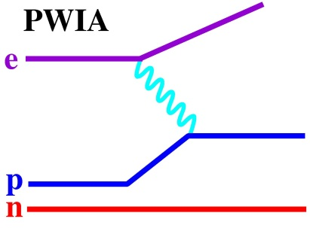
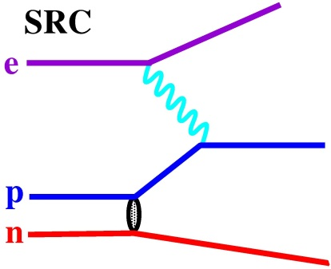
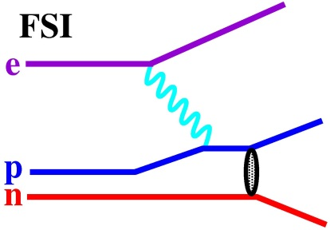
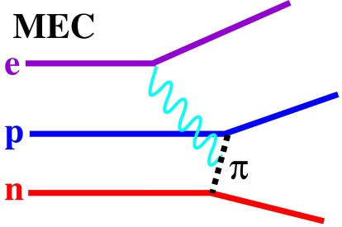
High momentum tails in A(e,e’p)
E89-004: Measure of ³He(e,e’p)d
Measured far into high momentum tail: Cross section is ~5-10x expectation
Difficulty
High momentum pair can come from SRC (initial state)
OR
Final State Interactions (FSI) and Meson Exchange Contributions (MEC)
“slow” nucleons
“fast” nucleons
p
p
p
p

Slide 7
Inclusive Scattering
Relative measurement
Reduced FSI
Test scaling in x and Q²
No direct information on isospin structure
Only via target isospin structure
No direct information on momentum distribution for A>2

Slide 8
Inclusive Scattering
Relative measurement
Reduced FSI
Test scaling in x and Q²
No direct information on isospin structure
Only via target isospin structure
No direct information on momentum distribution for A>2

Slide 9
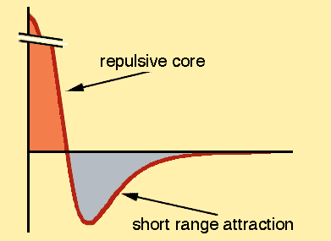
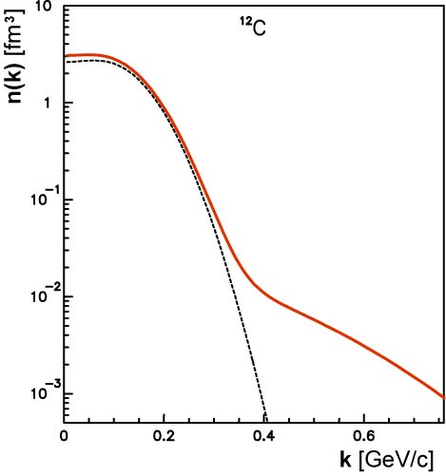
High momentum nucleons
- Short Range Correlations
3N SRC
2N SRC
Nucleon momentum distribution in ¹²C
Try inclusive scattering!
Select kinematics such that the initial nucleon momentum > k_{f}

Slide 10
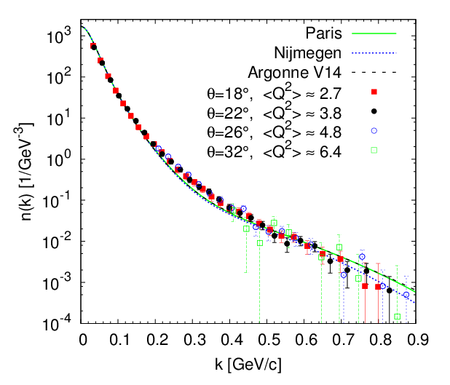
High momentum nucleons - Short Range Correlations
3N SRC
2N SRC
Deuterium
Fomin et al, PRL 108 (2012)

Slide 11
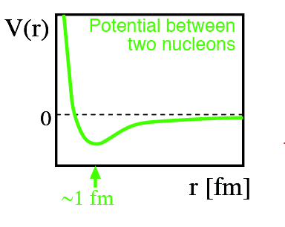
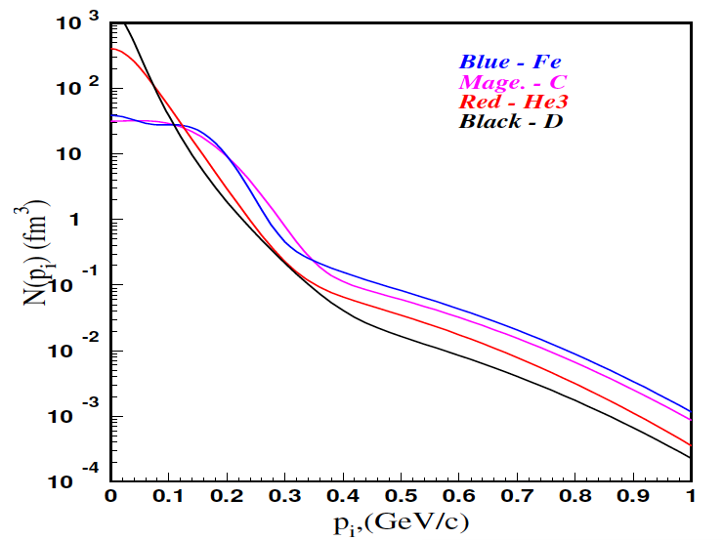
High momentum nucleons - Short Range Correlations
3N SRC
2N SRC
Nucleon momentum distribution in ¹²C
C. Ciofi degli Atti and S. Simula, Phys. Rev. C 53 (1996).

Slide 12
High momentum nucleons - Short Range Correlations
3N SRC
2N SRC
Nucleon momentum distribution in ¹²C
P>k_{fermi}
C. Ciofi degli Atti and S. Simula, Phys. Rev. C 53 (1996).

Slide 13
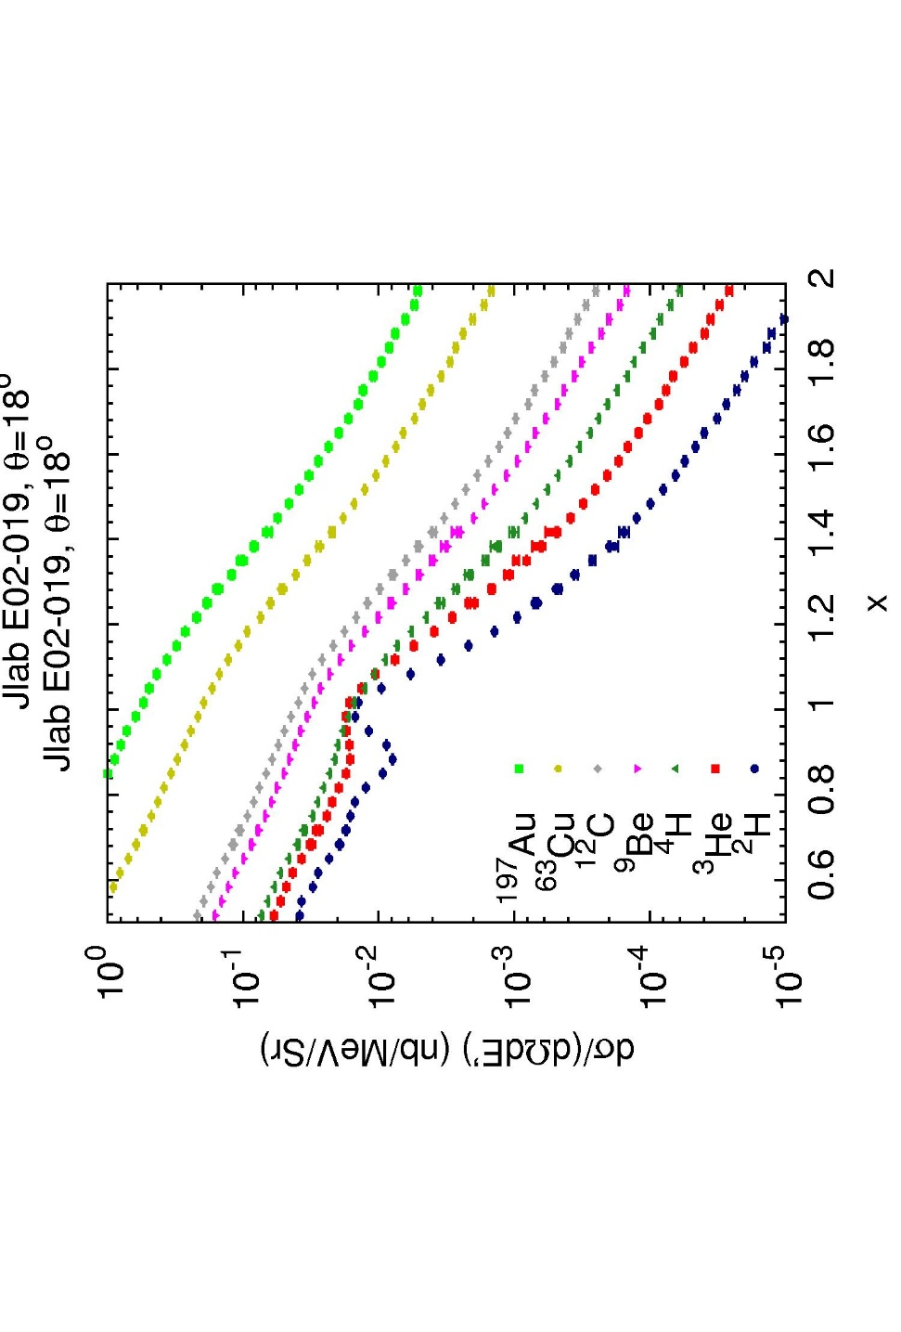
Short Range Correlations
To experimentally probe SRCs, must be in the high-momentum region (x>1)
To measure the relative probability of finding a correlation, ratios of heavy to light nuclei are taken
In the high momentum region, FSIs are thought to be confined to the SRCs and therefore, cancel in the cross section ratios
QE
Jlab E02-019
1.4<x<2 => 2 nucleon correlation

Slide 14
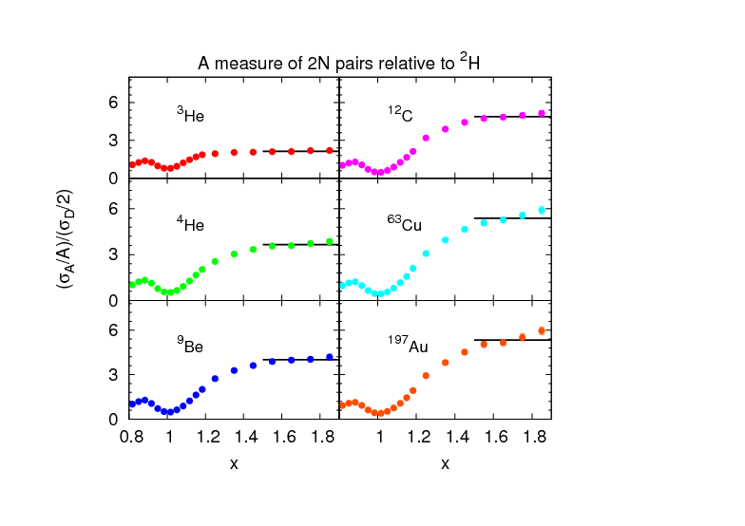

3N SRC
2N SRC
QE
Jlab E02-019
Fomin et al, PRL 108 (2012) Jlab E02-019
P>k_{fermi}
C. Ciofi degli Atti and S. Simula, Phys. Rev. C 53 (1996).
1.4<x<2 => 2 nucleon correlation

Slide 15
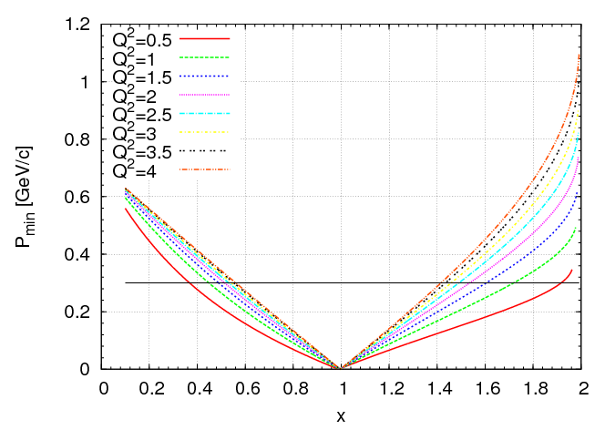
Q² threshold for 2N SRC Observation
Calculation for A=2
<Q²>~2.7 GeV²
Fomin et al, PRL 108 (2012) Jlab E02-019
Egiyan et al (2003)

Slide 16
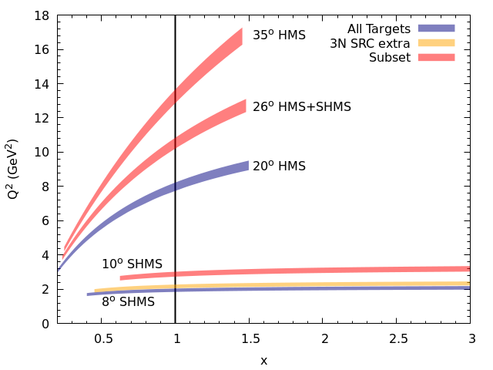
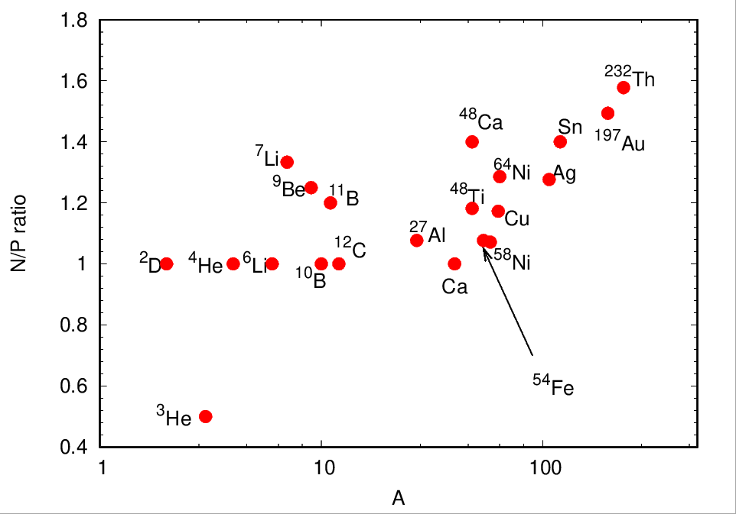
JLab E12-06-105 (XEM2): So Much Data
SFQ
EMC
SRC Land
2N
3N

Slide 17
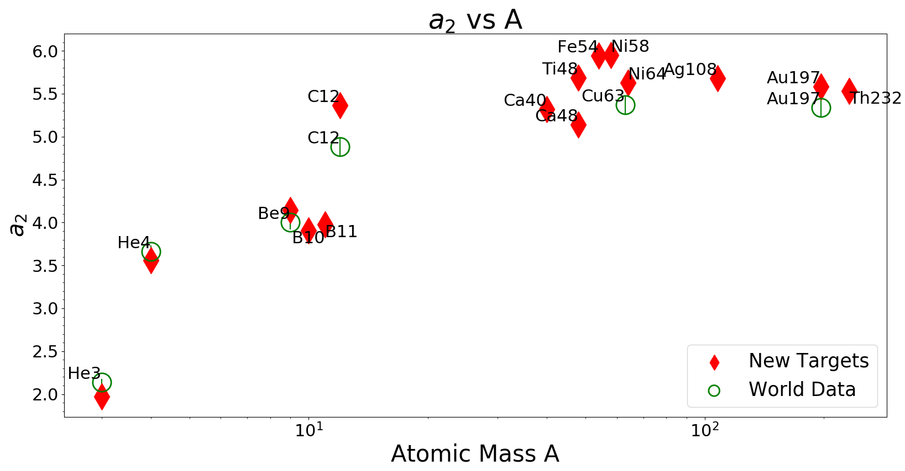
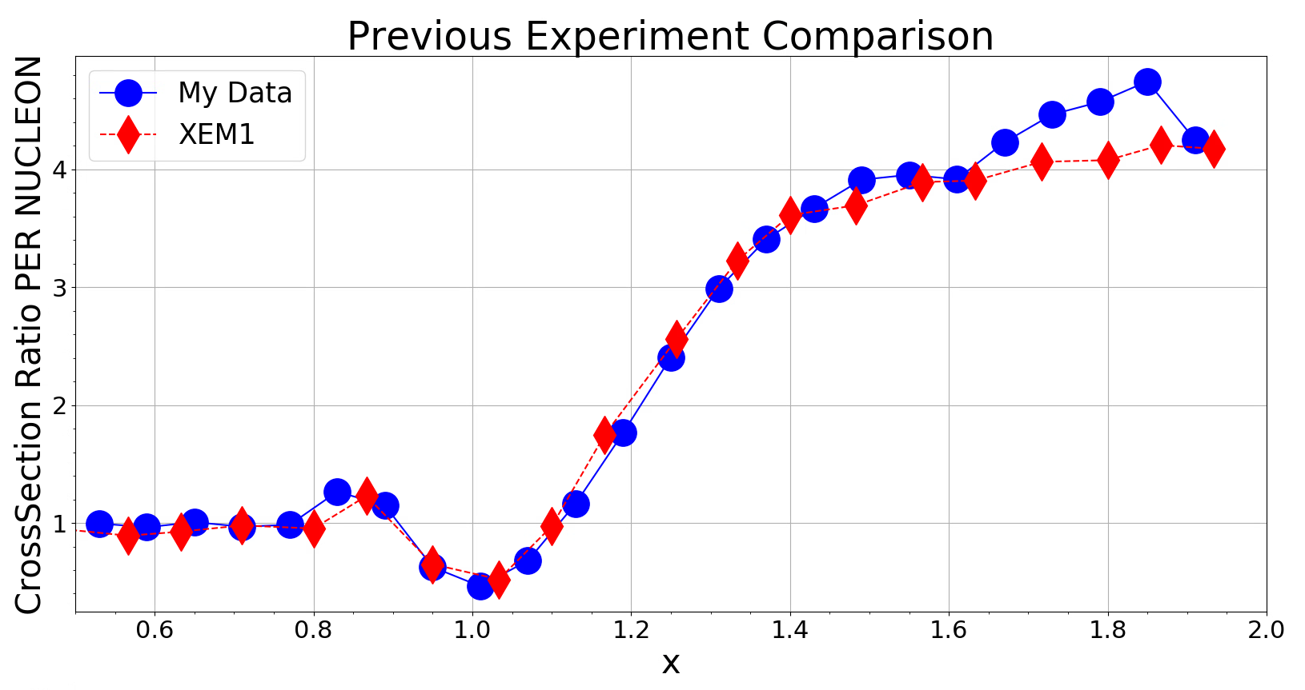
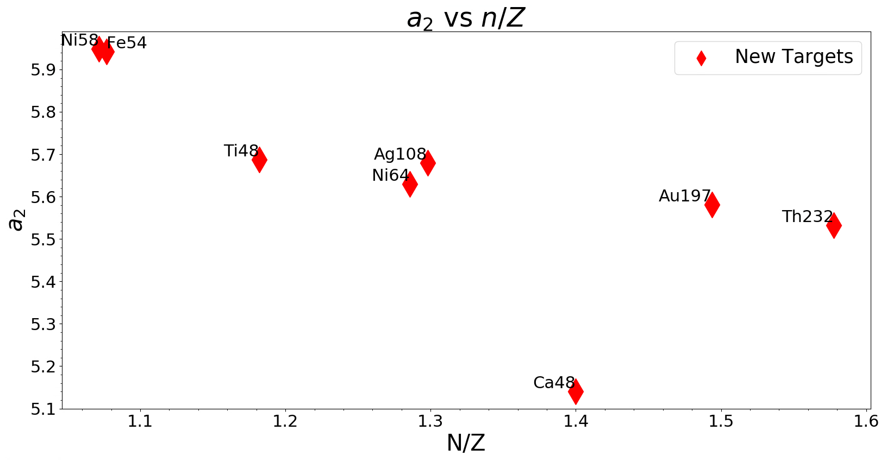
JLab E12-06-105 (XEM2)
Selected Results
PRELIMINARY
⁹Be
PRELIMINARY
PRELIMINARY
PhD Student Ramon Ogaz (UT)

Slide 18
2N SRCs – we’ve learned so much!

Slide 19
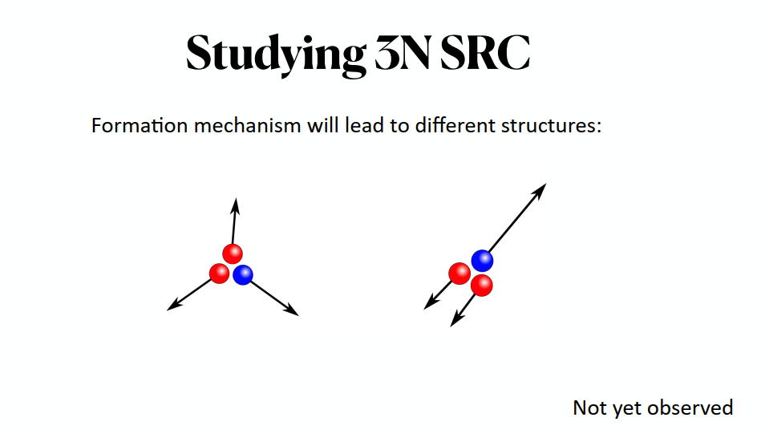
Can we isolate/study the 3-body force?

Slide 20


Slide 21
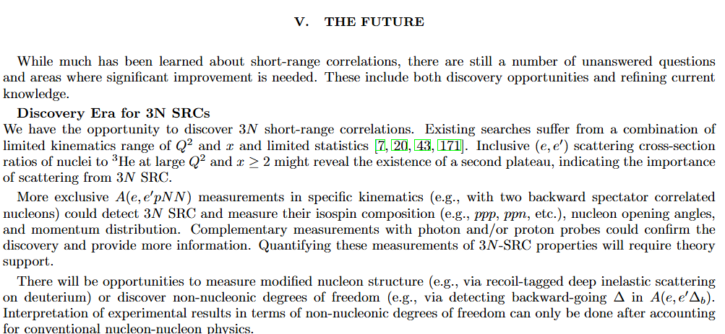

Slide 22
More nucleons in a correlation
3N SRC
1.4 < x < 2 => 2 nucleon correlation
2.4 < x < 3 => 3 nucleon correlation
2N SRC
Go to x>2 to see a second, 3N SRC plateau in $\frac{σ_{A}}{σ_{3He}}$

Slide 23
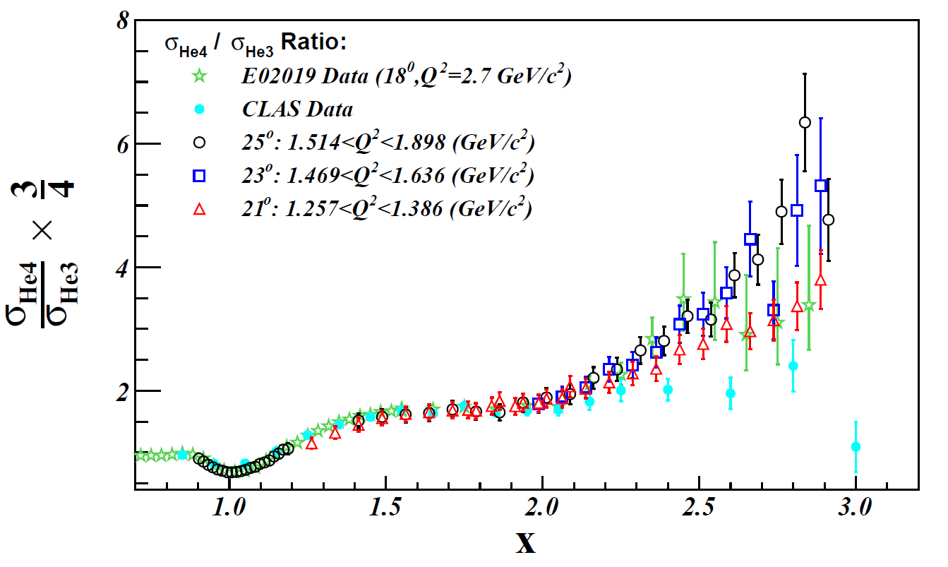
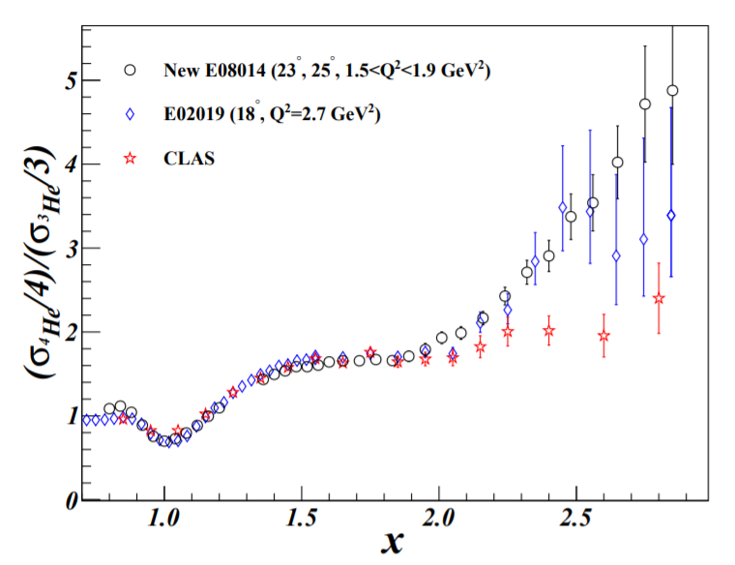
Inclusive 3N SRC data so far
Experiment | Q² range (GeV²) | Note
E02019 | ~2.7 | XEM (6 GeV)
E08014 | 1.3-1.9 | Hall A 6 GeV
CLAS | 1.6 (ave) | Resolution Limited

Slide 24

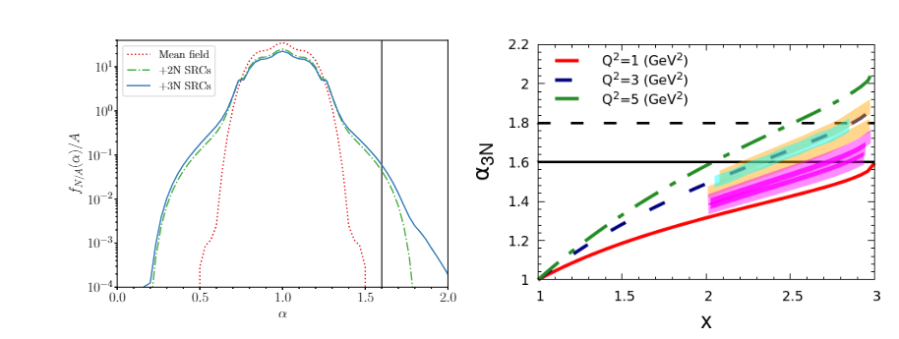
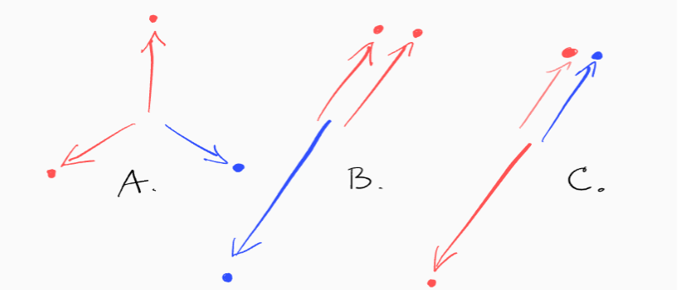
Onset of 3N Dominance
Light cone momentum fraction in a 3N system

Slide 25
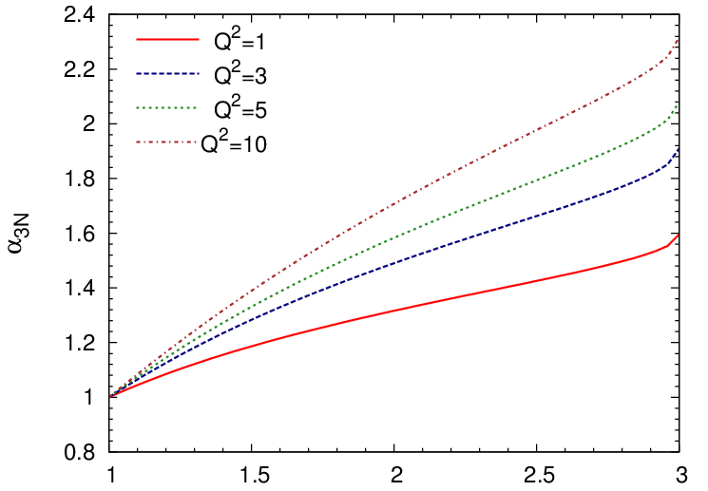
Onset of 3N Dominance
Light cone momentum fraction in a 3N system
Ann.Rev.Nucl.Part.Sci. 67 (2017)
α_{3N_MIN}=1.6
Spectator nucleons at ≥ 300 MeV/c

Slide 26
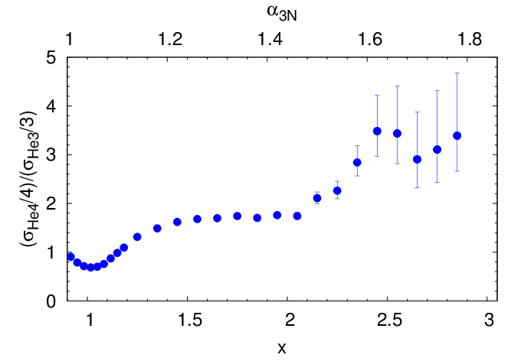
Hall C XEM data from 6 GeV
E02-019 (2.7 GeV²)
6 GeV XEM
12 GeV XEM2 (Under Analysis)
Hall A at 6 GeV

Slide 27
E12-06-105 (XEM2): 3N SRC Data Under Analysis
SFQ
EMC
SRC Land
2N
3N
6 GeV XEM
12 GeV XEM2 (Under Analysis)
Hall A at 6 GeV
CLAS 3N knockout data also under analysis by Andrew Denniston and Natalie Wright

Slide 28
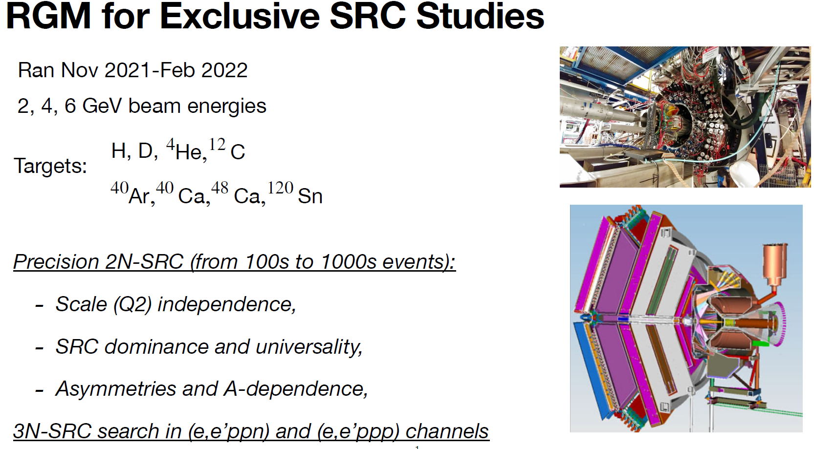
(courtesy N. Wright)

Slide 29
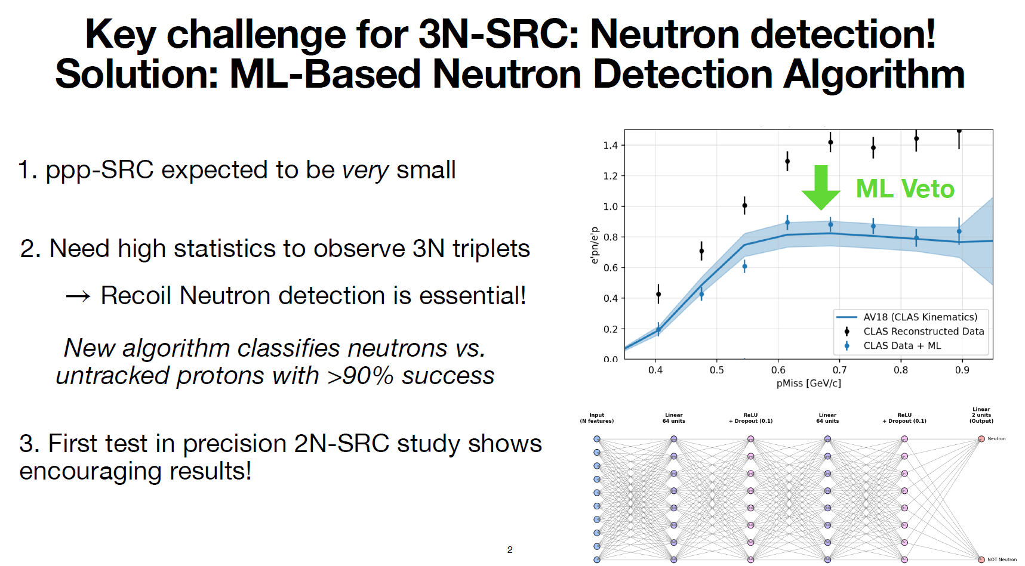
(courtesy N. Wright)

Slide 30
E12-06-105 (XEM2): 3N SRC Data Under Analysis
SFQ
EMC
SRC Land
2N
3N
6 GeV XEM
12 GeV XEM2 (Under Analysis)
Hall A at 6 GeV
CLAS 3N knockout data also under analysis by Andrew Denniston and Natalie Wright

Slide 31
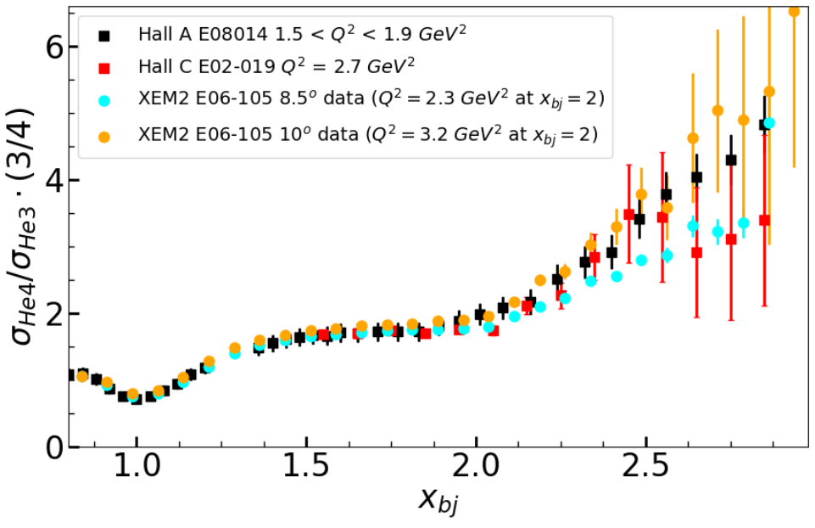
E12-06-105 (XEM2): 3N SRC Data Under Analysis
Preliminary
PhD Student Jordan O’Kronley (UT)
Notes:
Talk about targets

Slide 32
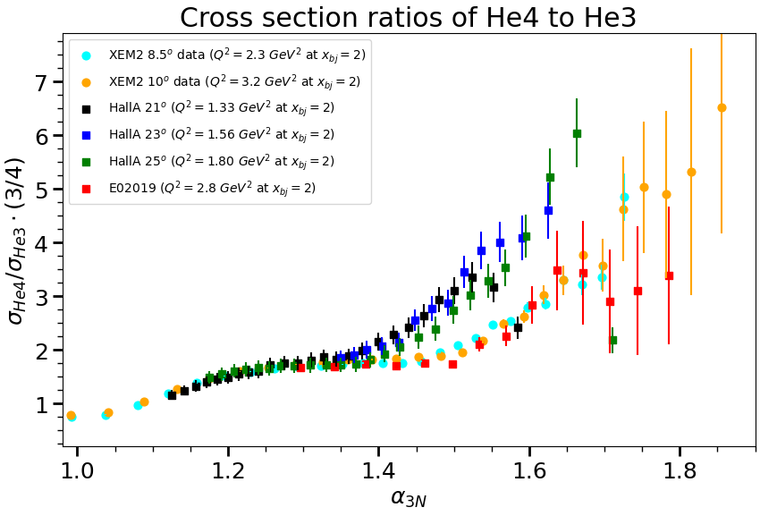
E12-06-105 (XEM2): 3N SRC Data Under Analysis
Preliminary
PhD Student Jordan O’Kronley (UT)

Slide 33
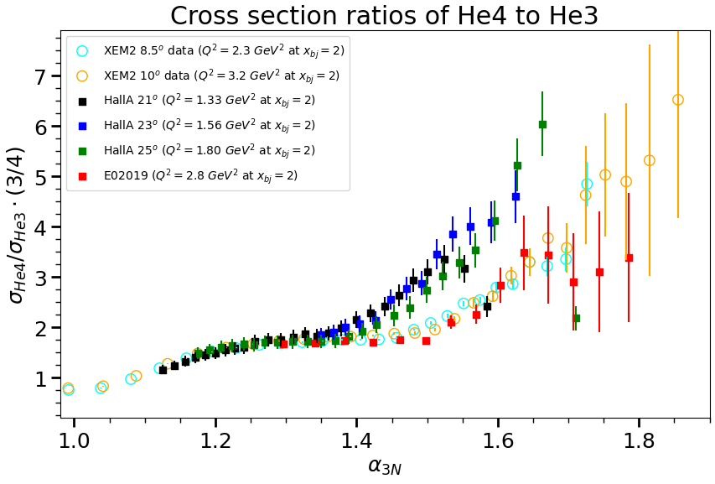
E12-06-105 (XEM2): 3N SRC Data Under Analysis
Preliminary
PhD Student Jordan O’Kronley (UT)

Slide 34
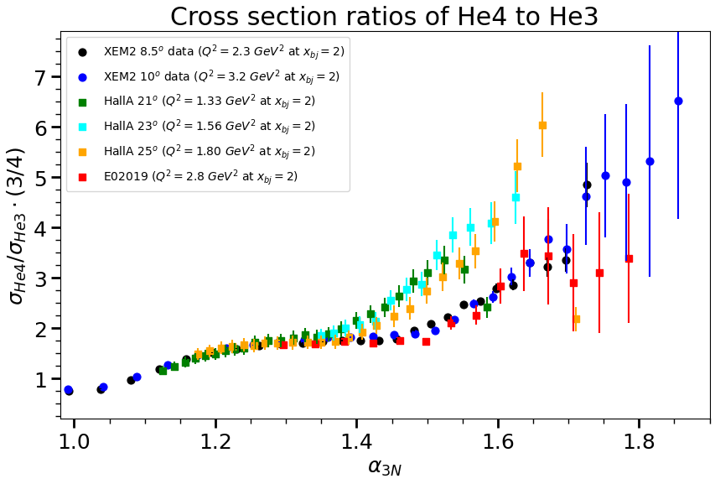
Preliminary
PhD Student Jordan O’Kronley (UT)

Slide 35
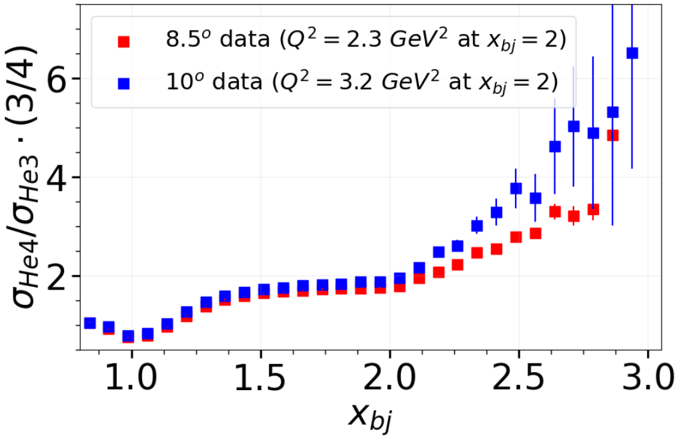
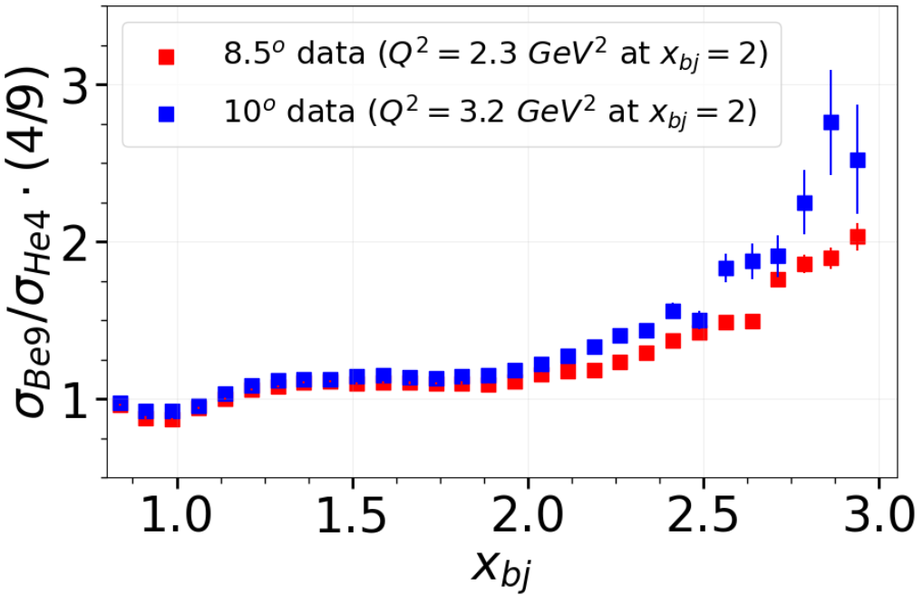
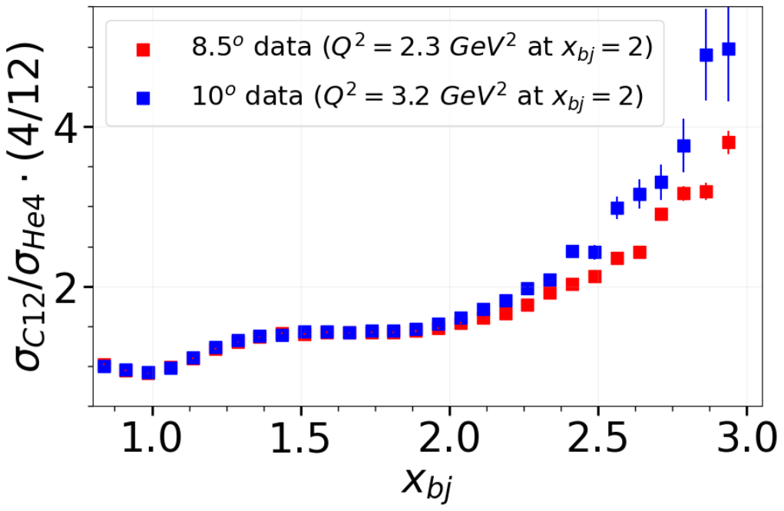
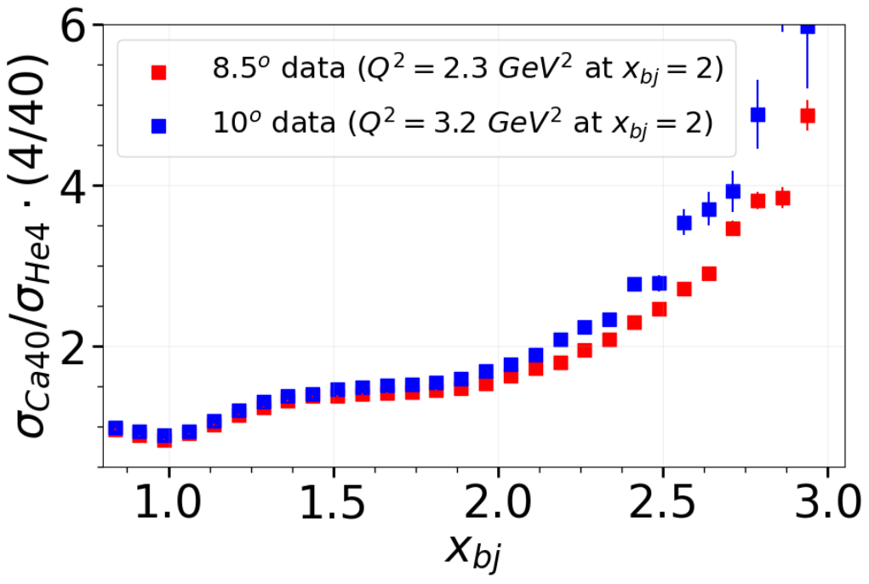
He4/He3
Be9/He4
Preliminary
Preliminary
C12/He4
Ca40/He4
Preliminary
Preliminary
PhD Student Jordan O’Kronley (UT)

Slide 36
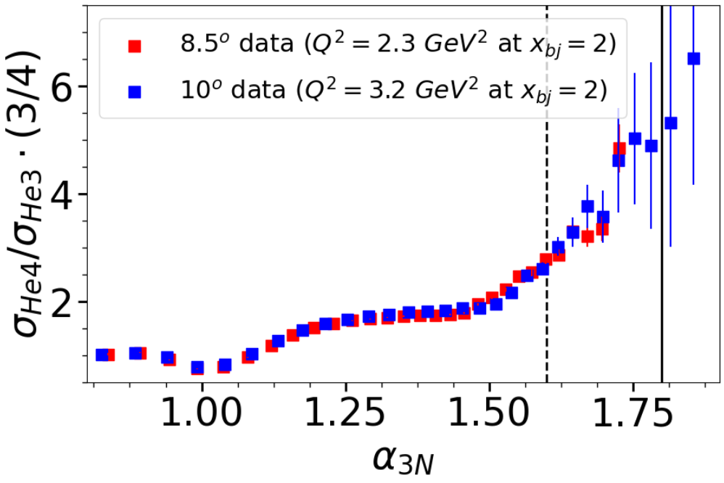
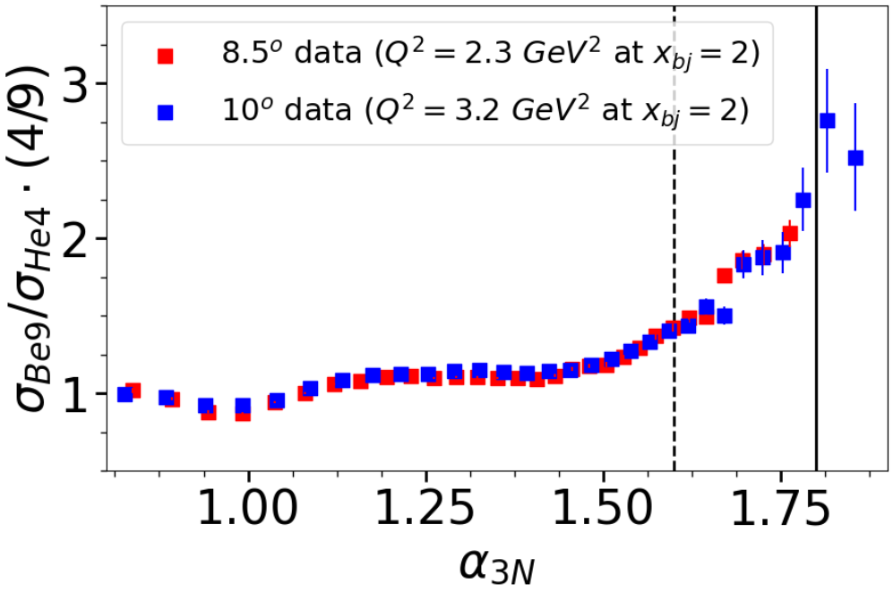
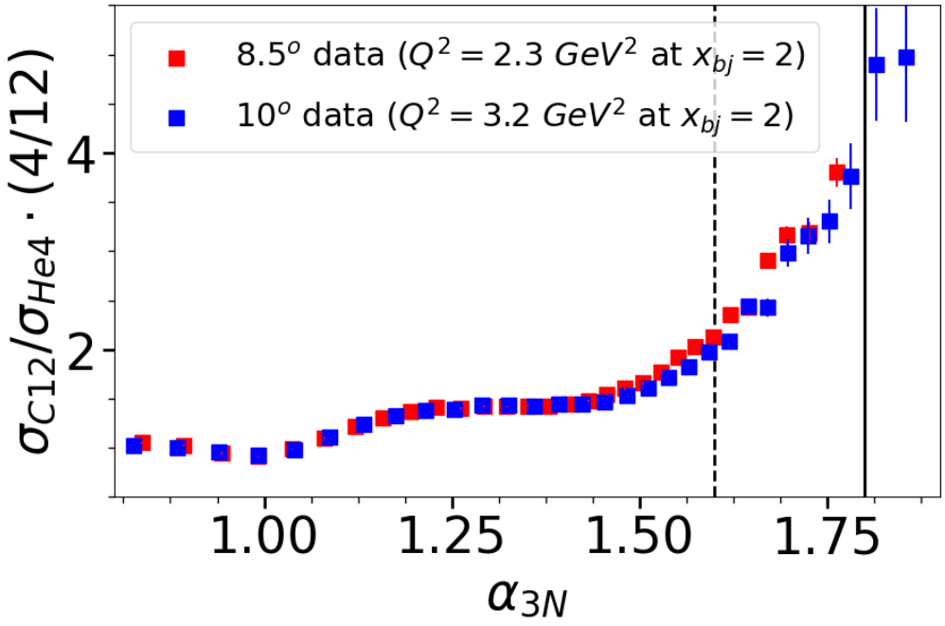
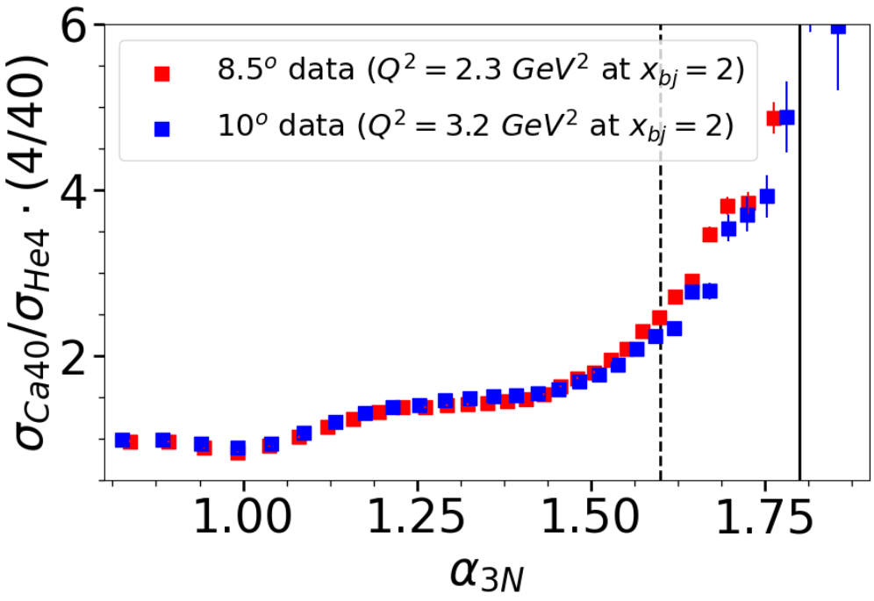
He4/He3
Be9/He4
Preliminary
Preliminary
C12/He4
Ca40/He4
Preliminary
Preliminary
PhD Student Jordan O’Kronley (UT)

Slide 37
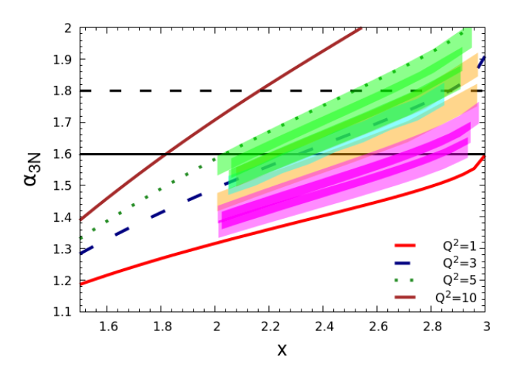
E12-06-105: 3N SRC Data Under Analysis
SFQ
EMC
SRC Land
2N
3N
Proposed Kinematics* (10,11,12)
XEM2 (Under analysis: 8.5, 10)
Hall A at 6 GeV

Slide 38
Other hints from high-x inclusive data

Slide 39
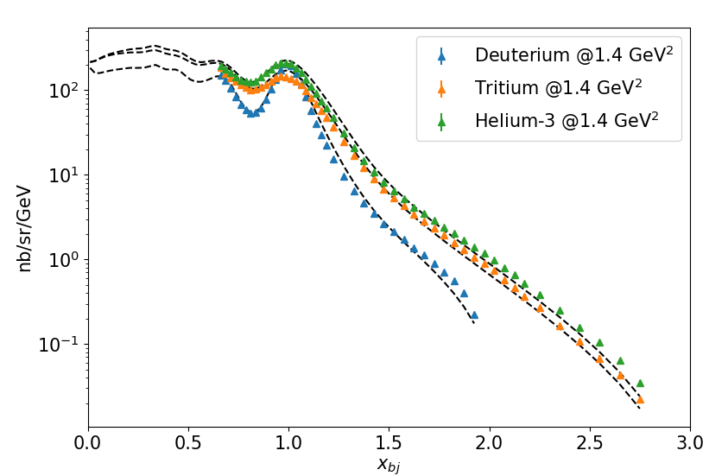
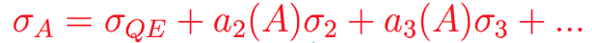
E12-11-112 Experiment in Hall A
QE peak for 10 Q² values, 0.6-2.8 GeV²
Neutron magnetic form factor
S. Santiesteban, et al., PRL 132 (2024) 162501.
Data to x ≈ 2 at Q² = 1.4, 1.9 GeV²
Isospin structure of 2N-SRCs.
S. Li, et al., Nature 609 (2022) 7925
QE scattering at large x from ²H, ³H, and ³He
Slide credit: John Arrington

Slide 40
E12-11-112 Experiment in Hall A
QE scattering at large x from ²H, ³H, and ³He
QE peak in SRC region: 5 Q² values, 0.6-1.9 GeV²
Low-Q² scaling violations in 2N-SRCs
Data to x ≈ 3 at Q² = 1.4, 1.9 GeV²
Potential for large 3N-SRC contributions
S. Li, et al., arXiv:2404.16235
Slide credit: John Arrington

Slide 41
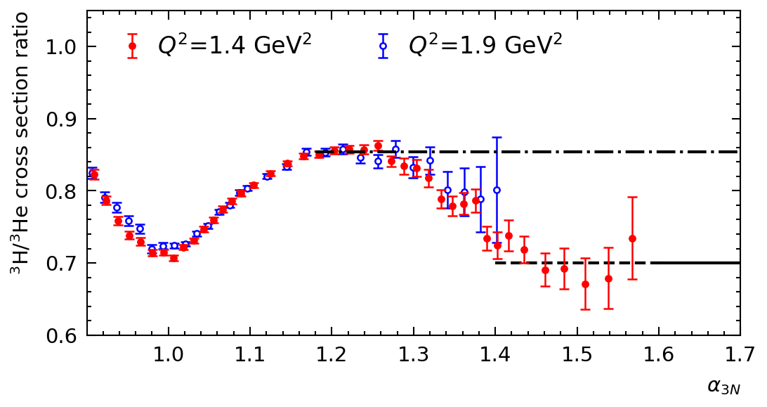
E12-11-112 Experiment in Hall A:
Cross Section beyond x=2
2N- and 3N-SRCs
2N-SRCs
2N-SRC region
3N-SRC region??
41
S. Li, et al. – arXiv:2404.16325
Mixture of 2N and 3N contributions → 3N SRCs could change the 2N scaling
³H/³He ratios show early onset of scaling in α_{2N}, and scaling extends to lower Q² values:
Slide credit: John Arrington

Slide 42
E12-11-112 Experiment in Hall A:
Cross Section beyond x=2
A/³He data do not show clear sign of 3N-SRC dominance
³H/³He ratios show early onset of scaling in α_{2N}, and scaling extends to lower Q² values:
2N-SRC region
3N-SRC region??
2N- and 3N-SRCs
2N-SRCs
42
S. Li, et al. – arXiv:2404.16325
Slide credit: John Arrington

Slide 43
Where do we go?
Observation
High Q² a₃ plateau observation
Medium Q² A=3 ratio
Exclusive measurement
→ detect 3 high-momentum nucleons
Detailed Studies
Isospin structure
Nuclear dependence
More!
Become an Author! (and send ideas)
Theory
A great deal of data already exists – need support for interpretation

Slide 45
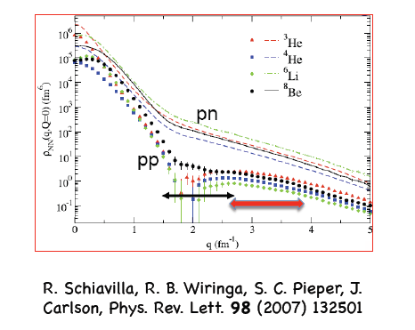


NP dominance
96 ± 23 %
R. Subedi et al., Science 320, 1476 (2008)
9.5 ± 2 %
R. Shneor et al., PRL 99, 072501 (2007)
also
→ Ciofi and Alvioli PRL 100, 162503 (2008)
→Sargsian, Abrahamyan, Strikman, Frankfurt PR C71 044615 (2005)

Slide 46


Note: $a_{2}=\frac{σ_{A}}{σ_{D}} !=$Relative #of SRCs
is the convolution of n_{D}(k) with the CM motion of correlated pairs in iron
Convolution
Following prescription from C. Ciofi degli Atti and S. Simula, Phys. Rev. C 53 (1996)
Deuteron
a₂=σ_{A}/σ_{D} → relative measure of high momentum nucleons
R_{2n} → relative measure of correlated pairs
46

Slide 47




Test scaling in x and Q²
³He
³He
¹²C
¹²C
Phys. Rev. C 48, 2451(1993)

Slide 48

Kinematic cutoff is A-dependent
For heavy nuclei, the minimum momentum changes → heavier recoil system requires less kinetic energy to balance the momentum of the struck nucleon
Larger fermi momenta for A>2 → MF contribution persists for longer
Imperfect plateau, but the picture still holds

Slide 49



Have we actually seen 3N SRC in ratios?

