Slide 1


Progress of Polarizabilities from Lattice QCD
Xu Feng (Peking U.)
2025.10.30
EINN2025 @ Paphos, Cyprus, 2025.10.28 – 11.01

Slide 2
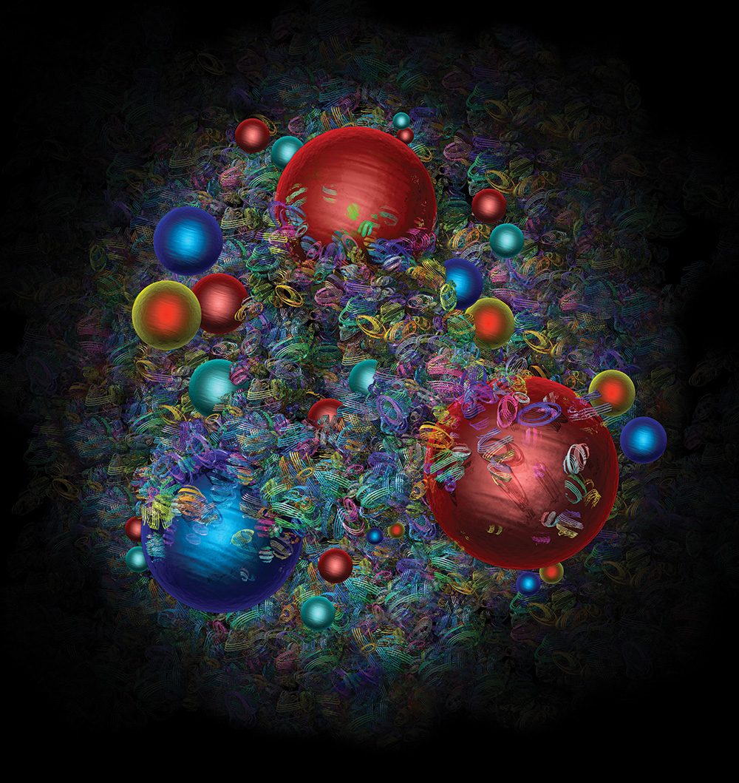
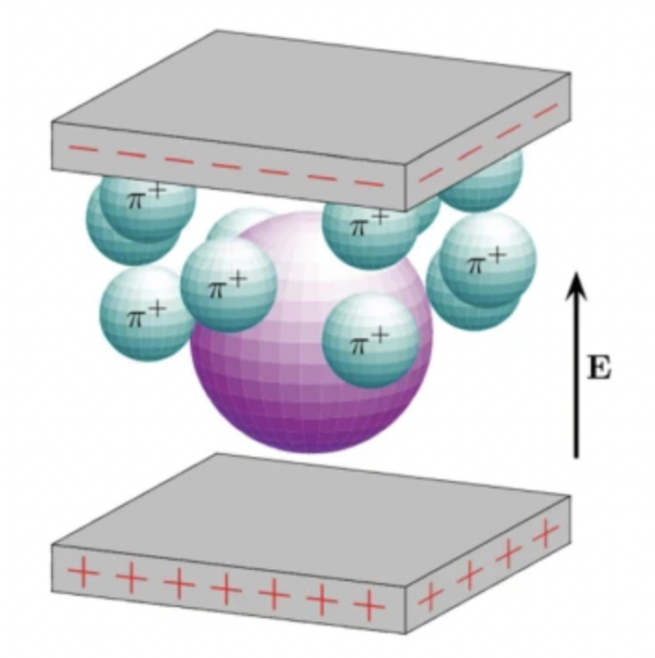
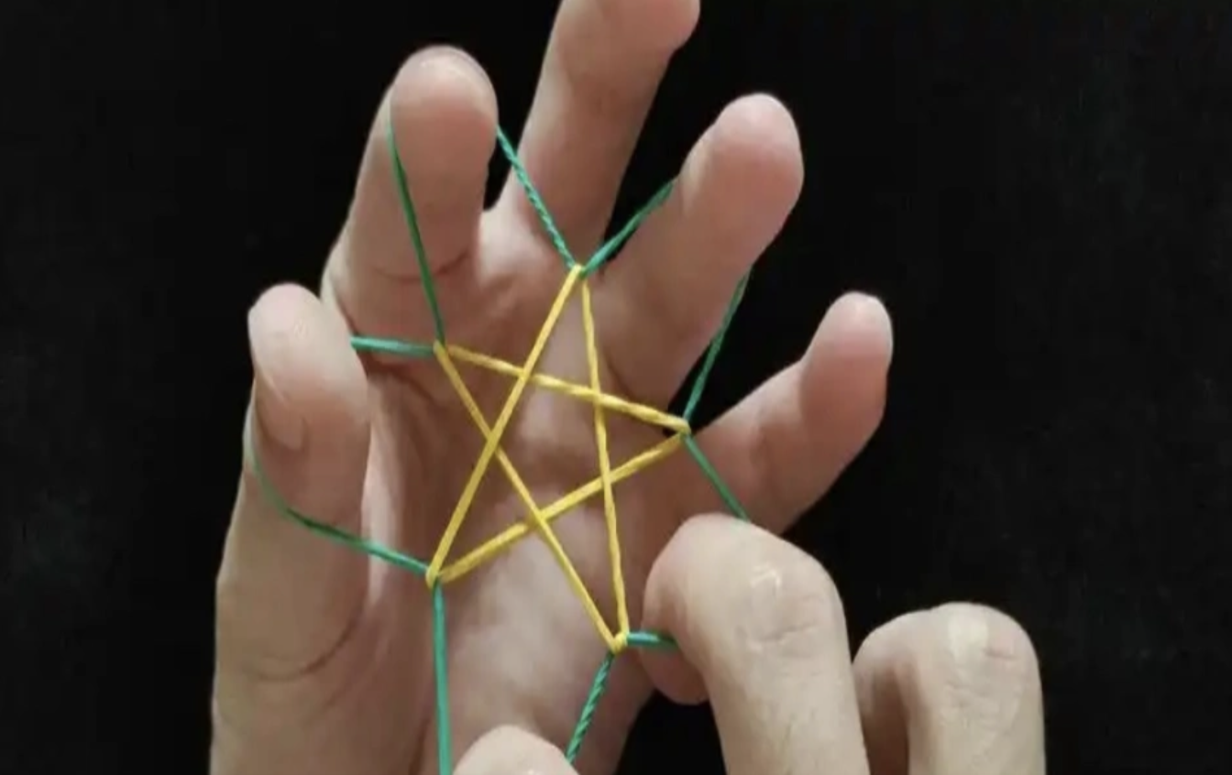
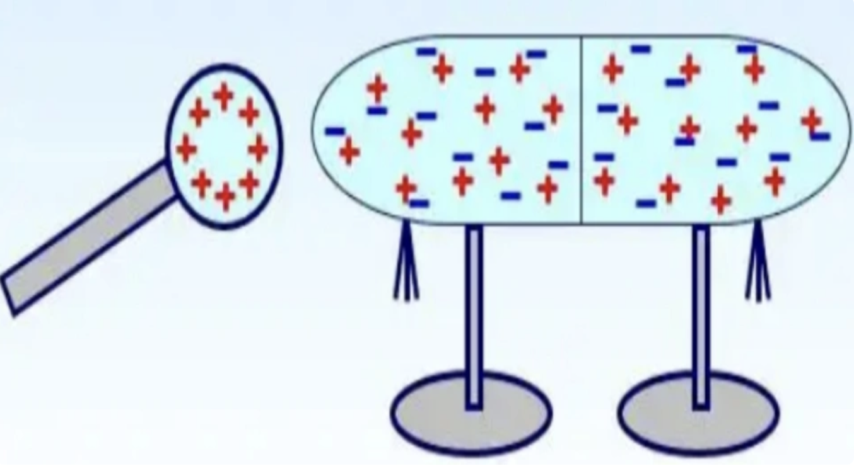

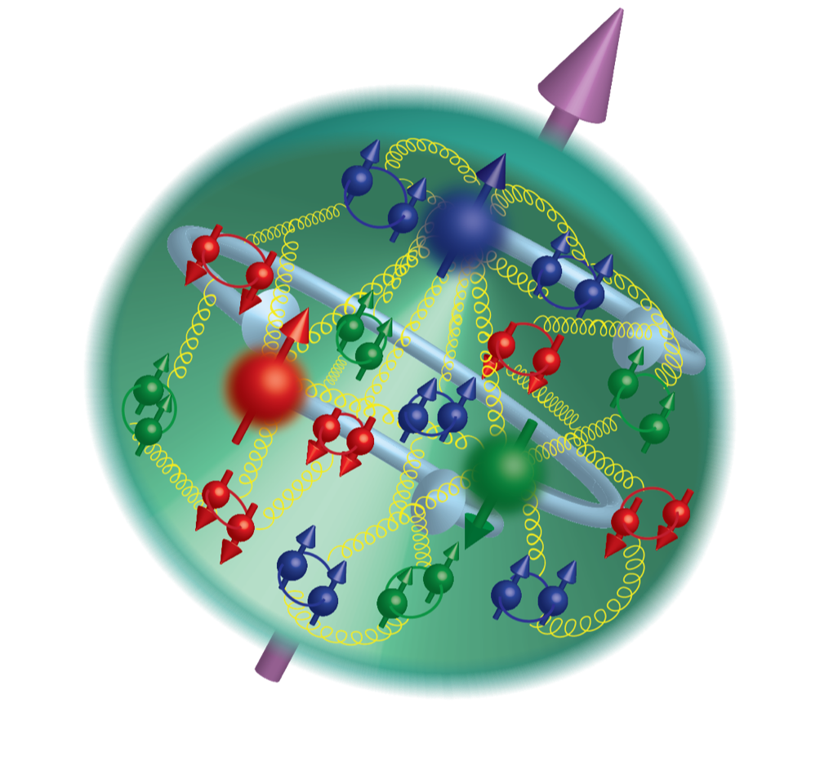
Complex nucleon structure
Polarization
Polarizabilities
Polarizabilities
– Intrinsic property of medium
Spin distribution
Charge radius
2

Slide 3
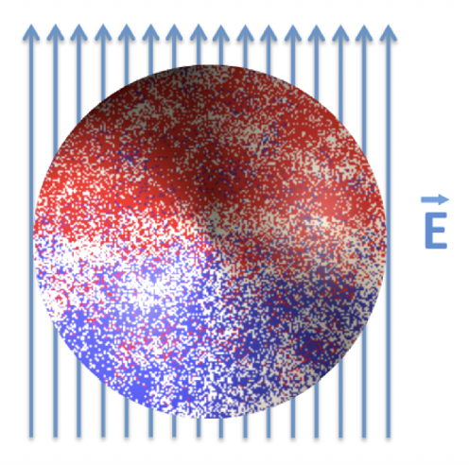
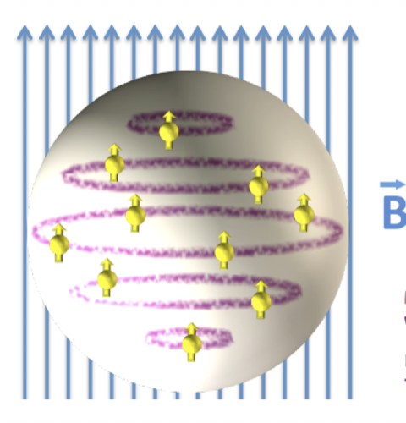




Electromagnetic polarizabilities
Polarizabilities offer insights into the distribution of charge and magnetism within nucleons, revealing their response to external electromagnetic fields
$$H_{eff}^{\left(2\right)}=−\frac{4π}{2}α_{E}E^{2}−\frac{4π}{2}β_{M}B^{2}$$
Polarization modifies the nucleon's energy, described by an effective Hamiltonian
Experimental determination of polarizabilities relies on Compton scattering, wherein external E&M fields polarize the target nucleon or deuteron
photon
$$μ$$
$$ν$$
nucleon
$$T^{μν}$$
3

Slide 4




Nucleon polarizabilities and Compton scattering
Nucleon E&M polarizabilities are most central quantities relevant for Compton scattering
$$q$$
$$μ$$
$$ν$$
$$P$$
$$T^{μν}$$
Unpolarized doubly virtual Compton scattering
$$T^{μν}\left(P,q\right)=T_{Born}^{μν}+\frac{8πM}{e^{2}}\left[−(β_{M}+O(q))K_{1}^{μν}+\left(α_{E}+β_{M}+O(q)\right)K_{2}^{μν}\right]$$
Born term
Polarizabilities
+
+……
Intermeidate states: $N$
Intermeidate states: $Nπ,N^{∗},Δ, ⋯$
4

Slide 5
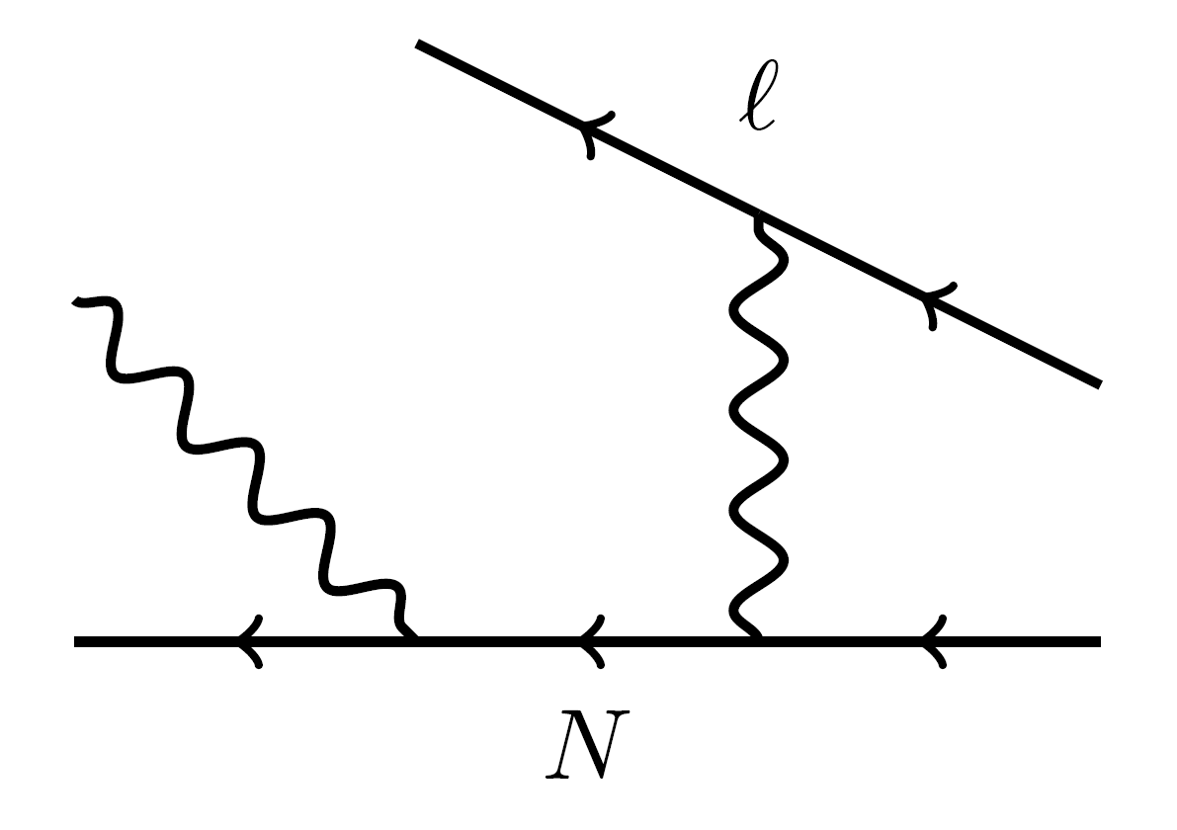



Generalized electric polarizabilities
In real-virtual Compton scattering
Interestingly, no existing theoretical model can explain this peak
$$α_{E}$$
$$α_{E}(Q^{2})$$
$$Q$$
R. Li et al., Nature 611 (2022) 7935, 265-270
Abnormal peak of generalized proton electric polarizability at $Q^{2}≈0.35 GeV^{2}$ ?
5

Slide 6
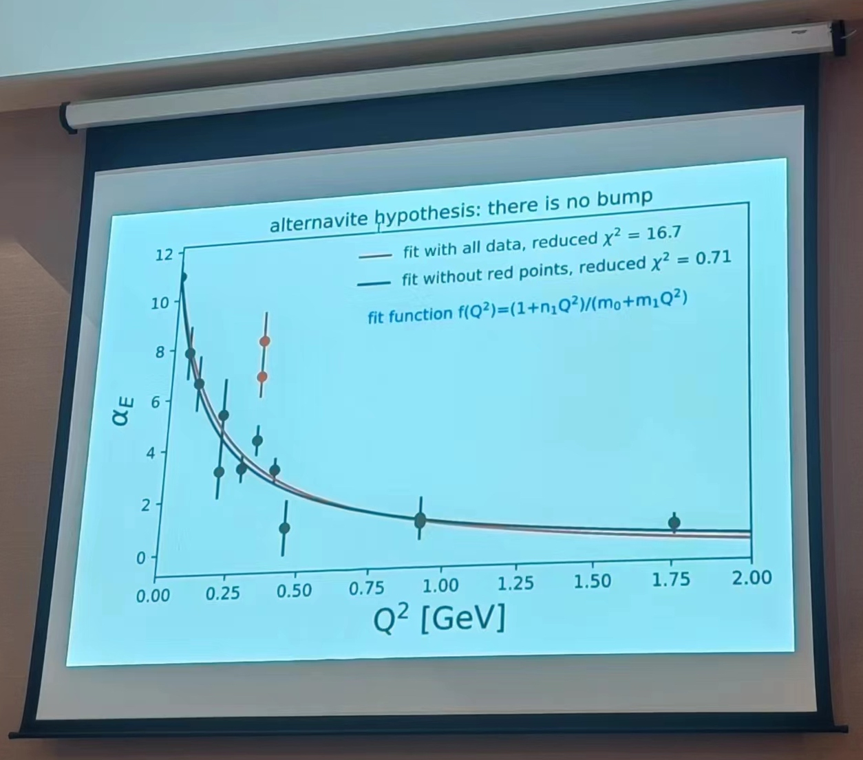
Generalized electric polarizabilities
Measured proton E&M structure deviates from theoretical predictions
Different viewpoints
VS
Figure shown by D. Higinbotham
@ 2nd Workshop on Nucleon Structure at Low Q, 2023
R. Li, N. Sparveris, et. al. Nature 611 (2022) 265
6

Slide 7
Determination of electric polarizabilities
Proton
Neutron
Experiment
Lattice QCD
7

Slide 8
Determination of electric polarizabilities
What is the primary source of discrepancy between lattice QCD and other studies?
Lattice calculations are performed at unphysical pion masses, ranging from 227 - 759 MeV
Unphysical quark mass effects
Background field technique is used, which converts 4pt function to 2pt function using Feynman-Hellman theorem
Hard to explore intermediate-state contributions and control systematics
Perform calculation at physical pion mass, using 4pt function
8

Slide 9
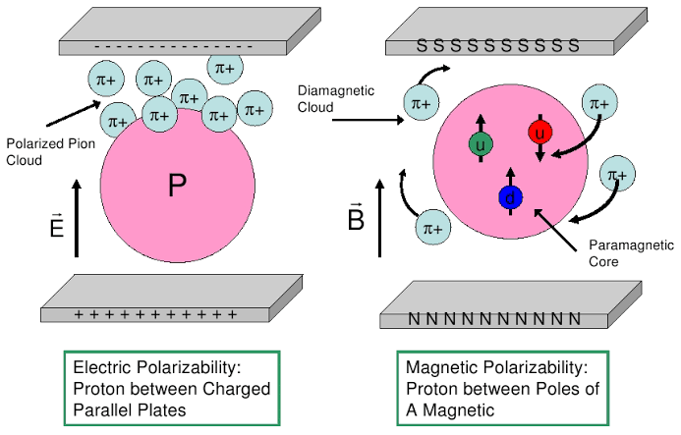
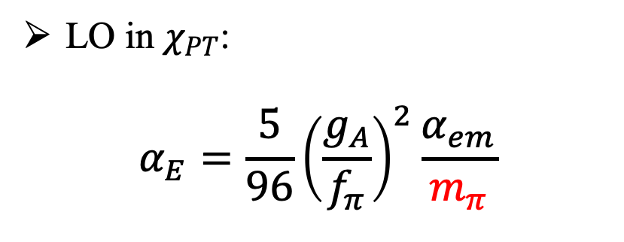
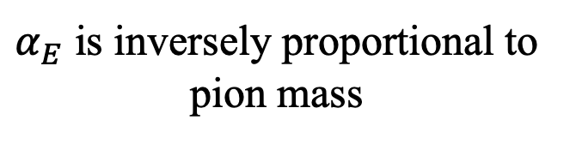
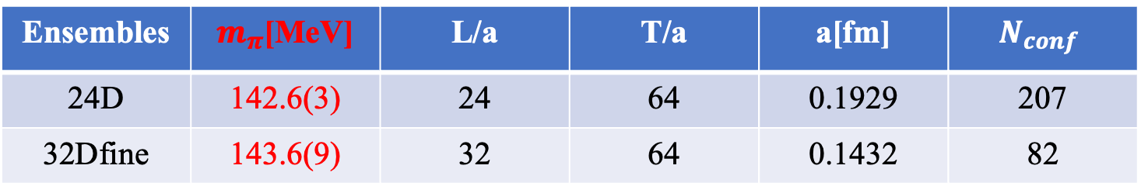
Why physical pion mass is important
Pion cloud in nucleon polarizabilities
LO in $χ_{PT}$:
$$α_{E}=\frac{5}{96}{\left(\frac{g_{A}}{f_{π}}\right)}^{2}\frac{α_{em}}{m_{π}}$$
V. Bernard et al., Phys. Rev. Lett. 67 (1991) 1515
$α_{E}$ is inversely proportional to pion mass
Use two DWF ensembles @ physical π mass
Ensembles | $m_{π}$[MeV] | L/a | T/a | a[fm] | $$N_{conf}$$
24D | 142.6(3) | 24 | 64 | 0.1929 | 207
32Dfine | 143.6(9) | 32 | 64 | 0.1432 | 82
9

Slide 10
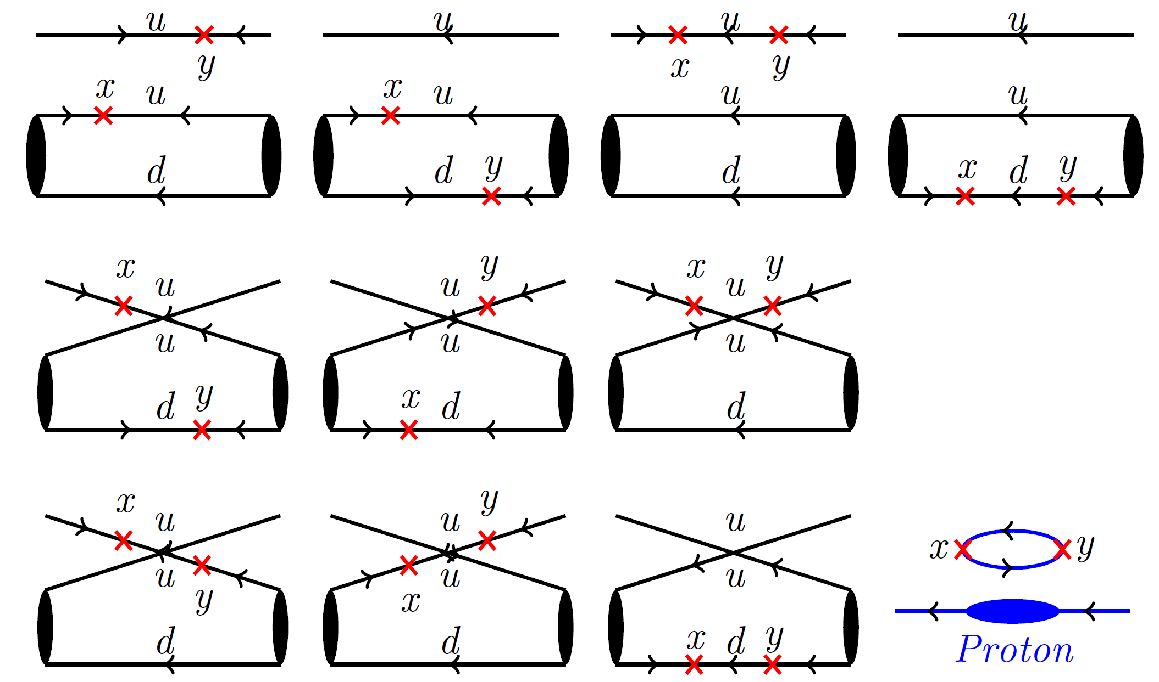
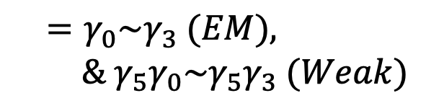
Numerical calculations
$$μ$$
$$ν$$
Complicated quark field contractions with two current insertions
$$T^{μν}$$
$$=γ_{0}\sim γ_{3} (EM),$$
$$\& γ_{5}γ_{0}\sim γ_{5}γ_{3} (Weak)$$
10

Slide 11

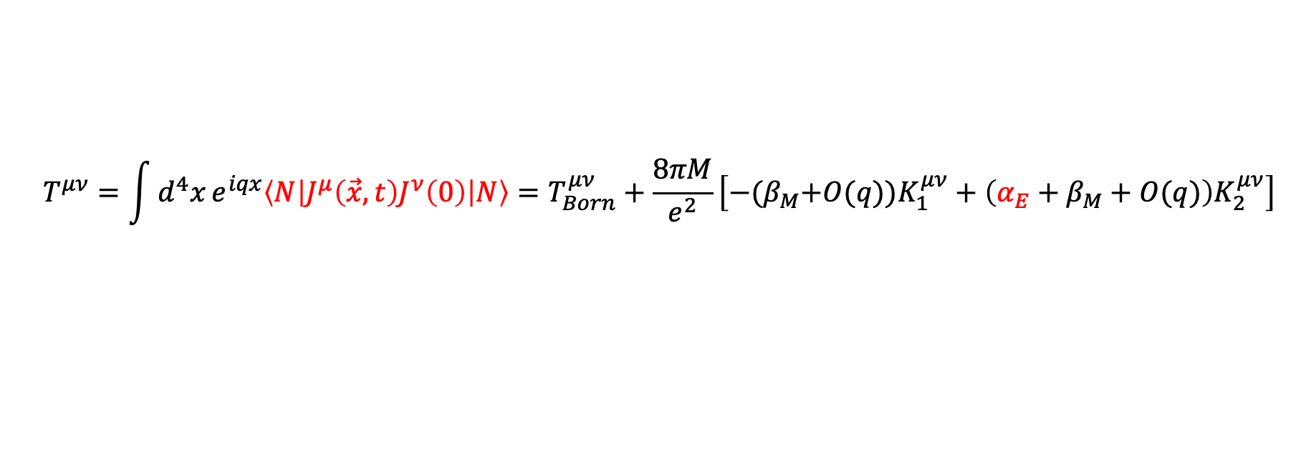


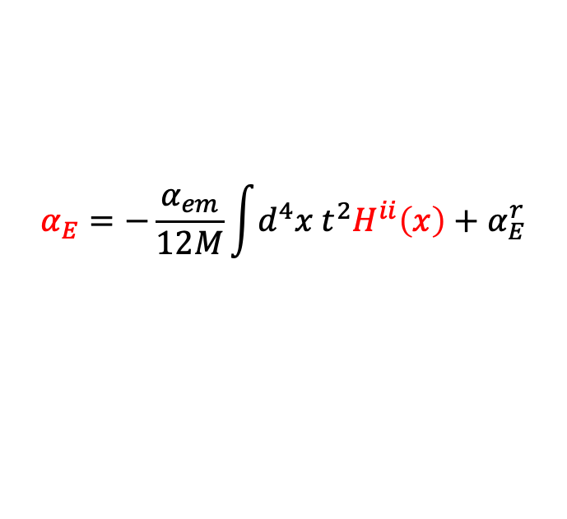


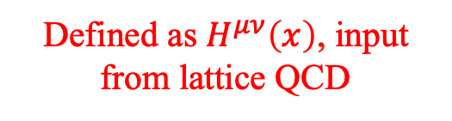

Electric polarizability from 4-pt function
Compton tensor
$$q$$
$$μ$$
$$ν$$
$$P$$
$$T^{μν}$$
$$T^{μν}=\int{d^{4}x}e^{iqx}\left\langle N\left|J^{μ}\left(\vec{x},t\right)J^{ν}\left(0\right)\right|N\right\rangle =T_{Born}^{μν}+\frac{8πM}{e^{2}}\left[−{(β}_{M}+O(q))K_{1}^{μν}+\left(α_{E}+β_{M}+O(q)\right)K_{2}^{μν}\right]$$
Defined as $H^{μν}\left(x\right)$, input from lattice QCD
$$α_{E}=−\frac{α_{em}}{12M}\int{d^{4}x{ t}^{2}H^{ii}\left(x\right)}+α_{E}^{r}$$
$$H^{ii}\left(\vec{x},t\right)=⟨N|J^{i}\left(\vec{x},t\right)J^{i}\left(0\right)|N⟩$$
11

Slide 12
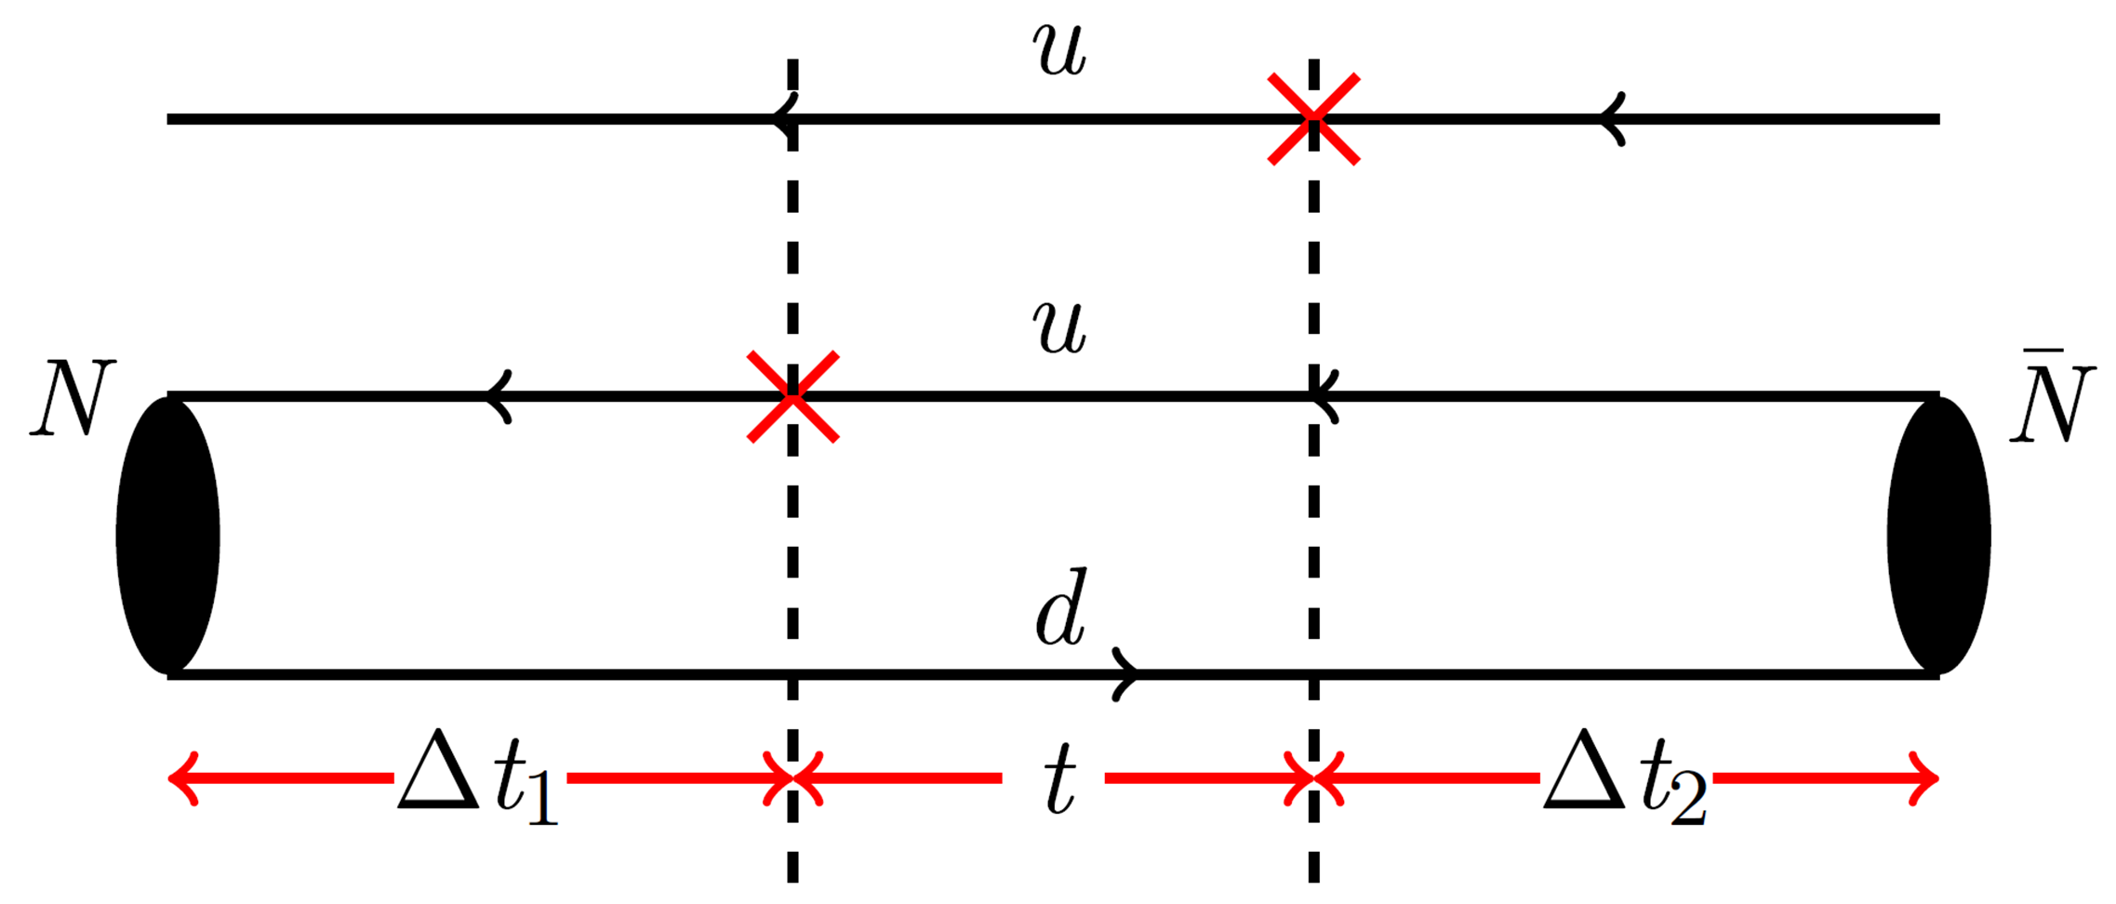
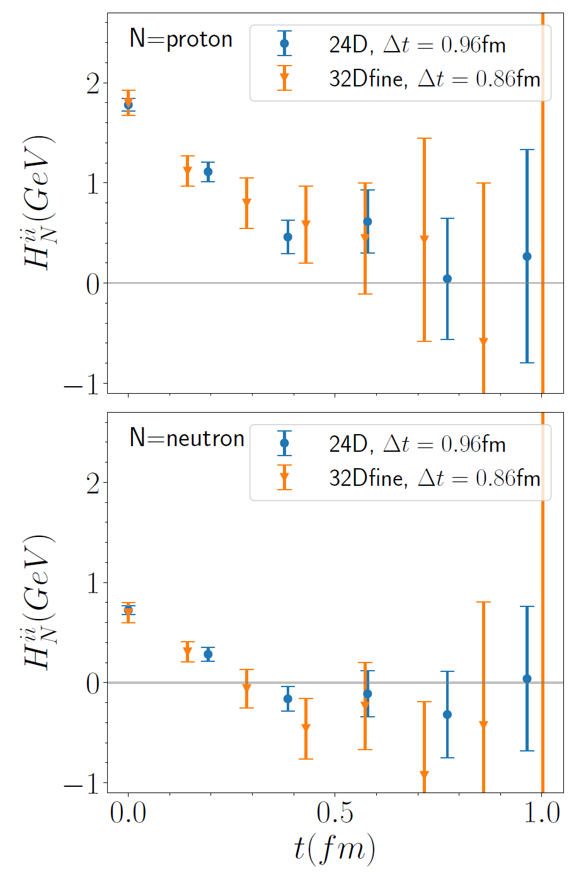
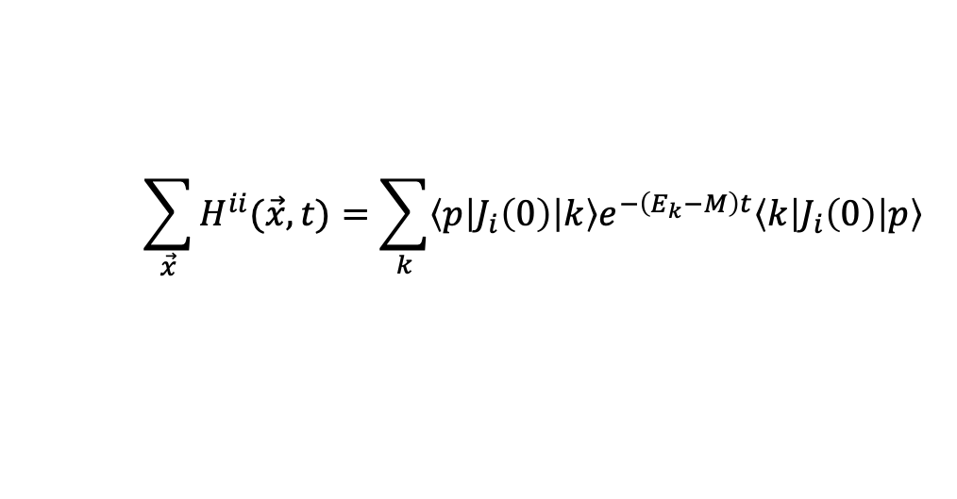
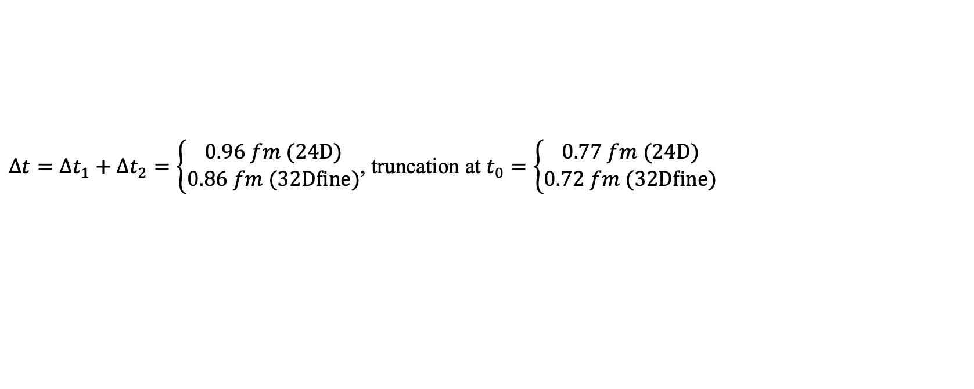
Signal of hadronic function
$$\sum_{\vec{x}}{H^{ii}(\vec{x},t)}=\sum_{k}{\left\langle p\left|J_{i}\left(0\right)\right|k\right\rangle e^{−\left(E_{k}−M\right)t}\left\langle k\left|J_{i}\left(0\right)\right|p\right\rangle }$$
signal region
Truncation
Truncation
$Δt=Δt_{1}+Δt_{2}=\left\{\begin{aligned}0.96 fm (24D) \\ 0.86 fm (32Dfine)\end{aligned}\right.$, truncation at $t_{0}=\left\{\begin{aligned}0.77 fm (24D) \\ 0.72 fm (32Dfine)\end{aligned}\right.$
In total, $Δt_{1}+Δt_{2}+t_{0}\sim$1.6-1.8 fm
12

Slide 13
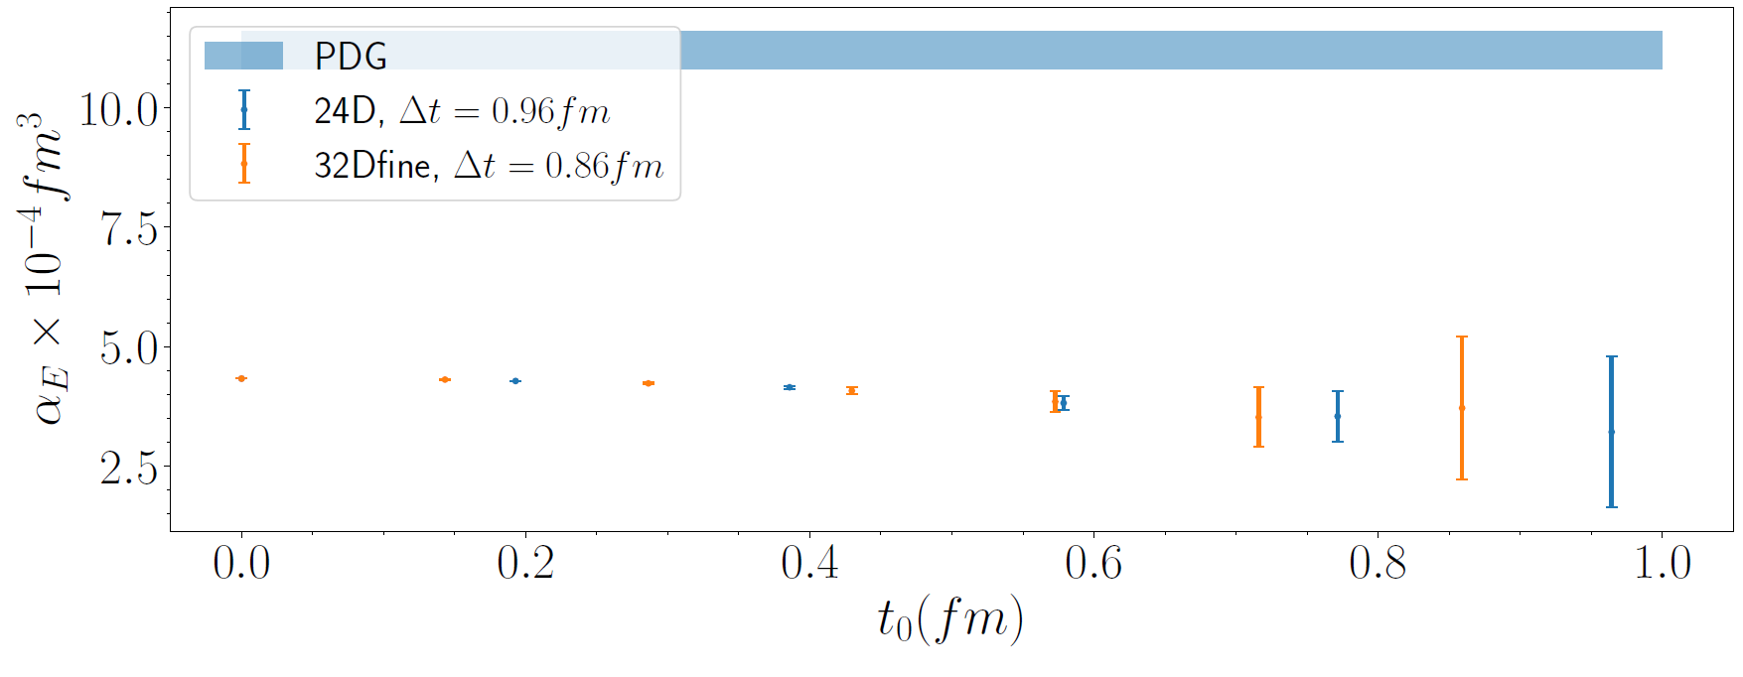
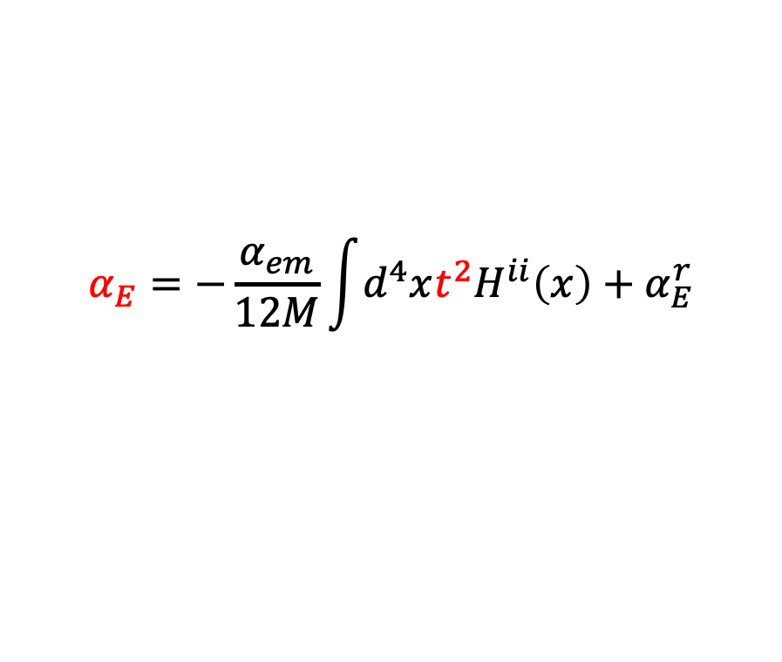

Polarizability $α_{E}$ from $H_{ii}(x)$
$$α_{E}=−\frac{α_{em}}{12M}\int{d^{4}xt^{2}H^{ii}\left(x\right)}+α_{E}^{r}$$
Polarizability extraction
Proton
PDG
Our truncation at $t_{0}$
Neutron
Experiment
Lattice QCD
However, lattice results are significantly below the PDG value.
13

Slide 14

Polarizability $α_{E}$ from $H_{ii}(x)$
$$α_{E}=−\frac{α_{em}}{12M}\int{d^{4}xt^{2}H^{ii}\left(x\right)}+α_{E}^{r}$$
Polarizability extraction
PDG
Our truncation at $t_{0}$
However, lattice results are significantly below the PDG value.
We need to look deeper!
14

Slide 15
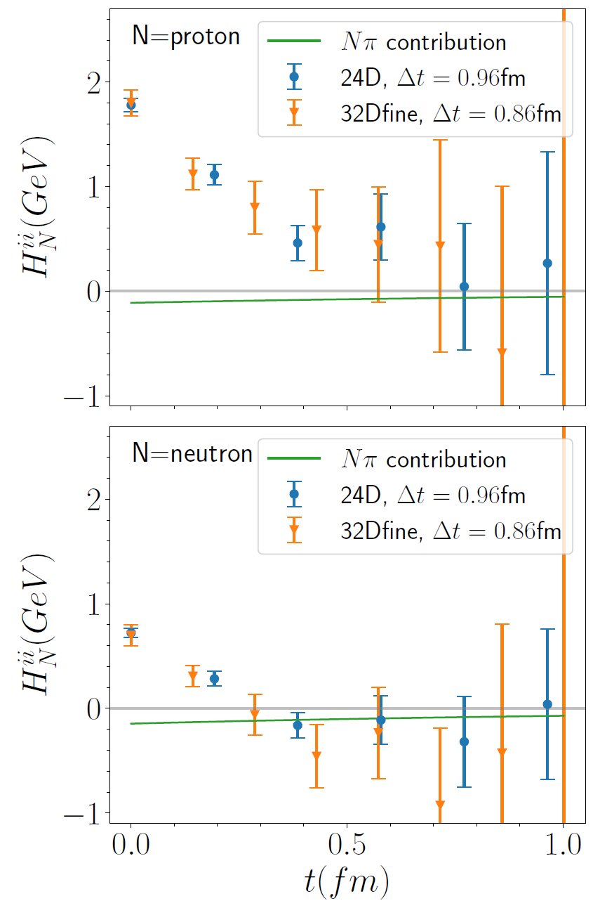
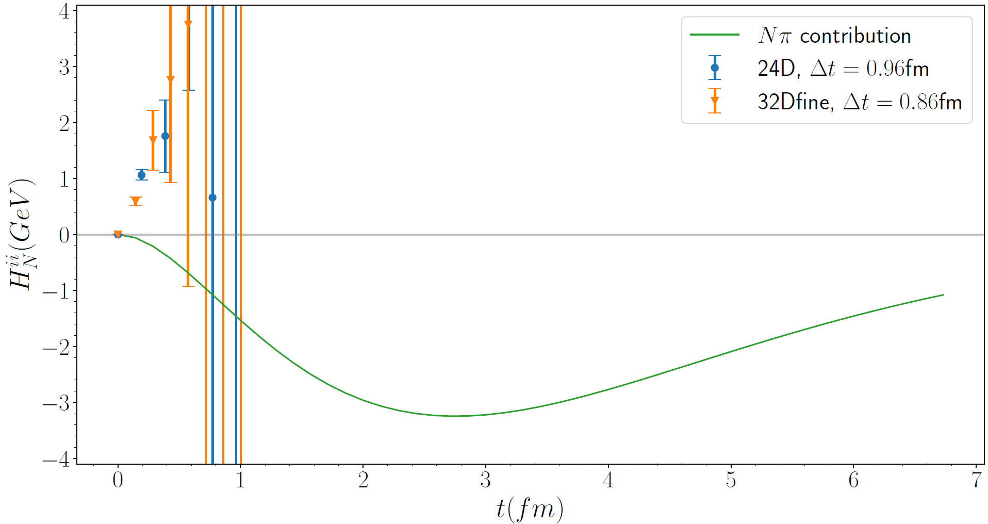
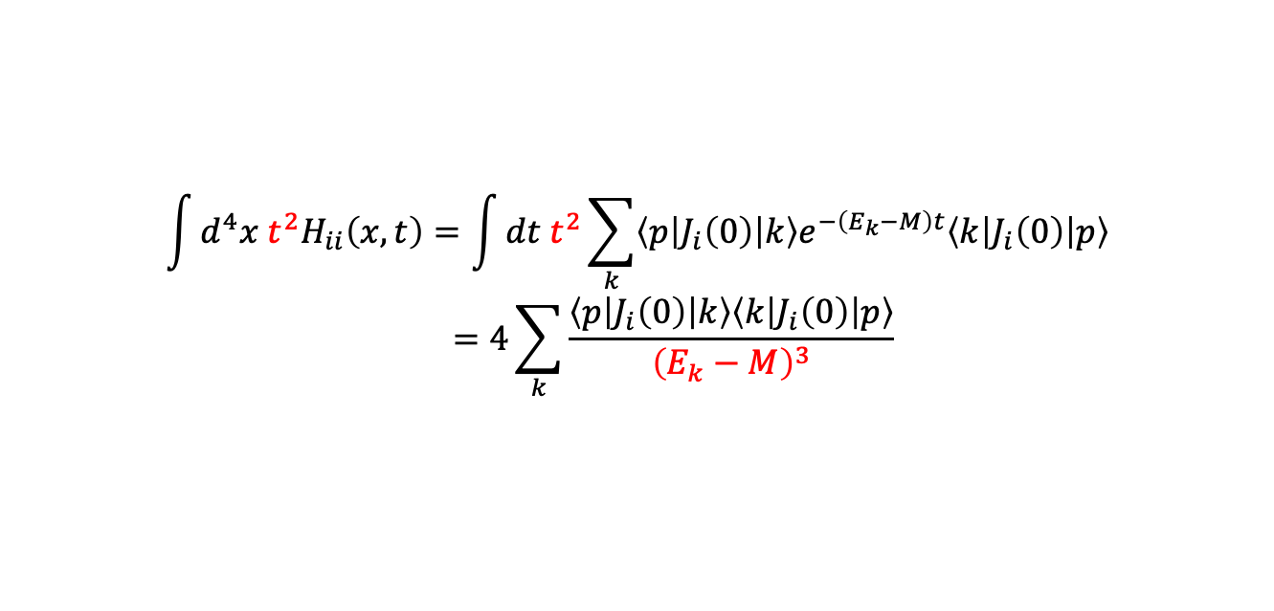




Nucleon polarizabilities and 𝑁𝜋 scattering
$$\int{d^{4}x t^{2}H_{ii}\left(x,t\right)=\int{dt t^{2}\sum_{k}{\left\langle p\left|J_{i}\left(0\right)\right|k\right\rangle e^{−\left(E_{k}−M\right)t}\left\langle k\left|J_{i}\left(0\right)\right|p\right\rangle }}}$$
$$=4\sum_{k}{\frac{\left\langle p\left|J_{i}\left(0\right)\right|k\right\rangle \left\langle k\left|J_{i}\left(0\right)\right|p\right\rangle }{{\left(E_{k}−M\right)}^{3}}}$$
Structure of hadronic function
The dominant contribution is given by $\left|k\right\rangle =|Nπ⟩$ states
$$t^{2}$$
Weight function
$$|Nπ⟩$$
$$|Nπ⟩$$
$|Nπ⟩$
$|Nπ⟩$ states contribution exhibits a peak at $t=2.8 fm$, far exceeding our truncation at $t_{0}≈0.75 fm$
Must calculate $Nπ$ contribution directly!
15

Slide 16
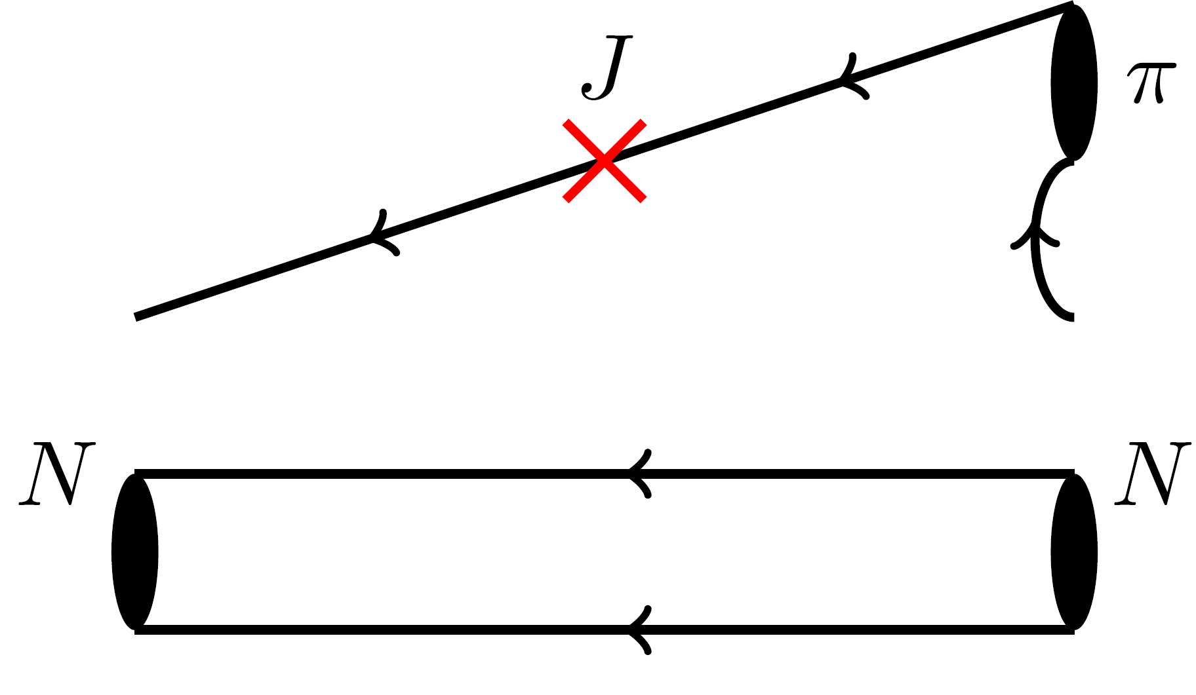
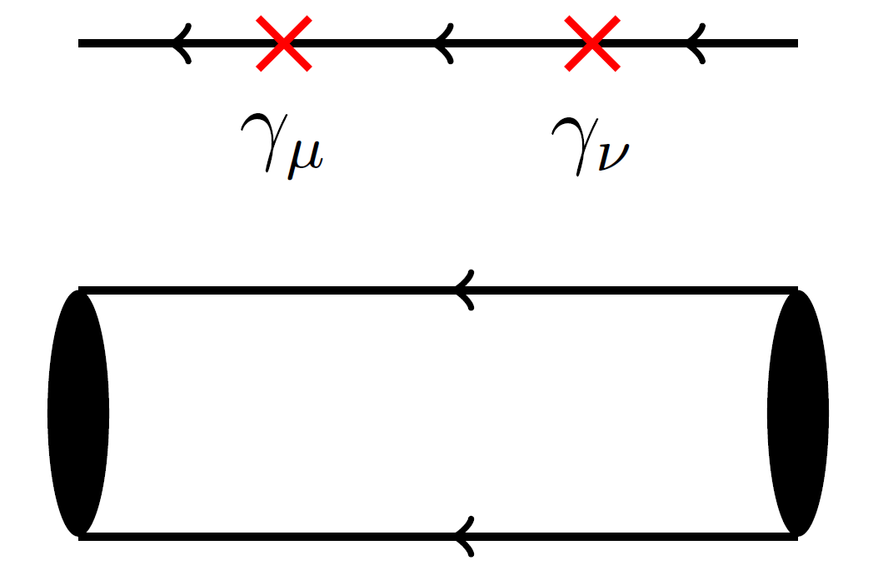
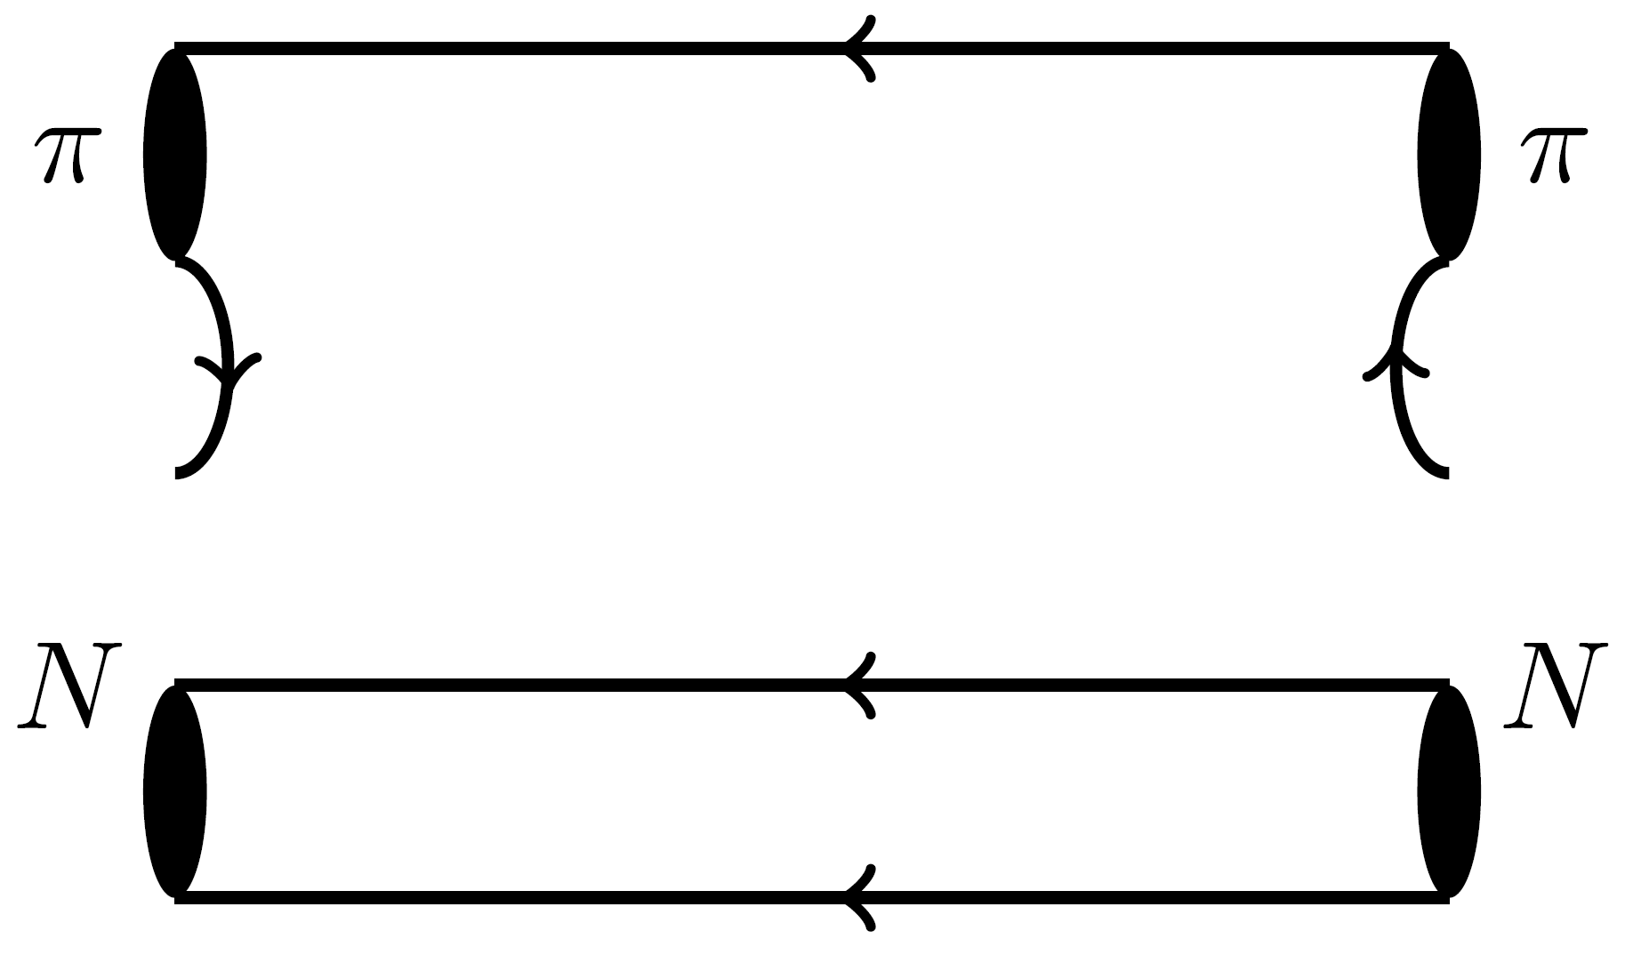


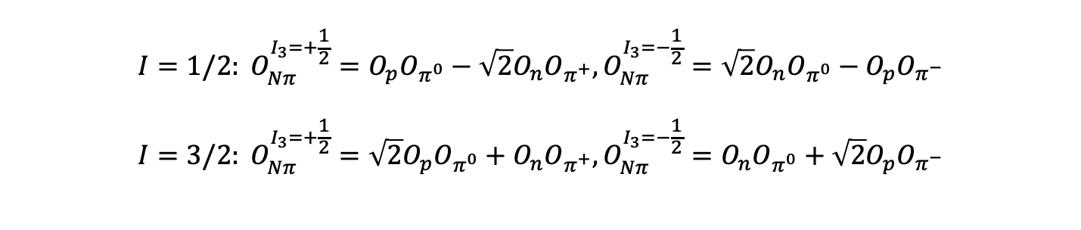
Wick contraction of $Nπ$ rescattering
$$N$$
$$N$$
$$I=1/2: O_{Nπ}^{I_{3}=+\frac{1}{2}}=O_{p}O_{π^{0}}−\sqrt{2}O_{n}O_{π^{+}},O_{Nπ}^{I_{3}=−\frac{1}{2}}=\sqrt{2}O_{n}O_{π^{0}}−O_{p}O_{π^{−}} \\ I=3/2: O_{Nπ}^{I_{3}=+\frac{1}{2}}=\sqrt{2}O_{p}O_{π^{0}}+O_{n}O_{π^{+}},O_{Nπ}^{I_{3}=−\frac{1}{2}}=O_{n}O_{π^{0}}+\sqrt{2}O_{p}O_{π^{−}}$$
}
Operators
16

Slide 17
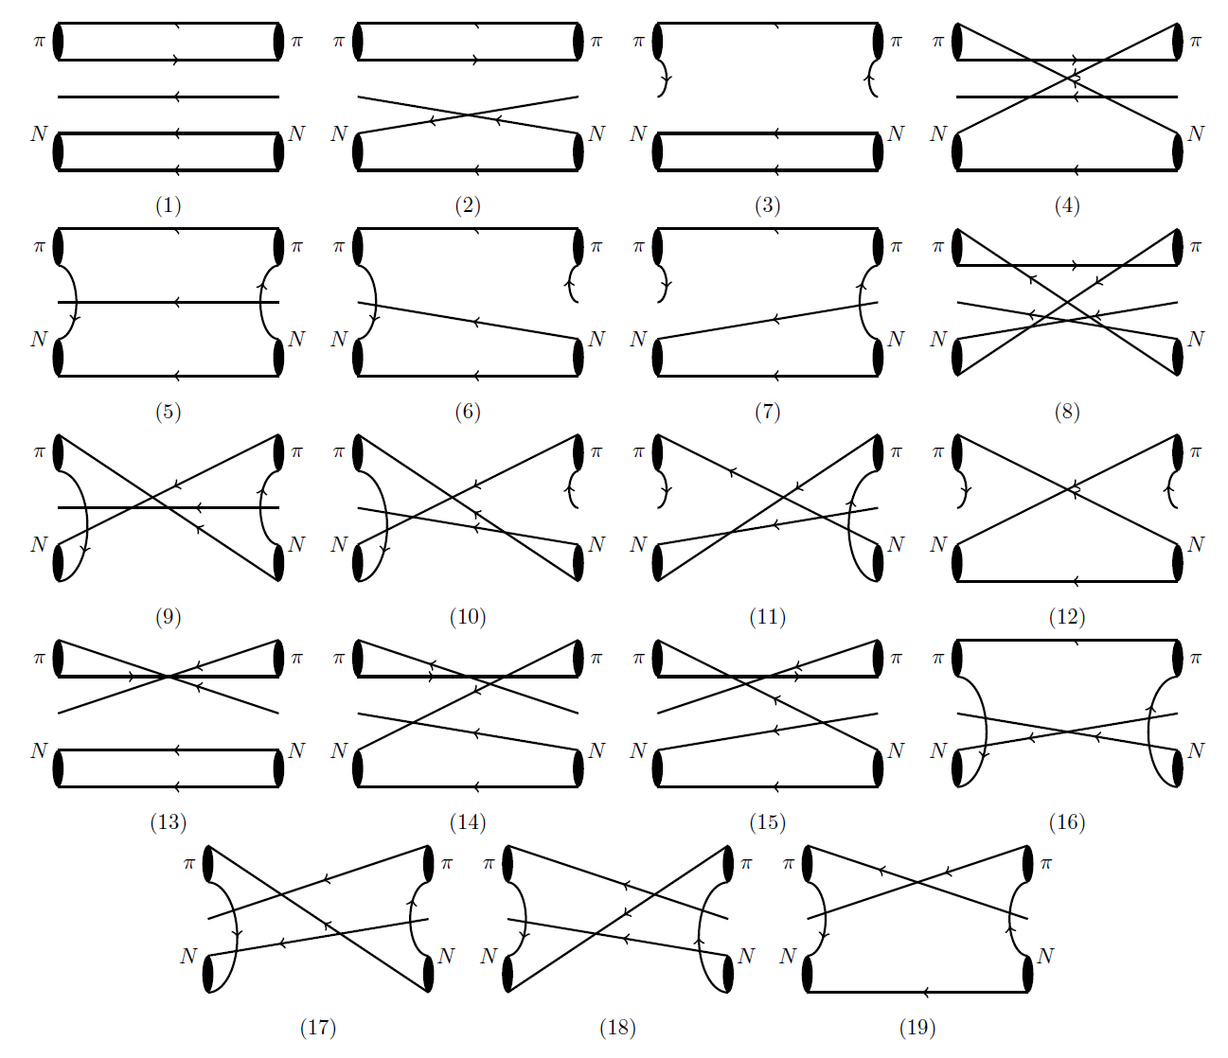
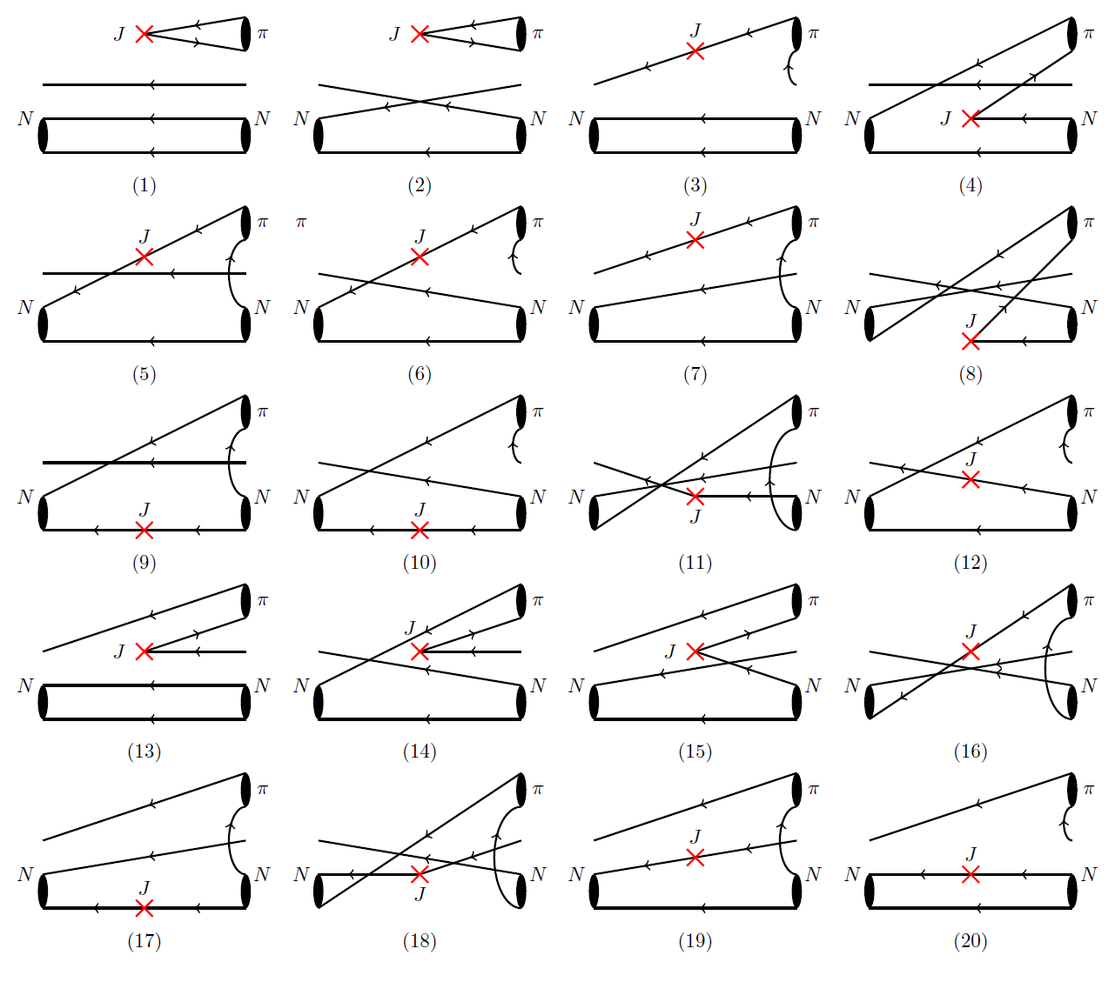
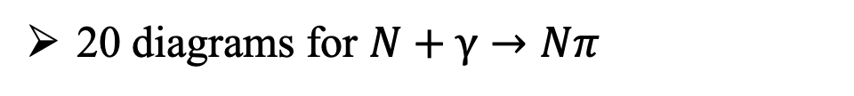
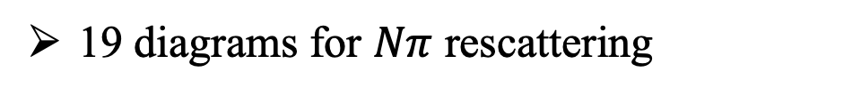
Wick contraction of $Nπ$ Rescattering
19 diagrams for $Nπ$ rescattering
20 diagrams for $N+γ→Nπ$
17

Slide 18
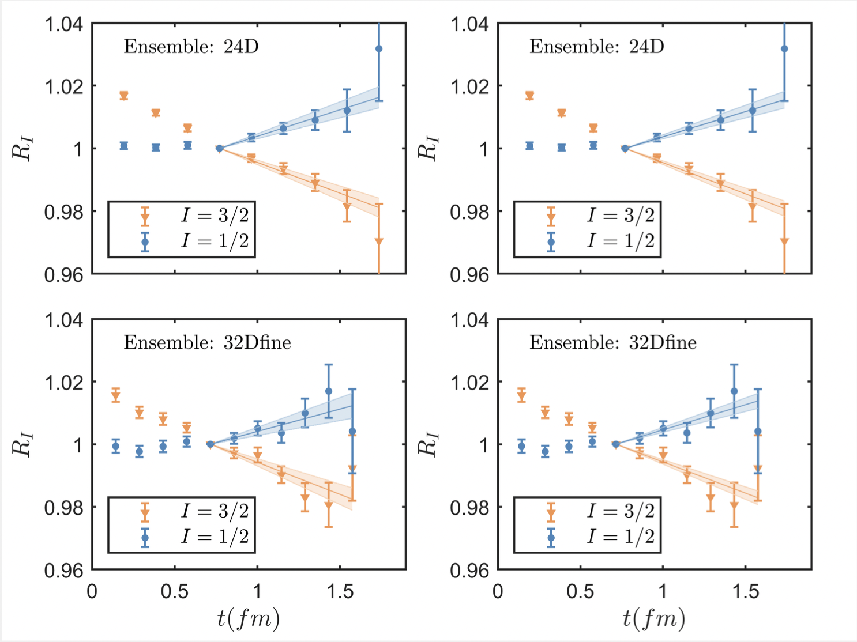

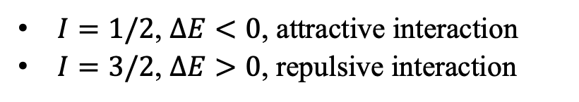
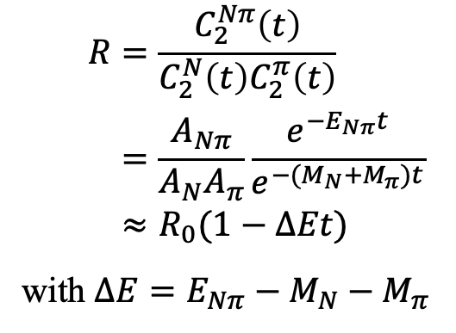
Results of $Nπ$ Scattering
Nπ scattering at m_{π}=142 MeV
combined
fit
$$R=\frac{C_{2}^{Nπ}\left(t\right)}{C_{2}^{N}\left(t\right)C_{2}^{π}\left(t\right)} \\ =\frac{A_{Nπ}}{A_{N}A_{π}}\frac{e^{−E_{Nπ}t}}{e^{−(M_{N}+M_{π})t}} \\ ≈R_{0}(1−ΔEt)$$
with $ΔE=E_{Nπ}−M_{N}−M_{π}$
Operators with four mom modes for GEVP
Results using data at threshold
$$a_{0}^{1/2}m_{π}=0.157\left(31\right), { a}_{0}^{3/2}m_{π}=−0.104\left(18\right)$$
ETMC [arXiv: 2307.12846] $a_{0}^{3/2}m_{π}=−0.13\left(4\right)$
Analysis based on cross section and πH, πD spectrum
$$a_{0}^{1/2}m_{π}=0.170\left(2\right), { a}_{0}^{3/2}m_{π}=−0.087\left(2\right)$$
Scattering for different isospin channel
~1σ
$I=1/2$, $ΔE<0$, attractive interaction
$I=3/2$, $ΔE>0$, repulsive interaction
M. Hoferichter et al, PLB 843 (2023) 138001
18

Slide 19
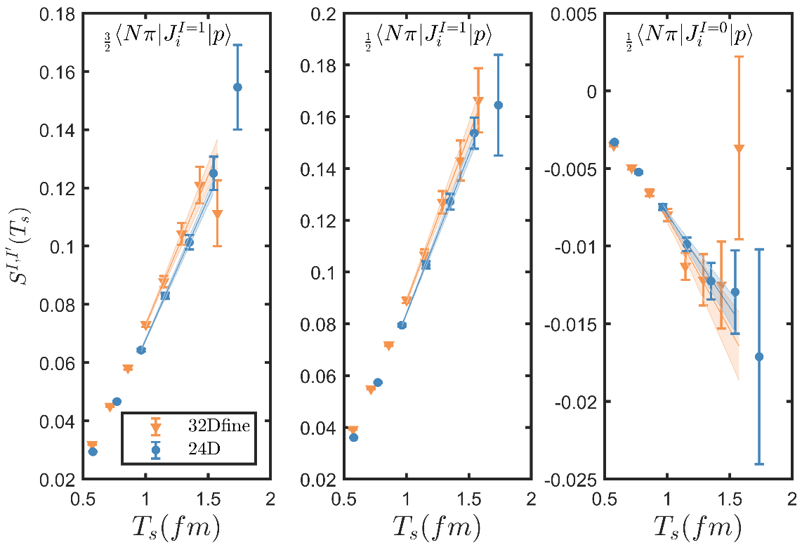
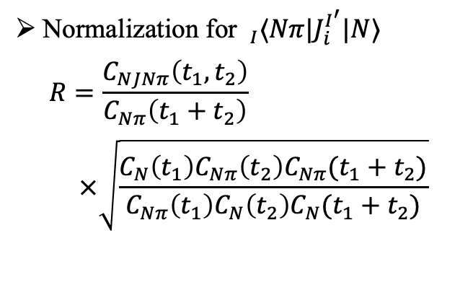

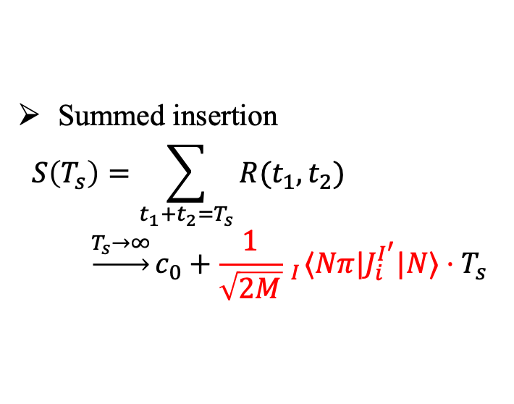
Matrix elements of 𝑁𝛾→𝑁𝜋
Nπ at the threshold
Normalization for $_{I}⟨Nπ|J_{i}^{I^{′}}|N⟩$
$$R=\frac{C_{NJNπ}\left(t_{1},t_{2}\right)}{C_{Nπ}\left(t_{1}+t_{2}\right)} \\ ×\sqrt{\frac{C_{N}\left(t_{1}\right)C_{Nπ}\left(t_{2}\right)C_{Nπ}(t_{1}+t_{2})}{C_{Nπ}\left(t_{1}\right)C_{N}\left(t_{2}\right)C_{N}(t_{1}+t_{2})}}$$
Maiani L. NPB, 293, 420(1987)
Summed insertion
$$S\left(T_{s}\right)=\sum_{t_{1}+t_{2}=T_{s}}{R(t_{1},t_{2})} \\ \underset{→}{T_{s}→∞}c_{0}+\frac{1}{\sqrt{2M}} _{I}⟨Nπ|J_{i}^{I^{′}}|N⟩⋅T_{s}$$
Linear fit $S\left(T_{s}\right)$ with $T_{s}$ to extract
19

Slide 20
Numerical results
Need to calculate $Nπ$ scattering and $π$-production, in total 3 times of workload
Reconstruction of contributions from $Nπ$ states – 60% for proton & 90% for neutron
X. Wang, Z. Zhang, X. Cao, XF, et. al. PRL 133 (2024) 141901
Our lattice results
20

Slide 21
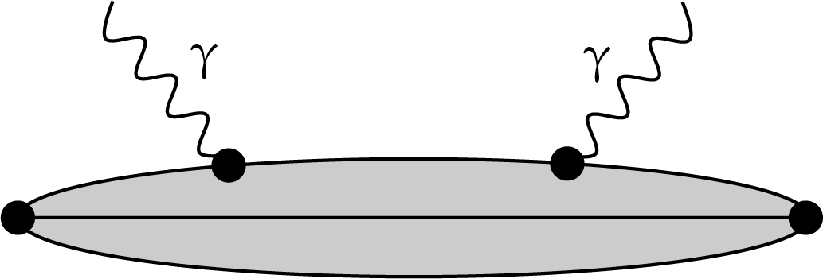
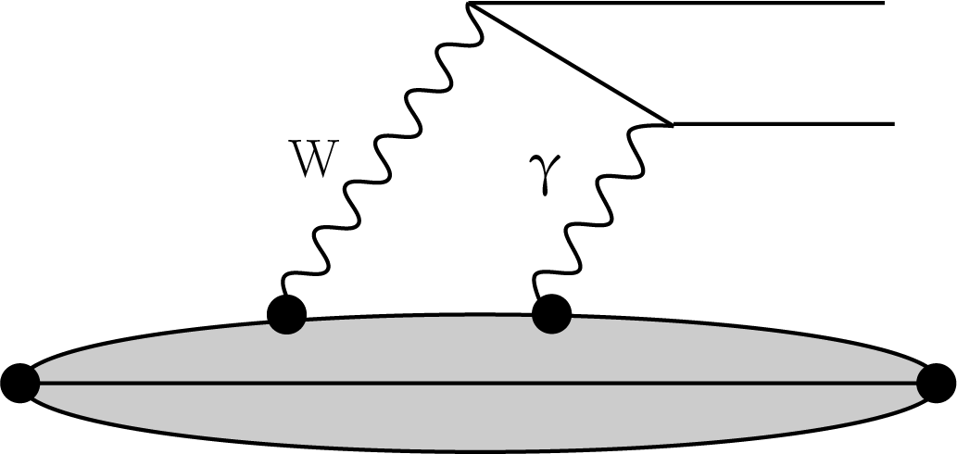
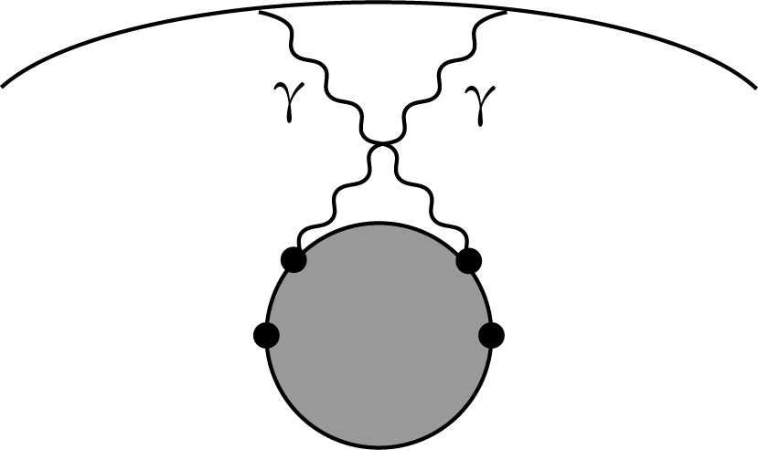
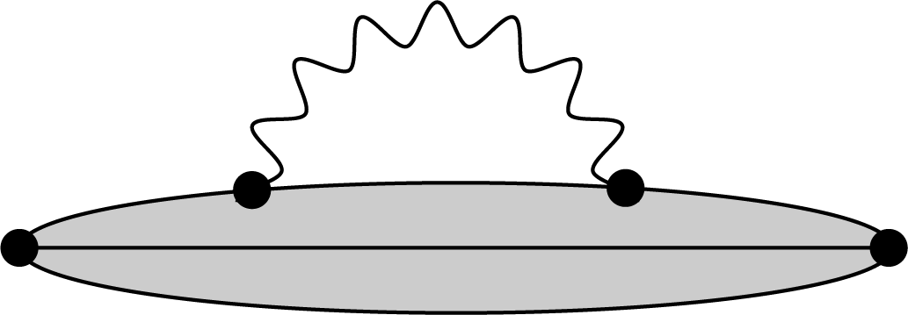
Hadronic tensor – a common structure in physical processes
Compton scattering
X. Wang, Z. Zhang, X. Cao, XF et.al. PRL 133 (2024) 141901
𝛾W box diag. in β decays
Hadron mass splitting
Two-photon exchange
XF, M. Gorchtein, L. Jin et. al
PRL 124 (2020) 192002
P. Ma, XF, M. Gorchtein, L. Jin et.al
PRL 132 (2024) 191901
XF, L. Jin
PRD 100 (2019) 094509
XF, L. Jin, M. Riberdy
PRL 128 (2022) 052003
Y. Fu, XF, L. Jin, C. Lu
PRL 128 (2022) 172002
Y. Fu, XF, L. Jin, C. Liu, S. Wen
PRL 134 (2025) 071903
21

Slide 22

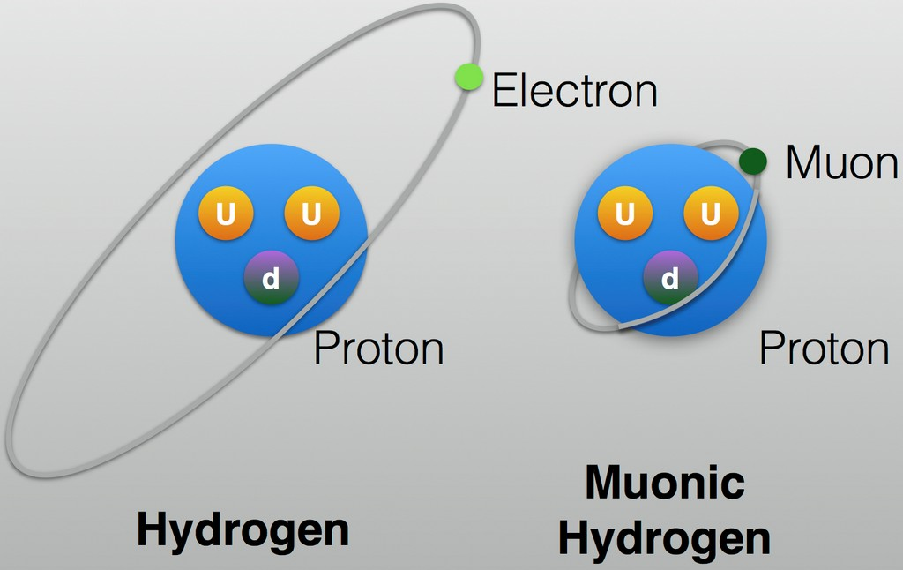
Extended projects – Take two-photon exchange as an example
2010, proton charge radius from μH
Precision 10 times better than before
4% smaller radius
【Nature 466 (2010) 213】
5σ deviation → Proton size puzzle
2
3
1
4
Largest theoretical uncertainties from two-photon exchange (TPE) contribution
Upgrade of CREMA@PSI can reduce experimental error by a factor of 5
Target: Compute TPE from first-principles → precision size of proton
22

Slide 23
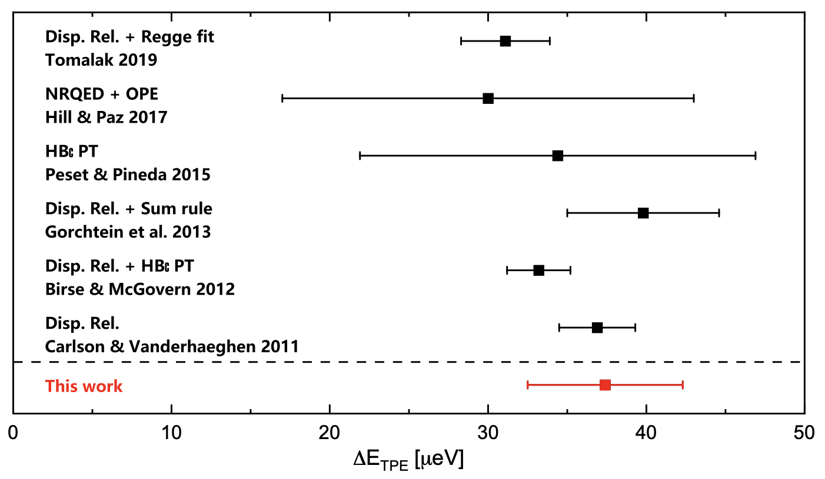
Lattice QCD calculation @ 2022
@m_{π}=140 MeV, TPE contribution has been computed for the first time using lattice QCD
Y. Fu, XF, L. Jin, C. Lu, PRL 128 (2022) 172002
Use infinite-volume method to resolve IR divergence → reliability of results
Develop new subtraction scheme to improve precision by 6 without increasing resources
Dispersive analysis
relies on data + models
ranges from 20 to 50 μeV
Lattice results
- desirable to improve precision
23

Slide 24
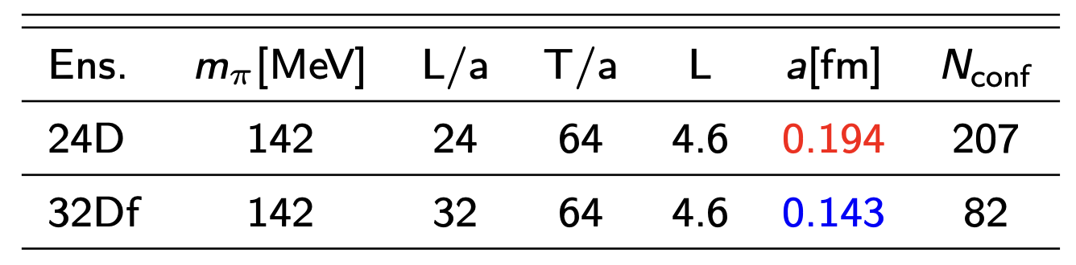
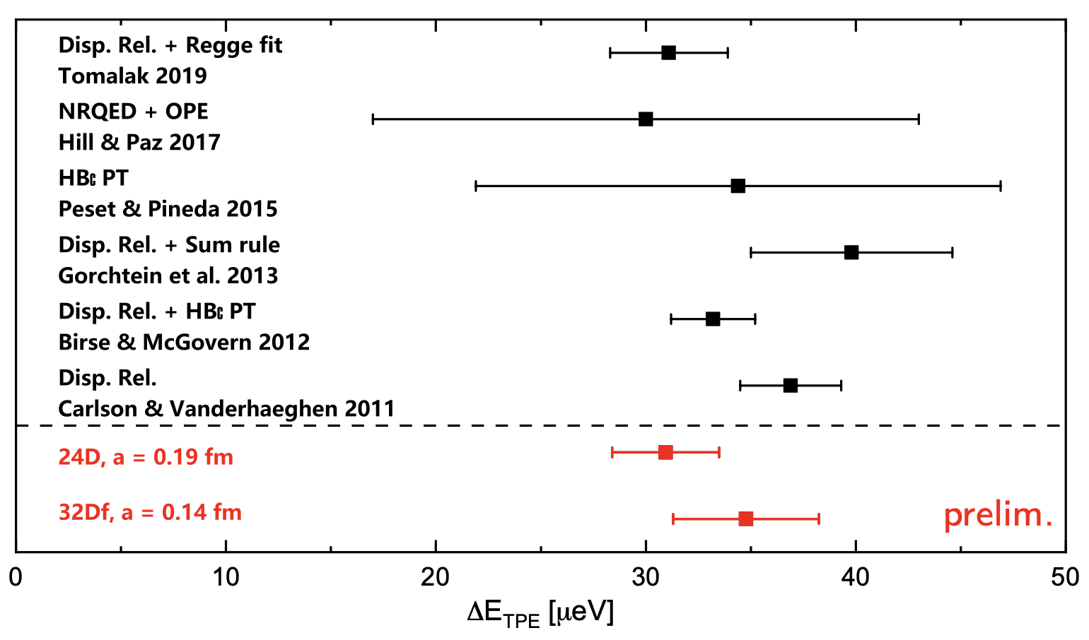
Updated results
Second ensemble: finer lattice spacing, same pion mass and volume
More statistics & gauge ensembles are on-going!
24

Slide 25


Joint dispersion relation & lattice QCD approach
Recall once-subtracted dispersion relation
Hadronic input for TPE
Subtraction function
Input from experimental data
Input from lattice QCD
25

Slide 26

Lattice QCD computation of subtraction function
ChPT
Lattice QCD
Nπ contribution
Perturbation Theory
Y. Fu, XF, L. Jin, et.al PRL 128 (2022) 172002
Reconstruction Nπ contribution is essential
LQCD provide accurate input for subtraction function
Joint approach: uncertainty reduced by ~4 times compared to pure lattice results
26

Slide 27

Extended projects – Threshold pion electro-weak production
In QCD, fluctuations of gluon fields are essential for understanding key features like quark confinement
If energy allows, quantum fluctuations manifest as the production of real particle, such as a pion
Electromagnetic process γ*(k)+N(p₁) → π(q)+N(p₂)
Weak process W*(k)+N(p₁) → π(q)+N(p₂)
Probe chiral dynamics of QCD
DUNE Conceptual Design Report:
Substitute for exp. measurement, such as MAMI
Uncertainties exceeding 1% for signals and 5% for backgrounds could significantly degrade sensitivity to CP violation and neutrino mass hierarchy
27

Slide 28
Extended projects – Threshold pion electro-weak production
V.Bernard, N.Kaiser, T.Lee, U.-G.Meißner, Phys.Rept. (1994)
The central object is to calculating the matrix element:
Electromagnetic current
Weak current
Extracting S-wave multipole amplitudes
28

Slide 29

Extended projects – Threshold pion electro-weak production
Vector current multipoles
Y. Gao, Z. Zhang, XF, L. Jin, et.al, PRL 134 (2025) 171904
Low energy theorem
– higher-order corrections omitted
Lattice results
– with two lattice spacings
Analysis of experimental data
– does not incorporate matching with
ChPT at low energies and momenta
29

Slide 30

Extended projects – Threshold pion electro-weak production
Axial vector multipoles
Y. Gao, Z. Zhang, XF, L. Jin, et.al, PRL 134 (2025) 171904
Comparable lattice results with predictions from low-energy theorem
A starting point for lattice QCD exploration of inelastic neutrino-nucleon scattering
30

Slide 31

Conclusion & outlook – A lattice QCD journey
Nucleon electric polarizability
Complex 4pt correlation function
Reconstruction of Nπ contributions
The challenging climb
Resolve the puzzle
Provide accurate subtraction function
Open new direction for pion EW production
The summit view
Start a new journey
Towards the shallow inelastic νN scattering
Parity violating e-p scattering
……
New frontiers, new methodology and new findings!
The next expedition
31

