Slide 1
The TDR subsection on readout chips for SVT strips
Valerio Re
INFN Pavia, University of Bergamo

Slide 2
Proposed layout
Mechanical Requirements:
Number of channels per chip: 128
Chip size: width ≤ 6 mm, length ≤ 4 mm
Pitch of input bonding pads: < 45 um
Test pads
Periph.
blocks
I/O bonding pads: AVDD,AGND, DVDD, DGND (how many pads for voltage supplies?)
Input clocks
Serial input and output for slow control
Output lines
Periph.
blocks
Input bonding pads
(to strips)
Digital backend
Analog channels
DATA
OUT
Periph.
blocks
Periph.
blocks
V. Re
Test pads
2

Slide 3
Operational Requirements:
Operating temperature: < 40 °C
Radiation tolerance: > 3 Mrad/year, > 5 . 10¹² n_{eq}/cm²/year (10 years)
Power dissipation: < 4 mW/channel
Separate analog and digital supply pads
AVDD, DVDD: 1.5 V
Shunt LDO regulators to provide 1.2V to analog and digital circuits
(from other projects, e.g. FE-I4, as for other peripheral blocks)
V. Re
3

Slide 4
Dynamic range:
The front-end chips must accept signals from either P and N-side of the strip detectors.
A linear response of the analog processing section is required from a minimum input charge corresponding to 0.2 MIP up to a full dynamic range of 10-15 MIP charge for dE/dx measurements.
Analog Resolution:
The front-end chips have to provide an analog information about the charge collected in the detector, which will be also used for calibrating and monitoring the system.
A resolution of 0.2 MIP charge is required for dE/dx measurements. In case of a compression-type ADC characteristic, this may translate in 4 bits of information.
Inner layers: ToT vs Flash ADC
Outer layers: other ADC options are also possible
V. Re
4

Slide 5
Readout bandwidth:
Data coming out of the chip will be substantially reduced by operating in a triggered mode.
The chips can use up to 4 output LVDS lines, as it is needed to handle the higher data throughput in inner SVT layers.
6 (7) input lines (LVDS):
3 clocks (System clock, Time Stamp clock, readout clock), see next slides
1 Slow Control Data In
(1 Slow Control Data In Enable)
1 Reset
1 Trigger
4 (5) output lines (LVDS):
(1 Slow Control Data Out)
4 Data Output
V. Re
5

Slide 6
Time Stamp:
30 ns time stamp resolution is required for inner layers to get a good hit time resolution in order to reduce the occupancy in the offline time window (50-100ns). In the outer layers the time stamp resolution is less critical since the hit time resolution will be dominated by the long pulse shaping time. A single 30 ns time stamp clock in all layers will be used.
Chip clock frequency:
Two main clocks will be used inside the readout chip, the time stamp clock (33 MHz) and the readout clock (132 MHz or 198 MHz). These clocks will be synchronized with the 66 MHz SuperB system clock.
In case the analog-to-digital conversion is based on the Time-Over-Threshold (TOT) method, a ToT clock has to be generated inside the chip. The TOT clock period should at least match the pulse shaping time to get a good analog resolution. A faster TOT clock could slightly improve the analog resolution but an upper limit (~3.5) on the ratio between TOT clock frequency and the shaping time frequency is imposed by the required dynamic range needed for low momentum particle dE/dx measurements (~10-15 MIP) and the number of bits available for TOT.
With the experience of the BaBar Atom chip, a TOT clock frequency 3 times higher than the pulse shaping frequency could be used: 132 MHz (66 MHz are probably ok too??) for L0, 66 MHz for L1-2, 16.5 MHz for Layer3 and 6.6-3.3 MHz for L4-5.
V. Re
6

Slide 7
Clock configuration (synchronized with the 66 MHz SuperB system clock) :
time stamp clock: 33 MHz
readout clock: 198 MHz (could be less in outer layers)
ToT clock: 132 MHz (66 MHz are probably ok too??) for L0, 66 MHz for L1-2, 16.5 MHz for Layer3 and 6.6-3.3 MHz for L4-5.
Could we provide a single clock signal to the chip, and derive the others on the chip? So far, the answer has been no.
V. Re
7

Slide 8
Maximum data rate: Simulations show that machine-related backgrounds dominate the overall rates. At nominal background levels, the maximum hit rate per strip is 2 MHz/strip in Layer0 (45 MHz/cm^2), 0.7 MHz/strip in Layer1, 0.4 MHz/strip in Layer2. These numbers include a safety factor of 5.
Deadtime limits: The maximum total deadtime of the system must not exceed 10 % at a 150 kHz trigger rate and background 5 times the nominal expected rate.
Trigger specifications: The trigger has a nominal latency of 7 us, a maximum jitter of 0.1 us, and the minimum time between triggers is 70 ns. The maximum Level 1 Trigger rate is 150 kHz.
Cross-talk: Must be less than 2 %
Microstrip output data content: The microstrip hit data must include the time stamp, chip identification number, and the microstrip hits (strip number and relevant signal amplitude) for that time stamp. The output data word for each strip hit should contain 25-30 bits (7 strip address, 9 TS, 1 data valid, 4 chip address, 4 TOT or 7 ADC, 2 additional bits)
V. Re
8

Slide 9
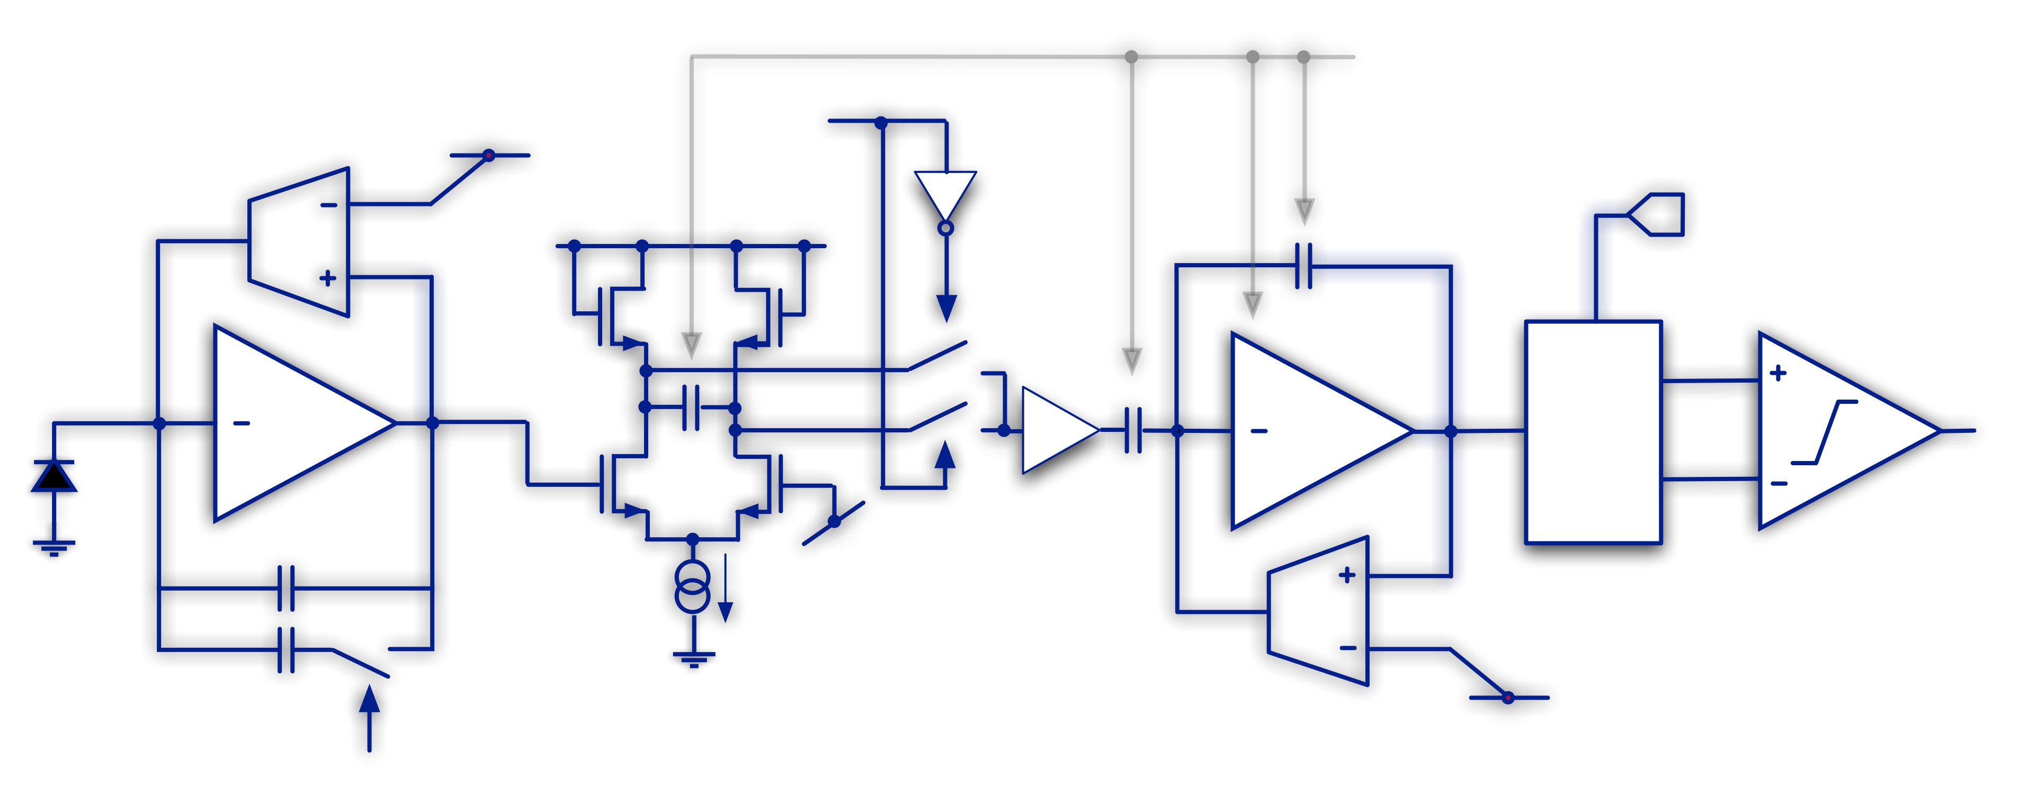
Fast front-end block diagram
The “slow” front-end for layers 4-5 is presently based on a different scheme
t_{p}-sel (25, 50 ,100 and 200 ns)
pol-sel
V_{th}
C₂
A(s)
C₁
C_{F1}
C_{F2}
single to double ended conversion and threshold generation
gain-sel (high for layer0, low for outer layers)
V. Re
9

Slide 10
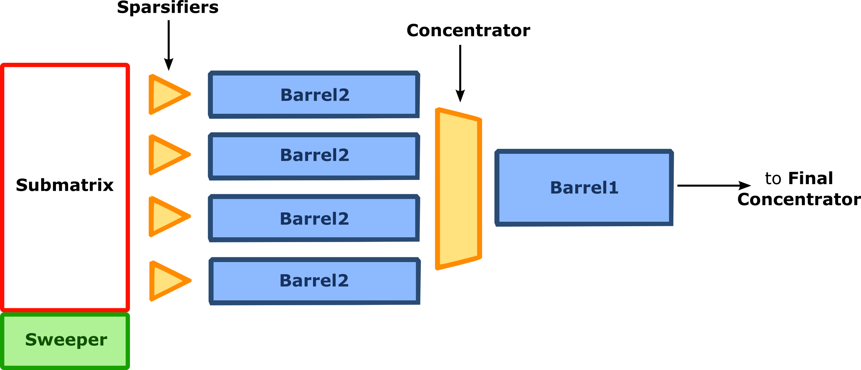
Readout architecture
~hit_rate * trig_latency
Sparsifier
strip #127
FE
ADC
Or ToT
Ctrl
logic
Buf
#k
...
Buf
#1
strip #0
FE
ADC
Or ToT
Ctrl
logic
Buf
#k
...
Buf
#1
BUF #1
Triggered hits only
readout/slow control
The readout architecture is being tested with realistic data created by Monte Carlo analysis of the interaction region. Verilog simulations demonstrate that the chip will be able to operate with more than 99% readout efficiency in the worst case condition, which includes the safety factor of 5 in the background levels.
V. Re
10

Slide 11
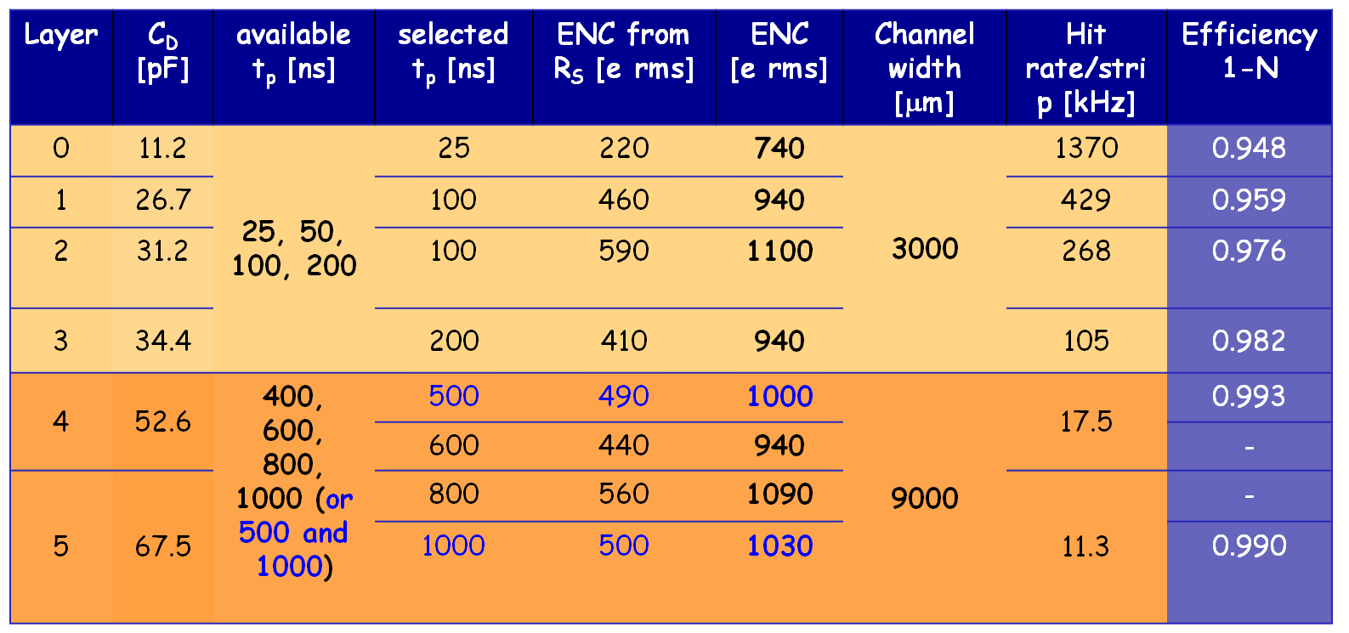
Table with peaking time, noise, efficiency
This table has to be updated on the basis of new background data
V. Re
11

Slide 12
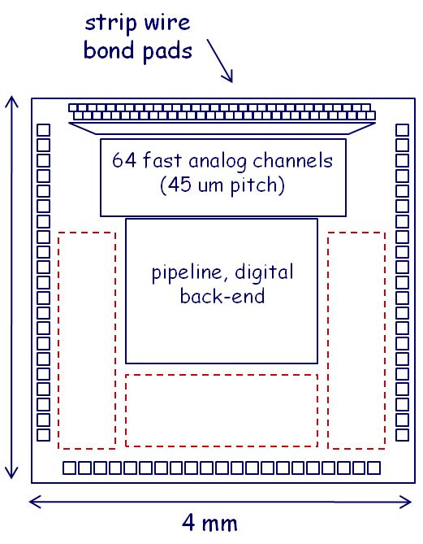
Strip front-end development
Fast and slow front-end prototype chip (IBM 130 nm)
Milestones for strip front-end development
2012: first test structures, 64 channels (fast and slow front-end), auxiliary blocks
2013: first fully operational prototype chip – 2 x 128 channels (fast and slow readout)
2014: production run
Account for some contingency after the first or the second step
area for test structures and auxiliary blocks
V. Re
12

