Slide 1
Pheripheral Electronics
Mauro Citterio
--------
INFN Milano

Slide 2
Index
Fanout layer 0 considerations
HDI considerations
Tail and Transition card ...
Very little

Slide 3
DAQ reading chain for L0-L5
DAQ chain independent on the chosen FE options
Optical 1 Gbit/s
Example of a read-out section
Front-end chips
Optical Link
2.5 Gbit/s to ROM
UPILEX+Cu (?)
FEB
C
Copper bus
Serdes
or FPGA
ROM
Detector
fibers
HDIs
~1-2 m
Transition card
LV1
High rad area 15Mrad/year
Off detector
low rad area
Counting room
Std electronics
Data Encoder IC .... Specs are under discussion
Rad-hard serializer to be finalized
→ looking into a low power/low speed version
Copper tail: lenght vs data transfer to be studied
3

Slide 4
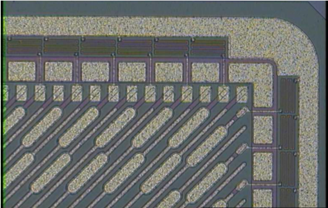
Fanout (layer 0)
Layer 0 dimensions
Physical |  | Length (mm) |  | 104
 |  | Width (mm) |  | 13.9
Frame Size (mm) |  |  |  | 0.5 |  | Hypothesis Stefano
Active |  | Length (mm) |  | 103
 |  | Width (mm) |  | 12.9
Trace (mm) |  |  |  | 0.025
Space (mm) |  |  |  | 0.025
Pitch (mm) |  |  |  | 0.05
→ Based on this numbers, the number of output lines exceeds 6x128
Details need to be defined …………….
Hp: Aluminum/Kapton 2 layer fanout
Sketch presented in Frascati (Dec. 2011).
Based on the assumption of staggering the two layers to “match” sensor pitch
Real design in progress IF fanout min. pitch is 85 um (~ twice IC pad pitch)
Bonding always toward detector side (Stefano/Filippo concern resolved)
Fanout resistance and inter-trace capacitance not estimated yet (Ref. 2Ω/cm, 6 pF)
Narrow pitch needed over a length of ~ 25 mm
Overall fanout widht not less than 35.9 mm
If adjacent sensor lines do not correspond to adjacent IC lines then overall thickness could be less (~ 30-31 mm)

Slide 5
HDI
Collaboration with Aurel is progressing
Technical meeting in Milano on Monday January 29th
Better definition of the “trial samples”
Schedule agreed upon (Milano is charged of characterizing samples)
Exercise completed by end of March
Size of HDI
Similar to Babar +/- 10%
Size stay ~ the same by taking advantage of improved trace resolution
Not sure I understand “gangling”, “pairing” …. (Help from …..)
How many ICs on each HDI type
Number of layers again similar to Babar HDI
What on the hybrid beside the ICs and the passive components
It strongly depends from the digital input/output of the IC
LVDS? All of them?
How many lines are proprietary per chip? How many can be shared?
3 clocks (System clock, Time Stamp clock, readout clock)
1 Data In
1 Reset
1 Trigger

Slide 6
HDI
How many Output Data lines?
From 1 to 4 ………… programmable quantity?
Status …..
The overall quantity of IN/OUT lines will tell us if we need a MUX/ENCODER (+SERIALIZER?) on the HDI
Goal has to limit the complexity of the “tail” between HDI and transition card
Hp: transmission at this point is on copper
Hp: we are using magnet wires
The tail length is ~ 20-30 cm
How to bundle them is related to the communication speed
The encoding is done in the IC?
It should be consistent with what be used in the transition card where the transition to optical fiber need to be done
MUX/ENCODER and tail in common to all layers will be advisable
MUX/ENCODER
Guess: we will end up having at least a MUX
At least in the innermost layers
In any case the IC has to be capable of driving the tail (test on bench on a 50 cm tail length, 6 lines “all/few on”, max rate, using prototype tail ) and receiving data from the tail (assuming “compatible transmission” from the tail)

Slide 7
HDI
Design of the MUX or MUX/ENCODER or MUX/Encoder/Serializer
Size of this IC
The only reference that we can have is the CERN GBT project
Taking away some blocks?
Some of the slow control maybe
Die size is …. < 2 x 2 mm …… reasonable
Size is not a stopping block
Using GBT has pros and cons
It does not look absolutely necessary
Such an IC is a challenging project
It is a overall problem (see Aloisio’s talks)
The functions really needed …….
Technology of choice
Milano/Bari would like to adopt TSMC 65 nm
No more SOS
Not worthwhile IBM
Capable of standing against radiation
Power distribution
HP: IC can not withstand voltages higher than 1.5 V
Even in case of interruption of sensing

Slide 8
HDI
Hp: current absorbed is ~ 1 Amp or more per HDI
An intermediate voltage regulation point IS NEEDED
DC-DC converter, LDO not yet decided
Where the max voltage is 2.5 Volt
More if a shunt LDO is used
The breaking point is as near as possible on the HDI
Nearest place is the transition card
Space required on the transition card at least 9 cm^2
Cooling required > 3 W on the card
Strongly dependent from the voltage drop absorbed by the transition card
“Step-Down” ratio is
Minimum 2, maximum is 5.5 if LDO
Minimum 2, reasonable maximum is 10-12 if DC-DC conversion
High Step down is better ….. Cable’s AWG increases
The devices at the breaking points must be rad-tolerant
Rad-tol DC-DC converter ?
Rad-tol LDO …… difficult to get some or EXTREMELY expensive
Remote power supply can NOT avoid this problem …

Slide 9
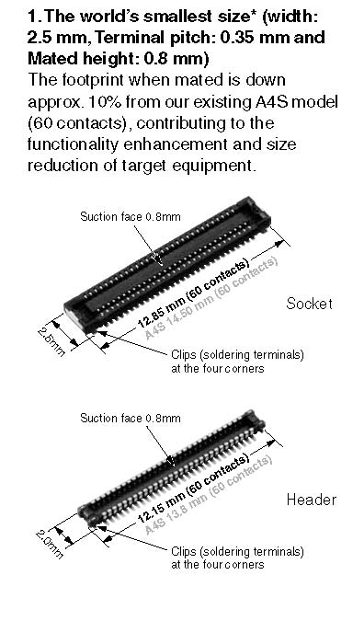
HDI
Connection between HDI and Transition Card (envelope on HDI W x L x H …….)
Detector bias
Not yet addressed
Supply Bias
2x4 wire (2 power, 2 sense), twist in quad + drain + shield
Grounding-shielding rules undefined
{2x[2xAWG28+2xAWG32]+drain+shield}
2-5 mW contact
Connector?
Strongly related to cable specs
Cable diameter
[~ 7-8 mm (not necessary round)]
Low mass aluminum
Hermetic class ….if any
How this was done in Babar? …………
Data lines
Magnet wire (AWG36 maybe AWG 38)
2x HDI Data Out Lines
No Mux example > 6x4x2x1.5mm^2
Interesting Panasonics connector
Maybe usable also for HV and LV also

Slide 10
HDI
Connection between HDI and Transition Card
Detector bias
Not yet addressed
Supply Bias
2x4 wire (2 power, 2 sense), twist in quad + drain + shield
Grounding-shielding rules undefined
{2x[2xAWG28+2xAWG32]+drain+shield}
2-5 mW contact
Connector?
Strongly related to cable specs
Cable diameter ~ 7-8 mm (not necessary round)
Low mass aluminum
Hermetic class ….if any
Data lines
Magnet wire (AWG36 maybe AWG 38-40)
Taking away some blocks?
Summary of what is on the HDI
Front-end Ics
MUX/ENCODER maybe
Connector HDI/Tail
Passive components

Slide 11
Tail and Transition Card
Tail
Magnet wires …. Many ideas, few results
IN/OUT connectors, again preference for the Panasonics
Length (two conflicting constraints)
Transition Card
It contains at least bi-directional electro/optical transmission (SERDES maybe, Laser Driver, VCSEL, …. )
I am trying to copy the info from the Versatile Project
It contains also the electronics for the voltage breaking point
It contains also the HV, LV connection
Not details yet
Mechanical aspects
Not yet addresses
Important the interface established between Pisa and Milano mechanical engineers
We need an overall envelope
Cooling is needed ….. 0.2-0.3 W/cm^2 … and growing ……

