Slide 2
Contents
Longitudinal Phase Space Linearization
ACC39 made by Fermilab for FLASH
AH1 made by INFN-LASA for European XFEL

Slide 3
Contents
Longitudinal Phase Space Linearization
ACC39 made by Fermilab for FLASH
AH1 made by INFN-LASA for European XFEL

Slide 4
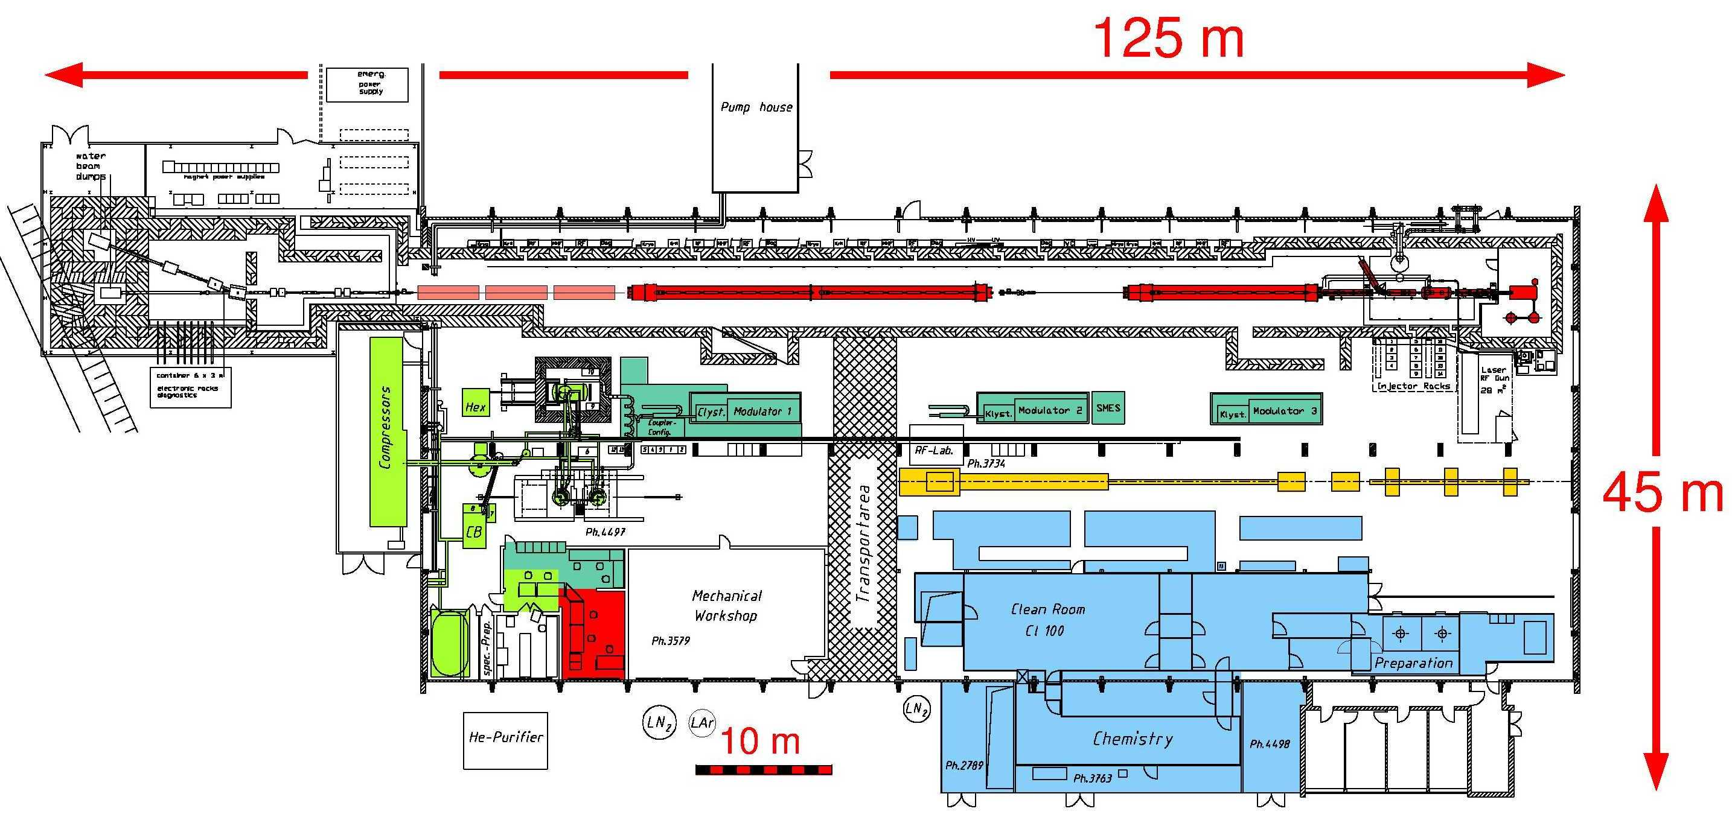
TESLA Test Facility for e⁺e⁻ Linear Collider

Slide 5






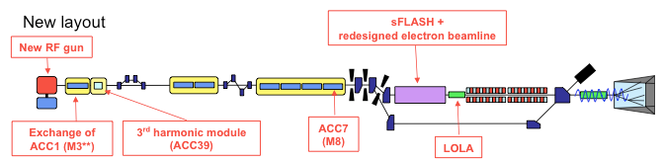
From TTF1 to TTF2/FLASH
beam diagnostics
bunch compressor
TTF1
laser driven electron RF gun
photon beam diagnostics
undulator
sc pre- accelerator
4 MeV
superconducting accelerating modules
120 MeV 250 MeV
16 MeV
TTF2/FLASH

Slide 6




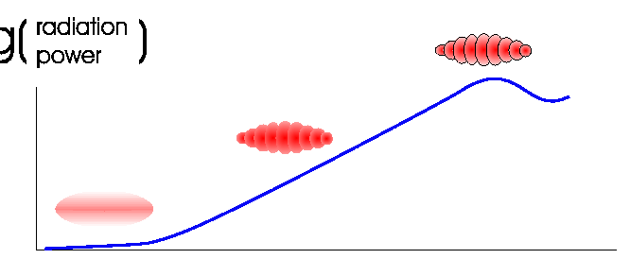
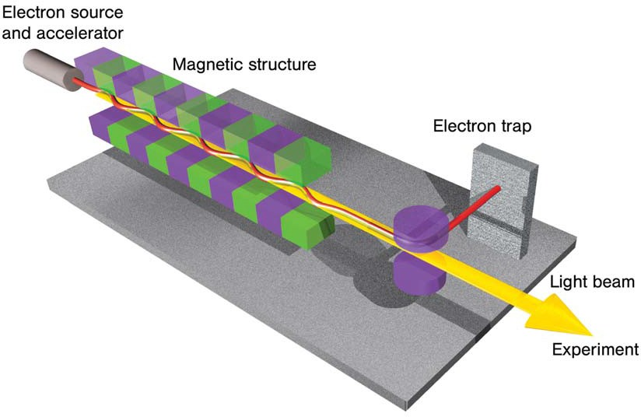
SASE: Self Amplifiesd Spontaneous Emission
log (power P)
low gain
non-linear
(high-gain linear
regime)
P(z) = P_{o} exp(z/L_{gain})
bunch interacts with undulator field
micro bunches develop
micro bunches emit coherently ~ N² (N ≈ 10⁶)
log (power P)
gain ~ 10⁵
exponential gain
P(z) = P_{o} exp(z/L_{gain})
gain ~ 10⁵
undulator length, z
Key requirement:
high peak currents of > 1 kA
low emittance < λ/4pi ~ 1-2 μm
low energy spread ∆E/E < 10⁻³

Slide 7
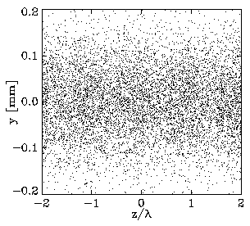
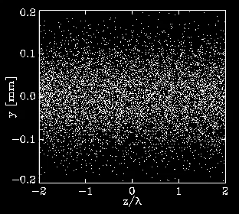
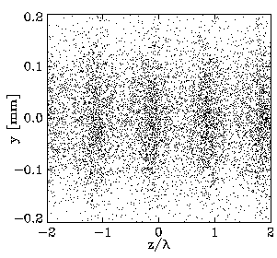
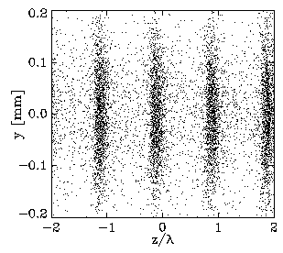
FEL asks for High Current and High Quality
Modulation of the electron bunches
undulator
entrance
half-way
saturation
full
saturation
GENESIS simulation of the TTF parameters
Sven Reiche (UCLA)

Slide 8
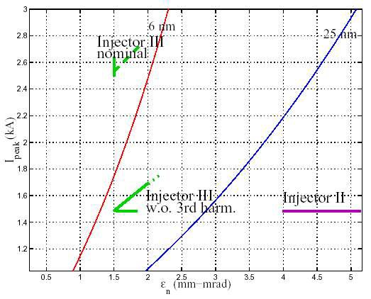
VUV­FEL requirements at TTF
from Proc. of EPAC 2002, 1798 (2002)
1st lasing of VUV-FEL at long wave length λ (32 nm acheived) does not require the 3.9 GHz module
Trying to lase at shorter λ requires higher peak current I ≈ 2.5 kA
3.9 Ghz module required for
  driving the FEL instability
  getting radiation pulse with significant energy
VUV­FEL beam requirements for lasing at 25 and 6 nm
3rd Harmonic Module mini-Review. P. Piot. 11.08.2005

Slide 9
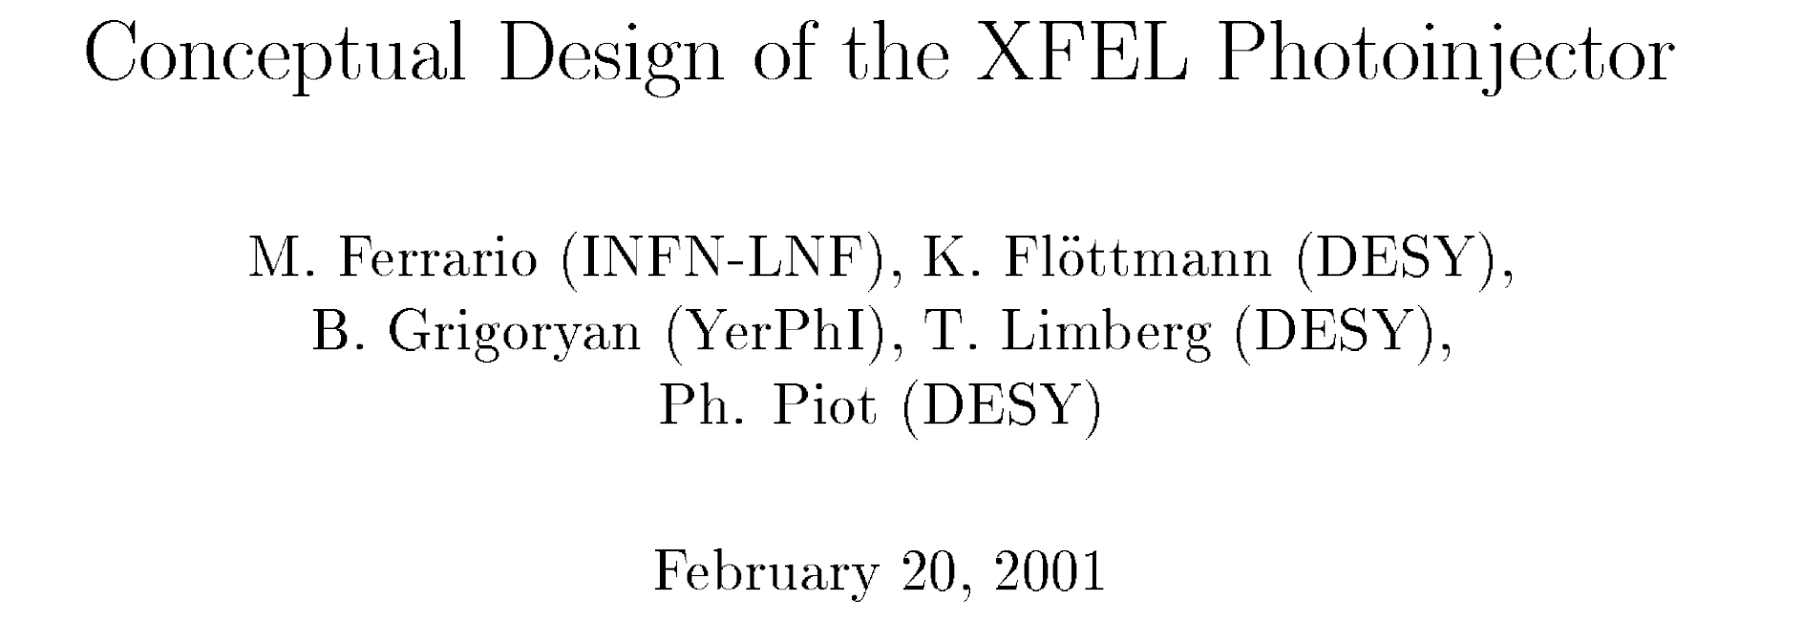
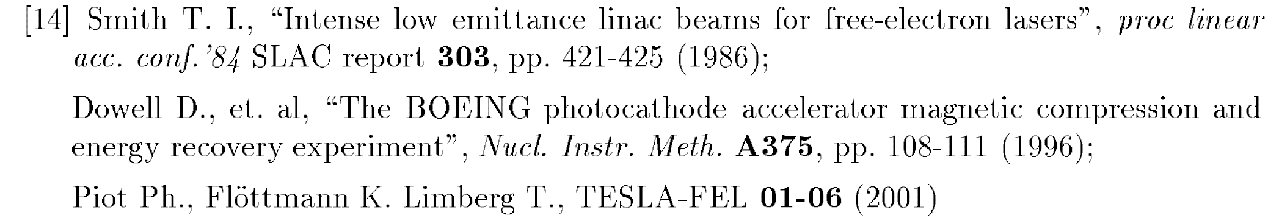
3rd Harmonic System for TTF
TESLA-FEL 01-03 (2001)

Slide 10
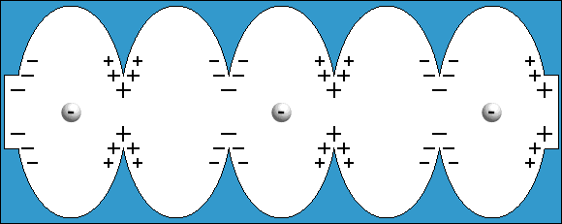
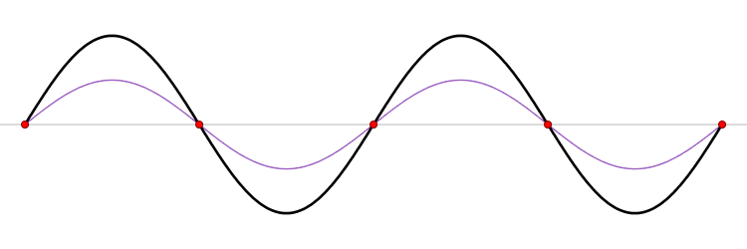
Origin of the non linear Energy Distribution
Electrons are gaining energy integrating the electric field while crossing the RF accelerating cavity
In each point of the cavity the field vary sinusoidally vs time
Because of the the non negligible bunch length the energy gain along the bunch is not constant and not linearly distributed
Bunch compression needed for high peak current is strongly affected
Standing Wave
TM₀₁₀ mode

Slide 11
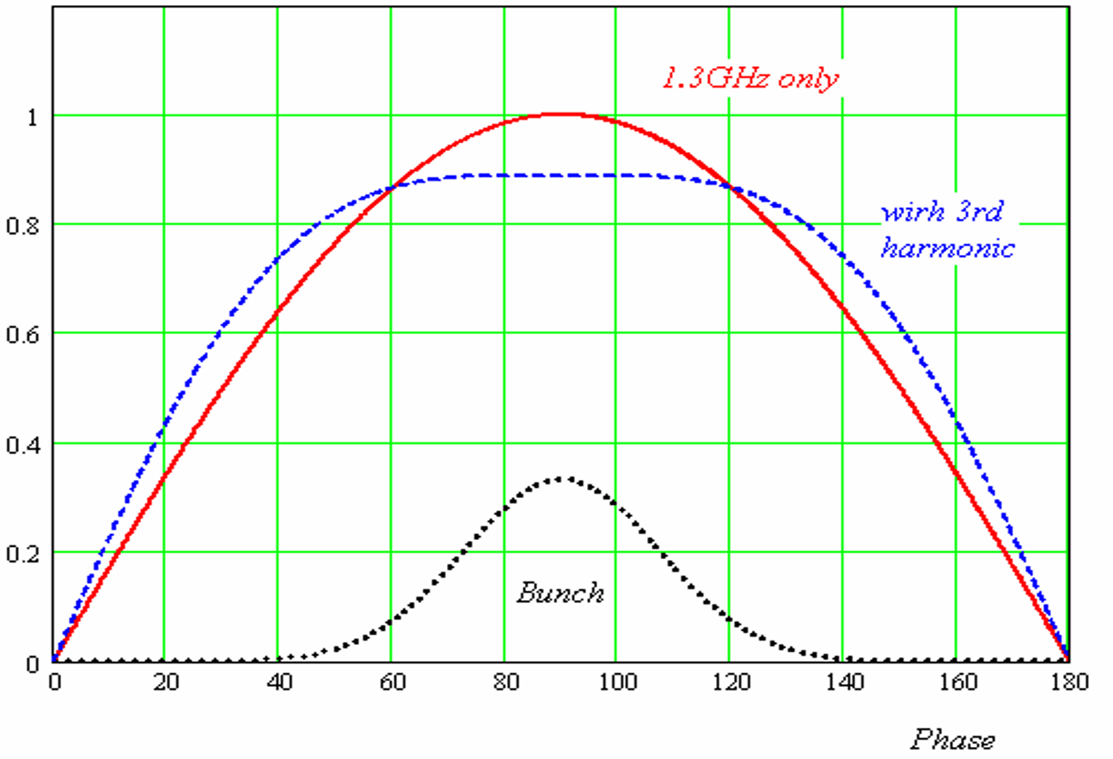
Energy Distribution along the Bumch
V₃ = V₁ / 9

Slide 12
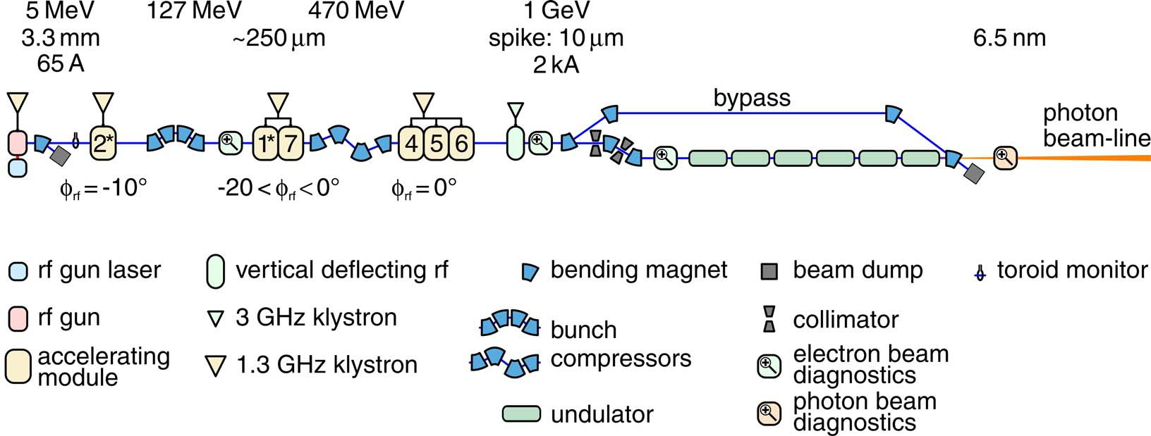
TTF/FLASH as in 2007
initial bunch length restricted by collective effects
two stage bunch compression
off crest acceleration in ACC1 and ACC2/3
requires good rf field stability

Slide 13
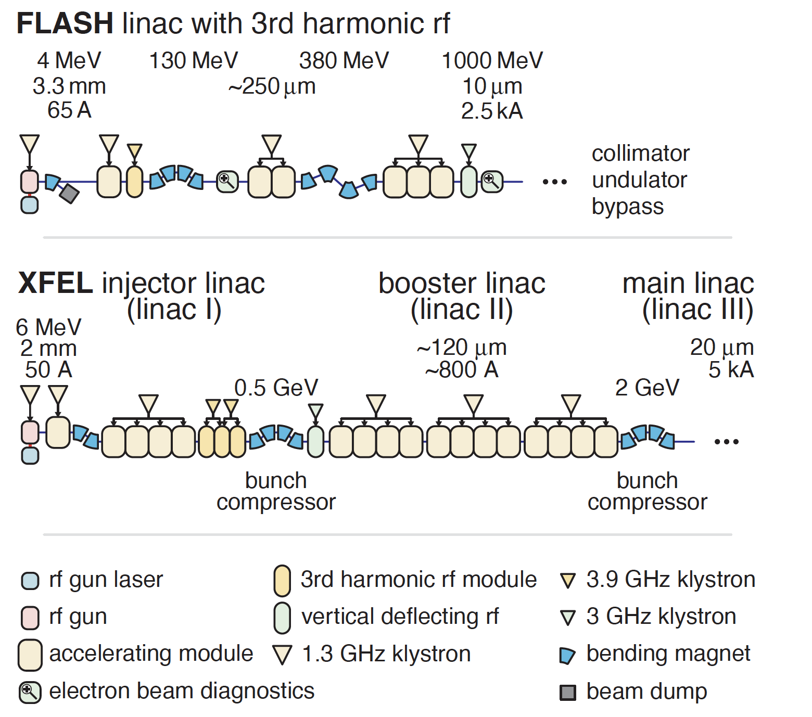
FLASH and XFEL with 3rd Harmonic

Slide 14
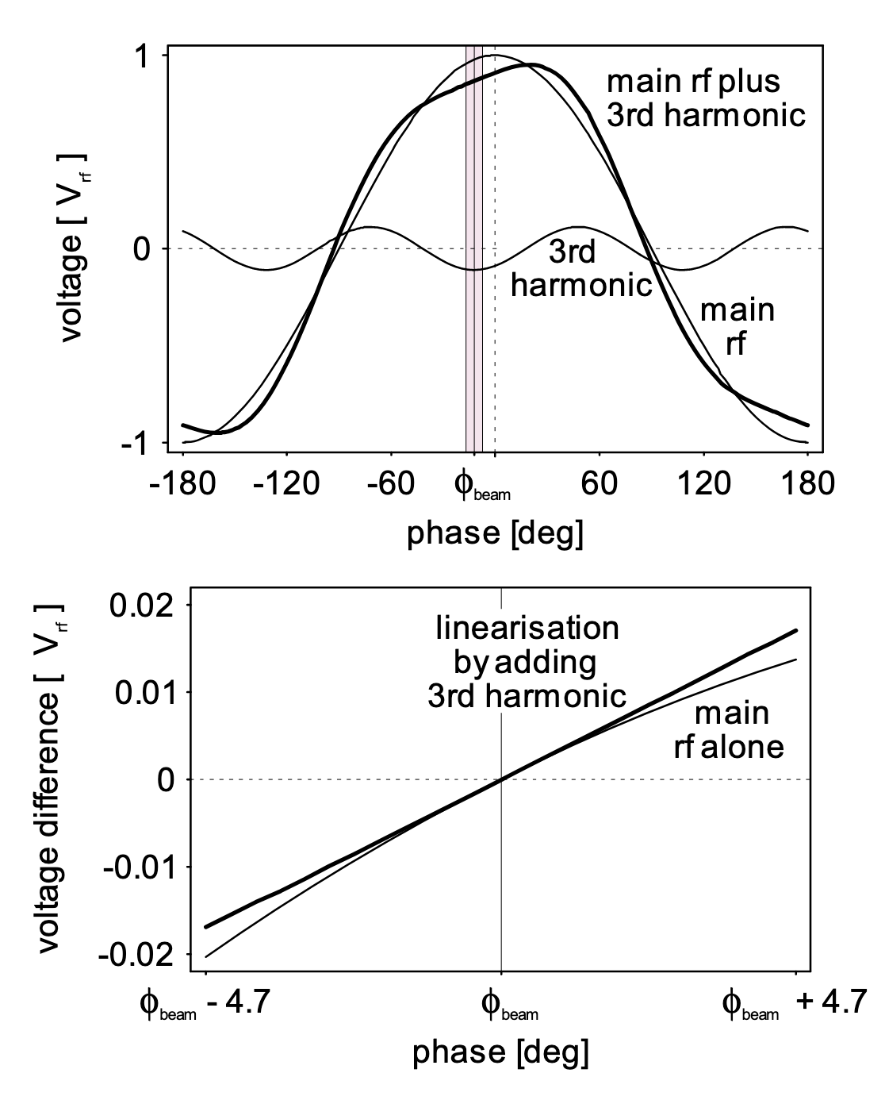
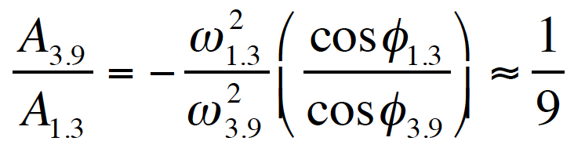
3rd Harmonic for high peak curreny
The 3rd harmonic module operating in decelerating phase in conjunction with the ACC1 module provides linearization of the rf acceleration field with time during the duration of the beam bunch.
Near crest at bunch center s = 0
ϕ_{3.9} is ~180 deg (decelerating mode) and s = - ct. The head of the bunch is at positive s and ϕ_{1.3} must be positive too
V₃ = V₁ / 9
Shifting ϕ_{3.9} by 12°, a linear chirp is obtailed for a more efficient compression

Slide 15
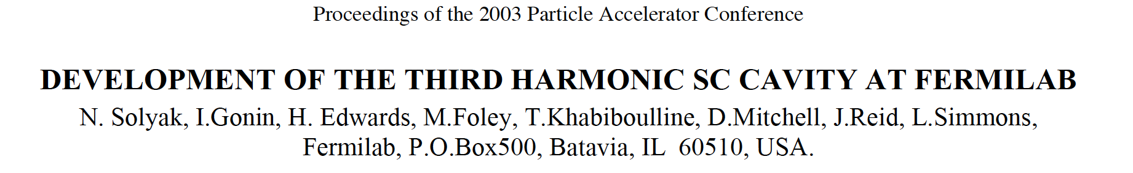
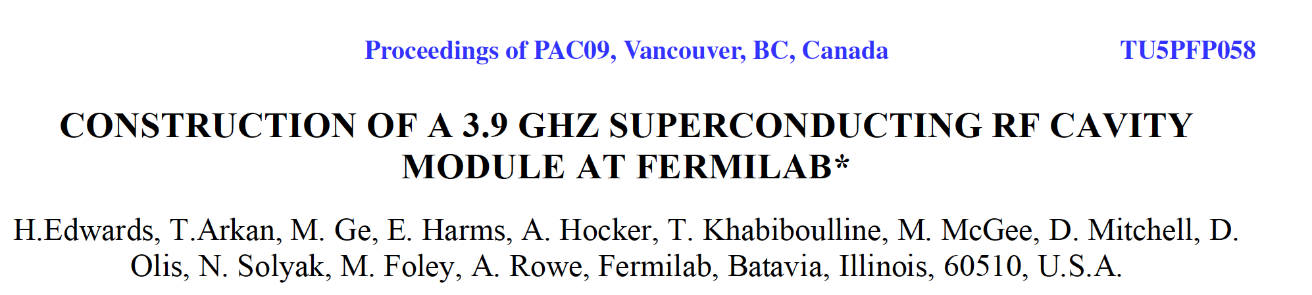
The 3rd Harmonic Module from Fermilab

Slide 16
Contents
Longitudinal Phase Space Linearization
ACC39 made by Fermilab for FLASH
AH1 made by INFN-LASA for European XFEL

Slide 17
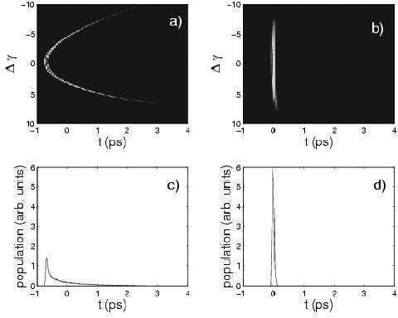
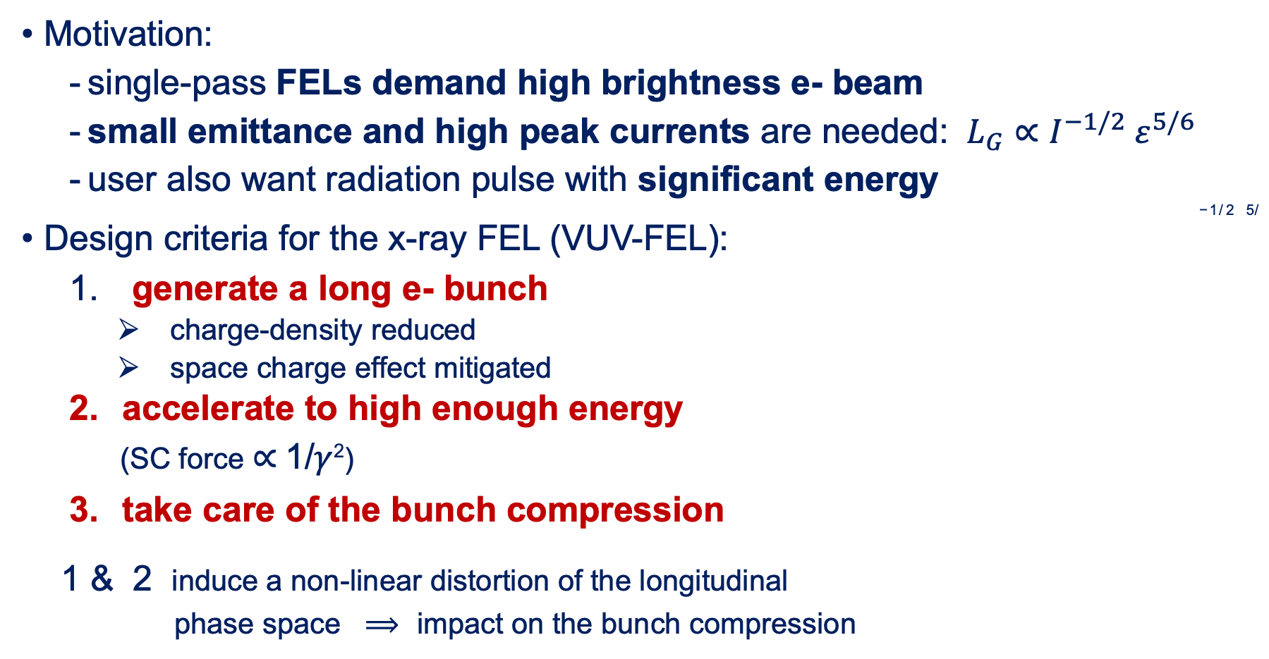
Beam dynamics aspects
Motivation:
  single-pass FELs demand high brightness e- beam
  small emittance and high peak currents are needed: $L_{G}∝I^{−1/2} ε^{5/6}$
  user also want radiation pulse with significant energy
−1/ 2 5/
Design criteria for the x-ray FEL (VUV-FEL):
generate a long e- bunch
charge-density reduced
space charge effect mitigated
accelerate to high enough energy
(SC force $∝$1/$γ$²)
take care of the bunch compression
1& 2 induce a non-linear distortion of the longitudinal
phase space $⟹$ impact on the bunch compression
3rd Harmonic Module mini-Review. P. Piot. 11.08.2005

Slide 18
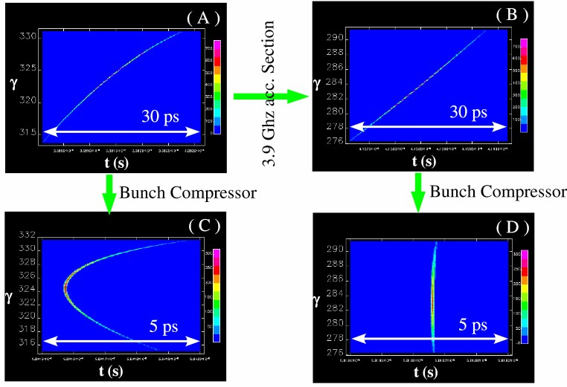
3rd Harm. to Improve Beam Characteristics
3rd Harmonic Module mini-Review. P. Piot. 11.08.2005
Energy distribution in the bunch before and after bunch compressor without (left) and with (right) the 3rd harmonic cavity, calculated for TTF photoinjector.

Slide 19
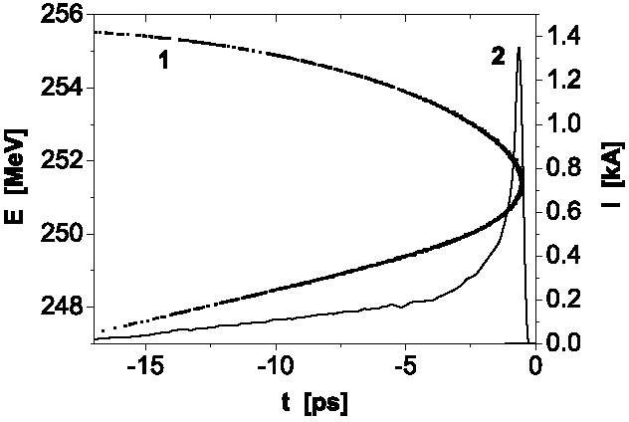
Case of TTF­1: nonlinear compression
from PRL 88, 104802 (2001)
Pros:
  sub-ps radiation pulses
  stable compression
  natural at TTF-1
Cons:
  throw away a lot of charges
  radiation pulse energy reduced
  beam dynamics associated to head and tail very different
  hard to tune and diagnose the e- beam
NOT lasing lasing
1: longitudinal phase space
2: charge temporal distribution
3rd Harmonic Module mini-Review. P. Piot. 11.08.2005

Slide 20
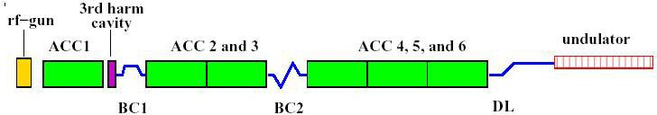
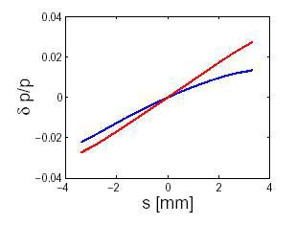
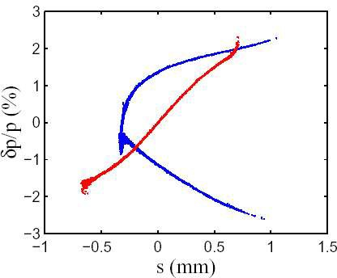
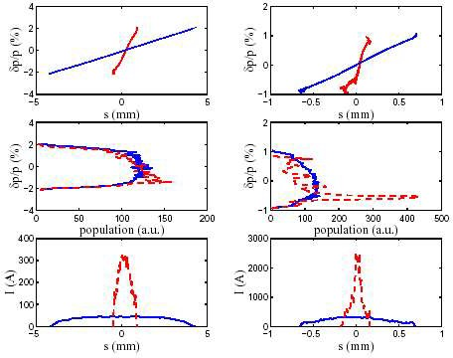
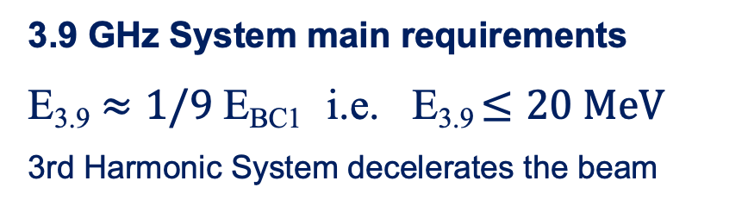
Beam dynamics aspects
3rd Harmonic on/off
BC1
3rd Harmonic on
BC2
phase spaces and
beam profiles before BCs
and
after BCs
3rd Harmonic Module mini-Review. P. Piot. 11.08.2005
3.9 GHz System main requirements
E_{3.9} $≈1/9$ E_{BC1} i.e. E_{3.9} $≤20 MeV$
3rd Harmonic System decelerates the beam

Slide 21
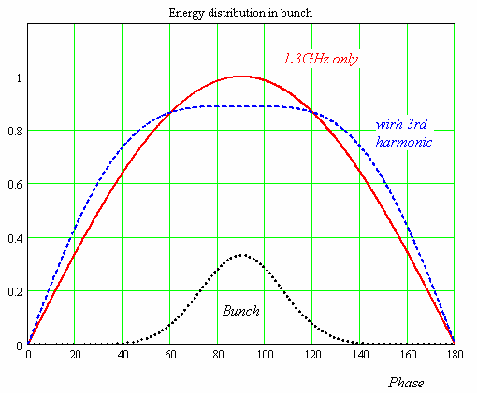
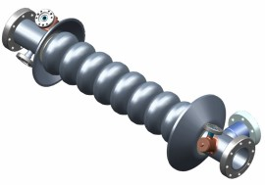
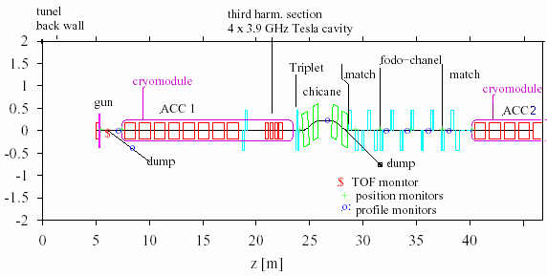

3.9 GHz Cavity General Parameters
Third harmonic cavity (3.9GHz) was proposed to compensate nonlinear distortion of the longitudinal phase space due to cosine-like voltage curvature of 1.3 GHz cavities.
3.9 GHz Cavity: Parameter List
V₃ = V₁ / 9
Number of cavities | 4
Active Length | 0.346 m
Gradient | 14 MV/m
Phase | -179 deg
R/Q | 750 Ω
^{E}peak^{/ E}acc | 2.26
B_{peak} (E_{acc}=14 MV/m) | 68 mT
Q_ext | 9.5 e+5
BBU limit for HOM, Q | <1.e+5
Total energy | 20 MeV
Beam current | 9 mA
Forward Power | 11.5 kW
Coupler power | 45 kW
180 MeV
-20 MeV
N. Solyak

Slide 22
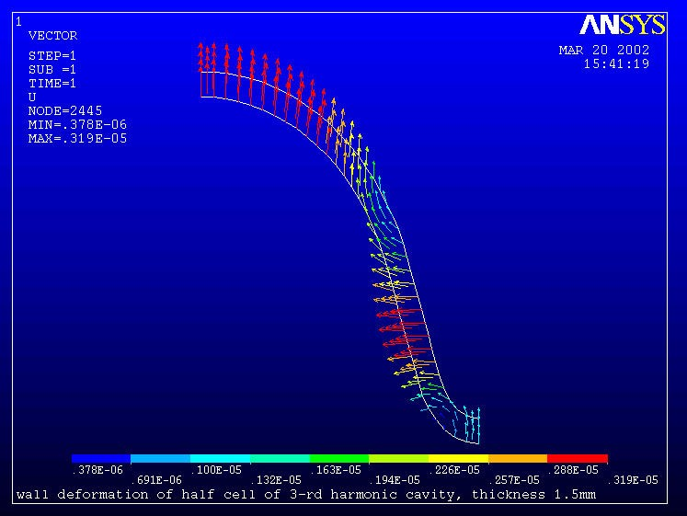
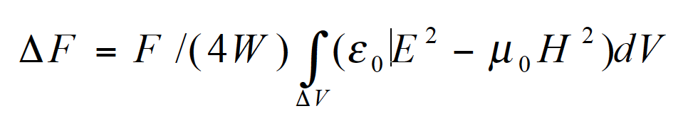

Frequency shift due to Lorentz forces
HFSS simulation of half cell
– P = (μ₀ Η ² − ε₀ E²)/4
  data exchange (HFSS-ANSYS)
ANSYS simulation of stresses in half cell
  different wall thickness
  Yung modulus, Poisson's ratio
Frequency shift due to Lorentz force (Slater’s Theorem)
2 2
E_{acc} = 15MV/m
Wall Thikness
$$∆F$$
N. Solyak
1.5 mm | 200 Hz
2.8 mm | 90 Hz
Displacement of the cell wall due to Lorentz force. (wall thickness = 1.5 mm)
Cavity bandwidth  4kHz No Stiffening ring

Slide 23
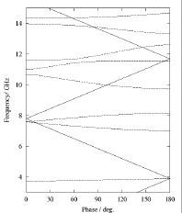
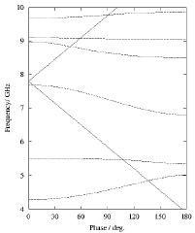

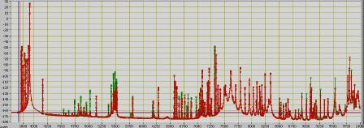
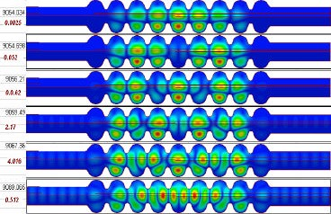
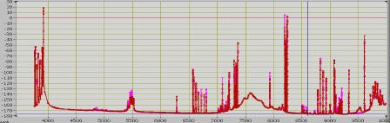
Extensive HFSS Calculation @ Fermilab
HFSS 3D 9 cells cavity model with:
2 High Order Mode (HOM) couplers,
matched Main coupler port,
different type of beam pipe terminations,
distributed and phased current sources.
Calculations in driven mode.
Monopole(left) and Dipole (right) passbands for mid-cell of the 3rd harmonic cavity
E/H boundaries. Red/green lines for different beam polarization (x/y). Few modes have Q>10⁵
3rd Harmonic Module mini-Review. T. Khabiboulline. 11.08.2005
Radiation boundaries. Three pass-bands are heavily dumped
Trapped modes in 5th dipole passband

Slide 24
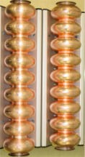
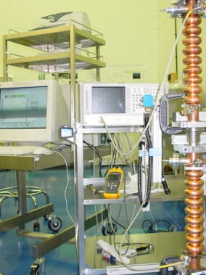
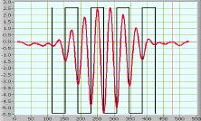
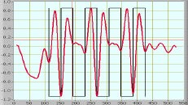
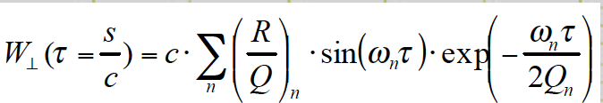
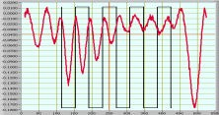
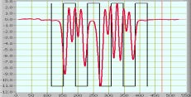

Qualification tests on Cu Cavity Prototypes
9 cells Cu cavity measurements with:
2 High Order Mode (HOM) couplers,
Main coupler port with matched termination,
Beam pipes with metal plates,
Excitation and pick-up from different ports. Bead-pull and S-parameter measurements for single cavity and double cavity system.
Dipole modes with high Qext (single cavity)
3rd Harmonic Module mini-Review. T. Khabiboulline. 11.08.2005
2-nd dipole band “Pi” mode. F=5325.2 MHz. Q=14000.
2-nd dipole band “6/9Pi” mode. F=5418.7 MHz. Q=11600.
1st dipole band.
F = 4979.6 MHz. Q=2200
5-th dipole band.F=9029.1 MHz. Q=32000.

Slide 25
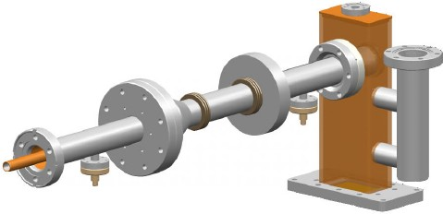
3.9 GHz RF Coupler Design: Parameters
3.9 GHz RF Coupler Main features
∅30mm/ ∅13mm coaxial line
Standard copper waveguide
Fix coupling
No DC biasing
Cold window: DESY TTF3 cylindrical ceramic
Warm window: CPI 3.9 GHz WG window
Two sets of bellows (flexibility)
All internal parts are copper plated (30 µm inner and 10 µm outer part of coax)
All part are brazed
Pick-ups and glass window for diagnostics
Good pumping performances
In Collaboration with CPI
P_{peak} = 45 kW (I_{b}=9mA) (processsing at 80kW) Pulse =1.3 ms
Rep. rate = 5Hz
N. Solyak

Slide 26
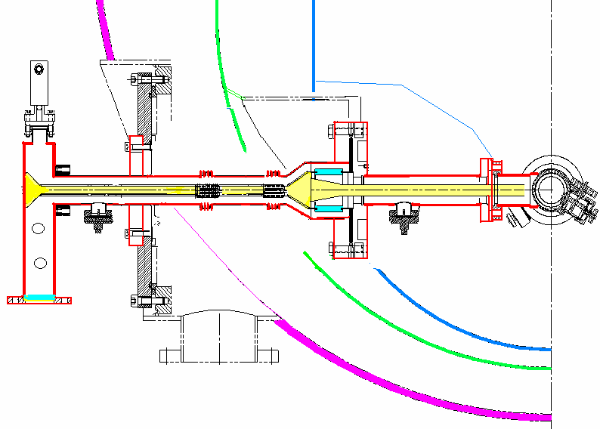
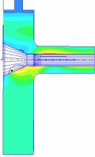
3.9 GHz RF Coupler Design: cut view
In Collaboration with CPI
Cold Window
Bellows section
Coax-to-WG transition
80 K
4K
Pick-up
80 K
4 K
Coax-to-wg, no pumping holes 0.7
0.6
0.5
0.4
0.3
0.2
0.1
0 | 3.5 |  | 3.6 |  | 3.7 |  | 3.8 |  | _{M}3_{H}.9_{z} |  | 4 |  | 4.1 |  | 4.2 |  | 4.3
300 K
N. Solyak
S11

Slide 27
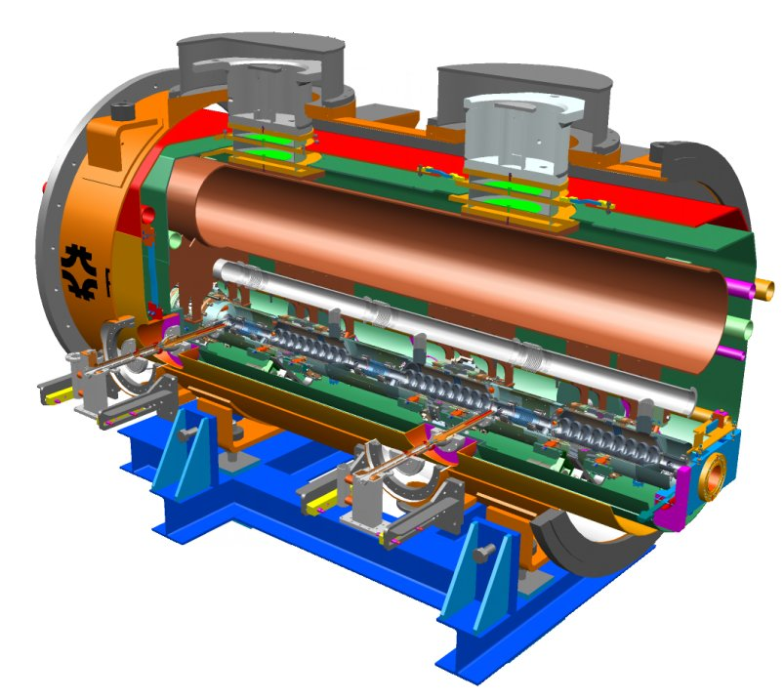

3rd Harmonic Cryomodule for TTF2
Don Mitchell

Slide 28


ACC39 Cryomodule designed at Fermilab
Don Mitchell

Slide 29


ACC39 Design derived from INFN Cry 2/3
ACC39
Cry 2
Cry 3
Module 1, 2 & 3 in TTF I

Slide 30





Cry2 to Cry3: Diameter Comparison

Slide 31


3rd Harmonic Cavity String
Don Mitchell

Slide 32

Cavity String closeup
Don Mitchell

Slide 33

Magnetic Shield closeup

Slide 34




ACC39 @ FLASH
Pei Zhang

Slide 35


ACC39 Module from Fermilab to FLASH

Slide 36

Commissioning of Fermilab Contribution

Slide 37


Phase Space Linearization Acheived

Slide 38
Contents
Longitudinal Phase Space Linearization
ACC39 made by Fermilab for FLASH
AH1 made by INFN-LASA for European XFEL

Slide 39

INFN In-Kind Contribution to the E-XFEL

Slide 40

Same Scheme in the 3 major XFELs
Hans Weise @ FEL2021

Slide 41




E-XFEL WP46 - 3rd Harmonic Module
Due to alternating couplers requirement, for coupler kick compensation, and to the position of the 2-phase pipe there are two dressed cavity configurations (left and right)
Blade tuner updated to the “slim” type, concept derived from ILC tuner work by INFN. Lighter, cheaper, motor to the side.
Design of the Module is “Plug compatible” with XFEL modules

Slide 42





E-XFEL 3rd Harmonic Module
10 3.9 GHz cavities produced and treated by the industry
Naked cavities Vertical tested at LASA
Integrated at the industry
Equipped with Power Coupler and assembled in the string at DESY
String moved into the cryomodule for final installation
Module in E-XFEL tunnel by end of September ‘15.
First beam in E-XFEL Injector by the end of ‘15,
Cavities after mechanical fabrication
Cavity after He-tank integration with tuner and motor
Cavities ready for Vertical Test @ LASA
3rd Harmonic Cryomodule
at the final installation stage
String of cavities with Power Coupler after
roll out from Clean Room @ DESY

Slide 43











Module Assembly by INFN at DESY

Slide 44








WP46 - Cavity Fabrication and Test
VT
preparation
String Assembly
Clean Room
at INFN
Weld inspection
RF
testing
XFEL Injector’ Beam
BCP
at EZ
Cavity Tests
VTA
at INFN
3rd Harm Off
All cavities above specifications!
3rd Harm On

Slide 45




XFEL 3rd harmonic: cavites and Cryomodule

Slide 46
E-XFEL in a nutshell
1.3 GHz SRF linac with 17.5 GeV, 5 kA bunches for an FEL operating in the 1-0.5 Å regime
  27000 e- bunches/s (0.6 ms flattop @ 10Hz, 2700 b/pulse)
  1 klystron driving 4 8-cavity modules in vector sum mode
Beam quality (emittance at high currents) is the key
  Three bunch compression stages at 130 MV, 600 MeV, 2.4 GeV to raise the bunch current
SASE2
300 kW
P. Pierini, SRF2017, Lanzhou
1 Module
A2
A3
A4
A5
A6
A24
A1
AH1
0.24 kW
5 kW
SASE1
300 kW
SASE3
n.c.Gun
1.3 GHz
6 MeV
LH, Dogleg, BC0
130 MeV
BC1
600 MeV
BC2
2.4 GeV
Collimation
6 to 17.5 GeV
300 kW
0 m
40 m
240 m
470 m
1460 m
2130 m
2440 m
3100 m
3300 m

Slide 47
3rd Harmonic for Longitudinal Phase Space
EXFEL needs longitudinal phase space manipulation before the bunch compression stages
  A proper current profile along the bunch for lasing is thus obtained by control of energy chirp, curvature, skewness in the longitudinal phase space
    Removing the RF curvature from the 1.3 GHz module caused by the long bunch length at the injector
    Compensating wake fields in the main linac, BC non linear optics, space charge effects…
How? Add a (third) harmonic voltage and properly set its amplitude and phase relative to the main accelerating voltage
M. Dohlus, T. Limberg, “Bunch compression stability dependence on RF parameters”, 27th FEL Conference (2005) p. 253

Slide 48







Phase space manipulation in a glance
Using only A1 to chirp the beam (no AH1)
At final compression stage
current spike
Large current spike
but low charge for FEL!
Longitudinal phase space
Current along bunch
👎🏻
1 mm
50 mm
chirp+curvature!
With third harmonic manipulation
After A1 (130 MeV)
After BC2 (2.4 GeV)
After L3+CL (17.5 GeV)
After A1 (150 MeV)
After AH1 (130 MeV)
P. Pierini, SRF2017, Lanzhou
👍🏻
10 mm
Off crest operation
creates chirp+curvature
AH1 removes curvature
and prepares for BC
At final compression stage
good current profile
Beam flattened for good
FEL emission

Slide 49




What is in the AH1 module?
The third harmonic system (AH1) is functionally like a standard main XFEL module, but contains 8 cavities at
3.9 GHz (3 times the frequency, therefore 1/3 of the size)
IN-KIND Contribution to XFEL by INFN (50%: Cavities and module) and DESY (50%: Couplers, RF and infrastructure)
  Joint: installation, technical commissioning and initial operation
P. Pierini, SRF2017, Lanzhou
Beam
A1
AH1

Slide 50


Cavity production and testing
3 prototypes and 2 batches of 10 cavities procured by INFN
  Mechanical production & BCP treatment at Vendor
  Preparation to test and VT at INFN-LASA
1st batch (X3M1)
2nd batch (X3M2)
11
MV/m
15
MV/m
P. Pierini, SRF2017, Lanzhou

Slide 51


VT Qualification summary
 | E_{acc} [MV/m] | Q₀ [10⁹]
First Batch | 20.4±1.1 | 2.39±0.29
Second Batch | 19.9±2.4 | 2.77±0.65
 | 20.1±1.9 | 2.58±0.45
R_{BCS}: as expected from the f² scaling
R₀: Follows JLAB scaling R₀=5.3+1.89 (f[GHz]) [nΩ]
<10 mG in VT
P. Pierini, SRF2017, Lanzhou

Slide 52




Behavior at high field
All cavities quench at around 20-22 MV/m
  Dissipated power on the cavity in the 20-100 W range
  Thermal equilibrium model with field dependent BCS reproduces the slope of Q₀ vs E_{acc} curves at different T
  Thermal breakdown around 20 MV/m seems the limiting mechanism of 3.9 GHz structures with BCP
Heat transfer can be linearized
assuming weak quasi-particle overheating
$${(T}_{qp}−T_{0}≪T_{0})$$
P. Pierini, SRF2017, Lanzhou
$$T_{qp}−T_{bath}=\frac{αT_{bath}}{R_{s,0}}{\left(\frac{H}{2H_{c}}\right)}^{2}R_{s}\left(H,T_{qp}\right)$$
$$T_{qp}−T_{bath}=\frac{αT_{bath}}{R_{s,0}}{\left(\frac{H}{2H_{c}}\right)}^{2}R_{s}\left(H,T_{qp}\right)$$
Overheating
parameter
$$α=\frac{R_{s,0}B_{c}^{2}}{2μ_{0}^{2}T_{bath}}\left(\frac{1}{Y}+\frac{d}{k}+\frac{1}{h_{k}}\right)$$
$$α=\frac{R_{s,0}B_{c}^{2}}{2μ_{0}^{2}T_{bath}}\left(\frac{1}{Y}+\frac{d}{k}+\frac{1}{h_{k}}\right)$$
$$α≅0.18$$
A. Gurevich, “Reduction of Dissipative Nonlinear…”, arXiv:1408.4467 (2014)
J.T. Maniscalco et al., ”The importance…”, JAP 121, 043910 (2017)

Slide 53


Validation test in AMTF (March 2015)
No module test prior to installation!
Horizontal test for the cavity package qualification
  Cold Tuning System & Coupler assembly
Open loop operation at 20 MV/m
  Quench at 24 MV/m,10 Hz, 1.3 ms
  VT: 21 MV/m (quasi CW)
P. Pierini, SRF2017, Lanzhou

Slide 54


Major AH1 Assembly Milestones
July 3 2015
P. Pierini, SRF2017, Lanzhou
September 23 2015

Slide 55



The assembly in Halle III (14 weeks)
P. Pierini, SRF2017, Lanzhou

Slide 56


Final Preparation stages in tunnel
November 11 2015
P. Pierini, SRF2017, Lanzhou
Assembly WG distribution
Injector String Integration
Dec 10: Start cooldown
Dec 15, Cryo OK- cavity pre-tuning
Dec 16, calibration: AH1 Ready

Slide 57


RF Distribution layout
Vector Sum
  8 cavities
1 Pulsed Klystron (Max. 80 kW)
Klystron up to 60 kW
P. Pierini, SRF2017, Lanzhou
Fixed coupler
3-stub tuners for QL adjustment cavity phasing

Slide 58

First operation at nominal gradient on Day 1
18 December 2015
  Operation with no beam
  First rough calibration (LLRF)
    Assume P_{cav}=P_{kly}/10
  Nominal pulse structure
    Fill: 750 us/FlatTop: 650 us
  Gradient well above nominal
    40 MV of VS voltage
    First quench > 45 MV
  Cavity phasing missing and Q_{L} values not yet tuned
  LLRF in FB mode
P. Pierini, SRF2017, Lanzhou
Arbitrary calibration/need beam

Slide 59


Beam Based calibration: Cavity Phases
January 2016, on beam
  Beam transients
  Phase Calibrations
Preliminary to :
  Phase Tuning
  Q_{L} tuning
Large initial cavity phase spread
  WG assembled in tunnel, no cal.
Cavity transient, QL determination and phase calibration
P. Pierini, SRF2017, Lanzhou
Beam induced cavity gradient changes
Tune with
  3-stub tuners
  WG Spacers
160°
After operation of a few stub tuners

Slide 60


Q_{L} tuning & Phase alignment
1 February 2016, AH1 moved 1 ms after the beam
  Allow injector commissioning while aligning cavity phases
Individual maps of all 3-stub tuner positions
Q_{L}-Phase region
Case of design in range of tuner
Q_{L}-Phase region
Case of design outside range of tuner
QL tuning & Phase alignment
P. Pierini, SRF2017, Lanzhou
WG spacers installed on 3 cavities

Slide 61


Started regular operation in injector
10 February 2016
  Q_{L} aligned well within the 10% requirement
  Phases within 15°
16 February 2016
  Back on beam
  Moved to -180°(wrt on-crest), calibration with beam energy
P. Pierini, SRF2017, Lanzhou

Slide 62

Quench Gradients (VT vs Module)
RF based calibration in tunnel initially did not correlate too well with VT quench gradients
  Due to large uncertainties in WG distribution details
  Good agreement after beam based calibrations
P. Pierini, SRF2017, Lanzhou

Slide 63

HOM performance
Cavity Q0 is 2E9 (VT measure)
Qt is 1E10 (VT calib)
C1 HOM1 suboptimal tuning
C4 HOM1 detuned (cavity Q0)
However, stable thermal behavior at 1.3 ms, 10 Hz operation up to SP in excess of 40 MV
Cav | QH1 | QH2
C1 | 7.29E+09 | 5.64E+11
C2 | 1.14E+12 | 5.72E+10
C3 | 8.70E+10 | 1.33E+11
C4 | 1.91E+09 | 6.29E+11
C5 | 3.18E+11 | 2.68E+11
C6 | 8.32E+11 | 5.05E+11
C7 | 1.36E+11 | 6.28E+10
C8 | 4.50E+11 | N/A
~40 MV, 0.5 K temperature rise
in C4 Hom region
P. Pierini, SRF2017, Lanzhou
Thermal sinking is sufficient for stability (at 1% d.f.)

Slide 64



Beam Based Calibration of Module voltage
RF calibration did not give sufficient consistency in A1/AH1 correlation. BB calibration using dispersive section.
A1/AH1 need to be in good relative calibration (phase and amplitude) to control the beam with Sum Voltage Controls
  Improved consistency in VT/XTIN quench fields
  Important to check after RF calibrations are done
P. Pierini, SRF2017, Lanzhou

Slide 65




RF Curvature linearization by AH1
Beam image on screen in the spectrometer beamline
← AH1 off
AH1 on →
X (i.e. E)
Y
X (i.e. E)
Beam image on screen in the spectrometer beamline, switching on the Transverse Deflecting Structure
← AH1 off
AH1 on →
Vector Sum Control of the sum RF field of the two modules allows to set the beam shape parameters (e.g. chirp, curvature, skewness) for proper matching to the downstream compression stages
P. Pierini, SRF2017, Lanzhou
Y (i.e. t or s along bunch)

Slide 66
Summary of 3.9 GHz Module Experience
RF commissioning and operation of the 3.9 GHz module in the tunnel was a success
  Achieved performances above nominal during the early injector commissioning stages in December 2015, with the AH1 pulse shifted in time from the beam
Module in regular operation with beam since January 2016 in the Injector run and ready for operation at the start of the XFEL commissioning phase in January 2017
First XFEL lasing at 9 Å on May 4th 2017 (then 2 and 1.5 Å reached in summer): final confirmation of proper third harmonic system performance
  (and of course of many other important systems…)
Since then, AH1 is a crucial part of the European XFEL user facility reliably operating in Hamburg

Slide 67


Thank you for your attention

