Slide 1
TRISS: A Versatile Tool for Unravelling Molecular Mechanisms How We Use Trapped Ions and X-rays to See How Proteins Break
Ouassim Hocine Hafiani Department of Physics and Astronomy, Uppsala University | MAX IV Laboratory

Slide 2
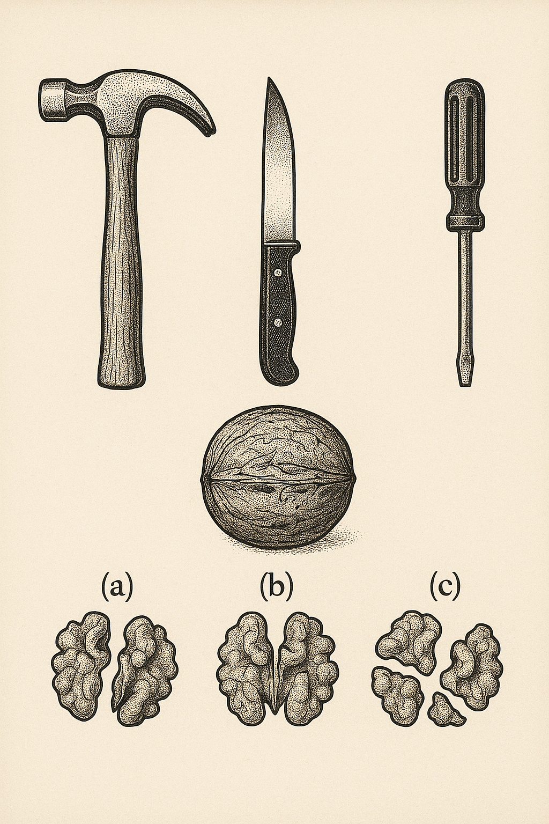
Defining a walnut structure
TRISS: TRapped Ion Spectrometer Setup
It’s an Iontrap Mass spectrometer
Creates ionic form of proteins / small molecules
Filter them (keep 1 unique mass)
Fragment them
We observe what are the resulting fragments using a Mass Specrometer

Slide 3
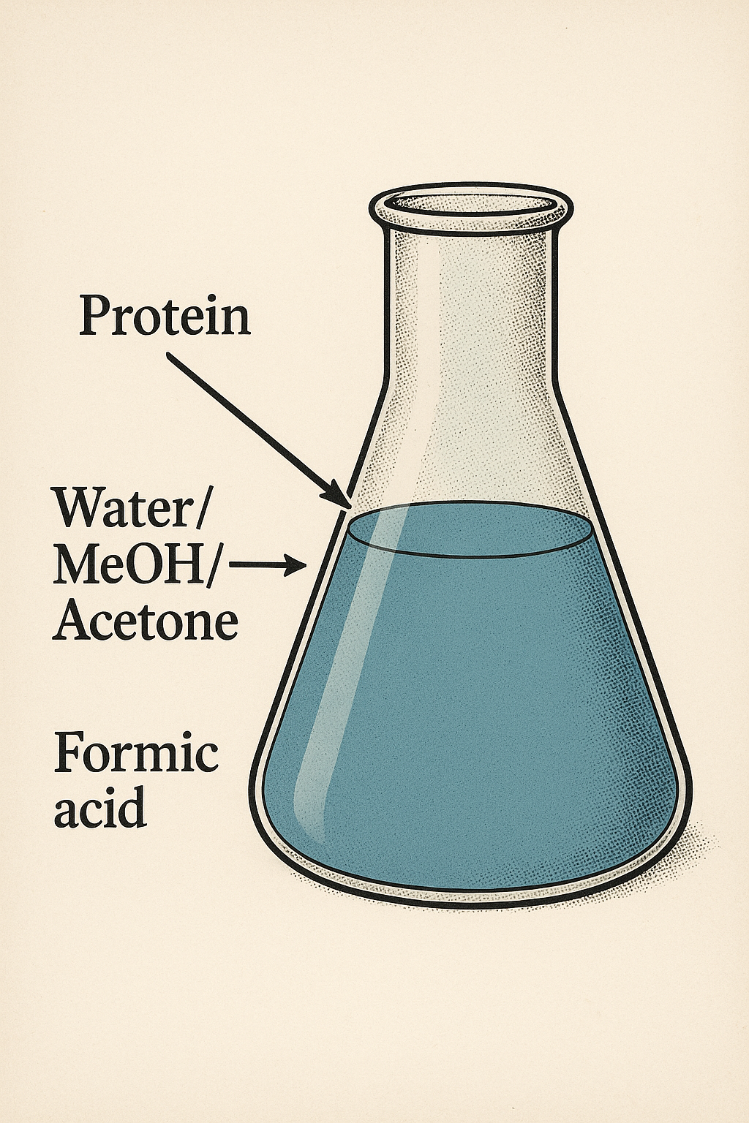
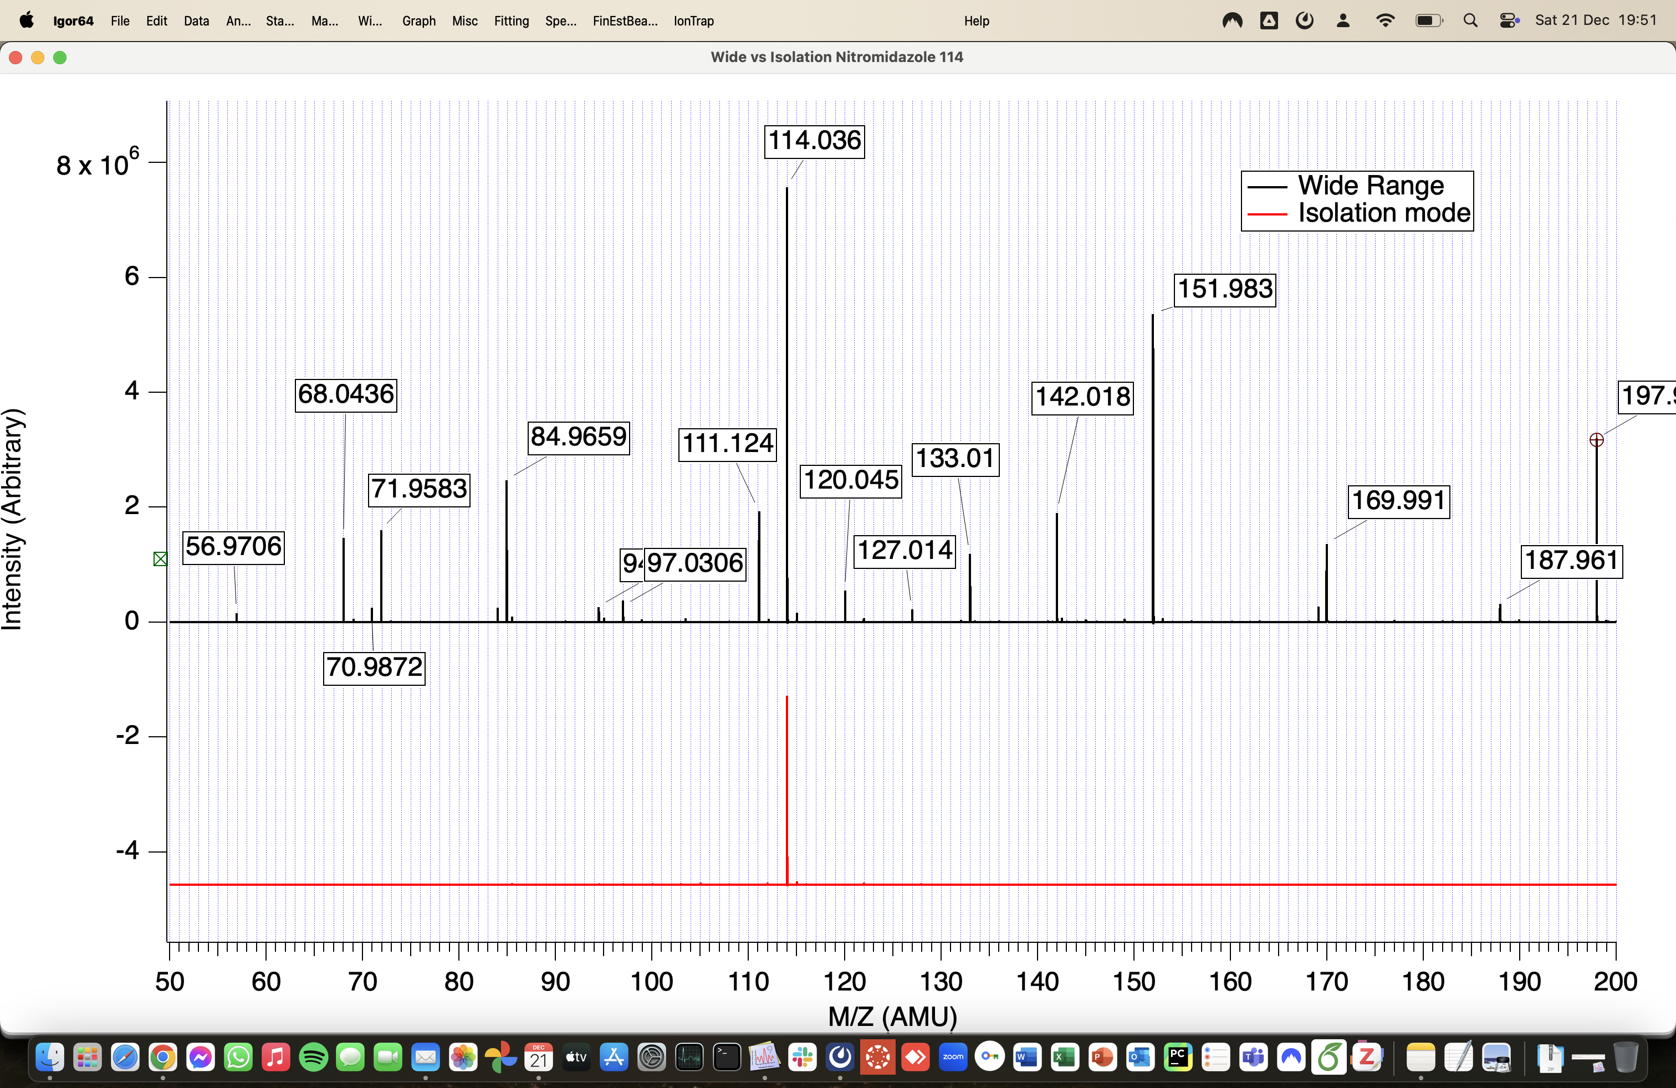
How TRISS Works
Create and guide the Ions:

Slide 4
How can we make sure that it’s the same protein?
Trapping/Isolating Ions:
A Trapping RF + an isolation RF
makes us isolate identical ions with the same m/z
Trapping Radio Frequency:
Low
High
Iontrap

Slide 5
How can we make sure that it’s the same protein?
Trapping/Isolating Ions:
A Trapping RF + an isolation RF
makes us isolate identical ions with the same m/z
Trapping Radio Frequency:
Low
High
+
Additional iosolation Radio Frequency
Identical Ions
Iontrap

Slide 6
Trapping/Isolating Ions:
A Trapping RF + an isolation RF
makes us isolate identical ions with the same m/z
Trapping Radio Frequency:
Low
High
+
Additional iosolation Radio Frequency
Identical Ions
Iontrap

Slide 7
Fragment the Ions:
Once isolated, we hit the trapped ions with a chosen "hammer":
Gas (CID): Colliding them with a neutral gas to shake them apart.
Electrons (ECD/EID): Gentle but effective for breaking the protein's backbone.
Photons: X-rays from the synchrotron for site-specific damage.
1
2
3

Slide 8
Analyze the fragments using a Mass spectrometer:

Slide 9
Defining a walnut structure
Summary
Gas / Electrons / Photons
Protein / Molecules
Different Mass spectrums

Slide 10
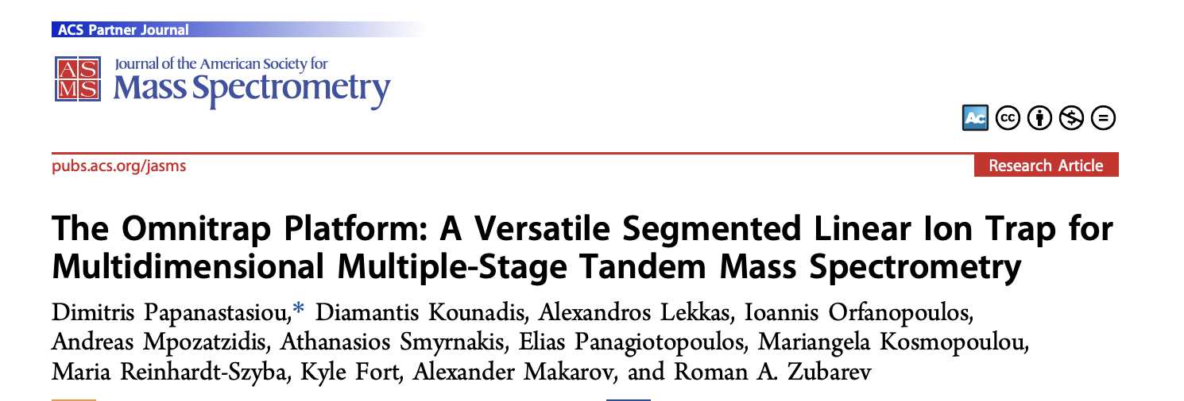
Conclusion
TRISS integrates ion trapping with an entire toolbox of fragmentation techniques.
Its key benefit is providing a more detailed structural analysis of proteins and molecules
This is used for biochemical physics, drug development, and for our understanding of radiation-induced damage.
Thank you!
Under GA 101081419

