Slide 1




Picosecond X-ray pulses at Elettra 2.0 with “crab cavities”
Simone Di Mitri
Elettra Sincrotrone Trieste & University of Trieste

Slide 2
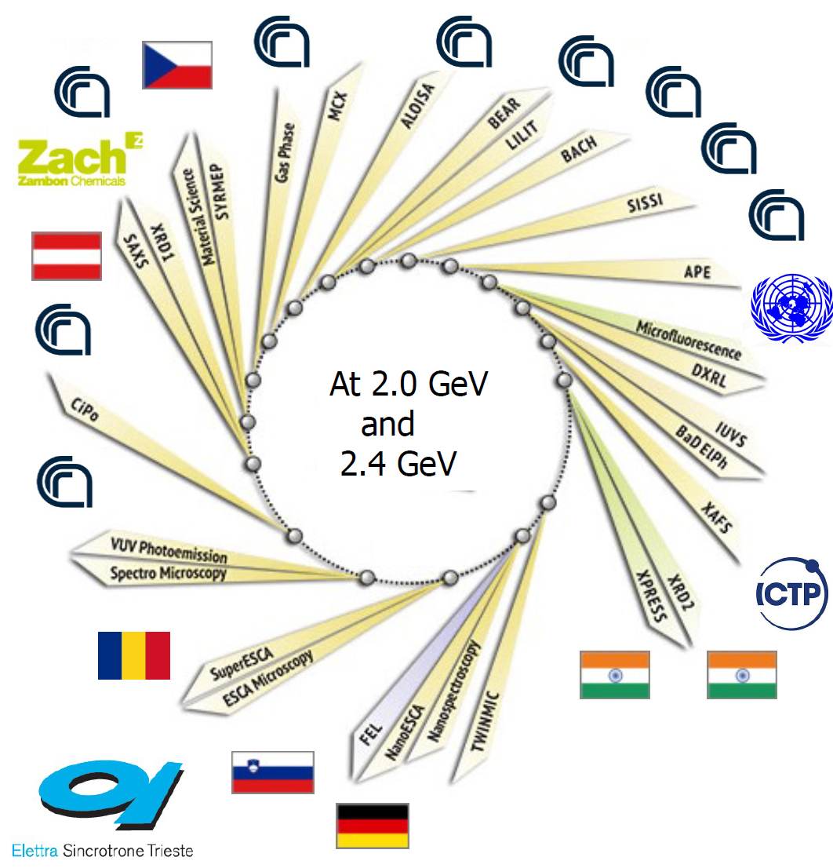
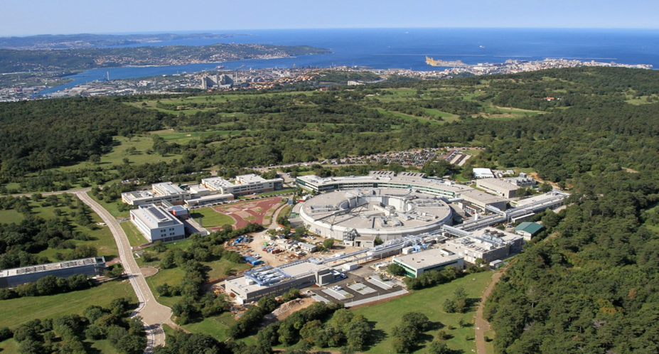
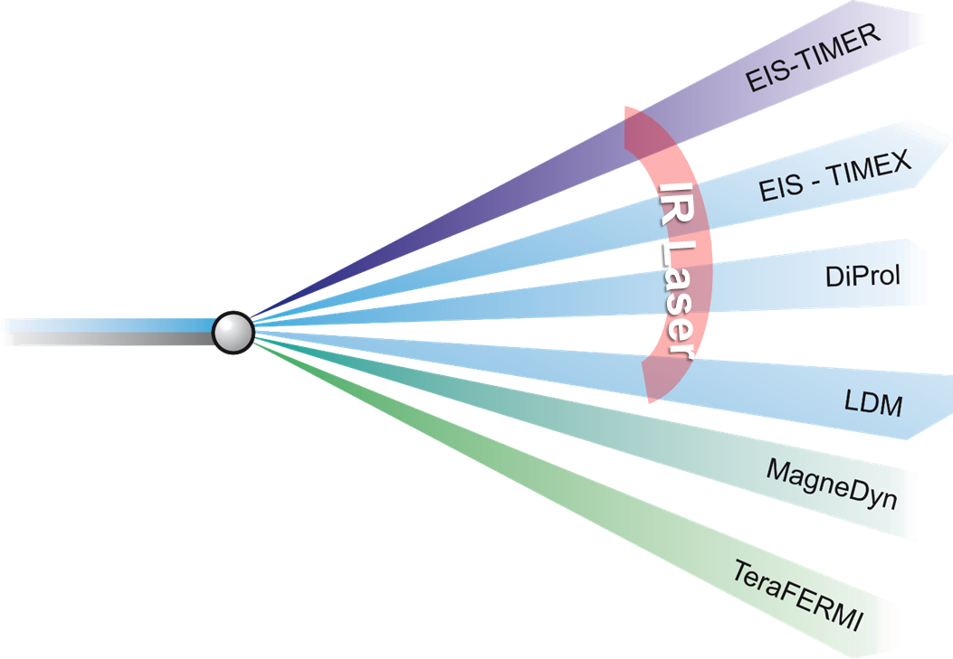
Elettra Sincrotrone Trieste
Elettra Sincrotrone Trieste is an international multidisciplinary research centre of excellence, open to the international research community, featuring a 2.0/2.4 GeV, third-generation synchrotron light source (Elettra), a free-electron laser light source (FERMI) and a variety of support laboratories.
Shut down in July for major upgrade
ELETTRA, 2-2.4 GeV SRLS:
in operation since 1994
FERMI, 1.5 GeV FEL:
in operation since 2010
Z. Ebrahimpour’s talk today

Slide 3
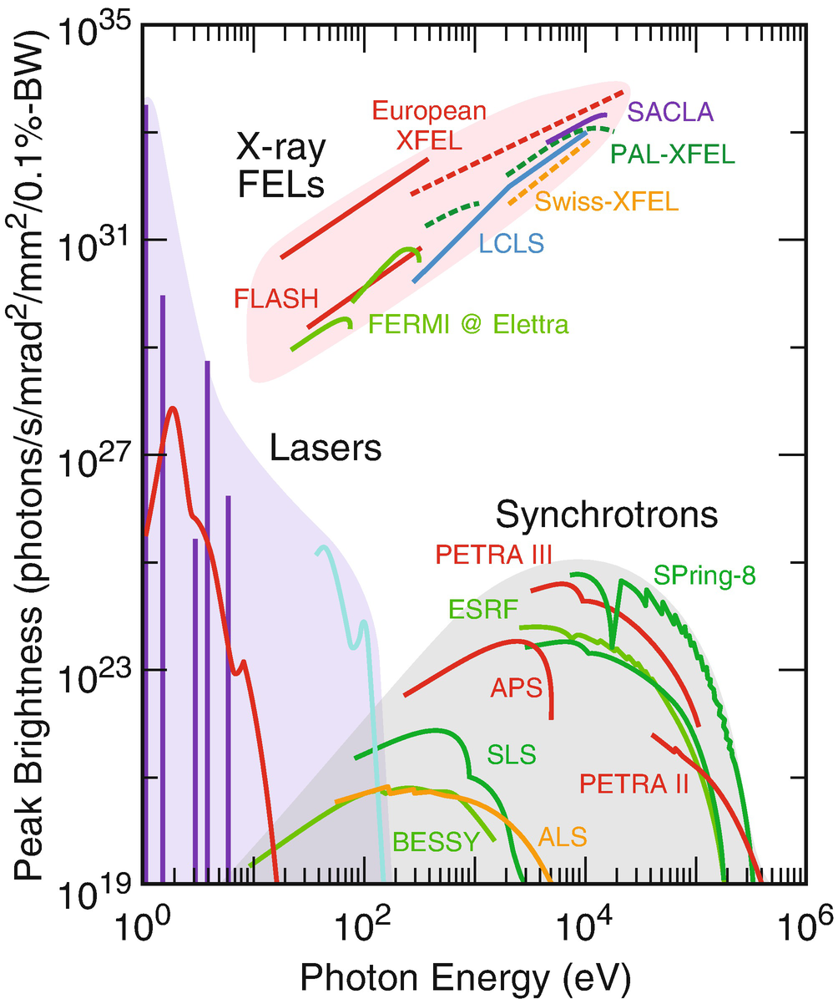



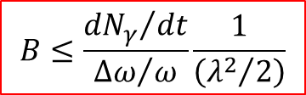


Elettra 2.0 – Diffraction Limit
Almost all experimental techniques gain from either a large 6-D photon density (brilliance) or a large coherent flux (degeneracy parameter):
$$n_{coh}≫ 1$$
$$n_{coh}=\frac{Bλ^{3}}{8c}$$
$$B≤\frac{{dN_{γ}}/{dt}}{{Δω}/ω}\frac{1}{\left({λ^{2}}/2\right)}$$
and
$$n_{coh}≈ 1$$
Diffraction Limit
4GSR
$$σ_{u}σ_{u^{′}}=ε_{u}≤\frac{λ}{4π}$$
for
More flux at the sample, for any given λ-range
Higher λ-harmonics by means of low-gap IDs
Shorter integrated time of measurement
Micro- and nano-focusing
Transverse x&y coherence up to 1 keV
ICS
$$n_{coh}≪ 1$$

Slide 4
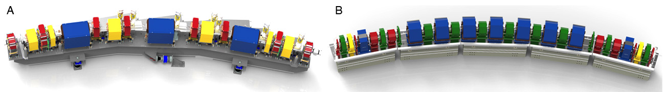
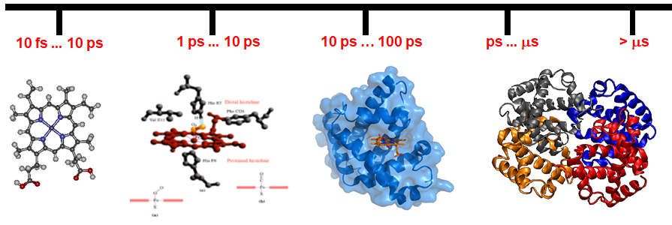
Science drivers of timing modes at SRLS
3GSR
4GSR
New science
  1–5 ps processes @ nm size:
  Elementary conformational protein dynamics & protein-protein interaction.
  Atomic motion in molecular vibrations.
  Chemical reaction intermediates.
Avoid sample burning or ablation
Avoid space charge shielding
Multi-MHz rep. rate
Wide & continuous λ-tuneability
Full polarization control
+ Improve lateral resolution
+ Improve energy resolution
+ Reduce the integrated time of measurements
  Track non-equilibrium states (e.g. aerosol in free-flight)
  Map reversible dynamics of molecular systems
  Probe charge transfer dynamics
  Image orbital, spin, and lattice degrees of freedom
  50–100 ps:
  PES, EXAFS, imaging

Slide 5
Elettra 2.0 – Timing Mode
Parameter | Elettra 2.0 | Crab Cavities | FERMI | Units
Spectral range | 0.02 - 50 | 0.1 - 10 | 0.01 – 0.7 | keV
Rep. rate | 1 – 400 | 0.1 – 1 | 0.05 | MHz
Pulse duration, rms | 30 | 0.5 – 2 | 0.005 – 0.1 | ps
Flux at sample, ave | 10⁶ – 10¹³ | 10⁵ – 10⁹ | 10⁹ – 10¹³ | ph/sec
Spectral resolution | 10⁻⁵ – 10⁻⁴ | 10⁻⁴ | 10⁻⁴ – 10⁻³ (w/o mono)
Polarization | all | all | all
Coherence | Hor. ≤ 1 keV | Hor. < 0.5 keV | full
# Beamlines / Run | 31 | < 10 | < 2

Slide 6
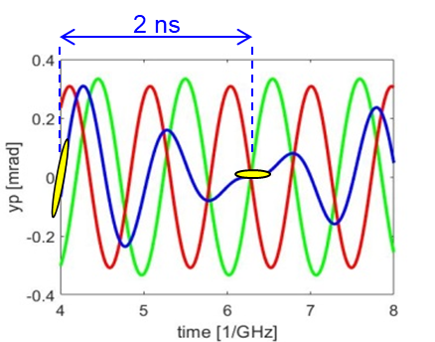
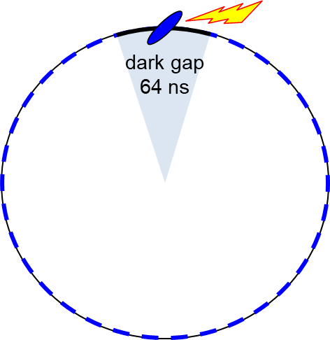
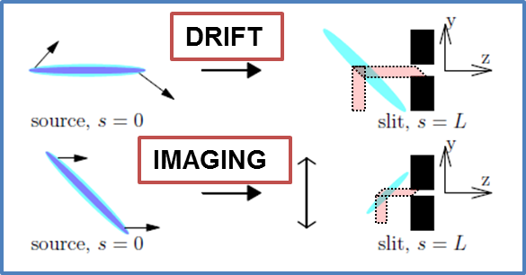
“Crab cavities” working principle
Fill pattern:
200 regular bunches, 2 mA/bunch, 4 ns-time sep.
1 tilted bunch, 2 mA , ±32 ns time sep., 1.157 MHz
Pulse selection:
  Temporal gating
  distorted orbit
  chopper
A. Lunin et al., Phys. Proc. 79 (2015) 54.
A. Lunin, T. Khabiboulline, V. Yakovlev , “A White Paper on Design and Fabrication of SRF Deflecting Cavities for Elettra 2.0”, FNAL note.
A. Zholents, NIM A 798 (2015) 111
See also: X. Huang, PRAB 2016, 2019, 2023

Slide 7
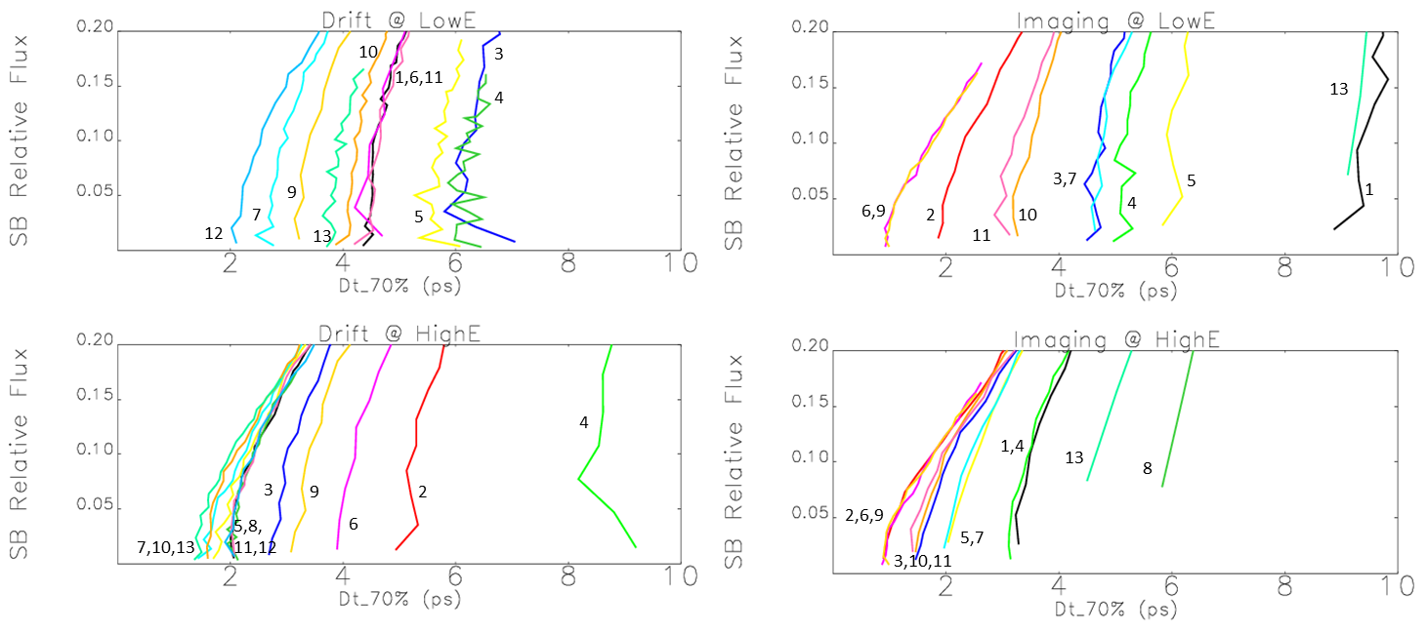
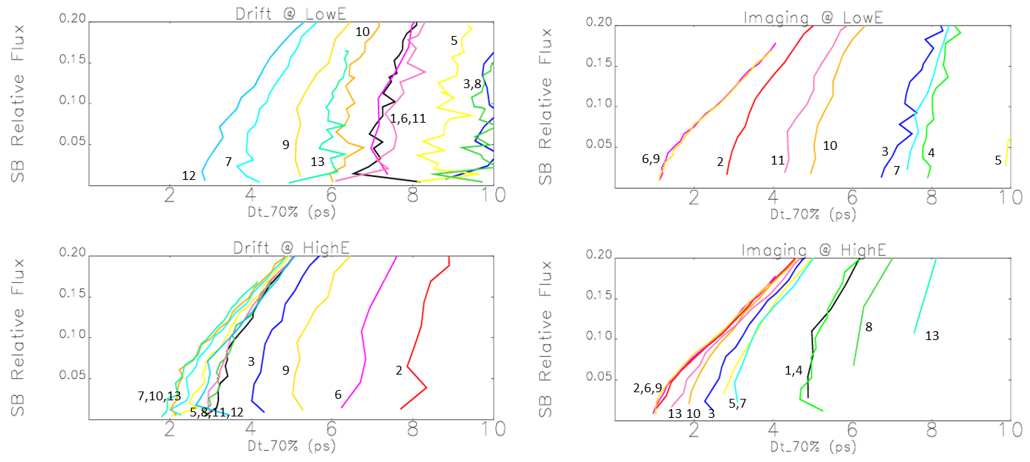
Flux vs. pulse duration
0.8 MV @ 3GHz
1.2 MV @ 3GHz
On-the-fly control of pulse duration, flux, rep. rate (chopper), polarization (ID)
  At each beamline, without interference with neither other beamlines nor accelerator operation

Slide 8
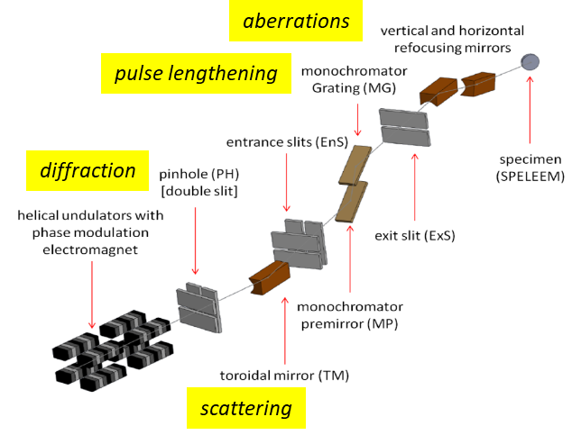
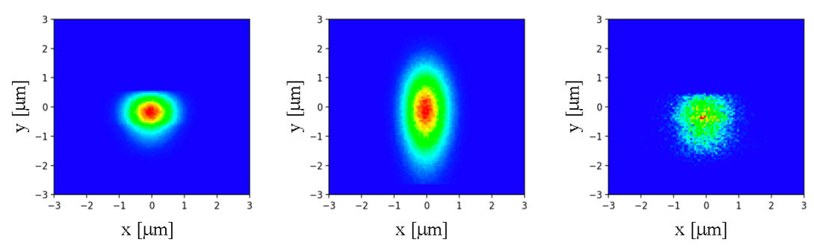
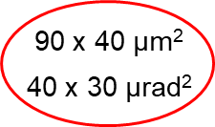
Nanospectroscopy @ 800 eV
From accelerator to sample (elegant + Spectra + ShadOUI):
1 x 0.9 µm²
1 x 2.3 µm²
1 x 1.3 µm²
REGULAR:
55 ps
1.3e10 ph/s
SHORT:
4 ps, drift
1.5e9 ph/s
SHORT:
4 ps, hybrid
1.8e9 ph/s
V-mono res. power: 2000 - 4500
The slit selects a sub-space of radiation emitted by the tilted e-bunch
Transverse coherence and energy resolution largely preserved

Slide 9
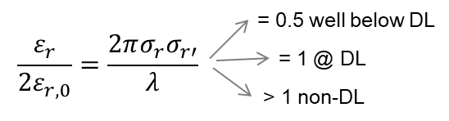
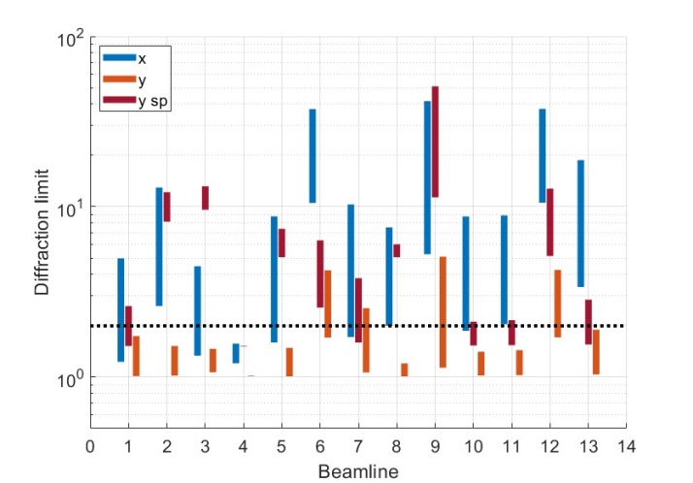
Diffraction limit, spectral flatness
Potentially useful for on-the-fly energy scan at EXAFS, XAS…
55ps, x-pol.
4ps, y-pol.
4ps, x-pol
3.7ps, x-pol

Slide 10
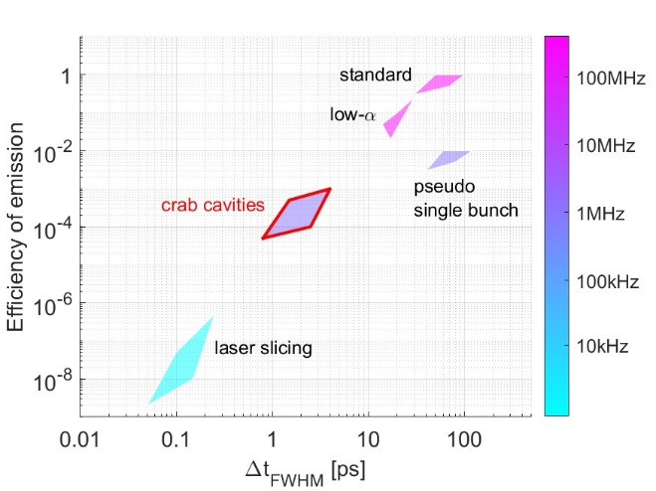
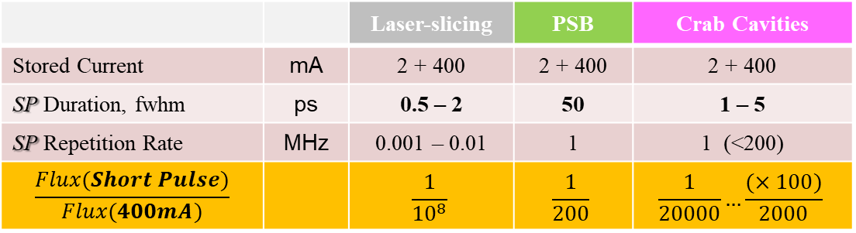
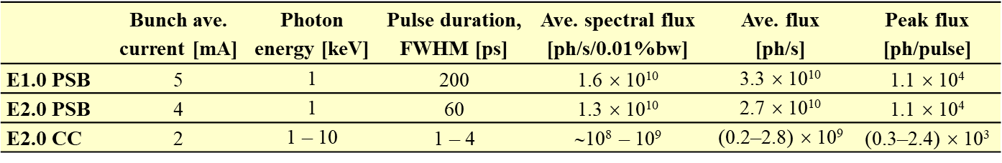
Timing modes @ SRLS
@ E2.0

Slide 11
Summary
Picosecond duration, at several beamlines, for E_{ph} > 100 eV
Tunable 0.1–1 (100) MHz rep. rate, 1–10 % flux relative to standard single bunch emission
Transverse coherence, energy resolution & polarization largely preserved
Standard bunches pay a doubled vertical emittance (6 → 12 pm rad)
Conceptual design report is being finalized. Technical design report is in progress
CCs are not in the Elettra 2.0 baseline. Still, full support from management, international committees and beamline scientists. Search for funds to prototype.

Slide 12
Acknowledgements
A. Zholents (ANL)
X. Huang (SLAC)
R. Calaga, A. Grudiev (CERN)
for guidance to “Crab Cavs” simulations
The Elettra team for the Crab Cavities:
A. Bianco (retired), M. Altissimo, E. Busetto, A. Carniel, S. Cleva, I. Cudin, S. Dastan, B. Diviacco, A. Fabris, E. Karantzoulis, S. Krecic, S. Lizzit, M. Lonza, K. Manukian, C. Masciovecchio, M. Modica, E. Principi, N. Shafqat
Thank you for your attention
Questions are welcome!

Slide 13
Back up slides

Slide 14
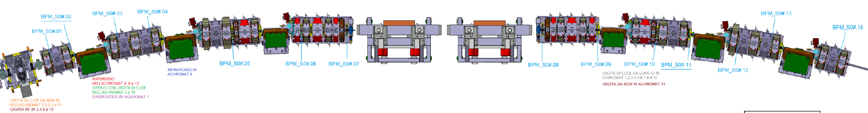
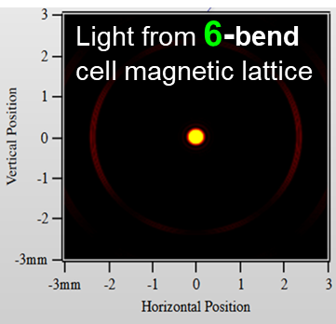
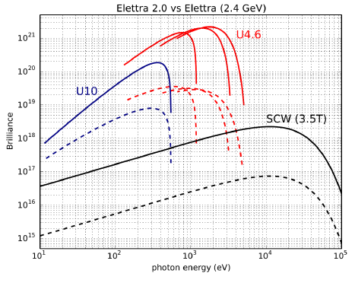
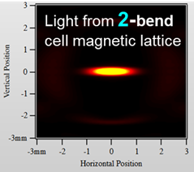
Magnetic lattice
The present magnetic lattice will be entirely replaced by a denser and stronger one, including combined-function elements (3x dipoles, 4x quadrupoles).
– 12 of such cell in the existing tunnel –
45-fold smaller e-beam emittances
5-fold smaller beam sizes at IDs
x100 brilliance at the source (1-10 keV)
Reduced acquisition time
Photon-hungry techniques
Lateral resolution
CDI in keV range, ptychography, XPCS

Slide 15
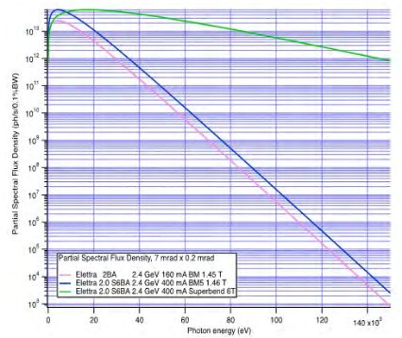
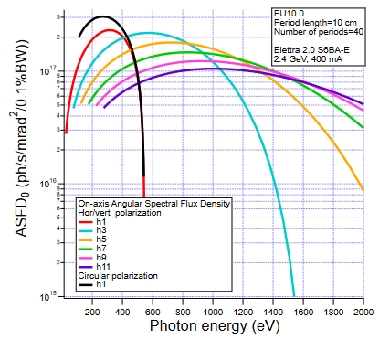
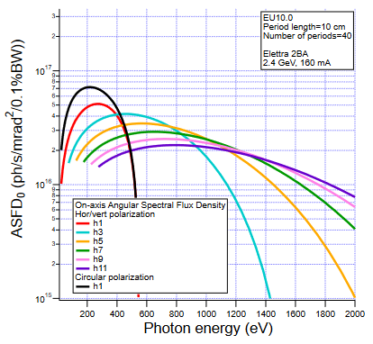
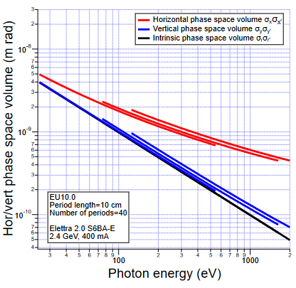
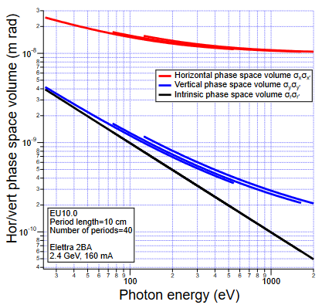
Improved radiation source
Elettra 2.0 @6T (superbend)
Elettra @1.6T
Elettra 2.0 @1.6T
Dipole magnet: spectral flux density
EPU: on-axis Ang. Spectr. Flux Density of odd harmonics 3 – 11.
EPU: radiation 4-D volume at the source

Slide 16
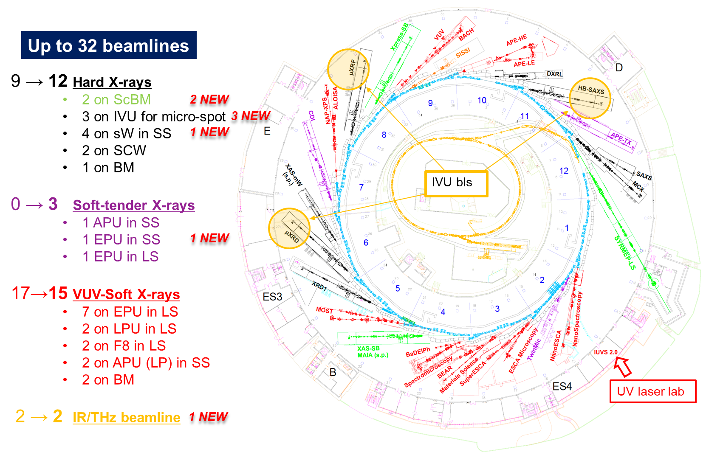
Beamlines

Slide 17
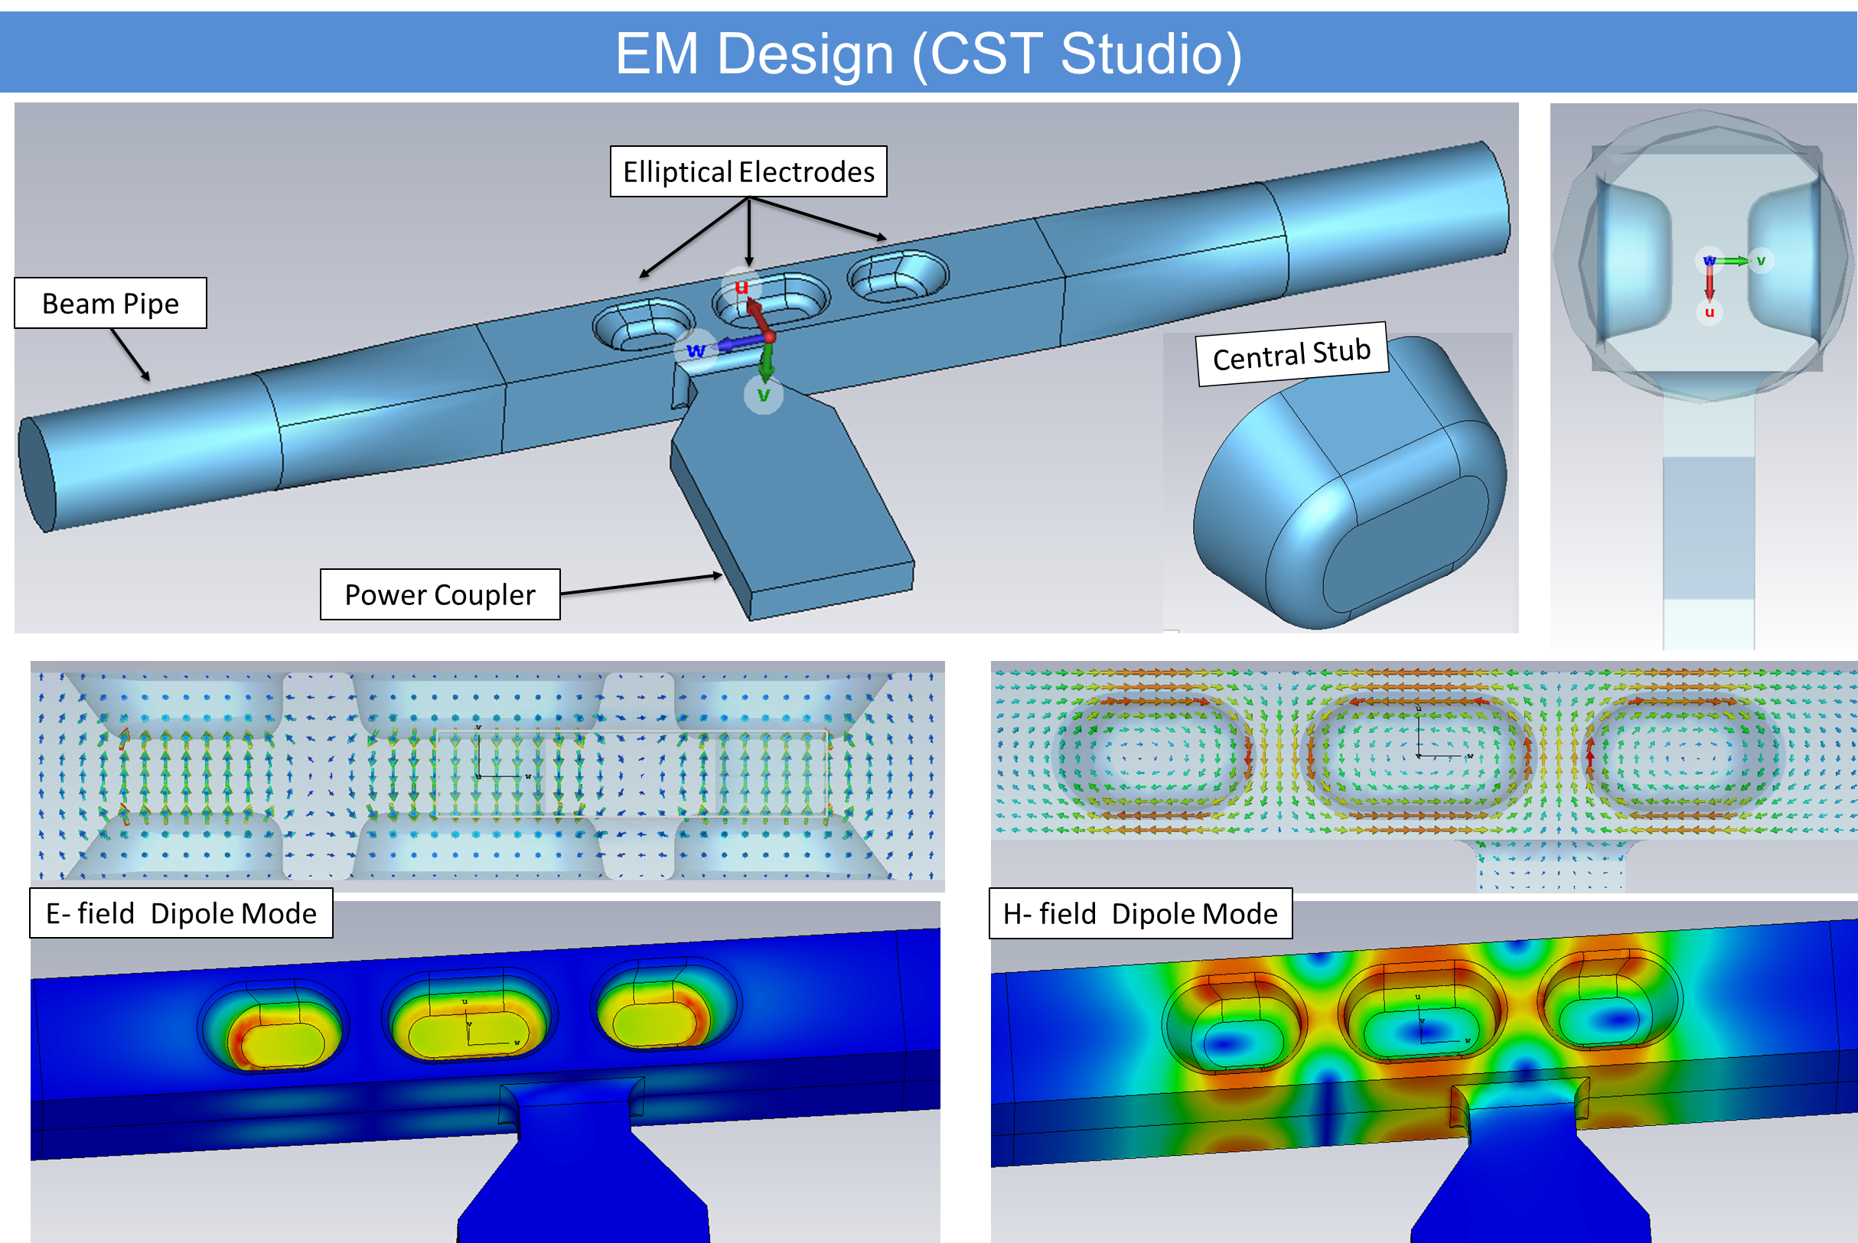
Deflecting voltages
A. Lunin et al., Phys. Proc. 79 (2015) 54.
A. Lunin, T. Khabiboulline, V. Yakovlev , “A White Paper on Design and Fabrication of SRF Deflecting Cavities for Elettra 2.0”, FNAL note.
Quasi-waveguide Multicell Resonator (QMiR) @ 2.815 GHz for APS (ANL).
Intrinsic low-Q SOMs and HOMs in a sparse frequency pattern.
Low gap, relatively high surface fields, nonlinear field components.
  Re-design of the ANL prototype for a larger beam aperture, to meet the requirements on short-range wakefields. Aperture > 8 mm-V x 12 mm-H.
  2 + 2 pure-Nb cavities @ 4,5 K (extension of the 3HC cryogenic system).
  RF source input power < 500 W per cavity
Design and optimization by N. Shafqat et al..

Slide 18
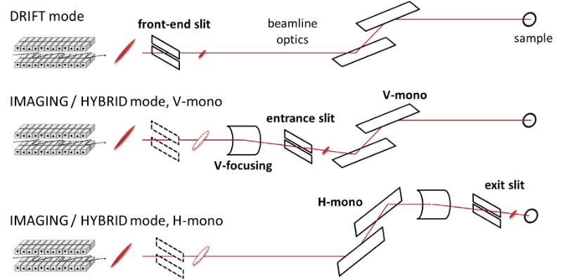

Short pulse production
The mode of short pulse selection depends on the beamline layout
The minimum pulse duration depends on deflecting voltage, beam emittances, photon energy
$$\left\{\begin{matrix}σ_{z,min}^{DR}≈\frac{1}{C_{21}}\sqrt{\frac{ε_{y}}{β_{y}}+Q_{a}^{2}\frac{λ}{4L_{u}}} \\ { σ}_{z,min}^{IM}≈\frac{1}{C_{11}}\sqrt{ε_{y}β_{y}+Q_{s}^{2}\frac{λL_{u}}{4π^{2}}}\end{matrix}\right.$$
Deflecting voltage, vertical tune and phase advance
Small coupling
Short wavelength
Small energy spread, small harmonic number, few ID periods

Slide 19
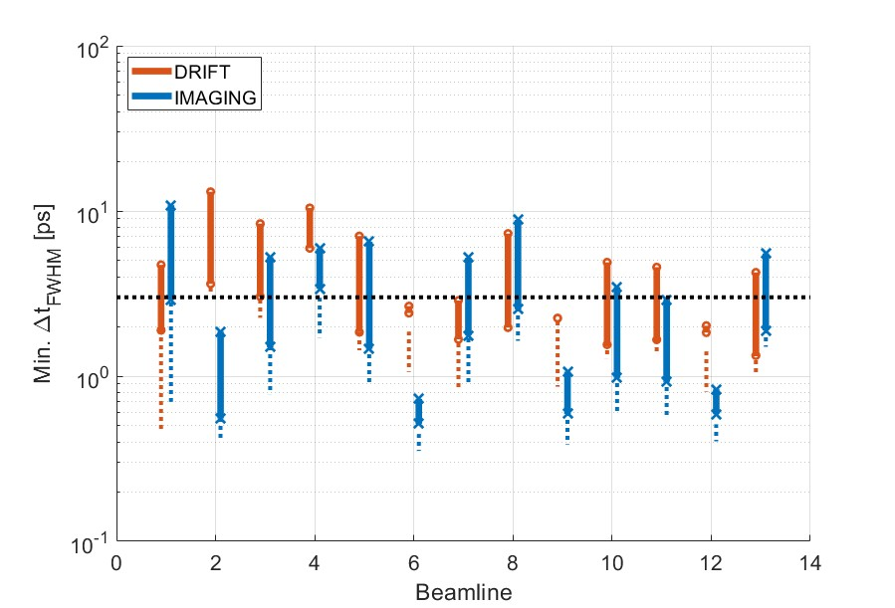
Theoretical minimum pulse durations
Theoretical minimum FWHM pulse duration calculated for drift (orange) and hybrid optics (blue), across the beamline’s full spectral range and for beam RMS energy spread of 0.1%.
Dashed vertical lines are for the ideal case of a monochromatic electron beam.
3 ps

Slide 20
Shortest durations at Elettra 2.0
Beamline | LOWEST photon energy |  |  |  | HIGHEST photon energy
Name [keV] | Δt_{FWHM} (ps) |  | ΔF/F (%) |  | Δt_{FWHM} (ps) |  | ΔF/F (%)
 | DR | HYB | DR | HYB | DR | HYB | DR | HYB
1.2 [0.03-1.7] | 17 | 9 | 6 | 2.5 | 3 | 1.7 | 1.5 | 2.8
2.1 [0.13-4.0] | 48.5 | 1.2 | 35 | 1.6 | 46 | 0.8 | 18 | 1.7
3.2 [0.01-0.2] | 48 | 10.5 | 20 | 1.6 | 42 | 2.1 | 5 | 1.8
4.2 [0.01-1.5] | 22 | 22 | 15 | 5 | 3.1 | 3.6 | 1 | 6.5
5.1 [4-21] | 34 | 6.4 | 12 | 2.7 | 18 | 3.0 | 5 | 2.6
5.2 [3.5-15] | 16 | 0.9 | 3 | 2 | 15 | 0.9 | 3 | 1.9
6.2 [0.34-4.0] | 3.7 | 3.7 | 0.5 | 3.6 | 1.7 | 1.9 | 0.5 | 3
7.2 [3.5-15] | 6.5 | 1 | 1 | 2 | 6.5 | 0.9 | 1.5 | 2
8.1 [0.15-1.5] | 27 | 1 | 9 | 1.4 | 9.6 | 0.8 | 1 | 1.7
8.2 [0.04-1.5] | 16 | 6 | 7 | 3 | 3.2 | 1.7 | 1 | 3.5
9.2a [0.01-0.2] | 38 | 6.7 | 15 | 1.9 | 13.5 | 1.8 | 3 | 2.0
9.2b [0.08-1.5] | 20 | 2.8 | 4 | 2 | 5.8 | 1.1 | 1 | 2.3
10.1 [0.5-7.0] | 12.5 | 0.7 | 1 | 1.3 | 8.5 | 0.7 | 2 | 1.6
10.2 [4-15] | 2.1 | 1.2 | 0.5 | 2.7 | 2.2 | 1.2 | 1 | 2.7
11.1 [3-15] | 28 | 33 | 12 | 12 | 14 | 19 | 6 | 17
11.2 [9-25] | 38 | 9 | 16 | 2 | 27 | 4.8 | 7 | 2.4
ΔF/F(%) is relative to single bunch emission @ ID

Slide 21
NanoSpectroscopy @ 800 eV (1/3)
Spectral flux in central cone, V/H-polarization, 2 mA/bunch – DRIFT mode
(blue) photon pulse from standard electron bunch, opening 60 µrad x 60 µrad:
55 ps, 1.9e12 ph/s/0.1%BW ; S₁/S₀=1 (EU, λu = 10 cm, Lu = 4 m)
(green) short photon pulse from tilted electron bunch, opening 60 µrad x 10 µrad:
3.7 ps FWHM, 4.3e10 ph/s/0.1% or ∼1e4 ph/pulse/0.1%, S₁/S₀= 0.98
(orange-pink) short photon pulse from tilted electron bunch, opening 60 µrad x 24 µrad:
4 ps FWHM, 1.1e11 ph/s/0.1% or ∼1e5 ph/pulse/0.1%, S₁/S₀= 0.98/-1
Single pulse useful spectral flux: 6%
Intensity drop at higher energies, off-axis electrons motion
V-pol.
λ_{r}
H-pol.
θ
λ(θ) > λ_{r}
H-pol.

Slide 22
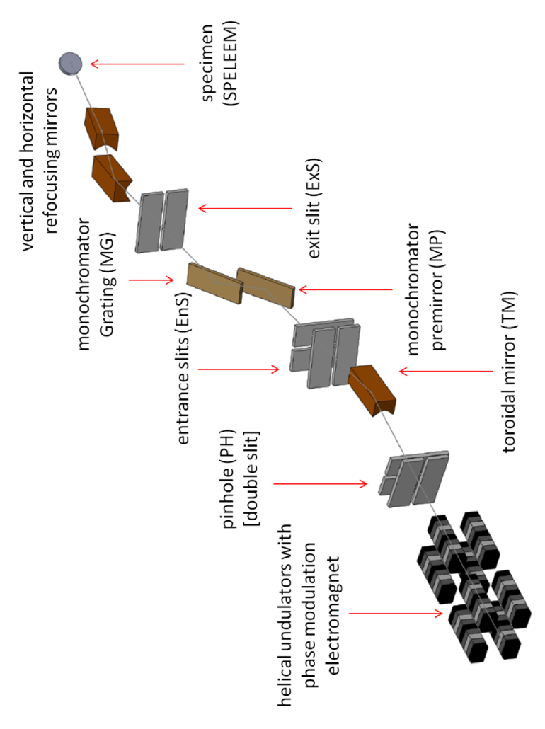
Example @ 0.8 keV
Nanospectroscopy-like soft x-ray beamline. 3% transmission efficiency.
Beamline optics | Standard | SP Drift | SP Hybrid
Photon energy [keV] | 0.8 | 0.8 | 0.8
FE slit gap (x × y) [μm] | 690 × 690 | 690 × 280 | 690 × 690
FE angular acceptance (x × y) [μrad] | 60 × 60 | 60 × 24 | 60 × 60
Slit gap at the monochromator entrance (y) [μm] | 8 | - | 10
Slit gap at the monochromator exit (y) [μm] | 6 | 12 | 10
Energy resolving power | 4500 | 2000 | 2900
Light pulse
Spatial size* at the FE slit, FWHM [μm] | 90 × 42 | 90 × 80 | 90 × 99
Angular divergence* at the FE slit, FWHM [μrad] | 38 × 32 | 38 × 23 | 38 × 59
Duration, FWHM [ps] | 55 | 4 | 4
Degree of linear polarization, S₁/S₀ | 1 | 0.98 | 0.98
Spectral flux at source point [10¹⁰ph/s/0.01%bw] | 19 | 1.1 | 1.7
Relative spectral flux at source point [%] | 100 | 6 | 9
Flux at sample [10¹⁰ph/s] | 1.3 | 0.15 | 0.18
Relative spectral flux at sample [%] | 100 | 12 | 14
Spatial size at sample, FWHM (x × y) [μm] | 1.0 × 0.9 | 1.0 × 2.3 | 1.0 × 1.3

Slide 23
Example @ 12 keV
HBSAXS-like tender x-ray beamline. 11% transmission efficiency.
Beamline optics | Standard | SP Drift-1 | SP Drift-2
Photon energy [keV] | 12 | 12 | 12
FE slit gap (x × y) [μm] | 550 × 550 | 550 × 400 | 550 × 200
FE angular acceptance (x × y) [μrad] | 48 × 48 | 48 × 35 | 48 × 17
Energy resolving power | 5700 | 5700 | 5700
Light pulse
Spatial size* at the FE slit, FWHM [μm] | 86 × 13 | 86 × 80 | 86 × 65
Angular divergence* at the FE slit, FWHM [μrad] | 24 × 24 | 24 × 35 | 24 × 28
Duration, FWHM [ps] | 55 | 2.7 | 2.3
Spectral flux at source point [10¹⁰ph/s/0.01%bw] | 3.8 | 0.2 | 0.1
Relative spectral flux at source point [%] | 100 | 6 | 3
Flux at sample [10¹⁰ph/s] | 0.73 | 0.04 | 0.02
Relative spectral flux at sample [%] | 100 | 6 | 3

