Slide 1
X-ray Emission Spectroscopy for Real-Time Diagnostics in SFX experiments A Machine Learning Approach
Harald Agelii, Alfredo Bellisario, Carl Caleman, Nicusor Timneanu, and Sebastian Cardoch*
Uppsala University
29.06.2025

Slide 2
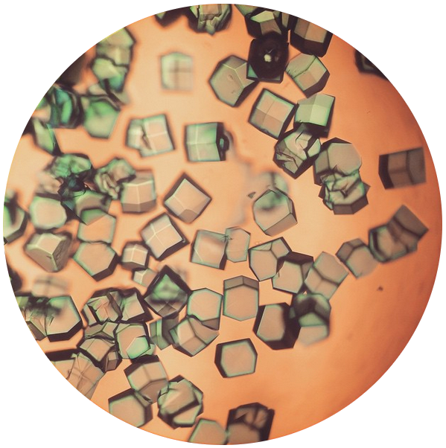
Serial Femtosecond X-ray crystallography (SFX)
1/13

Slide 3
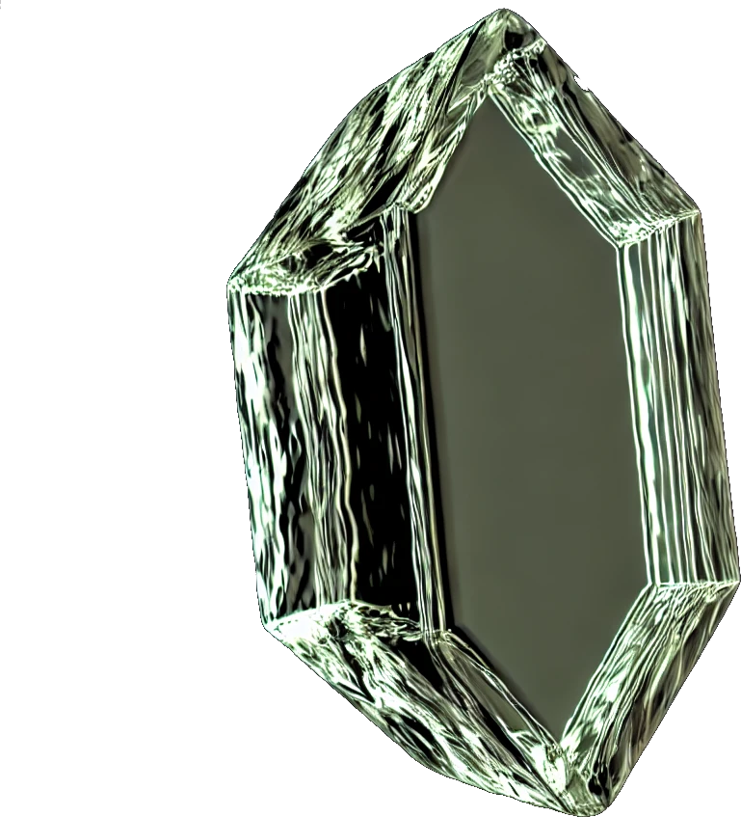
Serial Femtosecond X-ray crystallography (SFX)
SFX enables atomic structural insights and dynamics of biological samples at room temperature.
1/13

Slide 4
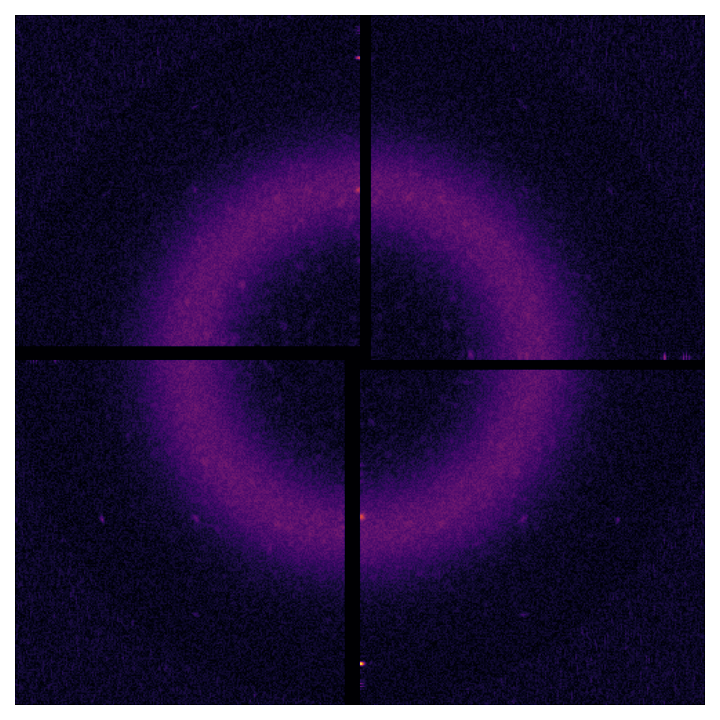
Serial Femtosecond X-ray crystallography (SFX)
SFX enables atomic structural insights and dynamics of biological samples at room temperature.
1/13

Slide 5
Serial Femtosecond X-ray crystallography (SFX)
SFX enables atomic structural insights and dynamics of biological samples at room temperature.
FELs provide high peak brilliance and focused pulses, lasting from a few to tens of femtoseconds, required for SFX.
1/13

Slide 6
Serial Femtosecond X-ray crystallography (SFX)
SFX enables atomic structural insights and dynamics of biological samples at room temperature.
FELs provide high peak brilliance and focused pulses, lasting from a few to tens of femtoseconds, required for SFX.
1/13

Slide 7
Serial Femtosecond X-ray crystallography (SFX)
SFX enables atomic structural insights and dynamics of biological samples at room temperature.
FELs provide high peak brilliance and focused pulses, lasting from a few to tens of femtoseconds, required for SFX.
1/13

Slide 8
Serial Femtosecond X-ray crystallography (SFX)
SFX enables atomic structural insights and dynamics of biological samples at room temperature.
No direct way to measure fluence on sample…
FELs provide high peak brilliance and focused pulses, lasting from a few to tens of femtoseconds, required for SFX.
1/13

Slide 9
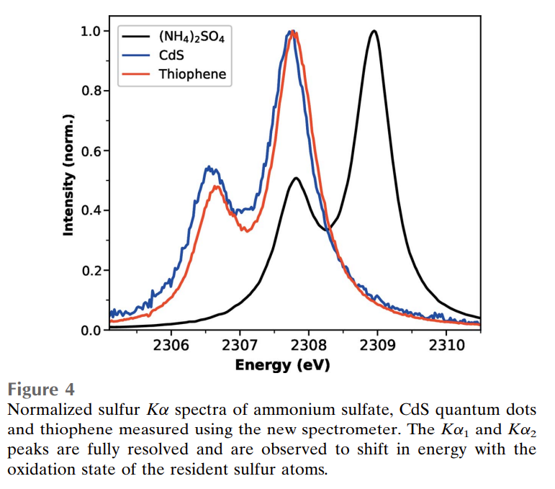
SFX + X-ray spectroscopy
No direct way to measure fluence on sample…
Spectrometer
2/13

Slide 10
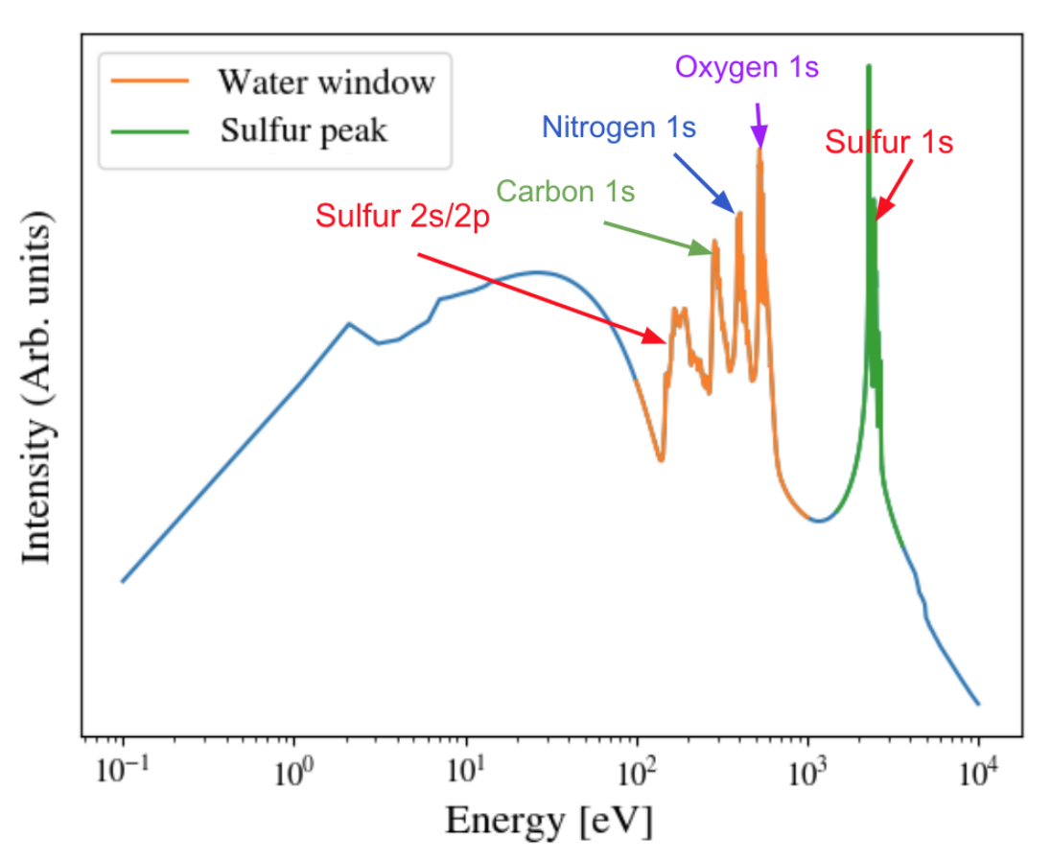
X-ray Emission Spectra: simulations
Atomic processes included:
radiative excitation, ionization
electron-ion, and ion-ion collisional excitation, ionization
autoionization / dielectronic recombination
all inverse processes
The code assumes no structural knowledge of the sample;
the sample is divided into zones or cells, for each it is possible to simulate:
radiation transport
conduction
ion/electron temperature evolution
laser absorption
X-ray emission
Simulations have been tested and compared to XFEL experiments
Figure from: H. Agelii, “A Machine Learning Approach on Analysis of Emission Spectra for Application in XFEL Experiments” (2023)
Scott, Howard A. "Cretin—a radiative transfer capability for laboratory plasmas." Journal of Quantitative Spectroscopy and Radiative Transfer 71.2-6 (2001)
3/13

Slide 11
X-ray Emission Spectra: simulations
Atomic processes included:
radiative excitation, ionization
electron-ion, and ion-ion collisional excitation, ionization
autoionization / dielectronic recombination
all inverse processes
The code assumes no structural knowledge of the sample;
the sample is divided into zones or cells, for each it is possible to simulate:
radiation transport
conduction
ion/electron temperature evolution
laser absorption
X-ray emission
Simulations have been tested and compared to XFEL experiments
Figure from: H. Agelii, “A Machine Learning Approach on Analysis of Emission Spectra for Application in XFEL Experiments” (2023)
Scott, Howard A. "Cretin—a radiative transfer capability for laboratory plasmas." Journal of Quantitative Spectroscopy and Radiative Transfer 71.2-6 (2001)
3/13

Slide 12
ML for fluence and pulse duration predictions
Fluence
Pulse duration
Baseline for a competitive prediction: Upstream X-ray Gas Monitor which have on average a 10% error in fluence prediction
Choosing the XES region:
Kα lines correspond to a 2p to 1s transition in Sulfur.
Changes in the ionization state are the most significant.
Relevant for biological samples…
4/13

Slide 13
Emission spectra: Datasets
Sample: Lysozyme crystal
Parameters:
Fluence: 5 × (10² - 10⁵ ) J/cm²
Photon energy: 12 keV
Pulse duration: 5-50 fs
Datasets: - 6 000 spectras at 12 keV and 10 fs - 21 000 spectras at 12 keV with varying fluence and pulse duration
Density: 1.13 g/cm³
H: 64.62%
C: 21.47% N: 6.76% O: 21.84% S: 0.35%
5/13

Slide 14
Emission spectra: Datasets
We apply a min-max normalization to each emission spectra to decouple the magnitude of the X-ray pulse intensity from the emission intensity
We augment the data by introducing a normally distributed random shift centred at zero with a standard deviation of 10%
We add noise to each spectrum from a normal distribution centered around zero and 0.1 % standard deviation.
5/13

Slide 15
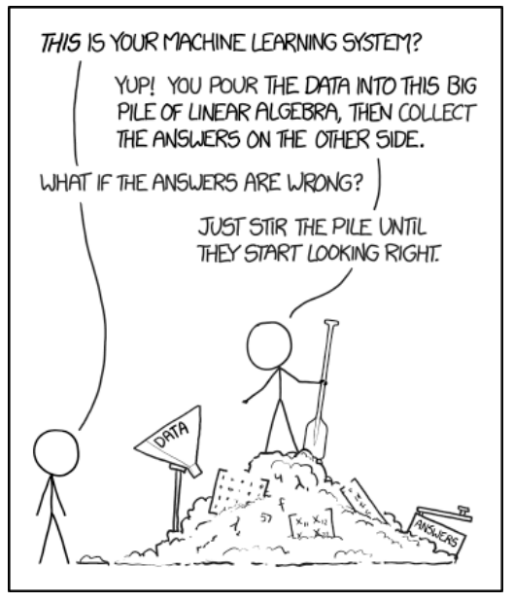
Machine Learning: Interpretability
6/13

Slide 16
Machine Learning: Interpretability
Interpretability VS Explainability
How vs Why (or Assess vs Decipher)
Interpretability – no consistent definition
6/13

Slide 17
Machine Learning: Interpretability
Interpretability VS Explainability
How vs Why (or Assess vs Decipher)
Interpretability – no consistent definition
Gradient-based methods
6/13

Slide 18
Machine Learning: Interpretability
Interpretability VS Explainability
How vs Why (or Assess vs Decipher)
Interpretability – no consistent definition
Gradient-based methods
SHAP (Shapley values)
6/13

Slide 19
Machine Learning: Interpretability
Interpretability VS Explainability
How vs Why (or Assess vs Decipher)
Interpretability – no consistent definition
Gradient-based methods
SHAP (Shapley values)
Difference between prediction and prediction without the feature i
6/13

Slide 20
Dataset 1: Fluence
We find accurate prediction of the fluence with normally distributed relative errors with a standard deviation 1.4%
7/13

Slide 21
Dataset 1: Absolute error
Low fluence spectra more challenging (lower Kβ contribution)
8/13

Slide 22
Dataset 1: SHAP&Gradient
9/13

Slide 23
Dataset 1: SHAP&Gradient
Kα
9/13

Slide 24
Dataset 1: SHAP&Gradient
Kα
Kβ
9/13

Slide 25
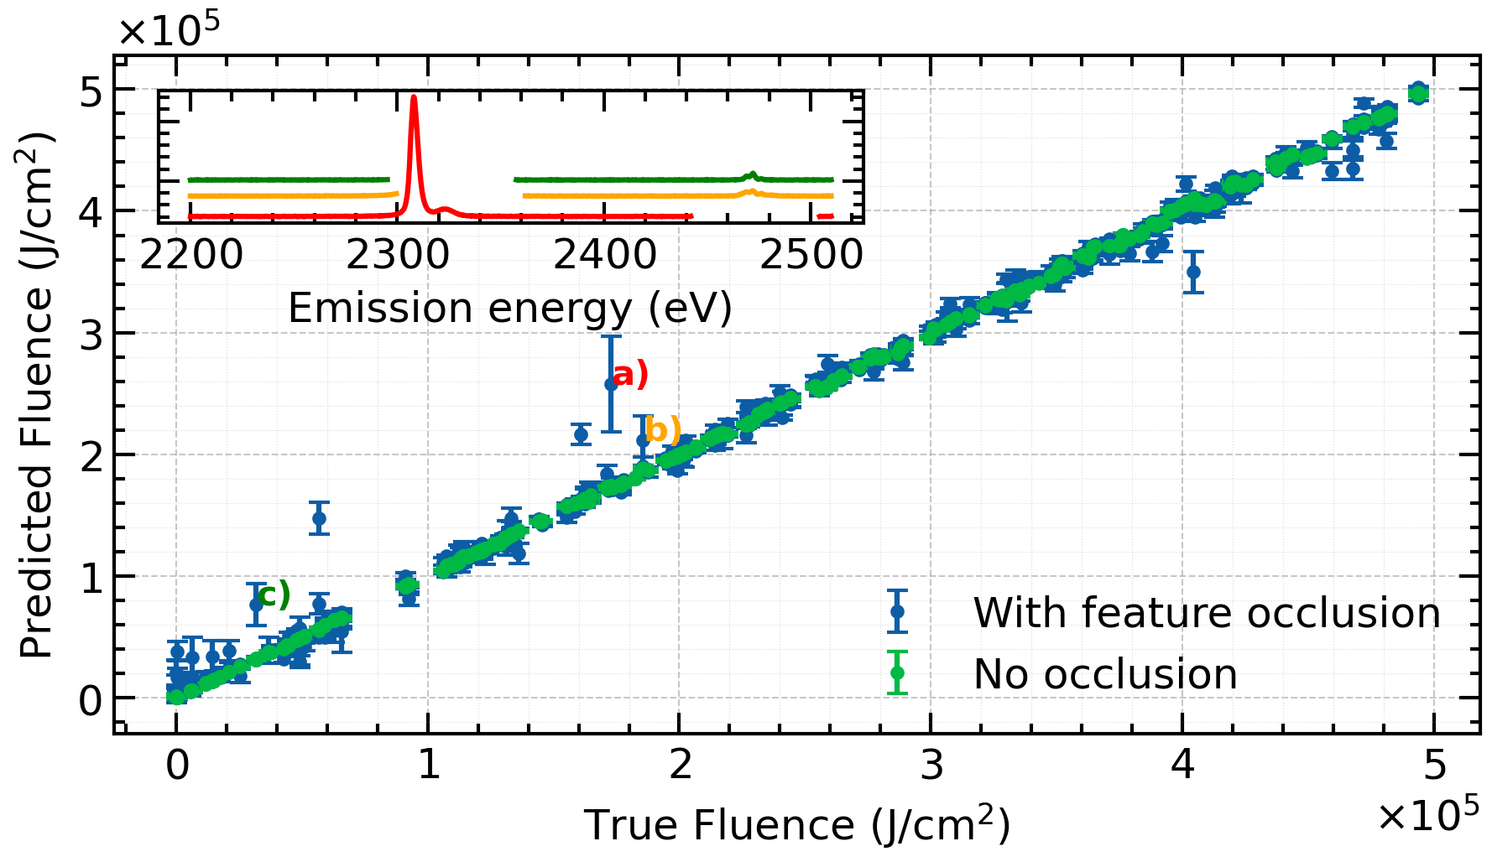
Dataset 1: Crossfold Validation
Retraining 10 models with random occluded regions of the spectra. Ensemble predictions remained accurate with low uncertainty, except for a few outliers occurring when key Kα and Kβ peaks were entirely removed.
10/13

Slide 26
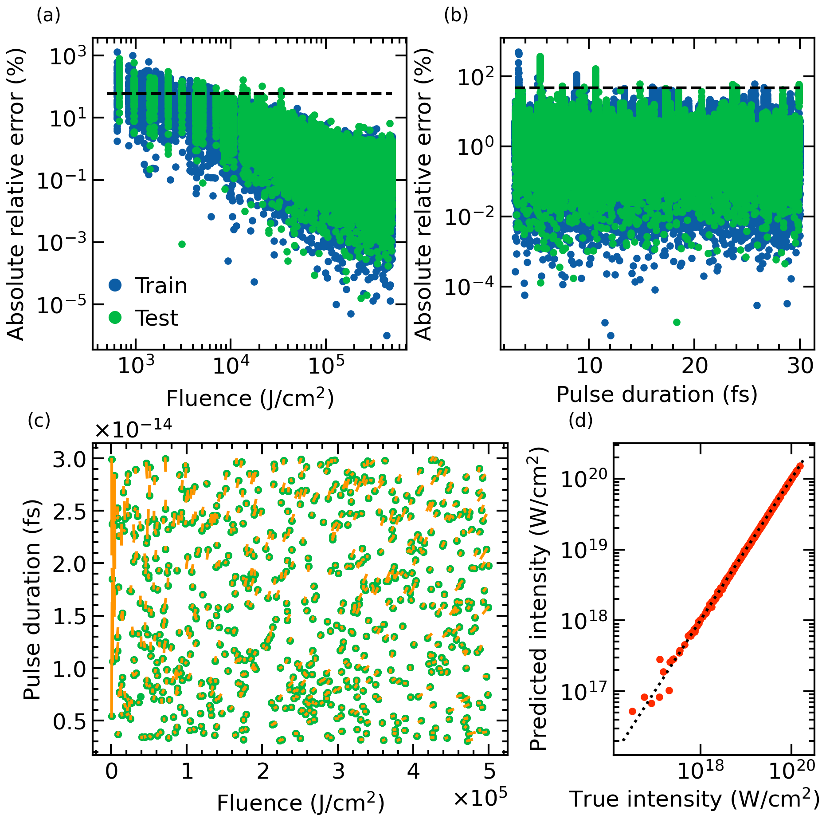
Dataset 2: Predictions
11/13

Slide 27
Dataset 2: Predictions
Fluence error: 11.8 %
Pulse duration error: 9.4 %
11/13

Slide 28
Dataset 2: Predictions
Fluence error: 11.8 %
Pulse duration error: 9.4 %
The model concurrently predicts pulse duration, with 11.8% error, performing comparably to existing monitoring systems (X-ray Gas Monitors - XGMs)
11/13

Slide 29
Dataset 2: Predictions
Fluence error: 11.8 %
Pulse duration error: 9.4 %
The model concurrently predicts pulse duration, with 11.8% error, performing comparably to existing monitoring systems (X-ray Gas Monitors - XGMs)
11/13

Slide 30
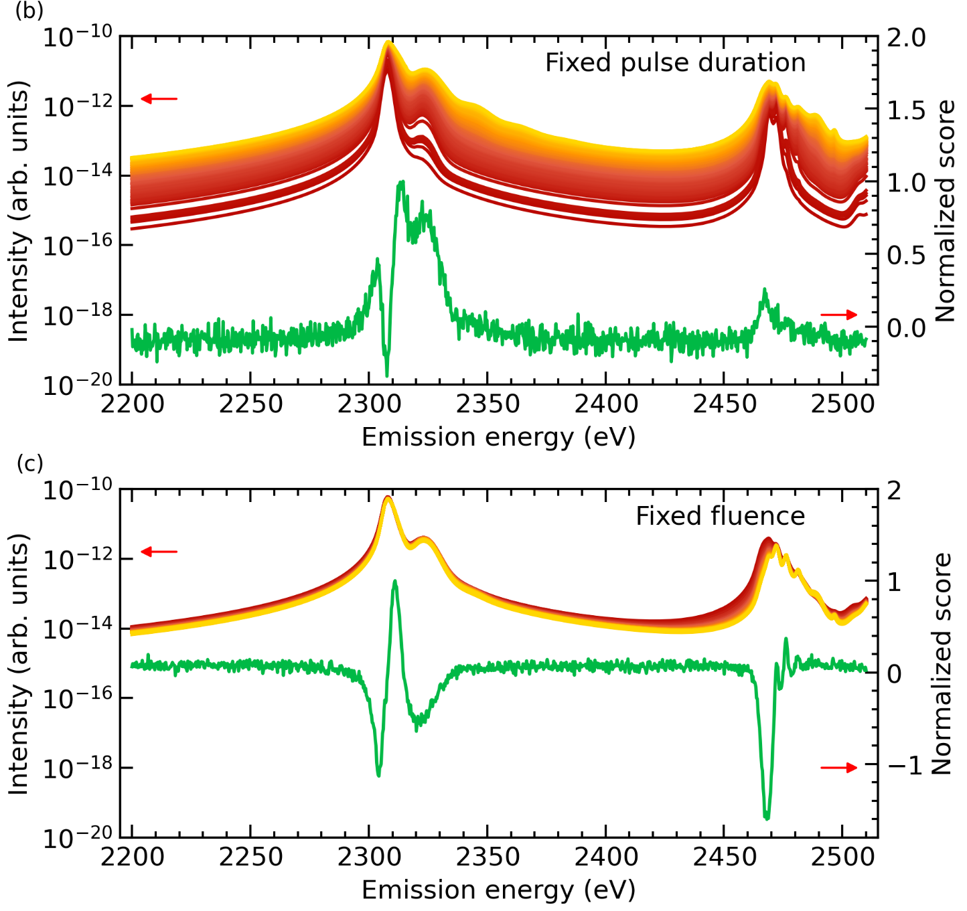
Dataset 2: SHAP&Gradient
12/13

Slide 31
Dataset 2: SHAP&Gradient
When the pulse duration is fixed, we recover similar results as for Dataset 1
12/13

Slide 32
Dataset 2: SHAP&Gradient
When the fluence is fixed, the K²–KL_{2,3} emission responds most strongly to changes in pulse duration and the normalized interpretation score highlights this region as significant for the prediction
As pulse duration decreases, incoming photons outrun radiative and non-radiative relaxation mechanisms (1s core-hole lifetime < 1.1 fs sulfur) leading to the creation of empty cores whose presence we detect via this emission channel!
We can connect model’s interpretation features to relevant physical features
12/13

Slide 33
Dataset 2: SHAP&Gradient
What did we learn?
1) For fluence predictions, the model emphasizes K-L emission due to highly charged sulfur
2) For pulse duration predictions, the model focuses on emissions from K-L double core hole.
12/13

Slide 34
Conclusions
Real-time X-ray Pulse Inference: Developed a neural network to predict X-ray fluence and pulse duration from sulfur K-shell emission spectra with high accuracy (≤1.5% error for fluence, ≤12% for duration), using synthetic data from collisional radiative simulations.
Explainability & Physical Insight: Applied interpretation methods (Gradient, SHAP, feature occlusion) to link spectral features to electronic mechanisms affected by X-ray parameters, advancing explainable AI for physical phenomena.
Limitations & Future Directions: Assumes uniform beam profile; real experiments may require modeling spatial variation and handling low signal-to-noise ratios. Future work includes signal robustness, stoichiometry prediction, and unsupervised training.
13/13

Slide 35
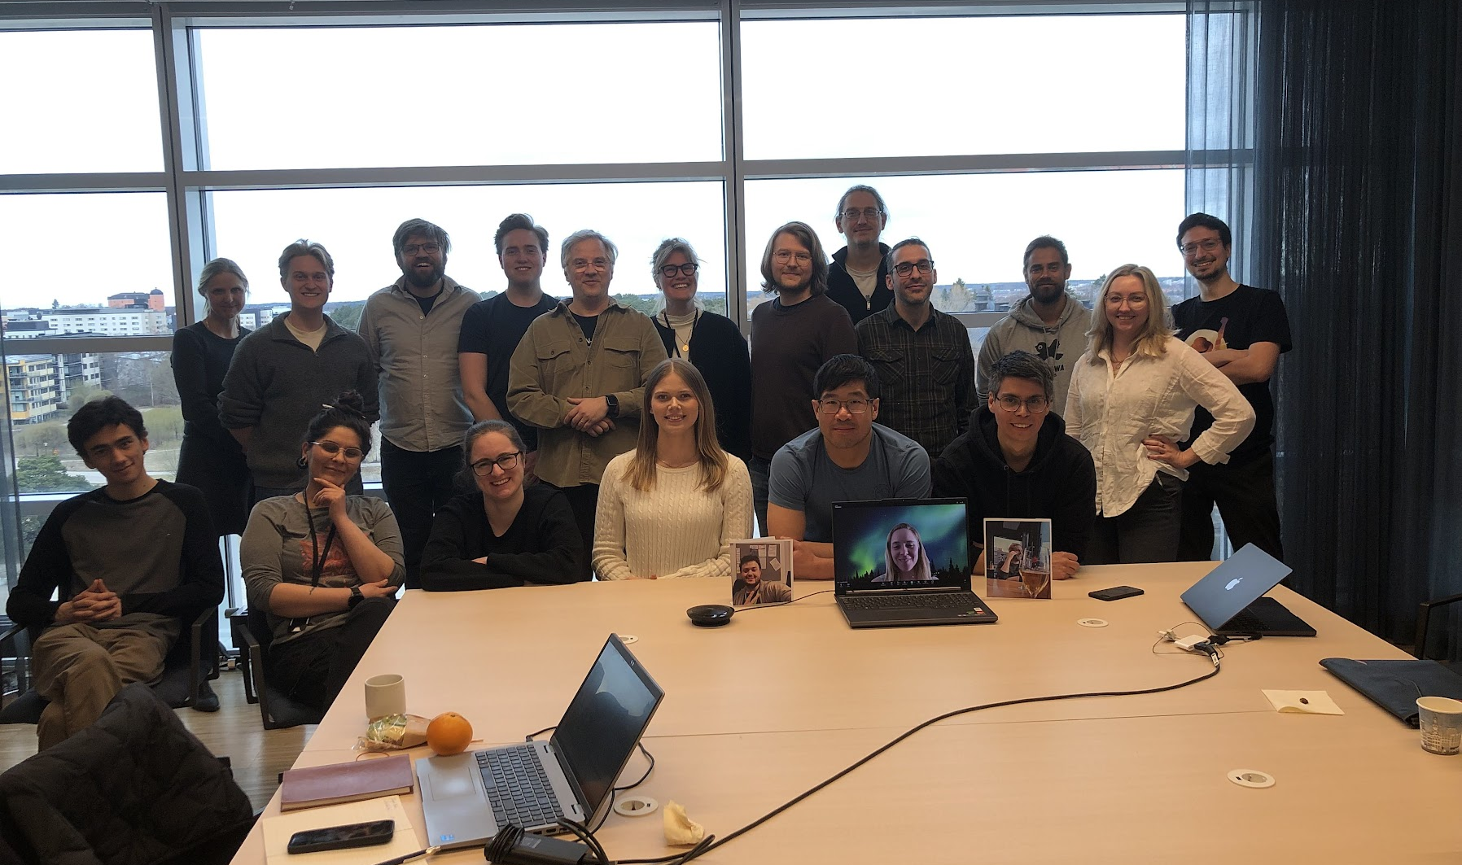
Thank you!
Acknowledgments:
- Nicusor Timneanu
- Carl Caleman - Tomas Ekeberg
- Filipe Maia
- Tomas André
- Thomas Mandl - Pamela Svensson
- Sebastian Cardoch
- Harald Agelii
- Friederike Krüger - Ouassim Hafiani
- Emiliano De Santis
- And everyone involved in Uppsala’s Biophysics Network

Slide 36
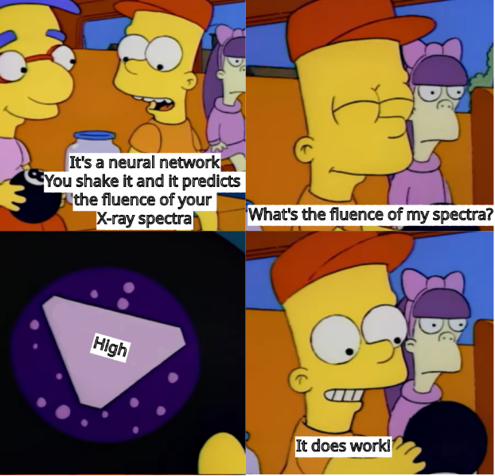
Interpretable Neural Network Predictions of High-Intensity Femtosecond X-ray Free-Electron Laser Pulses using Sulfur K-shell Emission Spectra
H. Agelii, A. Bellisario, C. Caleman,
N. Timneanu and S. Cardoch
Phys. Rev. Research
Accepted 23 June, 2025
Notes:
NT remix

Slide 37
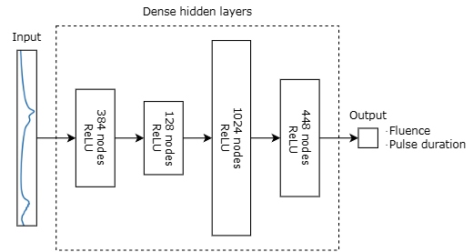
Deep Neural Network model
Extra Slide 1

Slide 38
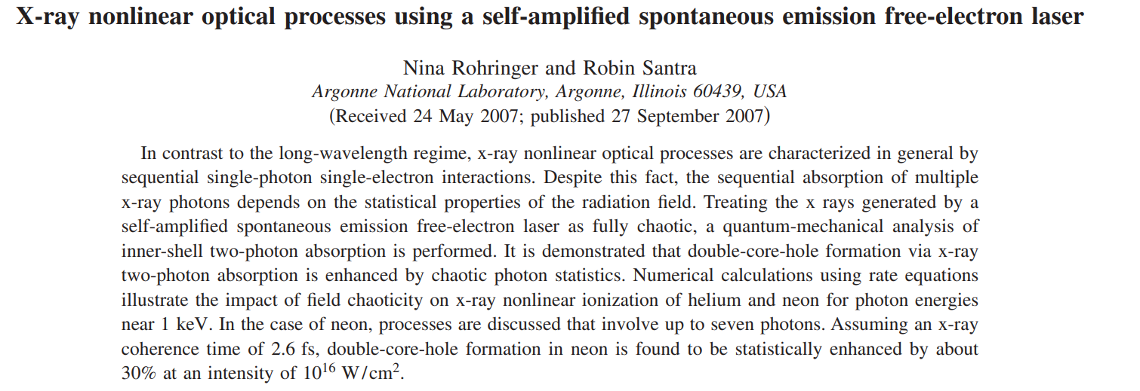
Beam shape assumption
In line with this, we find the highest discrepancy between the two pulse shapes around the K²–KM_{2,3} emission line with a maximum difference 313 in total emission in the Kβ region of roughly 15 %
Extra Slide 2

