Slide 1




Status Report on BENT crystalS for Mu2e Experiment
CLFV Searches with the Mu2e Experiment: LNF Workshop
Frascati 9-13 June 2025
Vincenzo Guidi on behalf of Ferrara team

Slide 2
OUTLINE
Short recap on crystal channeling
Crystal design and fabrication
Bent crystal characterization & installation
Conclusions and future plans

Slide 3
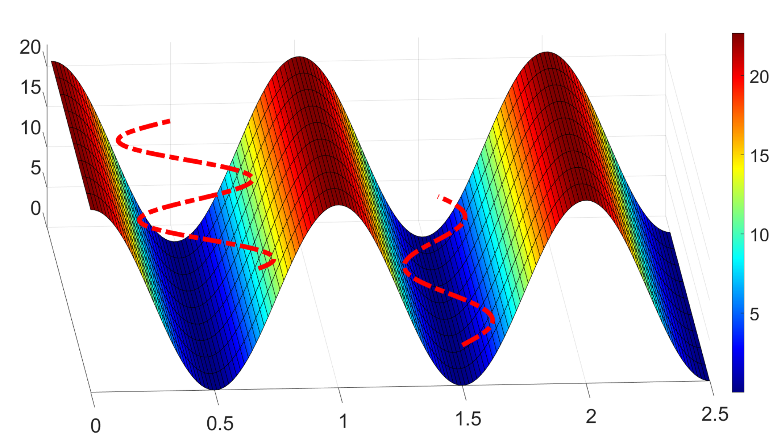
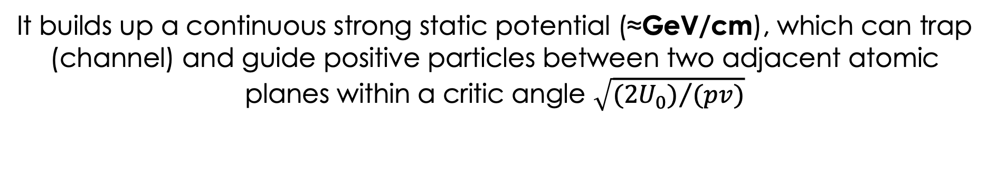
Channeling IN CRYSTALS
eV
eV
As a charged particle enters a crystal slightly atilt with respect to atomic planes, channelling takes place mainly due to:
Small scattering angle
Repeated periodic scattering against nuclei at nearly the same impact parameter
x/d
It builds up a continuous strong static potential (≈GeV/cm), which can trap (channel) and guide positive particles between two adjacent atomic planes within a critic angle $\sqrt{{(2U_{0})}/{(pv)}}$
3

Slide 4
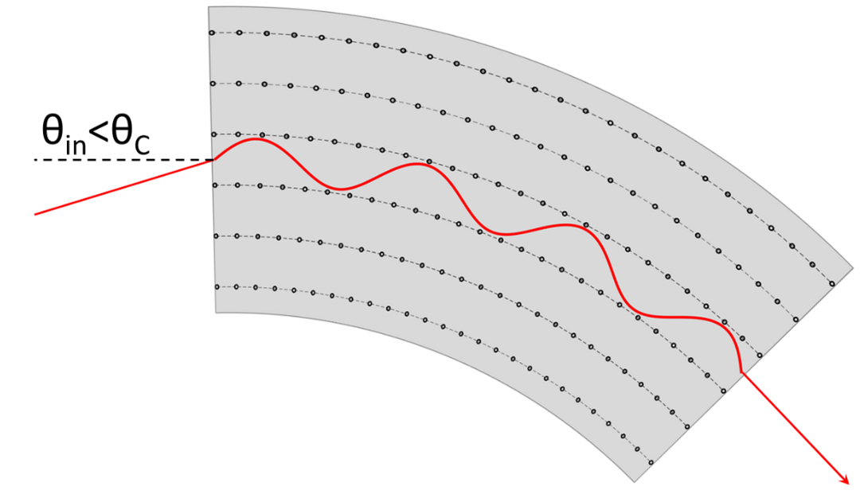
Channeling in bent crystals
Channeled particle follows the curvature of the lattice plane
A bent crystal can act as a sort of waveguide for channeled particle, steering them at angle depending on its geometry

Slide 5


Channeling in bent crystals
Channeled particle follows the curvature of the lattice plane
A bent crystal can act as a sort
of waveguide for channeled
particle, steering them at angle depending on its geometry
Large steering power can be obtained in few millimeters of crystal, equivalent to that of hundreds of Tesla magnetic dipole
Energy (GeV) | Deflection (μrad) | Size (mm) | Equivalent dipole (T)
6500 | 50 | 4 | 276
0.855 | 1500 | 0.015 | 285
20.53 | 400 | 0.06 | 456
2000 | 14000 | 70 | 1134

Slide 6
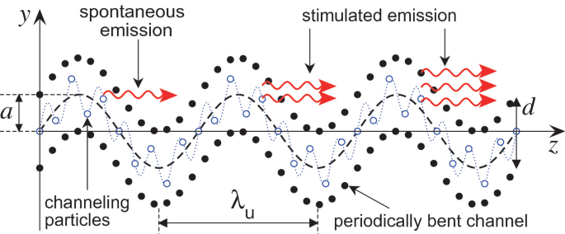
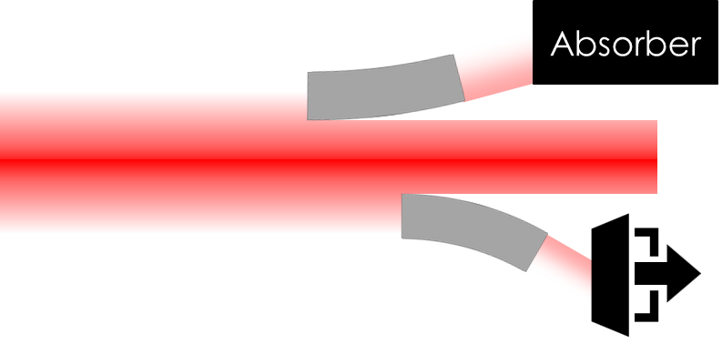
Bent crystal applications
Novel radiation sources
For channeled light particles (e⁺/e⁻) enhanced photon emission
Beam Collimation
With crystal high control of beam halo separation from primary beam
Baseline for HL-LHC
ion collimation
Beam Extraction
Surgical redirection of a beam portion, towards a precise location in the machine or in an external facility
Spin precession
Spin precession much faster in bent crystal wrt existing dipole magnets→EDM & MDM study of fast decaying particles

Slide 7
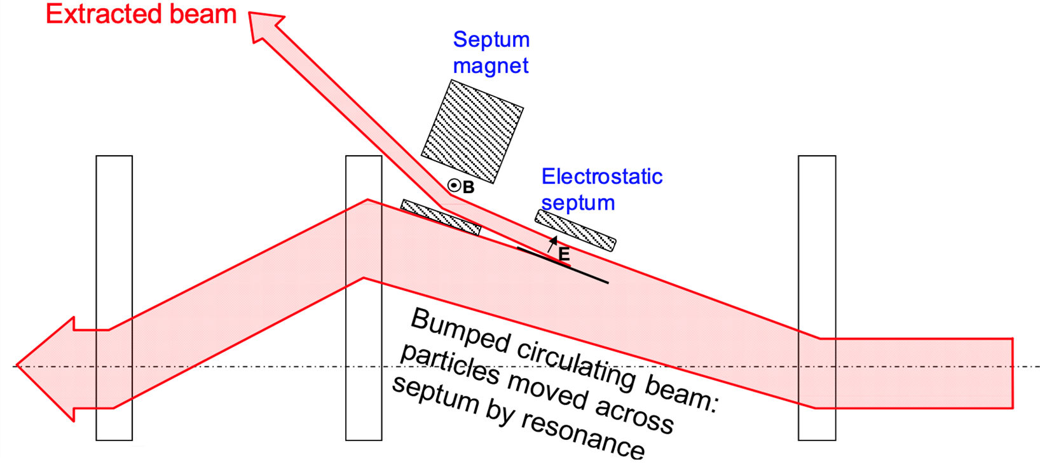
Septum magnet for slow resonant extraction
Resonance is driven by sextupoles
Largest oscillating particles are captured by the septum magnet yielding extraction
A fraction of the particle beam interact with the matter in the septum and generates losses

Slide 8
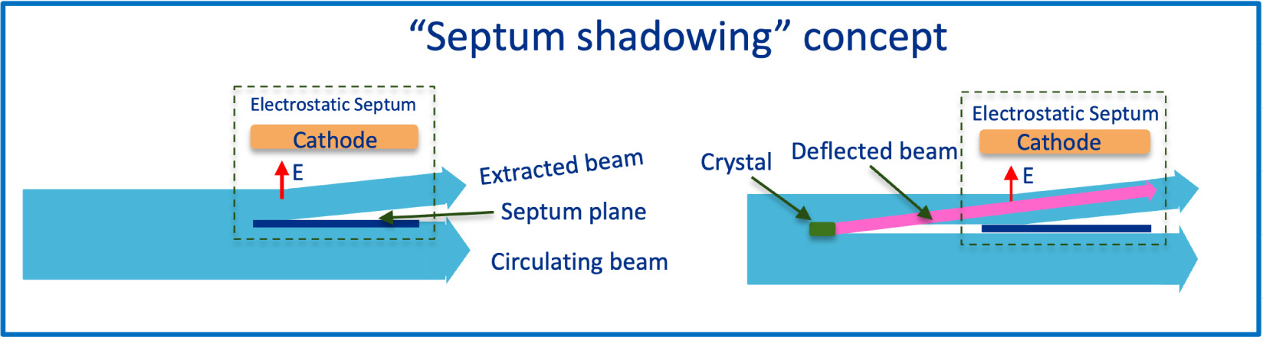
Beam shadowing with a bent crystal
An upstream bent crystal aligned wrt the beam deflect incoming particles
The crystal ”shadows” the septum plane
Tested at SPS for 400 GeV proton
Feasible also for 8 GeV proton of Mu2e beam
Miscetti, S., and Mu2e Collaboration. "Status of the Mu2e experiment." Nucl. Instrum. Methods Phys. Res. (2025): 170257.

Slide 9
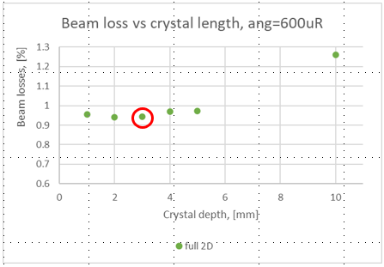
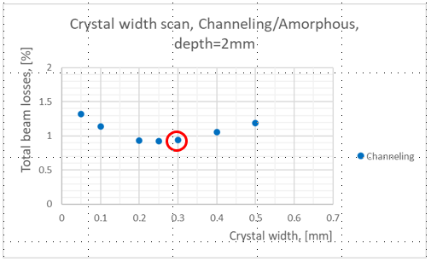
Simulation of best crystal condition
Beam losses from interaction of beam with the septum can cause high level of radiation and consequent limitation to beam intensity
Courtesy of Vladimir Nagaslaev (FNAL)

Slide 10
DESIGN PARAMETERS
Deflection Angle | 300-600 μrad
Crystal Thickness along the beam | 3 mm
Crystal Width across the beam | 300±20 μm
Crystal Torsion | <10 μrad/mm
Distance between crystal and holder | >10 mm
Crystal height free of clamping | >30 mm
Holder Material | Stainless steel
Bake-out cycle | No need

Slide 11
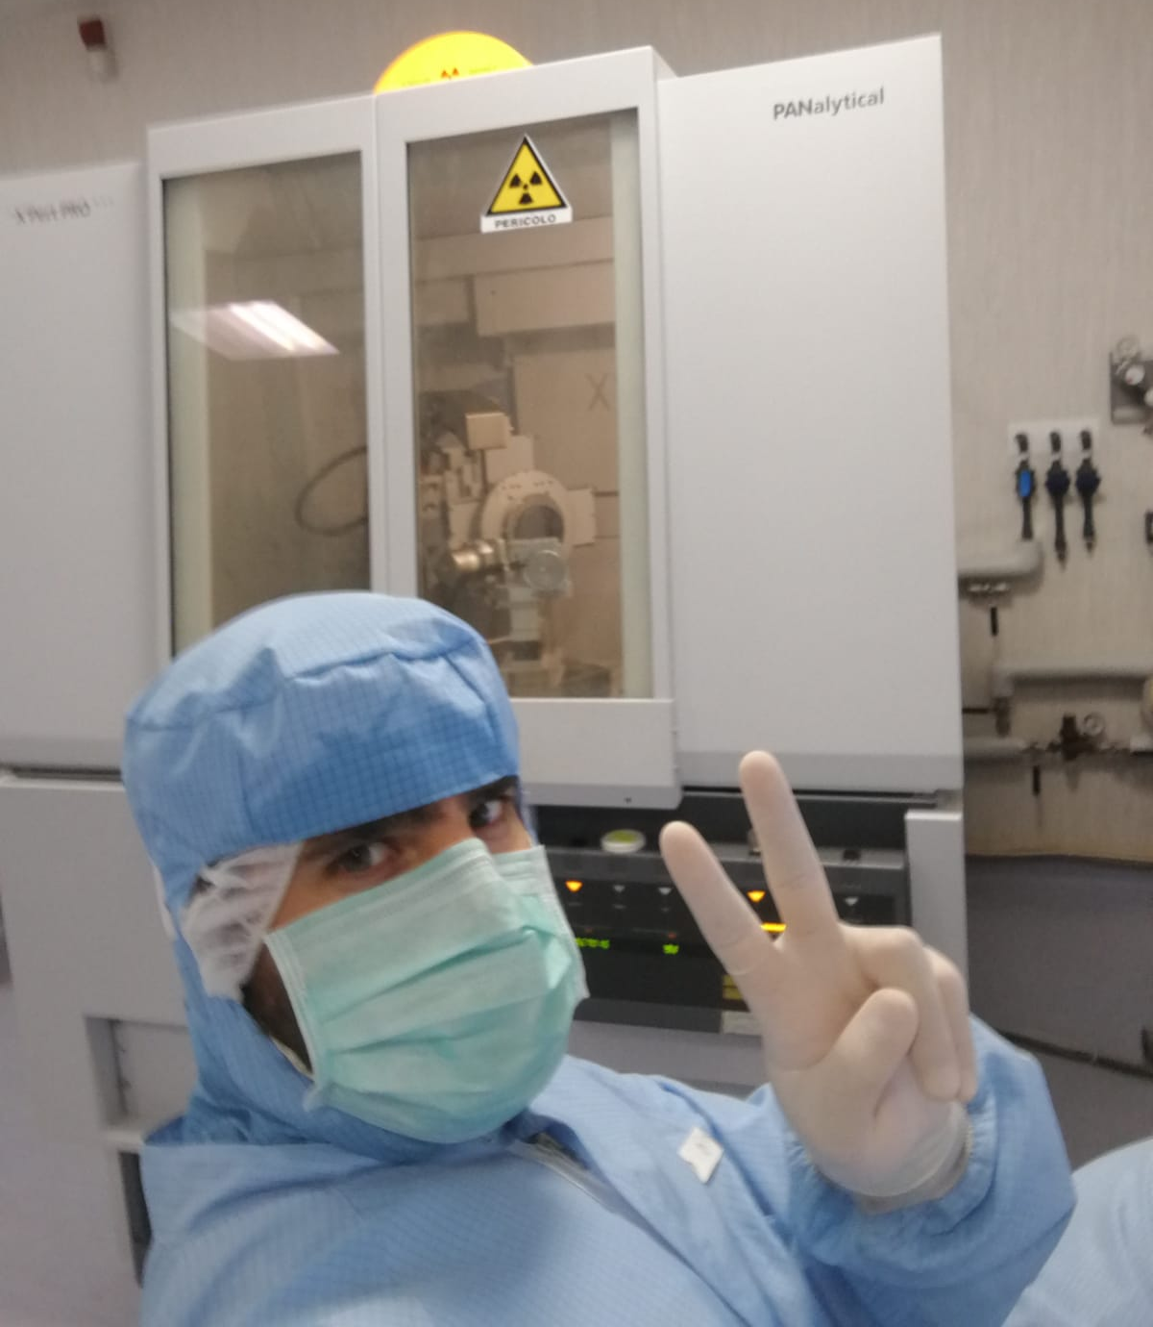
LET’S START!
Crystal fabrication at our clean-room facility

Slide 12
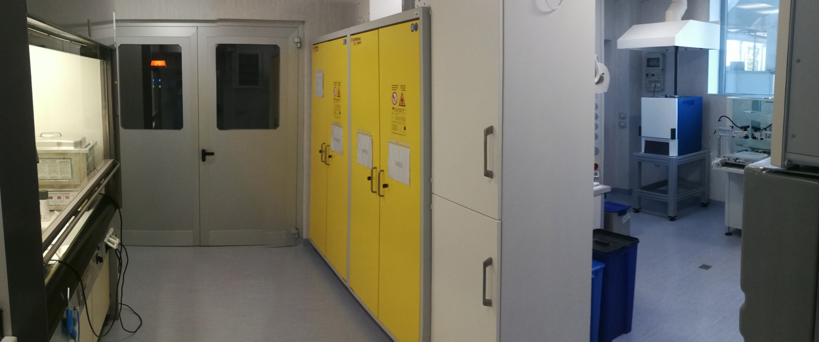
LET’S START!
Crystal fabrication at our clean-room facility

Slide 13
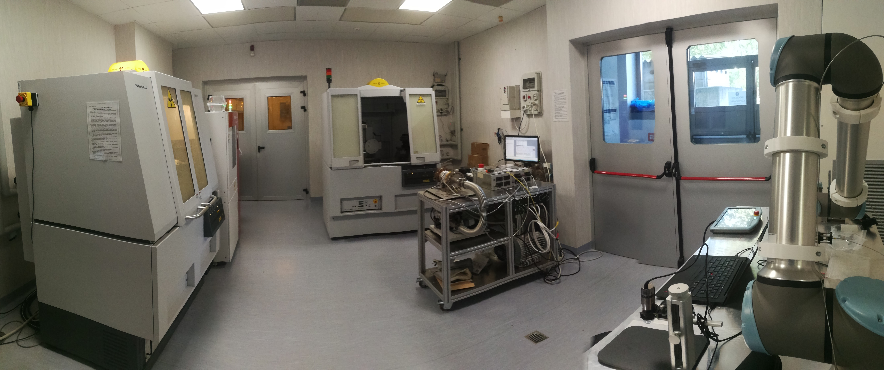
LET’S START!
Crystal fabrication at our clean-room facility

Slide 14
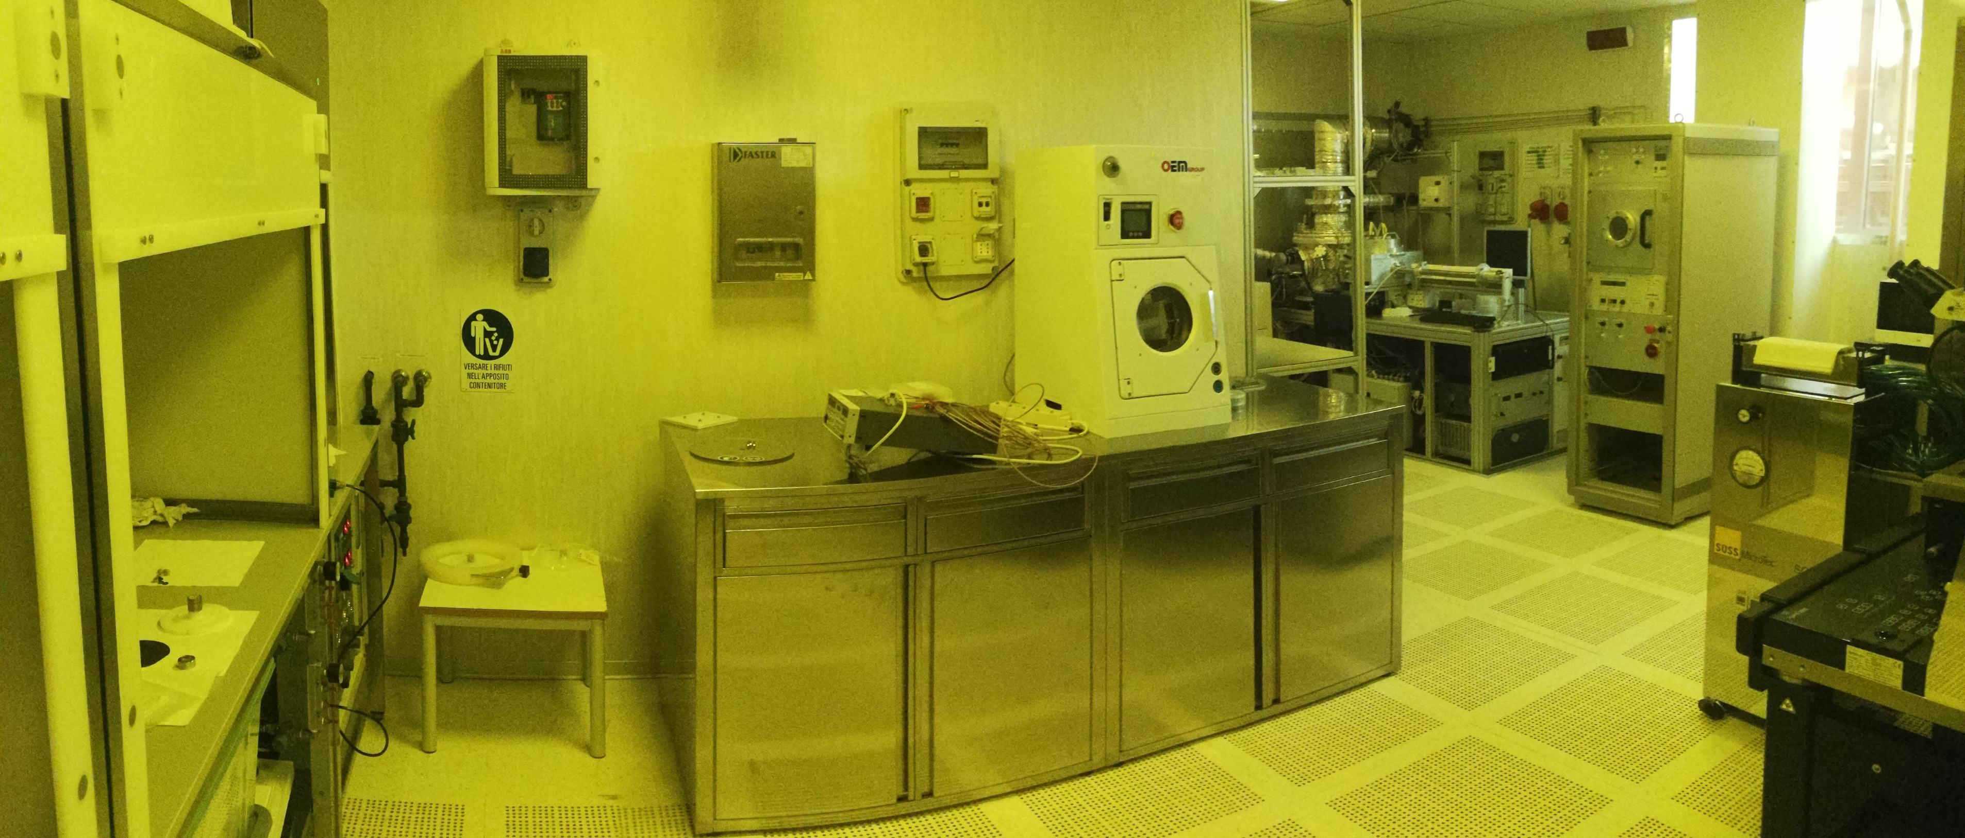
LET’S START!
Crystal fabrication at our clean-room facility

Slide 15
Sample fabrication
Prime-material quality control
Sample shaping
Mechanical bending
Bending characterization

Slide 16
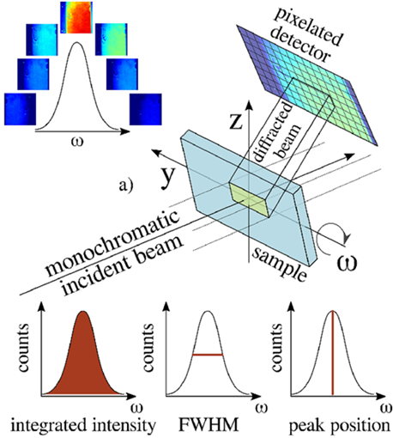
Wafer QUALITY ASSESSMENT
For high channeling efficiency, lattice quality is mandatory
X-ray topografy is powerful technique for crystal lattice characterization:
  Crystalline quality
  Lattice parameter variation
  Curvature, strain
  Defects

Slide 17
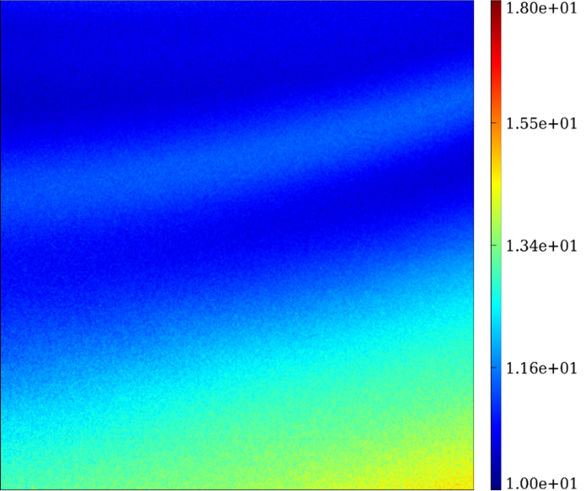
Wafer QUALITY ASSESSMENT
X-rays topography (performed at ESRF) allows detecting defects in the bulk of the crystal
Selected silicon wafers exhibited no dislocation
FWHM map (arcsec)
1.2 mm

Slide 18
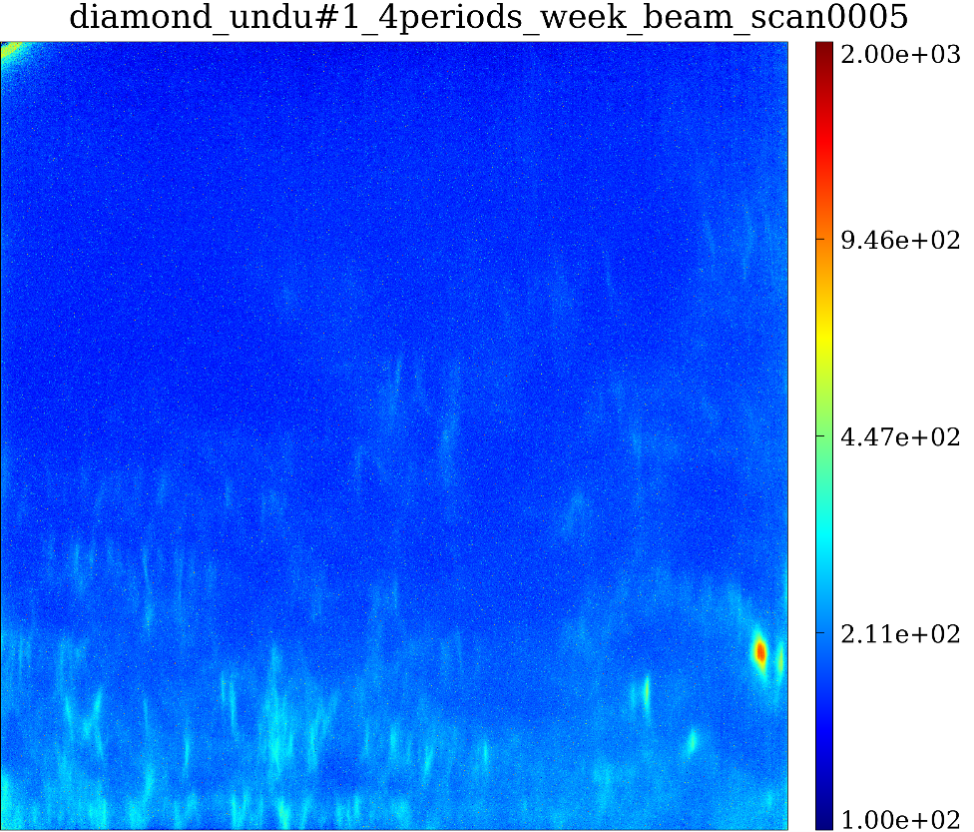
Wafer QUALITY ASSESSMENT
X-rays topography (performed at ESRF) allows detecting defects in the bulk of the crystal
Selected silicon wafers exhibited no dislocation
For comparison we show a faulted sample
FWHM map (arcsec)
1.2 mm

Slide 19
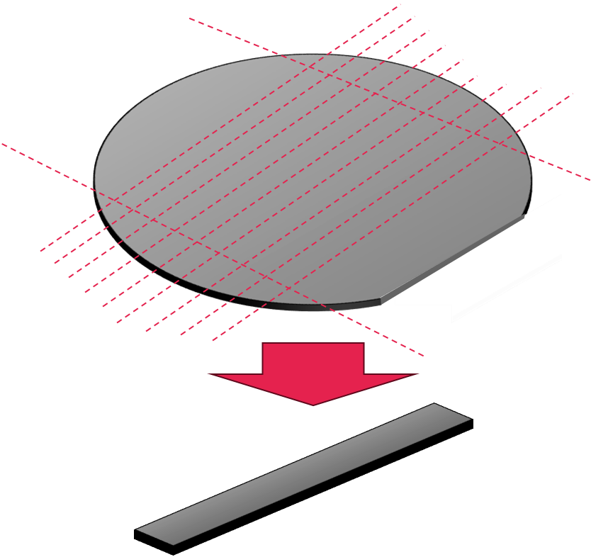
SAMPLE Preparation
Starting from a wafer, samples with parallelepiped shape are achieved
Shaping was done with dicing blades bonded with micro-diamonds
Micrometric precision can be achieved
Etching of cut surfaces to get rid of crystalline imperfections as a result of the cut
The entry faces for the beam are eventually lapped

Slide 20
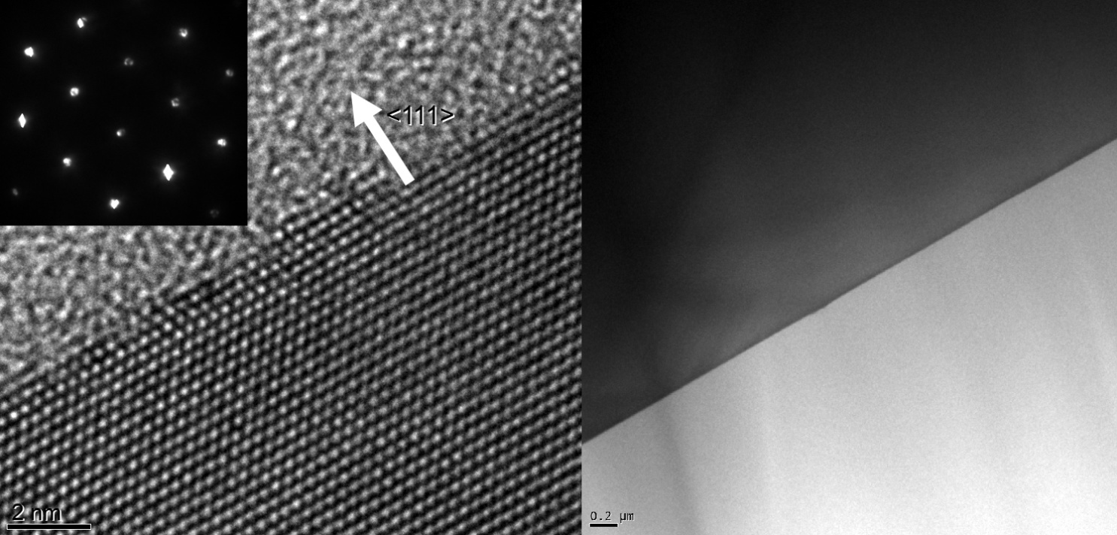
SAMPLE Preparation
HR-TEM image of the crystal edge

Slide 21
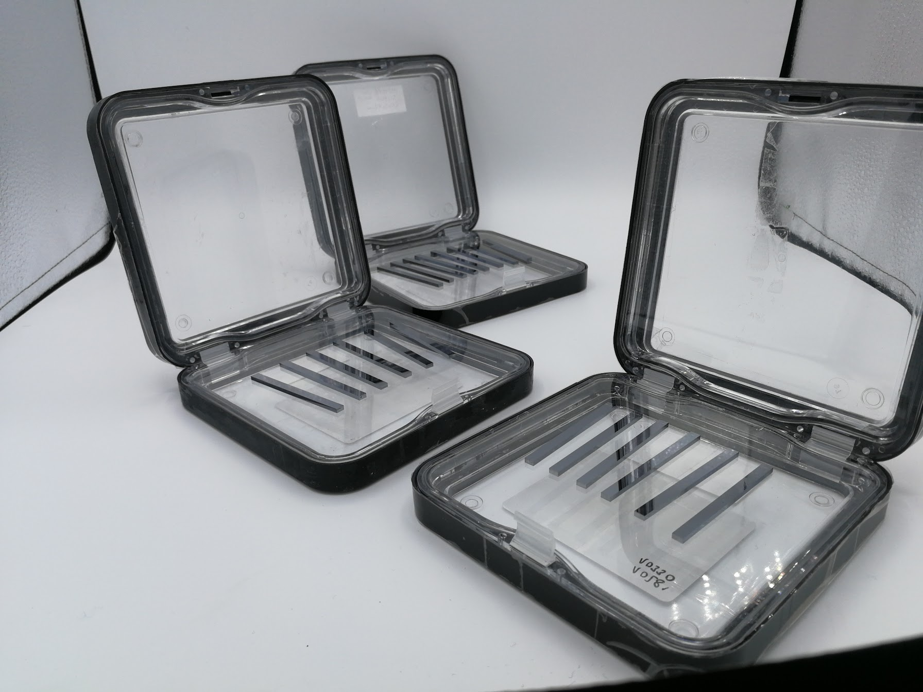
SAMPLE Preparation

Slide 22
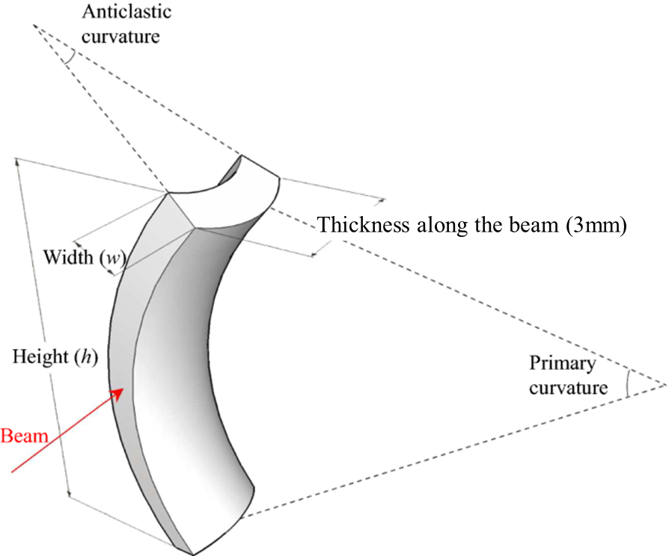
Crystal bending scheme
Secondary anticlastic curvature occurs spontaneously in all materials
Advantages:
  thin crystal width
  Crystal clamped at edges of the crystal, namely far from the beam
  large and uniform bending achievable

Slide 23
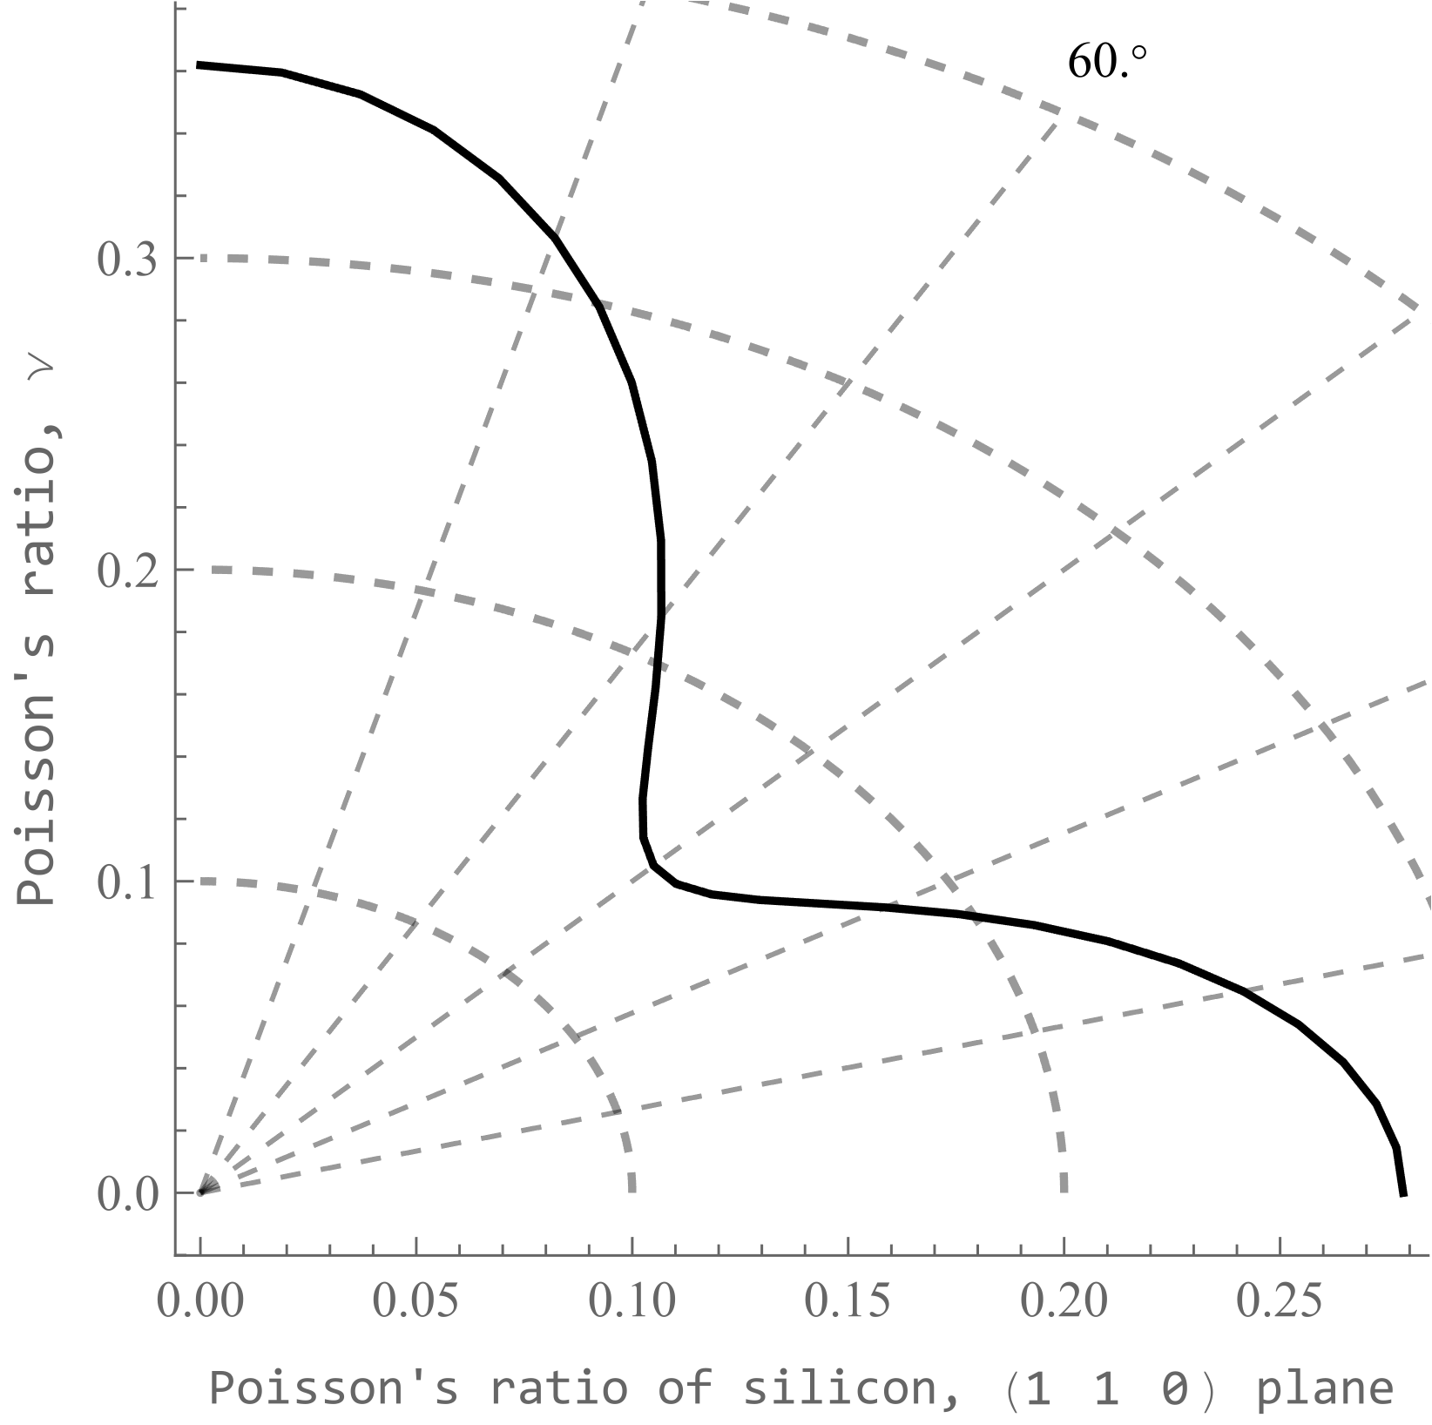
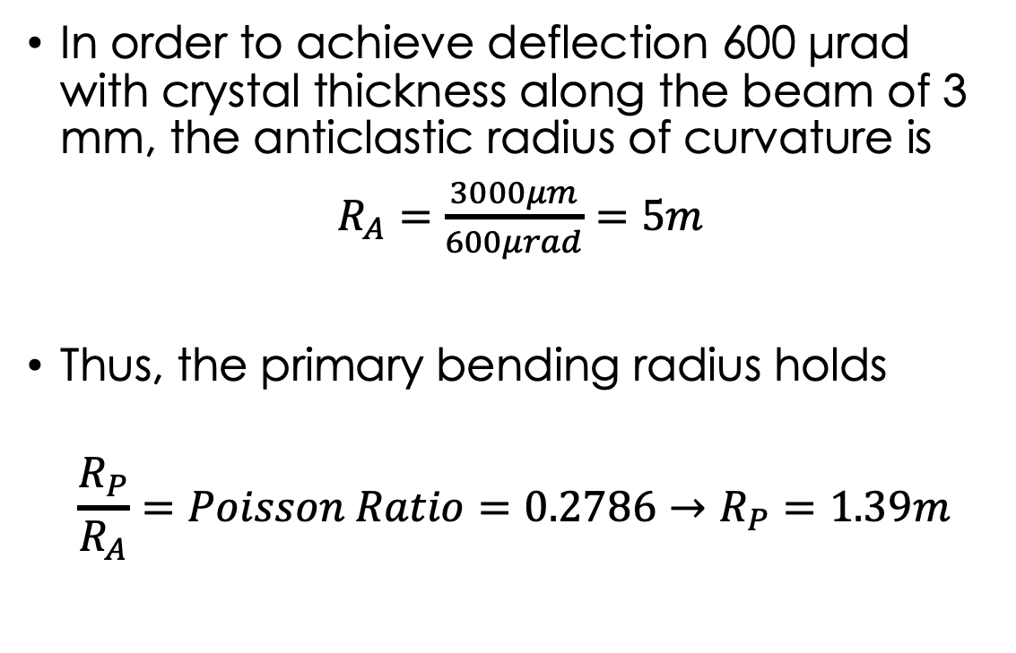
Crystal bending scheme
In order to achieve deflection 600 μrad with crystal thickness along the beam of 3 mm, the anticlastic radius of curvature is
$R_{A}=\frac{3000μm}{600μrad}=5m$
Thus, the primary bending radius holds
$$\frac{R_{P}}{R_{A}}=Poisson Ratio=0.2786→R_{P}=1.39m$$

Slide 24
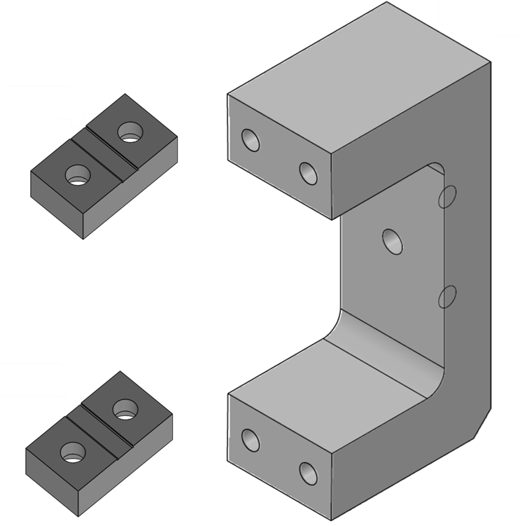
CRYSTAL holder
Holder designed with inclined support surfaces
The angle of inclination is obtained with high precision using Electrical Discharge Machining
The crystal sample is mounted and forced into arched position at R_{p}=1.39 m curvature radius.

Slide 25
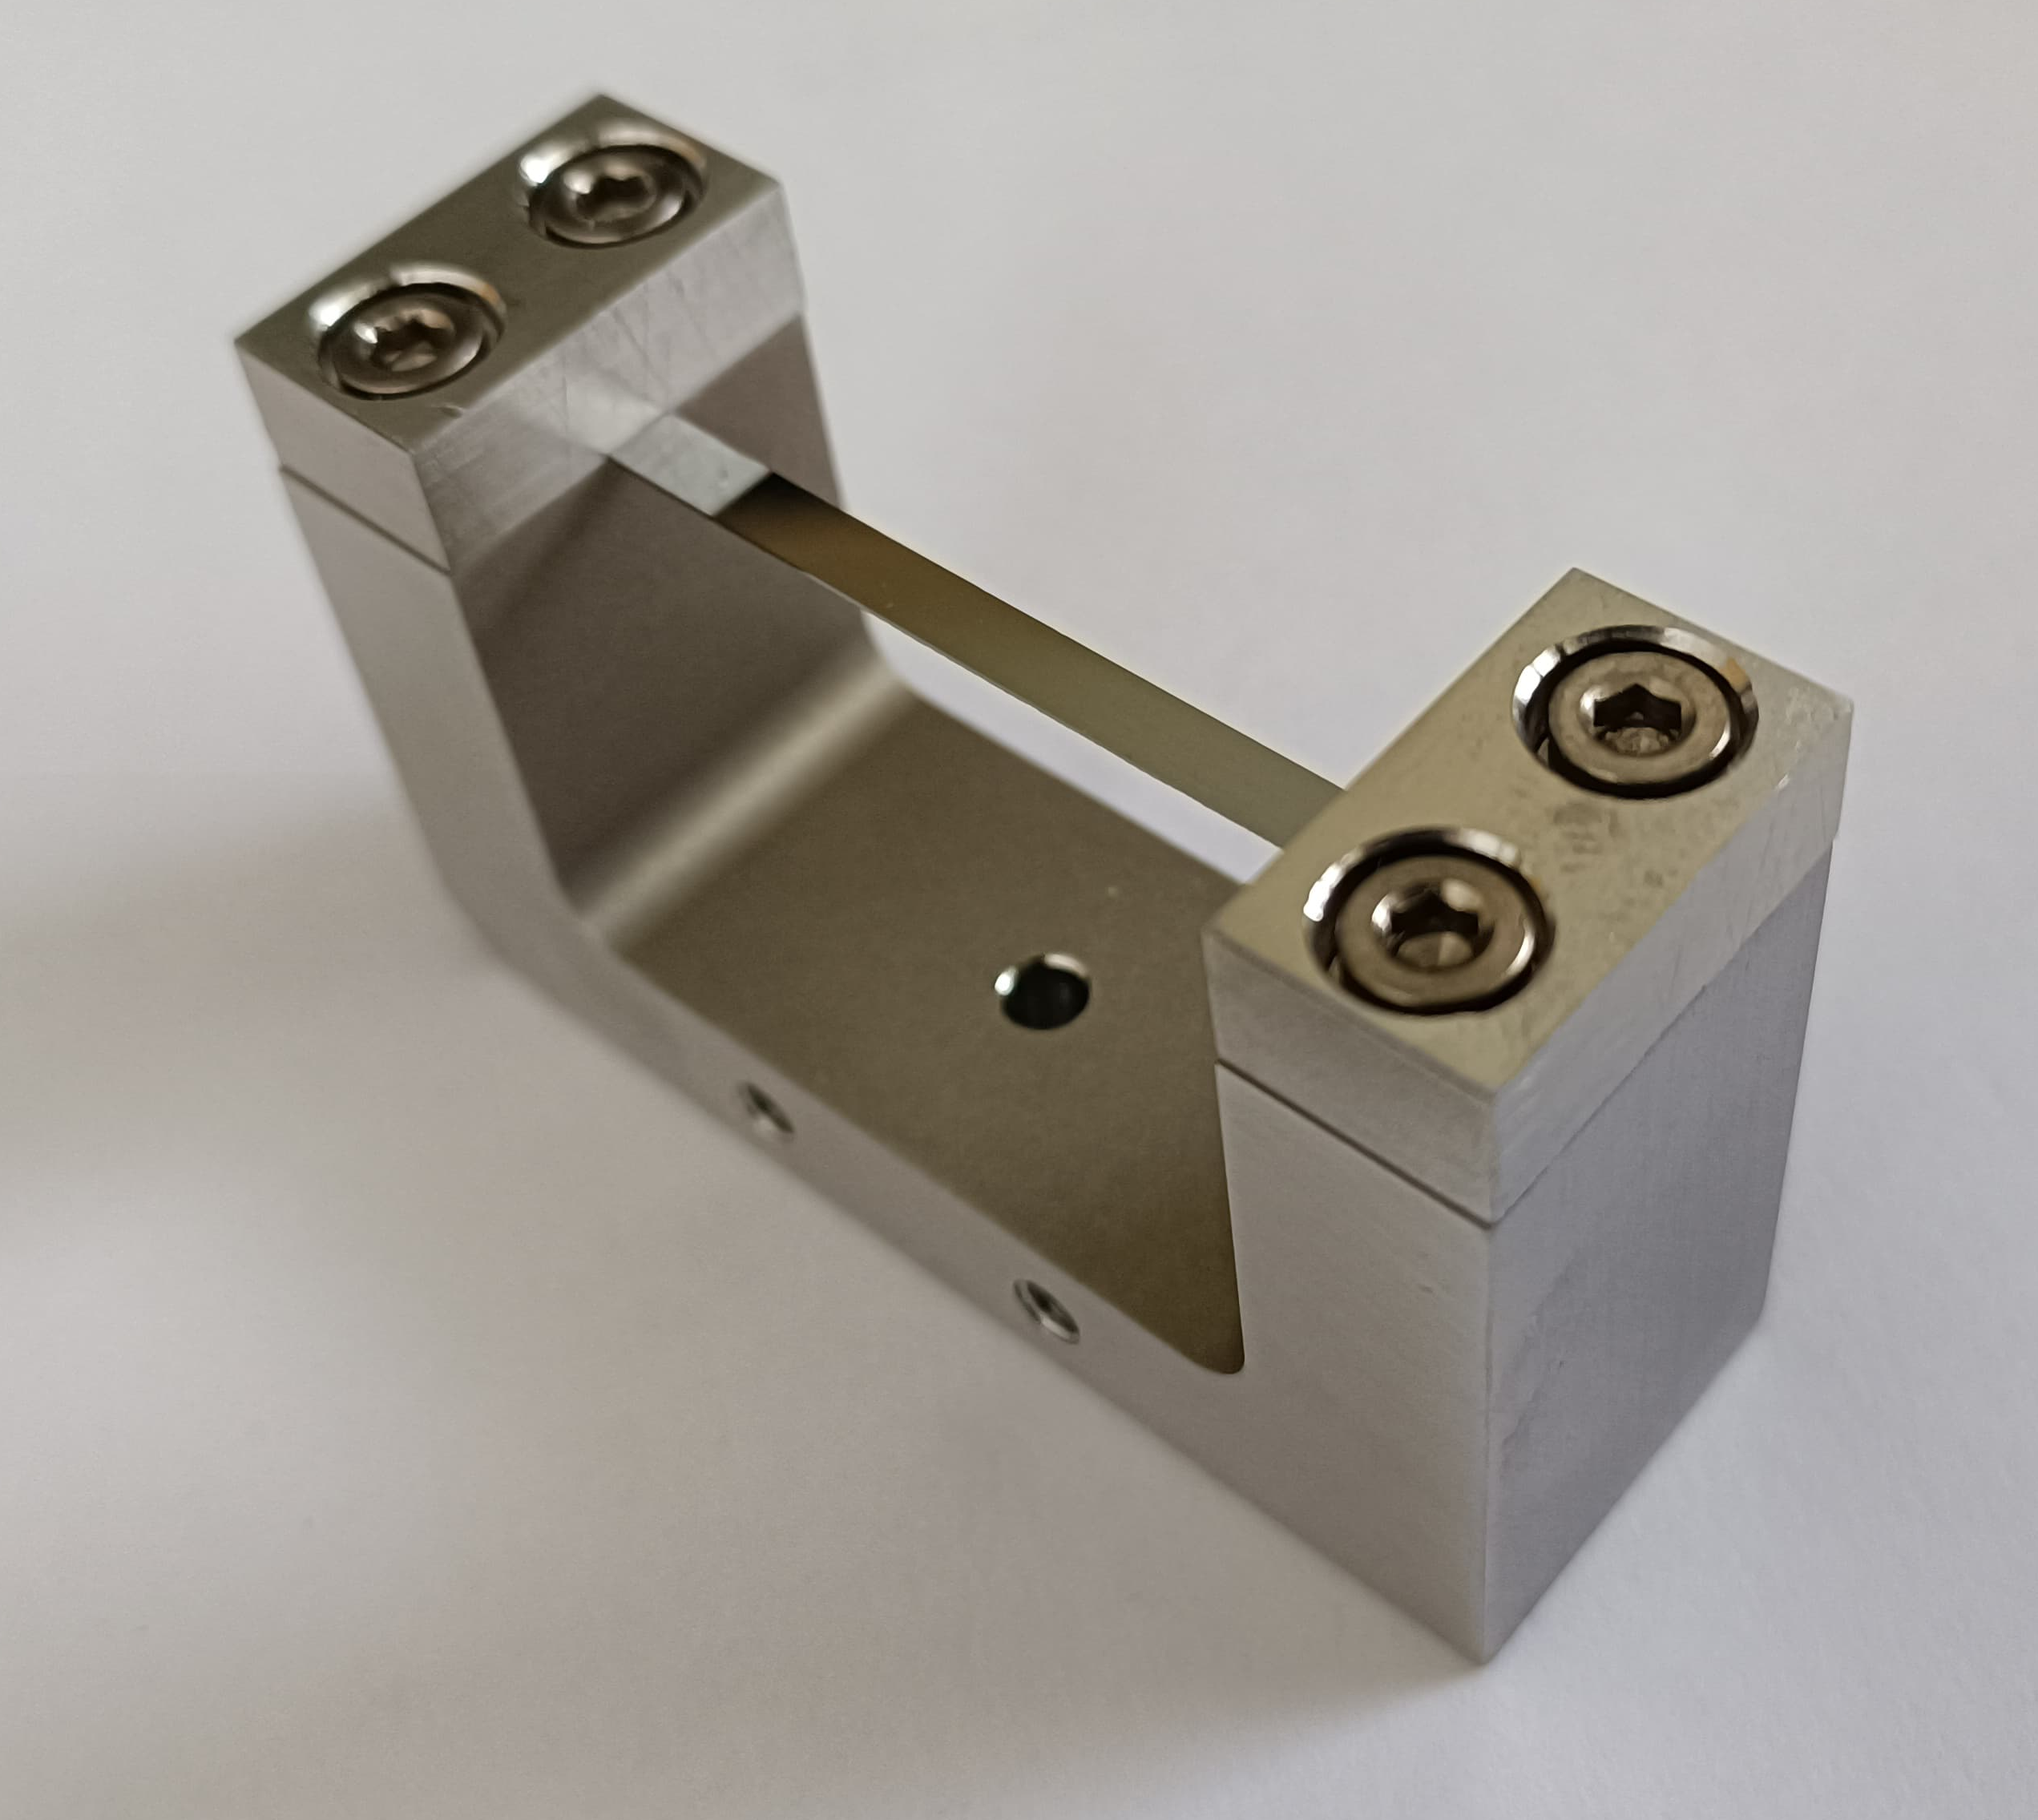
CRYSTAL holder
Holder designed with inclined support surfaces
The angle of inclination is obtained with high precision using Electrical Discharge Machining
The crystal sample (0.3x3x55mm³) was mounted and forced into arched position with radius of curvature R_{p}=1.39 m

Slide 26
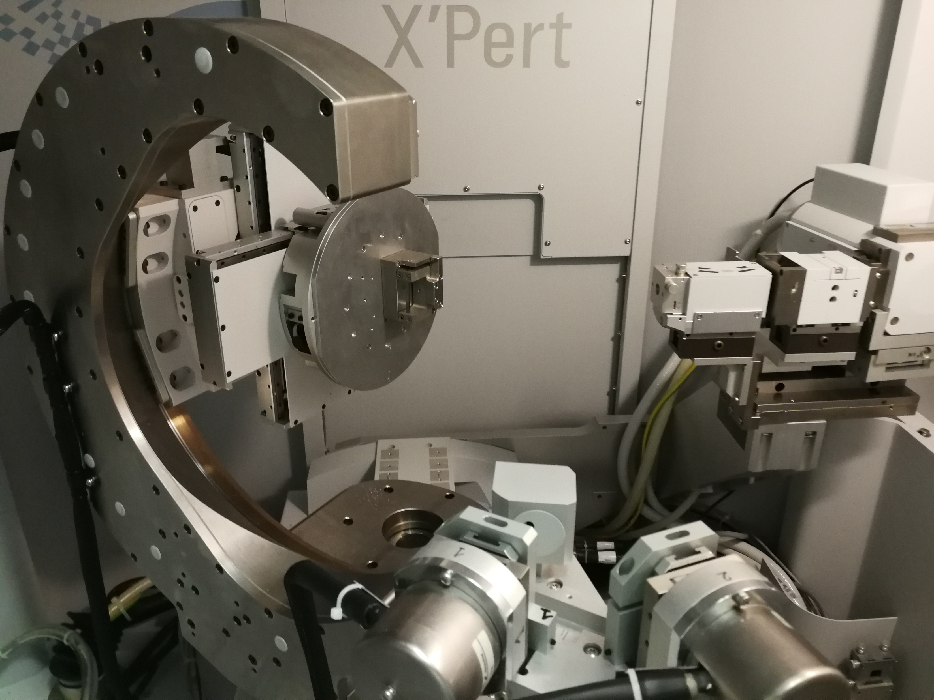
X-rays characterization
Direct measure of lattice planes curvature can be achieved via x-rays diffraction
In Ferrara Labs, a Panalytical X'Pert PRO MRD XL High Resolution diffractometer is used
Measure of local orientation of lattice planes with 0.0001° resolution
Angular shift allows to reconstruct the curvature along a direction

Slide 27
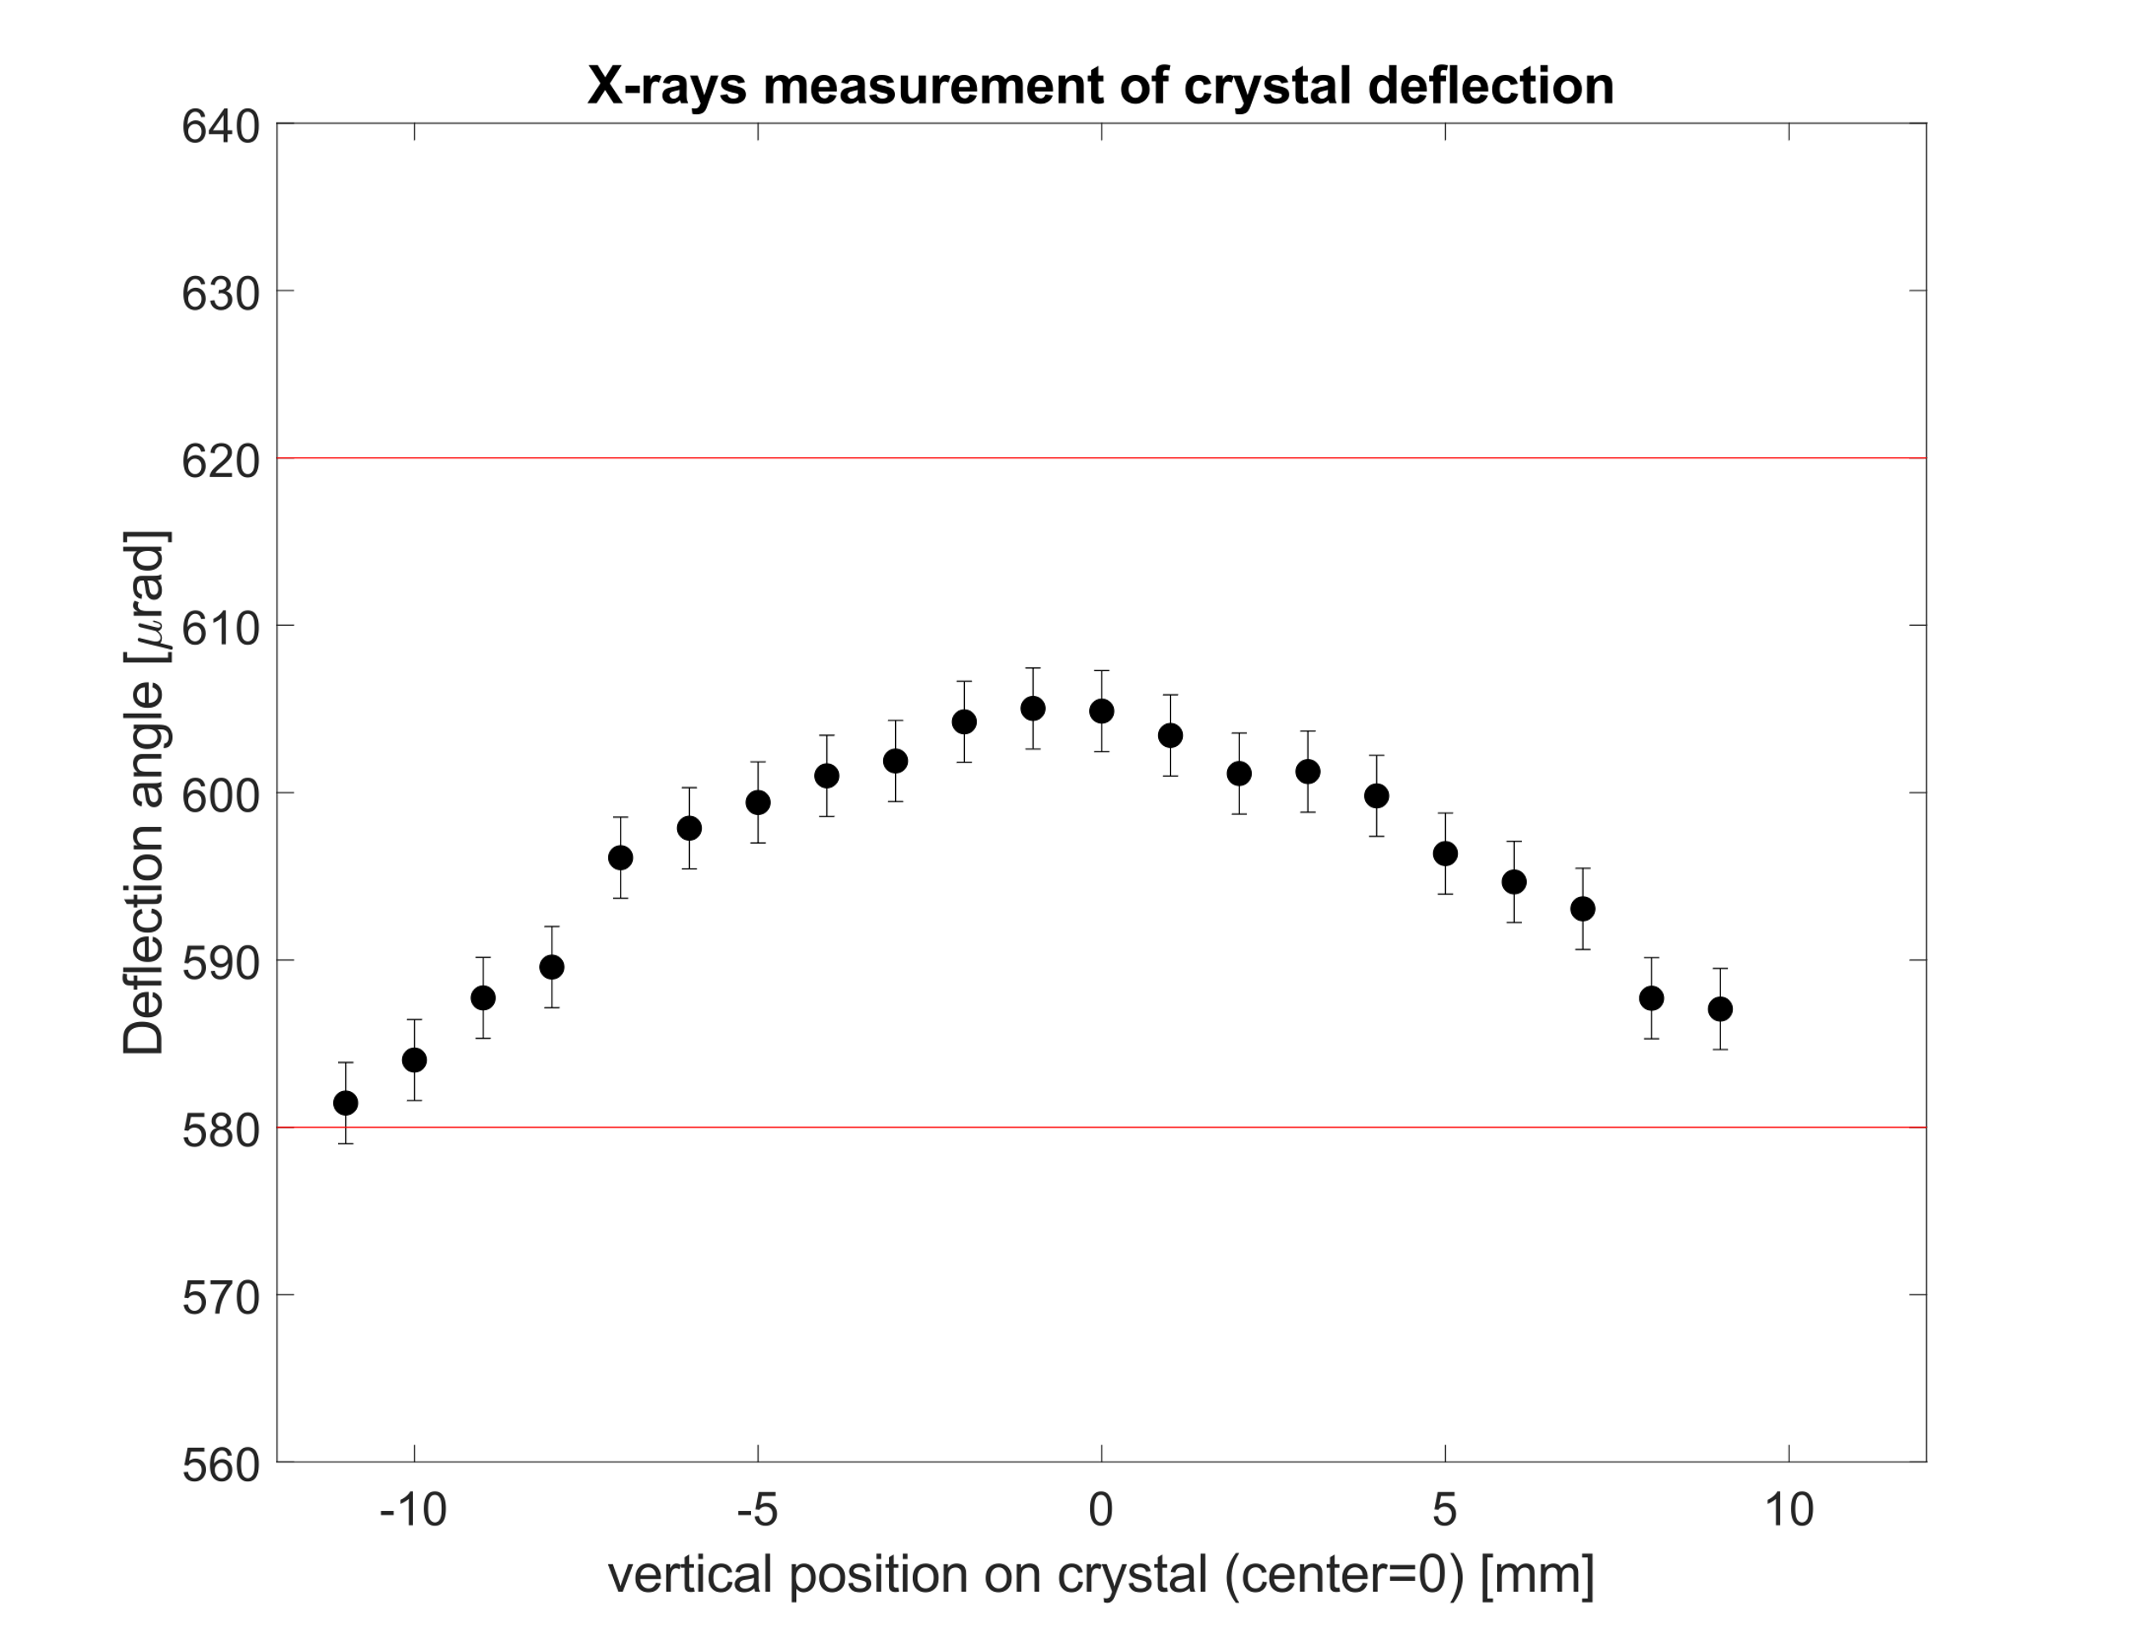
Curvature characterization
Measured deflection at different positions along the vertical size of the crystal
First measurements show values within acceptance
Further improvement may achieve still more homogeneous curvature

Slide 28
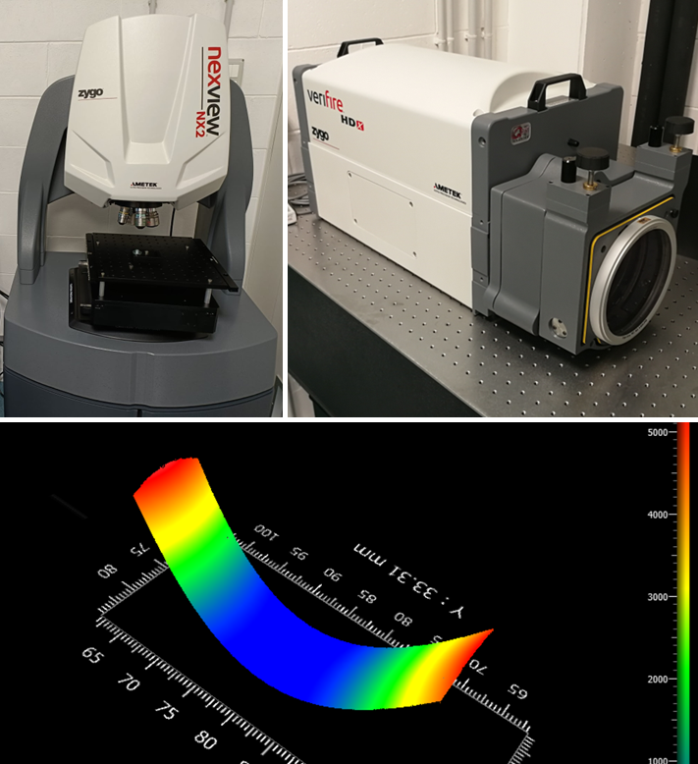
OPTICAL interferometry characterization
Characterization of curvature is of utmost importance for control of the channeled particle deflection
2-D measurement of surface profile can be achieved with nanometric precision with interferometric profilometer
In Ferrara 2 instruments are available:
  Zygo VeriFIRE HDX, for measure of large sample in 1-shot measurses
  Zygo NexView NX2, high resolution in small
  field of view

Slide 29
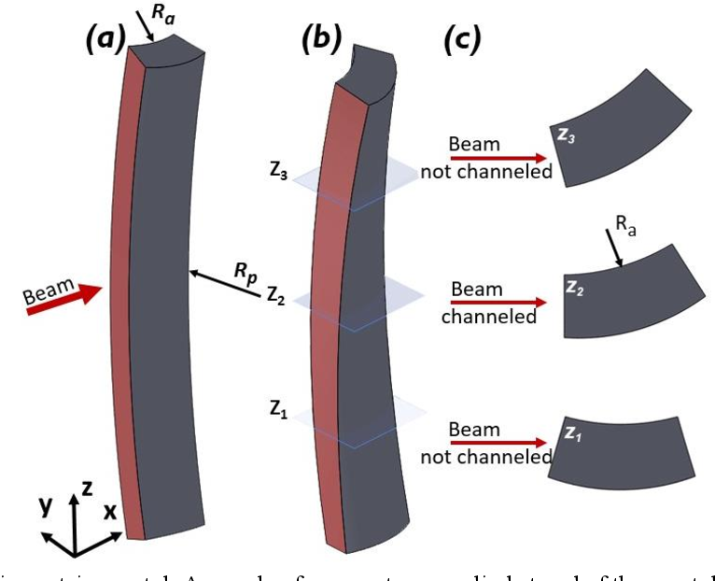
EFFECT OF Torsion
When flexed, a crystal may be subjected to torsion
Torsion changes alignment between crystal and beam along the vertical direction, decreasing the total channeling efficiency
X-rays diffraction allows measure of torsion, <10 μrad/mm is compatible with good steering efficiency

Slide 30
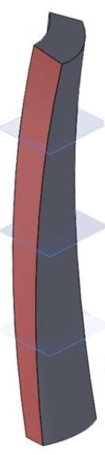

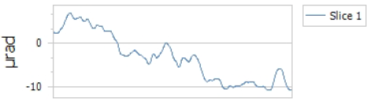
Torsion characterization
Final goal is torsion ≤10 μrad/mm
The optical characterization estimate ~5μrad/mm
μm
-500 μm
+500 μm

Slide 31
PARAMETER VERIFICATION
Deflection Angle | 300-600 μrad
Crystal Thickness along the beam | 3 mm
Crystal Width across the beam | 300±20 μm
Crystal Torsion | <10 μrad/mm
Distance between crystal and holder | >10 mm
Crystal height free of clamping | >30 mm
Holder Material | Stainless steel
Bake-out cycle | No need
✔️
✔️
✔️
✔️
✔️
✔️
✔️
✔️

Slide 32

ON-BEAM CHARACTERIZATION
Beamtime was granted as secondary user at H8 beamline of CERN-SPS North Area from July 30th though August 6th 2025.
High quality hadronic beam with particle momentum of 180 GeV/c
Setup in collaboration with University of Insubria, integrated DAQ of silicon strip tracker and high-resolution goniometer (from UniPD).
Crystal
≥ 8 m
≥ 8 m
Beam
PT1
PT2
PT3
PT4

Slide 33
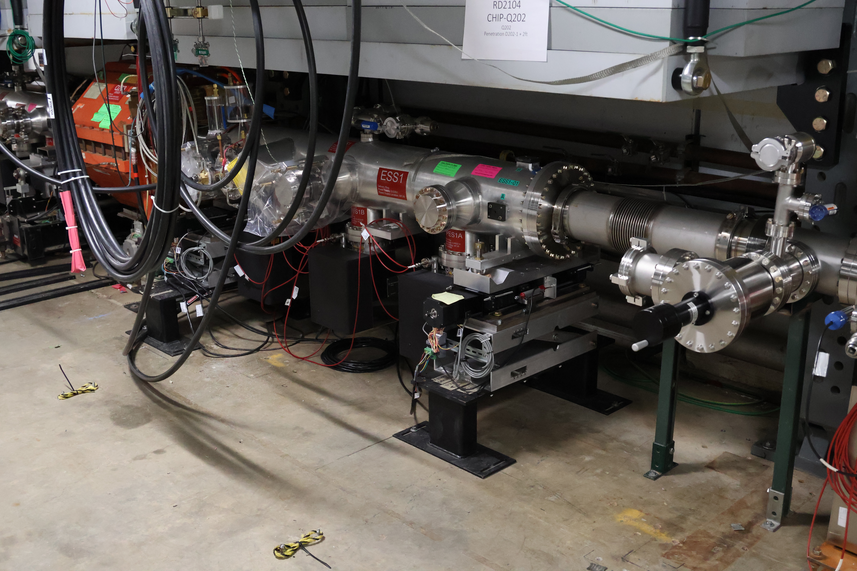
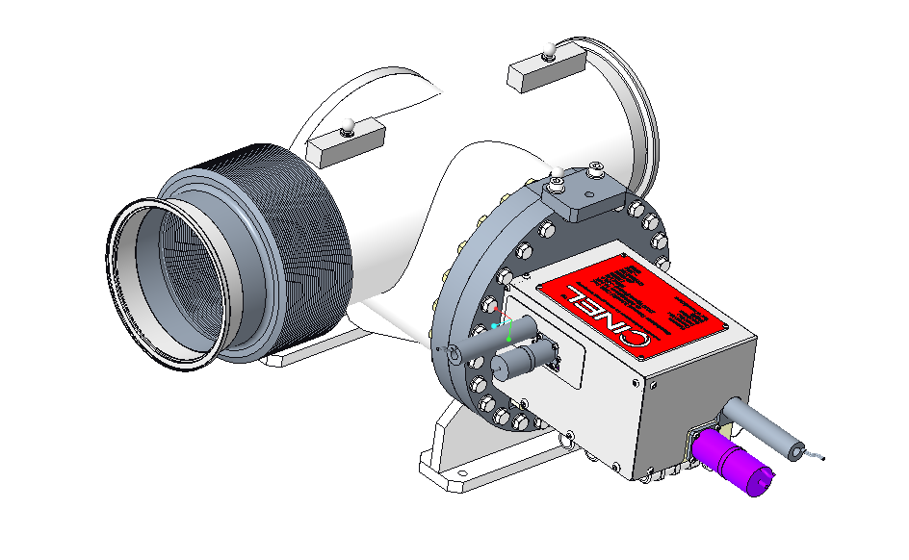
Location of the Crystal Collimation
station (goniometer) insert
Goniometer location
Crystal Collimation station
Proton beam direction
Electrostatic Septum
ESS1
Goniometer to be anchored to the floor and decoupled from the ESS1 by bellows
Courtesy of Vladimir Nagaslaev (FNAL)

Slide 34
Planning at Fermilab
The 3mm crystal fabrication has been completed by Ferrara
The Crystal Collimation station (CCS) insert is in production
  The contract awarded in October 2024
  The vendor has completed the design phase:
    FDR in April 2025
  We expect fabrication completed in late CY2025
Full installation of the CCS with the crystal is in the lab’s schedule to be done during the FNAL Summer shutdown 2026
  Installation may be done earlier, if the CCS is ready and opportunity exists in the Accelerator beam operations.
Courtesy of Vladimir Nagaslaev (FNAL)

Slide 35
Conclusions AND FUTURE PLANS
Mitigation scheme for beam losses through shadowing technique with bent crystal for Mu2e operation
First prototype 3-mm long fabricated and characterized – ready to be delivered
On-beam characterization in next months
Design and fabrication start for 2-mm long crystal

Slide 36


Ferrara, world heritage by
UNESCO since 1995
Thank you for your attention

