Slide 1
Tracker Summary :
D. Ambrose on behalf of the Tracker Team
Mu2e Collaboration Meeting
Fri Jun 13th, 2025

Slide 2
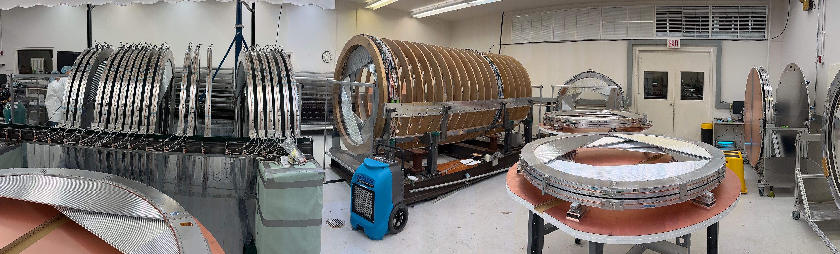
Overview
Tracker Construction : Plane Storage, Frame, and Stations
Tracker Overview
Tracker Production Statuses
Tracker Measurements

Slide 3
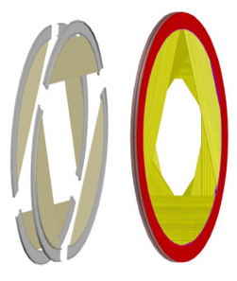
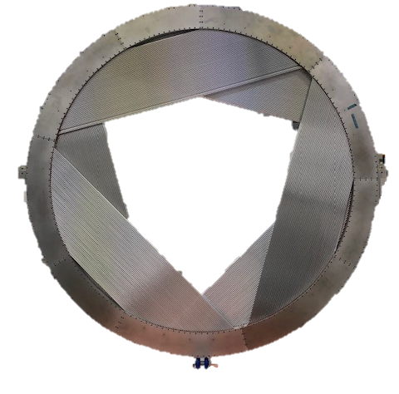
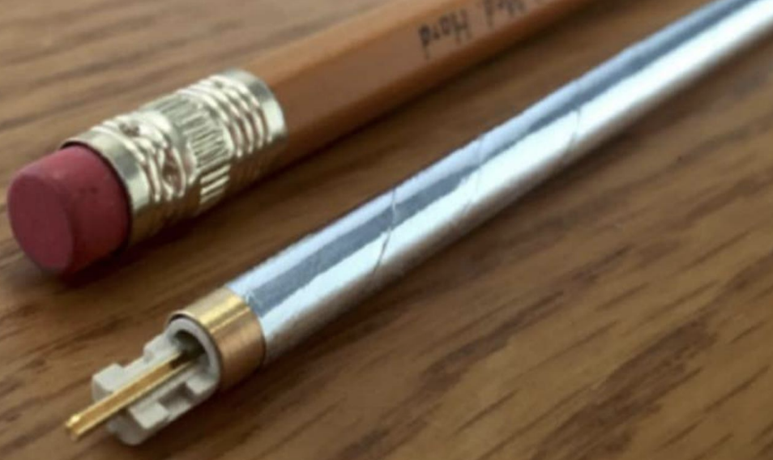
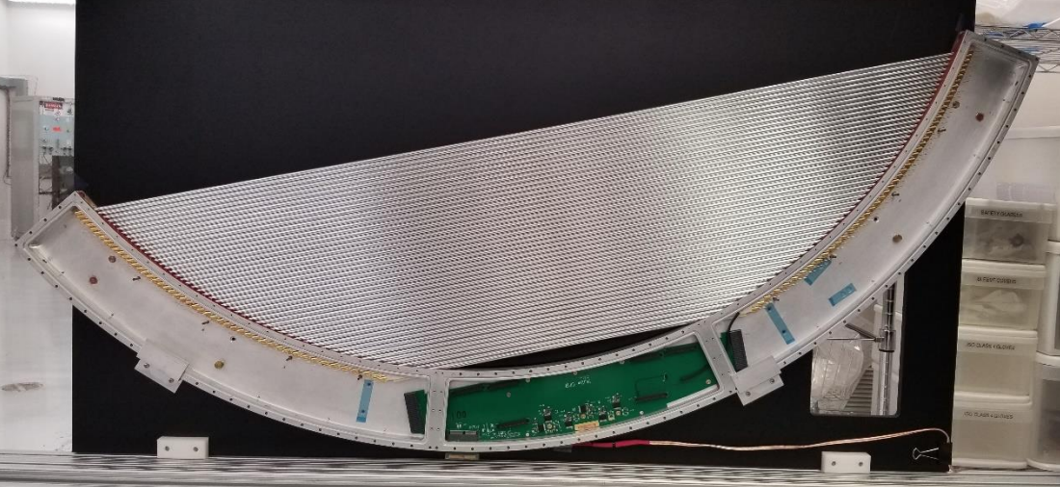
Tracker Overview
5mm diameter
Mylar Straw Tubes
6 panels make a plane
2 planes in a station
The Tracker is a low mass array of thin-walled Mylar straw drift tubes.
Tracker consists of :
20,736 straw channels (100% completed)
216 panels (100% completed)
36 planes (100% completed)
18 stations (28% completed)
1 Panel with 96 straws

Slide 4
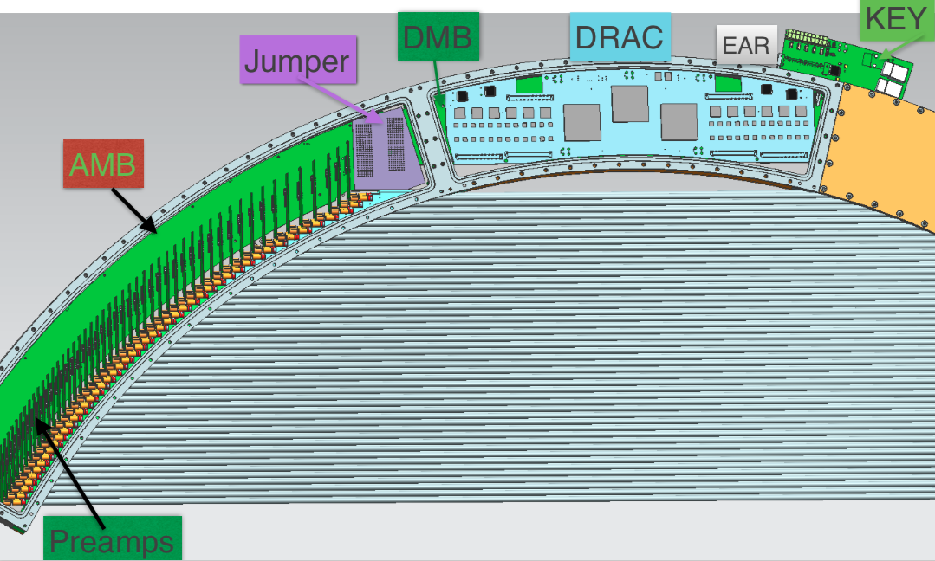
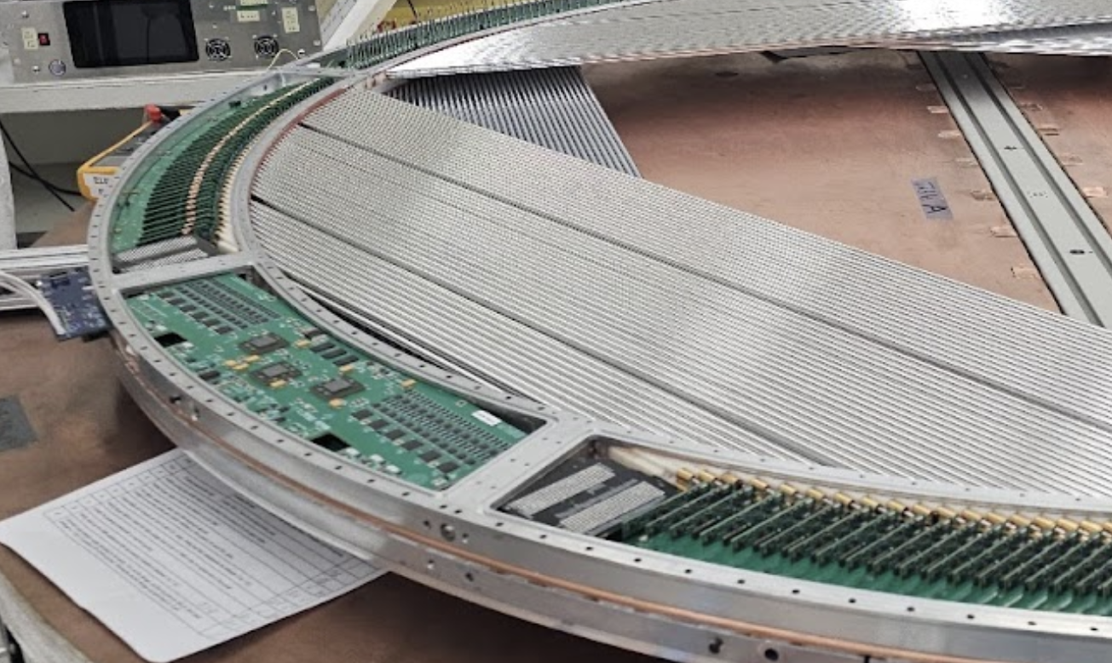
Tracker Electronics Overview
20,736x Preamps :
Each preamp attaches to 2 straws
Both sides require a preamp
532x AMB (Analog Motherboard)
2 per panel
216x DMB (Digital Motherboard)
1 per panel
216x DRAC (Digitizer Readout Assembler and Controller)
Each has 12 ADCs and 3 FPGAs
216x EAR :
Connects DMB to outside gas volume
216x KEY :
Reads out panels
Connects to fiber lines
Operates in Vacuum with VTRXs

Slide 5
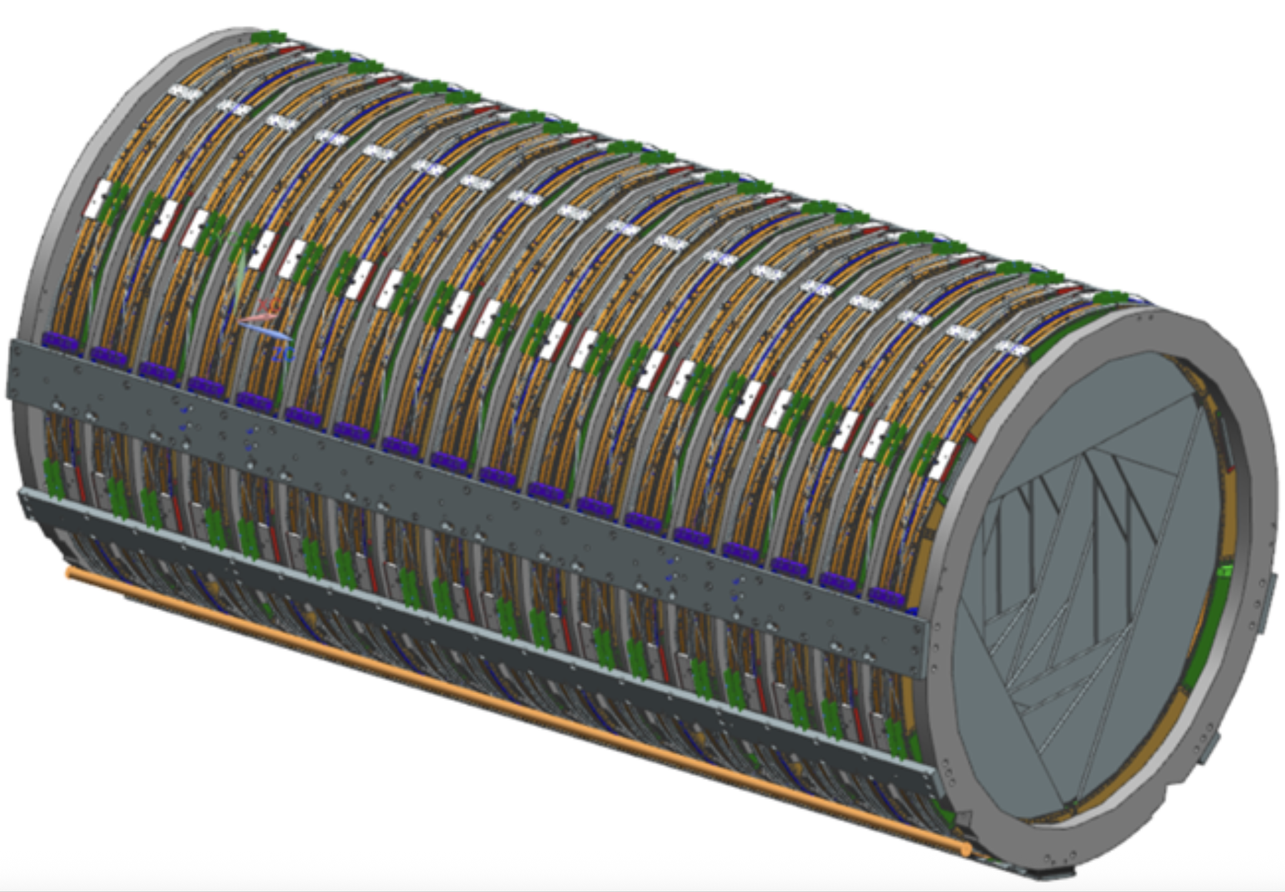
Tracker Structure Overview
Bronze Absorber, Support and End Rings
(19 units made in bronze)
Station [12 panels]
(18 units)
Upper Stave
(made in Al)
Lower Stave
(made in Al)
Lower Bar
(made in Al)

Slide 6
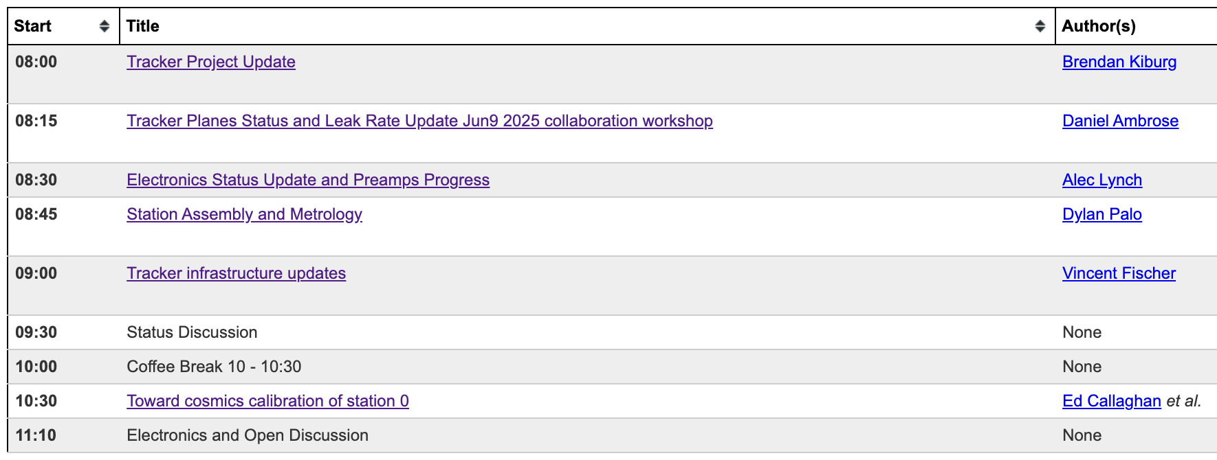
Tracker Workshop (Monday June 9th, 2025)
Split up for summary talk :
Production
Planes
Electronics Installation
Final Electronics
Station Building
Gas Lines and Cabling
Frame Installation
Infrastructure
Production Timeframe
Measurements
Plane HV and Onset of gain test
Panel Leak Rates
Check valve leak rates
Station Metrology
Station Readout
Station Noise Studies

Slide 7
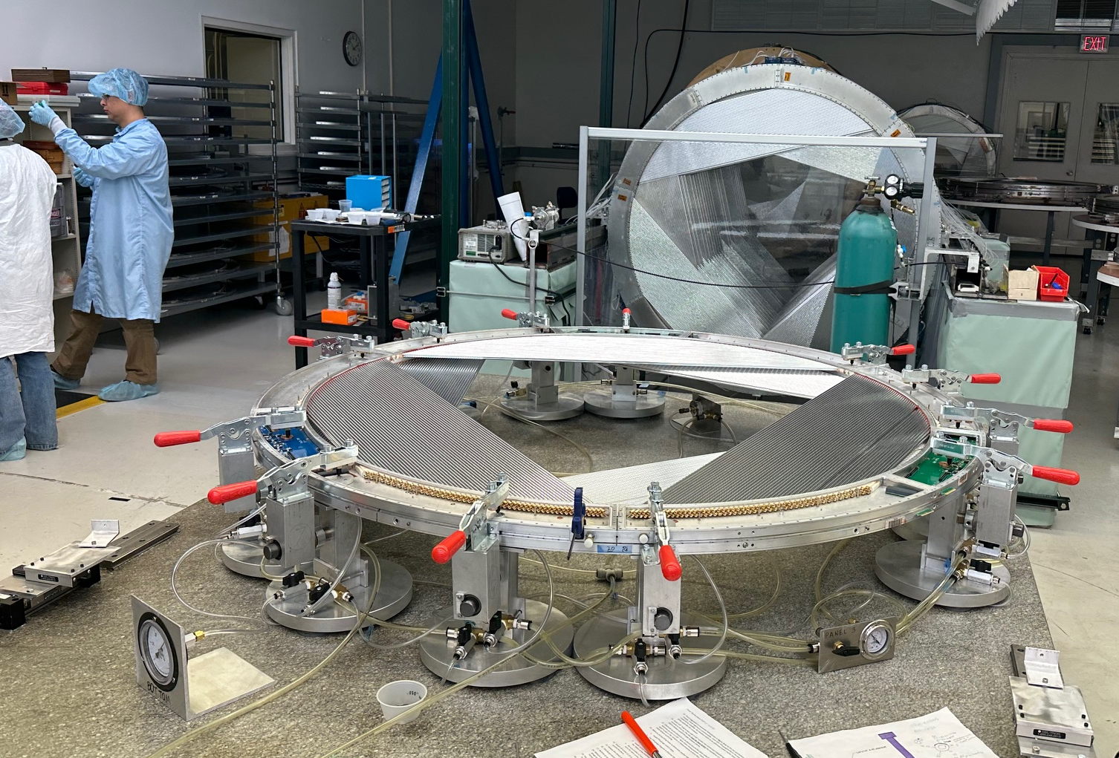
Planes Production
36 of 36 (100%)
D.Ambrose docdb 52894
Most plane work since last collaboration meeting has been on prepping planes for electronics and station construction.
Other plane work :
Fixing plane gas leaks
Replaced 2 panels : Both damage in Straw to Inner ring region
Replaced a panel on a plane with a cooling ring and some electronics installed.
Fixing and preparing spare panels
Have 7 prepped spare panels
Panel replacement on the granite table shared with station production

Slide 8
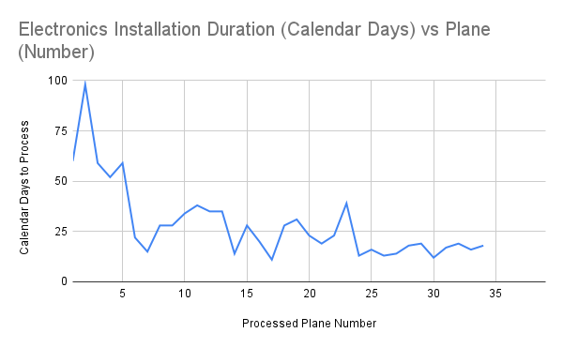
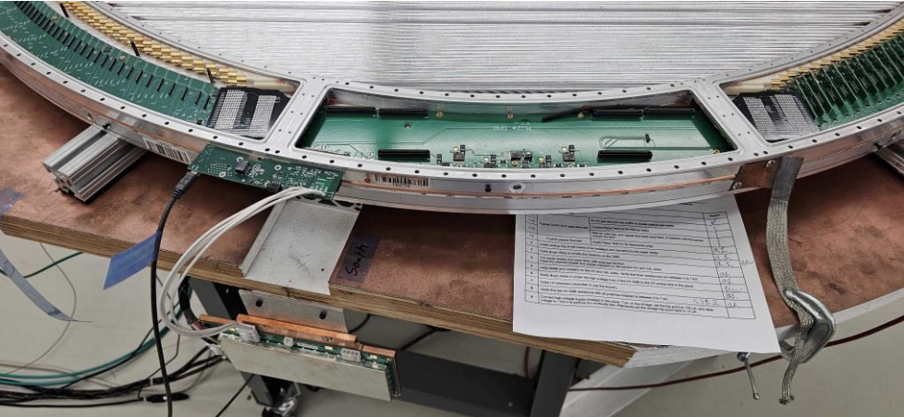
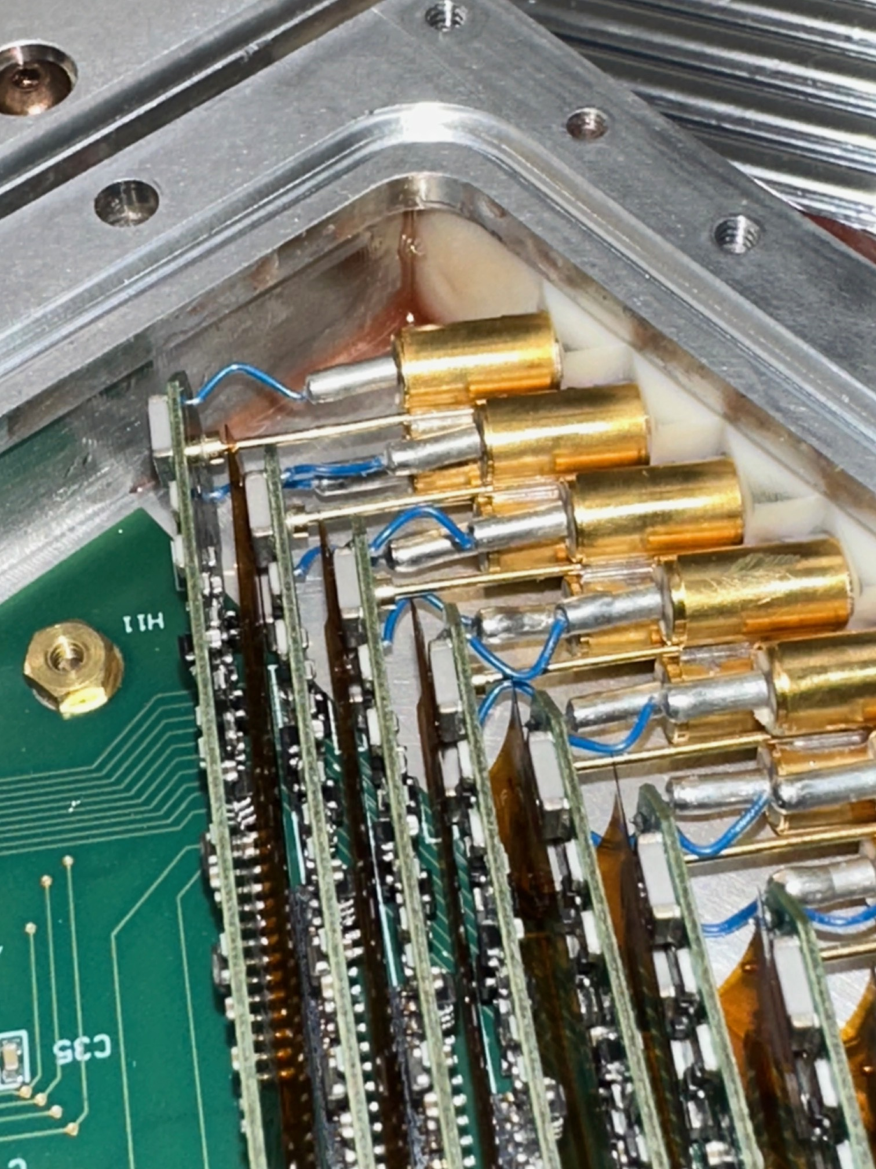
Electronics Installation
32 of 36 (89%)
Expected Completion July
A.Lynch docdb 52933
Installed electronics into 5 planes in last 3 months
Slowed processing rate in last month as shift focused on Station prep
Slow created by lowering number of tables dedicated to installation
Decision was made due to shortage of Preamps (more on next slide)
Finish installing electronics into final 4 planes in the next 2 months
Through 32 planes, we are at 1.8% channel failure rate

Slide 9
Electronics PreAmp Status
A.Lynch docdb 52933
All preamps have been processed.
Any preamps that need to have their anode sockets fixed are being sent back to Fermilab due to the influx of help that have come in.
Preamp with broken wire
 | CALs | HVs | Total
Received at UCB | 11600 | 12000 | 23600
Processed | 11600 | 12000 | 23600
Preamps sent for Anode Socket Wire Fix | 1000 | 500 | 1500
Need to be shipped | 750 | 250 | 1000
Remaining 2304 preamps to be installed are being fixed and tested

Slide 10
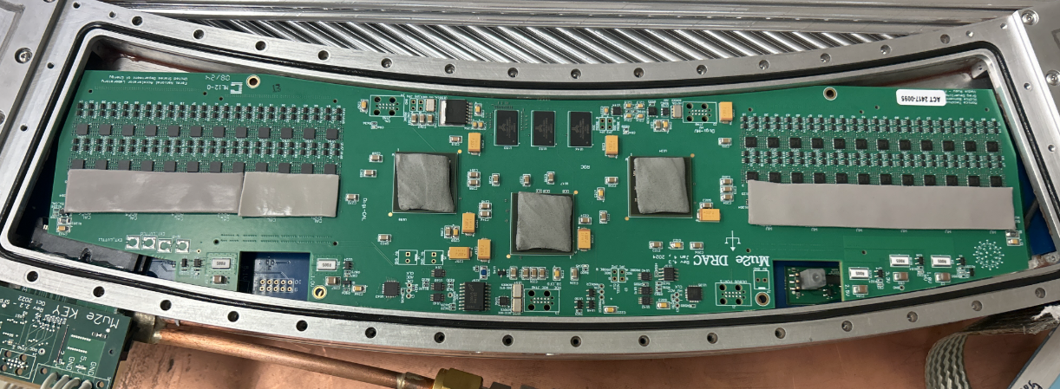
Final Electronics and Station Prepping
12 of 36 (33%)
Expected Completion August
Processing :
Add DC/DC converter mounting blocks
Add Copper clips to preamps on older planes
2.5 planes still need this
Install DRAC with coolzorb and heatsink cover
Recheck electronics
Test cooling on electronics while under 1 ATM pressure
Production DRAC with Coolzorb
Currently working on planes 13 and 14
Prepped 12 planes in last 3 months
Average 2 weeks per plane
Works on up to 5 planes at a time but shares resources with electronics installation
Expected to increase processing speed to finish in the next 3 months

Slide 11
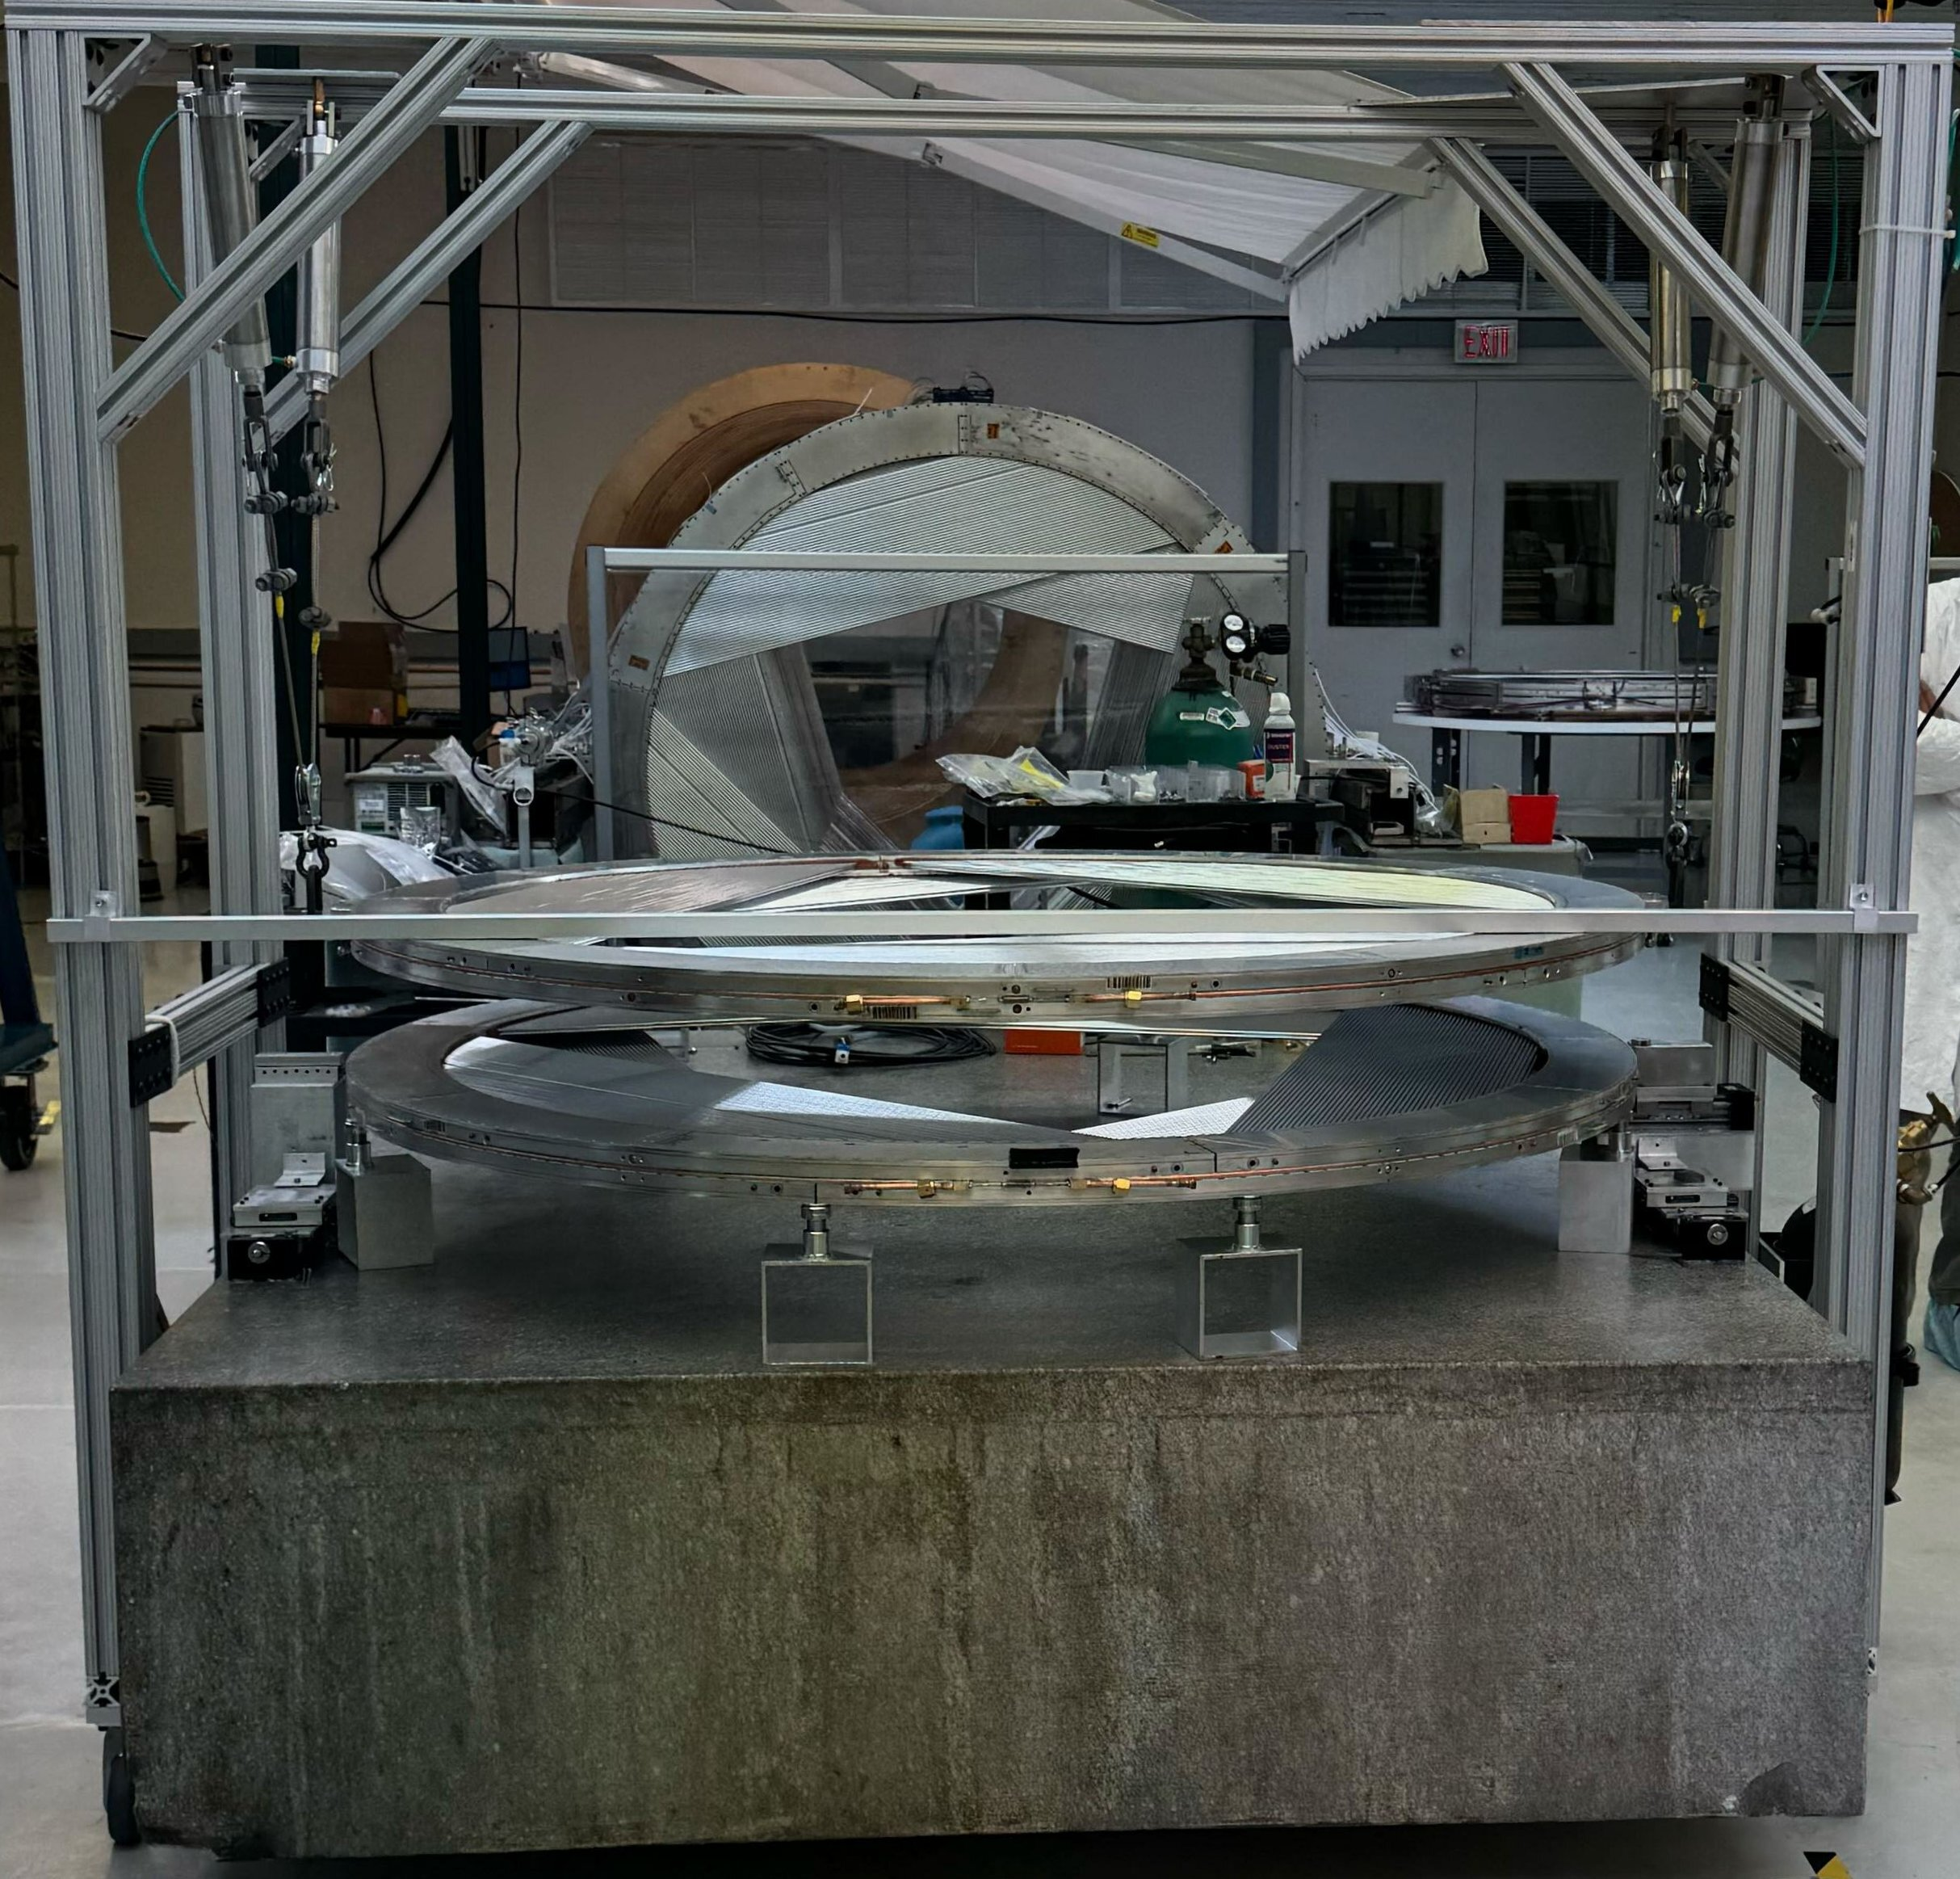
Station Building
5 of 18 (28%)
D.Palo docdb 52882
Expected Completion August
Station Assembly procedure and details :
Jangra, docdb 48168 - 3/18/24
Palo, docdb 50293 - 09/23/24
Upgrades :
Spatula for landing planes on the granite
Significantly speeds up assembly
New jig for measurements close to the cooling ring U-turns (discussed later)
With spatula, it takes on average, 2.5 days to assemble a station including reaming the plane pin holes.
An additional 0.5 day to make mechanical measurements and move into the metrology stand

Slide 12
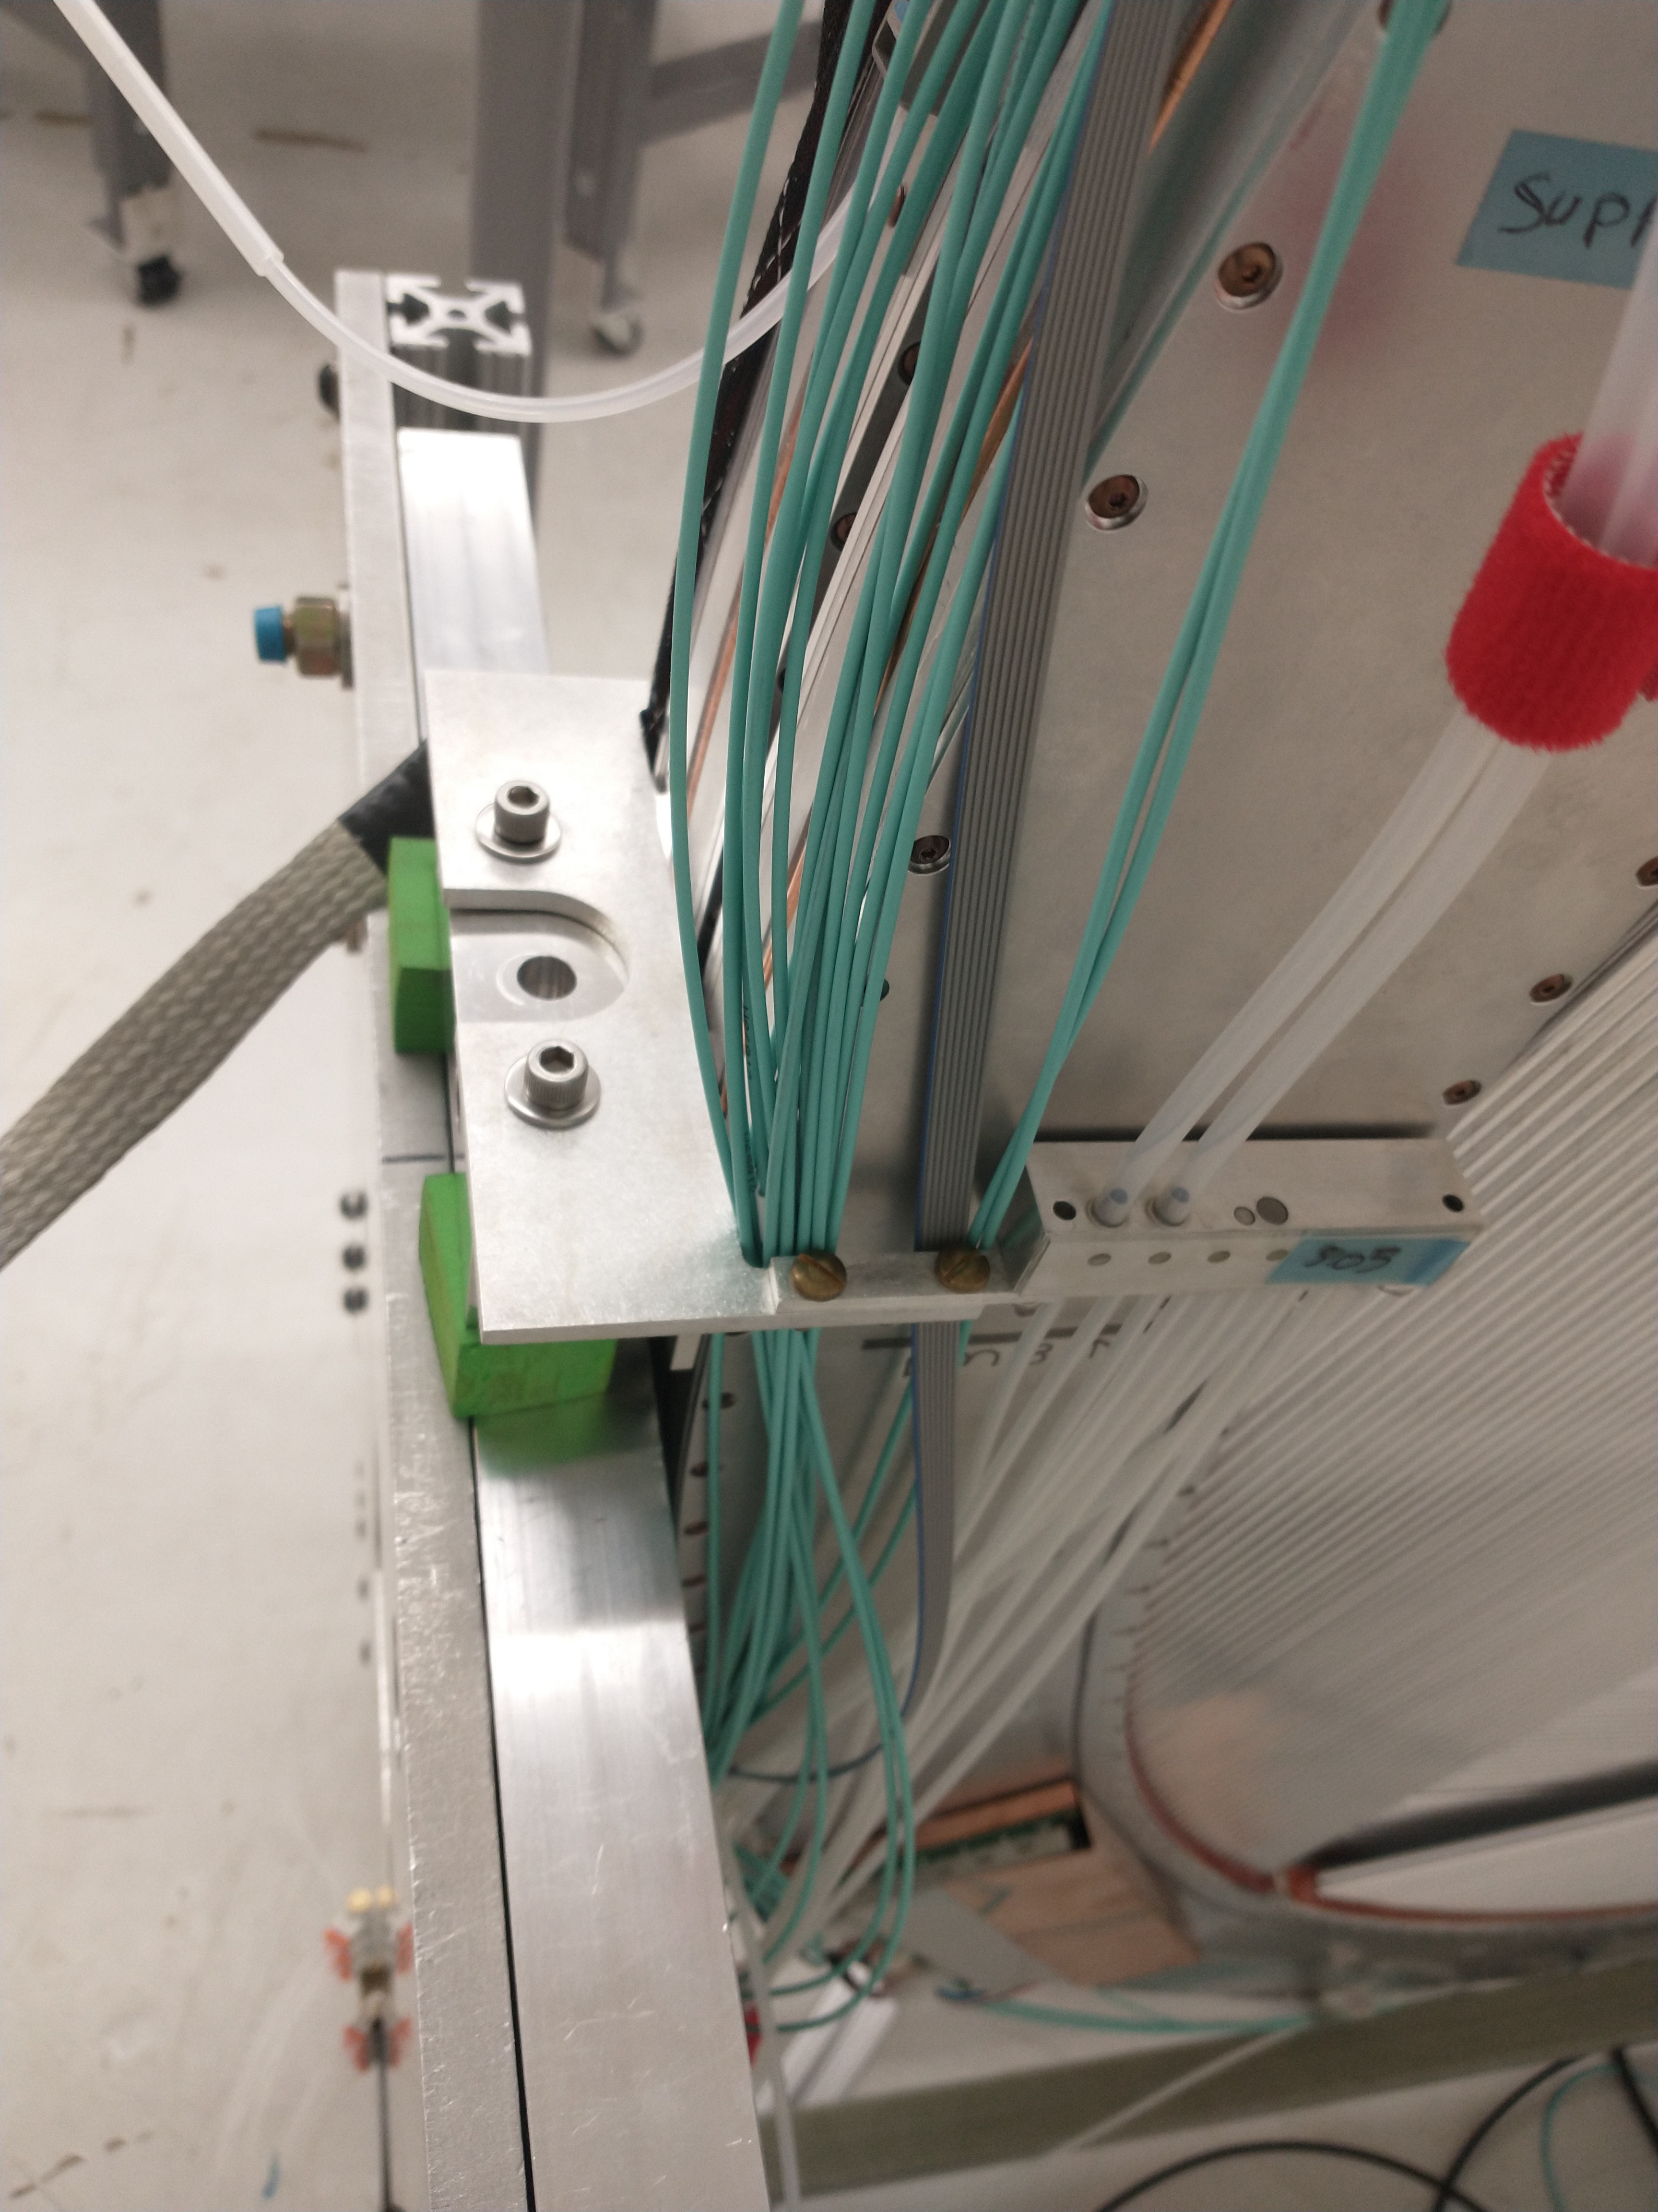
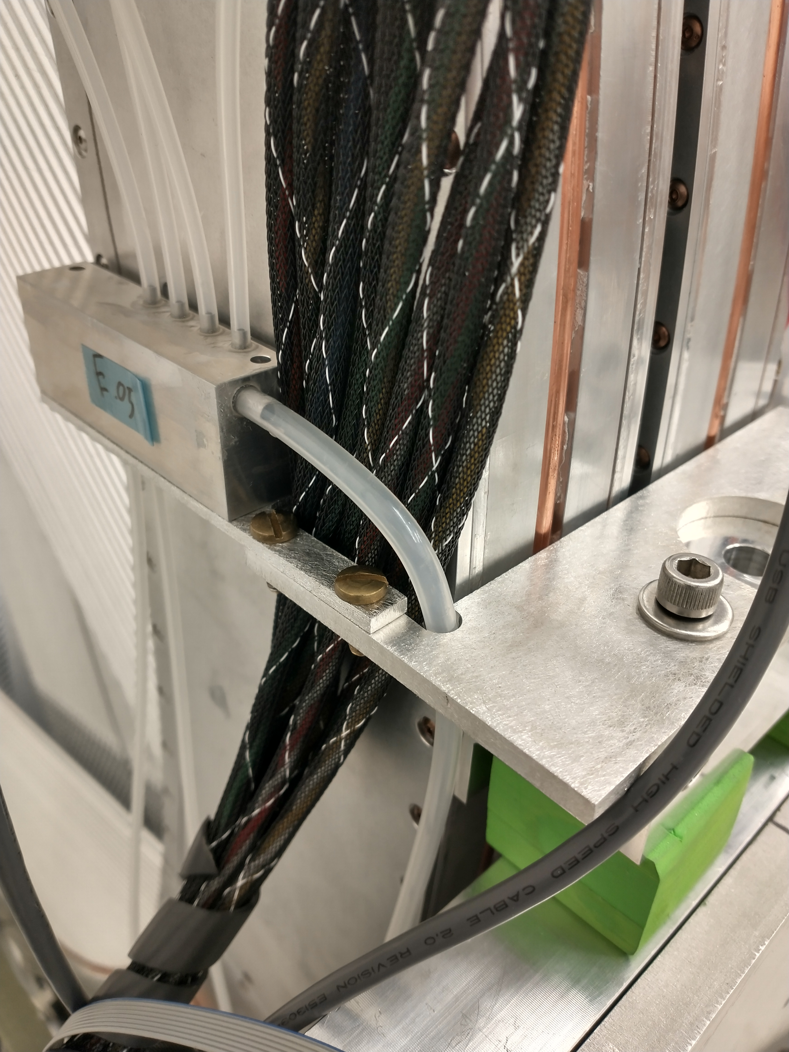
Gas lines and Cabling
3 of 18 (17%)
Expected Completion September
After Station metrology measurements, stations are landed horizontally and are cabled.
Cabling process mounts the DC/DC converters and includes gas fittings, HV lines, LV lines, and fiber.
Measurements have been made for both odd and even station types and we are ready to ramp up cabling and installation process.
LV/HV lines and gas lines near station’s arm
Read out fibers (teal) bundled within check valve brackets

Slide 13
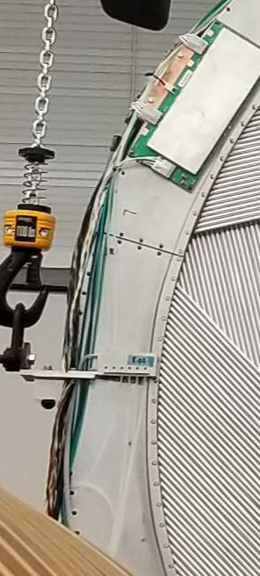
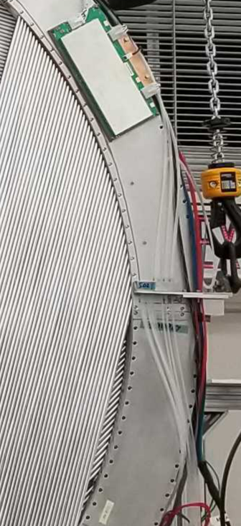
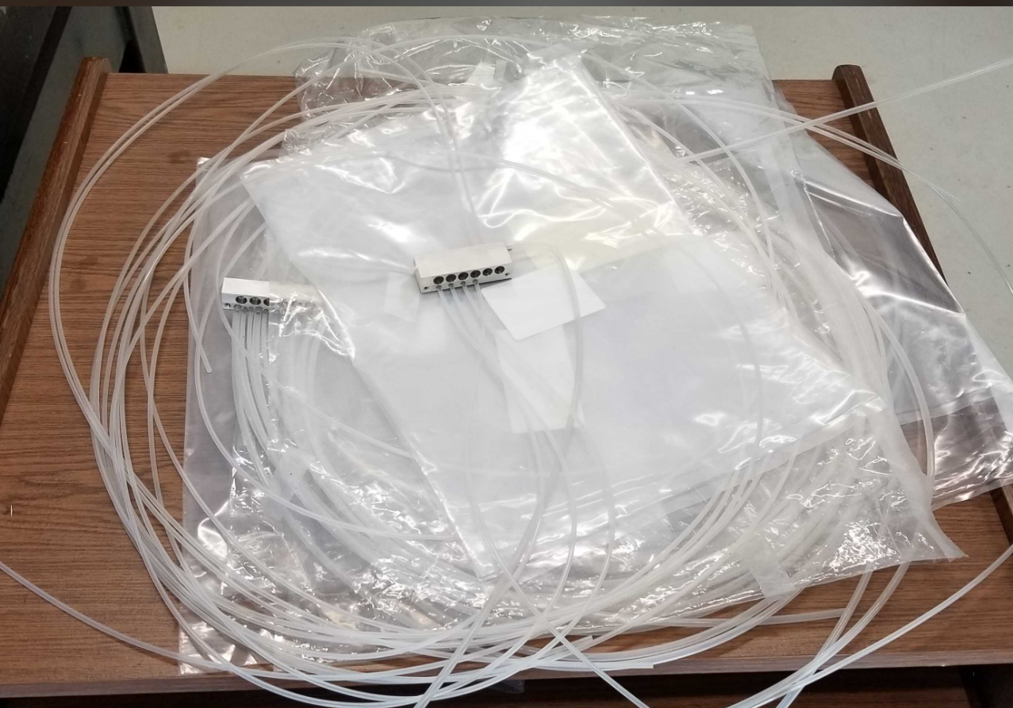
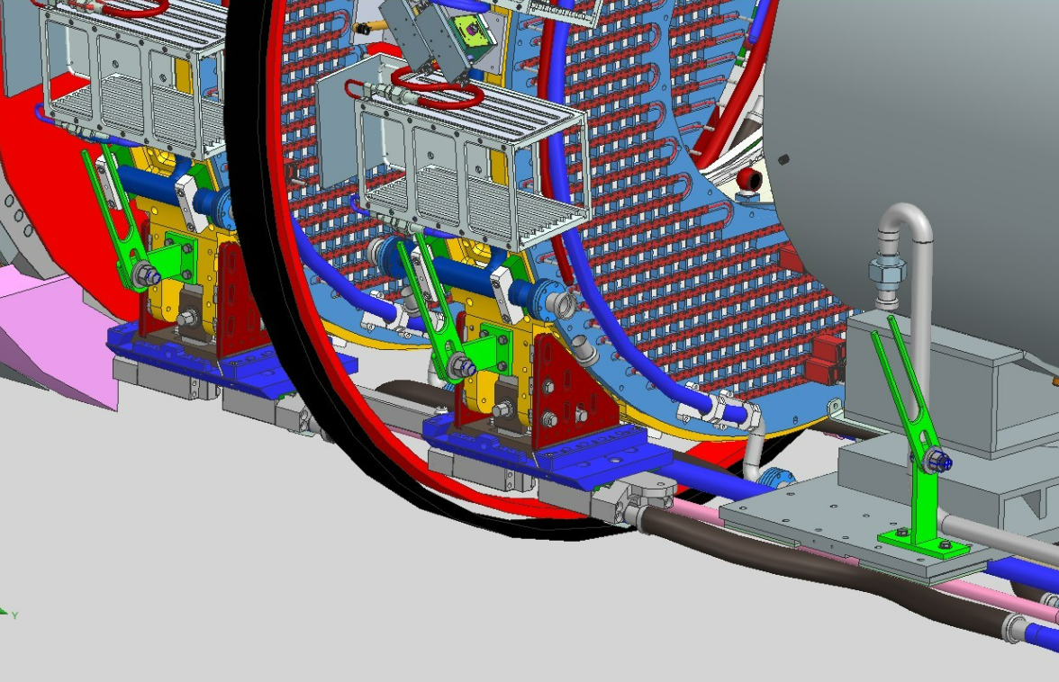
Gas system in DS
V.Fischer docdb 52939
Check valves
First production sets installed on Train Station and Station 0. Manifolds are being assembled
First sets showed issues:
Plugged ports -> Fixed through changes in assembly procedure
High leak rates then expected -> See dedicated slides
Connections
Tubing-to-tubing connections will be combination of push-to-connect fittings and plastic welds
Easier to install and replace, allows the use of PE tubing in some circumstances
Parts have to be ordered. Easy assembly
Holders
Services (gas lines, electrical wires, fibers) holders have been designed
Work with calorimeter to finalize positions on Muon Beam Stop

Slide 14
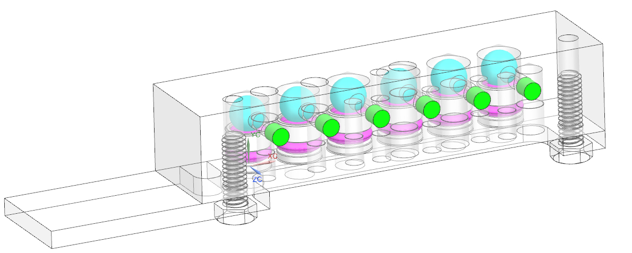
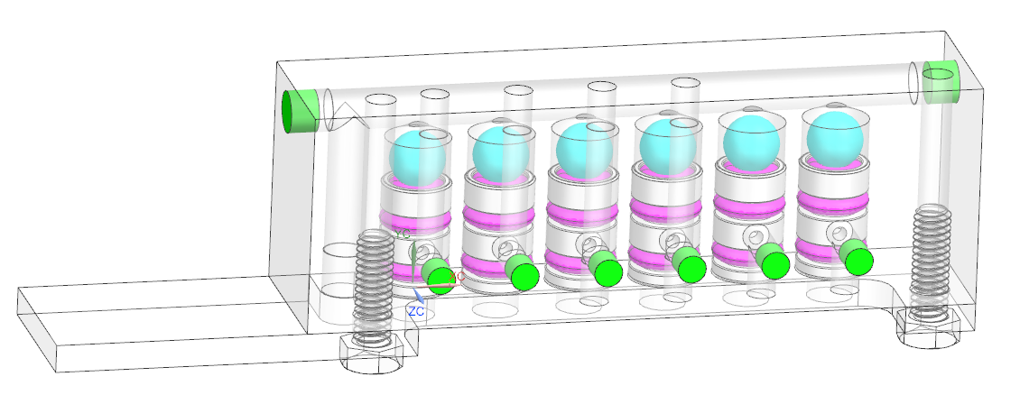
Check valves connections
1 of 18 (6%)
V.Fischer docdb 52939
Can be installed post installation into frame
2 check valves blocks per plane (supply and exhaust), 6 valves (one per panel) per block
Supply check valves:
Panel protection: Stays closed, only opens if DS pressure > panel pressure
Exhaust check valves:
Backflow protection: Always opened when flowing gas, closes if panel pressure < exhaust pressure
Design:
Main seal: Ball resting on o-ring in a dovetail on a bushing (easy removal and rotation)
Bushing seal: Radial o-ring
Borosilicate ball, Viton o-rings, Noryl bushings

Slide 15
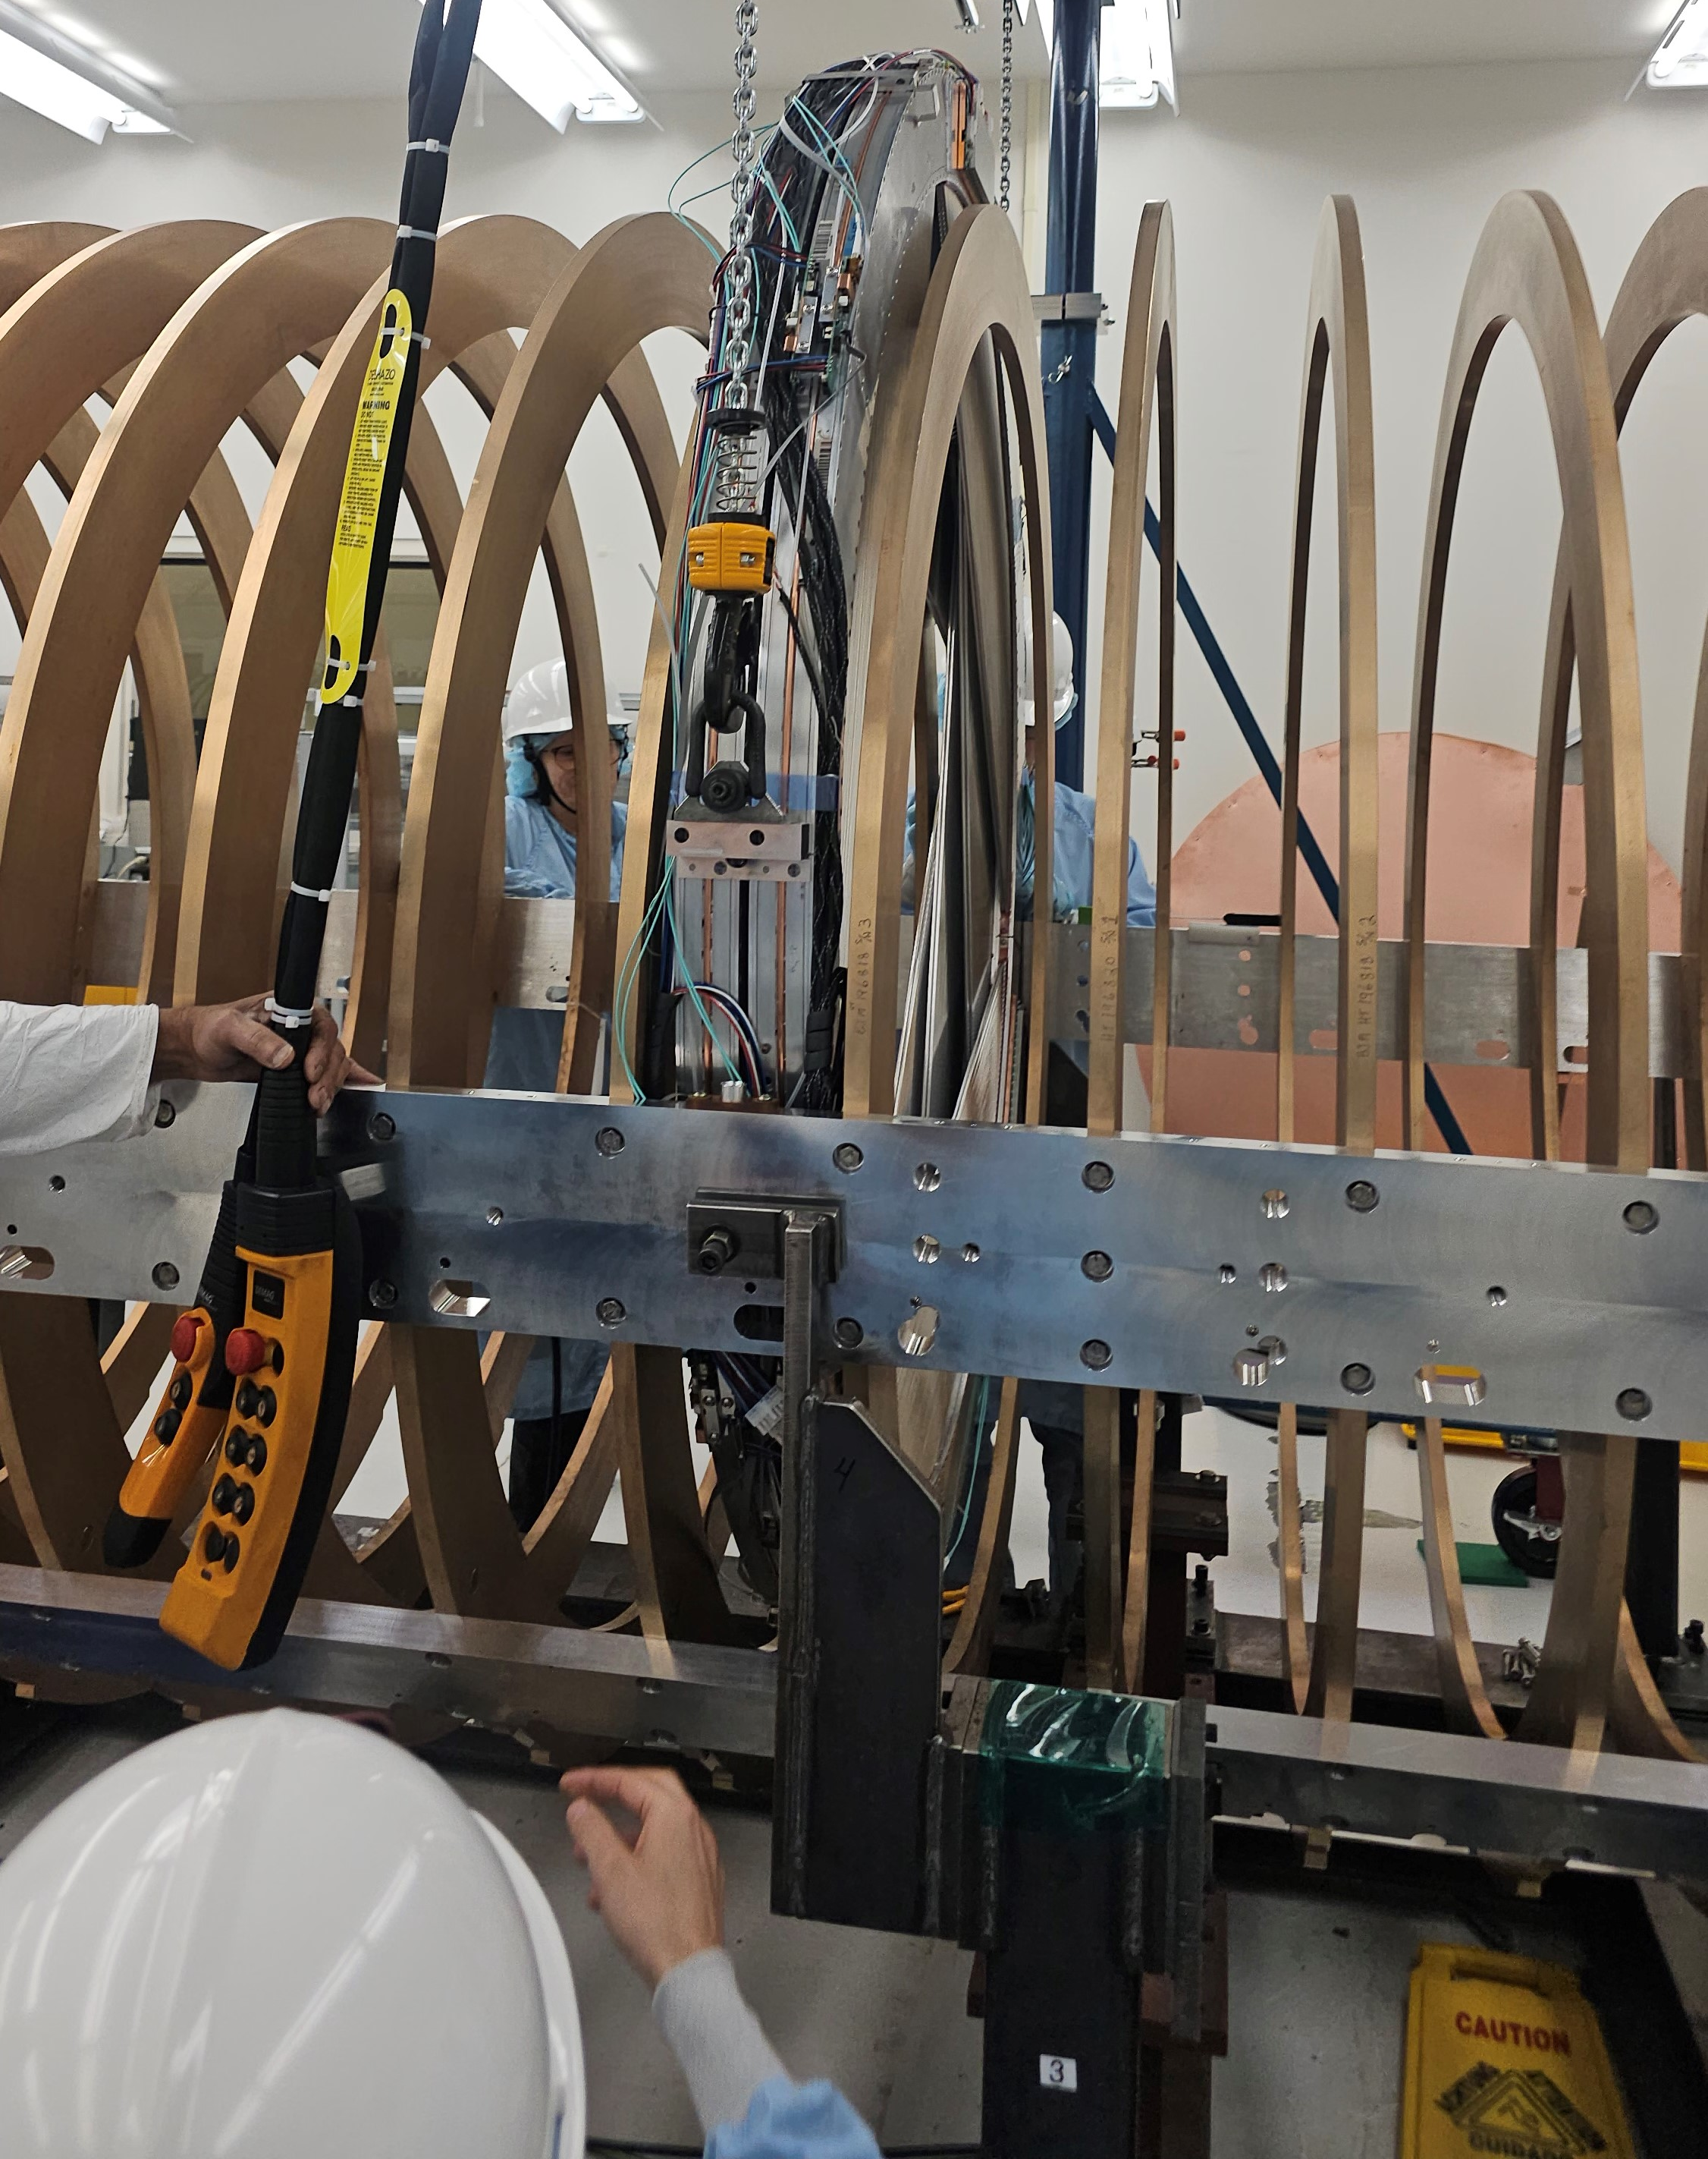
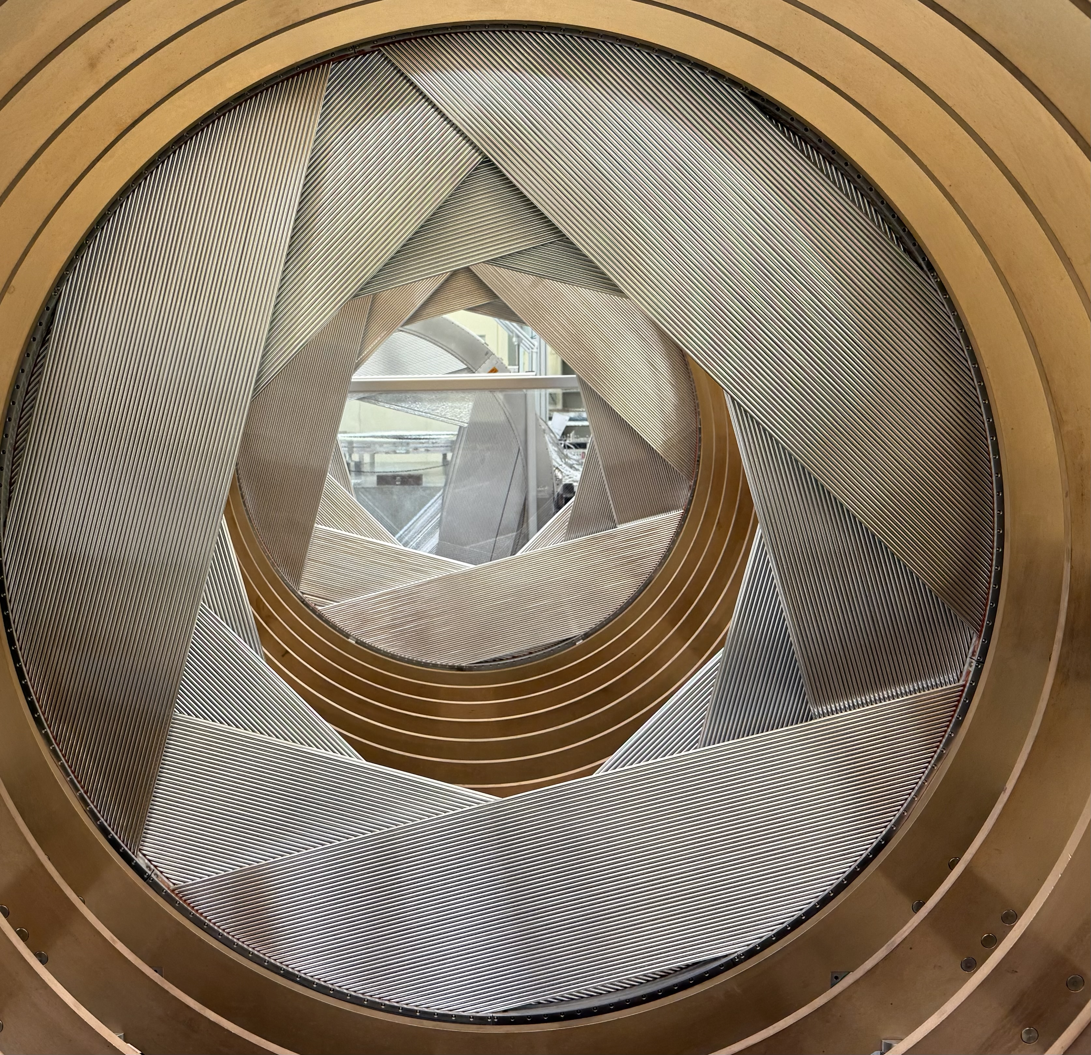
Installing into Frame
1 of 18 (6%)
Expected Completion September
D.Palo docdb 52882
Lesson learned:
Require many people:
1 Crane operator, 1x2 landing each arm, 1 watching level, 1 watching the bottom pin…
Ideally not as many people needed in future
Did not have check-valve clamp for holding cables/fibers at arms
Hopefully goes smoother with this (next week).. Need to work on this procedure
Installation of first production station into frame
2 stations (1 production, 1 Train Station) installed into frame

Slide 16
Tracker Production Time Frame
B.Kiburg docdb 52876

Slide 17
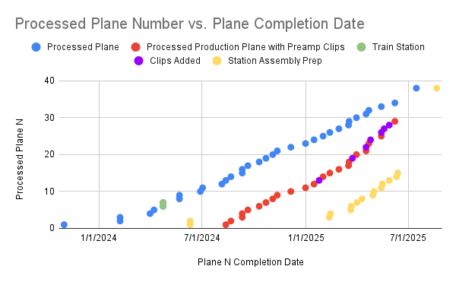
Tracker Production Time Frame
B.Kiburg docdb 52876
Strong steady progress, doing many things in parallel
Addressed many of the known, troublesome planes
Need to wrap up loose ends, enter production mode on station cabling and installation

Slide 18
Tracker Measurements
HV Onset of gain test on Planes
Leak Rates
Gas Check Valves
Station Metrology
Station taking data and Noise measurements

Slide 19
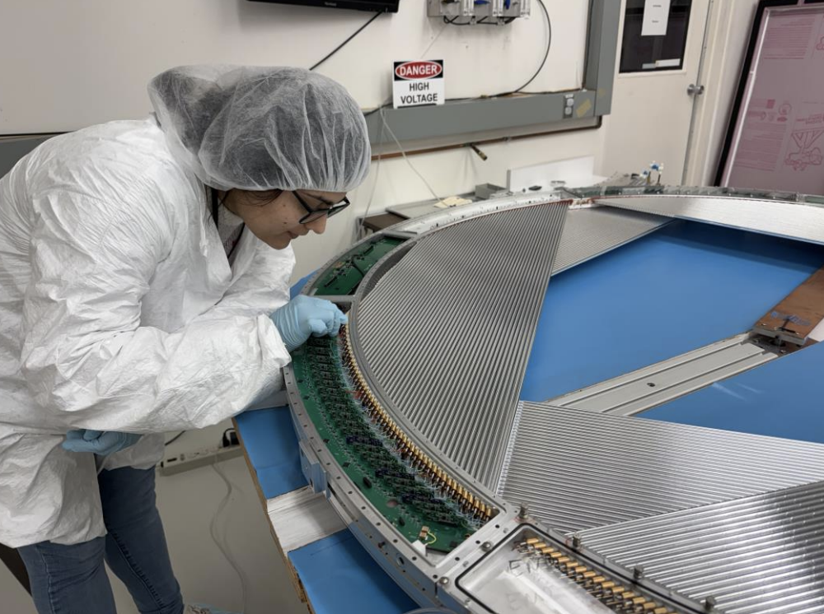
Plane HV/Scanning and onset of gain measurement
Fe 55 source emits xrays, creates signal in straws and read out through ear card.
Used to identify:
Blocked straws
Short/broken wires
High current wires
Ear card issues
Failure has on occasion led panel replacement required
Completed final 3 planes!
Mamta connecting cramps to a plane for HV scanning

Slide 20
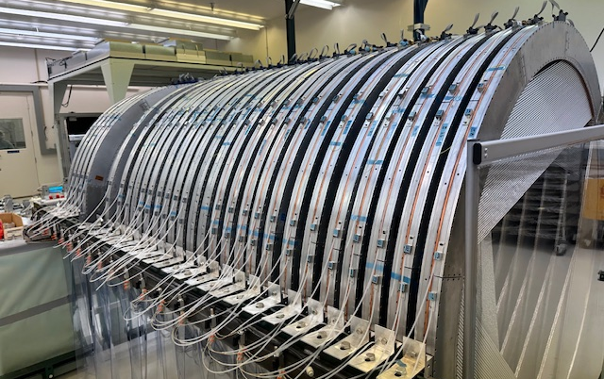
Leak Rates
Long term leak test has been running for over 2 years.
This will be wrapping up this summer as all planes go into stations.
Lose the ability to continuously monitor panel leak rate.
Leak rate has increased in the last 3 months by 10 sccm to 63.49 sccm.
59.2 sccm is from 3 panels.
Current plan is to fix these panels at hospital after tracker moves if time, else shut them down for initial run.
Large leaks (sccm)
Mar 25
Jun 25
44.0 | 44.0
6.2 | 7.8
0.6 | 7.4
 | 0.8
 | 0.11
 | 0.06
New leaks
Big leaks are on 4 planes

Slide 21
Tracker Future Leak Tests
Leak test prior and post station production.
Post station production is with final gas line terminations and HV plugs.
No leaks observed after station production, but a leaky HV plug was identified.
2 stations have been tested in a horizontal position
Developing plan to test stations in vertical for future checks in frame.

Slide 22
Check valves – Leak rates
Pressure (panel)
Lower pressure (exhaust)
Previous tests done on prototypes showed leak rates < 0.005 sccm per valve
New tests yielded leak rates up to 0.5 sccm per valve
Difference between tests and production:
O-rings and balls were not baked at 200 C after cleaning during tests
O-ring batch is different
Geometry of the valve (only non-critical dimensions)
Flammable gas sniffing shows a leak rate dominated by the main seal, not the radial seals
Visual inspection of o-rings and balls showed:
O-ring surface defects (rough patches)
Some scratches on glass balls
Pressure (panel)
Vacuum (DS)
Vacuum (DS)
Supply
Exhaust

Slide 23
Gas check valves and Leak Rates
Unfortunately, the type of o-ring used now has defects directly from the supplier (no specs on surface quality). We just got lucky during the tests
A new batch of o-rings is being purchased
Better Viton compound
Better surface quality specifications
Better Viton compound will make baking unnecessary. Any curing (for dry lubricant coating) is now performed at 150 C
This setback isn’t prevented us from making check valve blocks, only the bushings
However, we can’t install the bushings with the blocks already on the side of stations
So the check valves blocks must be mounted on stations after fixing the leak issues

Slide 24
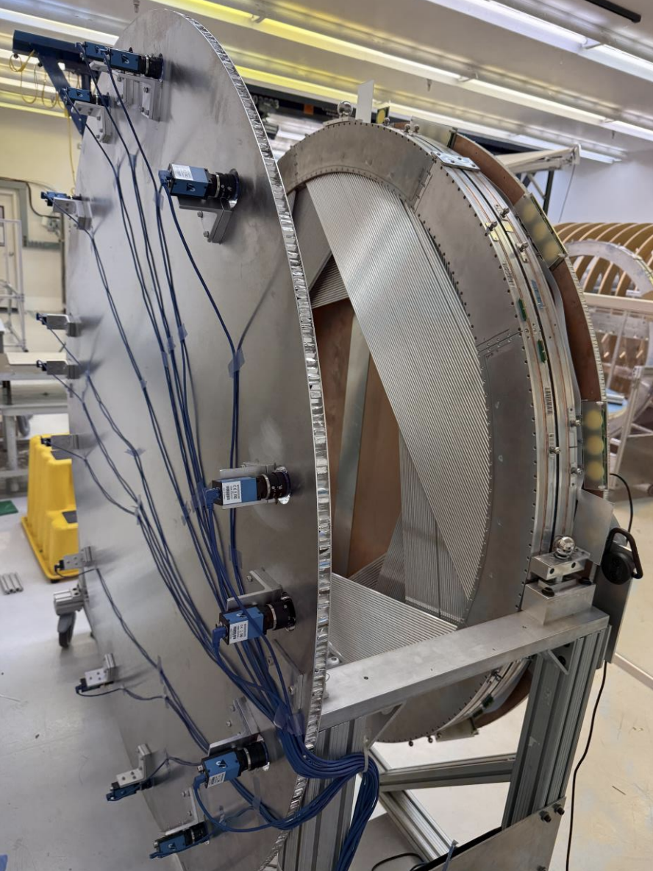
Station Metrology
Metrology data for all 5 production stations
Comparison with the Duke data are comparable to station 0 (last collab meeting): χ2/DOF ~1 with σ~100μm. One panel (1/60) had large discrepancy (length differences all are ~ 400μm)
χ2 is effectively the comparison of the lengths between the fiducials in the metrology stand and measured by Duke..
Improvement from the correction due to the ‘bump’ in the xray scanner.. (Seog)
Transform the data in the metrology stand to the tracker frame using frame CMM data + laser tracker data
Since the stations are in a kinematic mount, this is a perfectly defined transformation (ball: XYZ,V: YZ,Slot Z; fit for 6 parameter transformation)

Slide 25
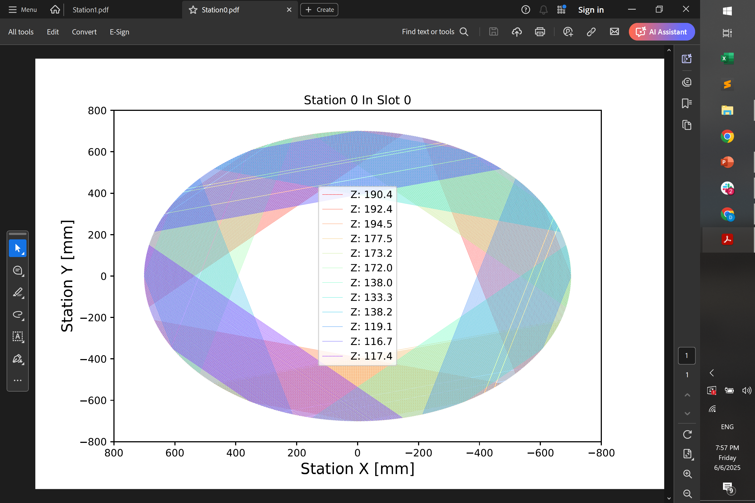
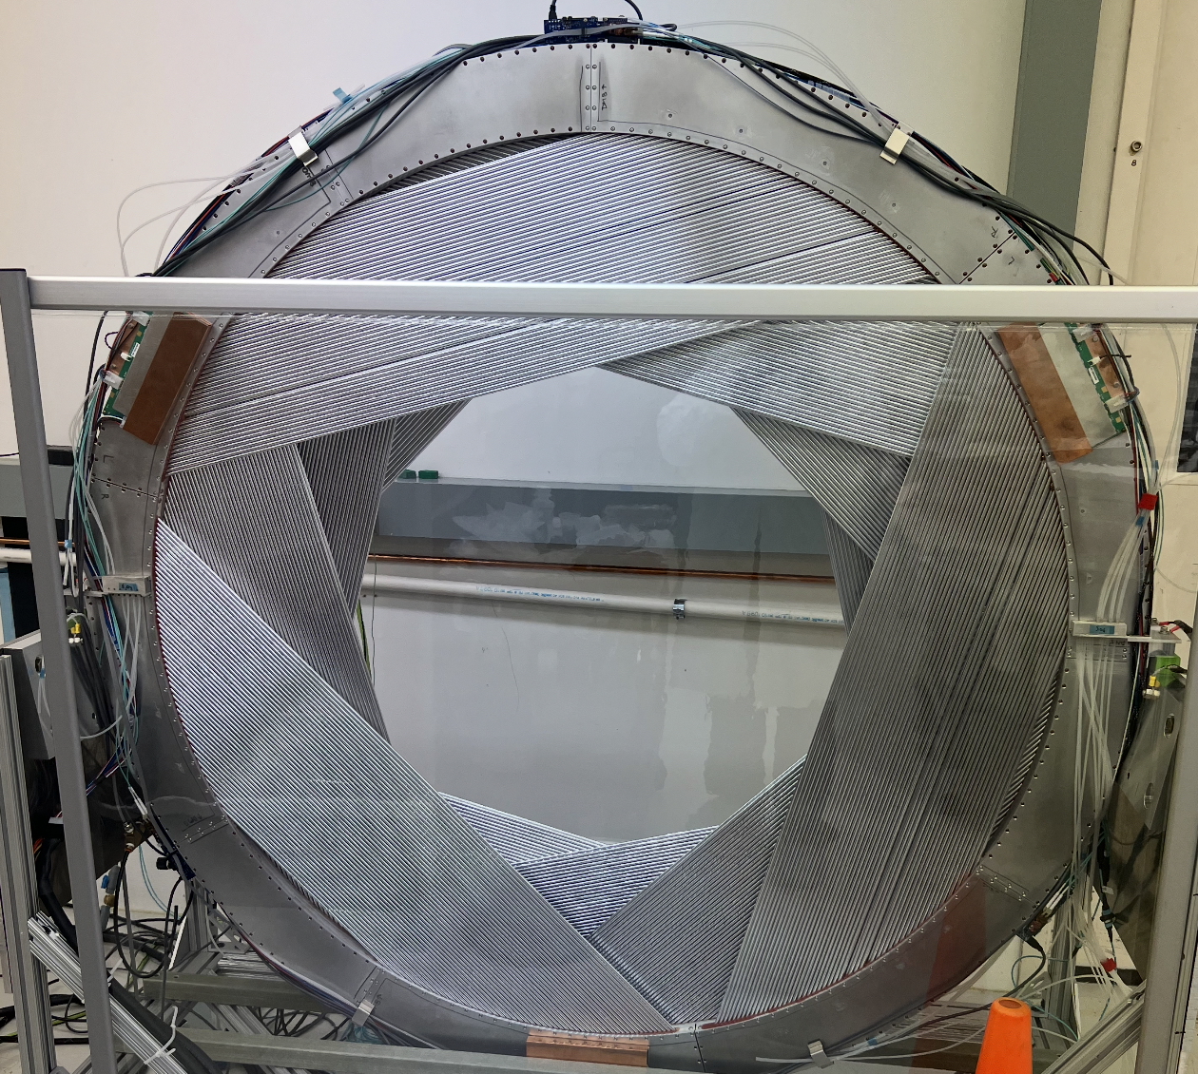
Station Metrology

Slide 26
Station Shift “potato chipping”
Exaggerated cartoon
Laser Tracker
Lifted
On table
After being lifted, it retains the potato chip shape in the vertical
Ends with a shift of ~4 mm from end to end

Slide 27
Potato Chip Deformation In Frame
Arm/Stave Joints
Arm/Stave Joints
Pin/Slot Joint
Pin/Slot Joint
Even/odd stations have opposing deformations in frame
Not a problem, something needed to be accounted for in simulations for expected position of wires and straws.

Slide 28
Station Data Collection
E.Callaghan docdb 52963
Taken together: cannot run with 100% livetime
One solution is sparse EW trains: N events followed by deadtime
Another solution is online filtering, e.g. discard noise-only events
But: filtering itself saturates at∼3 kHz
So to process high rates, need multiple parallel filter processes
Last file of run is not closed, and we lose associated data
“Generally speaking,” we have stable data-taking
Data flows through artdaq and makes it to disk
And can be deserialized and analyzed w/ standard Offline s.w.
The caveats
Finite per-event buffers on frontend
Upper limit on event length, depends on rate (right now, dom. by
noise)
artdaq cannot write arbitrarily-high rate of events to disk
Upper limit on event rate of∼3 kHz

Slide 29
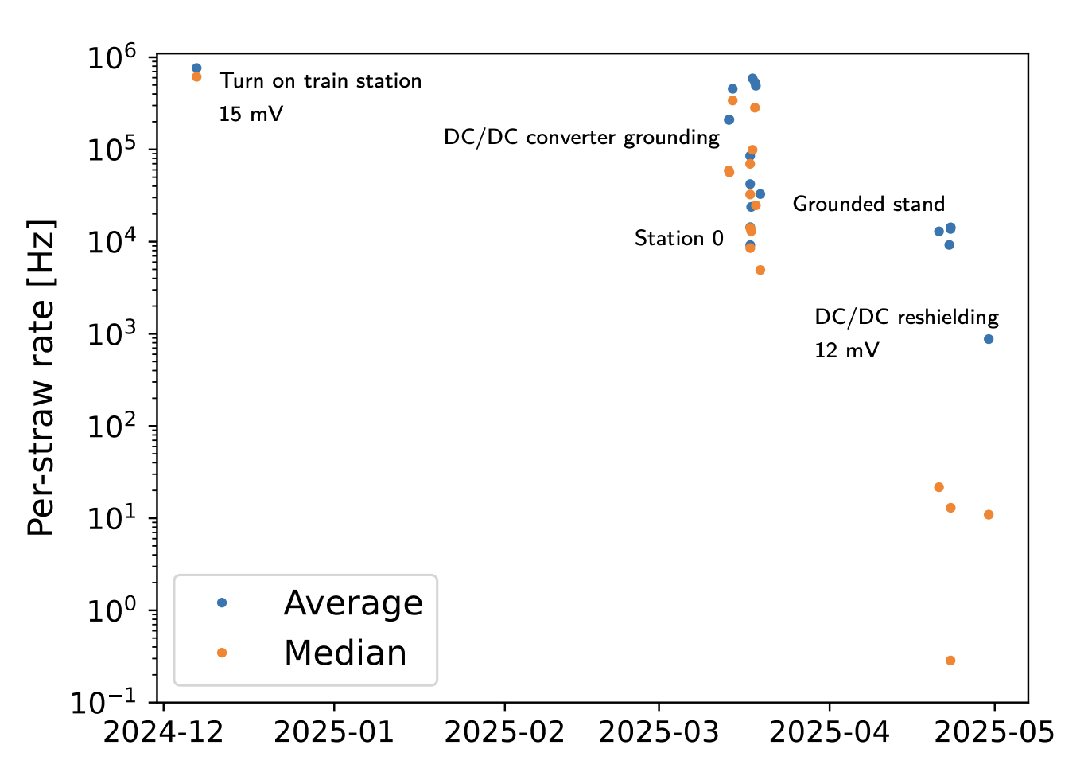
Station Noise History
E.Callaghan docdb 52963

Slide 30
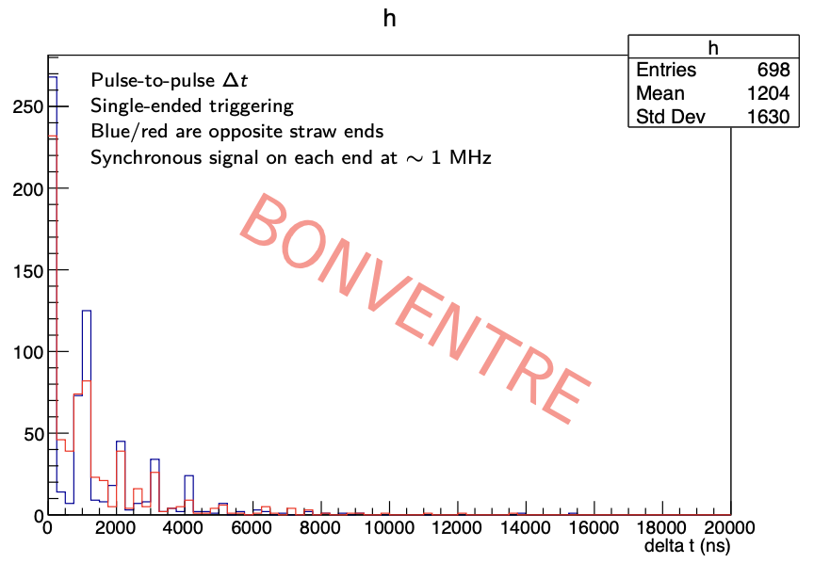
But: straw ends are individually triggering much faster, out-of-phase
So doesn’t clog readout
But does jeopardize time measurement
E.Callaghan docdb 52963

Slide 31
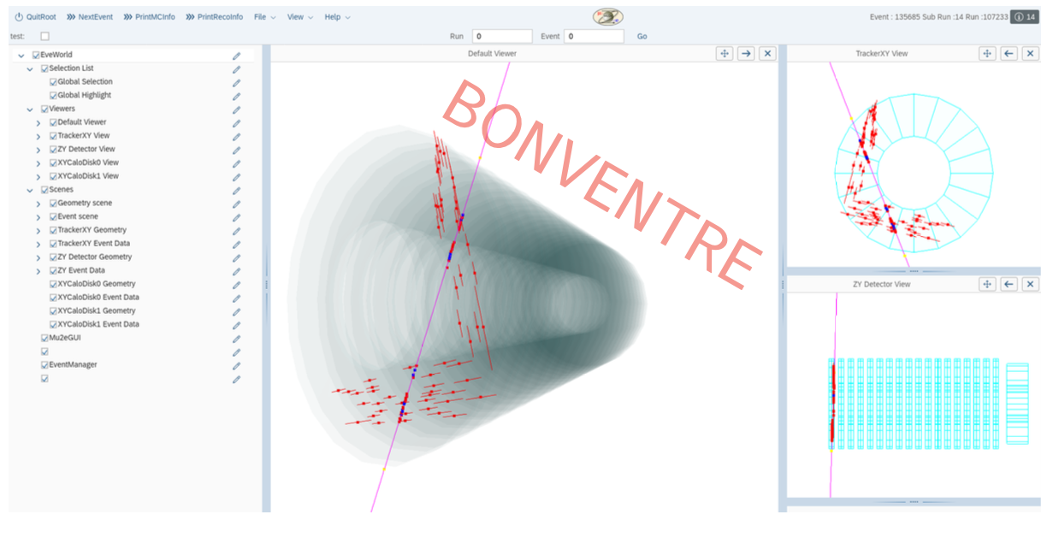
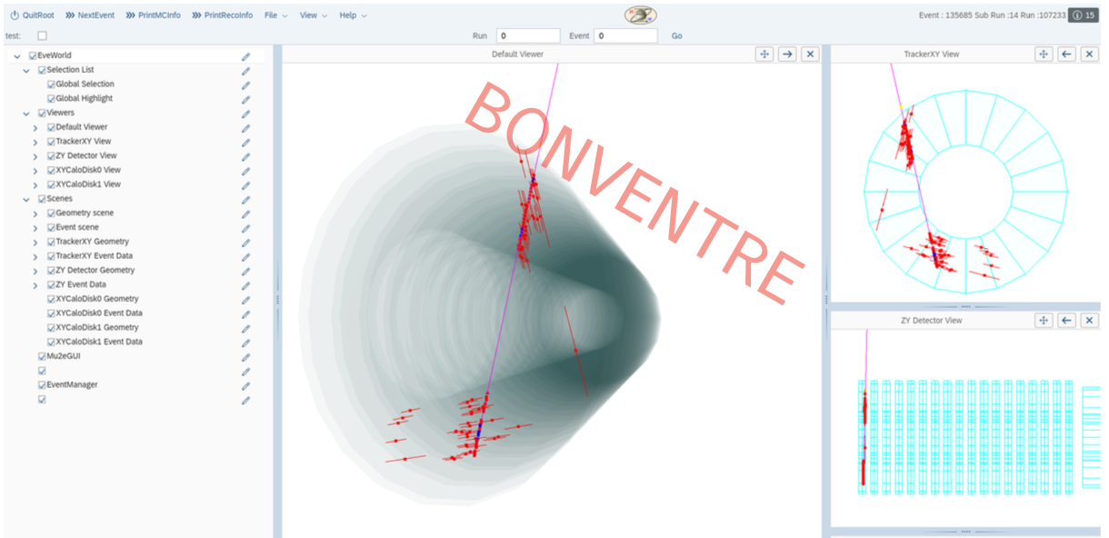
Station Data Collection
Before Calibration
E.Callaghan docdb 52963
After Calibration

Slide 32
Station Data Collection
E.Callaghan docdb 52963

Slide 33
Summary
Production :
Substantial progress made building the tracker
Each step has been done in the building process, now we need to complete it.
Many large milestones to be reached this summer and fall
Electronics fully installed in July
Stations fully built in August
Stations fully cabled and installed in Frame in September
Tracker moving into Mu2e Hall in October
Measurements :
Continue to manage and assess the leak rate in panels and components
Metrology measurements give us a precise starting point for placing wires and straws into our simulations.
Lots of great work collecting cosmic runs from a station and significantly reducing noise.

