Slide 1
Solenoids Report
June 13, 2025
Andy Hocker
Mu2e Level 2 Manager for Solenoids

Slide 2
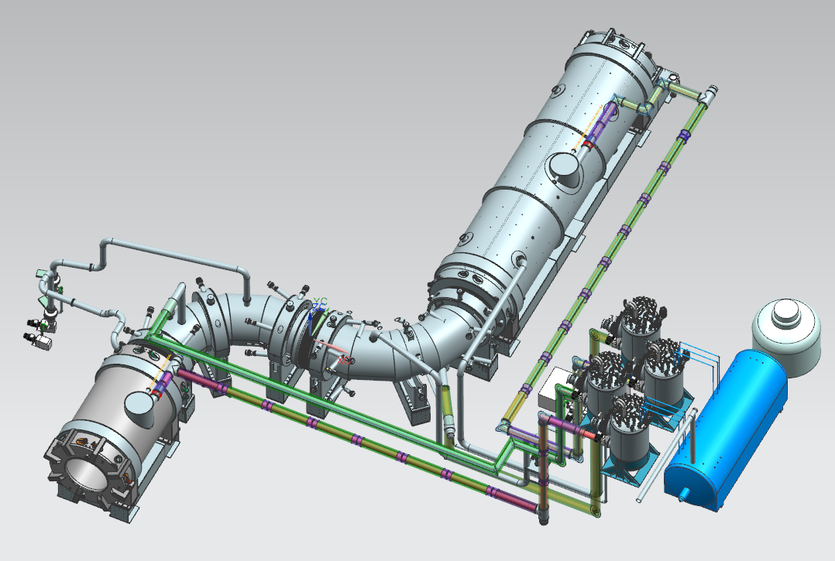
Mu2e Solenoid Project Scope
Production Solenoid (PS)
Transport Solenoid (TSu,TSd)
Detector Solenoid (DS)
Cryogenic Distribution
DONE
Quench Protection/Slow Monitoring
Power Supplies
Field Mapping
Ancillary Equipment
Installation/Commissioning
DS
DONE
DONE
DONE
TSu
TSd
PS

Slide 3
Production Solenoid

Slide 4
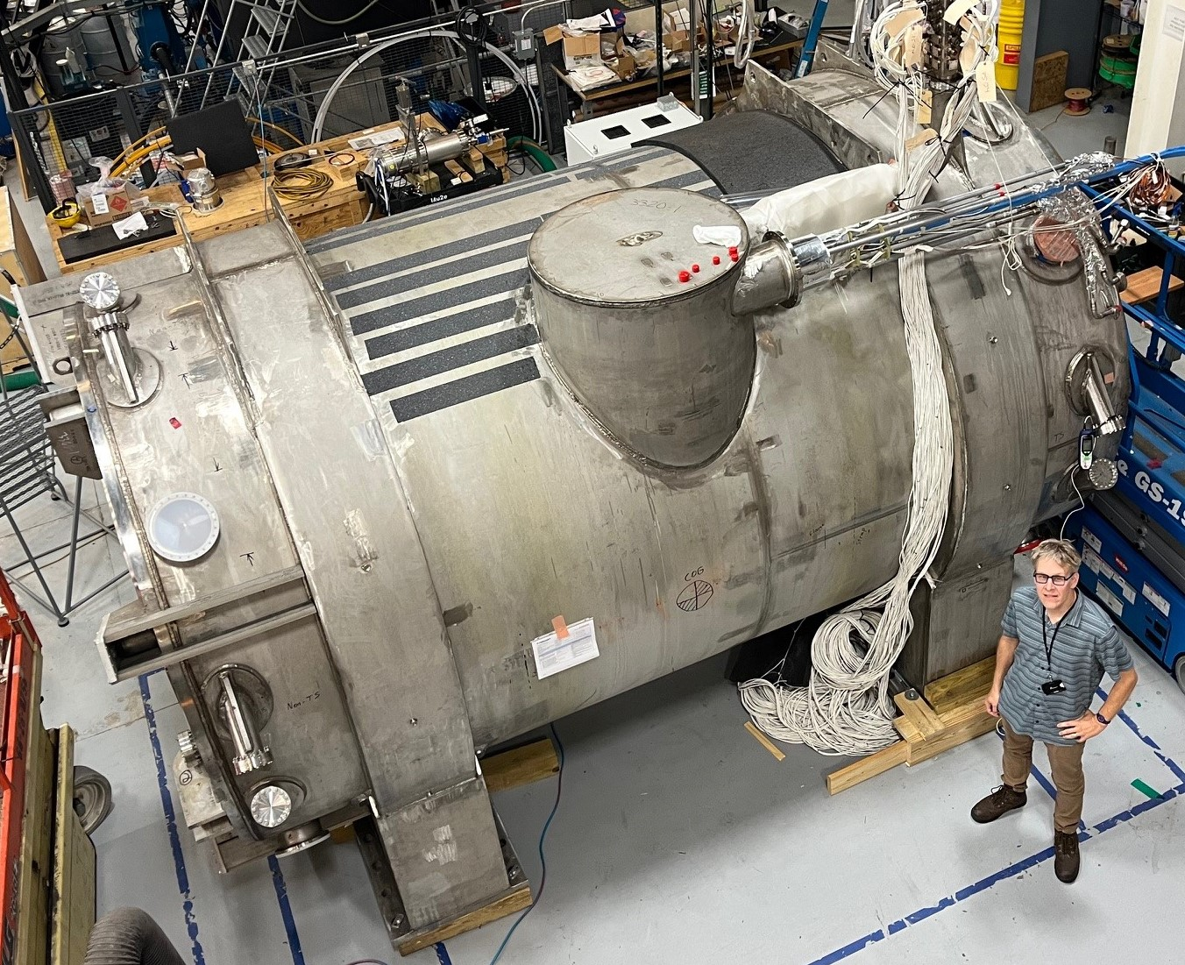
Production Solenoid (PS)
Since last collaboration meeting
Completed studies of leak in inner thermal shield nitrogen circuit
DocDB 52243 (and following slides)
Reviewed our conclusions with an external panel of SMEs
Concurred that getting the PS here ASAP was the best course of action
Authorized vendor to ship
Delivery date TBD

Slide 5
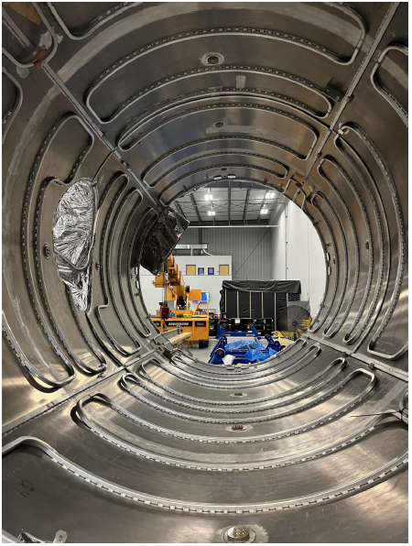
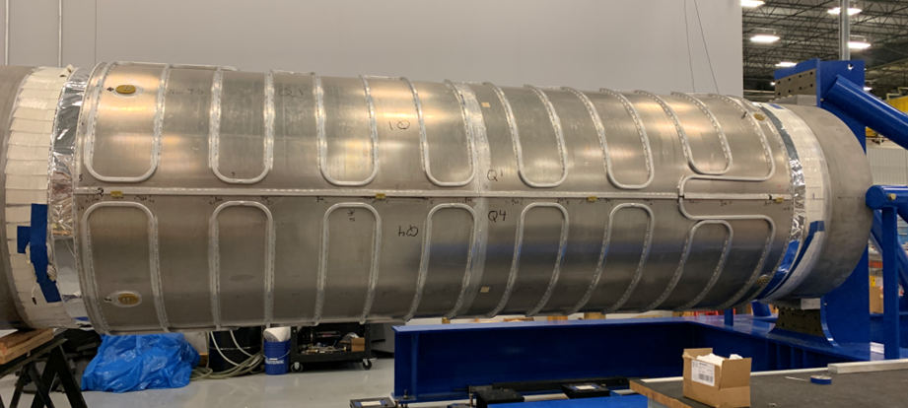
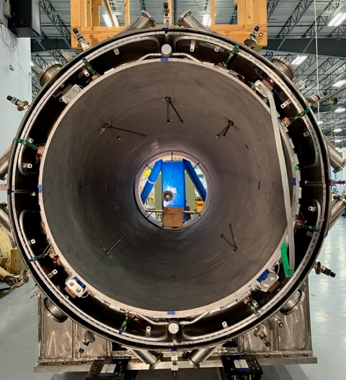
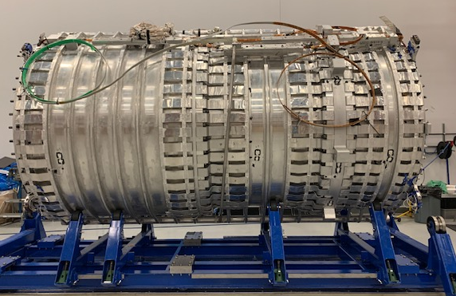
Anatomy of the PS
Inner bore and inner thermal shield
Muon Beamline vacuum space
Outer thermal shield
PS1
PS2
PS3
Insulating vacuum space
Cold mass

Slide 6
PS leak conclusions
Had vendor measure leak rate three different ways, all resulted in an expected nitrogen accumulation of a few tens of grams per year
Independent calculations by vendor agreed with ours
This nitrogen will likely freeze out on nearby 4.5 K surfaces (aka cryopumping)
An accumulation of a 50 micron thick layer over 1 m² in a year, negligible effect on heat load
Released as ~1.5 ft³ of gas and easily pumped out during annual PS warm-ups
This is how g-2 dealt with a similar (but 6x larger) leak --- warmed up every three months
Bottom line: this is a manageable leak.

Slide 7
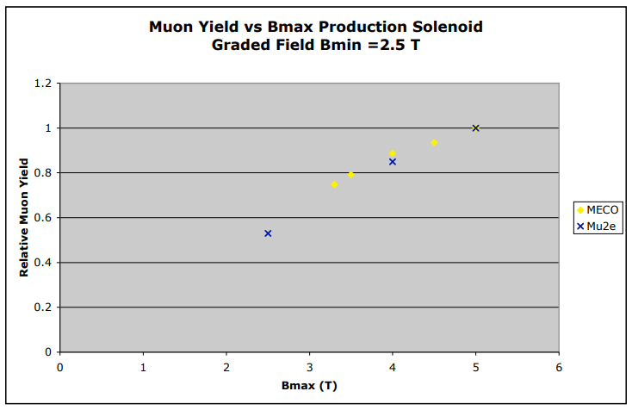
But what if it gets worse
How much worse? Assuming no help from cryopumping, leak starts to overwhelm vacuum pumps when 100-150x larger
Vendor thermal-cycled the inner thermal shield 5 times, saw no evidence of the leak getting worse
Mitigations we can pursue if needed:
More frequent mini-warm-ups (like g-2): costs a couple days of data-taking, coordinate with other sources of down-time
Reduce the nitrogen operating pressure (and hence leak rate)
The failsafe: turn off flow to the inner thermal shield completely
We require the coil to run 1.5 K less than quench temperature (“thermal margin”)
No shield -> coil runs hotter -> eats margin -> need to reduce current by 10% to recover margin
10% less current = 10% less field = 10% less muons
Complication: the transfer line uses this N2 flow too. Currently working this problem
R. Coleman, DocDB 652

Slide 8
PS shipping
Leave vendor in morning
Dummy test last year validated rigging and isolation scheme
Arrive FNAL next morning to allow plenty of time for unloading
See SEP-2024 collab meeting report (DocDB 50536)

Slide 9
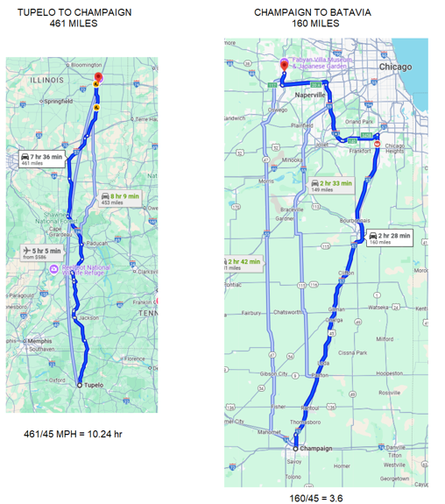
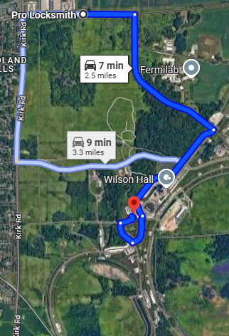
Shipping route
Chase car 1: FNAL
Chase car 2: Vendor engineer
To Mu2e

Slide 10
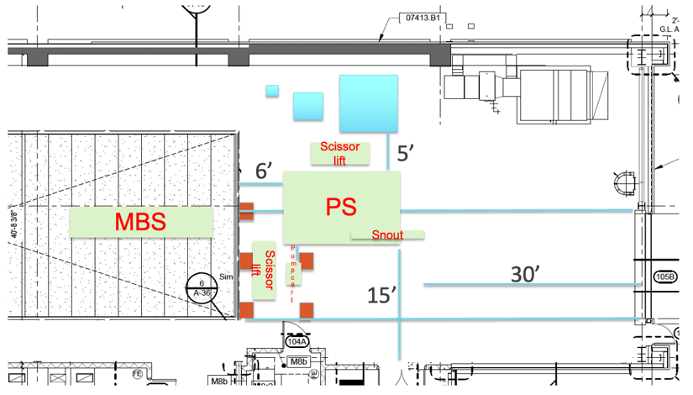
PS incoming inspection
Verify vessel, LHe circuit, outer thermal shield circuit leak-tight
Check that inner thermal shield circuit leak not worse
Electrical checks including hi-pot
Prep for moving downstairs

Slide 11
Detector Solenoid
02

Slide 12
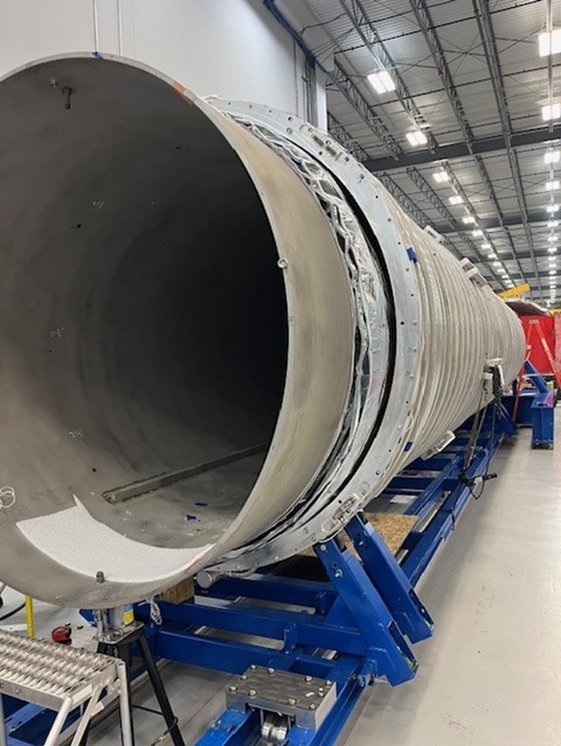
DS progress (1)
Laser survey of cold mass: total length (~10 m) within 0.1 mm of design value
Inner bore/thermal shield inserted into cold mass

Slide 13
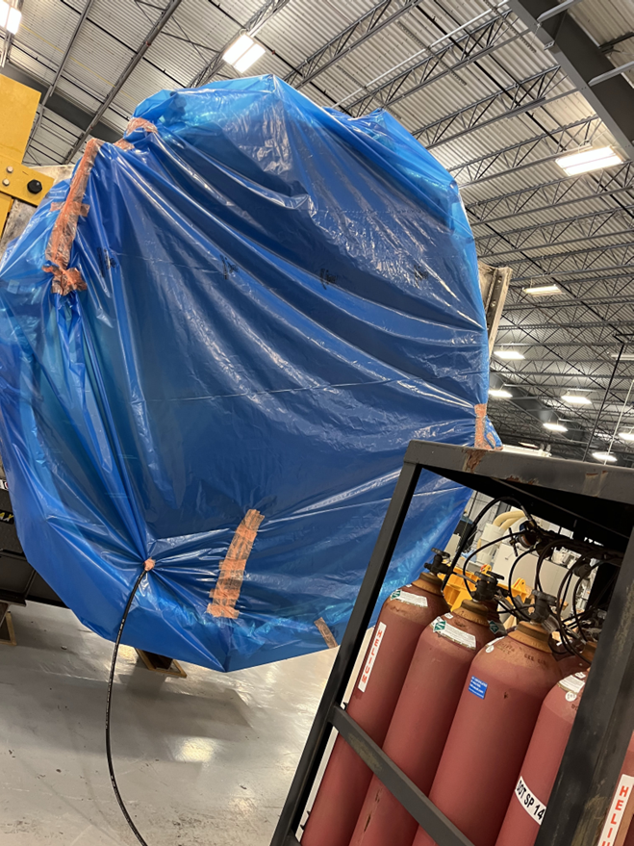
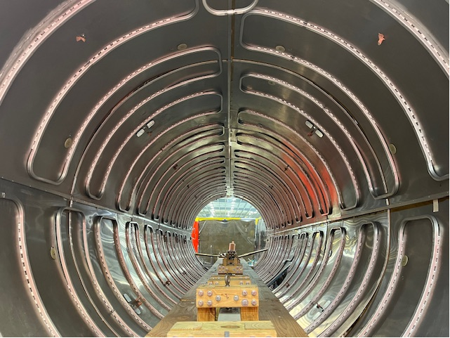
DS progress (2)
“Global” leak check performed on outer thermal shield
Evacuate pipes, flood volume with helium and look for helium in pipes
Supplements targeted leak checks of individual welds

Slide 14
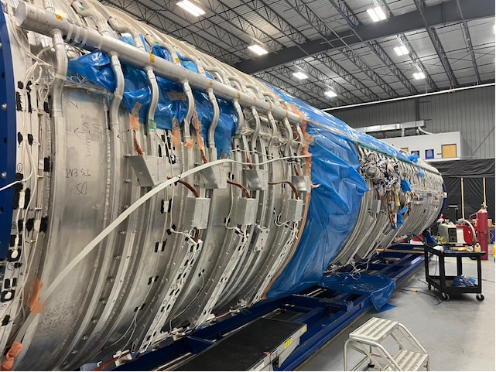
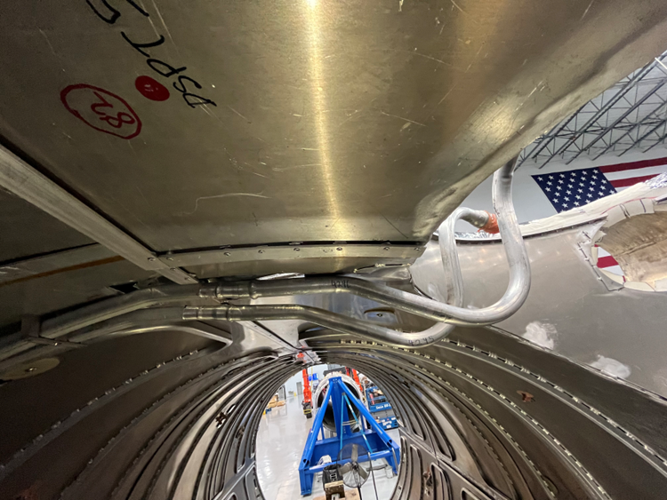
DS progress (3)
LHe manifold
Modify inner thermal shield LN2 transport tubes in chimney region to clear manifolds
This was not easy
Laser survey showed LHe manifolds stick out too far

Slide 15
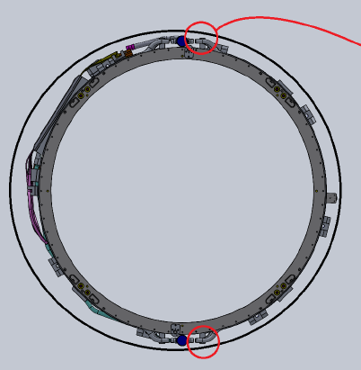
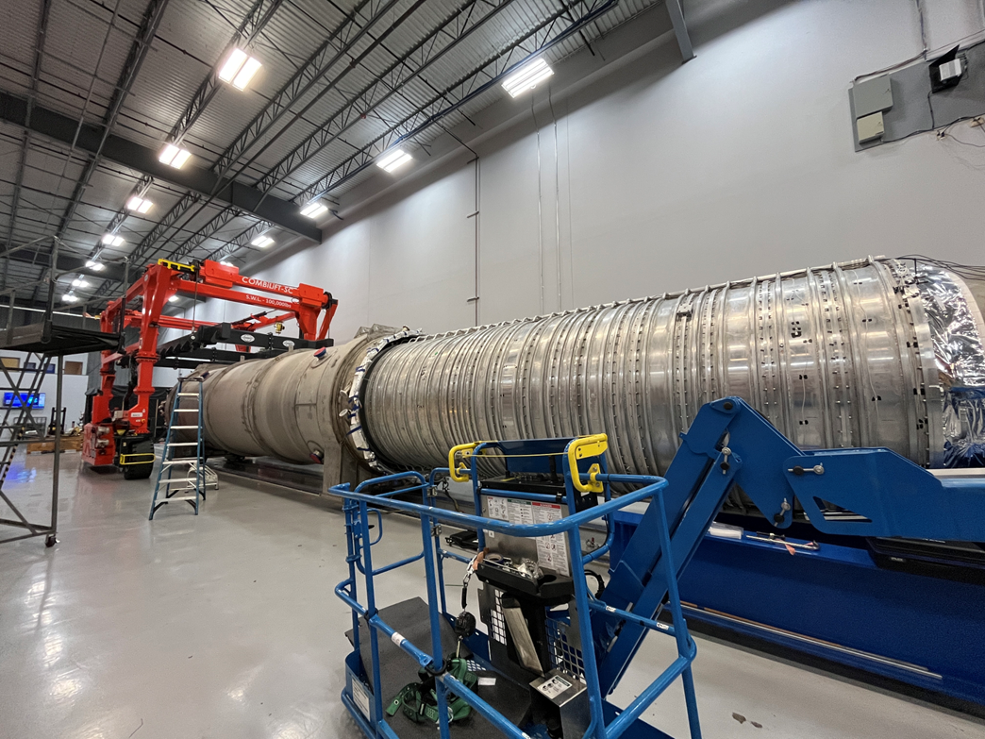
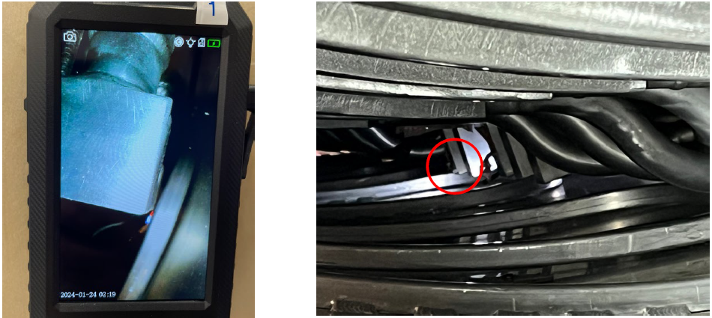
Current state of DS
Cold mass/vacuum vessel insertion “dry run” (no MLI)
Can jockey vessel around to temporarily clear features as the insertion progresses
Reached a limitation at about the halfway point
Will need to shave a few mm from corner of a siphon tube elbow
Could introduce a leak but it would be repairable
These are the things that cause schedule slips
Cold mass
Outer thermal shield

Slide 16
Transport Solenoid
03

Slide 17
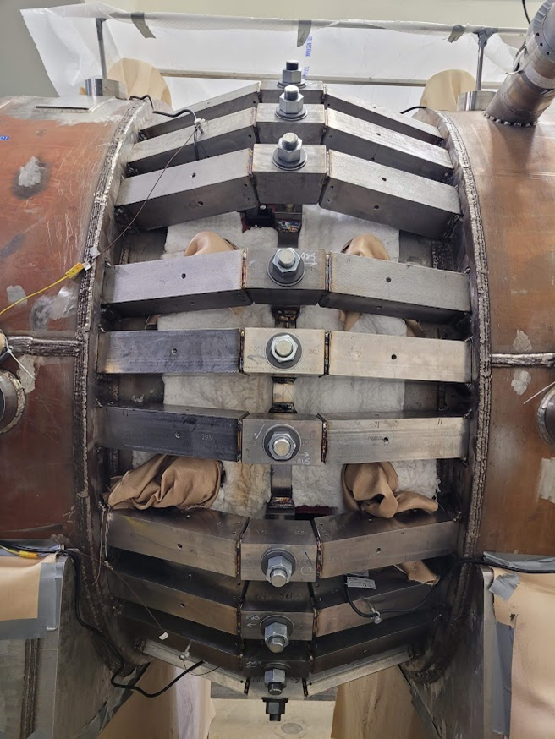
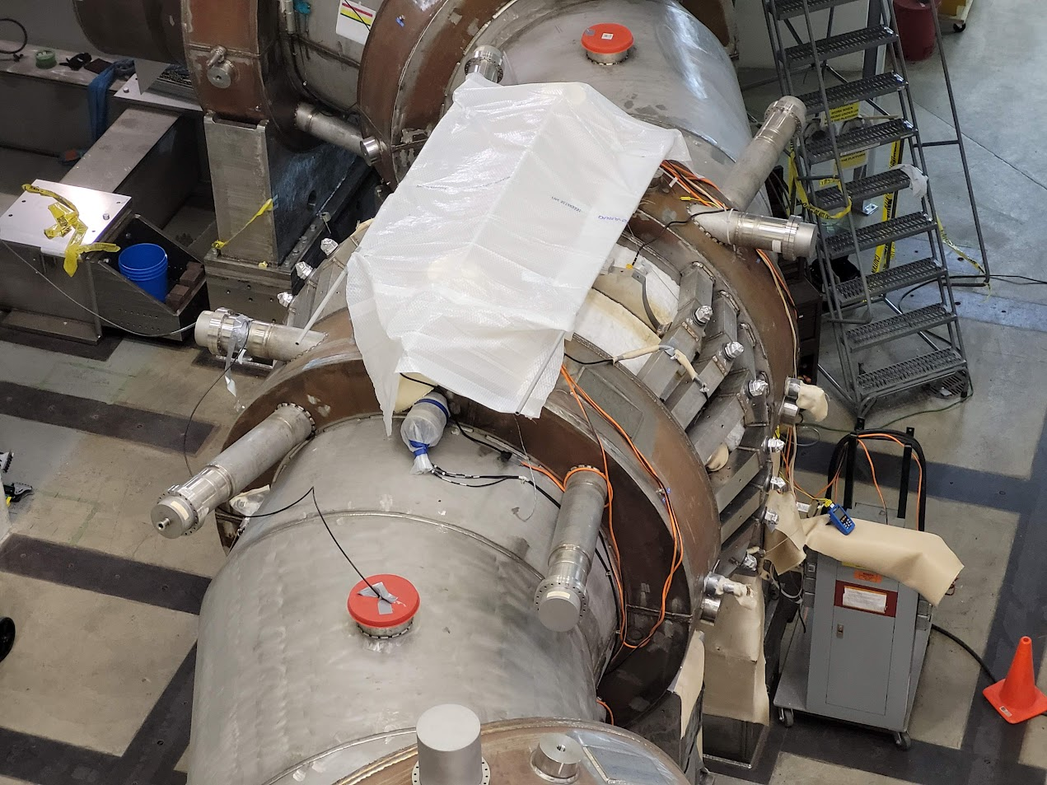
TS status
Currently all about the TSu/TSd interconnect region

Slide 18
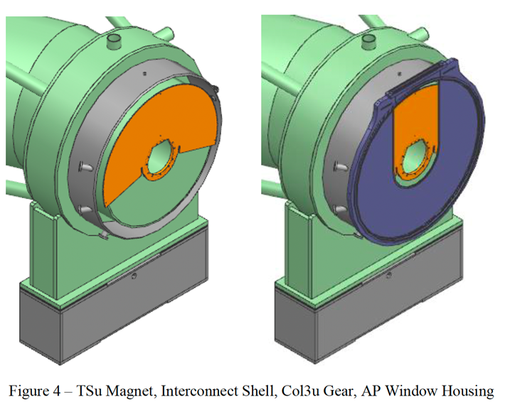
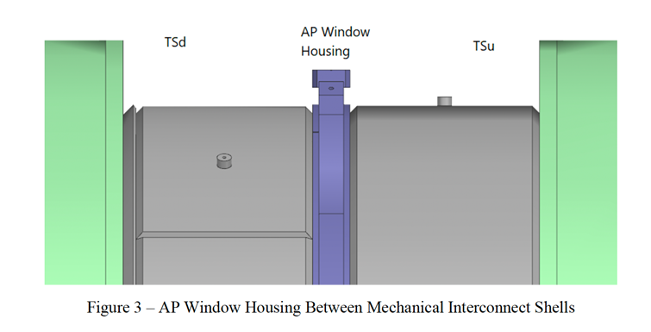
Antiproton window housing issue
Slot for blade
When welding the interconnect shells to the AP window housing, the diameter of the housing shrank and bowed out in the middle
COL3d ring gear can’t rotate
AP window blade (divides US/DS muon beamline vacuum) can’t fit in its slot
New brace system created to fix this
Thanks to Greg Rakness and Jeff Brandt for the following slides

Slide 19
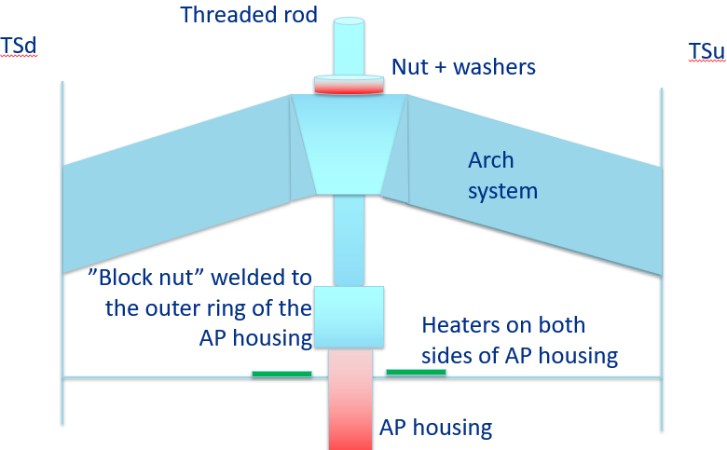
Brace system parts

Slide 20
Expand the housing diameter

Slide 21
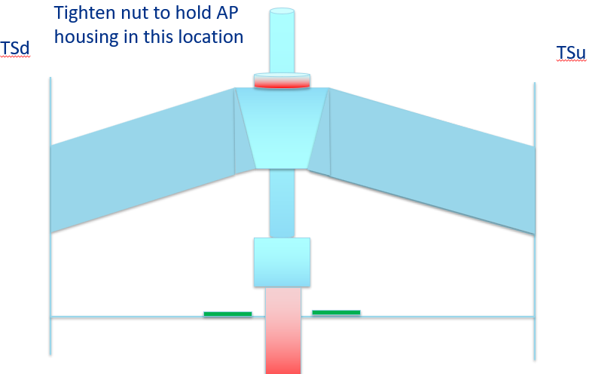
Lock in

Slide 22
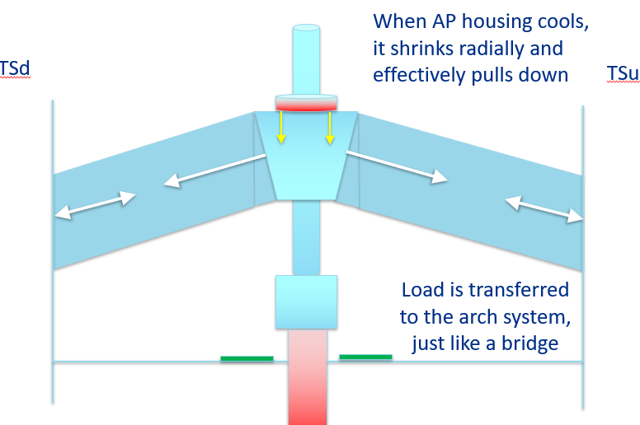
Cool off

Slide 23
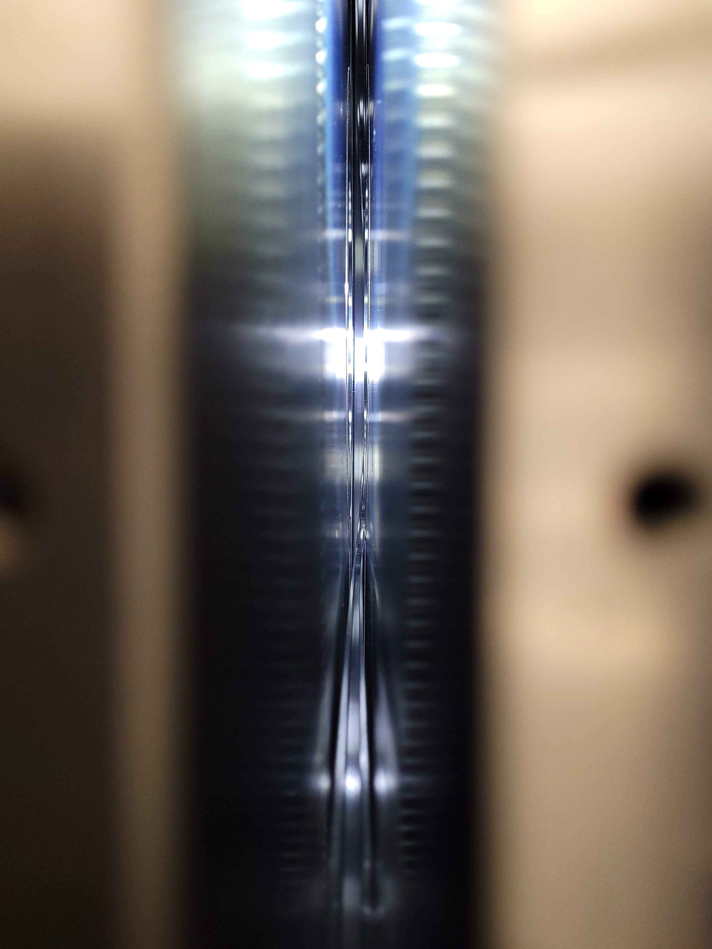
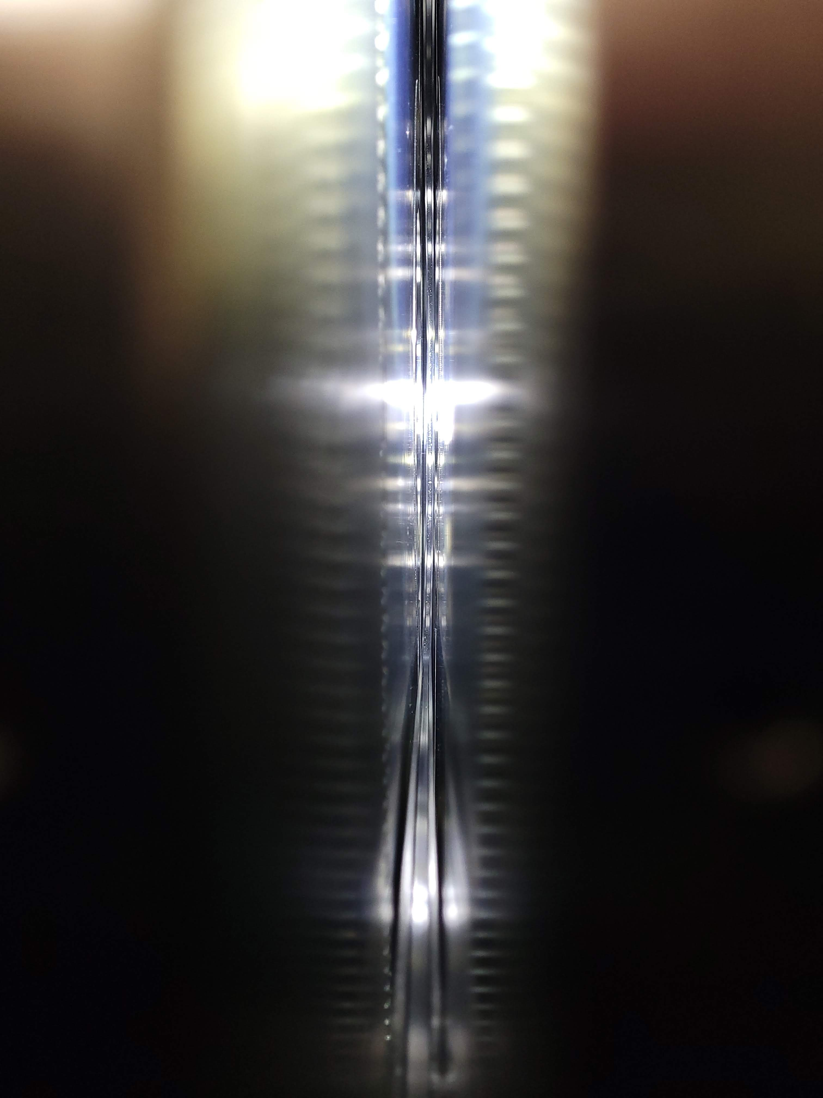
It’s working
You’ll either have to trust me, or do some zooming and panning of these images offline
No braces: housing disappears behind TSd gear
With braces: housing clears TSd gear
Tsu gear
TSd gear
Rotated COL3d about 1/3, felt resistance, work a little more on straightness
housing

Slide 24
Infrastructure etc.
04

Slide 25
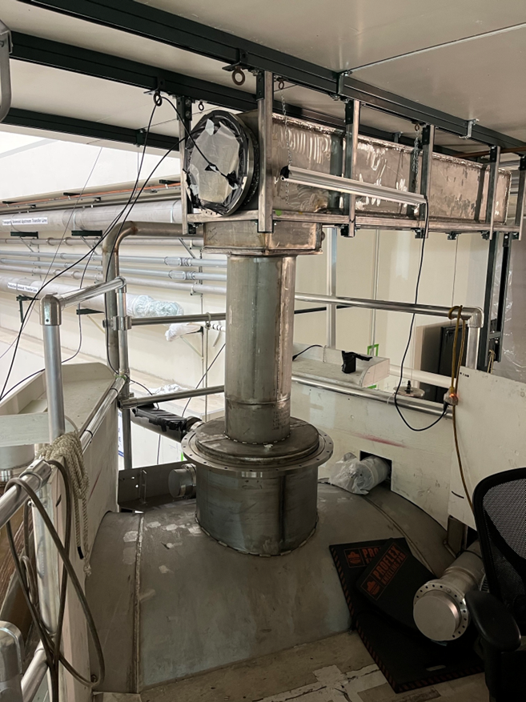
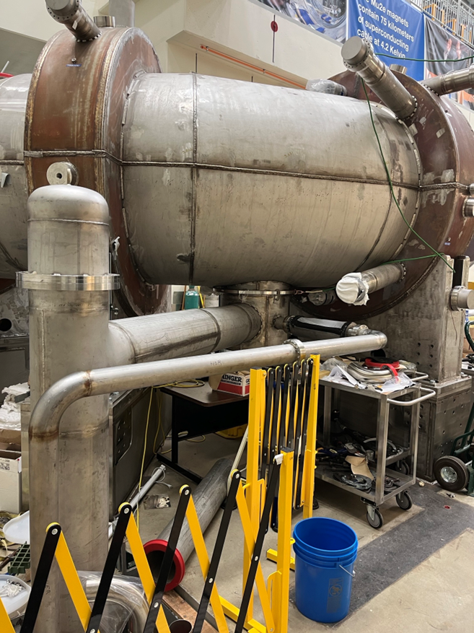
Cryogenic distribution
TSu and TSd cryogenic interconnects are done (magnet-to-transfer line)
Each contains
2x2 LN2 pipes (inner/outer thermal shield, sup/ret)
2x2 LHe pipes (cold mass and bus cooling, sup/ret)
2x2 superconducting leads (main and trim, +/-)
Vacuum instrumentation lines also installed
Glorified conduit for monitoring instrumentation wires (temperatures, strain gauges, etc.)
Wires not yet pulled

Slide 26
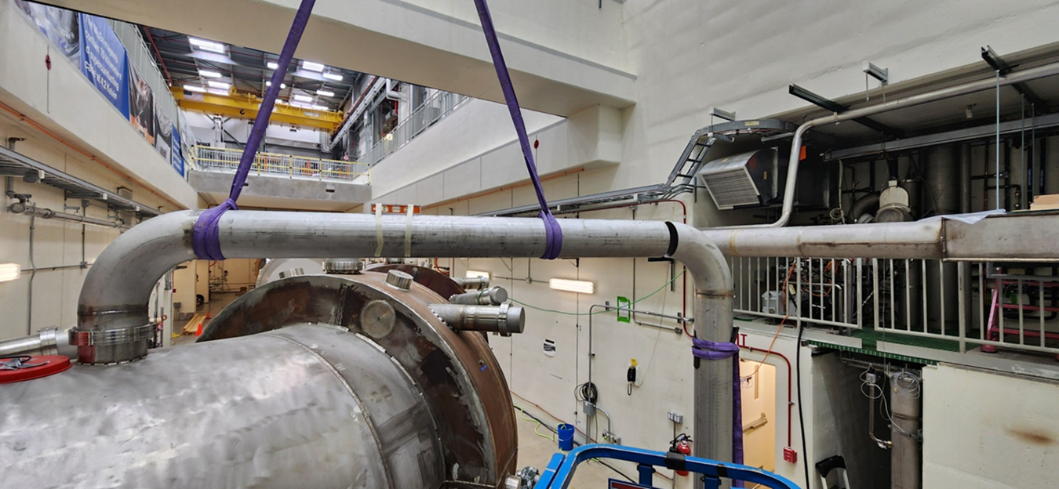
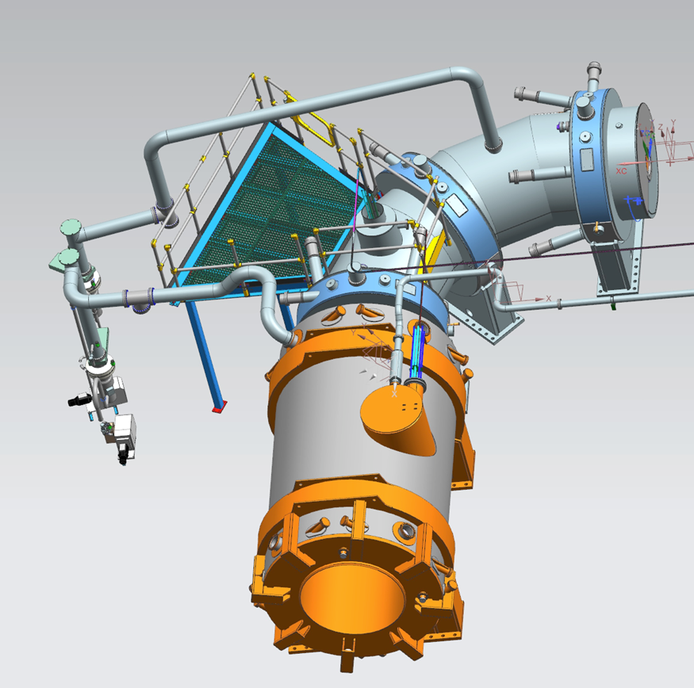
Insulating vacuum pumping line installation
TSu
TSd
The last piece of TS-specific cryo infrastructure
Preliminary system leak-checking to follow

Slide 27
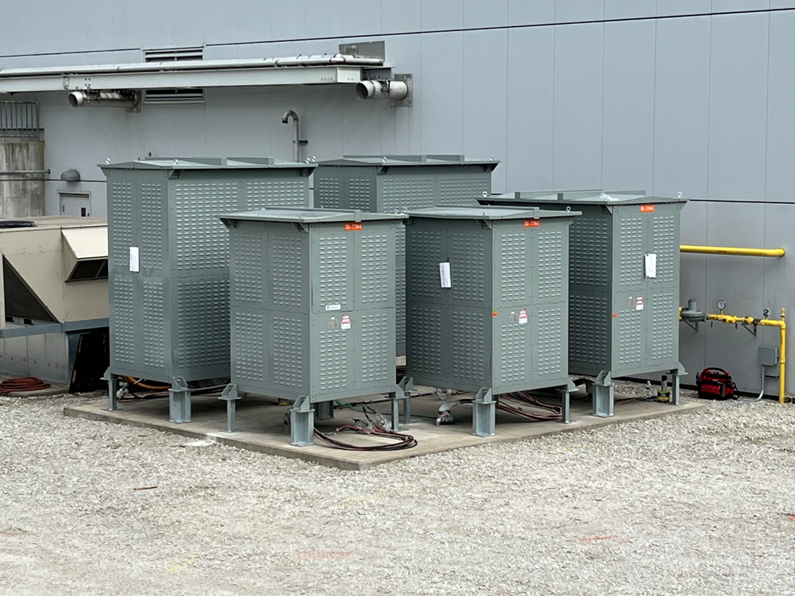
Power supply systems highlights (1)
Dump resistors installed at Mu2e
PS
DS
TSu
TSd

Slide 28
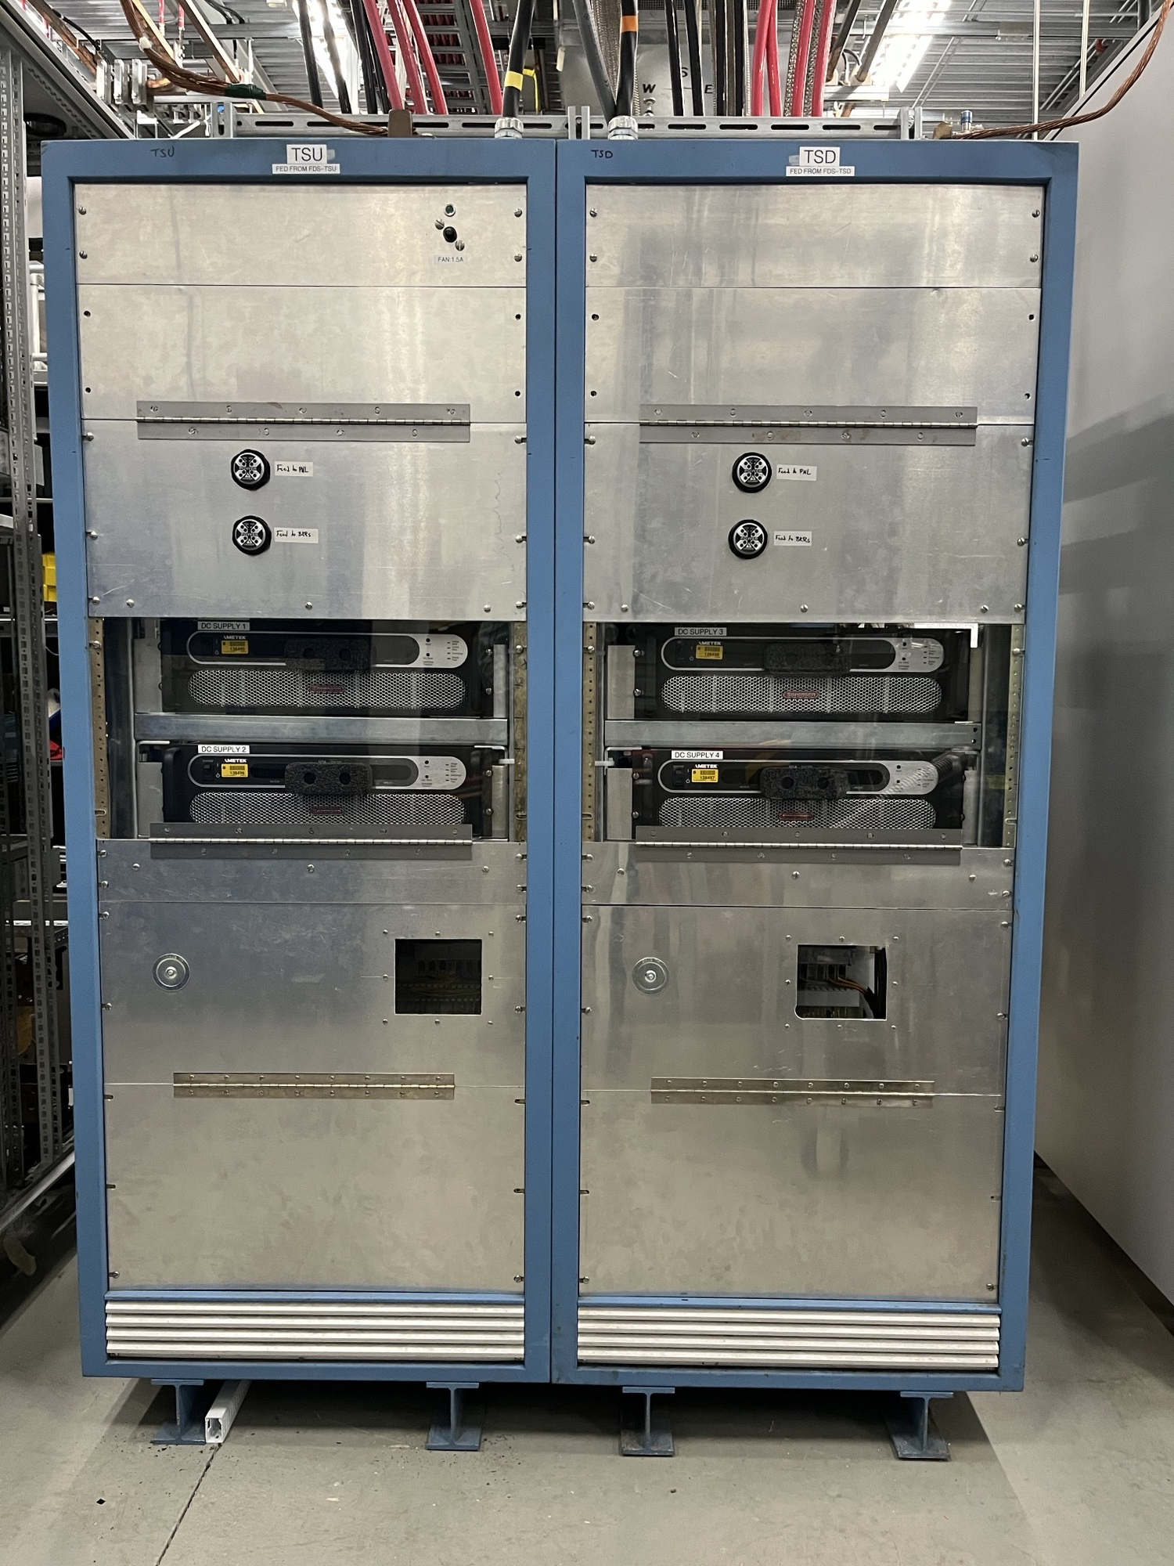
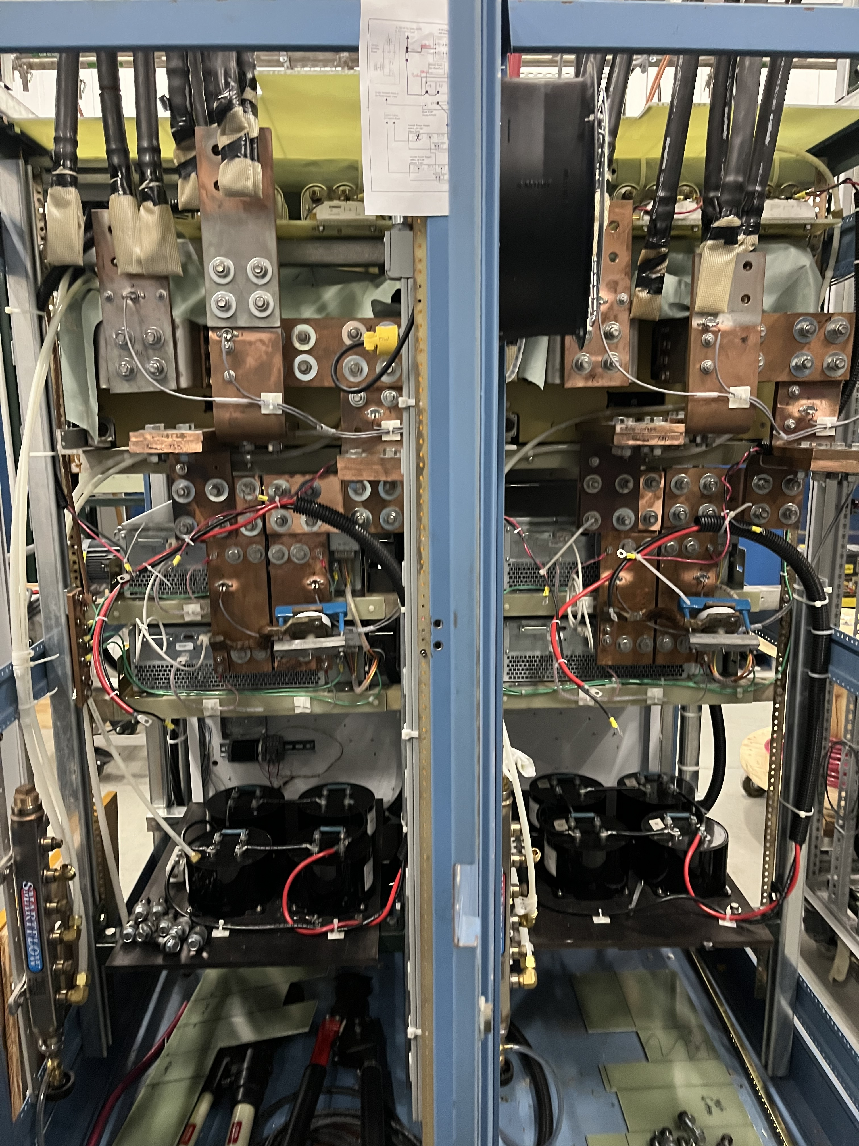
Power supply systems highlights (2)
TS main supply racks complete
Two pairs of 20 V, 1000 A Ametek power supplies donated by g-2
Original plan for repurposed Tevatron electron lens supplies abandoned due to attrition of expertise
About one month away from being technically ready to run power to a shorted bus
front
back

Slide 29
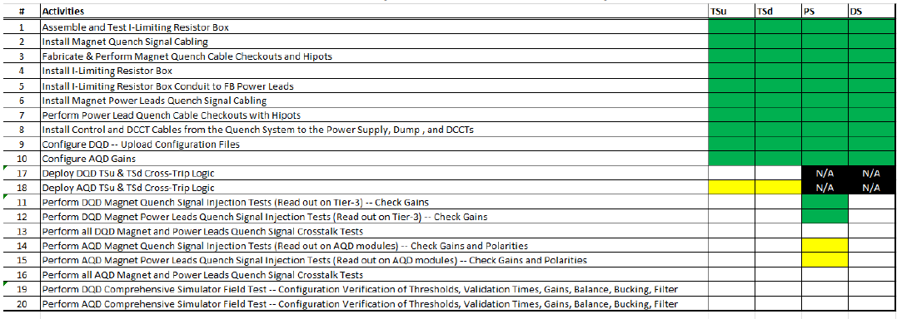
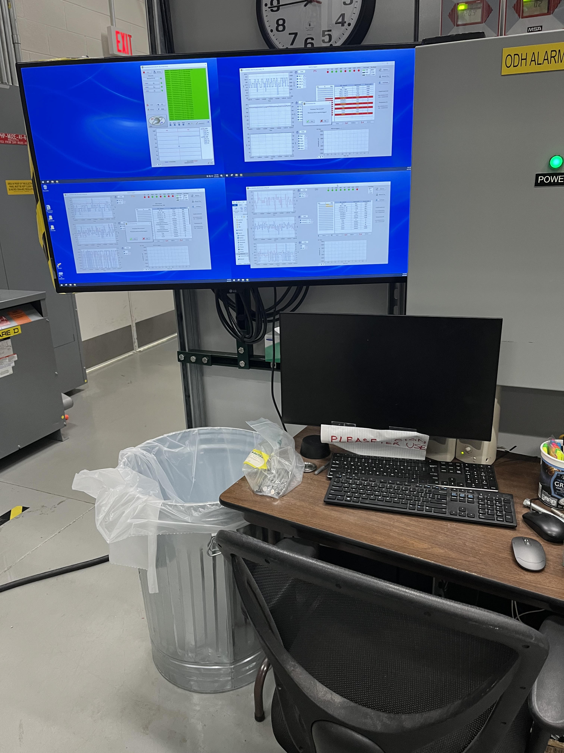
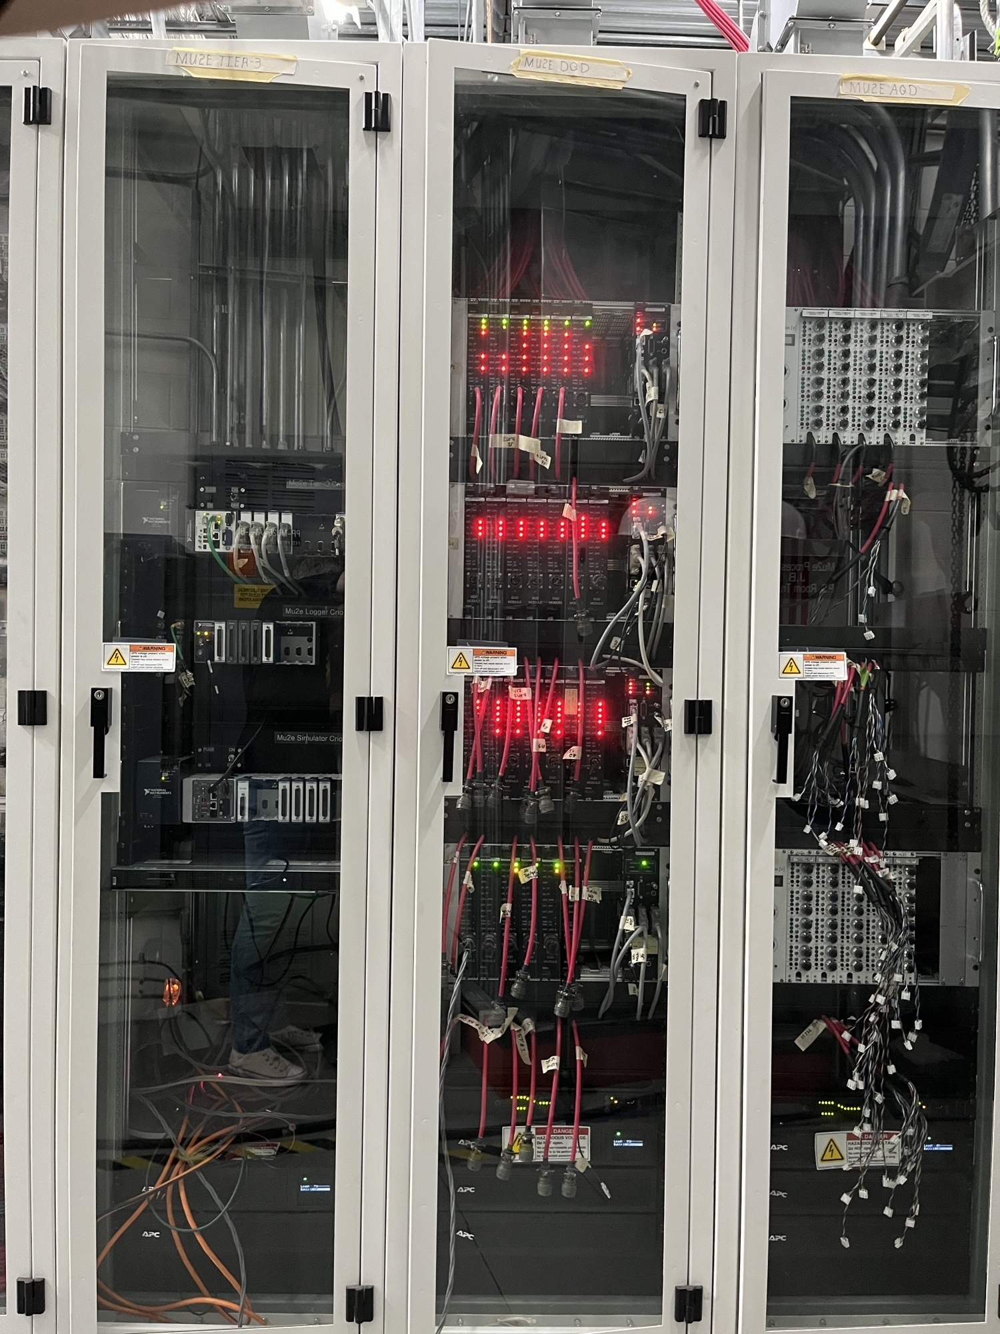
Quench protection system integration
Cabling between QP system and v-tap trees done
Cables pulled from QP system to power supply controls racks
Next: signal injection and simulated quench testing

Slide 30
Schedule considerations
Project baseline as of end-May
 | TSu | TSd | PS | DS | All
Deliver | Delivered | Delivered | 1-AUG-2025 | 15-JAN-2026
Cooldown | MAY-2026 | JUN-2026 | OCT-2026 | JAN-2027
Energize | JUN-JUL-2026 | JUL-2026 | NOV-2026 | FEB-2027 | MAR-2027
One driver of TS cooldown date is that it must be connected to PS/DS while warm
So it waits for PS/DS to be installed and aligned
We could advance the TS by 5-6 months at the cost of a thermal cycle
Cool down TS
Commission TS
Warm up
Connect to PS/DS when ready
Cool back down
The prospect of debugging cryo operations early is extremely attractive

Slide 31
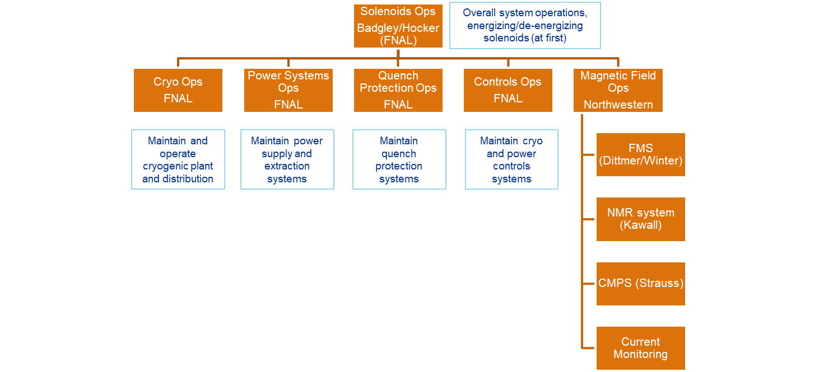
Operations
Active areas of effort
Re-starting the MC-1 refrigerator (new full-flow purifier)
Establishing magnetic field hazard mitigations and controls
Further development of field mapping system (see talk by Dittmer, this session)
Finalizing design of field monitoring system (see talk by Kawall, FMS session Tuesday)

Slide 32
Summary
Vendor is ready to ship PS, and we’re ready to receive it
However there remains some contractual wrangling related to the leak
All 3 top-level components of the DS are done
Inner bore and cold mass are integrated
Outer vessel integration in process
Technical challenges continue to delay DS delivery
Current project end date includes float to the DS delivery, that float is down to 2.5 months
Several important campaigns have completed
Installation of the AP window housing restraint system
TS cryogenic interconnects
Remediation and installation of the dump resistors
Looking forward to installing two more magnets and commissioning!

