Slide 1
Integration Talks at Mu2e Collaboration Meeting
Arnab Ghosh and the Mu2e Integration Team
6/12/2025

Slide 2
The Mu2e Integration Team
Mechanical, Electrical engineering and systems integration
Mu2e Integration Team coordinators:
  G. Rakness (FNAL)
  G. Ginther (FNAL)
  P. Wilson (FNAL)
  K. Byrum (ANL)
  T. Diehl (FNAL)
  A. Ghosh (FNAL)

Slide 3
Outline of slides
Electrical integration topics
Muon Campus power issues and planning
Some mechanical integration links
Overview of detector installation schedule
Regarding the calorimeter coming from LabA to Mu2e
Regarding the tracker coming from Lab3 to Mu2e
Access to the building
Work at the building
Meetings

Slide 4
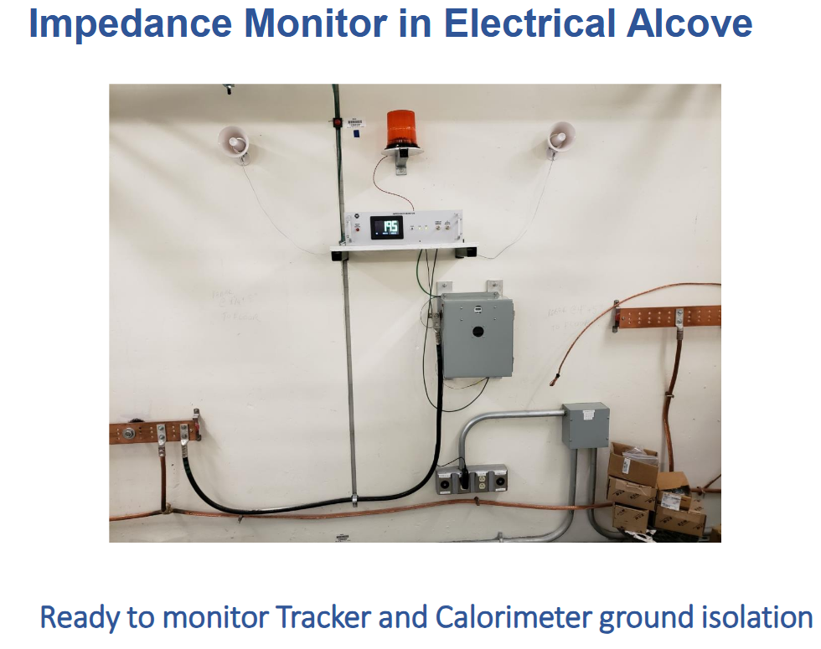
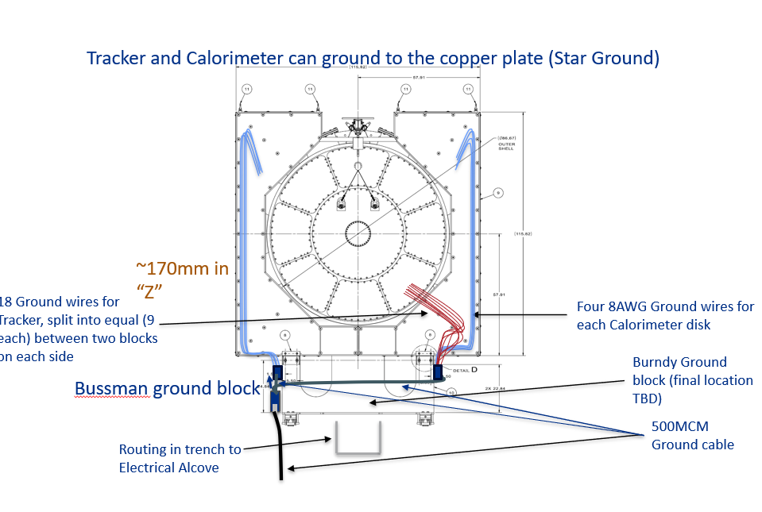
Detector Ground and Gizmo
The Gizmo provides continuous monitoring of the isolation between detector ground and building ground
Two Gizmos operational
Electrical alcove
Extinction monitor

Slide 5
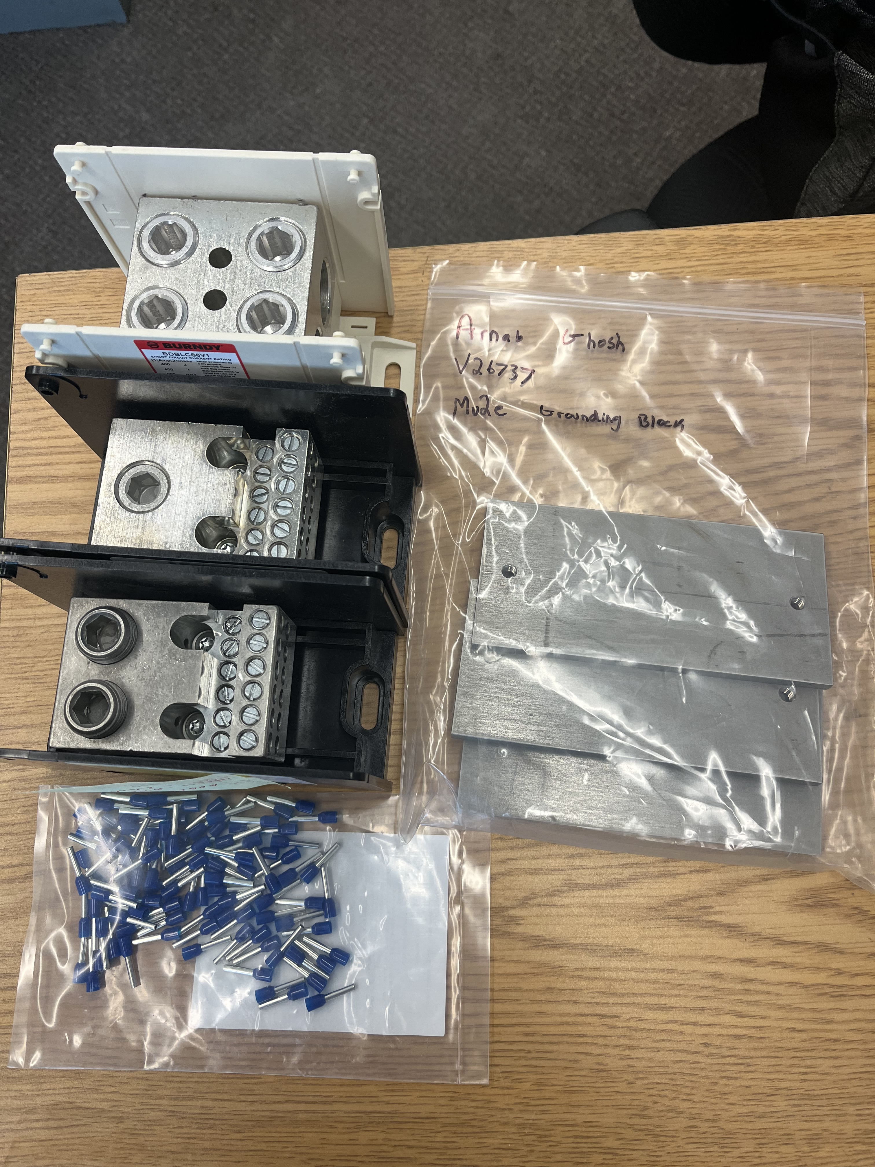
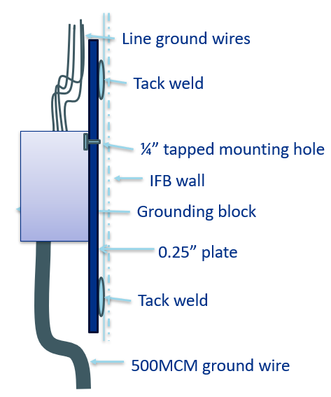
Ground Block Status
All three blocks and baseplates in hand
System is ready to go
Steve Chappa and Tyler to help with 500MCM cable termination

Slide 6
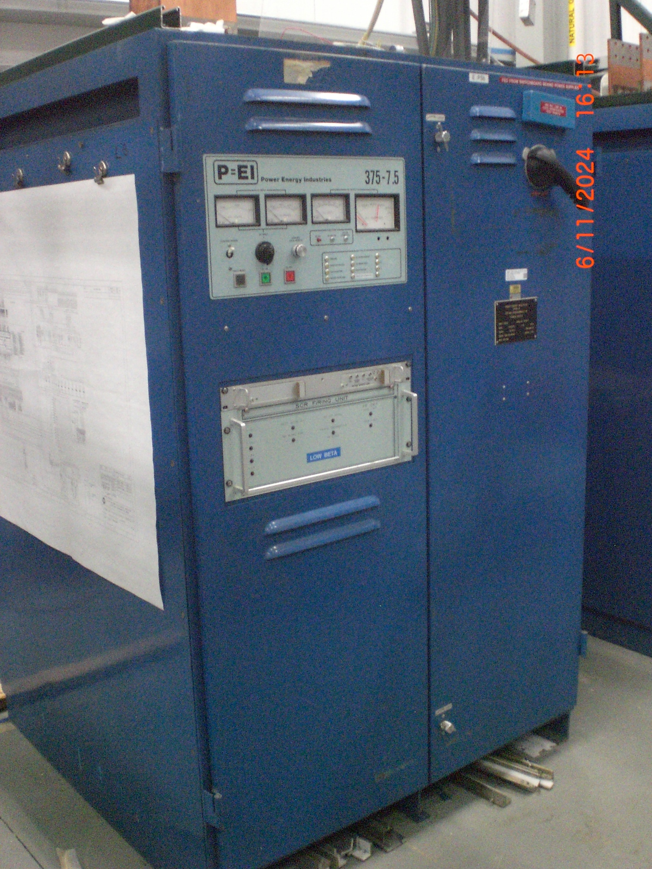
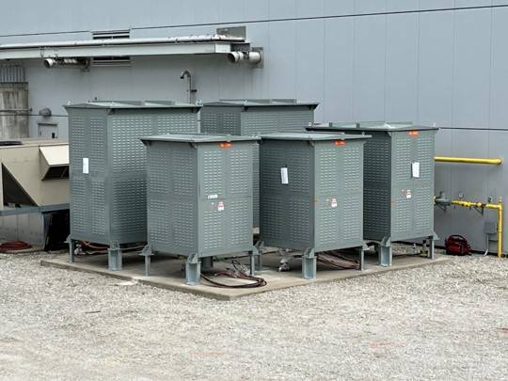
Solenoid PS Status (Steve Chappa)
The DS and PS power supplies are now tested and operational. Their AC power connections are now complete.
Remaining work: busbars, dump/trip cabinets, etc., will continue later this month. Controls racks are placed and are being wired up.
Dump resistors:
All hardware exchanged to increase the reliability. Resistors are placed/mounted on the outside concrete pad.
Cabling has been Hi-potted. They all look good, even after long exposure to the weather.
DC Cable connections are being made.
TSu and TSd solenoid power supply rack build:
The AC power installation is complete
All DC cabling is installed.
The power supply rack build is complete.
The trim coil power supply racks are being wired.

Slide 7
DAQ Status (Ryan Rivera)
Rad-hard fiber defined, working with vendors for procurement, waiting on delivery.
Setting up Global runs to test integration with subsystems; ORC in planning.
The transition to DAQ Ops is already under way.
The Cosmic Ray Test is scheduled for March 2026.
TDAQ template for response to emergencies: encourage all subsystems to adopt
Ryan Rivera Collab Meeting 6-11-25

Slide 8
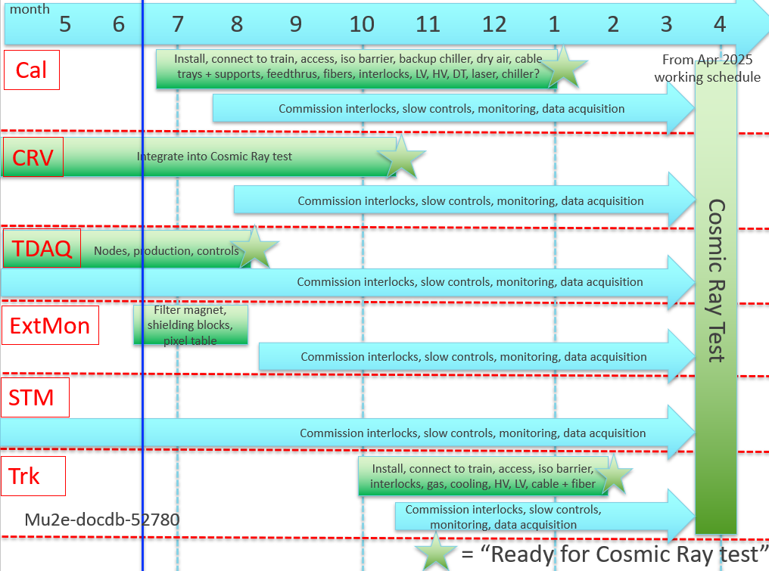
Detector installation schedule

Slide 9
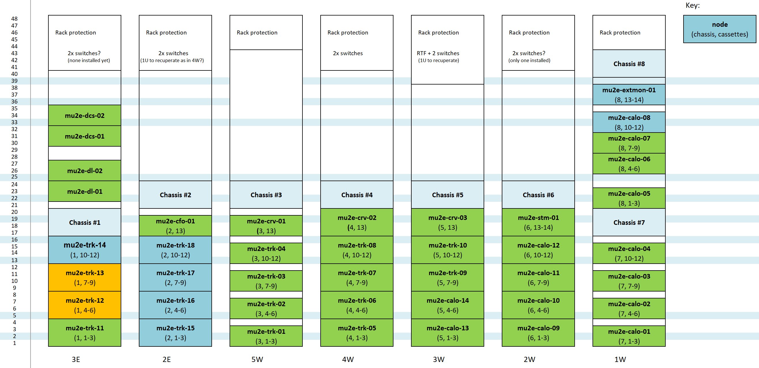
DAQ continued…
Joe Kaminski installing servers and DTCs,
Setting up DTCs for testing.
Plan for resolving water leak issue in ExtMon room.
Joe Kaminski (docdb-53014)

Slide 10
DAQ Cooling Status
Heat removal for DAQ electronics: Liebert HVAC
Capacity before CRV upgrade= 40.2kW (79%)
Capacity after CRV upgrade= 41.9kW (82%)
Margin ~ 9kW (18%)
Other heat sources in DAQ room:
  Known items unaccounted for: Two 45kVA xfmrs and UPS
  Calorimeter calibration laser system
  Unknown unknowns (missing items to be added)
DocDb 48810

Slide 11
Electrician contracts
Tracker cooling and ODH contracts to commence soon; parts in hand and PO through procurement
STM final locations and temporary chiller for the calorimeter: Scoping in progress
Remote Handling Room: Conversations with Jordan, Kim and process controls group regarding cable tray
  Crossover on top of elephant doors in RHR
  Constraint: Clearance for monorail crane operations

Slide 12
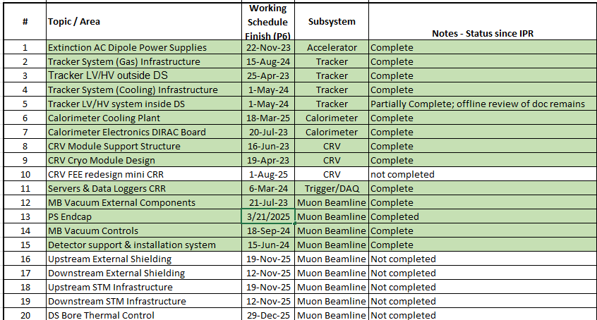
CRR statuses
Extinction Monitor System Pixel Interface Board CRR completed on 11-Dec-2024. Required PCB review prior to CRR.

Slide 13
Power outages
Issue: FNAL electric infrastructure has experienced failures affecting capabilities and resiliency. As a result…
  Main Injector cannot operate in FY2025 preventing NuMI and Fixed Target user program progress
  The overall laboratory operations are at risk of downtime
A detailed plan to mitigate these issues has been developed
  All experimenters’ meeting 04-Jun-2025 (https://indico.fnal.gov/event/69483/)
  Friday 9am AD Ops meeting 06-Jun-2025 (https://indico.fnal.gov/event/69835/)
We will work together with ISD / AD / PPD / Muon Ops / Collaboration Management to minimize the impact to Mu2e
(Possible timeframes that need to be dealt with might include
  Nov 2025
  Feb 2026
  Jun-Jul 2026
  Jan-Feb 2027)

Slide 14
Some Mechanical integration links
F10244732: new top-level assembly for Mu2e
  Future modeling work should take place within this new assembly
  Set of guidelines / best practices for working inside the assembly: Mu2e-doc-52638-v1: New Mu2e Top Level Integration Model F10244732 Update and Guidelines.
    Engineers and designers should refer to these suggestions before adding or modifying the new top level assembly model
Loading dock “layout”: mu2e-docdb-52564
Temperatures / humidities at various locations in Mu2e hall
  Archive of Temperatures / humidities history at Mu2e hall- Mu2e-docdb-9037-v18, continued in docdb-47257
  Locations of sensors at mu2e-docdb-49516
  (GR downloaded data end-May but still need to update docdb)

Slide 15
Concerns that might impact the scheduling of the calorimeter transportation and installation
Evaluate calo performance after water on Lab A floor?
Calorimeter breakout cables
Any additional services in the DS trench?
  Instrumentation for enables/interlocks?
    If we only monitor the chiller, it is not as reliable as we would like for an interlock
  Tracker gas line replacement
Mods to cal DT source manifold connections
Mods to MBS supports to support detector services
Installation of MBS supports and MBS
  DU-B pads
  MBS goes in before the calo and before CRV
Installation of calo feet on bearing blocks
Guard against ESD pickup during transport
Dry air purge
  Use tracker gas line?
Isolation barrier
  Decrease bird risk
Calorimeter transportation covers
  May need in-field modification
Documentation required for the transportation and critical lift
Weather
Calorimeter cooling related issue
  Clogged filter
G Ginther (docdb-52855)

Slide 16
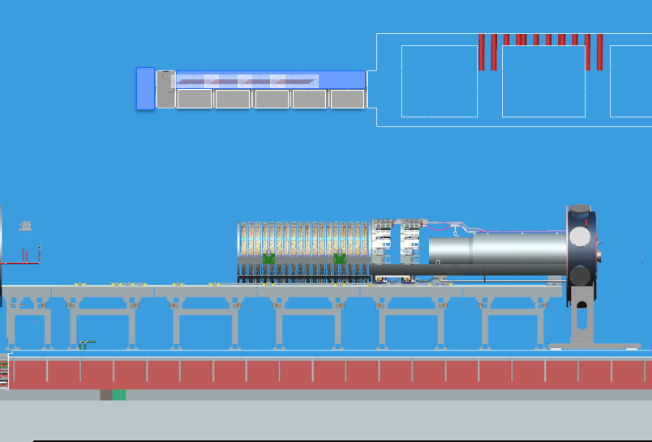
Eventual detector configuration in hall
←W
MBS currently up here
E→
CRV
G-blocks
Isolation Barrier (approx.)
IFB
Trk
Calo
MBS
External Stands
Trk+Calo services
DS trench

Slide 17
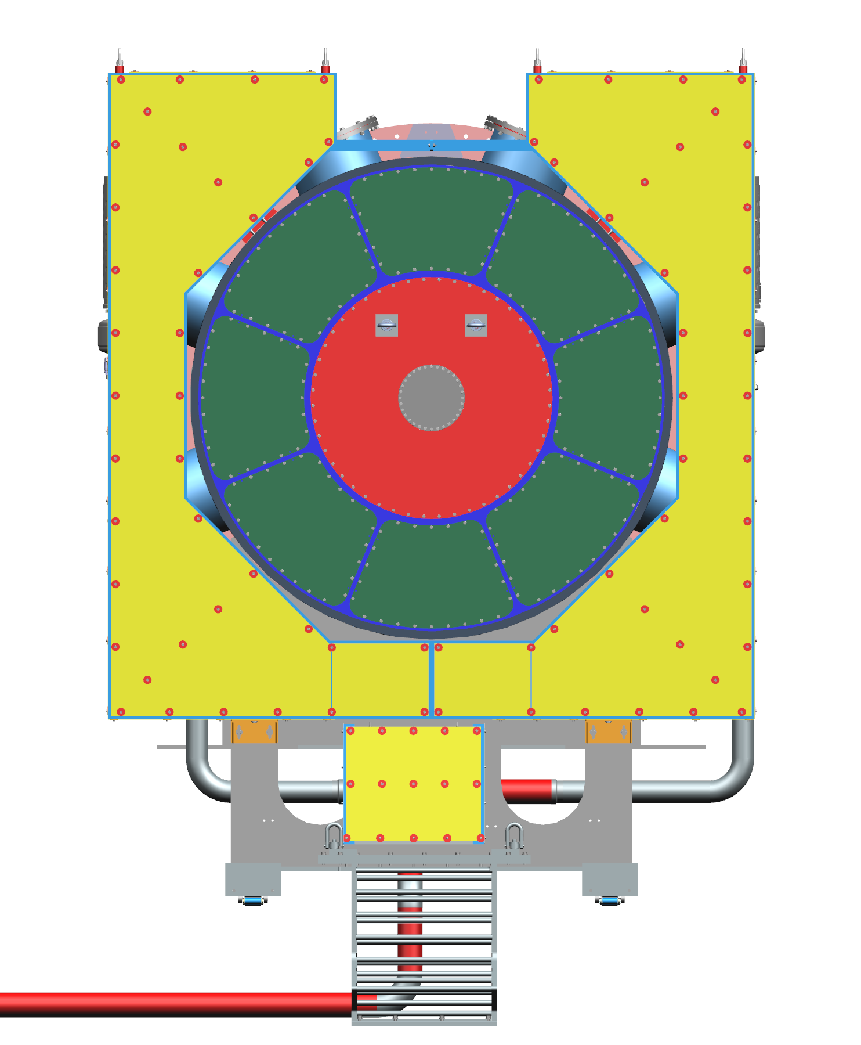
Expectations for after calo is delivered to Mu2e hall
Calorimeter access equipment?
  Including stand-offs to protect detectors
Conditions for transferring support of downstream end of MBS to the IFB
  Slack in the tracker services?
    Likely at least 50 cm (and perhaps as much as 150 cm for optical jumpers)
  Design of IFB rear feedthrough plate
  Availability of internal tracker and calorimeter chiller and cal DT source lines
    Including integrated flex segments with flanges
  Clamps and supports for pipes at the MBS supports
  Calorimeter cable tray
IFB cable backbone
IFB ground plates
Tested optical feedthroughs and leak check rear feedthrough plate
  Assembly and handling techniques?
Radial port D and E (chiller) feedthrough plates
Temporary chillers
  Temporary connections between calorimeter and chiller?
  Power for the chillers
Interlocks
Operational Readiness Clearance Review

Slide 18
Regarding tracker coming from Lab3 to Mu2e
Features to be finalized (and in many cases procured and installed) including:
  Isolation barrier
  Tracker adjustment mechanisms
    PO for adjustment mechanisms (without DU-B pads), first articles delivered
      PO for DU-B pad material issued, PO for machining of DU-B pads issued
  Hardware, shims, end of line stops for detector support system
  High-capacity trench plate
  Tracker access equipment
  Equipment cooling water (ECW) system commisioning

Slide 19
Needed soon after tracker arrival at Mu2e
Internal supports for tracker services
  At calorimeter disks
  Along muon beam stop
Tracker jumper cables
Optical feedthroughs
Rear feedthrough plate assemblies 4 and 6
  For tracker services
Radial port cover assemblies C and F
  For tracker gas
Tracker chiller infrastructure
Tracker gas infrastructure
  Including gas bottle pad north of high bay roll-up door

Slide 20
Access to building
Old procedure:
  Take Mu2e building hazard awareness training
  Email Dee to request access
  Dee did stuff behind the scenes
  Then, you get access
New procedure:
  Take Mu2e building hazard awareness training
  Go to link: https://ccdapps-prod.fnal.gov/pls/apex/f?p=106:32
    Select PD/MU2E (MC-2) 24/7
    Fill in Worker, Time Frame, and Justification
    Click "Create"
  Then the following people approve behind the scenes
    FNAL Point of Contact (for many of you, this is Bob Bernstein), Mu2e Ops Coordination, FNAL Security Ops
  Then, you get access
And then, if you want to do work at the Mu2e building → → → →

Slide 21
Work planning at the Mu2e building
https://mu2einternalwiki.fnal.gov/wiki/Operations
Please contact us at mu2e-integrationteam@listserv.fnal.gov
Depending on the job, we may ask to discuss at a Monday 1:00pm Mechanical Integration Meeting or Tuesday EI meeting
FESHM-2060 describes work planning & when you need a written hazard analysis
  Contact ES&H Manager (Paul Kesich) to review the work planning requirements well in advance of the work
When ready to work, schedule at a Thursday 08:00am weekly work planning meeting
  Mu2e Ops Coordination authorizes the work to proceed (in consultation with the Mu2e Integration team)
  The working schedule for work at the Mu2e building is at the link

Slide 22
Meetings
Mu2e mechanical integration meeting
  Mondays 1:00pm (13:00) FNAL time
  Always interested to hear about anything related to integration, please let us know
Mu2e bi-weekly electrical integration meeting
  Tuesdays 09:00am FNAL time
  Always interested to hear about anything related to integration, please let us know
Mu2e bi-weekly TDAQ meeting
  Alternates with EI meeting
Mu2e weekly work planning meeting
  Thursdays 08:00am FNAL time
  Near term activities in the Mu2e building scheduled during this meeting
  Always interested to hear about work at the Mu2e building, please let us know

Slide 23
Conclusion
Lots of good progress in detector hall and various subsystems
Need to be careful in integration of subsystems
Keep track of power supply interruptions
Safety considerations:
  Continue to maintain awareness of your surroundings and situation
  Minimize distractions
  Plan for and implement work safely

