Slide 1
Taskforce requirements and system decomposition 2nd in-person - Amsterdam
R. Meijer
2025-03-17

Slide 2
What to capture
Which are the elements to capture within a requirements framework?
Does the design of the system satisfy the science case?
→ Connection science case (OSB) – noise budget
How are key functions (/noises) distributed over the instrument?
→ ET → HFI, LFI level → nodes
→ Focus on: Quantum, seismic, others?
What is the rationale of the high-level optical design?
→ Distances between optics
→ Boundary conditions per node
What are the spatial dependencies between instrument and civil infrastructure?
→ Nodes per cavern/tunnel overview
→ Detector layout volume assumptions
Can requirements for the integrated nodes feasibly be met?
→ Conceptual integrated tower designs + classification
→ Initial node volume claims

Slide 3
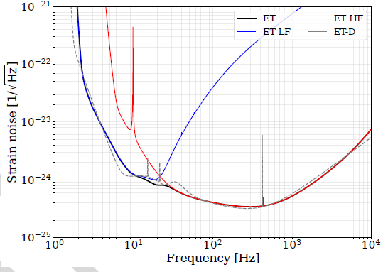
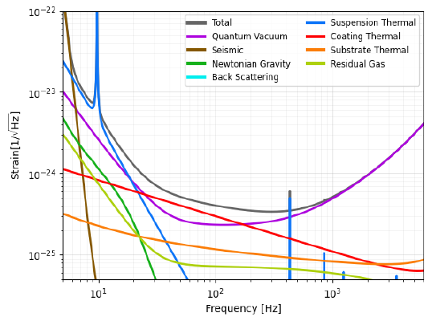
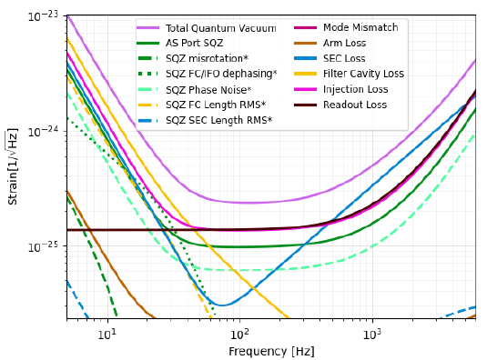
How are functions distributed?
REQ0001 - Einstein Telescope sensitivity budget
Set of decomposing noise curves such as in ET-0007C-23
(ET Sensitivity Curve update, Feb 2025)
For taskforce scope:
Quantum Vacuum
Seismic
Others?
REQ0002 – HFI sensitivity budget
REQ0003 – HFI Quantum Vac. budget
To design specs

Slide 4
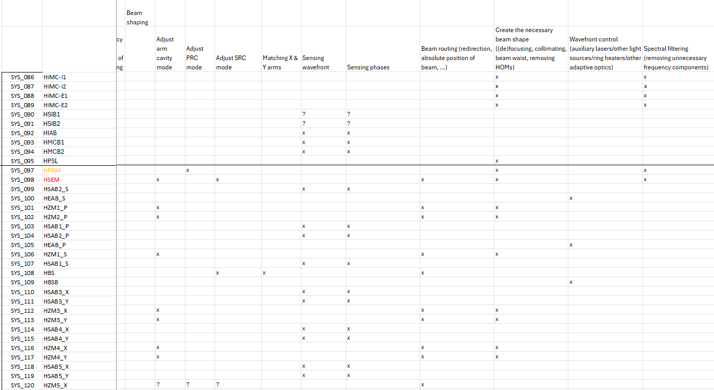
How are functions distributed?
Work since Pisa on function-systems pivot table: which nodes share functions?

Slide 5
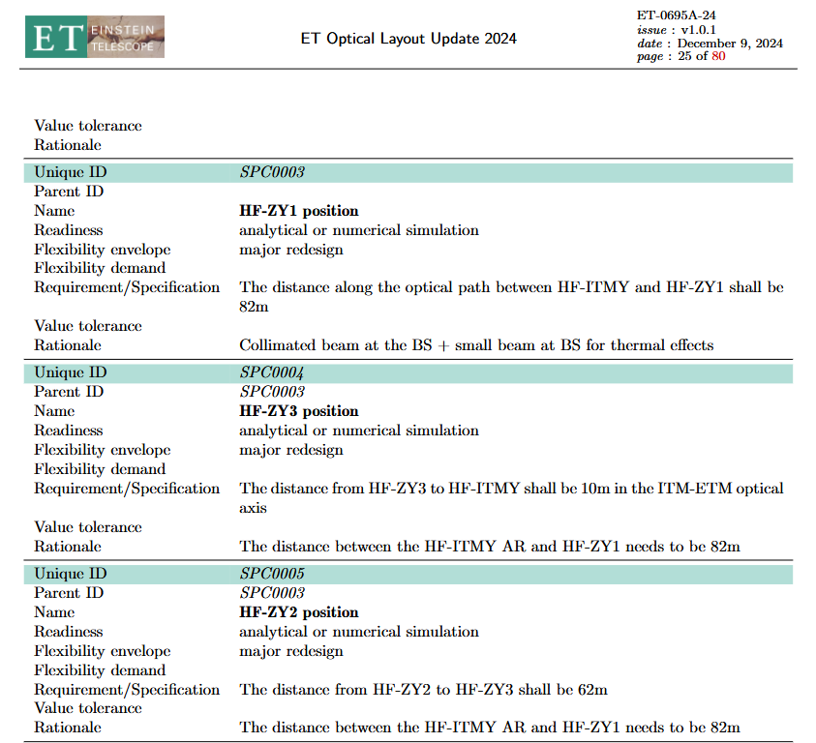
High-level optical design soundness?
Update to optical layout output tables
Distances between nodes + rationale
Already nicely formatted

Slide 6
High-level optical design soundness?
Complete node summary table
Boundary conditions per node
Optic characteristics
Residual Motion level
Access type
SUS architecture

Slide 7
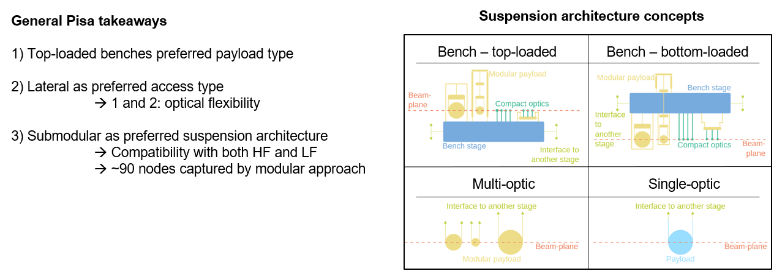
Conceptual node designs and classification?
Can boundary conditions per node be achieved?
Conceptual design (VAC & CRYO, SUS)
Node volume estimation
Node classification table
Lowest level of detail in Taskforce context

Slide 8
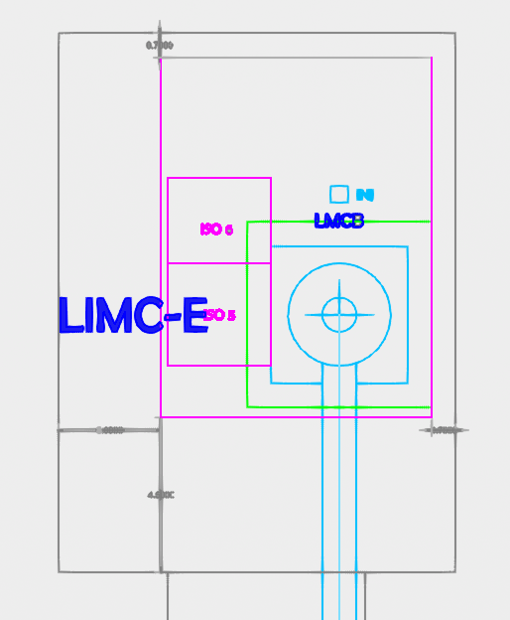
Instrument → infrastructure spatial dependencies?
Detector layout (ET-0676A-24) contributions update:
Node footprint (from Tower Categorization)
Node height (from Tower Categorization)
Scaffolding reserved space
Cleanroom reserved space
Linking pipe paths
Logistics paths
Include estimate for:
Support infrastructure
(HVAC, Cryo supply, ...?)
Noisy rooms

Slide 9
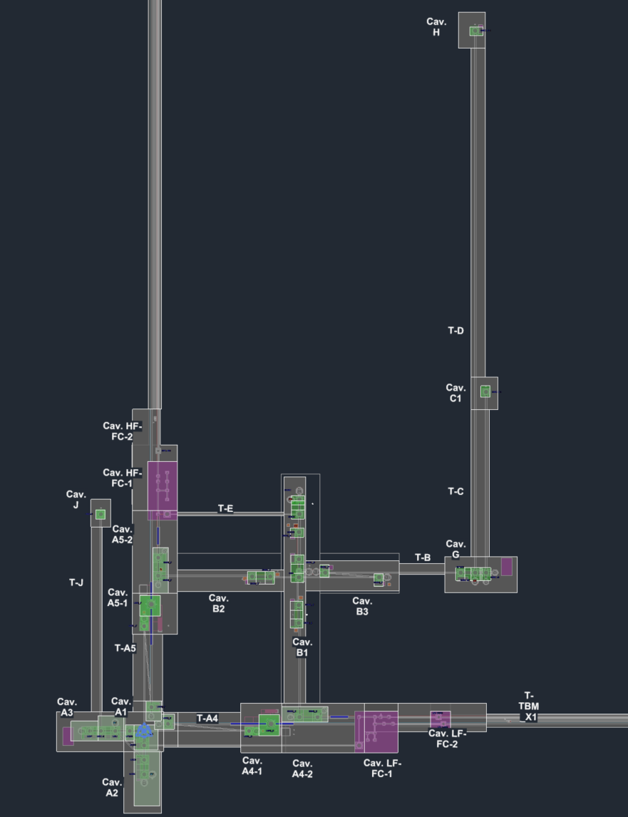
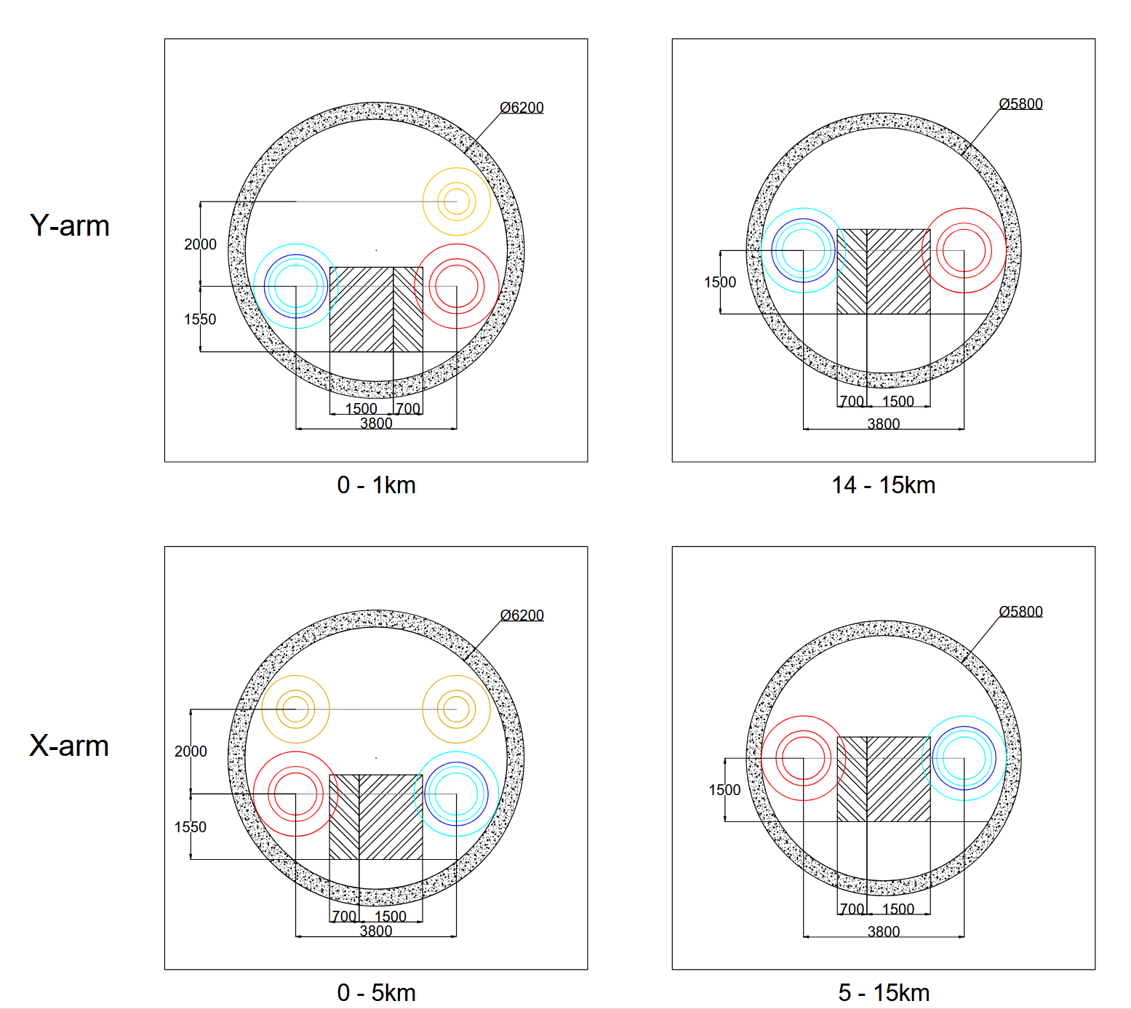
Instrument → infrastructure spatial dependencies?
Which node in which functional volume (e.g. cavern/tunnel?)
Estimated excavation volumes
Tunnel envelope

Slide 10
Some scope limiters
No distinguishing between specs, interfaces, requirements for now: all REQs. Use ranges:
Science case: REQ_0001 – REQ_999
Noise budget: REQ_1000 – REQ_1999
Optical layout: REQ_2000 – REQ_2999
Tower integration: REQ_3000 – REQ_3999
Civil Infra: REQ_4000 – REQ_4999
Instrument system decomposition follows optical layout until nodes
Infrastructure system decomposition follows functional volumes
Only a select # of noise paths considered
~

Slide 11
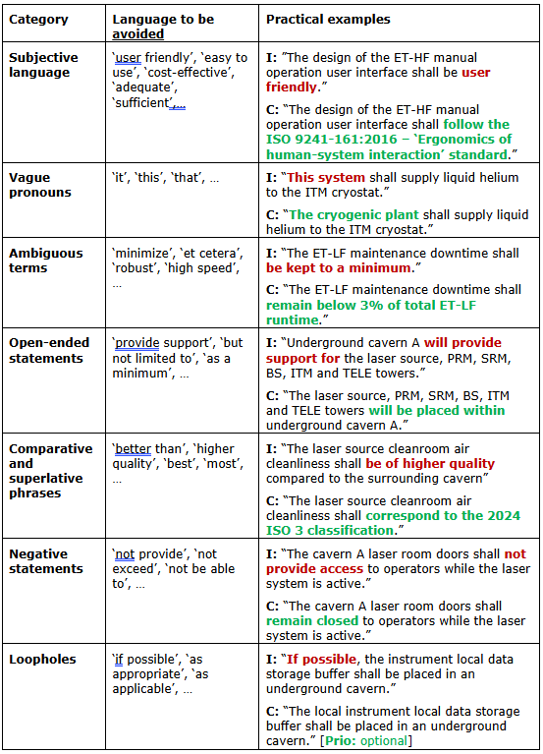
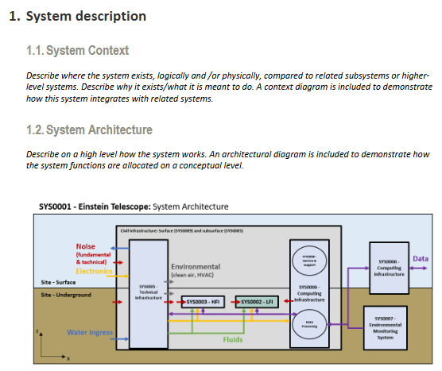
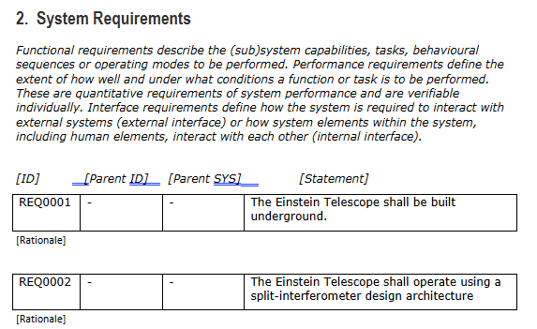
Requirements

Slide 12
Discussion – how to document?
For end of workshop, some thoughts:
Translate working documents into structured requirements
Use Overleaf document?
→ REQ template simplified so can be used as guidance for Overleaf chapters
→ Separate chapter on system decomposition?
→ Traceability through requirements
Sharepoint documents tree/decomposition redundant?
→ Labelled REQ documents + drawings in folders

