Slide 1
Civil Engineering (+Detector layout) Summary

Slide 2
Detector layout update (to be explained further in parallel sessions)
Reducing excavation volume → reducing costs (assumption)
Reduce tower volume (footprint + height): Tower Integration
Re-assess additional volumes (clean room access, scaffolding, hoisting, logistics)
Co-locate optics (merging vessels): Optical Layout
Co-locate vessels in same tunnel / caverns (FCs in arm cavity tunnels)
Adapt optional technologies (higher technical risk)

Slide 3
Optical layout update
Merging optics in shared vacuum vessels → removal of the following vessel nodes (6 main, 3 FC IMs):
HOOP, LOOP, HIOP1, HIOP2, HINJ, HZM2_S
LFC1-IM2, LFC2-IM2, HFC-IM2
Shortening LF IMC: 300m → 120m
Steering FCs in arm cavity tunnels by applying optional technologies:
Introducing a 2m periscope for both FCs + adding additional steering optics
Other updates tbd. (Tue. afternnoon session)

Slide 4
Optical layout update
2024 L Optical Layout
2025 L Optical Layout (ETO Task Force update)

Slide 5
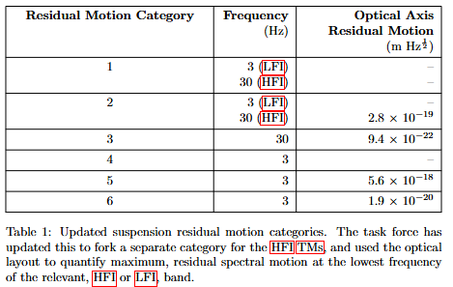
Tower volume update
Updating tower integration: Suspension categorization (+ limited integration with tower base vacuum)
Quantitative RM categorization resulted in addition of categories
Certain ‘non-baseline’ solutions now new ‘baseline’ → resulted in smaller suspension volumes
RM Cat. 2 follows LIGO-like approach for SUSP (AP + passive sub-susp) → alternative tower base design following a LIGO-like approach?
Temporary scaffolding? Temporary/mobile cleanrooms?
Less clearance-height required for hoisting + crane?
Discussions on cleanliness started (awaiting requirements)

Slide 6
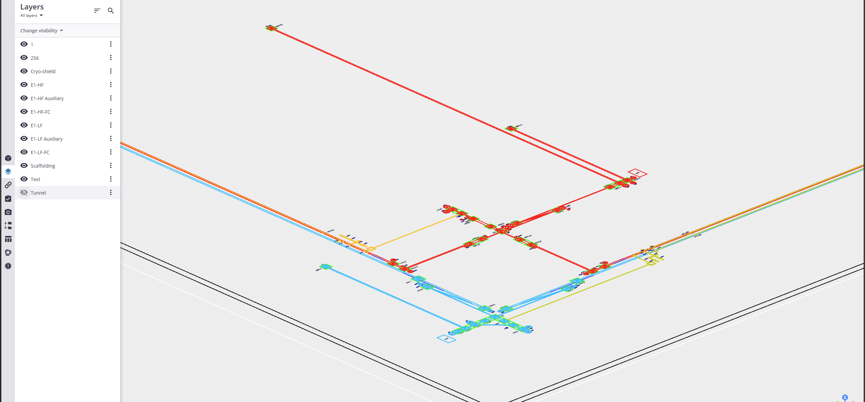
Updated L optical layout
+modifications following flexibility
HF-FC in Y-arm
LF-FC in X-arm

Slide 7
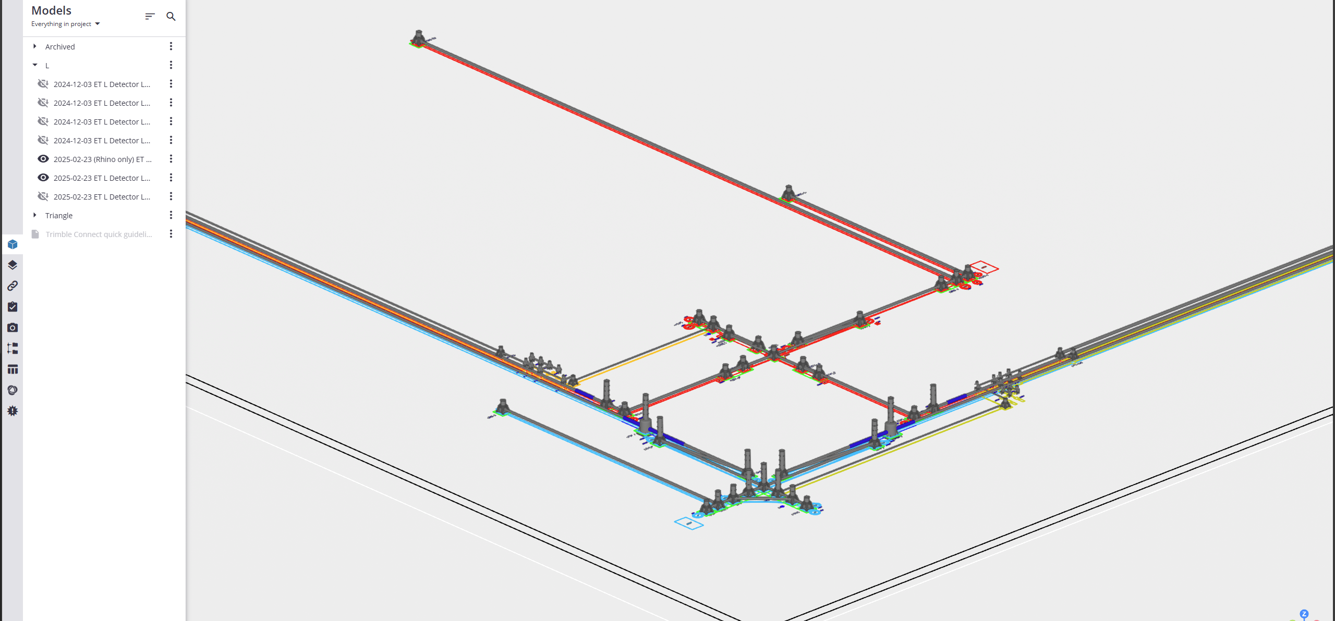
+updated tower categorization activity
These towers = indication of the total tower height and footprint, not the solution

Slide 8
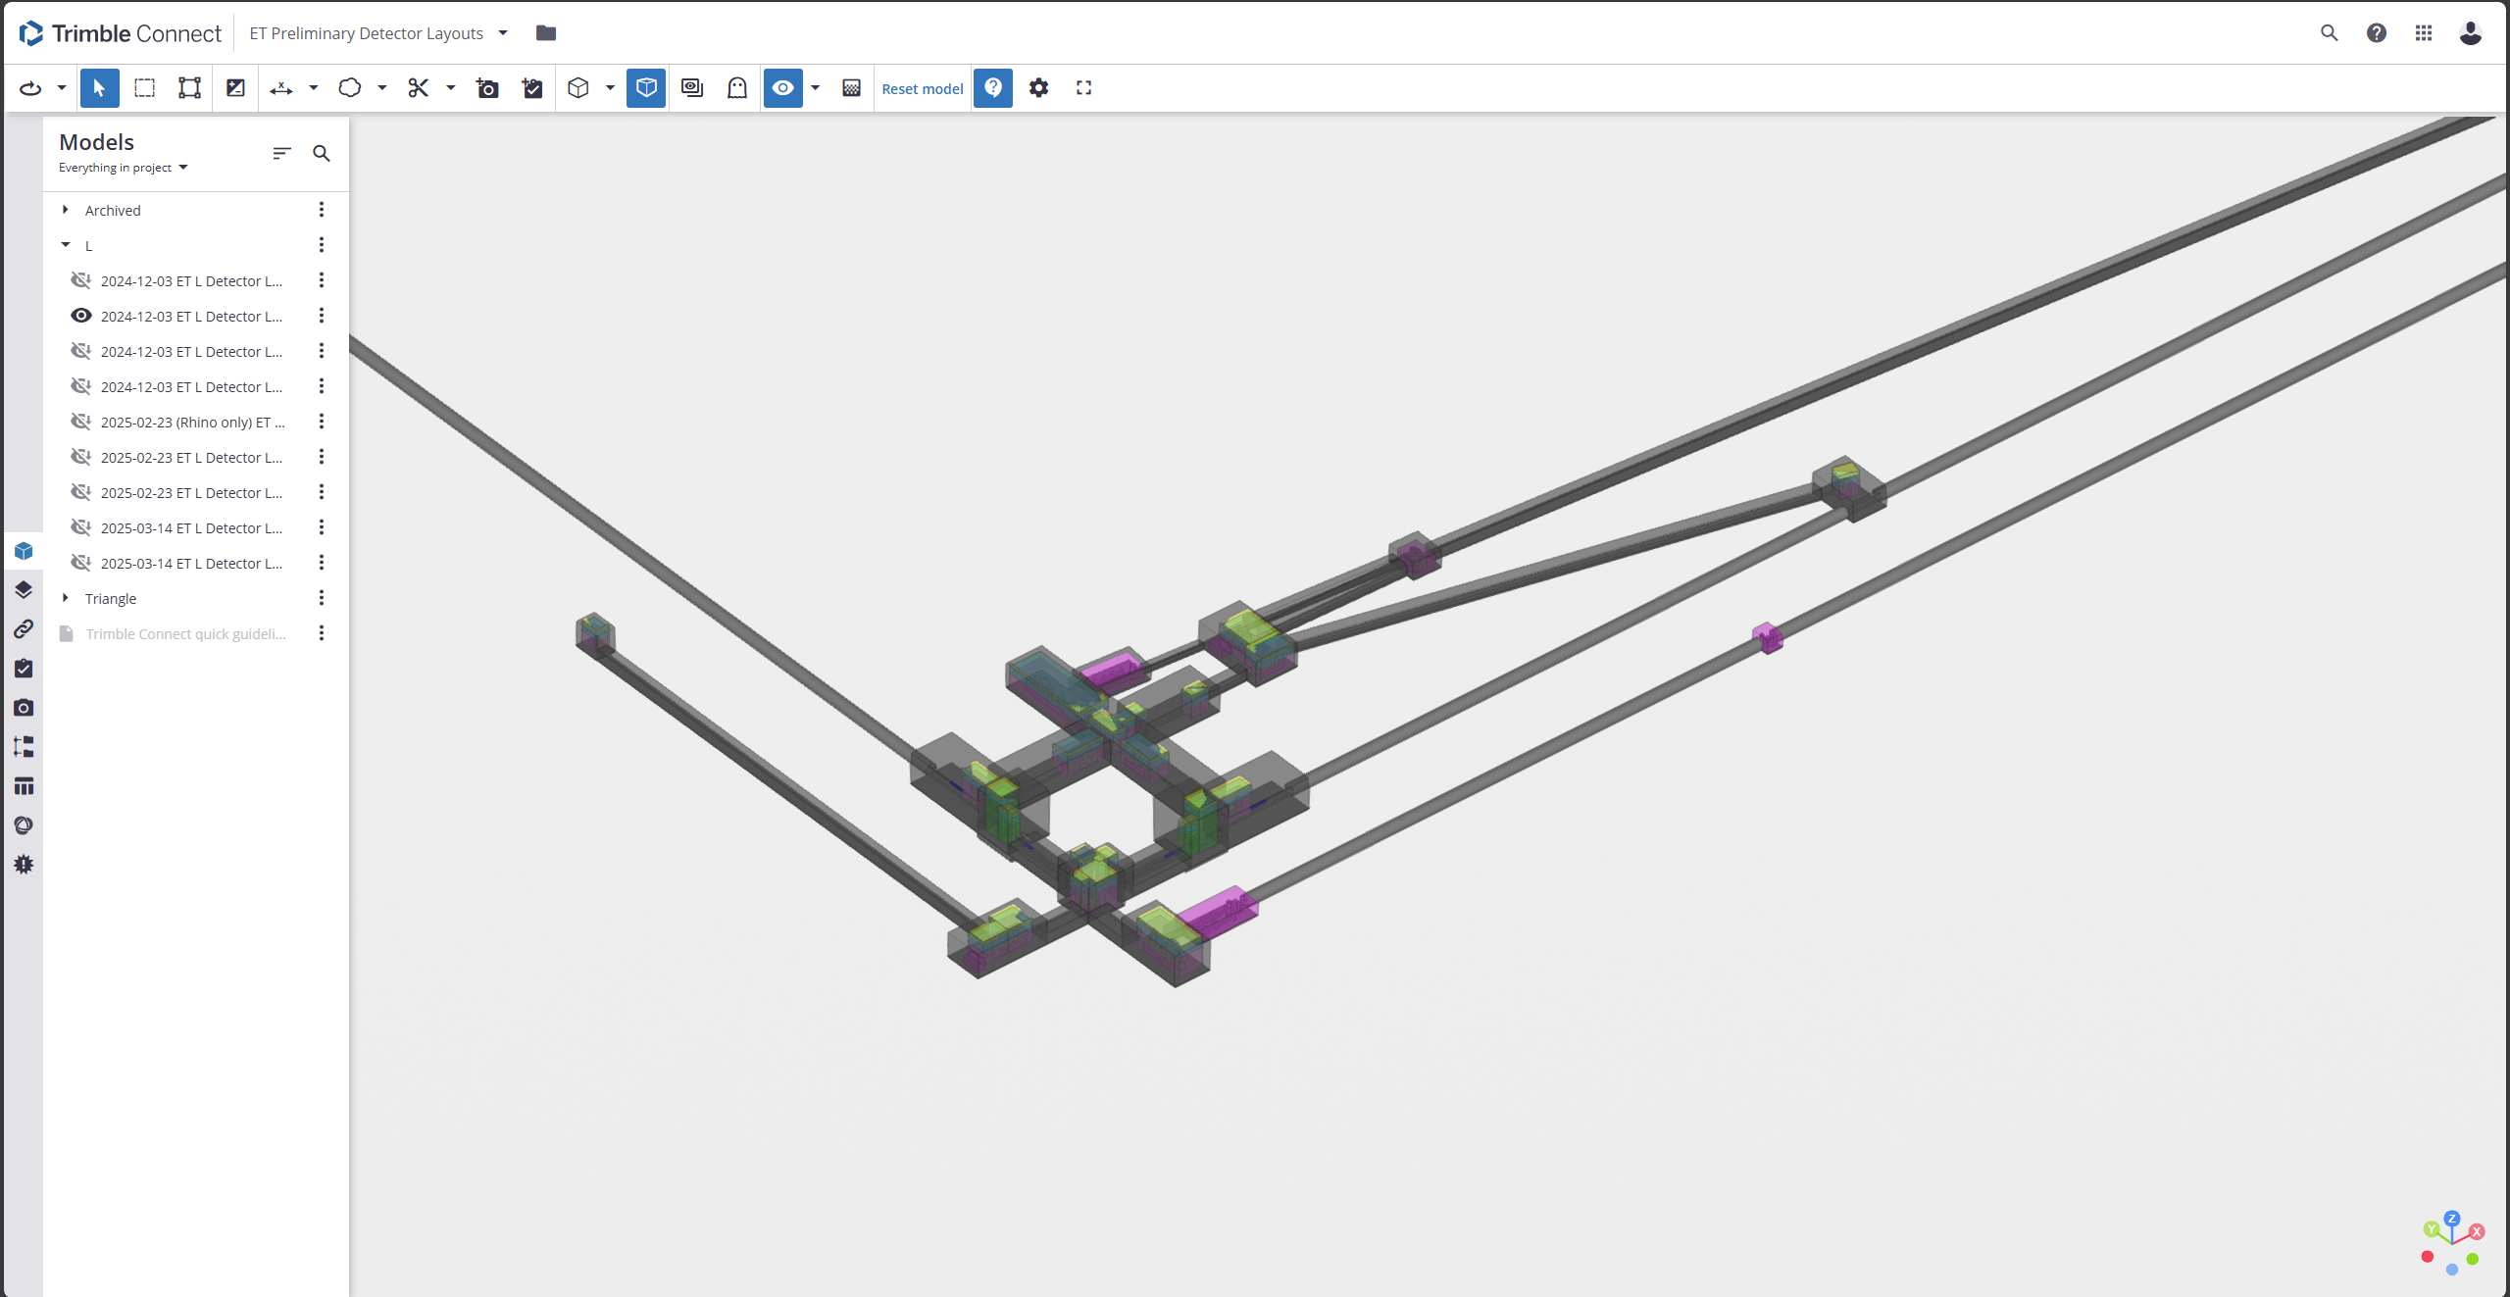
Previous Baseline L

Slide 9
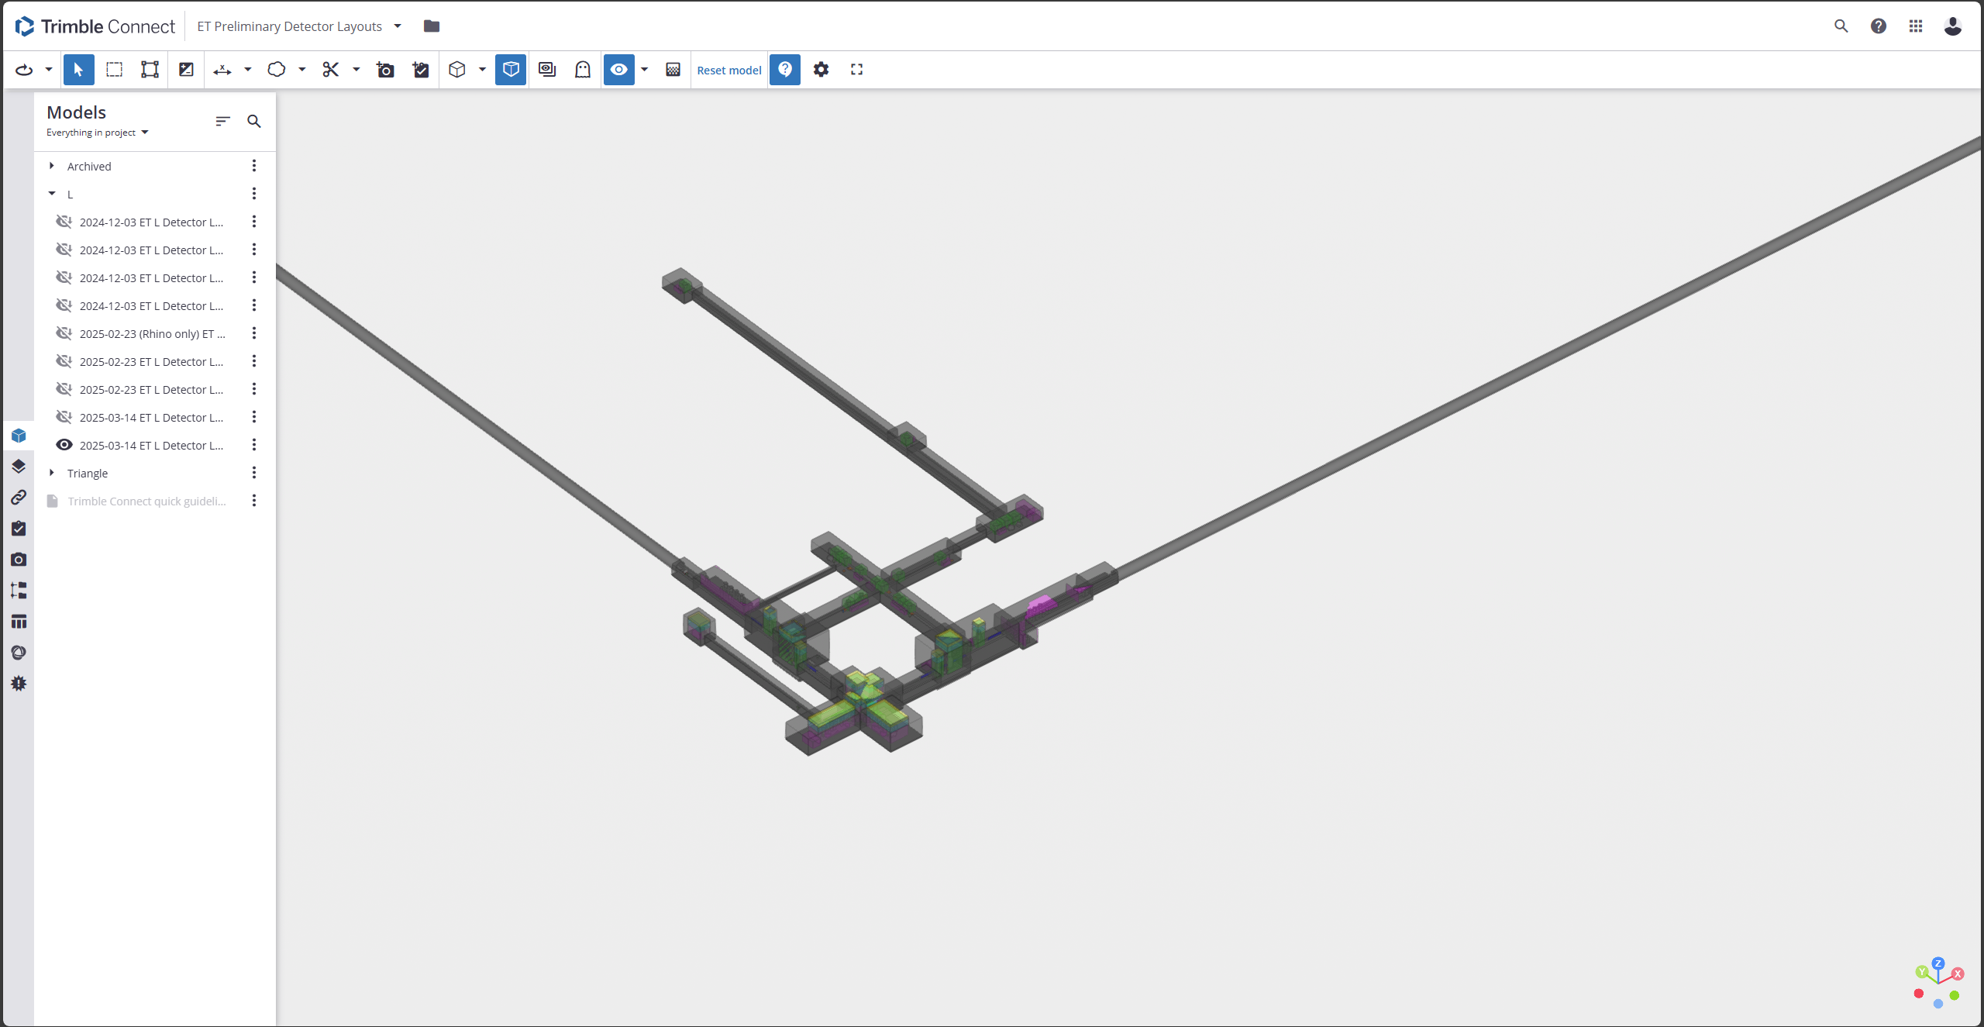
Current updated L Detector Layout
https://app21.connect.trimble.com/tc/api/2.0/s/1gfKqNXiyuyC9d_ELgxFpOw7SHLq8QumOOdEE2XYScwLo40IQTizFFQFTfa3cnP3

Slide 10
Arm Cavity Tunnel Layout (Courtesy of P. Werneke)
Beampipe Outer diameter envelope = 1300 mm
Inner diameter = 1000 mm
Wall thickness (4), stiffener height (50), thermal insulation (100), misalignment (25), tolerances
Beampipe to tunnel wall = 500 mm (request for welding tool and inspection)
Beampipe support system envelope
Space between beampipe and tunnel wall (500)
150 mm on the inside of the tunnel from the Beampipe Outer diameter envelope
Transport = 1500 mm
Safe passage = 700 mm

Slide 11
Arm Cavity Tunnel Layout (plenary session later today)
5800
3800
500
1000
300
700+1500
300
1000
500
2200
Source: P. Werneke

Slide 12
Updated Detector Layout (1st in person meeting) vs previous baseline - Caverns
Update (2025-03-14 ET L Detector Layout (ETO Task Force 1st in-person meeting update)) |  |  |  |  |  |  |  |  | Previous Baseline (2024-12-03 ET L Detector Layout (quasi-Delta))
Cavern | Detector Layout Block Dimmensions |  |  |  | Est. Excav. Vol. (m3) | Note | Vol. Difference (m3) | Vol. Diff. (%) | Cavern | Detector Layout Block Dimmensions |  |  |  | Est. Excav. Vol. (m3) | Note
 | Height (m) | Width (m) | Length (m) | Detector Layout (m3) |  |  |  |  |  | Height (m) | Width (m) | Length (m) | Detector Layout (m3)
A1 | 18 | 21.297 | 44.445 | 17,037.81 | 18,774.21 |  | -142.12 | -1% | A1 | 20.5 | 28 | 30 | 17,220.00 | 18,916.33
A2 | 14 | 24.5 | 28.5 | 9,775.50 | 10,940.29 |  | -5437.71 | -33% | A2 | 18 | 21 | 39.172 | 14,807.02 | 16,378.00
A3 | 14 | 21.297 | 40 | 11,926.32 | 13,283.96 |  | -1142.90 | -8% | A3 | 14 | 22 | 42.171 | 12,988.67 | 14,426.86
A4_1 | 23.2 | 24.272 | 22.671 | 14,138.24 | 15,860.69 | 6m BA CR | -4400.71 | -22% | A4_1 | 27.2 | 27.328 | 22.671 | 18,223.80 | 20,261.39 | 6m BA CR
A4_2 | 18 | 24.272 | 37.6 | 16,427.29 | 18,079.10 |  | -8289.14 | -31% | A4_2 | 18 | 27.328 | 49.245 | 24,223.81 | 26,368.23
A5_1 | 23.2 | 24.672 | 22.671 | 14,348.62 | 16,085.62 | 6m BA CR | -2646.23 | -14% | A5_1 | 27.2 | 25 | 22.671 | 16,788.24 | 18,731.85 | 6m BA CR
A5_2 | 18 | 24.672 | 26.329 | 11,692.60 | 13,012.31 |  | -11188.87 | -46% | A5_2 | 18 | 25 | 49.245 | 22,160.25 | 24,201.18
LF-FC_1 | 10 | 27.2 | 11.2 | 3,046.40 | 3,648.69 |  | 10117.2 | 184% | LF-FC | 8 | 16 | 37 | 4,736.00 | 5,512.33
LF-FC_2 | 10 | 15.5 | 52.445 | 8,128.98 | 9,280.01
LF-FC_3 | 8 | 12.728 | 22 | 2,240.13 | 2,700.79
B1 | 8 | 13.781 | 126.906 | 13,991.13 | 16,088.29 |  | -28580.51 | -64% | B1 | 14 | 21.5 | 135.828 | 40,884.23 | 44,668.80
B2 | 8 | 11.1 | 59.664 | 5,298.16 | 6,254.09 |  | -12348.00 | -66% | B2 | 14 | 21 | 57.226 | 16,824.44 | 18,602.09
B3 | 8 | 13.962 | 50.183 | 5,605.24 | 6,527.92 |  | -8569.72 | -57% | B3 | 14 | 22.093 | 44 | 13,609.29 | 15,097.64
G | 8 | 17.346 | 37.105 | 5,148.99 | 5,965.26 |  | -10344.67 | -63% | G | 14 | 25 | 42.174 | 14,760.90 | 16,309.93
H | 8 | 14.2 | 20 | 2,272.00 | 2,732.13 |  | -853.51 | -24% | H | 10 | 16.672 | 18.204 | 3,034.97 | 3,585.65
HF-FC_1 | 8 | 17.65 | 55.128 | 7,784.07 | 8,921.22 |  | 5562.54 | 104% | HF-FC | 8 | 18 | 32 | 4,608.00 | 5,353.50
HF-FC_2 | 8 | 10.1 | 20 | 1,616.00 | 1,994.82
C1 | 8 | 15 | 18 | 2,160.00 | 2,604.00 |  | -5560.17 | -68% | C1 | 12 | 20 | 30 | 7,200.00 | 8,164.17
C_X | 6 | 15 | 22.8 | 2,052.00 | 2,495.20 |  | 0.00 | 0% | C_X | 6 | 15 | 22.8 | 2,052.00 | 2,495.20
D_X | 23.2 | 21.25 | 21.572 | 11,609.46 | 13,132.90 | 6m BA CR | -2165.55 | -14% | D_X | 27.2 | 21.5 | 21.572 | 13,589.77 | 15,298.45 | 6m BA CR
E_X | 18 | 25 | 30 | 13,500.00 | 14,944.33 |  | 0.00 | 0% | E_X | 18 | 25 | 30 | 13,500.00 | 14,944.33
F_X | 6 | 16 | 41.672 | 4,000.51 | 4,736.59 |  | 0.00 | 0% | F_X | 6 | 16 | 41.672 | 4,000.51 | 4,736.59
C_Y | 6 | 15 | 22.8 | 2,052.00 | 2,495.20 |  | 0.00 | 0% | C_Y | 6 | 15 | 22.8 | 2,052.00 | 2,495.20
D_Y | 23.2 | 21.25 | 21.572 | 11,609.46 | 13,132.90 | 6m BA CR | -2165.55 | -14% | D_Y | 27.2 | 21.5 | 21.572 | 13,589.77 | 15,298.45 | 6m BA CR
E_Y | 18 | 25 | 30 | 13,500.00 | 14,944.33 |  | 0.00 | 0% | E_Y | 18 | 25 | 30 | 13,500.00 | 14,944.33
F_Y | 6 | 16 | 41.672 | 4,000.51 | 4,736.59 |  | 0.00 | 0% | F_Y | 6 | 16 | 41.672 | 4,000.51 | 4,736.59
I | 10 | 11 | 20 | 2,200.00 | 2,660.67 |  | -5974.67 | -69% | I | 10 | 19 | 40 | 7,600.00 | 8,635.33
J | 14 | 11.6 | 15.7 | 2,549.68 | 3,066.56 |  | 229.96 | 8% | J | 14 | 11 | 15.218 | 2,343.57 | 2,836.60
K | 8 | 14 | 27 | 3,024.00 | 3,588.67 |  | 1381.00 | 63% | K | 8 | 11 | 20.5 | 1,804.00 | 2,207.67
 |  |  | Vol (1L) | 222,735.10 | 252,687.35 |  | -92,519.37 |  |  |  |  | Vol (1L) | 310,101.75 | 345,206.72
Impact of shrinking HF
*Still many unsolved issues in this layout!
Scaffolding, cleanrooms, aux. benches, logistics, etc. Could lead to larger volumes needed

Slide 13
Updated Detector Layout (1st in person meeting) vs previous baseline - Tunnels
Update (2025-03-14 ET L Detector Layout (ETO Task Force 1st in-person meeting update)) |  |  |  |  |  |  |  |  |  | Previous Baseline (2024-12-03 ET L Detector Layout (quasi-Delta))
Tunnel | Detector Layout Block Dimensions |  |  |  |  | Est. Excav. Vol. (m3) | Note | Vol. Difference (m3) | Vol. Diff. (%) | Tunnel | Detector Layout Block Dimensions |  |  |  |  | Est. Excav. Vol. (m3) | Note
 | Height (m) | Width (m) | Length (m) | Inner Diameter (m) | Detector Layout (m3) |  |  |  |  |  | Height (m) | Width (m) | Length (m) | Inner Diameter (m) | Detector Layout (m3)
T-A2 | 0 | 0 | 0.0 | - | 0.00 | 0.00 |  | -2135.06 | -100% | T-A2 | 6 | 12.079 | 25.0 | - | 1,811.85 | 2,135.06
T-A3 | 0 | 0 | 0.0 | - | 0.00 | 0.00 |  | -2134.90 | -100% | T-A3 | 6 | 12.078 | 25.0 | - | 1,811.70 | 2,134.90
T-A4 | 8 | 14.1 | 31.6 | - | 3,567.75 | 4,072.84 |  | -479.00 | -11% | T-A4 | 6 | 19 | 34.8 | - | 3,970.51 | 4,551.84
T-A5 | 8 | 15.822 | 31.6 | - | 4,003.47 | 4,539.22 |  | 331.78 | 8% | T-A5 | 6 | 16.5 | 36.8 | - | 3,646.07 | 4,207.45
T-B | 6 | 6.2 | 25.7 | - | 956.52 | 1,205.93 |  | 57.70 | 5% | T-B | 6 | 6 | 25.2 | - | 906.59 | 1,148.23
T-C | 6 | 10 | 81.4 | - | 4,881.96 | 5,824.34 |  | -6969.52 | -54% | T-C | 6 | 6 | 281.1 | - | 10,120.72 | 12,793.86
T-D | 6 | 7.8 | 182.0 | - | 8,517.60 | 10,414.46 |  | 6535.27 | 168% | T-D | 6 | 6 | 85.2 | - | 3,067.34 | 3,879.18
T-E | 3 | 2 | 60.9 | - | 365.48 | 639.86 |  | 40.87 | 7% | T-E | 3 | 4 | 34.2 | - | 410.00 | 598.99
T-F | 0 | 0 | 0.0 | - | 0.00 | 0.00 |  | -2783.94 | -100% | T-F | 6 | 4 | 85.6 | - | 2,055.05 | 2,783.94
T-G | 0 | 0 | 0.0 | - | 0.00 | 0.00 |  | -37654.74 | -100% | T-G | 6 | 6 | 827.5 | - | 29,790.86 | 37,654.74
T-H_X | 6 | 12.8 | 16.8 | - | 1,286.40 | 1,513.40 |  | 0.00 | 0% | T-H_X | 6 | 12.8 | 16.8 | - | 1,286.40 | 1,513.40
T-H_Y | 6 | 12.8 | 16.8 | - | 1,286.40 | 1,513.40 |  | 0.00 | 0% | T-H_Y | 6 | 12.8 | 16.8 | - | 1,286.40 | 1,513.40
T-J | 6 | 5.75 | 102.2 | - | 3,526.00 | 4,486.36 |  | -8361.96 | -65% | T-J | 6 | 6 | 282.3 | - | 10,163.81 | 12,848.32
T-LFFC | - | - | 0.0 | 0 | 0.00 | 0.00 | TBM | -225938.38 | -100% | T-LFFC | - | - | 4980.5 | 6.5 | 165,268.29 | 225,938.38 | TBM
T-TBM_X1 | - | - | 4959.8 | 6.2 | 149,739.02 | 207,585.64 | TBM | -20814.09 | -2% | T-TBM_X1 | - | - | 338.8 | 6 | 9,578.55 | 13,412.63 | TBM
T-TBM_X2 | - | - | 9849.3 | 5.8 | 260,226.63 | 368,293.40 | TBM |  |  | T-TBM_X2 | - | - | 833.3 | 6 | 23,560.47 | 32,991.20 | TBM
T-TBM_X3 | - | - | 0.0 | 6 | 0.00 | 0.00 | TBM |  |  | T-TBM_X3 | - | - | 13899.0 | 6 | 392,985.81 | 550,289.30 | TBM
T-TBM_Y1 | - | - | 968.8 | 6.2 | 29,247.96 | 40,546.92 | TBM | -31167.41 | -2% | T-TBM_Y | - | - | 14910.1 | 6 | 421,572.66 | 590,318.83 | TBM
T-TBM_Y2 | - | - | 13869.1 | 5.8 | 366,432.59 | 518,604.51 | TBM
 |  |  |  | Vol/ (1L) | 467,605.20 | 1,169,240.27 |  | -331,473.39 |  |  |  |  |  | Vol/ (1L) | 1,083,293.09 | 1,500,713.66
Impact of moving HF-FC into Y-arm tunnel
Impact of moving LF-FC into X-arm tunnel
Total reduction of excavation volume = -423,992.76 m³
(-22.97%)
*Still many unsolved issues in this layout!
Scaffolding, cleanrooms, aux. benches, logistics, etc. Could lead to larger volumes
-26.80% for caverns -22.09% for tunnels

Slide 14
Unresolved issues (addressed later today and tomorrow morning)
HF BS area?
Access to BS vessels while maintaining flexibility
Cleanroom requirements for auxiliary bench vessels (TBD)
Volumes undifferentiated from preliminary detector layout (2024)?
Logistics envelope for FC EMs in the arm cavity tunnels
Currently, 1500mm clearance indicated for logistics (sufficient?)
Possibility to reduce clearances between beampipes to reduce excavation volume?
LF BHD solution might limit access to LF SEM (and LF BS?)
Different solution for BHD or for access?
Scaffolding around the RM Cat 2 type nodes - Is it required? Permanent or temporary?
Updating Tower integration with vessel footprints (benches)
Noisy rooms (cryo solution dependent?)

Slide 15
Overall ETO Task Force Process
Bottlenecks in the design iteration process

Slide 16
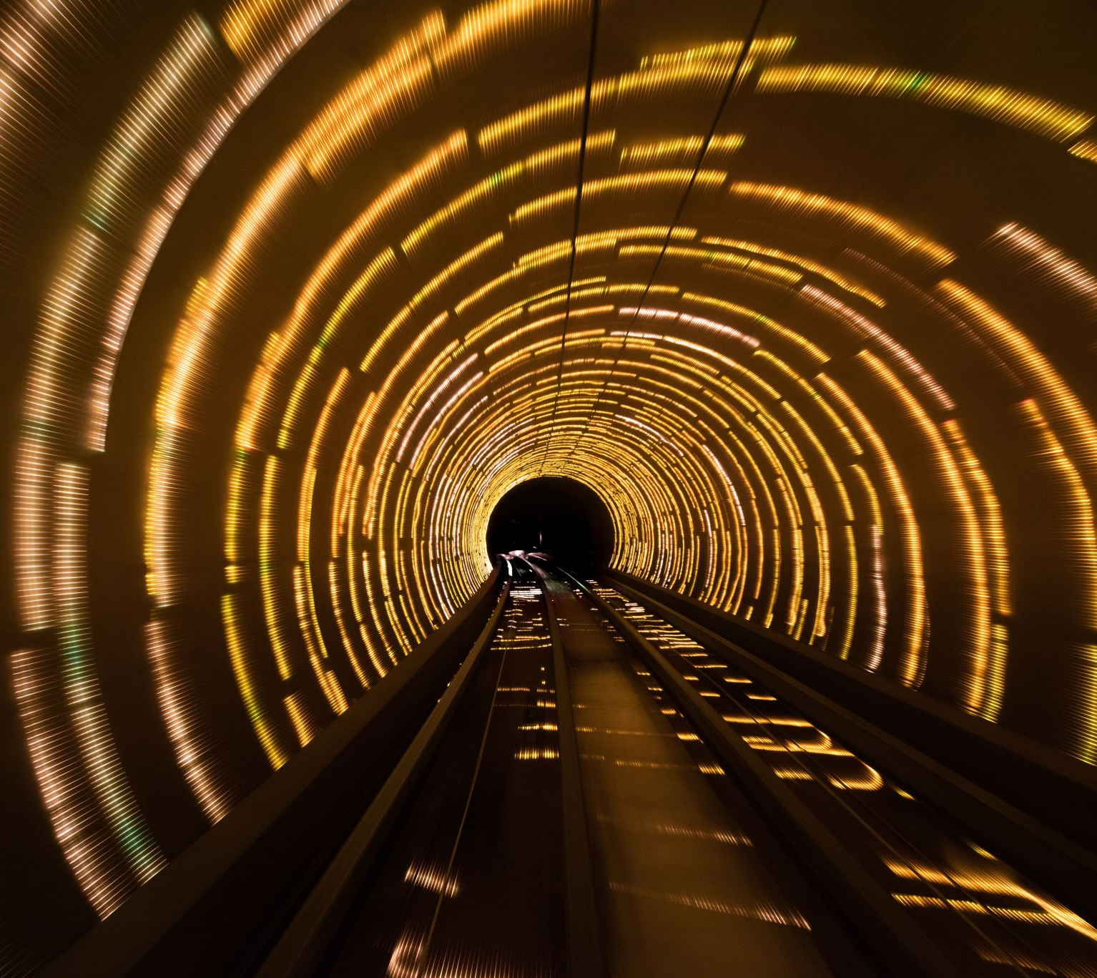
Cost Estimation Goal within Task-force goals and timeline
The objective of cost estimation is an essential component within the overarching goals and timeline established by the task force. This involves accurately assessing and projecting the financial resources required to achieve the task force's objectives, ensuring that all activities are aligned with the planned schedule and budgetary constraints. By focusing on precise cost estimation, we can enhance decision-making processes, allocate resources effectively, and ultimately drive the success of our initiatives.
a reference costing model simplified for the task force
computing reference infrastructure cost breakdown per section/area/cavern/tunnel, and
identify main cost drivers

Slide 17
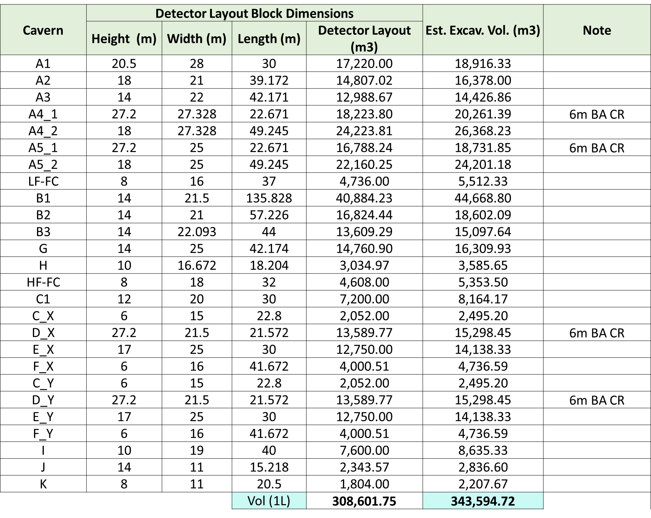
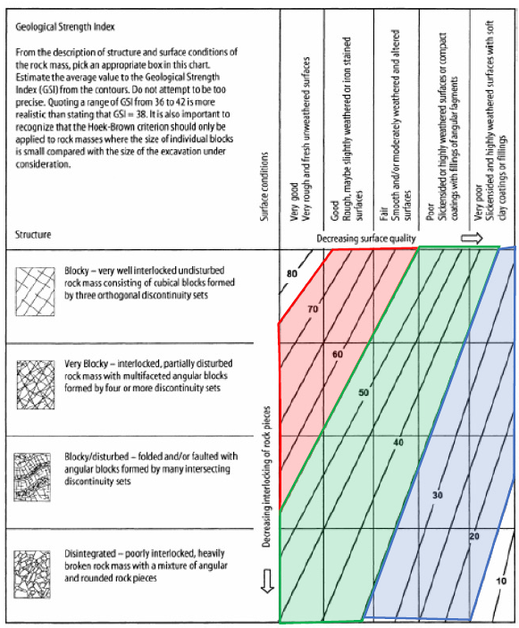
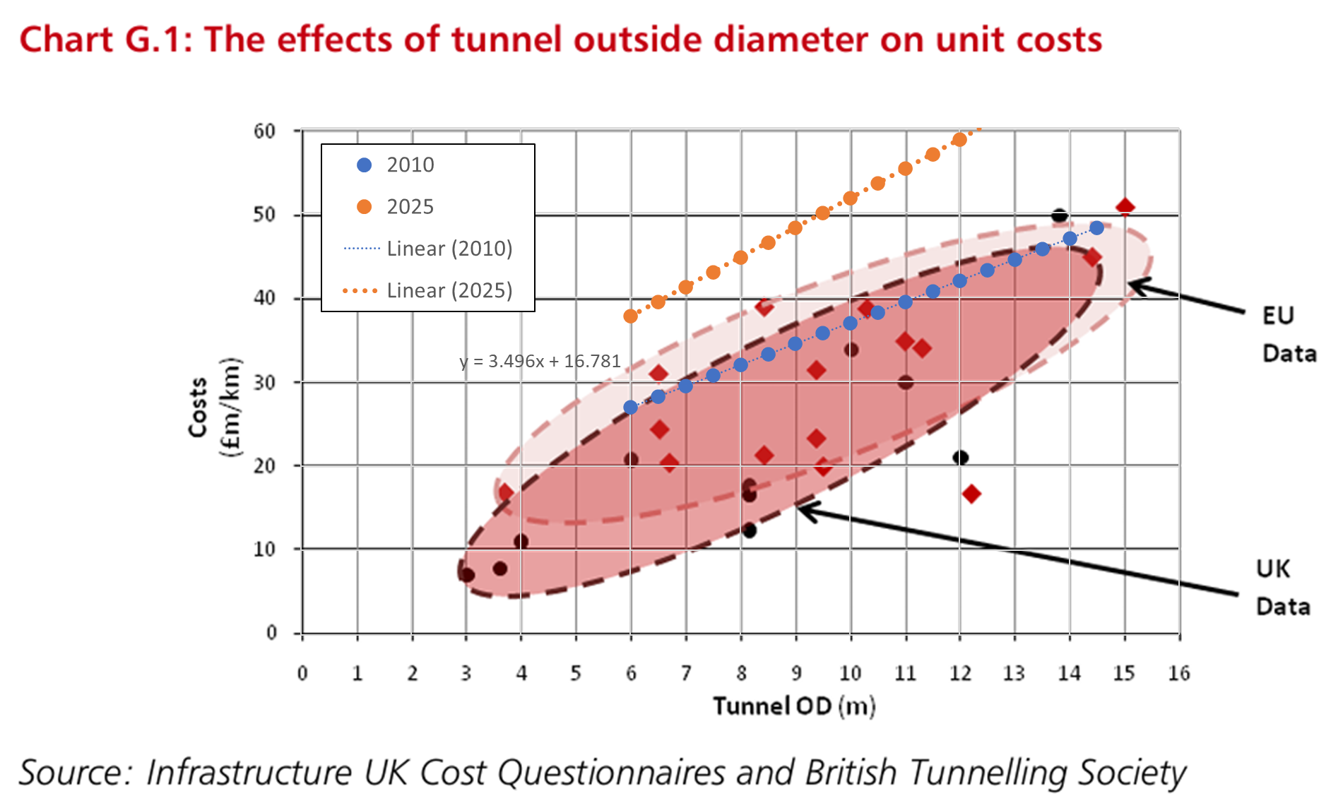
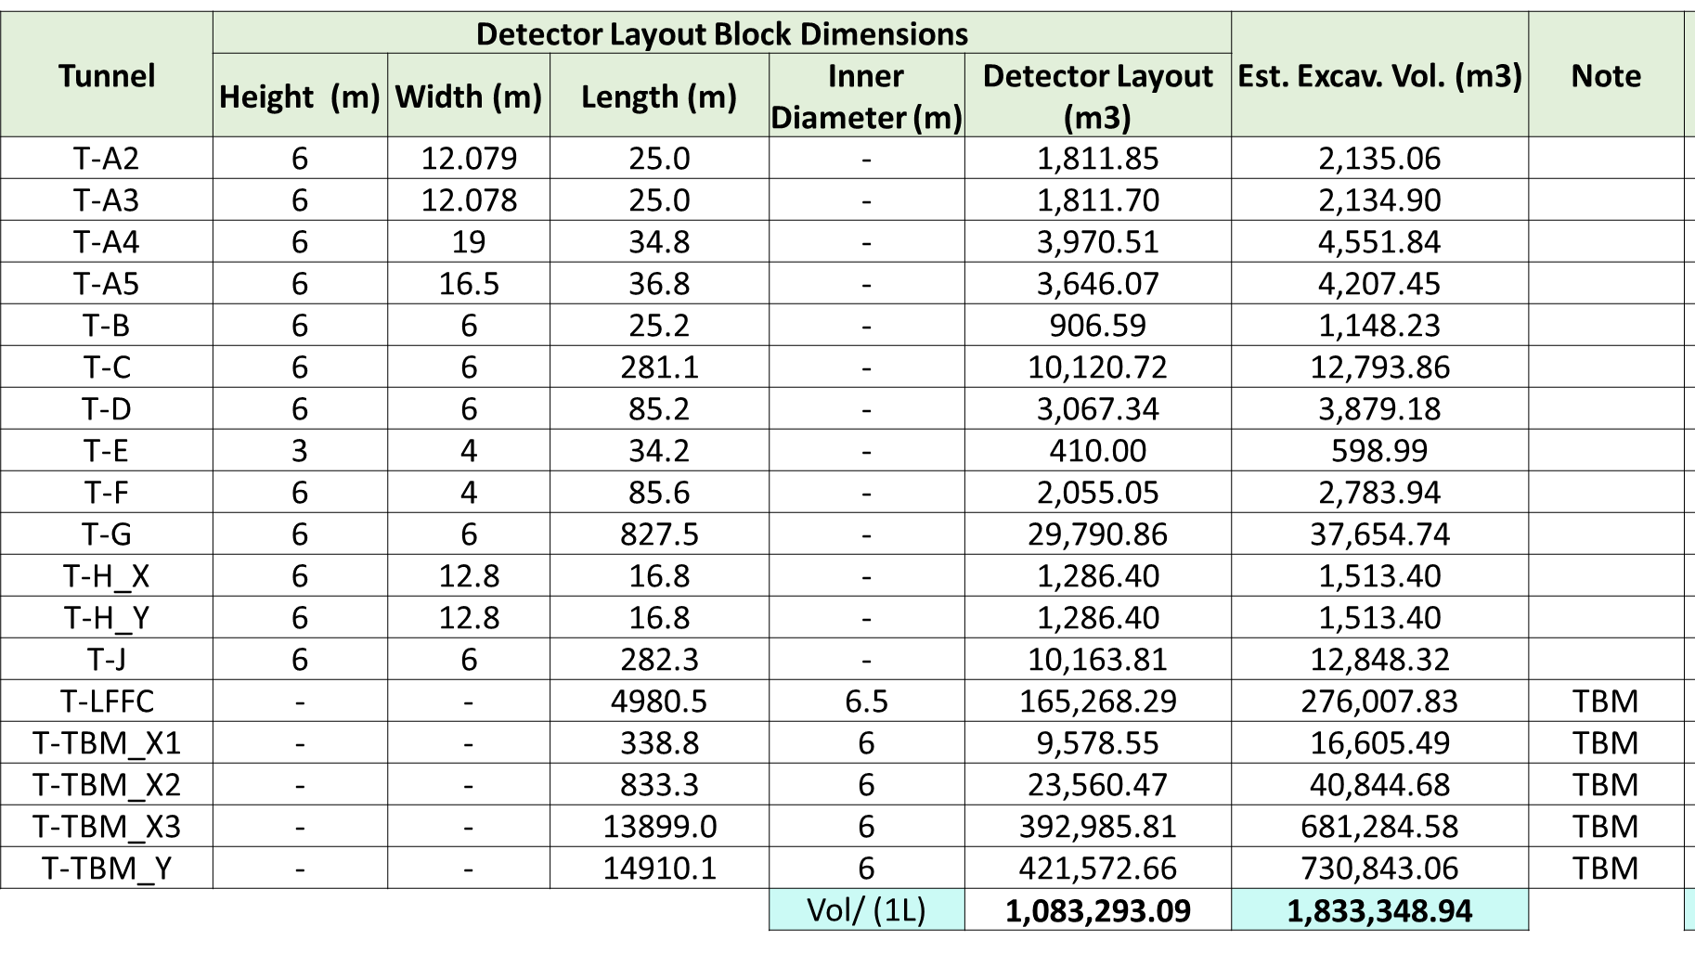
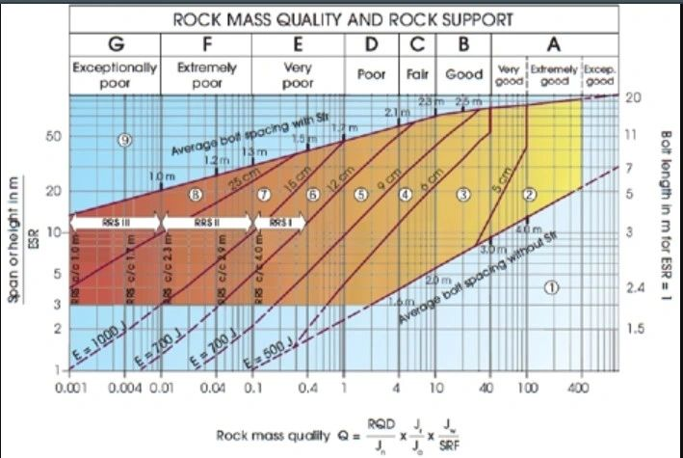
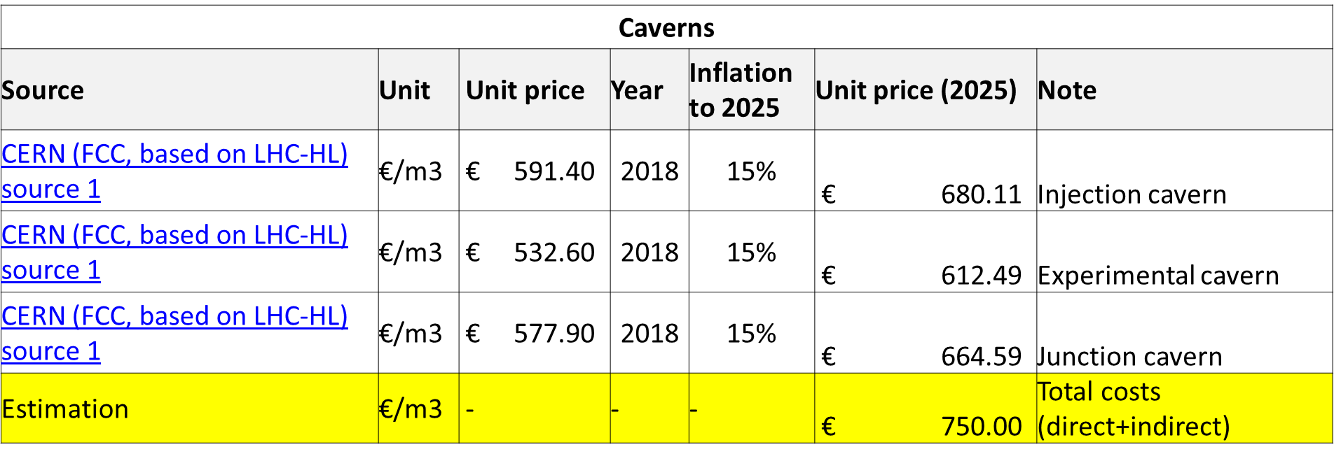
Cost Estimation Methodology
Limited to high level top-bottom estimation with high level of uncertainty (±50–100%)
Goal of identifying main cost drivers for design iteration process needs reliable/credible unit prices for cost estimation
Infrastructure geometry (volumes/quantity)
Assumed sizing of civil infrastructure components (tunnels, caverns) in function of the detector layout
Geological/Geotechnical (+other) conditions
Assumed rock conditions/quality
Unit prices
Assumed unit prices for tunnel/cavern construction
Cost differences
With breakdown per section/area/cavern/tunnel
Strategy for now while this methodology is being worked on: continue with the assumption of reducing volumes, but with qualitative input/opinions of the CE people in the taskforce to also steer the direction

Slide 18
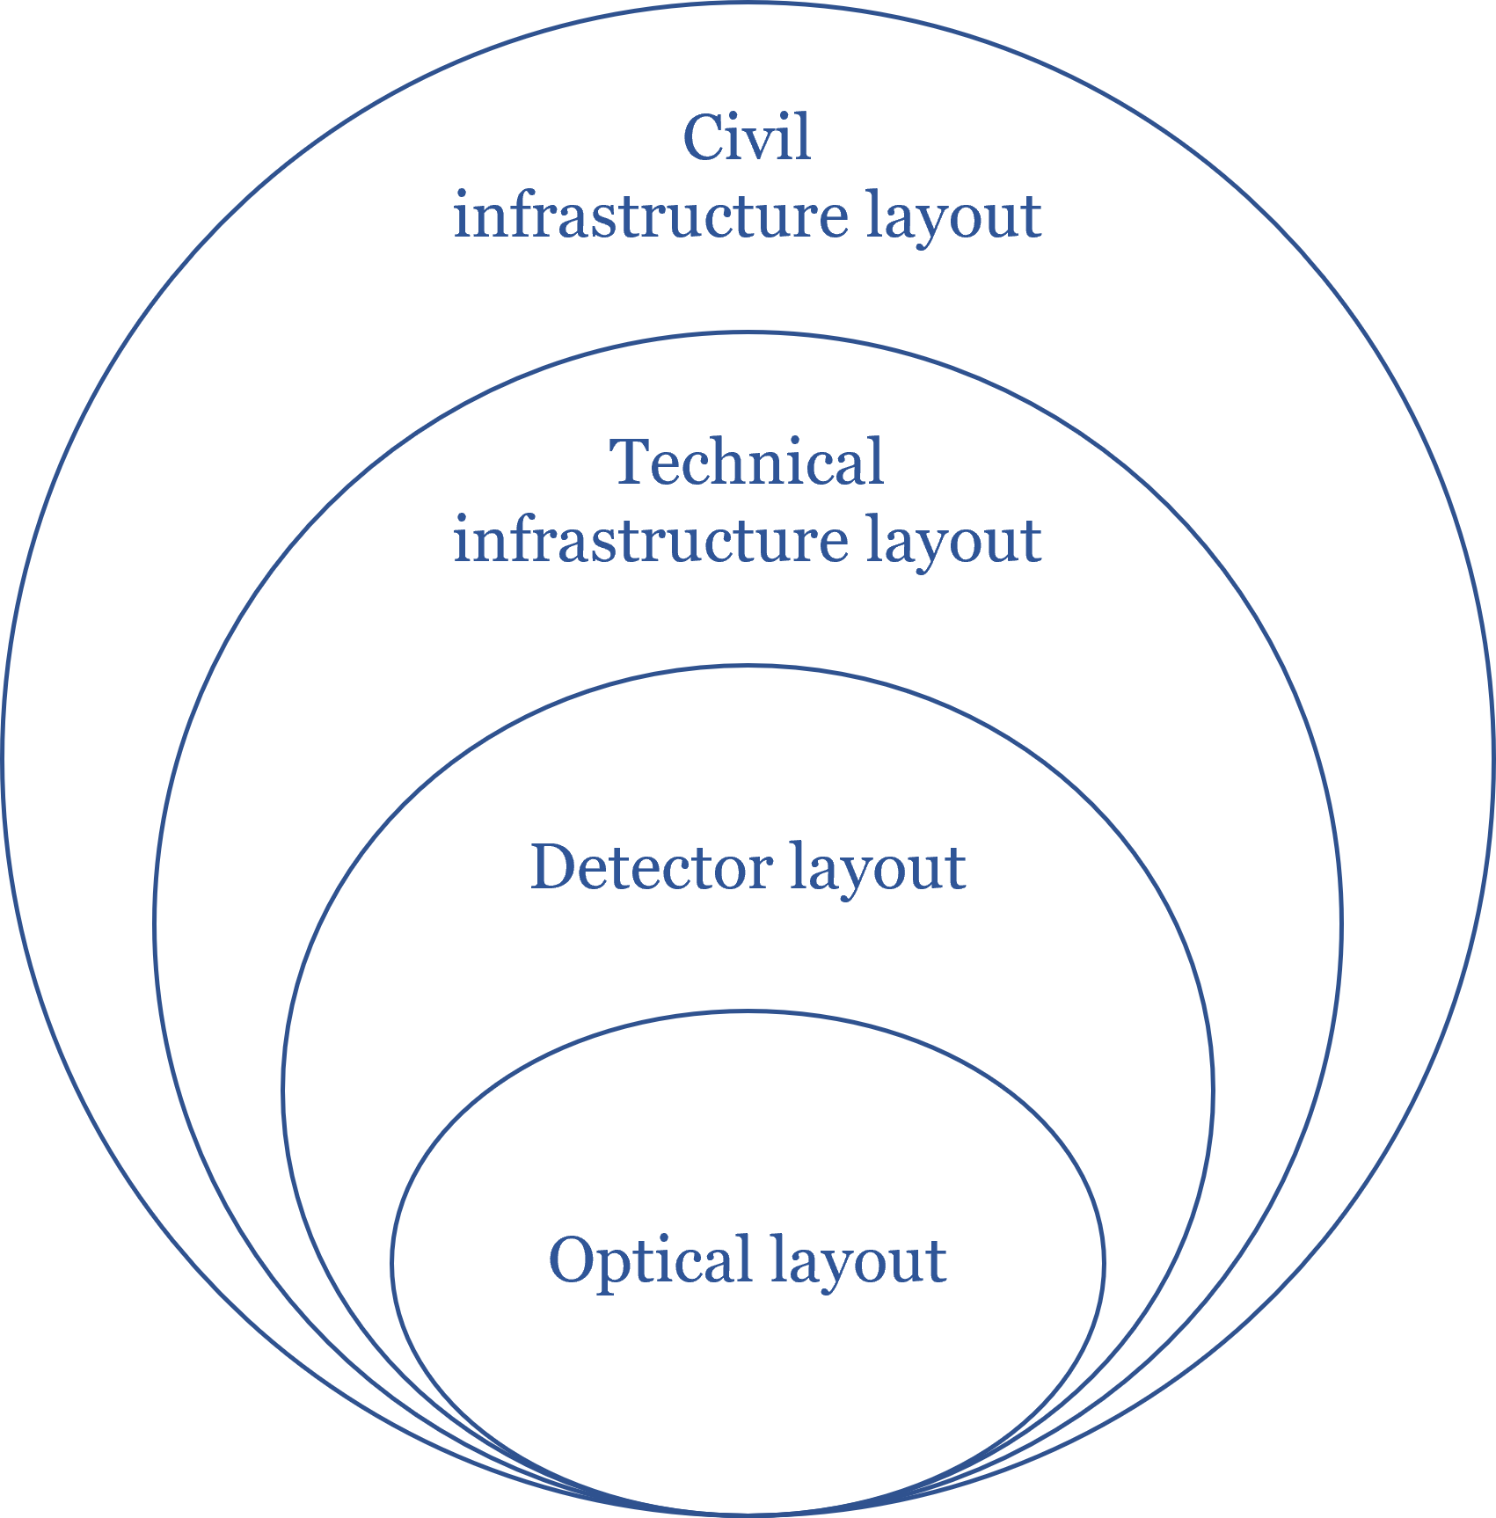
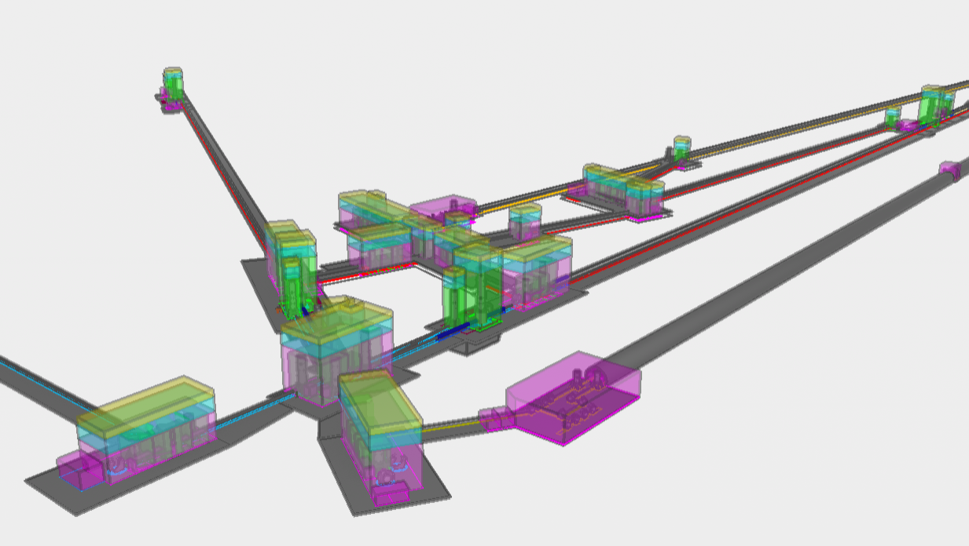
Detector Layout → Cost Estimation?
Tunnel,
Caverns,
Access shafts/tunnels
Emergency exits, etc.
Target for Cost Estimation
Mechanical systems
Cooling & ventilation,
Electrical systems,
Safety systems,
Logistics
Site independent cost estimation?
Issues:
Not tied to certain geographical and geological conditions
Can only assume geological/hydrological conditions to a certain level
Construction planning scheme(s) not considered
Not considering optimal cavern/tunnel shape
Assuming support system (primary and/or secondary lining, rockbolts, etc.)
Not considering access (shaft/tunnel), nor depth/position underground
Not considering additional tunnels needed for construction (e.g. connection/service tunnels for excavation of caverns)
Surface works not considered
Technical infrastructure not considered
Not fully considering safety (no personnel yet)
….
Tower base, suspensions, tower envelopes,
Scaffolding,
Clean rooms,
Auxiliary benches,
Beampipes
Logistics
Arm cavities + recycling cavities
Laser, injection, detection, squeezing

Slide 19
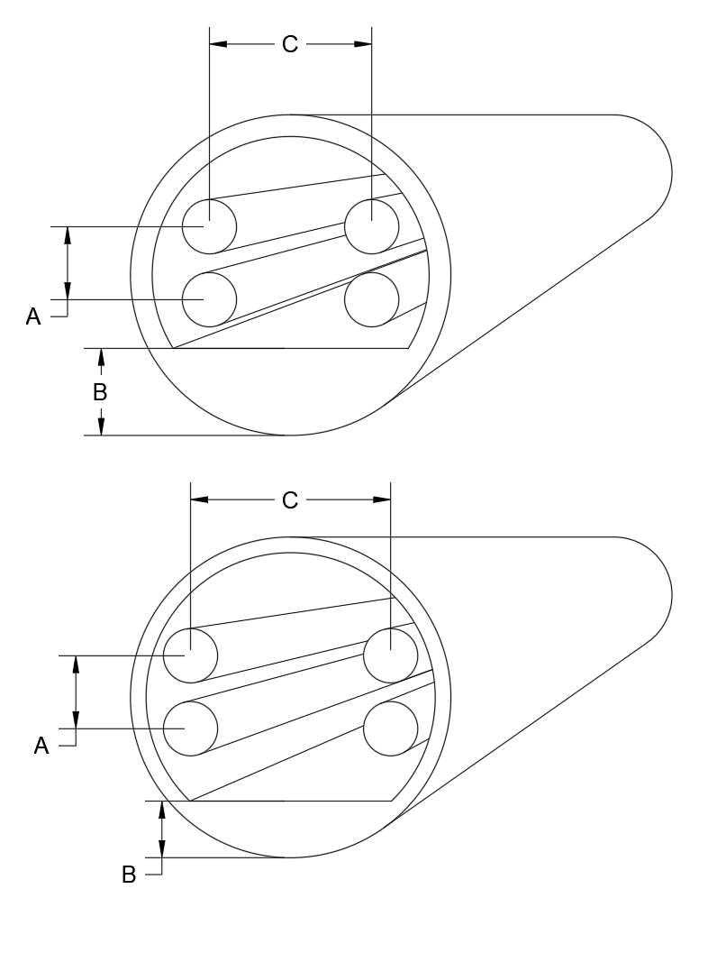
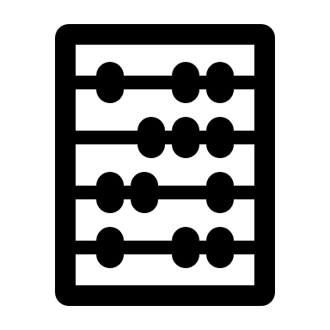
Outlook: Model-based parametric design and analysis
We propose to adapt parametric design methodology leveraging 3D models of the infrastructure not merely as a means of geometrical representation but as a versatile tool to:
Compare alternative scenarios and situations.
Perform real-time analyses (e.g., costs, quantities).
Automate solution generation where feasible.
This approach enhances efficiency, adaptability, and decision-making throughout the design process.
Parametric modelling
Option A
Real time Calculation: (Cavern Volumes, Tunnel Volumes & Lengths, Quantity of materials,.. )
Cost
Parameters set 1
Comparison
Option X
Validation
Decision making
Parameters set 2
Parametric model (Flexible with constraints) Which include the layout variants
Multi objective optimization
Automatic layout and sections proposals
Criteria to be considered
Generative design based on criteria to optimise

Slide 20
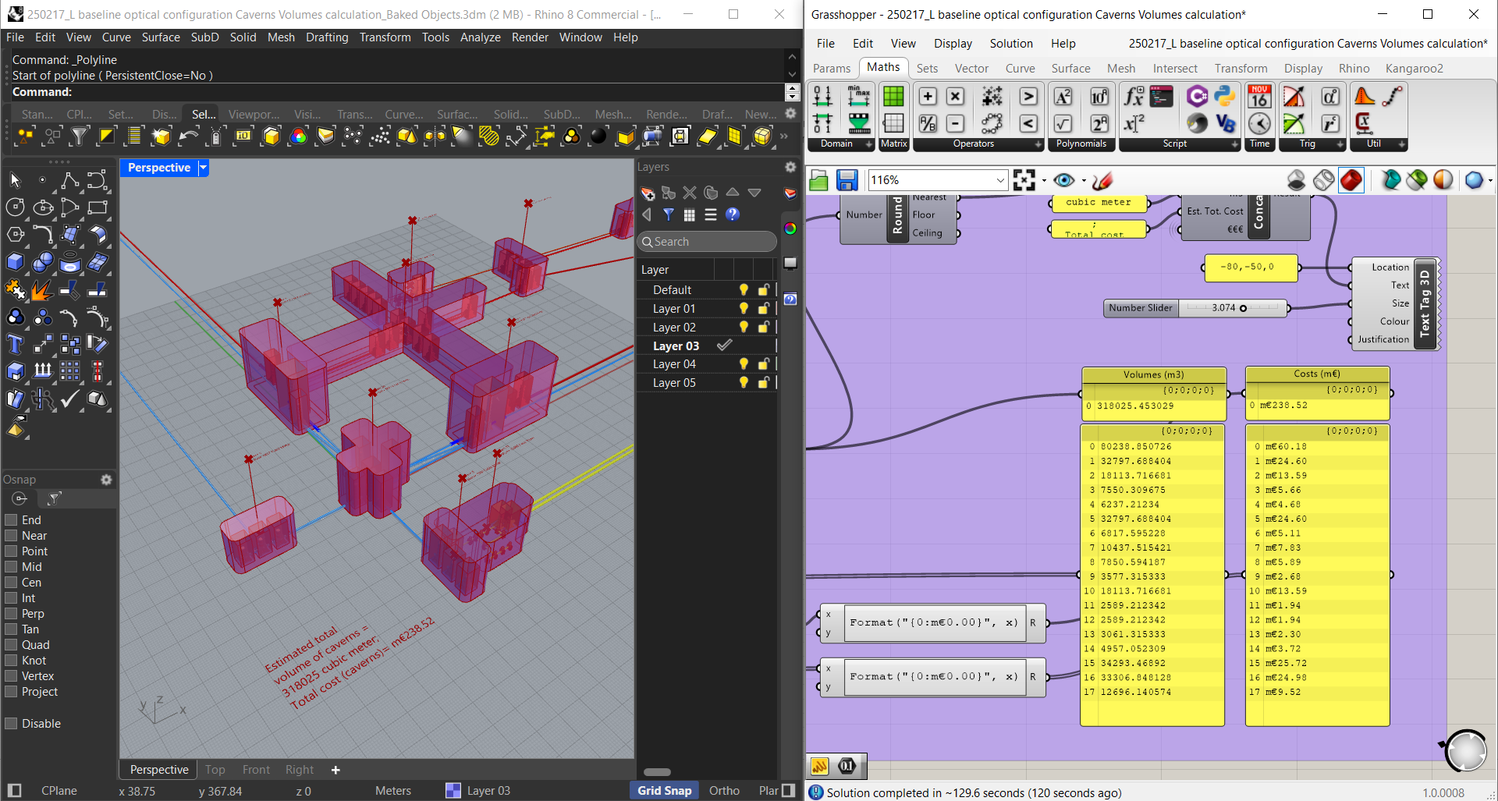
“Quick” layout tool for 1st Task Force Meeting

Slide 21
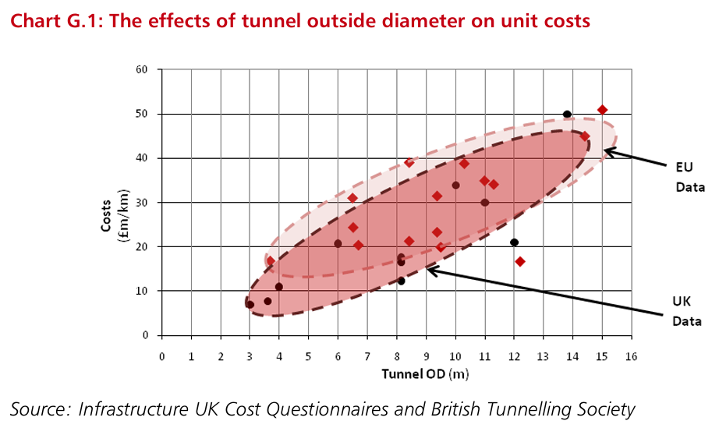
Unit Costs for ETO Task Force Purposes
Caverns
Source | Unit | Unit price | Year | Inflation to 2025 | Unit price (2025) | Note
CERN (FCC, based on LHC-HL) source 1 | €/m3 | € 591.40 | 2018 | 15% | € 680.11 | Injection cavern
CERN (FCC, based on LHC-HL) source 1 | €/m3 | € 532.60 | 2018 | 15% | € 612.49 | Experimental cavern
CERN (FCC, based on LHC-HL) source 1 | €/m3 | € 577.90 | 2018 | 15% | € 664.59 | Junction cavern
Estimation | €/m3 | - | - | - | € 750.00 | Total costs (direct+indirect)
DRAFT
Example using this unit cost for different cavern sizes:
25 x 30 m (724.6m2 excavation area) → unit cost = €543.472,50/m
20 x 30 m (579.6m2 excavation area) → unit cost = €434.670,00/m
25 x 25 m (592.6m2 excavation area) → unit cost = €444.450,00/m
17 x 12 m (191.3m2 excavation area) → unit cost = €143.482,50/m
Outer Diameter (m) | Unit price
 | 2010 | 2025
6 | € 27.0 | € 37.8
6.5 | € 28.3 | € 39.5
7 | € 29.5 | € 41.3
7.5 | € 30.8 | € 43.0
8 | € 32.0 | € 44.7
8.5 | € 33.3 | € 46.5
9 | € 34.5 | € 48.2
9.5 | € 35.8 | € 50.0
10 | € 37.0 | € 51.7
10.5 | € 38.3 | € 53.5
11 | € 39.5 | € 55.2
11.5 | € 40.8 | € 57.0
12 | € 42.0 | € 58.7
12.5 | € 43.3 | € 60.5
13 | € 44.5 | € 62.2
These assumptions are not verified by other parties. Do not take these numbers as absolute.

Slide 22
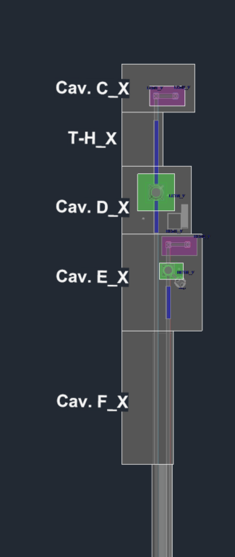
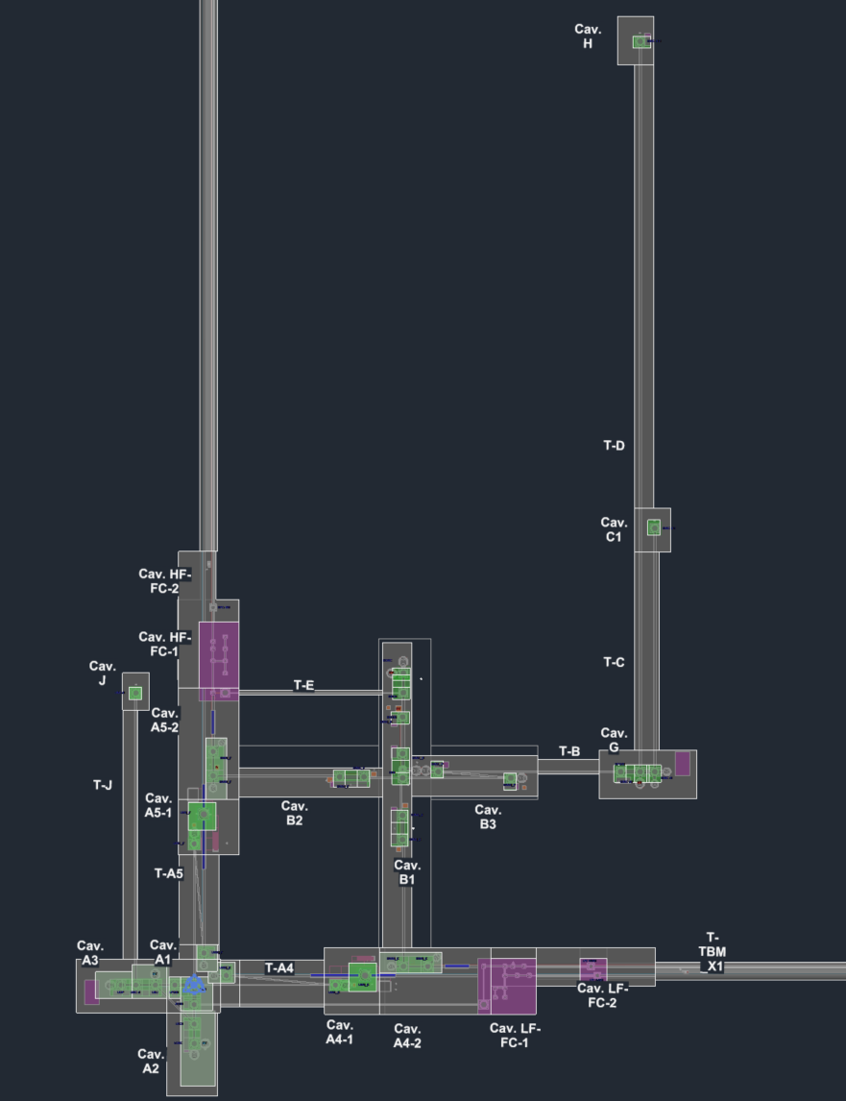
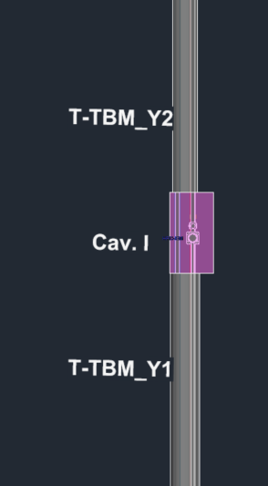
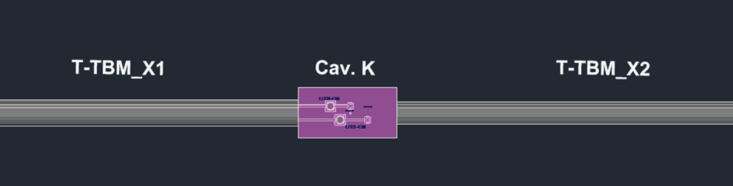
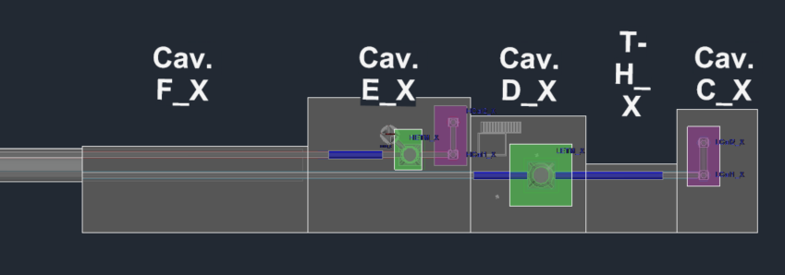

Slide 24
Discussion on needed requirements
Water management
Water tightness of caverns/tunnels,
Allowable waterflow rate+type (e.g. laminar flow) for the context of newtonian noise (also for airflow)
Distance of pumps to towers (e.g. LF TMs)
Related to the required type of lining (and finishing) for certain/all caverns/tunnels
Allowable inclination of interferometer - ~1 ‰ (and 2‰) (but also most relevant for TM suspensions and at vertexes)?
Environmental requirements
Humidity near LF/HF TMs, vertexes, arms
Temperature stability
Airflow
Cleanroom requirements (electrical, airflow, etc.)
Noisy equipment location?
Logistics -> implication on continuous cranes/caverns
What is the acceptable operational cost (e.g. time)?
Needed recesses in tunnels (aside from safety)?
Technical risk tolerance (e.g. shrinking tunnel envelopes and not leaving room for transport of certain tower bases in the future)
…

Slide 25
Thanks!

