Slide 1
Suspension Classification Update
2025-02-10

Slide 2
Previous classification work
Tower integration shared table between ETO-PO, OPT/ITF, SUS and VAC&CRYO
Effort to centralize known interfaces and boundary conditions between divisions
Includes build volumes, Residual Motion (RM) categories, payload dimensions and types, …
Can be accessed here
Preliminary Suspension Type Classification MEMO (ET-0577A-24)
TDS document by N.A. Holland, A. Spencer and R. Meijer, reviewed by SUS division
Classifies suspension systems based on similarity in system boundary conditions (between 6-9 types)
Why?
Start integrating divisions to later yield ‘node-specific’ solutions
Start both hierarchical and interface-driven requirements flows
Provides insight into what each system ‘needs’ to do whilst remaining design-agnostic
2025-02-10
Suspension Classification Update

Slide 3
What is written in ET-0577A-24?
Preliminary volume envelopes for in-vacuum ET suspensions.
Residual motion category, mass and required bench area (if applicable) from ITF Div. Δ layout work, and known special features - at each ITF node
Coarse, design agnostic, maximum volumes from LIGO/Virgo solutions + ET conceptual design
Incorporates experience from Virgo → AdV phase 2 and LIGO → LIGO A+ for:
Some functional requirements for seismic isolation systems in ET
Design and volume agnostic interface changes to seismic isolation
Represents a useful starting point for suspensions at all nodes of both ET ITFs
Can be accessed on TDS using: ET-0577A-24
2025-02-10
Suspension Classification Update

Slide 4
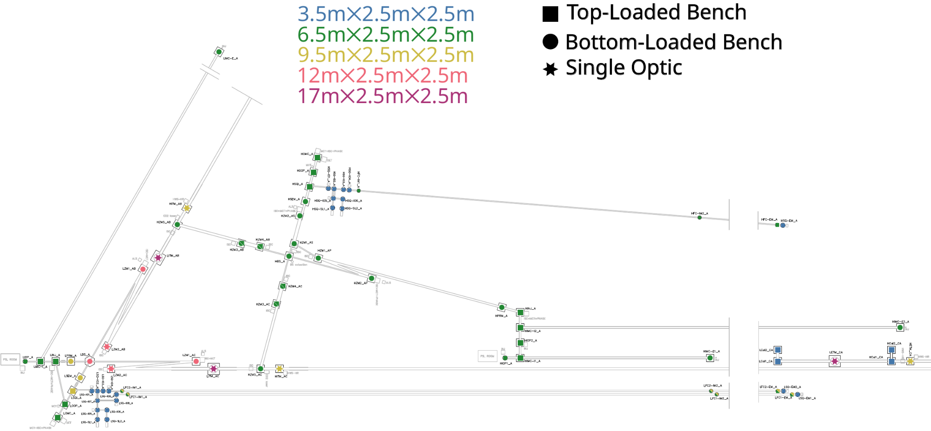
Conservative Classification - Starting Baseline
Higher residual motion category (1, 2, 3, 4, 5) requires more volume (height)
Benches, with functional requirements, provide greater (future) flexibility - preferred
2025-02-10
Suspension Classification Update

Slide 5
How can ET-0577A-24 already be improved?
Not all suspended, in-vacuum nodes were incorporated because they lacked unique names at the time - auxiliary benches particularly.
These were added in the Δ preliminary detector layout
Not all nodes were fully classified because they had conflicting boundary conditions - filter cavity mirrors are a particular example.
Two options for residual motion category were provided, 2 (less stringent) or 3 (more stringent)
Check the volumes of residual motion category 1 benches - see if they are all the same.
Plausible to do because they should all be listed, now auxiliary benches are added
Some locations had interface flexibility - no reason to select one.
Pending review
2025-02-10
Suspension Classification Update

Slide 6
Proposed update 1: Down Selection
HZM3_AB, HZM3_AC, HZM4_AB and HZM4_AC were assigned as either: category 2 top/bottom loaded bench + payload.
No strong/obvious reason to select between the top/bottom loaded bench options
A decision will help focus more detailed efforts
To match other ‘equivalent’ optics in the HFI central interferometer these have been assigned to: bottom loaded, category 2 bench + payload
Pending review
2025-02-10
Suspension Classification Update

Slide 7
Proposed update 2: Splitting Category 1 Benches
Review of ET-0676A-24 ‘Preliminary Detector Layout - 10 km Triangle’ revealed that there is insufficient space in some locations, HSSB_A specifically, where large category 1 benches won’t fit.
Not an issue in the preliminary L layout
Other locations where smaller category 1 benches could also be used
Split category 1 into category 1, ‘petite’ and ‘grand’, top loaded benches (S1TBp/S1TBg).
Provisionally intended for 3m × 3m and 4m × 4m footprint tanks, respectively
Provide 3.24 m² and 6.25 m² of area, respectively
Baseline is to provide S1TBg everywhere it can fit - open for discussion on this point
Pending review
2025-02-10
Suspension Classification Update

Slide 8
Proposed update 3: RM of LFI Filter Cavity Mirror nodes
Residual motion classification was undecided, by ITF Div, when preliminary classification was done.
LFC1-IM1_A, LFC1-IM2_A, LFC1-EM_A, LFC2-IM1_A, LFC2-IM2_A and LFC2-EM_A
Residual motion category 2 or 3 were nominated
Conservatively, these have been assigned to residual motion category 3.
Determination on interface; top/bottom bench + payload, multi-optic (not preferred), single optic (disfavoured) is not yet possible, and may vary per node.
Requires LFI FC integration solution, pending (more later)
Pending review
2025-02-10
Suspension Classification Update

Slide 9
What we bring to the 1st In-Person Meeting
ET-0577A-24 (preliminary classification)
+
Updates/Changes listed in slides 6-8
&
Points that follow on slides 10 and 11.
2025-02-10
Suspension Classification Update

Slide 10
Task Force Actions - With Other Experts
Move away from qualitative and towards quantitative residual motion categories - with ITF
Assist with viable LFI FC placement
Potential telescope options
Mirror suspension system options
Assist with DARM performance determination where suspension choice impact this
2025-02-10
Suspension Classification Update

Slide 11
Task Force Actions - With Other Experts
Already some specifics, too:
HSAB5_AB in (only) Δ preliminary detector layout
Proximity to cryo-baffle might require this to be S1TBp rather than S1TBg - depends on where the beam ‘lands’ on the bench too (w. ITF + V&C)
Multiplicity of category 1 benches in SQZ ‘hall’ - many small or few large (w. ITF)?
Better idea of sizes is now available
2025-02-10
Suspension Classification Update

Slide 12
Task Force Actions - Suspension Experts
Start to remove the ‘design agnostic’ aspect of volume claims from ET-0577A-24
Start to open the ‘payload design’ that was left unanswered in ET-0577A-24
Add ‘anticipated’ beam location and ground interface, within this volume claim
Guided always by: What is a viable volume?, not specifying final solution
Update suspension classification as design proposals are sketched
This will update and refine the volume claims
Incorporate work for ET-LF test-mass suspension which is ongoing in the wider SUSP Div
View link here: Overleaf
2025-02-10
Suspension Classification Update

Slide 13
Time for discussion
2025-02-10
Suspension Classification Update

