Slide 1
Feedthroughs for the Climatic Chamber

Slide 2
Emergency nitrogen pipes n. 1 – dia. 1/2 in / 12.7 mm
The PP2 will be placed outside the Climatic Chamber and the feedthrough will contain the type 2 cables that connect the PP1 to the PP2.
Cooling pipes – n. 2 – dia. 8/10 mm
Trunk fiber bundle – n. 2 – dia. 10 mm (3/20)
Optoboxes (4) environment
Power cables – n. 4 – dia. 14 mm (7/13.2)
VCAN cables – n. 4 – dia. 7 mm (4/6.3)
Optoboxes dry air pipes – n. 2 – dia. 8 mm
Extra data cables
34 + 32 + 36 twinax bundles
Climatic Chamber wall
Total cable feedthrough equal to 4500 mm² → d_{eq} = 75 mm
Total pipe feedthrough equal to 1500 mm² → d_{eq} = 45 mm
Type II cables – n. 7 – dia. 20 mm (4/20)
With 10 kΩ NTC on modules – n. 18 – dia. 3.5 mm (1) (embedded on type II cables)
CO₂ transfer lines – n. 2 – dia. 8 and 12 mm (+ 60 mm armaflex)
PTC Box
PTC inlet-middle-outlet of CO2 flow – n. 11 – dia. 3.5 mm (1) Interlock
ITk detector
(2/9.4)
Dew point
Humidity
Box
Humidity sensor cables – n. 2 – dia. 3.5 mm (1) Interlock
Dew point sensor cables – n. 2 – dia. 0.222 in / 5.7 mm (1) Interlock
Light
Flow meter
Pressure
Box
Flow meter cables – n. 2 – dia. 0.222 in / 5.7 mm (1) Interlock
Pressure sensor cables – n. 2 – dia. 0.222 in / 5.7 mm (1) Interlock
Light sensor cables – n. 2 – dia. 0.222 in / 5.7 mm (1) Interlock

Slide 3
Updates on cables for the climatic chamber feedthroughs
Off-detector services type | Units for one Endcap | Diameter (mm)
Alternative Type-2 power cables (25m) | 4 type-N | 15 to 20
Env Type-2 power cables (25m) | 2 | 9,4
Type-2 Opto-MoPS (30m) | 4 | 6,3
Type-2 Vopto (25m) | 7 | 13,2
Trunk fibres (25m) | 3 | 20

Slide 4
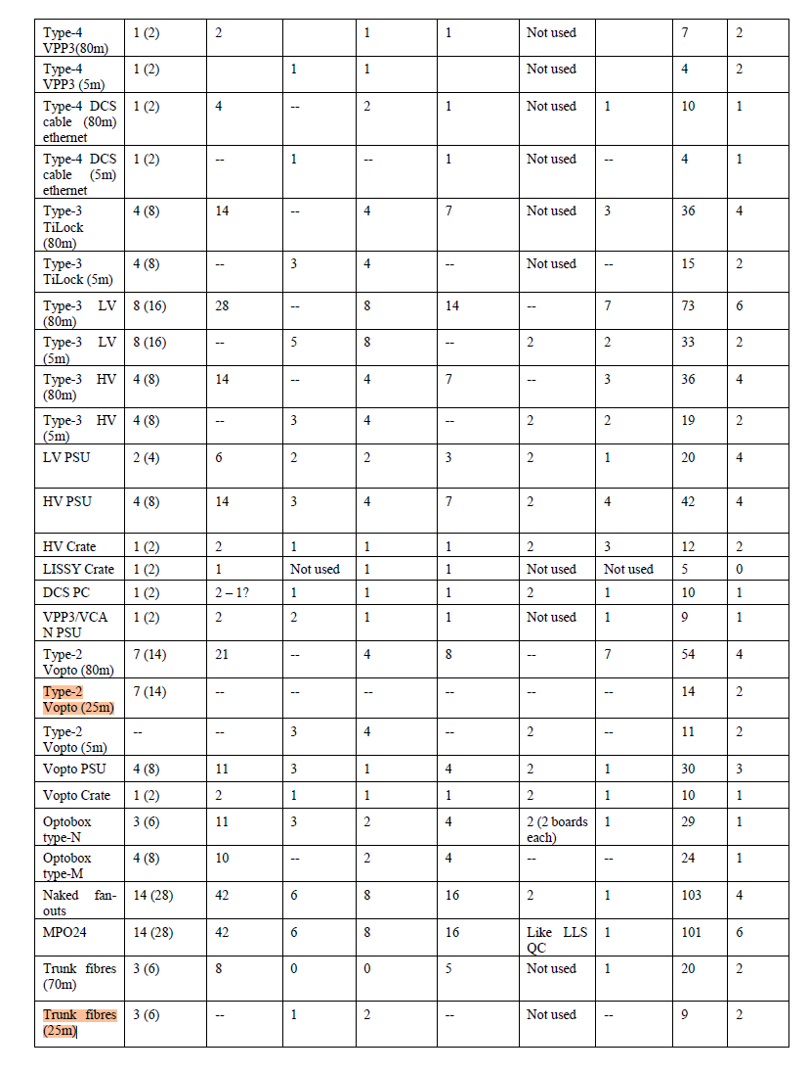
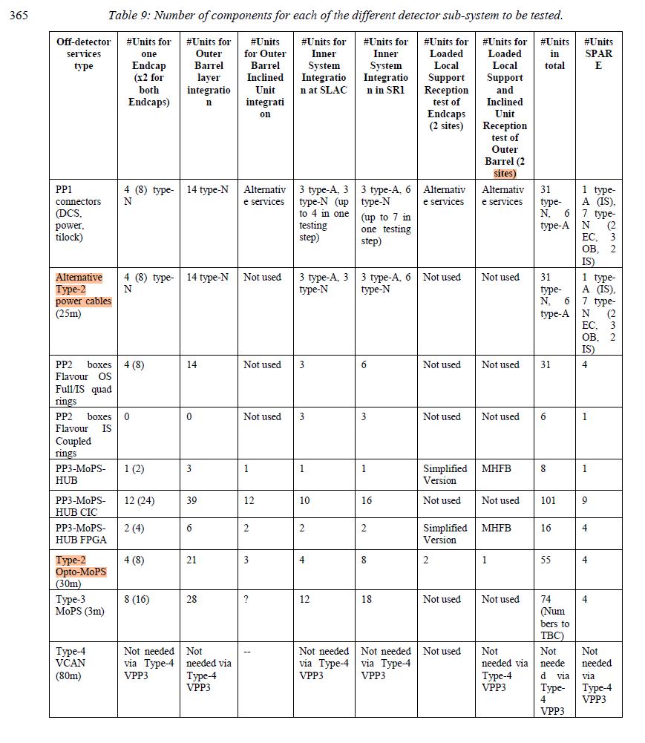
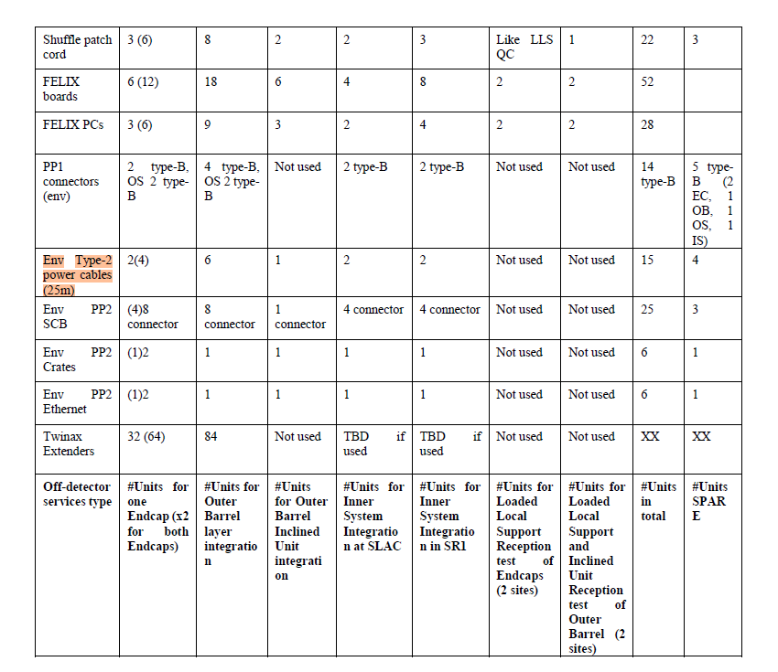

Slide 5
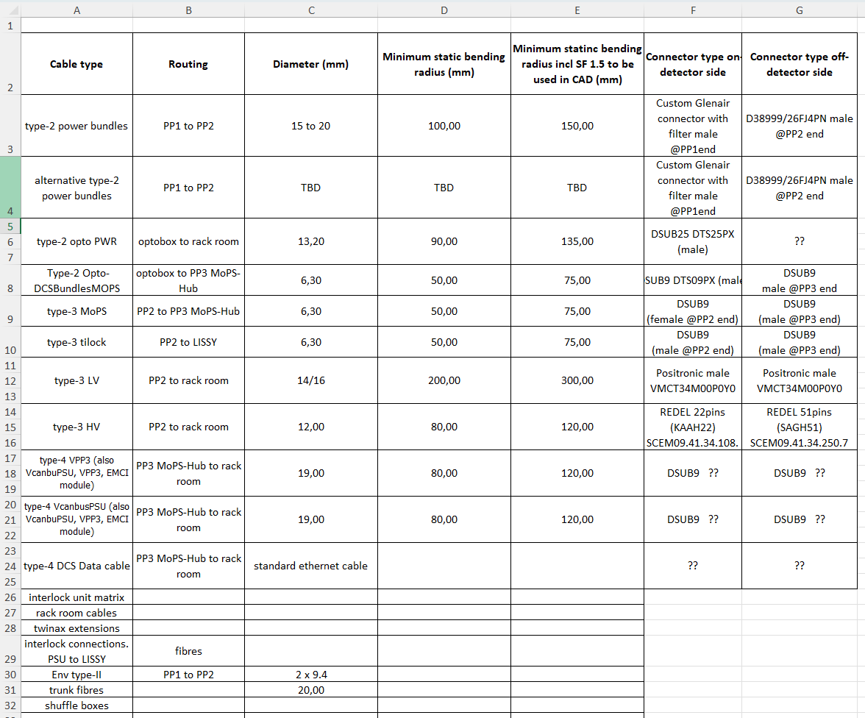

Slide 6
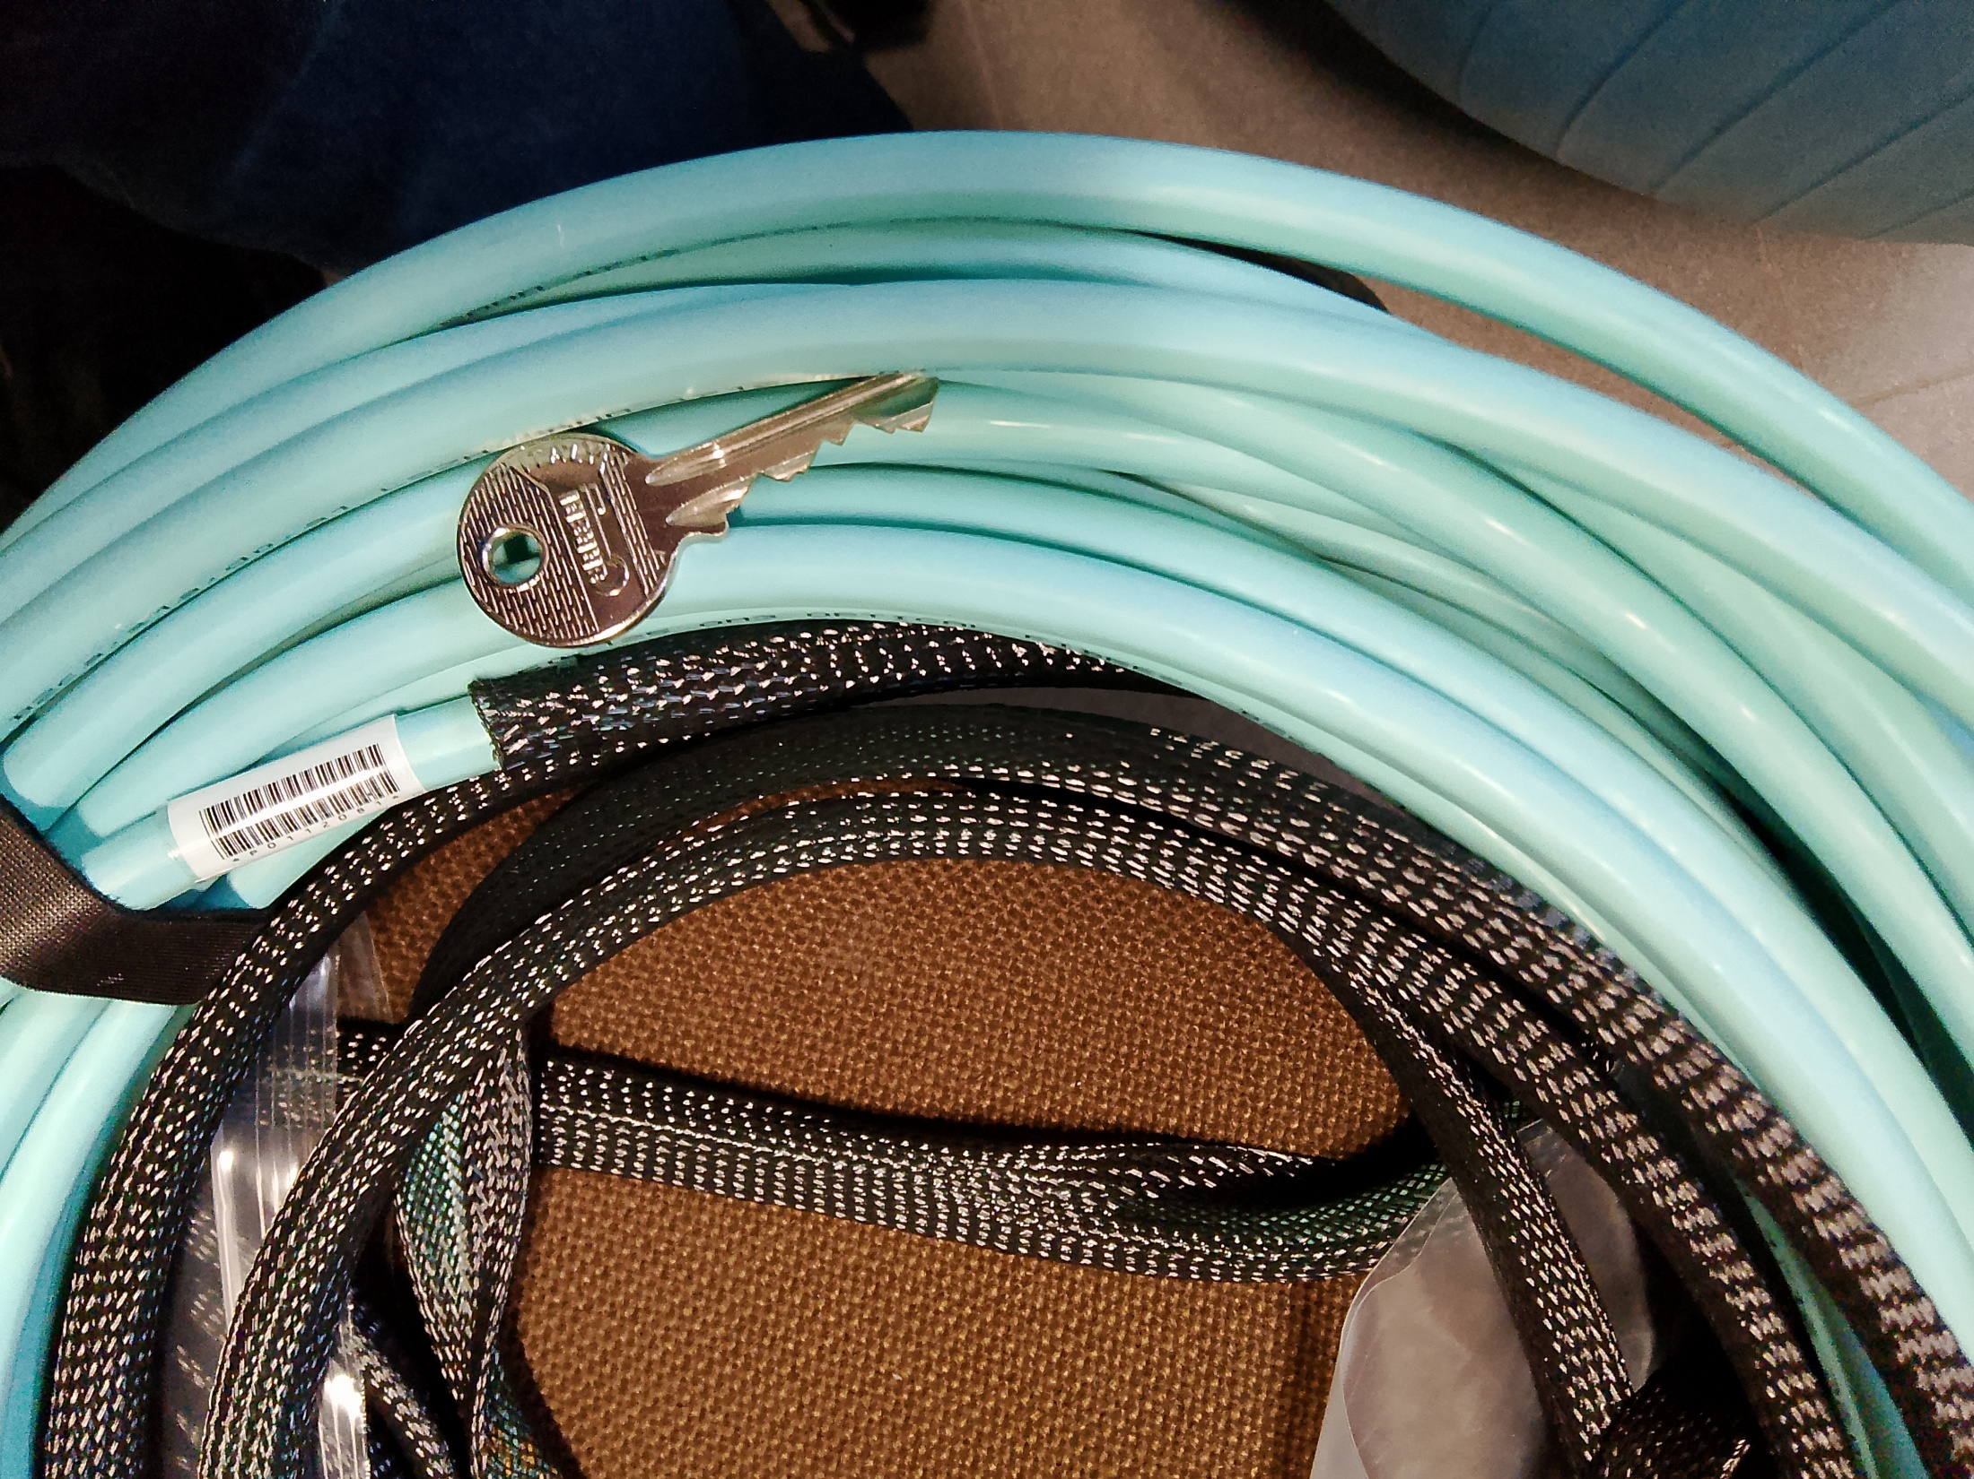

Slide 7
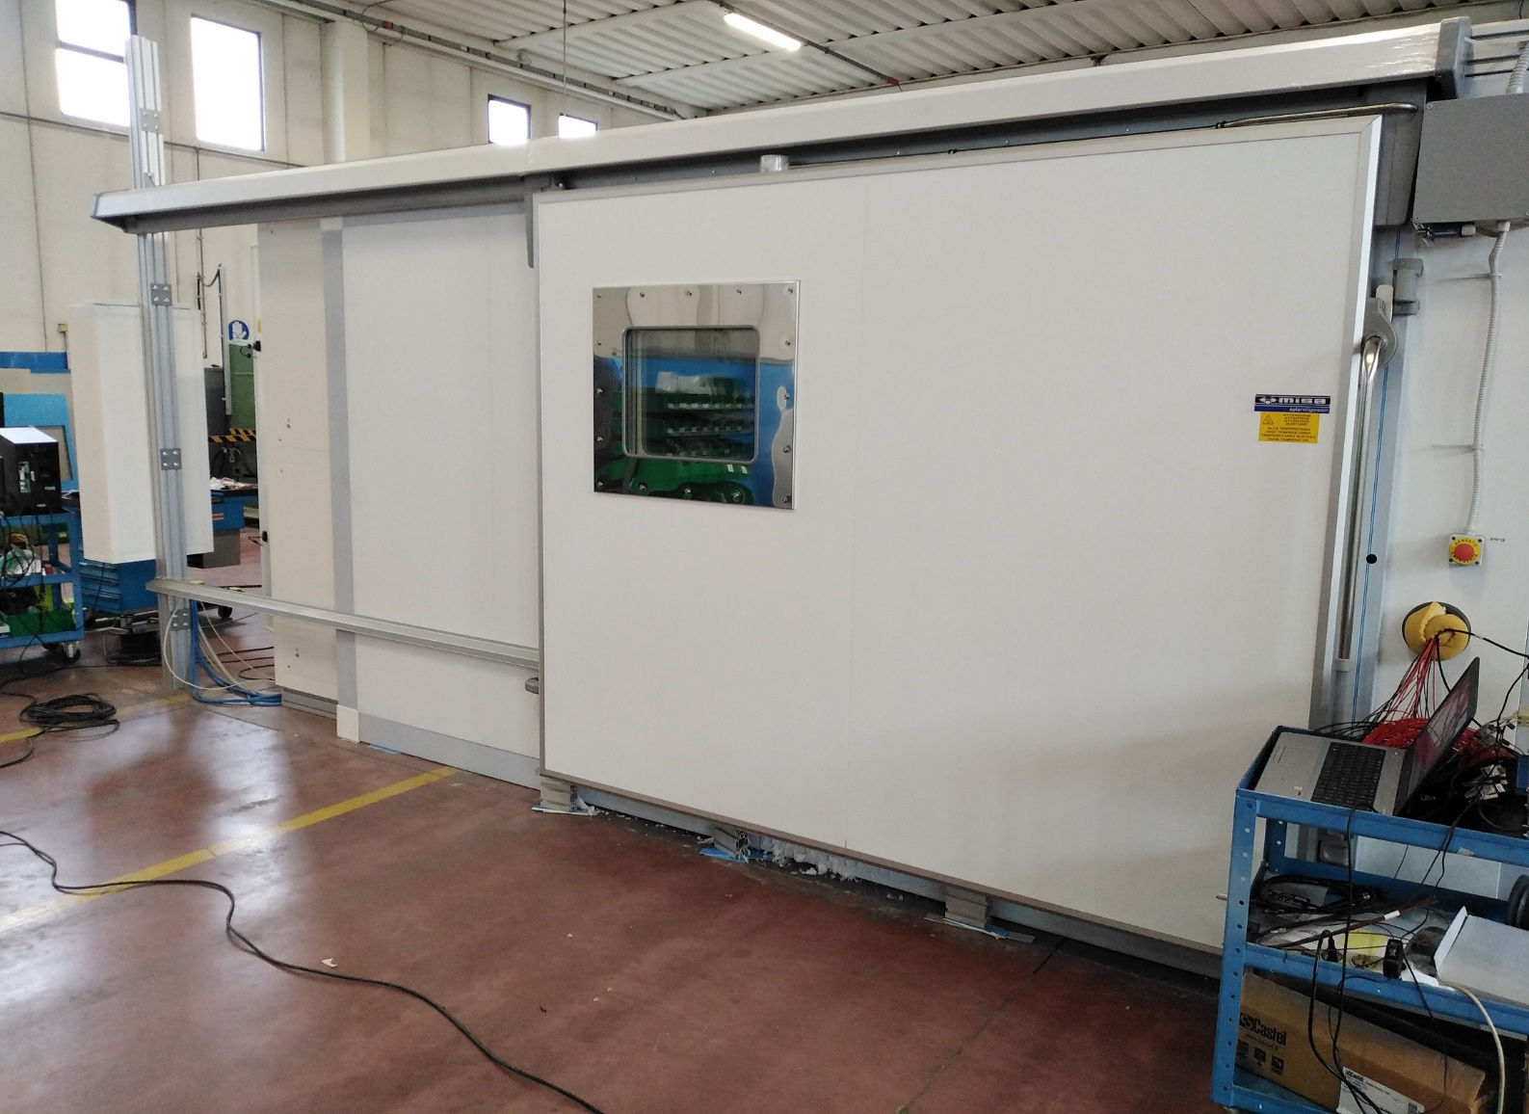
Dry air fans
3700 mm
Double glazing for thermal insulation
evaporators and resistors
4000 mm
Handle with electromechanical locking system
100 mm
400 mm
130 mm
2760 mm
Chamber wall considered for cable and pipe feedthroughs (with an existing 100 mm circular hole)

Slide 8
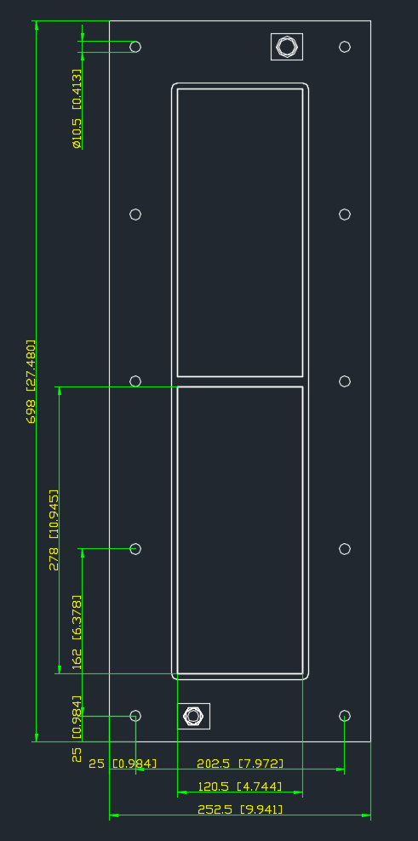
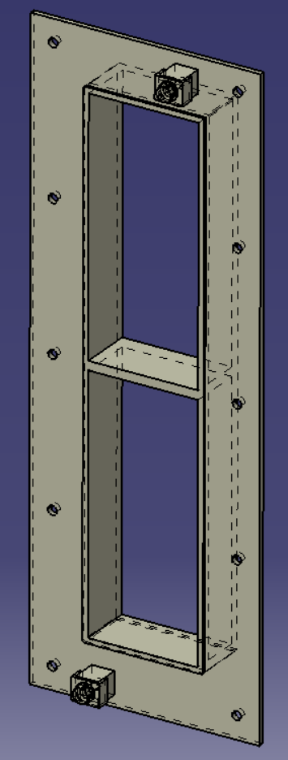
Sensors
Type II
CO₂
N₂ emergency
grounding

Slide 9
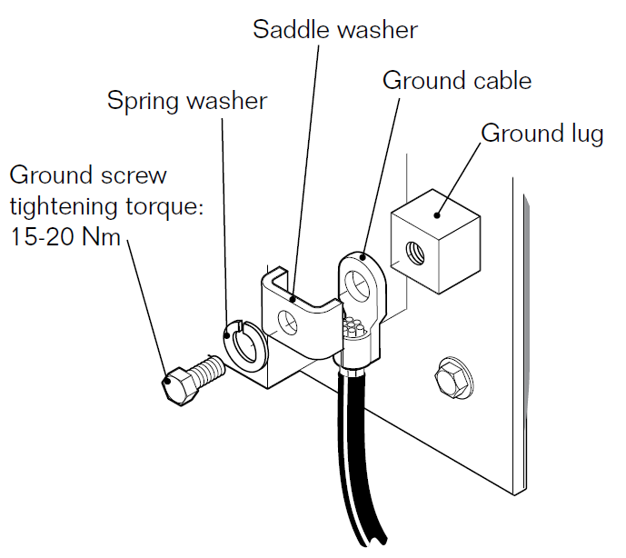
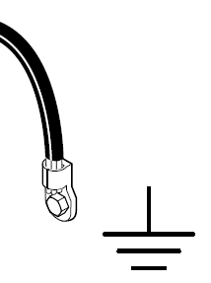
grounding

Slide 10
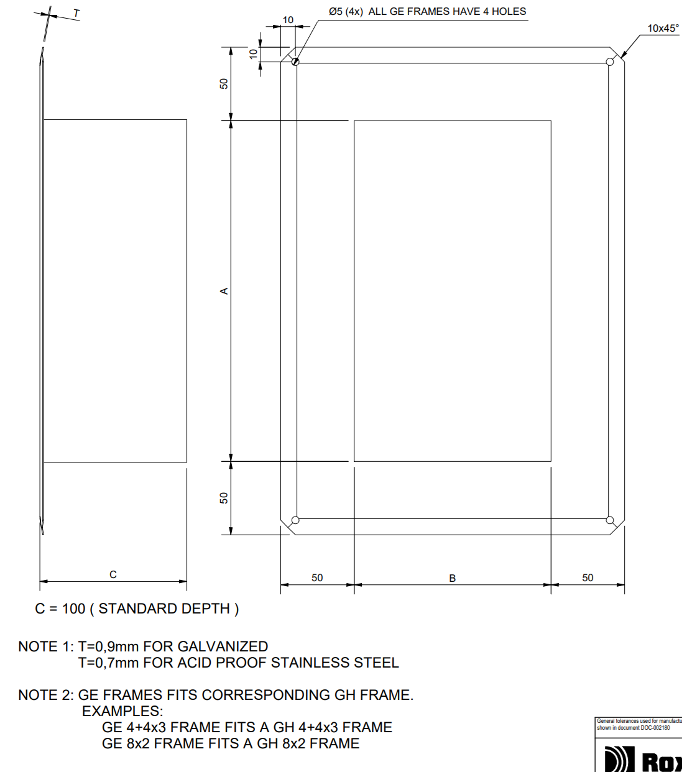
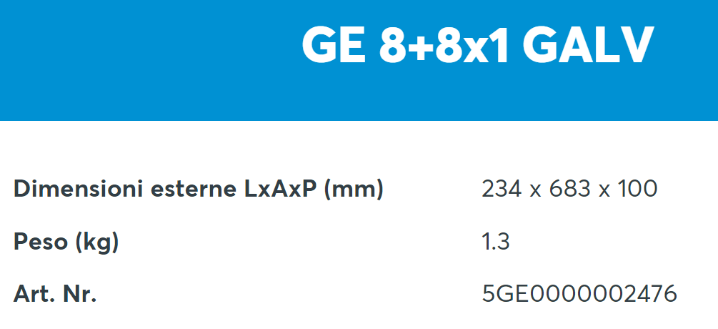
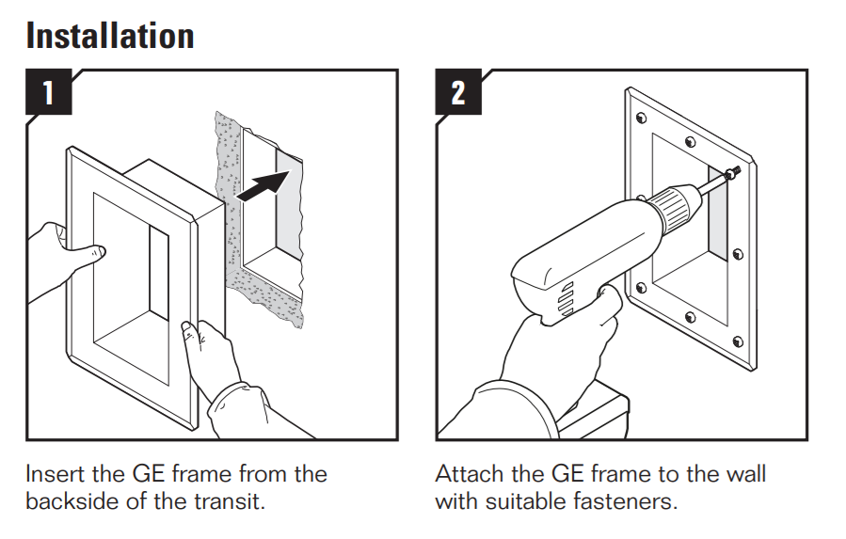

Slide 11
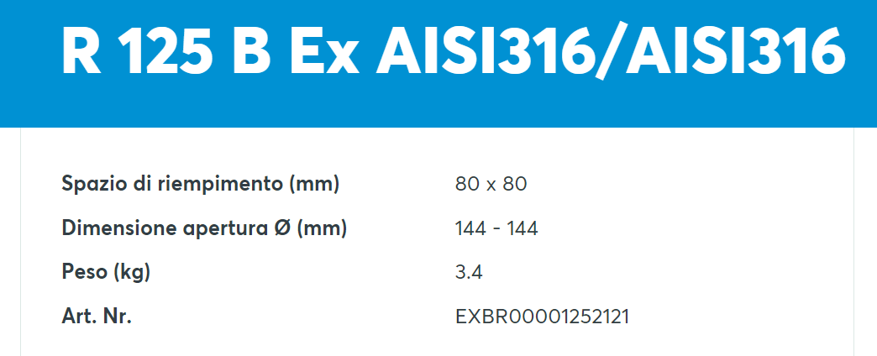
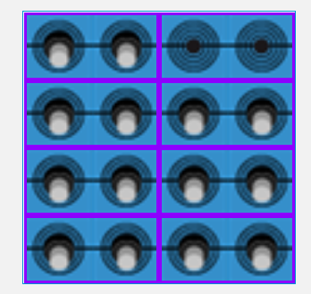
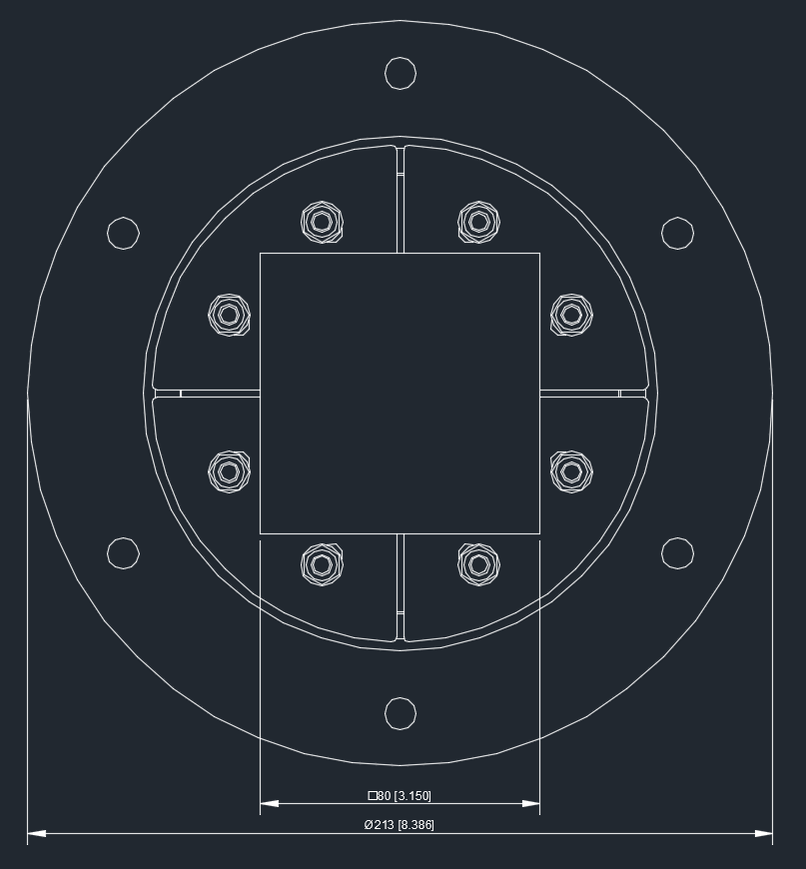
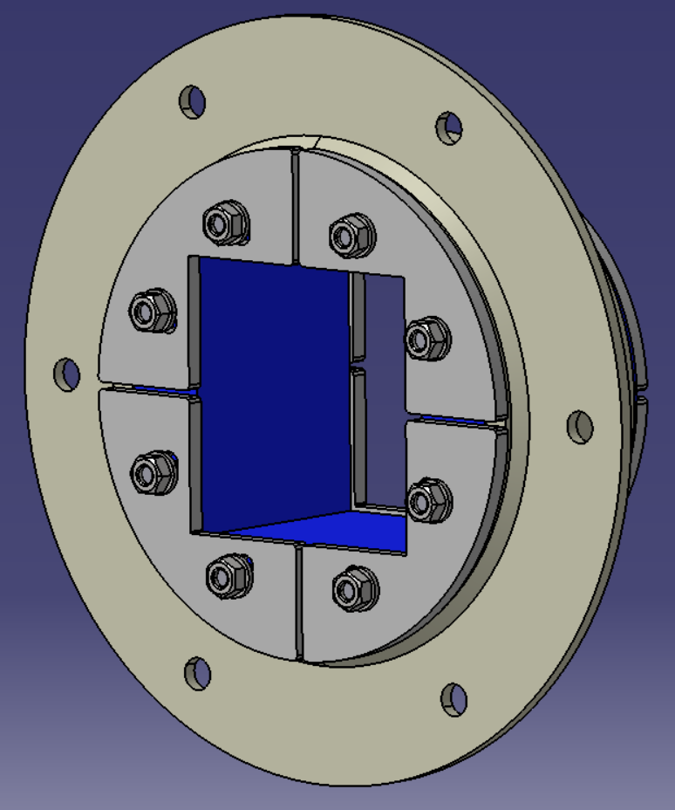
Cooling pipes – n. 2 – dia. 8/10 mm
Trunk fiber bundle – n. 2 – dia. 10 mm
Power cables – n. 4 – dia. 14 mm
Filling space
VCAN cables – n. 4 – dia. 7 mm
Opening size
Optoboxes dry air pipes – n. 2 – dia. 8 mm
Weight (kg)

Slide 12
