Slide 1


PTOLEMY magnet construction
PTOLEMY Italy meeting, 19/02/2025

Slide 2
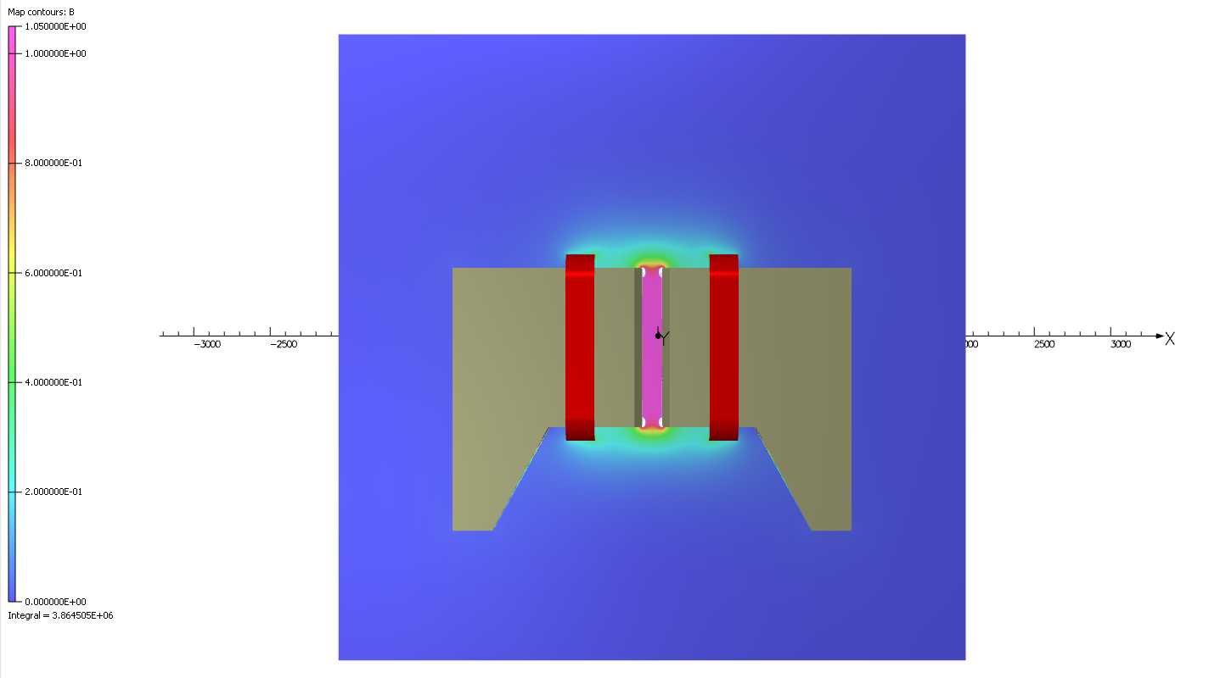
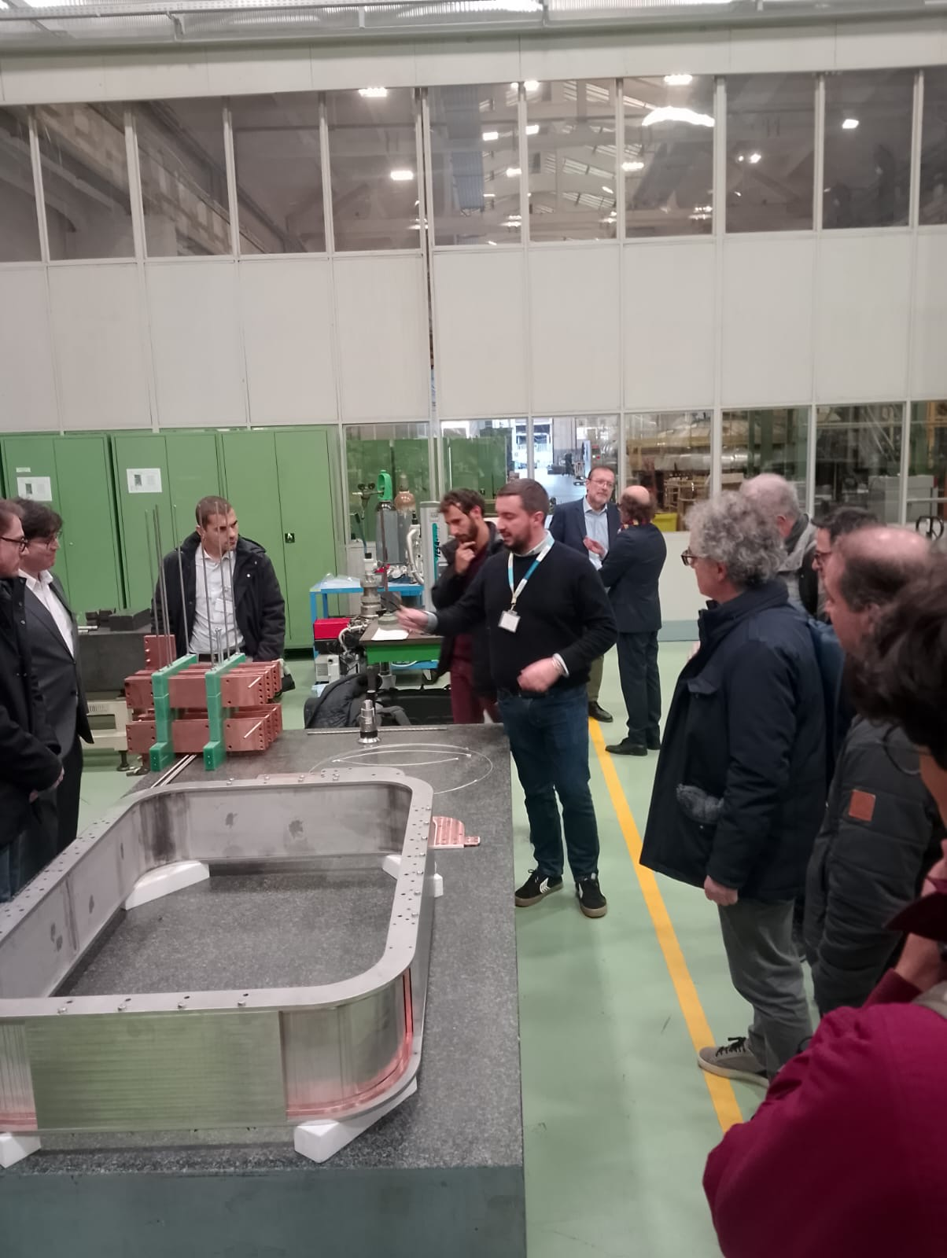
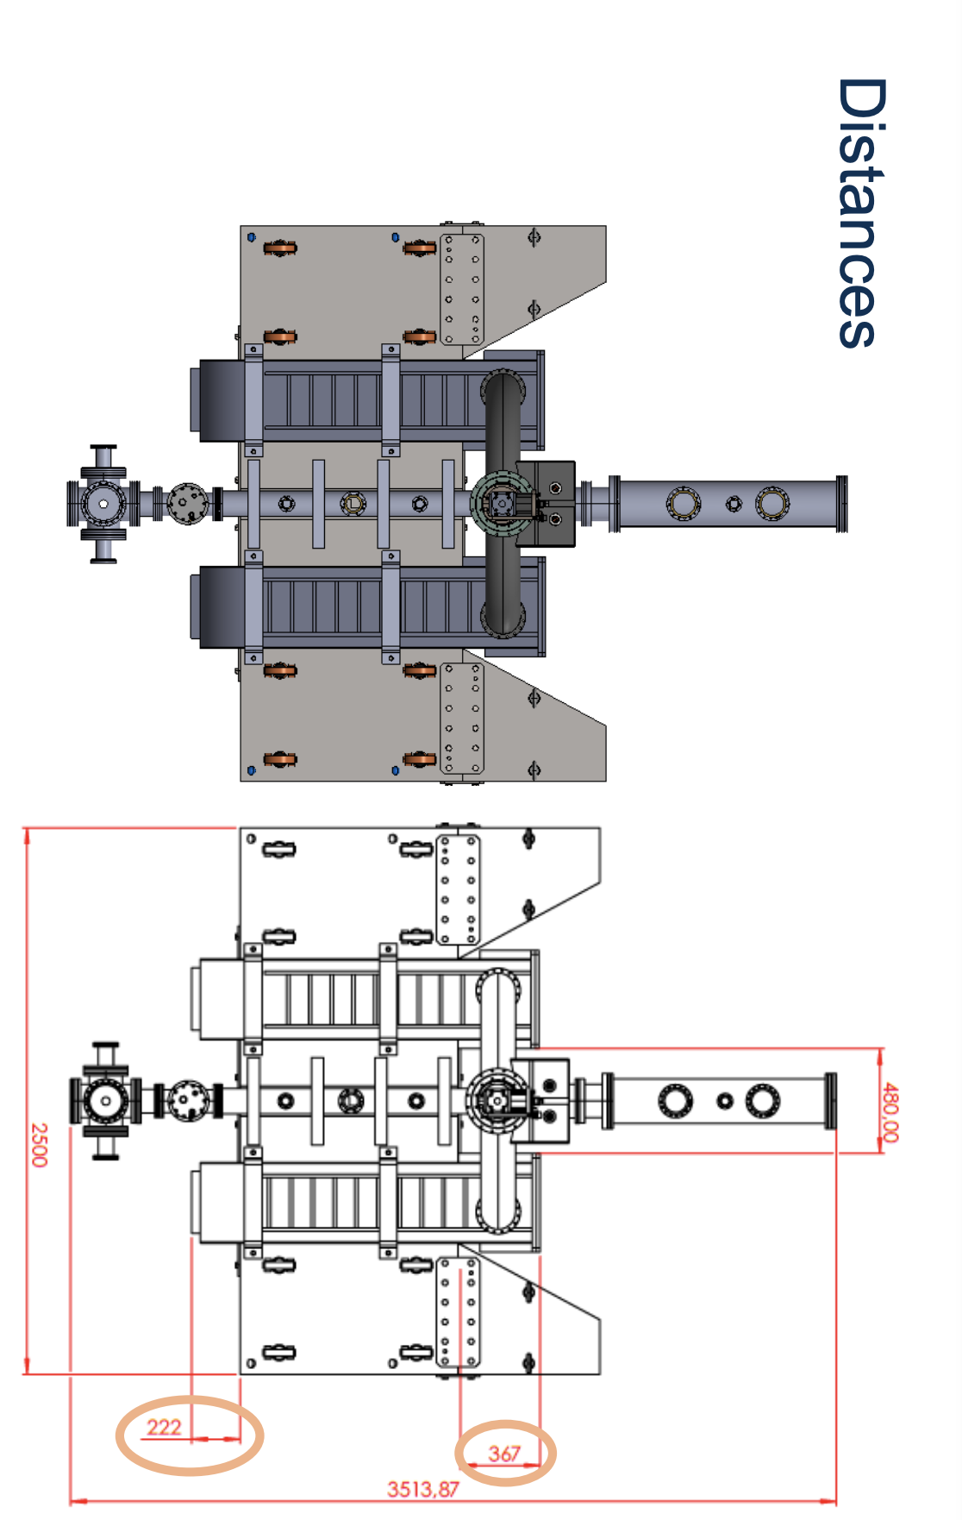
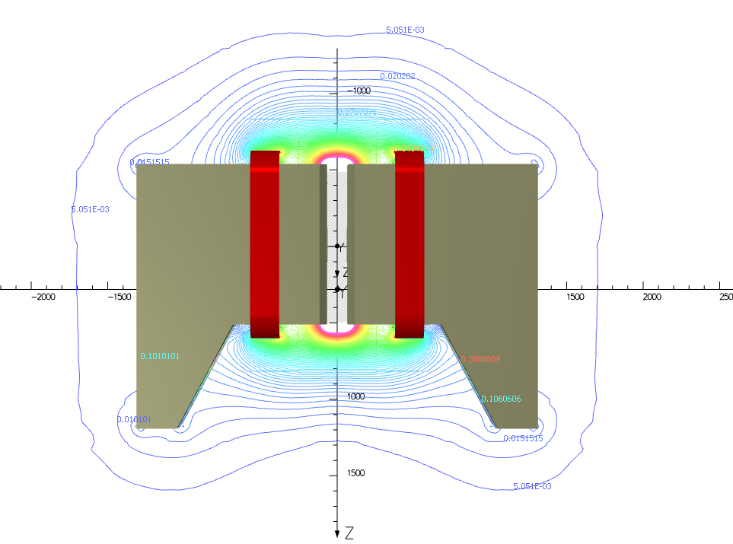
Demonstrator parts under constructions: magnet, order issued
Magnet: Key subsystem
ASG (Genova)/Suprasys(Bilbao)
2

Slide 3
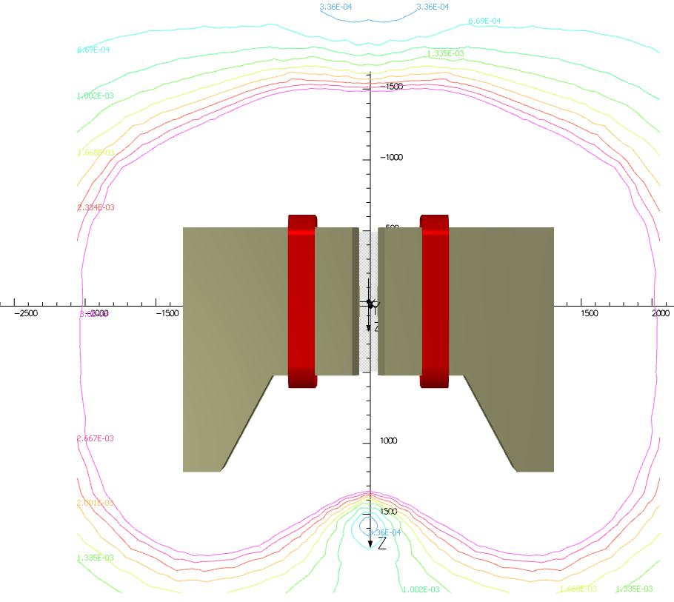
MIN 3.36E-04 T
MAX 2.33E-03 T

Slide 4
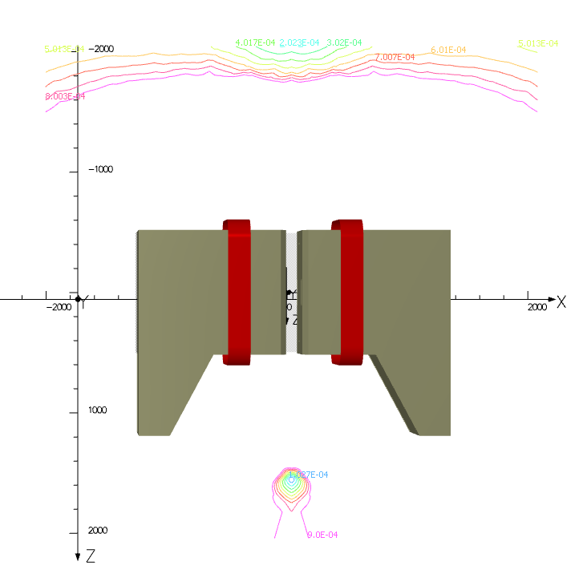
MIN 1.09E-04 T
MAX 9.00E-04 T

Slide 5
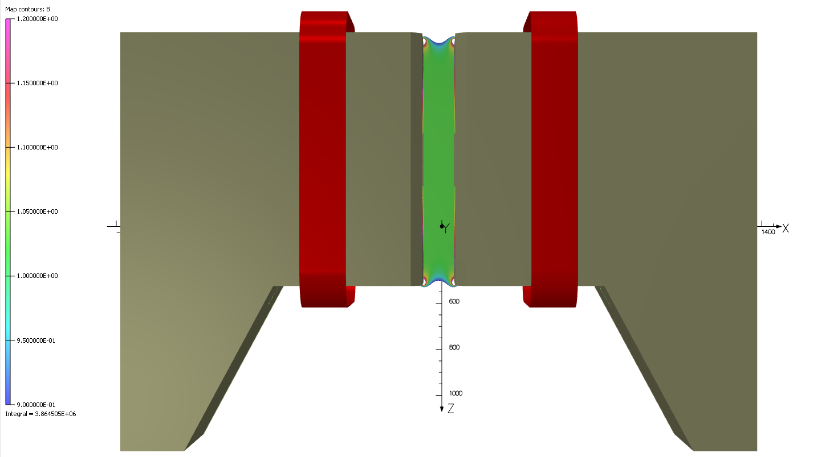

Slide 6
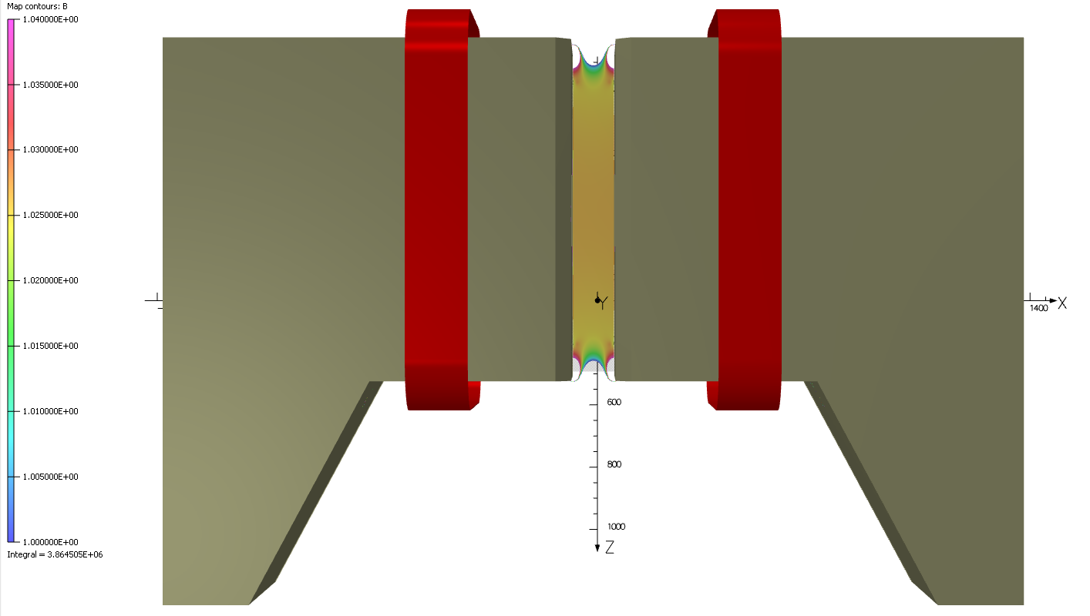

Slide 8
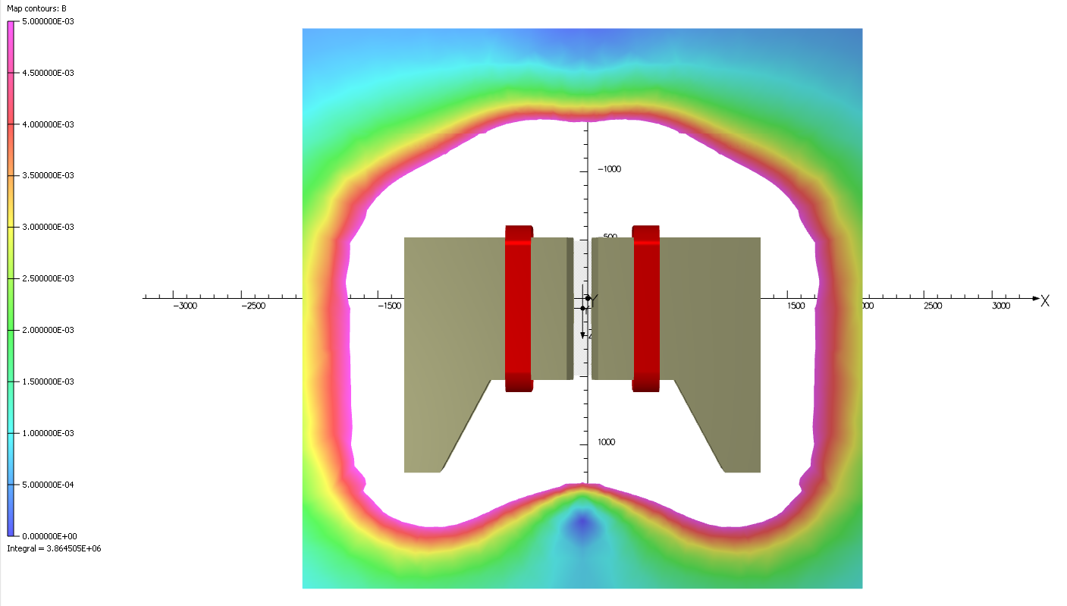

Slide 9
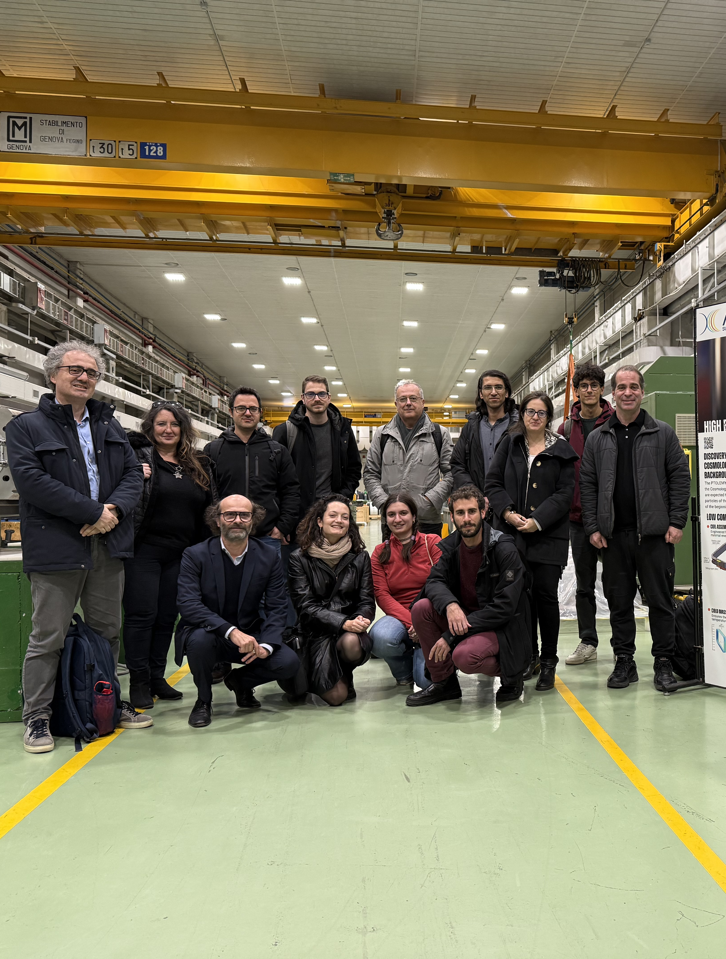
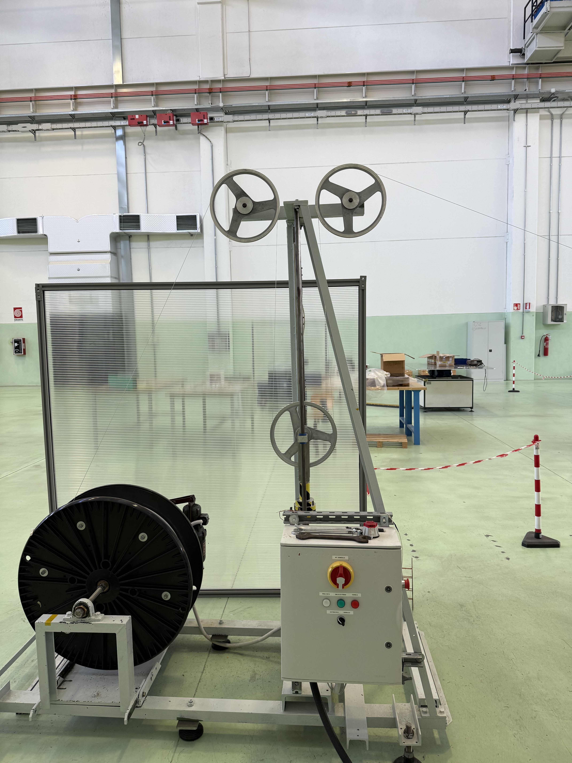
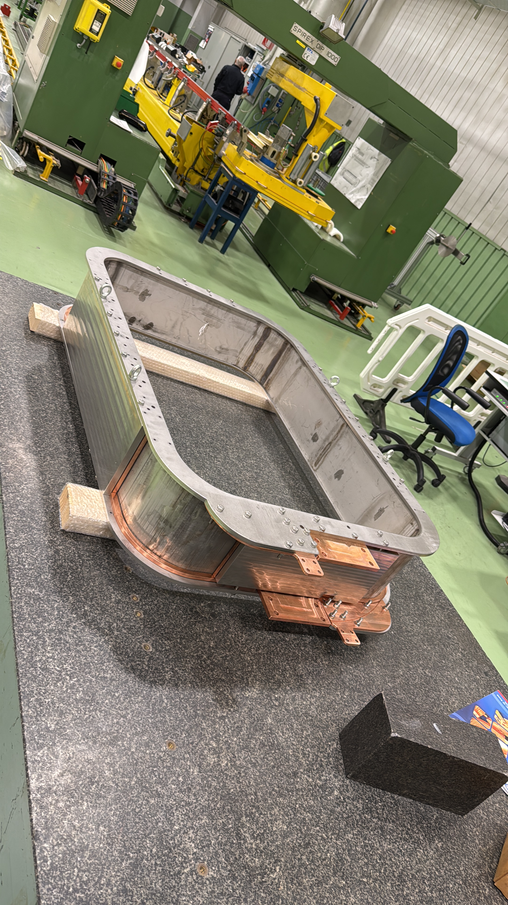
Picture gallery

Slide 10
Schedule
Delivery July 2025. Today winding starts

