Slide 1



Neutrino mass with the PTOLEMY project
PTOLEMY meeting Italia 19/02/2025

Slide 2
Detection concept: Neutrino Capture on 𝛽 unstable nuclei
Proposal for their direct experimental detection in
[AG.Cocco, G.Mangano, M.Messina JCAP 06(2007)015]
Beta decays
Relic capture
Electron flavor expected with
m ≳50meV
from neutrino oscillations
M.G. Betti et al JCAP 07(2019)047
CνB Detection Requires:
energy resolution set by m_{ν}
Requirements on energy resolution for neutrino mass measurement are weaker than relic case (50 meV)

Slide 3
PTOLEMY first physics goal: neutrino mass
We plan to reach neutrino mass sensitivity of below 150 meV in 5 years
HOW?
  Exploiting a novel concept of a compact dynamic electromagnetic filter
  By measuring the end-point of T spectrum by using O(10 μg) of atomic T

Slide 4
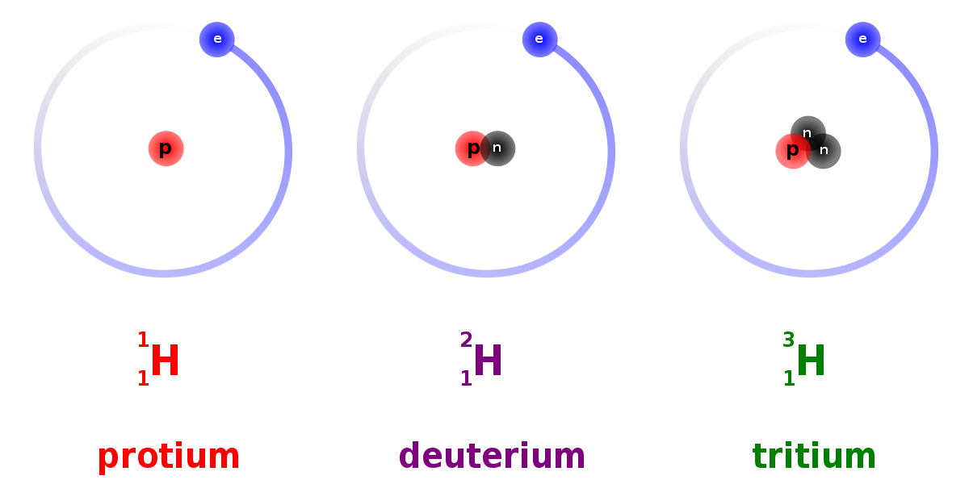

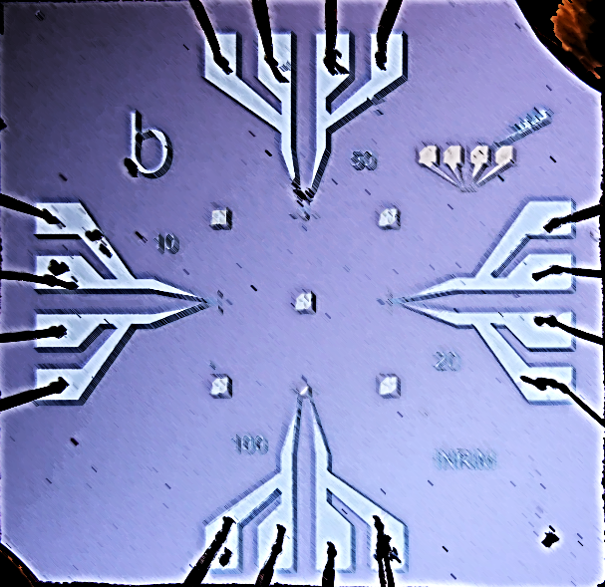
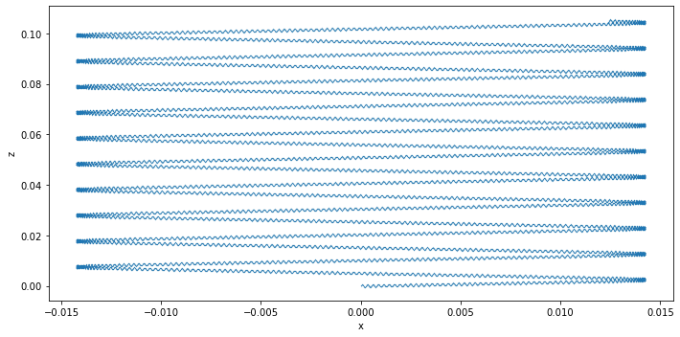





PTOLEMY detector scheme
PonTecorvo / PrinceTon Observatory for Light Early-universe Massive-neutrino Yield
$$|B_{x}|$$
$$x$$
$$z$$
Target
RF-tracker
Transverse drift filter
TES µCal
$$ν$$
$$e^{−}$$
p
18.6 keV
© James Mead
$$E_{total}=q\left(V_{TES}−V_{target}\right)+E_{RF}+E_{cal}$$
Notes:
Cryogenic transition edge sensor gives us the energy resolution BUT requires <100Hz rate to avoid saturation
Hence this 18.6 keV slowing potential and this EM filter BUT for this filter to be effective it needs to have a fast dynamic setting
To provide the trajectory information for the fast dynamic setting an CR-based tracking system is required between the target and the filter (NIKHEF)
Atomic tritium (to avoid smearing from molecular excitations) embedded on graphene will be the target for the prototype (this introduces its own problems)

Slide 5
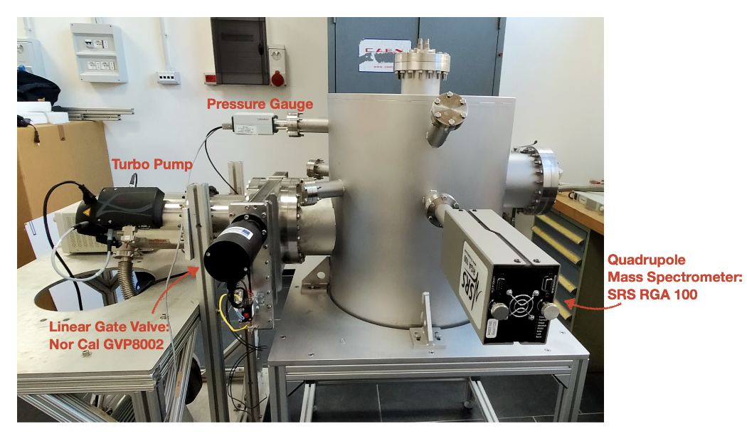
Hydrogen and Deuterium loading on graphene at Roma1 and Roma3
atomic H as a tool to ‘pinch’ the sp² bonds towards a sp³ configuration
while maintaining the planar nature of graphene
H on Nanoporous Graphene (NPG):
sp³ C-H bond
T-chamber in Rome side view:
Betti et all, Nano Lett. 22, 2971 (2022)
UKAEA’s Active Gas Handling System (tritium for JET, EU Tokamak) for feasibility study & design requirement of a new T loading chamber
Quote received few days ago
Notes:
5

Slide 6
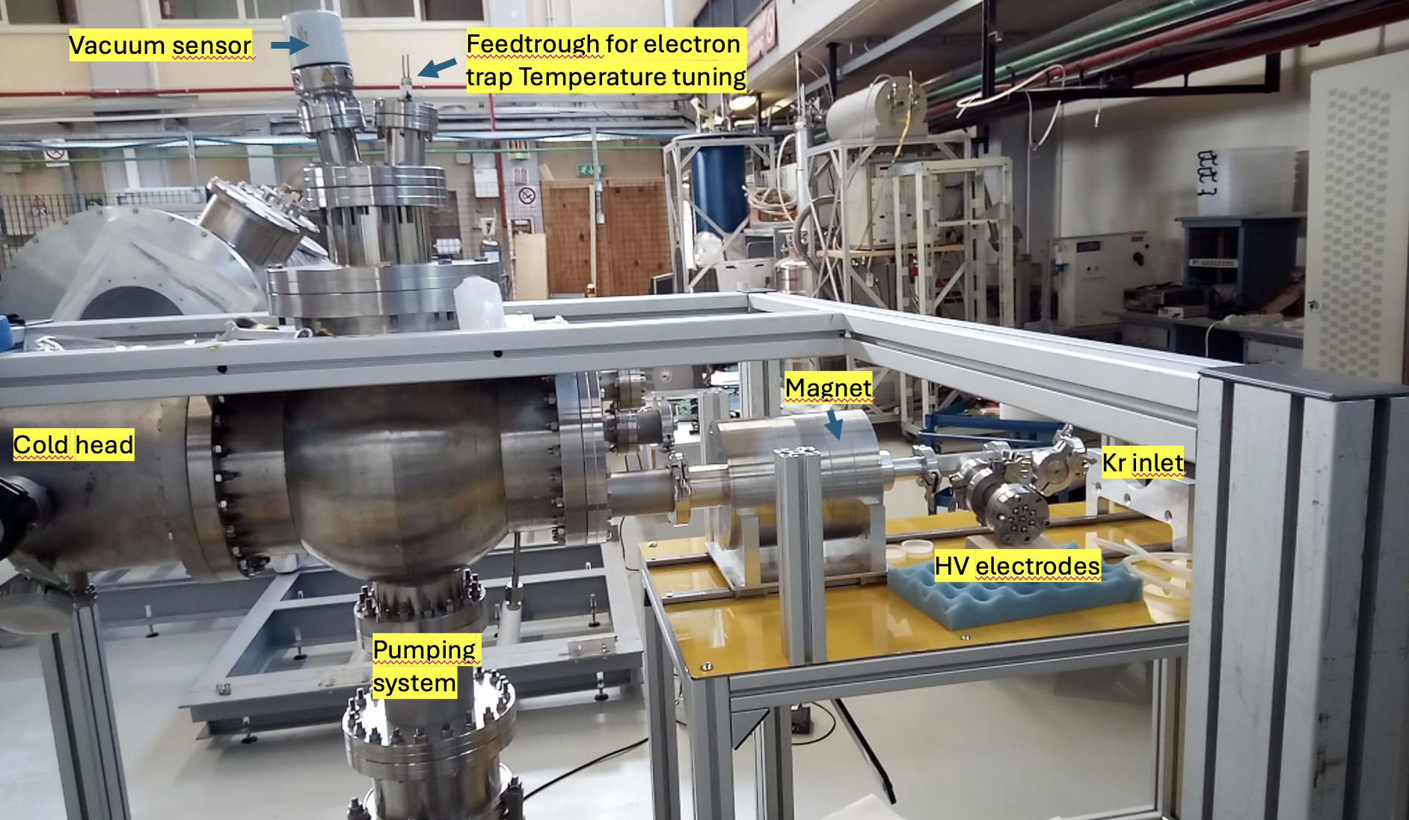
RF detection setup at LNGS: electron trap

Slide 7
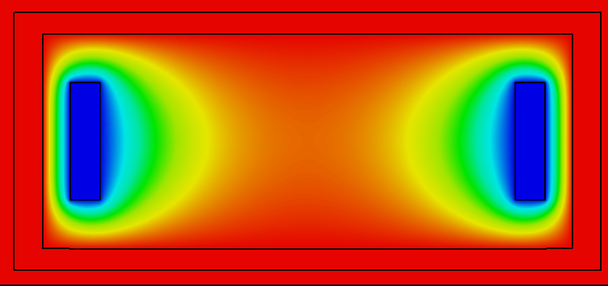
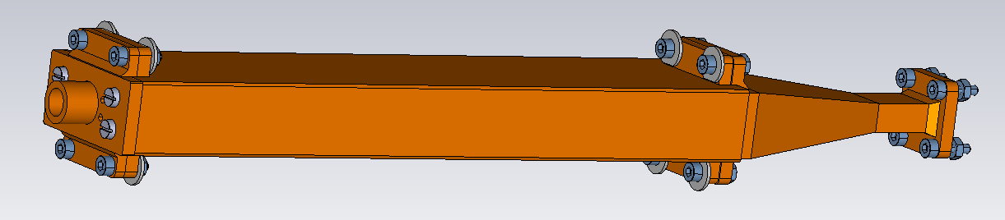
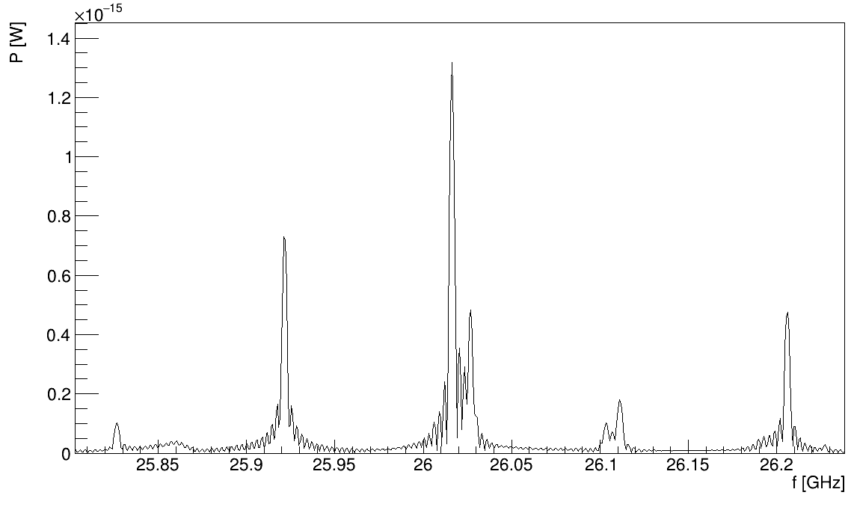
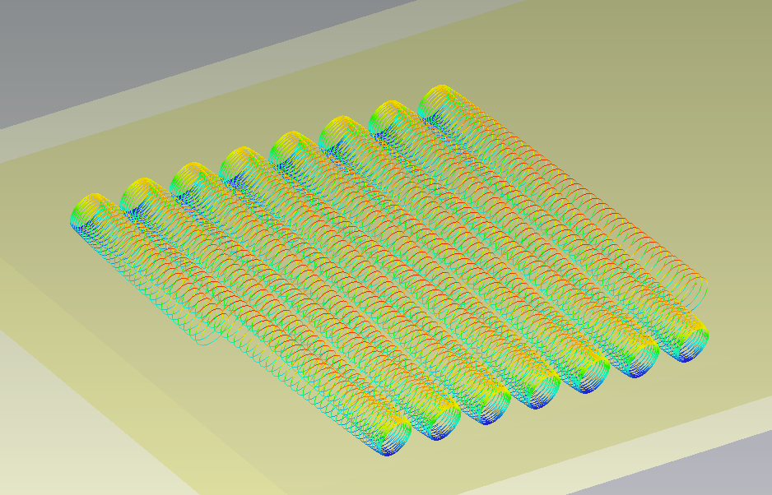

Electron cyclotron RF radiation studies
Kr inlet
RF detection
carrier
simulation of the pattern of RF radiation
CST simulation
sideband
secondary
sideband

Slide 8
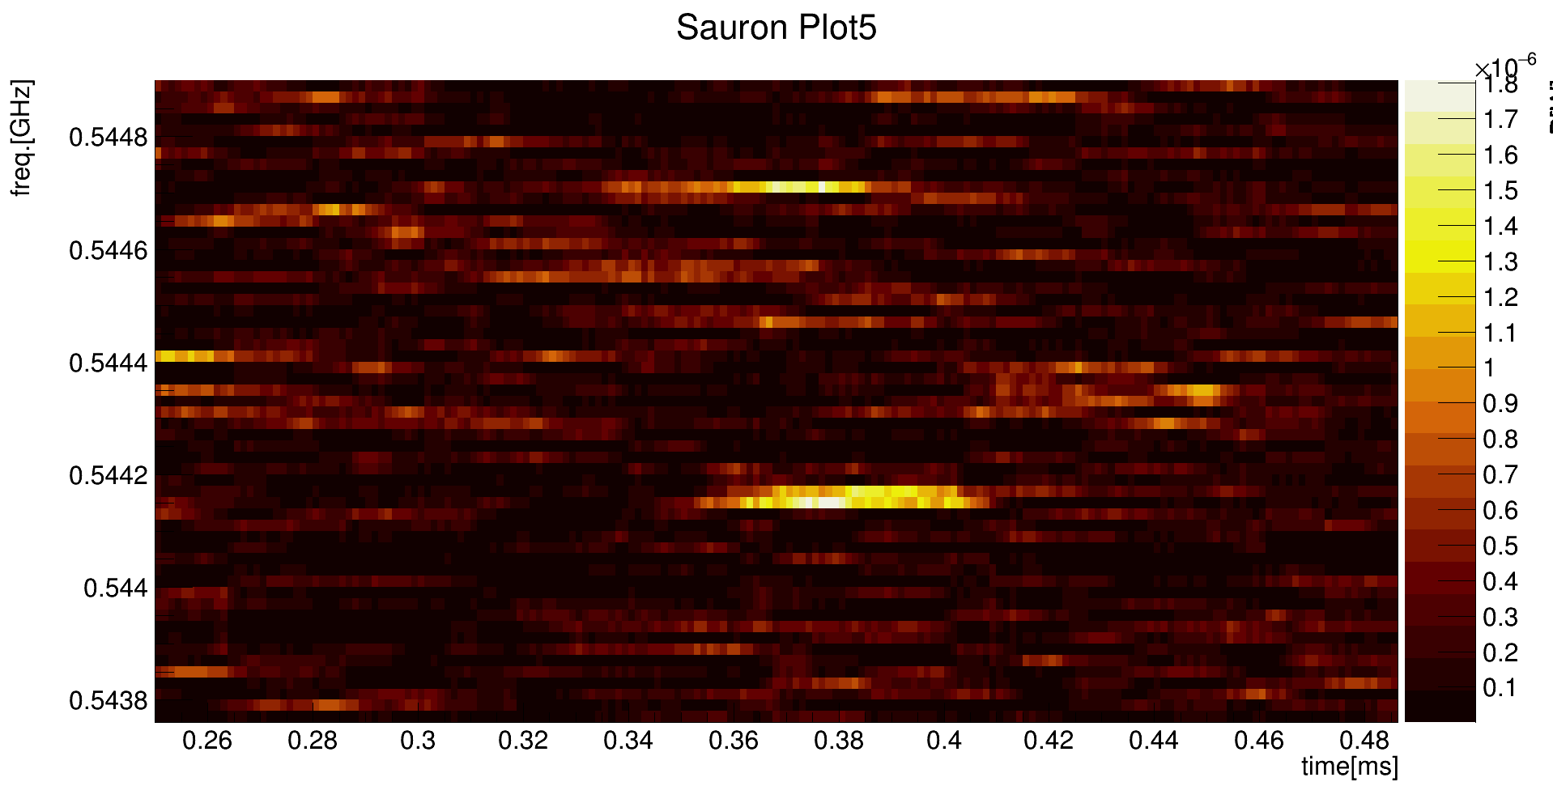
Candidate electron events
RF emission frequency vs time of single electron in the permanent magnet
Carrier
P[W]
Secondary

Slide 9
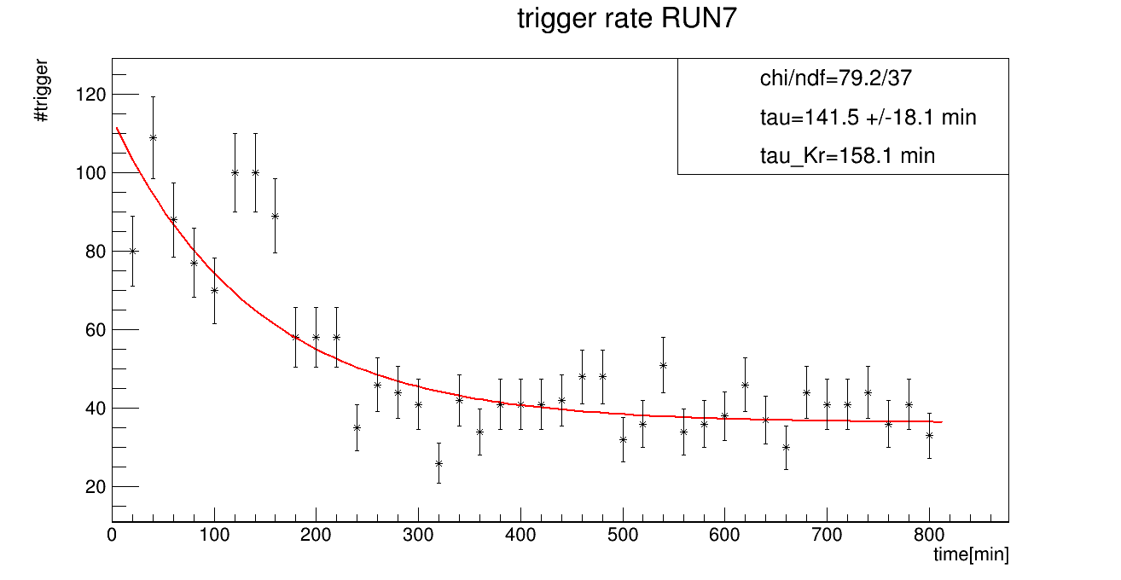
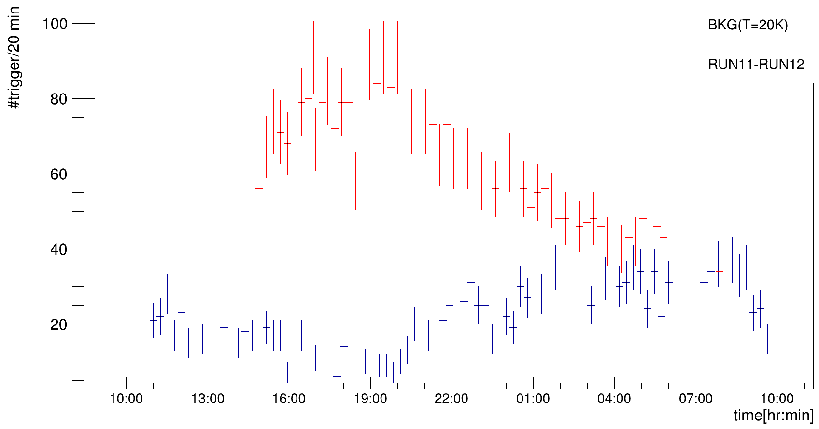
Electron signature: trigger rate (data)
Source closed
(t=0)
Source: ⁸⁵Rb → ^{83m}Kr
Lifetime Kr = 158.1 min
Source open
(RUN11)
Source closed
(RUN12)
BKG=14/1/25
RUN11-12=30/5/24
Freq_{RF}=26GHz
P_{RF}=1fW
Electronic chain:
Low noise amplification +
down-conversion
Freq_{IF}=550MHz
P_{RF}=2μW

Slide 10
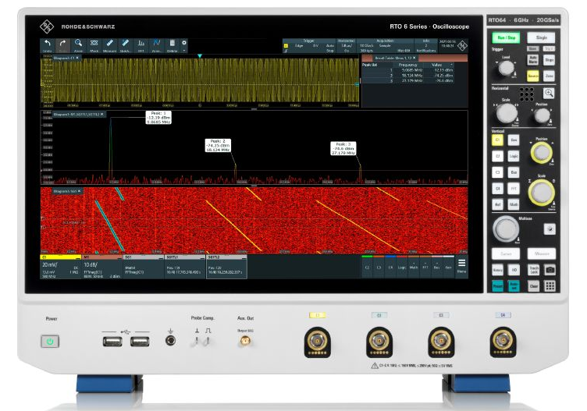
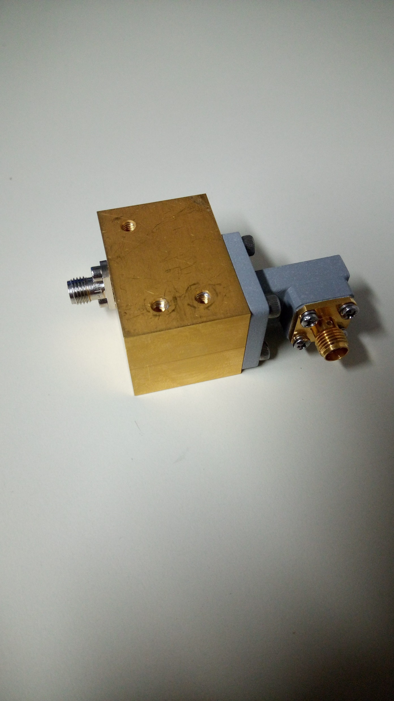
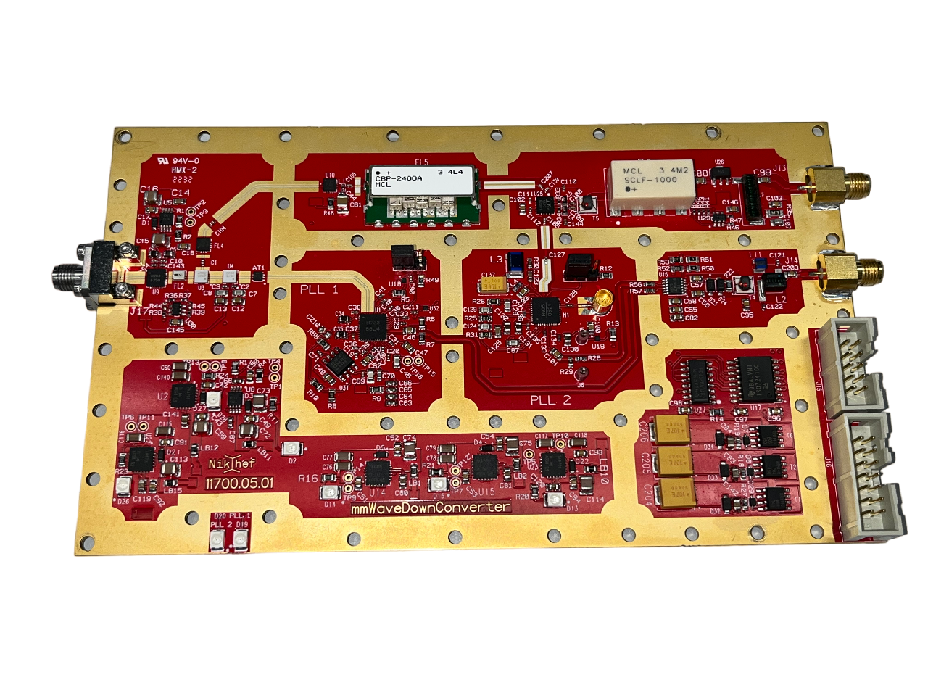
RF readout electronics
T_{c}
RF
IF
LNA
DIPLEXER
DAQ
LNA
RTO64 used for DAQ
Dedicated downconverter developed @ NIKHEF
DAQ with FPGA trigger under development @ NIKHEF

Slide 11
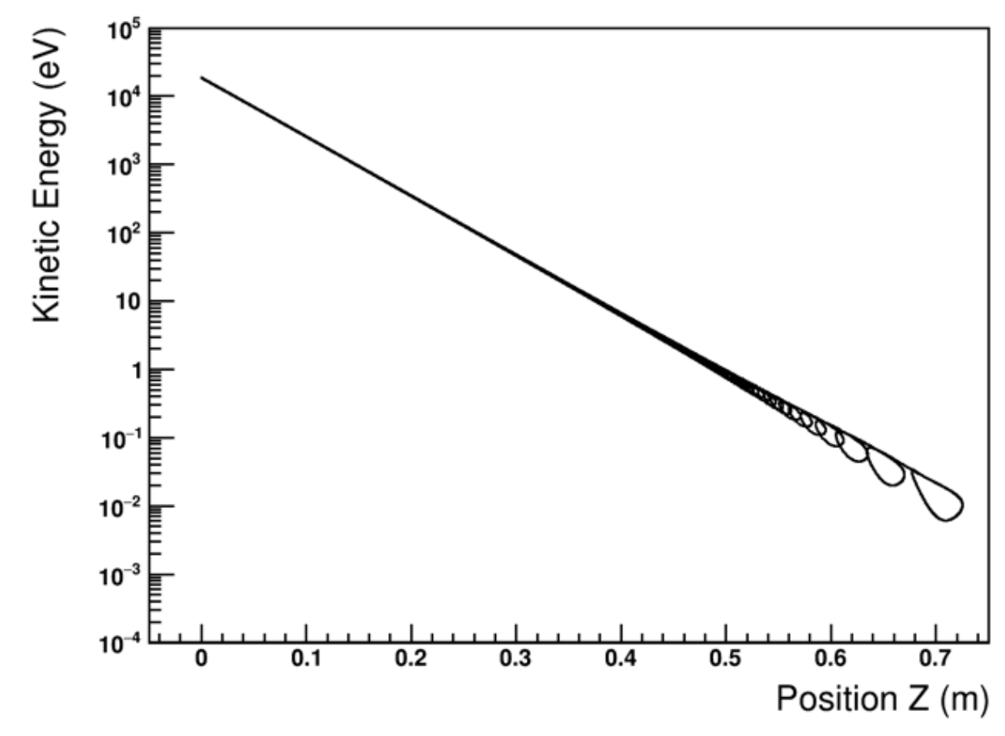
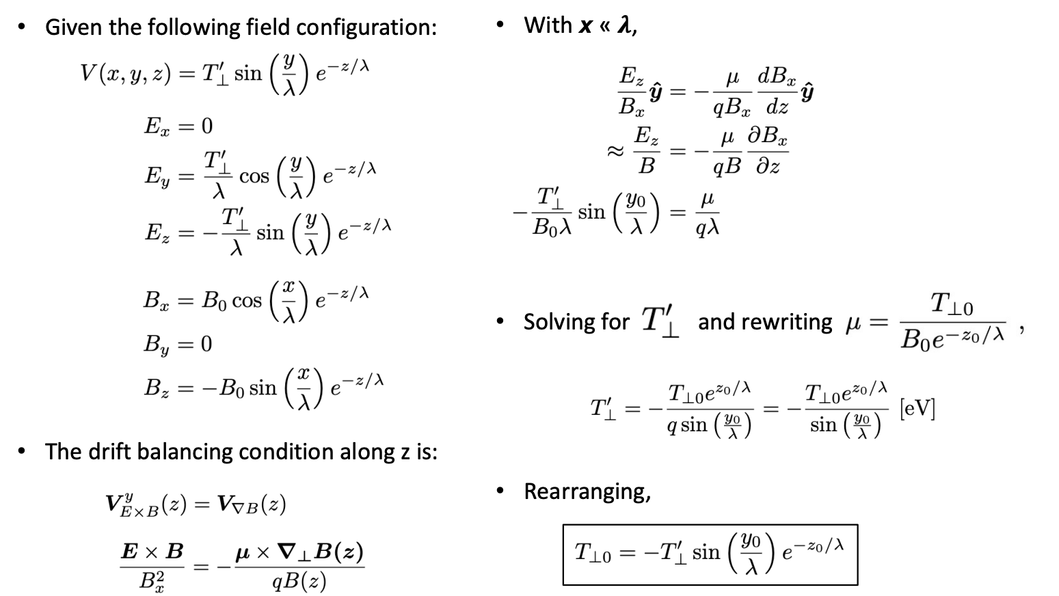
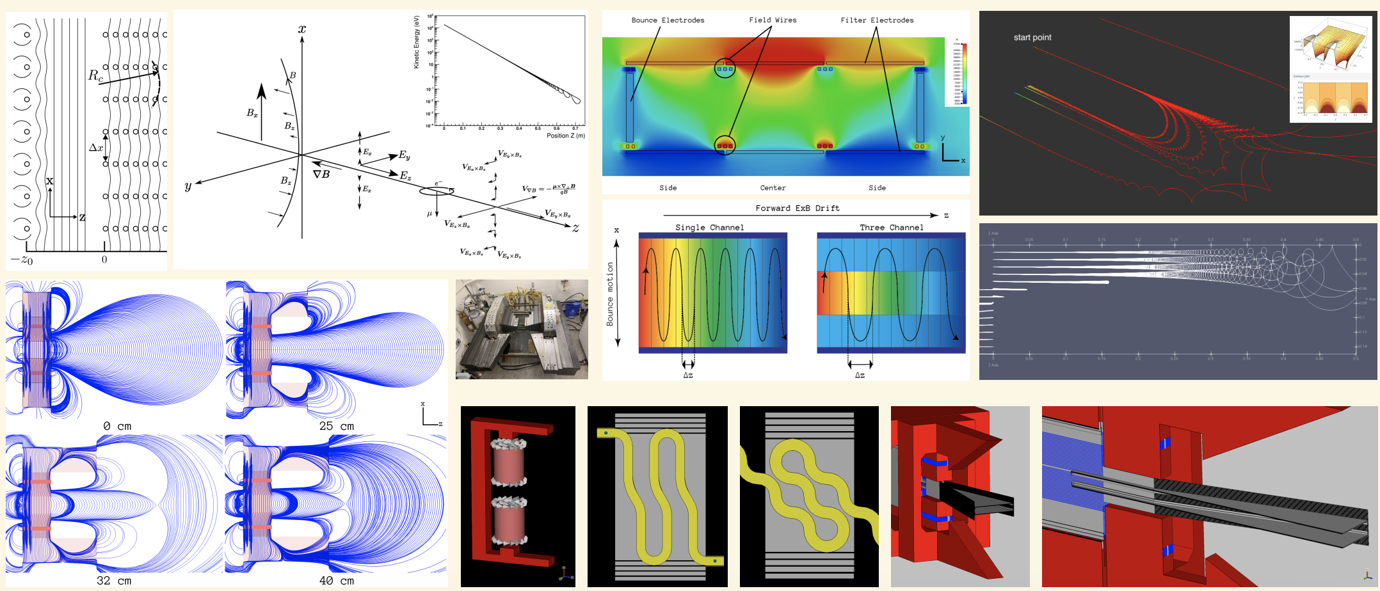
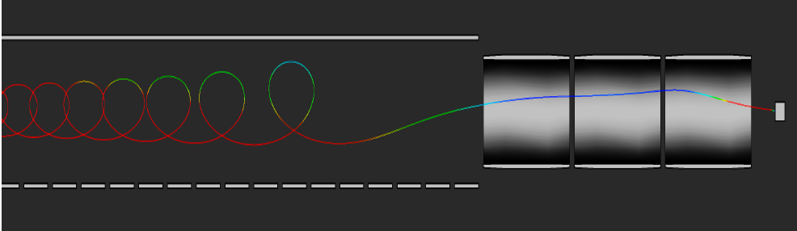
PTOLEMY filter: years of development
Particle trajectories can be calculated/predicted analytically:
From 18 keV to O(1 eV) in 50 cm
vs 70 m in the case of KATRIN
Implementation and optimization of the PTOLEMY transverse drift electromagnetic filter
A.Apponi et al, JINST 17 (2022) 05, P05021
A design for an electromagnetic filter for precision energy measurements at the tritium endpoint
M.G.Betti et al, Prog.Part.Nucl.Phys. 106 (2019) 120-131
FOCUSING
with Einzel lens
Microcalorimeter

Slide 12
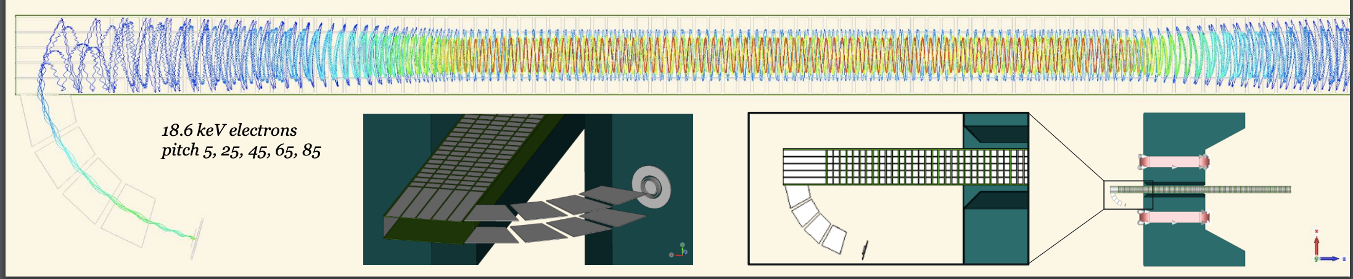
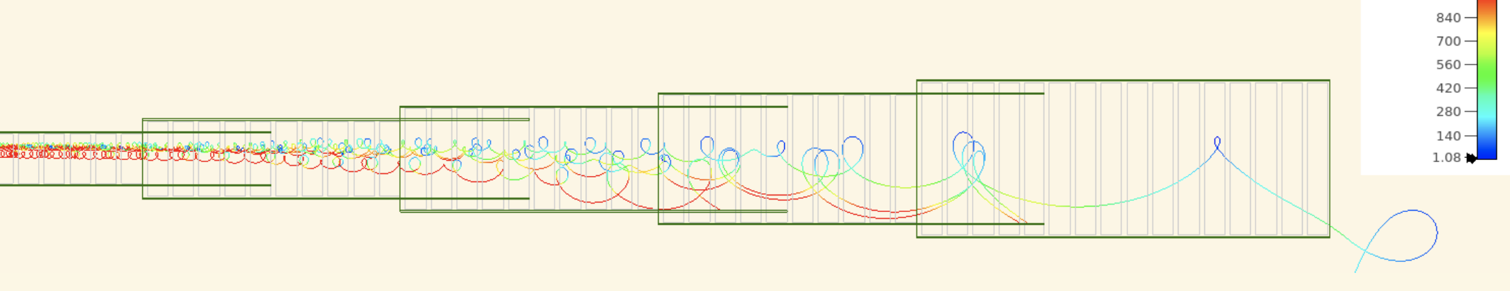
Full demonstrator simulation (Princeton)

Slide 13
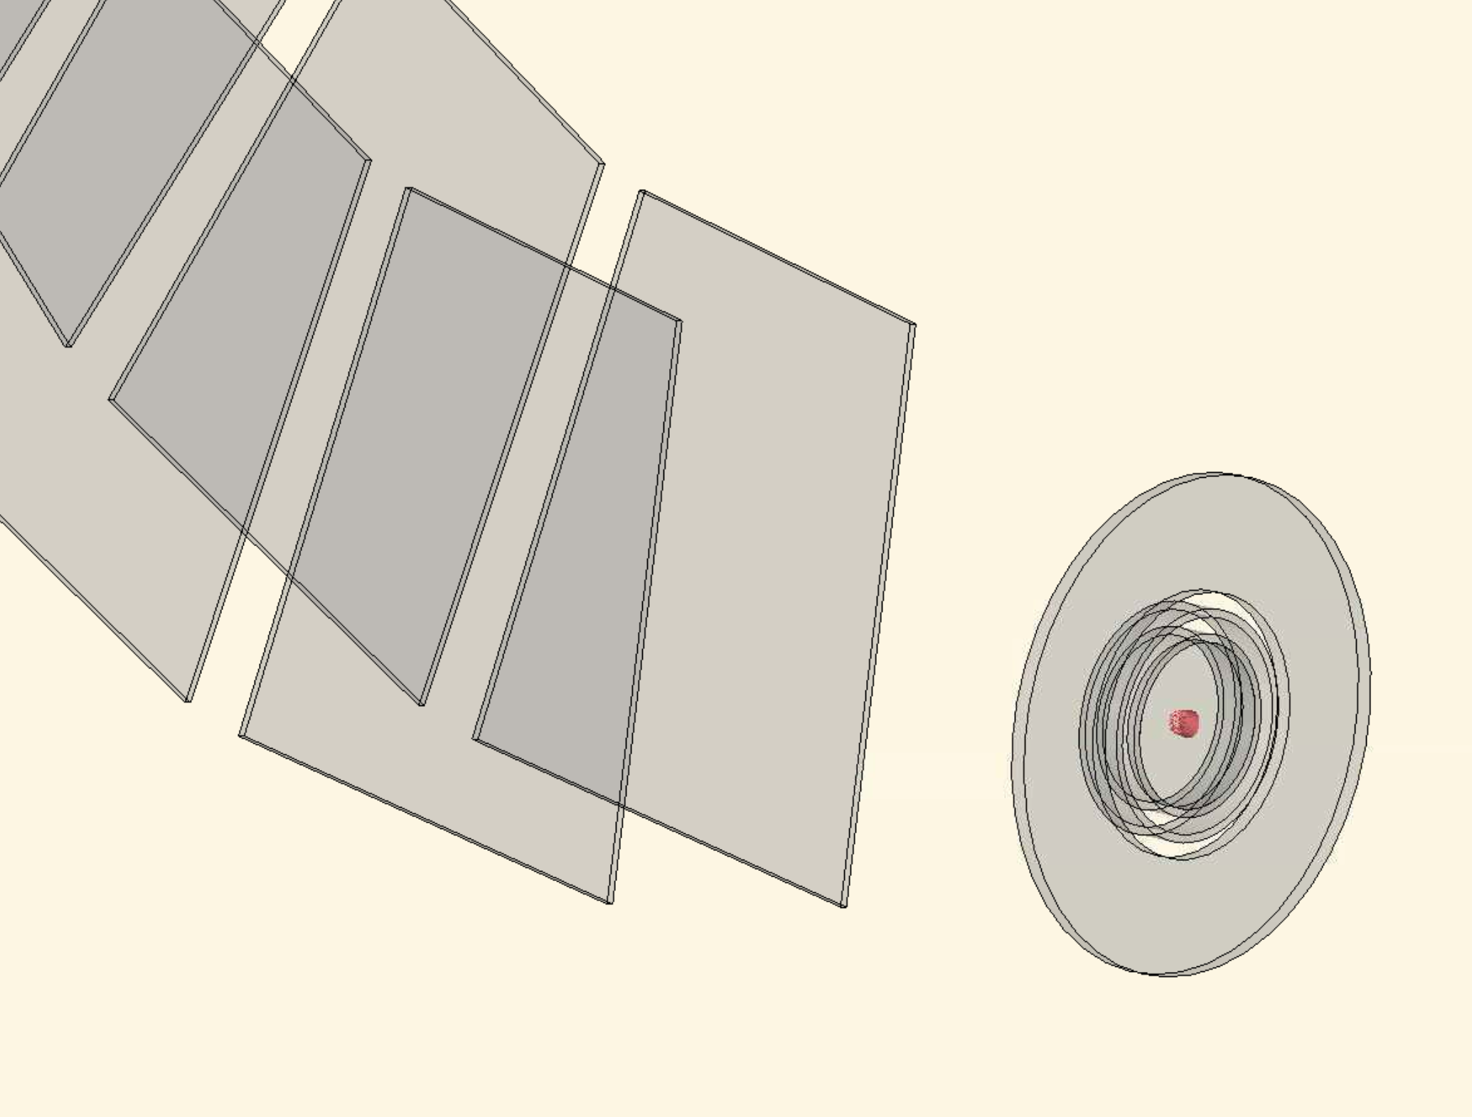
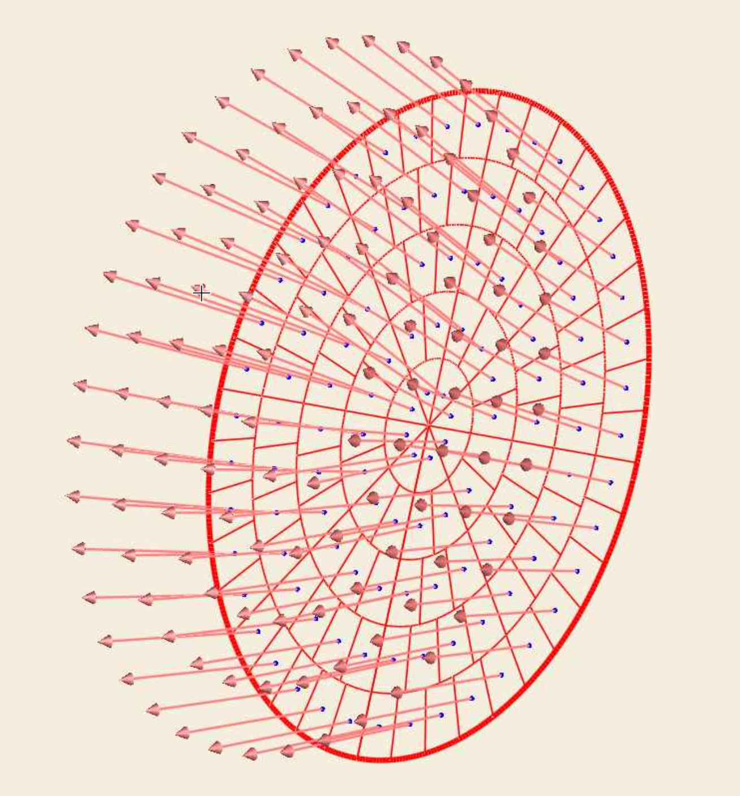
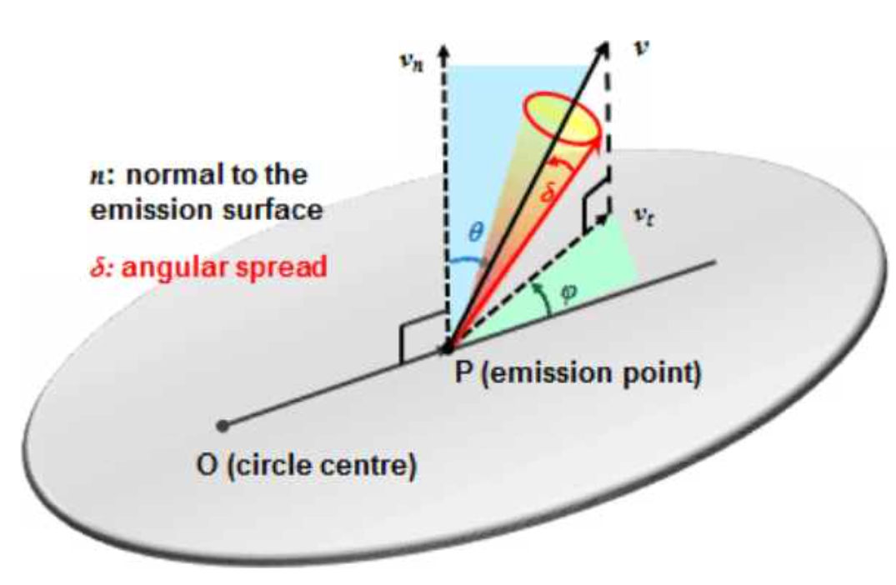
Transmission Simulation Setup
1 mm radius circular area split into 50 rings (5 shown)
50 rings = 10,200 particles
Uniform distribution of pitch θ within a 10 degree window
8 fixed phi Φ emission angles
All electrons with initial KE = 18.6 keV
E.g.
  θ = 30±5, Φ = 0 (N=10,200)
  θ = 30±5, Φ = 45 (N=10,200)
  …
  θ = 30±5, Φ = 315 (N=10,200)
θ = 30±5, Φ = 0..315 → N=81,600
θ = 40±5, Φ = 0..315 → N=81,600
…
1mm radius
(5 rings)

Slide 14
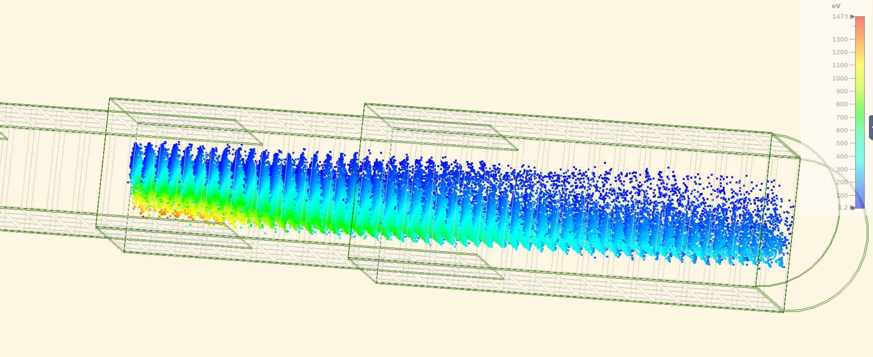
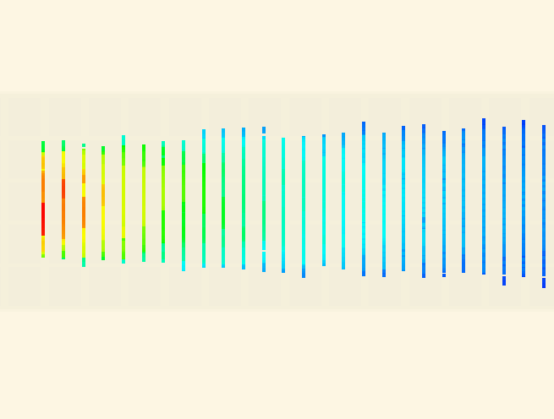
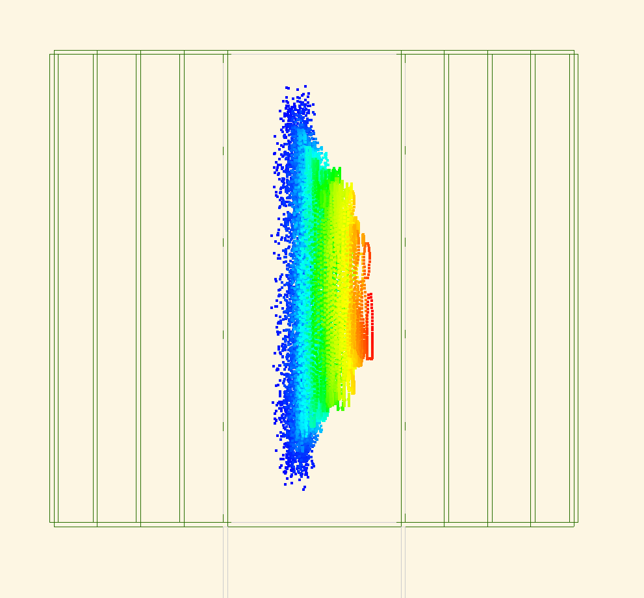
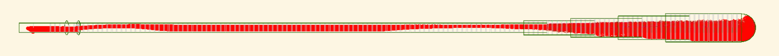
Methodology
2D plane monitors placed every 1 cm in z
  11x6 cm in (x,y) centered at (0,0)
Record individual particle hit information (incl. multiple hits per particle due to cyclotron motion)
At each Z coordinate:
Transmission efficiency: Extract # of unique particle hits per plane, express as percentage of N
Average KE: Take average over all hits (incl. duplicates)
Pitch angle: Calculate instantaneous pitch angle from momentum components for hits within 5mm of x=0, then take average pitch over these hits
x
z
+/-5mm
x
z
y

Slide 15
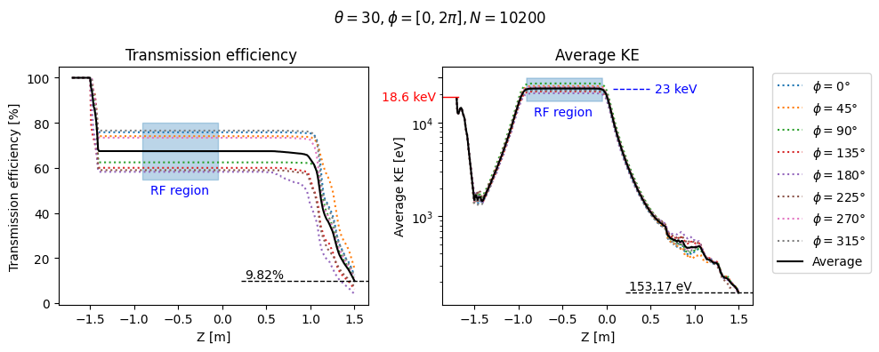
Showing θ = 30±5 with individual Φ bin

Slide 16
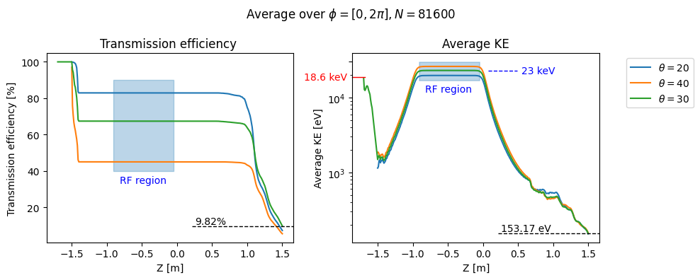
Showing θ = 20±5, 30±5, 40±5
averaged over Φ bins

Slide 17
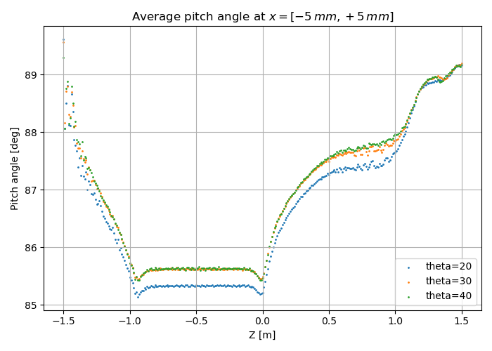
Showing θ = 20±5, 30±5, 40±5
averaged over Φ bins

Slide 18
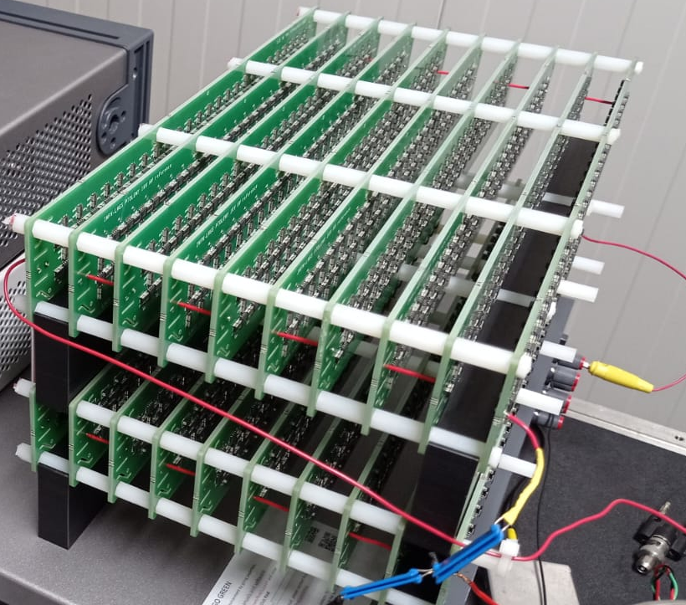
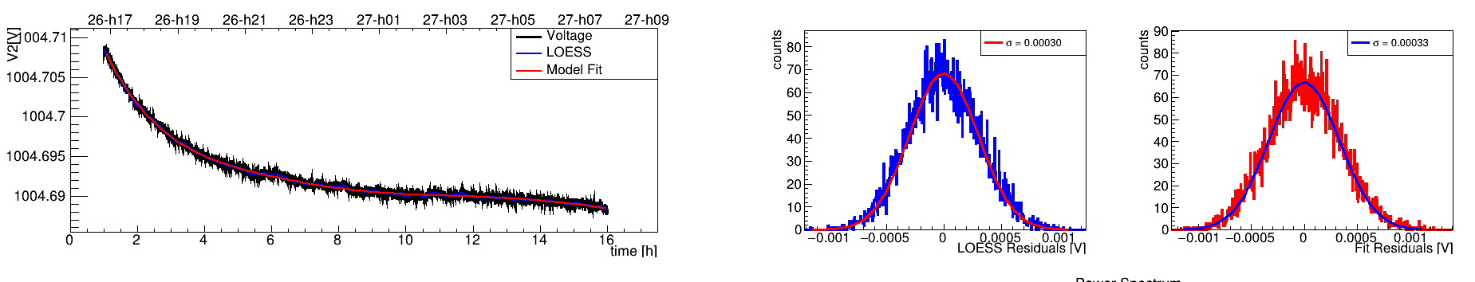
HV High precision stability (LNGS)
Vin
Vout
E
Differential Amp
Precision
Multimeter
HV Capacitor (?)
Diode
chain
Field
Mill
Climatic chamber - N2
Single board
(1 kV)
σ = 0.3 mV

Slide 19
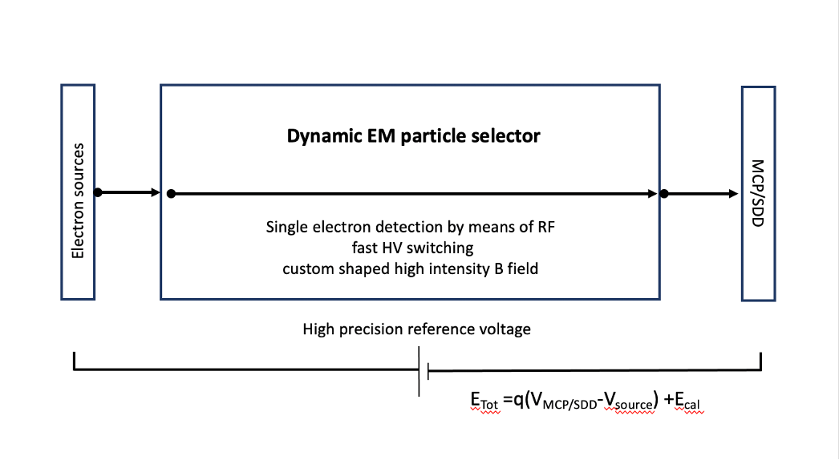
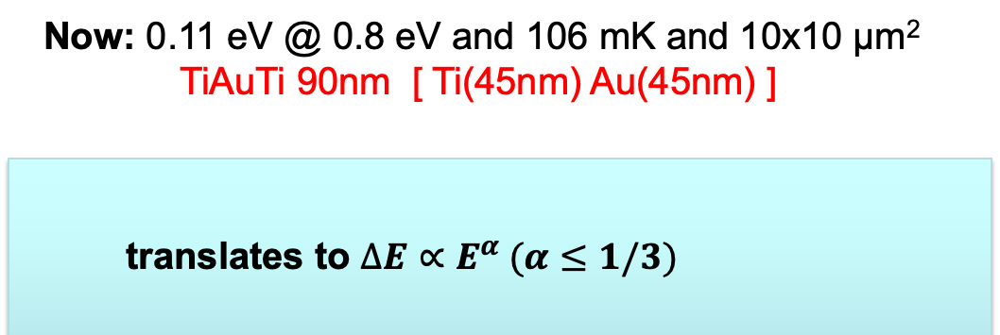

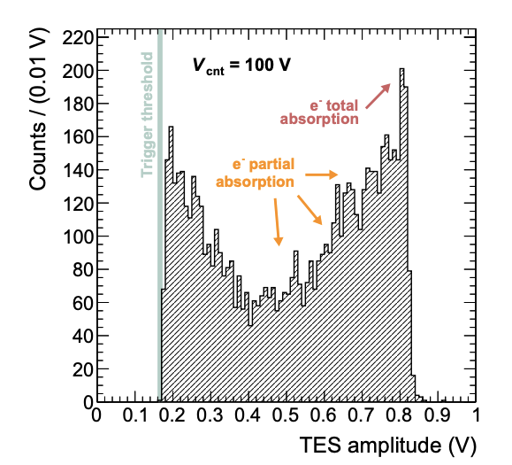

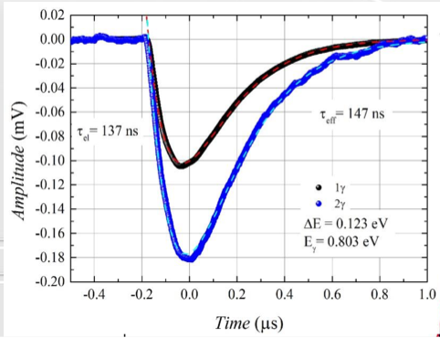
Calorimetry at INRiM
Based on the expertise of the INRiM electron detection with TES!
Key elements: high quality TES and new e-source based on nanostructures
𝝙EFWHM = 0.05 eV @ 10 eV
𝝙EFWHM = 0.022 eV @ 0.8 eV
First measurement of electrons
@ 100 eV with a resolution
~1-1.5 eV
Phys.Rev.Applied 22 (2024) 4, L041007
19

Slide 20
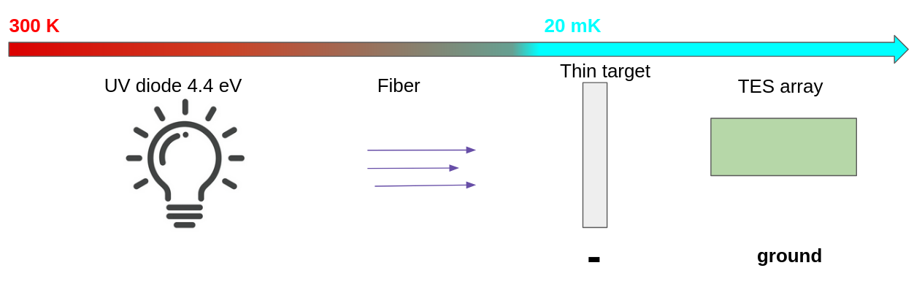
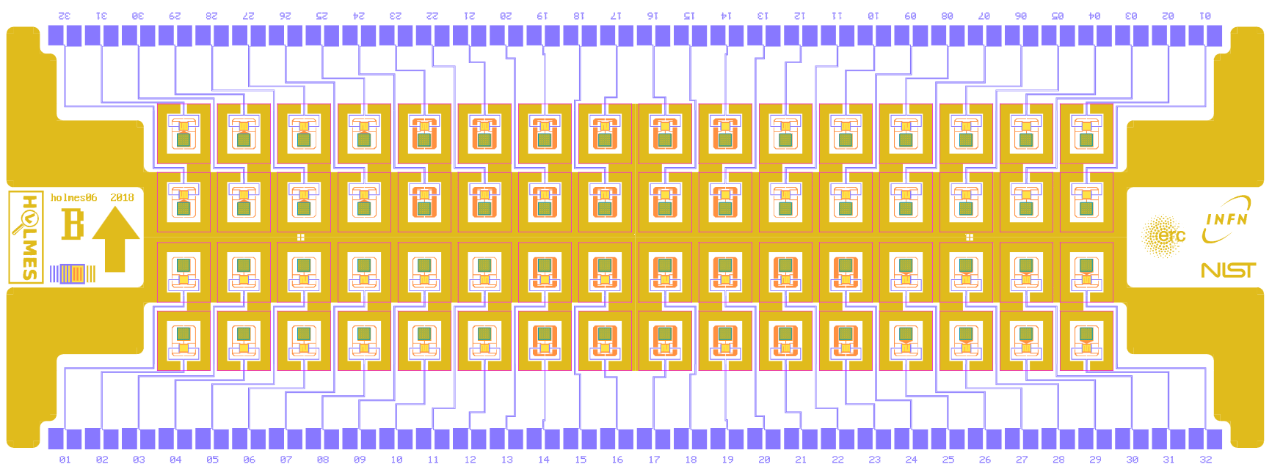
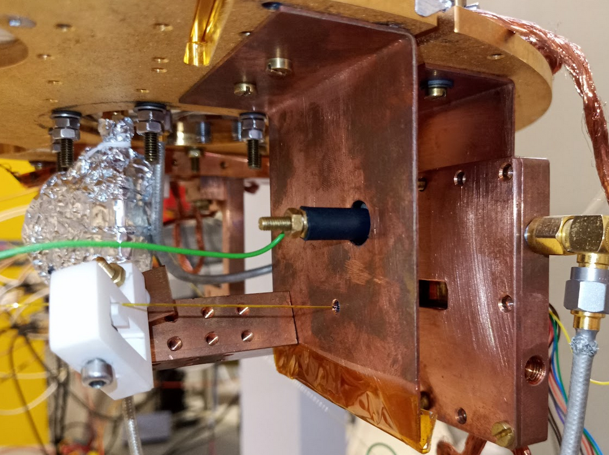
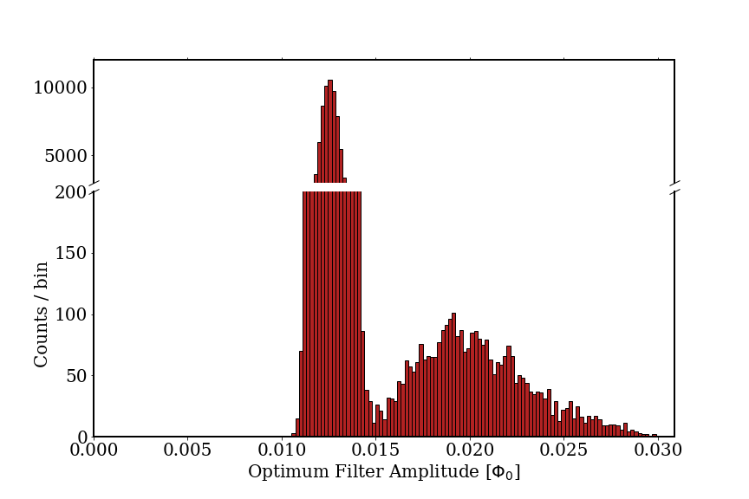
e-measurement at MiB
EGUN:
Performance:
TES designed for HOLMES
Dynamic range: soft X-ray (E<=10 keV)
Energy resolution: 4-5 eV FWHM @6 keV
Chip with 64 TES with different geometries
Microwave multiplexing readout
Cryogenic, compact (goal O(cm^3)), switchable
Electron rate and electron energy not correlated
~ 1.5 cm
HV
Electron spectrum @ dV= 100V
UV fiber
TES
noise
e-signal

Slide 21

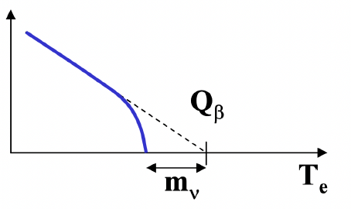
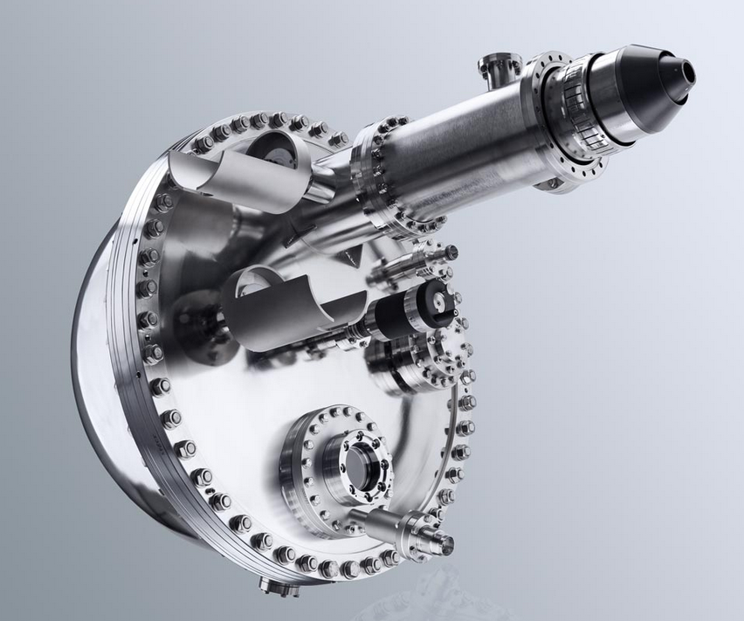
Electrostatic analyser as alternative electron detector
E_{w}
$$x_{t}$$
$$x_{a}$$
$$θ_{a}$$
RoI
$$θ_{t}$$
$$E_{k}$$
$$E_{p}$$
$$M_{θ}M_{l}$$
An example of Electron Analyser Project:
Functioning requests:
Specs Phoibos 225
E_{w}(eV) | E_{p}(eV) | ΔE (meV) | $R_{0}$(mm) | $x_{a}$(mm) | $$θ_{t}(°)$$
5 | 50 | 50 | 250 | 0.5 | 33
5 | 50 | 100 | 250 | 1 | 16
Magnetic field | < 5 mG
Operating temperature | T ambient
Surface stability vs time | Stable (graphite)
Max rate | 2 MHz
600 mm

Slide 22
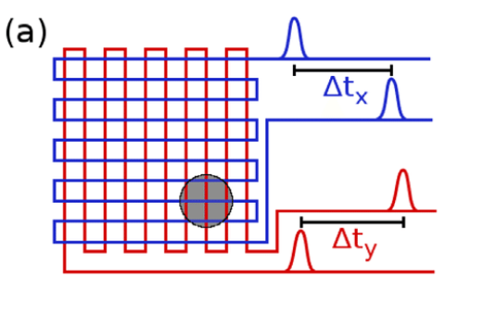

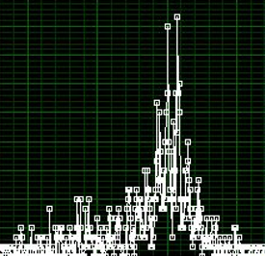

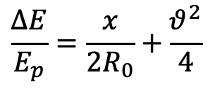

Alternative energy measurement
Electorstatic analyser
Electron optic basic equation
Electrostatic lenses
Helmholtz – Lagrange law
$$x_{t}$$
$$x_{a}$$
E_{p} + δE
$$x_{t}θ_{t}\sqrt{E_{k}}=x_{a}θ_{a}\sqrt{E_{p}}$$
$$θ_{a}$$
$$θ_{t}$$
$$E_{k}$$
E_{p}
$$E_{p}$$
Two concentric hemispheres
for the energy selection
$$M_{θ}M_{l}$$
E_{p}- δE
Ptolemy e.m. filter
Energy resolution
(bandpass energy):
Delay Line
MCP
Position sensitive detector (MCP+delay line)
allows parallel acquisition
$$\frac{∆E}{E_{p}}=\frac{x}{2R_{0}}+\frac{θ^{2}}{4}$$
preamp.
CFD
TDC
Anode
ΔE: energy resolution
E_{p} : pass energy
x: slit width
R₀: mean radius
θ: accepted angle

Slide 23
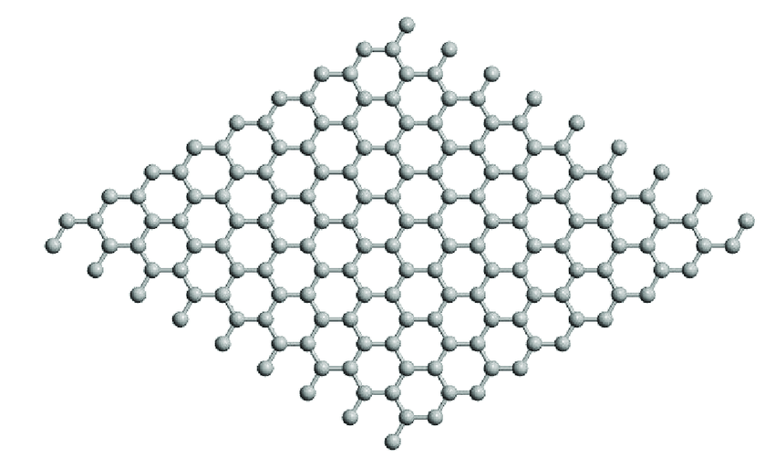
Reference source
Total number of β emissions from tritium:
7 cm
Source:
ρ = 0.2 mg/m²
(full loading)
1μg (50 cm²)
716 MBq
(19.3 mCi)
Esposure:
3 years
Efficiency:
50%
7 cm
3 years
Very small
& compact
source
23

Slide 24
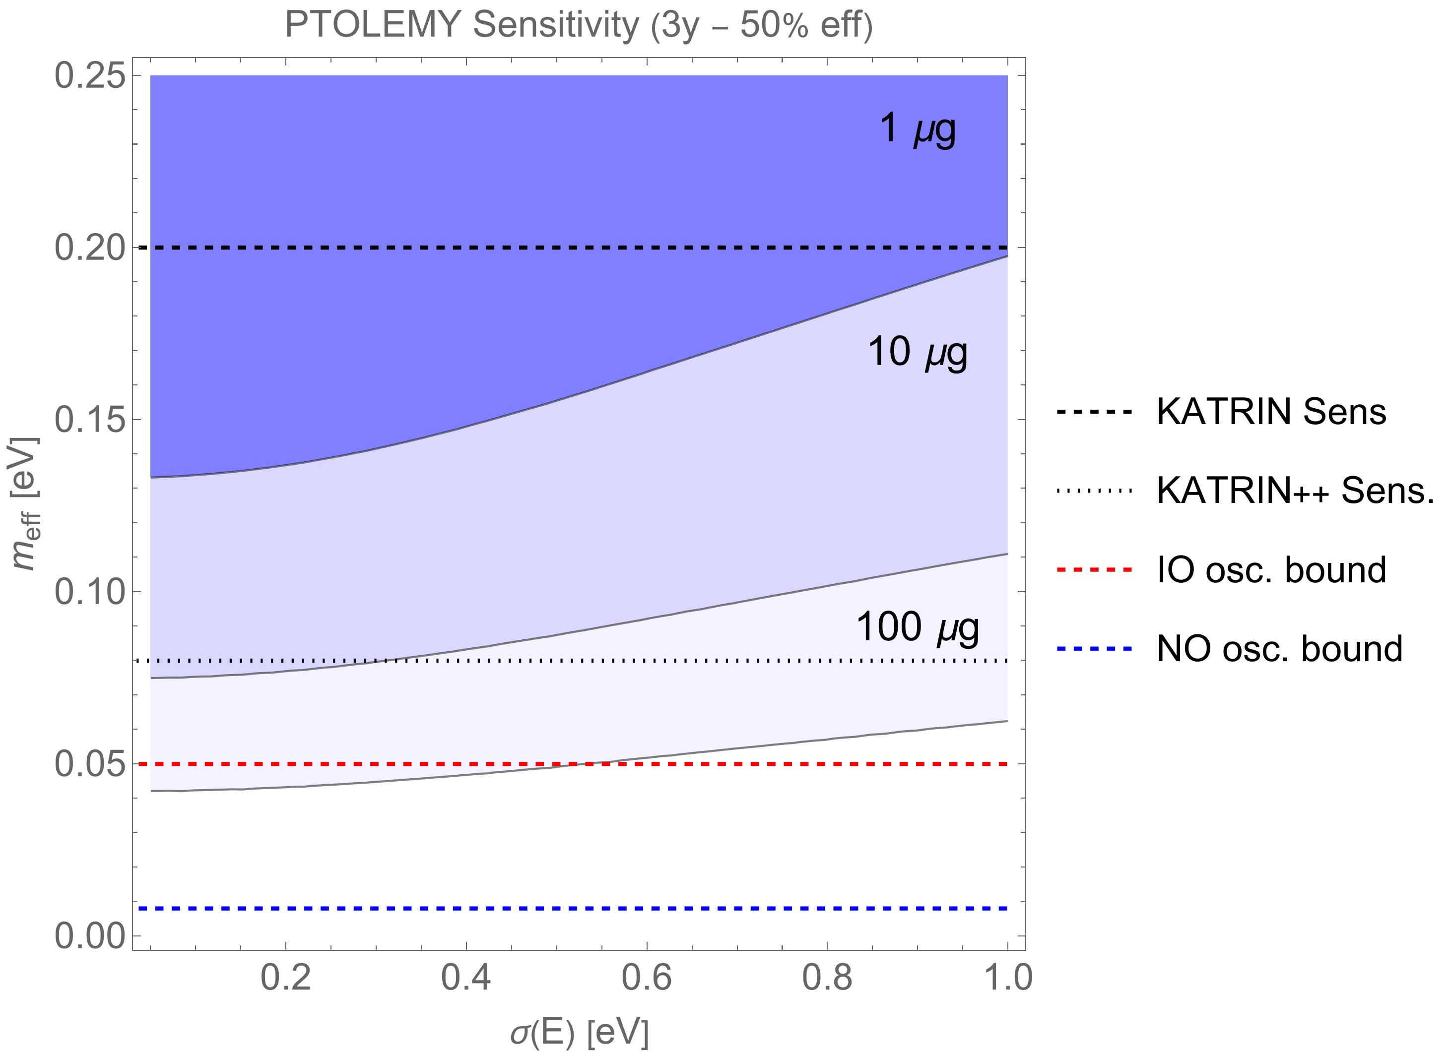
Sensitivity as a function of tritium mass
Remarks:
- the sensitivity is weakly dependent upon the energy resolution (500 meV is already a good starting point)
- 1 μg is potentially comparable or even better than the projection of the best technology on the market
- 100 μg (0.5 m²) can potentially probe the neutrino mass down to the IO scenario
(No syst. Uncertainty included)
In preparation a theory paper on solid state effects on the electron spectrum & consequent theory systematics on m_{ν} extraction (A. Casale, A. Esposito G. Menichetti, V. Tozzini)

Slide 25
PTOLEMY Demonstrator
aims at showing the capability of the PTOLEMY collaboration to master technologies
Integration of all sub-components to achieve full electron transport (fully budgeted)
Spectrum measurement of tritium electrons
Measurement with resolution O(1 eV)
New option for first e-measurement in low magnetic field
are under investigation: modified Skipper/CCD
Final mass sensitivity goal by using about 10 μg of tritium on graphene
25

Slide 26
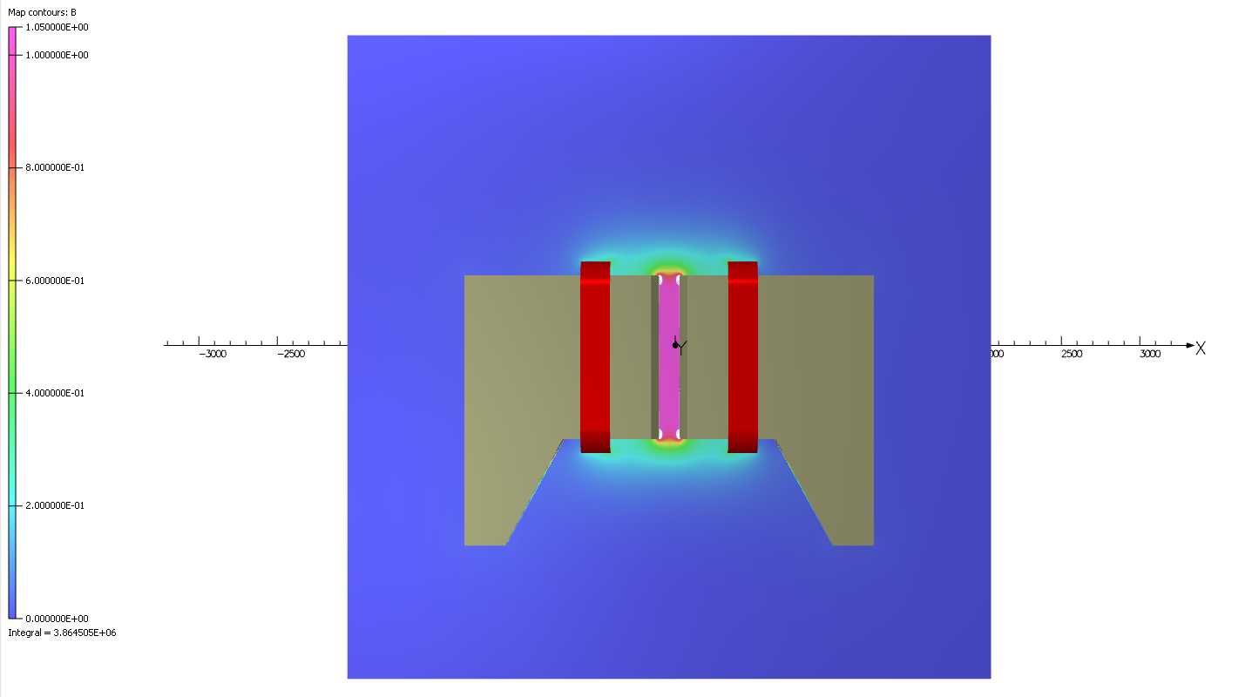
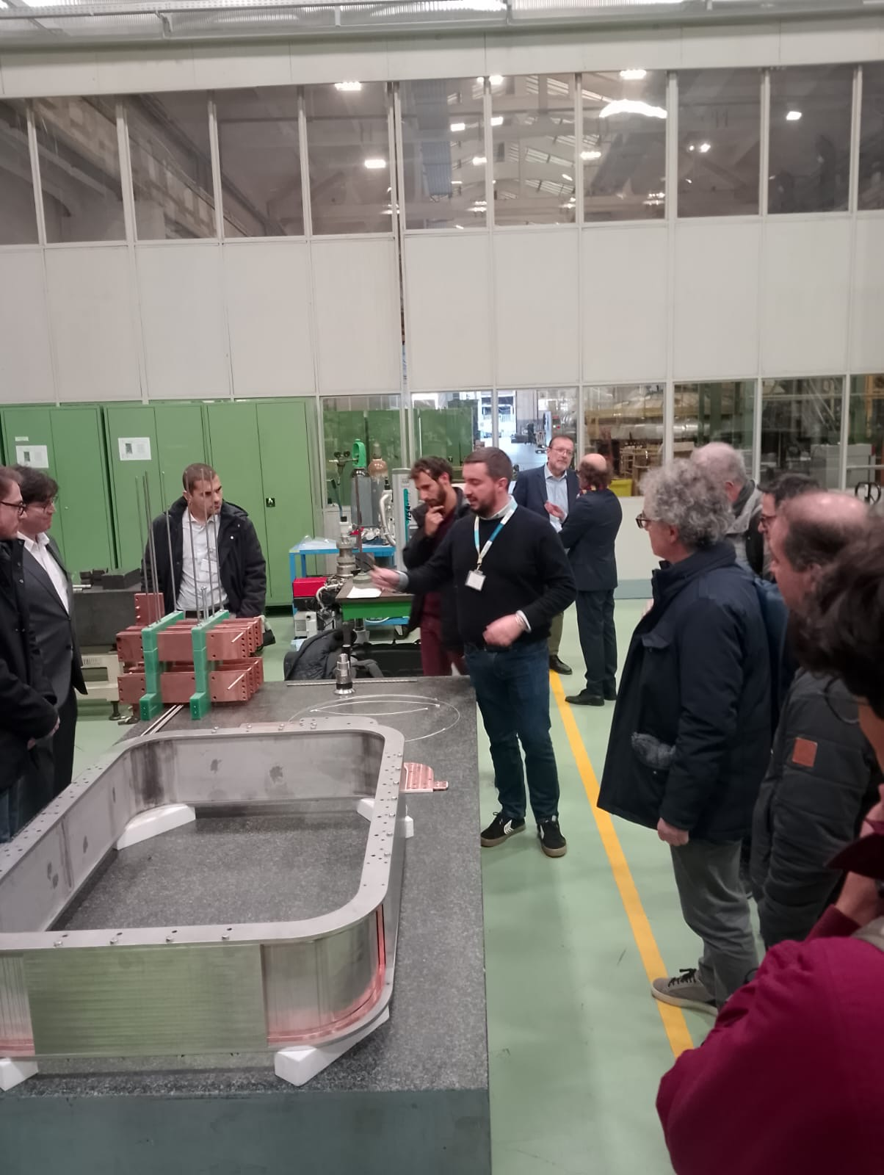


Demonstrator parts under constructions: magnet, order issued
Magnet: Key subsystem
ASG (Genova)/Suprasys(Bilbao)
26

Slide 27

Demonstrator parts under constructions: vacuum chamber
Cylindrical volume hosting future electron detector
(not drawn)
ALCA technology (Vicenza)
order issued
HV filter electrodes feedthrough
Vacuum gauge
Antenna signal FT
top or bottom or both
Cold source
For vacuum
environment
Volume hosting G-T sample
with standard CF flanges with
possibility to make it longer and
connected to vacuum suitcase
for G-T transfer. Possible adapter to be added afterword
200 mm OD
Vacuum
station
120 cm OD
Vacuum gauge
(not visible)

Slide 28

GANTT

Slide 29


GANTT Tasks and Milestones

Slide 30
To conclude: activities ongoing in 2025
Graphene hydrogenation demonstrated, to be ported to tritium - no scientific show-stopper
Plans to collaborate with UK AEA
2) Magnet ready in few months, at LNGS by fall 2025, electrodes design ongoing
3) RF radiation detection well advanced - to be integrated in the demonstrator
4) Several electron source for calibration, HV stability close to requirement
5) First detection of 100 eV electron with TES, warm detector based on
electrostatic analyser commercially available with 50 meV resolution

Slide 31
Outlooks
First operation in 2026
Aim to physics results after 3 years
LoI/CDR in preparation for July CSN II meeting

Slide 32
Backup

Slide 33
Methodology
2D plane monitors placed every 1 cm in z
  11x6 cm in (x,y) centered at (0,0)
Record individual particle hit information (incl. multiple hits per particle due to cyclotron motion)
At each Z coordinate:
Transmission efficiency: Extract # of unique particle hits per plane, express as percentage of N
Average KE: Take average over all hits (incl. duplicates)
Pitch angle: Calculate instantaneous pitch angle from momentum components for hits within 5mm of x=0, then take average pitch over these hits
x
z
+/-5mm
x
z
y

Slide 34



Coils per trasporto di elettroni
Magnete permanente da 1T triziato

Slide 35

Impacchettamento target: scalabilità

Slide 36

Simulazione di un array
3x4
B=0.1T
3x4
3x3

Slide 37


solid state effects on decay (Casale, esposito, menichetti, tozzini)
Various final states of ${\text{He}}^{++}$ induce features in the electron spectrum
To determine the final helium binding potential is very subtle
Different ways of implementing the sudden approximation lead to different predicted rates
The paper studies this and other solid state effects. It also provides a first rough rule of thumb to determine the theory systematics on $m_{ν}$
Angelo Esposito
LNF 2025

Slide 38


Sensitivity with Profile Likelihood
[Cowan et al. (2013)]
median
L0
L0
L
Median sensitivity (90% CL)
In 50% of cases the alternative hypothesis exceeds the 10% tail of the null hypothesis
L0: Null hypothesis
Mass distortion is not simulated but is fitted
L1: Alternative hypothesis
Mass distortion is simulated and fitted

