Slide 1
Longitudinal beam coupling impedance mitigation studies for CERN PS accelerator complex
Ph.D. in Accelerator Physics – XXXVII cycle
Michela Neroni*
Advisors
Prof. Andrea Mostacci (Sapienza, University of Rome)
Dr. Christine Vollinger (CERN)
Final Defence - 30th of January 2025
*michela.neroni@uniroma1.it

Slide 2
Outline
Introduction and motivations
Longitudinal beam coupling impedance of:
Extraction kickers
Septa magnets
Pumping manifolds
Conclusions
Introduction and motivations
Longitudinal beam coupling impedance of:
Extraction kickers
Septa magnets
Pumping manifolds
Conclusions

Slide 3
Beam intensity upgrades in the CERN injector complex
Proton Synchrotron (PS) accelerates ions and protons beams towards experimental areas and Super Proton Synchrotron (SPS).
Oldest CERN synchrotron → it was designed for working with lower intensities.
Constant need for higher intensity and brightness beams (High Luminosity LHC, Physics Beyond Colliders projects) ➔ high quality beam from the injectors complex is crucial.
LHC
North Area
SPS
AWAKE
AD
PSB
East Area
From LINAC 4
PS
n-TOF
From LINAC 3 and LEIR
Parasitic mechanisms leading to beam instabilities and losses must be limited in the Proton Synchrotron (PS).

Slide 4
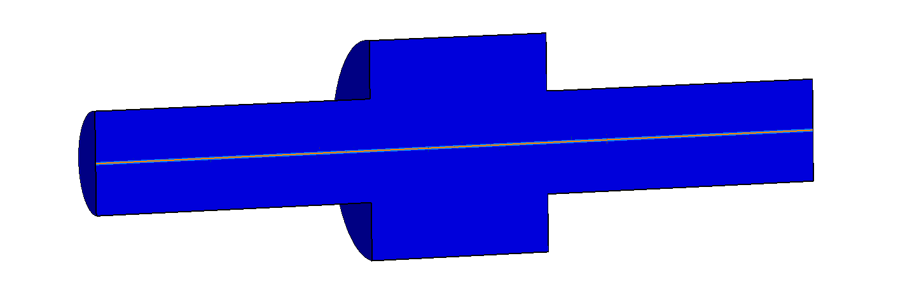
Longitudinal beam coupling impedance
Bunch of charged particles facing:
Cross section variations of beam chamber
Finite resistivity of the walls
Wake field
It can affect one or more following bunches ➔ Beam quality degradation and beam instabilities
CST Studio Suite®
Effect of wake field produced by a moving leading particle, $q_{1}$, on a point charge $q_{2}$, at a fixed distance $s$ in the longitudinal direction can be quantified through the longitudinal wake function:
$$w_{z}\left(\vec{r_{1}},\vec{r_{2}}, s\right)=−\frac{1}{{q_{2}q}_{1}}\int_{−∞}^{+∞}{F_{z}\left(\vec{r_{2}},\vec{r_{1}}, t=\frac{z_{2}+s}{βc}\right) dz}$$
x
$$q_{1}$$
$$\vec{r_{1}}$$
$$\vec{v}=βc\hat{z}$$
$$z_{2}$$
Fourier transform
Lorentz force
$$z_{1}$$
$$z$$
$$\vec{r_{2}}$$
$$s=βcτ$$
$$Z\left(\vec{r_{1}},\vec{r_{2}},f\right)=\int_{−∞}^{+∞}{w_{z}\left(\vec{r_{2}},\vec{r_{1}}, τ\right)e^{−j2πfτ}}dτ$$
Longitudinal beam coupling impedance
y
$$q_{2}$$
$$\vec{v}=βc\hat{z}$$

Slide 5
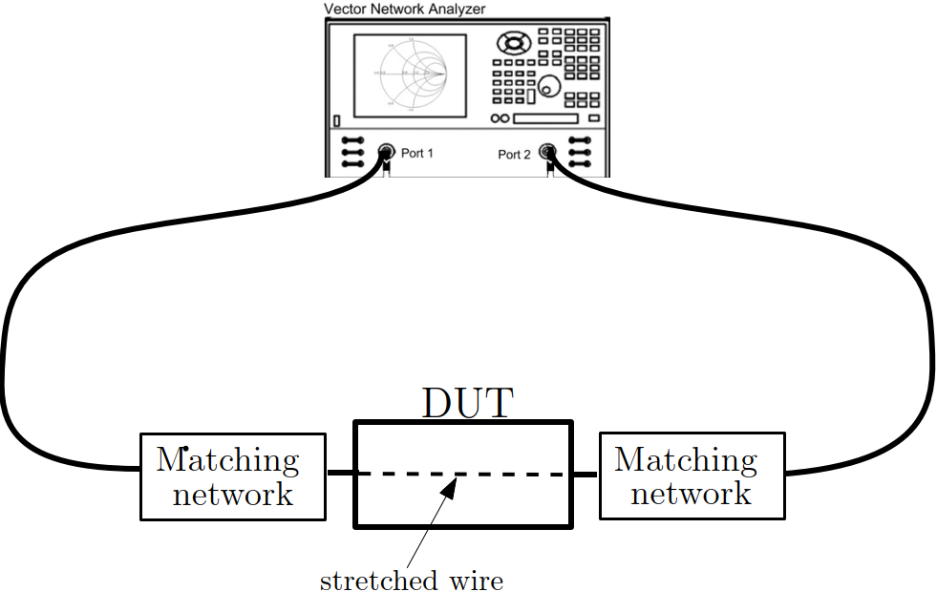
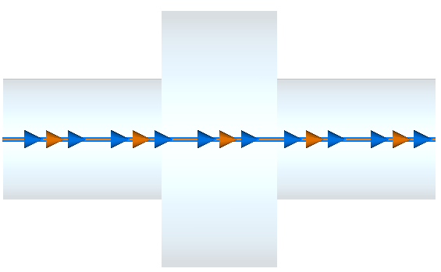
Longitudinal beam coupling impedance evaluation
Electromagnetic simulations
Single stretched wire measurements*
Modern software allows the analysis of complex geometries with high accuracy.
E.g. Wakefield simulation
$$q_{2}$$
$$q_{1}$$
Particle beam
z
→ Device Under Test
s
Stretched thin wire
CST Studio Suite®
Wake potential: ${W_{z}\left(s\right)=q_{2}w}_{z}\left(s\right)$
Log-formula, related to distributed impedances:
$Z=−2Z_{L}ln(S_{{21}_{DUT}})$,
with $Z_{L}$ characteristic impedance of the device including coaxial wire.
Longitudinal wake impedance
$$Z(ω)=\frac{\int_{−∞}^{+∞}{W_{z}(s)e^{−jωs}ds}}{\int_{−∞}^{+∞}{λ(s)e^{−jωs}}ds}$$
Charge distribution function
*H. Hahn and F. Pedersen, “On Coaxial Wire Measurements of the Longitudinal Coupling Impedance,” Tech. Rep. BNL-50870, Brookhaven National Laboratory, 1978.

Slide 6
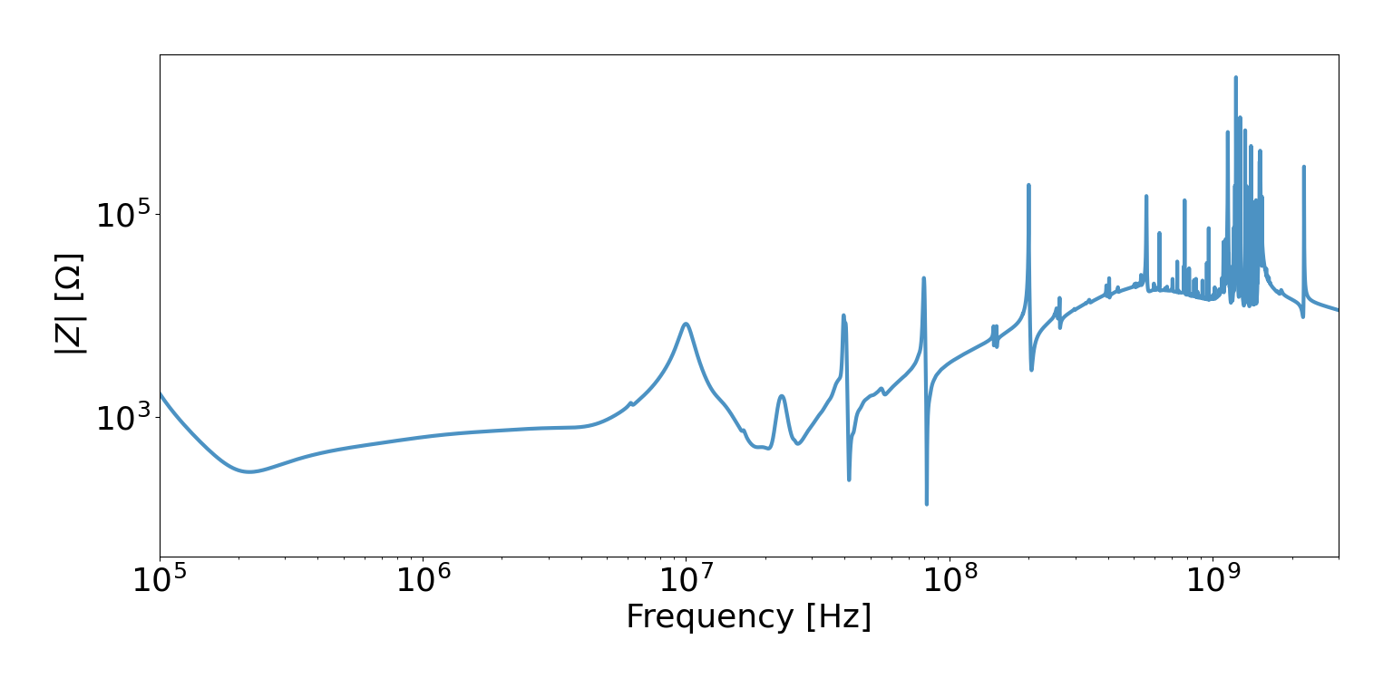
Proton Synchrotron longitudinal impedance model
Impedance of each accelerator component (e.g. kickers, septa, beam diagnostics,..)
Ʃ
Accelerator impedance model
Input for beam dynamics simulation
Latest update of PS longitudinal impedance model was in 2020. LHC Injectors Upgrade (LIU) requirements have been achieved in the PS ($I_{b}=2.6 ×{10}^{11}$ p/b, with $72$ bunches).
Tackling critical impedance sources and adding missing contributors (e.g. septa magnets) will provide additional margin.
Impedance model must be kept up-to-date, to ensure the use of the most recent geometrical model of each component.
Total Longitudinal PS Impedance Model*
Vacuum equipment
RF cavities
Kickers
*A. Lasheen. PS Longitudinal Impedance Model. Zenodo, 2020. doi:10.5281/zenodo.4722835.

Slide 7
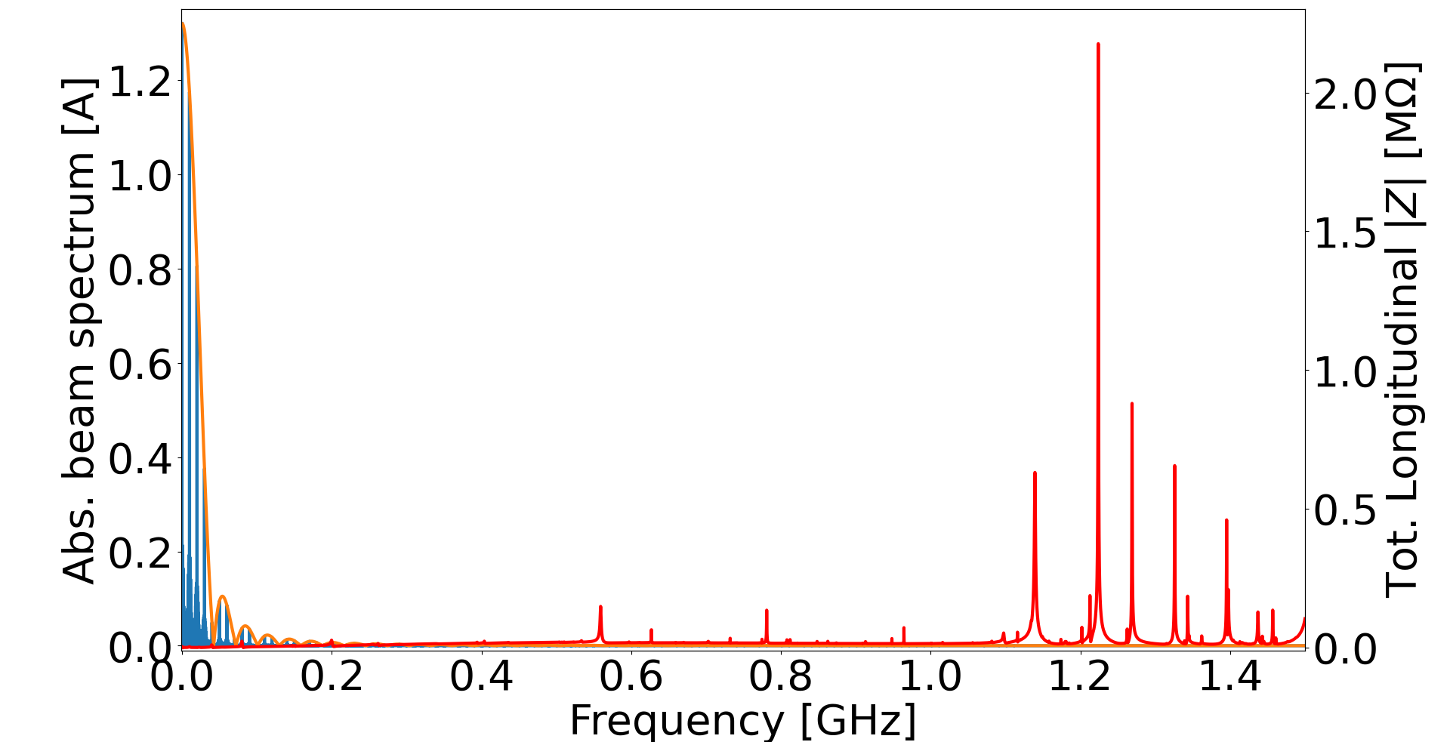
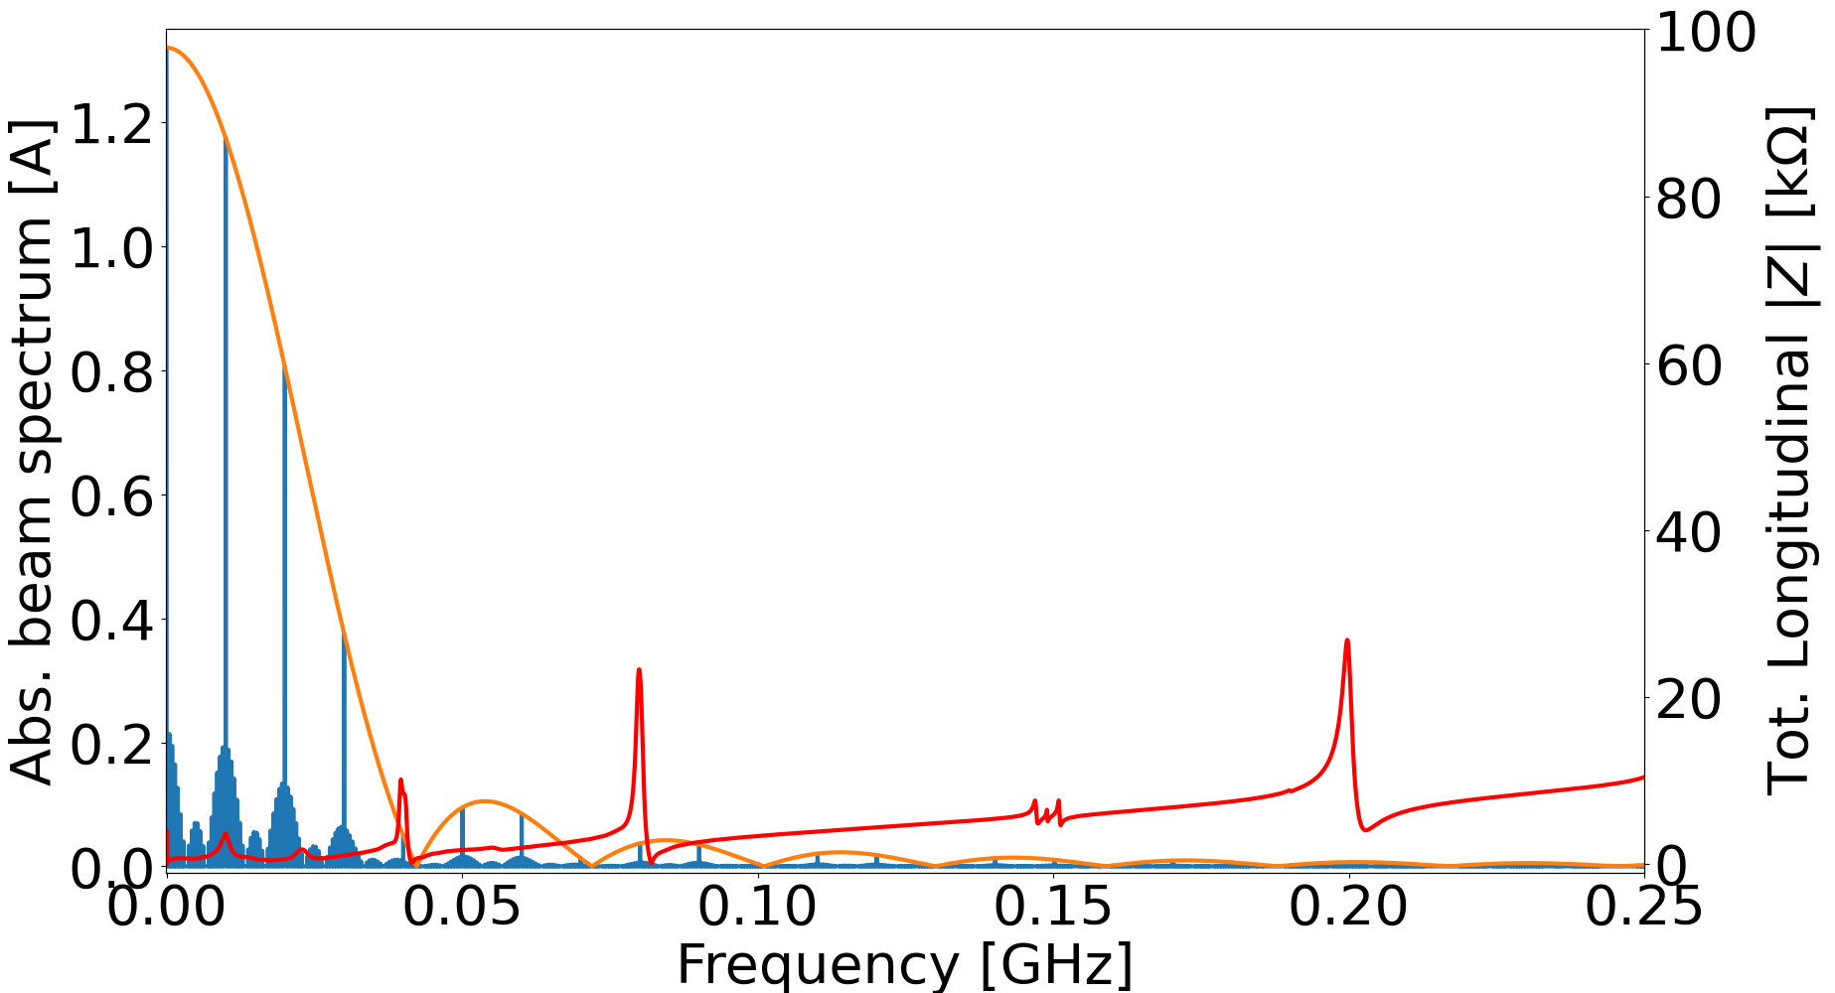
Impedance model and beam spectrum in the CERN Proton Synchrotron
PS beam spectrum and impedance at flat top for LHC proton beam
The impedance sources have different effects depending on their wavelength-to-bunch length ratio, $f_{r}τ$, with $f_{r}$ frequency of the impedance peak and $τ$ bunch length.
Low frequency range includes sources up to 40 MHz $(f_{r}τ\sim 1)$ → Longitudinal coupled-bunch instabilities expected in this frequency range.
High frequency sources ${(f}_{r}τ≫1)$ are expected to drive microwave instability, leading to uncontrolled emittance blow-up.

Slide 8
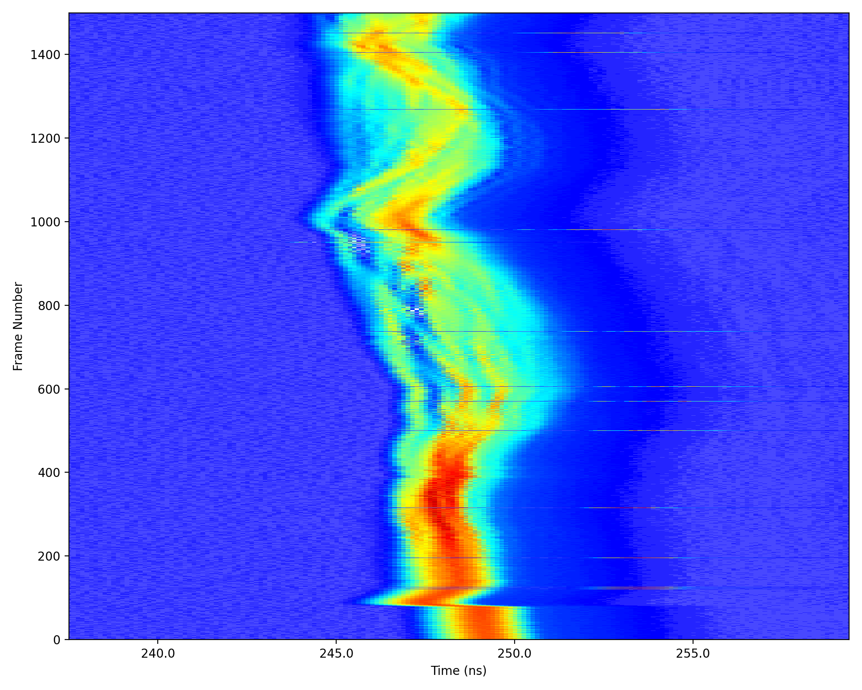
Observations of longitudinal instabilities at CERN Proton Synchrotron
Among the beams in the PS, some were observed to be at the longitudinal stability limit:
Coupled bunch instabilities observed in LHC and fixed target protons beams, characterized by train of bunches.
Narrowband and high shunt impedance sources acting in the same frequency range of action of RF system (low frequency range)¹→ extraction kickers suspected contributors with some peaks at low frequency.
Microwave instabilities observed at transition crossing in AWAKE beam and LHC ions beam.
Measurements of high frequency modulation with RF off in long bunch regime², showed beam modulation at 1.2 GHz, compatible with pumping manifold impedance (vacuum equipment).
1400
Large variety of beams produced in the PS results in different beam stability regimes ➔ important to tackle specific impedance source causing instability.
1000
Example of recent observation of microwave instability at transition crossing for LHC ions beam:
Frame number
600
200
0
240
245
250
255
Time (ns)
A. Lasheen et al., “Identification of impedance sources responsible for longitudinal beam instabilities in the CERN PS,” in CERN Yellow Reports: Conference Proceedings, vol. 9, pp. 323–323, 2020.
E. Vinten and A. Lasheen, “Longitudinal microwave instability with long bunches in the CERN Proton Synchrotron,” in Proc. IPAC’23, Venice, Italy, pp. 2661–2664, 2023.

Slide 9
Methodology overview
CST Studio Suite®
Objective:
Upgrade of existing accelerator for working with higher intensities
Identification of impedance source
Wakefield simulations
(Particle beam source)
Analytical evaluation
(applicable just in simpler cases)
Eigenmode simulations
(resonator structures)
Electromagnetic simulations
Frequency domain
(S-parameters)
Useful for direct comparison with bench measurements
Radio frequency measurements
Is there agreement?
Benchmark of simulation model
Full understanding of impedance contribution
If yes
Complementary tools, to be used in conjunction
Update of existing impedance model
Impedance mitigation strategy
To be equally proven with simulations and measurements

Slide 10
Outline
Introduction and motivations
Longitudinal beam coupling impedance of:
Extraction kickers
Septa magnets
Pumping manifolds
Conclusions
Introduction and motivations
Longitudinal beam coupling impedance of:
Extraction kickers
Septa magnets
Pumping manifolds
Conclusions

Slide 11
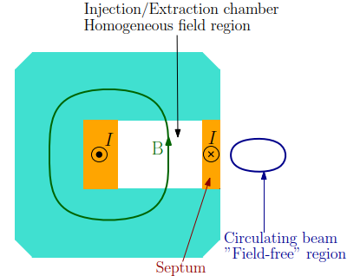
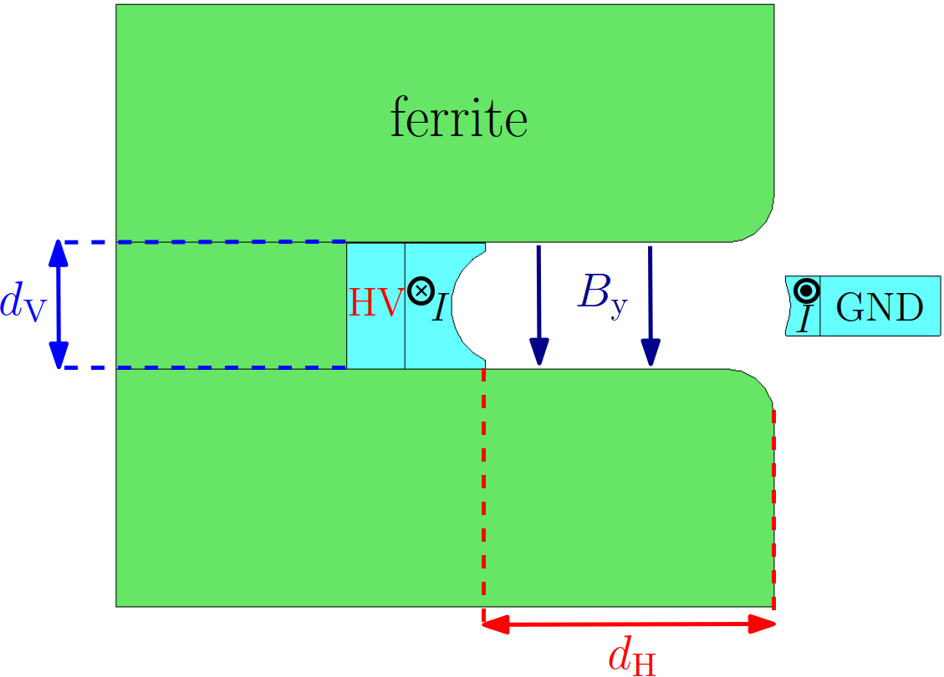
Fast extraction process: kickers and septa magnets
Extracted beam
Septum magnet
Kicker magnet
Circulating beam
Magnetic septum
Kicker magnet
Fast rise/fall time ($\sim 100$ ns) for magnetic field pulse
Ferrite material
Fast deflection brings the beam from the circular orbit to the extraction channel.
It gives the final deflection to the extracted beam.
M. J. Barnes, “Kicker Systems,” in CERN Accelerator School: Beam Injection, Extraction and Transfer, vol. 5, p. 229, CERN Yellow Reports: School Proceedings, 2017.

Slide 12
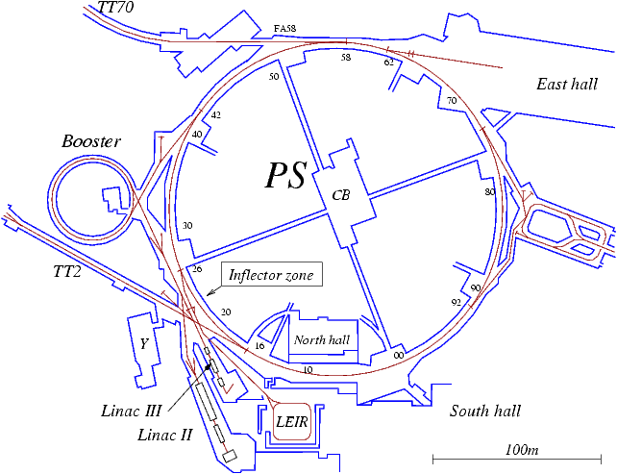
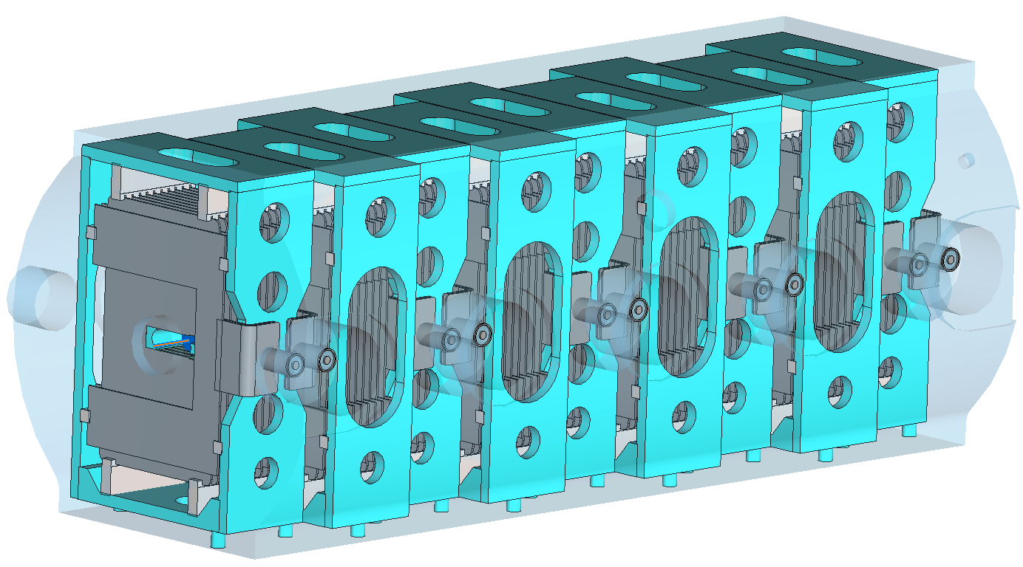
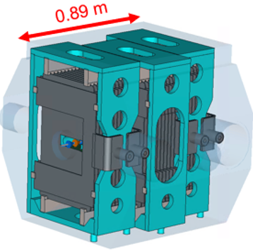
Proton Synchrotron extraction kickers
Two kickers and one septum magnet involved in the main extraction from PS towards SPS and experimental areas.
Kickers first installed in the 1970s.
Twelve magnet modules foreseen for extraction, split in two different devices.
2.45 m
KFA71
KFA79
SMH16
IV
Impedance study of the 3-modules kicker can be extended on the 9-modules kicker.

Slide 13
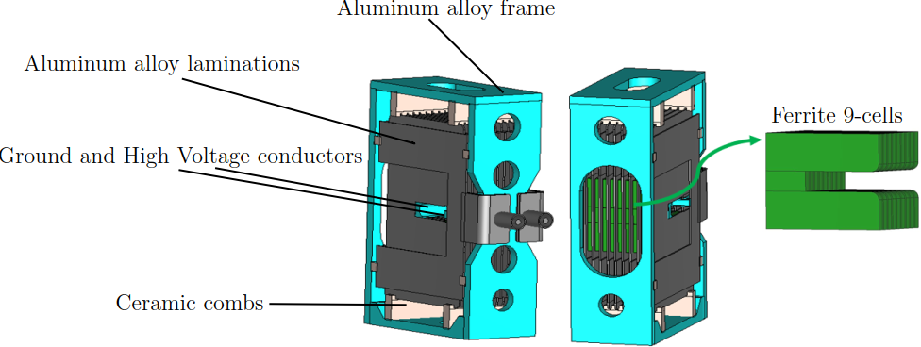
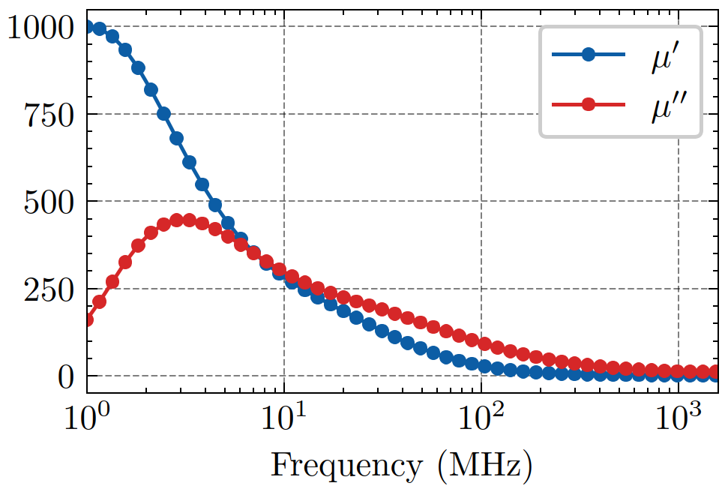
Model geometry and materials
n-cells transmission line magnet
Beam
Beam
Characteristic impedance of each module is 15 Ω
Accurate geometry and material definition in electromagnetic simulation is of paramount importance:
3D models built starting from technical drawings and existing models.
Ferrite dispersive behaviour → experimental values* of relative magnetic permeability of Ferrite 8C11.
$$μ_{r}=μ^{′}−jμ"$$
Optimization of simulation settings is also required to properly handle large complexity
*M. Giovannozzi et al., The CERN PS multi-turn extraction based on beam splitting in stable islands of transverse phase space: Design Report. CERN Yellow Reports: Monographs, Geneva, Switzerland: CERN, 2006.

Slide 14
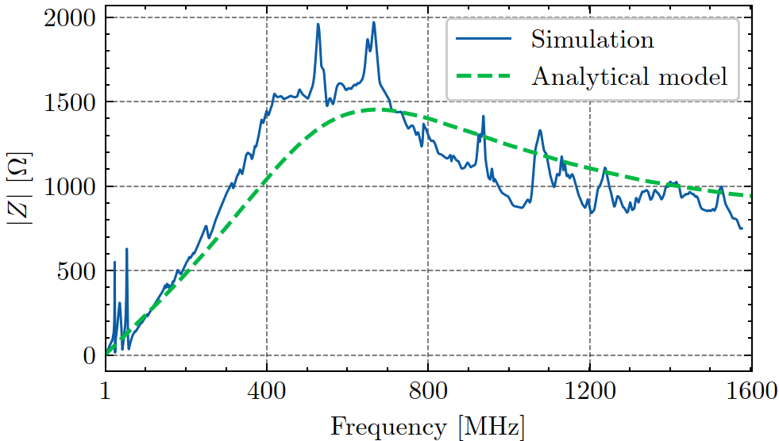
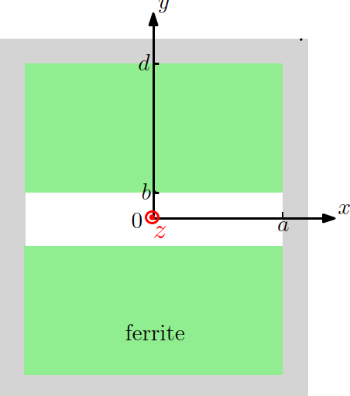
Analytical and simulated longitudinal impedance
3-modules kicker
Analytical model geometry*
Impedance per unit length can be derived ➔ Effective magnet length used in this case
Ferrite drives the broadband behaviour as described by analytical model*.
Narrowband resonances in the low frequency range problematic for coupled bunch instabilities.
* H. Tsutsui, “Some simplified models of ferrite kicker magnet for calculation of longitudinal coupling impedance”, Tech. Rep. CERN-SL-2000-004-AP, CERN, 2000

Slide 15
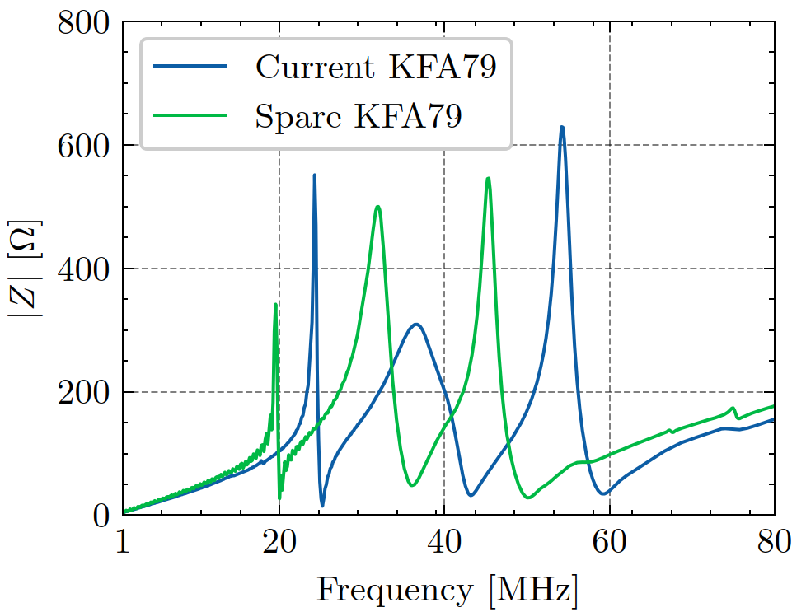
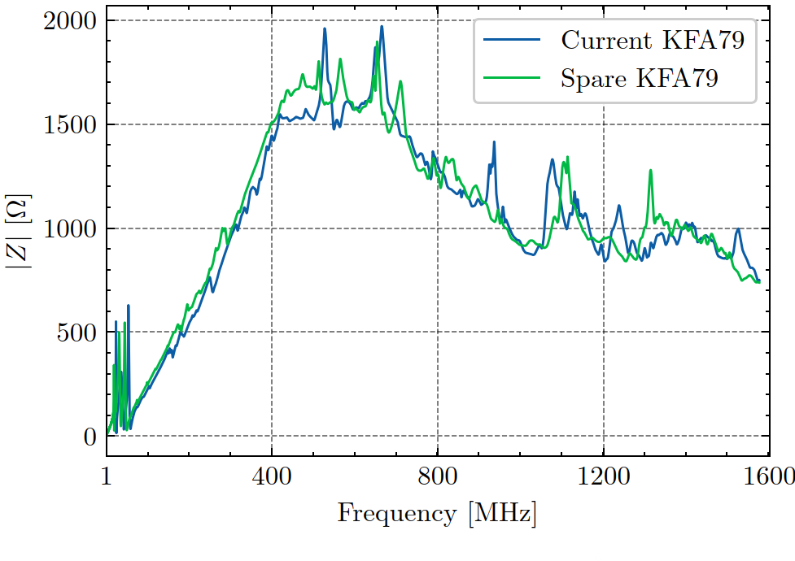
Spare and current kicker module geometry
Current
Spare
Spare 3-modules kicker (KFA79) available for impedance measurements equipped with a new module unit whose laminations and frame are differently shaped.
Beam
Beam spectrum
Impedance validation and mitigation carried out on the spare kicker geometry.

Slide 16
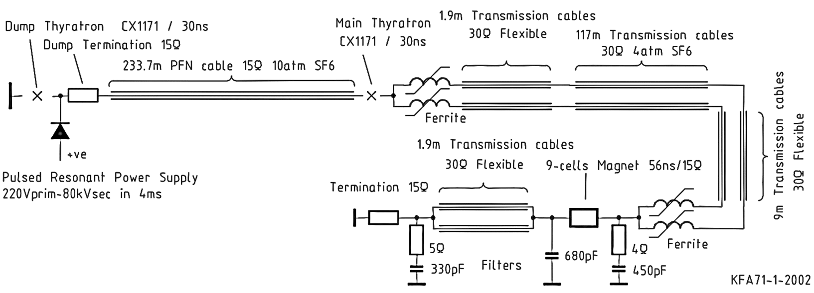
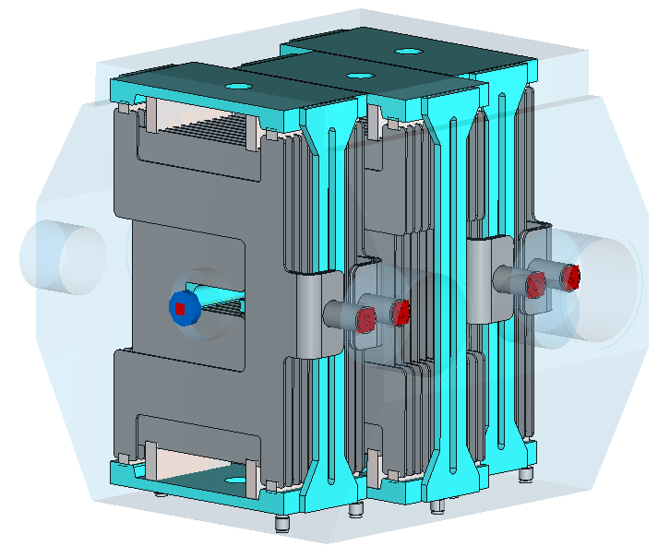
Adding cable terminations
Previous simulations were considering kicker in stand-alone... Each magnet module is connected to the power circuit by means of long transmission line cables ➔ impedance model of the component must include the kicker as it is in the actual configuration in the accelerator.
Circuit schematic of a magnet module unit*
Spare 3-modules kicker
Beam axis
Frequency domain simulation reproducing wire measurements setup (wire simulation)→
output connector terminated with 15 Ω resistor (actual kicker configuration).
Input connector → cables terminated on open circuit when the main switch in off-state, i.e. when not extracting from the PS
Output connector →
Connecting cables terminated on 15 Ω
* L. Sermeus et al., “The kicker systems for the PS Multi-turn Extraction”, No. CERN-ATS-2010-140, 2010

Slide 17
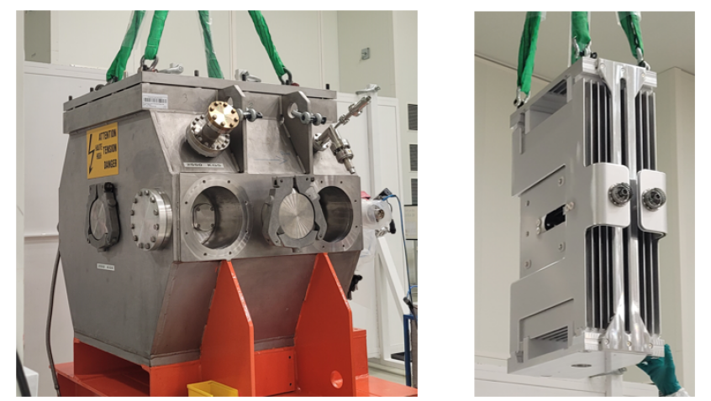
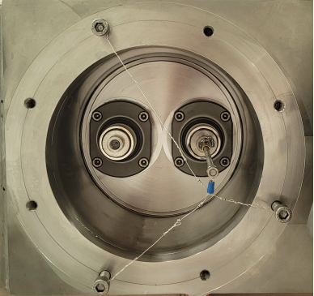
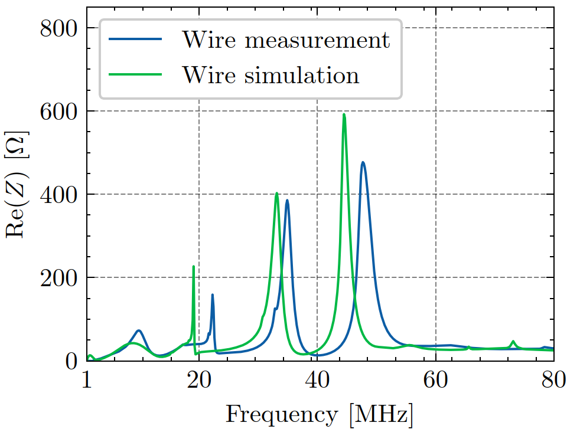
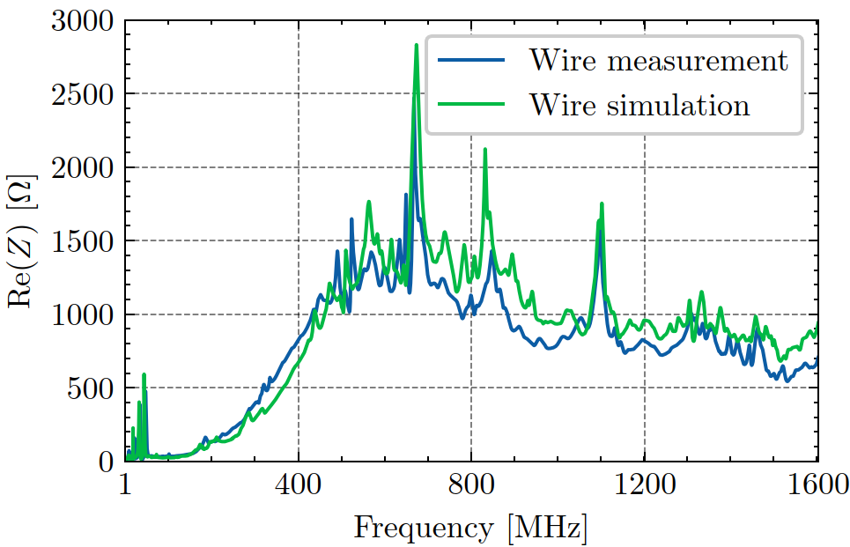
Stretched wire measurements of the spare 3-modules kicker
Output power connectors terminated on a 15 Ω resistor and input connectors left undefined open
Beam axis
Excellent agreement of simulations and measurements ➔ 3D model benchmarked.

Slide 18
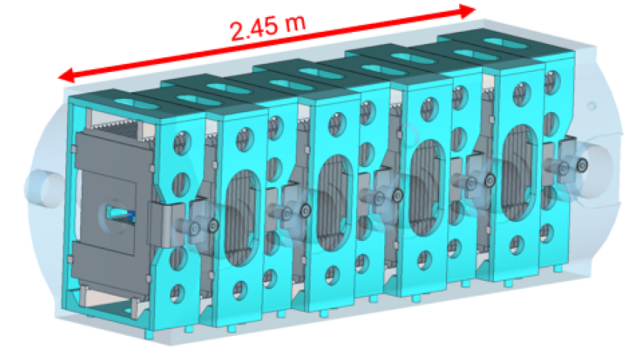
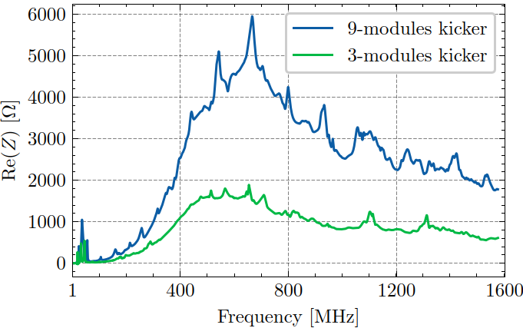
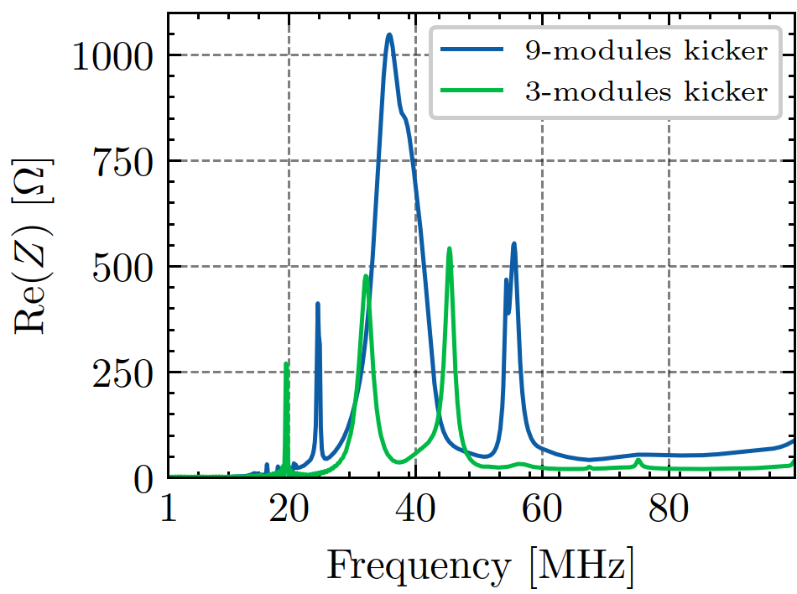
Wakefield simulations of the 9-modules kicker
Beam
Beam spectrum
Impedance amplitude driven by number of ferrite elements.
High shunt impedance resonances at low frequency. Shunt impedance comparable to the one of an RF cavity.
Full understanding of kickers impedance allows starting with a mitigation strategy to address the low frequency resonances

Slide 19
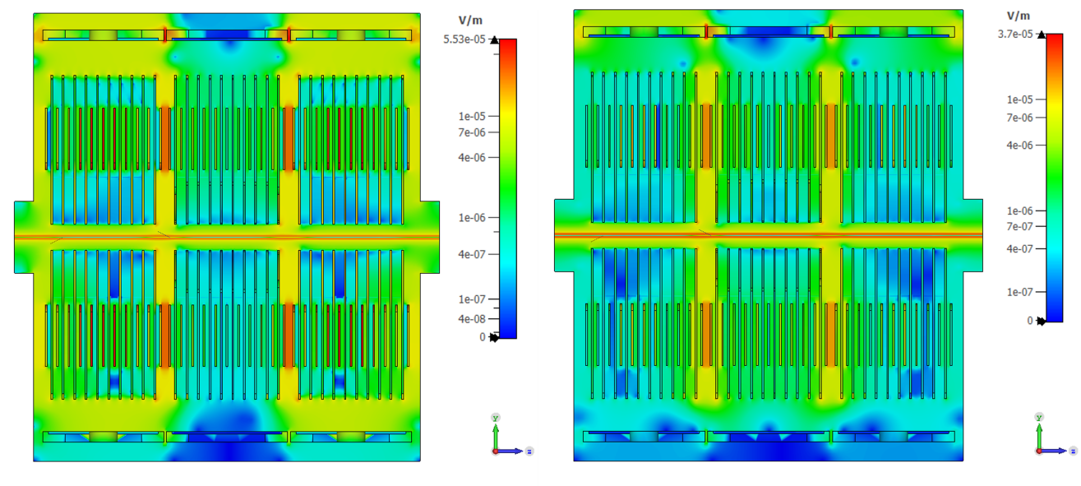
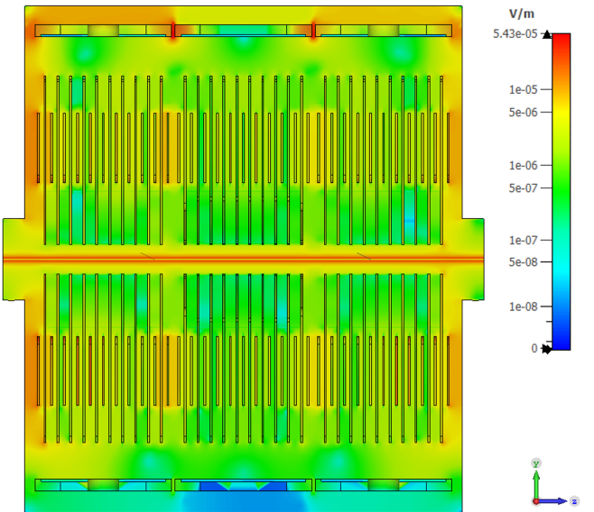
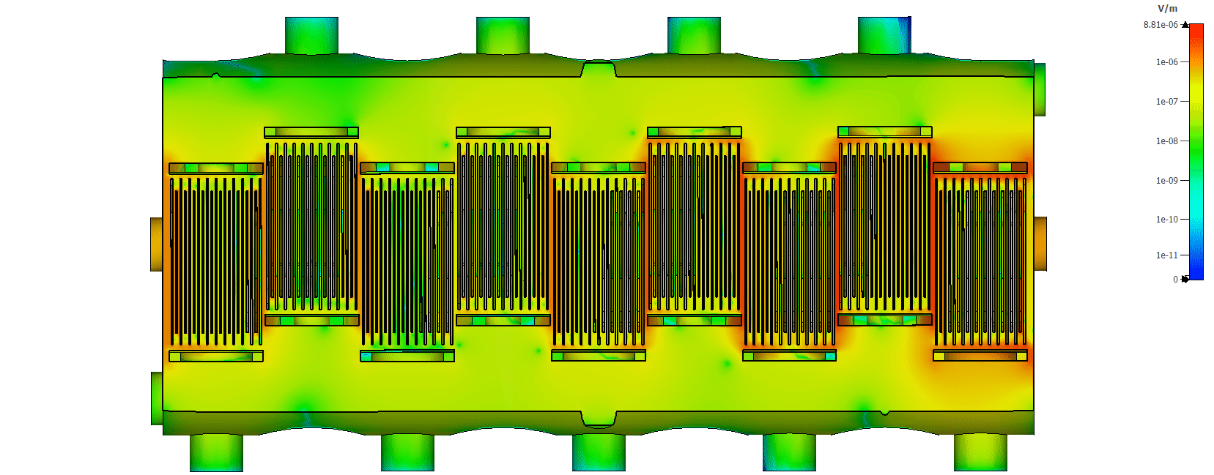
Location of the low frequency resonances
3-modules kicker – Side view: E-field monitor at 19.7 MHz, 32.2 MHz and 45.5 MHz.
Beam axis
9-modules kicker – Top view
E-field monitor at 35.7 MHz
Beam axis

Slide 20
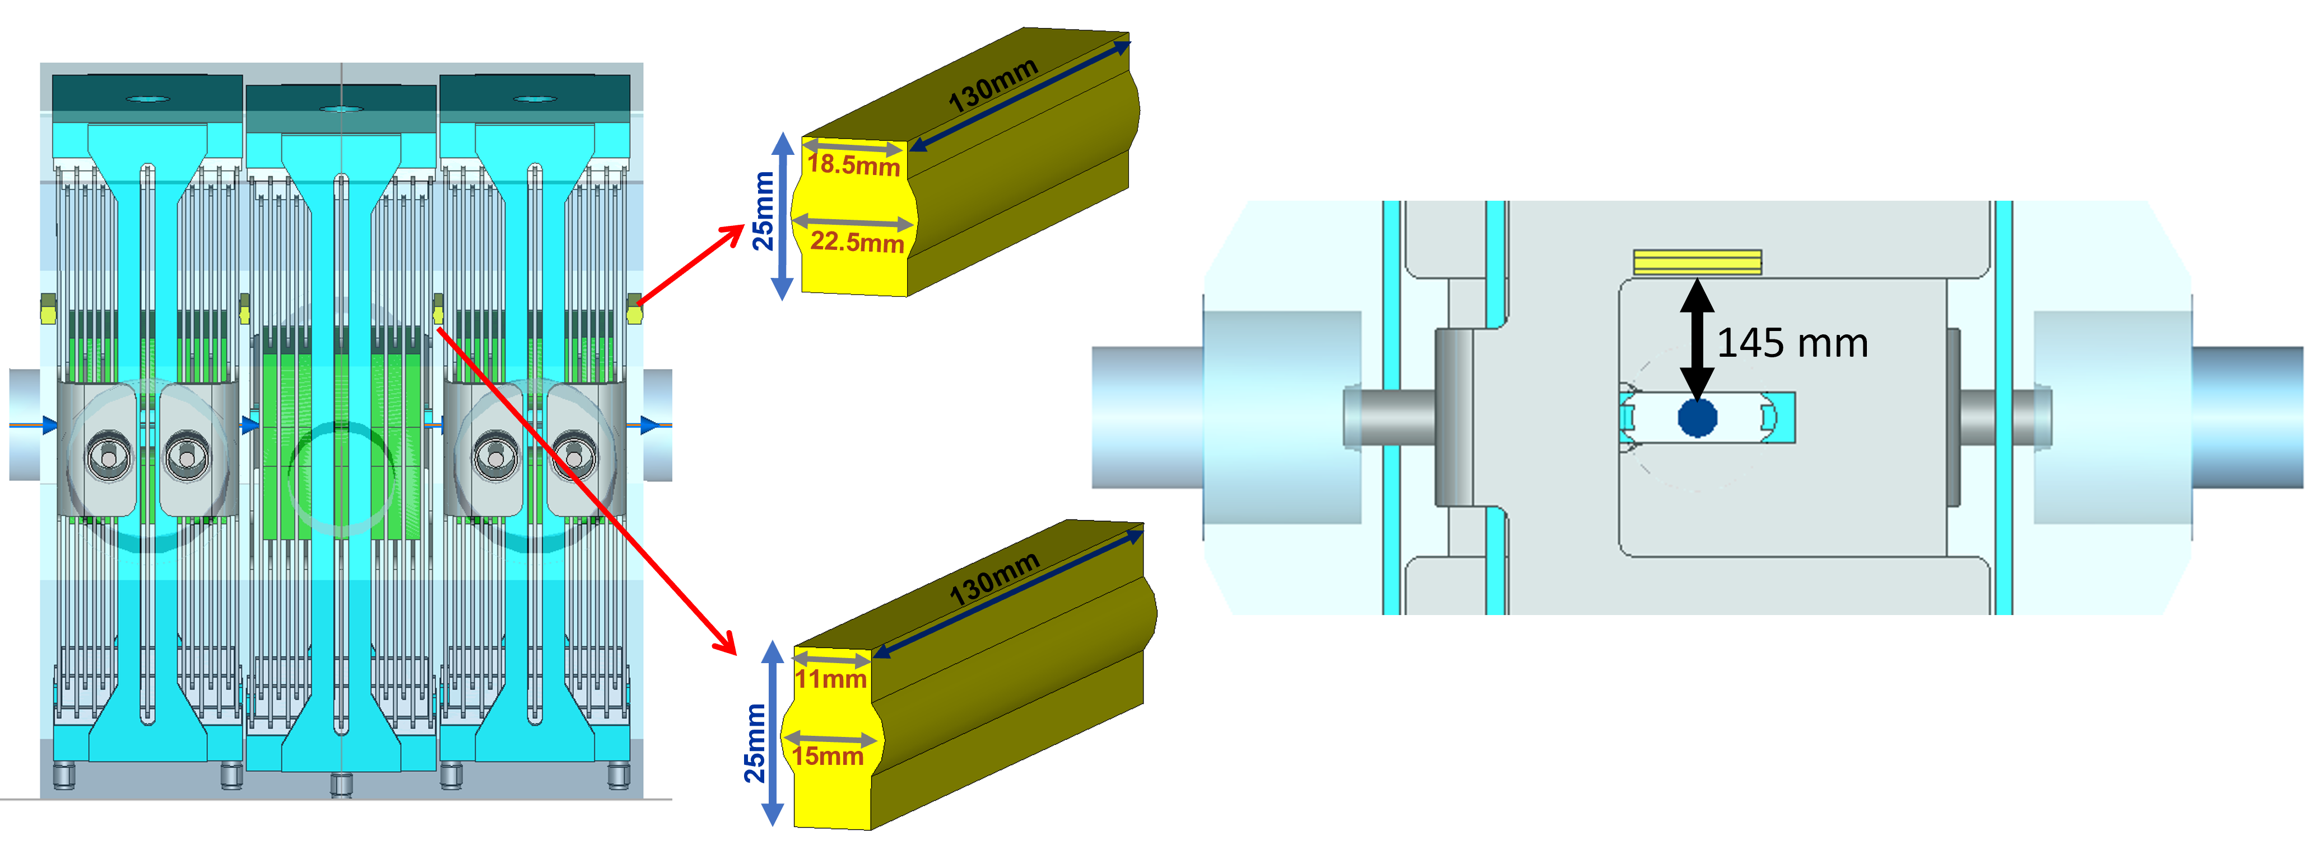
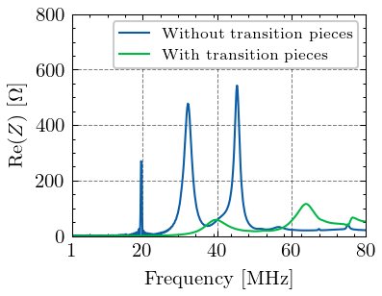
Mitigation solution for Proton Synchrotron extraction kickers
How can we mitigate the unwanted contributions?
Idea: create a path for the induced currents by connecting all the ground contacts.
3-modules spare kicker
Beam
Leading in simulation to an impedance peak reduction of a factor five.
The same mitigation solution with equal outcome was observed in simulations of the 9-modules kicker.

Slide 21
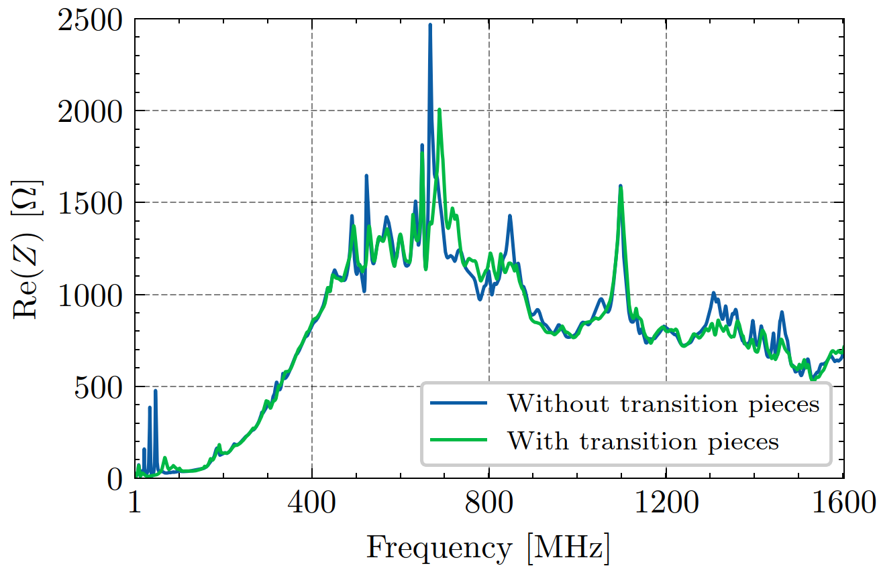
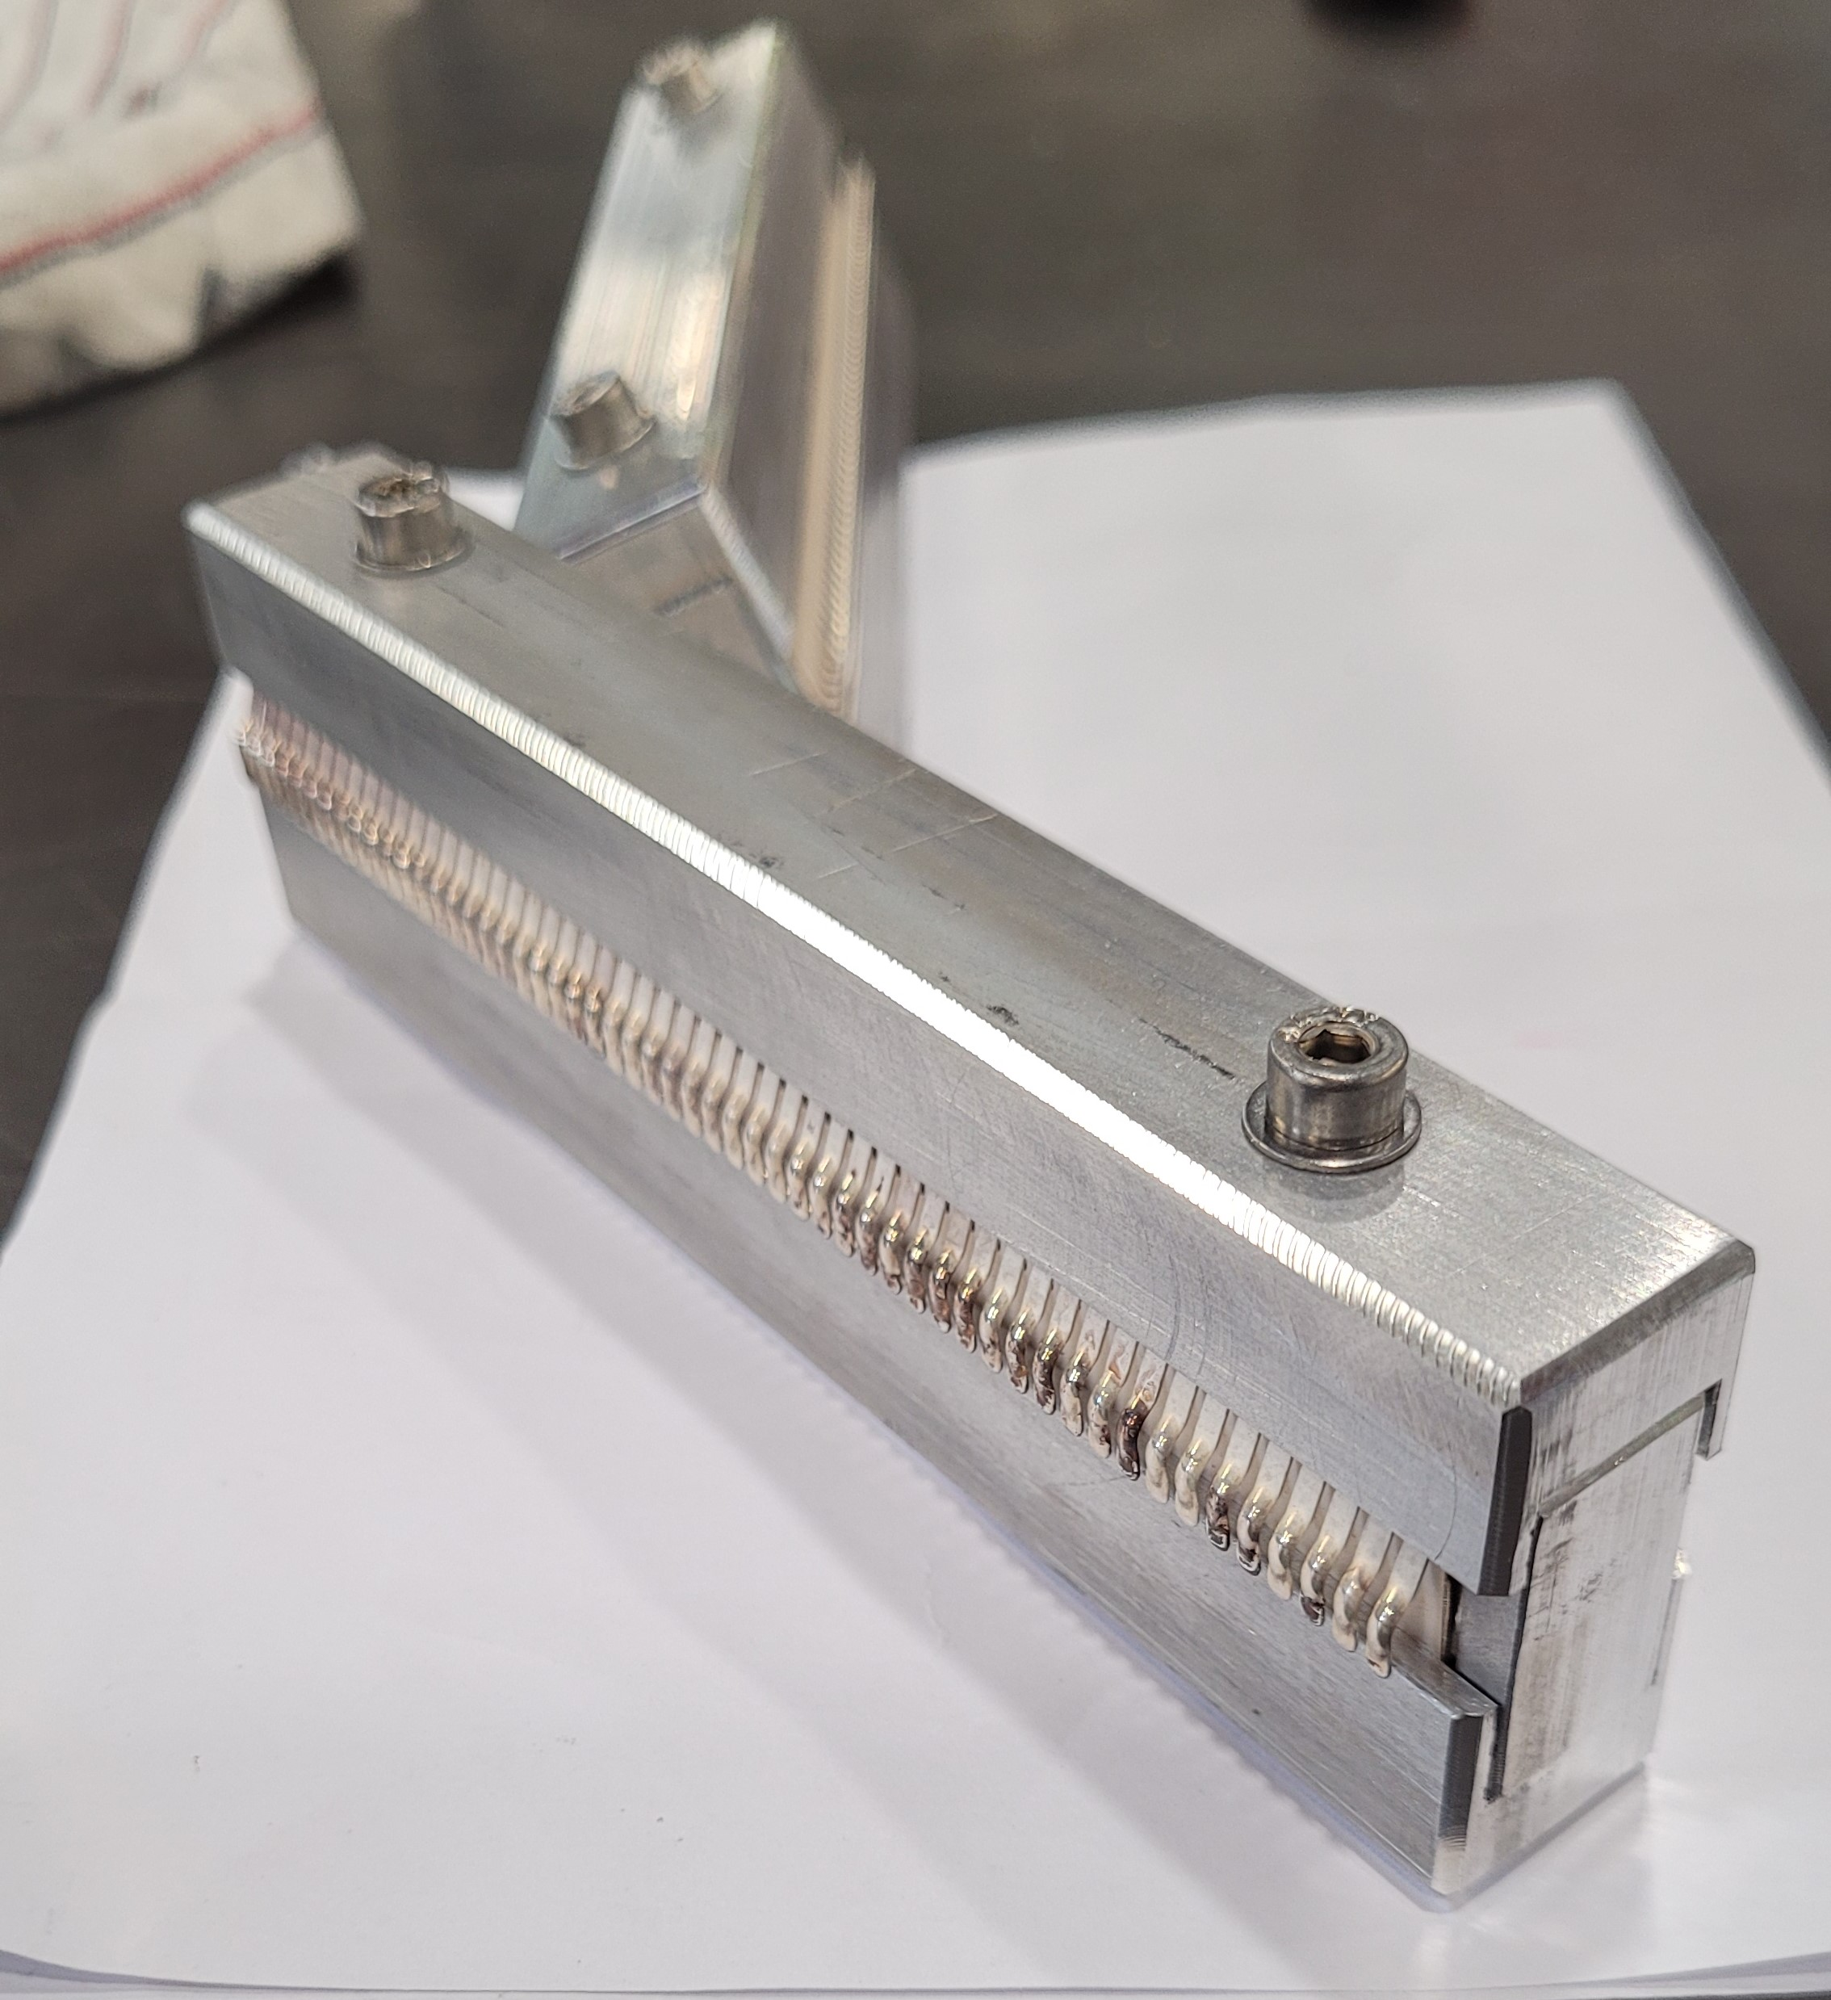
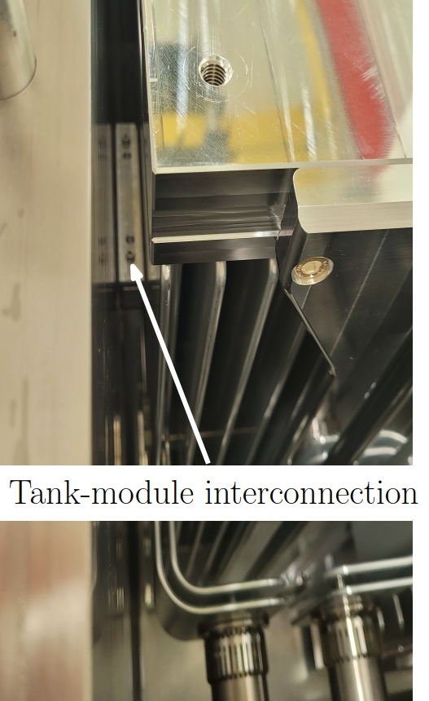
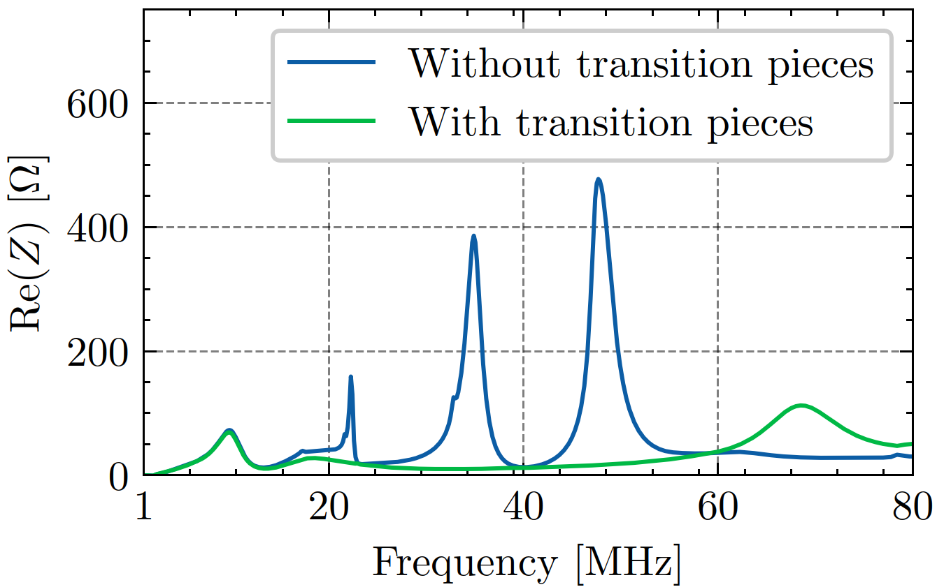
Impedance measurements with transition pieces of 3-modules kicker
Mitigation solution fully proven. Low frequency resonances completely dampened with the insertion of transition pieces.

Slide 22
Outline
Introduction and motivations
Longitudinal beam coupling impedance of:
Extraction kickers
Septa magnets
Pumping manifolds
Conclusions
Introduction and motivations
Longitudinal beam coupling impedance of:
Extraction kickers
Septa magnets
Pumping manifolds
Conclusions

Slide 23
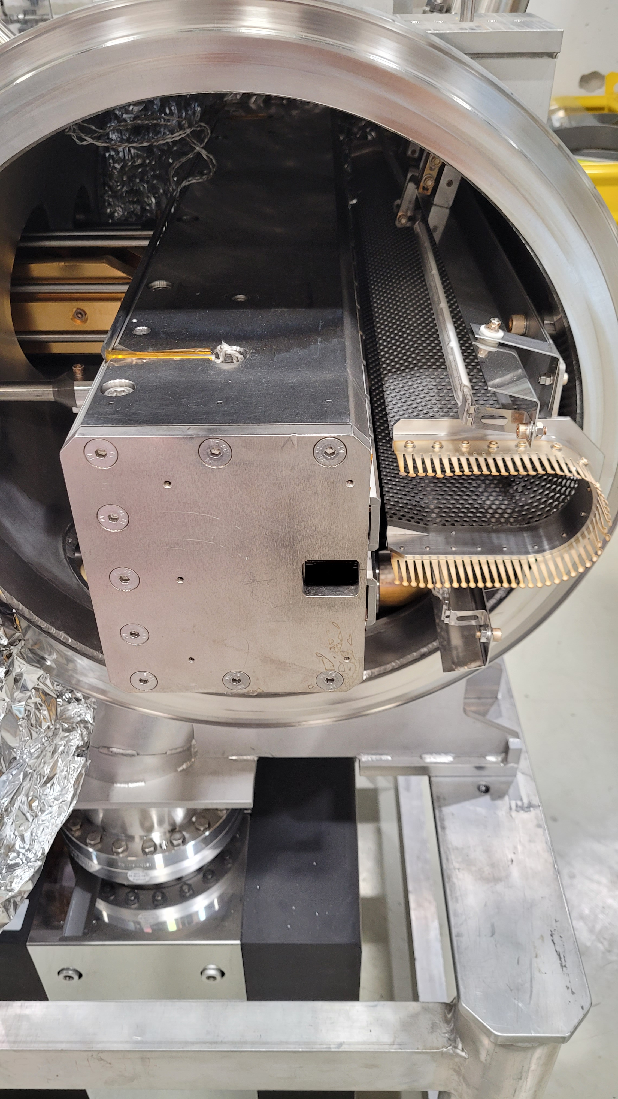
Proton Synchrotron septa magnets
Picture of an extraction septum
Beam screen
PS impedance model to be updated with missing septa impedance.
Mainly resistive wall impedance driven by the conductivity of beam screen material ➔ broadband impedance contribution expected.
Extremely complex geometry and yoke laminations material properties as a function of frequency are unknown ➔ difficult to address the impedance evaluation with simulations.
RF fingers: placed to bridge the gap between the impedance screen and the end covers on both sides.
Circulating beam
Movable magnet yoke
Septum blade
Extracted beam
Impedance evaluation addressed with stretched wire measurements.
4 septa magnets measured, one case example shown here ➔ Extraction septum (SMH16).

Slide 24
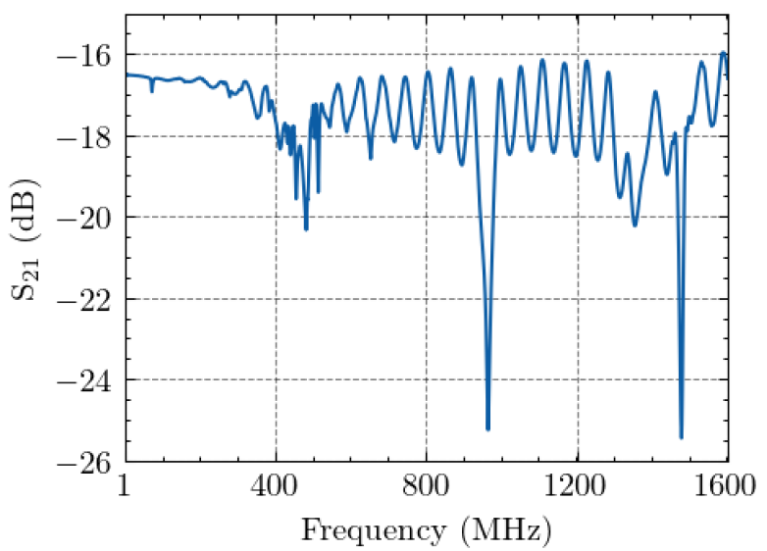
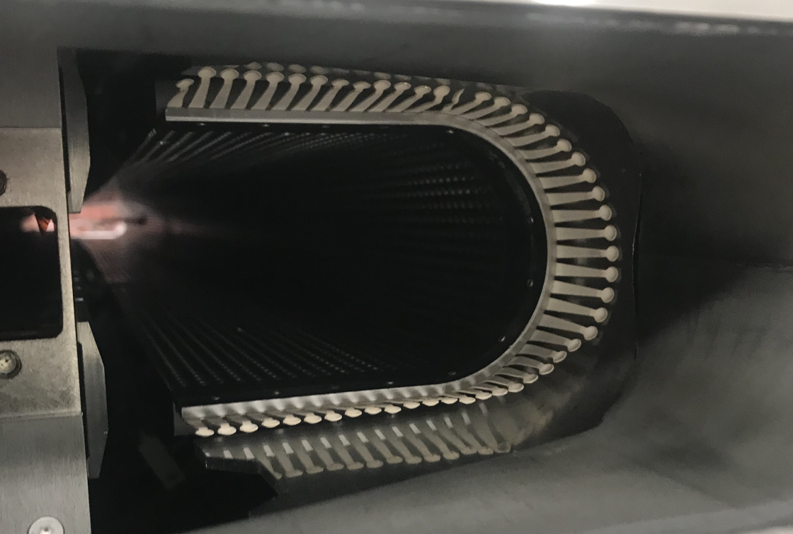
Stretched wire measurements of the extraction septum
A spare septum was measured, impedance assessment needed to qualify for installation.
Wire stretched along beam axis
Port 1
Port 2
Visual inspection showed RF fingers all lifted. Rework on non-contacting fingers needed.
Multiple reflections caused by the remaining mismatch between the VNA and the DUT at the flange interface.
Two sharp notches at frequencies of 965 MHz and 1.47 GHz, and additional notch above 400 MHz.
Suspicion of RF contact issues

Slide 25
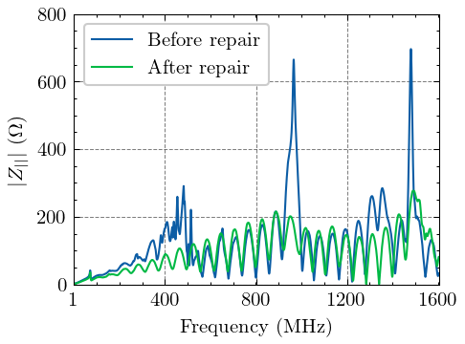
Stretched wire measurements of the extraction septum
Septum magnet remeasured after repair on the contact fingers.
Large impedance peaks at frequencies of 965 MHz and 1.47 GHz, as well as resonance above 400 MHz, are now greatly attenuated.
Narrowband resonances corresponded to a gap or discontinuity along the circulating beam path.
Mainly broadband impedance contribution.
Impedance measurements proven to be essential for determining impedance contribution of septa magnets and to check the presence of any assembly defects, not discernible through simulations.
➔ Mitigation of unwanted impedance contribution addressed by measuring each device before installation.

Slide 26
Outline
Introduction and motivations
Longitudinal beam coupling impedance of:
Extraction kickers
Septa magnets
Pumping manifolds
Conclusions
Introduction and motivations
Longitudinal beam coupling impedance of:
Extraction kickers
Septa magnets
Pumping manifolds
Conclusions

Slide 27
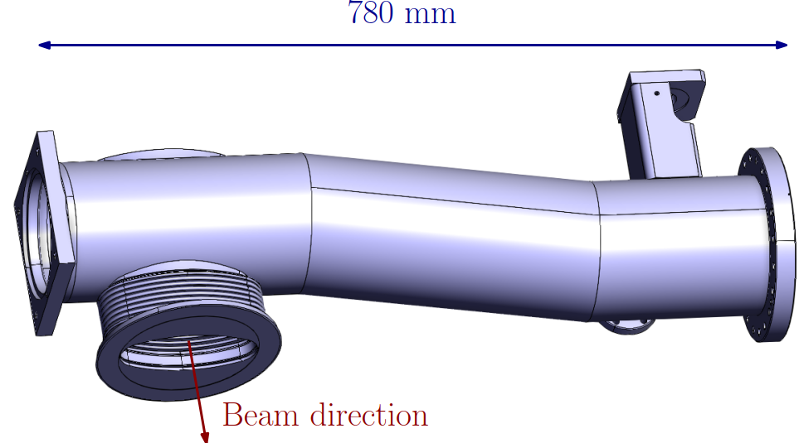
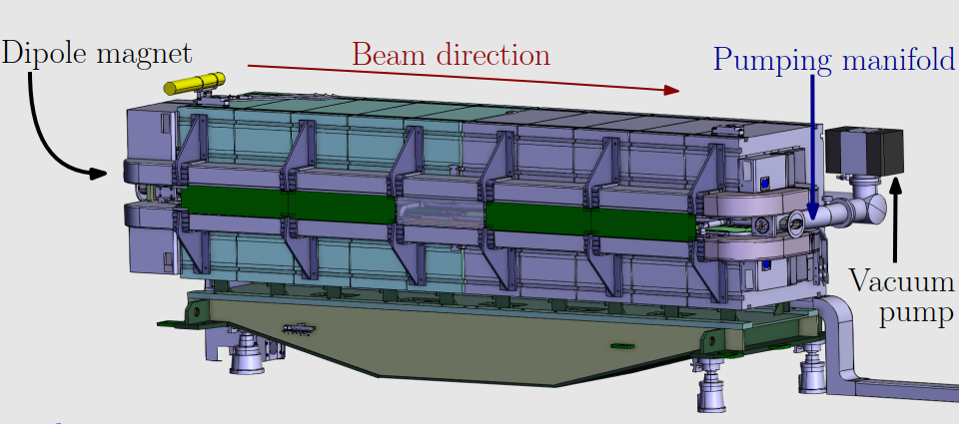
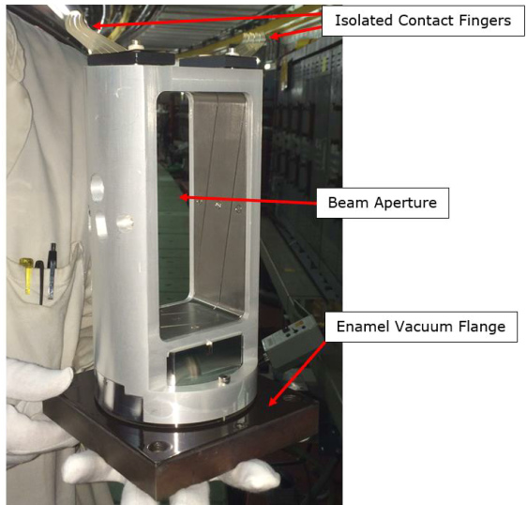
Proton Synchrotron pumping manifolds impedance
Vacuum pump connection
Inner radius $a = 71.5$ mm
Insertion blind flange or pickup unit
There are 100 straight sections along the PS accelerator, generally 1 manifold for each section:
50 empty manifold units.
55 manifolds equipped with beam diagnostic instrumentation, or pickup.
Empty pumping manifolds suspected to be the source of microwave instabilities.
Impedance study addressed through eigenmode, wakefield simulations, and analytical considerations.

Slide 28
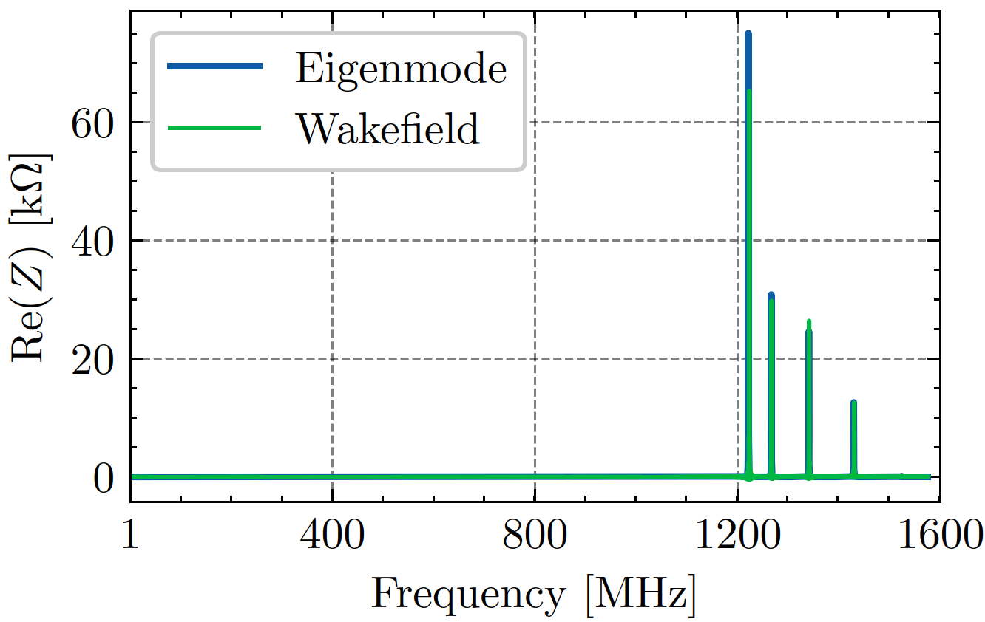
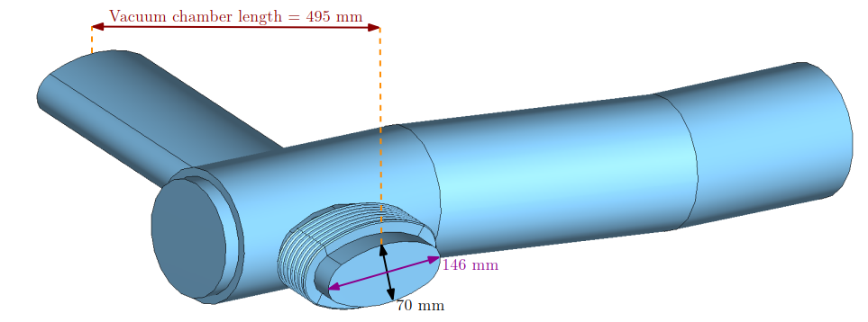
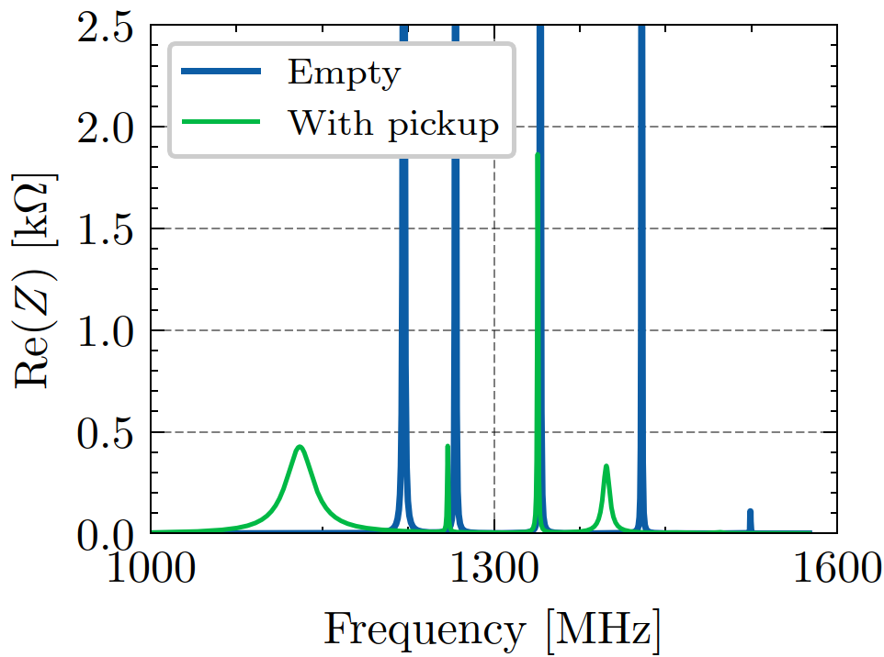
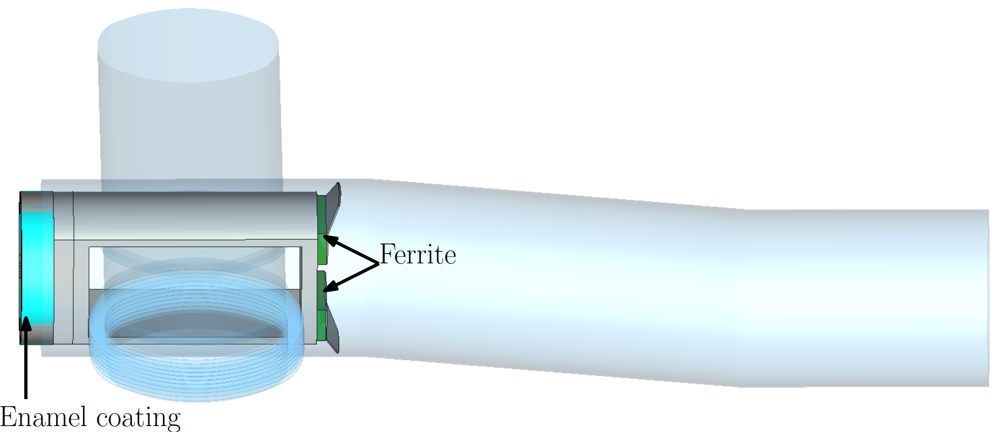
Longitudinal impedance simulations of pumping manifold
Empty manifold
Maximum shunt impedance of 75 kΩ at 1.2 GHz
Beam
Manifold with pickup
Beam
Maximum shunt impedance reduced to 1.8 kΩ
Pickup already acting as a shield ➔ empty case is the target for impedance mitigation.

Slide 29
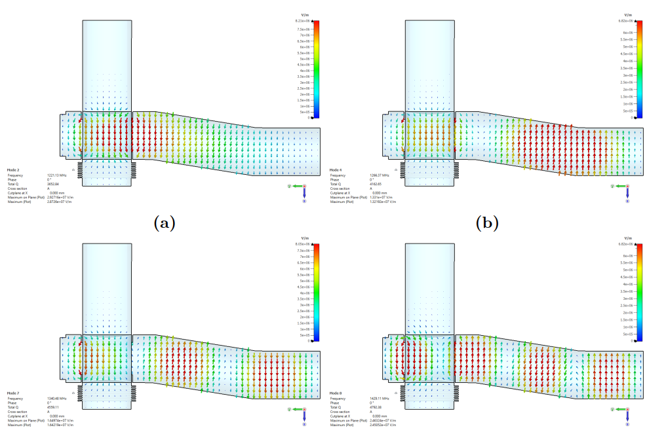
Empty manifold – field monitors
Empty manifold acts as a cylindrical resonator, with radius $a=71.5$ mm
Beam
Beam
1.22 GHz
1.26 GHz
First four modes of a cylindrical resonator with the same dimensions:
$TE_{111}, TE_{112}, TE_{113}, TE_{114}.$
Beam
Beam
1.34 GHz
1.43 GHz
➔ Shield needed to mitigate manifold impedance contribution.

Slide 30
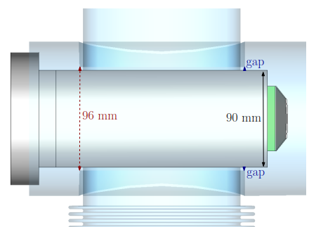
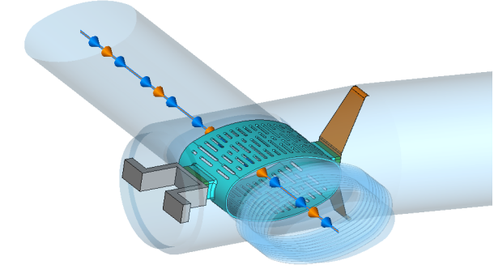
Mitigation solutions
Among the different alternatives, two solutions were giving best performance:
Dummy pickup, longer and with elliptical cross-section.
Stainless steel beam screen.
Beam
RF fingers
Ferrite
Ferrite
Beam

Slide 31
Simulated impedance with mitigation solutions
Remembering that one empty manifold unit gives a shunt impedance of 75 kΩ at 1.2 GHz.
Impedance comparing the two mitigation solutions:
Elliptical pickup
Beam
Beam
Ferrite
RF fingers
Beam screen
Ferrite
A dummy and longer pickup with an elliptical cross-section gives the best performance for impedance reduction.

Slide 32
Outline
Introduction and motivations
Longitudinal beam coupling impedance of:
Extraction kickers
Septa magnets
Pumping manifolds
Conclusions
Introduction and motivations
Longitudinal beam coupling impedance of:
Extraction kickers
Septa magnets
Pumping manifolds
Conclusions

Slide 33
Conclusions
Methodology: electromagnetic simulation and bench measurements applied to Proton Synchrotron (PS) key components.
Excellent agreement of electromagnetic simulations and bench measurements of impedance model for the extraction kicker magnets.
High accuracy impedance model in the low frequency range allows a better prediction of longitudinal coupled bunch instability.
Effective mitigation solutions including transition pieces were proposed and installed in the spare 3-modules kicker for future replacement of the kicker in the PS.
Impedance evaluation of septa magnets highlighted the importance of radio frequency measurements to detect assembly defects and to address the impedance problem when simulations become complex.
For empty pumping manifolds impedance mitigation was needed to limit the impact on microwave instabilities. Effective mitigation solutions showed a huge reduction of the empty manifold impedance.
The study allows to update the PS longitudinal impedance model ➔ accurate prediction of accelerator performance.

Slide 34
Thank you for the attention!

Slide 35
Lists of publications
Journal Articles
M. Neroni, M. Barnes, L. Ducimetiere, et al., “Characterization of the longitudinal beam coupling impedance and mitigation strategy for the fast extraction kicker KFA79 in the CERN PS,” Journal of Physics: Conference Series, vol. 2687, no. 6, p. 062 012, Jan. 2024. doi: 10.1088/1742-6596/2687/6/062012.
M. Neroni, M. Barnes, A. Lasheen, A. Mostacci, B. Popovic, and C. Vollinger, “Beam coupling impedance of the main extraction kickers in the CERN PS,” Journal of Instrumentation, vol. 19, no. 08, T08001, Aug. 2024. doi: 10.1088/1748-0221/19/08/T08001.
S. Singh, M. Neroni, P. Benoit, et al., “Development and Implementation of a RC Snubber to Suppress Breaker Arcing Present in High-Stored-Energy Superconducting Magnet Systems,” IEEE Transactions on Applied Superconductivity, vol. 33, no. 5, pp. 1–4, 2023. doi: 10.1109/TASC.2023.3238294.
S. Singh, W. Głuchowska, M. Neroni, B. Cure, A. Dudarev, and M. Mentink, “CERN North Area Multi-Purpose Superconducting Magnet Facility,” IEEE Transactions on Applied Superconductivity, vol. 32, no. 6, pp. 1–5, 2022. doi: 10.1109/TASC.2022.3146809.
Conference Proceedings
M. Neroni, S. Albright, H. Damerau, et al., “Recent updates in the impedance characterization of the CERN PS Booster Finemet RF system,” English, in Proc. IPAC’24, (Nashville, TN), ser. IPAC’24 - 15th International Particle Accelerator Conference, JACoW Publishing, Geneva, Switzerland, May 2024, pp. 3120–3123, ISBN: 978-3-95450-247-9. doi: 10.18429/JACoW-IPAC2024-THPC52.
C. Vollinger, M. Sullivan, and M. Neroni, “Mitigation of beam coupling impedance for the wire scanners in the CERN Super Proton Synchrotron,” English, in Proc. IPAC’24, (Nashville, TN), ser. IPAC’24 - 15th International Particle Accelerator Conference, JACoW Publishing, Geneva, Switzerland, May 2024, pp. 3116–3119, ISBN: 978-3-95450-247-9. doi: 10.18429/JACoW-IPAC2024-THPC51.
P. Krkotic, S. Calatroni, M. Neroni, et al., “Impedance analysis of deformable RF contact bridges for high luminosity LHC,” English, in Proc. IPAC’23, (Venice, Italy), ser. IPAC’23 - 14th International Particle Accelerator Conference, JACoW Publishing, Geneva, Switzerland, May 2023, pp. 3470–3473, ISBN:978-3-95450-231-8. doi: 10.18429/JACoW-IPAC2023-WEPL153.
Talks in international conferences
Contributed oral: M. Neroni et al., ”Beam coupling impedance of the main extraction kickers in the CERN PS”, in Proc. 68th ICFA Advanced beam dynamics workshop on High-Intensity and High-Brightness Hadron beams (HB2023), CERN, Geneva, Switzerland, Oct. 2023.
Internal notes and presentations given at internal meetings
M. Neroni, ”Impedance measurements and simulation on the KFA79”, Presentation at Impedance Working Group meeting, CERN, Geneva, Switzerland, July 2022. https://indico.cern.ch/event/1181518
M. Neroni, ”Longitudinal impedance studies of KFA79”, Presentation at Accelerator Beam Transfer Forum meeting, CERN, Geneva, Switzerland, Oct. 2022. https://indico.cern.ch/event/1208317
M. Valente Dos Santos, M. Neroni and C. Vollinger, ”Measurement of the SMH16.3 Magnetic Septa”, No. CERN-ACC-NOTE-2023-0013, CERN, Geneva, Switzerland, Sept. 2023. http://cds.cern.ch/record/2870131
M. Neroni, ”Beam coupling impedance of the main extraction kickers in the CERN PS”, Presentation at PS Coordination Meeting #111, CERN, Geneva, Switzerland, Oct. 2023. https://indico.cern.ch/event/1340543/
M. Neroni, ”Longitudinal beam coupling impedance mitigation studies for CERN PS accelerator complex”, Presentation at SY-RF Seminars, CERN, Geneva, Switzerland, Nov. 2023. https://indico.cern.ch/event/1280060/

Slide 36
Spare slides

Slide 37
The CERN Proton Synchrotron
PS beam parameters for LHC injection and fixed target experiments.
Parameter | LHC (protons) | LHC (ions) | AWAKE | n-TOF | East Area | AD | SFTPRO
Total intensity [${×10}^{10}$] | 1870 | 10 | 30 | 850 | 60 | 2000 | 2400-3000
Intensity per bunch [${×10}^{11}$ ppb or cpb] | 2.6 | 2.5 | 3 | 85 | 6 | 40 | 240-300
Long. Emittance [eVs] | 1.2 | 10 | 0.3 | 3 | 3 | 3 | 2
Long. instability type | Coupled bunch | Microwave | Microwave | Not limited by long. instability |  |  | Coupled bunch

Slide 38
Beam instabilities and mitigation strategy
Depending on the decay time of the wake field, we can distinguish two types of impedances:
Narrow-band impedances $(Δω≪1/τ$, $Δω$ impedance bandwidth and $τ$ bunch length). Wake field lasts during the passage of many bunches
➔ coupled bunch instabilities.
➔ Reducing Q factor: introduction of HOM-couplers, broadening methods like insertion of absorbers (e.g. ferrites).
$Resonator model$:
$Z\left(f\right)= \frac{R_{s}}{1+jQ\left(\frac{ω}{ω_{0}}−\frac{ω_{0}}{ω}\right)}$, $Q=\frac{ω_{0}}{∆ω}$
Broad-band impedances ($Δω≫1/τ$). Wake field produced by these impedance sources decays over one bunch length
➔ single bunch instabilities.
➔ Reducing R/Q and therefore changing the overall geometry (to be decided in the design phase or mitigated with adding shields in an existing structure)
C. Vollinger et al., “Needs and solution for machine impedance reduction”, Proc. of ICFA Mini-Workshop on Impedances and Beam Instabilities in Particle Accelerators, Benevento, Italy, 2017.
E. Shaposhnikova, “Present knowledge of the longitudinal SPS impedance”, 10th Workshop on LEP - SPS Performance: Chamonix X, Chamonix, 2000.

Slide 39
Shunt impedance threshold for coupled-bunch instabilities
Courtesy of Alexandre Lasheen
Courtesy of Jake Flowerdew
Comparison between impedance of RF cavities and extraction kickers at flat top energy in the low frequency range up to 80 MHz.
E. Shaposhnikova, “Longitudinal stability of the LHC beam in the SPS,” Tech.
Rep. SL-Note-2001-031-HRF, CERN, Geneva, Switzerland, 2001.
Courtesy of A. Lasheen

Slide 40
PS Microwave instability with Pb Ions
Growth rate:
No longitudinal emittance blow-up
$2.65×{10}^{11}$ ppb
200 MHz controlled emittance blow-up
Uncaptured beam
Microwave instability occurs at PS transition.
Can be avoided with 200 MHz controlled emittance blow up.
With emittance blowup we observe uncaptured beam at handover to 80 MHz system → At stability limit.

Slide 41
Wire simulation on 3-modules kicker
Simulated $S_{21}$ between kicker input and output port, when adding a wire along beam axis and changing output connector termination.
Cable terminations highly impacting on impedance behaviour in the low frequency range ➔ 15 Ω terminations must be considered in the measurements.

Slide 42
Longitudinal impedance measurements on the KFA71
Output power connectors terminated on a 15 Ω resistor and input connectors left undefined open.
Satisfactory convergence could not be reached for frequency domain simulations of KFA71 due to geometrical complexity of the model ➔ Wakefield simulations used for comparison.

Slide 43
Alternative positioning of transition pieces
Transition pieces placed closer to the beam chamber
Module-Tank: ground conductor contact
Module-Module: HV plates contact
→ Almost just broadband contribution caused by the ferrite left

