Slide 1




Study and characterization of betatron radiation source from plasma wakefield accelerator
XXXVII PhD School in Accelerator Physics
University of Rome “Sapienza”
Daniele Francescone
daniele.francescone@uniroma1.it
Supervisors:
Prof. Enrica Chiadroni
Dr. Giancarlo Gatti

Slide 2
Outline
Introduction
Plasma acceleration
EuPRAXIA/EuAPS
Betatron radiation
Equation of motion
Calculated radiated spectrum
Theory
Simulation
Particle In Cell simulations
Centro de Laseres Pulsados Ultracortos CLPU
Experimental setup
Measurements
Phase Contrast Imaging
Experiment
1

Slide 3
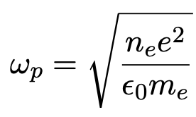
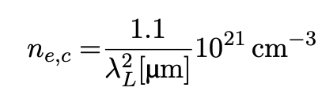
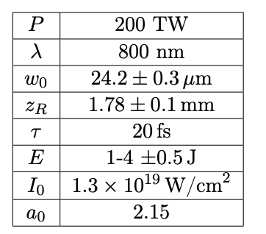

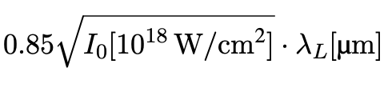


Plasma acceleration: Laser WakeField Acceleration
Gasjet
Plasma frequency
$$n_{e}=\sim 10^{18}[cm^{−3}]$$
Laser
$He/H_{2} /N_{2}$..
Critical density
plasma channel
Electron
Normalized vector potential
2
Notes:
When a femtosecond high-intensity laser pulse is focused into a gas jet, it ionizes the gas, creating plasma. At such high intensities, the laser interacts with the plasma, forming a channel where electrons can enter and be accelerated by the energy provided by the laser.
NOW LETS LOOK WHAT HAPPEN SINSIDE THE CHANNell

Slide 4
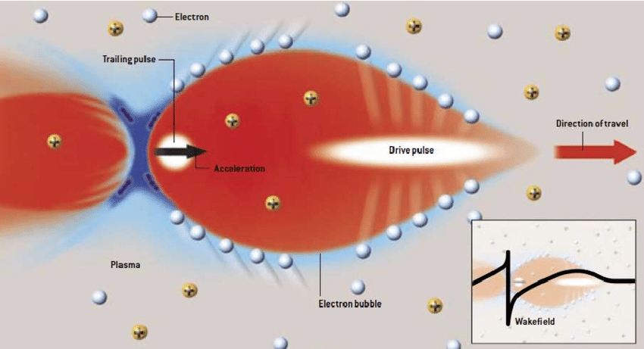


Laser-driven acceleration principle
Laser
$$a_{0}>2$$
Pondermotive Force
$$n_{e}=10^{18}[cm^{−3}]$$
Credits: C. Joshi, UCLA
3
Notes:
The driver pulse propagates into the plasma, causing the expulsion of plasma electrons, due to the pondermotive force of the lasere. creating a bubble region on the micron scale

Slide 5


Laser-driven acceleration principle
Laser
$$λ_{p}\sim 10 −50μm$$
$$a_{0}>2$$
Pondermotive Force
$$r_{β} \sim 1−10μm$$
$$n_{e}=10^{18}[cm^{−3}]$$
Credits: C. Joshi, UCLA
4
Notes:
Because ions are much heavier than electrons, they remain nearly stationary.

Slide 6


Laser-driven acceleration principle
Laser
$$λ_{p}\sim 10 −50μm$$
Self-injection
$$a_{0}>2$$
Pondermotive Force
$$r_{β} \sim 1−10μm$$
$$n_{e}=10^{18}[cm^{−3}]$$
Credits: C. Joshi, UCLA
5
Notes:
The expelled electrons, driven by the strong electric field created between the ions and electrons, are self-injected into the back of the bubble and then accelerated.

Slide 7
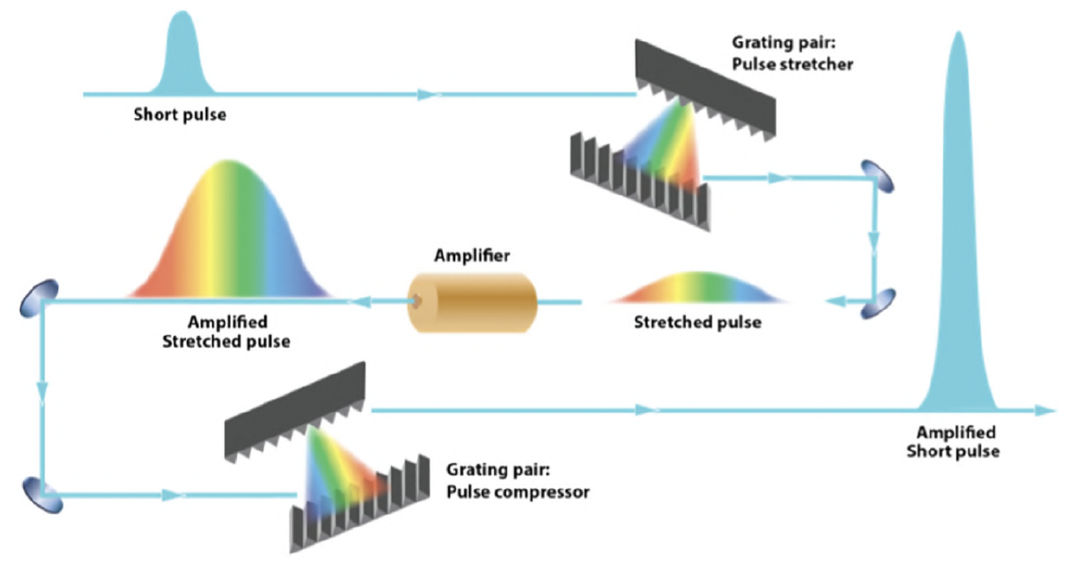


Evolution of Laser Wakefield Acceleration
Chirped Pulsed Amplification (CPA)
6
Notes:
The advent of laser wakefield acceleration is largely thanks to advancements in laser technology. Since the invention of chirped pulse amplification in the 1980s, it has become possible to achieve extremely high-power laser pulses. And countless studies on laser-plasma acceleration have been published.
Currently, state-of-the-art facilities use lasers operating at terawatt and petawatt levels, capable of generating intensities up to 10^22–10^23 W/cm^2.
As laser power increased, there was a race to achieve higher electron acceleration. In 2002, the record energy was 200 MeV, but by 2019, it had reached 7.8 GeV.
In recent years, however, the focus has shifted from simply increasing energy to improving beam quality, stabilizing the output, and finding applications beyond research. This effort culminates in the project known as EuPRAXIA."

Slide 8
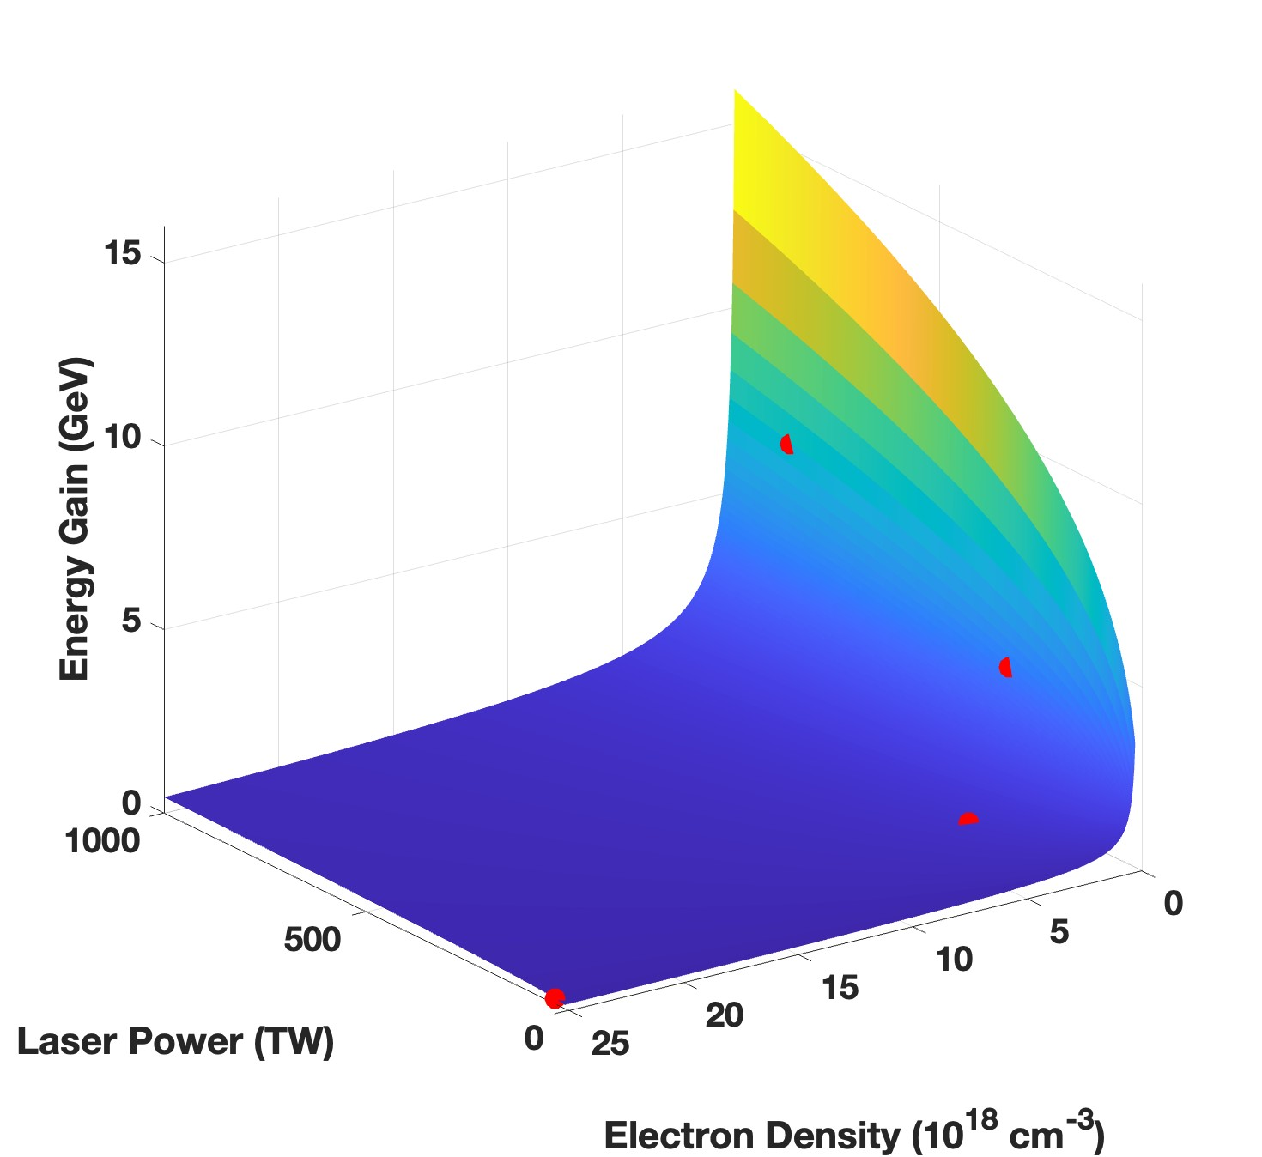

Evolution of Laser Wakefield Acceleration
Chirped Pulsed Amplification (CPA)
$$ΔE\left[GeV\right]≃17{\left(\frac{P\left[TW\right]}{100} \right)}^{\frac{1}{3}}{\left(\frac{0.8}{λ_{0}\left[μm\right]}\right)}^{\frac{4}{3}}{\left(\frac{1}{n_{e}[10^{18}cm^{−3}]}\right)}^{2/3}$$
d
c
200 MeV- 33 TW V. Malka et al. (2002)
1.45 GeV-220 TW C. E. Clayton (2010)
4 GeV-300 TW W.P Leemans et al. (2014)
7.8 GeV-850 TW A.J. Gonsalves et al. (2019)
a
b
7
Notes:
The advent of laser wakefield acceleration is largely thanks to advancements in laser technology. Since the invention of chirped pulse amplification in the 1980s, it has become possible to achieve extremely high-power laser pulses. And countless studies on laser-plasma acceleration have been published.
Currently, state-of-the-art facilities use lasers operating at terawatt and petawatt levels, capable of generating intensities up to 10^22–10^23 W/cm^2.
As laser power increased, there was a race to achieve higher electron acceleration. In 2002, the record energy was 200 MeV, but by 2019, it had reached 7.8 GeV.
In recent years, however, the focus has shifted from simply increasing energy to improving beam quality, stabilizing the output, and finding applications beyond research. This effort culminates in the project known as EuPRAXIA."

Slide 9
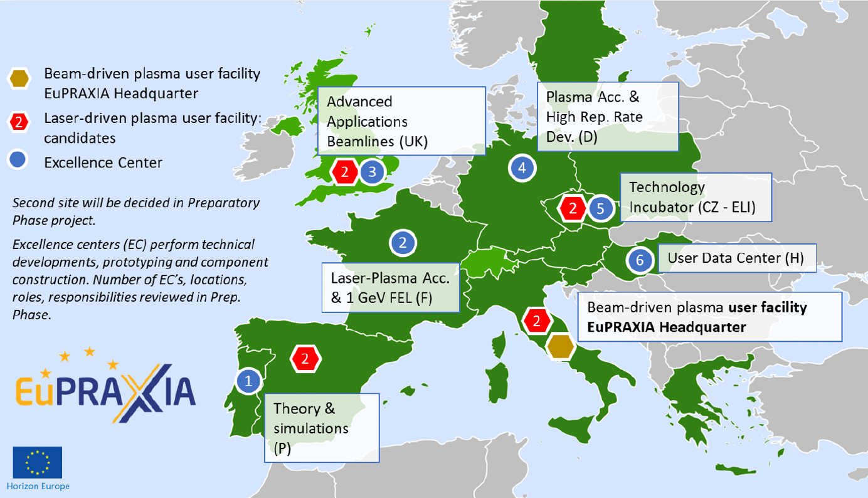
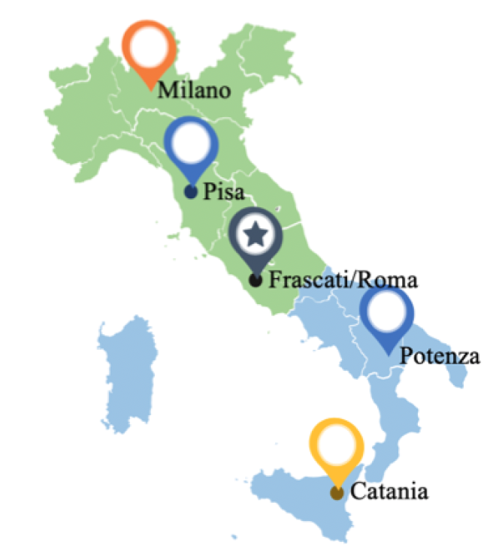
EuPRAXIA-EuAPS
Eupraxia
First plasma accelerator based user facility
Headquarter Frascati LNF –INFN
EuPRAXIA@SPARC_LAB project
EuAPS
EuPRAXIA Advanced Photon Sources project
Collaboration:
INFN (Milano, Roma, Catania)
CNR (Pisa, Montelibretti (RM), Potenza)
University of Tor Vergata (Roma)
www.eupraxia-project.eu
Objective:
Development a compact photon sources to drive plasma accelerators and the setup of ultra-compact, high performing X ray and particle sources for users.
euaps.infn.it
8
Notes:
EuPRAXIA (European Plasma Research Accelerator with Excellence in Applications) is a groundbreaking project aimed at building the world's first plasma-based accelerator user-facility.
It is an international collaboration involving leading research institutions from around the globe, with its headquarters established at the INFN in Frascati, Italy
In this framework,we found the EuAPS project, focused on developing advanced photon sources and related laser technologies essential for supporting the EuPRAXIA project. My thesis has been developed within this context.

Slide 10
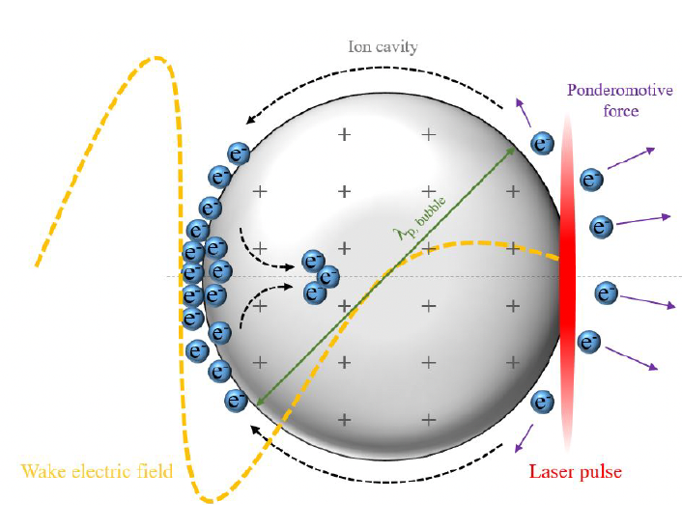
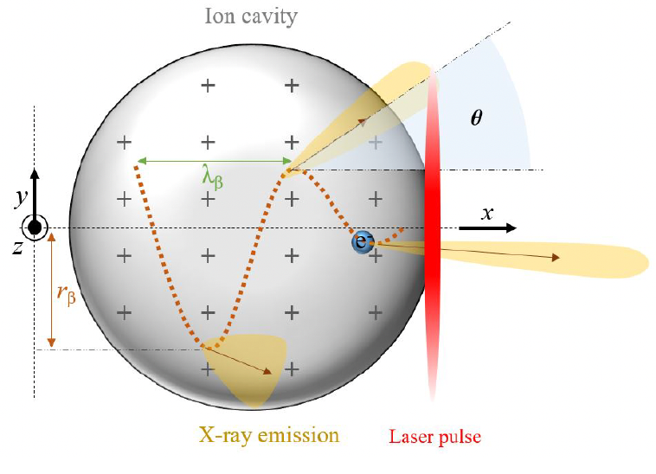
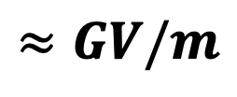
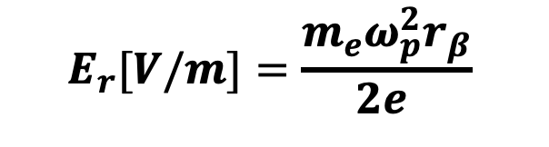
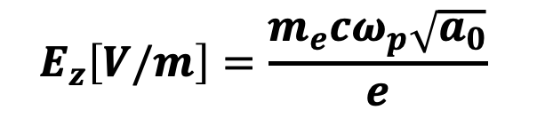

Betatron radiation : Source
Self injection
Electron Oscillation in plasma bubble
$$r_{β}$$
Oscillation amplitude
Strong longitudinal and transverse force
$$E_{z}\left[V/m\right]=\frac{m_{e}cω_{p}\sqrt{a_{0}}}{e}$$
$$≈GV/m$$
$$E_{r}[V/m]=\frac{{m_{e}ω}_{p}^{2}r_{β}}{2e }$$
9
Notes:
In particular:
When electrons are re-injected into the bubble (with the self injection mechanism), they experience a strong electric field—both longitudinal, responsible for accelerating the electrons, and transverse, responsible for their oscillations around the axis. These oscillations give rise to betatron radiation.

Slide 11
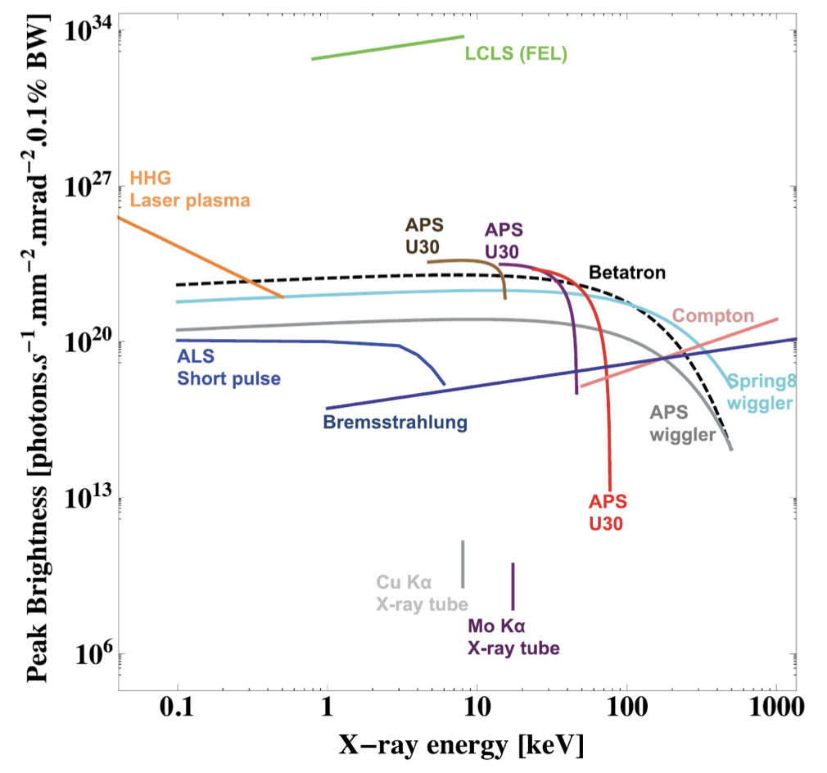
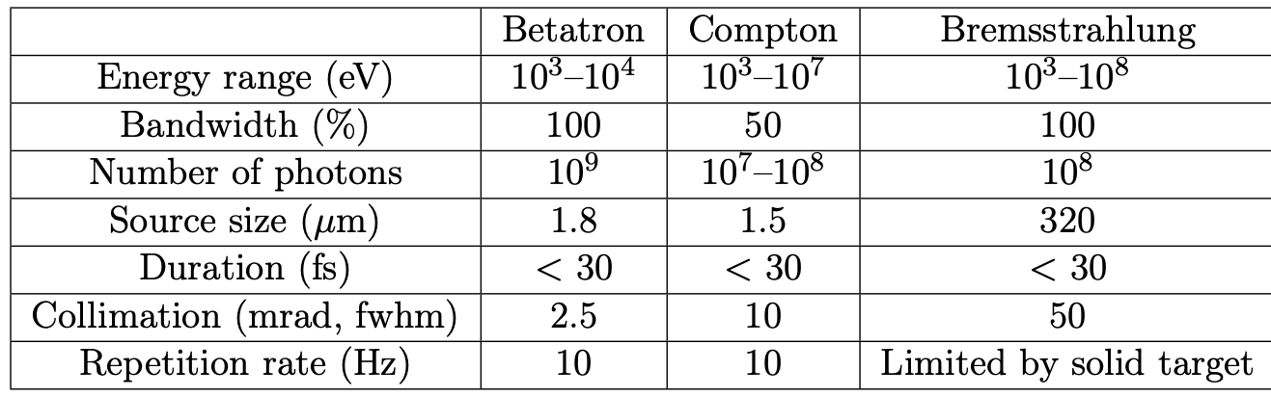

Betatron radiation: Features
PROPERTIES
APPLICATIONS
Spatially coherent
Energy: keV range
Time duration: few tens of fs
X-ray collimated beam
Imaging
Spectroscopy
Ultrafast studies
COMPARISON WITH OTHER PLASMA BASED SOURCES
F.Albert et al. “Laser wakefield accelerator based light sources: Potential applications and Requirements “, Plasma Phys. Control. Fusion
10
Notes:
The properties of this radiation place it between that produced by a synchrotron and a free-electron laser.
The emitted radiation has the following characteristics: it is spatially collimated (on the milliradian scale), spatially coherent, and its pulse duration is approximately comparable to that of the laser, meaning it is on the femtosecond timescale. Its energy falls within the X-ray range.
This radiation is suitable for classical applications such as imaging and spectroscopy. Moreover, thanks to its extremely short pulse duration, it enables ultrafast studies.

Slide 12
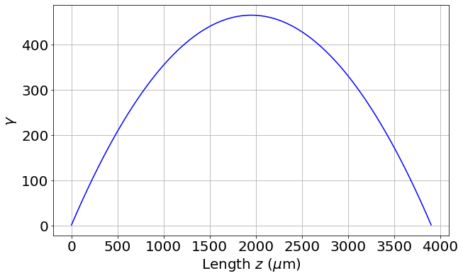
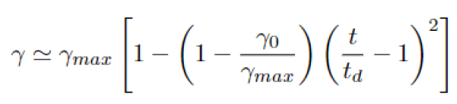
Betatron radiation: Equation of motion
F.Albert et al. “Laser wakefield accelerator based light sources: Potential applications and Requirements “, Plasma Phys. Control. Fusion
Lorentz factor
11
Notes:
The study of betatron radiation begins with analyzing the equations of motion of electrons within the bubble.
Being in a transient regime characterized by strong nonlinearity significantly complicates the calculations.
In this slide, I present the considerations necessary to simplify the calculations that lead to the determination of the spectrum.
Inside the bubble, electrons are accelerating, which means their Lorentz factor is changing. We can assume this variation follows a parabolic model.
This results in trajectories of electtronsn where both amplitude and frequency depends on time
To stabilize these oscillations, we focus on the point of maximum acceleration, where the Lorentz factor gamma reaches its maximum, also known as the dephasing length. This approach allows us to simplify the equations and approximate the motion as a cosine-like oscillation.

Slide 13
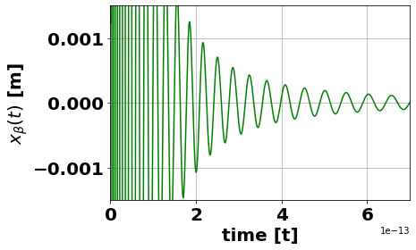

Betatron radiation: Equation of motion
F.Albert et al. “Laser wakefield accelerator based light sources: Potential applications and Requirements “, Plasma Phys. Control. Fusion
Lorentz factor
Equation of motion
Betatron frequency
$$ω_{β}=\frac{ω_{p}}{\sqrt{2γ}}$$
12
Notes:
The study of betatron radiation begins with analyzing the equations of motion of electrons within the bubble.
Being in a transient regime characterized by strong nonlinearity significantly complicates the calculations.
In this slide, I present the considerations necessary to simplify the calculations that lead to the determination of the spectrum.
Inside the bubble, electrons are accelerating, which means their Lorentz factor is changing. We can assume this variation follows a parabolic model.
This results in trajectories of electtronsn where both amplitude and frequency depends on time
To stabilize these oscillations, we focus on the point of maximum acceleration, where the Lorentz factor gamma reaches its maximum, also known as the dephasing length. This approach allows us to simplify the equations and approximate the motion as a cosine-like oscillation.

Slide 14
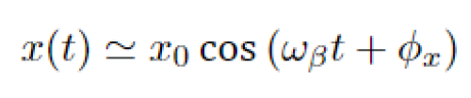


Betatron radiation: Equation of motion
F.Albert et al. “Laser wakefield accelerator based light sources: Potential applications and Requirements “, Plasma Phys. Control. Fusion
Lorentz factor
Equation of motion
Betatron frequency
$$ω_{β}=\frac{ω_{p}}{\sqrt{2γ}}$$
$$γ_{max}=γ\left(t_{d}\right)$$
13
Notes:
The study of betatron radiation begins with analyzing the equations of motion of electrons within the bubble.
Being in a transient regime characterized by strong nonlinearity significantly complicates the calculations.
In this slide, I present the considerations necessary to simplify the calculations that lead to the determination of the spectrum.
Inside the bubble, electrons are accelerating, which means their Lorentz factor is changing. We can assume this variation follows a parabolic model.
This results in trajectories of electtronsn where both amplitude and frequency depends on time
To stabilize these oscillations, we focus on the point of maximum acceleration, where the Lorentz factor gamma reaches its maximum, also known as the dephasing length. This approach allows us to simplify the equations and approximate the motion as a cosine-like oscillation.

Slide 15
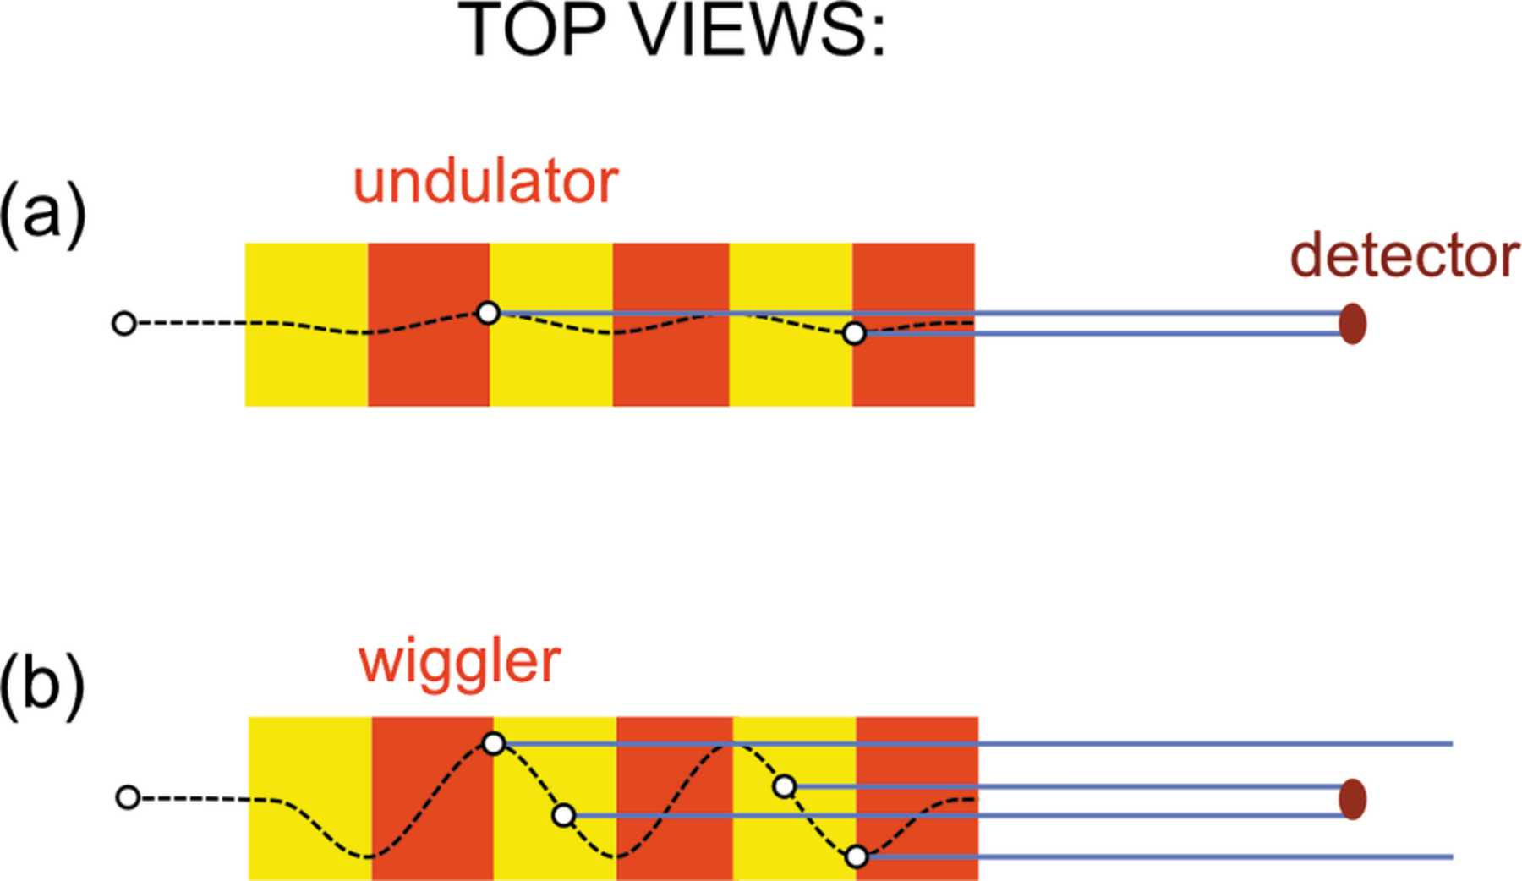
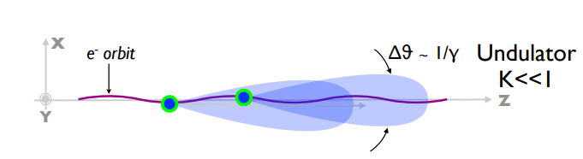

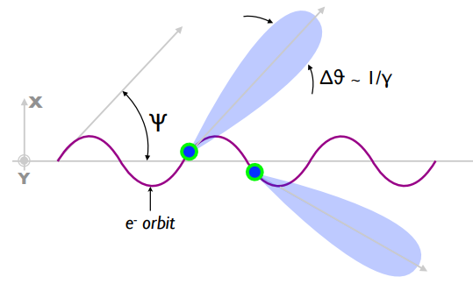


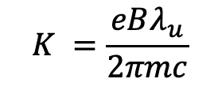
Betatron Strenght Parameter K
Strength parameter
$$K =\frac{eBλ_{u}}{2πmc}$$
For the betatron radiation:
Wiggler + Undultor
Betatron
Strength parameter
$$K_{β}=γrω_{β}/c$$
Corde, Sébastien, et al. "Femtosecond x rays from laser-plasma accelerators." Reviews of Modern Physics 85.1 (2013): 1.
14
Notes:
An important parameter to discuss is the betatron strength parameter, which, by analogy with wigglers and undulators, helps distinguish between two different electron oscillation regimes.
On the left, we see the classic strength parameter defined for wigglers and undulators. It depends on the magnetic field \(B\) and the distance between magnets, or the period \(\lambda_u\). These are fixed parameters, determined by the device itself. For undulators, \(K < 1\), which results in more confined oscillations around the axis. When \(K > 1\), we have wigglers, where the oscillation amplitude is significantly larger.
For electrons, shown on the right, the betatron strength parameter depends on the electron's energy, the oscillation amplitude, and the oscillation frequency.
The key approximation we will make here is to treat these parameters as constant and uniform for all electrons for now, simplifying our calculations.
However, for electrons, it is not possible to clearly distinguish between the two regimes, \(K \ll 1\) and \(K \gg 1\), as both tend to coexist.

Slide 16
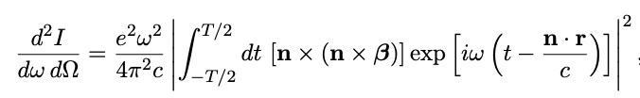
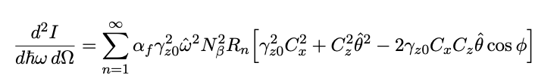
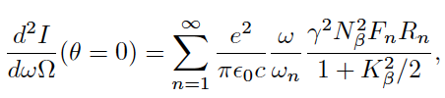
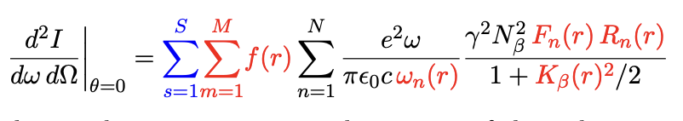
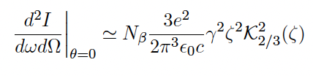
Radiated spectrum
Initial simplifications
From Liénard–Wiechert potential
Models in the literature
1
New model
2
4
3
15
Notes:
Starting from the Liénard-Wiechert potentials, and incorporating all the approximations presented, we arrive at this analytical expression for calculating radiation. We can refer to it as "1D" since it considers a linear polarization of oscillating electrons.
Within this equation, we find fundamental elements such as Bessel functions and \(R_n\), the resonance function. Additionally, we observe a strong dependence on the parameter \(K\).
On the left, we see a plot of these equations, illustrating how the harmonics vary with the observation angle \(\theta\). However, given that the radiation is highly collimated, it is particularly interesting to examine what happens on-axis, that is, for \(\theta \approx 0\).

Slide 17
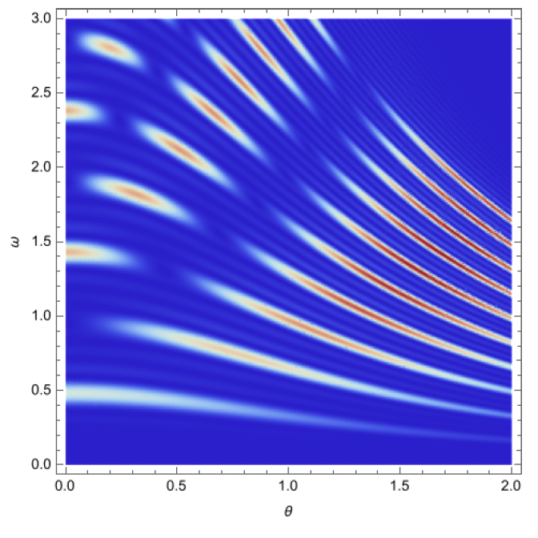
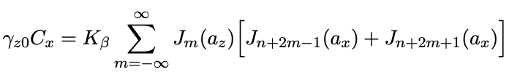
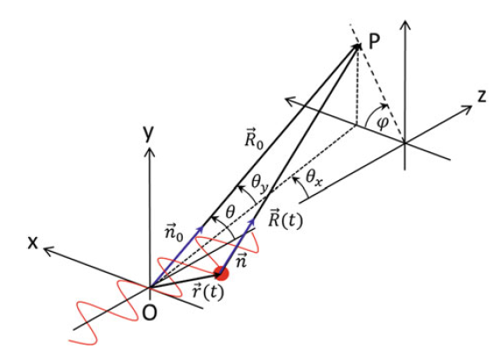
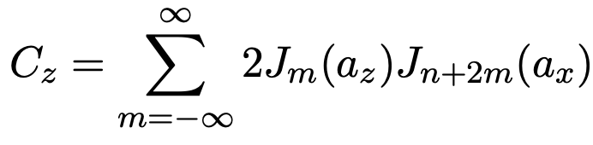
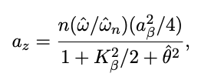
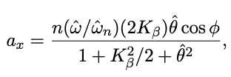
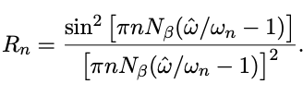



Radiated spectrum- model 1
From Liénard–Wiechert potential
Spectral lines vs angle$θ, φ=0$
1
Normalized frequency $ω/ω_{n}$
Normalized angle $θ/γ$
16
Notes:
Starting from the Liénard-Wiechert potentials, and incorporating all the approximations presented, we arrive at this analytical expression for calculating radiation. We can refer to it as "1D" since it considers a linear polarization of oscillating electrons.
Within this equation, we find fundamental elements such as Bessel functions and \(R_n\), the resonance function. Additionally, we observe a strong dependence on the parameter \(K\).
On the left, we see a plot of these equations, illustrating how the harmonics vary with the observation angle \(\theta\). However, given that the radiation is highly collimated, it is particularly interesting to examine what happens on-axis, that is, for \(\theta \approx 0\).

Slide 18

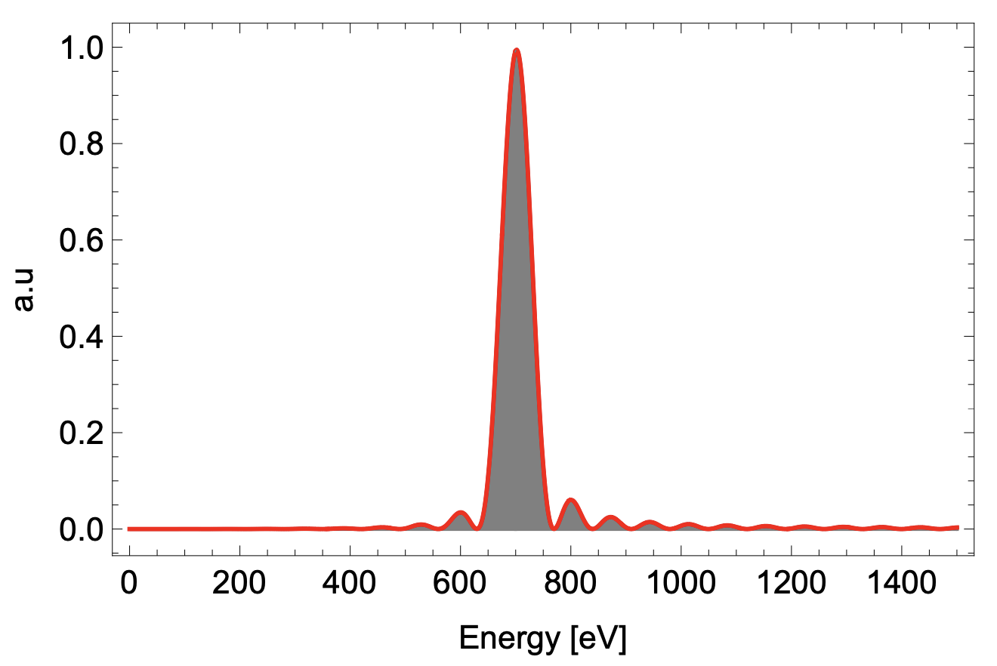
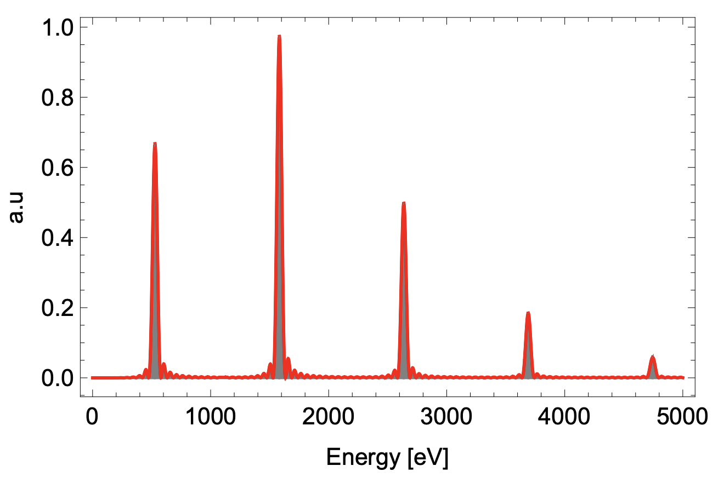
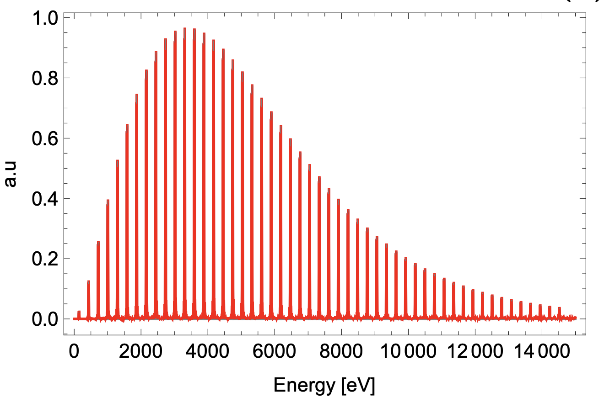









Radiated spectrum on axis- model 2
2
Same energy
Same oscillation amplitude
Single particle
Harmonic function
Betatron strength parameter
$$K_{β}=γrω_{β}/c$$
$$K_{β}<1$$
$$K_{β}=1$$
$$K_{β}=3$$
$$γ=15 MeV$$
$$γ=15 MeV$$
$$γ=15 MeV$$
$$r=1.5 μm$$
$$r=1 μm$$
$$r=1.5 μm$$
Undulator like
Wiggler like
17
Notes:
On-axis, the dependence on \(\theta\) disappears, and the spectrum appears as shown here. The only parameter that truly matters in this case is the **betatron strength parameter**. Depending on its value, we observe extreme cases ranging from undulator-like to wiggler-like behavior.
As mentioned earlier, betatron electrons can exhibit both behaviors, as it is not yet possible to achieve complete control over the motion of the electrons.
For example, we can observe that, for the same electron energy \(\gamma\) and oscillation frequency \(\omega\), different behaviors emerge depending on the oscillation amplitude. Let’s analyze what happens for high values of \(K\).

Slide 19
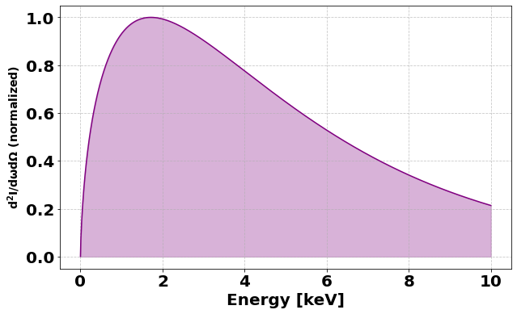
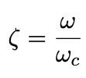




Asymptotic limit spectrum K>>1 - model 3
$$K_{β}<1$$
$$K_{β}=1$$
$$K_{β}=3$$
3
18
Notes:
Now let’s analyze what happens for K > >1 . This model, known as the asymptotic limit, is valid for a single electron.
First, we examine the case where electrons have different energies. As we can see, the spectrum increases in amplitude and shifts its critical energy. On the right, we observe the sum of the contributions received by a detector. Since the radiation is temporally incoherent, we can simply sum these contributions.
If, instead, we vary the oscillation amplitude, we notice that only the critical energy changes, while the overall shape of the spectrum remains consistent.

Slide 20
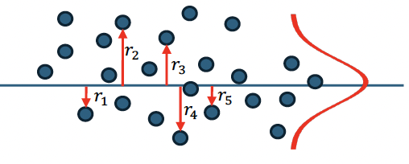
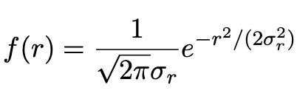
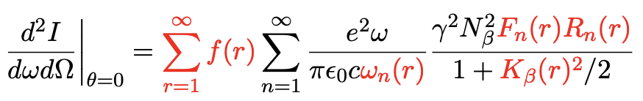
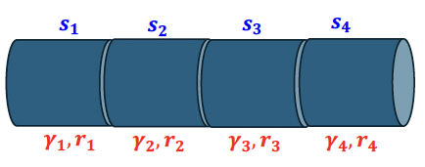
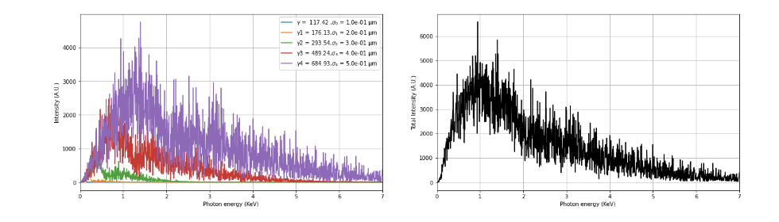


Quick model for spectrum studies (any K) - model 4
2
Gaussian bunch around the axis
$$σ_{r}$$
Divided plasma channel into slices
4
19
Notes:
Now, let’s move on to the work I’ve done. Building on the on-axis spectrum model (highlighted in the red box), my focus has been on removing some of the simplifying assumptions previously discussed. I developed, albeit numerically, a model that allows for the definition of multiple particles with varying energies and oscillation amplitudes.
To achieve this, I weighted the radiation function with a Gaussian distribution. Specifically, the particles were sampled from a Gaussian distribution with a mean of zero—indicating that their center is along the propagation axis—and a variance that defines the oscillation amplitude. This is represented by the summation in red, which influences other parameters also highlighted in red.
Secondly, I divided the plasma channel into slices. Within each slice, I defined distinct values of γγ and σσ. The resulting spectra, shown on the right

Slide 21
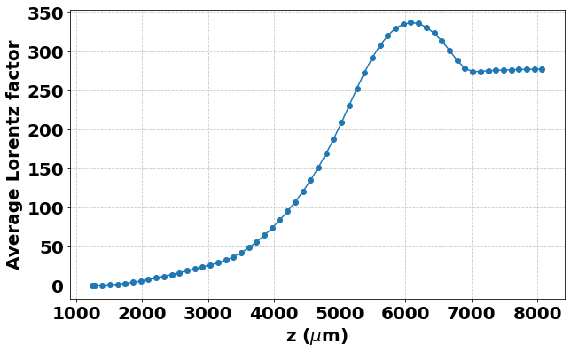
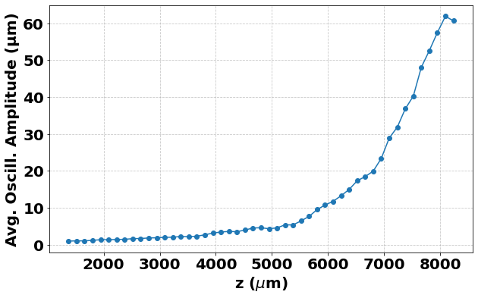
Quick model for spectrum: Advantages
Evolution parameters:
We can define in slices:
Why is useful
Gaussian distribution
Different energy
Different oscillation amplitude
More accuracy in describing the spectrum
It can help study the effect of different electron behaviors on the spectral shape
Time-convinient
20
Notes:
Now, let’s move on to the work I’ve done. Building on the on-axis spectrum model (highlighted in the red box), my focus has been on removing some of the simplifying assumptions previously discussed. I developed, albeit numerically, a model that allows for the definition of multiple particles with varying energies and oscillation amplitudes.
To achieve this, I weighted the radiation function with a Gaussian distribution. Specifically, the particles were sampled from a Gaussian distribution with a mean of zero—indicating that their center is along the propagation axis—and a variance that defines the oscillation amplitude. This is represented by the summation in red, which influences other parameters also highlighted in red.
Secondly, I divided the plasma channel into slices. Within each slice, I defined distinct values of γγ and σσ. The resulting spectra, shown on the right

Slide 22
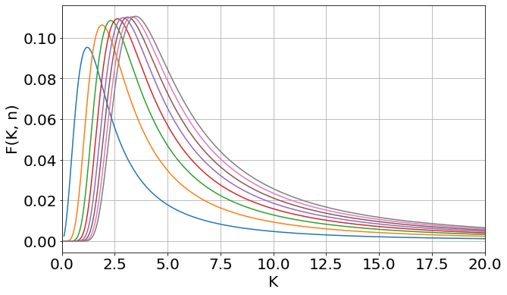
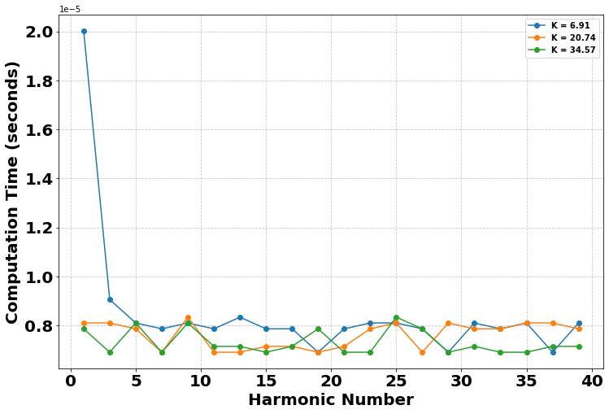
Influence of K parameter on the spectrum
Bessel functions enhance
the first harmonics
More computational expensive
K= 6.91
K=20.74
K=34.57
Harmonic function
Slices = 1
Number of particle = 300
Number of harmonics = 15
The shape of the spectrum cannot depend on the number of harmonics
K= 0.52
K=1.04
K=1.57
K= 1.86
K=2.59
K=3.7
K= 5.22
K=10.45
K=15.7
21
Notes:
Now that we have our new model, let’s focus on making it efficient for specific studies. The goal is to create a model that is not computationally expensive, works quickly, and provides more information compared to existing models.
Let’s take a closer look at the parameters we need to choose and how to select them.
The first study was on the number of harmonics required. While exact results can be obtained by including the largest number of harmonics, are they really necessary? The answer is no. This is because the model includes a function \(F_n\), which is a combination of Bessel functions. Bessel functions inherently assign less significance to higher harmonics, meaning their contributions decrease progressively.
This allows us to simplify the model by focusing only on the harmonics that have a meaningful impact, significantly reducing computational cost without sacrificing accuracy.
The plots at the bottom illustrate how the shape of the spectrum varies for 15 harmonics: for different values of K. We can see that for low K values, the first harmonic dominates. However, as K increases, the higher harmonics contribute more significantly to the overall spectrum.

Slide 23




Parameter studies
Slices = 5
Number of particle = 300
Sum
Number of harmonics = 25
Changing energies in each slices
$$γ_{1}=117.42, { γ}_{2}=176.13 , γ_{3}=293.54 , γ_{4}=489.24 γ_{5}=686.93$$
$$r_{β}=0.1 μm$$
Sum
Changing oscillation amplitude in each slices
$$r_{β1}=0.1 μm, { r}_{β2}=0.2 μm,r_{β3}=0.3 μm,r_{β4}=0.4 μm, { r}_{β5}=0.5 μm$$
$$γ=195.69 μm$$
Changing energies and different oscillation amplitude in each slices
Sum
$$γ_{1}=117.42, { γ}_{2}=176.13 , γ_{3}=293.54 , γ_{4}=489.24 γ_{5}=686.93$$
$$r_{β1}=0.1 μm, { r}_{β2}=0.2 μm,r_{β3}=0.3 μm,r_{β4}=0.4 μm, { r}_{β5}=0.5 μm$$
22
Notes:
To conclude this section, I’ll show how the spectrum evolves when varying certain parameters of the electrons:
1.*Electrons with different energies and same oscillation amplitude
2. Electrons with the same energy but the different oscillation amplitude :
While this cases are purely hypothetical and non-physical—since it’s not possible to fix one parameter while allowing the other to evolve
3. **Electrons with different energies and different oscillation amplitudes**:
This scenario is the most realistic, as it closely represents the physical conditions inside the plasma.
By comparing these cases, we can better understand the interplay of energy and oscillation amplitude in shaping the emitted spectrum.

Slide 24




FourierBesselParticleInCell FBPIC
Common tool for simulation of plasma acceleration
Numerical solver of Maxwell equation in spectral domain
We need to initialize:
Laser parameters
Simulation box parameters
Initial particle parameters
A spectral, quasi-3D particle-in-cell code for plasma simulations. Available at: fbpic.github.io
23
Notes:
Particle-in-Cell (PIC) codes are the most commonly used tools for studying plasma acceleration.
The code I used is called FBPIC.
In the FBPIC code, electromagnetic fields are represented on a cylindrical grid and decomposed into azimuthal modes. This approach is particularly well-suited for systems with cylindrical symmetry. The azimuthal decomposition represents fields as a sum of azimuthal modes, using Fourier decomposition along the azimuthal angle θθ. The equations are solved in the spectral domain, which helps minimize numerical errors.
In general the PICs algorithm at each time step involves four steps:
updating particle velocities and positions
using the Newton–Lorentz equations, depositing charge and current densities onto the grid through interpo-
lation, solving Maxwell’s equations to update fields, and interpolating these fields back to the particles for
the next iteration.
To run a simulation, several parameters must be initialized, including laser properties, the simulation box dimensions, and the particle distribution.

Slide 25

FBPIC - Electron density evolution
Electron density evolution: Bubble formation – Self-injection – electron oscillation – recombination
24
Notes:
By setting the parameters that will later be used in the experimental campaign, we obtained the evolution of the electron bunch within the plasma. The results show the self-injection of electrons into the bubble, their oscillation, and, once the dephasing length is reached, the recombination of electrons.

Slide 26


FBPIC - Evolution parameters
Electron trajectories
Oscillation amplitude
evolution
recombination
Lorentz factor evolution
recombination
recombination
Low energy tail
Energy distribution
Average energy
200 MeV
25
Notes:
The evolution of oscillation amplitude and energy parameters, as shown earlier, was derived from these trajectories in FBPIC.
Previously, I mentioned that the values of gamma are underestimated. Let’s see why. While the average value of gamma peaks at around 250, we observe that the energy distribution shows a peak at approximately 200 MeV.

Slide 27





FBPIC - Simulations
$$n_{e}=3.5×{10}^{18}cm^{−3}$$
Low energy tail
Average energy
200 MeV
$$n_{e}=4×{10}^{18}cm^{−3}$$
$$n_{e}=5×{10}^{18}cm^{−3}$$
Second bunch
First bunch
26
Notes:
This can be explained observing that, within the same bubble, other electrons may have enough energy to enter, creating another electron bunch behind the first one. This new bunch will inevitably have lower energy because it lags behind the first bunch and will not reach the maximum energy gain. As a result, it will influence the average \(\gamma\) value, lowering it. In questa slide mostro anche diverse simulazioni con con diverse densita’ di elettroni. 3.5

Slide 28






Synchrad: python library
Numerical solver of the spectrum starting from trajectories of FBPIC
Quick model
$$s_{5}$$
Photon spectrum comparison
$$γ_{5},r_{5}$$
Parameter scan of gamma value
$${run}_{2}$$
$${run}_{3}$$
$${run}_{1}$$
A Python library for simulating synchrotron radiation. Available at: github.com/hightower8083/synchrad
27
Notes:
Since there is no PIC code capable of directly extracting betatron radiation, external tools are required. In this case, the tool used is **Synchrad**, a Python library that takes the electron trajectories extracted from FBPIC as input to compute the radiation spectrum.
Here, I present a photon spot, the divergence obtained with Synchrad, and a comparison between the spectrum generated using Synchrad and the spectrum obtained with the fast model discussed earlier. The comparison was made by varying energy parameters across different runs with varying values of K.
The goal of this plot is not to show the overlap of solutions but to understand how the contributions of electrons with different K values shape the final spectrum.
Electrons with lower K values dominate the leftmost part of the spectrum, while electrons with higher K values contribute to the rightmost part.
This detailed analysis would not be possible if we relied on a single slice.

Slide 29


Laser Vega II parameter used
Experimental campaign at
Laser system
Peak Power | Energy/shot | Pulse | Rep. Rate | Central @
200 TW | ~4 J | ~25 fs | 10 Hz | 800 nm
28
Notes:
In this final section, I will discuss the experimental activities carried out at CLPU, a research center in Spain equipped with a petawatt-class laser system.
This is the layout of the laser system, which is divided into three lines: **VEGA 1**, **VEGA 2**, and **VEGA 3**. For our experiment, we used **VEGA 2**, as it offered greater accessibility and flexibility, making it the most suitable choice for our needs.

Slide 30

Laser WakeField Acceleration setup
Lanex screen
e⁻
Laser
Gasjet
Dipole
Sample
CCD
Density characterization
Electon characterizations
Radiation
characterization
Wavelegth
calibration
29
Notes:
The experimental campaign focused on a laser wakefield acceleration experiment with the goal of measuring betatron radiation
The novelty of this experiment lies in the measurement not only in the typical X-ray range but also in the EUV (Extreme Ultraviolet) range.
This is a schematic of the setup. A laser is focused onto a gas target, which is ionized and transformed into plasma. Within the plasma, electrons are emitted, and betatron radiation is generated co-axially.
The emitted electrons are then deflected by a magnetic dipole, allowing the betatron radiation to travel undisturbed to the detector, where it is measured and analyzed.
The methods used to achieve the objective will be illustrated, focusing on two key aspects: the measurement of betatron radiation and the implementation of phase contrast imaging.

Slide 31



Experimental apparatus
Experimental parameters
Gas density measurments
$$H_{2}$$
30
Notes:
Here is a photo of the main vacuum chamber, whit the main parameter of the experiment.
We can see the gas jet nozzle, where a measurement of the density profile was previously performed

Slide 32
Experimental apparatus
Experimental parameters
Dipole calibration for energy measurements
31
Notes:
Here we can see the **magnetic dipole**, which is essential for deflecting the trajectory of the electrons. These electrons are directed towards a **Lanex screen**, where their energy is characterized.
In this case, the work involved creating a **calibration map** that associates the position of the electrons on the Lanex screen with their corresponding energy.

Slide 33

Experimental apparatus
Experimental parameters
Lanex calibration and
post-processing of images
32
Notes:
The **dipole** is mounted on a movable stage. When the dipole is inserted, it deflects the electrons, allowing us to measure their **energy**. Conversely, when the dipole is off-axis, the electrons hit the **Lanex screen** directly, enabling a measurement of the **spot divergence

Slide 34






Electron measurements
Spotsize measurements
Lanex screen
Energy Measurements
33
Notes:
In this slide, I present the two different measurements.
At the top, we show the **electron spot size** measurement. On the right is the raw data, and on the left is the data after post-processing. By averaging over 10 shots, we obtained an electron beam divergence of approximately **12 mrad**.
At the bottom, we display the **energy measurement**. Again, after averaging 10 shots, we determined a mean Lorentz factor of **364.19

Slide 35






Spectra reconstruction
EUV spectrum measurements
X-ray spectrum measurements
Grazing incidence monochromator
Single photon counting
34
Notes:
The spectrum reconstruction was performed using two different techniques.
The **EUV spectrum** was measured with a **monochromator** equipped with a grazing incidence grating.
For the **X-rays**, a simple X-ray camera was sufficient to capture the spectrum without requiring additional optical components.

Slide 36



Spectra measurements
EUV spectrum
X-ray spectrum
Plasma
Grating
Al filter
CCD
Plasma
Al filter
CCD
35
Notes:
Here, we can see the experimental setups for the two measurements, along with the corresponding spectra obtained below.
It is important to highlight that the spectra were deconvoluted using different transfer functions, which can introduce significant sources of error. For the EUV radiation, the deconvolution accounted for the efficiency of the grating, the aluminum filter, and the quantum efficiency of the CCD camera. For the X-rays, the deconvolution involved only the aluminum filter and the quantum efficiency of the CCD camera.
The 10-micron aluminum filter played a crucial role in blocking the initial laser radiation, ensuring that only the desired radiation was measured. This careful deconvolution process was essential for accurately interpreting the results.

Slide 37





Spectra reconstruction and comparison
Noise of CCD
Synchrad and measurements
Synchrad and quick model
Quick model and
measurements
36
Notes:
Gli spettri ottenuti sono poi stati uniti e fittati con il modello per K>>1, per i valori estrapolati dall’esperimento

Slide 38








X-ray Phase Contrast Imaging
edge enhancemen
local focusing
Complex refractive index
phase shift
absorption
$$δ≫β$$
Phase Contrast Imaging
$${\sim 10}^{−6}$$
$${\sim 10}^{−10}$$
Accumulated phase delay
Spatial Coherence
$${\sim 10}^{−6}μm$$
Betatron wavelength
Source size
37
Notes:
To conclude, I present the phase contrast imaging measurement that was performed.
X-ray Phase Contrast Imaging is a technique that enhances spatial contrast by exploiting changes in the thickness and refractive index of a specimen
Refractive index for x ray could be rapresented as n = 1-delta+ibeta. Where delta takes into accoutn for phase shift, while beta for the absorption.
In phase contrast the value of thelta si order of magnitude bigger than beta. In our case, avendo preso un campione biologico, posso essere stimati questi valori.
When X-rays pass through a phase object, spatial variations in δδ distort an initially spherical wavefront. As the distorted wavefront propagates over a sufficient distance , it undergoes local focusing, resulting in converging wave vectors that enhance edge features on an area detector.
A key requirement for phase contrast imaging is transverse coherence, defined as Ltrans=λu/(2πw)Ltrans​=λu/(2πw), where λ is the X-ray wavelength, u is the distance from the source, and w is the source size.
Our setup is shown at the bottom right, where we achieve a spatial coherence of approximately 10−6 μm.

Slide 39







PCI Resolution comparison
Scientific reports 2019
z = 3 m
z = 1 m
z = 0 m
Magnification factor x3
FWHM of the detail
$$30 μm FWHM$$
Guo, B., Zhang, X., Zhang, J., et al. High-resolution phase-contrast imaging of biological specimens using a stable betatron X-ray source in the multiple-exposure mode. Scientific Reports, 9, 8791 (2019).
38
Notes:
Here, I present the original sample—a spider—and the reconstruction obtained with three single shots.
The resolution was evaluated using several methods. The most common approach found in the literature for this type of experiment is to project a specific detail onto a line and then calculate the FWHM. In this case, the resolution obtained is 14 microns.
Another evaluation method is the **Edge Spread Function (ESF)**, which involves assessing the contrast at a sample edge and fitting it with a sigmoidal function. The distance between the 10% and 90% contrast levels defines the resolution, which in this test is **24 microns**.
Finally, starting from the ESF, by deriving it and applying a Fourier transform, we obtain the last evaluation method, known as the **Modulation Transfer Function (MTF)**. By taking the spatial frequency at 0.5 of the amplitude, the resolution is measured as **166 microns**.

Slide 40
List of publication
On the betatron radiation in cylindrically symmetric plasma-ion channels
Authors: Francescone, D.; Bosco, F.; Carillo, M.; Chiadroni, E.; Curcio, A.; Cianchi, A.; Ferrario, M.; Galletti, M.; Giuliano, L.; Migliorati, M.; Mostacci, A.; Palumbo, L.; Rossi, A. R.; Shpakov, V.; Silvi, G. J. Details: In: JOURNAL OF PHYSICS. CONFERENCE SERIES. ISSN: 1742-6588. (2024), pp. 2170-2173. DOI: 10.18429/jacow-ipac2023-tupl182.
UV-Soft X-ray betatron radiation characterization from laser-plasma wakefield accelerationAuthors: Francescone, D.; Carillo, M.; Chiadroni, E.; Curcio, A.; Cianchi, A.; Ferrario, M.; Gatti, G.; Galletti, M.; Giuliano, L.; Migliorati, M.; Mostacci, A.; Palumbo, L.; Rossi, A. R.; Stocchi, F.; Silvi, G. J. Details: (2024), pp. 573-575. DOI: 10.18429/jacow-ipac2024-mopr58.
Perspectives in linear accelerator for FLASH VHEE: study of a compact C-band systemAuthors: Faillace, L.; Alesini, D.; Bisogni, G.; Bosco, F.; Carillo, M.; Cirrone, P.; Cuttone, G.; De Arcangelis, D.; De Gregorio, A.; Di Martino, F.; Favaudon, V.; Ficcadenti, L.; Francescone, D.; Franciosini, G.; Gallo, A.; Heinrich, S.; Migliorati, M.; Mostacci, A.; Palumbo, L.; Patera, V.; Patriarca, A.; Pensavalle, J.; Perondi, F.; Remetti, R.; Sarti, A.; Spataro, B.; Torrisi, G.; Vannozzi, A.; Giuliano, L. Details: In: PHYSICA MEDICA. ISSN: 1120-1797. 104:(2022), pp. 149-159.
Design study of a compact injector for a synchrotron light source. (accepted)
Authors: D. Francescone, P. Craievich, M. Gaspar, T. Lucas, A. Mostacci, R. Zennaro Details: IEEE Transactions on Nuclear Science, Gen. 2025.
Measurement of femtosecond incoherent X-ray pulses using shot-noise-driven fluctuations in plasma betatron sources
Authors: A. Curcio, E. Chiadroni, A. Cianchi, A. Del Dotto, D. Francescone, M. Galletti, V. Horný, A. Huerta, A. Mostacci, J. A. Pérez-Hernández, M. Petrarca, C. Salgado López, F. Stocchi, P. Tomassini, M. Ferrario, G. Gatti Details: Phys. Rev. E,
Advance spectroscopic analysis: integration of ultra-wideband QCL with ATR-FTIR spectroscopy using polarized THz radiation
Authors: F. J. P. Magboo, D. Francescone, C. Moffa, A. Curcio, T.-Y. Kao, A. W. M. Lee, M. Petrarca
Recovering hidden layers through terahertz reflection fingerprints: a novel mapping approach for unveiling Cultural Heritage materials
Authors: C.Moffa, A. Curcio, F. J. P. Magboo, V.Orsini, D. Francescone, A.Felici, M. Petrarca [non so quali altri nomi ci vanno]
39

Slide 41

Conclusion
Laser wakefield acceleration (LWFA) and EuPRAXIA/EuAPS have been presented
Betatron radiation has been studied teoretically, numerically and experimentally and the results have been shown
A Quick model has been developed and tested, taking into account gaussian particle distribution,
slices division, and variation in energy and amplitude oscillation of electrons
Analyzed how variations in electron energy and oscillation amplitude influence the shape of the radiation spectra.
Results of the experimental campaign has been presented: Betatron radiation has been measured for the first time in EUV range
39

Slide 42
Backslides

Slide 43




Electron spotsize measurements
Measurements
Setup
Calculation of the oscillation amplitude of electrons
Lanex screen
Data
We need the energy to calculate the amplitude of oscillation

Slide 44


Electron energy measurements
Setup
Energy spectrum (RAW data)
Energy spectrum (post processed data)

Slide 45







Grazing incidence monochromator
1) Alignment
2) Slit measurement
3) Calibration for EUV with mercury lamp and Zemax
Mercury line
Notes:
Il monocromatore, e’ uno spettrometro con all’interno un grating, una slit di ingresso ed una di uscita.

Slide 46


Grazing incidence monochromator

Slide 47


Slide 48


Slide 49



Single photon counting
Photons directly hit the CCD camera.
The number of photons must be very low, and the pixels that will be hit will have a very low density
Calibration
Two sources were used:
Fe55 and copper
The intensity histogram is compared with the typical emission line
Calibration curve for the CCD camera

