Slide 1




Experimental and theoretical development of m-scale and high repetition rate plasma sources for plasma-based particle accelerators
PhD School in Accelerator Physics (XXXVII cycle), Sapienza University of Rome
Lucio Crincoli
lucio.crincoli@uniroma1.it
Thesis Advisors:
Prof. Massimo Ferrario (LNF-INFN)
Dr. Angelo Biagioni (LNF-INFN)

Slide 2
Outline
Introduction
Plasma-based particle acceleration
Segmented capillary for m-scale plasma sources
Integrated capillary for staged focusing-acceleration
Motivation of the thesis project
High repetition rate plasma sources
Advanced ceramic capillaries
Novel schemes for compact m-scale plasma sources
Preliminary design of a 60 cm-long capillary for EuPRAXIA@SPARC_LAB project
Curved capillary for Active Bending Plasmas
Laser-induced plasma filaments
Conclusions and Future Perspectives
Plasma discharge capillary design and testing at Plasma_lab (LNF-INFN)
Lucio Crincoli | Final defense, 30th Jan 2025 PhD in Accelerator Physics, Sapienza Università di Roma

Slide 3
Outline
Introduction
Plasma-based particle acceleration
Segmented capillary for m-scale plasma sources
Integrated capillary for staged focusing-acceleration
Motivation of the thesis project
High repetition rate plasma sources
Advanced ceramic capillaries
Plasma discharge capillary design and testing at Plasma_lab (LNF-INFN)
Novel schemes for compact m-scale plasma sources
Preliminary design of a 60 cm-long capillary for EuPRAXIA@SPARC_LAB project
Curved capillary for Active Bending Plasmas
Laser-induced plasma filaments
Conclusions and Future Perspectives
Lucio Crincoli | Final defense, 30th Jan 2025 PhD in Accelerator Physics, Sapienza Università di Roma

Slide 4
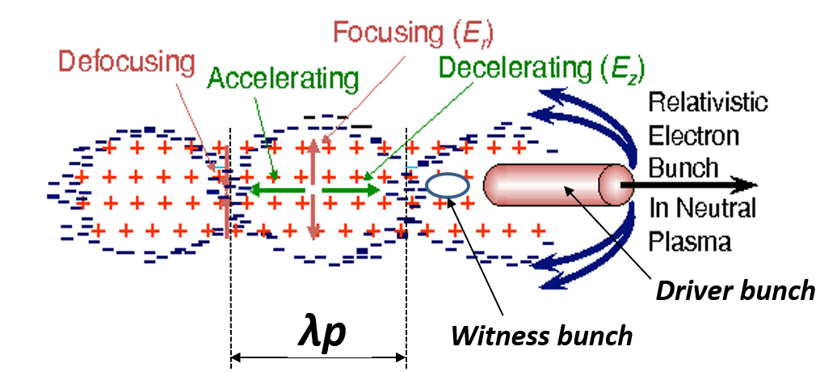
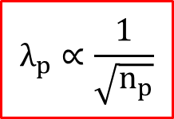
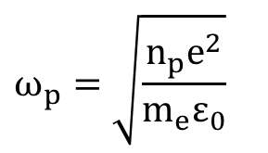
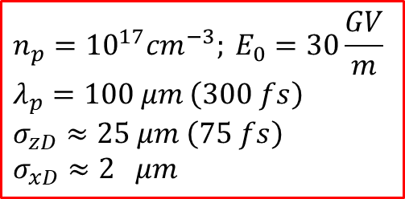
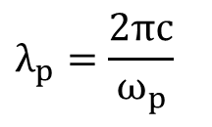

Plasma-based particle acceleration
Introduction
Pre-formed plasma channel
Density modulation excited by a driver beam, which can be a laser pulse (LWFA) or an ultra-relativistic particle bunch (PWFA)
Bubble shaped structure with GV/m accelerating fields in the driver wake
Particle (witness) bunch properly injected for high gradient acceleration
$$E_{acc}$$
$$n_{p}=10^{17}cm^{−3}; E_{0}=30\frac{GV}{m} \\ λ_{p}=100 μm \left(300 fs\right) \\ σ_{zD}≈25 μm \left(75 fs\right)$$
$$σ_{xD}≈2 μm$$
$$ω_{p}=\sqrt{\frac{n_{p}e^{2}}{m_{e}ε_{0}}}$$
$$λ_{p}=\frac{2πc}{ω_{p}}$$
$$λ_{p}∝\frac{1}{\sqrt{n_{p}}}$$
Lucio Crincoli | Final defense, 30th Jan 2025 PhD in Accelerator Physics, Sapienza Università di Roma

Slide 5


Introduction
Motivation of the thesis project
R&D on plasma sources
Fine control of the plasma channel is crucial for efficient acceleration:
  Plasma density uniformity
  Controlled density ramps for particle injection, matching and extraction
m-scale plasma channels for high gain plasma acceleration
Long-term operation at high repetition rate required by many accelerator applications
  Linear colliders and FEL facilities
$$E_{acc}$$
$$n_{p}=10^{17}cm^{−3}; E_{0}=30\frac{GV}{m} \\ λ_{p}=100 μm \left(300 fs\right) \\ σ_{zD}≈25 μm \left(75 fs\right)$$
$$σ_{xD}≈2 μm$$
$$λ_{p}∝\frac{1}{\sqrt{n_{p}}}$$
Lucio Crincoli | Final defense, 30th Jan 2025 PhD in Accelerator Physics, Sapienza Università di Roma

Slide 6
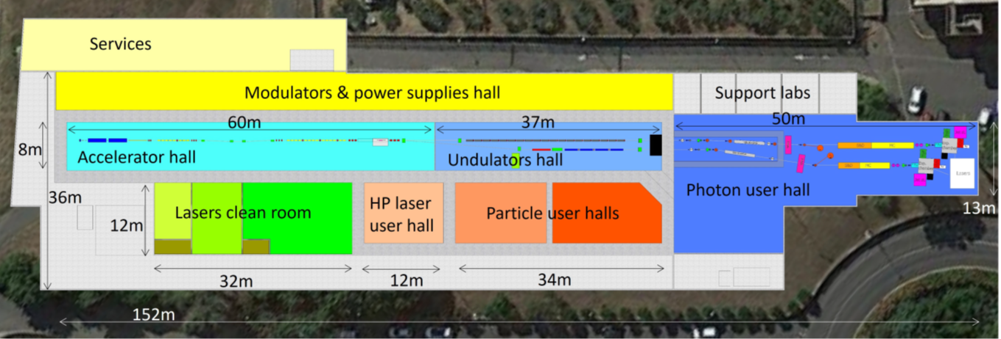
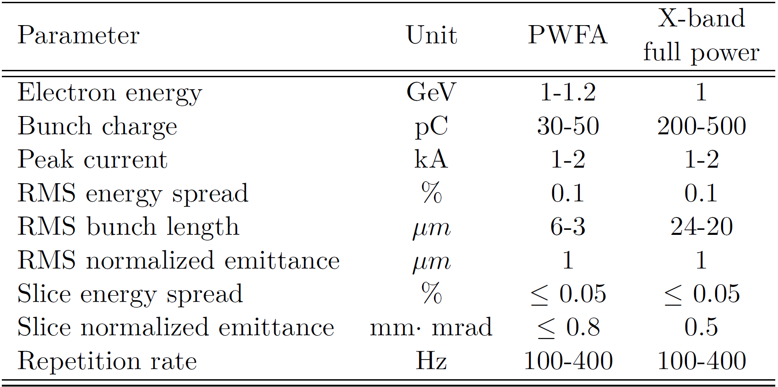
Introduction
Motivation of the thesis project
EuPRAXIA@SPARC_LAB project
First FEL user facility driven by a plasma accelerator (PWFA), including:
  S-band photoinjector
  X-band booster
  60 cm long plasma discharge capillary for PWFA
Future upgrade to 5 GeV with 3 m long PWFA stage
Lucio Crincoli | Final defense, 30th Jan 2025 PhD in Accelerator Physics, Sapienza Università di Roma

Slide 7
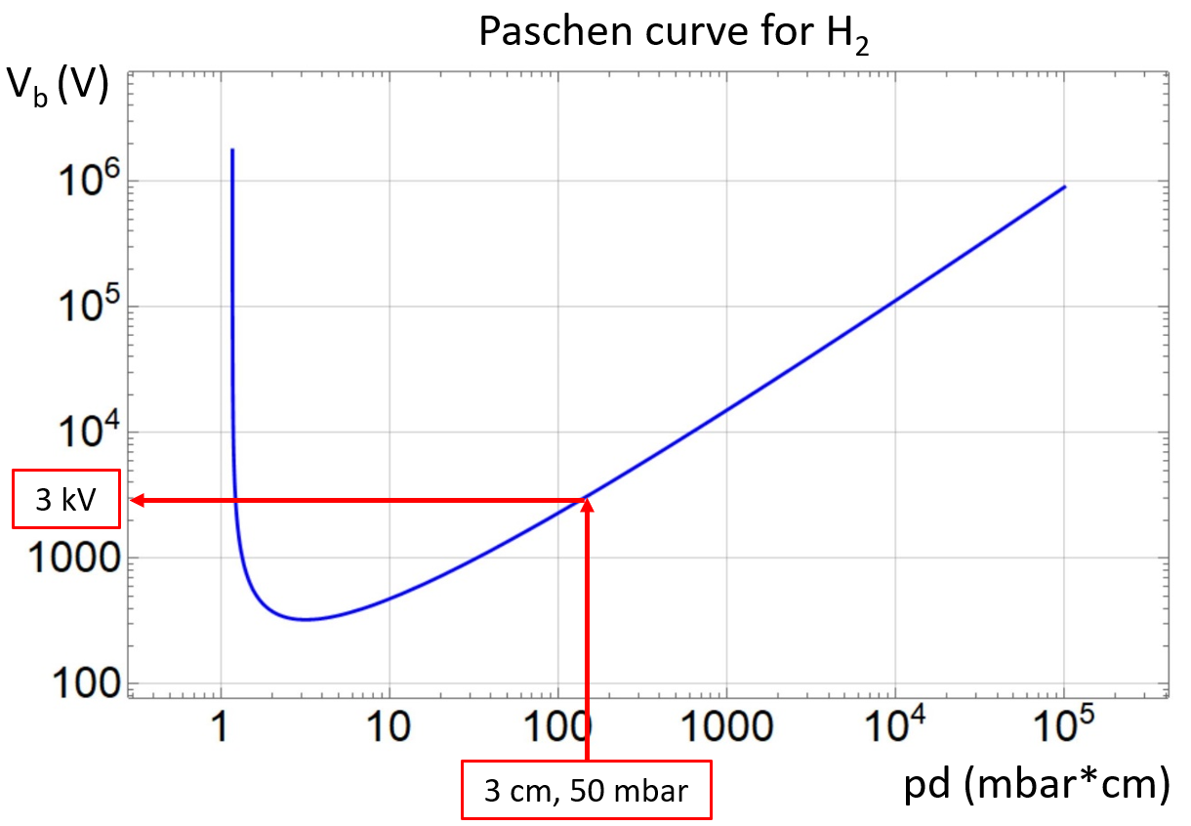
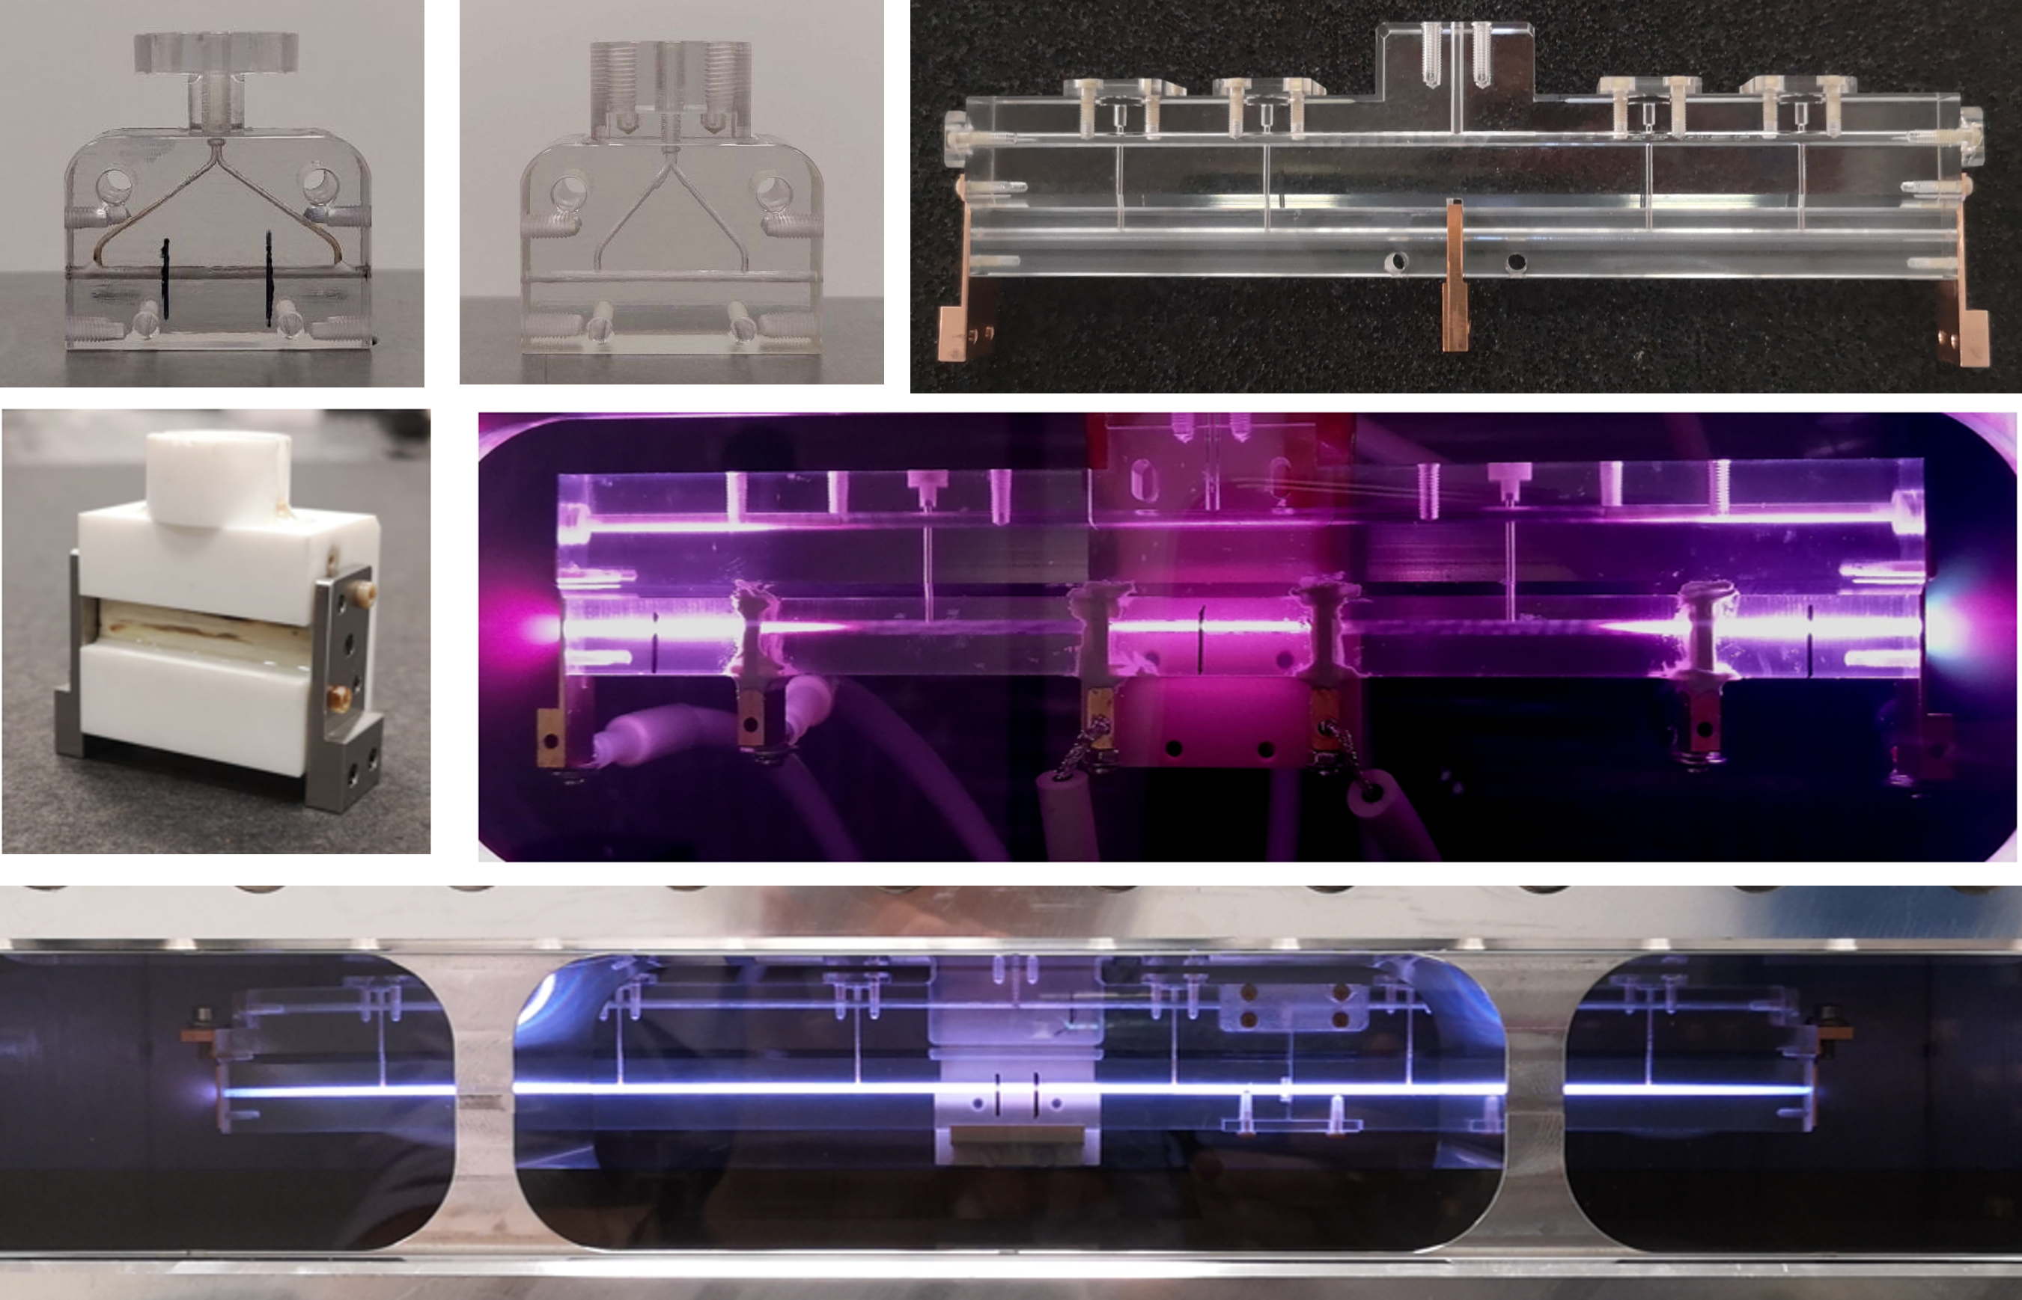
Gas-filled plasma discharge capillaries
Introduction
Plasma formation:
10-100 mbar of H₂, N₂, Ar
5-20 kV pulses
100 A – 1 kA peak current
Design:
Geometry
Plasma formation techniques
Materials
Lucio Crincoli | Final defense, 30th Jan 2025 PhD in Accelerator Physics, Sapienza Università di Roma

Slide 8
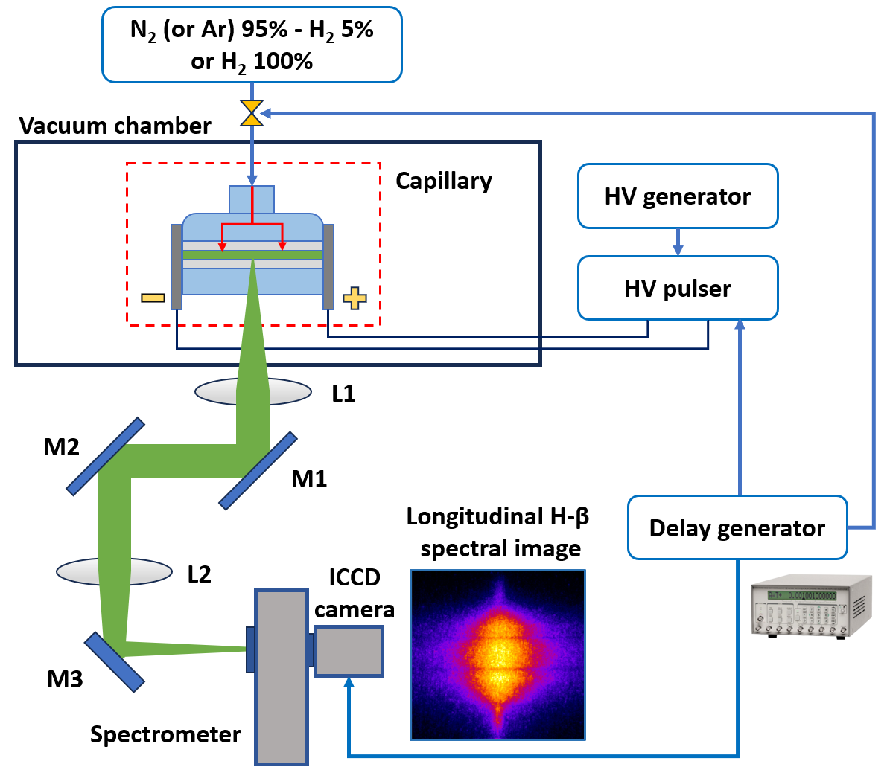
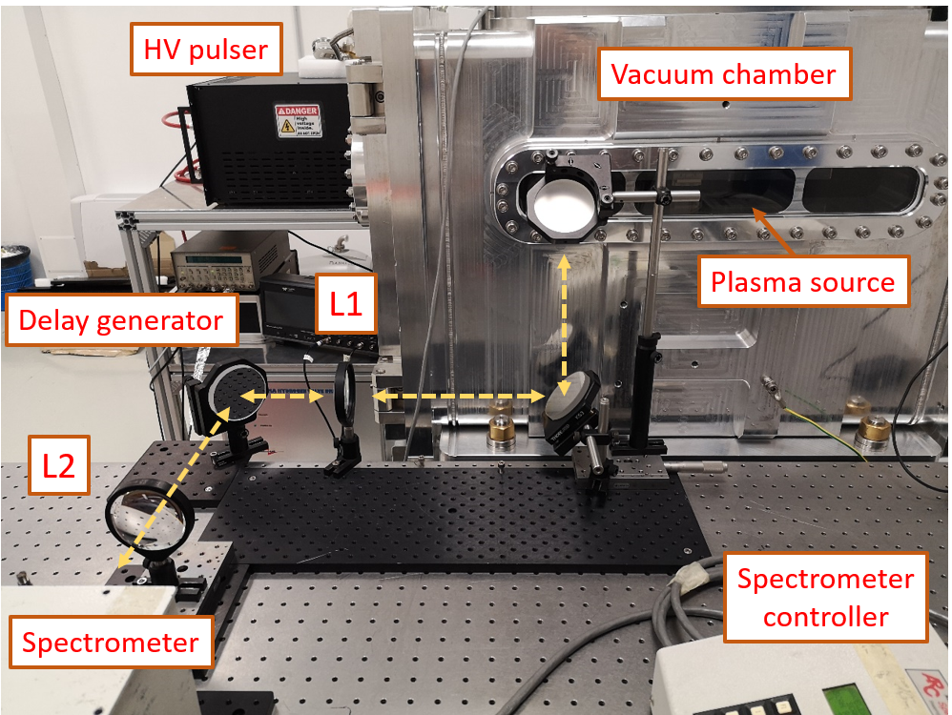
Plasma module setup at Plasma_lab
Introduction
Vacuum chamber
  10⁻⁶ mbar, 2 primary scroll pumps, 1 turbo-molecular pump
Gas injection system
  H₂, N₂, Ar
  10-50 mbar at 1 Hz
High voltage system
  HV generator and pulser circuit
  5-20 kV us-short pulses
Delay generator
Diagnostic system
  Optical line
  Imaging spectrometer
  ICCD camera
Lucio Crincoli | Final defense, 30th Jan 2025 PhD in Accelerator Physics, Sapienza Università di Roma

Slide 9
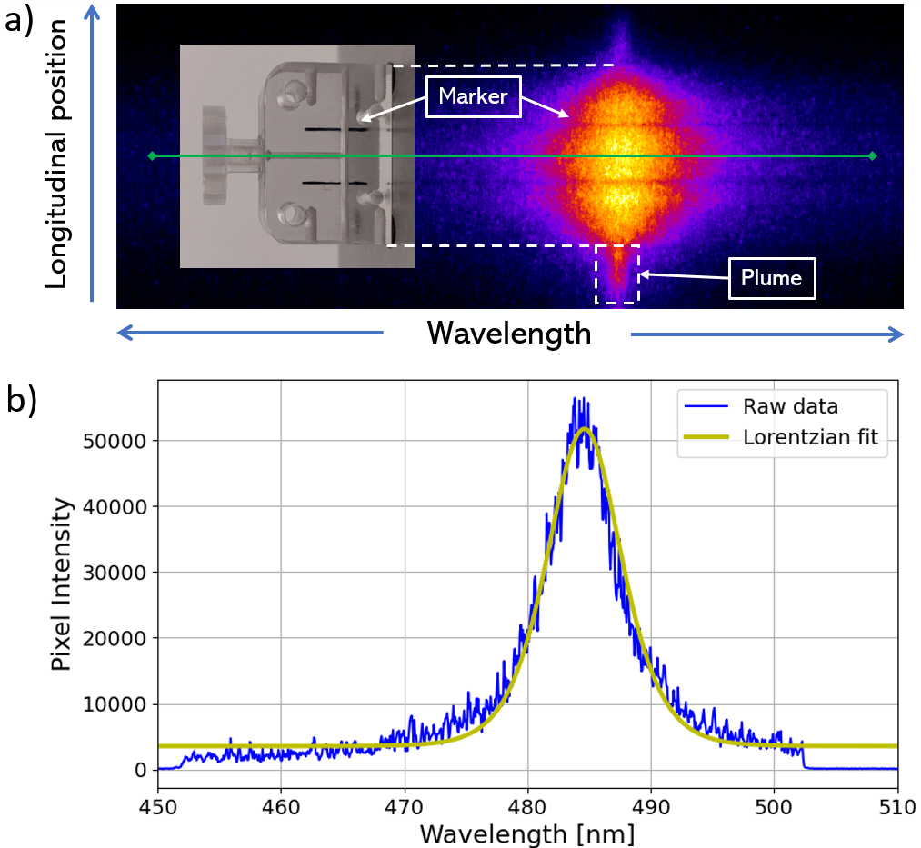
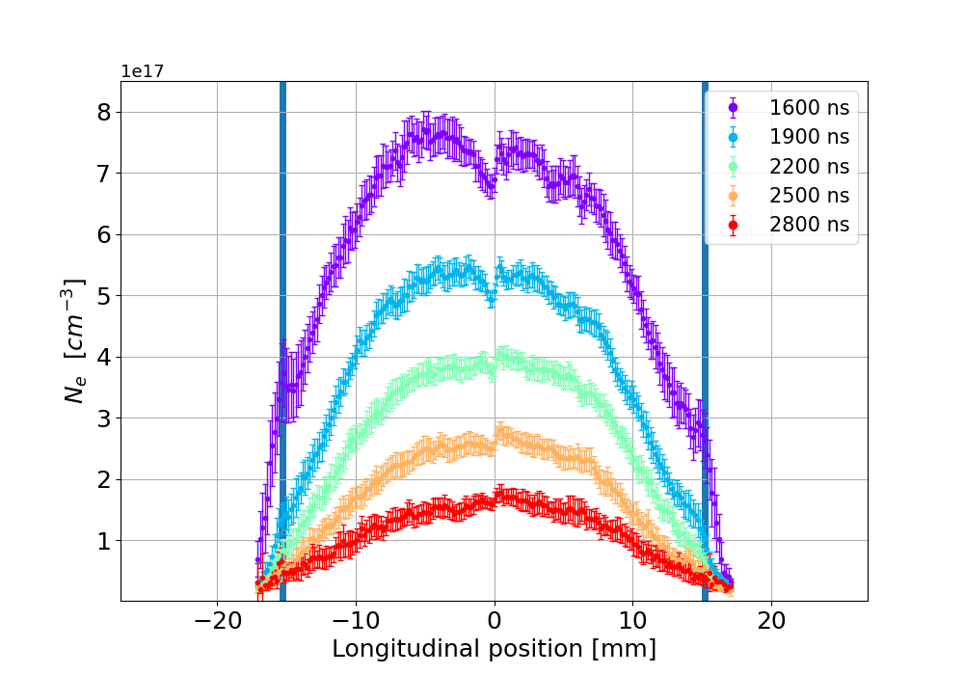
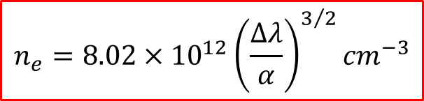
Stark broadening method
Introduction
The spectrometer acquires hydrogen spectral lines of Balmer series
Stark effect: correlation between plasma density and hydrogen spectral linewidth
Temporal and spatial resolved measurements of plasma density
$$n_{e}=8.02×{10}^{12}{\left(\frac{∆λ}{α}\right)}^{3/2}{cm}^{−3}$$
Lucio Crincoli | Final defense, 30th Jan 2025 PhD in Accelerator Physics, Sapienza Università di Roma

Slide 10
Outline
Introduction
Plasma-based particle acceleration
Segmented capillary for m-scale plasma sources
Integrated capillary for staged focusing-acceleration
Motivation of the thesis project
High repetition rate plasma sources
Advanced ceramic capillaries
Novel schemes for compact m-scale plasma sources
Preliminary design of a 60 cm-long capillary for EuPRAXIA@SPARC_LAB project
Curved capillary for Active Bending Plasmas
Laser-induced plasma filaments
Conclusions and Future Perspectives
Plasma discharge capillary design and testing at Plasma_lab (LNF-INFN)
Lucio Crincoli | Final defense, 30th Jan 2025 PhD in Accelerator Physics, Sapienza Università di Roma

Slide 11
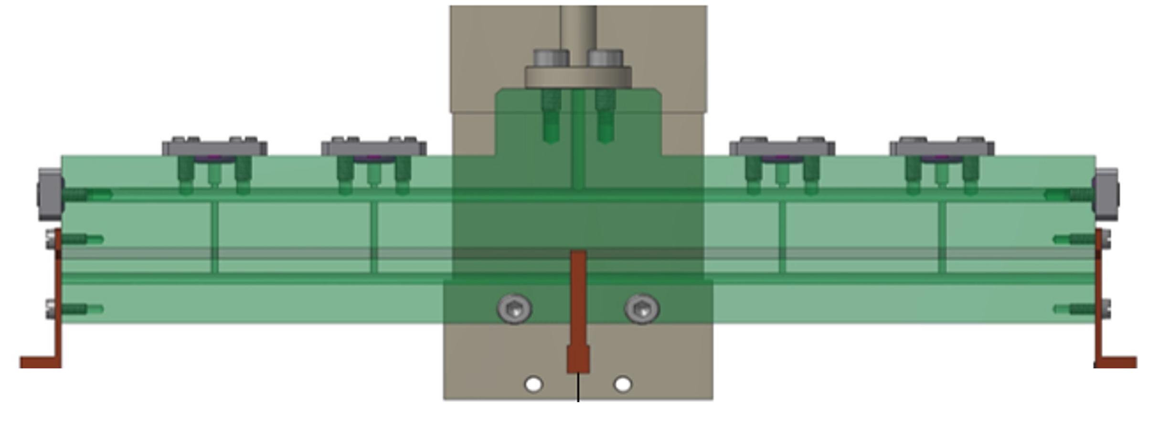
Segmented capillary
Novel schemes for compact m-scale plasma sources
Independent plasma discharges
Parallel HV circuits
Modulation of longitudinal plasma density profile
Cheap and compact m-scale sources
HV
HV
Lucio Crincoli | Final defense, 30th Jan 2025 PhD in Accelerator Physics, Sapienza Università di Roma

Slide 12
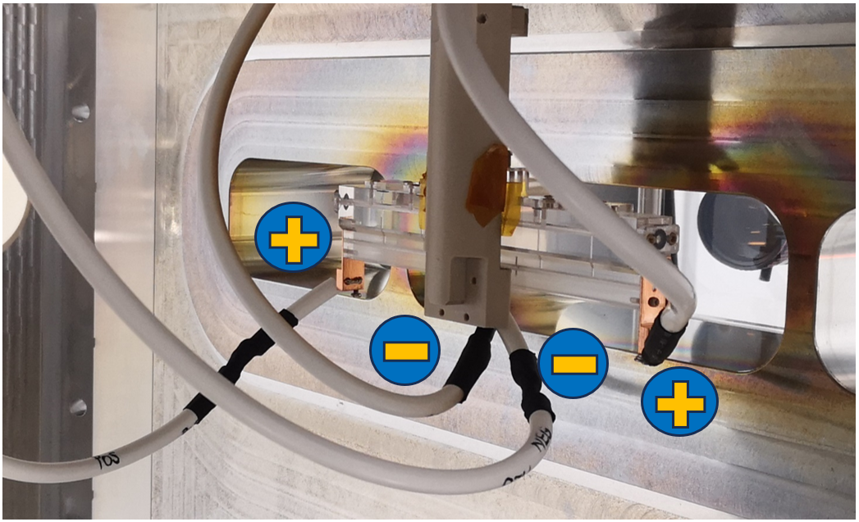
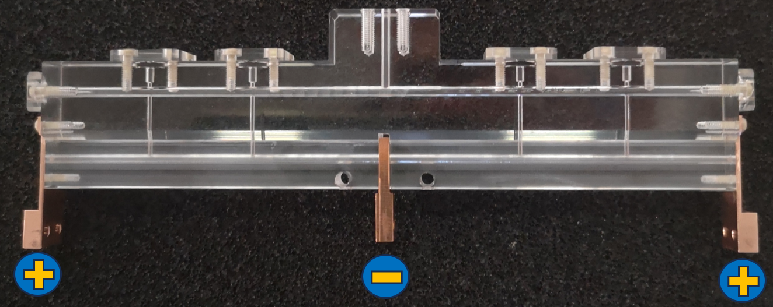
Novel schemes for compact m-scale plasma sources
Capillary features
2 segments 8 cm long
2 mm diameter
Common grounded electrode
Experimental setup
2 HV generators and pulsers, one for each segment
5-20 kV voltage pulses
H2, N2, Ar neutral gas
10-50 mbar 1 Hz pulsed injection
Delay generator for discharge synchronization
Lucio Crincoli | Final defense, 30th Jan 2025 PhD in Accelerator Physics, Sapienza Università di Roma

Slide 13
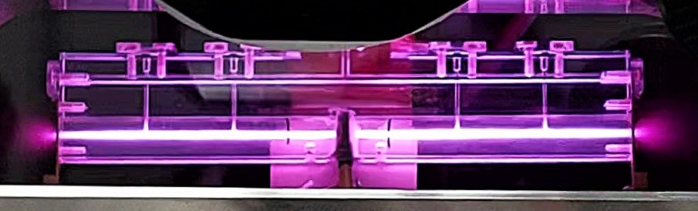
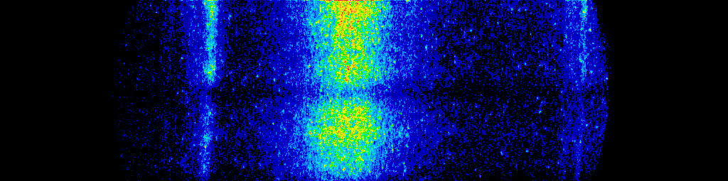
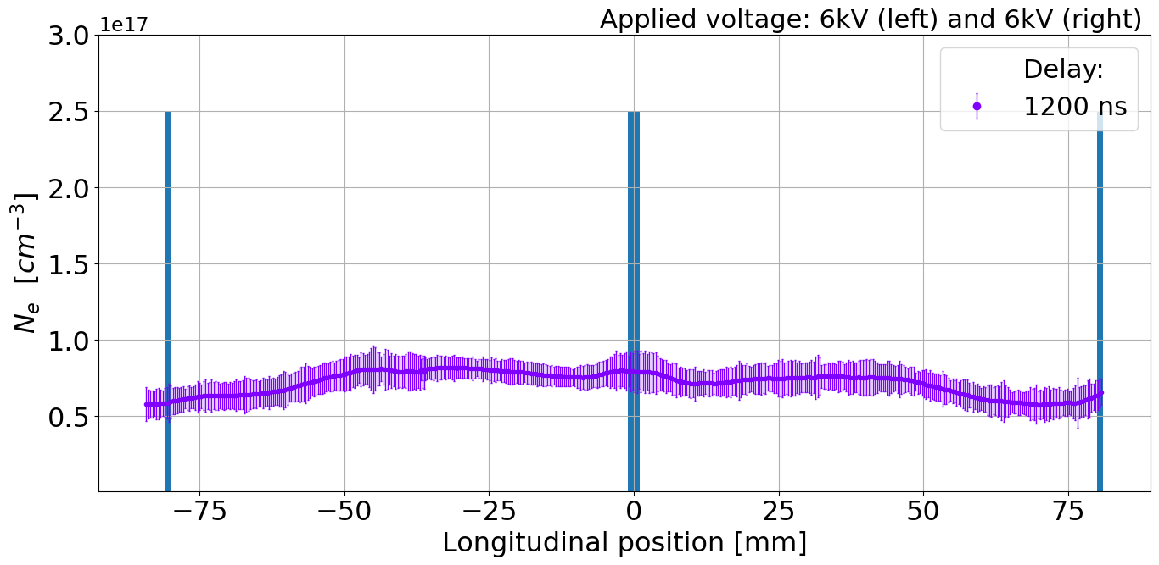
Novel schemes for compact m-scale plasma sources
1st test
Goal
Uniform density profile
Test settings
Left segment: 6 kV
Right segment: 6 kV
Results
Uniform distribution during plasma formation
6 kV
6 kV
H_{β} Balmer spectral line acquired by ICCD camera
Central electrode
Lucio Crincoli | Final defense, 30th Jan 2025 PhD in Accelerator Physics, Sapienza Università di Roma
13

Slide 14
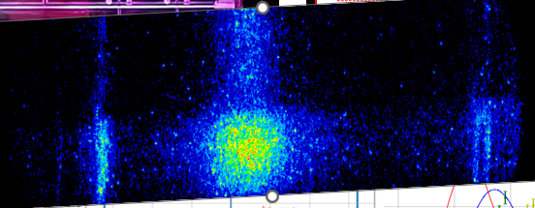
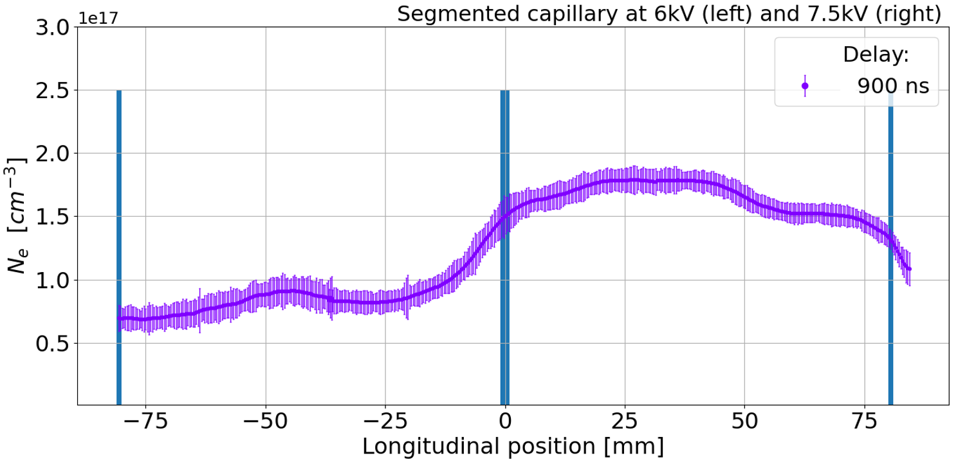
Novel schemes for compact m-scale plasma sources
2nd test
Goal
Steep density gradient at segments crossing
Test settings
Left segment: 6 kV
Right segment: 7.5 kV
Results
Localized density gradient during the HV discharges
6 kV
7.5 kV
H_{β} Balmer spectral line acquired by ICCD camera
Central electrode
Lucio Crincoli | Final defense, 30th Jan 2025 PhD in Accelerator Physics, Sapienza Università di Roma
14

Slide 15
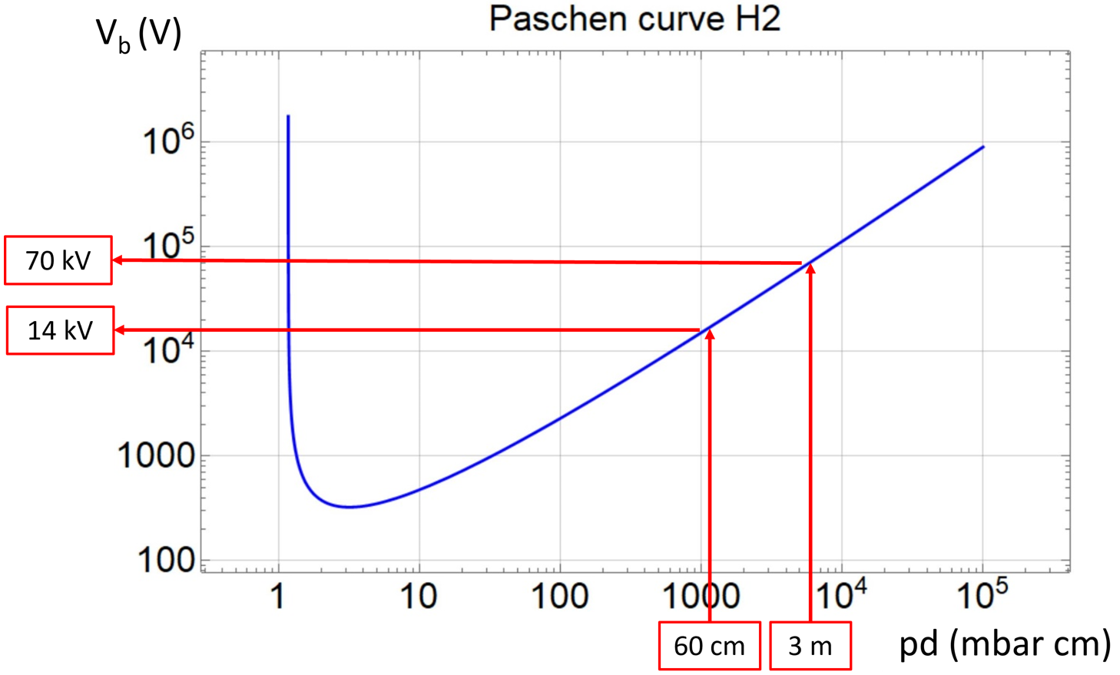
Novel schemes for compact m-scale plasma sources
m-scale sources:
Continuous vs segmented channels
EuPRAXIA@SPARC_LAB 5 GeV case (1.5 GV/m)
Single segment
  3 m, 20 mbar
  50-70 kV
5 segments
  60 cm, 20 mbar
  10-15 kV
Lucio Crincoli | Final defense, 30th Jan 2025 PhD in Accelerator Physics, Sapienza Università di Roma
15

Slide 16
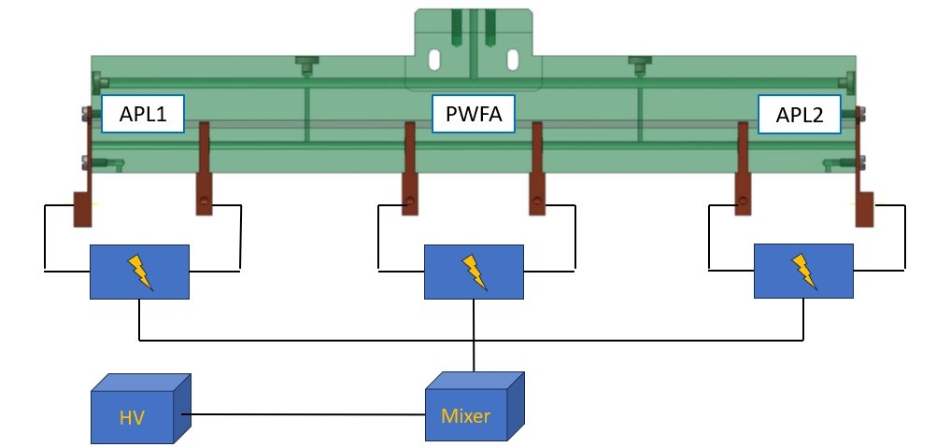
Integrated capillary for staged focusing and acceleration
Novel schemes for compact m-scale plasma sources
Lucio Crincoli | Final defense, 30th Jan 2025 PhD in Accelerator Physics, Sapienza Università di Roma

Slide 17
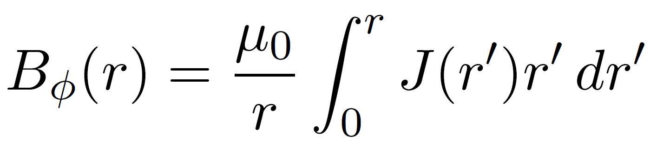
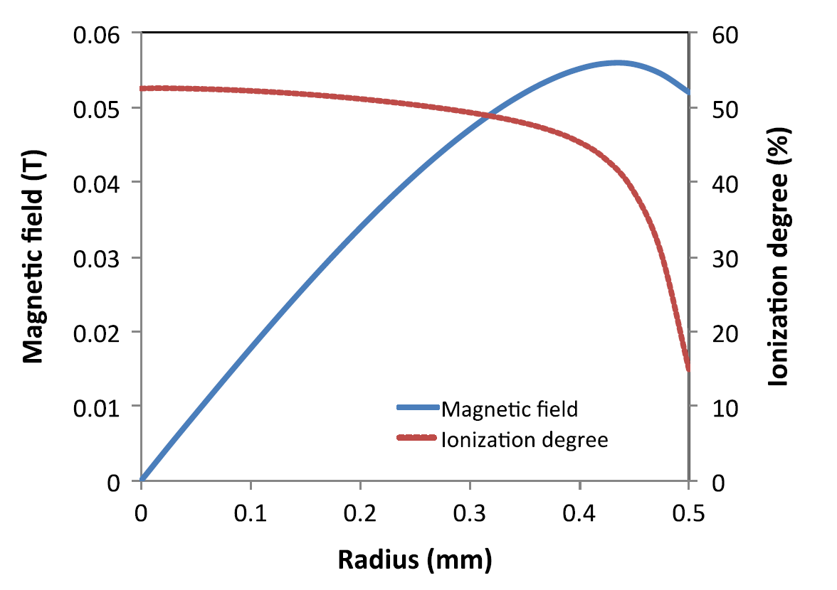
Backup slides
Active plasma lenses
Azimuthal magnetic field generated by the electrical discharge current
Radial focusing with kT/m strength
Lucio Crincoli | Final defense, 30th Jan 2025 PhD in Accelerator Physics, Sapienza Università di Roma
17

Slide 18
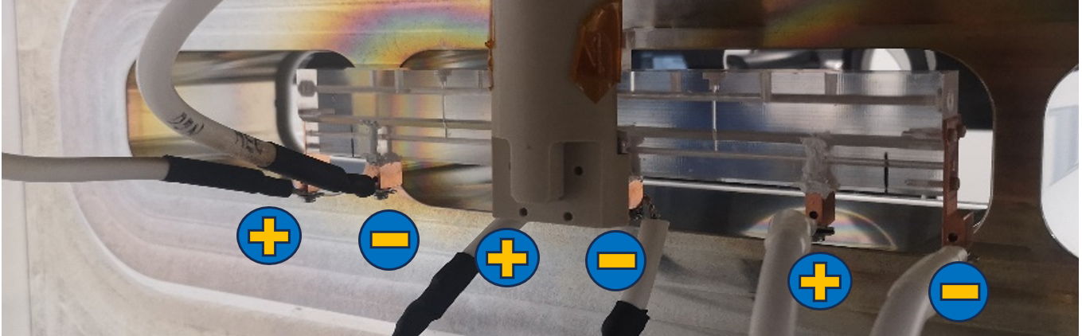
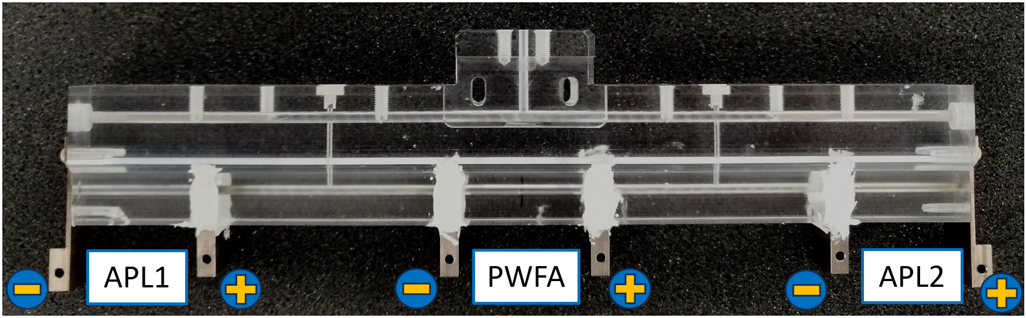
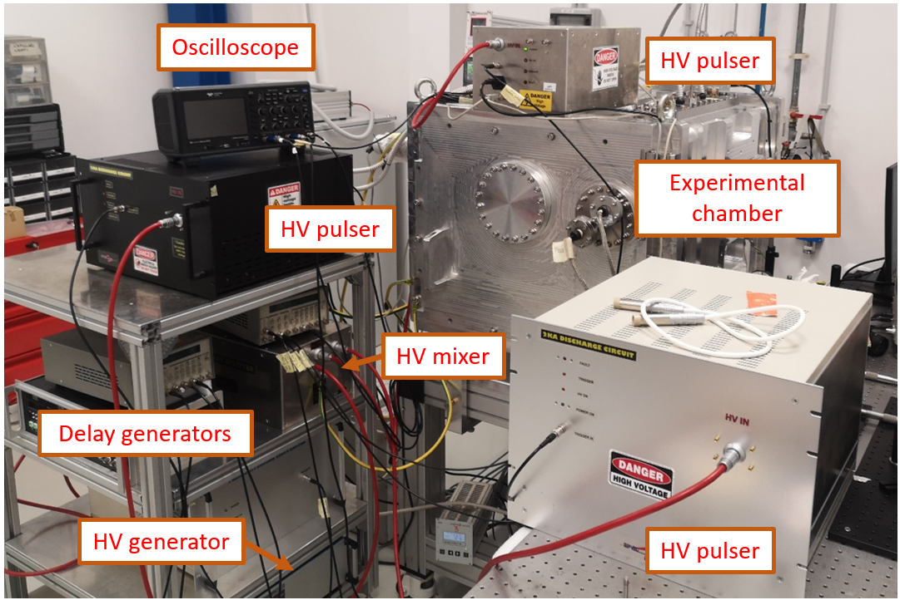
Novel schemes for compact m-scale plasma sources
Design
3 segments, each 3 cm long
  2 active plasma lenses
  1 accelerating stage
5 cm long drifts
2 Inlets in the drifts
2 mm diameter
Experimental setup
1 High voltage generator
HV mixer feeding 3 parallel pulsers
Alternating polarization
Lucio Crincoli | Final defense, 30th Jan 2025 PhD in Accelerator Physics, Sapienza Università di Roma

Slide 19
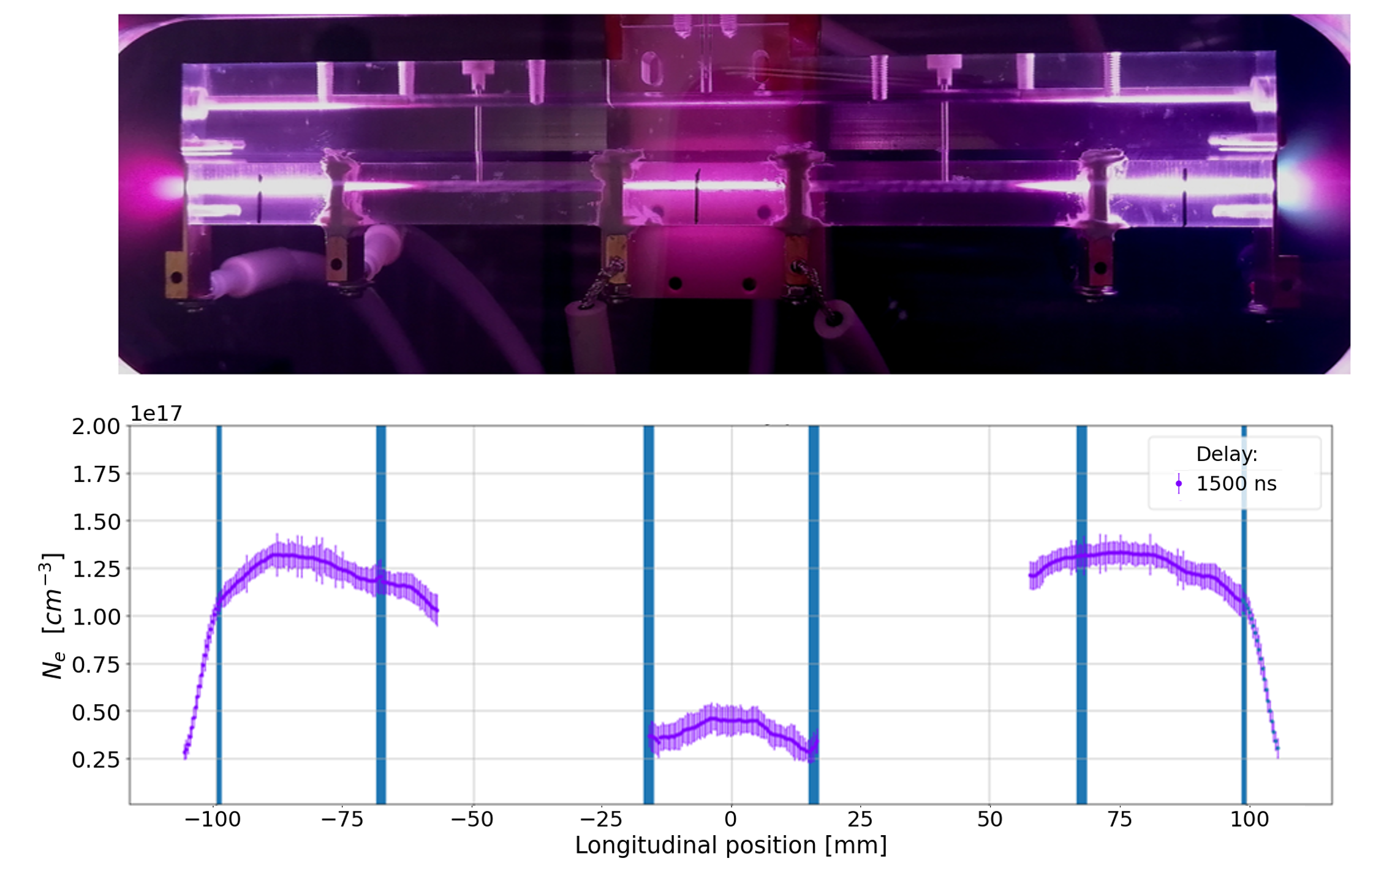
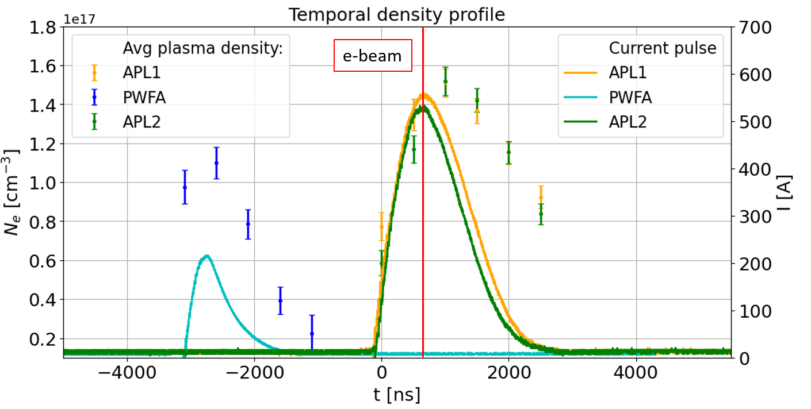

Novel schemes for compact m-scale plasma sources
Operating properties
Discharges synchronization
  Lenses synchronized with the beam entrance
  Central discharge applied 3 µs before for plasma acceleration
10 kV voltage resulting in:
  500 A on the lenses
  250 A in the accelerator
Internal drifts behave like spacers
$$n_{p}=10^{15}cm^{−3}; E_{0}=3\frac{GV}{m} \\ λ_{p}=1 mm \left(3 ps\right) \\ σ_{zD}≈250 μm \left(750 fs\right)$$
$$σ_{xD}≈20 μm$$
Lucio Crincoli | Final defense, 30th Jan 2025 PhD in Accelerator Physics, Sapienza Università di Roma
19

Slide 20
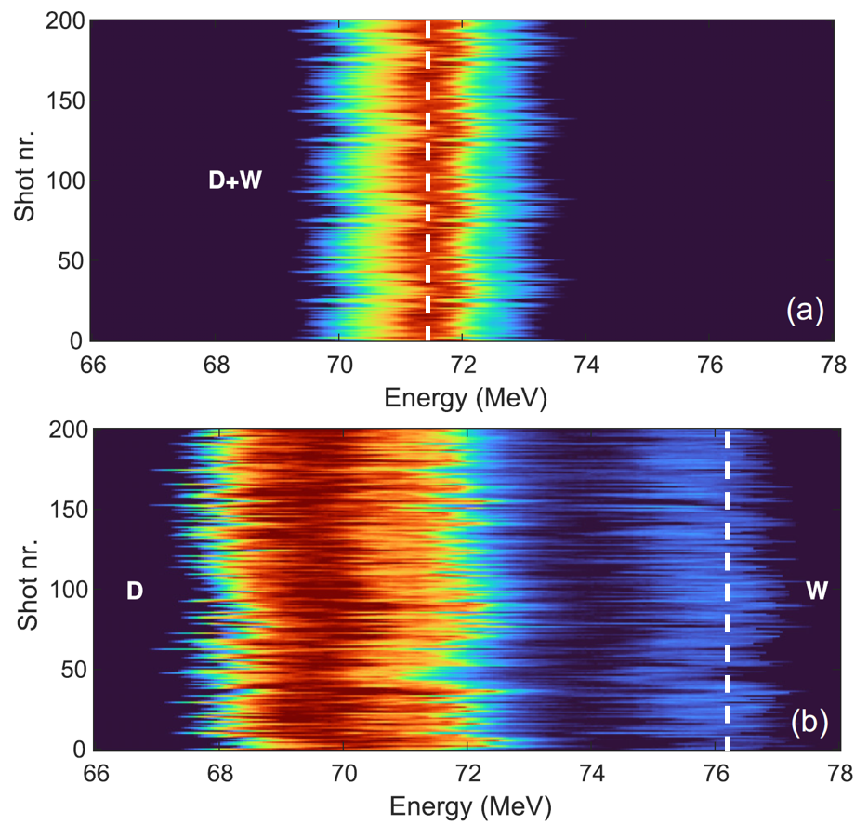
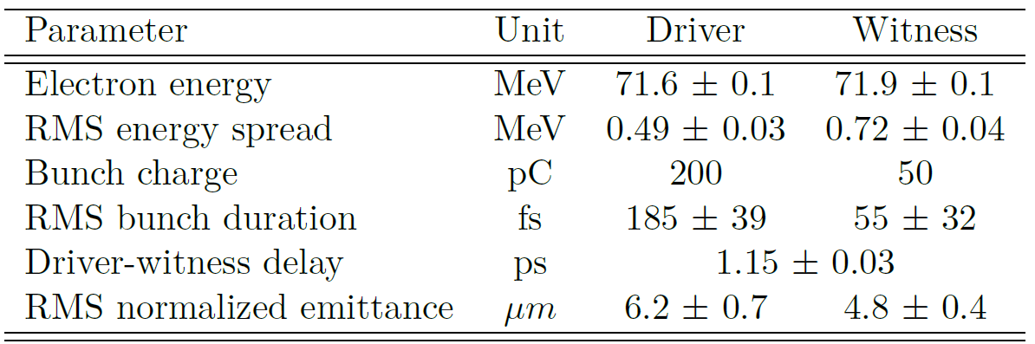
Novel schemes for compact m-scale plasma sources
Electron beam focusing and acceleration at SPARC_LAB
200 consecutive shots taken with accelerated beam
4.5 MeV gain over 3 cm (150 MV/m gradient)
Proof of principle of staged plasma-based focusing-acceleration of electron beams within a compact integrated plasma source
Lucio Crincoli | Final defense, 30th Jan 2025 PhD in Accelerator Physics, Sapienza Università di Roma
20

Slide 21
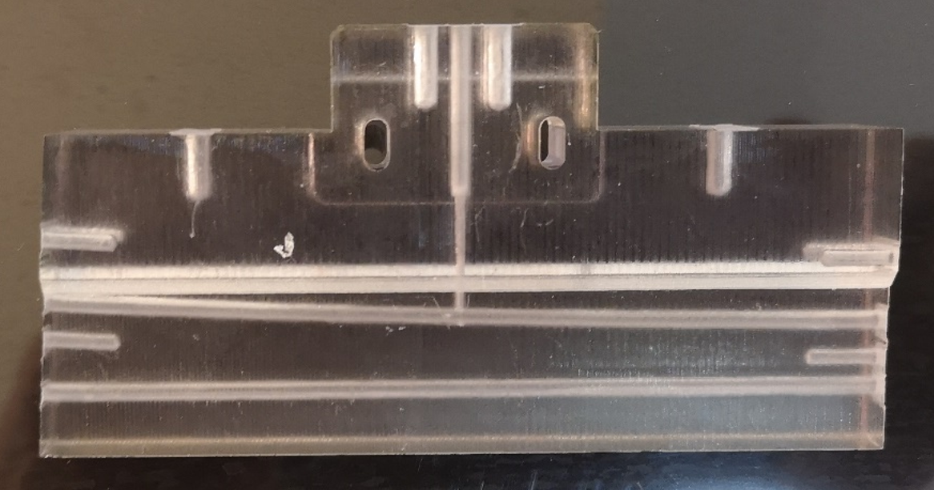
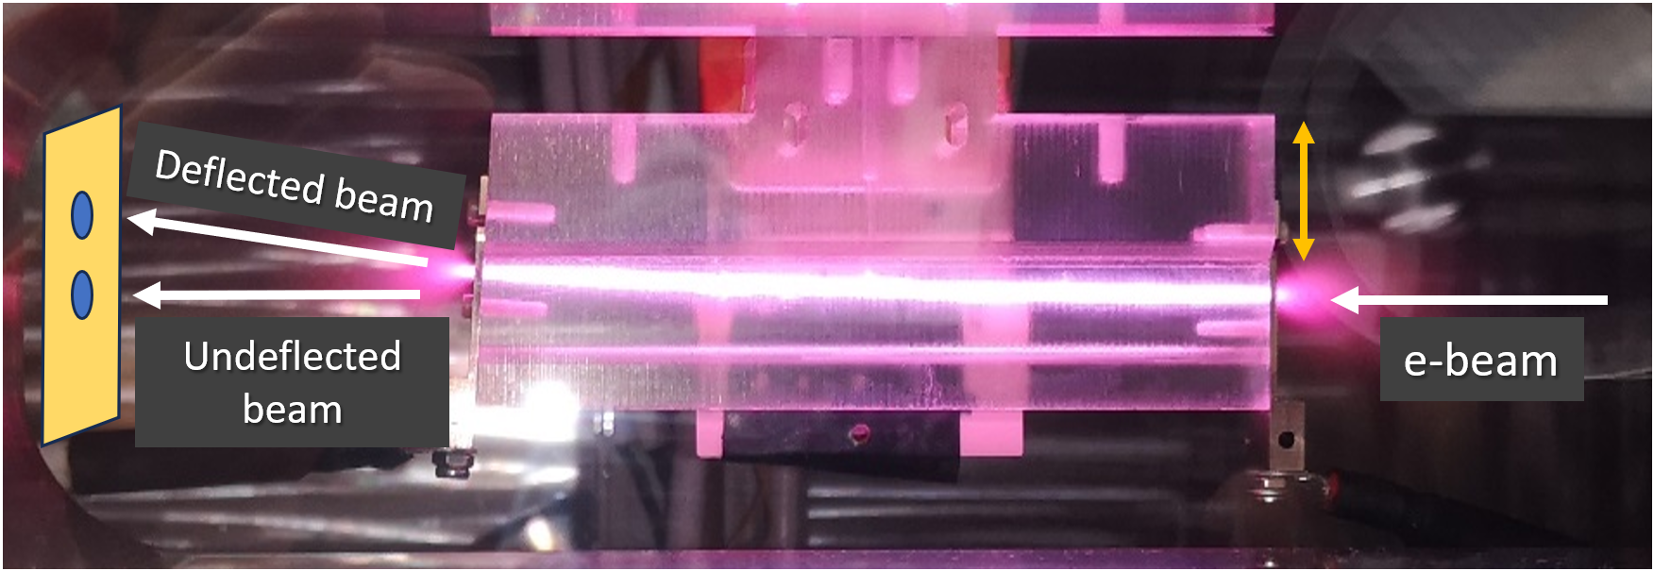
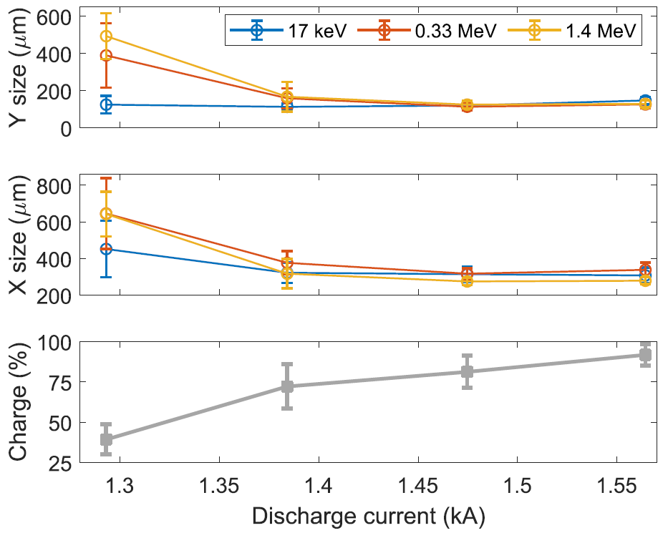
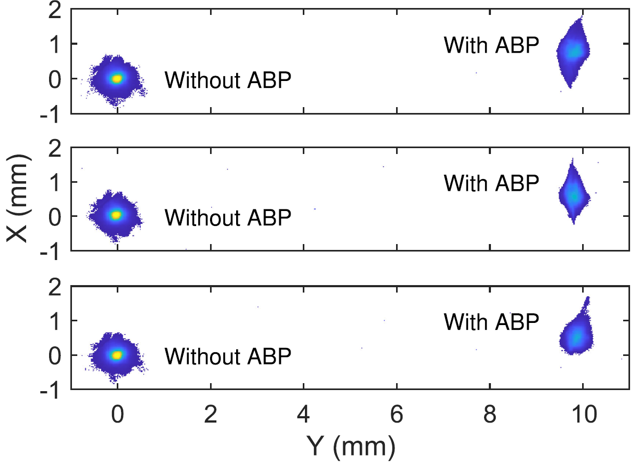
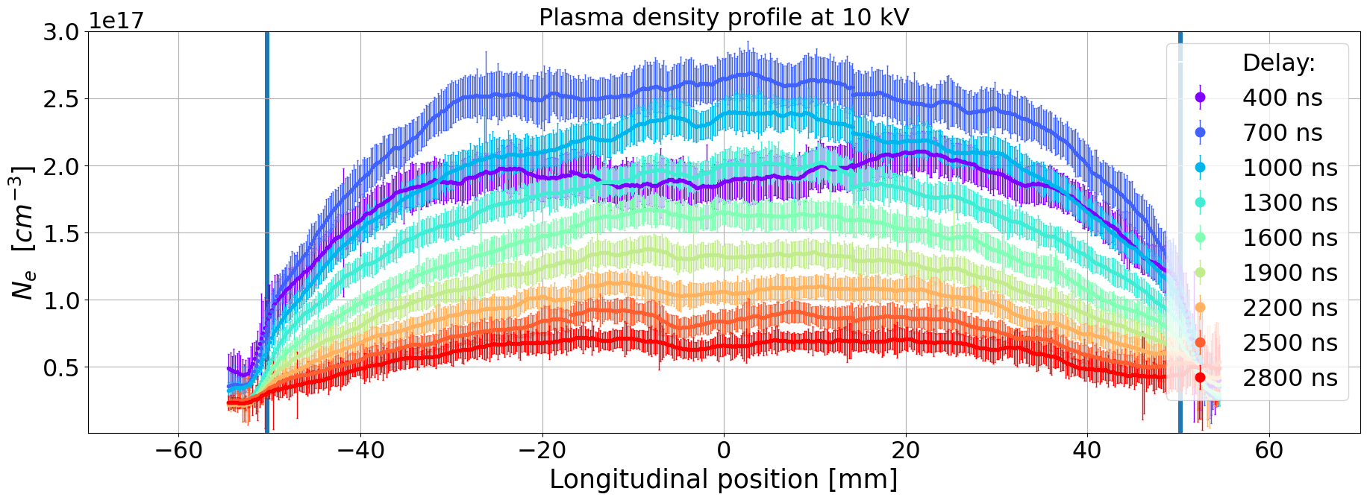
Novel schemes for compact m-scale plasma sources
Curved capillary for Active Bending Plasma
Bending dipole
ABP
Dispersion
0.03%
60 MeV 50 pC bunch with three energy spread configurations
4° trajectory bending with 10 mm offset on screen
No dispersion observed
0.55%
2.3%
Lucio Crincoli | Final defense, 30th Jan 2025 PhD in Accelerator Physics, Sapienza Università di Roma
21

Slide 22
Outline
Introduction
Plasma-based particle acceleration
Segmented capillary for m-scale plasma sources
Integrated capillary for staged focusing-acceleration
Motivation of the thesis project
High repetition rate plasma sources
Advanced ceramic capillaries
Novel schemes for compact m-scale plasma sources
Preliminary design of a 60 cm-long capillary for EuPRAXIA@SPARC_LAB project
Curved capillary for Active Bending Plasmas
Laser-induced plasma filaments
Conclusions and Future Perspectives
Plasma discharge capillary design and testing at Plasma_lab (LNF-INFN)
Lucio Crincoli | Final defense, 30th Jan 2025 PhD in Accelerator Physics, Sapienza Università di Roma

Slide 23
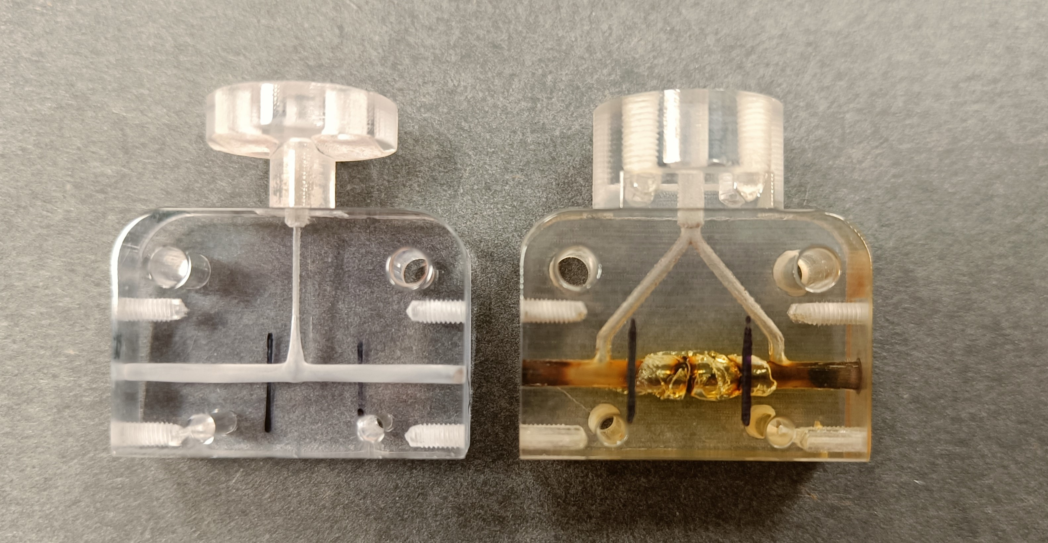
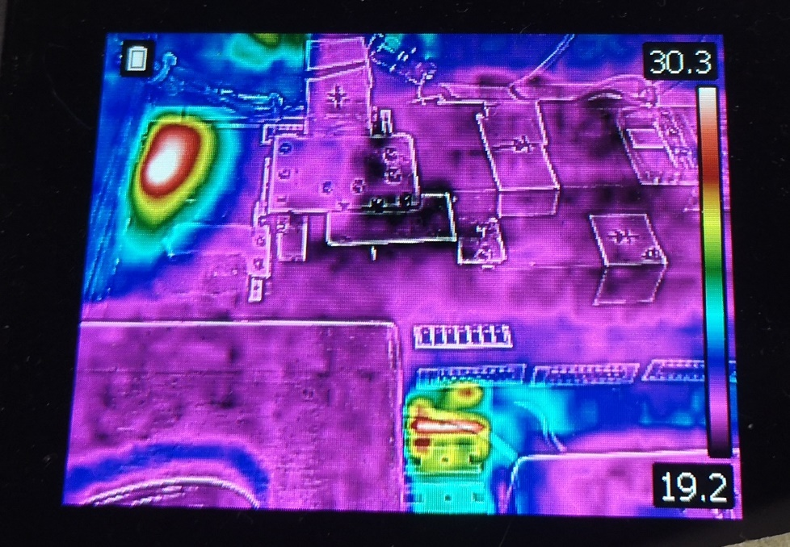
Plasma module operation at high repetition rate
High repetition rate plasma sources
Slow valve activation
  Continuous flow injection
Overheating of vacuum pumps
  Water cooling system
Overheating of HV pulser circuit
  Air cooling system
Capillary erosion/damage
Lucio Crincoli | Final defense, 30th Jan 2025 PhD in Accelerator Physics, Sapienza Università di Roma
23

Slide 24
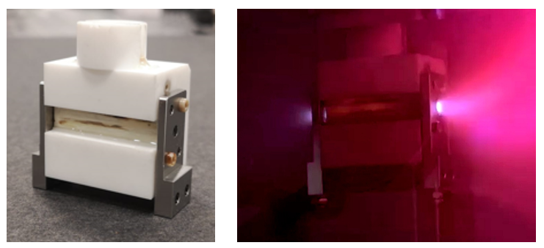
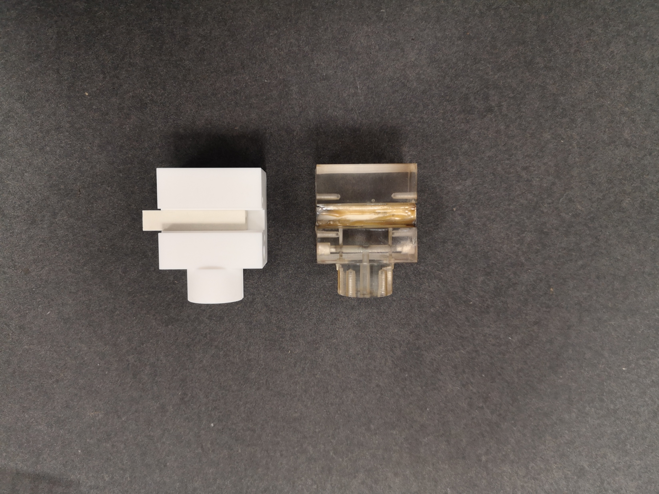
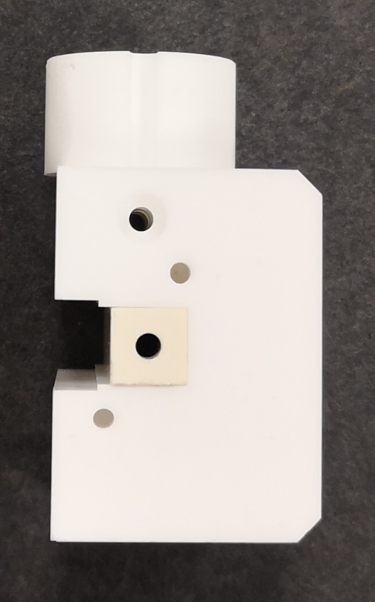
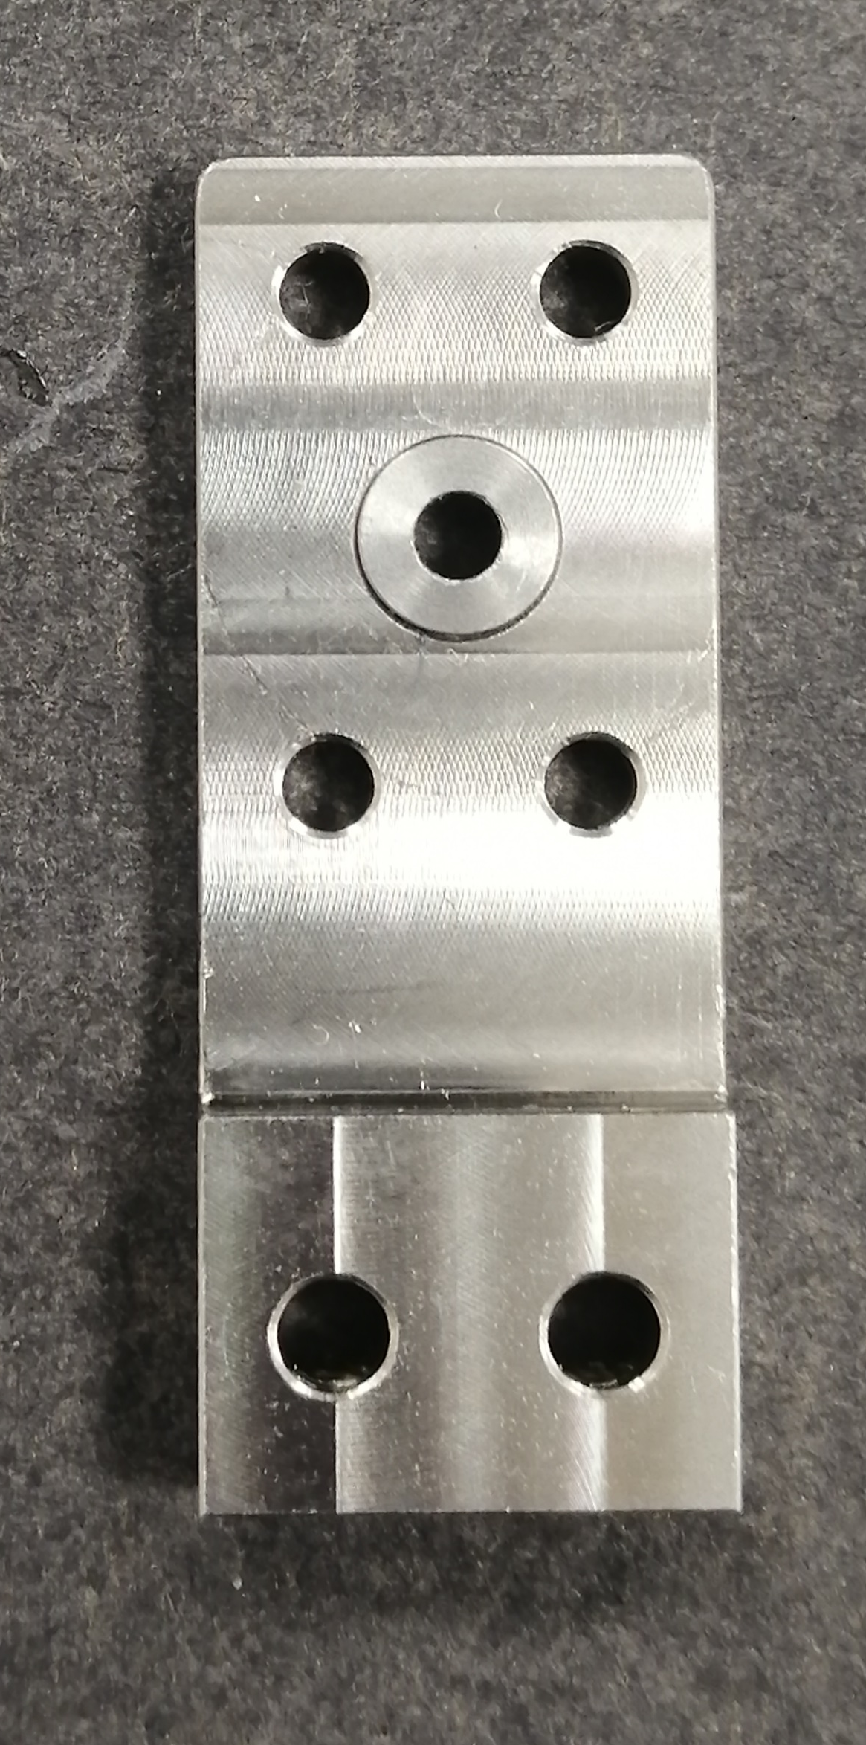
Advanced ceramic capillaries
High repetition rate plasma sources
Shapal (Aluminum Nitride) and Macor (glass-ceramic)
High thermal conductivity (92 W/mK for Shapal)
High max operating temperature (2000 and 1000°C)
Good machinability, cost-effectiveness and availability for large geometries
Molybdenum
3 cm long, 2 mm diameter
Shapal
Stainless
steel
Macor
Lucio Crincoli | Final defense, 30th Jan 2025 PhD in Accelerator Physics, Sapienza Università di Roma
24

Slide 25
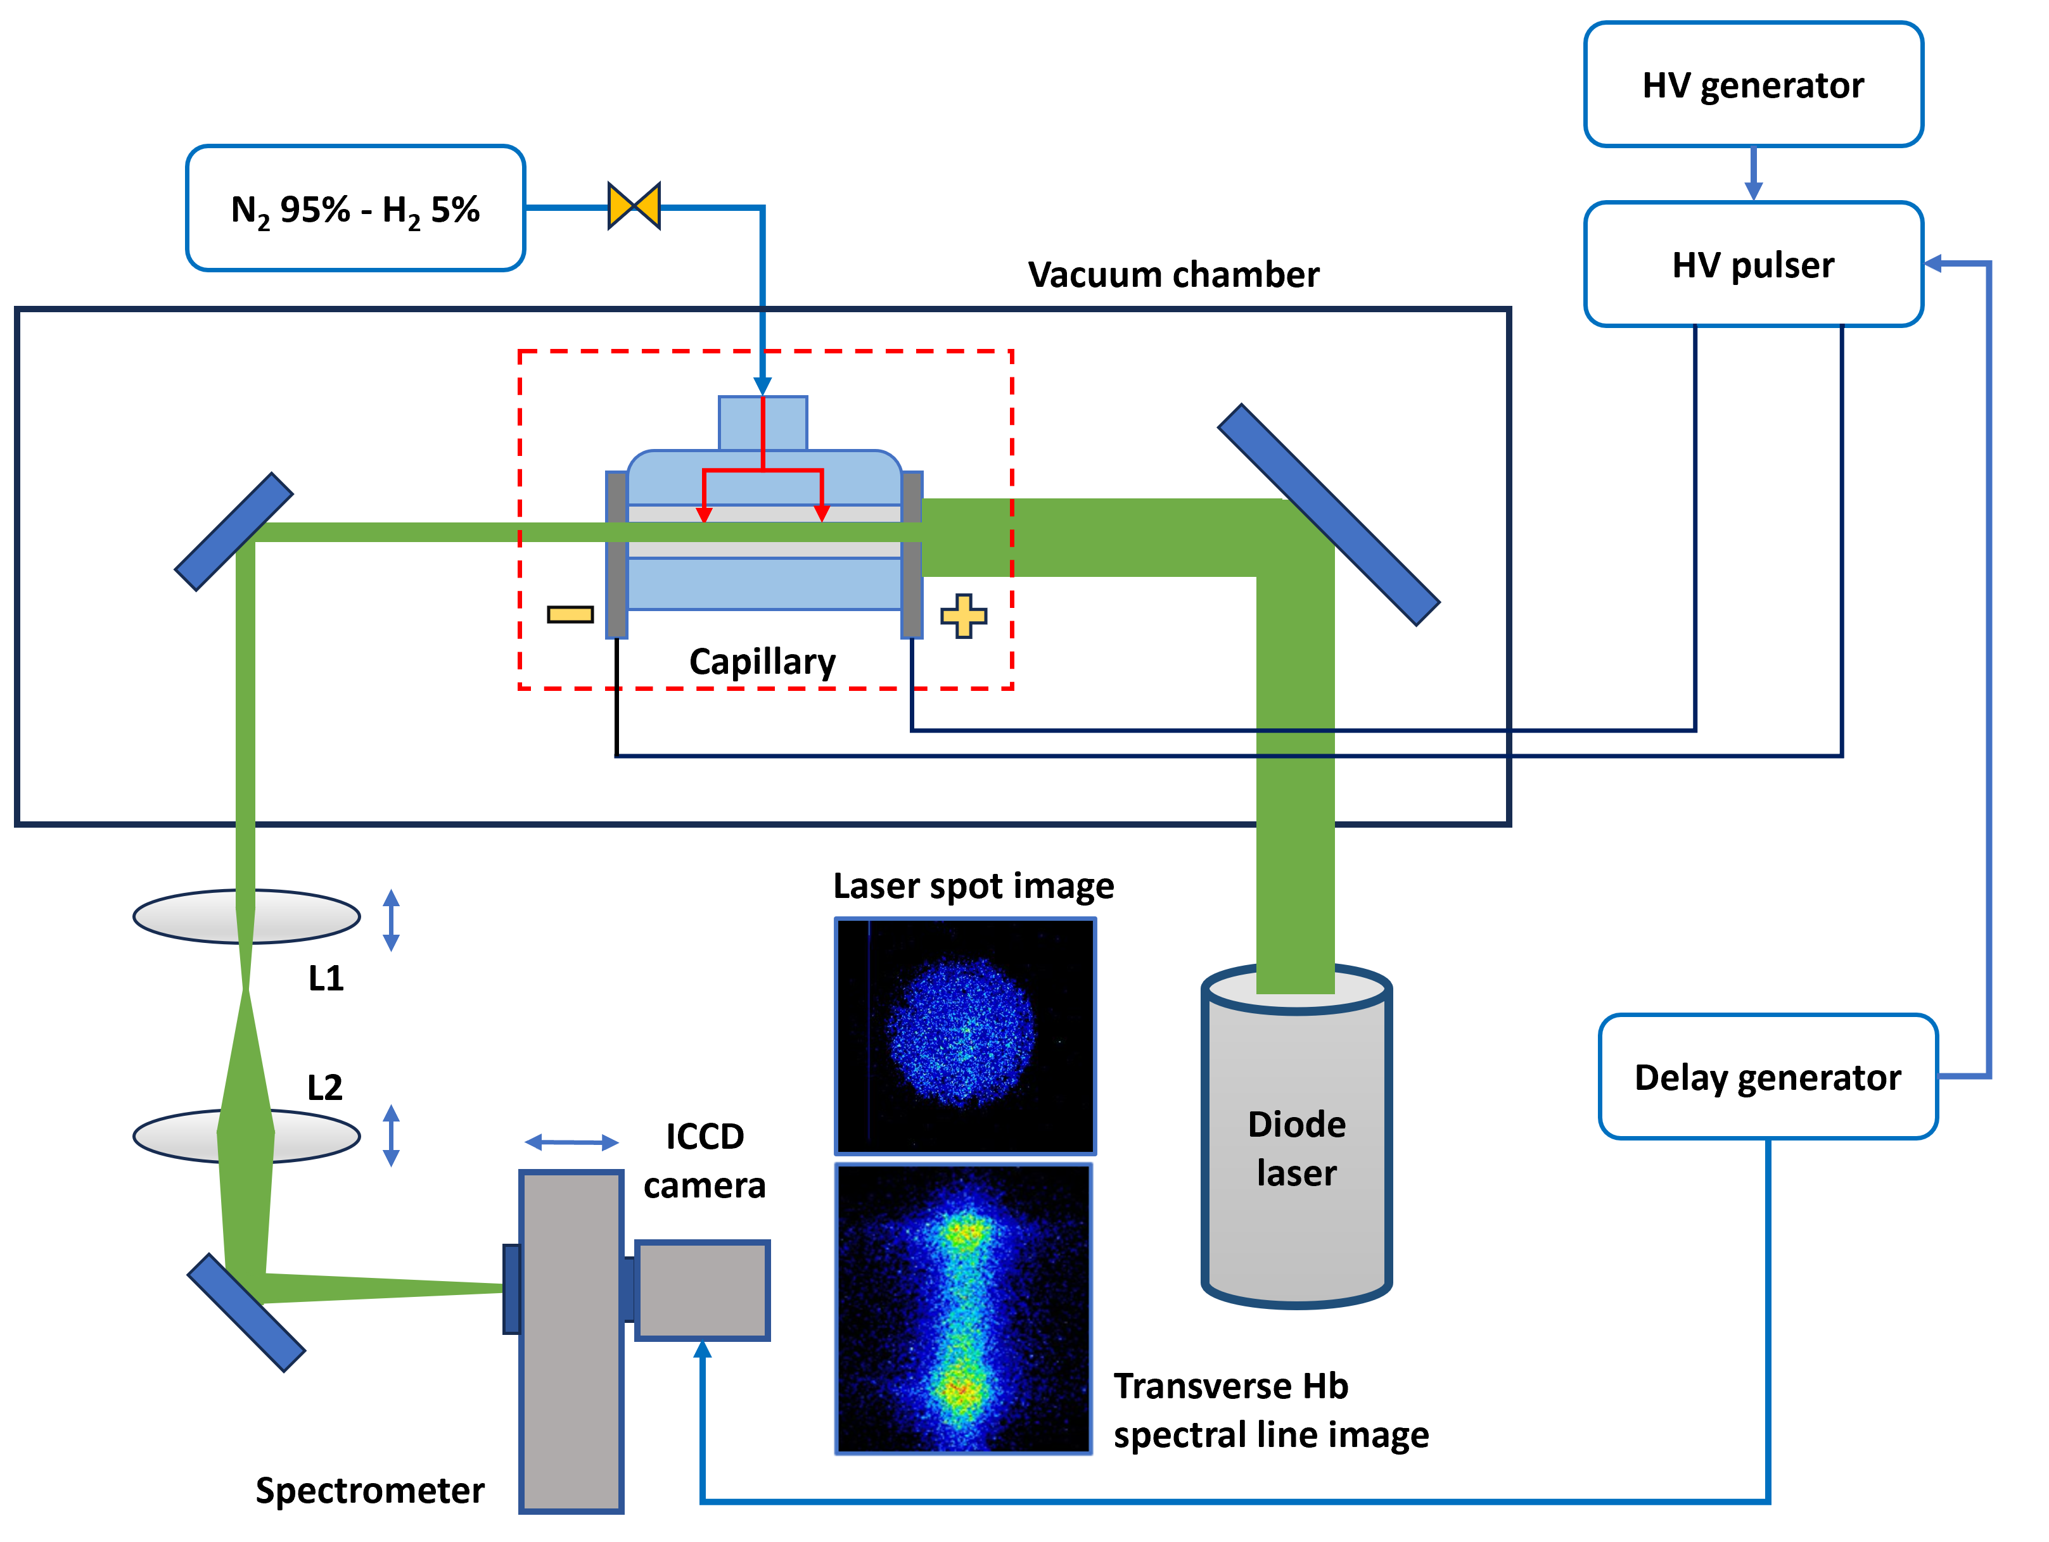
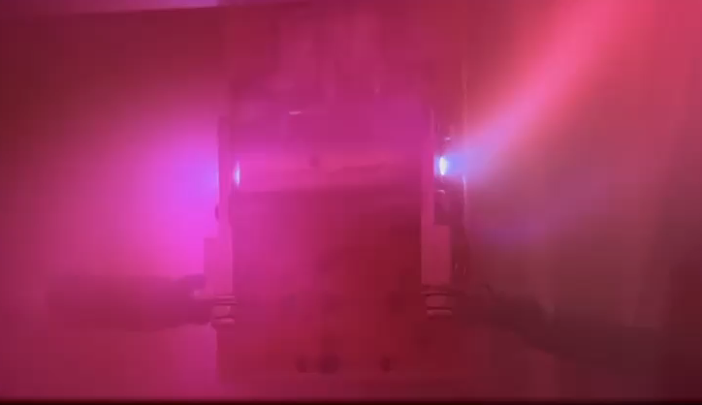
Experimental testing
High repetition rate plasma sources
10-150 Hz operation
N₂ 80-100 mbar in continuous flow
5 kV – 400 A
100 Hz repetition rate discharges
Lucio Crincoli | Final defense, 30th Jan 2025 PhD in Accelerator Physics, Sapienza Università di Roma
25

Slide 26
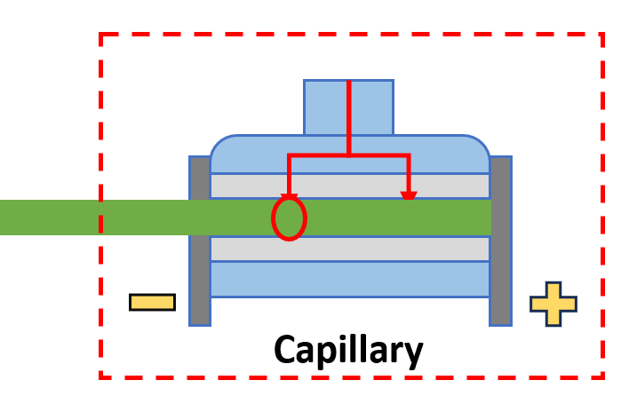
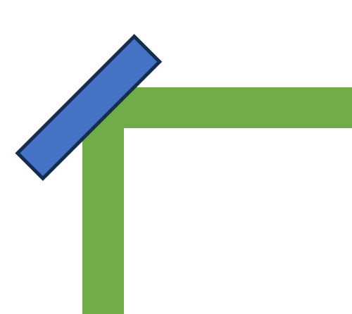
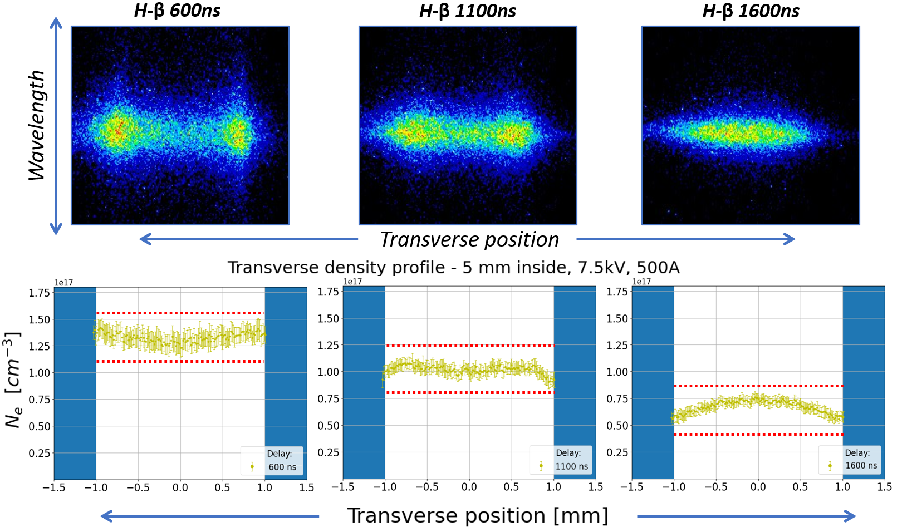


High repetition rate plasma sources
Transverse Stark broadening method
H₂ 80-100 mbar, 1 Hz injection, 7.5 kV – 500 A
Imaging of plasma channel slices
Optical line shift for longitudinal scan
Time-resolved measurements
Capillary
L1
H-β line
L2
ICCD camera
Transverse position
Spectrometer
Wavelength
Lucio Crincoli | Final defense, 30th Jan 2025 PhD in Accelerator Physics, Sapienza Università di Roma
26

Slide 27


High repetition rate plasma sources
Experimental results
Transverse density profile at the density peak
No alteration in plasma density distribution
Lucio Crincoli | Final defense, 30th Jan 2025 PhD in Accelerator Physics, Sapienza Università di Roma
27

Slide 28

High repetition rate plasma sources
Laser spot imaging
Diode laser beam impinging on the capillary channel
The laser beam is collected into the spectrometer to acquire laser spot images by means of the ICCD
Laser spot size lineouts measured during the experimental campaign
No alteration in laser spot size
Lucio Crincoli | Final defense, 30th Jan 2025 PhD in Accelerator Physics, Sapienza Università di Roma
28

Slide 29






Microscopic analysis
High repetition rate plasma sources
1
Optical Stereomicroscope Euromex
Magnification: 1x
16
1mm
Stainless
steel
Molybdenum/steel
Magnification: 3.5x
2194.67 μm
2194.67 μm
5X10⁶ shots
10⁷ shots
100 μm
100 μm
0 shots
Lucio Crincoli | Final defense, 30th Jan 2025 PhD in Accelerator Physics, Sapienza Università di Roma
29

Slide 30





High repetition rate plasma sources
Heat transfer analysis
Ohmic heating inside the plasma channel:
$$T_{e}=5.7{\left(\frac{I[kA]}{R_{0}[mm]}\right)}^{2/5}eV$$
$$P\left(t\right)=R_{p}(t)I_{p}^{2}(t)$$
$R_{p}(t)=ρ_{ei}(t)\frac{L}{S}$
$ρ_{ei}(t)=\frac{m_{e}}{n_{e}(t)e^{2}}υ_{ei}$
$υ_{ei}=\frac{4}{3}\sqrt{\frac{2π}{m_{e}}}\frac{e^{4}n_{e}lnλ_{ei}}{{\left(4πε_{0}\right)}^{2}{\left(k_{B}T\right)}^{3/2}}$
$lnλ_{ei}=ln\left[\frac{3}{2\sqrt{2π}}\frac{{\left(4πε_{0}\right)}^{3/2}{\left(k_{B}T\right)}^{3/2}}{e^{3}n_{e}^{1/2}}\right]$
Lucio Crincoli | Final defense, 30th Jan 2025 PhD in Accelerator Physics, Sapienza Università di Roma
30

Slide 31







Heat transfer analysis
High repetition rate plasma sources
Ohmic heating inside the plasma channel:
$$P\left(t\right)=R_{p}(t)I_{p}^{2}(t)$$
$$Q_{p}=\int_{0}^{τ}{P(t)}≈100 mJ$$
$$f=10, 100, 1000 Hz$$
$$P_{avg}=1, 10, 100 W$$
Lucio Crincoli | Final defense, 30th Jan 2025 PhD in Accelerator Physics, Sapienza Università di Roma
31

Slide 32



High repetition rate plasma sources
Heat transfer simulations
Fourier’s Law:
$$\vec{q}=−k(T)∇T$$
Capillary channel walls
  Heat source $P_{m}$
Vacuum chamber and HV circuit
  Heat sink
Lucio Crincoli | Final defense, 30th Jan 2025 PhD in Accelerator Physics, Sapienza Università di Roma
32

Slide 33





High repetition rate plasma sources
Heat transfer simulations
$$P_{avg}=f∙Q_{p}$$
EuPRAXIA@SPARC_LAB goal
100 Hz
$$f↗⟹Q_{p}↘⟹I,τ↘$$
Lucio Crincoli | Final defense, 30th Jan 2025 PhD in Accelerator Physics, Sapienza Università di Roma
33

Slide 34

Laser-induced plasma filaments
High repetition rate plasma sources
Experimental setup
Ti:Sapphire laser system:
  10 mJ, 350 fs FWHM, 10 Hz
10 cm X 1 m gas cell
1 mbar N₂ 95% - H₂ 5%
Experimental characterization
Side imaging fluorescence technique
  Filament size
Spectral analysis
  Plasma density and temperature distribution
Photodiode
  Decay time
Lucio Crincoli | Final defense, 30th Jan 2025 PhD in Accelerator Physics, Sapienza Università di Roma
34

Slide 35





High repetition rate plasma sources
Laser-induced plasma filaments
Plasma filament properties
4cm x 300 um
n_{e} = 10¹⁶ cm⁻³
T_{e} = 1.3 eV
Decay time 8 ns
Advantages
Low energy deposition
Tunable dimensions and density
No time-jitter
Low gas injection
Lucio Crincoli | Final defense, 30th Jan 2025 PhD in Accelerator Physics, Sapienza Università di Roma
35

Slide 36





Preliminary design of a 60 cm-long capillary for EuPRAXIA@SPARC_LAB project
60 cm long modular capillary
Numerical design:
  Inlets arrangement for uniform gas distribution
Design and realization with a novel approach:
  Modular structure for gas injection
  Holder matrix
Lucio Crincoli | Final defense, 30th Jan 2025 PhD in Accelerator Physics, Sapienza Università di Roma
36

Slide 37

Conclusions and Future Perspectives
Conclusions
m-scale plasma discharge capillaries
  Segmented capillary:
    Uniform plasma channels with independent discharges
    Density modulation for controlled injection, matching or extraction
  Integrated capillary:
    Demonstration of staged focusing-acceleration of electron beams (150 MV/m) within a compact device
  Curved capillary for ABP:
    Demonstration of electron beams guiding along a curved plasma channel, with 4° disperionless bending
High repetition rate plasma sources
  Advanced ceramic capillaries:
    Demonstration of long-term operation up to 150 Hz, with possibility to reach 400 Hz
  Laser-induced plasma filaments:
    Complete characterization of a reliable source for high repetition rate acceleration
60 cm long modular capillary for EuPRAXIA@SPARC_LAB project
Lucio Crincoli | Final defense, 30th Jan 2025 PhD in Accelerator Physics, Sapienza Università di Roma
37

Slide 38
Conclusions and Future Perspectives
Publications
Articles
• Crincoli, L. et al. (2024). Characterization of plasma-discharge capillaries for plasma-based particle acceleration. Journal of Physics Conference Series. doi:10.1088/1742-6596/2687/4/042006
• Pompili, R. et al. (2024). Recovery of hydrogen plasma at the sub-nanosecond timescale in a plasma-wakefield accelerator. Communications Physics, 7, 241. doi:https://doi.org/10.1038/s42005-024-01739-x
• Pompili, R. [R.] et al. (2024). Acceleration and focusing of relativistic electron beams in a compact plasma device. Phys. Rev. E, 109, 055202. doi:10.1103/PhysRevE.109.055202
• Pompili, R. [R.] et al. (2024). Guiding of charged particle beams in curved plasma-discharge capillaries. Phys. Rev. Lett., 132, 215001. doi:10.1103/PhysRevLett.132.215001
• Verra, L. et al. (2024). Experimental observation of space-charge field screening of a relativistic particle bunch in plasma. Phys. Rev. Lett., 133, 035001. doi:10.1103/PhysRevLett.133.035001
• Carillo, M. et al. (2023). Beam dynamics optimization for high gradient beam driven plasma wakefield acceleration at sparc-lab. doi:10.18429/JACoW-IPAC2023-THOGB1
• Iovine, P. et al. (2023). Study of the transfer and matching line for a pwfa-driven fel. doi:10.1088/1742-6596/2687/4/042004
• Romeo, S. et al. (2023). Evaluation of the transfer matrix of a plasma ramp with squared cosine shape via an approximate solution of mathieu differential equation. Plasma Physics and Controlled Fusion, 65(11), 115005. doi:10.1088/1361-6587/acfbf6
Deposited Patent
Plasma source for high repetition rate particle accelerators
Conference proceedings
• Villa, F. et al. (2023). Eupraxia@ sparc_lab status update. In X-ray free-electron lasers: Advances in source development and instrumentation vi (Vol. 12581, 125810H). SPIE.
• Arjmand, S. et al. (2022). Spectroscopic measurements as diagnostic tool for plasma-filled capillaries. 13th International Particle Accelerator Conference.
Lucio Crincoli | Final defense, 30th Jan 2025 PhD in Accelerator Physics, Sapienza Università di Roma
38

Slide 39
Conclusions and Future Perspectives
References
Tajima T and Dawson J M 1979 Phys. Rev. Lett. 43(4) 267–270
Spence D J and Hooker S M 2000 Phys. Rev. E 63(1) 015401
Ferrario M et al. 2013 Nuclear Instruments and Methods in Physics Research Section B: Beam Interactions with Materials and Atoms 309 183–188 ISSN 0168-583X the 5th International Conference ”Channeling 2012”, ”Charged Neutral Particles Channeling Phenomena” September 23-28,2012, Alghero (Sardinia), Italy
Ferrario M et al. 2018 Nuclear Instruments and Methods in Physics Research Section A: Accelerators, Spectrometers, Detectors and Associated Equipment 909 134–138 ISSN 0168-9002 3rd European Advanced Accelerator Concepts workshop (EAAC2017)
Griem H R 1974 Spectral line broadening by plasmas (University of Maryland, College Park, Maryland: Academic Press)
Romeo S et al, 2023 Plasma Phys. Control. Fusion 65 115005
Weller H G, Tabor G, Jasak H and Fureby C 1998 Computer in Physics 12 620–631 ISSN 0894-1866
Chiadroni, E., et al. Overview of plasma lens experiments and recent results at sparc_lab. Nuclear Instruments and Methods in Physics Research Section A: Accelerators, Spectrometers, Detectors and Associated Equipment, 909 (2018), 16. 3rd European Advanced Accelerator Concepts workshop (EAAC2017).
Pompili R et al, 2018 Phys. Rev. Lett. 121(17) 174801.
Pompili, R., et al. Guiding of charged particle beams in curved plasma-discharge capillaries. Phys. Rev. Lett., 132 (2024), 215001
Pompili, R., et al. Acceleration and focusing of relativistic electron beams in a compact plasma device. Phys. Rev. E, 109 (2024), 055202.
Gonsalves, A. J., et al. Demonstration of a high repetition rate capillary discharge waveguide. Journal of Applied Physics, 119 (2016), 033302.
Lucio Crincoli | Final defense, 30th Jan 2025 PhD in Accelerator Physics, Sapienza Università di Roma
39

Slide 40
Thank you for the attention!
Lucio Crincoli | Final defense, 30th Jan 2025 PhD in Accelerator Physics, Sapienza Università di Roma
Special thanks to M. Ferrario and A. Biagioni, Prof. Zigler and Riccardi, all the SPARC_LAB group
and

Slide 41
Backup slides
Lucio Crincoli | Final defense, 30th Jan 2025 PhD in Accelerator Physics, Sapienza Università di Roma

Slide 42














Plasma sources
Introduction
Gas-filled discharge capillaries
Lithium/rubidium vapor ovens
Gas jet plasma sources
Gas cells
HOFI channels
Lucio Crincoli | Final defense, 30th Jan 2025 PhD in Accelerator Physics, Sapienza Università di Roma
42

Slide 43






Geometrical design of plasma discharge capillaries for plasma density modulation
Experimental and numerical study of capillary geometry
3 cm long channel
1 mm diameter
2 inlets:
  Uniform channel
  Different distance between inlets (9, 15 and 24 mm)
1 inlet, various channel shapes:
  Uniform (Ø 1 mm)
  Cigar shape (Ø 1.3 mm inner, Ø 1 mm outer)
  Tapered with conical ends (Ø 1 mm inner, Ø 2 mm outer)
Lucio Crincoli | Final defense, 30th Jan 2025 PhD in Accelerator Physics, Sapienza Università di Roma

Slide 44


Plasma density measurements
Experimental and numerical study of capillary geometry
H₂ pulses at 50 mbar
Opening valve for 5 ms at 1 Hz
7 kV pulses applied 7 ms after valve closure
Lucio Crincoli | Final defense, 30th Jan 2025 PhD in Accelerator Physics, Sapienza Università di Roma

Slide 45



Neutral gas dynamics with OpenFOAM
Experimental and numerical study of capillary geometry
SonicFOAM solver
Mesh refinement 100-200 um
Vacuum boxes
p_in 40 mbar
Lucio Crincoli | Final defense, 30th Jan 2025 PhD in Accelerator Physics, Sapienza Università di Roma

Slide 46


Longitudinal hydrogen density profiles
Experimental and numerical study of capillary geometry
2 inlets:
  Higher uniformity with closer inlets at ionization instant
1 inlet:
  Higher uniformity with cigar shape
  Controlled ramps with conical ends
Lucio Crincoli | Final defense, 30th Jan 2025 PhD in Accelerator Physics, Sapienza Università di Roma

Slide 47


Plasma density measurements
Experimental and numerical study of capillary geometry
Lucio Crincoli | Final defense, 30th Jan 2025 PhD in Accelerator Physics, Sapienza Università di Roma

Slide 48
Novel schemes for compact m-scale plasma sources
Operating properties
Discharges synchronization
  Lenses synchronized with the beam entrance
  Central discharge applied 3 µs before for plasma acceleration
10 kV voltage resulting in:
  500 A on the lenses
  250 A in the accelerator
Internal drifts behave like spacers
Lucio Crincoli | Final defense, 30th Jan 2025 PhD in Accelerator Physics, Sapienza Università di Roma
48

Slide 49



Novel schemes for compact m-scale plasma sources
Crosstalk and upgraded versions
Inlets directly injecting in the stages
Open drifts to reduce electrical conductivity
Tungsten-copper electrodes to reduce sputtering
Spacers only in the central stage for density ramps
Shields to block plasma jets
Reduced crosstalk
Lucio Crincoli | Final defense, 30th Jan 2025 PhD in Accelerator Physics, Sapienza Università di Roma
49

Slide 50





Backup slides
Electron beam focusing and acceleration at SPARC_LAB
Active plasma lens
Acelerating
section
Integrated plasma module
Focusing
lens
Plasma capillary
Plasma capillary
Extraction
lens
Lucio Crincoli | Final defense, 30th Jan 2025 PhD in Accelerator Physics, Sapienza Università di Roma
50

Slide 51


Novel schemes for compact m-scale plasma sources
Capillary erosion and plasma properties alteration
Lucio Crincoli | Final defense, 30th Jan 2025 PhD in Accelerator Physics, Sapienza Università di Roma
51

Slide 52













Spectroscopic analysis of the plasma discharge
Transverse position
Space-time resolved plasma density measurements
Wavelength
H₂ 80-100 mbar in pulsed injection (1 Hz)
7.5 kV – 500 A plasma discharges
H-β 1000ns
H-β 2000ns
H-β 2500ns
H-β 3000ns
H-β 1500ns
Lucio Crincoli | Final defense, 30th Jan 2025 PhD in Accelerator Physics, Sapienza Università di Roma
Lucio Crincoli – EuPRAXIA_PP Annual Meeting, La Biodola Bay, Isola d'Elba, Italy 26th September 2024
52

Slide 53

Spectroscopic analysis of the plasma discharge
Analytical estimate of driver heat deposition in plasma
EuPRAXIA@SPARC_LAB starting case (1 GV/m in 60 cm long capillary)
$E_{d, in}=E_{w, in}=500 MeV$
$E_{d, out}=250 MeV$
$E_{w, out}=1.2 GeV$
200 pC driver, 50 pC witness:
$Q_{driver}=250{MeV}/e∙200 pC=50 mJ$
$Q_{witness}=700{MeV}/e∙50 pC=35 mJ$
$Q_{plasma}=15 mJ$
Lucio Crincoli | Final defense, 30th Jan 2025 PhD in Accelerator Physics, Sapienza Università di Roma
Lucio Crincoli – EuPRAXIA_PP Annual Meeting, La Biodola Bay, Isola d'Elba, Italy 26th September 2024
53

Slide 54



High repetition rate plasma sources
Plasma filaments characterization
Plasma temperature measurements
Combining integrated line intensity definition with Saha equation and the ratio between the populations of a given ion in two bound states:
Lucio Crincoli | Final defense, 30th Jan 2025 PhD in Accelerator Physics, Sapienza Università di Roma
54

Slide 55


High repetition rate plasma sources
Plasma filaments characterization
Plasma temperature measurements
Ratio of integrated line intensity of subsequent ionization states
Lucio Crincoli | Final defense, 30th Jan 2025 PhD in Accelerator Physics, Sapienza Università di Roma
55

Slide 56


Novel schemes for compact m-scale plasma sources
1st test
Goal
Uniform density profile
Test settings
Left segment: 6 kV
Right segment: 6 kV
Results
Uniform distribution during plasma formation
Longitudinal density gradient in the recombination phase
6 kV
6 kV
H_{β} Balmer spectral line acquired by ICCD camera
Central electrode
Lucio Crincoli | Final defense, 30th Jan 2025 PhD in Accelerator Physics, Sapienza Università di Roma
56

Slide 57


Novel schemes for compact m-scale plasma sources
2nd test
Goal
Steep density gradient at segments crossing
Test settings
Left segment: 6 kV
Right segment: 7.5 kV
Results
Density gradient during the HV discharges
Symmetric distribution during recombination
6 kV
7.5 kV
H_{β} Balmer spectral line acquired by ICCD camera
Central electrode
Lucio Crincoli | Final defense, 30th Jan 2025 PhD in Accelerator Physics, Sapienza Università di Roma
57

Slide 58
Novel schemes for compact m-scale plasma sources
Curved capillary for Active Bending Plasma
Bending dipole
ABP
Dispersion
Frazzitta, A. et al, Phys. Rev. Accel.Beams, 27 (2024), 091301
Lucio Crincoli | Final defense, 30th Jan 2025 PhD in Accelerator Physics, Sapienza Università di Roma
58

Slide 59

EuPRAXIA@SPARC_LAB
Lucio Crincoli | Final defense, 30th Jan 2025 PhD in Accelerator Physics, Sapienza Università di Roma
59

Slide 60




EuPRAXIA@SPARC_LAB
Parameter | Unit | AQUA PWFA | AQUA X-band | ARIA PWFA | ARIA X-band
Radiation Wavelength | nm eV | 3-10 415-120 | 4-10 310-120 | 50-150 25-8 | 50-150 25-8
Photons per Pulse | $$×{10}^{12}$$ | 0.25-1 | 0.25-1 | 10-60 | 12-150
Photon Bandwith | % | 0.3 | 0.3 | 0.05 | 3
Configuration |  | SASE | 30 | HGHG seeding | 30
AQUA PWFA
linear
ARIA PWFA configuration
Courtesy of L. Giannessi, F. Stellato
Lucio Crincoli | Final defense, 30th Jan 2025 PhD in Accelerator Physics, Sapienza Università di Roma
60

Slide 61
Conclusions and Future Perspectives
Attended conferences
4th Smilei user & training workshop, Prague, Czech Republic, 08/11/2023 – 10/11/2023 https://indico.math.cnrs.fr/event/9577/
6th European Advanced Accelerator Concepts workshop - EAAC 2023, Baia La Biodola, Isola d’Elba, Italia 17/09/2023 – 23/09/2023 https://agenda.infn.it/event/35577/
  Talk: "Segmented plasma discharge capillary for staged particle acceleration".
14th International Particle Accelerator Conference - IPAC 2023, Venezia, Italia 07/05/2023 – 12/05/2023 https://www.ipac23.org/
  Student Grant with poster: "Characterization of plasma-discharge capillaries for plasma-based particle acceleration".
European Network for Novel Accelerators - EuroNNAc 4, Baia La Biodola, Isola d’Elba, Italia 18/09/2022 – 24/09/2022 https://agenda.infn.it/event/28376/
  Student Grant with poster: "Experimental and theoretical characterization of very long plasma source for plasma-based particle accelerators".
7th International Conference on Frontiers in Diagnostics Technologies – ICFDT7, Laboratori Nazionali di Frascati 21-23 Oct 2024 https://agenda.infn.it/event/39380/
  Talk: "Advanced Diagnostics for Novel Ceramic Plasma Discharge Capillaries”.
Invited talks
Società Italiana di Luce di Sincrotrone – SILS 2024, 5-7 September 2024, Università della Calabria Campus, Rende https://sites.google.com/view/sils2024/home
  Invited Talk: “EuPRAXIA@SPARC_LAB status update".
EuPRAXIA_PP Annual Meeting 2024, Baia La Biodola, Isola d’Elba, Italia 22/09/2024 – 28/09/2024 https://agenda.infn.it/event/41613/
  Invited Talk: " High Repetition rate Plasma sources”.
Lucio Crincoli | Final defense, 30th Jan 2025 PhD in Accelerator Physics, Sapienza Università di Roma
61

